Slide 1
Preliminary investigation for the design and implementation of a Rad-Tol analog output peripheral card
TE-CRG-IC
Instrumentation & Control for Cryogenics
Author
Francesco POZIELLO
Supervisor
Nikolaos TRIKOUPIS

Slide 2
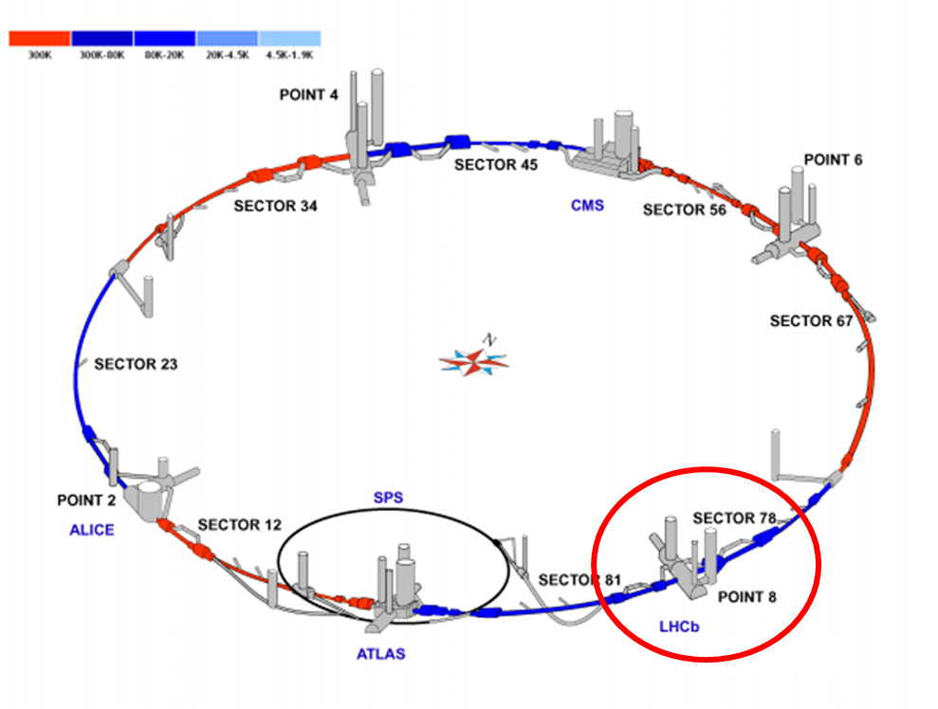
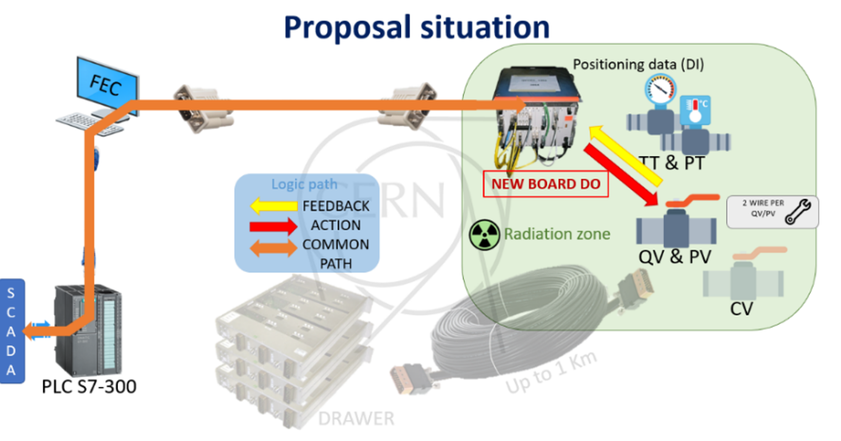
Introduction – Contents
The purpose of this presentation is to describe the process and all the phases for the development of the R&D peripheral card for the LHCb upgrade for the Long Shutdown 4.
For Digital Input and Digital Output card, the design has been validated and tested under radiation this fall.
The “new” R&D card design has started in the beginning of October 2023.
The selection of radiation tolerant components has been validated by the BE-CEM-EPR section.
The TE-VSC-ISC section gave support for the output topology.
Figure 1: CERN’s Large Hadron Collider
Figure 2: DI/DO card proposed solution for crate

Slide 3
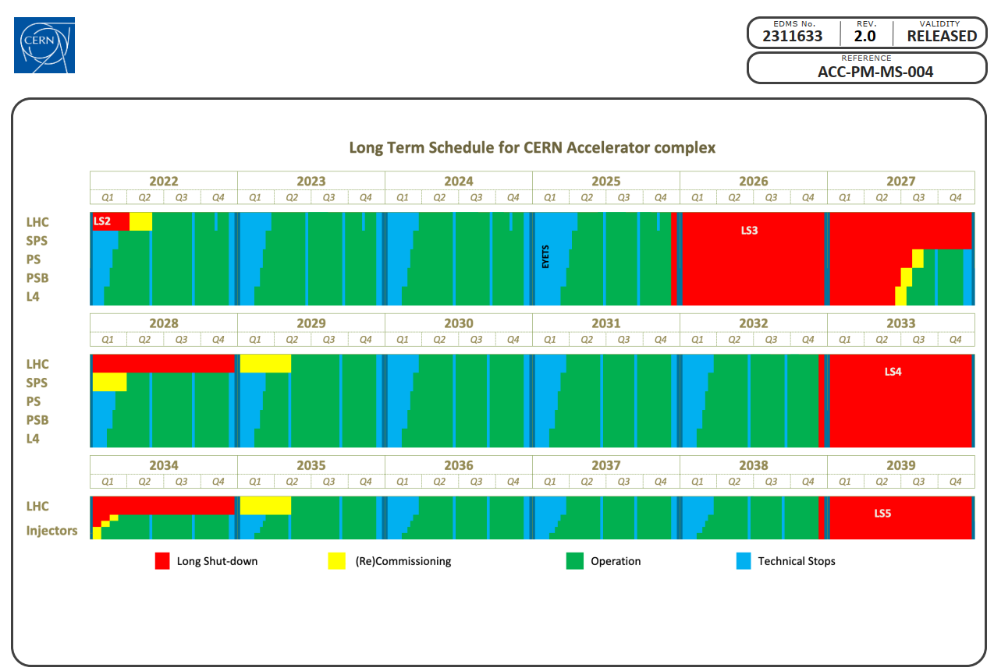
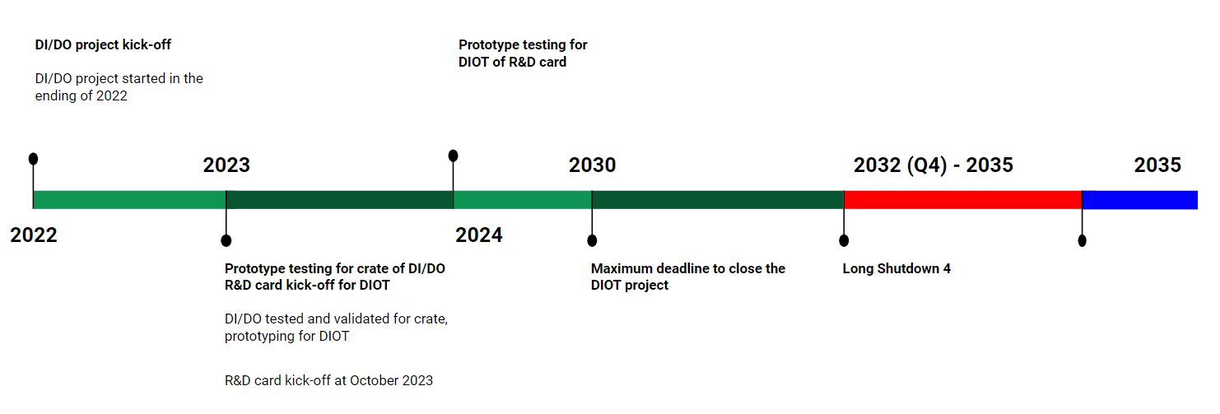
Context and goal
Guaranteed and certified Rad-Tol (Radiation Tolerant) system (CERN standard) for the LHCb (point 8) for LS4.
Currently, the I/O PLC modules are in the free radiated areas.
QURA, QURC-A, QURC-B and QUIC.
≈ 450 input channels.
≈ 80 output channels.
Pros:
Input/Output rad-tol card (up to 450 Gy).
Free space in ULs zones.
Design control.
Compliance with cryogenic IC’s CERN new standard.
3 versions.
Figure 3: EDMS 2311633, Long Term Schedule for CERN’s accelerator complex
Figure 4: Chronology of upgoming events for R&D design for DIOT from CRG-IC

Slide 4
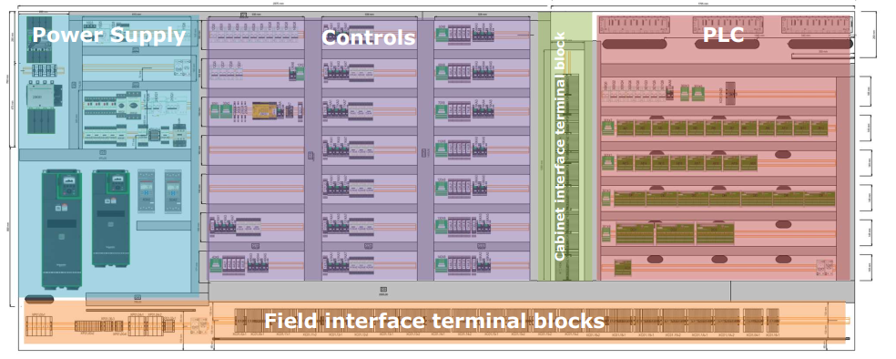
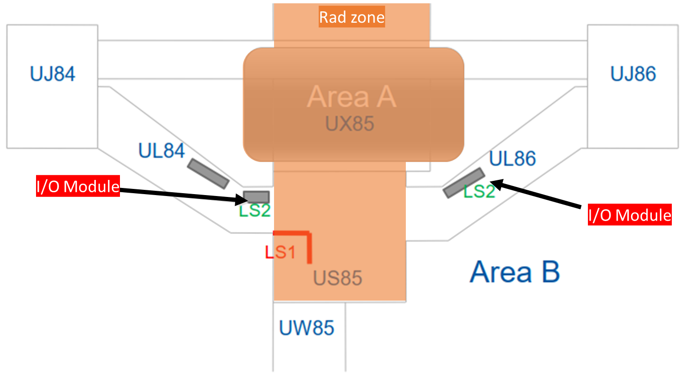
Context and goal | Current situation
PLC & PLC I/O
(UL84 & UL86)
Figure 5: Electrical cabinet current strategy according to EDMS 1970931
Figure 6: Point 8 underground scenario. UX85 is the cavern, QURA is in US85. In UL84 and UL86 there are the AI/AO modules

Slide 5
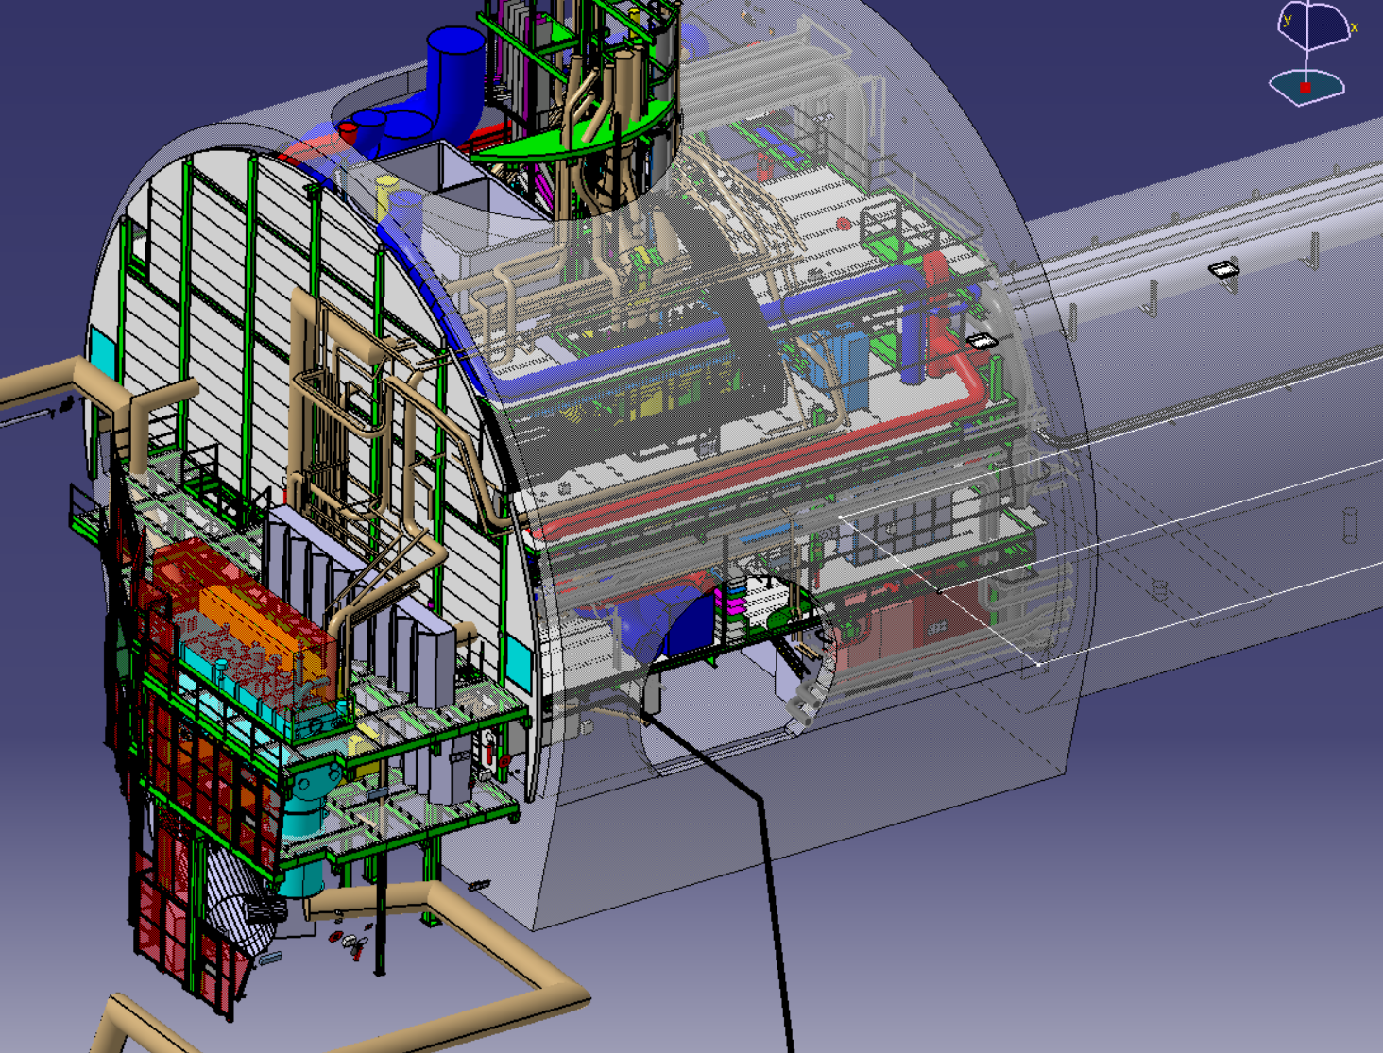
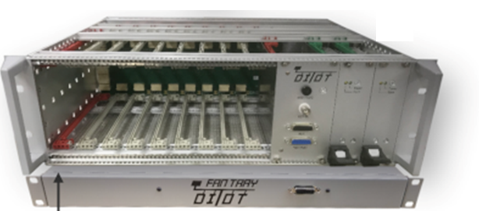
Context and goal | Proposal
PLC
US85
(UL84 & UL86)
UX85
UL84/86
R&D card (Analog and Digital)
Figure 7: Proposed Solution with the DI/OT in LHCb

Slide 6
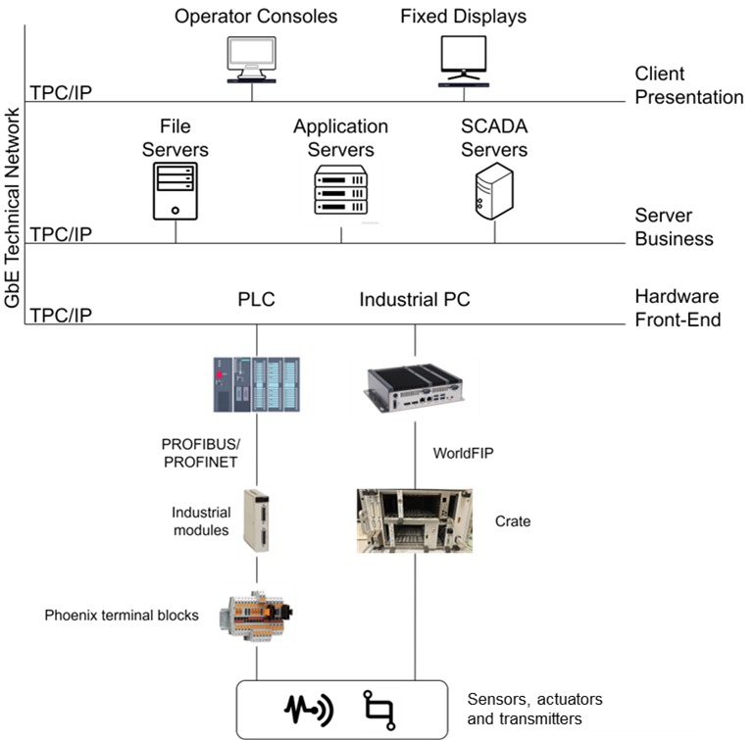
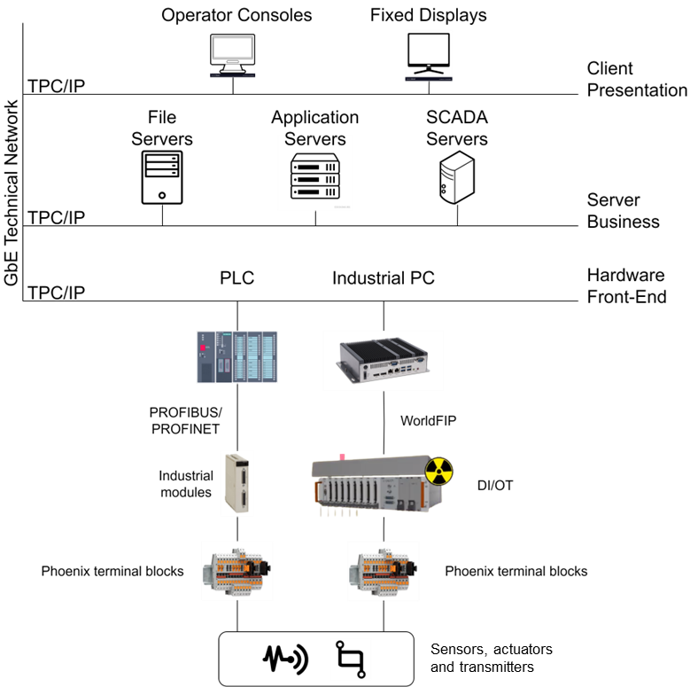
Context and goal | Proposal
Figure 8: Proposed Solution from a control system point of view. On the left: The current solution. On the right: the proposed solution with the DI/OT

Slide 7
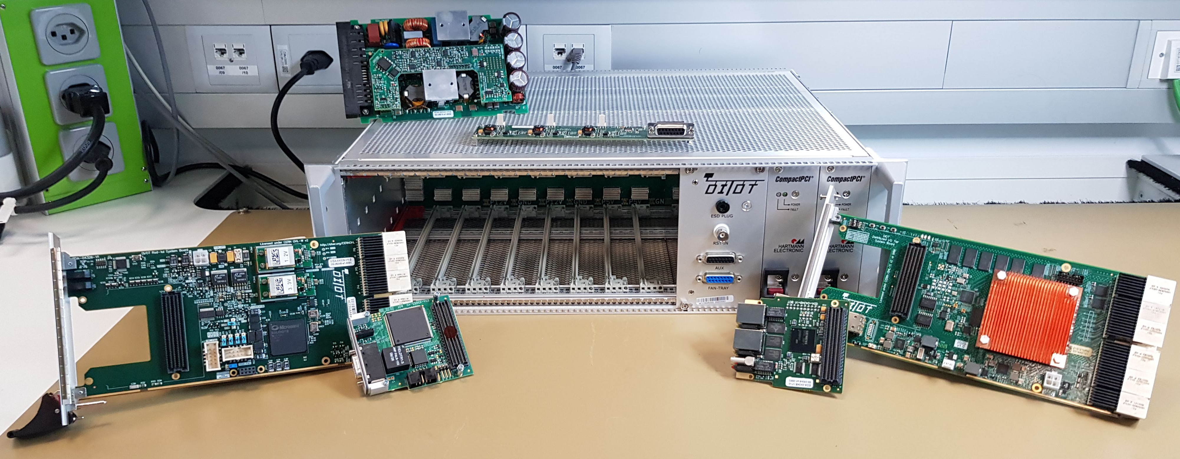
Context and goal | Proposal
The designed cards will be placed inside the DIOT (Distributed Input/Output Tier), which comprises electronics modules near a particle accelerator, controlled by the master in the Front-end tier via a fieldbus.
Typically feature FPGA-based boards for data sampling, output control, and safety-critical tasks in radiation-exposed or radiation-free areas.
Figure 9: The DI/OT tier from BE-CEM group

Slide 8
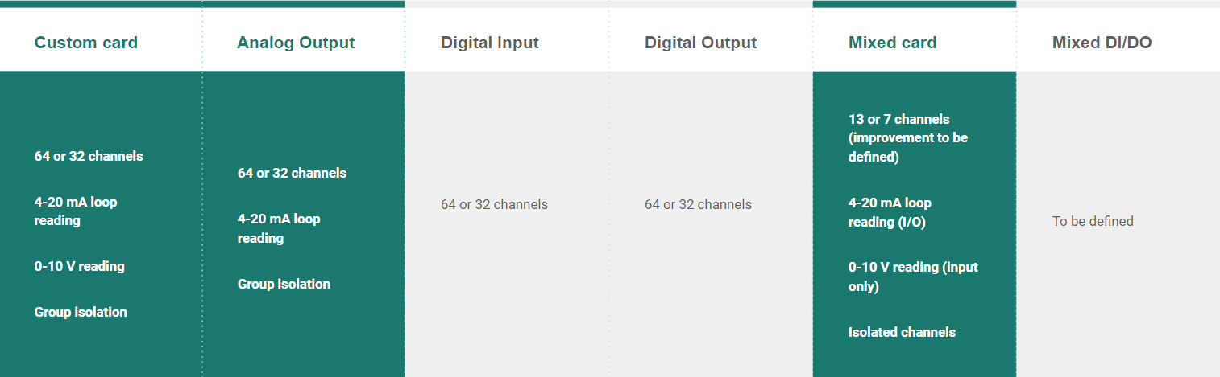
Requirements
Connectors:
Female pins to power side
Safety
D-SUB type
Widely used
Easy buying
Compact (→ more channels)

Slide 9
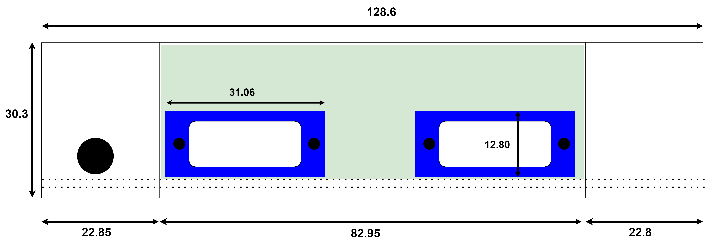
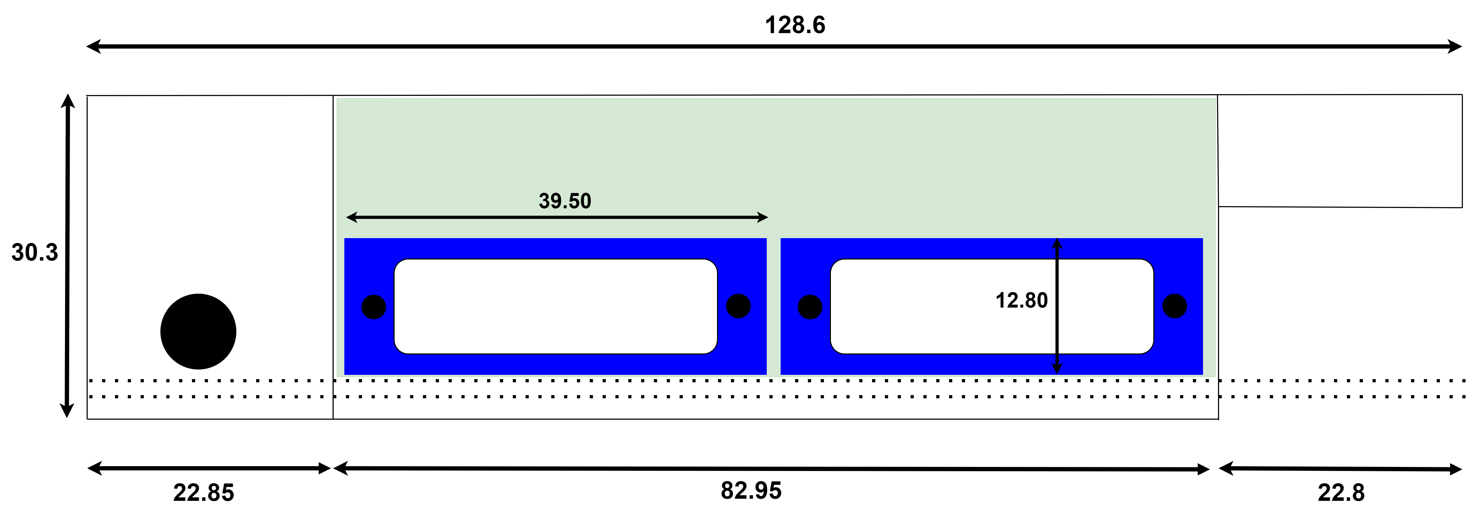
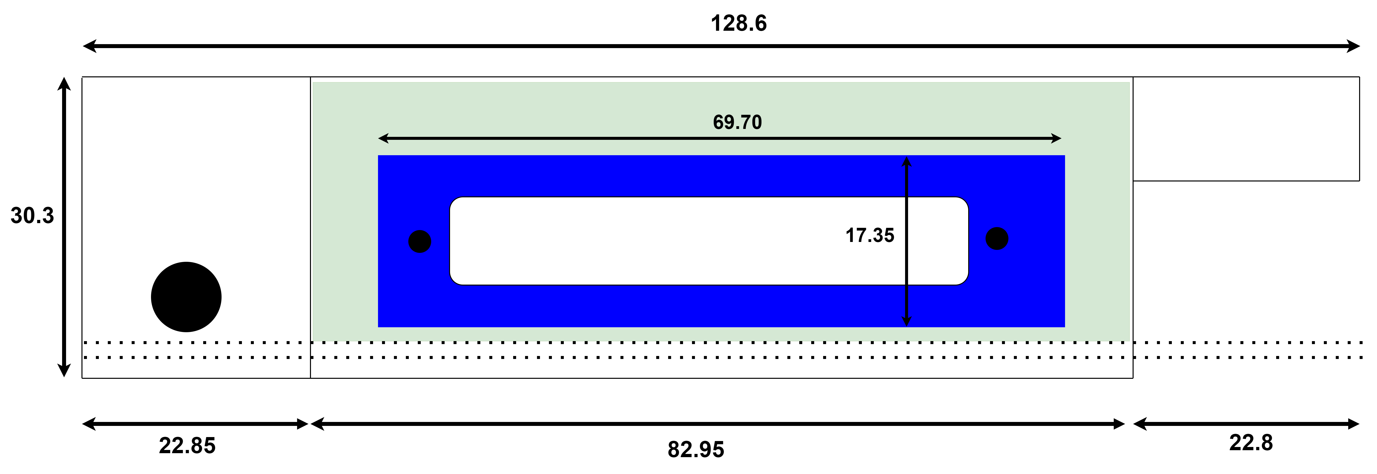
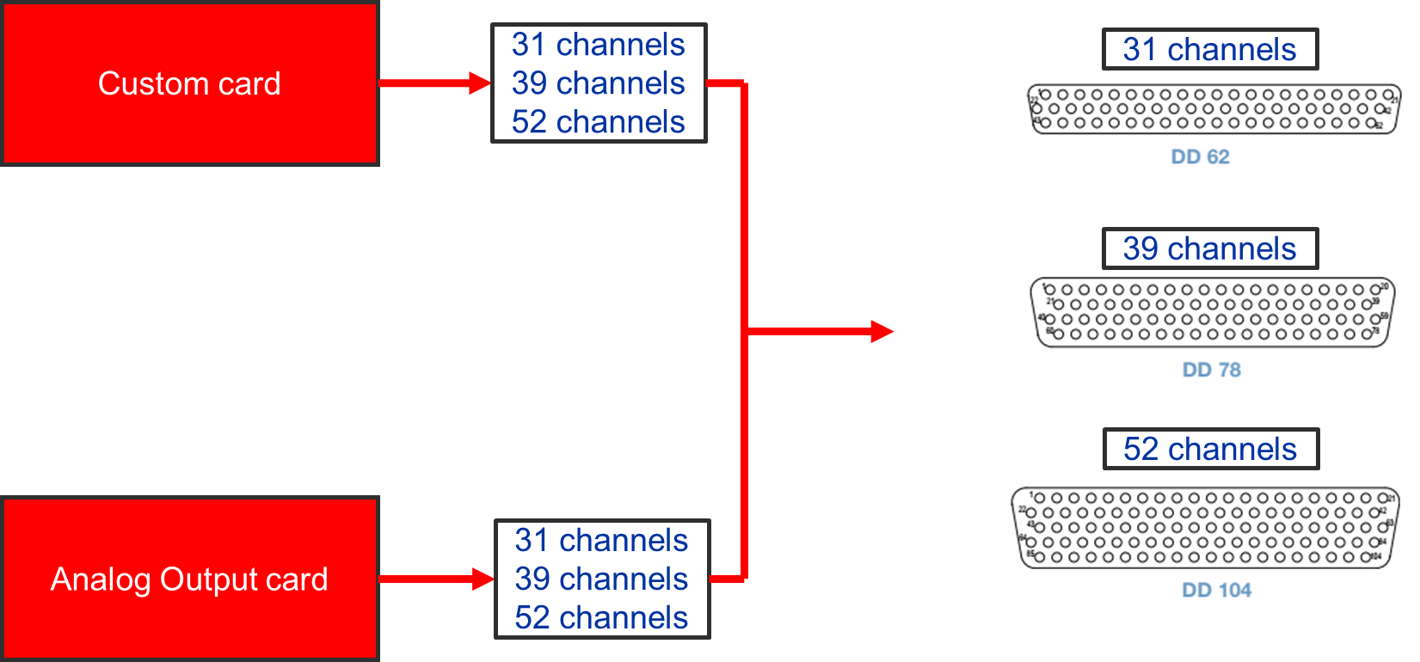
Connectors
Figure 10: Front Panel DIOT with D-SUB connectors
15 pins SUB-D connector case: here we will have a maximum of 7 channels (mixed version)
Figure 11: Front Panel DIOT with D-SUB connectors
26 pins SUB-D connector case: here we will have a maximum of 13 channels (mixed version)
Figure 12: Front Panel DIOT with D-SUB connectors
104 pins SUB-D connector case: here we will have a maximum of 52 channels

Slide 10
RoadMap developments for R&D card
Stage 1
Technical requirement collection for I/Os
Stage 3
Prototype and testing
Stage 2
Design and components selection

Slide 11
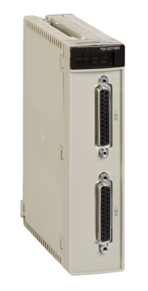
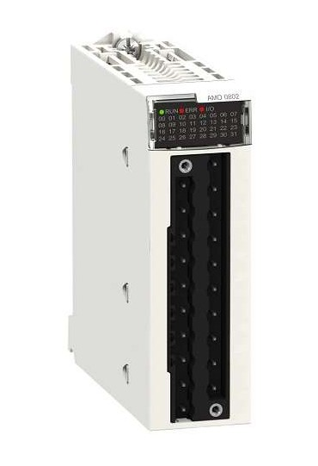
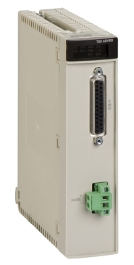
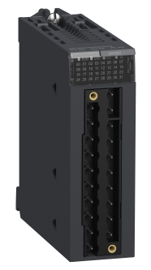
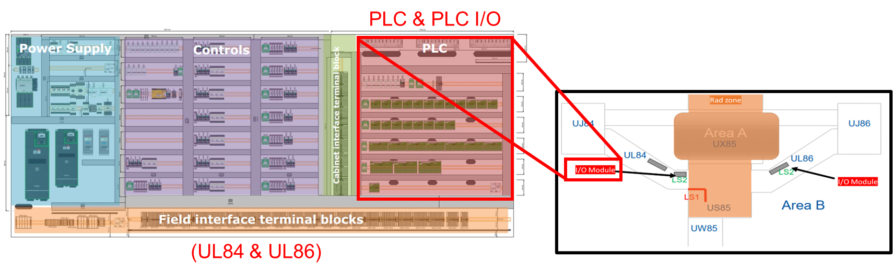
Stage 1: Technical requirement collection for I/Os
BMX-AMI-0810 isolated analog input module.
28 ways, 1 connector.
Analog input type: 4-20 mA and 0 – 10 V.
Analog input number: 8.
ADC: 16 bit.
BMX-AMI-0802 non-isolated analog output module.
20 ways, 1 connector.
Analog output type: 4-20 mA.
Analog output number: 8.
Resolution: 16 bit.
Replacement during LS3
Figure 13: Schneider obsolete not channel isolated TSXAEY1600 input module
Figure 14: Schneider new channel isolated BMX AMI 0810 input module
Replacement during LS3
Figure 15: Schneider obsolete not channel isolated TSXASY800 output module
Figure 16: Schneider new not channel isolated BMX AMI 0802 output module
Figure 17: Modules which would be placed in the free radiated area

Slide 12
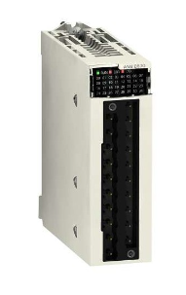
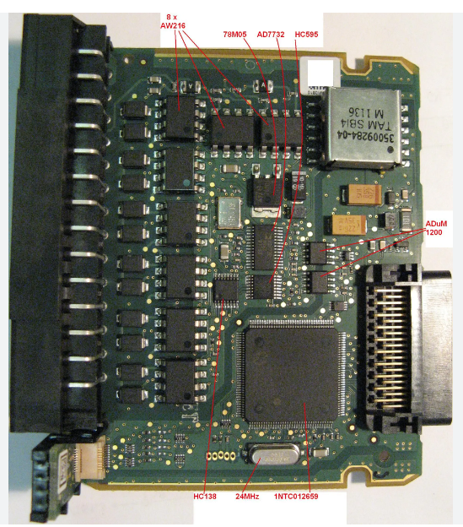
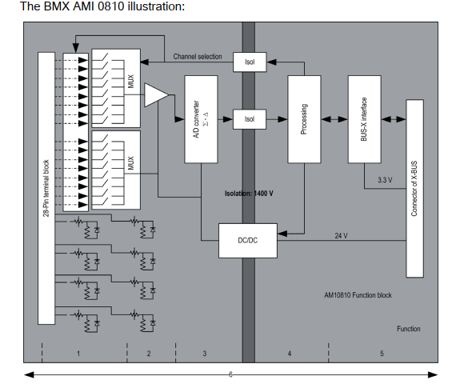
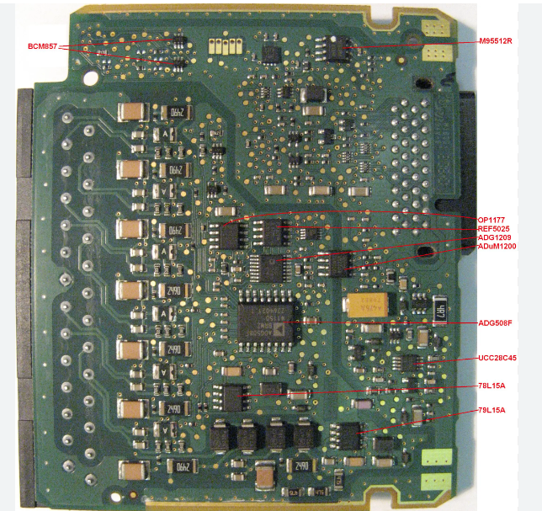
Stage 1: Reverse engineer of I/Os industrial modules
Isolation → static multiplexing through optoswitches.
Between channels ± 300 V_{DC}.
Between channels and ground ± 1400 V_{DC}.
Figure 18: Schneider new channel isolated BMX AMI 0810 input module
Figure 19: Top view of BMX AMI 0810 PCB
Figure 20: Bottom view of BMX AMI 0810 PCB
Figure 21: High level block diagram of BMX AMI 0810

Slide 13

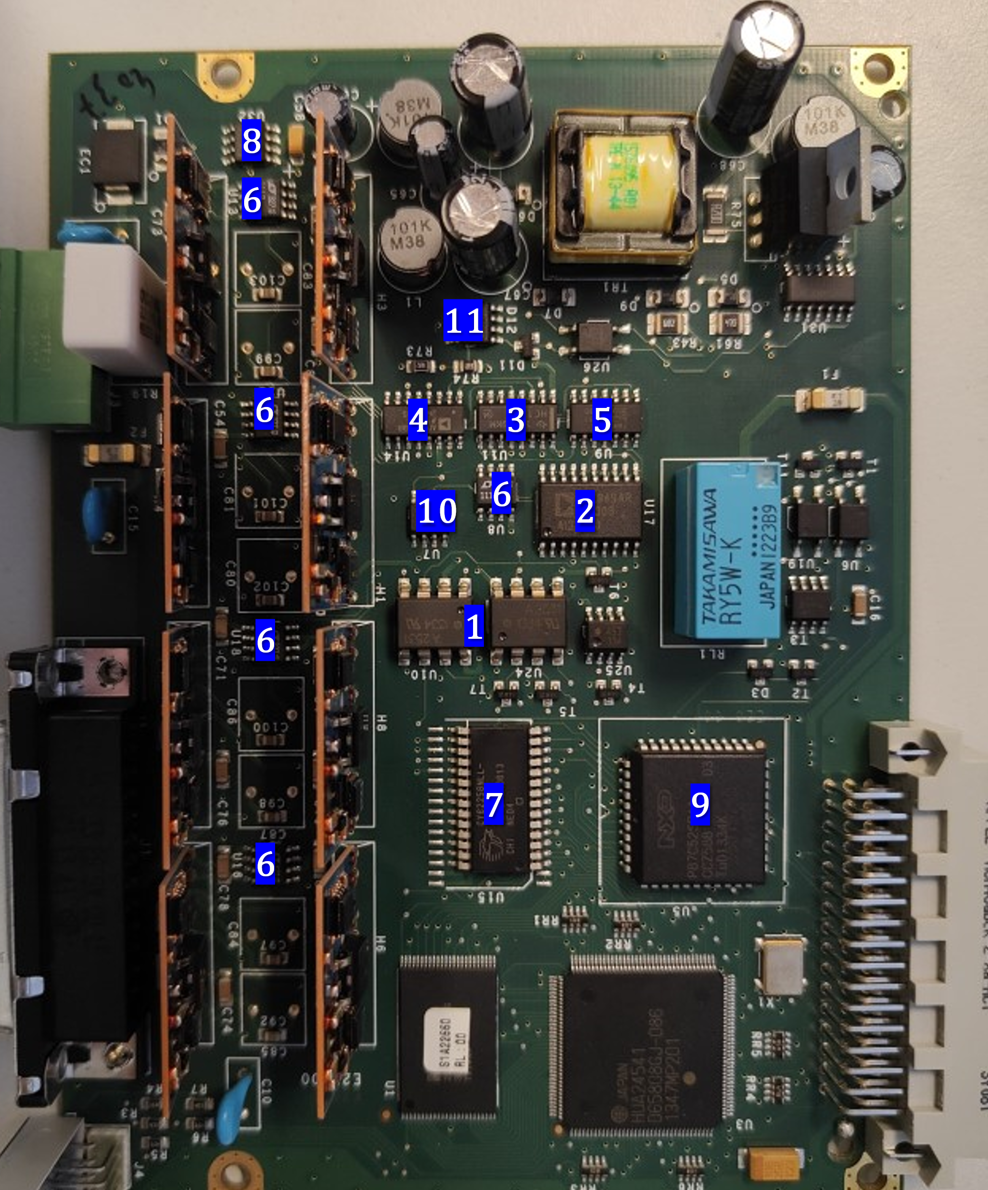
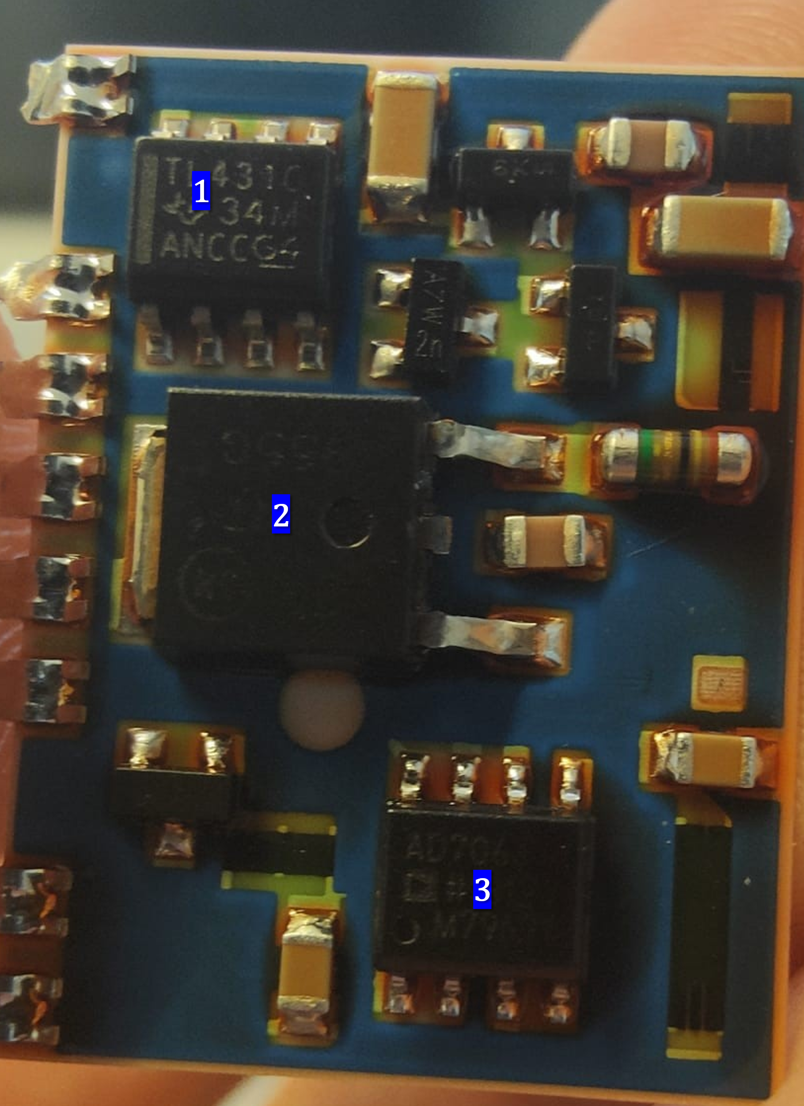
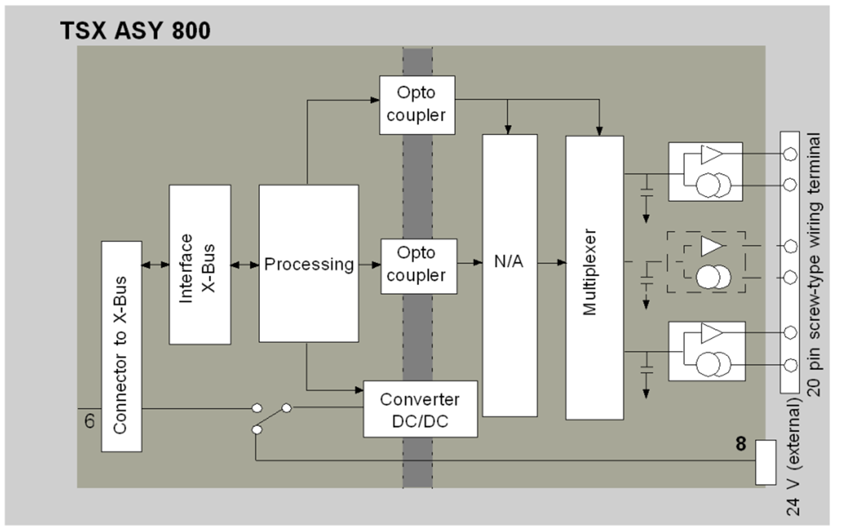
Stage 1: Reverse engineer of I/Os industrial modules
No isolation.
Between channels and bus ± 1000 V_{RMS}.
Between channels and ground ± 1000 V_{RMS}.
Figure 22: Schneider obsolete not channel isolated TSXASY800 output module
Figure 23: Top view of TSXASY800 output module PCB
Figure 24: Top view of TSXASY800 output module, vertical mini-PCB
Figure 25: High level block diagram of TSXASY800 output module

Slide 14
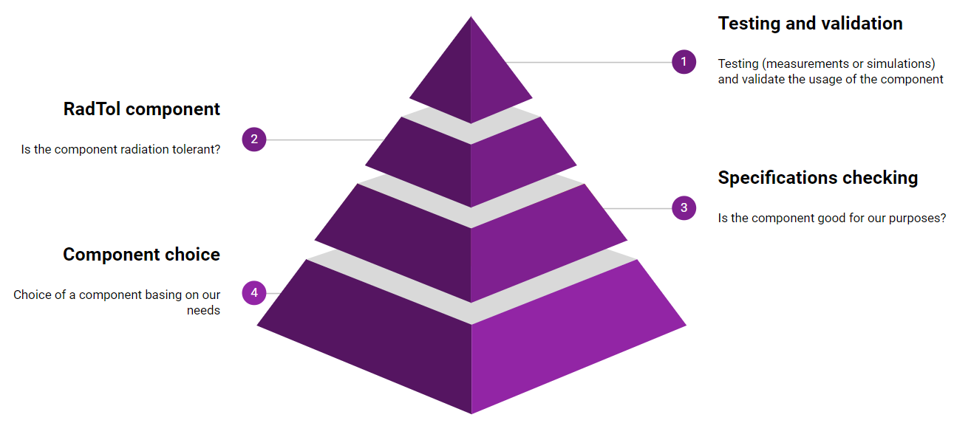
Stage 2: Design and components choice
Bottom-up approach.
Radiation Tolerant components.
RADWG database.
Cooperation with BE-CEM-EPR section.
Connectivity.
SUB-D connector.
Simple design.
Minimize the number of active components.
Tested industrial design.
DI/OT standards.
Cooperation with BE-CEM, DIOT project leader.
Figure 26: Components selecting approach for R&D project design

Slide 15
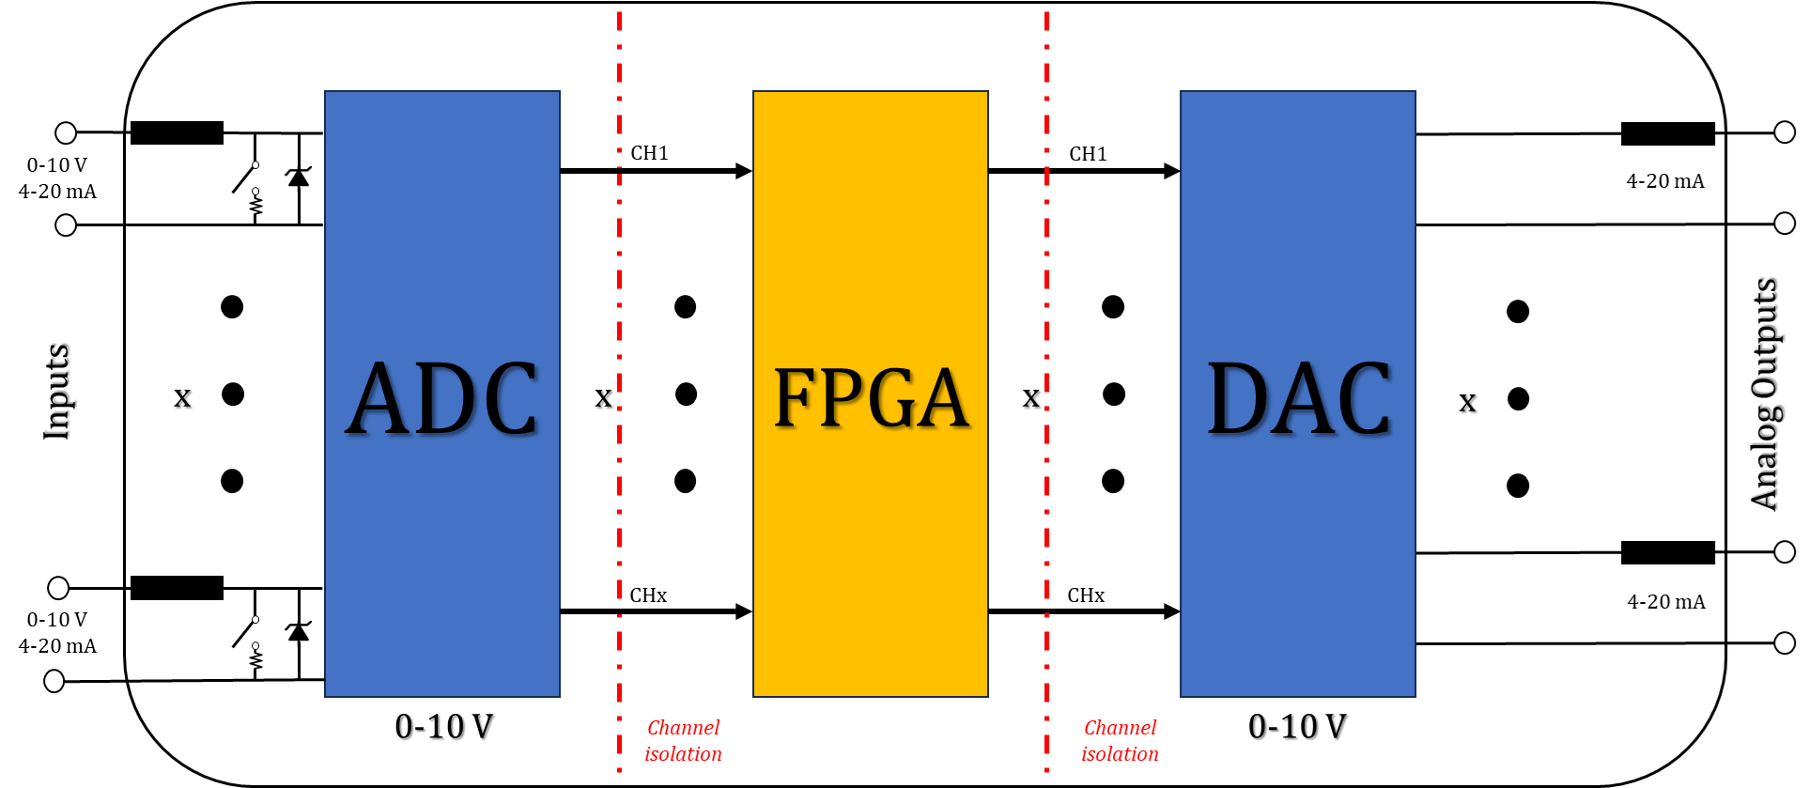
Stage 2 – Design and components choice
Custom mixed block diagram
DAC: cons
Active component: suffers radiations
Less space
Costs
Figure 27: High level block diagram of the R&D card for LHCb

Slide 16
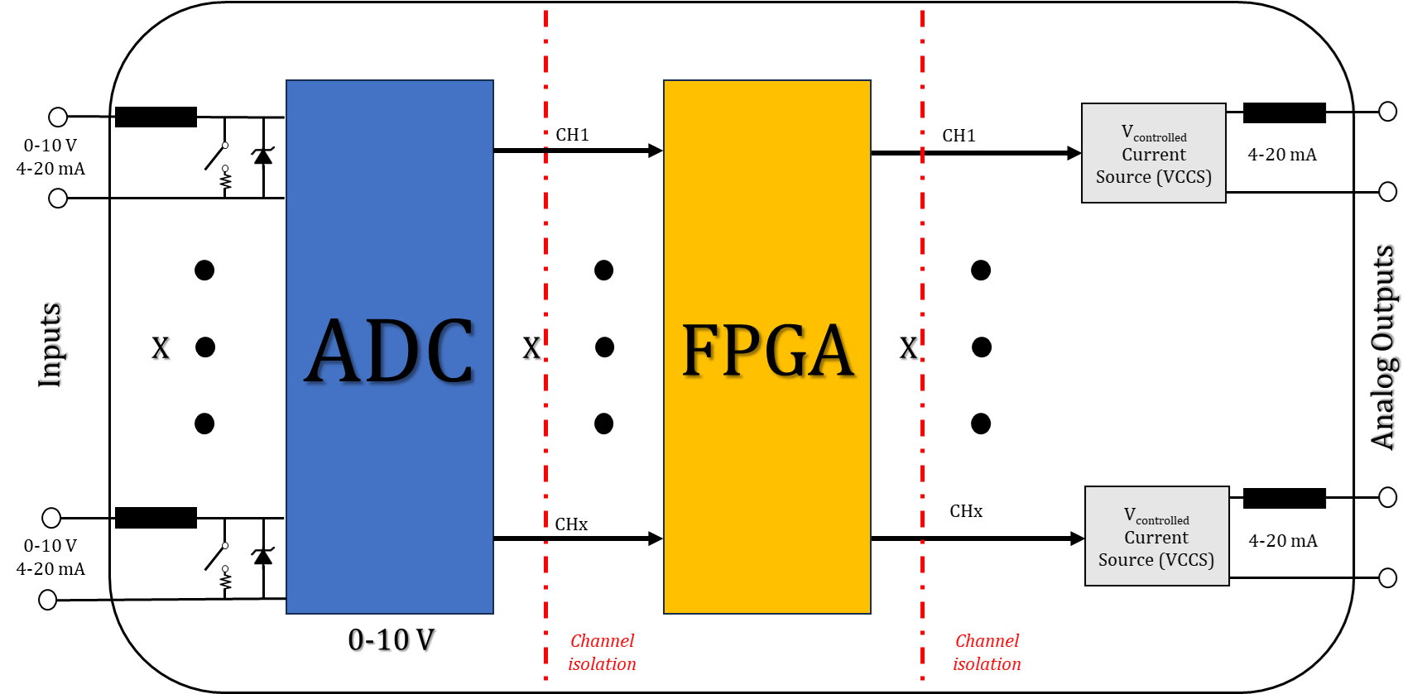
Stage 2: Design and components choice
Figure 28: High level design for the R&D card. It is possible to observe that there is no DAC in output, since we will use a VCCS to produce directly the 4-20 mA loop

Slide 17
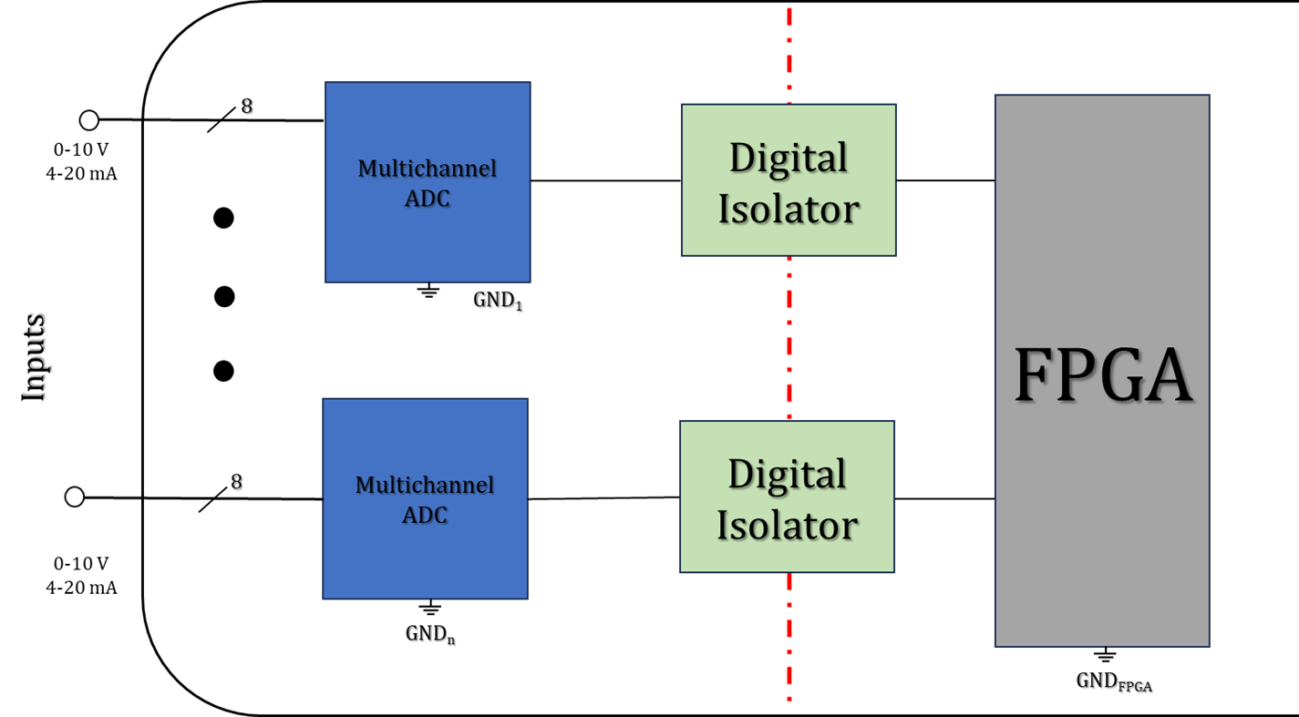
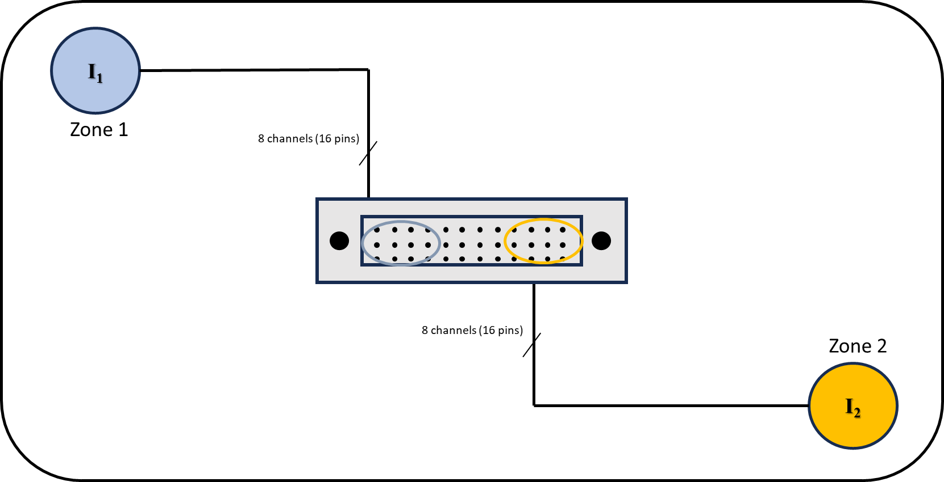
Stage 2 – Design | Input side: channel isolation
Space-channel isolation trade-off
Channel-to-channel isolation
No isolation
Group isolation
Isolation between different zones into the cavern.
Figure 29: Group isolation between 8 channels
Figure 30: Different zones with group isolation

Slide 18
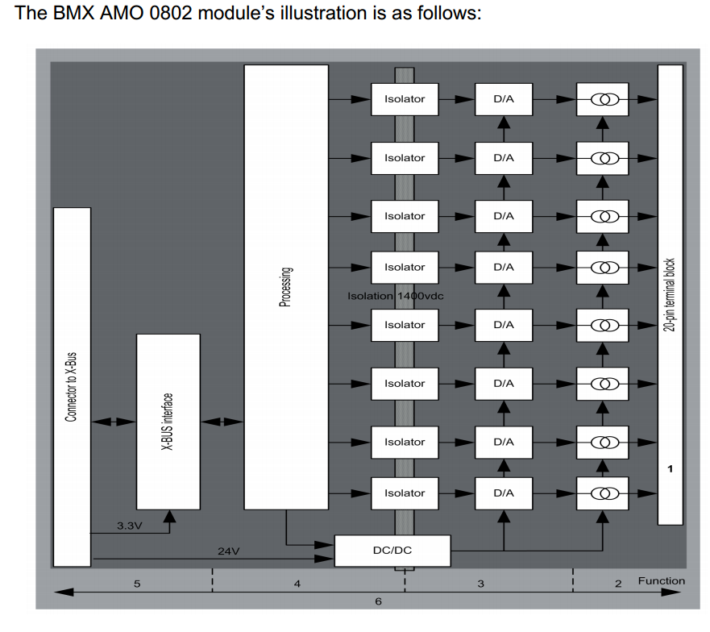
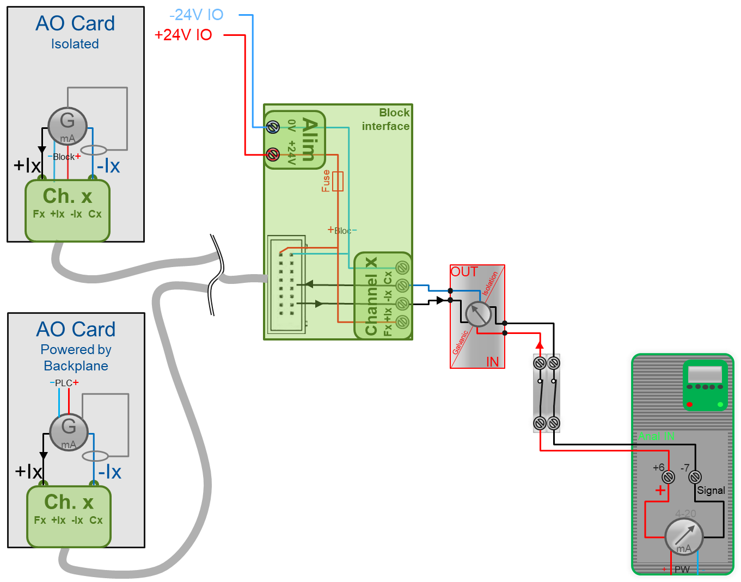
Stage 2 – Design | Output side: isolation
IMPORTANT REMARK
The galvanic isolation in output may be made externally.
Figure 31: External galvanic isolation for output (Simon Francois Martin’s credits)

Slide 19
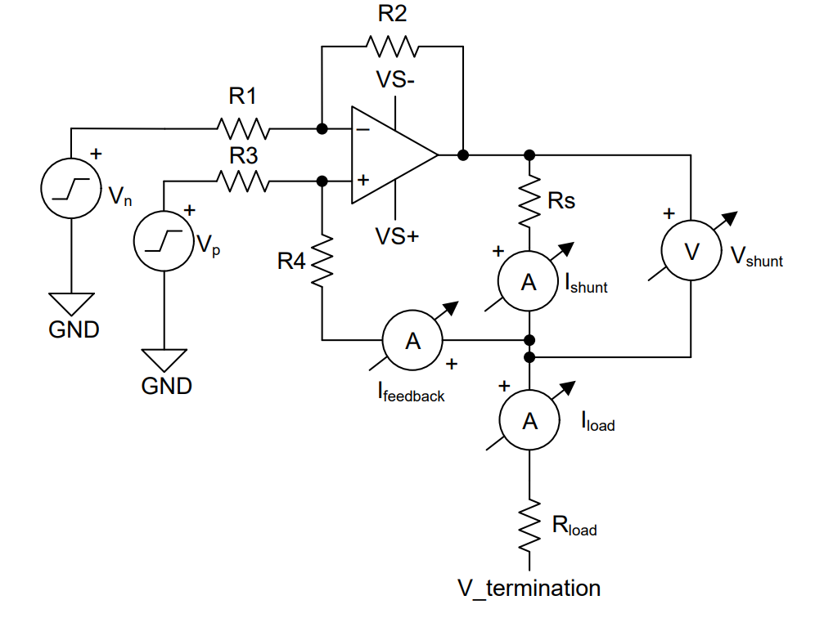
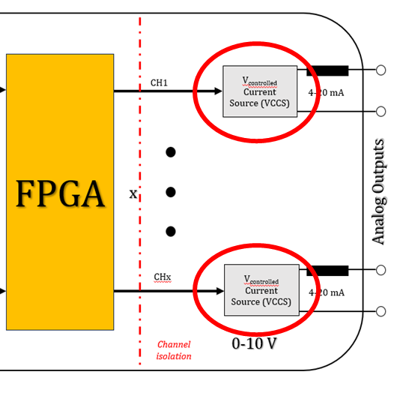
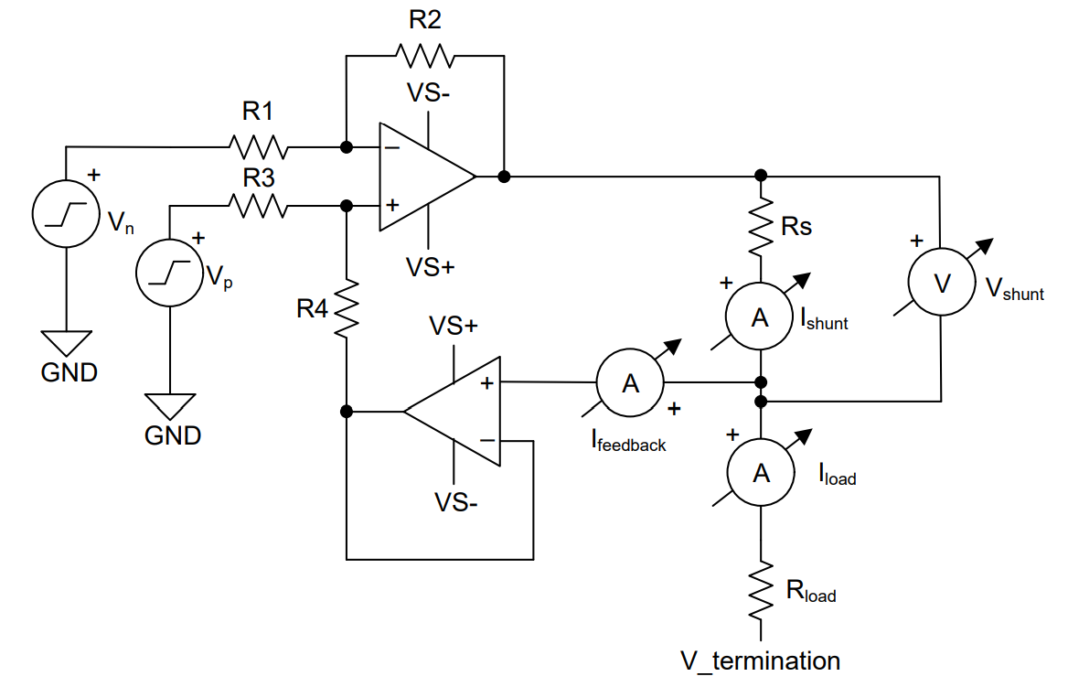
Stage 2 – Output design
Our primary goal was to generate a 4-20 mA output using a voltage-controlled current source (VCSS). To minimize the use of active components, we opted for the enhanced version of the Howland Current Pump, which gives in output a fixed current for a certain DC voltage.
Simple
Figure 32: Howland Current Pump for 4-20 mA standard, simple version
Improved
Figure 33: Howland Current Pump for 4-20 mA standard, improved version

Slide 20

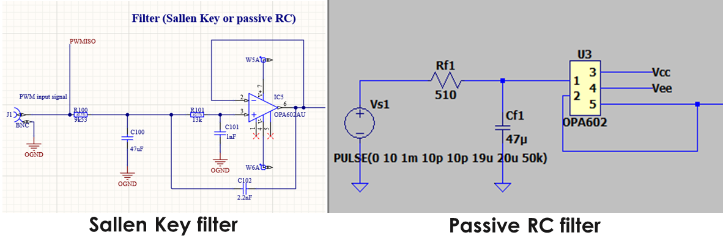
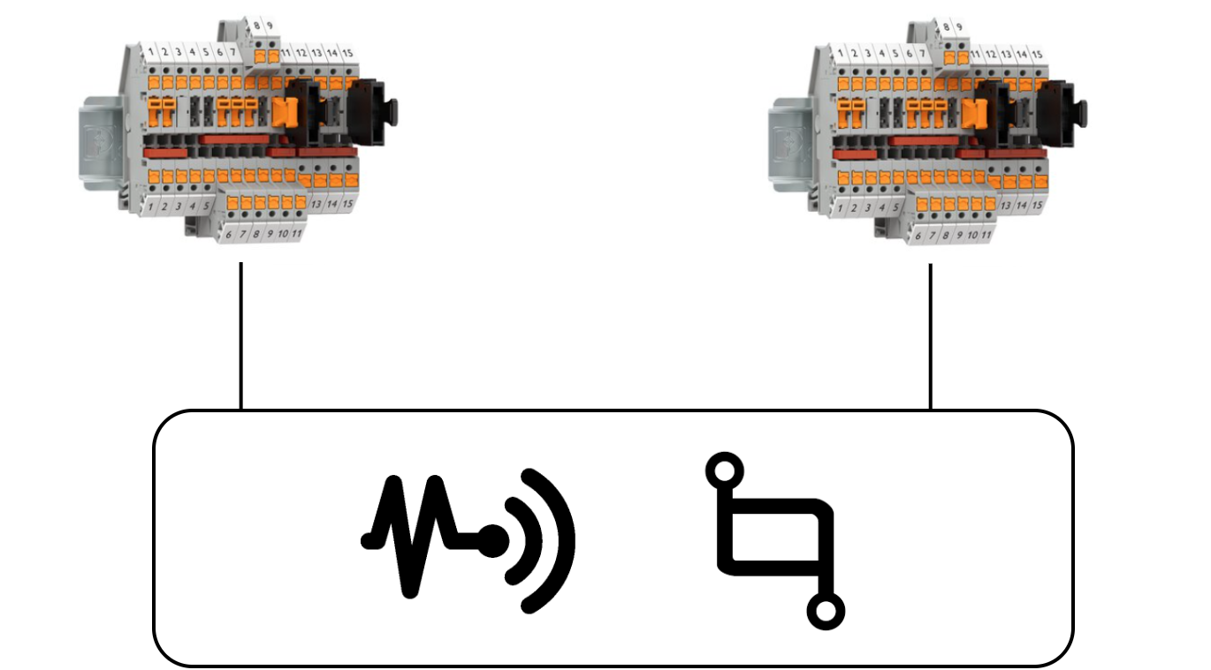
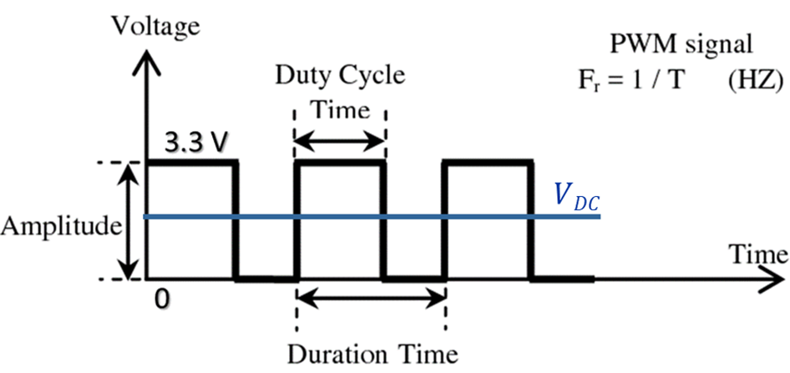


Stage 2 – Output design
FPGA
PWM [3.3 V]
Figure 34: Low-pass filter with unity gain to filter the DC component from PWM signal
Phoenix Block
Low-Pass Filter
Howland Current Pump
V_{DC}
4-20 mA
Output
$$V_{DC}=Amplitude∙Duty Cycle=A∙\frac{T_{ON} }{T}$$
Figure 35: PWM signal, in blue the DC component
Actuators and transmitters
$$\left[0.6 V; 3V\right] ⇾\left[4 mA;20 mA\right]$$

Slide 21
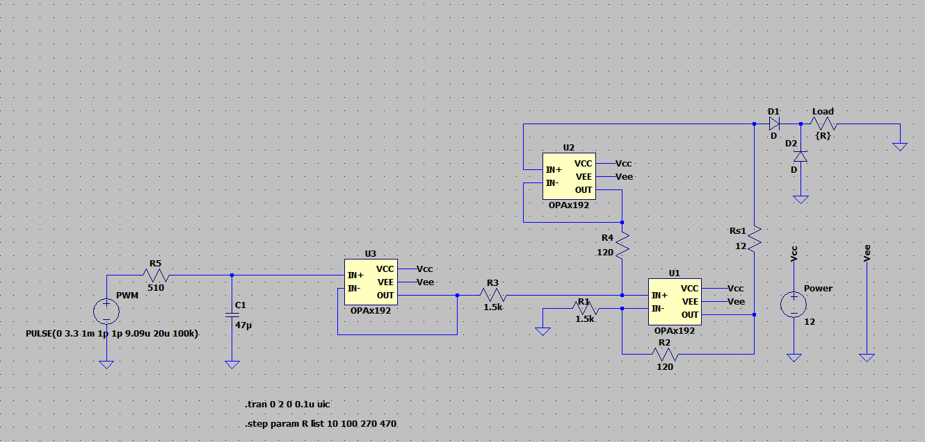
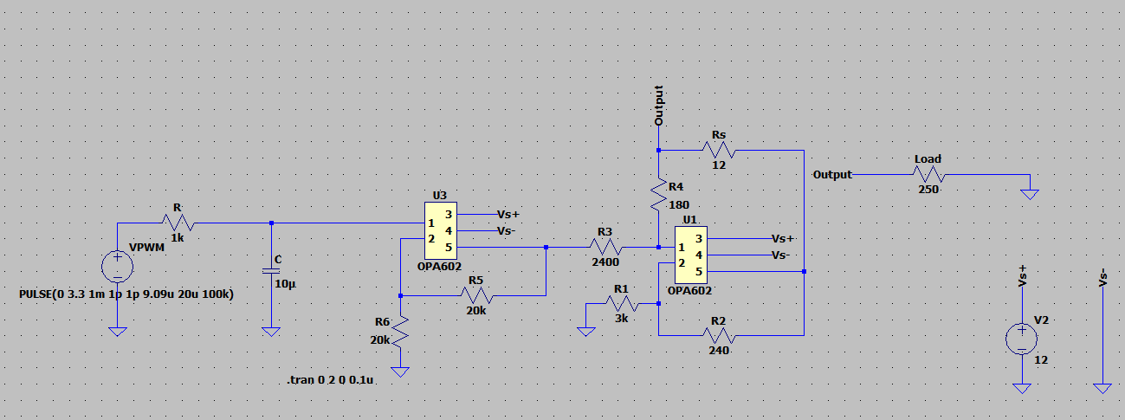
Stage 2 – Output design: simulations
We performed several simulations on LTSpice to test the efficiency of these circuits.
Best results are achieved from the improved configuration.
Different radiation tolerant components tested.
The simulations has been validated from measurements in the laboratory.
Figure 36: LTSpice improved Howland current pump for 4-20 mA
Figure 37: LTSpice simple Howland current pump for 4-20 mA

Slide 22
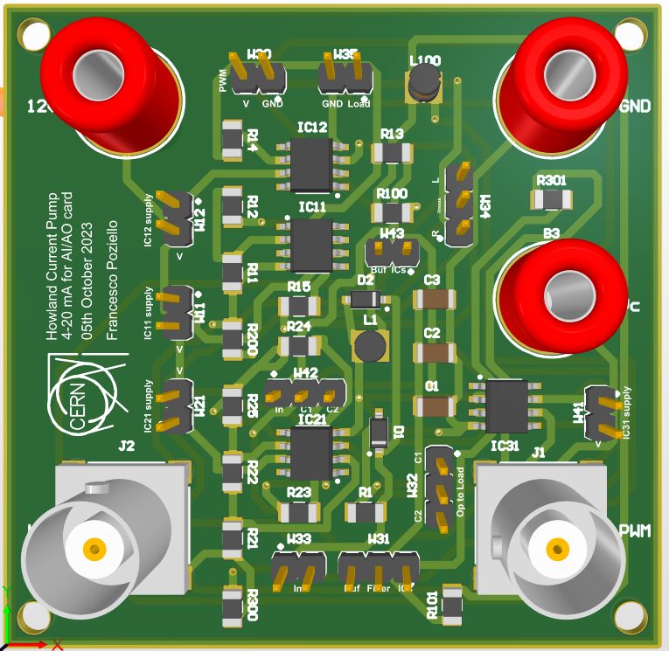
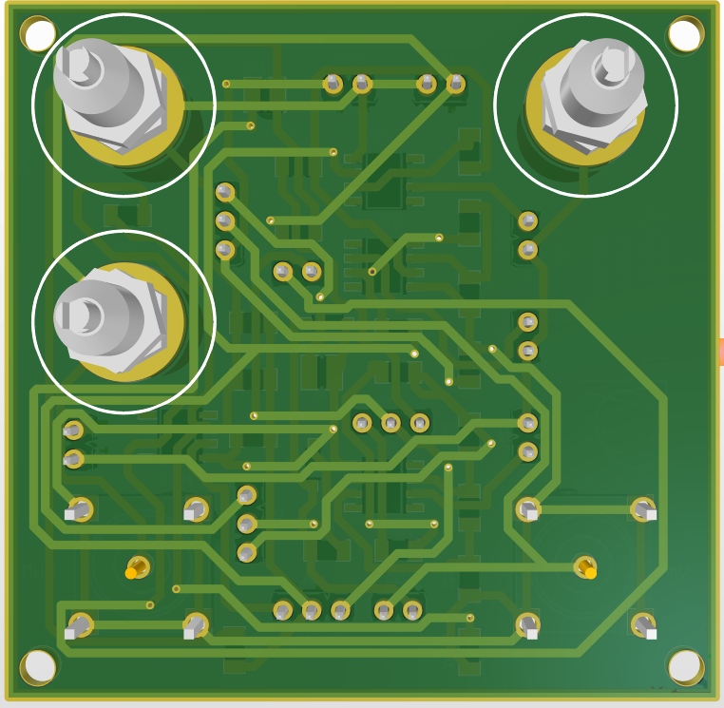
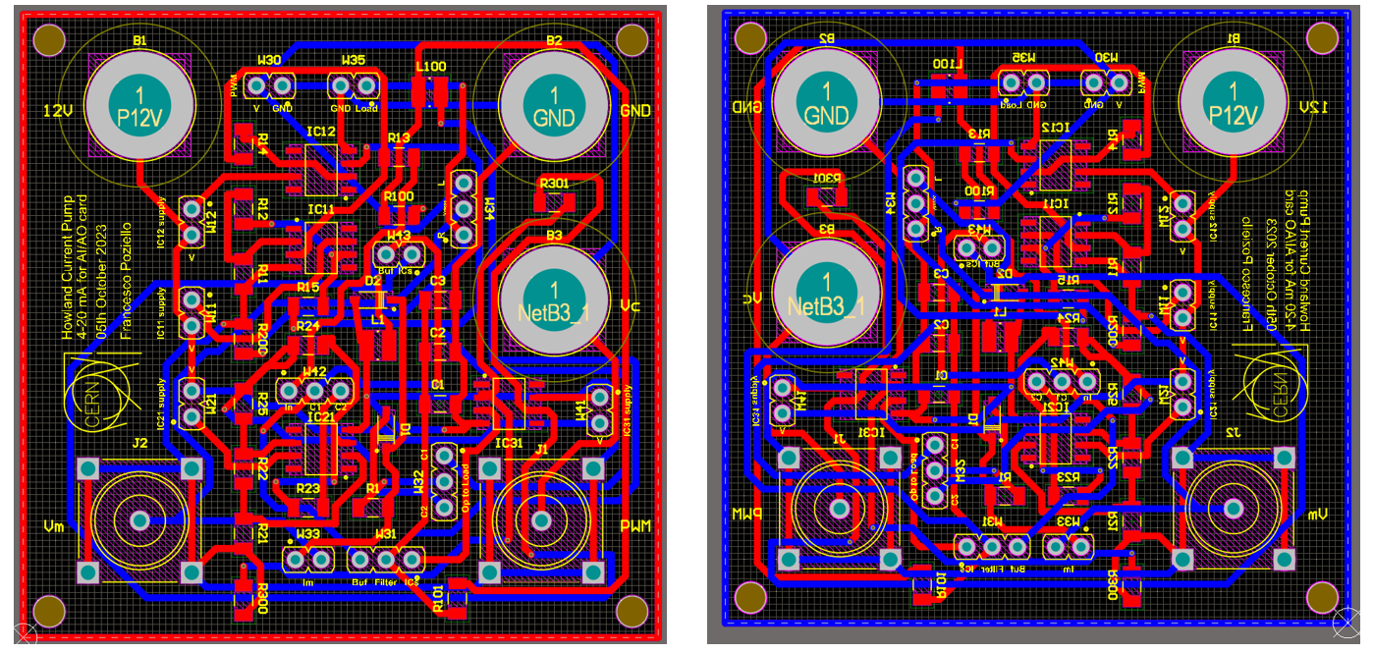
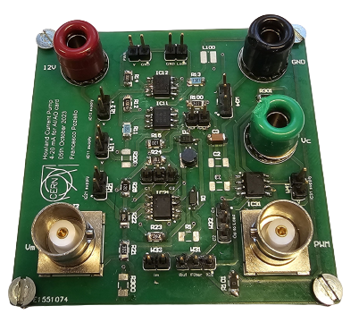
Stage 2 – Output design: PCB designing
Instrumentation for the measurements.
Power supply for op-amps.
Function generator for the PWM signal.
Frequency of 50 kHz for current resolution.
Digital multimeter for measurements.
Figure 39: 3D view of the PCB prototype
Figure 38: Top and Bottom view of the output prototype
Figure 40: Picture of the PCB during the testing

Slide 23
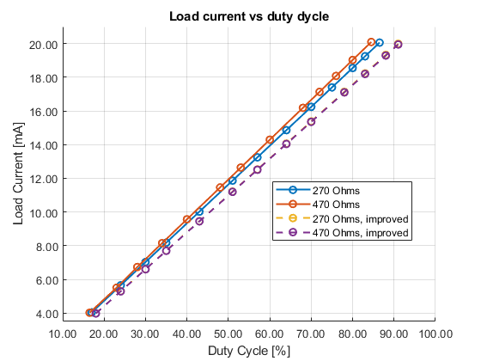
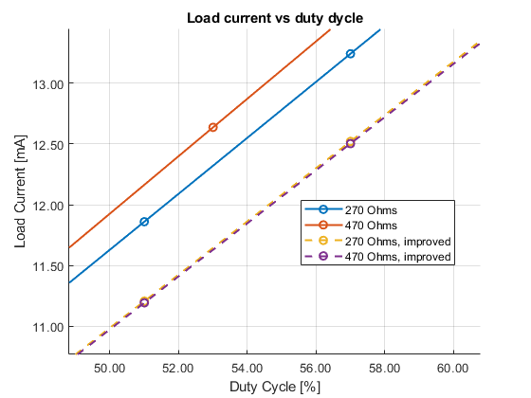
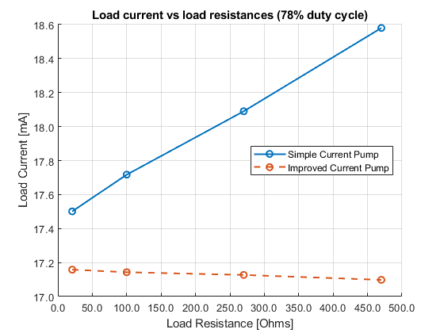
Stage 2 – Output design: 4-20 mA testing results
Figure 41: Load current vs Duty cycle for output prototype for different loads
Figure 42: Load current vs Duty cycle for output prototype for different loads (zoomed)
Figure 43: Load current vs load resistance for output prototype for a fixed duty cycle (78%)
Results obtained with 5% of resistance tolerances.

Slide 24

Stage 2 – Output design: testing results
Figure 44: Load current vs load resistance for output prototype for fixed duty cycle (78%), with 5% of resistance tolerances
Figure 45: Load current vs load resistance for output prototype for fixed duty cycle, with 0.1% of resistance tolerances

Slide 25
Stage 2 – Output design: final remarks
The improved version is necessary if we use resistors with high tolerances.
The buffer is necessary.
The improved version requires more supply current from the backplane.
The tests have been conducted with the operational amplifier OPA192.
The operational amplifier OPA602 has to be tested.
The tolerance of feedback resistors must be taken in account.
Figure 44: Results with 5% of resistance tolerances
Figure 45: Results with 0.1% of resistance tolerances

Slide 26
Stage 3 – R&D prototype
The project has led to a meeting between the CRG-IC section with other CERN’s sections.
BE-CEM-EDL: Greg Daniluk (DI/OT project leader).
BE-CEM-EPR: Salvatore Danzeca (section leader), Raphael Berberat, Salvatore Fiore, Rudy Ferraro.
An output design for 4-20 mA from TE-VSC-ICM section has been already validated and tested (Nikolaos Chatzigeorgiou).
It is based on the Howland Current Pump.
Validated radiation tolerant design (e.g. EDA-03944).
Tested and used in several designs from the VSC group.
R&D prototype has been designed and on-going testing.
Testing of the output design from VSC group for the 4-20 mA.
Testing of an ADS7852 (ADC) radiation tolerant from EPR section’s advice.
Testing of a negative charge power supply.
Testing of general-purpose component measurement circuits.

Slide 27


Stage 3 – R&D Prototype
Figure 46: Top and Bottom view of R&D prototype

Slide 28

Stage 3 – R&D Prototype
Figure 47: Picture of the R&D PCB realized

Slide 29

Stage 3 – Output design from VSC group
Figure 48: 4-20 mA loop transmitter from VSC group (Nikolaos Chatzigeorgiou)
Pros
4-20 mA transmitter tested and validated.
Radiation Tolerant.
Support from VSC group.
Simple design.
Howland Current Pump with a BJT.
Cons
More components.
More supply.

Slide 30

Stage 3 – Negative Charge Pump
Positive Power Supply [+V_{DC}]
Negative Charge Pump
Negative Power Supply [-V_{DC}]
Figure 49: Negative Charge Pump to produce negative power supply

Slide 31


Stage 3 – 4-wire resistance measurements
In 4-wire resistance measurements, current is forced through the source terminals (HI, LO). The sense terminals (HISENSE, LOSENSE) are configured for high impedance, and this configuration directs current through the resistance.
We will use the output design from VSC group to produce this current, with a different current span.
Figure 51: 4-wire resistance measurements circuit
Figure 50: Current generator from the VSC group

Slide 32



Stage 3 – Capacitance measurement circuit
We also added a measuring capacitance circuit, which works just like as a digital multimeter.
The method is based on the rise time measurement.
Figure 53: Circuit to measure the capacitance
$$I=C \frac{dV}{dt}$$
Measuring the time → Calculate capacitance
Figure 52: Circuit to measure the capacitance on the R&D prototype

Slide 33

Conclusions and remarks
The investigation regarding of the custom card is on-going.
Tests will be made on the R&D prototype PCB to validate the topologies showed.
The output design based on the Howland Current Pump from the VSC group for the 4-20 mA generation is validated and tested under radiations.
This study has been interesting and fascinating, showing all the aspects regarding the radiation tolerance compliance and the hardware design with the best rule of thumbs.
From this work I wrote my Master’s Thesis, graduating with honors at Università degli studi di Napoli ‘Federico II’ and at Politechnika Łódzka on December 2023.
Figure 54: Title page of my MSc’s thesis

Slide 34
Thanks for your attention!

Slide 35

Questions?

