Slide 1
Electromagnetism
A refresher
Piotr Skowronski

Slide 2

Copyright statement and speaker’s release for video publishing
The author consents to the photographic, audio and video recording of this lecture at the CERN Accelerator School. The term “lecture” includes any material incorporated therein including but not limited to text, images and references.
The author hereby grants CERN a royalty-free license to use his image and name as well as the recordings mentioned above, in order to broadcast them online to all registered students and to post them without any further processing on the CAS website.
The author hereby confirms that the content of the lecture does not infringe the copyright, intellectual property or privacy rights of any third party. The author has cited and credited any third-party contribution in accordance with applicable professional standards and legislation in matters of attribution.

Slide 3
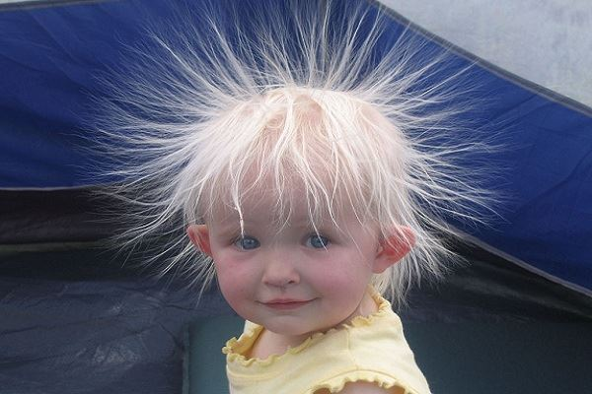
Electric force
Common life examples
  A kid sliding on a plastic surface

Slide 4
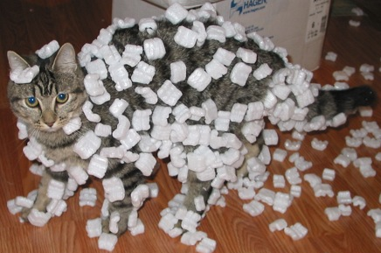
Electric force
Common life examples
  Polystyrene on a cat

Slide 5
Electric force
The force that
  repels the hairs
  attracts polystyrene to the cat’s fur
is due to electric charge
If electric charges are at rest then we call it
electrostatic force

Slide 6
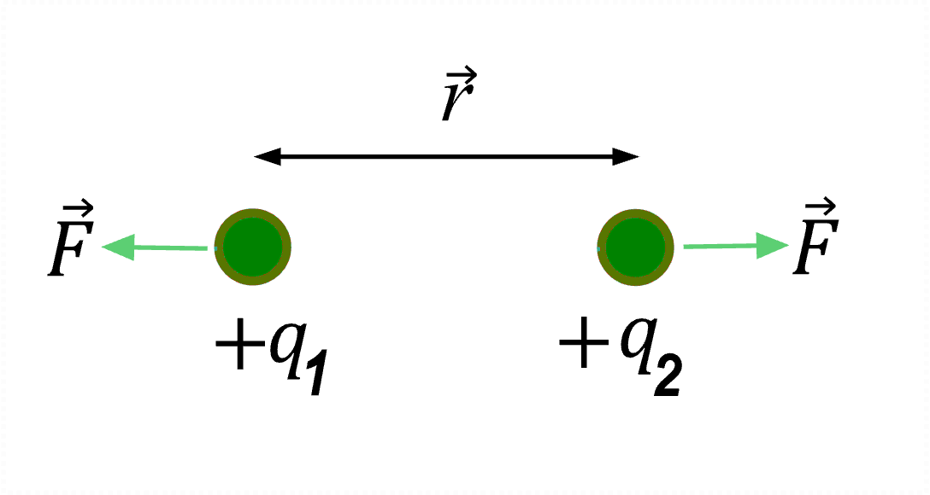
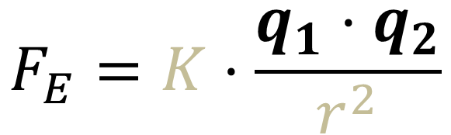
Coulomb law
$$F_{E}=K⋅\frac{q_{1}⋅q_{2}}{r^{2}}$$
Electrostatic force between point-like objects is
  Proportional to electric charge of
  each of the two interacting objects

Slide 7
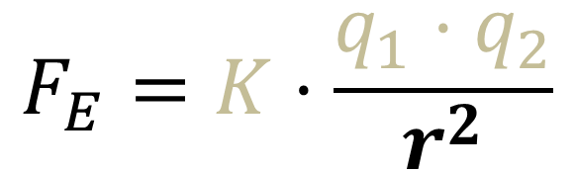
Coulomb law
$$F_{E}=K⋅\frac{q_{1}⋅q_{2}}{r^{2}}$$
Electrostatic force between point-like objects is
  Proportional to electric charge of
  each of the two interacting objects
  Inversely proportional to square of the distance

Slide 8
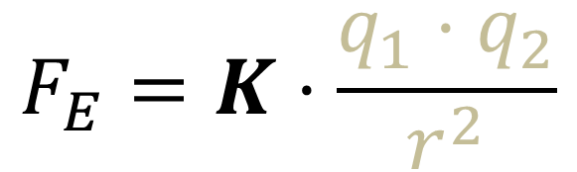
Coulomb law
$$F_{E}=K⋅\frac{q_{1}⋅q_{2}}{r^{2}}$$
Electrostatic force between point-like objects is
  Proportional to electric charge of
  each of the two interacting objects
  Inversely proportional to square of the distance
  Proportional to Coulomb constant K
    Which depends on medium type (vacuum, air, water)

Slide 9
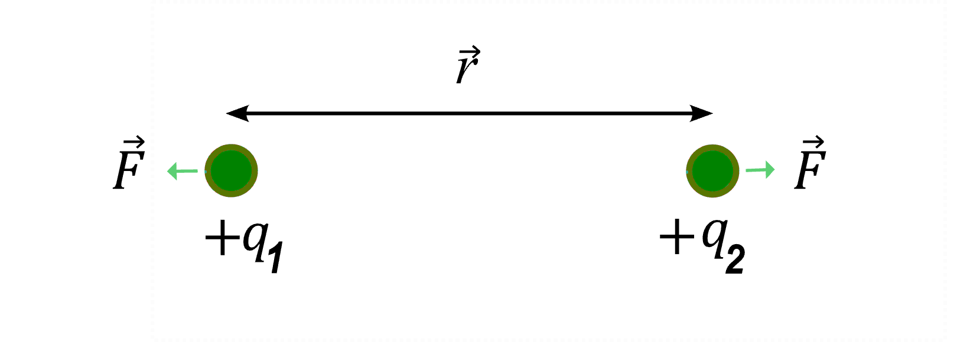

Distance
$$F_{E}=K⋅\frac{q_{1}⋅q_{2}}{r^{2}}$$
Electrostatic force between point-like objects is
  Inversely proportional to square of the distance
  If we increase the distance 2x then the force is 4x smaller
  If we increase the distance 10x then the force is 100x smaller

Slide 10
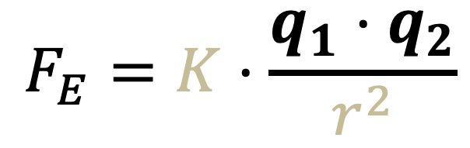
Electric charge
$$F_{E}=K⋅\frac{q_{1}⋅q_{2}}{r^{2}}$$
Electrostatic force between point-like objects is
  Proportional to electric charge of
  each interacting objects
  It means that if one of the objects has 2x more charge
  then the force is 2x stronger

Slide 11
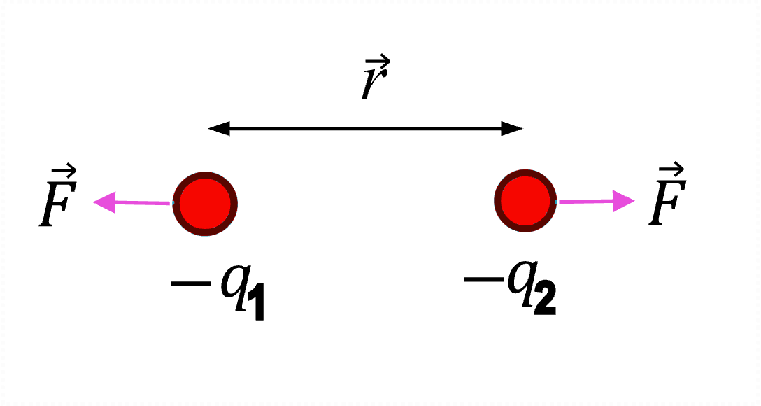
Electric charge
$$F_{E}=K⋅\frac{q_{1}⋅q_{2}}{r^{2}}$$
Electric charge can be negative or positive
If charge of both objects is the same then
the force is repelling

Slide 12
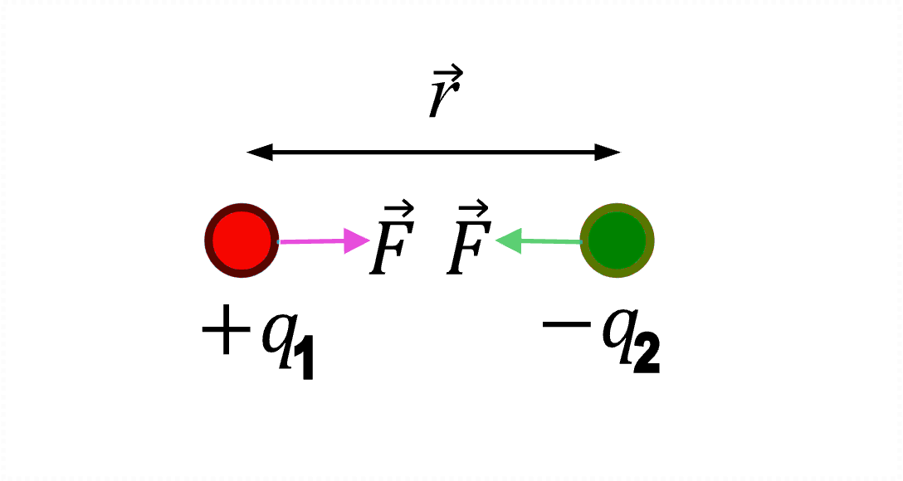
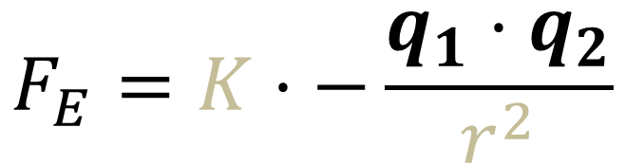
Electric charge
$$F_{E}=K⋅−\frac{q_{1}⋅q_{2}}{r^{2}}$$
Electric charge can be negative or positive
If charge of both objects is opposite then
the force is attracting

Slide 13
What is electric charge?
It is a fundamental property of
some elementary particles
It has unit of Coulomb [C]

Slide 14
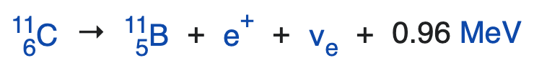
What is electric charge?
Charge can be negative, for example for electron,
or positive, for example for proton
Electron charge, e = -1.602∙10⁻¹⁹ C,
is exactly opposite of proton charge
  Why? Because proton can decay to
  positron, i.e. anti-electron, plus neutral stuff

Slide 15
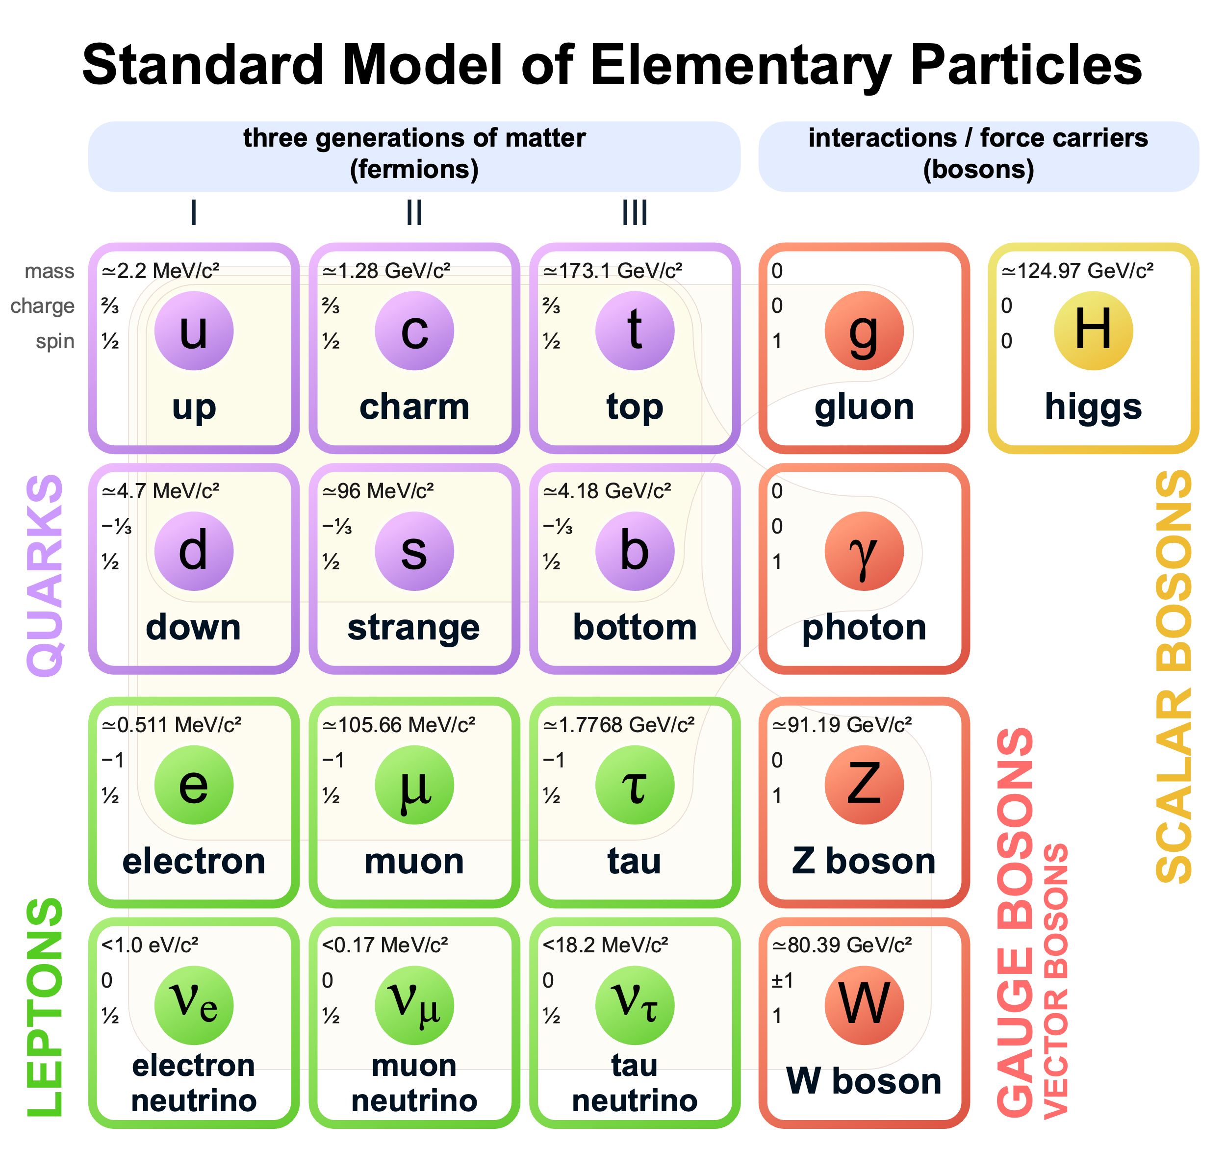
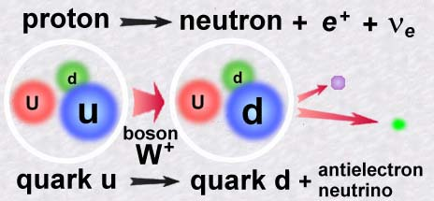
Electric charge
All free particles have charge that is multiple of e
Quarks have charge of 2/3 or -1/3 of e
  But they are bound to exist only in triplets
  such that the total charge is 0, e, 2e
  N.B. beta decay is in fact
  a decay of up quark to down quark

Slide 16

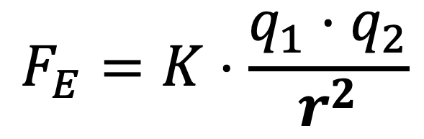
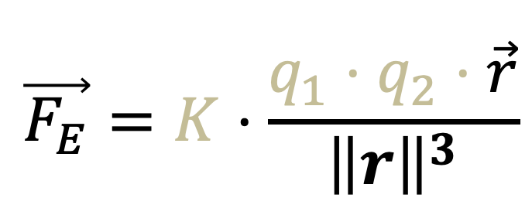
Electrostatic force
The force acts in direction of the 2 objects
In vector notation the equation is written
$$F_{E}=K⋅\frac{q_{1}⋅q_{2}}{r^{2}}$$
$$\vec{F_{E}}=K⋅\frac{q_{1}⋅q_{2}⋅\vec{r}}{{\left\|r\right\|}^{3}}$$

Slide 17
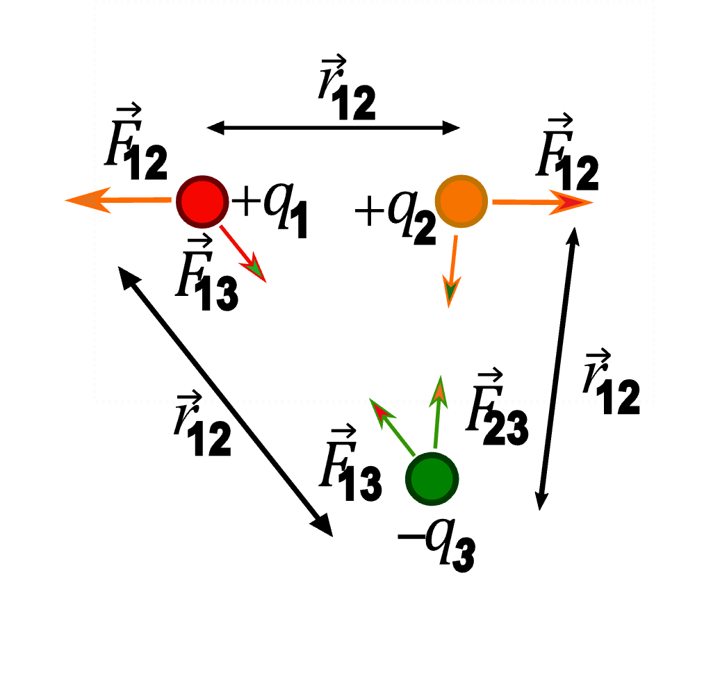
Multibody interaction
If there is more than 2 charges interacting then we can calculate force of each pair
and add the resulting forces as vectors:
principle of superposition

Slide 18
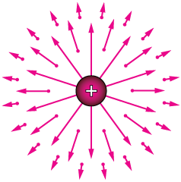
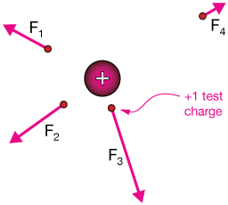
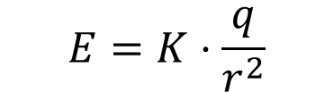
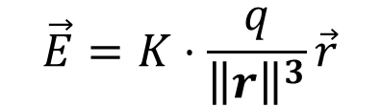
Electric field
It is much easier to do multibody calculations
if we introduce electric field
To every point in space we assign a vector
It corresponds to force that the charged object creating the field would exert on a 1 Coulomb point like charge
Electric field of a
positively charged sphere
e.g., a proton
$$\vec{E}=K⋅\frac{q}{{\left\|r\right\|}^{3}}\vec{r}$$
$$E=K⋅\frac{q}{r^{2}}$$

Slide 19
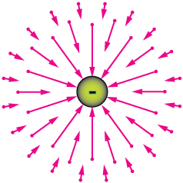
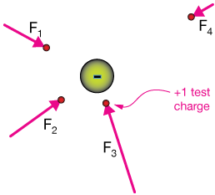
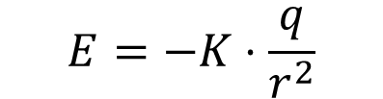
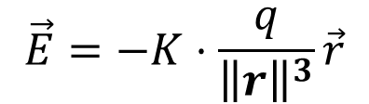
Electric field
It is much easier to do multibody calculations
if we introduce electric field
To every point in space we assign a vector
It corresponds to force that the charged object creating the field would exert on a 1 Coulomb point like charge
Electric field of a
negatively charged sphere
e.g., an electron
$$\vec{E}=−K⋅\frac{q}{{\left\|r\right\|}^{3}}\vec{r}$$
$$E=−K⋅\frac{q}{r^{2}}$$

Slide 20
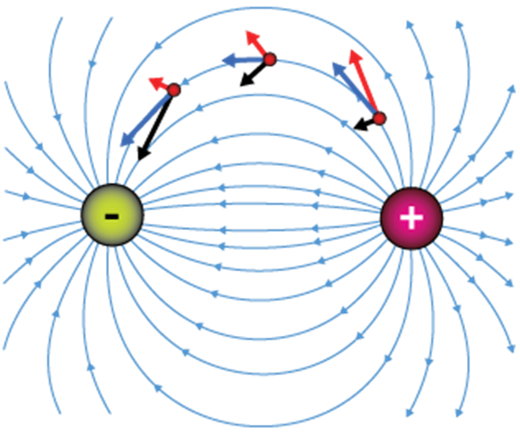
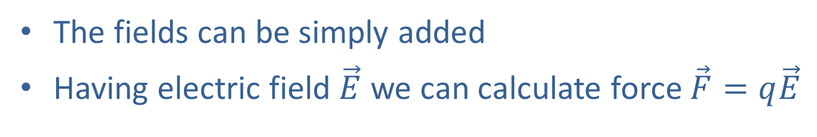
Superposition of electric fields
The fields can be simply added
Having electric field $\vec{E}$ we can calculate force $\vec{F}=q\vec{E}$

Slide 21
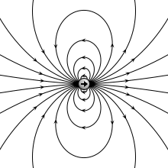
Electric fields
Field of an electric dipole

Slide 22
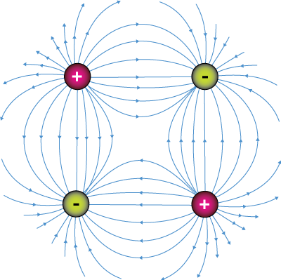
Electric fields
Field of an electric quadrupole

Slide 23
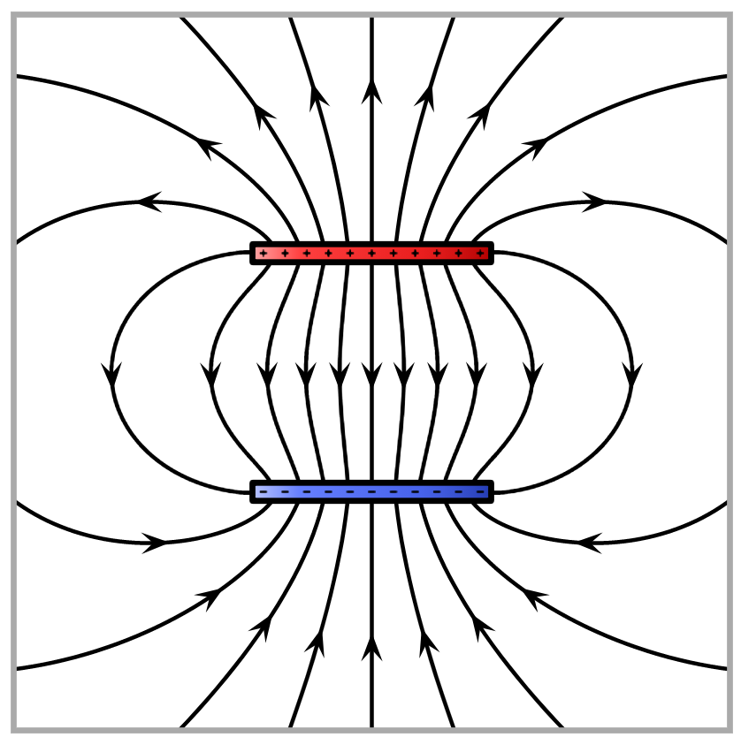
Electric fields
Field between charged plates

Slide 24
Electrostatic forces and object shapes
The electric field distribution depends on the shape
of the charged objects
The same way the electrostatic force between arbitrary objects depends on their shape

Slide 25
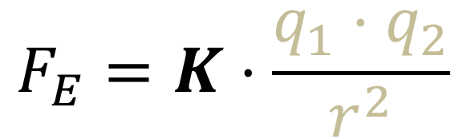
Influence of medium
$$F_{E}=K⋅\frac{q_{1}⋅q_{2}}{r^{2}}$$
The force changes depending on the medium that the objects are immersed in
  Why? Electric charge stays the same …
  Because the medium is made of charged particles

Slide 26

Influence of medium
$$F_{E}=K⋅\frac{q_{1}⋅q_{2}}{r^{2}}$$
In metals electrons can freely move within volume
+
+
+
+
+
+
+
+
+
+
+
+
+
+
+
+
+
+
+
+
+
+
+
+
+
+
+
+
+
+
+
+
+

Slide 27
Influence of medium
$$F_{E}=K⋅\frac{q_{1}⋅q_{2}}{r^{2}}$$
In metals electrons can freely move within volume
External charge exerts force on the electrons and protons
+
+
+
+
+
+
+
+
+
+
+
+
+
+
+
+
+
+
+
+
+
+
+
+
+
+
+
+
+
+
+
+
+
+
+
+
+
+
+
+
+
+
+
+
+
+
+
+

Slide 28
Influence of medium
$$F_{E}=K⋅\frac{q_{1}⋅q_{2}}{r^{2}}$$
In metals electrons can freely move within volume
External charge exerts force on the electrons and protons
  Electrons are attracted towards a positive charge and
  are repelled from a negative one
  Their displacement creates uneven distribution within the volume
+
+
+
+
+
+
+
+
+
+
+
+
+
+
+
+
+
+
+
+
+
+
+
+
+
+
+
+
+
+
+
+
+
+
+
+
+
+
+
+
+
+
+
+
+
+
+
+

Slide 29
Influence of medium
$$F_{E}=K⋅\frac{q_{1}⋅q_{2}}{r^{2}}$$
In metals electrons can freely move within volume
External charge exerts force on the electrons and protons
  Electrons are attracted towards a positive charge and
  are repelled from a negative one
  Their displacement creates uneven distribution within the volume
  The resulting electric field is exactly opposite
  to the one of the external charge
+
+
+
+
+
+
+
+
+
+
+
+
+
+
+
+
+
+
+
+
+
+
+
+
+
+
+
+
+
+
+
+
+
+
+
+
+
+
+
+
+
+
+
+
+
+
+
+

Slide 30
Influence of medium
$$F_{E}=K⋅\frac{q_{1}⋅q_{2}}{r^{2}}$$
In metals electrons can freely move within volume
External charge exerts force on the electrons and protons
  Electrons are attracted towards positive charge and
  are repelled from a negative one
  Their displacement creates uneven distribution within the volume
  The resulting electric field is exactly opposite
  to the one of the external charge
  The electron motion
  continues until
  there is no electric
  field in the volume
+
+
+
+
+
+
+
+
+
+
+
+
+
+
+
+
+
+
+
+
+
+
+
+
+
+
+
+
+
+
+
+
+
+
+
+
+
+
+
+
+
+
+
+
+
+
+
+

Slide 31
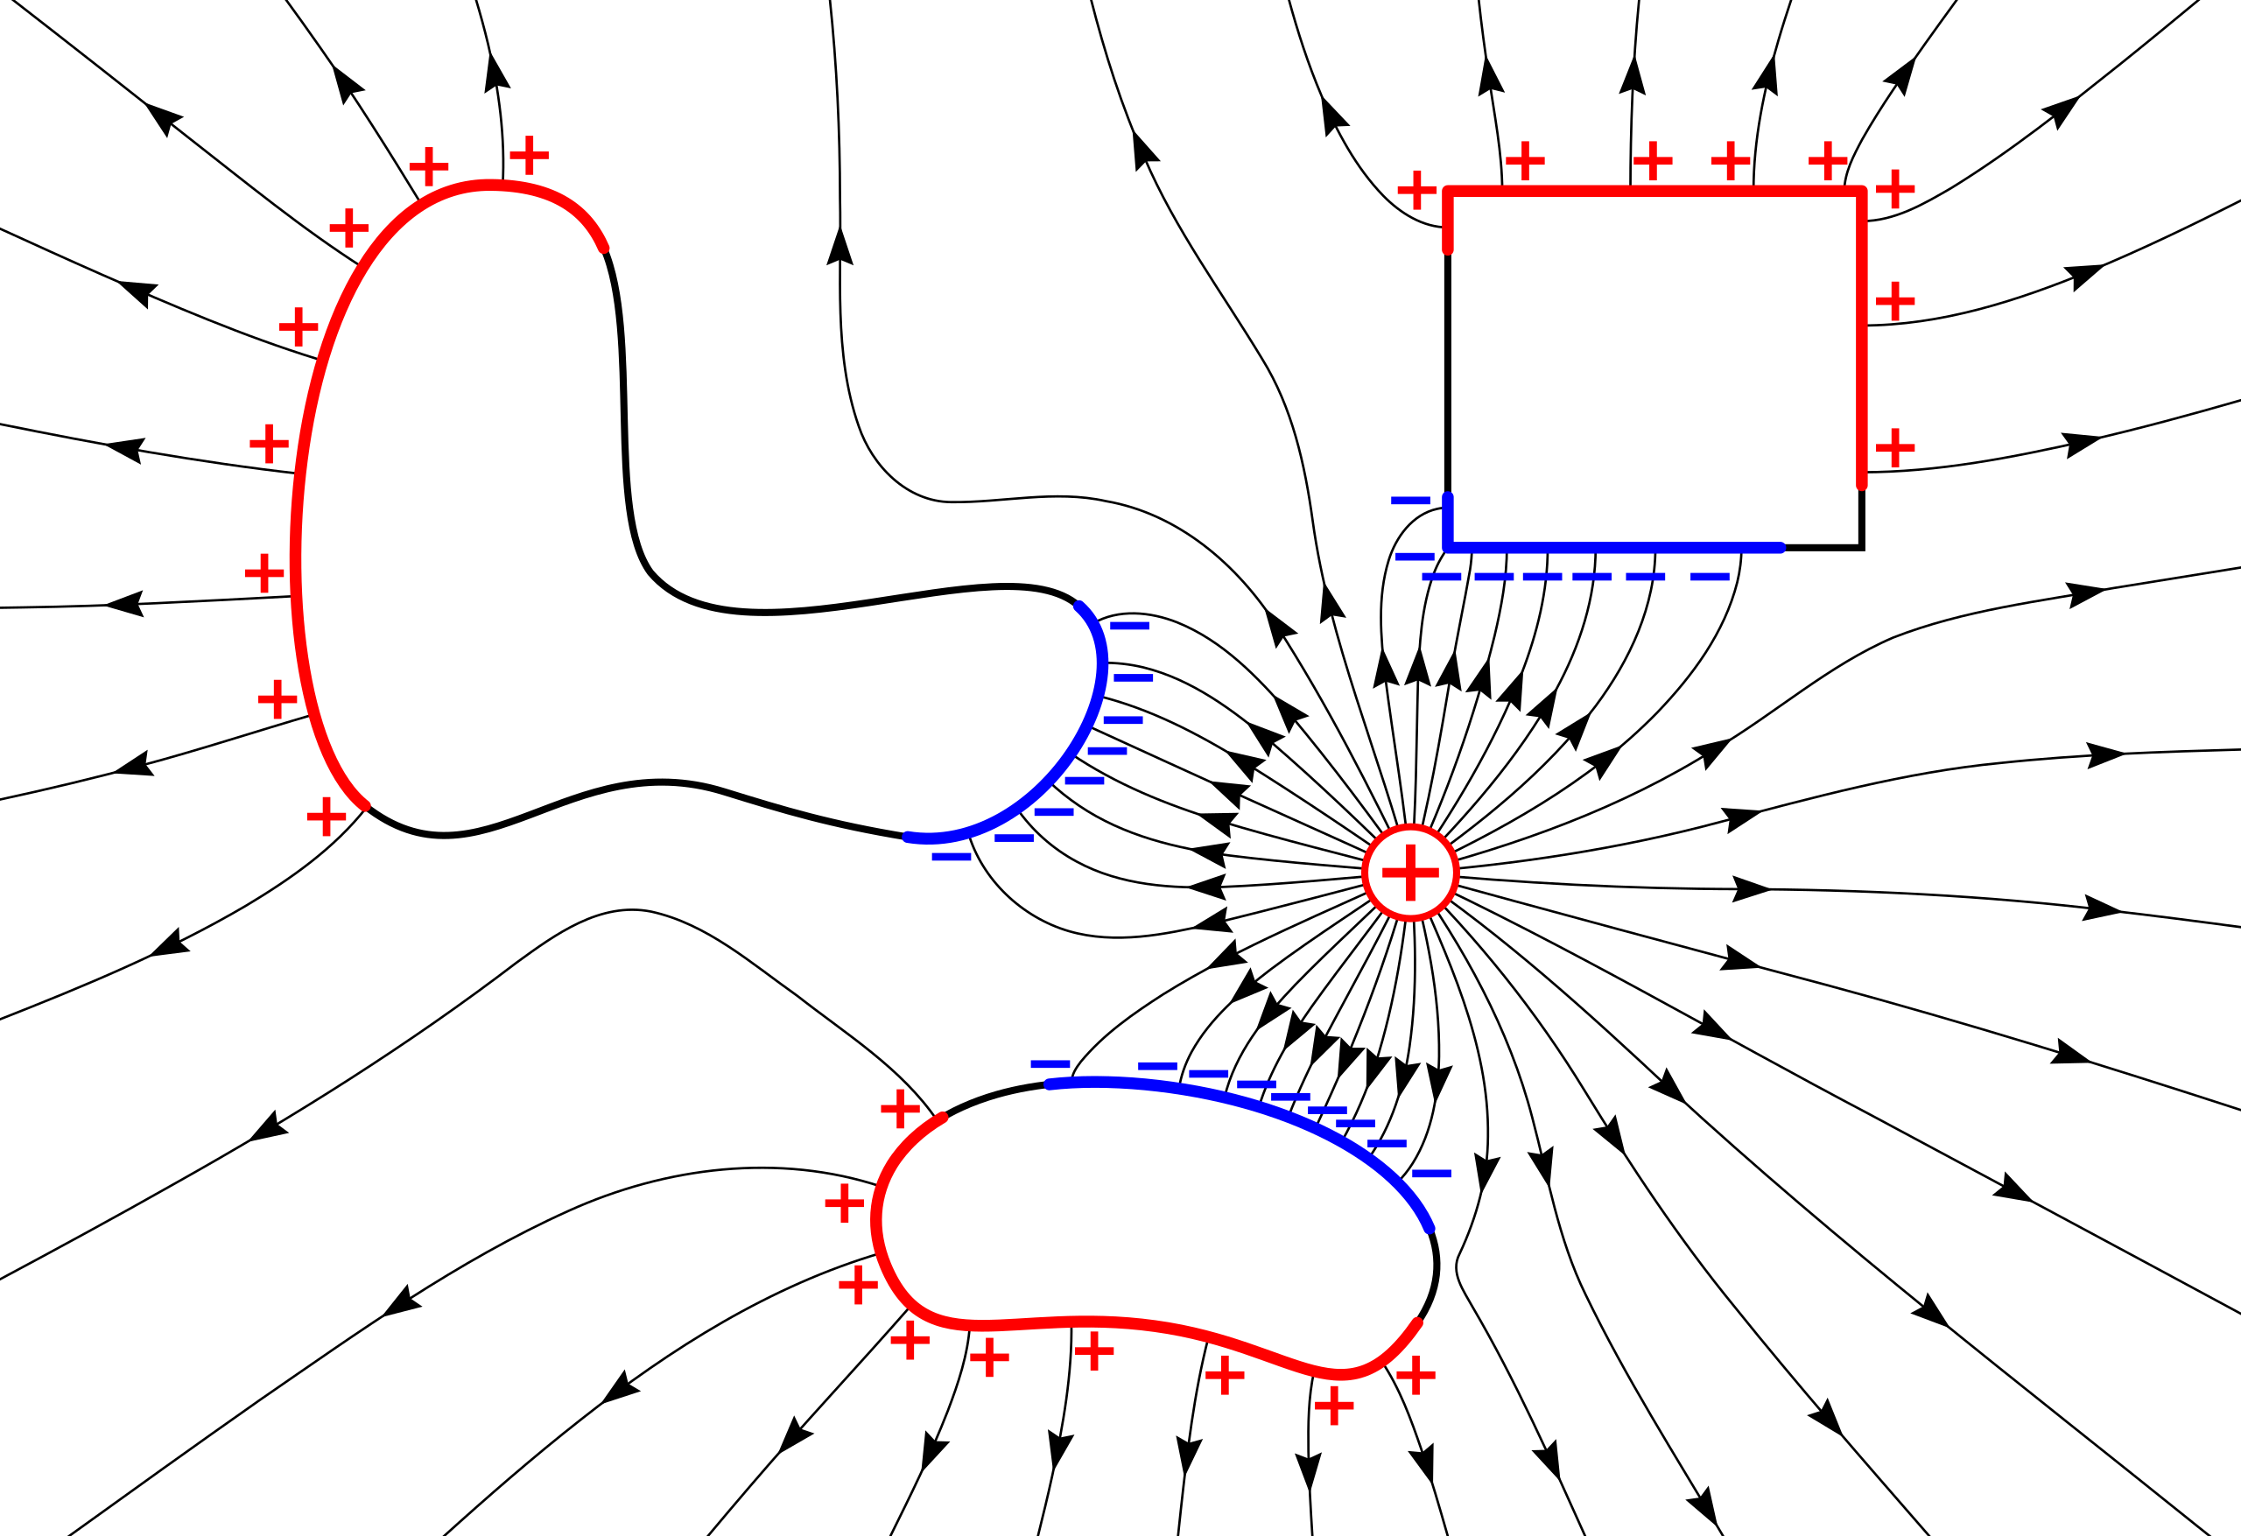
Influence of medium
$$F_{E}=K⋅\frac{q_{1}⋅q_{2}}{r^{2}}$$
In metals electrons can freely move within volume
→ Electric fields cannot penetrate metallic volumes
→ Field lines are perpendicular to metallic surfaces

Slide 32
Influence of medium
$$F_{E}=K⋅\frac{q_{1}⋅q_{2}}{r^{2}}$$
In non-metallic materials electrons cannot freely move
Still upon external electric field electrons displace within their molecules and the material becomes polarized
Induced electric field reduces the external field
by the amount that depends on
how much the electrons can displace
+
+
+
+
+
+
+
+
+
+
+
+
+
+
+
+
+
+
+
+
+
+
+
+
+
+
+
+
+
+
+
+
+
+
+
+
+
+
+
+
+
+
+
+
+
+
+
+

Slide 33
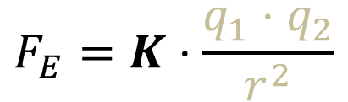
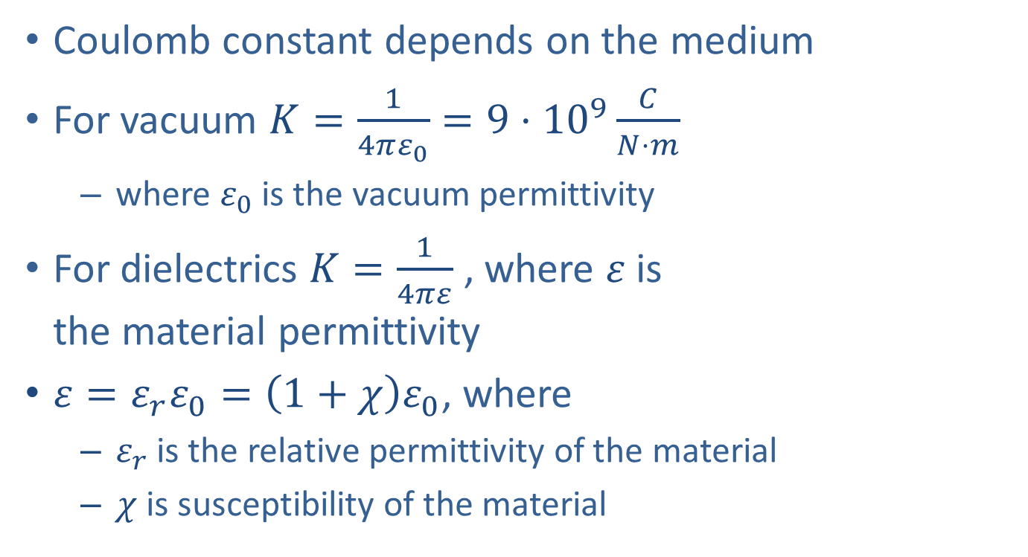
Influence of medium
$$F_{E}=K⋅\frac{q_{1}⋅q_{2}}{r^{2}}$$
Coulomb constant depends on the medium
For vacuum $K=\frac{1}{4πε_{0}}=9⋅{10}^{9}\frac{C}{N⋅m}$
  where $ε_{0}$ is the vacuum permittivity
For dielectrics $K=\frac{1}{4πε}$ , where $ε$is
the material permittivity
$ε={ε_{r}ε}_{0}=\left(1+χ\right)ε_{0}$, where
  $ε_{r}$ is the relative permittivity of the material
  $χ$ is susceptibility of the material

Slide 34
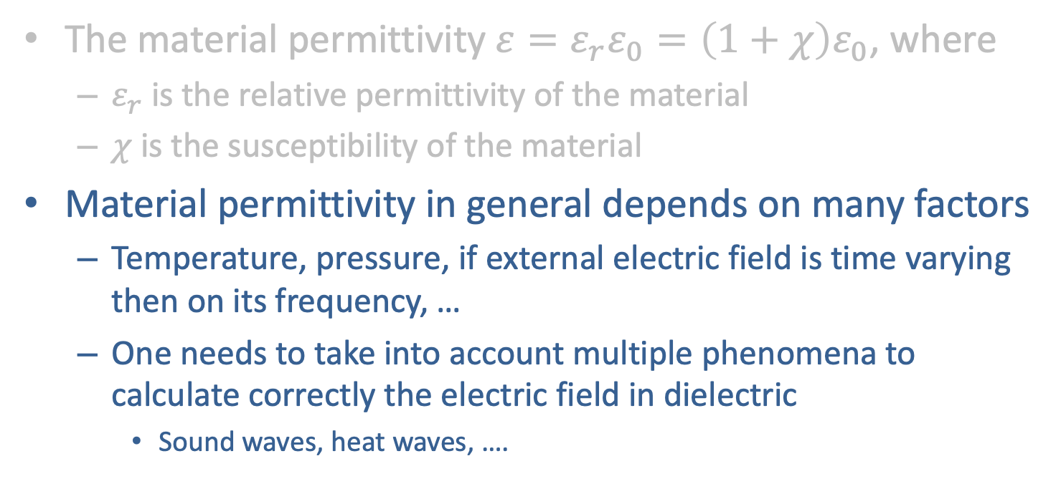
Influence of medium
$$F_{E}=K⋅\frac{q_{1}⋅q_{2}}{r^{2}}$$
The material permittivity$ε={ε_{r}ε}_{0}=\left(1+χ\right)ε_{0}$, where
  $ε_{r}$ is the relative permittivity of the material
  $χ$ is the susceptibility of the material
Material permittivity in general depends on many factors
  Temperature, pressure, if external electric field is time varying then on its frequency, …
  One needs to take into account multiple phenomena to calculate correctly the electric field in dielectric
    Sound waves, heat waves, ….

Slide 35
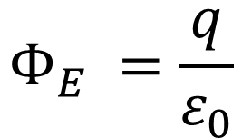
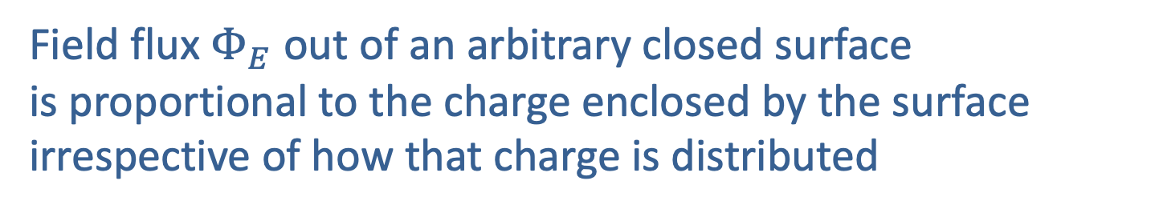
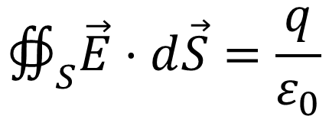
Gauss Law
Field flux $Φ_{E}$ out of an arbitrary closed surface
is proportional to the charge enclosed by the surface
irrespective of how that charge is distributed
$$Φ_{E} =\frac{q}{ε_{0}}$$
or
+
$$∯_{S}\vec{E}⋅d\vec{S}=\frac{q}{ε_{0}}$$

Slide 36
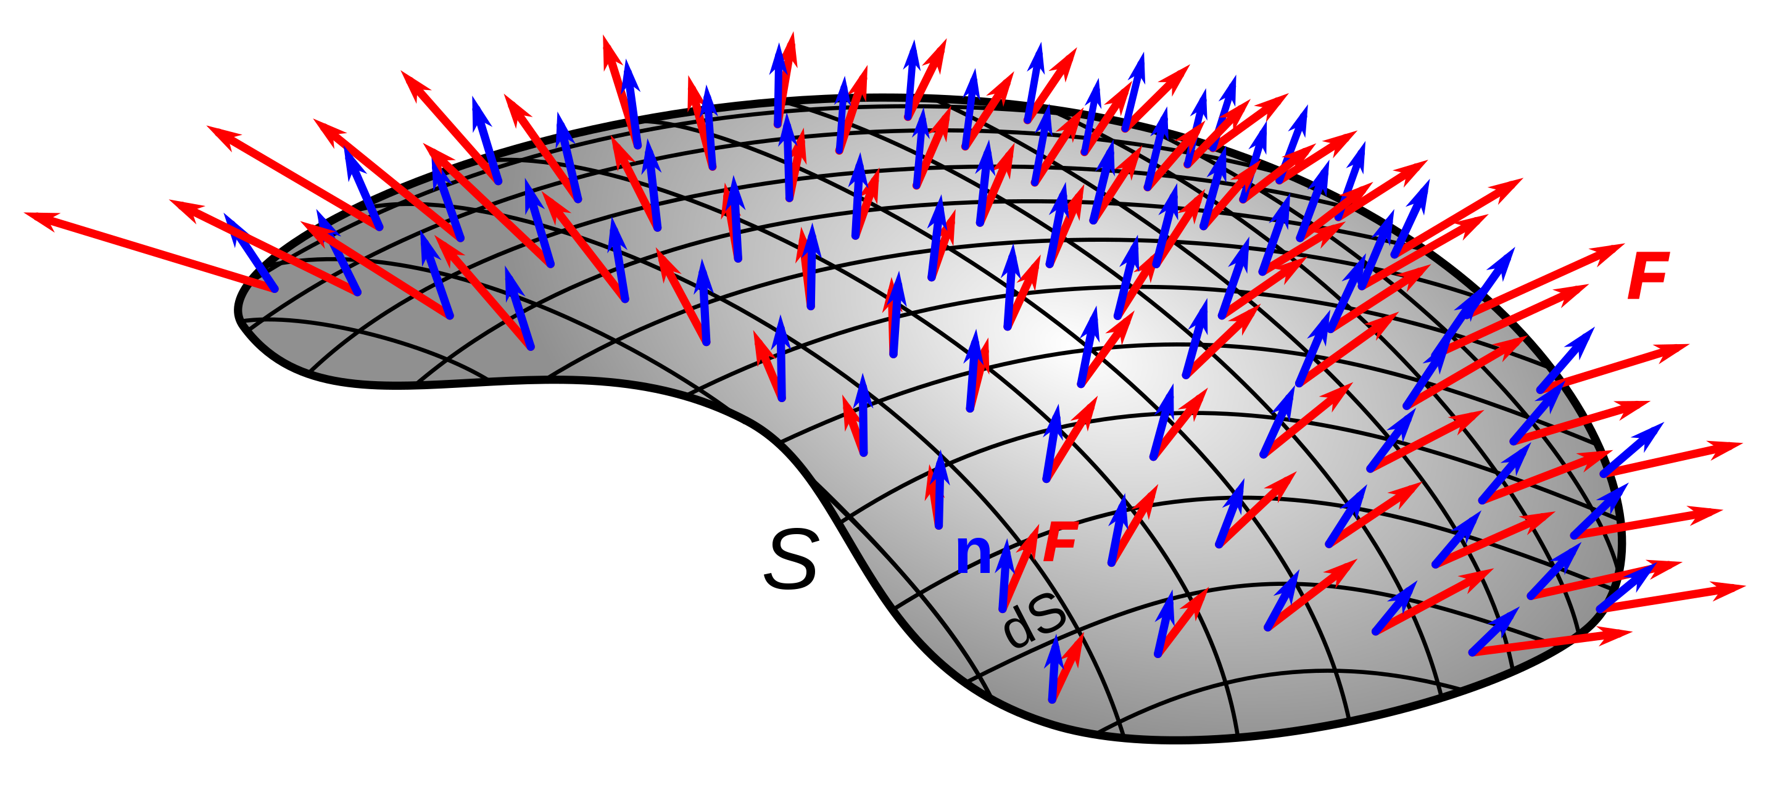



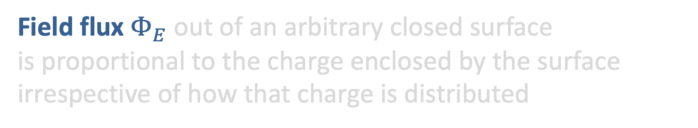
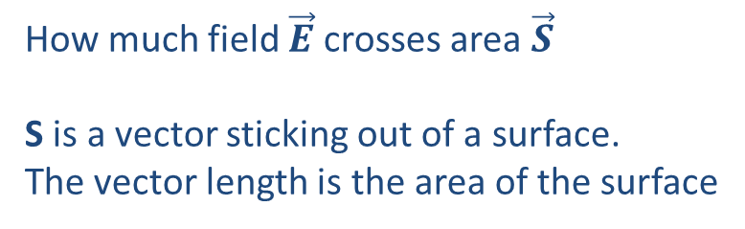



Gauss Law
Field flux $Φ_{E}$out of an arbitrary closed surface
is proportional to the charge enclosed by the surface
irrespective of how that charge is distributed
How much field $\vec{E}$ crosses area $\vec{S}$
S is a vector sticking out of a surface.
The vector length is the area of the surface
For and infinitesimally small area
we get a differential equation
$$\vec{S}$$
$$θ$$
$$\vec{E}$$
$${dΦ}_{E}=\vec{E}⋅d\vec{S}$$
$$Φ_{E}=∯_{S}\vec{E}⋅d\vec{S}$$

Slide 37
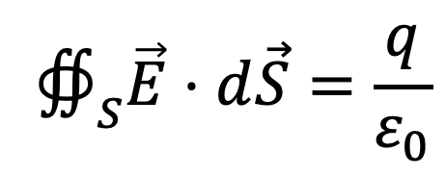
Gauss Law
Field flux out of an arbitrary closed surface
is proportional to the charge enclosed by the surface
irrespective of how that charge is distributed
$$∯_{S}\vec{E}⋅d\vec{S}=\frac{q}{ε_{0}}$$
+

Slide 38

Gauss Law
Field flux out of an arbitrary closed surface
is proportional to the charge enclosed by the surface
irrespective of how that charge is distributed
Only electric charges
can create field lines
$$∯_{S}\vec{E}⋅d\vec{S}=\frac{q}{ε_{0}}$$
+

Slide 39
Gauss Law
If there is no charge inside the volume, then
the total flux is zero, because the same amount of field enters the volume as it leaves it
+

Slide 40

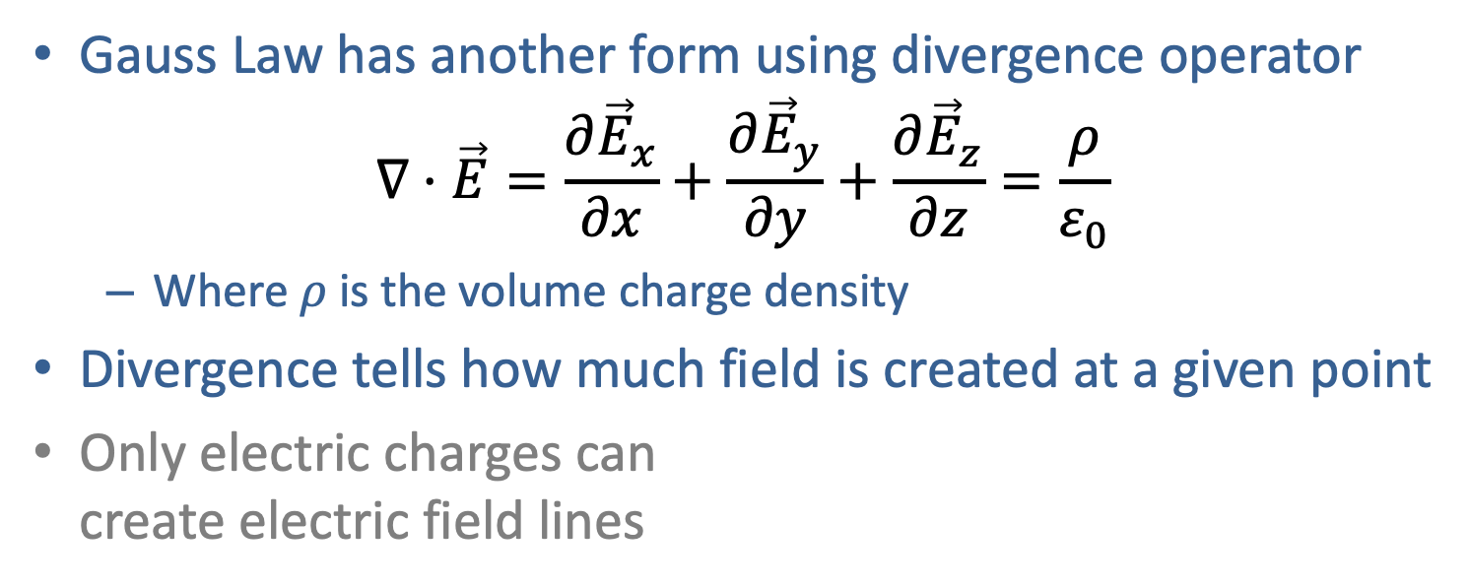
Gauss Law
Gauss Law has another form using divergence operator
$∇⋅\vec{E}=\frac{∂{\vec{E}}_{x}}{∂x}+\frac{∂{\vec{E}}_{y}}{∂y}+\frac{∂{\vec{E}}_{z}}{∂z}=\frac{ρ}{ε_{0}}$
  Where $ρ$ is the volume charge density
Divergence tells how much field is created at a given point
Only electric charges can
create electric field lines
$$∯_{S}\vec{E}⋅d\vec{S}=\frac{q}{ε_{0}}$$
Field flux out of an arbitrary closed surface
is proportional to the charge enclosed by the surface
irrespective of how that charge is distributed
+

Slide 41
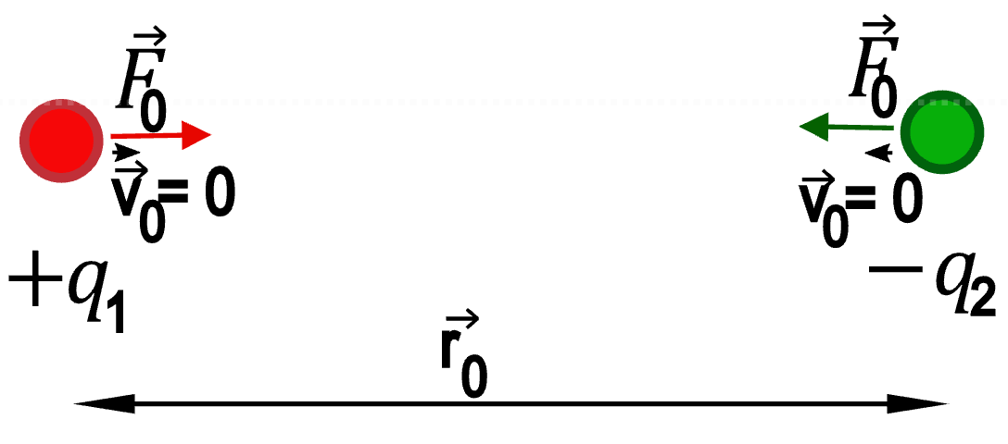
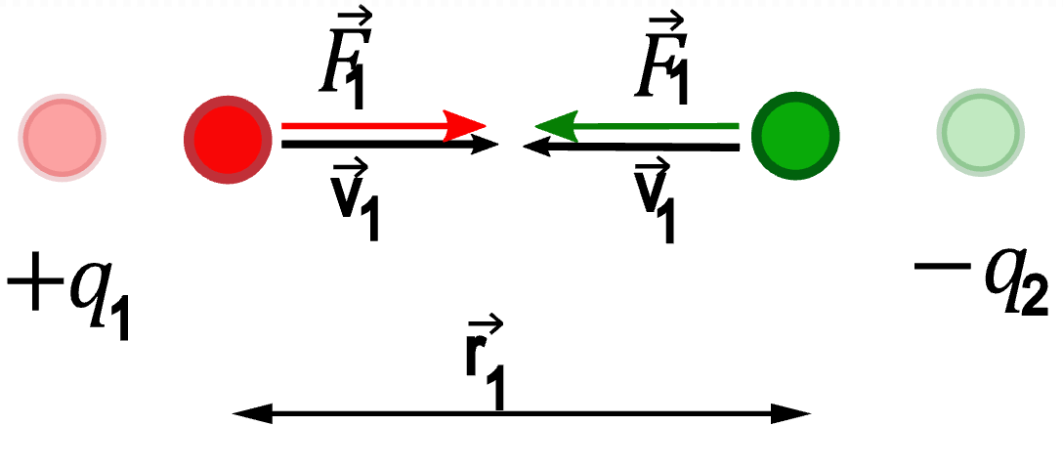
Electrostatic potential energy
If we let the charges move upon electrostatic force,
then they start accelerating → they gain kinetic energy

Slide 42
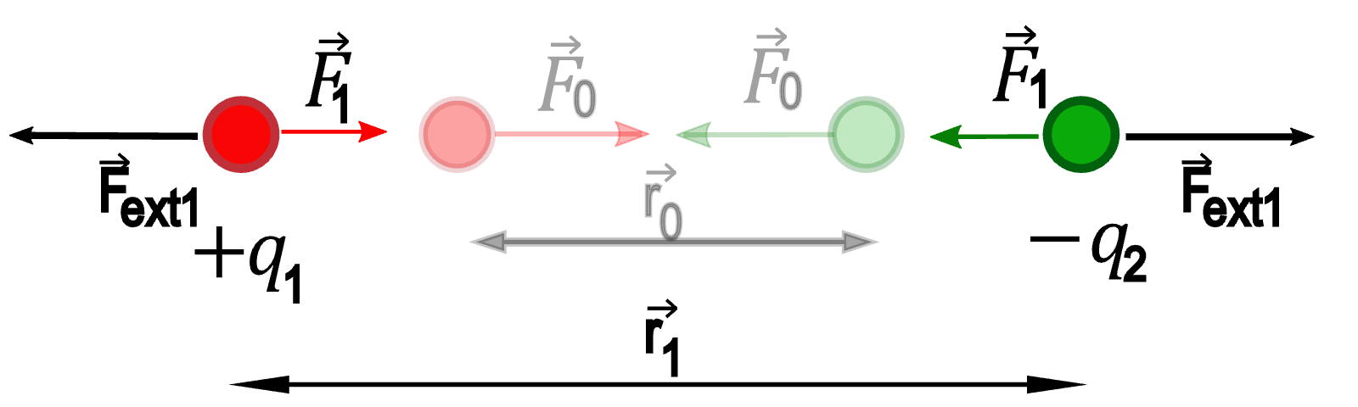
Electrostatic potential energy
If we want to separate opposite sign charges,
then we need to put work into it

Slide 43
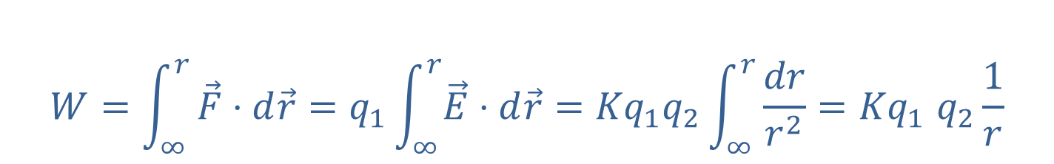
Electrostatic potential energy
Work needed to bring 2 point-like charges to a distance r
$$W=\int_{∞}^{r}{\vec{F}⋅d\vec{r}=q_{1}\int_{∞}^{r}{\vec{E}⋅d\vec{r}}}={Kq}_{1}q_{2}\int_{∞}^{r}{\frac{dr}{r^{2}}}{=Kq}_{1}q_{2}\frac{1}{r}$$

Slide 44
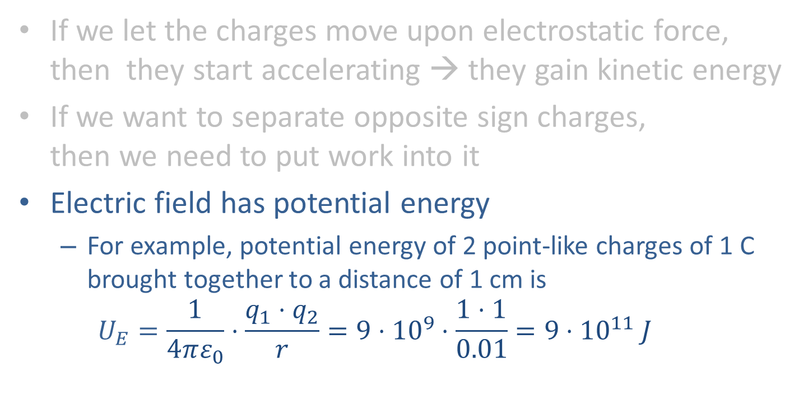
Electrostatic potential energy
If we let the charges move upon electrostatic force,
then they start accelerating → they gain kinetic energy
If we want to separate opposite sign charges,
then we need to put work into it
Electric field has potential energy
  For example, potential energy of 2 point-like charges of 1 C brought together to a distance of 1 cm is
  $U_{E}=\frac{1}{4πε_{0}}⋅\frac{q_{1}⋅q_{2}}{r}=9⋅{10}^{9}⋅\frac{1⋅1}{0.01}=9⋅{10}^{11} J$

Slide 45

Electrostatic potential energy
Potential energy of electric field
  For example, potential energy of 2 point-like charges of +1 C brought together at distance of 1cm is
  $U_{E}=\frac{1}{4πε_{0}}⋅\frac{q_{1}⋅q_{2}}{r}=9⋅{10}^{9}⋅\frac{1⋅1}{0.01}=9⋅{10}^{7} J$
  If one of the charges has mass of 1 kg and we let it go,
  then all the potential energy will be converted to kinetic energy
  $U_{E}=E_{K}= \frac{mv^{2}}{2}⇒$
  $v=\sqrt{{2U}_{E}/m}=1′341.6{km}/s=4^{′}829′907{km}/h$
  1 Coulomb it is a lot of charge!

Slide 46


Electric potential
Potential energy per 1 Coulomb is called potential
$V= \frac{U_{E}}{q}$
It corresponds to the energy needed to
bring 1 C charge from infinity to a given point
Unit is called Volt [V]
For point-like charges
$V=K\frac{q}{r}$

Slide 47

Electric potential
Usually, it is much easier to solve equations using potentials than using fields and forces
  Potential is a scalar, single value at each point in space
  Field is a vector, it has 3 values for each point in space,
  so normally 3 equations are needed
  Field can be easily obtained from potential, namely,
  field is equal to gradient of potential:
  $\vec{E}=\left(E_{x},E_{y},E_{z}\right)=\left(\frac{∂V}{∂x},\frac{∂V}{∂y},\frac{∂V}{∂z}\right)=∇$V

Slide 48


Field and potential
$$\vec{E}=(\frac{∂V}{∂x},\frac{∂V}{∂y},\frac{∂V}{∂z})$$
Thin lines = equipotential lines
Thick lines = electric field lines
Electric field lines are
always perpendicular to equipotential lines

Slide 49

Capacitance
It’s the ratio between
charge and produced voltage
$C= \frac{q}{V}$
Unit is Farad [F]

Slide 50
Magnetism

Slide 51






Magnetic Force
Real life examples
  Compass
  Magnets
  Attracted pair of wires
$$I_{1}$$
$$I_{2}$$
$$\vec{F}$$
$$\vec{F}$$

Slide 52


Electric current
Magnetic force is due to moving electric charges
Flow of charges is called electric current
$$I=\frac{dq}{dt}$$
It measures how much charge
flows through a surface
in a unit of time
Unit is Ampere [A]

Slide 53
Electric current
Positive current when
  Positive charge moves towards positive direction
  Negative charge moves towards negative direction

Slide 54








Magnetic Force
Magnetic force occurs only when
both charges are moving
$$I_{1}$$
$$\vec{v}$$
$$I_{1}$$
$$I_{2}$$
+
$$q$$
$$\vec{F}$$
$$\vec{F}$$
$$\vec{F}$$

Slide 55








Magnetic Force charge and wire
Only velocity component in plane with the wire and charge is important
$$\vec{F}=\frac{μ_{0}}{2πr}q{\vec{v}}_{∥ }I_{1}$$
If current and charge are positive, then
the force is always towards the wire
As closer to the wire as
stronger the force
Is proportional to charge and current
$μ_{0}$ is the magnetic vacuum permeability (physical const.)
$$\vec{v}$$
$$α$$
$$I_{1}$$
$${\vec{v}}_{∥}$$
$${\vec{v}}_{⊥}$$
+
$$I_{2}$$
$$\vec{F}$$

Slide 56








Magnetic Field
The force is the same for the same r: $\vec{F}=\frac{μ_{0}}{2πr}q{\vec{v}}_{∥}I_{1}$
Field of magnetic force creates circles around the wire
Strength of magnetic field from a wire is $B=\frac{μ_{0}}{2πr}I_{1}$
$$\vec{v}$$
$$α$$
$${\vec{v}}_{⊥}$$
$${\vec{v}}_{∥}$$
+
$$q$$
$$\vec{F}$$
$$I_{1}$$

Slide 57

Direction of magnetic field
For positive current direction of magnetic field is determined with rule of right hand

Slide 58










Magnetic Force
Equation for force from magnetic field
$\vec{F}=q⋅\vec{v}×\vec{B}$
Direction of force determined with
rule of right hand
  Index finger: direction of v
  Middle finger: direction of B
  Thumb gives direction of force
$$\vec{B}$$
$$\vec{v}$$
$$α$$
$${\vec{v}}_{∥}$$
$${\vec{v}}_{⊥}$$
+
$$q$$
$$\vec{F}$$
$$I_{1}$$

Slide 59


Magnetic Force
Equation for force from magnetic field
$\vec{F}=q⋅\vec{v}×\vec{B}$
Direction of force determined with
rule of right hand
  Index finger: direction of I
  Middle finger: direction of B
  Thumb gives direction of force

Slide 60
electromagnetisM

Slide 61
Electromagnetism
Magnetic force is electrostatic force
transformed by relativistic motion of charges

Slide 62



Electromagnetism
Magnetic force is electrostatic force
transformed by relativistic motion of charges
$$v_{e}$$
$$I$$
+
+
+
+
+
+
+
+
+
+
+
+
+
+
+
+
+
+
+
+
+
+
+
+
+
+
+
+
+
+
$$v_{cable}=0$$
Let’s take a cable with flowing electric current
  Positive current to the right
  Electrons are flowing to the left
The cable is electrically neutral
Atoms of the metal are at rest

Slide 63




Electromagnetism
Magnetic force is electrostatic force
transformed by relativistic motion of charges
$$v_{ec}$$
$$I$$
+
+
+
+
+
+
+
+
+
+
+
+
+
+
+
+
+
+
+
+
+
+
+
+
+
+
+
+
+
+
$$F_{magn}$$
$$v_{cable}=0$$
$$v_{t}$$
A test negative charge moves along the cable to the left
Magnetic force attracts the test charge to the cable

Slide 64




Electromagnetism
Magnetic force is electrostatic force
transformed by relativistic motion of charges
$$v_{ec}≃0$$
$$I$$
+
+
+
+
+
+
+
+
+
+
+
+
+
+
+
+
+
+
+
+
+
+
+
+
+
+
+
+
+
+
$$v_{cable}≫0$$
$$v_{t}=0$$
Lets move to the rest frame of the test charge
The test charge now is at rest
Electrons in the cable are almost at rest ($v_{t}≃v_{ec}$)
Cable atoms move to the right with ${−v}_{t}$

Slide 65
Electromagnetism
Magnetic force is electrostatic force
transformed by relativistic motion of charges
$$v_{ec}≃0$$
$$I$$
+
+
+
+
+
+
+
+
+
+
+
+
+
+
+
+
+
+
+
+
+
+
+
+
+
+
+
+
+
+
$$v_{cable}≫0$$
$$v_{t}=0$$
Due to relativistic Lorentz contraction the cable gets shorter
Distance between atoms (positive charges) gets smaller
Density of positive charges gets larger

Slide 66
Electromagnetism
Magnetic force is electrostatic force
transformed by relativistic motion of charges
$$v_{ec}≃0$$
$$I$$
+
+
+
+
+
+
+
+
+
+
+
+
+
+
+
+
+
+
+
+
+
+
+
+
+
+
+
+
+
+
$$v_{cable}≫0$$
$$v_{t}=0$$
Density of positive charges gets larger
Density of electrons gets smaller
Therefore, the cable is positively charged

Slide 67

Electromagnetism
Magnetic force is electrostatic force
transformed by relativistic motion of charges
$$v_{ec}≃0$$
$$I$$
+
+
+
+
+
+
+
+
+
+
+
+
+
+
+
+
+
+
+
+
+
+
+
+
+
+
+
+
+
+
$$F_{electr}$$
$$v_{cable}≫0$$
$$v_{t}=0$$
Cable is positively charged
Electrostatic force attracts the test charge to the cable

Slide 68










Electromagnetism
Magnetic force is electrostatic force
transformed by relativistic motion of charges
$$v_{ec}$$
$$I$$
$$v_{ec}≃0$$
$$I$$
+
+
+
+
+
+
+
+
+
+
+
+
+
+
+
+
+
+
+
+
+
+
+
+
+
+
+
+
+
+
+
+
+
+
+
+
+
+
+
+
+
+
+
+
$$F_{magn}$$
$$F_{electr}$$
$$v_{cable}≫0$$
$$v_{cable}=0$$
$$v_{t}$$
$$v_{t}=0$$
Magnetic force when cable is at rest is the same as
electric force when test charge is at rest
With reference frame change
one field changes to another one

Slide 69


Electromagnetism
With reference frame change
one field changes to another one
Only transverse components change
Electric field gets weaker with speed
Magnetic field gets stronger
The reason we use magnetic fields
at high particle energies

Slide 70

Force strength comparison
As an example, let’s compare “easily achievable”
electric and magnetic fields
  Electric: 1 MV/m (10 MV voltage over 10 cm gap)
  Magnetic: 1 T
$\frac{F_{magn}}{F_{elec}}=\frac{qvB}{qE}=\frac{cβ_{rel}B}{E}=\frac{cβ_{rel}B}{E}$=$β_{rel}\frac{3⋅{10}^{8}⋅1}{{10}^{6}}=300⋅β_{rel}$
If $β_{rel}$ is smaller than 1/300
then the electric force is stronger
  At CERN only behind the particle sources and in ELENA

Slide 71
LoreNtz force

Slide 72

Lorentz force
The electromagnetic force is called Lorentz force
$$\vec{F}=q⋅\left(\vec{E}+\vec{v}×\vec{B}\right)$$
It is the sum of forces due to
electric and magnetic fields

Slide 73
Ampere’s law

Slide 74



Ampere’s law
The field integrated around any closed loop
is proportional to the current enclosed by the loop
irrespective of how that current is distributed
$$∮_{C}\vec{B}⋅d\vec{l} =μ_{0}I$$
$$\vec{B}$$
Magnetostatic case!
When fields are time-varying additional term needs to be added on R.H.S.
$$I$$

Slide 75



Magnetic coil
Ampere’s law allows to calculate magnetic fields from given distribution of electric currents
  Or shapes of the wire
For example, of a
  Loop
  Solenoid coil

Slide 76




Solenoid coil
Selecting contour like the orange box:
only the line inside solenoid counts and
it has constant B field
N: number of windings
$$∮_{C}\vec{B}⋅d\vec{l} =μ_{0}I$$

Slide 77





A loop with current
In many problems it is conceptually useful to split a source of magnetic field into very small loops with current
$Iab$ or $IA$ is called magnetic dipole moment vector
or simply magnetic moment
z
$$B_{x}= \frac{Iab}{4πε_{0}c^{2} }\frac{3xz}{R^{5}}$$
y
$$B_{y}= \frac{Iab}{4πε_{0}c^{2} }\frac{3yz}{R^{5}}$$
b
x
$$B_{x}= \frac{Iab}{4πε_{0}c^{2} }(\frac{1}{R^{3}}−\frac{3z^{2}}{R^{5}})$$
I
a

Slide 78






Forces acting on loop with current
Put a loop with current in uniform magnetic field and
it will rotate such that μ is in direction of the field
Torque $\vec{τ}=\vec{μ}×\vec{B}$
Energy $U=−\vec{μ}⋅\vec{B}$
z
y
$$\vec{μ}$$
$$\vec{B}$$
$$\vec{F}$$
I
x
$$\vec{B}$$
$$\vec{F}$$

Slide 79
Magnetic moments of particles and atoms
Charged elementary particles have magnetic moments
They act like very small loops with current
One can think of it as charge rotating due to spin
Usually, magnetic moments are distributed randomly
But some materials can have moments of their atoms aligned: they are magnets

Slide 80




Magnets
Magnetic materials can have their moments aligned,
they can be magnetized by external magnetic field
Magnetization can stay forever: permanent magnets
Or only when external field is present: electromagnets
Ferrimagnetic
Ferromagnetic

Slide 81
Magnetic induction

Slide 82

Magnetic Induction
Real life examples:
  Electric generator
    Voltage out of rotating magnet

Slide 83

Induction
Change of magnetic field induces electric field
Change of electric field induces magnetic field

Slide 84


Faraday law
Change of magnetic field induces electric field
  When magnet is inserted into the loop then $\vec{B}$ is increasing and
  electric field is induced along the wire loop
  Electric field pushes electrons in the wire
  and generates induced current
  Induced current creates magnetic field ${\vec{B}}_{induced}$
  such that it is against the external field $\vec{B}$

Slide 85



Faraday law
$$ε_{elecromotive}=∮_{C}\vec{E}⋅d\vec{l}=−\frac{dΦ_{B}}{dt}$$
$$Φ_{B}=∯_{S}\vec{B}⋅d\vec{S}$$
Electromotive force around a closed loop C is opposite to change of magnetic field flux in time
Unit is Volt [V]
The sign of B field is not important
But what is important it is
if B field is increasing or
if it is decreasing in time

Slide 86


Maxwell's addition to Ampere's law
$$∮_{C}\vec{B}⋅d\vec{l} =μ_{0}I+μ_{0}ε_{0}\frac{dΦ_{E}}{dt}$$
Magnetic Field integrated around any closed loop
is proportional to the current enclosed by the loop
plus change of electric field flux in time
$$Φ_{E}=∯_{S}\vec{E}⋅d\vec{S}$$

Slide 87
Maxwell equations
Putting it all together

Slide 88
Maxwell equations
Gauss law for electric field
  - Electric charge is the source of electric field
Gauss law for magnetic field
  - Magnetic field has no source, there is no “magnetic charges”
Faraday law
  - Electric field around a loop (electromotive force) is
  opposite to change of magnetic field flux through the loop
Ampere law
  - Magnetic field around a loop is equal to
  electric current plus change of electric field flux through the loop

Slide 89




Maxwell equations
Integral form
$$∯_{S}\vec{E}⋅d\vec{S}=\frac{q}{ε_{0}}$$
$$∯_{S}\vec{B}⋅d\vec{S}=0$$
$$∮_{C}\vec{E}⋅d\vec{l}=−∯_{S}\vec{\frac{∂B}{∂t}}⋅d\vec{S}$$
$$∮_{C}\vec{B}⋅d\vec{l} =μ_{0}I+μ_{0}ε_{0}∯_{S}\vec{\frac{∂E}{∂t}}⋅d\vec{S}$$

Slide 90


Curl
Curl is, by definition, line integral around
infinitesimally small closed loop
It measures how much the field is curling, or circulating

Slide 91








Maxwell equations
Integral form
Differential form
$$∯_{S}\vec{E}⋅d\vec{S}=\frac{q}{ε_{0}}$$
$$∇⋅\vec{E}=\frac{ρ}{ε_{0}}$$
$$∯_{S}\vec{B}⋅d\vec{S}=0$$
$$∇⋅\vec{B}=0$$
$$∮_{C}\vec{E}⋅d\vec{l}=−∯_{S}\vec{\frac{∂B}{∂t}}⋅d\vec{S}$$
$$∇×\vec{E}=−\vec{\frac{∂B}{∂t}}$$
$$∮_{C}\vec{B}⋅d\vec{l} =μ_{0}I+μ_{0}ε_{0}∯_{S}\vec{\frac{∂E}{∂t}}⋅d\vec{S}$$
$$∇×\vec{B} =μ_{0}\vec{J}+μ_{0}ε_{0}\vec{\frac{∂E}{∂t}}$$

Slide 92
Electromagnetic waves

Slide 93
How the fields propagate ?
Solve Maxwell equations for different
situations and conditions

Slide 94



EM field propagation in vacuum:
Wave equations
$$∇^{2}\vec{E}=μ_{0}ε_{0}\frac{∂^{2}\vec{E}}{∂t^{2}}$$
Derivations in Appendix
These are vector equations
  Vectors have direction
    We can always choose a reference frame
    we chose it so the wave moves along x axis
  This allows to reduce them to a scalar equation
$$∇^{2}\vec{B}=μ_{0}ε_{0}\frac{∂^{2}\vec{B}}{∂t^{2}}$$
$$\frac{∂^{2}E_{y}}{∂x^{2}}=μ_{0}ε_{0}\frac{∂^{2}E_{y}}{∂t^{2}}$$

Slide 95
Solution of wave eq. in vacuum:
Plane waves
General solution:
How did we find it?
Someone guessed it and it fits
f and g are arbitrary functions, they are defined by
the source of the wave
$$E_{y}=f\left(x−t/\sqrt{μ_{0}ε_{0}}\right)+g(x−t/\sqrt{μ_{0}ε_{0}})$$

Slide 96











Plane wave
$$E_{y}=f\left(x−ct\right)+f(x+ct)$$
f can be an arbitrary function
  At t=0 source at x=0 generates E_{y} pulse
  Pulse in space at time t₁ and t₂:
$$E_{y}$$
$$f$$
$$t$$
$$f(x+ct)$$
$$f(x−ct)$$
is the wave moving left
from the source
is the wave moving right
from the source
$$E_{y}$$
$${−t}_{2}/\sqrt{μ_{0}ε_{0}}$$
$${−t}_{1}/\sqrt{μ_{0}ε_{0}}$$
$$t_{1}/\sqrt{μ_{0}ε_{0}}$$
$$x$$
$$t_{2}/\sqrt{μ_{0}ε_{0}}$$

Slide 97




Sinusoidal plane waves
If the source is resonating with frequency $ω$,
and the source amplitude is sinusoidal $A_{s}=A_{0s}\sin{ωt}$,
then the wave accordingly has sinusoidal form
To facilitate calculations and equation,
very often complex exponents are employed
  But only the real part has a physical meaning
$$E_{y}=E_{0y}\sin{ω\left(t−x/c\right)}$$
$$E_{y}=E_{0y}e^{iω\left(t−x/c\right)}$$
A function of (t-x/c) is also function of (x-ct)
$F\left(t−\frac{x}{c}\right)=F\left(−\frac{x−ct}{c}\right)=f\left(x−ct\right)$

Slide 98


Wavenumber
If plane wave propagates in an arbitrary direction
then equation becomes
To simplify, we put k = 𝜔/c
k is called angular wavenumber
  It describes how phase changes per unit length
  The unit is radian/m
$$E_{y}=E_{0y}e^{iω\left(t−\frac{x}{c}−\frac{y}{c}−\frac{z}{c}\right)}$$
$$E_{y}=E_{0y}e^{i(ωt −kx −ky−kz)}$$

Slide 99
Rectangular waveguide

Slide 100



Rectangular waveguide
Metallic (ideally conducting) tube
with a rectangular profile
Vacuum inside the tube
  No charges, no currents
Wave equations still hold
Boundary conditions need
to be respected
  No electric fields along the metallic surfaces
  No magnetic fields perpendicular to metallic surfaces
$$∇^{2}\vec{E}=μ_{0}ε_{0}\frac{∂^{2}\vec{E}}{∂t^{2}}$$
$$∇^{2}\vec{B}=μ_{0}ε_{0}\frac{∂^{2}\vec{B}}{∂t^{2}}$$

Slide 101


Rectangular waveguide
Independent 2 equations that lead to independent 2 solutions
  The final solution is sum of these 2 solutions

Slide 102
TE and TM modes
If one takes E_{z} = 0 and B_{z} ≠ 0, then only transverse
E_{x} and E_{y} remain: TE (Transverse Electric) wave
If one takes E_{z} ≠ 0 and B_{z} = 0, then only transverse
B_{x} and B_{y} remain: TM (Transverse Magnetic) wave

Slide 103



Rectangular waveguide modes
$\frac{∂B_{z}}{∂x}=0$ for x = 0 and x = a ()
so, $k_{x}=mπ/a$
The same applies for Y
Finally
$$B_{z}=B_{0}\cos\left(\frac{mπx}{a}\right)\cos\left(\frac{nπy}{b}\right)cos⁡(ω\left(t−z/c\right))$$
Electric field Ex component of
the TE₃₁ mode inside
a hollow metallic waveguide.

Slide 104












Electric field for different modes
TE₁₀
TE₀₁
TE₁₁
TE₂₁
TE₂₀
TE₁₁
TE₁₂
TE₂₂
TE₂₀
TM₁₁
TM₂₁
TM₁₂
https://cds.cern.ch/record/1416619/

Slide 105





Frequencies of the modes
$$B_{z}=B_{0}\cos\left(\frac{mπx}{a}\right)\cos\left(\frac{nπy}{b}\right)$$
Wavenumber
It must be positive, what gives condition for minimum frequency that can propagate,
the cutoff frequency:
The lowest 𝜔_{mn} is for mode TE₁₀ (m=1 and n=0)$: ω_{10}=\frac{cπ}{a}$
Waves with lower frequencies cannot propagate in waveguide having width a (assuming b<a)

Slide 106
Credits
Certain figures were copied from
  Wikipedia.org
  xaktly.com by Dr. Jeff Cruzan
    Creative Commons Attribution-NonCommercial-ShareAlike 3.0 Unported License.
  Erk Jensen’s lecture on CAS 2010 https://cds.cern.ch/record/1416619/

Slide 107


Rectangular waveguide
The wave needs to propagate along the waveguide
so the x dependent component needs to be $E_{x}=e^{i(ωt −kx)}$
Putting these to Faraday and Ampere laws
$${E\left(x,y,z,t\right)=E_{T}\left(y,z\right)e}^{i(ωt −kx)}$$
$${B\left(x,y,z,t\right)=B_{T}\left(y,z\right)e}^{i(ωt −kx)}$$
$$\frac{{∂E}_{z}}{∂y} +\frac{{∂E}_{y}}{∂z}=iωB_{x}$$
$\frac{{∂E}_{x}}{∂z} +\frac{{∂E}_{z}}{∂x}$ = $i ωB_{y}$
$$\frac{{∂E}_{y}}{∂x} +\frac{{∂E}_{z}}{∂y}=iωB_{z}$$

Slide 108
Appendixes

Slide 109
Solving Maxwell equations in vacuum:
Wave equation

Slide 110




Solving Maxwell equation in vacuum
The trick to quickly solve the equations:
$$∇ × ∇×\vec{E}=∇ ×(−\frac{∂\overset{⃑}{B}}{∂t})$$
$∇ × ∇×\vec{E}≡∇$($∇⋅\vec{E}$) - $∇^{2}\vec{E}=−\frac{∂}{∂t}∇×\vec{B}$
Apply curl operator on both sides on Faraday Law
Apply Gauss and Ampere laws
$$∇⋅\vec{E}=\frac{ρ}{ε_{0}}$$
$$∇×\vec{B} =μ_{0}\vec{J}+μ_{0}ε_{0}\frac{∂\vec{E}}{∂t}$$
$∇$($\frac{ρ}{ε_{0}}$) -$∇^{2}\vec{E}=−$ $μ_{0}\frac{∂\vec{J}}{∂t}−μ_{0}ε_{0}\frac{∂^{2}\vec{E}}{∂t^{2}}$

Slide 111



How the fields propagate in vacuum?
$∇$($\frac{ρ}{ε_{0}}$) -$∇^{2}\vec{E}=−$ $μ_{0}\frac{∂\vec{J}}{∂t}−μ_{0}ε_{0}\frac{∂^{2}\vec{E}}{∂t^{2}}$
In vacuum there is no charges and no currents
$ρ$ = 0
$$\vec{J}=0$$
$$∇^{2}\vec{E}≡\frac{∂^{2}E_{x}}{∂t^{2}}+\frac{∂^{2}E_{y}}{∂t^{2}}+\frac{∂^{2}E_{z}}{∂t^{2}}=μ_{0}ε_{0}\frac{∂^{2}\vec{E}}{∂t^{2}}$$

Slide 112


How the fields propagate in vacuum?
The same trick with curl applied on both sides of Ampere’s Law leads to
$$∇^{2}\vec{B}=μ_{0}ε_{0}\frac{∂^{2}\vec{B}}{∂t^{2}}$$
$$∇^{2}\vec{B}≡\frac{∂^{2}B_{x}}{∂t^{2}}+\frac{∂^{2}B_{y}}{∂t^{2}}+\frac{∂^{2}B_{z}}{∂t^{2}}=μ_{0}ε_{0}\frac{∂^{2}\vec{B}}{∂t^{2}}$$

Slide 113


How the fields propagate in vacuum?
$$∇^{2}\vec{E}=μ_{0}ε_{0}\frac{∂^{2}\vec{E}}{∂t^{2}}$$
Wave equations
These are vector equations
  Vectors have direction
    We can always choose a reference frame
    we chose it so the wave moves along x axis
  We induce that the amplitudes do not change in transverse
  i.e. all derivatives w.r.t. y and z are zero
$$∇^{2}\vec{B}=μ_{0}ε_{0}\frac{∂^{2}\vec{B}}{∂t^{2}}$$

Slide 114


How the fields propagate in vacuum?
$\frac{{∂E}_{x}}{∂x}+$ $\frac{{∂E}_{y}}{∂y}$ $+\frac{{∂E}_{z}}{∂z}=0 ⇒\frac{{∂E}_{x}}{∂x}+$ $0$ $+0=0⇒$
$\frac{{∂E}_{x}}{∂x}=0$ $⇒$
Gauss Law
E_{x} constant along x
not interesting, choosing special case E_{x} = 0
Faraday Law, developing curl operator
B_{x} constant in time
B_{y} constant in time
Only B_{z} is changing in time
putting B_{x}=0 and B_{y}=0 (constant fields are not interesting)
${(∇×\vec{E})}_{x}=−\frac{{∂B}_{x}}{∂t}⇒\frac{{∂E}_{z}}{∂y} +\frac{{∂E}_{y}}{∂z}=−\frac{{∂B}_{x}}{∂t}$ $⇒\frac{{∂B}_{x}}{∂t}=0$
${(∇×\vec{E})}_{y}=−\frac{{∂B}_{y}}{∂t}⇒\frac{{∂E}_{x}}{∂z} +\frac{{∂E}_{z}}{∂x}=−\frac{{∂B}_{y}}{∂t}$ $⇒\frac{{∂B}_{y}}{∂t}=0$
${(∇×\vec{E})}_{z}=−\frac{{∂B}_{z}}{∂t}⇒\frac{{∂E}_{y}}{∂x} +\frac{{∂E}_{x}}{∂y}=\frac{{∂B}_{z}}{∂t}$ $⇒\frac{{∂E}_{y}}{∂x}=−\frac{{∂B}_{z}}{∂t}$

Slide 115

How the fields propagate in vacuum?
Ampere’s Law, developing curl operator
Only E_{y} is changing in time
putting E_{x}=0 and E_{z}=0 (constant fields are not interesting)
${(∇×\vec{B})}_{x}=μ_{0}ε_{0}\frac{{∂E}_{x}}{∂t} ⇒ \frac{{∂B}_{z}}{∂y} +\frac{{∂B}_{y}}{∂z}=μ_{0}ε_{0}\frac{{∂E}_{x}}{∂t}$ $⇒ \frac{{∂E}_{x}}{∂t}=0$
${(∇×\vec{B})}_{y}=μ_{0}ε_{0}\frac{{∂E}_{y}}{∂t} ⇒ \frac{{∂B}_{x}}{∂z} +\frac{{∂B}_{z}}{∂x}=μ_{0}ε_{0}\frac{{∂E}_{y}}{∂t}$ $⇒ \frac{{∂B}_{z}}{∂x}=μ_{0}ε_{0}\frac{{∂E}_{y}}{∂t}$
${(∇×\vec{B})}_{z}=μ_{0}ε_{0}\frac{{∂E}_{z}}{∂t} ⇒ \frac{{∂B}_{z}}{∂x} +\frac{{∂B}_{z}}{∂y}=μ_{0}ε_{0}\frac{{∂E}_{x}}{∂t}$ $⇒ \frac{{∂B}_{z}}{∂t}=0$

Slide 116



How the fields propagate in vacuum?
$$\frac{{∂B}_{z}}{∂x}=−μ_{0}ε_{0}\frac{{∂E}_{y}}{∂t}$$
Only E_{y} and B_{z} are left
  Electric field changes only in Y plane
  Magnetic field changes only in Z plane
  Magnetic field is perpendicular to electric field
Putting all together allows to reduce it to
a single scalar wave equation
$$\frac{{∂E}_{y}}{∂x}=−\frac{{∂B}_{z}}{∂t}$$
$$\frac{∂^{2}E_{y}}{∂x^{2}}=μ_{0}ε_{0}\frac{∂^{2}E_{y}}{∂t^{2}}$$

Slide 117
Plane waves
General solution:
How did we find it?
Someone guessed it and it fits
f and g are arbitrary functions, they are defined by
the source of the wave
$$E_{y}=f\left(x−t/\sqrt{μ_{0}ε_{0}}\right)+g(x−t/\sqrt{μ_{0}ε_{0}})$$

Slide 118







Plane wave
$$E_{y}=f\left(x−t/\sqrt{μ_{0}ε_{0}}\right)+f(x+t/\sqrt{μ_{0}ε_{0}})$$
f can be an arbitrary function
  At t=0 source at x=0 generates E_{y} pulse
  Pulse in space at time t₁ and t₂:
$$E_{y}$$
$$f$$
$$E_{y}$$
$$t$$
$${−t}_{2}/\sqrt{μ_{0}ε_{0}}$$
$${−t}_{1}/\sqrt{μ_{0}ε_{0}}$$
$$t_{1}/\sqrt{μ_{0}ε_{0}}$$
$$t_{2}/\sqrt{μ_{0}ε_{0}}$$
$$x$$
$\frac{1}{\sqrt{μ_{0}ε_{0}}}=c=$299792458 m/s
is the speed of propagation

Slide 119
Plane wave
$$E_{y}=f\left(x−ct\right)+f(x+ct)$$
f can be an arbitrary function
  At t=0 source at x=0 generates E_{y} pulse
  Pulse in space at time t₁ and t₂:
$$E_{y}$$
$$f$$
$$t$$
$$f(x+ct)$$
$$f(x−ct)$$
is the wave moving left
from the source
is the wave moving right
from the source
$$E_{y}$$
$${−t}_{2}/\sqrt{μ_{0}ε_{0}}$$
$${−t}_{1}/\sqrt{μ_{0}ε_{0}}$$
$$t_{1}/\sqrt{μ_{0}ε_{0}}$$
$$x$$
$$t_{2}/\sqrt{μ_{0}ε_{0}}$$

Slide 120
Sinusoidal plane waves
If the source is resonating with frequency $ω$,
and the source amplitude is sinusoidal $A_{s}=A_{0s}\sin{ωt}$,
then the wave accordingly has sinusoidal form
To facilitate calculations and equation,
very often complex exponents are employed
  But only the real part has a physical meaning
$$E_{y}=E_{0y}\sin{ω\left(t−x/c\right)}$$
$$E_{y}=E_{0y}e^{iω\left(t−x/c\right)}$$
A function of (t-x/c) is also function of (x-ct)
$F\left(t−\frac{x}{c}\right)=F\left(−\frac{x−ct}{c}\right)=f\left(x−ct\right)$

Slide 121
Sinusoidal plane wave
If plane wave propagates in an arbitrary direction
then equation becomes
To simplify, we put k = 𝜔/c
k is called angular wavenumber
  It describes how phase changes per unit length
  The unit is radian/m
$$E_{y}=E_{0y}e^{iω\left(t−\frac{x}{c}−\frac{y}{c}−\frac{z}{c}\right)}$$
$$E_{y}=E_{0y}e^{i(ωt −kx −ky−kz)}$$

Slide 122

Source of plane waves
A metallic plate of infinite dimensions
Not really a realistic concept
But in many cases
a very good approximation
  For example, close to the plate
  Far away from the source
It allows to simplify the equations

Slide 124
Rectangular waveguide
Metallic (ideally conducting) tube
with a rectangular profile
Vacuum inside the tube
  No charges, no currents
Wave equations still hold
Boundary conditions need
to be respected
  No electric fields along the metallic surfaces
  No magnetic fields perpendicular to metallic surfaces
$$∇^{2}\vec{E}=μ_{0}ε_{0}\frac{∂^{2}\vec{E}}{∂t^{2}}$$
$$∇^{2}\vec{B}=μ_{0}ε_{0}\frac{∂^{2}\vec{B}}{∂t^{2}}$$

Slide 125

Rectangular waveguide
We assume that source is a resonating one
The wave propagates along the waveguide,
so only z component depends on time t
$$E\left(x,y,z,t\right)=E_{T}\left(x,y\right)e^{i(kz−ωt)}$$
$$B\left(x,y,z,t\right)=B_{T}\left(x,y\right)e^{i(kz−ωt)}$$
y
Different reference system
then used for vacuum!
Now wave propagates towards z
z
x

Slide 126




Rectangular waveguide
$$E\left(x,y,z,t\right)=E_{T}\left(x,y\right)e^{i(kz−ωt)}$$
$$B\left(x,y,z,t\right)=B_{T}\left(x,y\right)e^{i(kz−ωt)}$$
Step1: Insert these
into Faraday’s and Ampere’s
Laws
It gives

Slide 127

Rectangular waveguide
These equations reduce to
All 4 depend only on the longitudinal fields E_{z} and B_{z}

Slide 128


Rectangular waveguide
$$E\left(x,y,z,t\right)=E_{T}\left(x,y\right)e^{i(kz−ωt)}$$
$$B\left(x,y,z,t\right)=B_{T}\left(x,y\right)e^{i(kz−ωt)}$$
Step 2: put these
into Gauss Law
Use E_{x} and E_{y}
from previous page

Slide 129
Rectangular waveguide
Gives
Step 3: Using Gauss Law for magnetic field yields
Independent 2 equations that lead to independent 2 solutions
  The final solution is sum of these 2 solutions

Slide 130
Rectangular waveguide
If one takes E_{z} = 0 and B_{z} ≠ 0, then only transverse
E_{x} and E_{y} remain: TE (Transverse Electric) wave
If one takes E_{z} ≠ 0 and B_{z} = 0, then only transverse
B_{x} and B_{y} remain: TM (Transverse Magnetic) wave

Slide 131




Rectangular waveguide
We consider TE wave
Write
Then
is
$k^{2}−\frac{ω^{2}}{c^{2}}$ is a constant, so $\frac{1}{X}\frac{∂^{2}X}{∂x^{2}}$ = const and $\frac{1}{Y}\frac{∂^{2}Y}{∂y^{2}}$ = const
$$B_{z}\left(x,y\right)=X\left(x\right)Y(y)$$
$$\frac{1}{X}\frac{∂^{2}X}{∂x^{2}}+\frac{1}{Y}\frac{∂^{2}Y}{∂y^{2}}=k^{2}−\frac{ω^{2}}{c^{2}}$$

Slide 132



Rectangular waveguide
$\frac{1}{X}\frac{∂^{2}X}{∂x^{2}}=−k_{x}^{2}$
$\frac{1}{Y}\frac{∂^{2}Y}{∂y^{2}}=−k_{y}^{2}$
So, we can write and
General solution of this equation is
But
must vanish at the waveguide boundary, so $\frac{∂B_{z}}{∂x}=0$ for
x = 0 and x = a

Slide 133


Rectangular waveguide
$\frac{∂B_{z}}{∂x}=0$ for x = 0 and x = a
so, $k_{x}=mπ/a$
The same applies for Y
Finally
$$B_{z}=B_{0}\cos\left(\frac{mπx}{a}\right)\cos\left(\frac{nπy}{b}\right)$$
Electric field Ex component of
the TE₃₁ mode inside
a hollow metallic waveguide.

Slide 134


Rectangular waveguide
$$B_{z}=B_{0}\cos\left(\frac{mπx}{a}\right)\cos\left(\frac{nπy}{b}\right)$$
Wavenumber
It must be positive, what gives condition for minimum frequency that can propagate,
the cutoff frequency:
The lowest 𝜔_{mn} is for mode TE₁₀ (m=1 and n=0)$: ω_{10}=\frac{cπ}{a}$
Waves with lower frequencies cannot propagate

