Slide 1
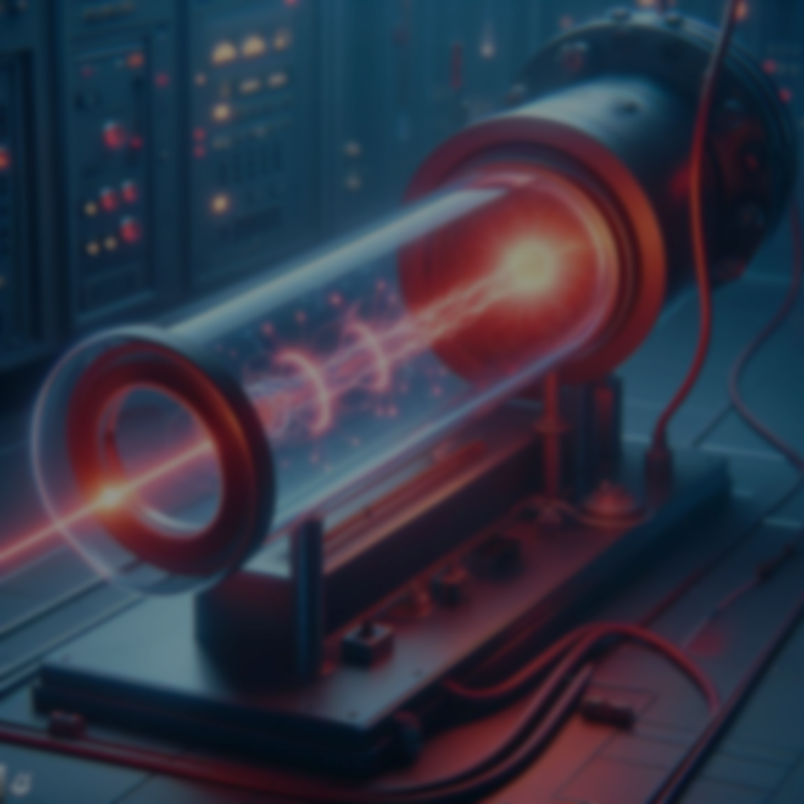
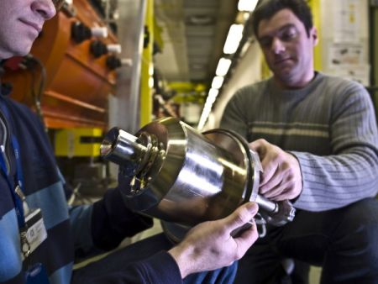
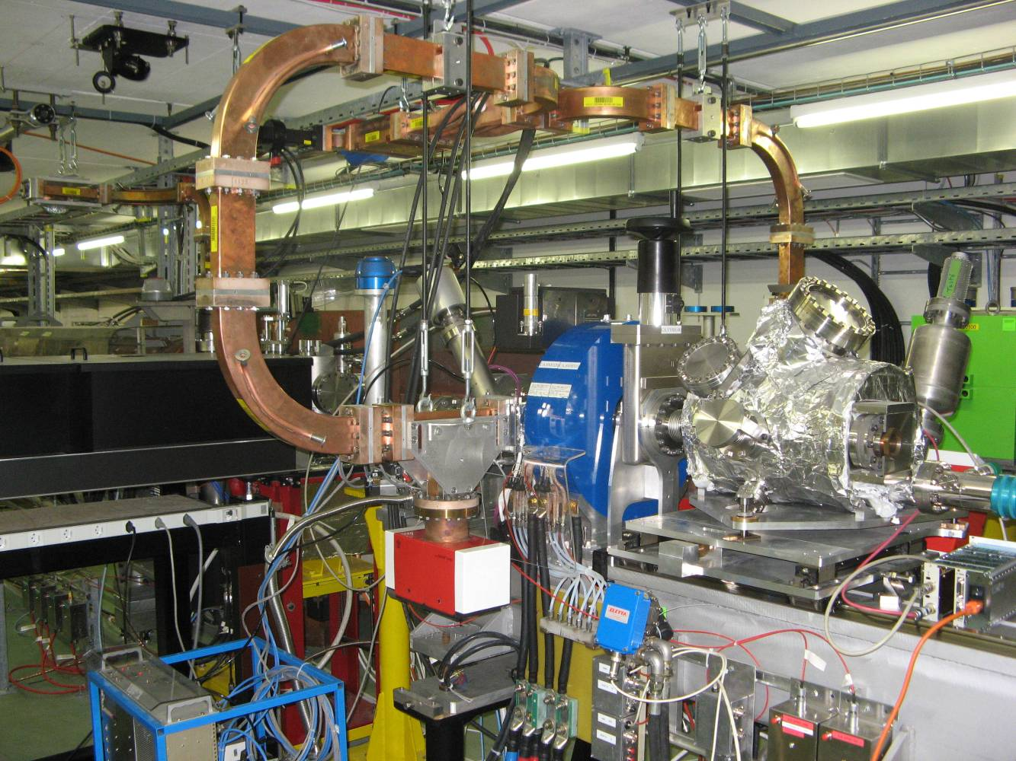
Richard Scrivens, BE Dept, CERN.
CAS@CERN, March 2024

Slide 2
Layout
Electron and Ion Sources
Electron Sources
  Thermionic
  Photo-Cathodes
Ion Sources
  Particle motion in plasmas
  Protons
  Negative Ions
  ECR Ion Source
  Radioactive Ions
Notes:
Essential part of Particle Accelerators
Will talk about e and Ion Source.
Will NOT talk about exotic sources (p-, e+, muon, pion etc)

Slide 3
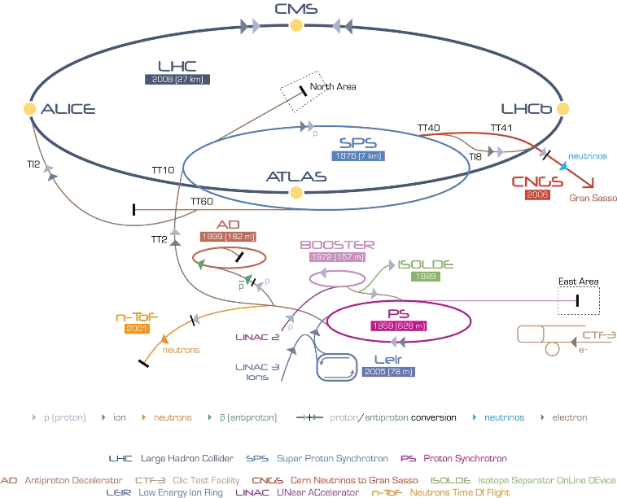
Every accelerator chain needs a source!
AWAKE
LINAC4

Slide 4
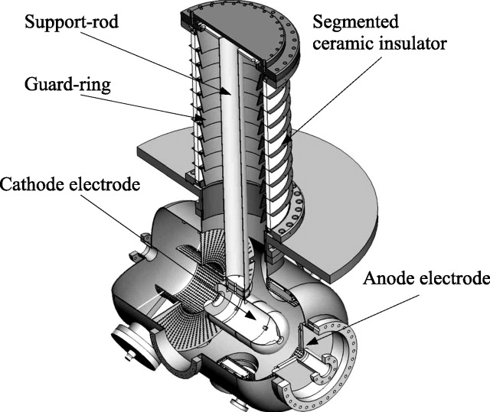
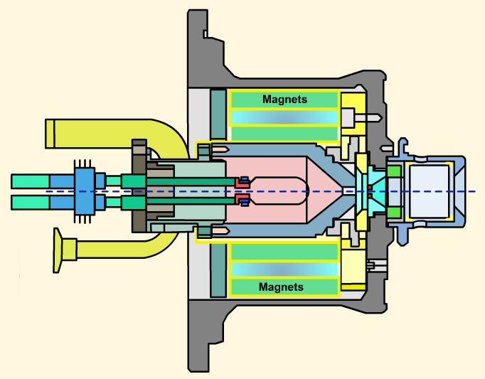
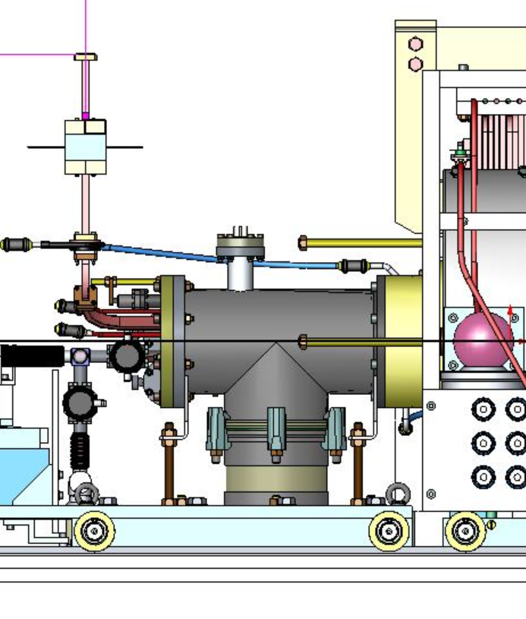
Every accelerator chain needs a source!
Protons
Ions
Principles of the electron guns, with thermionic and photo cathodes
Principles of ion sources, and the types used at CERN.

Slide 5
Electron Sources
  Thermionic
  Photo-Cathodes
Ion Sources
  Particle motion in plasmas
  Protons
  Negative Ions
  ECR Ion Source
  Radioactive Ions

Slide 6
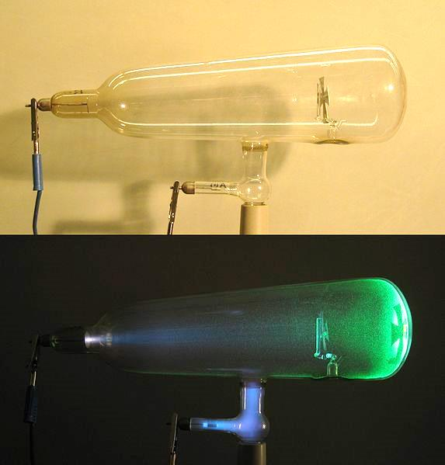
Electron Sources - Basics
Insulator
Chamber
E-field
Beam
Cathode
(Electron source)
HT
Power Supply
The classic Cathode Ray Experiment
Crookes Tube
Notes:
What is shown is a Crookes Tube. Electrons come from the cathode from back ion acceleration, they ionise the residual gas, and fluoress the glass.
Used by the likes of Hittorf, Goldstein and Thompson to explain what cathode rays are, and discover the electron.

Slide 7
Electron Sources
  Thermionic
  Photo-Cathodes
Ion Sources
  Particle motion in plasmas
  Protons
  Negative Ions
  ECR Ion Source
  Radioactive Ions

Slide 8

Electrons – Thermionic Emission
Electrons inside a cold cathode are in the lowest energy states, and do not have enough energy to escape the material.
As the material is heated, some electrons move to higher energies.
Cathode emission is dominated by the Richardson Dushmann equation.
Energy difference between
highest energy electron and vacuum
Work Function φ_{s}
Energy
Electrons
Material

Slide 9
Electrons – Thermionic Emission
Therefore, at high temperatures there is an ELECTRON CLOUD around the material. The current density can then be found by integrating the available electrons and their energy.
J: current density of electrons
This electron current is available
to be pulled off the surface…
Richardson-Dushmann equation
Rev. Mod. Phys. 2, p382 (1930)
This factor A is not achieved in practice (some electrons are reflected from the inner surface)
Notes:
Available electrons are those above the work function.
“A” is a pseudo constant – but NOT temperature dependent.

Slide 10
Electrons – Thermionic Emission
 | A Acm⁻²K⁻² | U_{work} eV
W | 60 | 4.54
W Thoriated | 3 | 2.63
Mixed Oxide | 0.01 | 1
Cesium | 162 | 1.81
Ta | 60 | 4.12
Cs/O/W | 0.003* | 0.72*
LaB₆ | 29 | 2.66
Element melting point v work function for selected metals : Nature does not provide an ideal solution
*- A and work function depend on the Cs/O layer thickness and purity
Notes:
www.peakpeak.com/~jdavis/boron/LaB.htm for LaB6 melting point - Richardson-Dushmann A for LaB6 from Charged Particle Beams book, chp7
Metal melting point v work function from (http://www.lns.cornell.edu/~hoff/LECTURES/08S_688/08S_688_080225.pdf
)
Very hot cathodes can lead to a thermal limited emittance.

Slide 11
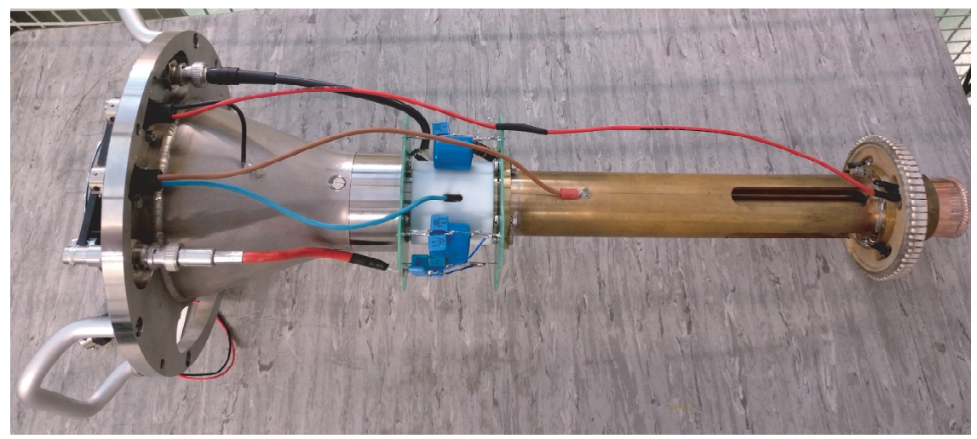
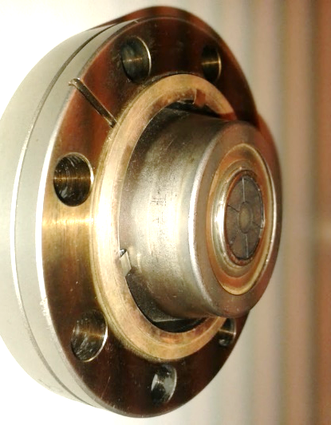
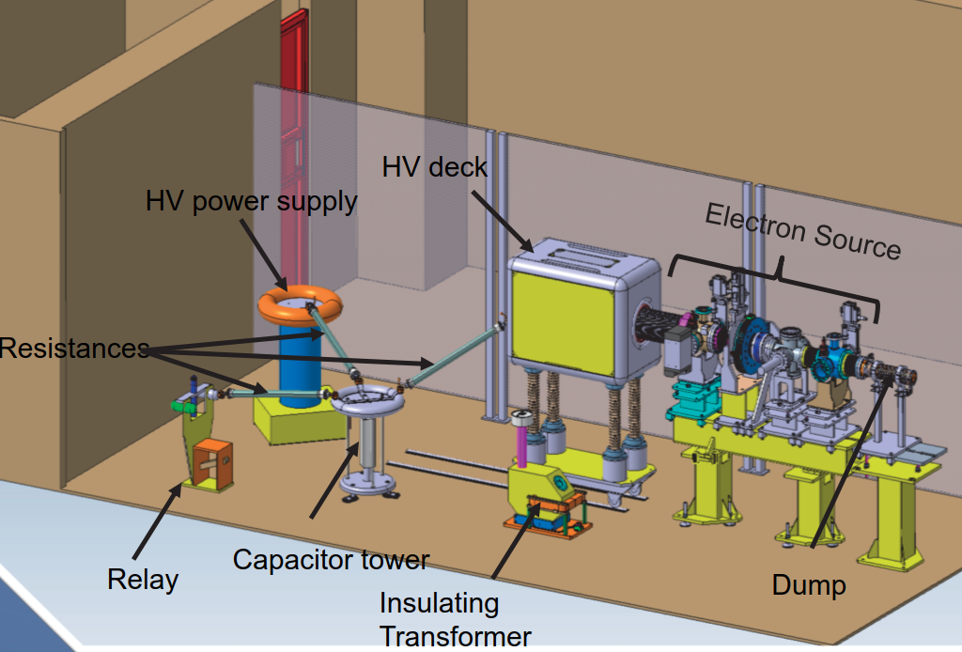
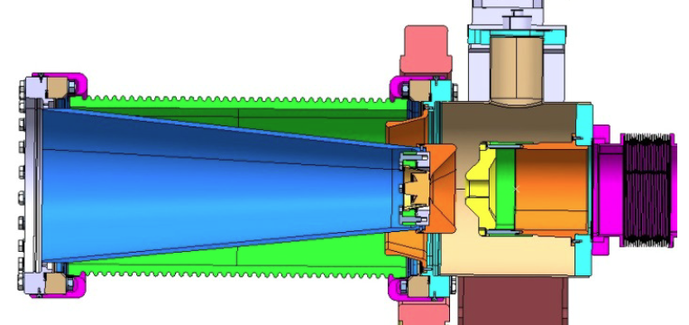
CLIC Drive Beam Thermionic Gun
Dispenser
Cathode
Cathode
Cathode System
Test Stand
CLIC – Compact Linear Collider.
Drive Beam – High intensity e-beam used to drive the high energy beam.
The CLIC Drive Beam Electron Gun is a Thermonic Gun.

Slide 12
Electron Sources
  Thermionic
  Photo-Cathodes
Ion Sources
  Particle motion in plasmas
  Protons
  Negative Ions
  ECR Ion Source
  Radioactive Ions

Slide 13
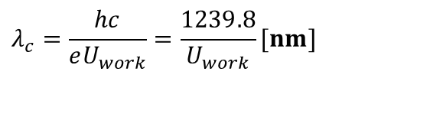
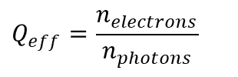
Electrons – Photo Emission
E
The energy of an electron in a material can be increased above the vacuum energy by absorbing photons - photoelectric effect.
U_{work}
E_{Fermi}
METAL
VACUUM
Quantum efficiency
$$Q_{eff}=\frac{n_{electrons}}{n_{photons}}$$
$$λ_{c}=\frac{hc}{eU_{work}}=\frac{1239.8}{U_{work}}[nm]$$
For metals:
Low quantum efficiency (Q_{eff}<4x10⁻⁴) requires high power lasers.
Very robust and simple to use cathode material.
 | U_{work} (eV) | λ_{c} (nm)
W | 4.5 | 275
Mg | 3.67 | 340
Cu | 4.65 | 267
Notes:
K2CsSb is bialkali, used as the photo cathode in photo multiplier tubes – Sb=Antimony. K=Potassium.
Cs2Te requires UV laser (highest powers are not yet available), Cs:GaAs and K2CsSb can work with green lasers.

Slide 14
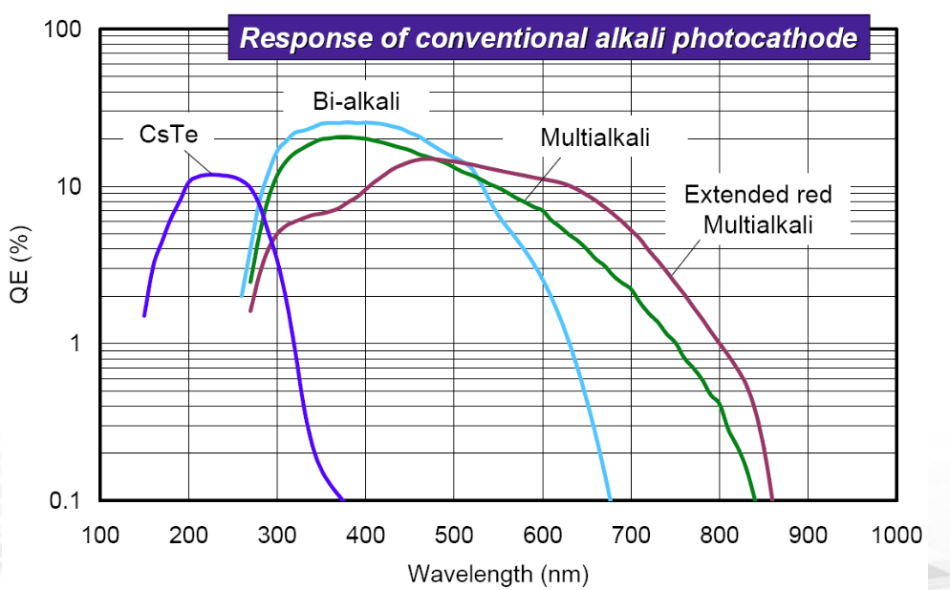
Electrons – Photo Emission
E_{a}
E
Semi-conductors can produce higher Quantum Efficiency at longer wavelengths.
Difficult to use in a high radiation area of an electron-gun (x-rays and ions cause decomposition and surface damage).
Cs₂Te (Cesium Telluride) – High Quantum Efficiency in UV wavelength.
U_{work}
E_{GAP}
E_{Fermi}
SEMI-COND
VACUUM
 | E_{g}+E_{a} (eV) | λ_{c} (nm)
GaAs | 5.5 | 225
Cs₂Te | ~3.5 | 350
K₂CsSb | 2.1 | 590
From: Mengjia Gaowei
Notes:
K2CsSb is bialkali, used as the photo cathode in photo multiplier tubes – Sb=Antimony. K=Potassium.
Cs2Te requires UV laser (highest powers are not yet available), Cs:GaAs and K2CsSb can work with green lasers.
PhotoCathode Response plot:
https://indico.cern.ch/event/759878/contributions/3151886/attachments/1733384/2806102/P3_2018_Cs2Te__BNLtemplate.pdfMetals:

Slide 15
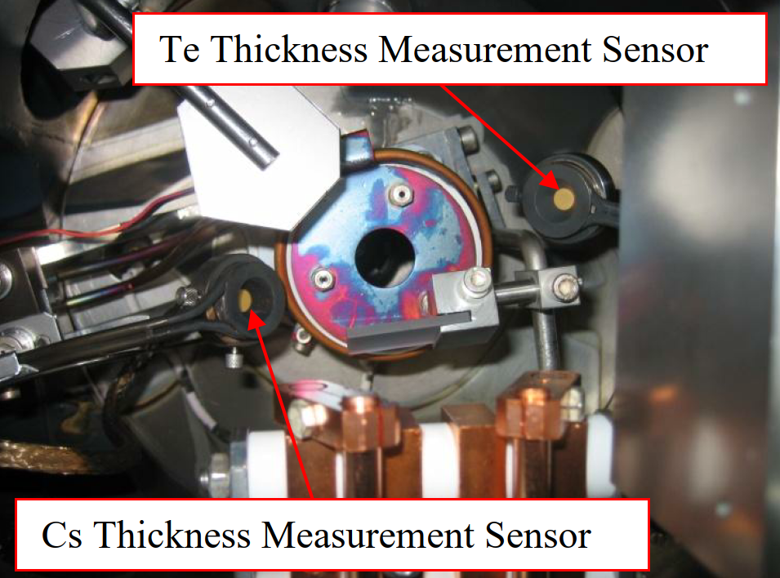
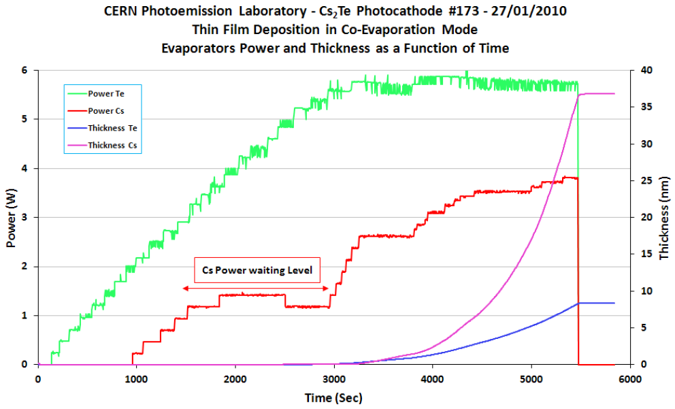
Electrons – Photo Emission
Cs₂Te cathodes produced in house at CERN.
Cs and Te evaporators produce a vapour, which condenses on the Cu substrate.
Cathode must be stored and transported under vacuum – or produced in-situ.
During cathode production, control of ratio of the 2 elements in the vapour to produce the correct stoichiometry for the cathode, and the highest Quantum Efficiency.

Slide 16
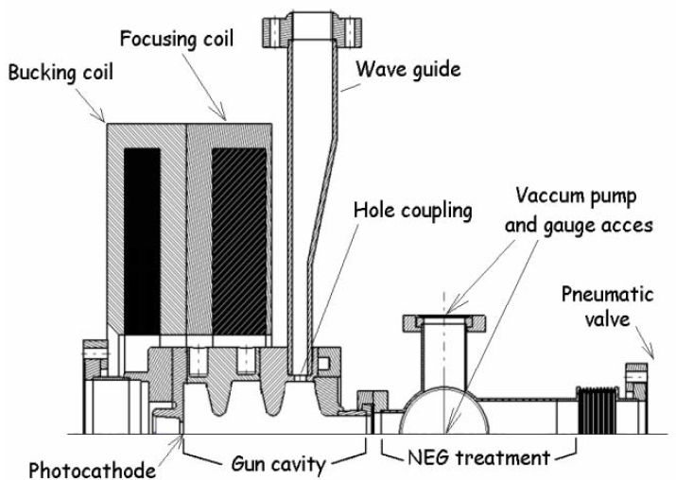
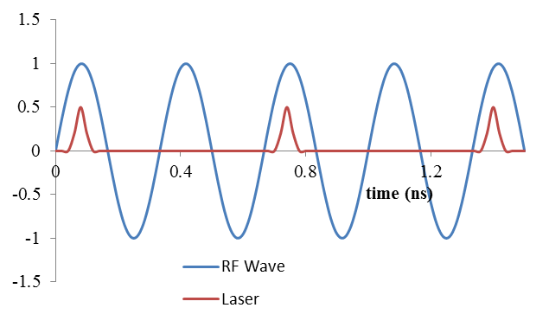
CLEAR RF Photo Electron Source
Nd:YLF – 4x frequency -> UV
  The RF gun accelerates to 5MeV in ~15cm, which combats space charge forces.
  The short laser pulses (~6ps) generate short electron bunches from the Cs₂Te photo cathode.
  The laser can pulse at a different harmonic of the RF system. 1.5GHz laser-electron bunches are created, using RF 3GHz acceleration.
Photo cathode
Notes:
CONSTRUCTION OF THE PROBE BEAM PHOTO-INJECTOR OF CTF3, Proceedings of EPAC 2006, Edinburgh, Scotland, MOPLS114
See also https://indico.cern.ch/getFile.py/access?contribId=28&resId=22&materialId=poster&confId=177701

Slide 17
CLEAR RF Photo Electron Source
Electron Current | 0.9 A
Electron Energy | 5-6 MeV
Emittance | 20 mm.mrad
Pulse | 150ns @ 5 Hz
Notes:
Status and progress of the CTF3 probe beam: http://indico.cern.ch/getFile.py/access?contribId=26&sessionId=1&resId=2&materialId=slides&confId=45580

Slide 18
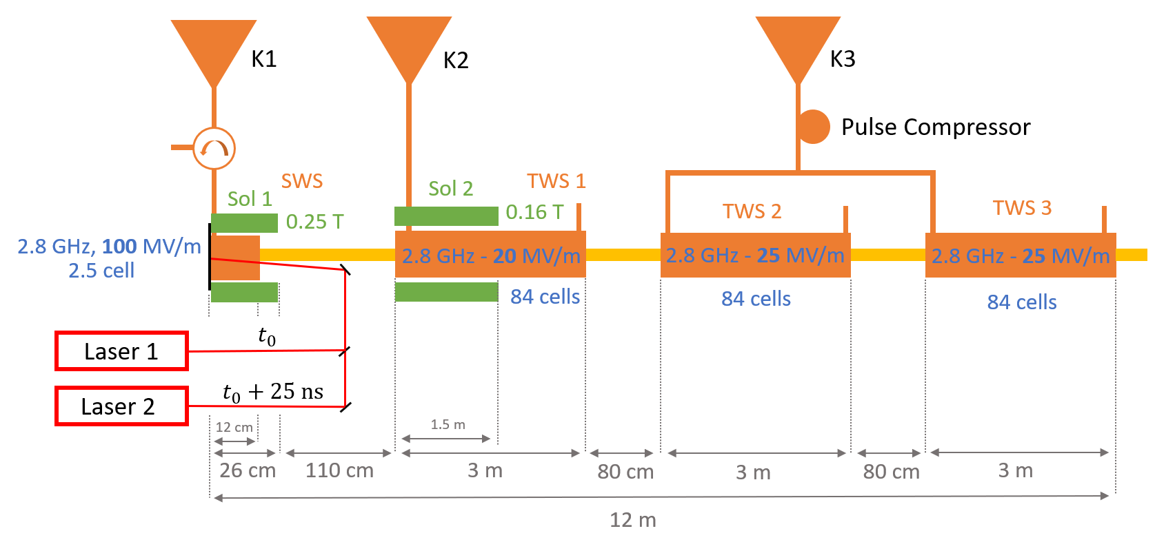
FCC-ee Electron Gun
  FCC-ee plans to use a photo-cathode based 2.8GHz RF electron gun.
  Collaboration with PSI, ICJ lab (Orsay) and INFN (Frascati).
  Cathode Type: Cs₂Te
  Bunch Structure: A train is 2 bunches length=7ps, spacing=25ns, repetition=200Hz.
  FCC-ee top up injection scheme requires 100% variability of intensity on-demand.
  Positrons created by shooting 6 GeV electrons on target.

Slide 19
Electron Sources
  Thermionic
  Photo-Cathodes
Ion Sources
  Particle motion in plasmas
  Protons
  Negative Ions
  ECR Ion Source
  Radioactive Ions

Slide 20
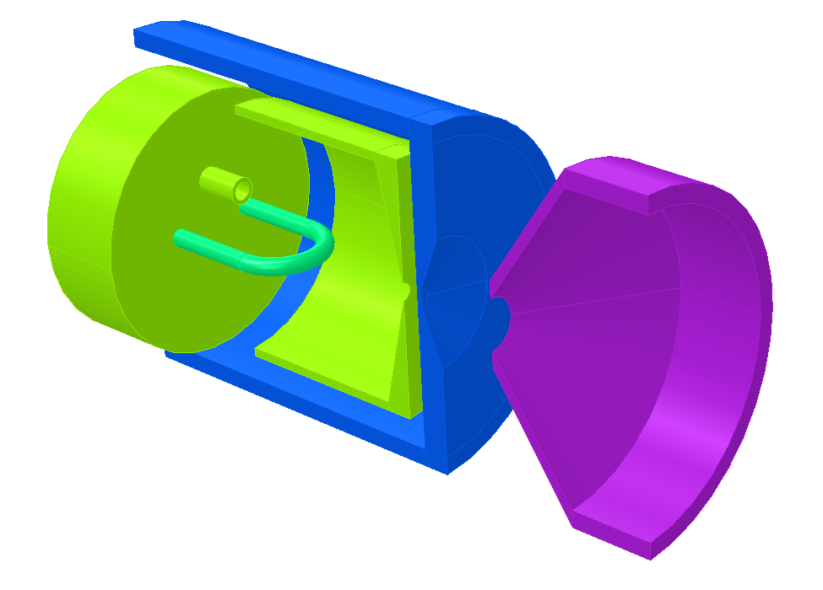
Ion Sources - Basics
An Ion Source requires an “ion production” region and an “ion extraction” system.
In most (but not all) cases, ion production occurs in a plasma.
A plasma or discharge chamber
A hole to let the ions out!
Material input
Power to create a plasma / discharge
An extraction system

Slide 21
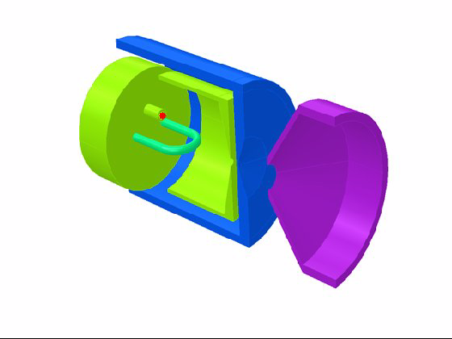
Ion Sources - Basics

Slide 22
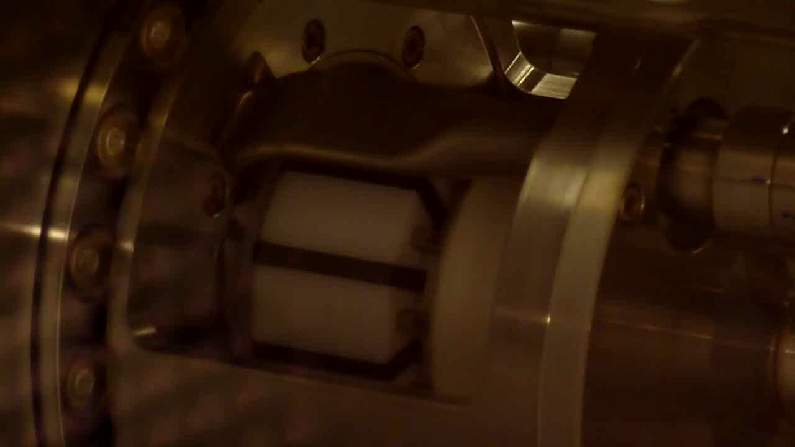
Ion Sources - Basics
Hydrogen plasma (for protons or H-) from an RF source.
Hydrogen plasma emits a pink light from an atomic transition.

Slide 23
Electron Sources
  Thermionic
  Photo-Cathodes
Ion Sources
  Particle motion in plasmas
  Protons
  Negative Ions
  ECR Ion Source
  Radioactive Ions

Slide 24
Ion Source Essentials
Many sources work on one of two electron heating techniques:
  Cathode – Anode Discharge: A DC voltage between the cathode and anode is used to accelerate the electrons.
  RF Discharge: An RF electromatic wave is sent into the chamber, and the electric field can accelerate electrons.
The electrons impact on the injected material in the source to produce ions. The gas can be a compound form (e.g. Carbon from CO) or from a vapour (e.g. lead vapour from an oven).

Slide 25
Ion Source Essentials
Electron impact ionization of atoms/molecules

Slide 26
Ion Source Essentials
We need to create electrons, accelerate them to a few times the ionization potential of the material, and get them to interact with atoms.
Highest probability is at ~3-5x the ionization potential.
Ionization Cross Section by Electron Impact
R. Rejoub, B. G. Lindsay, and R. F. Stebbings, Phys. Rev. A 65, 042713 (2002)
Except H: Y.-K. Kim and M.E. Rudd, Phys. Rev. A 50, 3954 (1994)

Slide 27
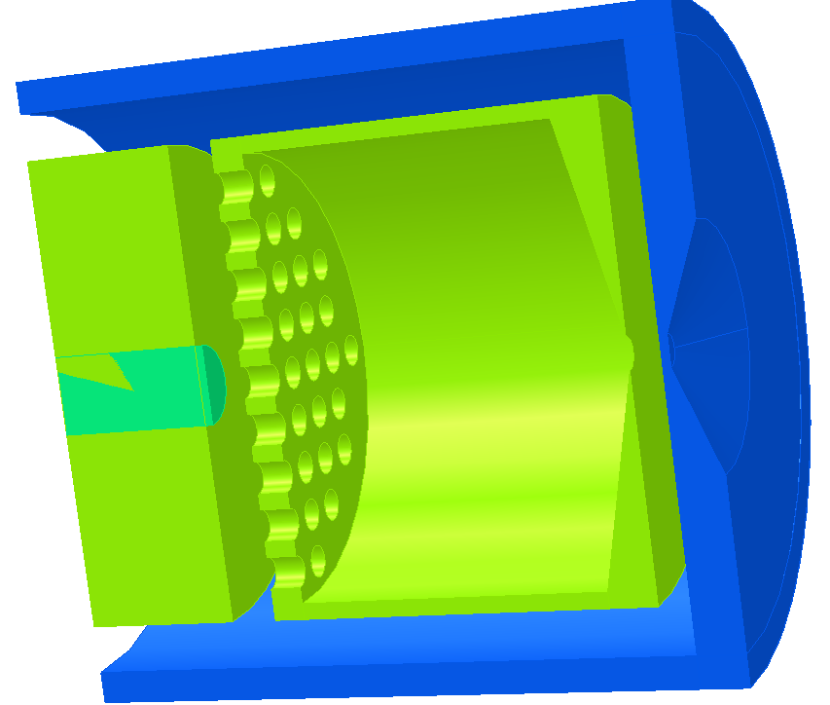
Ion Source Essentials
A simple source can produce electrons from a cathode, accelerate them to ~100eV, and let them strike atoms in a gas.
Grid
Ionization
region
Cathode
R.L. Gill, A. Piotrowski, NIM A, Vol 234 (2), p213, 1985.
http://dx.doi.org/10.1016/0168-9002(85)90907-6

Slide 28
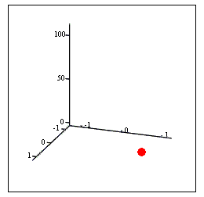
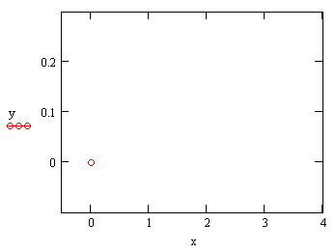


Plasma Particle Motion
E
B
B
$$ρ_{c}=\frac{\sqrt{2mE_{⊥}}}{eB},ω_{c}=\frac{eB}{m}$$
$$v_{drift}=\frac{\overset{→}{E}×\overset{→}{B}}{B^{2}}$$

Slide 29
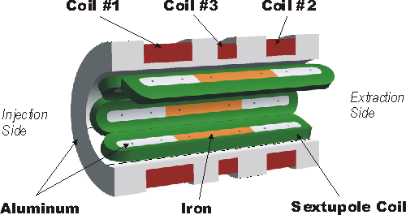
Ion Source Essentials
In order to control the electrons and ions, we make use magnetic fields to alter the particle trajectories.

Slide 30
Plasma Particle Motion
B
cf: opposite to classical
energy – velocity equation !

Slide 31
Electron Sources
  Thermionic
  Photo-Cathodes
Ion Sources
  Particle motion in plasmas
  Protons
  Negative Ions
  ECR Ion Source
  Radioactive Ions

Slide 32
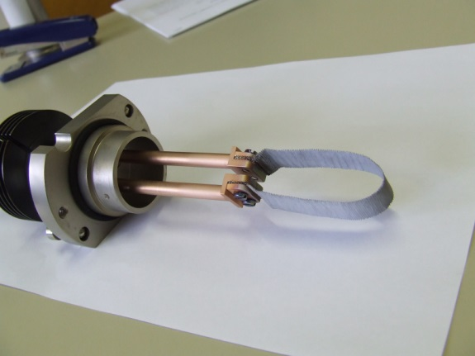
Ion Source – Duoplasmatron – Linac2
Solenoid
Cathode
Anode
Proton Current | 200 mA
Proton Energy | 90 keV
Emittance | ~0.4 mm.mrad
Pulse for LHC | 20us @ 1 Hz
# protons / pulse | 2.5x10¹³
# LHC bunches | ~24 *
Gas feed
Expansion Cup
* Creation of LHC bunches is a complicated process, this is an example for 50ns LHC bunches
Notes:
Magnetic = 2 ROLES. Stop electrons to walls. Increase path length.

Slide 33
Electron Sources
  Thermionic
  Photo-Cathodes
Ion Sources
  Particle motion in plasmas
  Protons
  Negative Ions
  ECR Ion Source
  Radioactive Ions

Slide 34
Ion Sources – Negative Ions
In 2021 – CERN moved from Linac2 produced protons to Linac4 produced H- ions (at higher Linac energy).
H- give the possibility for stripping injection into PSB synchrotron.
 | Electron Affinity (eV)
H | 0.7542
He | <0
Li | 0.6182
Be | <0
B | 0.277
C | 1.2629
N | <0
O | 1.462
F | 3.399
The bonding energy for an electron onto an atom is the Electron Affinity.
Ea < 0 for Noble Gases
Large Ea for Halogens
Two categories of negative ion sources
  Surface – an atom on a surface can be desorbed with an extra electron (whose wave-function overlapped the atom).
  Volume – Through collisions, e-capture and molecular dissociation, negative ions can be formed.
AB + e → A- + B A + B → A- + B+
AB* + e → A- + B A+ + B → A- + B2+
Notes:
Dissociative attachment Atomic Double charge transfer
Dissociative attachment to vibrationally excited state Atomic Two electron capture

Slide 35
H⁻ Surface Ion Production
Surface
Cs
Cs
H-
H+, H₂+
e-
e-
e-
Protons from the plasma are accelerated to the cathode, which has a coating of caesium, producing a low work function.
The protons desorbed from the low work function surface, with an additional electron.
The plasma must not be too hot, to avoid ionising the H⁻.
Penning, Magnetron, RF sources can produce H⁻ this way.

Slide 36
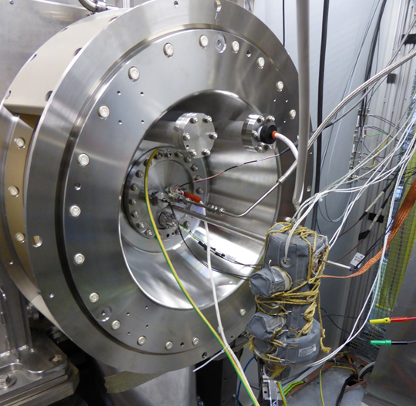
Ion Sources – Negative Ions – Linac4
Linac4 Ion Source uses a 2MHz RF driven plasma
Plasma is created using 2MHz RF in a solenoid coil.
A surface near the extraction is coated with cesium, evaporated from an oven at the back of the source.
The plasma protons strike the cesium surface and H⁻ are emitted.

Slide 37
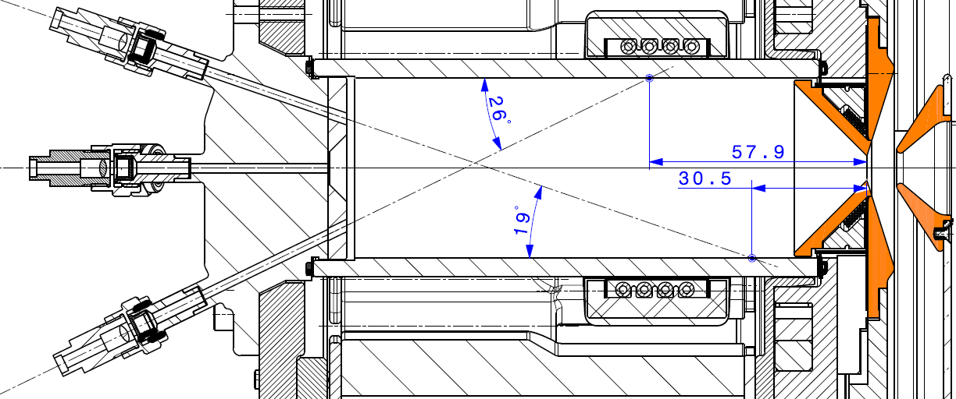
Ion Sources – Negative Ions – Linac4
Electrodes with Cs surface coating
Solenoid Antenna – plasma heating
Magnets slow stop hot electrons

Slide 38
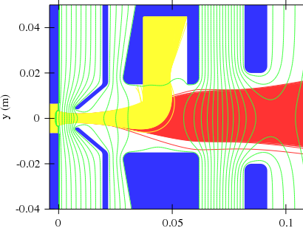
Ion Sources – Negative Ions – Linac4
-45kV
-25kV
-35kV
0kV
Electrons (yellow) are extracted along with negative ions (red).
Electrons can be separated with a dipole B field in extraction.
In the Linac4 RF source electron current is:
  >1 A without caesium
  ~ 35mA with caesium

Slide 39
Electron Sources
  Thermionic
  Photo-Cathodes
Ion Sources
  Particle motion in plasmas
  Protons
  Negative Ions
  ECR Ion Source
  Radioactive Ions

Slide 40
Ion Source – ECR – Linac3
Electron Cyclotron Resonance Ion Source (ECR)
For a given magnetic field, non-relativistic electrons have a fixed revolution frequency.
The plasma electrons will absorb energy at this frequency (just as particles in a cyclotron).
If confined in a magnetic bottle, the electrons can be heated to the keV and even MeV range.
Ions also trapped by the charge of the electrons, but for milli-seconds allowing mutliple ionisation.
The solenoid magnetic field still allows losses on axis – these ions make the beam.
Electron orbit
Frf
½ RF period later
Frf
Notes:
After Fecr – go to drawing

Slide 41
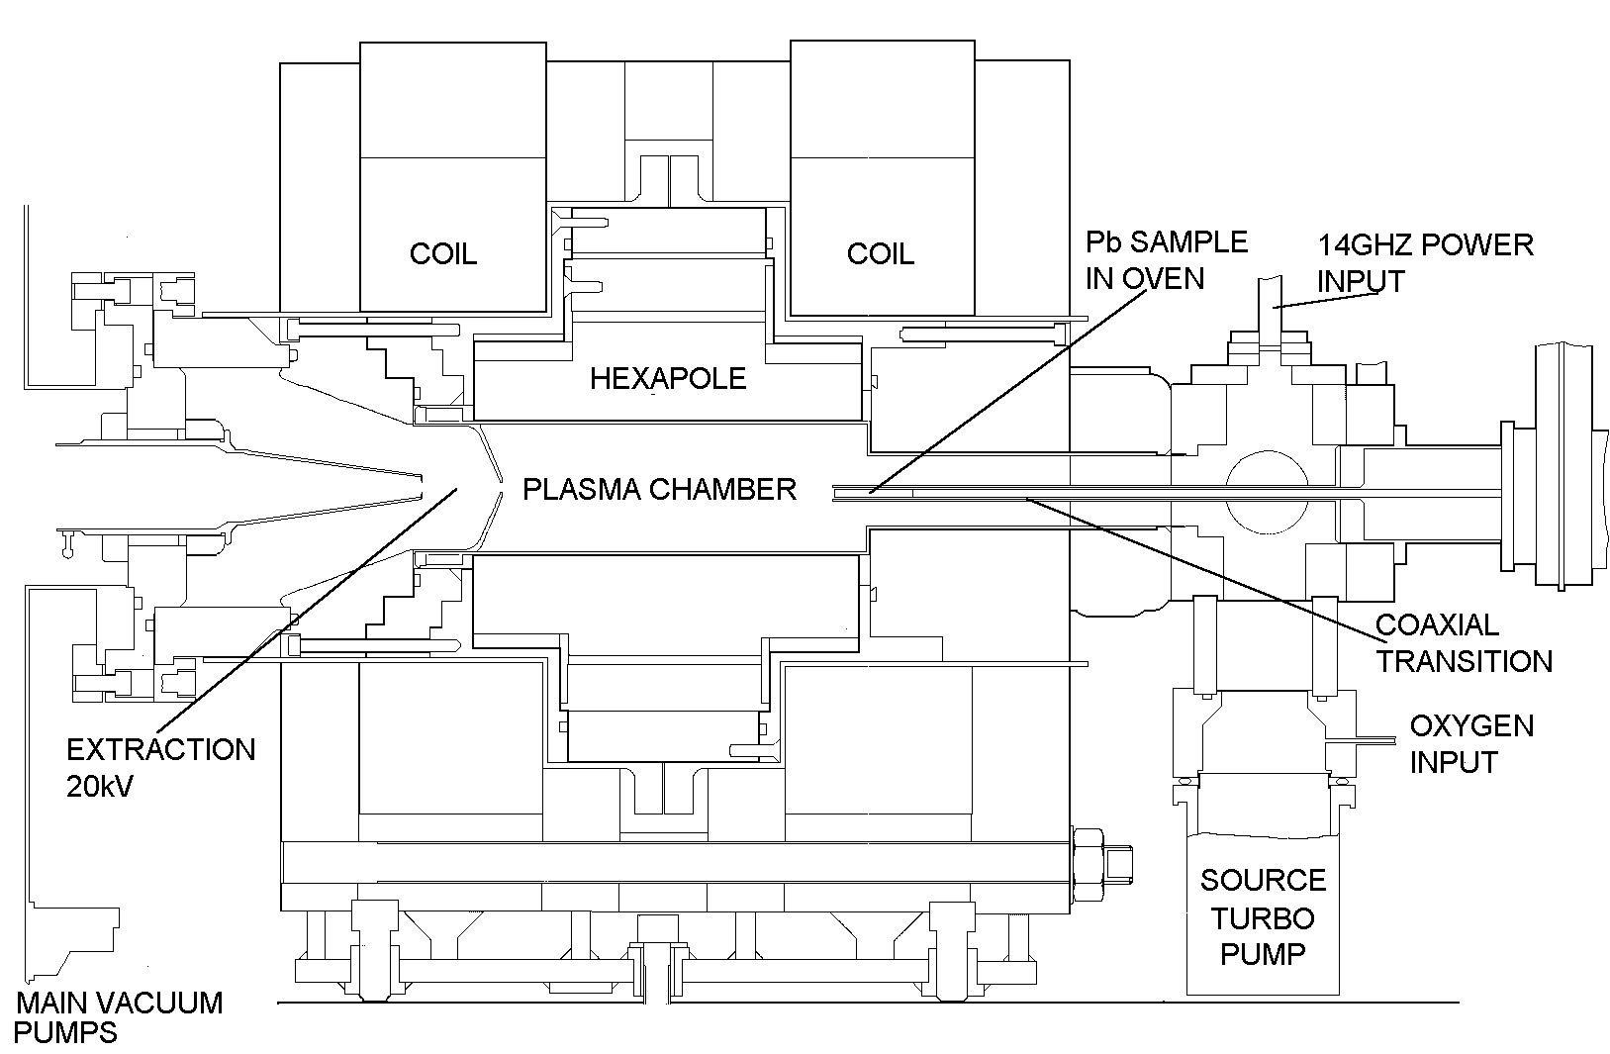
Ion Source – ECR
CERN ECR4 – Built by GANIL

Slide 42
Ion Source – ECR – High charge states
No filament is needed, greatly increasing the source lifetime.
Singly, multiply and highly charged ions can be produced by these sources (although the source construction will influence this).
A → A+ → A2+ → A3+
Stepwise ionisation.
Gaseous ions are easily made. Metallic ions come from an OVEN or from a compound gas (e.g UF6 for uranium).
In the afterglow mode, the ion intensity increases AFTER switching off the micro-waves.

Slide 43
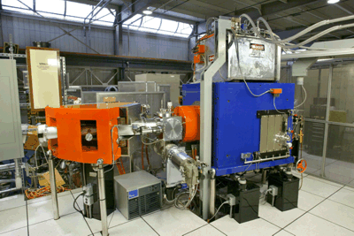
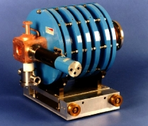
Ion Source – ECR – High charge states + industry solutions
Plasma density increases with frequency and associated magnetic field.
Example: VENUS source and Berkeley, Ca, uses superconducting solenoid and sextapole magnets.
Industry can now provide turnkey solutions for ECR ions sources, usually using permanent magnets.

Slide 44
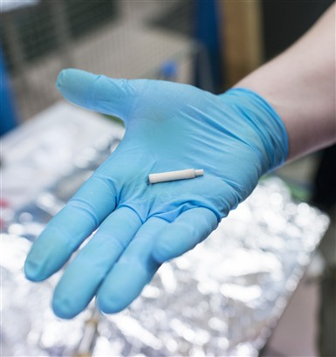
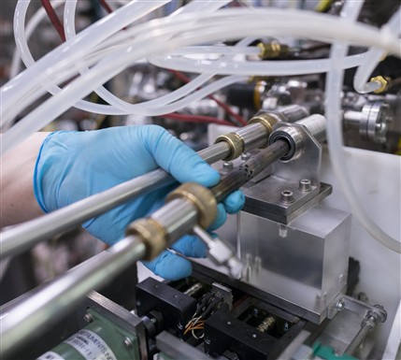
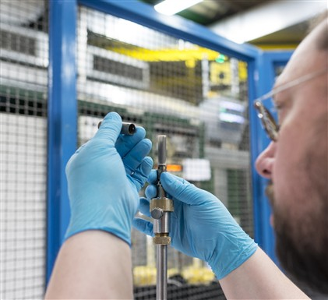
Lead (Pb) is evapourated from a micro oven in the source

Slide 45
Electron Sources
  Thermionic
  Photo-Cathodes
Ion Sources
  Particle motion in plasmas
  Protons
  Negative Ions
  ECR Ion Source
  Radioactive Ions

Slide 46
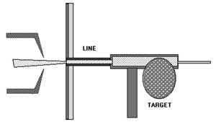
Ion Source – Radioactive Ions – ISOLDE
A gas/vapour of new isotopes is produced from 1.4GeV protons onto a target.
The ion source is used to ionize the gas.
The ions will be mass selected in an ion spectrometer.
An important goal is to have a high conversion rate of the desired gas to ions.
The sources must be robust to work in the extreme radiation environment. For example minimize use of any organic compounds.
The sources can help to reduce the contamination (i.e. stable/other isotopes of the same mass) through some selective process (e.g. using lasers to selectively ionize the atom of interest).
Notes:
Magnetic = 2 ROLES. Stop electrons to walls. Increase path length

Slide 47
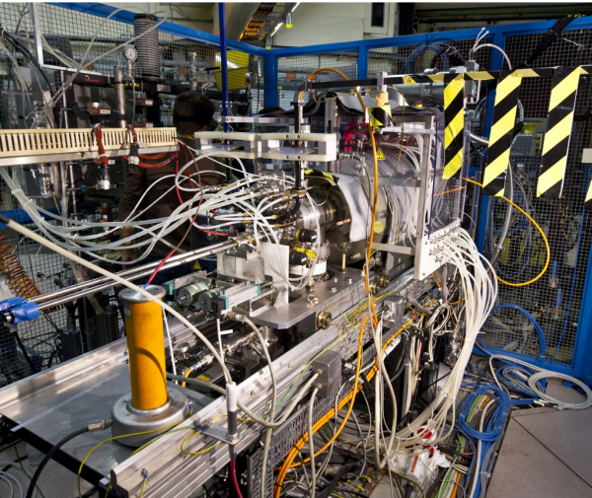
For sources, all we have seen so far is the ion generation.
You still have to add the high voltage systems, pumping, cooling, power convertors, controls…

Slide 48
Summary
Electron Source Summary
  Thermionic Source. Some thermal electrons are above the Work-Function.
  Use low work-function or high melting point materials to obtain the most electrons
  Photo-cathodes – Use photons above the work-function or E_{g}+E_{a}.
  Metals – Stable but have a low quantum efficiency
  Semiconductors – high Q_{eff}, but can be unstable and degrade in use.
Ion Source Summary
  Plasmas are a common production method for ions.
  There are many ways to produce, heat and confine a plasma, leading to many source types.
  CERN already uses quite an array of these types.

Slide 49
Further Reading
Handbook of Ion Source, B. Wolf, Boca Raton, FL: CRC Press, 1995
Ion Sources, Zhang Hua Shun, Berlin: Springer, 1999.
The Physics and Technology of Ion Source, I. G. Brown, New York, NY: Wiley, 1989
Large Ion Beams: Fundamentals of Generation and Propagation, T. A .Forrester, New York, NY: Wiley, 1988
CAS – 5th General School (CERN 94-01 ) and Cyclotrons, Linacs… (CERN-96-02 )

Slide 50
Thank you for your attention.

Slide 51
A: Richardson-Dushman constant
B: Magnetic field
D: Diffusion rate
E: Particle Kinetic Energy
E: Electric field
J: Current density
m: Particle Mass
n: Particle density
T: Temperature
U,V: Voltage
v: Particle velocity
v_{drift}: Particle drift velocity
β: Relativistic beta
γ: Relativistic gamma
φ_{s}: Work Function (Voltage)
ν: Collision Frequency
ρ_{c}: Cyclotron Radius
ω_{c}: Cyclotron Frequency

Slide 52
Ion Sources - Basics
Ion Sources at CERN.
Linac2 – Protons - Dupolasmatron
Linac3 – Ions (Pb, O, Ar) – ECR
ISOLDE – Radioactive ions – Surface, laser, Electron Bombardment.
Linac4 – Negative Hydrogen – RF

Slide 53

Electrons – Thermionic Emission (the maths)
Conducting materials contain free electrons, who follow the Fermi-Dirac energy distribution inside the material.
When a material is heated, the electrons energy distribution shifts from the zero temperature Fermi distribution.
E_{Fermi}
These electrons can escape the material
$$n(E)dE=\left[\frac{4π(2m_{e})^{3/2}}{h^{3}}\right]\left[\frac{\sqrt{E}}{1+\exp\left(\frac{E−E_{Fermi}}{kT}\right)}\right]dE$$
Number of Free Electrons
Notes:
2 non-integer spin particles cannot occupy same energy level (Pauli exclusion)
Hence Fermi-Dirac equation gives the occupation of conduction electrons at different energy levels.
Integrate the equation above the work-function

Slide 54
ECR Source – Magnetic Mirror
A force acts in the opposite direction to the
Increasing B field
y
x
F2
B1
F1
B2
v
Vdrift
Energy is transferred
from Vdrift to Vecr
= magnetic moment
K = total kinetic energy

Slide 55
By applying a magnetic field, electrons can have longer path lengths inside the source, and the rate of ionization is increased.

