Slide 1
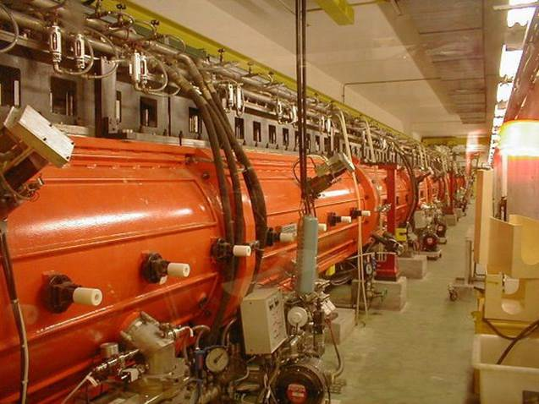
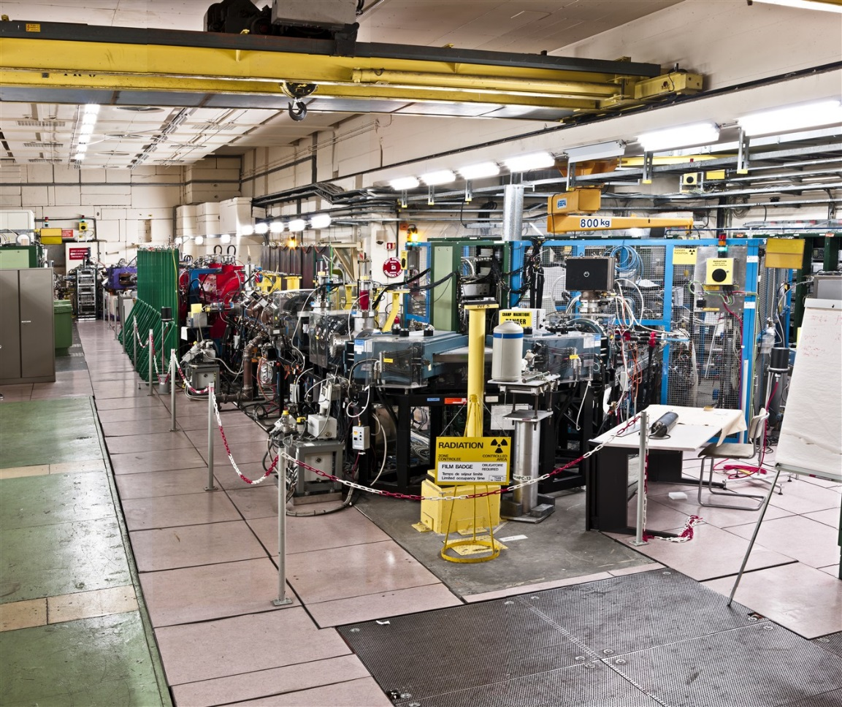
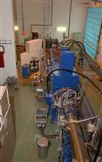
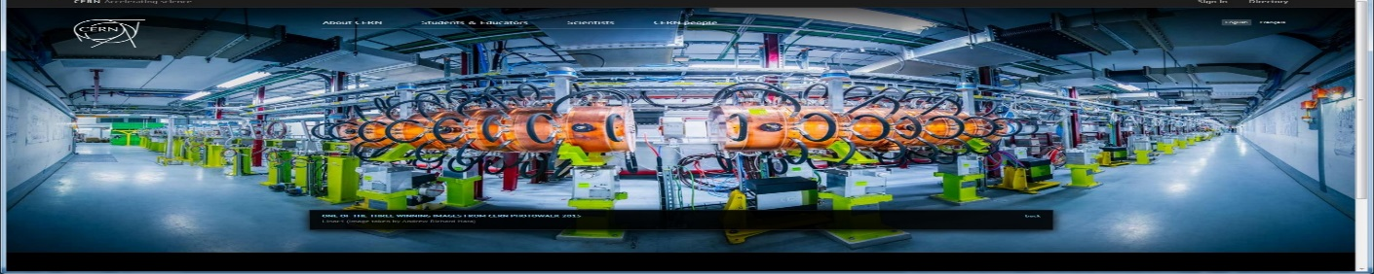
Linacs
Linac2 -1978
Linac3 -1994
Alessandra M. Lombardi
CERN BE/ABP
Linac4 -2016
Rex Linac -

Slide 2
Outline and more
Introduction
Virtual visit to LINAC4 and LINAC3
What is a LINAC and LINAC building blocks
  Acceleration : Radio Frequency Cavities
  Focusing : Quadrupoles
After this lecture we should know
  Why LINAC3 and LINAC4 are so different and why do we need both
  Why we have so many different structure in a linac
  And a few tricks on how to design a linac

Slide 3
A short history
Acceleration by time varying electromagnetic field overcomes the limitation of static acceleration
First experiment towards an RF linac : Wideroe linac 1928 on a proposal by Ising dated 1925. A bunch of potassium ions were accelerated to 50 keV in a system of drift tubes in an evacuated glass cylinder. The available generator provided 25 keV at 1 MHz.
First realization of a linac : 1931 by Sloan and Lawrence at Berkeley laboratory
From experiment to a practical accelerator : Wideroe to Alvarez
    to proceed to higher energies it was necessary to increase by order of magnitude the frequency and to enclose the drift tubes in a RF cavity (resonator)
    this concept was proposed and realized by Luis Alvarez at University of California in 1955 : A 200 MHz 12 m long Drift Tube Linac accelerated protons from 4 to 32 MeV.
    the realization of the first linac was made possible by the availability of high-frequency power generators developed for radar application during World War

Slide 4
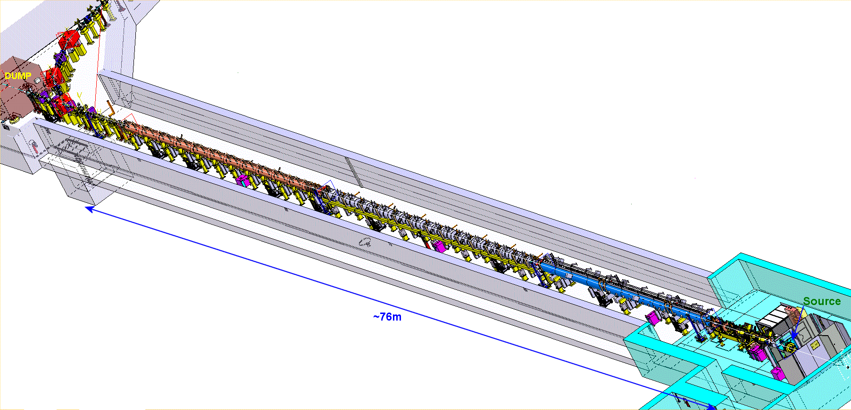
LINAC4 – 160MeV
LINAC4 machine layout- 352MHz
Π-mode | CC-DTL | Drift Tube L | Pre-injector
160 MeV (beta=0.52) | 100 MeV (beta=0.42) | 50 MeV (beta=0.3) | 3MeV (beta=0.08)
23 m 12 Modules 8 Klystrons: 12MW installed 12 Quadrupoles 12 steerer | 25 m 7 Modules 7 Klystrons : 7 MWinstalled 21 Quadrupoles 7 steerers | 19 m 3 Tanks 3 Klystrons:5 MW 115 quadrupoles 2 steerers | 9 m Source(s) 2 solenoids Radio Frequency Quadrupole 11 EMQ 3 Cavities 2 Chopper units In-line dump
beam

Slide 5

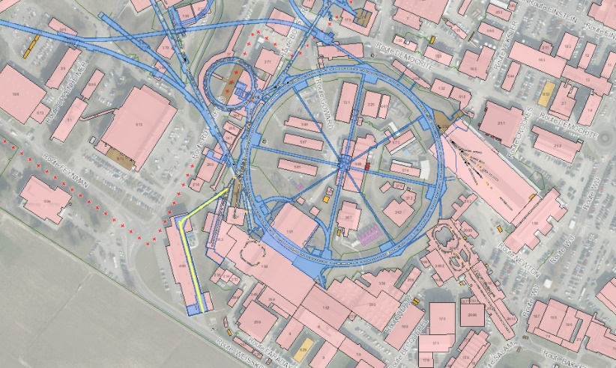
Movie: https://videos.cern.ch/record/2284968
Frequency : 352 MHz
Duty cycle for PSB : 0.06 %
Max duty cycle : 5%
Located 12m underground
Power efficiency :
15MeV/MW 6MeV/MW
beam

Slide 6
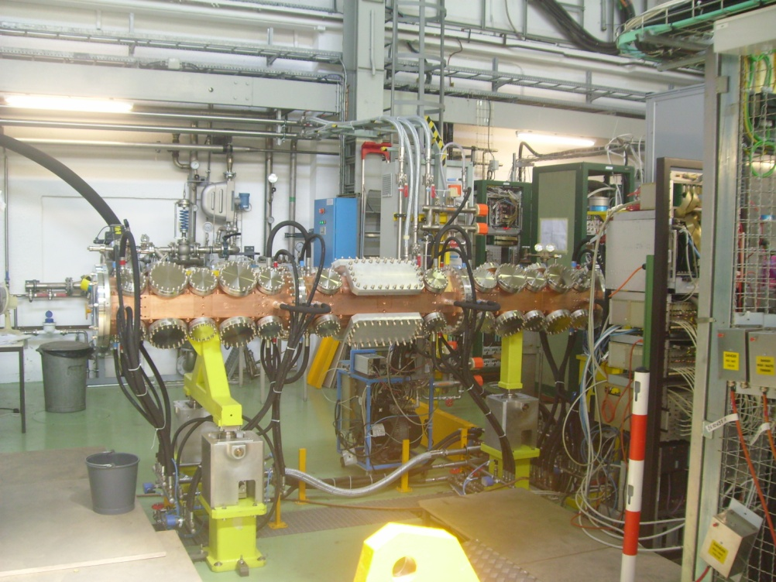
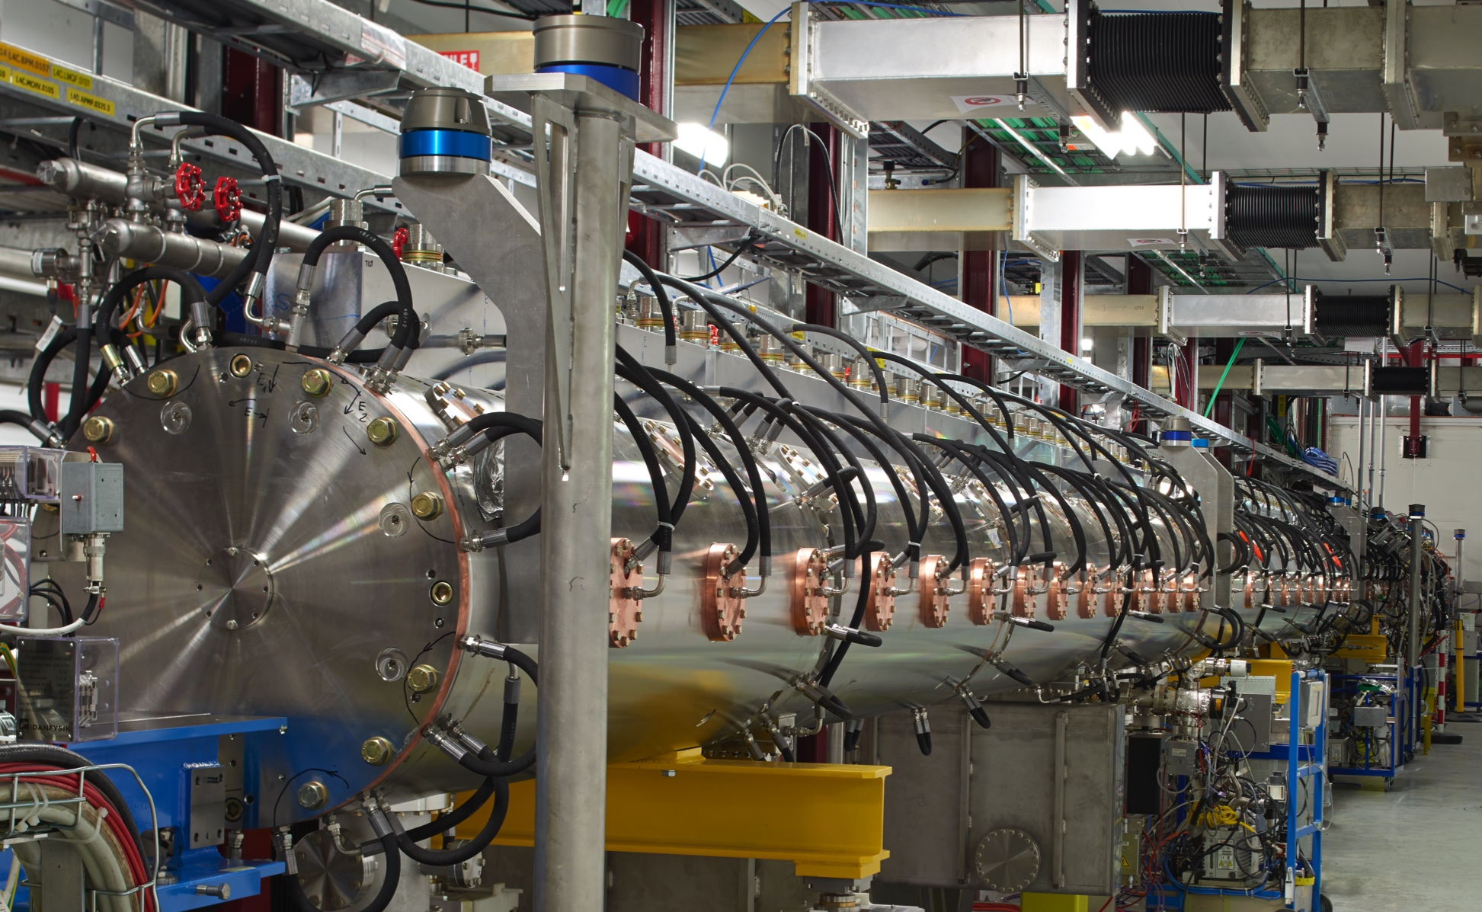
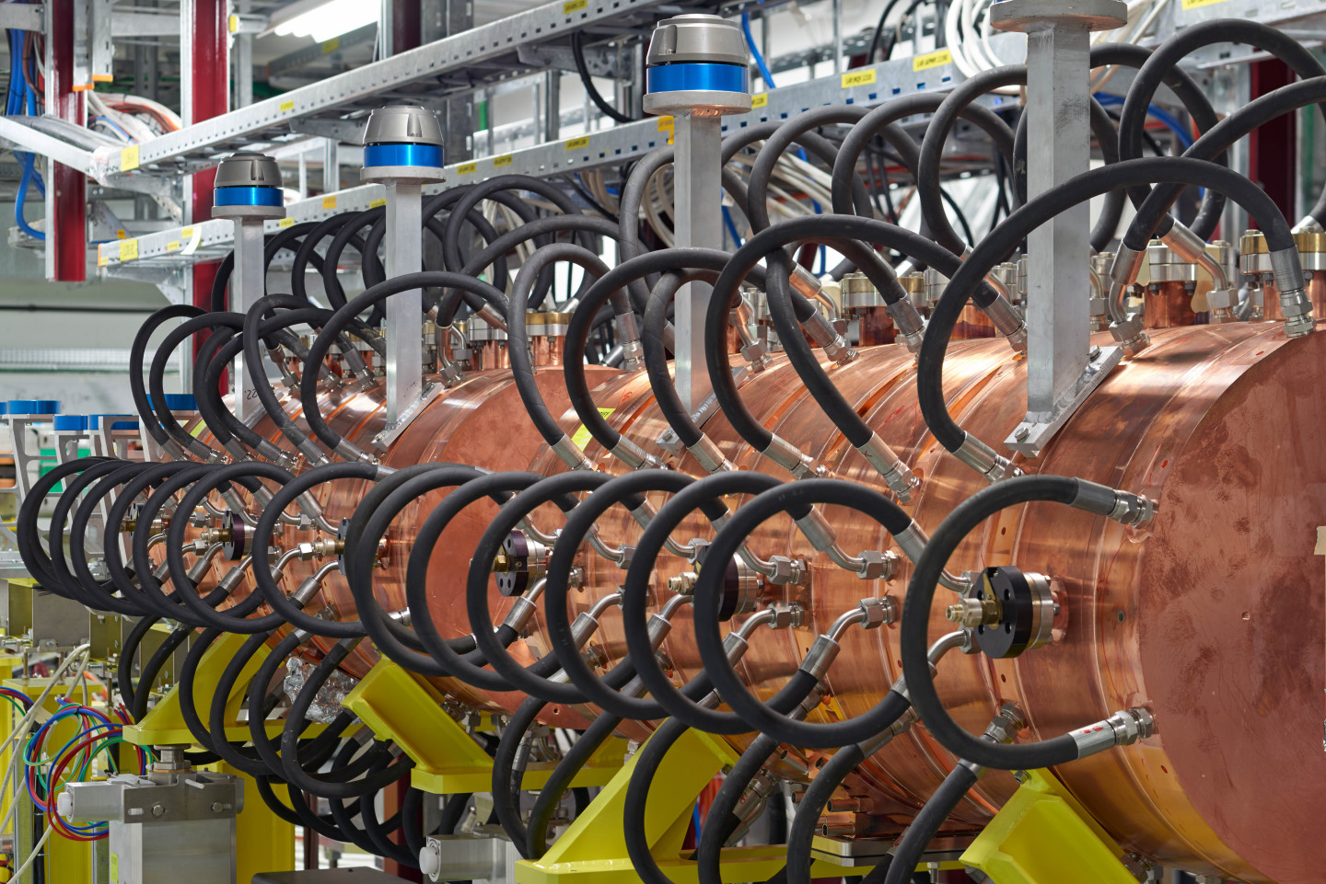
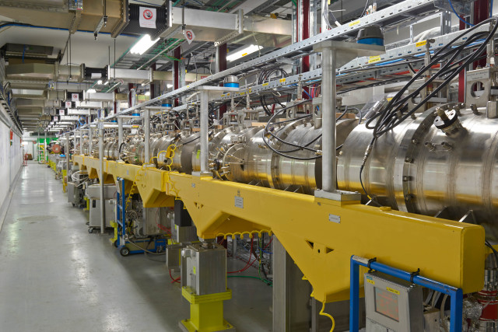
LINAC4 RF structures
Drift Tube Linac
Radio Frequency Quadrupole
Cell-coupled DTL
PI-mode Structure

Slide 7
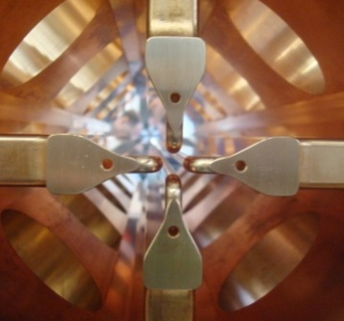
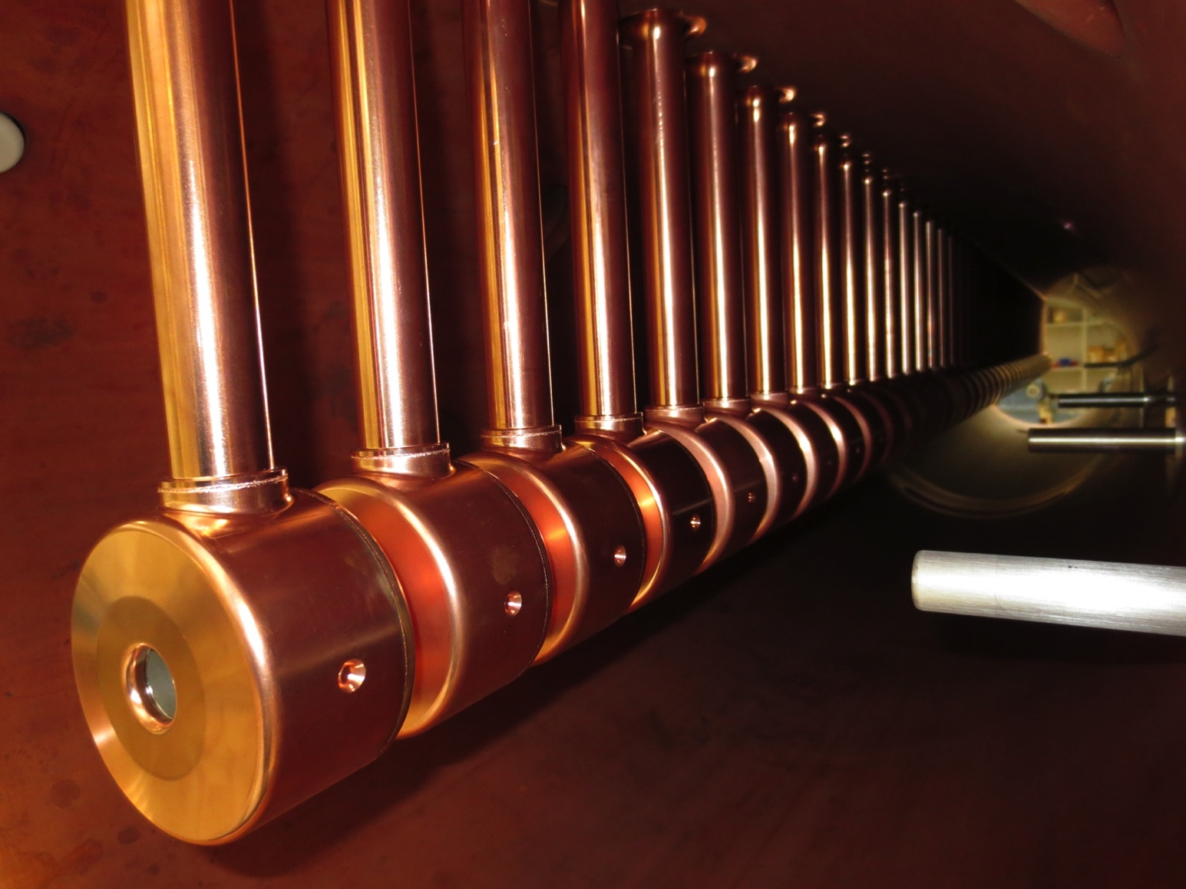
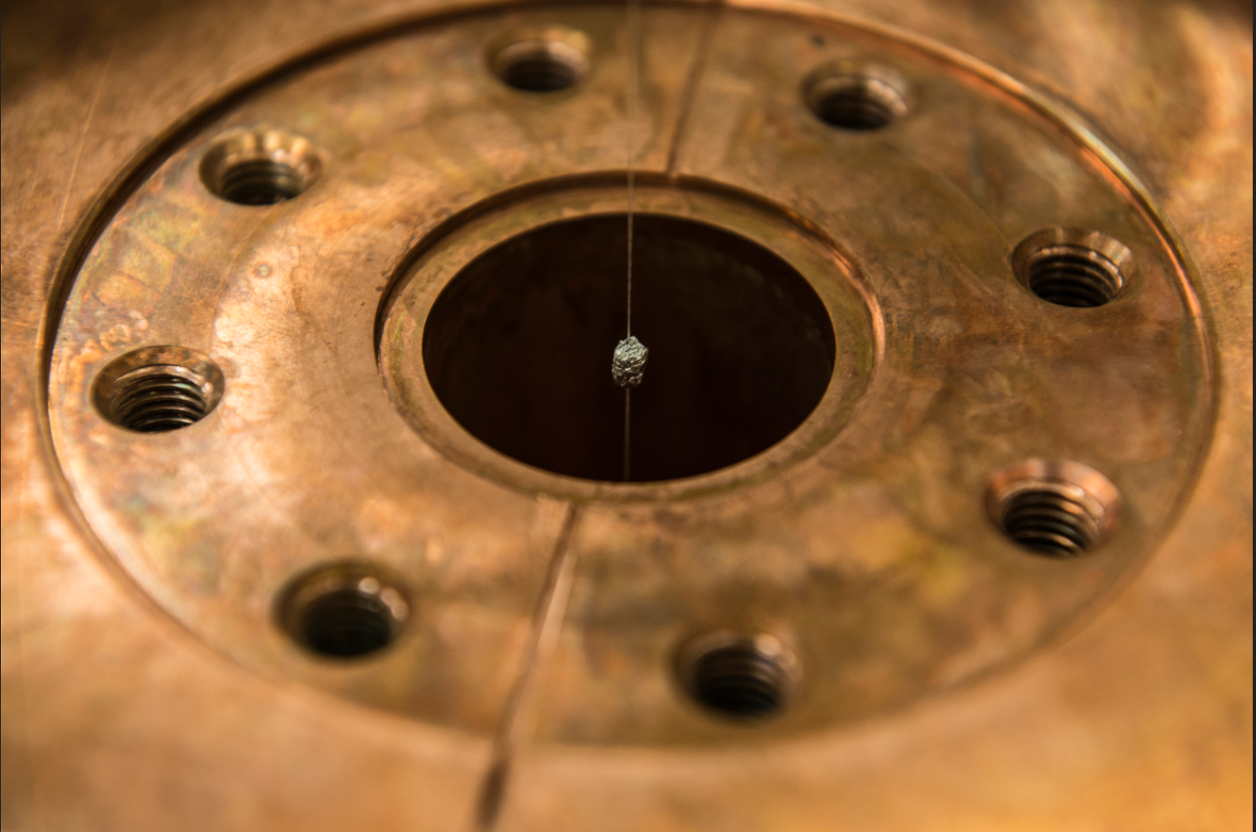
LINAC4 RF structures
Drift Tube Linac
Radio Frequency Quadrupole
PI-mode Structure

Slide 8

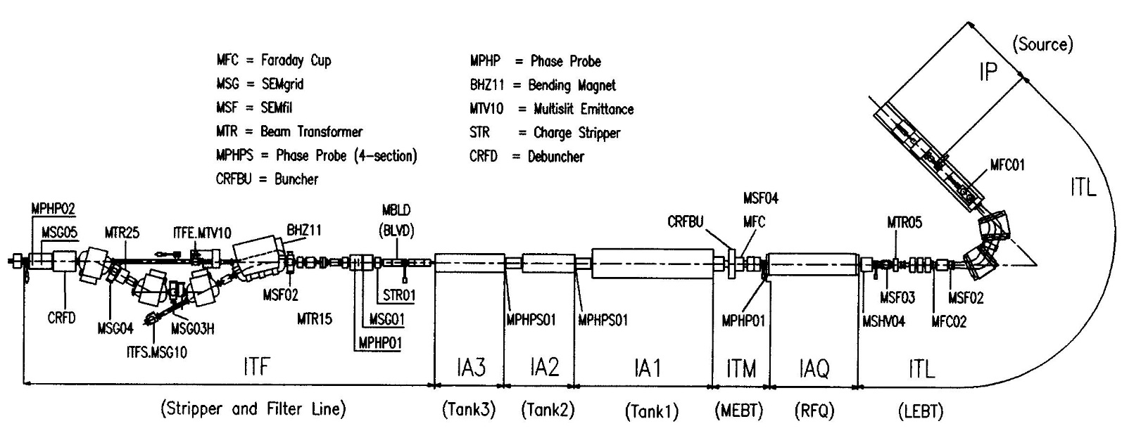
LINAC3- heavy ions
LINAC3 machine layout- 100 and 200MHz
IH –LINAC | Pre-injector
4.2 MeV/u (beta=0.094) | 0.0025 MeV /u (beta=0.0023)
7 m 3 Tanks 3 rf power source:5 MW 12 quadrupoles 2 steerers | 10 m ECRIS Source with multiple charges 2 solenoids Radio Frequency Quadrupole 8 EMQuadrupoles 2 Cavities 2 bendings
Stripper: Pb29+→ Pb54+

Slide 9
What is a linac
LINear ACcelerator : single pass device that increases the energy of a charged particle by means of a (radio frequency) electric field and it is equipped with magnetic elements (quadrupoles, solenoids, bending magnets) to keep the charged particle on a given trajectory.
Motion equation of a charged particle in an electromagnetic field

Slide 10
What is a linac-cont’ed
Relativistic or not
γ=7461 in LHC
γ=1.17 in LINAC4
type of focusing
type of particle :
charge couples with the field, mass slows the acceleration
type of RF structure

Slide 11
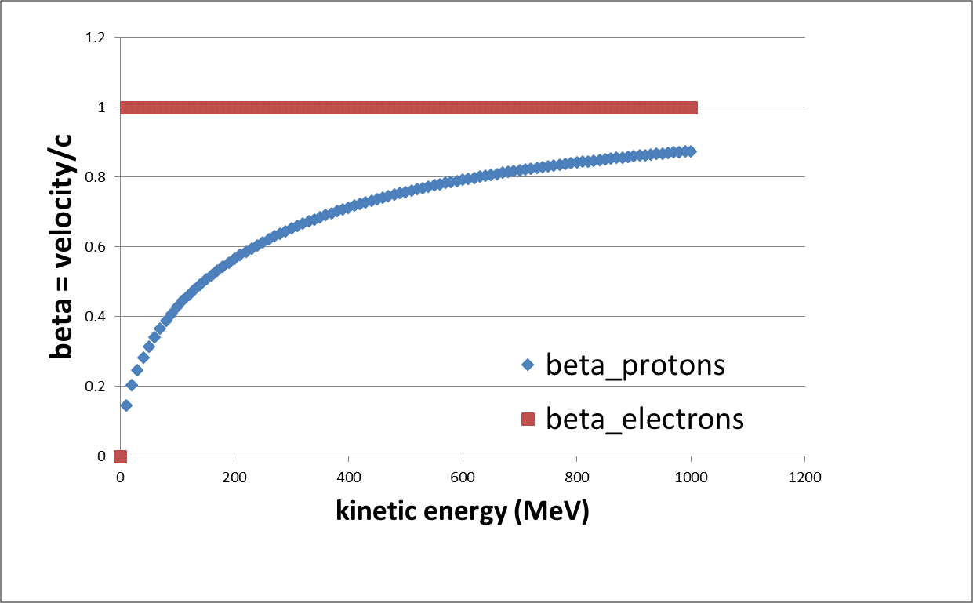

Type of particles
$$γ=\sqrt{\frac{1}{1−β^{2}}}$$
electron, mass 0.511 MeV, quickly relativistic, easi(er) to accelerate
proton, mass 938.28 MeV, q/m=1
lead ions , mass 195.16 GeV , q/m=1/8.32 (in the linac,)
Xenon ions , mass 122 GeV, q/m=1/5.8
At 0.1 MeV
beta =0.015, gamma= 1
At 50 MeV
beta =0.3 , gamma=1.05
At 160 MeV
beta =0.52 , gamma=1.17
Notes:
Remind 1.5 meter after the proton source is equivalent to 100 m in the LHC, GAMMA IN THE lhc IS 7461 7 TEV

Slide 12
Velocity of the particles
Synchronicity with the accelerating electric field
(accelerator is single purpose)
Geometry of the accelerator has to be adapted step-by-step
The phase of the radio frequency field has to be optimised independently
Space charge effects
(more severe the lower the velocity)
The beam cannot be compressed in a small volume
The beam quality degradation is more severe

Slide 13
What is a linac-cont’ed
From 1 to 1.17
type of focusing
q/m=1/1 to q/m=1/8
type of RF structure

Slide 14
Types of RF structures
Type of structure | Used at CERN in
Radio Frequency Quadrupole | LINAC2,LINAC3,LINAC4,LINAC5, REX-ISOLDE
Interdigital-H structure | LINAC3 , REX-ISOLDE
Drift Tube Linac | LINAC2,LINAC4, LINAC5
CellCoupled DTL | LINAC4
PIMS | LINAC4

Slide 15
RF cavities
RF power source: generator of electromagnetic wave of a specified frequency. It feeds a
Cavity : space enclosed in a metallic boundary which resonates with the frequency of the wave and tailors the field pattern to the
Beam : flux of particles that we push through the cavity when the field is maximized as to increase its
Energy.
RF power source
Wave guide
Power coupler
Cavity

Slide 16
wave equation -recap
Maxwell equation for E and B field:
In free space the electromagnetic fields are of the transverse electro magnetic,TEM, type: the electric and magnetic field vectors are ⊥ to each other and to the direction of propagation.
In a bounded medium (cavity) the solution of the equation must satisfy the boundary conditions :
In a cavity we have Tranverse Electric (TE modes ) or Transverse magnetic (TM modes)

Slide 17
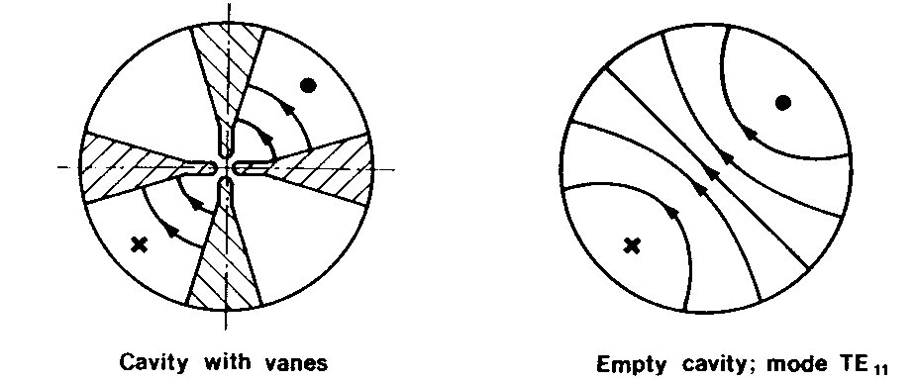
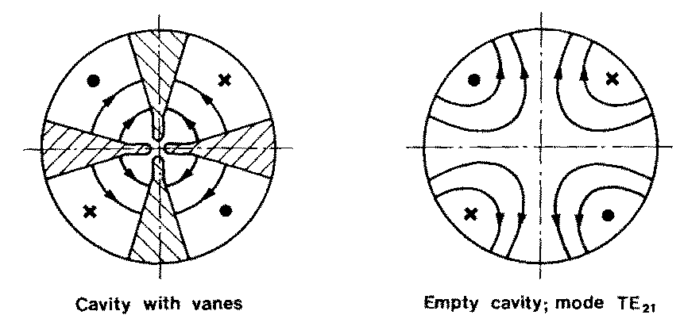
n : azimuthal,
m : radial
l longitudinal component
dipole mode used in the IH structures
quadrupole mode used in Radio Frequency Quadrupole

Slide 18
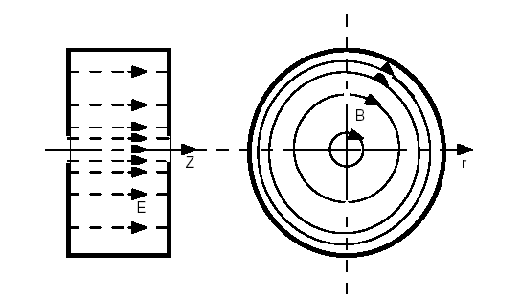
n : azimuthal,
m : radial
l longitudinal component
TM010 mode , most commonly used accelerating mode

Slide 19
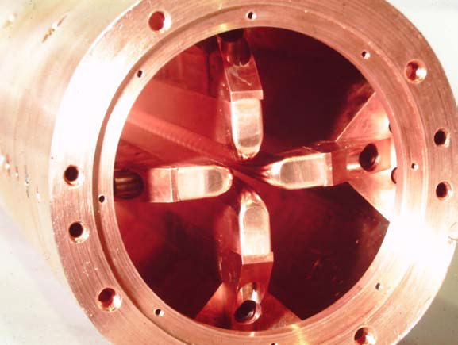
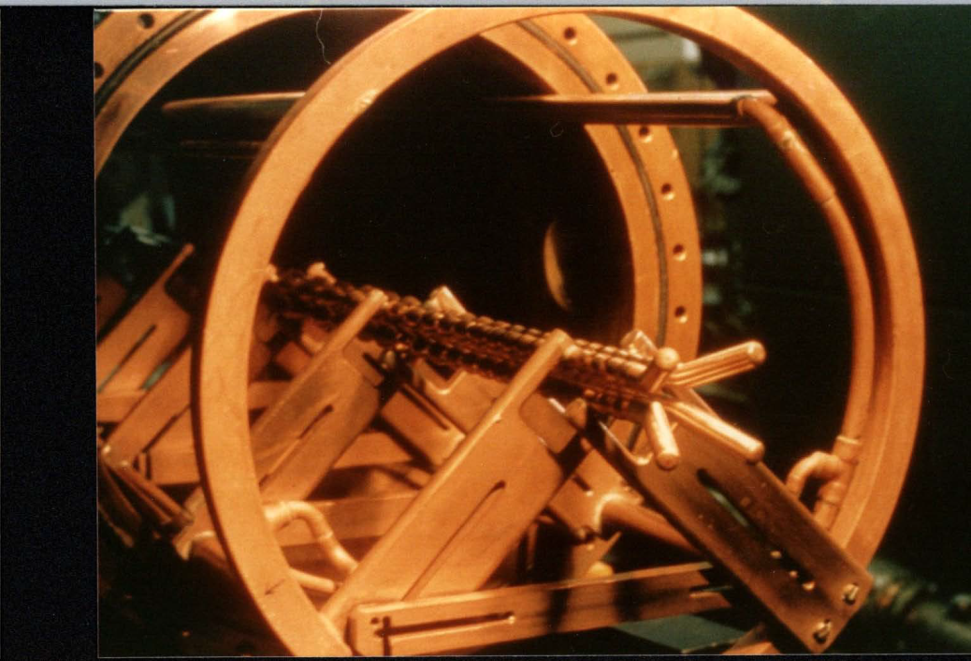

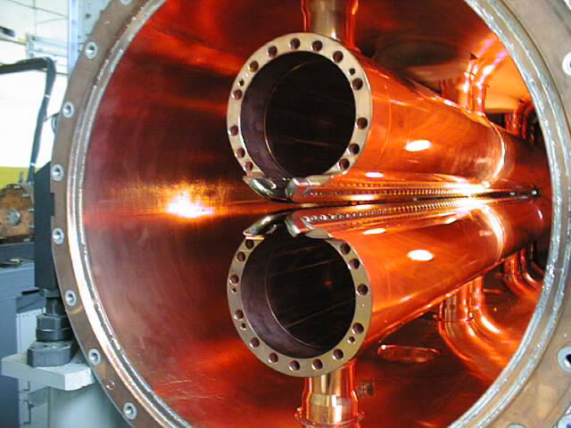
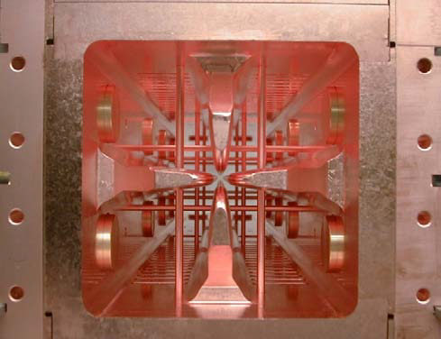
Radio Frequency Quadrupoles

Slide 20
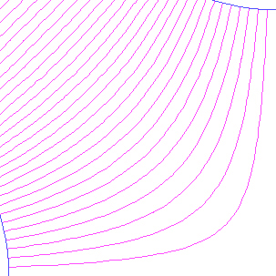
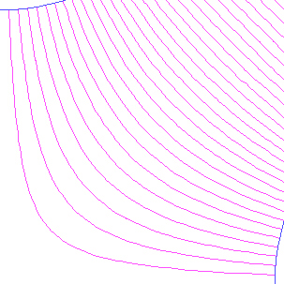
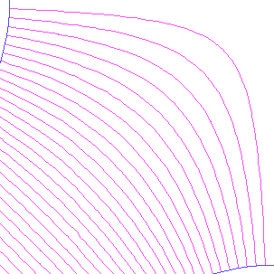
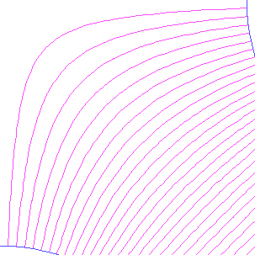
transverse field in an RFQ
-
-
alternating gradient focussing structure with period length βλ
(in half RF period the particles have travelled a length βλ/2 )
+
+
+
+
-
-
Beam goes into the paper in between the 4 vane tips

Slide 21
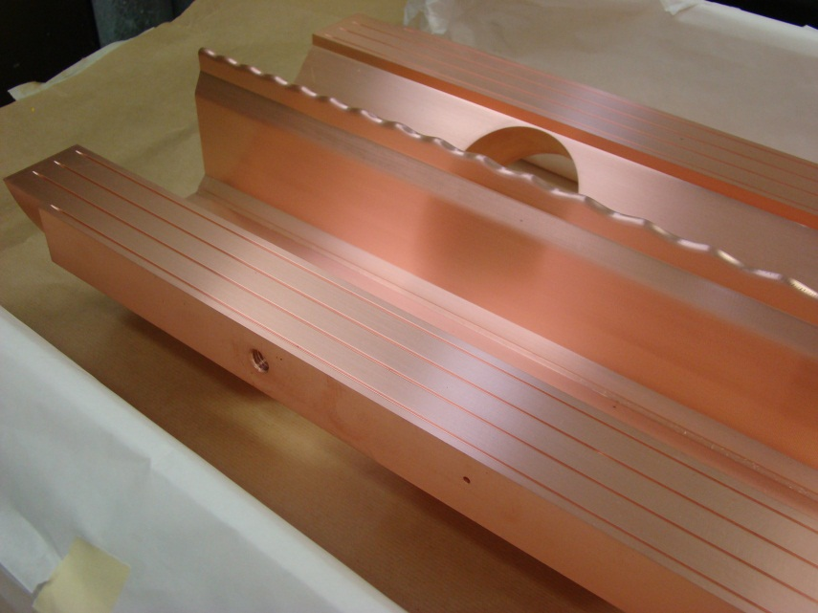
acceleration in RFQ
longitudinal modulation on the electrodes creates a longitudinal component in the TE mode

Slide 22
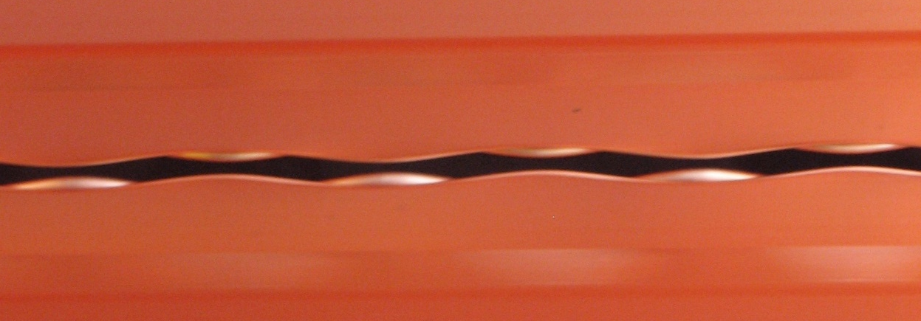
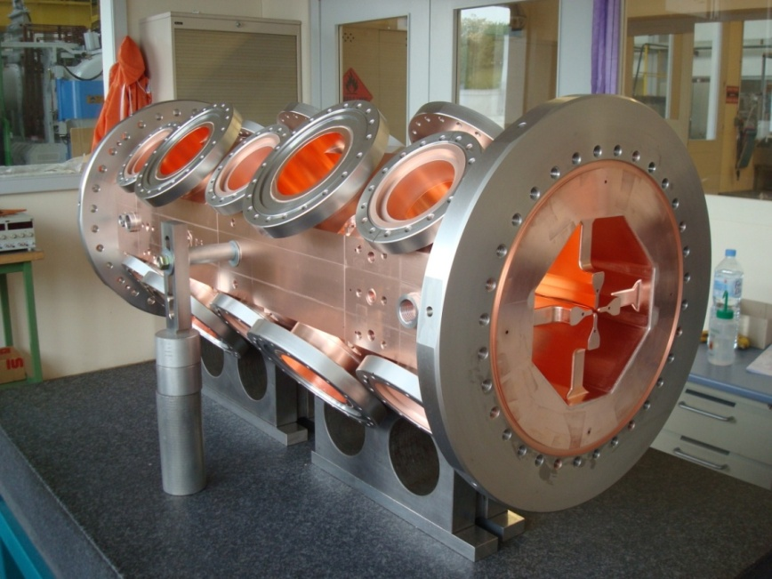
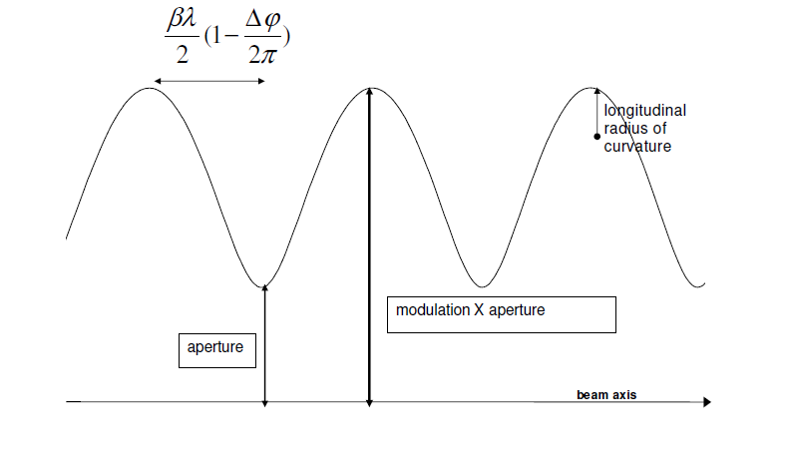
Modulation-Acceleration
Looking in from the RF port : these are adjacent vanes

Slide 23
RFQ
The resonating mode of the cavity is a focusing mode (TE mode)
Alternating the voltage on the electrodes produces an alternating focusing channel
A longitudinal modulation of the electrodes produces a field in the direction of propagation of the beam which bunches and accelerates the beam
Both the focusing as well as the bunching and acceleration are performed by the RF field
Not very efficient accelerator
The RFQ is the only linear accelerator that can accept a low energy CONTINOUS beam of particles
1970 Kapchinskij and Teplyakov propose the idea of the radiofrequency quadrupole ( I. M. Kapchinskii and V. A. Teplvakov, Prib.Tekh. Eksp. No. 2, 19 (1970))

Slide 24
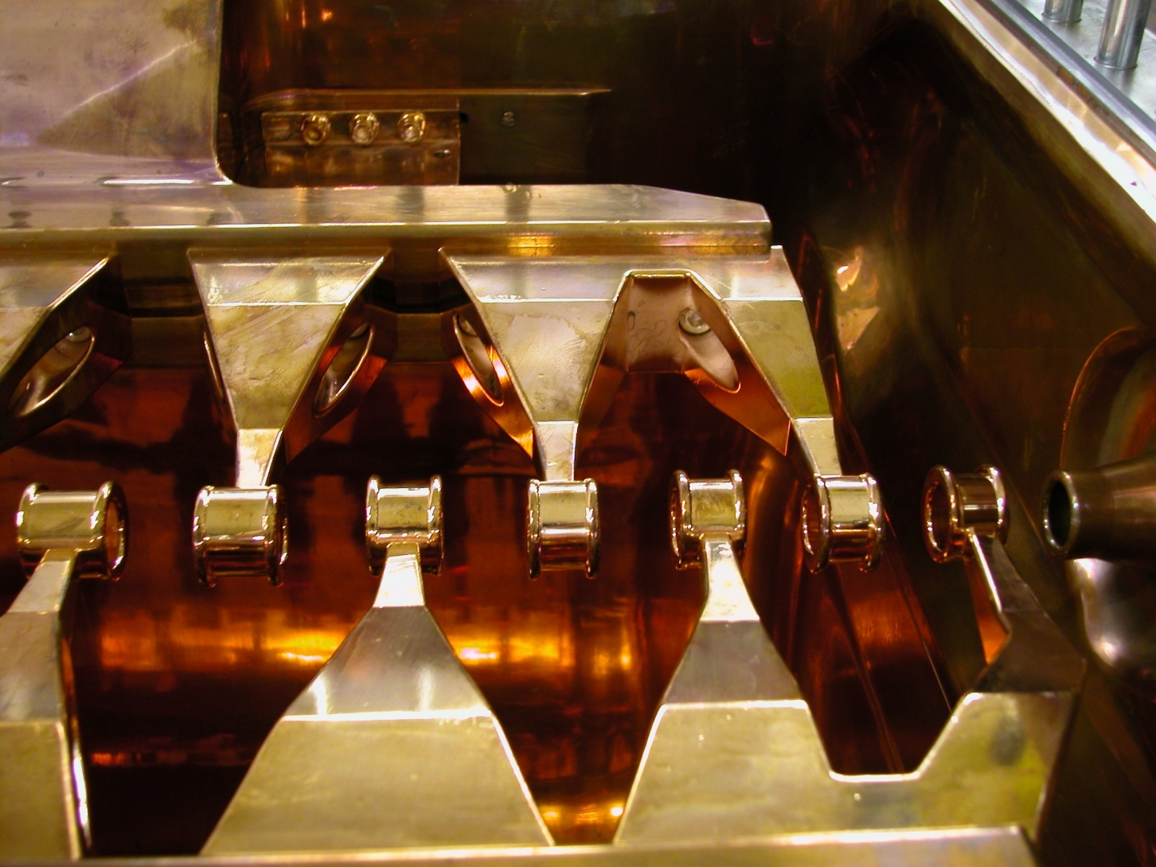
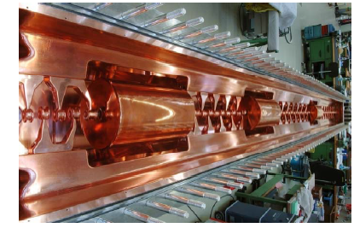
Interdigital H structure

Slide 25
Interdigital H structure
the mode is the TE110

Slide 26
Interdigital H structure
stem on alternating side of the drift tube force a longitudinal field between the drift tubes
focalisation is provided by quadrupole triplets places OUTSIDE the drift tubes or OUTSIDE the tank

Slide 27
IH
The resonating mode of the cavity is a dipole mode mode
The cavity is equipped with thin drift tubes.
Alternating the stems on each side of the drift tubes produces a field in the direction of propagation of the beam which accelerates the beam
Focusing is provided by quadrupole triplets located inside the tank in a dedicated section
Very efficient in the low beta region ((β ≅ 0.02 to 0.08 ) and low frequency (up to 200MHz)
not for high intensity beam due to long focusing period
ideal for low beta ion acceleration

Slide 28
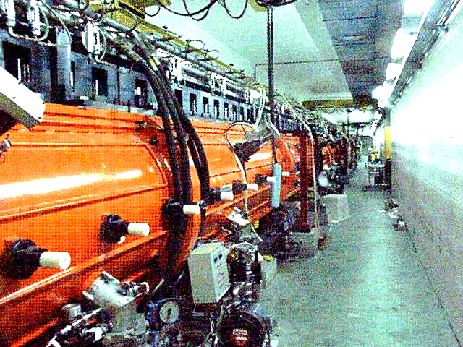
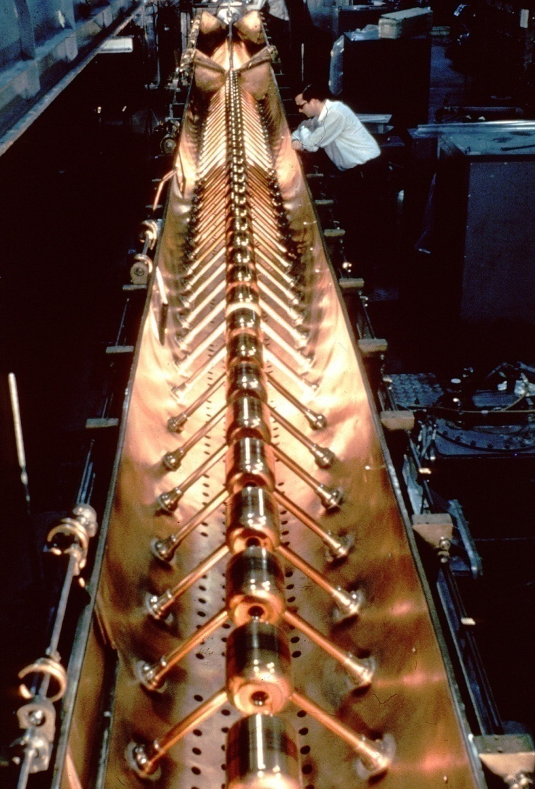
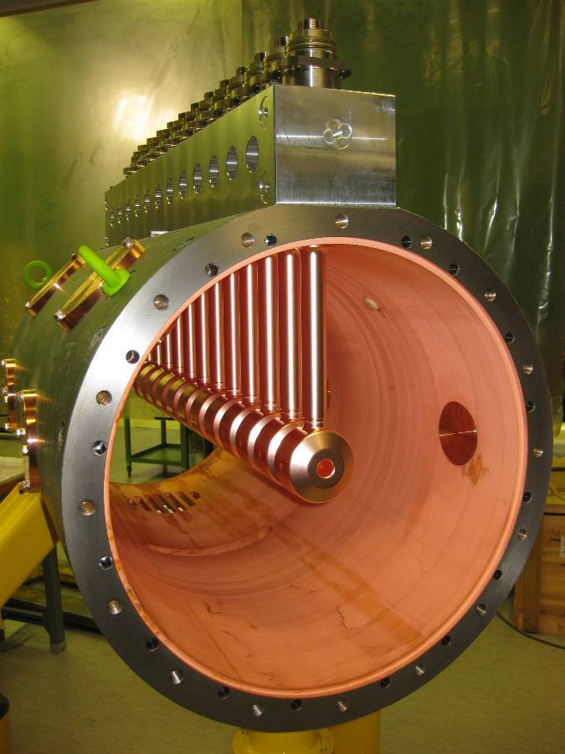
Drift Tube Linac

Slide 29
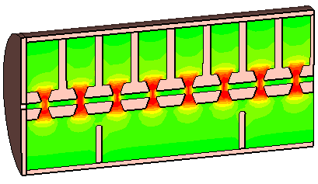
DTL : electric field
Mode is TM010

Slide 31
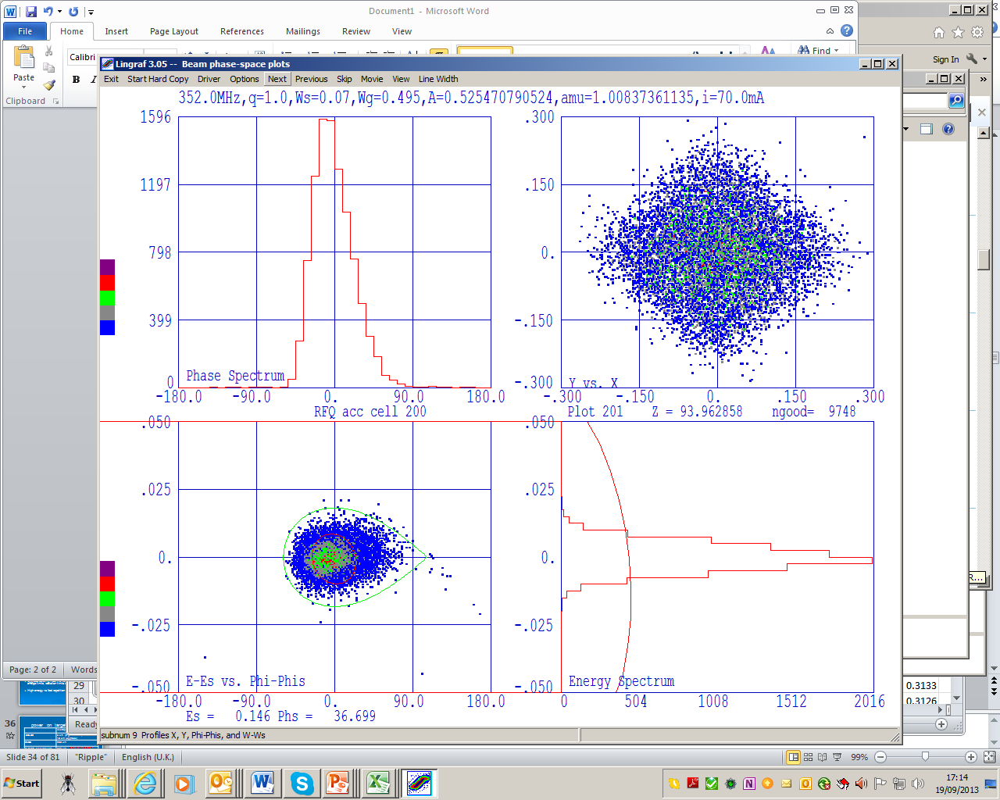
Synchronous particle
it’s the (possibly fictitious) particle that we use to calculate and determine the phase along the accelerator. It is the particle whose velocity is used to determine the synchronicity with the electric field. Design for that particle and provide longitudinal focusing so that the other stick with it!

Slide 32
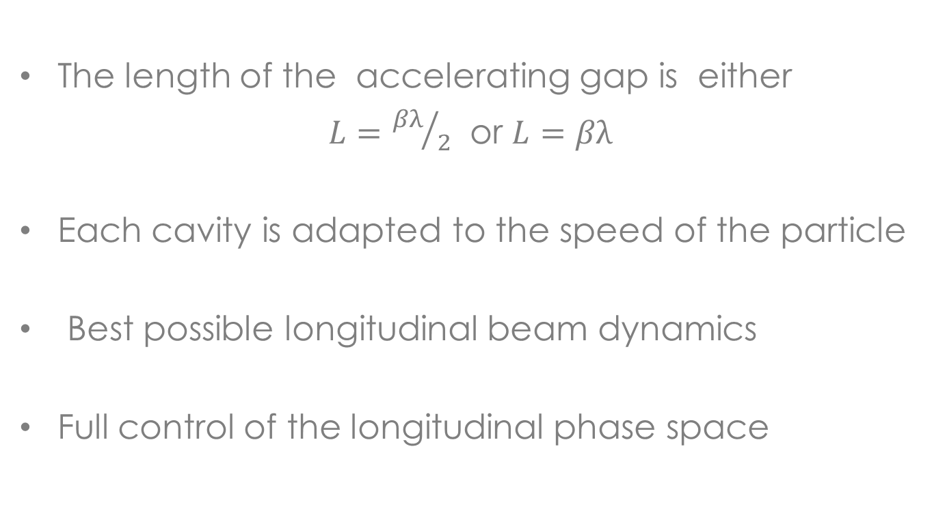
Perfect synchronicity
The length of the accelerating gap is either
$L={βλ}/2$ or $L=βλ$
Each cavity is adapted to the speed of the particle
Best possible longitudinal beam dynamics
Full control of the longitudinal phase space

Slide 33
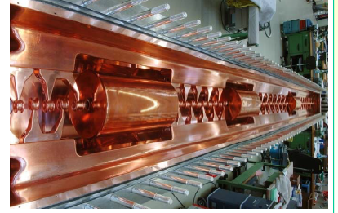
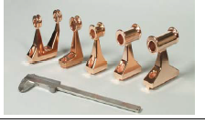
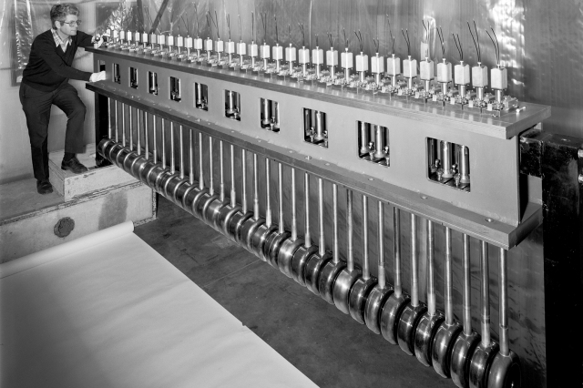
Synchronous structures

Slide 34
Beta vs W

Slide 35
Almost perfect synchronicity
for simplifying construction and therefore keeping down the cost, cavities are not individually tailored to the evolution of the beam velocity but they are constructed in blocks of identical cavities (tanks). several tanks are fed by the same RF source.
This simplification implies a “phase slippage” i.e. a motion of the centre of the beam . The phase slippage is proportional to the number of cavities in a tank and it should be carefully controlled for successful acceleration.

Slide 36
phase slippage
Lcavity = β_{g}λ/2
particle enters the cavity with β_{s}< β_{g}. It is accelerated
the particle has not left the cavity when the field has changed sign : it is also a bit decelerated
the particle arrives at the second cavity with a “delay”
........and so on and so on
we have to optimize the initial phase for minimum phase slippage
for a given velocity there is a maximum number of cavity we can accept in a tank

Slide 37
Adapting the structure to the velocity of the particle
Case1 : the geometry of the cavity/structure is continuously changing to adapt to the change of velocity of the “synchronous particle”
Case2 : the geometry of the cavity/structure is adapted in step to the velocity of the particle. Loss of perfect synchronicity, phase slippage.
Case3 : the particle velocity is beta=1 and there is no problem of adapting the structure to the speed.

Slide 38
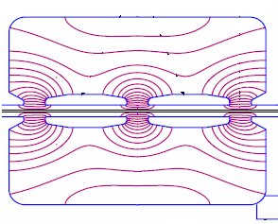
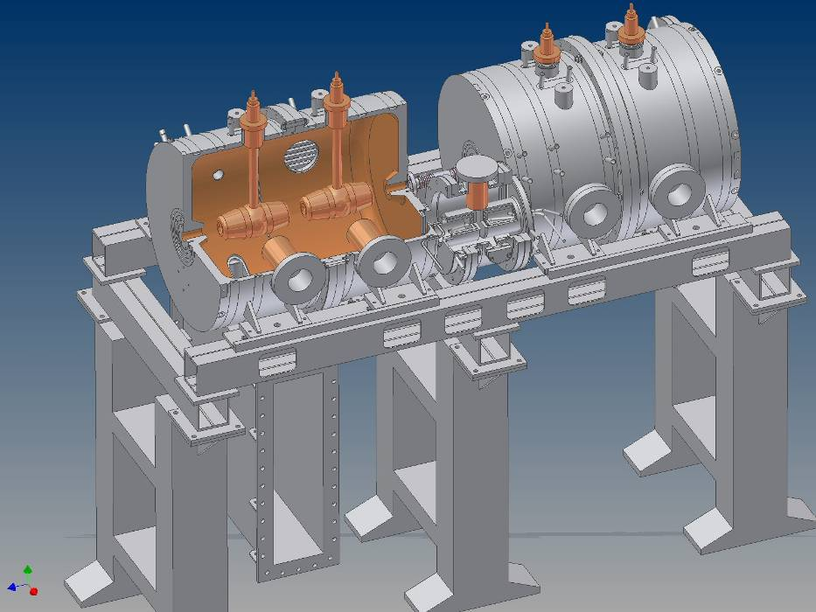
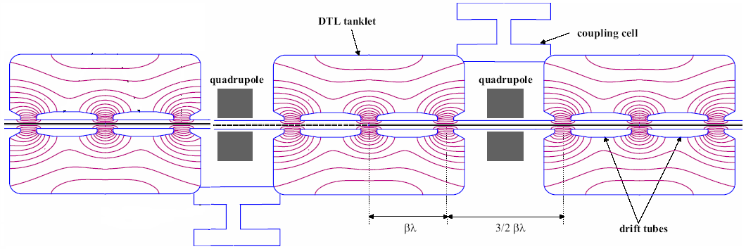
Cell Coupled-DTL
Single Accelerating
CCDTL tank
1 Power coupler / klystron
Module

Slide 39
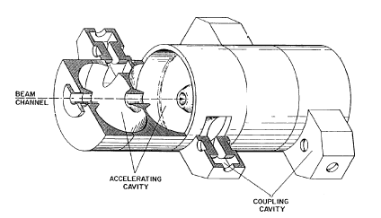
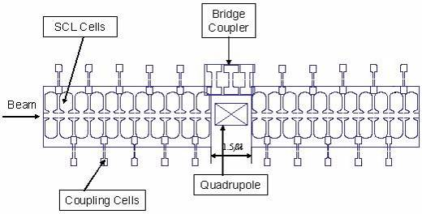
Side Coupled Linac
Chain of cells, coupled via slots and off-axis coupling cells.
Invented at Los Alamos in the 60’s.
Operates in the π/2 mode (stability).
CERN SCL design:
Each klystron feeds 5 tanks of 11 accelerating cells each, connected by 3-cell bridge couplers.
Quadrupoles are placed between tanks.
Notes:
How it looks like

Slide 40
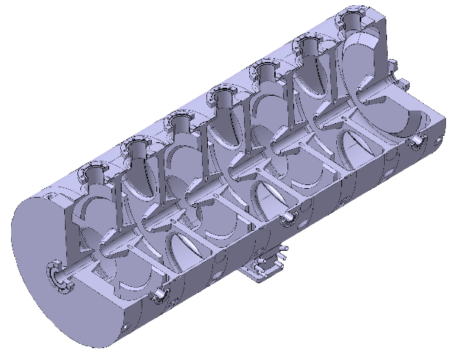
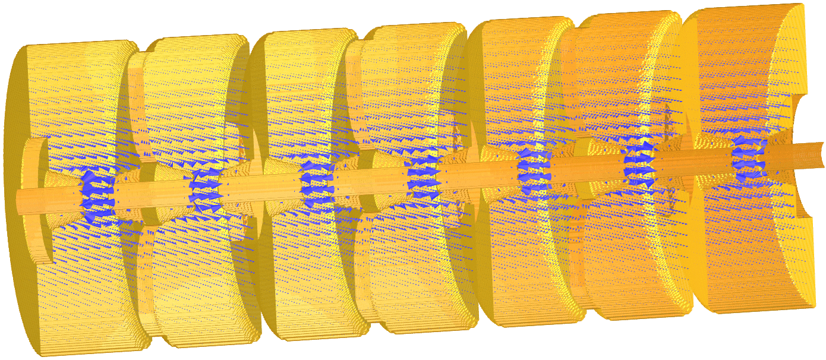
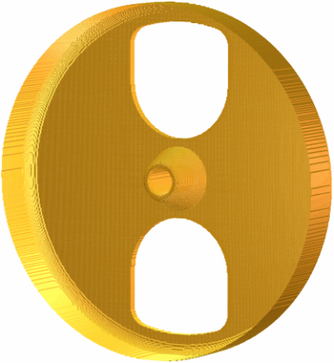
PI-mode structure
beam

Slide 41


extras

Slide 42
Beam centre phase in LINAC4

Slide 43
How to choose
Compact Linac but not too demanding on power
Structures adapted to the velocity of the particles
Effective transfer of power from the electromagnetic power source to the beam

Slide 44
cavity geometry and related parameters definition
field
y
beam
x
Cavity
z
L=cavity length
1-Maximum field/average field
2-Shunt impedance
3-Quality factor
4-Filling time
5-Transit time factor
6-Effective shunt impedance

Slide 45
Average electric field
Average electric field ( E₀ measured in V/m) is the space average of the electric field along the direction of propagation of the beam in a given moment in time when F(t) is maximum.
physically it gives a measure how much field is available for acceleration
it depends on the cavity shape, on the resonating mode and on the frequency

Slide 46
Kilpatrick sparking criterion
What limits the field
f = 1.64 E² exp (-8.5/E)
GUIDELINE nowadays : peak surface field up to 2*kilpatrick field
Quality factor for normal conducting cavity is E_{peak}/E_{o}T

Slide 47


The higher the frequency
1990 LINAC2 RFQ2 200 MHz 0.5 MeV /m Weight : 900kg/m Ext. diametre : ~45 cm Beam current: 200 mA | 2007 LINAC4 RFQ 352 MHz 1MeV/m Weight : 400kg/m Ext. diametre : 29 cm Beam current : 80 mA | 2014 HF RFQ 750MHz 2.5MeV/m Weight : 100 kg/m Ext. diametre : 13 cm Beam current : 0.1 mA

Slide 48
Transit time factor
transit time factor ( T, dimensionless) is defined as the maximum energy gain per charge of a particles traversing a cavity over the average voltage of the cavity.
Write the field as
The energy gain of a particle entering the cavity on axis at phase φ is

Slide 49
cavity parameters-5
assume constant velocity through the cavity (APPROXIMATION!!) we can relate position and time via
we can write the energy gain as
and define transit time factor as
T depends on the particle velocity and on the gap length. IT DOESN”T depend on the field

Slide 50
Transit time factor
if we don’t get the length right we can end up decelerating!!!

Slide 51
effective shunt impedance
Effective shunt impedance ( Z measured in Ω/m) is defined as the ratio of the average effective electric field squared (E0T ) to the power (P) per unit length (L) dissipated on the wall surface.
it is independent of the field level and cavity length, it depends on the cavity mode and geometry and on the velocity of the particle to be accelerated
Measure of how much energy a charged particle can gain for 1 w of power when travelling over 1 m of structure.
measure if the structure is optimized and adapted to the velocity of the particle to be accelerated

Slide 52
overview
take with CAUTION!
 | Ideal range of beta | frequency | Effective gradient | Particles
RFQ | Low!!! - 0.05 | 40-400 MHz | 1 MV/m (350MHz) | Ions / protons
IH | 0.02 to 0.08 | 40-200 MHz | 4.5 MV/m (200MHz) | Ions and also protons
DTL | 0.04-0.5 | 100-400 MHz | 3.5 MV/m (350MHz) | Ions / protons
SCL | Ideal Beta=1 But as low as beta 0.3 | 800 - 3000 MHz | 20 MV/m (3000MHz) | protons

Slide 53
What is a linac-cont’ed
Relativistic or not
type of focusing
type of particle :
charge couples with the field, mass slows the acceleration
type of RF structure

Slide 54





Magnetic quadrupoles
ElectroMQ
Permanent MQ

Slide 55


Focusing force
B=magnetic field/F=force
Positively charged particles going into the screen

Slide 56



Magnetic quadrupole
Magnetic field
Magnetic force
Focusing in one plan, defocusing in the other
y envelope
x envelope
sequence of focusing and defocusing quadrupoles

Slide 57









F0D0 focusing
D
F
D
F
D
F
D
F
1
2
3
4
5
6
7
8
1
2
3
4
5
6
7
8
The beam is matched, after every period, the twiss parameters are identical.

Slide 58
Building blocks-recap

Slide 59
Choices / Questions
Frequency? | Frequency and size Frequency and acceptance Frequency and maximum accelerating field Frequency and duty cycle
RFQ output energy? | Into which structure do we inject How long is the RFQ (compared to wavelenght)
Continue with TE mode or switch to TM mode? | Start thinking about transverse focusing Think about the final energy Think about the energy at the transition (NB treshold for copper activation is around few MeV)
At what energy we start standardising the RF structures | Quasi-synchronous condition
PMQ or EMQ? | Cheap and easy or maximum flexibility

