Slide 1

SUPERCONDUCTING MAGNETS: AN ENABLING TECHNOLOGY FOR HIGH ENERGY PHYSICS DISCOVERIES
Ezio Todesco
European Organization for Nuclear Research (CERN)
Technology Department
Magnets, superconductors and cryostat group

Slide 2
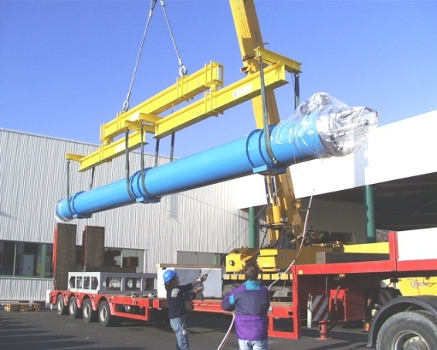
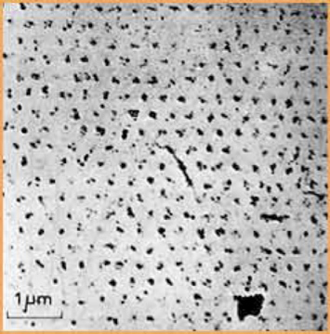
FOREWORD
The science of superconducting magnets is a exciting, fancy and dirty mixture of physics, engineering, and chemistry
An example of the variety of the issues to be taken into account
  The field of the LHC dipoles (8.3 T) is related to the critical field of Niobium-Titanium (Nb-Ti), which is determined by the microscopic quantum properties of the material, plus aspects related to superconducting magnet design (margins, instabilities, …)
  The length of the LHC dipoles (15 m) has been determined by the maximal dimensions of (regular) trucks allowed on European roads
Quantized fluxoids penetrating a superconductor used in accelerator magnets
A 15 m truck unloading a 27 tons LHC dipole

Slide 3
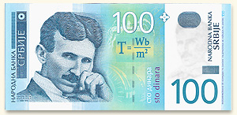
FOREWORD
The cost optimization is a key element of the design
  The magnet system is a major part of the high energy collider cost
  In the LHC budget (accelerator only, not experiments, and having the LEP tunnel), 50% for the magnets, and 15% for the cryogenics to keep them at 1.9 K
Affordable magnets → compact devices
  This is another intrinsic feature of superconducting magnets for the collider main arcs

Slide 4
CONTENTS
Generating magnetic field and the superconducting leap
From the ISR to the LHC
Towards higher fields: HL-LHC and beyond

Slide 5
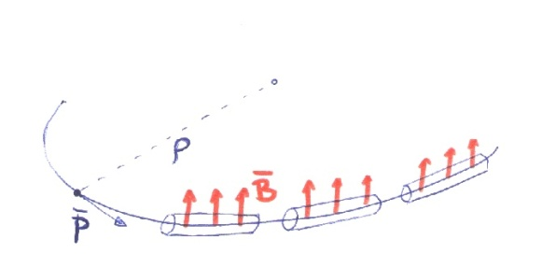

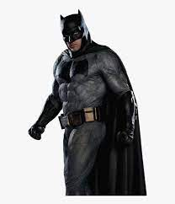
MAKING ENERGY …
In a circular collider, one has the well-known relation between field, curvature radius and momentum
  In ultra-relativistic regime pc>>mc²
  LHC at 7 TeV: 8.3 T and 2800 m curvature radius
How to get more energy?
  Larger accelerators (brute force)
  Higher fields (the technological path)

Slide 6
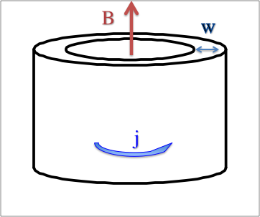
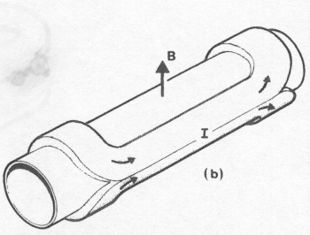
… AND MAKING MAGNETIC FIELDS
In a solenoid field is given by product of current density and winding width
In a dipole one has about half of it
The constant μ is terribly small (≈10⁻⁶ T m/A)
Field in a solenoid
Field in a dipole

Slide 7
… AND MAKING MAGNETIC FIELDS
To make dipolar fields, you need current density and winding width
How to get more field?
  Thicker coils (brute force)
  Higher current density (the technological path)
Dipole

Slide 8
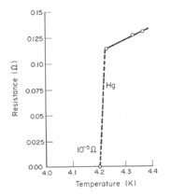
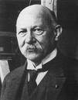
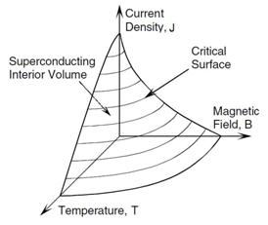
THE SUPERCONDUCTING LEAP
Resistive conductors can operate at 2 to 10 A/mm²
  To produce ∼ 8 T field, one would need 1.2 m to 6 m of coil width ! Possible, but huge magnet transverse size, requiring larger tunnel diameter, logistics, …
Superconductors allow operating at 100 times larger current densities (and without power consumption) – typically at order of ∼500 A/mm² overall density (current/surface of insulated coil)
  Discovery in 1911, but took 50 years to apply to build magnets giving order of few teslas
Heinke Kamerlingh Onnes, Dutch
(1853 –1928) Nobel prize 1913
Superconductor critical surface

Slide 9
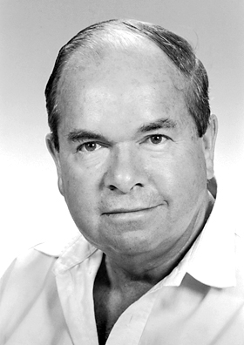
TYPE II SUPERCONDUCTORS
First magnets build soon after Omnes discovery were limited to extremely small fields
  To have magnets reaching order of teslas, one requires type II superconductors, where the field is not explused but penetrates in quantized fluxoids
Alexei Abrikosov, Russian
(1928-2017) Nobel prize 2003
Flux penetration in type II superconductor
Stekly, Z.J.J. & Zar, J.L. IEEE TransNucl Science NS-12 (1965)

Slide 10
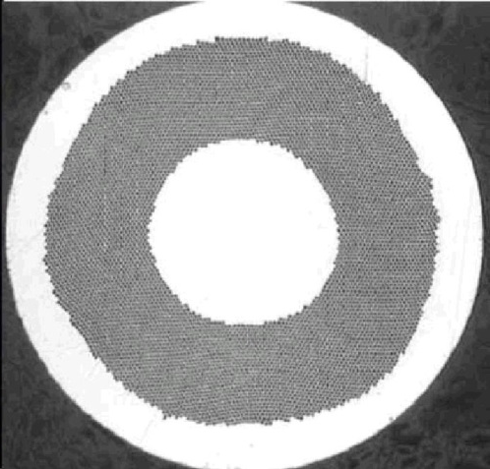
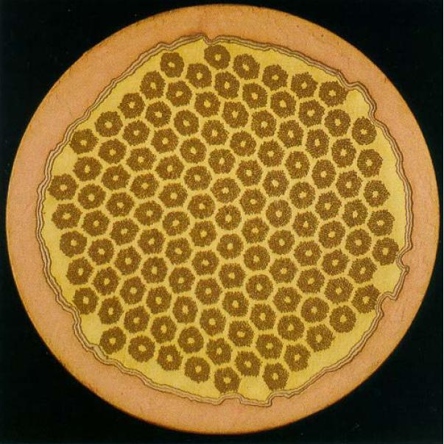
STRAND ARCHITECTURE
Moreover, a bulk superconductor cannot be used in superconducting magnets
  About half of the strand must be composed of Cu to allow the longitudinal dissipation of the heat in case of resistive transition – otherwise the heat locally diverges
  The superconductor magnetization creates instabilities (heat dissipation followed by thermal runaway) – superconductor must be arranged in filaments of 0.01 to 0.1 mm transverse size
About 1 mm
Nb-Ti strand used for the LHC dipole
filament size 6-7 μm
Nb₃Sn strand used in LARP
filament size ≈50 μm

Slide 11
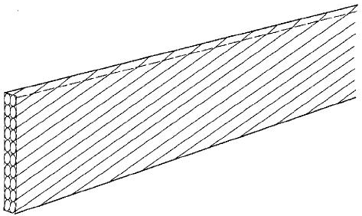
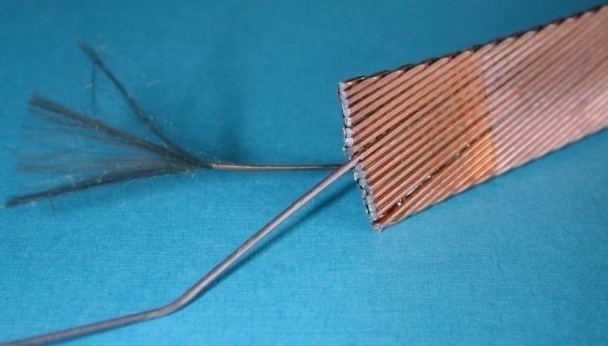
CABLE ARCHITECTURE AND FILLING FACTOR
Superconducting strands are assembled in high current cables to allow more effective winding and to lower the magnet inductance
  Rutherford cable is the typical geometry
  Cables are insulated with polymide/fiberglass, 0.10-0.15 mm thick
An insulated cable contains 1/3 to ¼ of superconductor, and therefore typical operational currents in superconducting magnets for accelerators are order of ∼1500 A/mm²
Rutherford cables

Slide 12
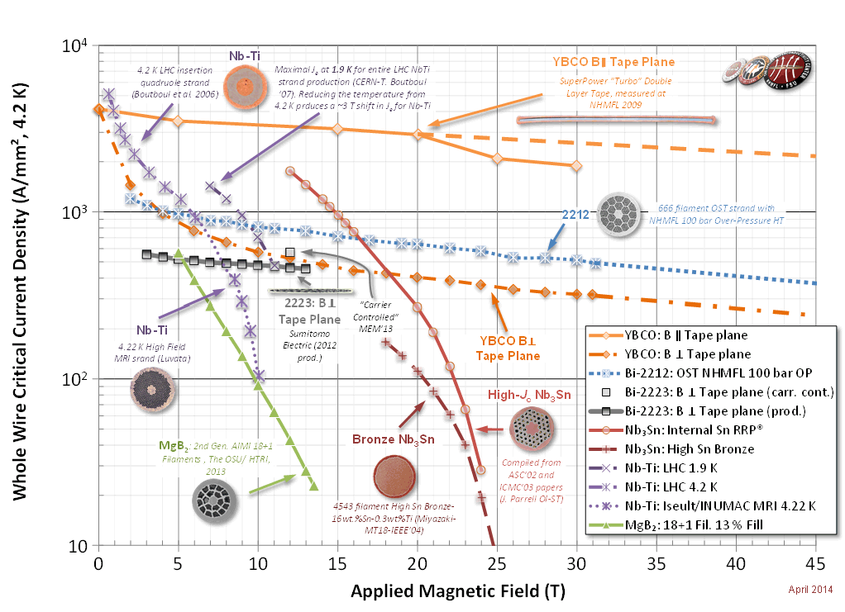
PRACTICAL SUPERCONDUCTORS
Superconductive state is destroyed by large temperatures, large current densities, and large magnetic fields
  LTS: low temperature superconductors, operating below 10 K, are used in accelerator magnets, essentially Nb-Ti and Nb₃Sn
  HTS is a promising brave new world towards higher fields > 20 T and higher operational temperatures (>10 K)
Nb₃Sn
Nb-Ti
Superconductor critical surfaces at 4.5 K and 1.9 K (courtesy of P. Lee)

Slide 13
CONTENTS
Creating field and the superconducting leap
From ISR to the LHC
Towards higher fields: HL-LHC and beyond

Slide 14
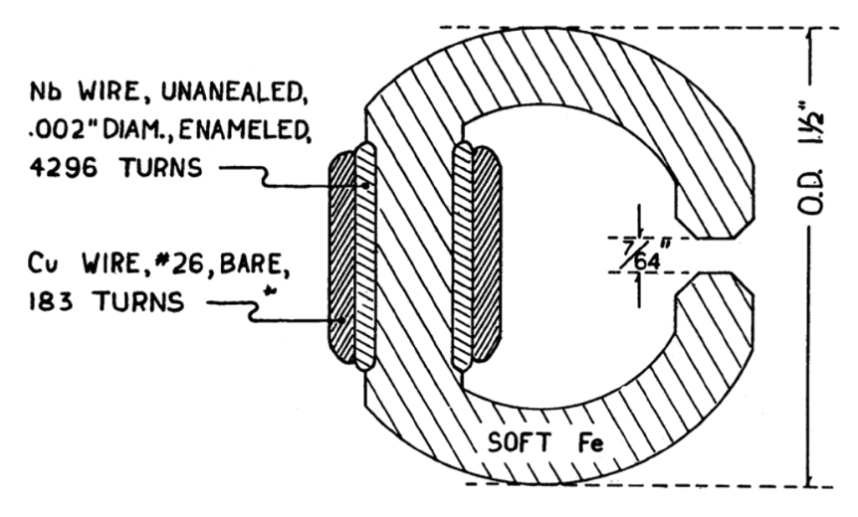
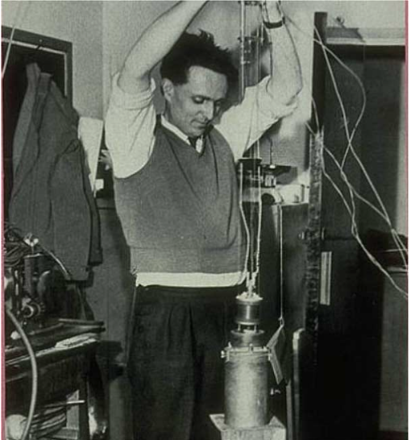
FIRST MAGNETS IN THE TESLA RANGE
1956: a Nb superconducting magnet reaching 0.7 T
1962: a 4 T magnet (M. Wood, et al)
1964: a 10 T NbTi solenoid (H. T. Coffey and J. K. Hulm et al., J. Appl. Phys. 36 (1965) 128
  See M. Wilson, IEEE TAS 22 (2012) 3800212 for an historical review
G. Yntema, IEEE Trans. MAG-23, no. 2, p. 390, 1987
M. Wood with the first Oxford instruments magnet

Slide 15
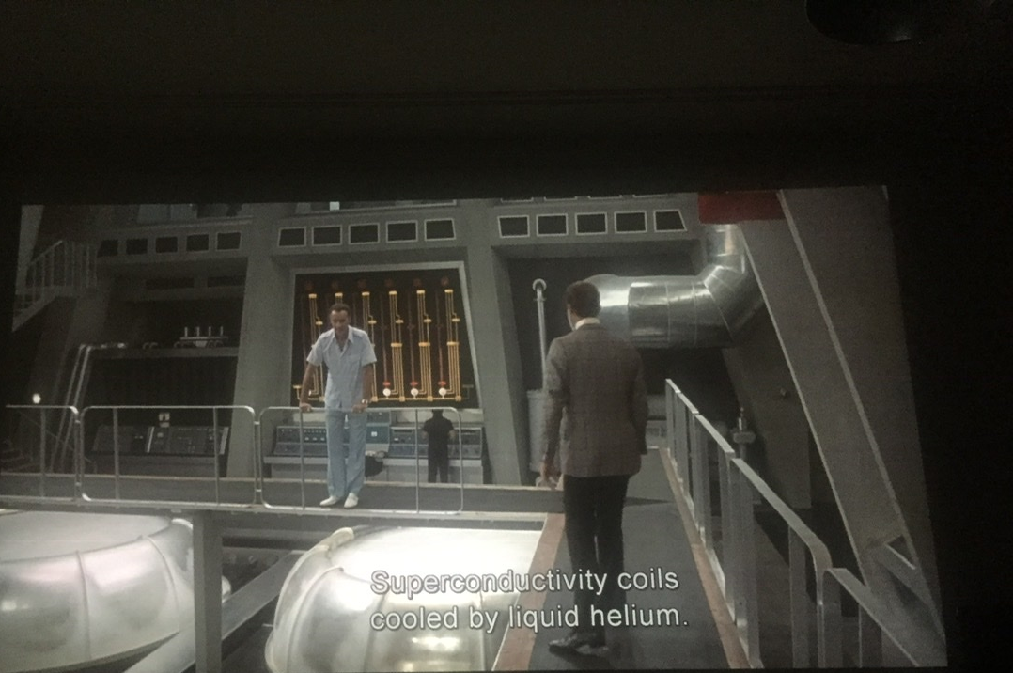
MY NAME IS BOND …
Superconducting magnets rapidly entered the collective imagination https://www.youtube.com/watch?v=Rwqc4V6Pd70
The bad guy
(C. Lee)
James Bond
(R. Moore)
G. Hamilton, “A007 – The man with the golden gun” EON production (1974)

Slide 16
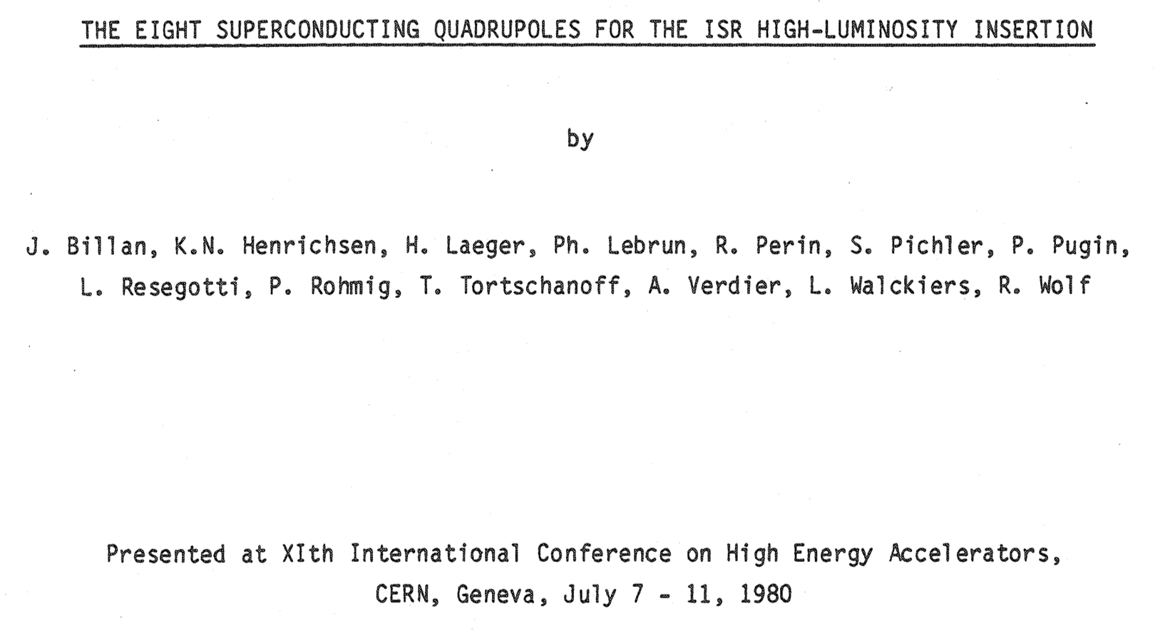
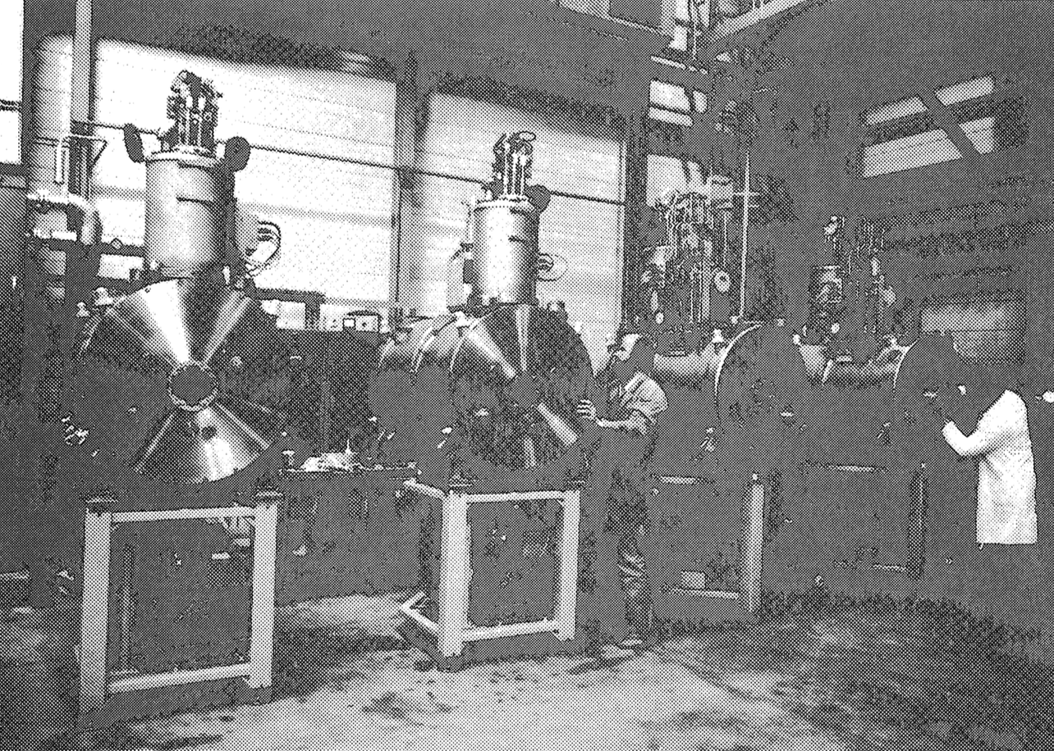
THE INTERSECTION STORAGE RING INTERACTION REGIONS
Few years later, first superconducting magnets are installed in a collider: ISR interaction region (after other attempts done in the US, see Isabelle)
These are quadrupoles in Nb-Ti, conductor peak field above 5 T
Allowed increasing the ISR luminosity by factor 10
  40 years later … same path is being followed for HL-LHC, with Nb₃Sn triplet

Slide 17
WHAT MAKES THINGS SO CHALLENGING
Overall current densities of several hunderds of ampere per mm² are a peculiar challenge for accelerator magnets
  This is related to the compactness required in the transverse size
    Other applications have much lower operational current densities
    However, other challenges are present as total size for experimental magnets, and total size plus pulsed field for ITER)
  The story of superconducting magnets for accelerators walks around the 450 A/mm² current density (about 3 T each 10 mm of coil width), getting more field via thicker coils
 | Overall current density (A/mm²) | Superconductor current density (A/mm²) | Ramp | Field in conductor
Tevatron dipole | 360 | 1550 | static | 4.7
LHC dipole | 360/440 | 1260/1820 | static | 8.6
ATLAS BCT | 30 | 950 | static | 3.9
ITER (TF & CS) | 20 to 40 | 150 | pulsed | 5 to 13

Slide 18
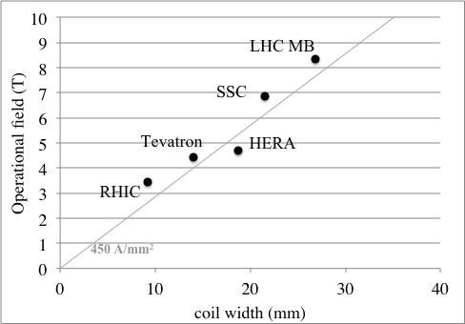
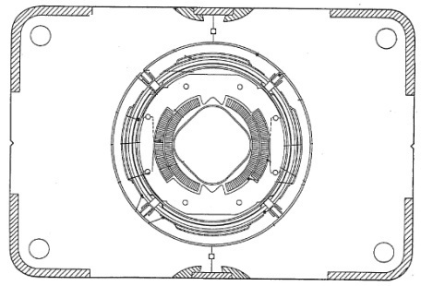
FROM ISR TO LHC
1980-1986: Tevatron dipoles with 4.3 T bore field are the first superconducting magnets installed as main dipoles in a collider
  774 dipoles, 6-m-long magnets, in house production in FNAL
  [R. Hanft et al., TM-1182, 1630, 03/1983]
Tevatron dipole cross-section

Slide 19
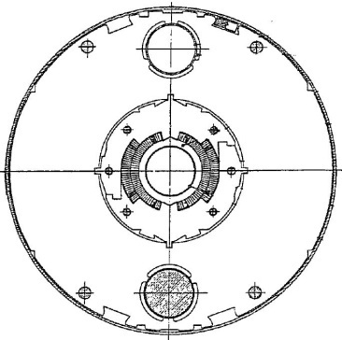
FROM ISR TO LHC
1985-1990: HERA dipoles break the 4.5 T barrier
  454 dipoles, 9-m-long magnets, industrial production
  [R. Meinke, IEEE Trans. Appl. Supercond. 27, 1728 (1991)]
HERA dipole cross-section

Slide 20
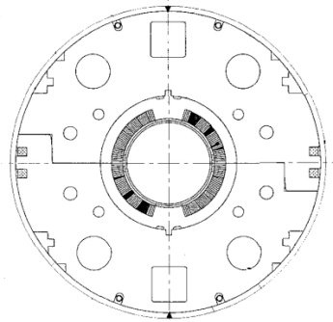
FROM ISR TO LHC
1994-1996: RHIC dipoles with 3.5 T bore field explored the low-cost option
  296 dipoles, 9.5-m-long magnets, industrial production
  [M. Anerella et al., Nucl. Instrum. Methods A 499, 280 (2003)]
RHIC dipole cross-section

Slide 21
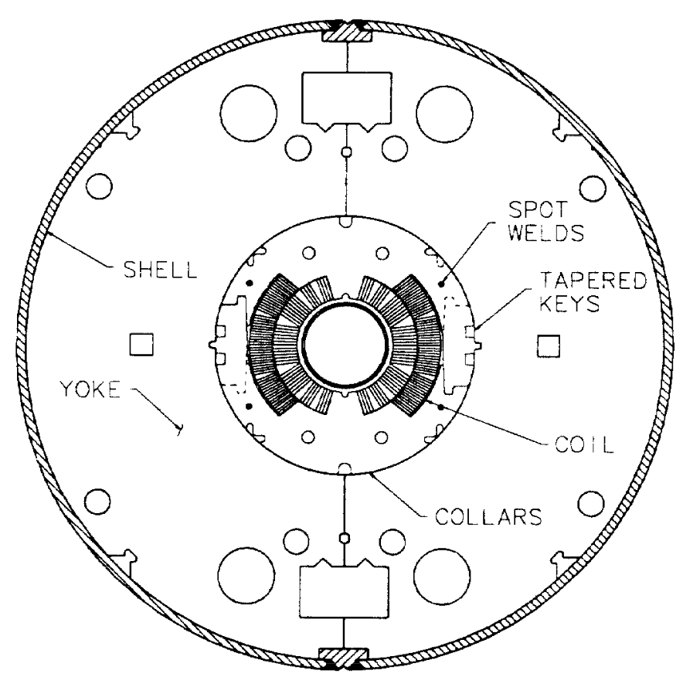
FROM ISR TO LHC
1984-1995: SSC protoypes break the 6.5 T barrier
  19 dipole prototypes, 17-m-long magnets with 50 mm aperture
  15 dipole prototypes, 15-m-long magnets with 40 mm aperture
  [A. Devred et al., SSCL-P-82 1992]
  Project canceled in 1993
SSC dipole cross-section

Slide 22
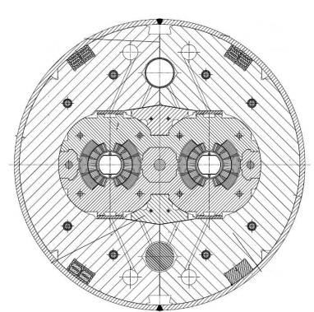
FROM ISR TO LHC
2000-2005: LHC dipoles break the 8 T barrier
  1278 dipoles, 14.3-m-long magnets, industrial production – towards the limit of Nb-Ti for main dipoles in accelerator
    First operation at 1.9 K following Tore Supra experience
  [R. Perin, in Encyclopedia of Applied Superconductivity (IOP, London, 1998) 919–950 and L. Rossi, IEEE Trans. Appl. Supercond. 13, 1221 (2003) ]
LHC dipole cross-section

Slide 23
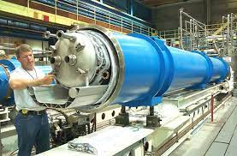
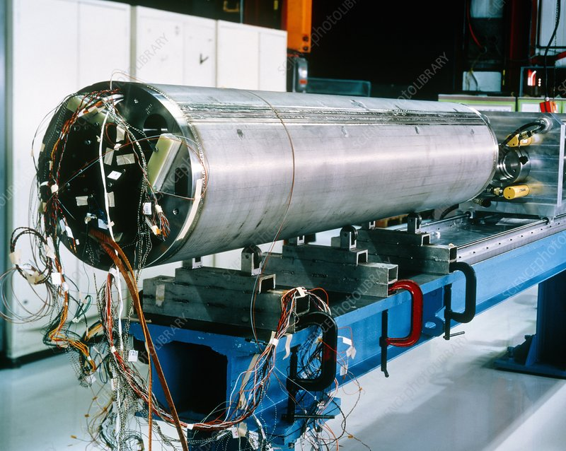
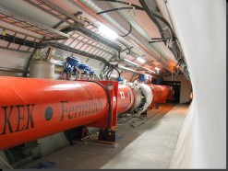
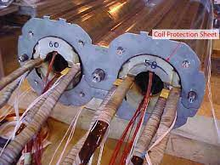
GALLERY
LHC dipole integration in cryostat
LHC quadrupole
Triplet from KEK and FNAL
LHC dipole collared coil

Slide 24
CONTENTS
Creating field and the superconducting leap
From ISR to the LHC
Towards higher fields: HL-LHC and beyond

Slide 25
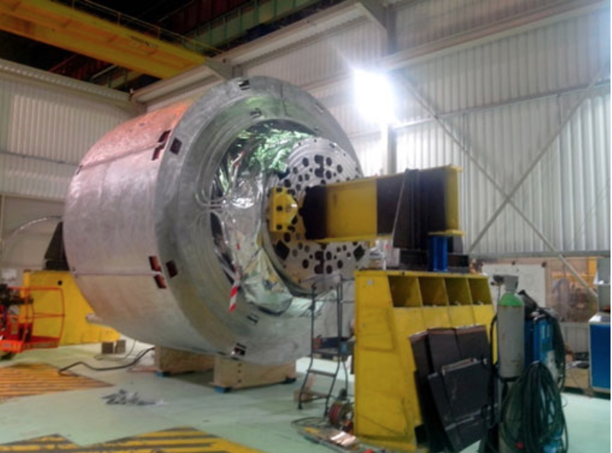
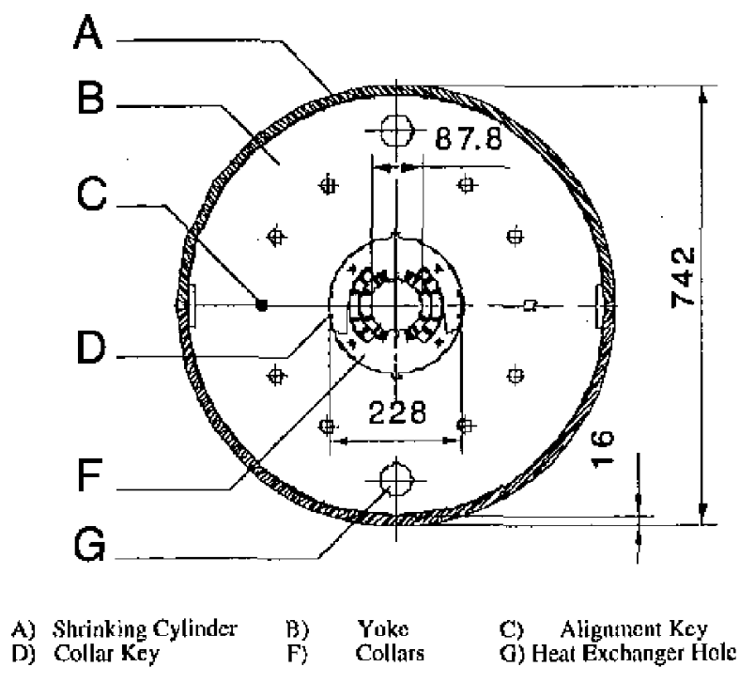
… AND ABOVE
Fresca Nb-Ti magnet break the 10 T barrier (10.07 T)
  End of Nb-Ti? For accelerator magnets yes – given the cost/size optimization
  But Nb-Ti solenoids up to 11.7 T have been built (CEA, Iseult)
Fresca cross-section
D. Leroy, et al, IEEE TAS 10 (2000) 178
Iseult solenoid
(L. Quettier, et al. IEEE TAS 30 (2020) 4400604)

Slide 26

THE DIRECTION ? STRAIGHT
There are few reasons that do not allow to go at much higher current densities than 450 A/mm²
  Magnet protection (see later)
  Limitation of the superconductor
  Mechanics

Slide 27


HOW ENERGY CAN BE RELATIVE
A typical argument used to show how large is the stored energy in the magnetic field of one LHC dipole (7 MJ) is to compare to the kinetic energy of a 20 tons lorry at 100 km/h
A 7 MJ lorry [S. Spielberg, “Duel” Universal Pictures, 1971]

Slide 28


HOW ENERGY CAN BE RELATIVE
On the other hand I can easily convince you that the stored energy is very small …
  7 MJ is a glass of gasoline
A quench is an irreversible transition from superconducting to normal state
  During a quench, all stored energy has to be absorbed by the coil enthalpy
  Maybe the best way to represent the protection challenge for the LHC dipole is burning a glass of gasoline in the magnet at 1.9 K and avoid that any part of the coil goes above 300 K
 | Energy | Weight | Energy density
LHC dipoles | 7 MJ | 27000 kg | 0.3 kJ/kg
Car battery | ∼100-360 MJ | ∼300 kg | ∼0.3-1 MJ/kg
Tank of gasoline (50 l) | 1500 MJ | 35 kg | 45 MJ/kg

Slide 29
THE PROTECTION OF THE MAGNETS
Enthalpy of the insulated coil from 2 K to 300 K is order of 0.5 J/mm³
  Stored energy density in the LHC dipole superconducting coil is ten times lower- this leaves 0.1 s to the protection system to react
  Strategy: to make all the coil resisitive, so that the energy is distributed over the whole mass of the coil
This is done via strips of stainless steel in close contact to the coil where an impulse of current is put as soon as the quench is detected
  For Nb₃Sn magnets, the reaction time has been lowered to 0.05 s: they operate with 1/5 of the coil enthalpy
  This physical limit does not allow operating at overall current densities much larger than 500 A/mm²
  The aletrnative path would be to extract the energy from the magnet

Slide 30
… AND ABOVE
The way to accelerator magnet above 10 T is Nb₃Sn
This is the sequence of Nb₃Sn records in the past 30 years
  1989: CERN Elin dipole, reaching 9.5 T at 4.3 K
    It was a Nb₃Sn option for LHC
  1992-97: MSUT reached 11.3 T at 4.5 K, and 11.5 T at 1.9 K 25 years later
  1993-1997: LNBL D20 reached 13.5 T at 1.8 K (followed by degradation)
  2005-2010: LBNL HD2 reached 13.8 T at 4.5 K
  2012-2019: FrescaII reached 14.5 T at 1.9 K
  2016-2022: RMM reached 16.4 T at 1.9 K (but with flat ends)

Slide 31
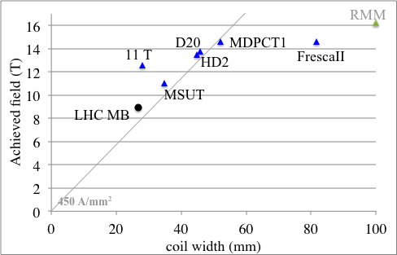
THE DIRECTION ? STRAIGHT
HL-LHC project is building Nb₃Sn quadrupoles operating at 11.5 T peak field on the conductor
HFM program targets a 14 T dipole in Nb₃Sn, and 20 T dipole in HTS
MQXF
11 T
Note this is achieved field in the best magnet versus coil width - operational field needs to be at least 10% smaller!

Slide 32
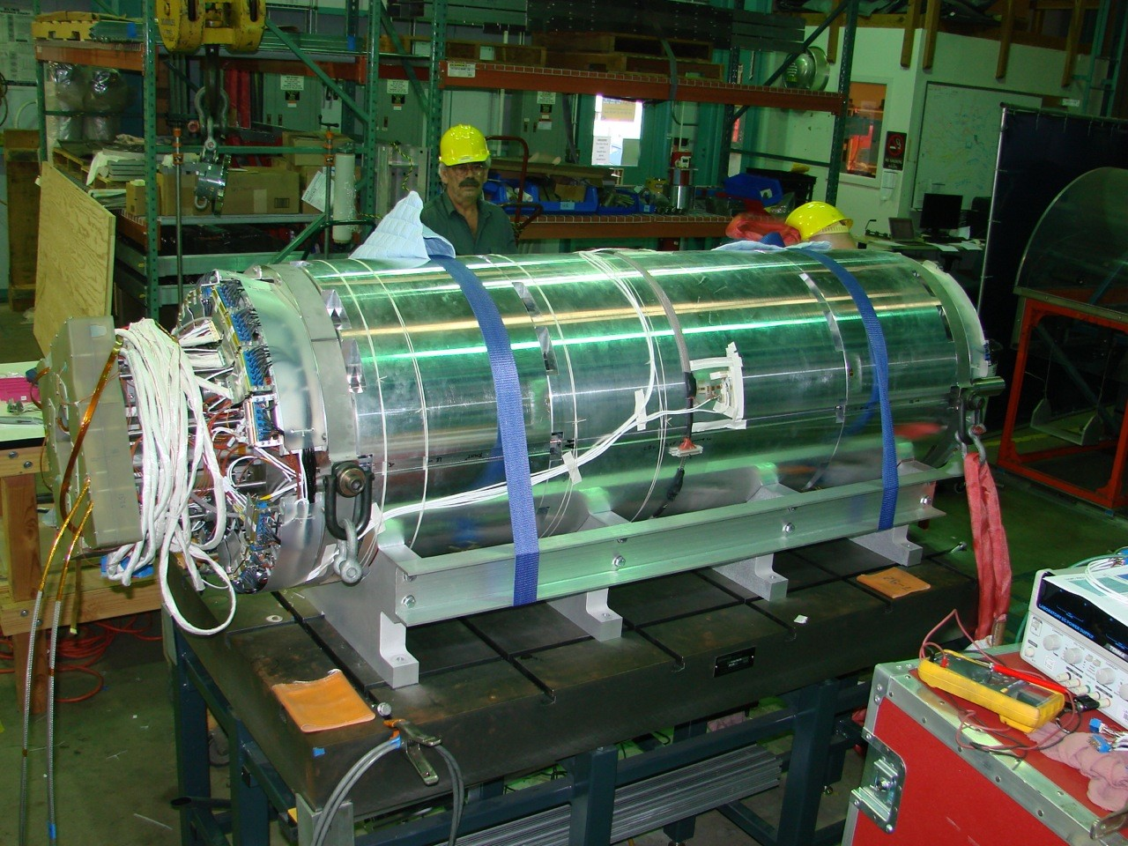
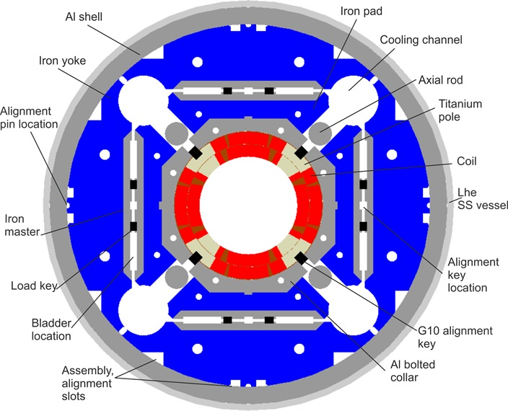
THE HL-LHC Nb₃Sn QUADRUPOLES
The adventure of the HL-LHC upgrade based on Nb₃Sn quadrupoles starts in the US in 2003 with LARP (LHC R&D program)
  Large aperture quadrupole based on Nb₃Sn conductor, with operational peak field of the order of 11 T
The positive outcome of the program makes possible the HL-LHC project, starting in 2014
MQXF cross-section
First MQXF short model, a joint venture
between US labs and CERN (2015)

Slide 33
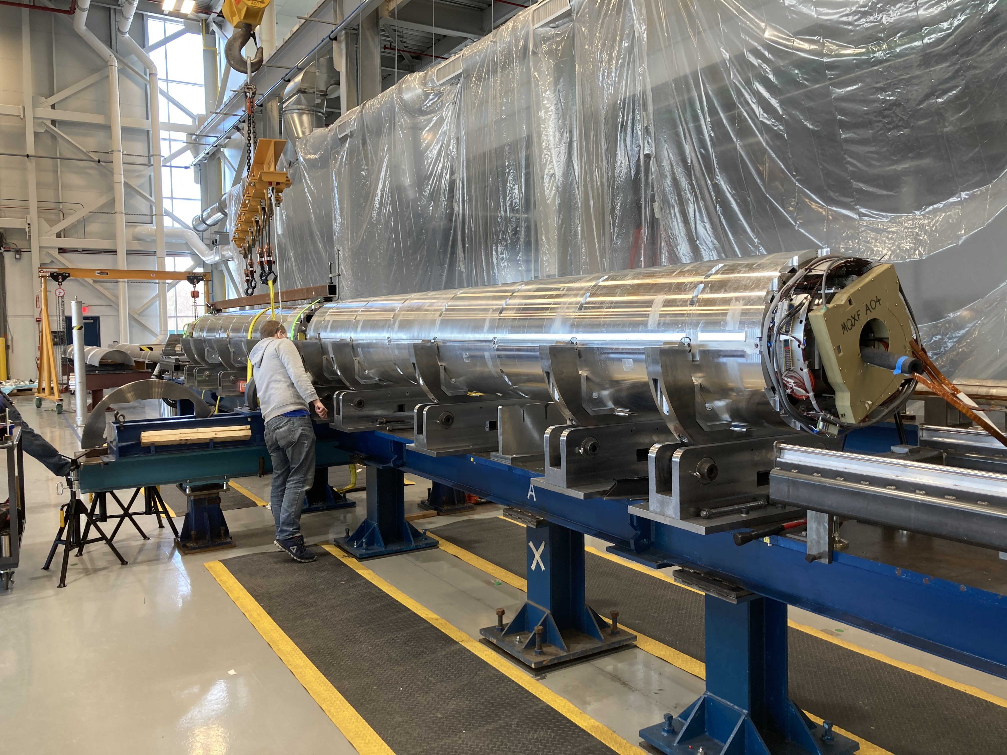
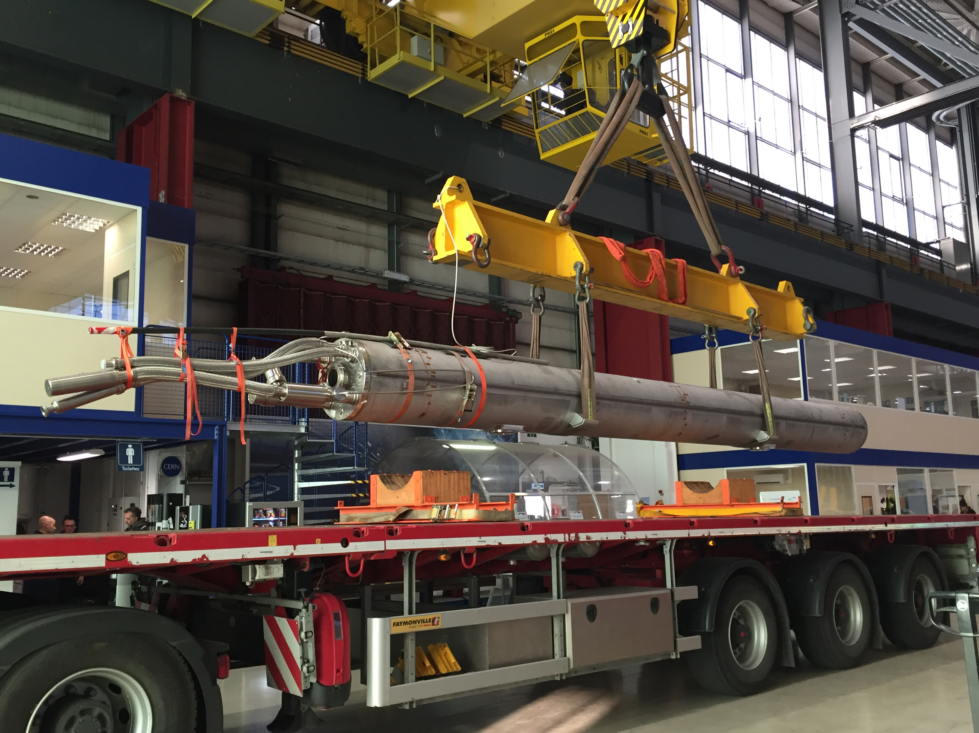
THE HL-LHC Nb₃Sn QUADRUPOLES
In 2019, first 4-m-long magnets are succesfully built and tested in the US
CERN builds 7-m-long magnets, with the same design, succesfully built and tested three years later
  Both scaling in length non trivial, going through advancements and setbacks
Two 4-m-long MQXF magnets in US
A 7-m-long MQXF magnets at CERN

Slide 34
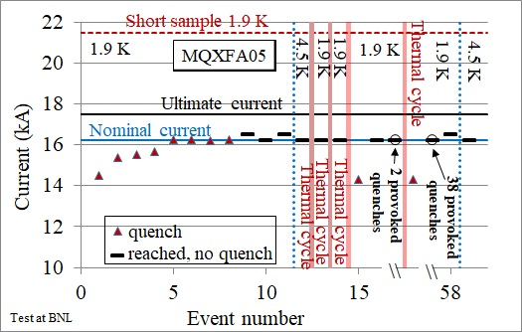
THE HL-LHC Nb₃Sn QUADRUPOLES
The construction of Nb₃Sn magnets proves to be more challenging than Nb-Ti, but performance is achieved
  Short models systematically reaching peak fields above 13 T
  10 magnets out of 20 needed built in the US, 3 out of 10 at CERN
  Long term performance, protection, field quality systematically checked on short and long magnets
Endurance test of one of the US series magnets

Slide 35
AN OUTLOOK ON HTS
HTS have a very flat critical surface, tolerating much higher fields (well above 15 T): huge potential – efforts are ongoing to use this for accelerator dipoles
  Solenoids have been successfully built - compatible accelerator dipole still to come
  A main challenge is protection and detection
  Lot of enthusiasm and funds for HTS devices for fusion (e.g. SPARC), but also controversial (see the discussion in the last MT conference)
Nb₃Sn
Nb-Ti
Superconductor critical surfaces at 4.5 K and 1.9 K (courtesy of P. Lee)

Slide 36
SUMMARY
Superconductivity allows not only to have ecological electromagnets (no dissipation by Joule effect) …
… but also a double ecological effect: to build very compact devices, minimizing size and ecological impact of the accelerator and of its components
  This has been an enabling factor for the discovery of the Higgs boson
To achieve these targets, superconducting magnets for a collider have a particular challenge: using very large current density: 500 A/mm² overall (over the insulated coil)
  This allowed to build Nb-Ti 8 T magnets with a 3 cm thick coil !
  Nb₃Sn has proved the possibility of building accelerator magnets in the 10-15 T range
  HTS coud allow to go above, towards 20 T and more – but for the moment, only solenoids were done

Slide 37
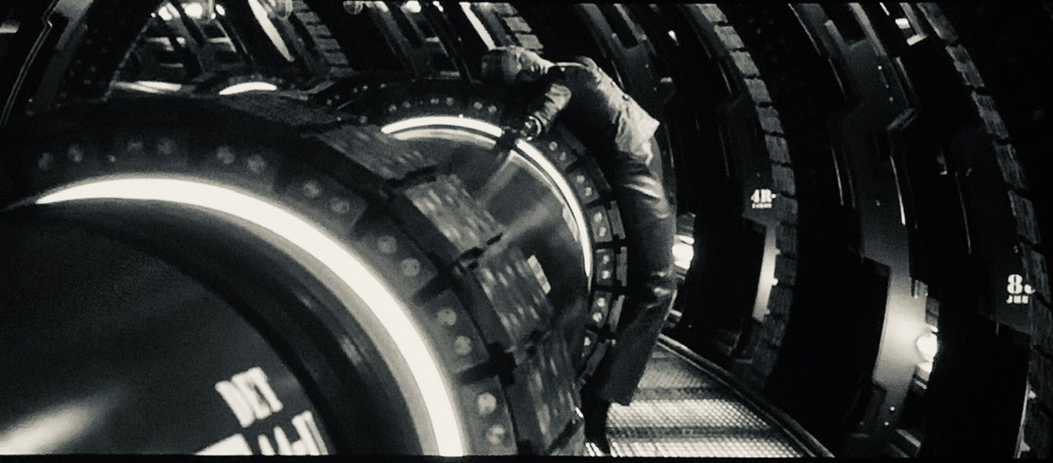

SOME REFERENCES
FROM THE INDUSTRY OF DREAMS
  Terminator: the rise of the machines (J. Mostow, Intermedia and C2 pictures, 2003)
  A ferromegnetic Terminator captured by the fringe fields of a ≈600 T dipoles operating in a 5.76 TeV accelerator
  Maybe the most accurate from the scientific point of view

Slide 38
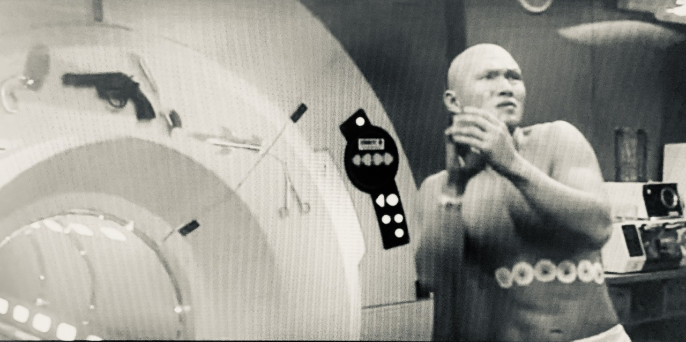
SOME REFERENCES
FROM THE INDUSTRY OF DREAMS
  A007, Die another day (L. Tamahori, Eon productions, 2002)
  James Bond switching on and off an MRI magnet during a fight to get rid of the pistol of the bad guy
  Well, MRI do not switch on and off as a lamp …
THIS IS THE
BAD GUY
MRI MAGNET
WITH BAD GUY
PISTOL STUCK
ON IT

Slide 39
SOME REFERENCES
FROM THE INDUSTRY OF DREAMS
The man with golden gun (G. Hamilton, Eon productions, 1974)
  James Bond explaining to the M. Scaramanga how solar energy can be stored in superconducting magnets operating in liquid helium
  Well, magnetic field is not the best place to store energy …
Live and let die (G. Hamilton, Eon productions, 1973)
  James Bond using a magnetic watch to catch M’s tea spoon, to open a closet and to unzip the clothes of a spy
  Well, I let you make the computations…
X-Men 2 (B. Singer, 20th Century Fox, Marvel ent. et al, 2003)
  Magneto escaping from his all-polymide prison using the iron in the blood of the guard
  I’m not able to comment this …

Slide 40
REFERENCES
Conte-MacKay «Introduction to particle accelerators» World Scientific (Singapore, 1985)
  Good intriduction to beam dynamics and magnets
K. H. Mess, P. Schmuser, S. Wolff, « Superconducting accelerator magnets » World Scientific (Singapore, 1996)
  Very good, clear and concise introduction to superconducting magnets for accelerators
M. N. Wilson «Superconducting magnets» Clarendon Press (Oxford, 1983)
  The bible of superconducting magnets, very dense
CAS proceedings
  Several courses dedicated to superconductivity
USPAS (uspas.fnal.gov)
  Superconducting accelerator magnets, every 2-3 years
And thanks to many teachers and colleagues, in particular R. Perin, C. Wyss, L. Rossi, P. Lebrun, T. Taylor, W. Scandale, J. P. Koutchouk, P. Ferracin, J. M. Jimenez, L. Bottura, A. Devred, M. Wilson, A. Ballarino, S. Le Naour, A. Verweij, S. Caspi, M. Lamont, J. Wenninger, B. Bellesia, A. Milanese, S. Izquierdo Bermudez, M. Bajko, A. Foussat, L. Fiscarelli, …

Slide 41
APPENDIX
A couple of technical remarks on how I built the plot in slides 18-22 and 31
  Coil width is the « equivalent coil width » i.e. wedges are removed
    That’s why for LHC dipole we have 28 mm and not 31
    I was obliged to be able to compare block coils as HD2, FrescaII and RRM
  Field is the nominal field – this does not mean that some (or all) magnets achieved much more
    For the LHC dipole I put 7 TeV and not 7.5 TeV
    For BNL case, for instance, magnet have a large margin and can reach higher values – they were so confident that they installed wihtout testing

Slide 42
APPENDIX
A couple of technical remarks on how I built the plot in slides 18-22 and 31
  The line of 450 A/mm² corresponds to the case of an ironless magnet – therefore it is there just to guide the eye and give an order of magnitude
  If a magnet sits on the 450 A/mm² line, it does not mean that this is its actual overall current density as the presence of iron reduces the current
  In some magnets, grading is used, so for instance in the LHC dipole inner layer is at 360 A/mm² and outer layer is at 440 A/mm² – obviously this complexity is not visible in the plot

Slide 43
APPENDIX
A couple of technical remarks on how I built the plot in slides 31
  Coil width is the « equivalent coil width » i.e. wedges are removed as in the previous case
  Field is the achieved bore field
    In case of several magnets I put the best
    I am obliged to put achived field since in some short models the « nominal » is not defined
    This does not mean that one can build an accelerator with this value of field – there has been some confision in the community between maximum achived and operational
  In slide 26, I also added the results of MQXF (a quadrupole) using the peak field – small inconsistency since it is compared to bore fields of dipoles, and not to their peak field (few percent difference)

Slide 44
APPENDIX
The LHC path in energy and luminosity

Slide 45
THE LHC PATH TOWARDS 7 TeV
LHC was designed to reach 7 TeV per beam, corresponding to 8.3 T dipole field
  All accepted magnets were tested above the 7 TeV level
  Half of them were tested up to 9.0 T (the so called ultimate energy of LHC, i.e. 7.5 TeV)
Current reached in the 1276 LHC dipoles

Slide 46

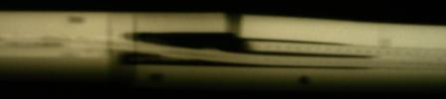
THE LHC PATH TOWARDS 7 TeV
First run (2012-2015, RunI) was limited initially at 3.5 TeV and then at 4 TeV due to a weakness in the magnet-to-magnet splices that led to the 2008 incident
  Splices were repaired in Long Shutdown I, and this removed the limitation
Cross-section of the intreconnection and
radiography showing missing continuity
[F. Bordry, J. P. Tock and LS1 team]

Slide 47
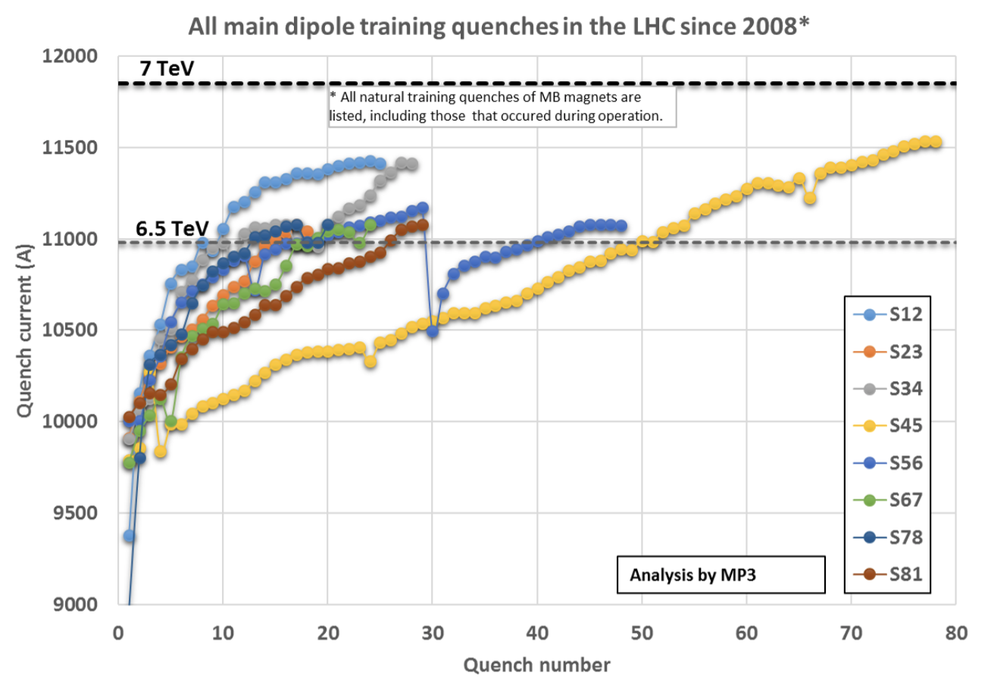
THE LHC PATH TOWARDS 7 TeV
Second run (2018-2020) was at 6.5 TeV
  This field level was reached with ∼200 retraining quenches in the LHC dipoles (about one out of six) – quench is related to stored energy …
Training of the different dipole sectors during LS1
[A. Verweij, for the MP3 team]

Slide 48
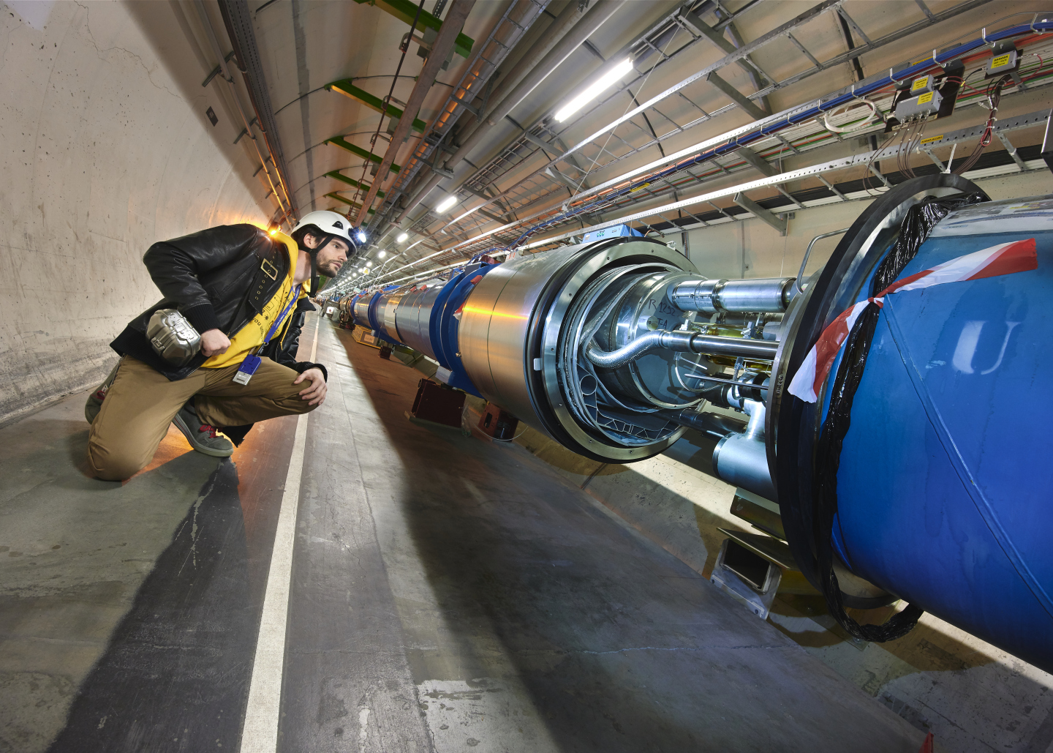
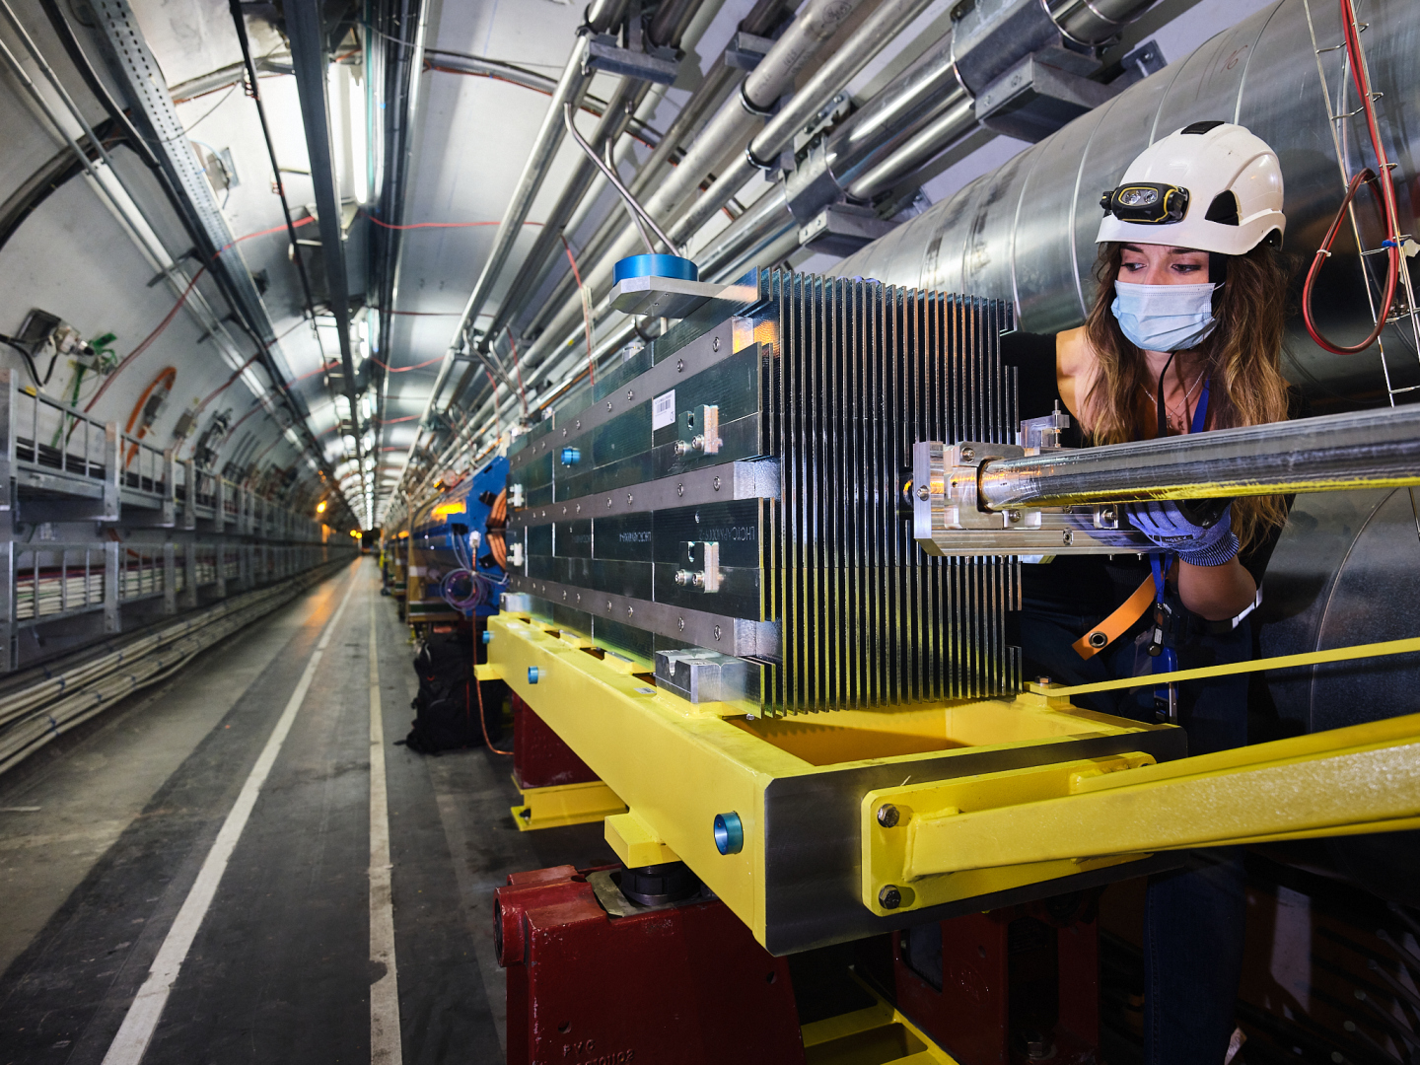
THE LHC PATH TOWARDS 7 TeV
During LS2 (2019-2021), interventions to minimize the risks associated to quenches [J.-M. Jimenez, J.-P. Tock et many al]
  The plan was to have massive training to go towards operation at 7 TeV
Third run (2022-2025) is at 6.8 TeV
  This field level was reached with ∼350 retraining quenches (+ secondary ones) – 3 sectors reached 7 TeV with 80 quenches each
  Need of reparing two sectors due to issues generated by quenches
  No showstopper to 7 TeV, it is a weight between risks and benefits

Slide 49
THE LHC PATH TOWARDS LUMINOSITY
LHC design aimed at ambitious targets for luminosity
    The competition with SSC, having 3 times larger energy, was done on luminosity; here LHC target (10³⁴) was ten times larger then SSC (10³³)
  Nominal luminosity (10³⁴ cm⁻² s⁻¹) was achieved already in RunI
  Ultimate luminosity (2×10³⁴ cm⁻² s⁻¹) was reached in RunII
LHC luminosity ramp up in the 10’s (M. Lamont, J. Wenninger, and many many others)

Slide 50
THE LHC PATH TOWARDS LUMINOSITY
The control of nonlinearities of the magnets was one of the (many) key elements to reach ultimate luminosity
  Much concern in the 90’s about these nonlinearities - affecting beam stability and provoking beam losses
  SSC team increased the dipole aperture from 40 to 50 mm at the beginning of the 90’s
  LHC team increased the dipole aperture from 50 to 56 mm in the mid 90’s
For the LHC significant efforts in two directions:
  Steering the field quality towards the beam dynamic targets during the whole production – three corrective actions done « on the fly » for the dipoles
  Modeling the nonlineraties with extreme accuracy and feeding back to the correctors

Slide 51
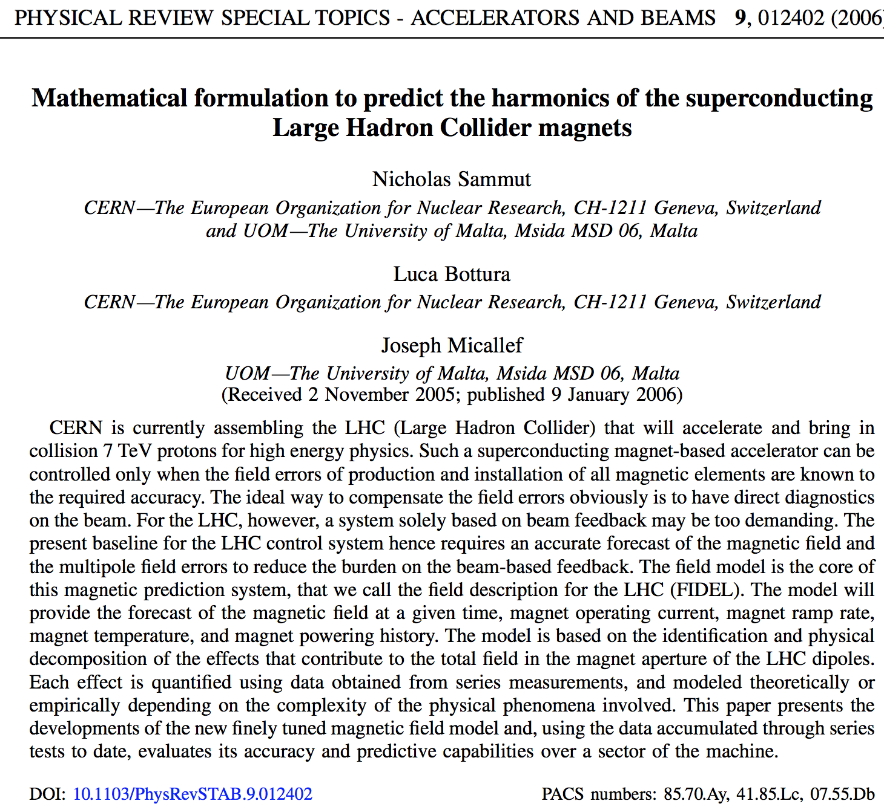
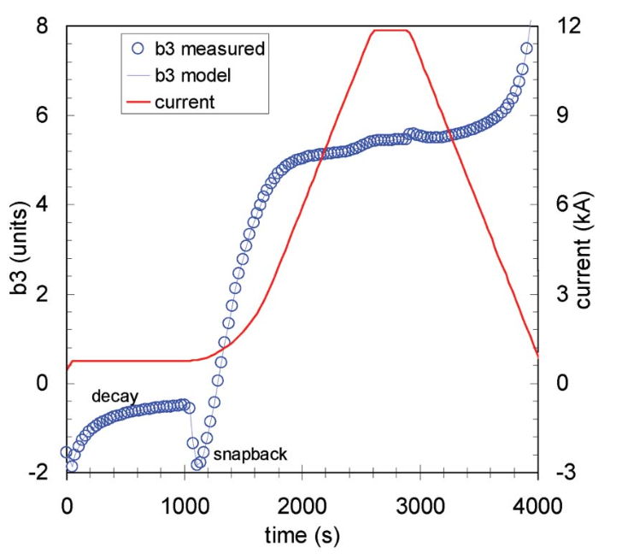
THE LHC PATH TOWARDS LUMINOSITY
The LHC field model: an essential element of the accelerator control
The model of b3 in the dipole during operation

