Slide 2
Introduction to Cryogenics
T. Koettig, P. Borges de Sousa, J. Bremer
Contributions from S. Claudet and Ph. Lebrun
CAS: Basics of Accelerator Physics and Technology, 2024.

Slide 3
Content
Introduction to cryogenic installations
Motivation => reducing thermal energy in a system
Heat transfer and thermal insulation
Helium cryogenics, He I => He II
Conclusions
References

Slide 4
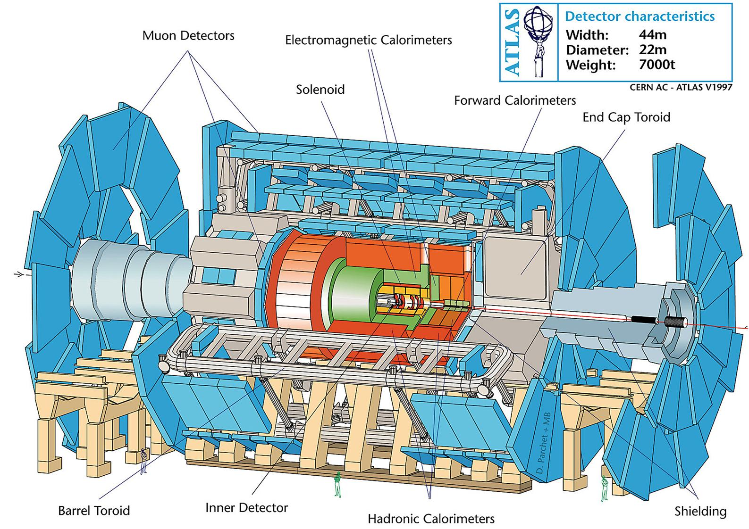
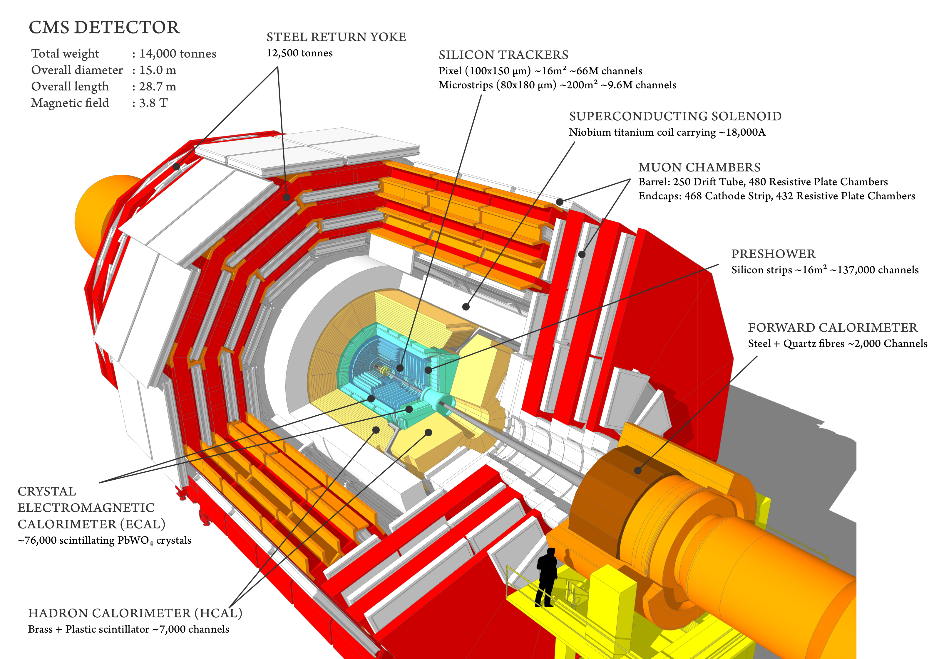
Overview of cryogenics at CERN - Detectors
Superconducting coils of LHC detectors @ 4.5 K (ATLAS, CMS)
LAr Calorimeter - LN₂ cooled
Different types of cryogens (Helium, Nitrogen and Argon)
From: CERN-DI-9803026
From: http://cms.web.cern.ch/news/cms-detector-design

Slide 5
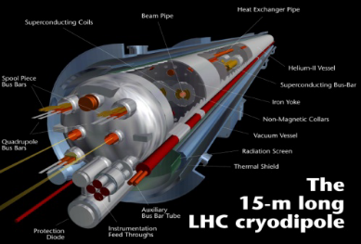
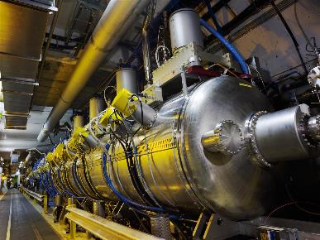
Overview of cryogenics at CERN - LHC
Helium at different operating temperatures (thermal shields, beam screens, distribution and magnets,…)
Superconducting (SC) magnets of the LHC ring
Accelerating SC cavities
CERN CDS-EX-0712013

Slide 6
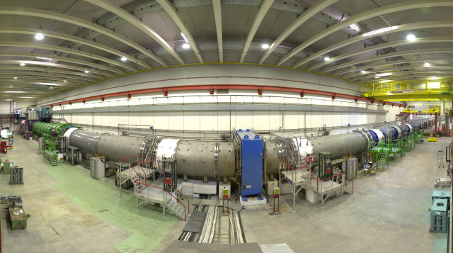
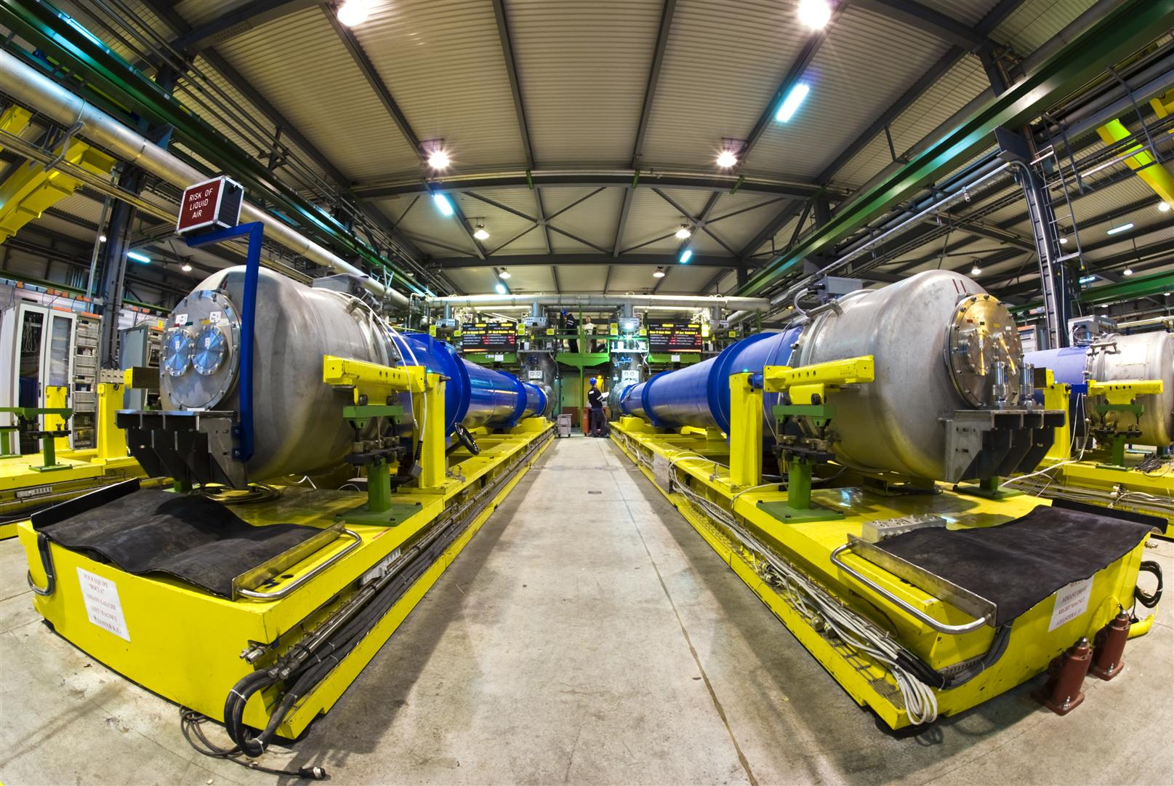
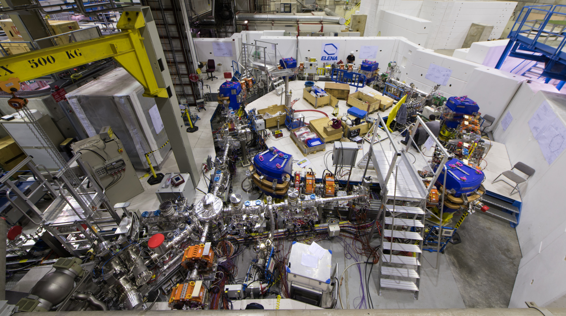
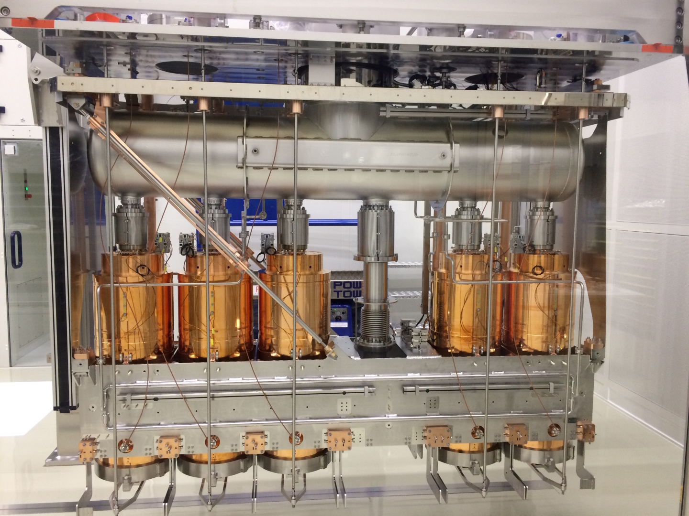
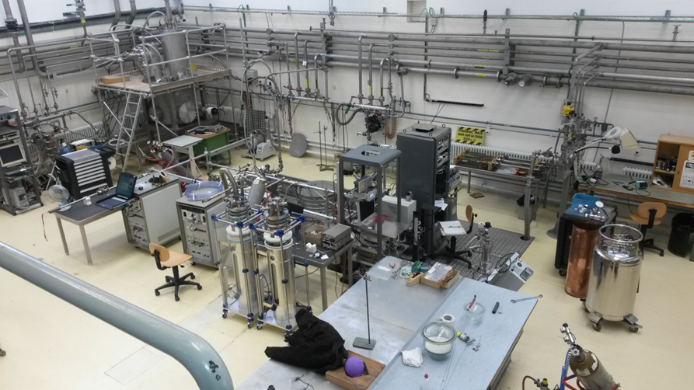
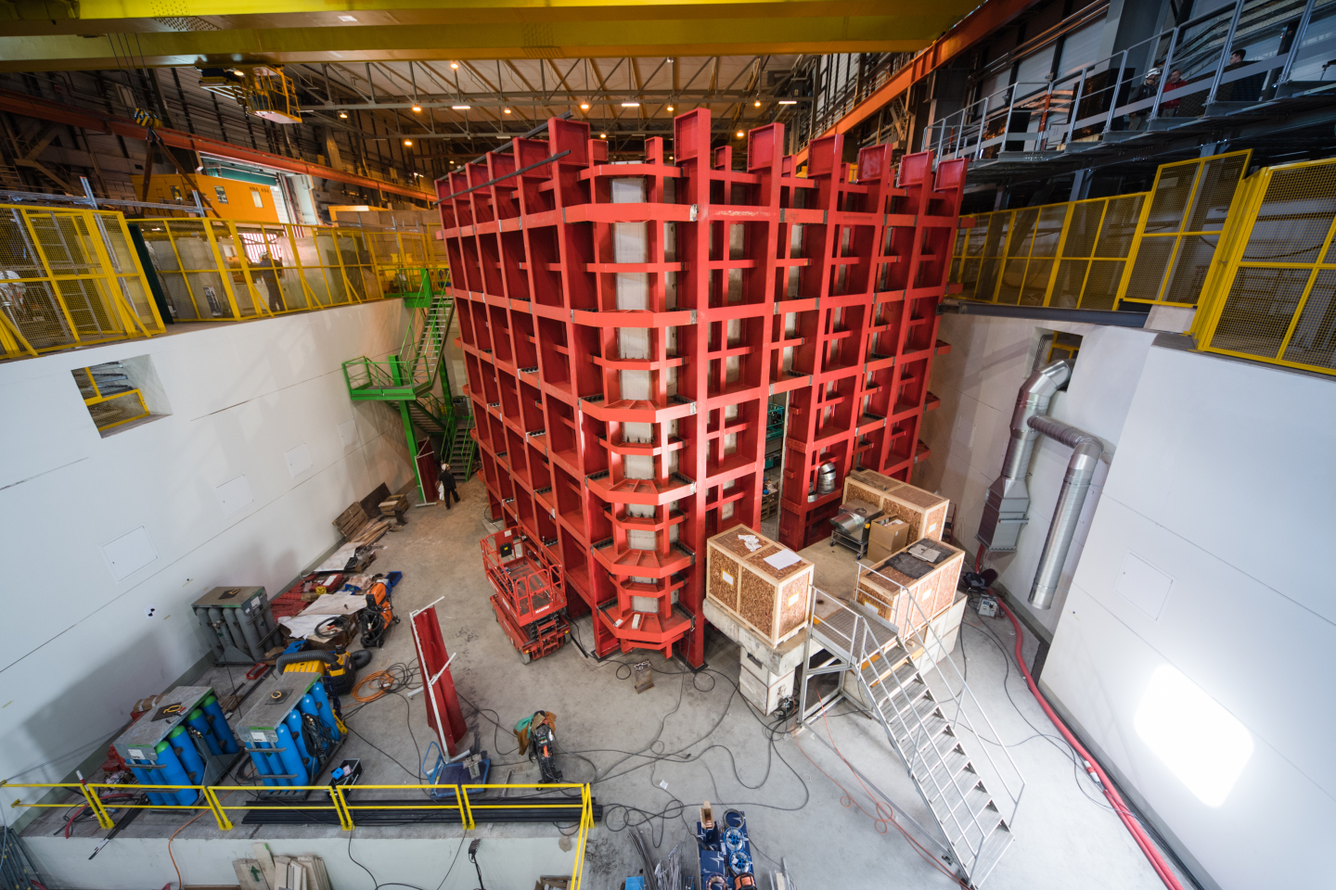
Overview of cryogenics at CERN
North area =>
SM18
Antimatter Factory =>
HIE-Isolde
Test facilities =>
Neutrino Platform
…
Sources: CERN-PHOTO-201509-239, CERN-EX-0606017, CERN-PHOTO-201607-170-3, OPEN-PHO-ACCEL-2016-016-7, CERN-PHOTO-201703-077-4

Slide 7
Cryogenic fluids - Thermophysical properties
Fluid | ⁴He | N₂ | Ar | H₂ | O₂ | Kr | Ne | Xe | Air | Water
Boiling temperature (K) @ 1.013 bar | 4.2 | 77.3 | 87.3 | 20.3 | 90.2 | 119.8 | 27.1 | 165.1 | 78.8 | 373
Latent heat of evaporation @ T_{b} in kJ/kg | 20.9 | 199.1 | 163.2 | 448 | 213.1 | 107.7 | 87.2 | 95.6 | 205.2 | 2260
Volume ratio gas_{(273 K)} / liquid | 709 | 652 | 795 | 798 | 808 | 653 | 1356 | 527 | 685 | -----
Volume ratio saturated vapor to liquid (1.013 bar) | 7.5 | 177.0 | 244.8 | 53.9 | 258.7 | 277.5 | 127.6 | 297.7 | 194.9 | 1623.8
Specific mass of liquid (at Tb) – kg/m³ | 125 | 804 | 1400 | 71 | 1140 | 2413 | 1204 | 2942 | 874 | 960

Slide 8
Cryogenics and Superconductivity

Slide 9
Characteristic temperatures of low-energy phenomena
Phenomenon | Temperature
Debye temperature of metals | few 100 K
High-temperature superconductors | ~ 100 K
Low-temperature superconductors | ~ 10 K
Intrinsic transport properties of metals | < 10 K
Cryo-pumping | few K
Cosmic microwave background | 2.725 K
Superfluid ⁴He | < 2.17 K
Bolometers for cosmic radiation | < 1 K
ADR stages, Bose-Einstein condensates | ~ μK

Slide 10
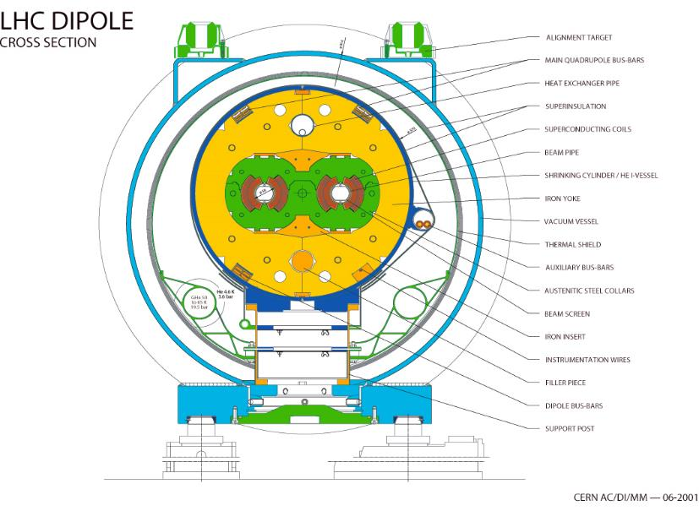
Cryogenic application: Dipole magnets of the LHC
LHC main cryostat
(Cross-section)
Alignment targets
All circuits are cooled by helium
Multi layer insulation (MLI)
Vacuum vessel
Thermal shield
Bottom tray
(50-65 K feed line
~ 19.5 bar)
Beam screen
5-20 K support post
heat intercept
Magnet support posts (GFRE)
External supports (jacks)

Slide 11
Heat Transfer and Thermal Insulation

Slide 12
Cryogenic System Design
Low temperature environment
Source of refrigeration
Heat exchange strategy
Sample environment
Thermal insulation
Structural support
Instrumentation and control
Refrig.
T_{high}
Thermal insulation
Instr. &
Control
T_{low}
Heat load
Vacuum
Structural support

Slide 13
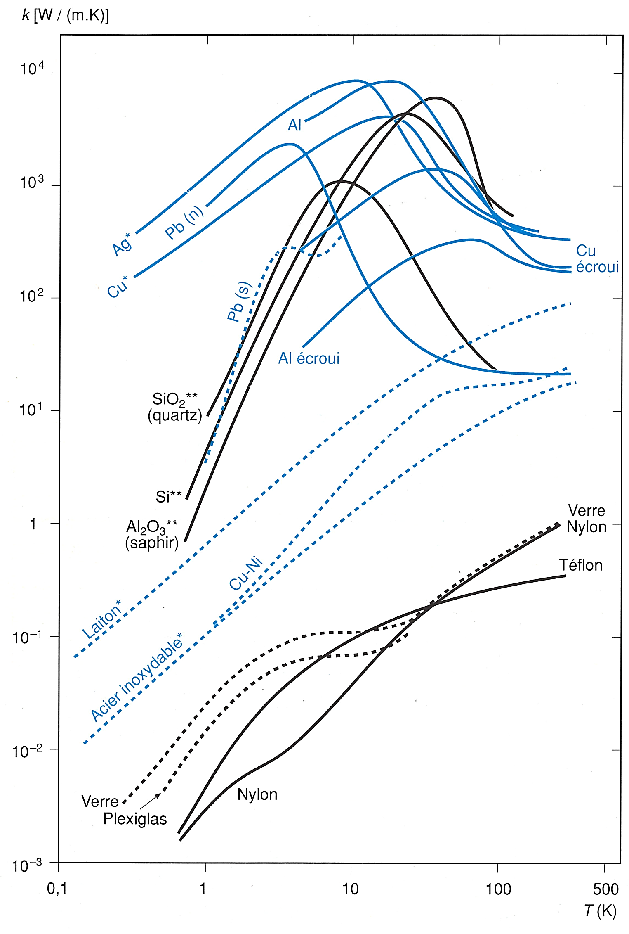



Thermal conductivity, solid conduction – how to cool?
$\text{λ}$ (W/m K)
Heat transport in solids
Fourier's law:
$$\dot{Q}=−\text{λ}\text{(}\text{T}\text{) }\frac{A}{l} ∇T$$
Pure dielectric crystals: phonons
Dielectrics/Insulators: phonons
Pure metals: free electron gas and phonons
Alloyed metals: electrons and phonons
$T$ (K)
From: Cryogenie, Institut International du Froid, Paris

Slide 14
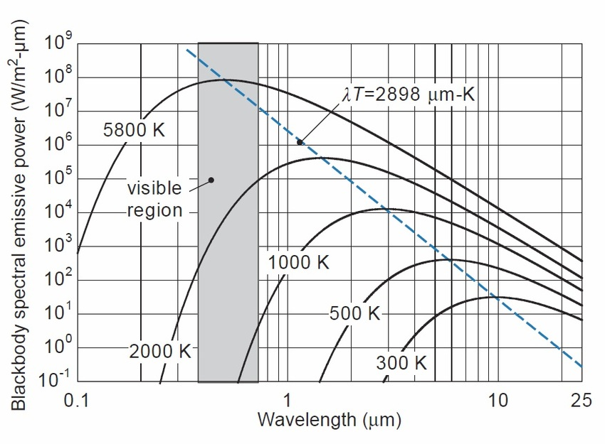
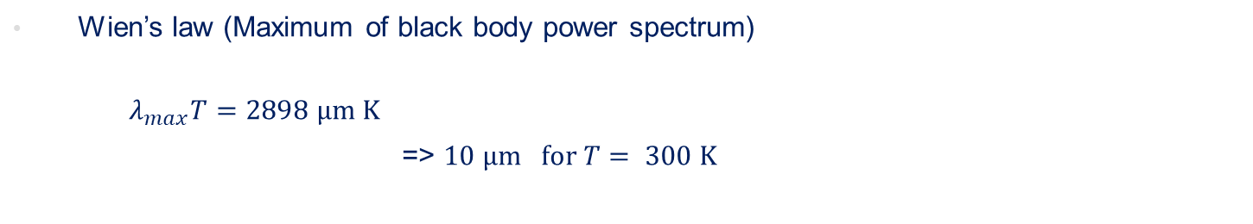
Radiative heat transfer – Black body
Wien’s law (Maximum of black body power spectrum)
  $λ_{max}T=2898 μm K$
  => $10 μm for T= 300 K$
Source: https://www.researchgate.net/figure/Blackbody-spectral-emissive-power-as-a-function-of-wavelength-for-various-values-of_fig4_320298109

Slide 15

Radiative heat transfer – Grey body
Wien’s law (Maximum of black body power spectrum)
  $λ_{max}T=2898 μm K$
  => $10 μm for T= 300 K$
Stefan-Boltzmann’s law
  Black body Q_{rad} = σ AT⁴ σ = 5.67 x 10⁻⁸ W/(m² K⁴)
  (Stefan-Boltzmann’s constant)
  “Grey” body Q_{rad} = ε σ A T⁴ ε - emissivity of surface
  “Grey” surfaces at T₁ and T₂ Q_{rad} = E σ A (T₁⁴ –T₂⁴) E - function of ε₁, ε₂, geometry
.
.
.

Slide 16
Emissivity of technical materials at low temperatures
 | Surface at 77 K | Surface at 4.2 K
Stainless steel, as found | 0.34 | 0.12
Stainless steel, mech. polished | 0.12 | 0.07
Stainless steel, electropolished | 0.10 | 0.07
Stainless steel + Al foil | 0.05 | 0.02
Aluminium, as found | 0.12 | 0.07
Aluminium, mech. polished | 0.10 | 0.06
Aluminium, electropolished | 0.08 | 0.04
Copper, as found | 0.12 | 0.06
Copper, mech. polished | 0.06 | 0.02
From: Ph. Lebrun, CAS School on Vacuum in Accelerators, 2006
Condensed layers from gas phase easily vary these values !

Slide 17
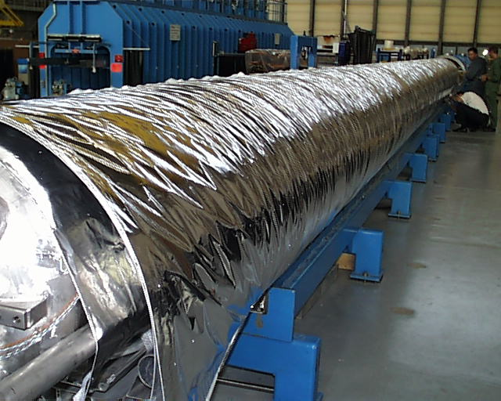
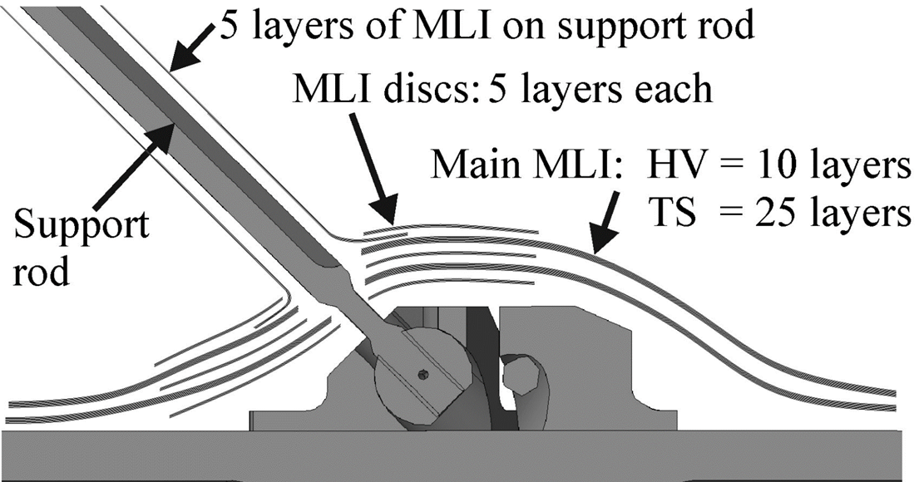
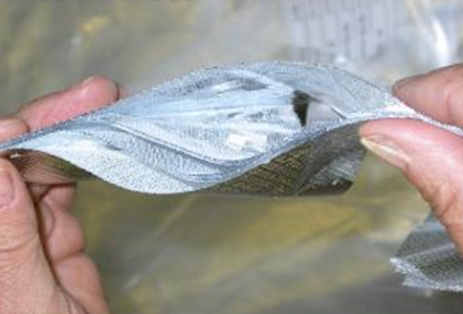
Multi-layer insulation (MLI)
Complex system involving three heat transfer processes
  Q_{MLI} = Q_{radiation} + Q_{solid} + Q_{residual}
  With n reflective layers of equal emissivity, Q_{radiation} ~ 1/(n+1)
  Parasitic contacts between layers, Q_{solid} increases with layer density
  Q_{residual} due to residual gas trapped between layers, scales as 1/n in molecular regime
  Non-linear behavior requires layer-to-layer modeling
Cold surface
Solutions for penetrations and support structures
Large surface application

Slide 18
Typical heat fluxes between flat plates (cold side vanishingly low)
Configuration | W/m²
Black-body radiation from 293 K | 420
Black-body radiation from 80 K | 2.3
Gas conduction (10⁻³ mbar He) from 290 K | 19
Gas conduction (10⁻⁵ mbar He) from 290 K | 0.19
Gas conduction (10⁻³ mbar He) from 80 K | 6.8
Gas conduction (10⁻⁵ mbar He) from 80 K | 0.07
MLI (30 layers) from 290 K, pressure below 10⁻⁵ mbar | 1-1.5
MLI (10 layers) from 80 K, pressure below 10⁻⁵ mbar | 0.05
MLI (10 layers) from 80 K, pressure 10⁻³ mbar | 1-2

Slide 19
Refrigeration and Liquefaction

Slide 20
Thermodynamics of cryogenic refrigeration
Graph for T_{warm} = 300 K
For low temperatures e_{c}=
He @ 1.8 K e_{c}=166 => 1/COP 980
Use of low temperatures if no alternative
Better intercept heat at higher temperatures
He @ 4.5 K e_{c}=65.7 => 1/COP 230
H₂ @ 20 K e_{c}=14
N₂ @ 77 K e_{c}=2.9
2
5
10
300

Slide 21
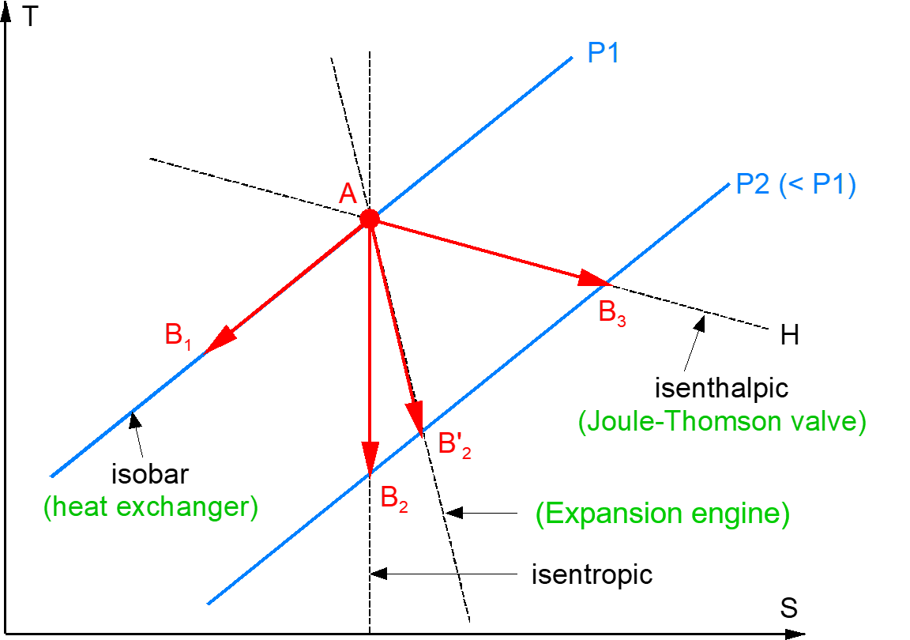
Elementary cooling processes in a T-s diagram
p₁
p₂ < p₁
isobaric

Slide 22
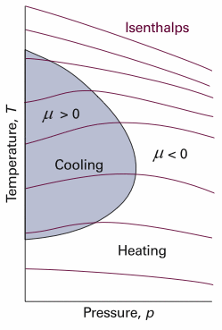
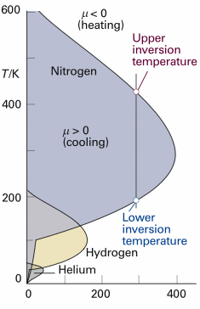
Maximum Joule-Thomson inversion temperatures
p/bar
Source: http://faculty.chem.queensu.ca/people/faculty/mombourquette/
Chem221/3_FirstLaw/ChangeFunctions.asp

Slide 23
Maximum Joule-Thomson inversion temperatures
Cryogen | Max. inversion temperature [K]
Helium | 43
Hydrogen | 202
Neon | 260
Air | 603
Nitrogen | 623
Argon | 723
Source: Refprop® NIST
p/bar
Source: http://faculty.chem.queensu.ca/people/faculty/mombourquette/
Chem221/3_FirstLaw/ChangeFunctions.asp
Air can be cooled down and liquefied by J-T expansion from room temperature,
Helium and hydrogen need precooling down to below the inversion temperature by heat exchange or work-extracting expansion (e.g. in turbines)

Slide 24
Combining all three processes in a cryoplant
p₁
p₂ < p₁
isobaric

Slide 25
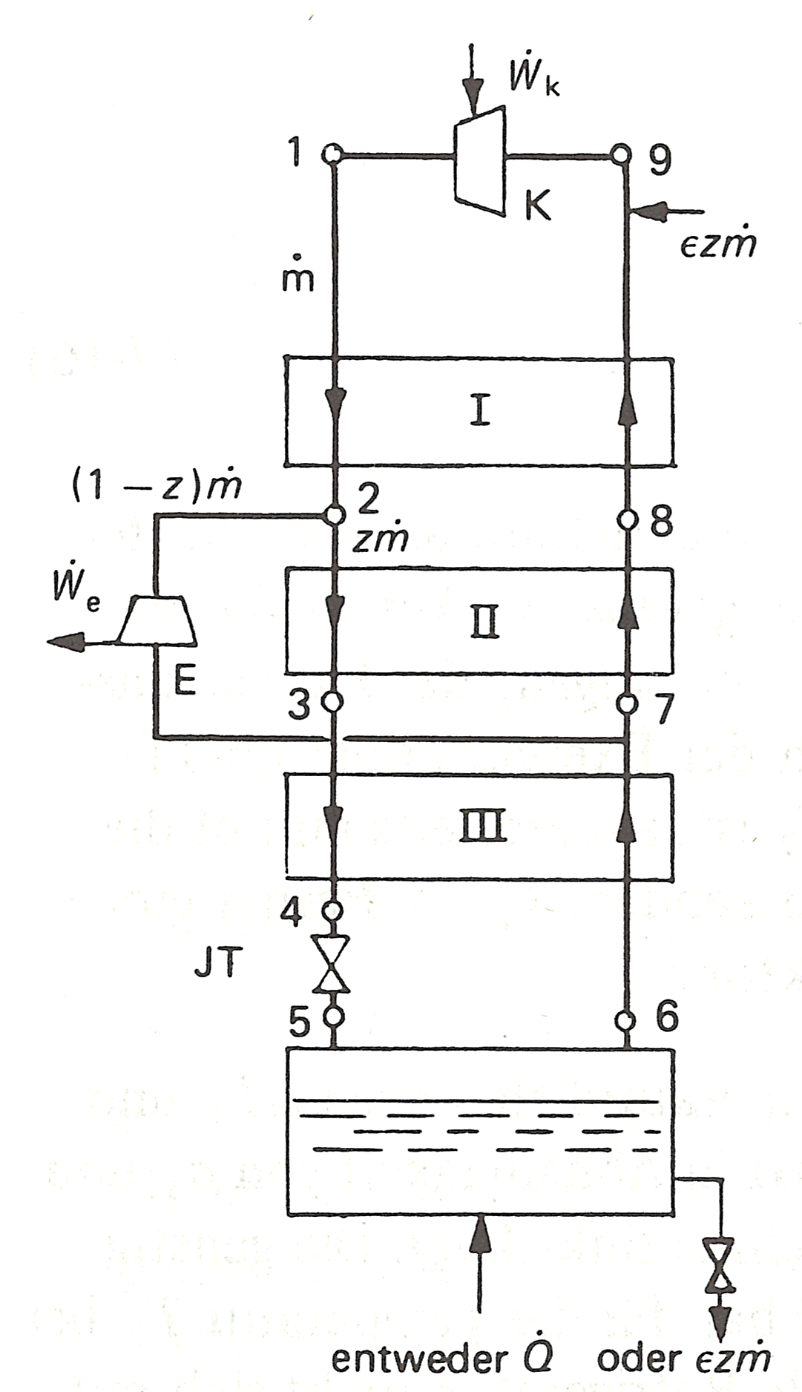
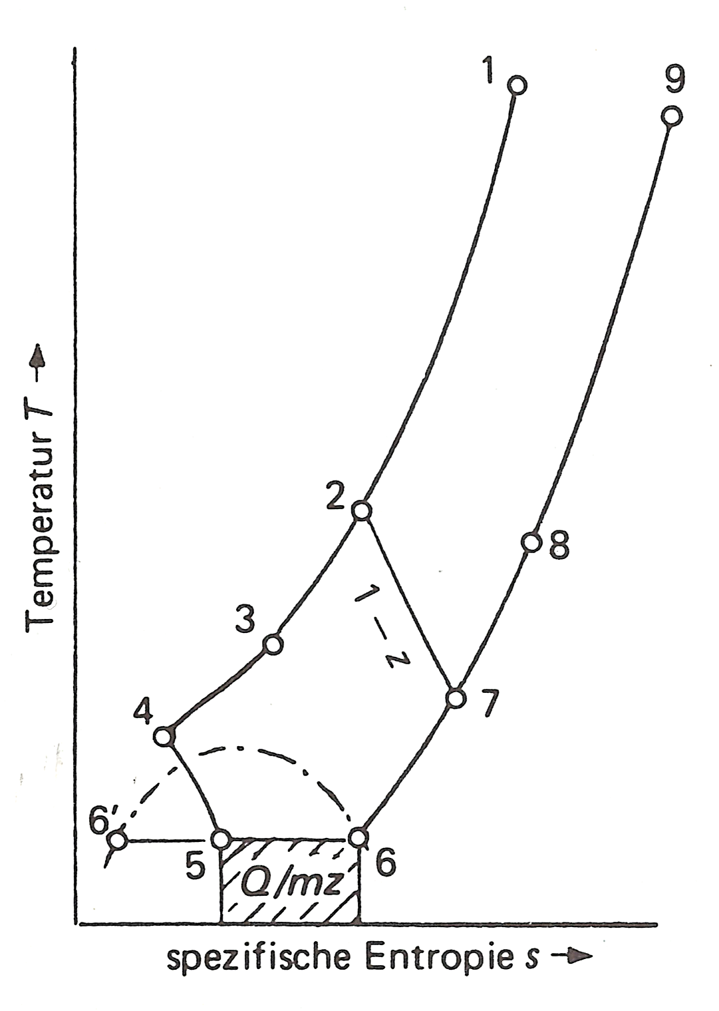

Claude cycle ( Turbo Brayton + JT )
Temperature →
HEX
Turbin
expan.
HEX
JT
${ \dot{Q}}_{in}$
Specific entropy s →
Source: Frey, Haefer, Tieftemperaturtechnologie, VDI Verlag 1981, ISBN 3-18-400503-8, adapted.

Slide 26
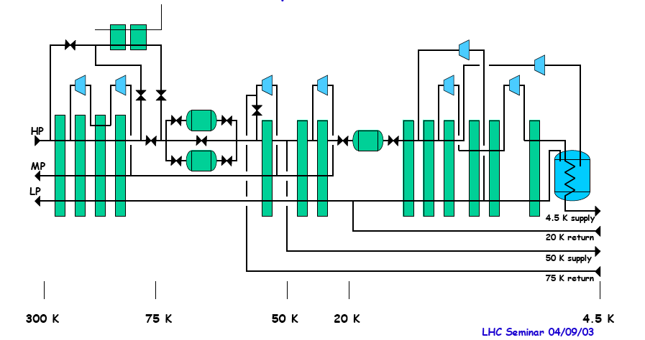
Process diagram, LHC refrigerator 18 kW @ 4.5 K
LN2 (cool-down)
Adsorbers (remove impurities)
Turbines
Heat exchangers

Slide 27
COP of large cryogenic helium refrigerators
Size of the plant matters
Tokamak
in France
Heavy ion
collider US
e⁺e⁻ Accel.
in Japan
LINAC ring
US
Circular acc.
Germany
e⁺e⁻ Accel.
CERN
Hadron Acc.
CERN

Slide 28
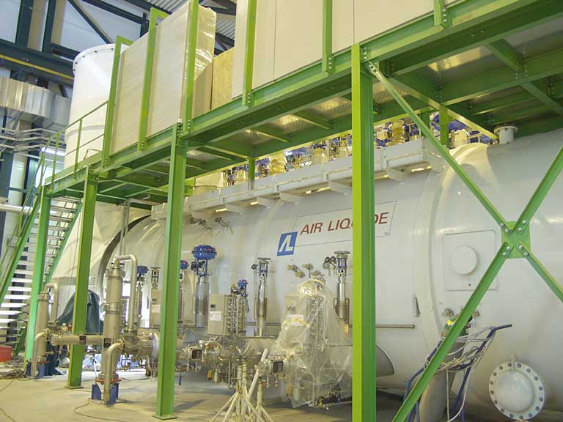
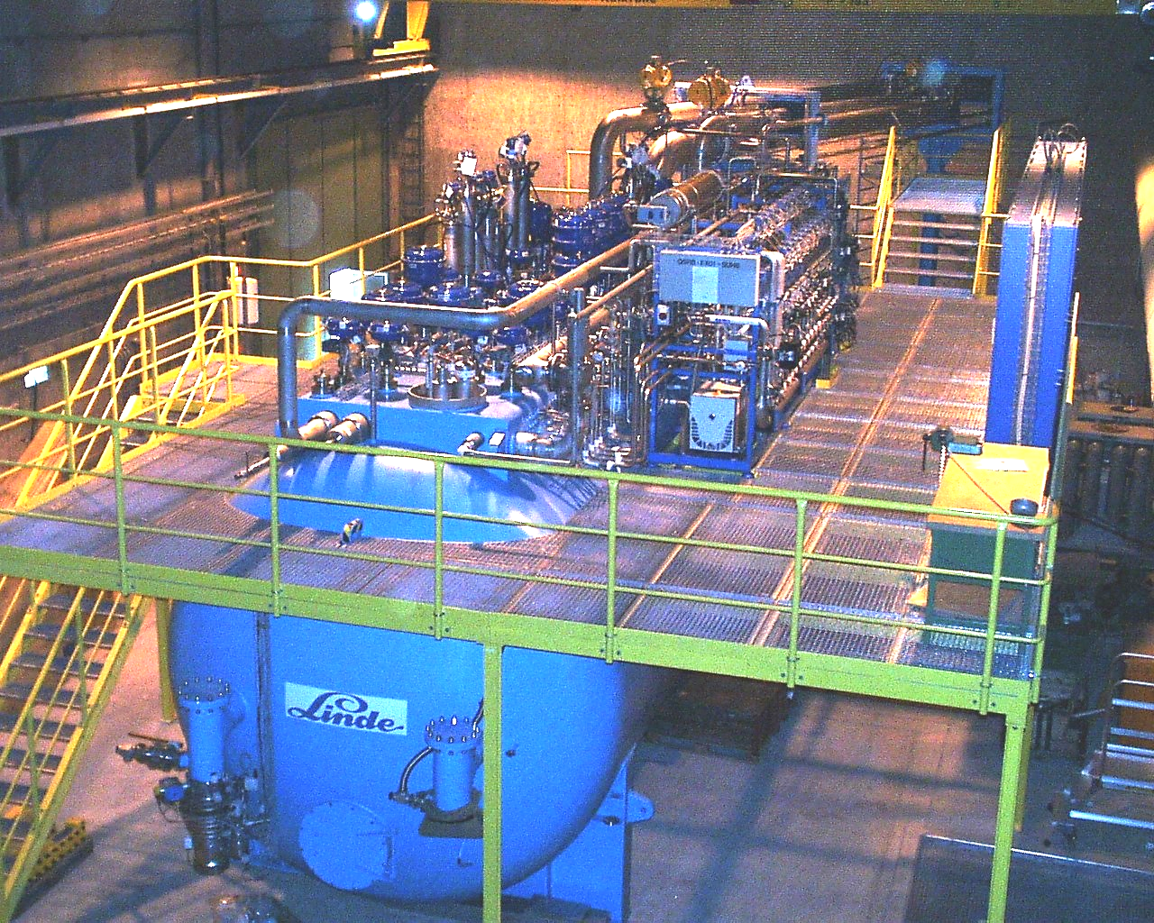
LHC 18 kW @ 4.5 K helium cryoplants
Th. shields: 33 kW @ 50 K to 75 K
Beam screen: 23 kW @ 4.6 K to 20 K
Current leads: 41 g/s liquefaction
4 MW compressor power
1/COP 220-230 W_{el}/W @ 4.5 K
Air Liquide
Linde

Slide 29
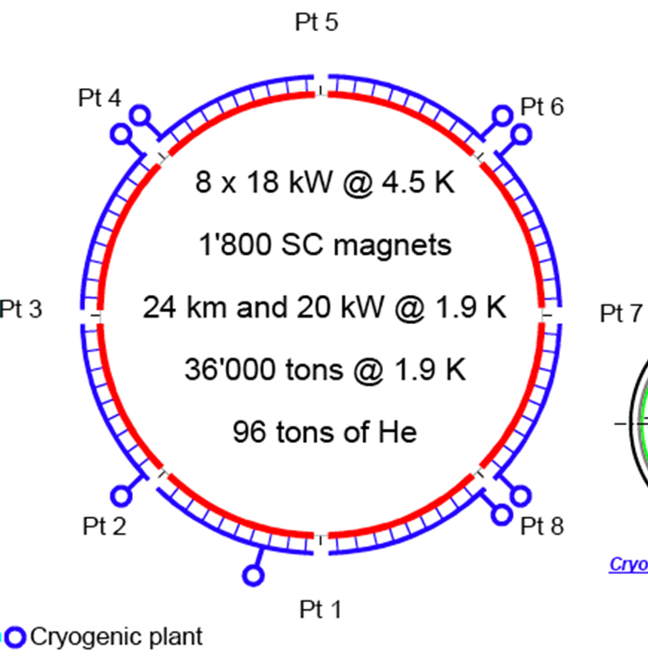
LHC 18 kW @ 4.5 K helium cryoplants
33 kW @ 50 K to 75 K
23 kW @ 4.6 K to 20 K
41 g/s liquefaction
4 MW compressor power
COP 220-230 W/W @ 4.5 K
8 x 18 kW @ 4.5 K
1800 SC magnets
36,000 ton @ 1.9 K
96 ton of He
24 km and 20 kW @ 1.9 K
Air Liquide
Linde

Slide 30
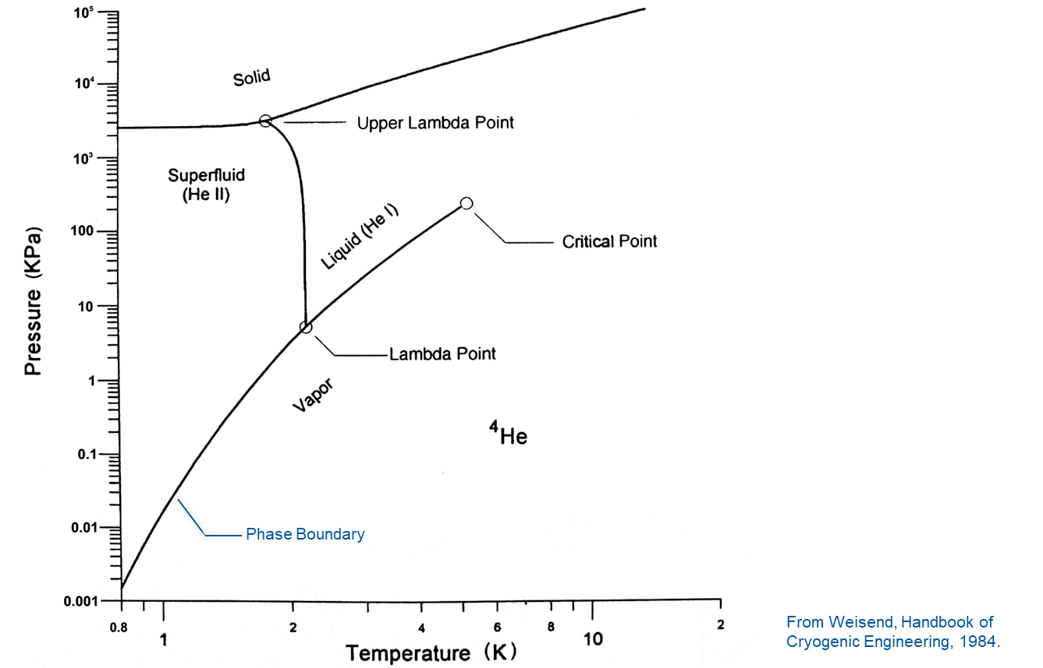
⁴He phase diagram
Pressure (kPa)
Helium has no triple point
Solid He only above 25 bar
Lambda line => He I / He II separ.
He II with very special properties
From Weisend, Handbook of
Cryogenic Engineering, 1984.

Slide 31
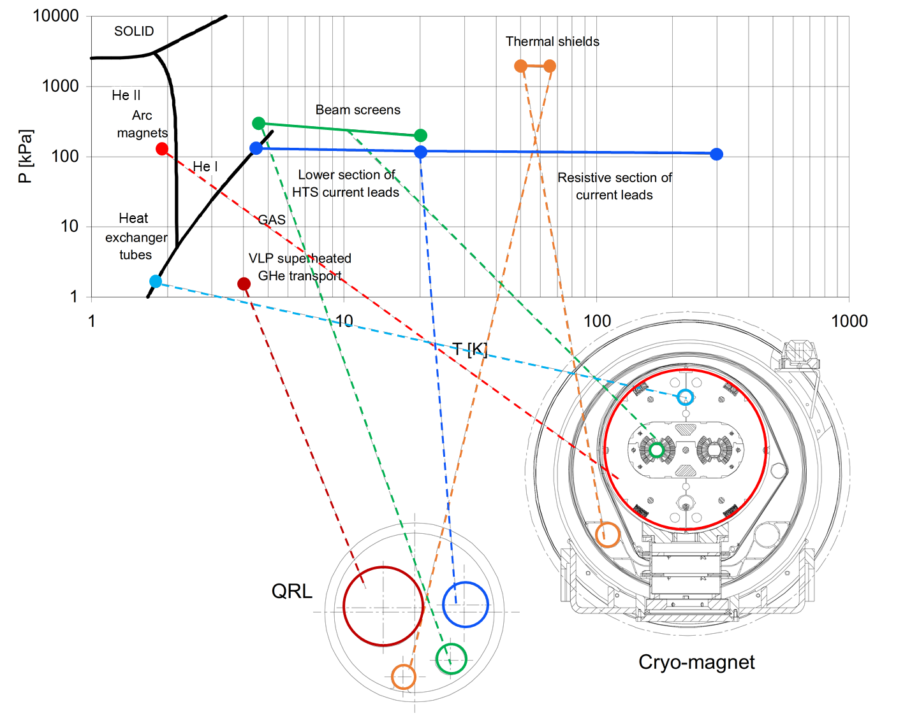
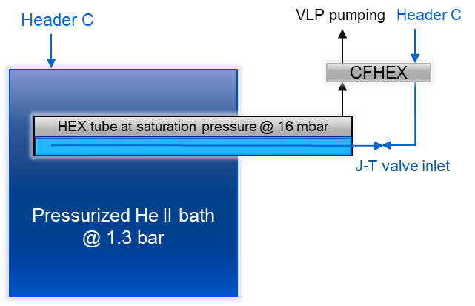
LHC Cooling scheme
From
From
Main supply
Current leads return
SC cavities are cooled in a 4.5 K saturated LHe bath
Header D
20 K return
E
Header B
VLP pumping
Header F
Shield return
Header C
4.6 K, 3 bara
Source: adapted from CERN, LHC design report, ch. 11

Slide 32
Cryogenic Fluid Properties
He I and He II

Slide 33
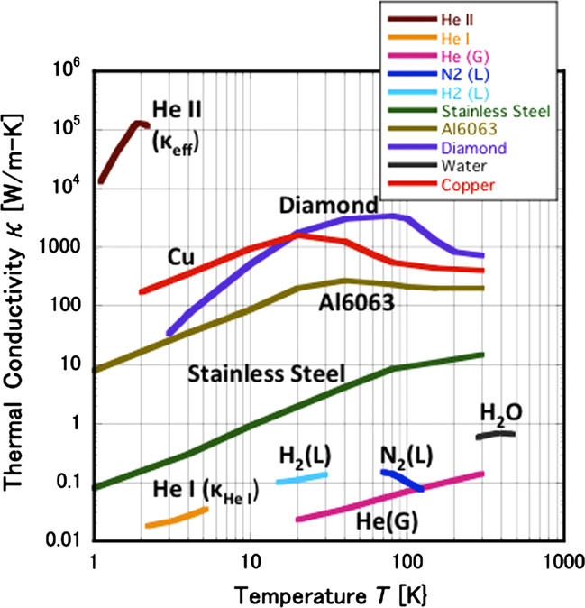
From He I to He II
Normal fluid helium => He I
    Like a standard fluid: viscosity etc.
Superfluid helium => He II
  Temperature < 2.17 K
  Peak in heat capacity c_{p} at T_{λ}
  Very high thermal conductivity
  Low / vanishing viscosity
Murakami, Experimental study of thermo-fluid dynamic effect in He II cavitating flow, Cryogenics, 2012.

Slide 34
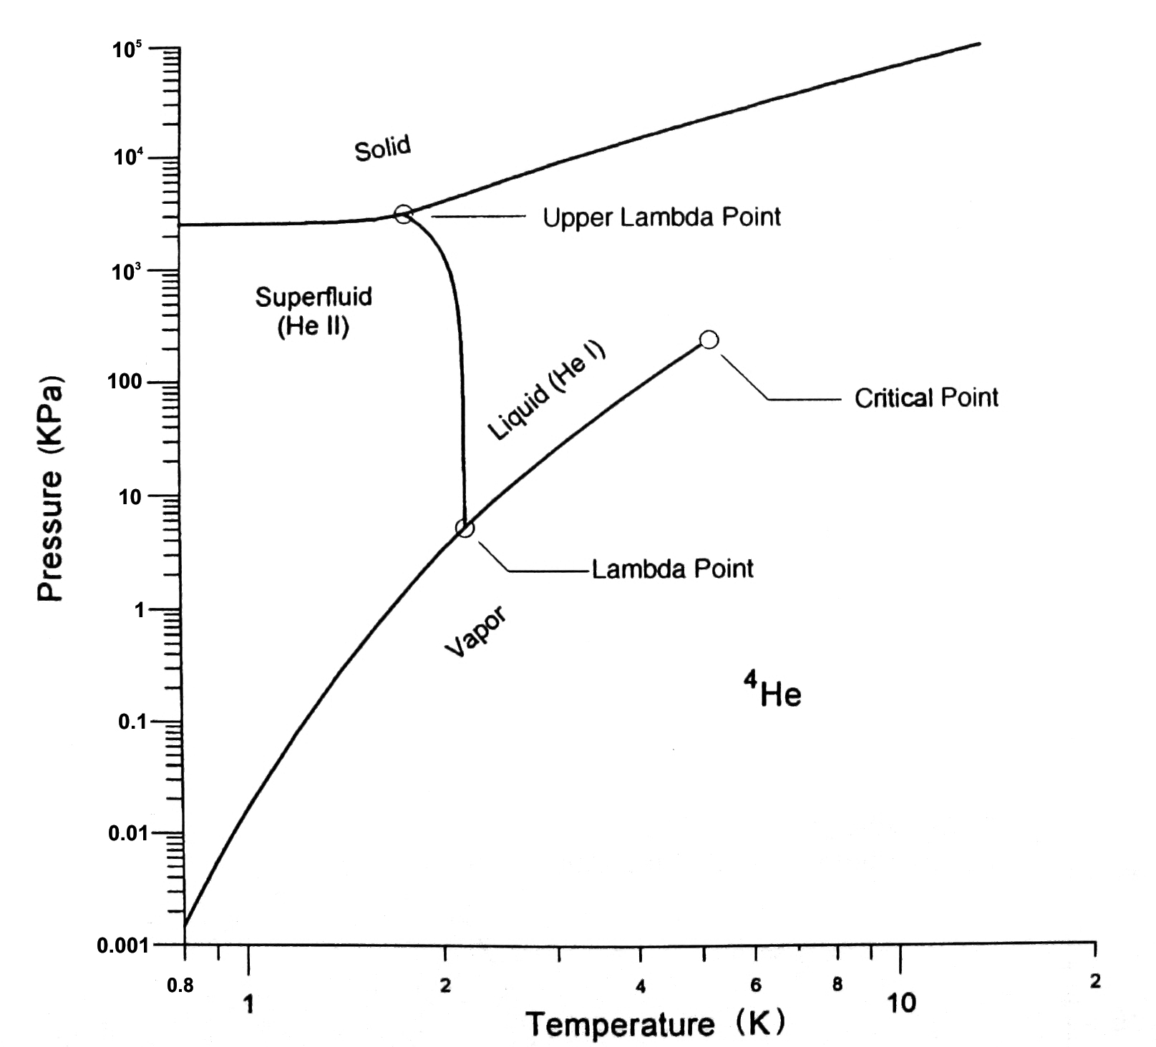
Phase diagram of ⁴He
T_{λ} ≈2.1768 K @
p_{λ} ≈ 50.41 mbar
Phase Boundary
From Weisend, Handbook of
Cryogenic Engineering, 1984.

Slide 35
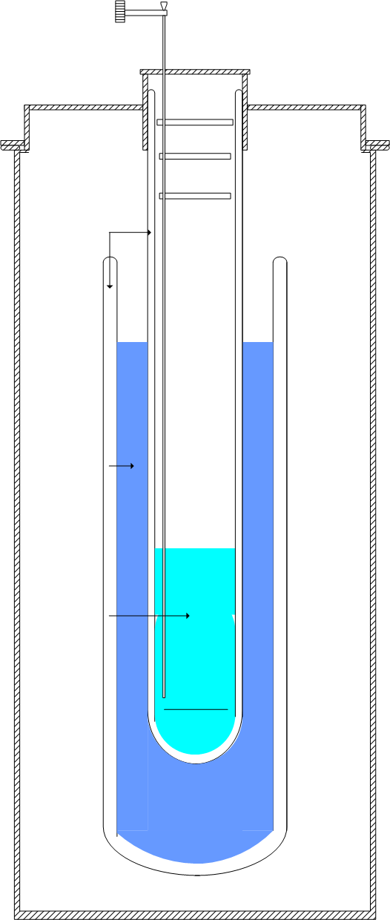
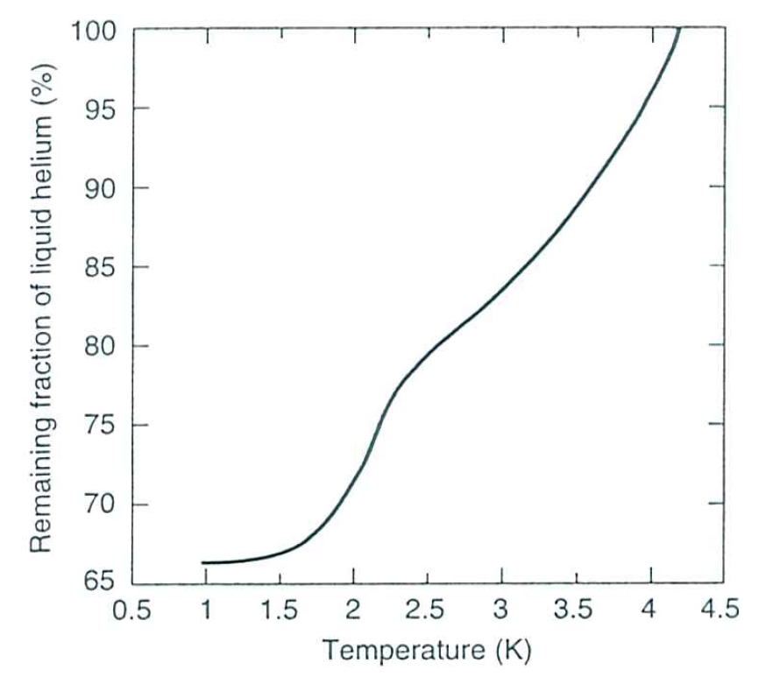
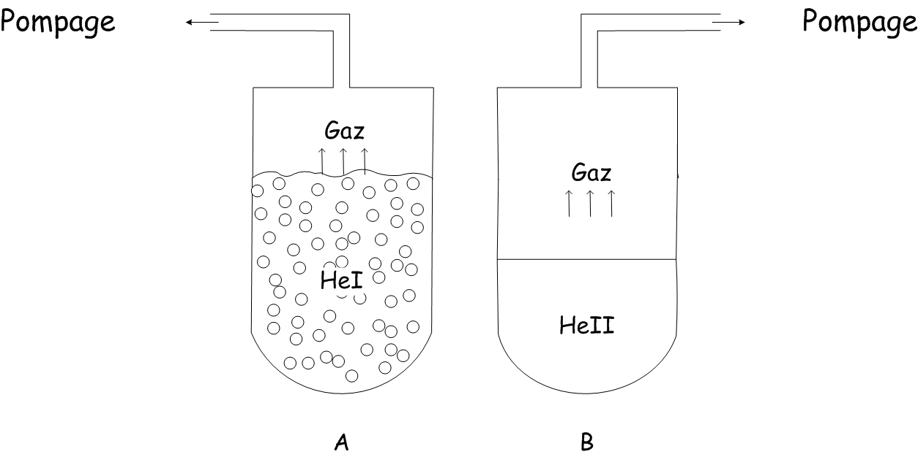
Glass cryostat set-up
Vacuum
pump
Transfer line
Vacuum
insulation
Pumping
Boiling suddenly
stops in He II
LN₂
LHe
Boiling in He I
From Ekin, Experimental Techniques for Low Temperature Measurements, 2006.

Slide 36
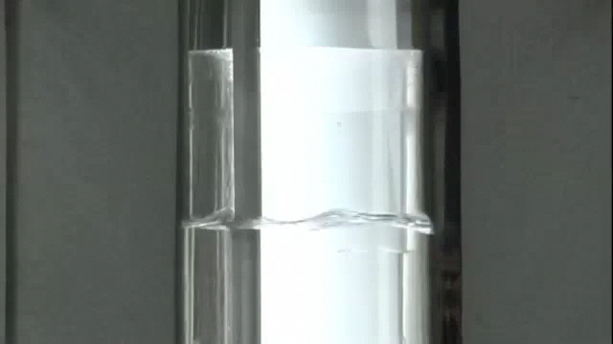
Boiling effects during cooldown / Pumping on the He vapour

Slide 37
How to explain that unique behaviour ?
Two fluid model of L. Tisza:
He II is composed of two components

Slide 38
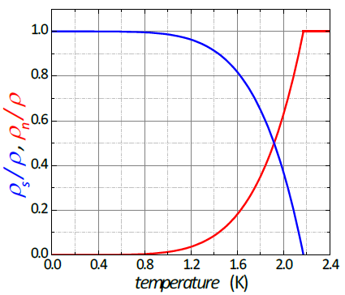
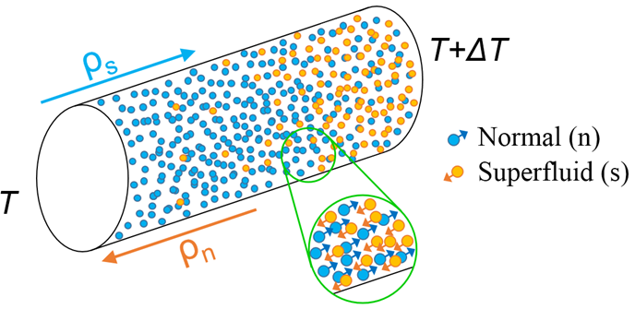
Two-fluid model of He II by Tisza, 1938
ρ_{s}/ρ, ρ_{n}/ρ
From Gross, Marx, Wather-Meissner Institut, 2009.
Superfluid component:
no entropy: S_{s} = 0
zero viscosity: η_{s} = 0
Normal component:
carries total entropy: S_{n} = S
finite viscosity: η_{n} = η_{n}
Temperature / K
Formal description of He II as the sum of a normal and a superfluid component.
Ratio ρs/ρn depends on temperature

Slide 39
He II in practice

Slide 40

Superleak below T_{l}
1963 movie by Alfred Leitner, Michigan State University

Slide 41
Critical heat flux in He II
Power supply
Heat and mass flow are
limited by a critical velocity:
v > v_{cr}
Superfluid behavior becomes
non-linear (mutual friction)
k and η
Formation of vapor bubbles at
the surface of the heater
In He II re-condensation of
the vapor
Surface tension let the bubbles
implode
Implosion speed exceeds v₁
Shock wave => cavitation
He II level
Heater
Cryostat

Slide 42
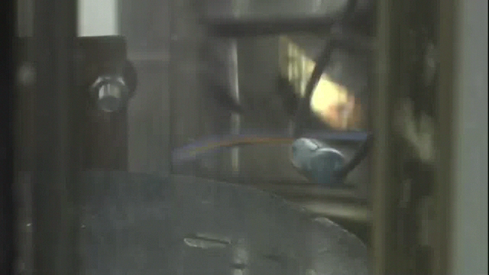
Critical heat flux in He II (T<T_{l})

Slide 43
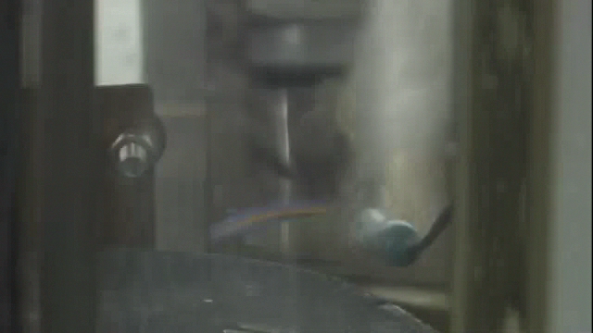
LHe I cooling (T>T_{l})

Slide 44
Concluding remarks
Cryogenics serving superconducting systems is now part of all major accelerators and future projects.
While advanced applications tend to favour “T< 2 K”, many almost industrial applications are based on “4.5 K” and R&D continues for “high temperature” applications.
Reducing the amount of required helium as cooling fluid is essential for future installations.
Even though cryogenic engineering follows well defined rules and standards, there are still variants depending on boundary conditions, project schedule …
I could only recommend that demonstrated experience is evaluated and adapted to specific requirements you may have.

Slide 45
Some references
K. Mendelssohn, The quest for absolute zero, McGraw Hill (1966)
R.B. Scott, Cryogenic engineering, Van Nostrand, Princeton (1959)
G.G. Haselden, Cryogenic fundamentals, Academic Press, London (1971)
R.A. Barron, Cryogenic systems, Oxford University Press, New York (1985)
B.A. Hands, Cryogenic engineering, Academic Press, London (1986)
S.W. van Sciver, Helium cryogenics, Plenum Press, New York (1986)
K.D. Timmerhaus & T.M. Flynn, Cryogenic process engineering, Plenum Press, New York (1989)
Proceedings of CAS School on Superconductivity and Cryogenics for Particle Accelerators and Detectors, Erice (2002)
  U. Wagner, Refrigeration
  G. Vandoni, Heat transfer
  Ph. Lebrun, Design of a cryostat for superconducting accelerator magnet
  Ph. Lebrun & L. Tavian, The technology of superfluid helium
Proceedings of ICEC and CEC/ICMC conferences
CERN, HSE, Cryogenic Safety courses 1-3

Slide 46
Thank you for your attention.

Slide 48
Spare slides

Slide 49
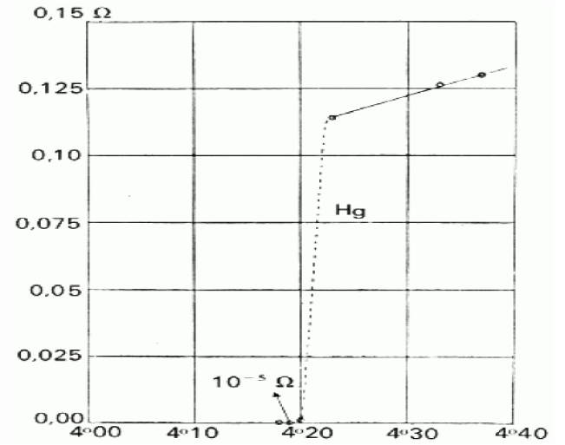
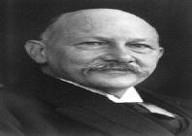
Superconductivity
H. Kamerlingh Onnes
Liquefied helium in 1909 at 4.2 K with 60 g He inventory
Observed in 1911 for the first time superconductivity of mercury
Nobel prize 1913
Historic graph showing the superconducting transition of mercury, measured in Leiden in 1911 by H. Kamerlingh Onnes.

Slide 50
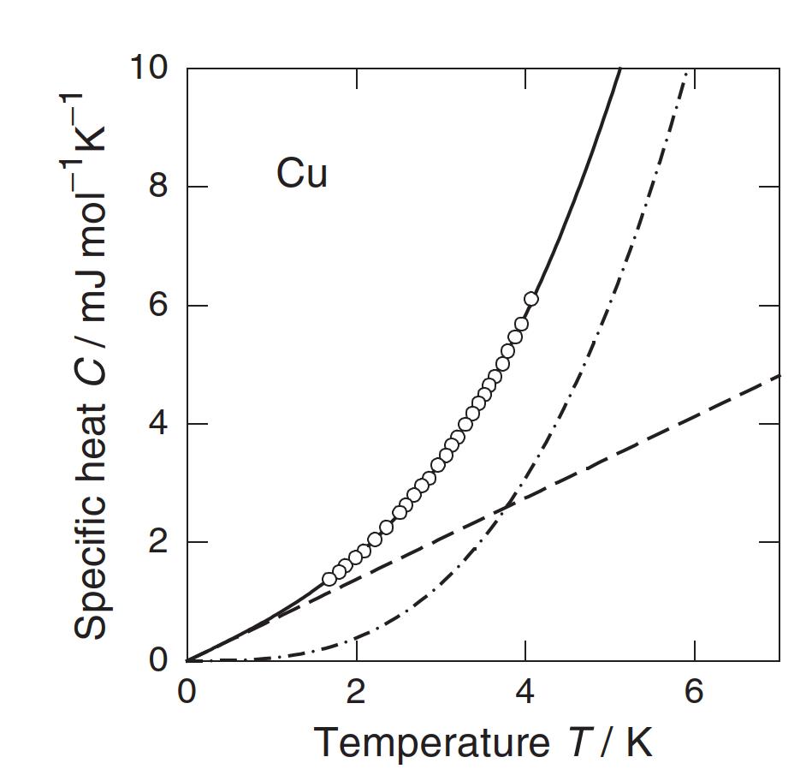
Heat capacity of materials – what to cool?
Discrete lattice vibrations => Phonons
Metals have a contribution of free electron gas => dominant at very low temperature
Source: Ekin, Experimental Techniques for Low-Temperature Measurements.
Source: Enss, Low temperature physics.

Slide 51
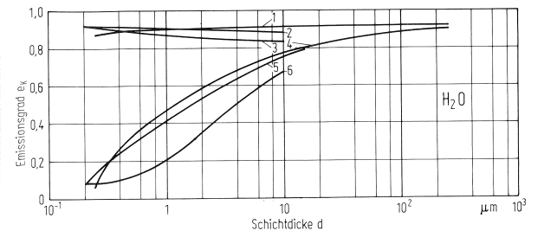
Emissivity of technical materials at low temperatures
Emissivity of cold surface coated with water condensate dependent on layer thickness
Emissivity ε
Source: Haefer, Kryovakuumtechnik, 1981
Layer thickness d
 | Cold surface, 77 K | Gas inlet
1 | Al + Cat-a-Lac | Uniform over time, 0.06 Pa
2 | Ni + Black Velvet 101-C10/3M | Sporadic
3 | Ni + Black Velvet 101-C10/3M | Uniform over time, 0.1 Pa
4 | Al, polished, ε = 0.07 | Uniform over time, 0.06 Pa
5 | Ni, polished | Sporadic
6 | Ni, polished | Uniform over time, 0.1 Pa

Slide 52
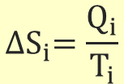
Thermodynamics of cryogenic refrigeration
First principle [Joule]
Second principle [Clausius]
(= for reversible process)
Hence,
which can be written in different ways:
introducing entropy S as
$${∆S}_{i}=\frac{Q_{i}}{T_{i}}$$
Carnot factor

Slide 53
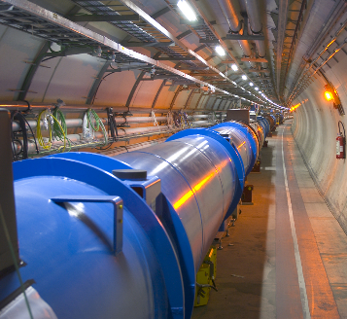
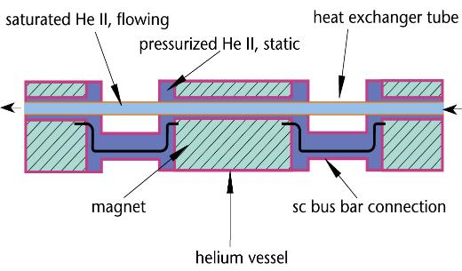
LHC cryogenic distribution scheme - QRL
Q_{dist} = 450 W
Pressurized/saturated He II
Q_{load} = 2400 W
T_{sink} = 1.85 K
T_{load_max} = 1.9 K
37’500 tons at 1.9 K
Source: Ph. Lebrun, Cooling with Superfluid Helium

Slide 54
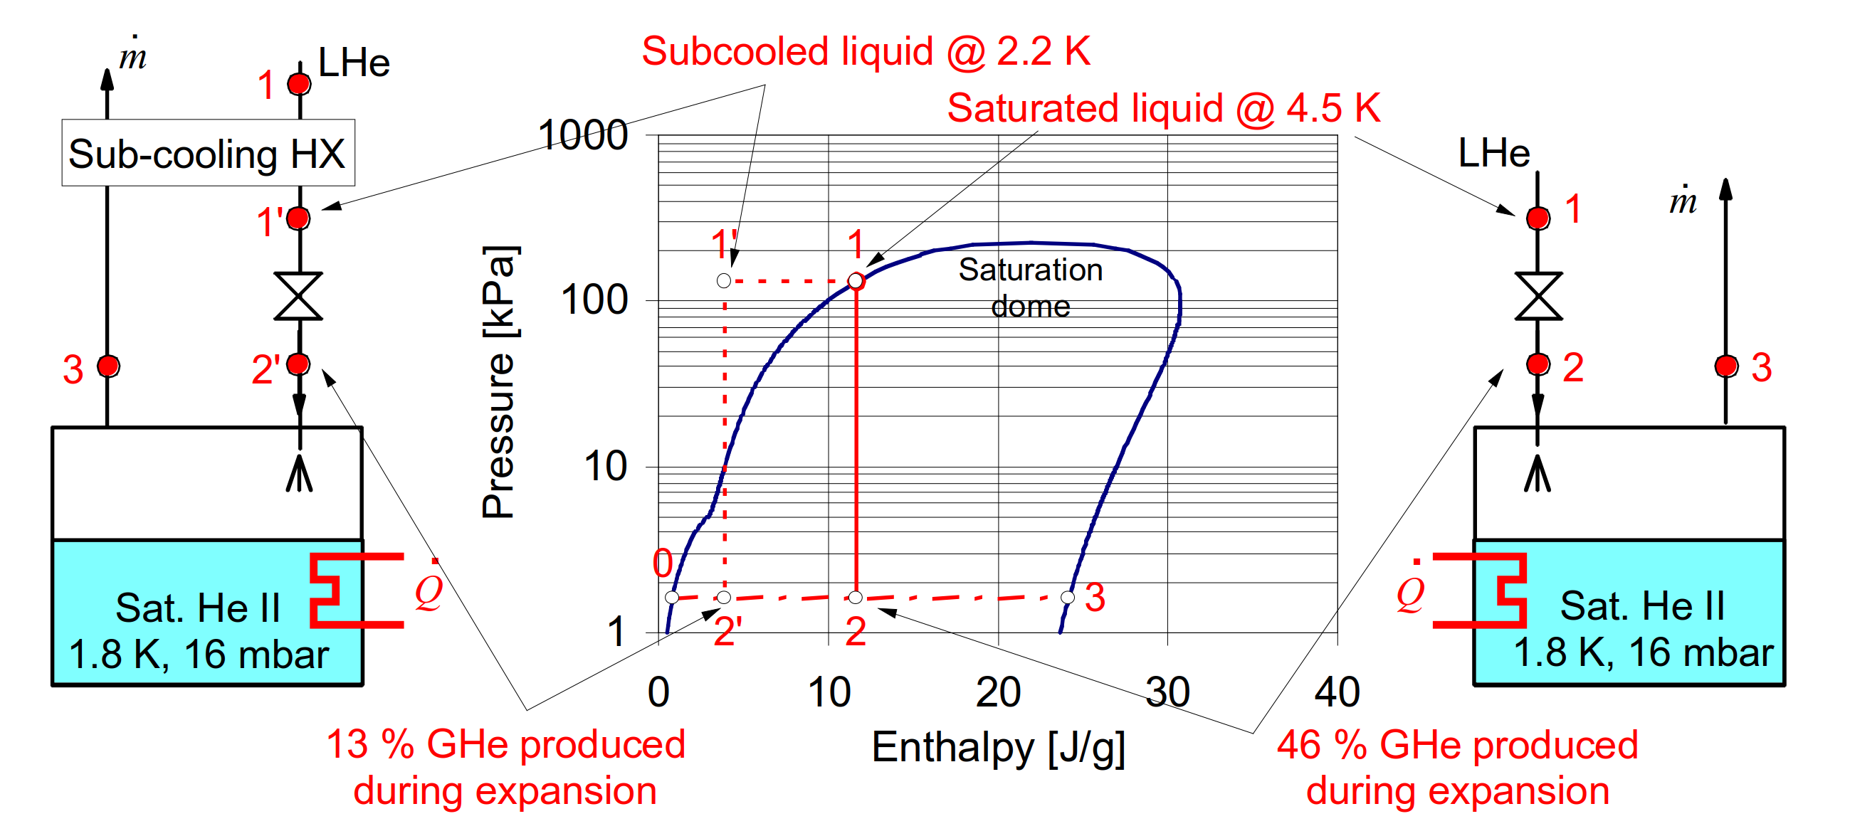
The effectiveness of J-T expansion
Source: Ph. Lebrun, Cooling with Superfluid Helium

Slide 55
Refrigerator Liquefier

Slide 56
Refrigerator Liquefier
For refrigerators/liquefiers with the same efficiency:

Slide 57
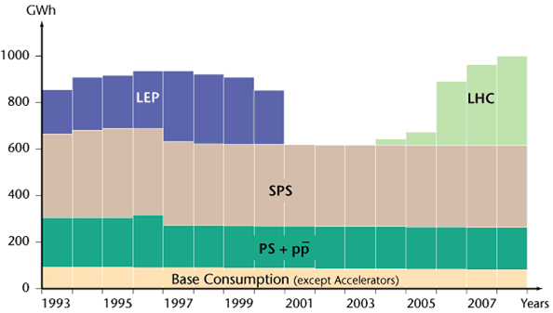
Energy consumption CERN, LHC and Cryo
CERN in total is around 200 MW with LHC contributing by 115 MW
1.25 TWh in 2018
Source: https://www.lhc-closer.es/taking_a_closer_look _at_lhc/0.energy_consumption
When the LHC is up and running the total average power for the whole CERN site will peak during July at about 180 MW of which:
  LHC cryogenics 27.5 MW (40 MW installed)
  LHC experiments 22 MW

