Slide 1

Copyright statement and speaker’s release for video publishing
The author consents to the photographic, audio and video recording of this lecture at the CERN Accelerator School. The term “lecture” includes any material incorporated therein including but not limited to text, images and references.
The author hereby grants CERN a royalty-free license to use his image and name as well as the recordings mentioned above, in order to broadcast them online to all registered students and to post them without any further processing on the CAS website.
The author hereby confirms that the content of the lecture does not infringe the copyright, intellectual property or privacy rights of any third party. The author has cited and credited any third-party contribution in accordance with applicable professional standards and legislation in matters of attribution.

Slide 2
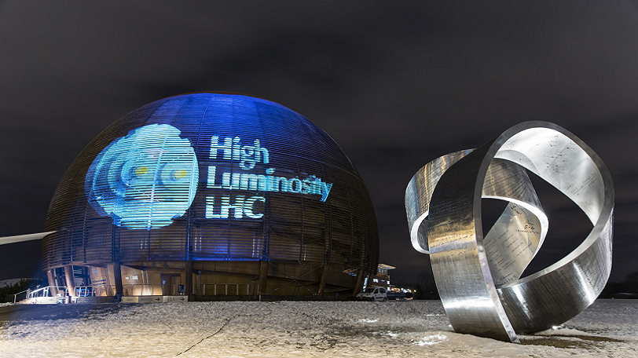
High Luminosity LHC – Status and Prospects
CAS March 2024
Markus Zerlauth with acknowledgements to O.Brüning, M.Lamont, L.Rossi, J. Wenninger and many other CERN colleagues

Slide 3
Outline
LHC design performance and HL-LHC upgrade goals
(Main) Technical challenges of the HL-LHC upgrade
Inner Triplet String
Preparing HL-LHC operation and performance ramp-up
Conclusions
3

Slide 4
Outline
LHC design performance and HL-LHC upgrade goals
(Main) Technical challenges of the HL-LHC upgrade
Inner Triplet String
Preparing HL-LHC operation and performance ramp-up
Conclusions
4

Slide 5
Introduction: LHC Performance Goals
Collision energy: Higgs discovery requires E_{CM} > 1 TeV
p collisions E_{beam} > 5 TeV LHC: E = 7 TeV
[3.5/4TeV; 6.5TeV; 6.8TeV]
Instantaneous luminosity: rate of events in detector
rare events L > 10³³cm⁻²sec⁻¹ L = 10³⁴cm⁻²sec⁻¹
[2×10³⁴cm⁻²sec⁻¹]
Integrated luminosity: total number of events L
300 fb⁻¹ with 1barn = 10⁻²⁸m² and femto = 10⁻¹⁵
[270 fb⁻¹]
depends on the beam lifetime, the LHC cycle and
‘turn around’ time and overall accelerator efficiency

Slide 6
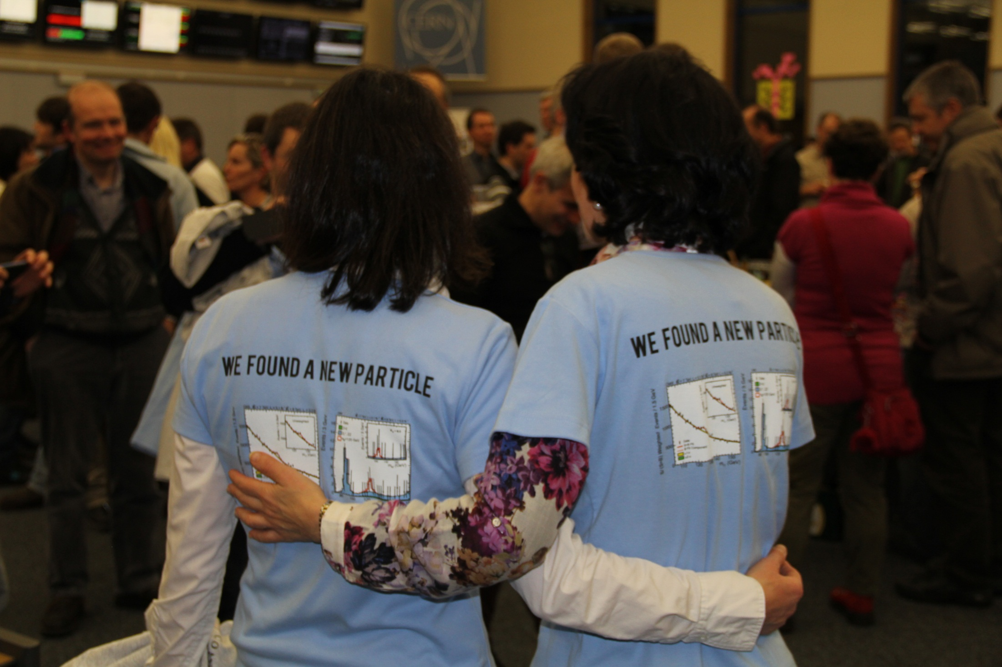

Slide 7
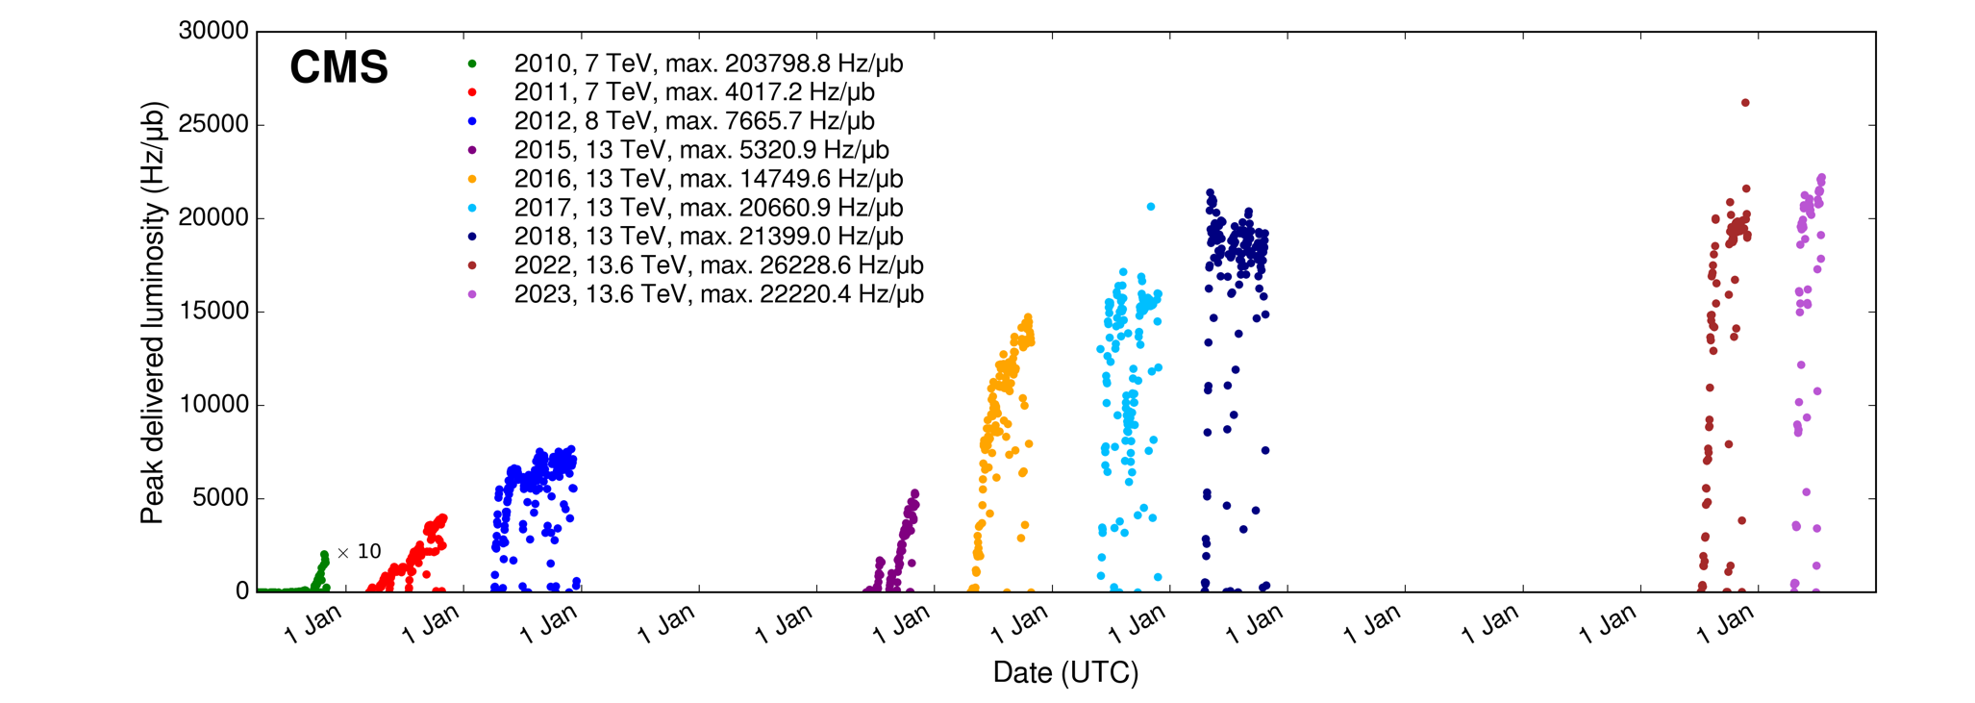
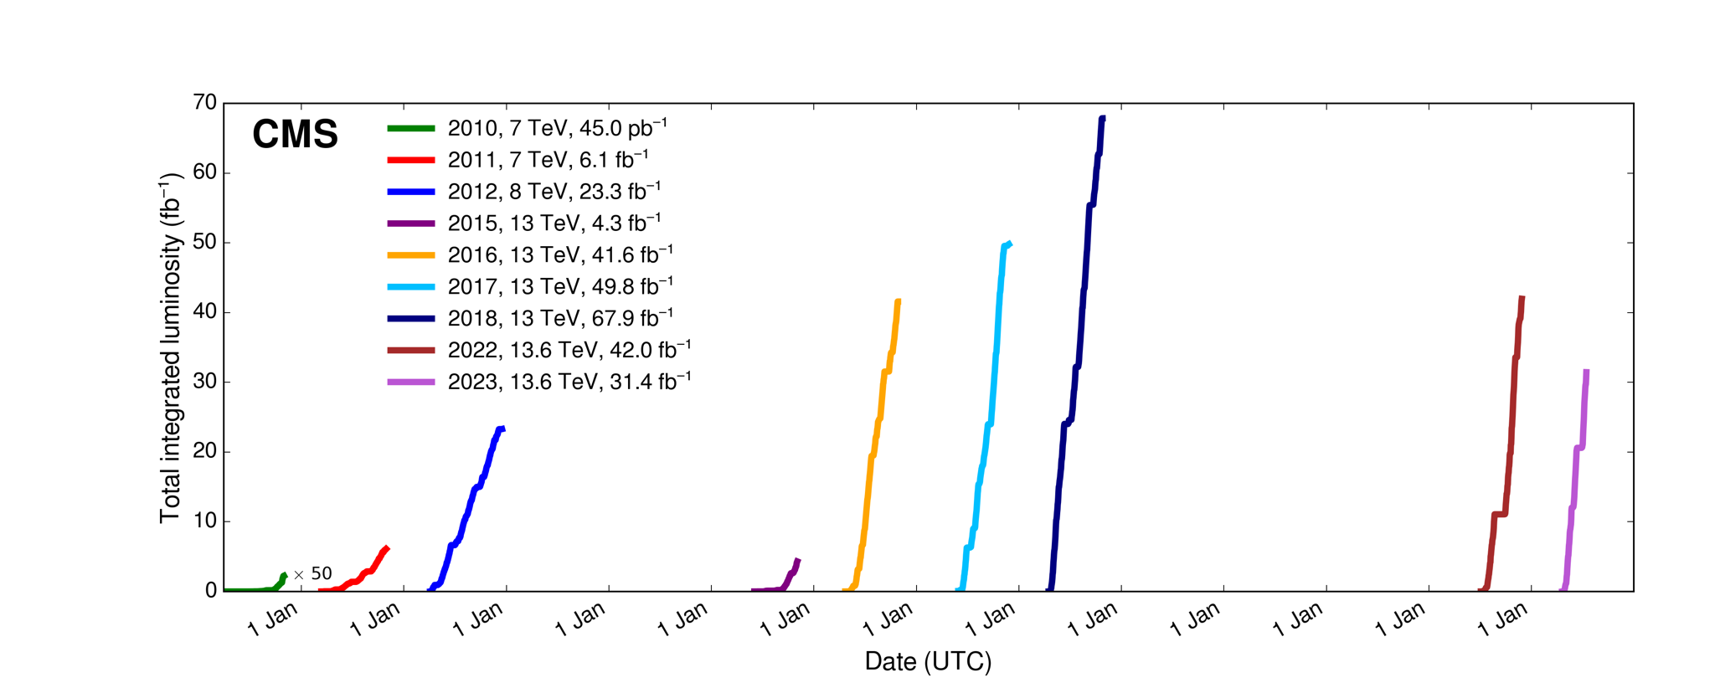
After that it’s been quite a ride

Slide 8
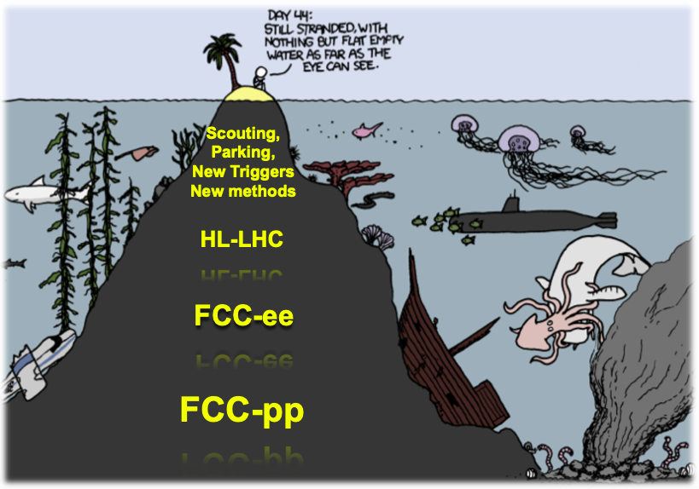
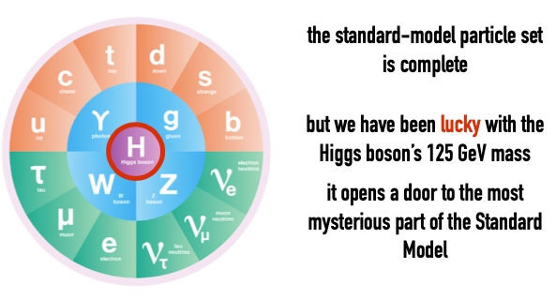
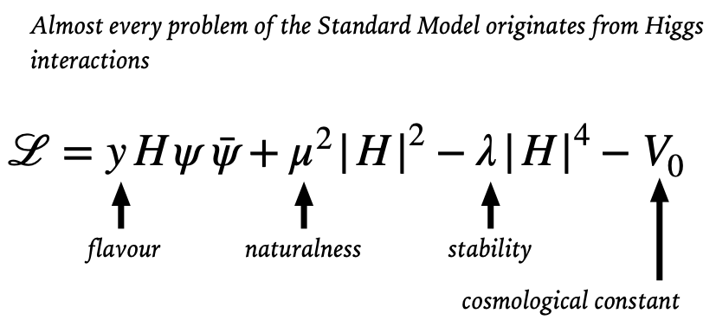
Run 3
]

Slide 9
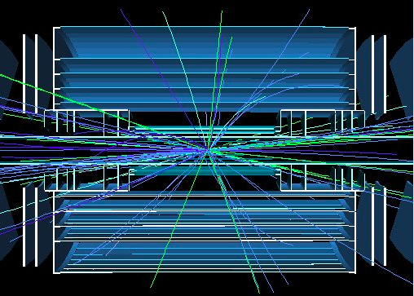
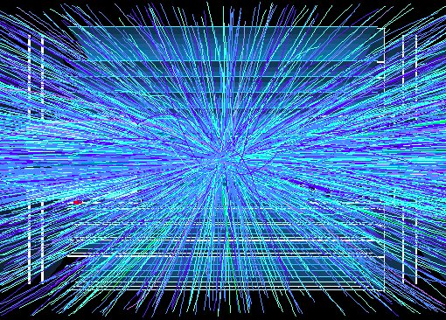
Goal of HL-LHC upgrade project
Many questions remain! (Higgs properties/couplings?, more than just 1 Higgs? Beyond SM physics? Dark Matter/energy?)
The main objective of the HL-LHC is to determine and build a hardware configuration and a set of beam parameters that will allow the LHC to reach the following targets:
Prepare machine for operation beyond 2025 and up to the early 2040s
Devise beam parameters and operational scenarios for:
# enabling at total integrated luminosity of 3000 fb⁻¹
# implying an integrated luminosity of 250 fb⁻¹ per year,
# design oper. for μ ≤ 140 (➔ peak luminosity 5 x 10³⁴ cm⁻² s⁻¹)
5 events
400 events
Implies overcoming several limitations in the existing LHC!!!
Cryo cooling of triplet magnets & radiation damage in triplet magnets & machine efficiency!
But also for the experiments!!
➔ Need for an Upgrade!

Slide 10
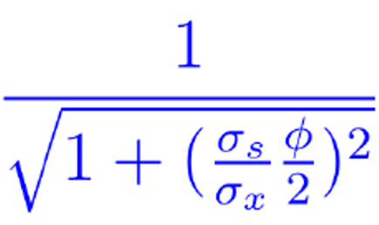


Higher Intensity
Increase bunch population
Increase F
Crossing angle reduction factor
Shorter bunches, smaller crossing angle, crab cavities
$$ℒ=\frac{N^{2}f_{rev}k_{c}}{4πβ^{∗}ε_{xy}}F$$
Smaller $β^{∗}$
Reduced emittance
Smaller beam size at IP

Slide 11
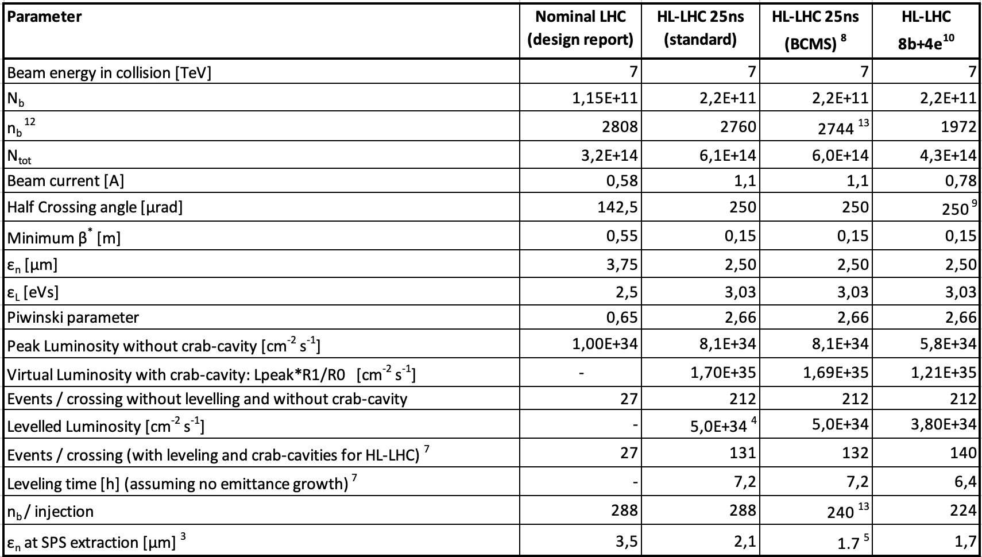
HL-LHC Design Parameters
LHC Magnet system
LHC injector complex
HL-LHC triplet magnets
HL-LHC crab cavities
Machine operation &
availability
LHC injector complex
Notes:
To be updated with last version before the CMSDAS meeting

Slide 12
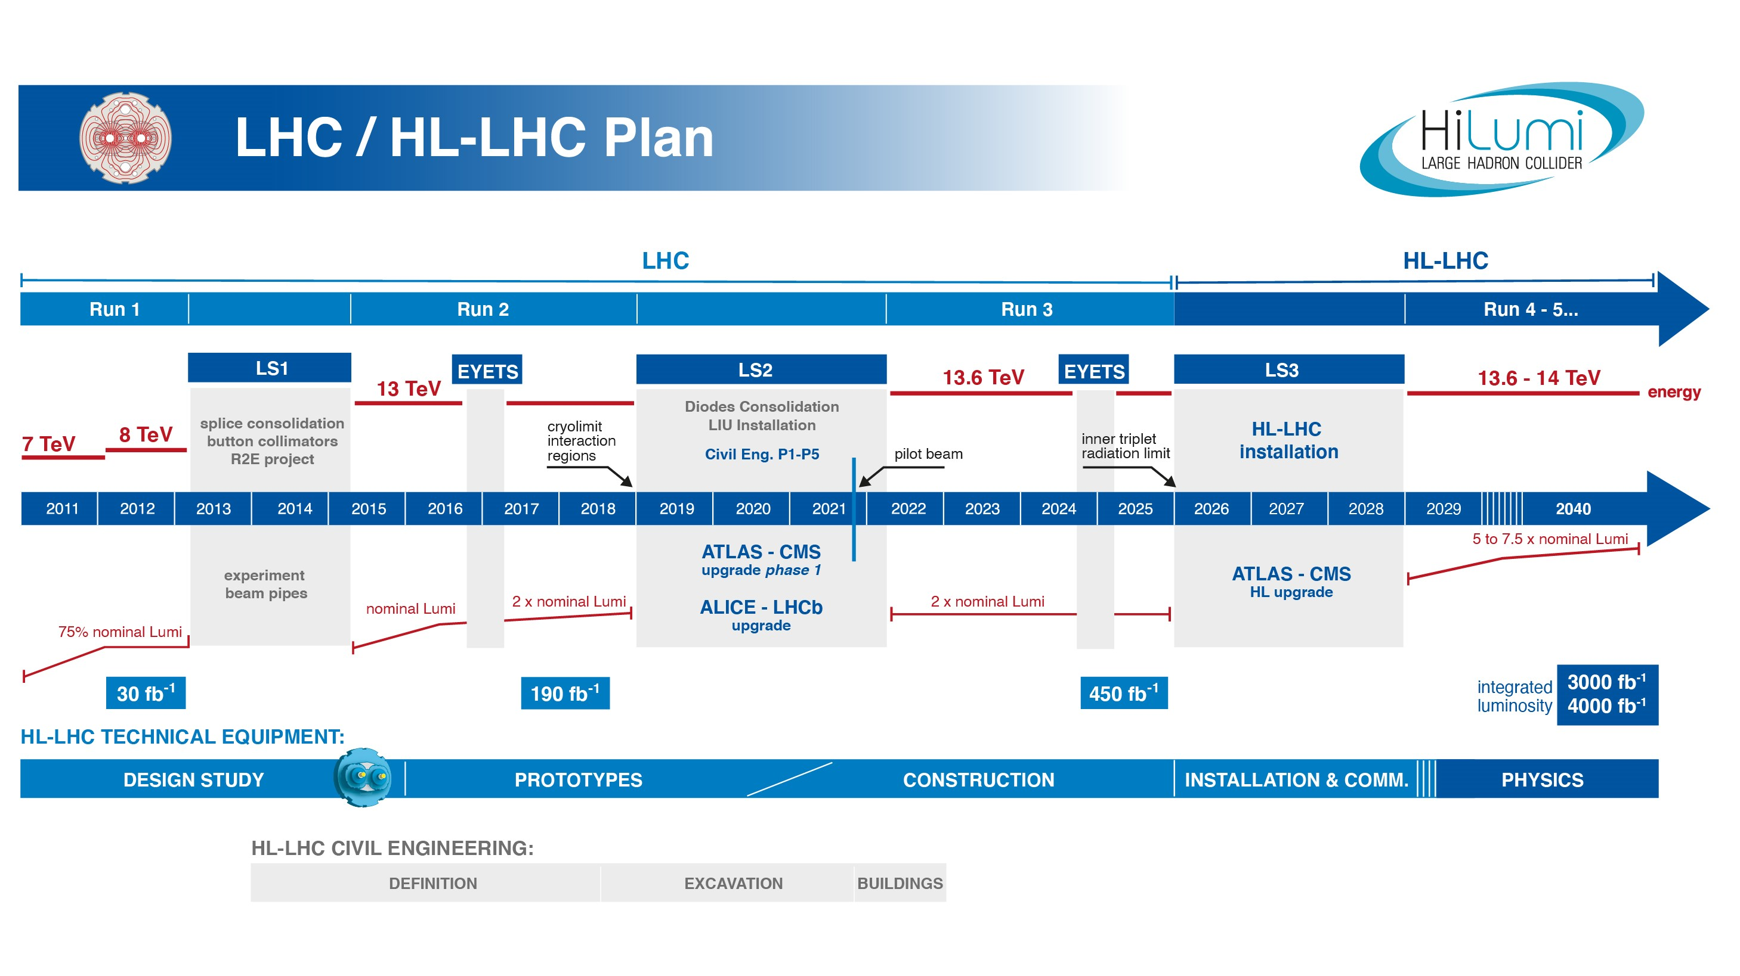
EU funded HiLumi
Design Study
Approval of
HL-LHC Project
We are here
HL-LHC Operation
Run3 operation
1.5 years until start of Long Shutdown 3
75% of the project budget of ~1.1 BCHF already committed
The project is ready for installation start in 2026! ➔ endorsed by 2023 C&SR

Slide 13
Outline
LHC design performance and HL-LHC upgrade goals
(Main) Technical challenges of the HL-LHC upgrade
Inner Triplet String
Preparing HL-LHC operation and performance ramp-up
Conclusions
13

Slide 14
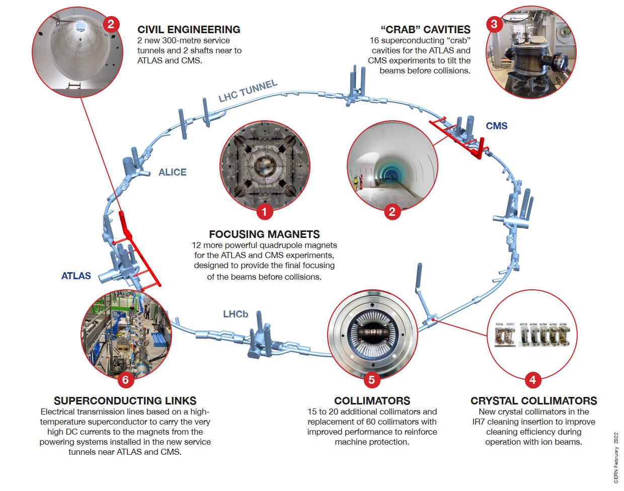
HL-LHC technology landmarks
No accelerator upgrade project has so many challenging novelties covering such a broad technology spectrum
Technology intensive project!
Major upgrades in P1 and P5, large fraction of LHC will remain unchanged

Slide 15


HL-LHC Technical Challenges: Triplet Magnets
Operation beyond 2025:
Requires replacement of LHC Triplet magnets
10 x the luminosity ➔ Requires new, more radiation resistant triplet magnets
Epoxy and most insulation materials
will become brittle at these radiation levels and loose their mechanical integrity!!!
Cold bore insulation
≈ 35 MGy
Q2
27 MGy
MCBX3 20 MGy
ATLAS
CMS
15

Slide 16
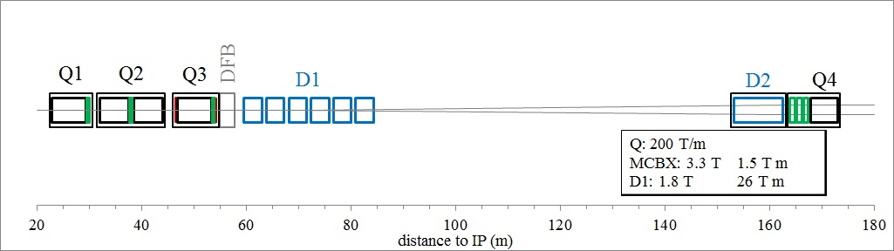


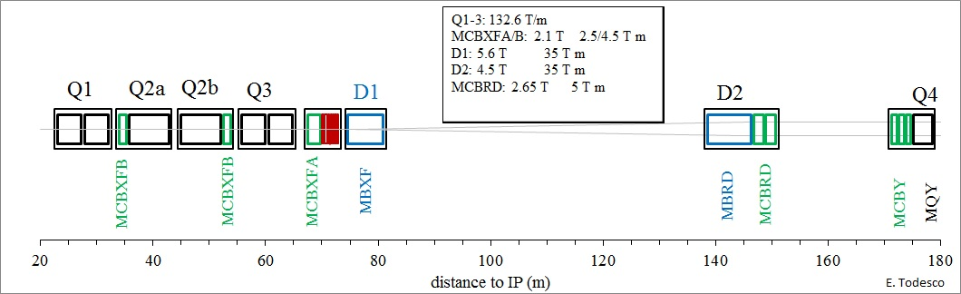
New HL-LHC Triplet Layout
Need for shielding and larger crossing angle results in aperture of 150 mm, requiring novel Nb₃Sn superconductors
Longer Triplet assembly implies longer distance over which the 2 LHC beams share the same path!
ca. 40 unwanted [parasitic] collision points
Crossing angle & Crab Cavities
ATLAS
CMS

Slide 17
New interaction region layout
New insertion and final focusing magnets
  Main quadrupole magnets MQXFA (Q1, Q3) from AUP and MQXFB (Q2) from CERN
  Superconducting separation and recombination dipoles, D1 from Japan and D2 from Italy
  Higher Order Corrector package (CP) and orbit correctors (MCBX) from Italy and Spain
ATLAS
CMS
LHC
ATLAS
CMS
HL-LHC

Slide 18
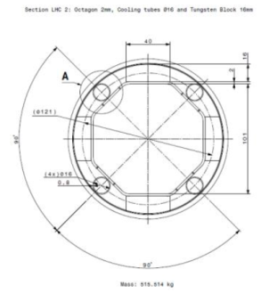
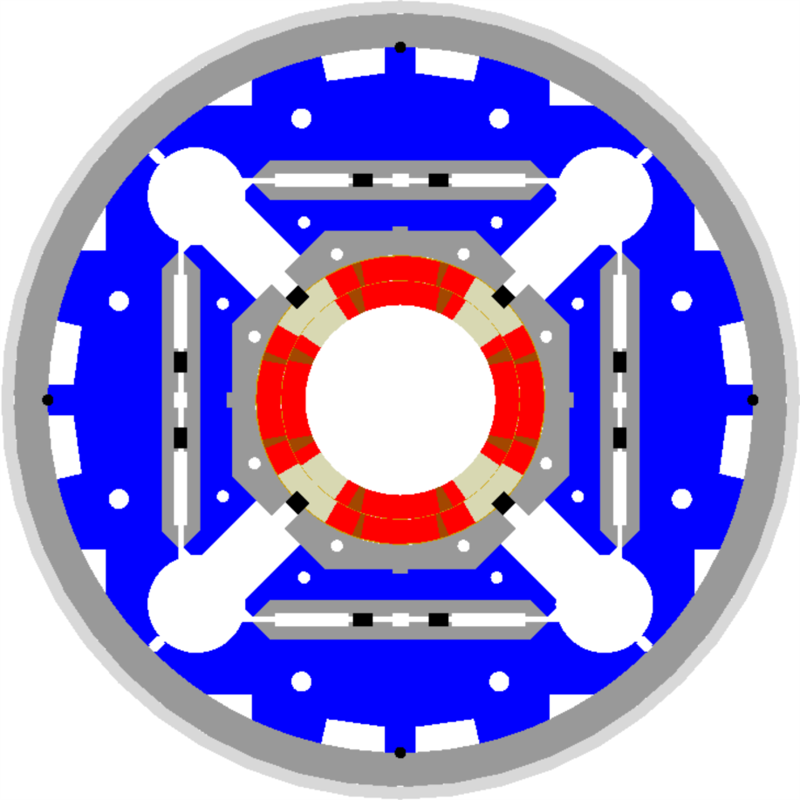
HL-LHC technical bottleneck:
Radiation damage to inner triplet magnets
Tungsten blocks
Need to replace existing triplet magnets with radiation hard system (shielding!) such that the new magnet coils receive a similar radiation dose @ 10 times higher integrated luminosity!!!!! ➔ Shielding!
Requires larger aperture!
70 mm at 210 T/m ➔150 mm diameter 140 T/m
8 T peak field at coils ➔ 12 T field at coils (Nb₃Sn)!!!
➔ New magnet technology!
Capillaries
US-LARP MQXF magnet design
Based on Nb₃Sn
technology

Slide 19
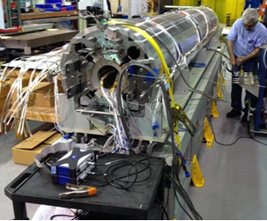
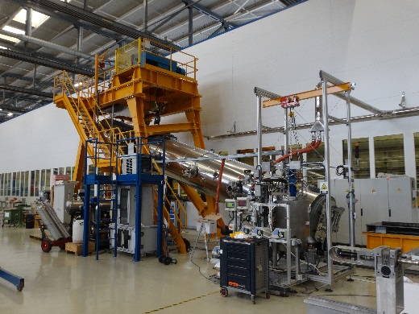
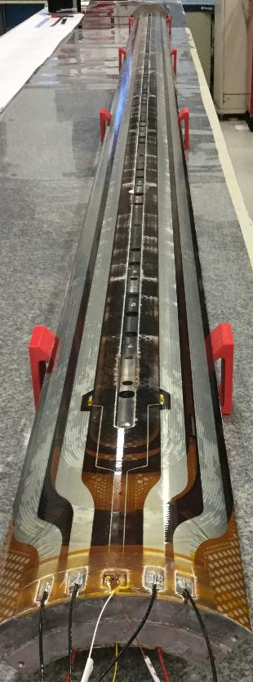
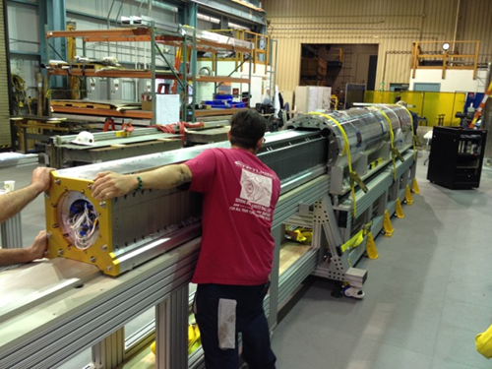
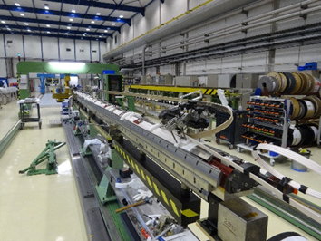

Nb₃Sn quadrupole: Transition from Prototype to Series production
Second short (1.5 m) under preparation for test at CERN
Insertion of coil package inside mechanical structure of the first IT quad prototypes (4.2 m long) in LBNL-USA
19

Slide 20
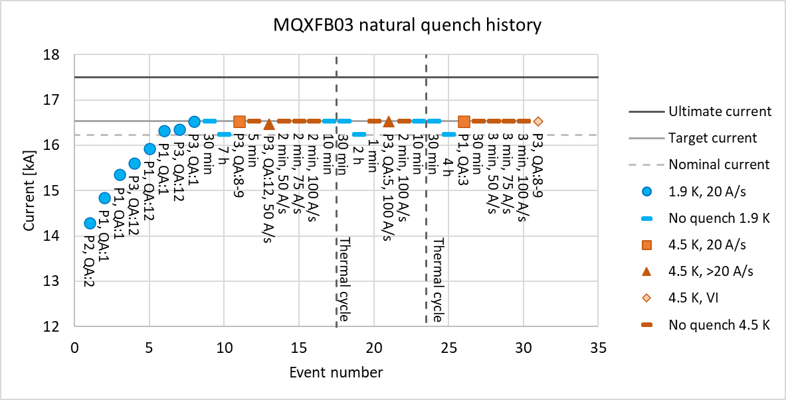
Improvement Plan for MQXFB
After steady progress with prototypes and first of series which already reached acceptance criteria at 1.9K, MQXFB03 is the 3rd magnet of 3-stage strategy, integrating full set of improvements for cold mass assembly, magnet loading and coil manufacturing
It was tested in Q3/Q4 2023 and is the first 7.2-m-long MQXFB magnet to achieve target current of 16.53 kA at both 1.9 K and 4.5 K.
It shows good endurance after 2 warm-up/ cooldown cycles with no retraining at 1.9 K; no ramp rate degradation up to 100 A/s; initial training quenches at 1.9 K are all in coil ends

Slide 21
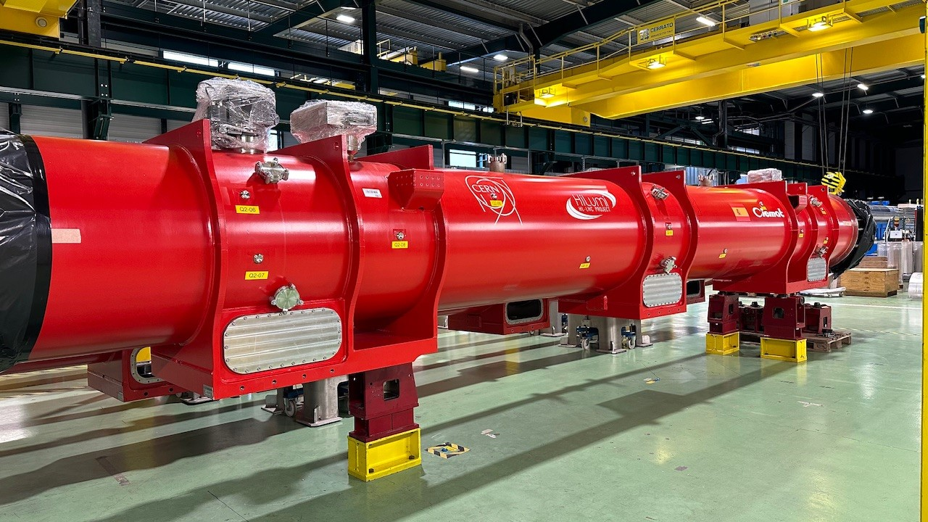
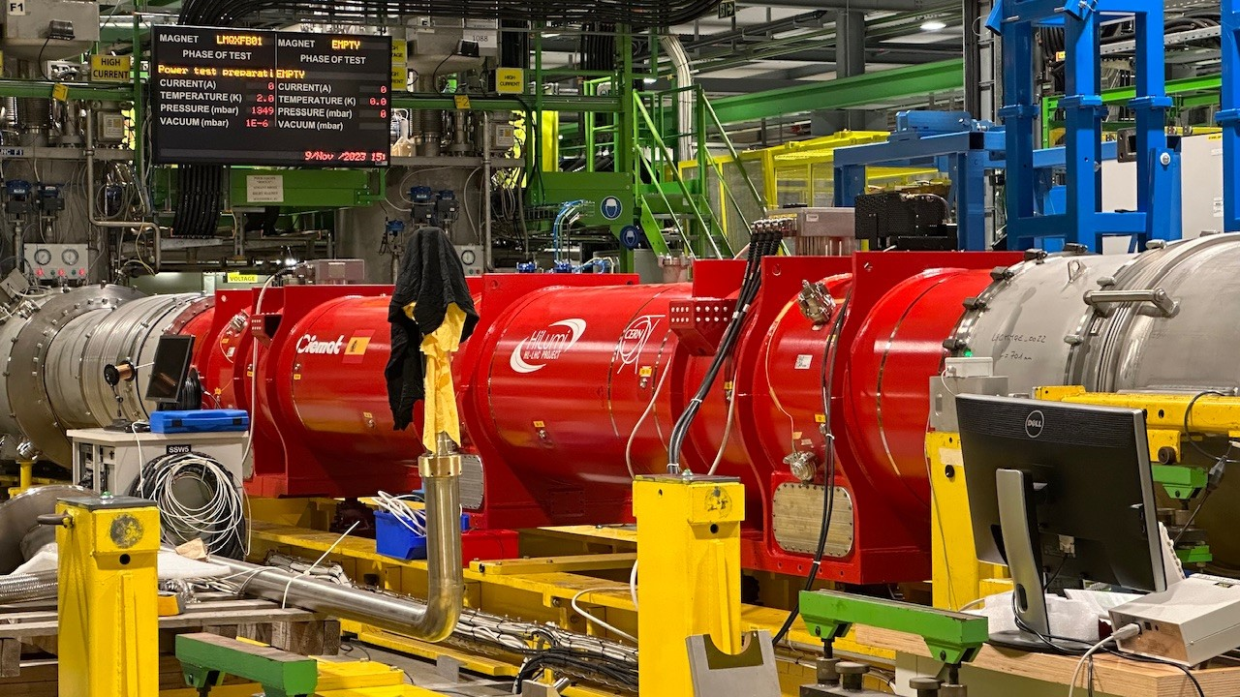
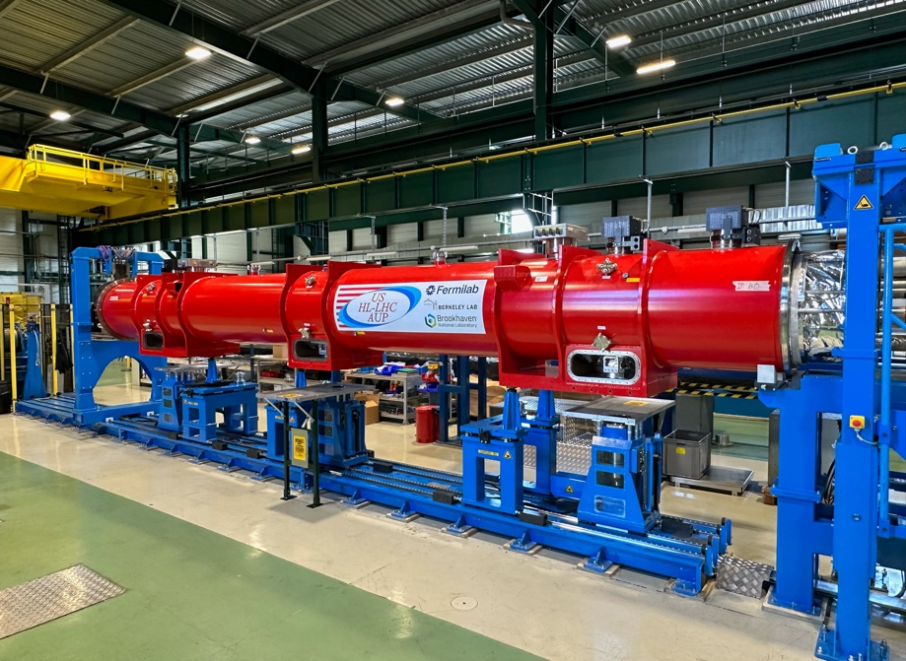
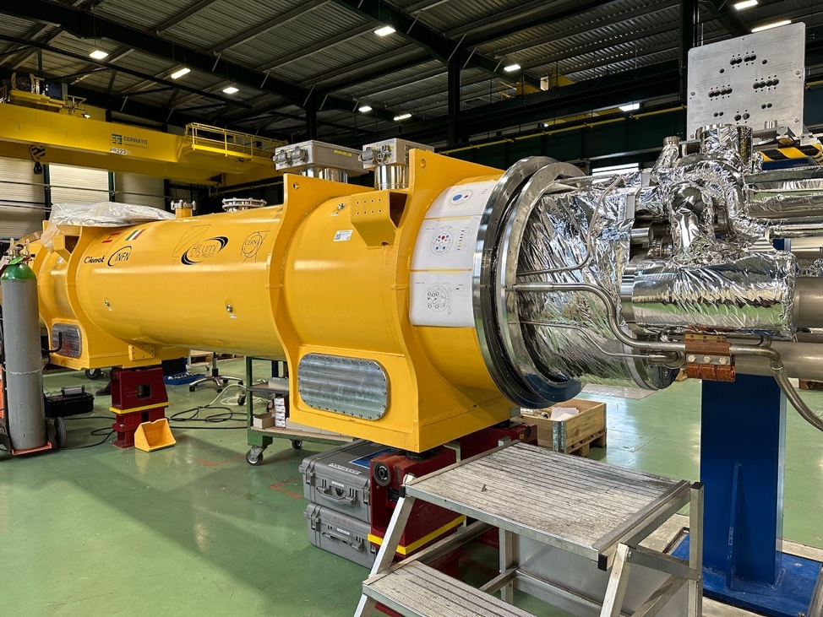
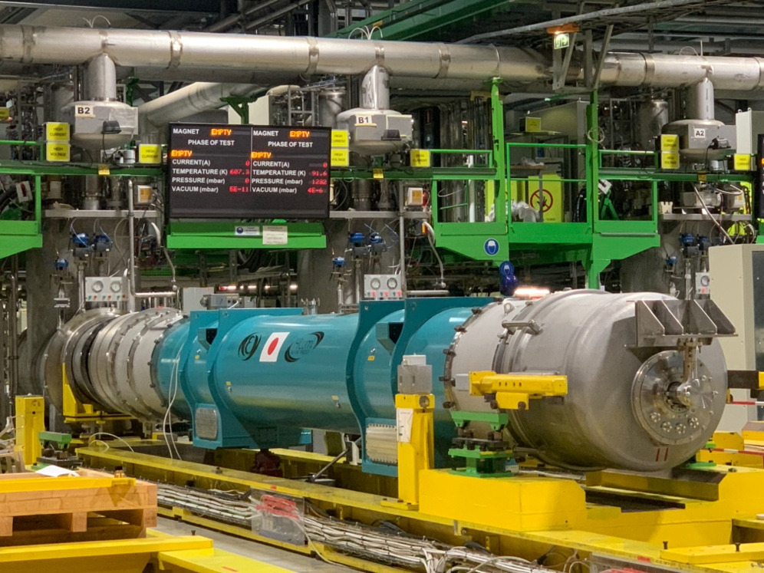
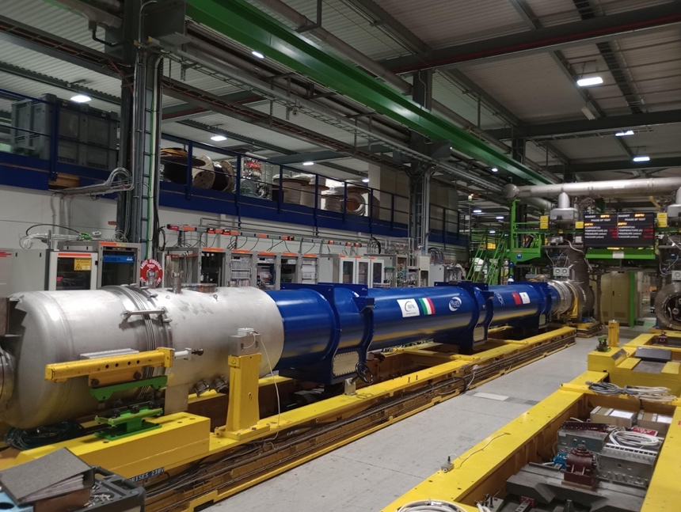

Magnets
Arrival of AUP magnet @ CERN

Slide 22
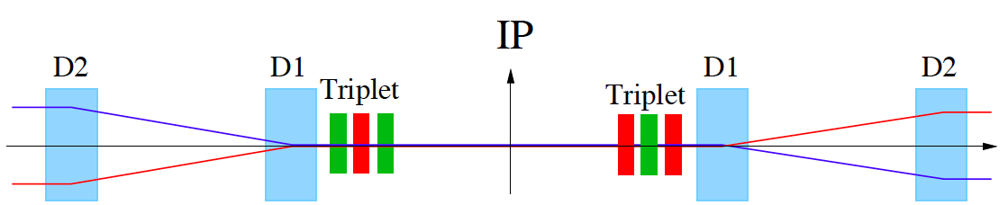
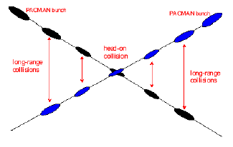
HL-LHC Challenges: Crossing Angle I
Insertion Layout:
ca.130m ➔ 150m
ca.50m
Maximize the number of Protons:
Operation with ca. 2800 bunches @ 25ns spacing ➔ approximately 30 unwanted collision per
Interaction Region (IR).
➔ Operation requires crossing angle
non-linear fields from long-range beam-beam interaction:
efficient operation requires large beam separation at unwanted collision points ➔ Separation of 10 -12 σ ➔ large crossing angle at Interaction Point!

Slide 23
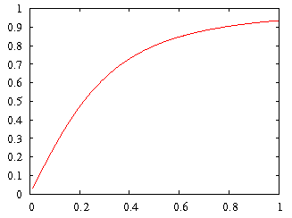
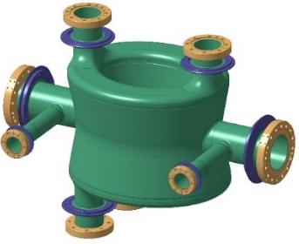
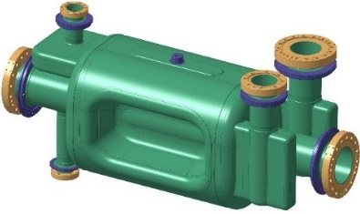
HL-LHC Technical Challenges: Crab Cavities
Geometric Luminosity Reduction Factor:
Crab Cavities:
Full Crossing angle:
285 mrad LHC TDR
-> 329 mrad in LHC op
-> 500 mrad HL TDR
DQW
RF-Dipole
effective cross section
nom HL-LHC
nom LHC
early LHC
Challenging space constraints – 194 mm separation between the 2 beams
➔ requires compact cavity design
23

Slide 24
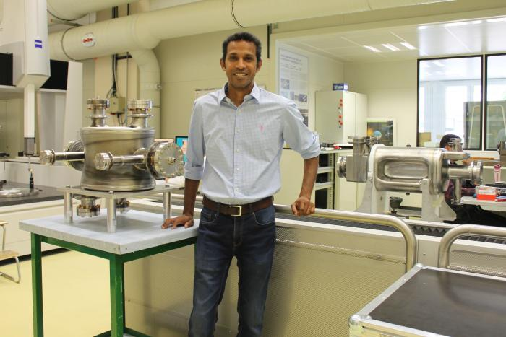

Slide 25
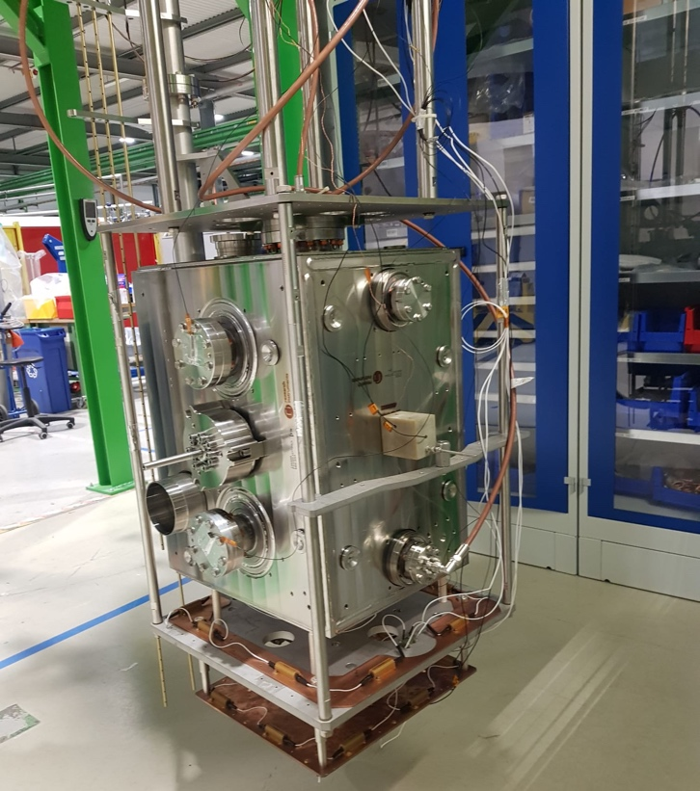
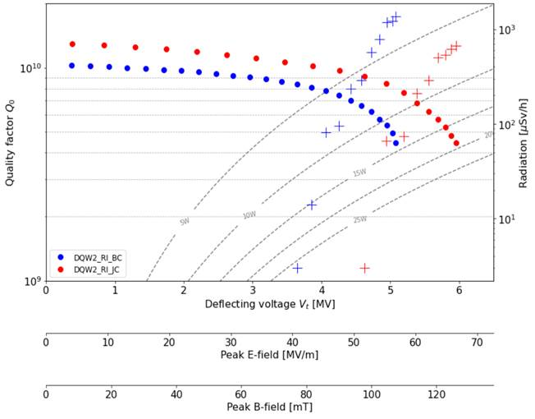
Industrial DQW Series (RI)
1st pre-series jacketed cavity with excellent results, metrology to be finalized before acceptance
2nd cavity in metrology and cold tests soon

Slide 26
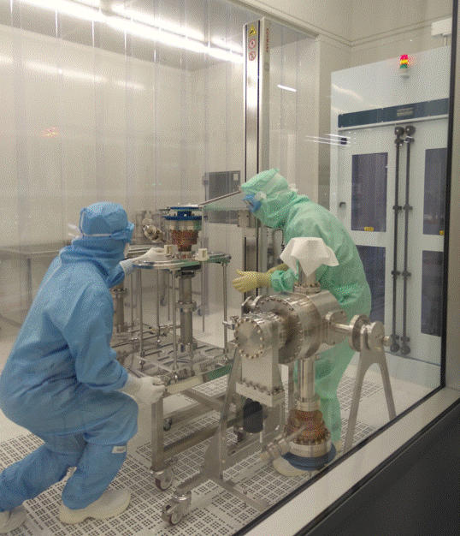
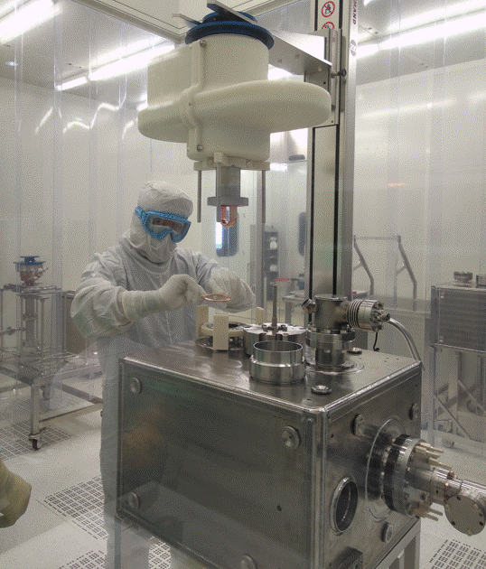
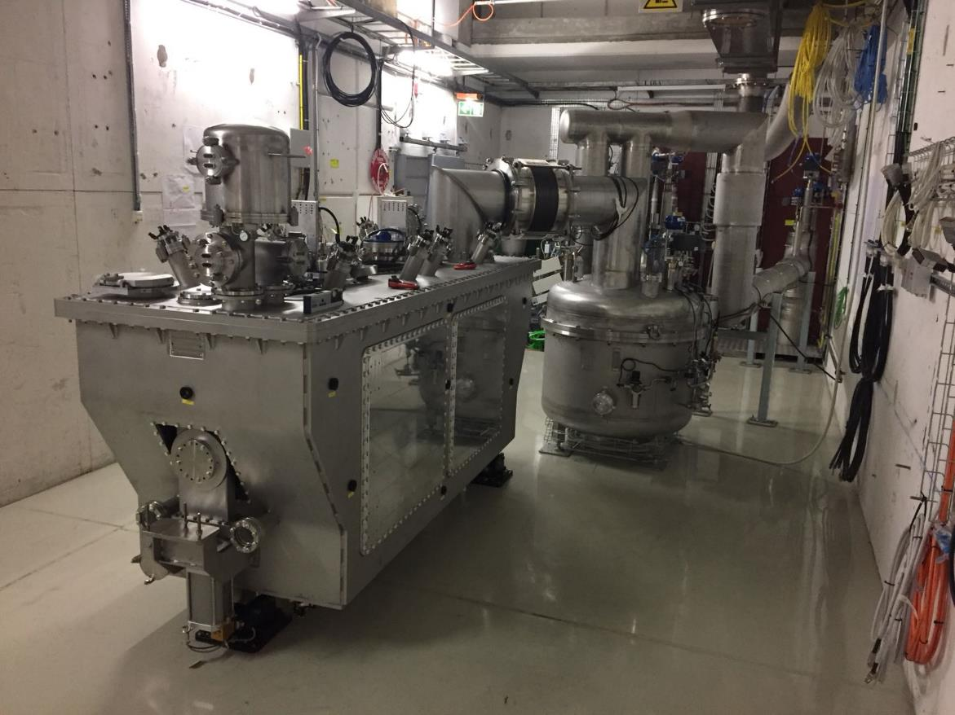
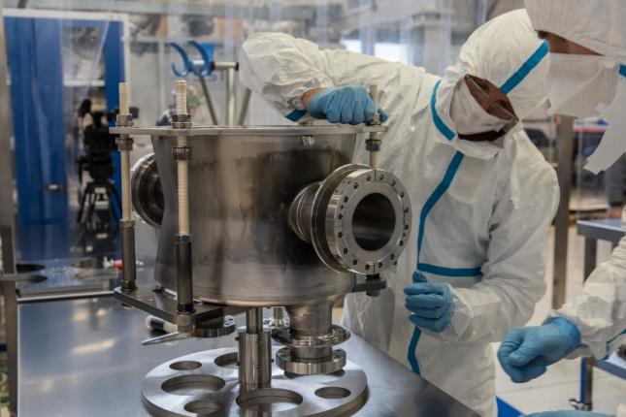
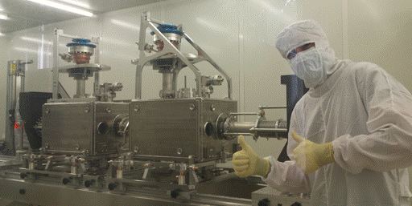
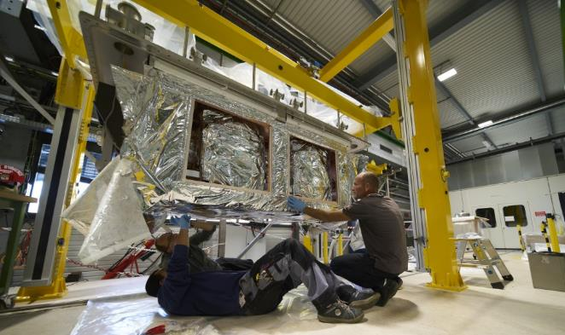
Crab cavity cryo-module for installation in the SPS
26

Slide 27
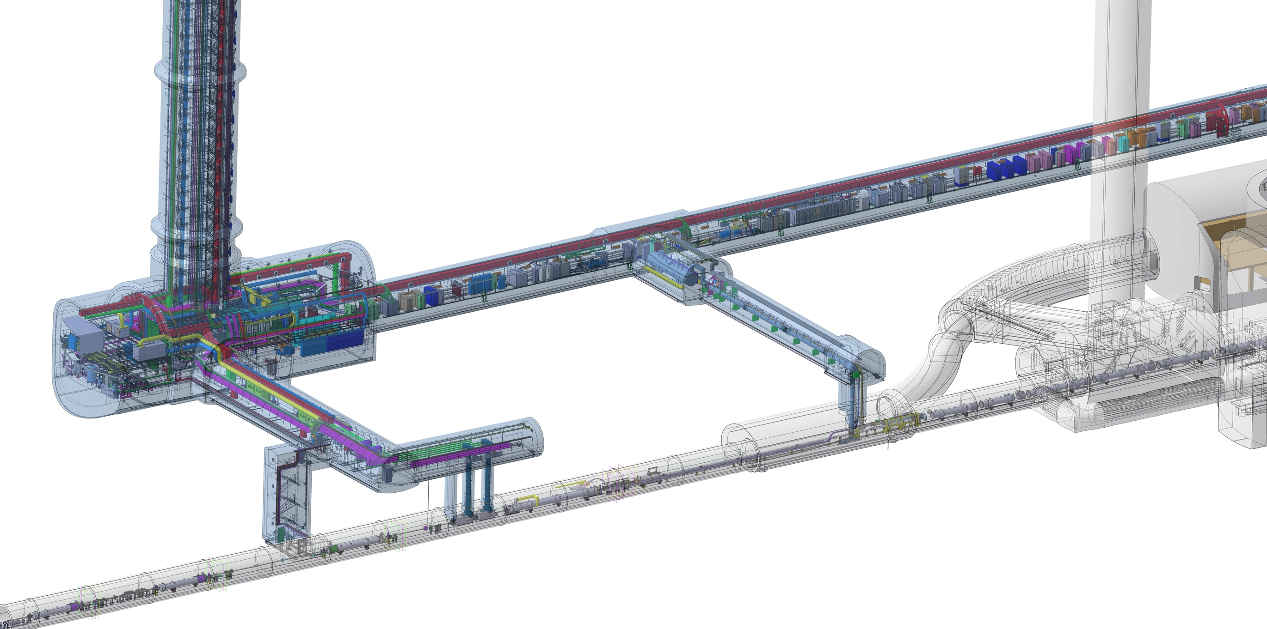
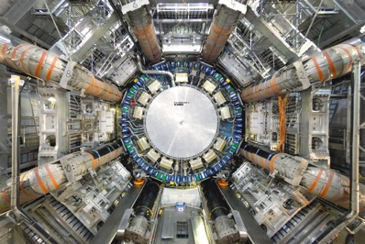
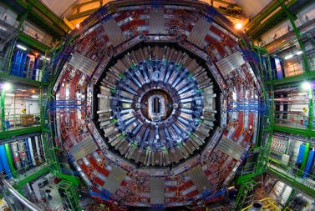
HL-LHC Technical Challenges: Machine Efficiency
QDS
UR55
Warm Diodes
CLIQ
PIC,BIS
CDBs
OC EE
Valve box
DFHX
D2 OC PCs
DFHM
US57
D2 PC
D1 PC
OC PCs
UW57
PC IT
PCs IT Trims
CDBs
DSHX
D2 OC EE
UL57
Cold box
DSHM
UA57
D1
CP
Q3
Q2B
Q2A
Q1
RF Powering
DFM
DCM
Cooling and Ventilation
DFX
UPR57
Cold Diodes
TAXN
Operation with levelled lumi calls for longer physics fills
Low radiation areas for electronics
Accessibility of equipment -> increased maintainability
But up to 100m between PC and magnets!
D2
DQHDS
Crab
Cavities
Q4
Q5
Q6

Slide 28
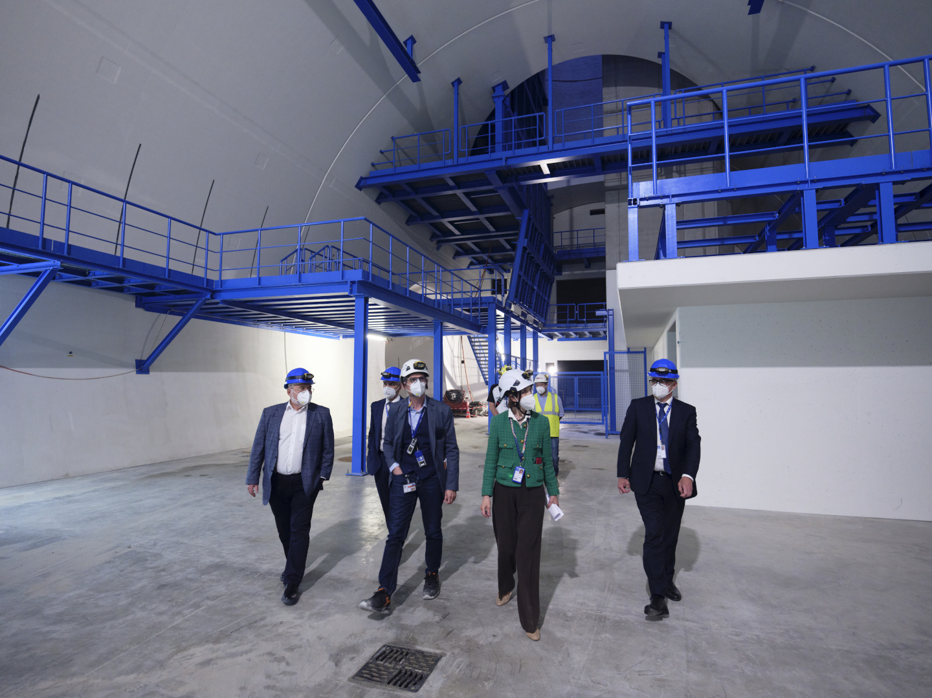
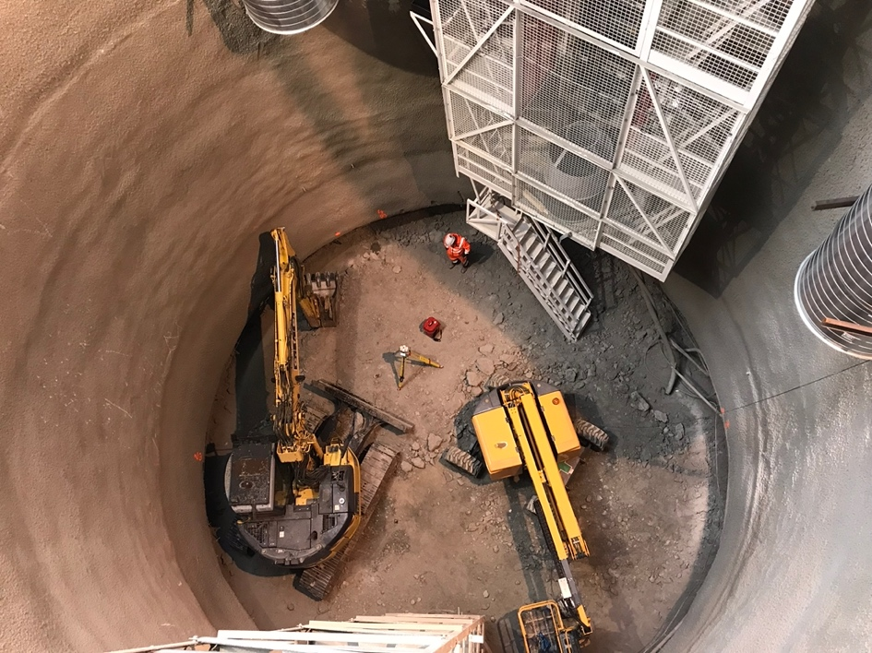
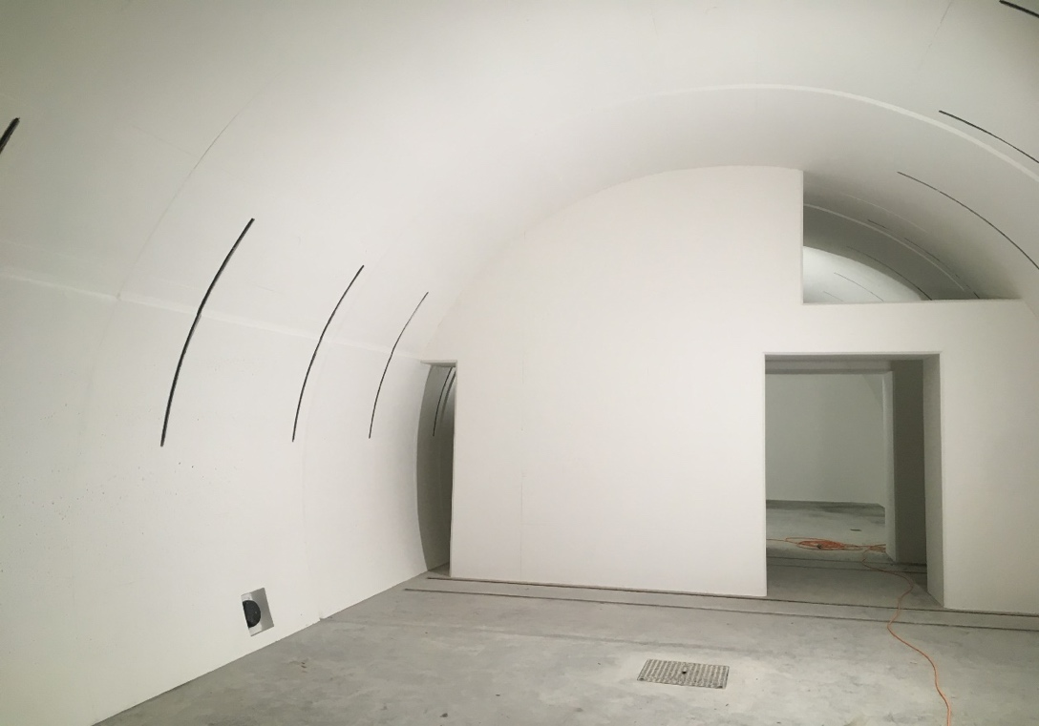
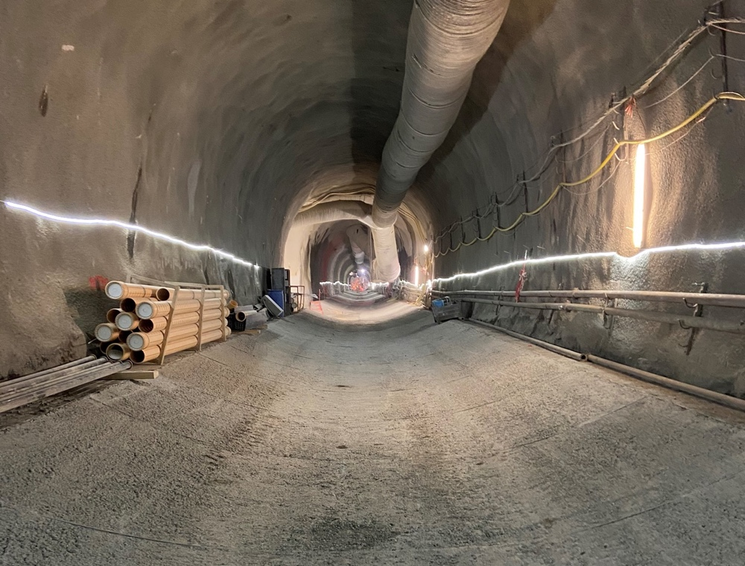






IR1/5 underground civil engineering completed in 2022
Construction Finished End 2022
Work started at End Run1 during 2018
Most of the work was conducted during LS2 ➔ vibration impact
Transition to LHC tunnel
28
Notes:
18

Slide 29



Completion of Surface buildings in 2023
Work Ended Spring 2023
SF17
SU17
SE17
SHM17
SD17
Example Point 1
20th January 2023
Celebration Ceremony: Point 5

Slide 30









HL-LHC Technical Challenges: Cold powering systems based on flexible sc link using MgB₂ superconductor
DFHM
DFHX
DSHM
DSHX
DSHM
DSHX
D2
DCM
D1
CP
Q3
Q2B
Q2A
Q1
DFM
Diam ca. 90mm
> 100kA @ 25K
DFX
30

Slide 31



Mg2B Superconductor and Superconducting link
Cable production complete !
More than half of flexible cryostats at CERN
Assembly of the first complete
system incl. flexible cryostats
is ongoing
Demo-3 in SM18
Successfully Demonstrated
Concept between 2020 / 22
with > 120kA @ 30K
31

Slide 32











Complete System Test ongoing in SM18
SC-Link-DFHX assembly in pictures

Slide 33











The realization of HL-LHC is a truly international collaboration
Connection to LHC (UL)
Service gallery (UR)
UA Gallery
Service cavern
DQHDS
DFHX
DFHM
Q4
Collimators
SC Links
D2
Crab cavities
D1
CP
Q3
TAXN
DFM
DFX
Q2b
Q2a
Q1
TAXS
Notes:
17

Slide 34
Outline
LHC design performance and HL-LHC upgrade goals
(Main) Technical challenges of the HL-LHC upgrade
Inner Triplet String
Preparing HL-LHC operation and performance ramp-up
Conclusions
34

Slide 35




HL-LHC IT STRING: P5L
P4
P5
P5
P3
P2
HL-LHC
P6
P5R
SPS
P7
P1
P5L
P8
HL-LHC Cost & Schedule Review 2022, November 2022

Slide 36




HL-LHC testing facilities in SM18
Magnet Testbenches
IT Test Area
SRF Section
Cold-powering Test Area

Slide 37


The IT STRING Scope
The scope of the IT STRING is to represent, as best as reasonably achievable in a surface building, the various operation modes to STUDY and VALIDATE the COLLECTIVE BEHAVIOUR of the different systems of the HL-LHC’s IT zone (magnets, magnet protection, cryogenics of the magnets and of the superconducting link, magnet powering, vacuum, alignment, interconnections between magnets, and the superconducting link itself).
The IT STRING will deliver the first complete experience of installing and operating the IT zone
Early involvement of OP would be extremely important and beneficial for later commissioning in machine
Ref. HL-LHC IT STRING Scope https://edms.cern.ch/document/1693312/1

Slide 38






IT String Status in pictures
PC and Energy Extraction racks installed on the metallic structure
Cryo Distribution
On top of the empty metallic structure
Under the metallic structure
Q4 2024
Q1’25
Q2-Q4 2025
Q1’26
Q2’26

Slide 39





FIRST 10 Ampers in the HL-LHC IT STRING
The 120 A circuits are with the smallest current ratings among all STRING circuits. They rely on known LHC technology.
slides.of Y. Thurel are here for more details
All eight converters ramping from -10A to +10A | Imeas [A]

Slide 40
Outline
LHC design performance and HL-LHC upgrade goals
(Main) Technical challenges of the HL-LHC upgrade
Inner Triplet String
Preparing HL-LHC operation and performance ramp-up
Conclusions
40

Slide 41

HL Installation in the LHC during LS3 @ P1&P5

Slide 42

HL-LHC hardware commissioning to start already in mid 2028, machine checkout in Q2 2029!

Slide 43

Start of HL-LHC exploitation and performance ramp-up

Slide 44

Then another miracle happens…
Extension of the ALICE run beyond LS4 and the planned LHCb upgrade in LS4, both will have an impact on LHC operation and on the performance reach of HL-LHC.

Slide 45
Outline
LHC design performance and HL-LHC upgrade goals
(Main) Technical challenges of the HL-LHC upgrade
Inner Triplet String
Preparing HL-LHC operation and performance ramp-up
Conclusions
45

Slide 46


Slide 47

Conclusions:
Civil Engineering Work Completed
Nb₃Sn Technology validated
Repaired
MB Dipole
MQXFBP3
Superconducting Link demonstrated
Crab Cavity Operation and Production demonstrated
MQXFB02
D1
proto
CP
The project is on Track for installation
during LS3 starting in 2026
Stay Tuned for completion of the IT-String installation in 2023/24 and operation @ cold as of 2025!
1st Part of Collimation Upgrade completed
All magnet productions on good track!

Slide 48


TDR V1.0 - The last version of the TDR including the added scope - 2020
V0.1 Published in electronic version for the October 2016 Cost & Schedule review
EDMS: 1723851
and as CERN Yellow Book in October 2017
Updated Version V 1.0 published as
CERN Yellow Book in December 2020
https://e-publishing.cern.ch/index.php/CYRM/issue/view/127

Slide 50

Ideal (HL-)LHC operation
Event pile-up in experiments >200
Levelling with
crab-cavity
1x10³⁴ cm⁻²s⁻¹

Slide 51


Flexible MgB₂ superconducting links
MgB₂ cable:
Φ ∼ 90 mm
|Itot| > 100 kA @ 25 K
Φ∼ 90 mm
System demonstrator in SM 18
DEMO2
Demonstration of 2 x 20kA +
2 x 7kA in June
in MgB₂ @ 30K
in flexible cryostat
over 60m [54kA total]
MgB₂
L= 60 m
51

Slide 52



MgB₂ Cable Assemblies (1/2)
Received from ICAS 2nd (Triplets) and 3rd (Matching Sections) MgB₂ series cables
Φ∼ 90 mm
  Wire grading and cable map approval procedures established
  Continuous tests at CERN of extracted strands from each constituent cable before approving further operations – 694 test pieces in 2021
  Production planned to be completed by end 2022
Successfully HV tested both in industry and at CERN
To be produced: 5+5 Units

Slide 53



SC Link Cryostats
Received first series SC Link cryostat for Triplets – produced in industry
Leak/pressure tests at the company
Delivery & Reception @ CERN
Final length for Triplets: 74.5 m
  Optimization of leak test procedure
  Visual and endoscopic inspections, dimension controls

Slide 54


First DFHX constructed @ CERN (2/3)
Completed blank assembly of DFHX and
studied of MgB₂/HTS routing

Slide 55


DFX Cryostat
Completed pre-series DFX by SOTON (UK1 ) !
DFHM
DFHX
DSHM
DSHX
D2
DCM
D1
CP
Q3
Q2B
Q2A
Q1
DFM
DFX
CERN-UK1 collaboration under addendum #4 of KE3299/TE/HL-LHC
Design, Manufacturing, QC & CE certification under the responsibility of Southampton University
PRR 3 March 2020. 1.5 intense years from raw material procurement to completion of qualification and CE certification by notified body
Completed in March 2022 at LTI Metaltech & delivered to CERN

Slide 56
Re-Organisation of the HL-LHC Project Office
Departure of Beniamino di Girolamo
➔ Appointment of Lars Jensen as new Collaboration Officer
Request after the Cost & Schedule Review 2022 to separate Budget and Schedule Office
➔ Reinforcement of the Schedule monitoring & control
➔ Redefinition of Project Office Mandates and names
➔ Dedicated Schedule Officer to be appointed by the end of the year
Internal Audit of the HL-LHC project by CERN audit team
➔ Revision and update of ALL HL-LHC related mandates
Migration of the Project Webpages to the New SharePoint platform
https://cern.sharepoint.com/sites/HL-LHC/WP1/SitePages/Collaborations.aspx -> new Collaborations office pages
https://cern.sharepoint.com/sites/HL-LHC/ -> new project Intranet
https://cern.sharepoint.com/sites/HL-LHC/CB/ -> new HLCB site
The HL-LHC Project is in the process of
Strengthening the liaison with the CERN central support team and
Safety Units for the
LS3 Organization

Slide 57

HL Project Management and Organsiation

Slide 58

Recovery Plan for MQXFB
- New coldmass
- New loading
- New coils
MQXFB03 is the 3rd magnet of 3-stage strategy, integrating all recovery actions
  (1) improved cold mass assembly and fixed point;
  (2) improved magnet loading to avoid overshoot;
  (3) improved coil manufacturing to remove hump & belly.
It was tested in Q3/Q4 2023 and is the first 7.2-m-long MQXFB magnet to achieve target current of 16.53 kA at both 1.9 K and 4.5 K.
It shows good endurance after 2 warm-up/ cooldown cycles with no retraining at 1.9 K; no ramp rate degradation up to 100 A/s; initial training quenches at 1.9 K are all in coil ends (2 training quenches at 4.5 K upon reaching target current plateau under investigation).
Quench Performance of 7.2-m-Long MQXFB03 Quadrupole Magnet at CERN
Ramp rate sensitivity of 7.2-m-Long MQXFB03 Quadrupole Magnet at CERN
Performance limitation and phenomenology observed on previous, full-length, MQXFB magnet straight sections (near apex of hump & belly) have been overcome and root cause has been eliminated.
Series production has been launched (next magnet, MQXFB04, already loaded).

Slide 59


Highlights on MQXFA (US Contribution)
AUP has completed the assembly and has successfully tested on an horizontal bench at Fermilab the first Q1/Q3 cryo-magnet (LQXFA01).
LQXFA01 includes 2 4.2-m-long quadrupole magnets: MQXFA03 and MQXFA04, which were previously tested in vertical station; neither of them exhibited any retraining.
LQXFA01 was shipped to CERN and arrived in SMI2 on 28 November 2022.
It will be retested at CERN on upgraded test bench A2 in Spring 2024 prior to installation in the string (but cannot be used as is for tunnel installation).
Warm thanks to all of those in LMF, EN-MME and HSE who contributed to resolve the issue of weld procedure qualification and paved the way for use of this cryomagnet in the string.
Quench summary of LQXFA01 tested horizontally at Fermilab
Courtesy of S. Feher and G. Ambrosio (Fermilab)
First AUP LQXFA01 cryomagnet mounted on Cryostat Tooling in SMI2 at CERN
Courtesy of D. Duarte Ramos (CERN TE-MSC)

Slide 60

























Nb‒Ti Magnets for HL-LHC
After E. Todesco (CERN TE-MSC)
Good progress on industrial productions of Nb‒Ti magnets for HL-LHC, thanks to efficient collaborations with partner institutes; production of remaining MCBXF correctors to be internalized by CIEMAT and CERN.
MCBRD04
8-m-long, 105-mm-double aperture D2 dipole magnet prototype (4.5/5.3 T bore/peak field @12.23 kA)
2-m-long, 105-mm-double aperture, CCT orbit corrector magnet (2.6/2.94 T bore/peak field @394 A)
Courtesy of S. Farinon (INFN-Genova) and A. Foussat (CERN TE-MSC)
Courtesy of Q. Xu (IHEP) and A. Foussat (CERN TE-MSC)
High-order corrector magnets production completed; all magnets tested and accepted; cryostating of first corrector package underway at SMI2.
MCBXFB04
Courtesy of M. Statera (INFN-Milano) and E. Gautheron (CERN TE-MSC)
6.7-m-long, 150-single-aperture D1 dipole magnet (5.6/6.58 T bore/peak field @12.11 kA)
1.2/2.2-m-long, 150-single-aperture nested dipole magnet corrector (2.1/4.13 T bore/peak field @1.58 kA)
Courtesy of T. Natsumoto (KEK) and J.-C. Perez (CERN TE-MSC)
Courtesy of F. Toral (CIEMAT) and J.-C. Perez (CERN TE-MSC)

Slide 61






Status MQXFA – Q1 & Q3- Assemblies at AUP
STATUS
8 out of 20 magnets build, tested and validated!
From 15 that were produced – 3 during COVID ➔ all non-conformed being repaired ➔ 2 repaired validated
MQXFA08b & MQXFA14b repaired and validating coil replacement procedure and coil production planning
Endurance test on MQXFA05: 50 quenches, 5 TC ➔ magnet remains @ nominal! ✓
Unscheduled mechanical robustness test for MQXFA11 ➔ road accident ✓
Magnet passed acceptance criteria at vertical test station ✓
CA-01: First cold mass reaching nominal performance – no retraining after thermal cycle
Nonconformities but accepted in close collaboration with AUP to assure in-time delivery for IT-String
➔ shipment on its way ➔ Arrival at CERN in December [acceptable for IT-String, not yet for machine]
Cabling completed: https://newscenter.lbl.gov/2023/08/30/cabling-for-lhc-upgrade-wraps-up/
Second Cold-Mass Assembly being prepared for testing at FNAL ➔ second out of 10 CMA
CA01 Arriving @ CERN November 28th 2023
CA01 Leaving FNAL October 30th 2023

Slide 62






Lift Installation in Pt1 and Pt5
    PM17 issue resolved thanks to help of many CERN teams (EN-ACE, SCE, HSE WP17,…)
25/01/2023
concrete spalling
30/01-03/02/2023
Inspection
30/06/2023
Closure of NC
Impact on Schedule minimized by swapping start of Lift Installation from Pt1 to Pt5, but overall ca. 6 month lost for installation of technical infrastructure
➔ Not critical, completion of Technical Infrastructure installation still before start of LS3

Slide 63

CERN accelerator complex

Slide 64


LHC Injector Upgrade Project (LIU)
HL-LHC performance relies on more intense and brighter bunches from injector complex (2.2E11p / 2um at SPS extraction wrt to LHC nominal of 1.15E11p / 3.4um)
25ns beam limited by space charge in PS, PSB, SPS; SPS RF power and SPS longitudinal instabilities
50ns beam limited by PS longitudinal instabilities & SPS space charge and SPS TMCI

Slide 65
LHC Injector Upgrade Project (LIU)
Linac4 in for Linac2 | H⁻ injection into PSB at 160 MeV Expected double brightness for LHC beams out of the PSB
Booster | Increase energy to 2 GeV New RF system New main power supply
PS | Injection at 2 GeV Beam production schemes Feedback systems: new wide-band longitudinal feedback; transverse feedback against head-tail and e-cloud instabilities
SPS | Power upgrade of the main 200 MHz RF system Electron cloud mitigation through a-C coating (baseline) or beam induced scrubbing
Successfully deployed during LS2 in 2019/2020

Slide 66


Electron cloud and cryogenic heat load
Electrons are inevitably produced inside the LHC beam chamber. Seed electrons (e.g. from synchrotron radiation) hitting chamber’s walls and ejecting secondary electrons
These electrons can subsequently be accelerated by the proton bunches. When they hit the vacuum chamber wall, they have a probability of ejecting more electrons, the cycle continues, and the electron cloud (e-cloud) is created.
Parameter of interest is the Secondary Emission Yield (SEY), which is the average number of electrons produced per impact
E-cloud both affects beam quality and considerable increases heat load on cryogenic system -> Potential limitation + electricity cost!

Slide 67


Electron cloud and cryogenic heat load
Mitigation: ‘Scrubbing’ runs where increased bunch intensity and train lengths are injected to condition the beam screens
Evolution of the secondary emission yield (SEY) over the 2022 scrubbing run has shown a
A clear reduction of the average SEY is observed in every sector
Conditioning is initially fast and gets slower as the SEY decreases

Slide 68

SEY evolution over scrubbing run
Significant conditioning has taken place in every sector
  Sector 78 showed significantly higher SEY than the other sectors from the beginning, and stays higher even after conditioning
  Sectors 34 and 45 continue to show the lowest SEYs, as in Run 2
SEY start of Run3
SEY today

Slide 69

SEY comparison to 2018
A first analysis has been performed to compare the present cell-by-cell SEY to 2018
In most sectors, the SEYs are currently very close to their 2018 values (at 450 GeV)
  The differences are within the error bars of the analysis
Sectors 67 and 78 still show much higher SEY than in 2018
Sector 56 shows a mildly higher SEY than in 2018
SEY in 2018
SEY in 2022

Slide 70
Outline
HL-LHC design parameters and upgrade goals
Start of LHC Run 3 and lessons learnt for HL-LHC era
  Completion of LHC Injector Upgrade
  E-cloud and heat load
  UFOs and Radiation to Electronics
  Magnet training
  Machine Availability and physics output
Preparing HL-LHC operation
  IT String
Current Project planning and performance ramp-up

Slide 71


UFOs and their interactions with the LHC beams
Dust particles are inevitably present in the LHC vacuum chamber
They get charged and can travel along the electric and magnetic fields of the beam and the surrounding magnets
Interactions with the high intensity proton beams generate fast, localised beam losses that affect operation (and can generate magnet quenches)
Dust samples from the ceramic tube of an injection kicker magnet. (b) shows an enlarged view of an Al₂O₃ particle with a radius of about 5 um
Examples of orbits of charged dust particulates around the LHC beam. Beam screen height is ~37 mm

Slide 72

UFO conditioning in Run2 compared to 2022

Slide 73

UFO rate 2015 vs 2022
Conclusion:
Expected re-conditioning of UFOs at the start of Run3.
Much lower quench margins at 7 TeV and with HL-LHC beam parameters
  Could have a considerable impact on machine availability (especially early in the run)!
(Part) of physics behind UFO mechanism still not fully understood

Slide 74
Quench limits vs UFOs
6.5 TeV
7 TeV
Conclusion:
Expected re-conditioning of UFOs at the start of Run3.
Much lower quench margins at 7 TeV and with HL-LHC beam parameters
  Could have a considerable impact on machine availability (especially early in the run)!
(Part) of physics behind UFO mechanism still not fully understood

Slide 75

Radiation to Electronics
2015:
Start of the year: nQPS SEEs (introduced in LS1)
Rest of the year: mainly FGC2 in the arc
2016:
SEE rate reduction mainly due to lower arc radiation levels (vacuum conditioning)
2017:
Further improvement thanks to FGClite deployment in ARC; most R2E events in power converters in RR (upgraded in LS2 with radiation tolerant versions)
2018:
Increased radiation levels in DS of IP1 and IP5 due to TCL6 opening → impact on QPS equipment (possibly lifetime related, i.e. no longer linear versus integrated luminosity)

Slide 76
Outline
HL-LHC design parameters and upgrade goals
Start of LHC Run 3 and lessons learnt for HL-LHC era
  Completion of LHC Injector Upgrade
  E-cloud and heat load
  UFOs and Radiation to Electronics
  Magnet training
  Machine Availability and physics output
Preparing HL-LHC operation
  IT String
Current Project planning and performance ramp-up

Slide 77
LHC machine sectorisation
5
For superconducting magnets, no DC powering across IPs
Main DC power feed at even points (MB, MQ), some DC power feed at odd points
8 main dipole + 16 quadrupole circuits in LHC
4
6
DC Power feed
Octant
3
DC Power
7
arc cryostat
LHC Sector
Commissioning possible for each sector independent of other sectors
More complex powering system and tracking between sectors
2
8
Sector
1

Slide 78

Training quenches RB Circuits
Collision energy of (HL-)LHC is strictly linked to achievable current of the 1232 (= 8 x 154) LHC main dipole magnets
5 sectors reached 6.8 TeV equivalent, 3 sectors reached 7 TeV
No sign of permanent degradation.

Slide 79

Training history RB.A23
54 circuit quench events,
64 magnet training quenches,
301 magnet heater firings
The 64 quenches in S23 after the 2nd additional TC came as a surprise, as usually training goes faster after a TC
Detailed analysis of the dipole training campaigns is ongoing, including results from reception tests in SM18.

Slide 80

Total nr of quenches in LHC main dipoles
Nr of quenches in the same dipole magnet | Nr of dipole magnets
5 | 3
4 | 11
3 | 56
2 | 154
1 | 446
0 | 562
Conclusion:
Still 562 dipole magnets (45%) never experienced a training quench in the LHC since 2008.
Some circuits (including corrector circuits) showed much longer training than in previous campaigns, and their behavior will be closely monitored in the coming years.
Desired operating currents can still be reached (with only a few exceptions) 14 years after the start of the LHC, with several thermal cycles, numerous current cycles, radiation, and large number of quenches.
a quench is a very violent process (especially in the high-current circuits), and that each quench implies a certain unavoidable risk (short-to-gnd, internal short, quench heater failure, etc).
Decision of collision energy post LS3 will inevitably involve a cost/benefit analysis of required re-training effort (which implies technical risks and considerable time!)

Slide 81
Progress and (initial) training of HL-LHC triplet magnets
Six magnets of type MQXFA from AUP reached performance
  Operation at nominal current plus 300 A, both at 1.9 K and 4.5 K
  Perfect memory, i.e. no retraining, and some robustness
Powering test of conform MQXFA magnets (J. Muratore, B. Ahia, S. Feher et al.)

Slide 82


Progress and (initial) training of HL-LHC triplet magnets
MQXFBP3 includes the new procedures used for LHe vessel integration
  Nominal plus 300 A reached during first powering with one training quench
  No degradation, three thermal cycles
MQXFBP3 on SM18 test bench (left) and test results (right)
(S. Izquierdo Bermudez, F. Mangiarotti, et al.)

Slide 83
Advancements on MQXFBP1 diagnosis
MQXFBP1 performance limitation (6.5 TeV) analysis had a significant breakthrough in January 2022: analysis of limiting coil 108
  Broken filaments in a strand always in the same position of the cross-section, in several sections close to the transition in the poles –in agreement with voltage tap and quench antenna localization
Broken filaments in coil 108, limiting MQXFBP1 (M. Crouvizier, A. Moros, S. Sgobba, et al.)

Slide 84
Outline
HL-LHC design parameters and upgrade goals
Start of LHC Run 3 and lessons learnt for HL-LHC era
  Completion of LHC Injector Upgrade
  E-cloud and heat load
  UFOs and Radiation to Electronics
  Magnet training
  Machine Availability and physics output
Preparing HL-LHC operation
  IT String
Current Project planning and performance ramp-up

Slide 85

Machine Availability vs Physics output – an example
TS1
TS2
TS3

Slide 86

Machine Availability vs Physics output – an example

Slide 87
What defines the productivity / physics output?
Physics output is a function of…
time producing physics beams
turnaround between successive experiments
time to clear faults
physics performance during experiments
machine
understanding
& operator skill
Availability
Maintainability
Scheduling

Slide 88

Availability vs HL-LHC luminosities

Slide 89



LHC 27km circumference: Big & Cold
Beam dumps
Injection B2
Injection B1
RF
1720 Power converters
> 9000 magnetic elements
7568 Quench detection systems
1088 Beam position monitors
4000 Beam loss monitors
150 tonnes Helium, ~90 tonnes at 1.9 K
140 MJ stored beam energy in 2012
370 MJ design and > 700 MJ for HL-LHC!
830 MJ magnetic energy per sector at 6.5 TeV
➔ ≈ 10 GJ total @ 7 TeV

Slide 90
LHC (Large Hadron Collider)
14 TeV proton-proton accelerator-collider built in the LEP tunnel
Lead-Lead (Lead-proton) collisions
1983 : First studies for the LHC project
1988 : First magnet model (feasibility)
: Approval by the CERN Council
1996-1999 : Series production industrialisation
: Declaration of Public Utility &
Start of civil engineering
1998-2000 : Placement of main production contracts
2004 : Start of the LHC installation
2005-2007 : Magnets Installation in the tunnel
2006-2008 : Hardware commissioning
2008-2009 : Beam commissioning and repair
2010-2025 : Physics exploitation
Ca. 20 years magnet development!!!
Ca. 30 years machine development!!!
➔ Significant Time scale extending well beyond that of a physicist’s career!!!
A 27 km circumference collider…

Slide 91



Energy management Challenges in the LHC
Energy stored in the LHC magnet system [8.3T]: ∼10 GJoule
10 GJoule ≅ flying 700 km/h
10 GJoule ≅ 55 km/h
Sectorization!!
-> Tracking
-> [ppm]!!!
560 tons
88’000 tons
Energy stored in the two beams: 720 MJ [ 6 10¹⁴ protons (1 ng of H+) at 7 TeV ]
700 MJ melt one ton of copper
700 MJoule dissipated in 88 us (1 turn)
➔ 8 TW
Installed World Electrical Capacity:
3.8 TW
Beam Dump robustness [core and windows]
Kicker reliability -> many kicker elements
-> Failure likelihood & reliability
1 electron volt = 1,602× 10⁻¹⁹ joule
Notes:
91
Aircraft carrier

Slide 92

(Ideal) LHC cycle and machine efficiency
This becomes more challenging with increased Collider size and Requires even more powerful injector complex!!!!
Minimum of 2h between end of one, and start of the next fill
Average LHC Turnaround time of 4-5h!!!!
Average LHC fill length of 8h ➔ 65% of scheduled physics time!!!
ca. 50% in LHC operation including faults at best conditions!
92

Slide 93


Reality…. 3 typical weeks of LHC Machine operation….

Slide 94
Ideal HL-LHC operation with luminosity levelling
Event pile-up in experiments >200
Levelling with
crab-cavity
1x10³⁴ cm⁻²s⁻¹

Slide 95

Peak luminosities of Hadron Colliders
LHC
HL-LHC
Worldwide Integrated Luminosity prior to LHC: ca. 11 fb⁻¹
LHC Design Goal: 300 fb⁻¹ ➔ LHC likely to reach end of Run3: 350 fb⁻¹ to 400 fb⁻¹
HL-LHC goal: 3000 fb⁻¹ to 4000 fb⁻¹ !
x 35
x 10
Proton / Proton
Proton / Anti-proton
V. Shiltsev,
Physics Uspekhi 55
(2012) 965
Polarized Proton / Proton
Electron / Proton
2020
2030

Slide 96
HL-LHC targets a rich and diverse physics programme
Headline deliverable is 3 ab⁻¹ p-p but the physics programme promises to be impressively diverse…
Ions (ALICE 3 proposed for LS4)
b-physics (LHCb upgrade proposed for LS4)
Forward physics (PPS2)
Neutrinos (SND, FASERnu, FPF)
Long Lived Particles (GPDs, FASER, MoEDAL, CODEX-b, milliQan, MATHUSLA, ANIBUS, FPF)
Fixed target (SMOG-2, Crystal-FT)
https://www.ichep2022.it

Slide 97

SC Magnet
technology
source: L. Rossi
Nb₃Sn
HL-LHC with 11-12T
16 T for HEP
Almost a commodity!
  15-20 t per year for MRI
  ITER needs 500 t
ca x5 cost LHC Nb-Ti
Brittle material
HTS (needed → 20 T)
➔ on going R&D!
Bi-2212: cost today 2-5x Nb₃Sn
YBCO: cost today 10x Nb₃Sn
97

Slide 98

High Field superconducting Magnets
Magnet development requires substantial R&D effort!!!
Transition from NbTi to Nb₃Sn:
HL-LH lead the R&D for 11-15T magnets based on Nb₃Sn technology:
➔15-20 years R&D program
Transition to HTS:
Assume R&D period of similar size ➔ 2035?
Transition from NbTi to Nb₃Sn: requires similar length of R&D!
HL-LHC led the R&D for 11-15 T magnets based on Nb₃Sn technology:
Started in early 2000
➔15-20 years R&D program
➔ Ready by 2025
courtesy: L. Rossi (CERN)
98

