Slide 1


LangChain and HuggingFace: make your life easier!
V. Bencini
MLCF
13/12/2024

Slide 2


Huggingface +Langchain
Huggingface: is a platform that collects tools to build ML applications
Models can be accessed and used directly using a dedicated API
Models for almost every task (https://huggingface.co/tasks)
LangChain: is a framework designed to simplify the creation of applications using large language models.
API provides impressive amount of tools to preprocess data (data retrieving, embeddings, tokenizer ..) for LLMs and to use the models

Slide 3
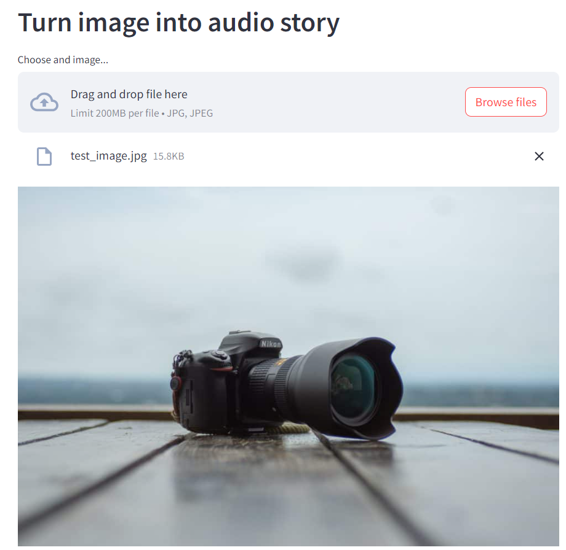
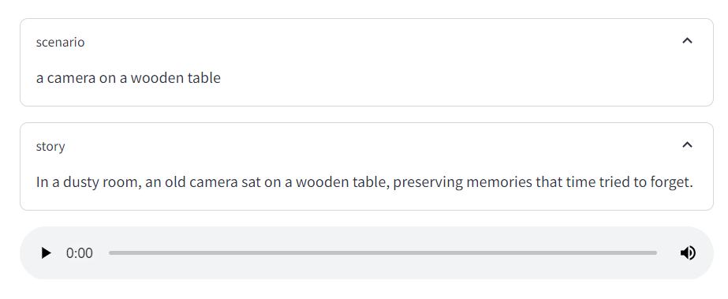
Huggingface +Langchain
Huggingface: is a platform that collects tools to build ML applications
Models can be accessed and used directly using a dedicated API
Models for almost every task (https://huggingface.co/tasks)
LangChain: is a framework designed to simplify the creation of applications using large language models.
API provides impressive amount of tools to preprocess data (data retrieving, embeddings, tokenizer ..) for LLMs and to use the models
Example: Build an app that:
- Captions an image
- Creates a story based on the caption
- Generate a synthetic audio file telling the story
project source: https://www.youtube.com/watch?v=_j7JEDWuqLE

Slide 4
Libraries
Story generation
from dotenv import find_dotenv, load_dotenv
from transformers import pipeline
from langchain.prompts import PromptTemplate
from langchain.chains import LLMChain
from langchain.llms.huggingface_hub import HuggingFaceHub
import requests
import os
from langchain.llms import OpenAI
import streamlit as st
load_dotenv(find_dotenv())
OPENAI_API_TOKEN = os.getenv("OPENAI_API_TOKEN")
os.environ["OPENAI_API_KEY"] = OPENAI_API_TOKEN
HUGGINGFACEHUB_API_TOKEN = os.getenv("HUGGINGFACEHUB_API_TOKEN")
def generate_story(scenario):
template = '''
You are a story teller;
You can generate a short story based on a simple narrative, the story should be no more than 20 words;
CONTEXT: {scenario}
STORY:
'''
prompt = PromptTemplate(template=template, input_variables=['scenario'])
story_line = LLMChain(llm=OpenAI(temperature=1, model_name='gpt-3.5-turbo'), prompt=prompt, verbose=True)
story = story_line.run(scenario=scenario)
print(story)
return story
Image to text
Text to speech
def img2text(url):
image_to_text = pipeline("image-to-text", model="Salesforce/blip-image-captioning-base")
text = image_to_text(url)[0]['generated_text']
return text
scenario = img2text('test_image.jpg')
def text2speach(message):
API_URL = "https://api-inference.huggingface.co/models/espnet/kan-bayashi_ljspeech_vits"
headers = {"Authorization": f"Bearer {HUGGINGFACEHUB_API_TOKEN}"}
def query(payload):
response = requests.post(API_URL, headers=headers, json=payload)
return response
response = query({
"inputs": message,
})
# You can access the audio with IPython.display for example
with open('audio.flac', 'wb') as file:
file.write(response.content)

Slide 5
Useful resources
Projects: Image to speech: https://gitlab.cern.ch/vbencini/image_to_speach
Object detection: https://gitlab.cern.ch/vbencini/object_detection
Huggingface:
  Website:
  https://huggingface.co/
  Education:
  https://huggingface.co/learn
  https://www.youtube.com/watch?v=_j7JEDWuqLE
LangChain:
  Website:
  https://python.langchain.com/docs/get_started/introduction
  Education:
  https://www.deeplearning.ai/short-courses/langchain-for-llm-application-development/
  https://www.deeplearning.ai/short-courses/langchain-chat-with-your-data/

