Slide 1
Supervised learning for Non-Linear Corrections in the LHC
Alejandro Börjesson Carazo BE-ABP-LNO
13/12/2023

Slide 2
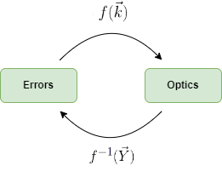
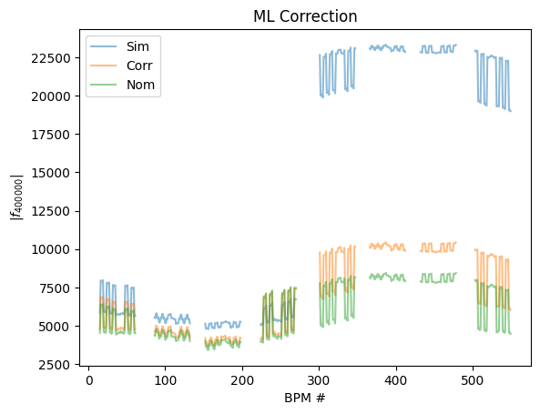
Correction of RDTs in the LHC using supervised learning
  Non-Linear optics simulations are computationally intensive!
  MADX-PTC execution time: 27.17 [min]
  MADNG execution time: 20.00 [s] 82 times faster!
  Datasets vary in size from 7k to 100k samples running on HTCondor
  Best results with bagging ridge regression
  Input: 8 different RDTs simulated all around 376 BPMs in the LHC => 6016 Dim
  Output: K2L, K2SL, K3L and K3SL Errors in the main quadrupoles for IP1 and IP5 => 64 Dim
  R² of 0.9
  Bayesian optimization has been tested, it has proven to be challenging due to the number of variables
Fig 1. Error prediction
Fig 2. ML RDT Correction

