Slide 1

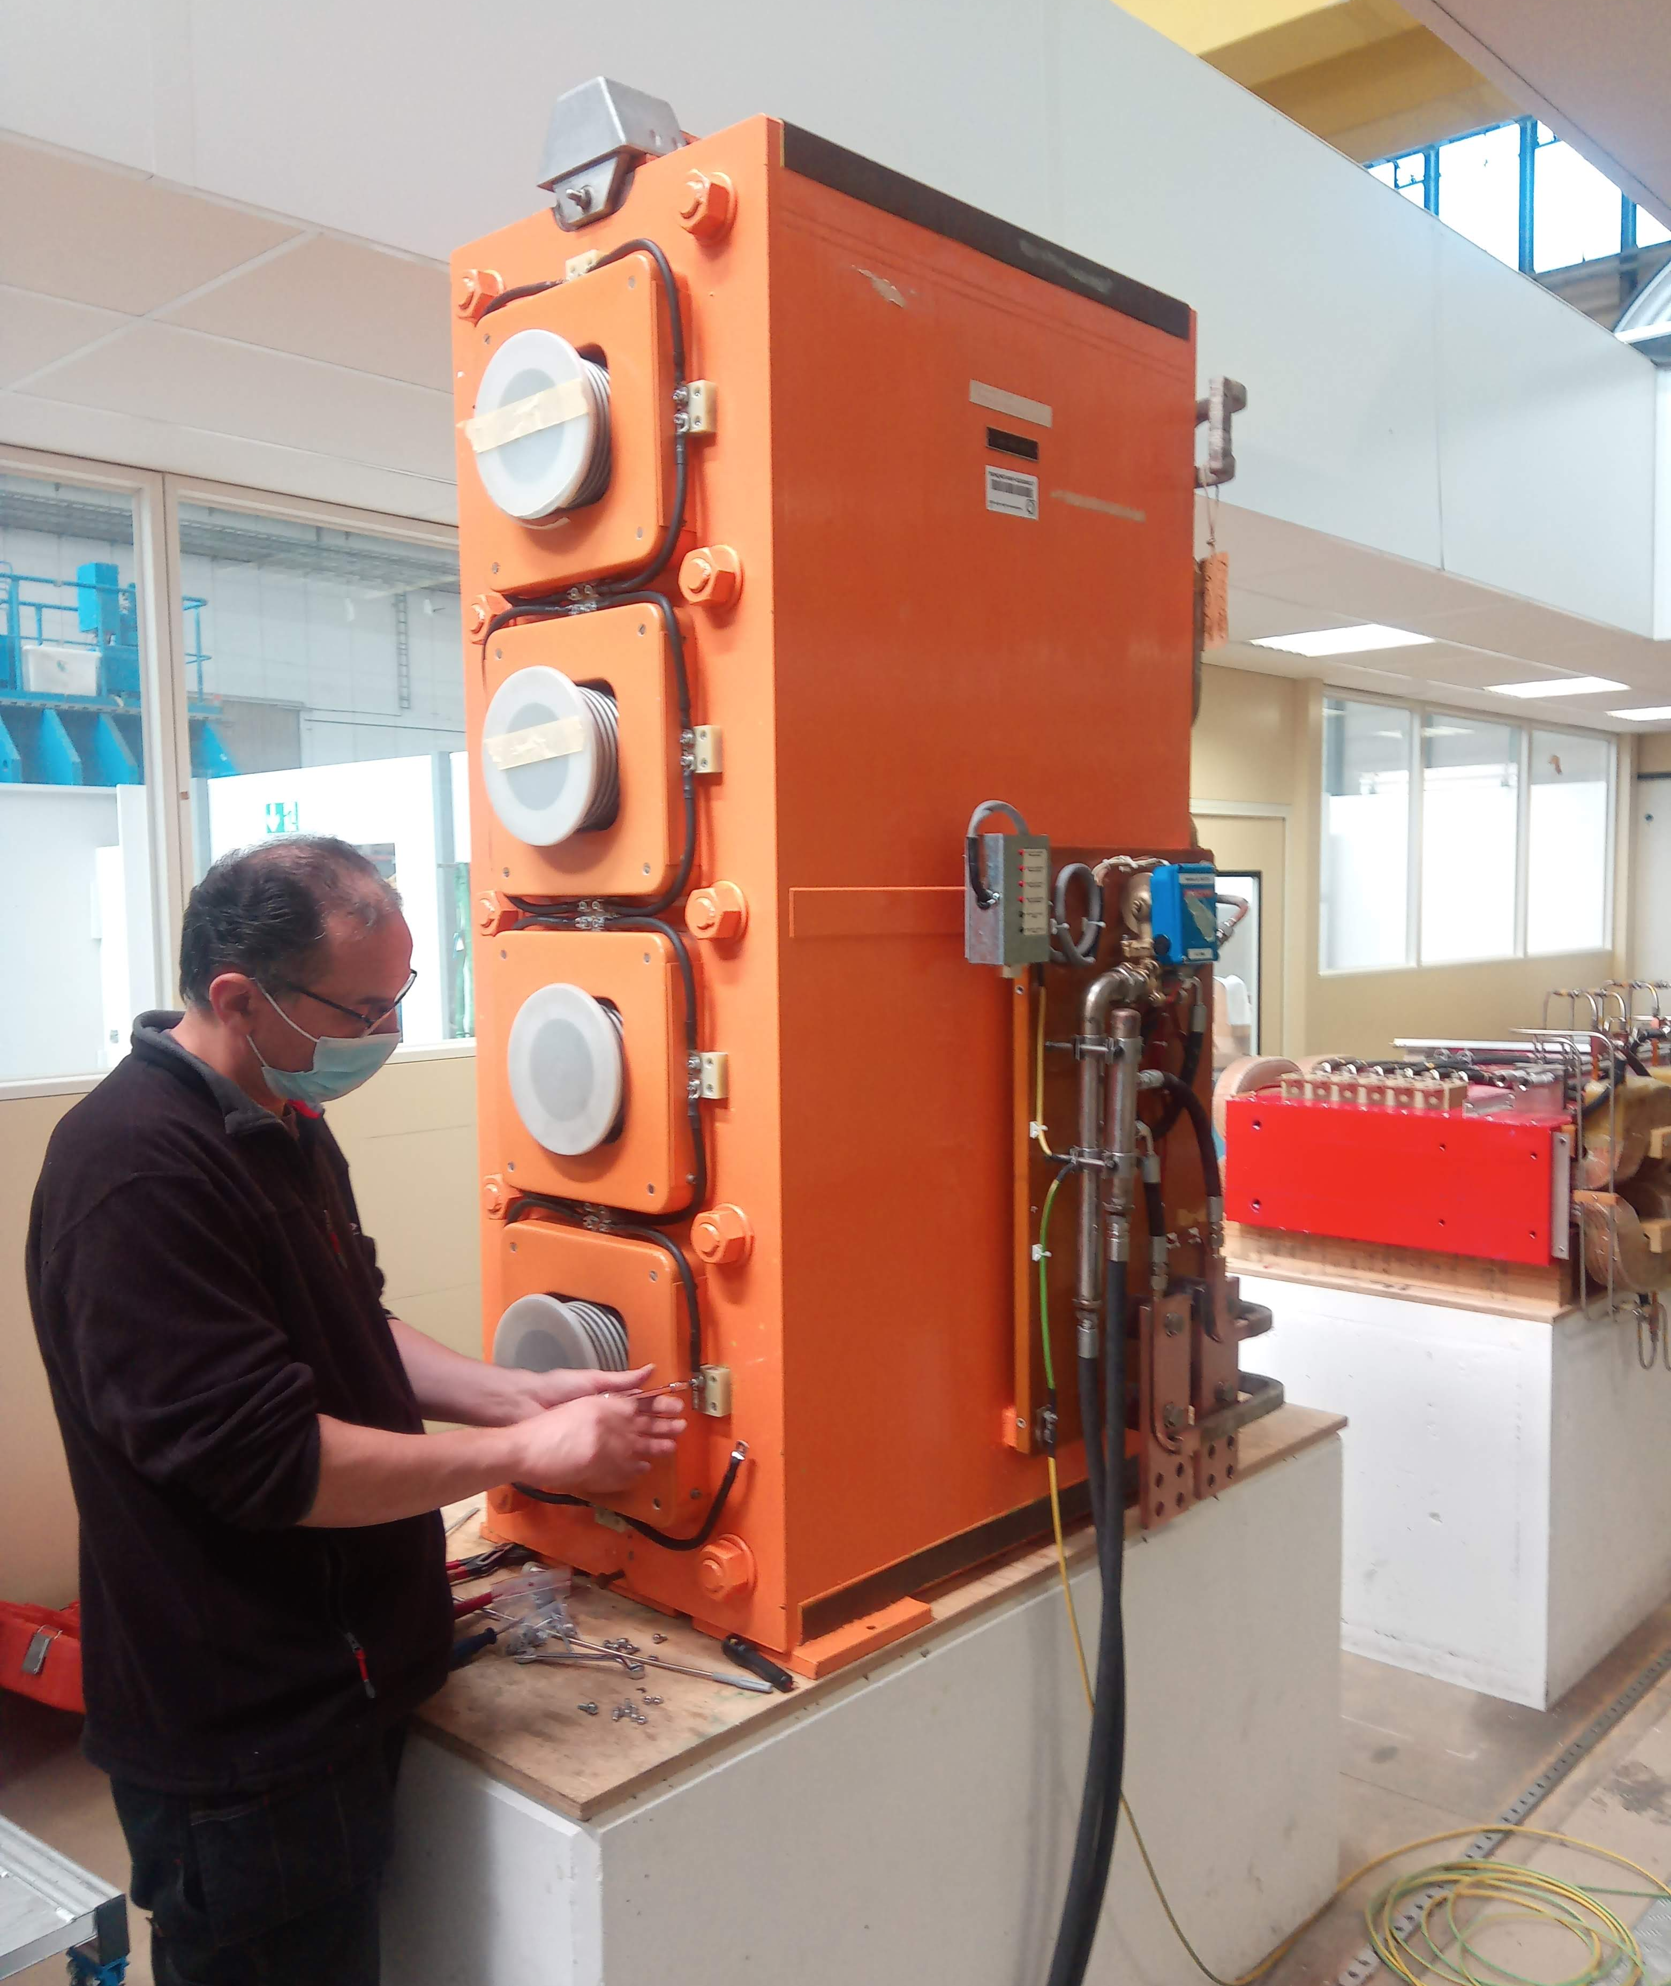

PSB Quadrupole
Renovation & Production Update Dec-2023
M. Karppinen

Slide 2
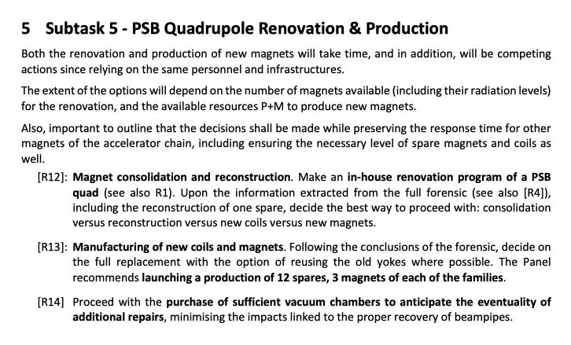

Slide 3
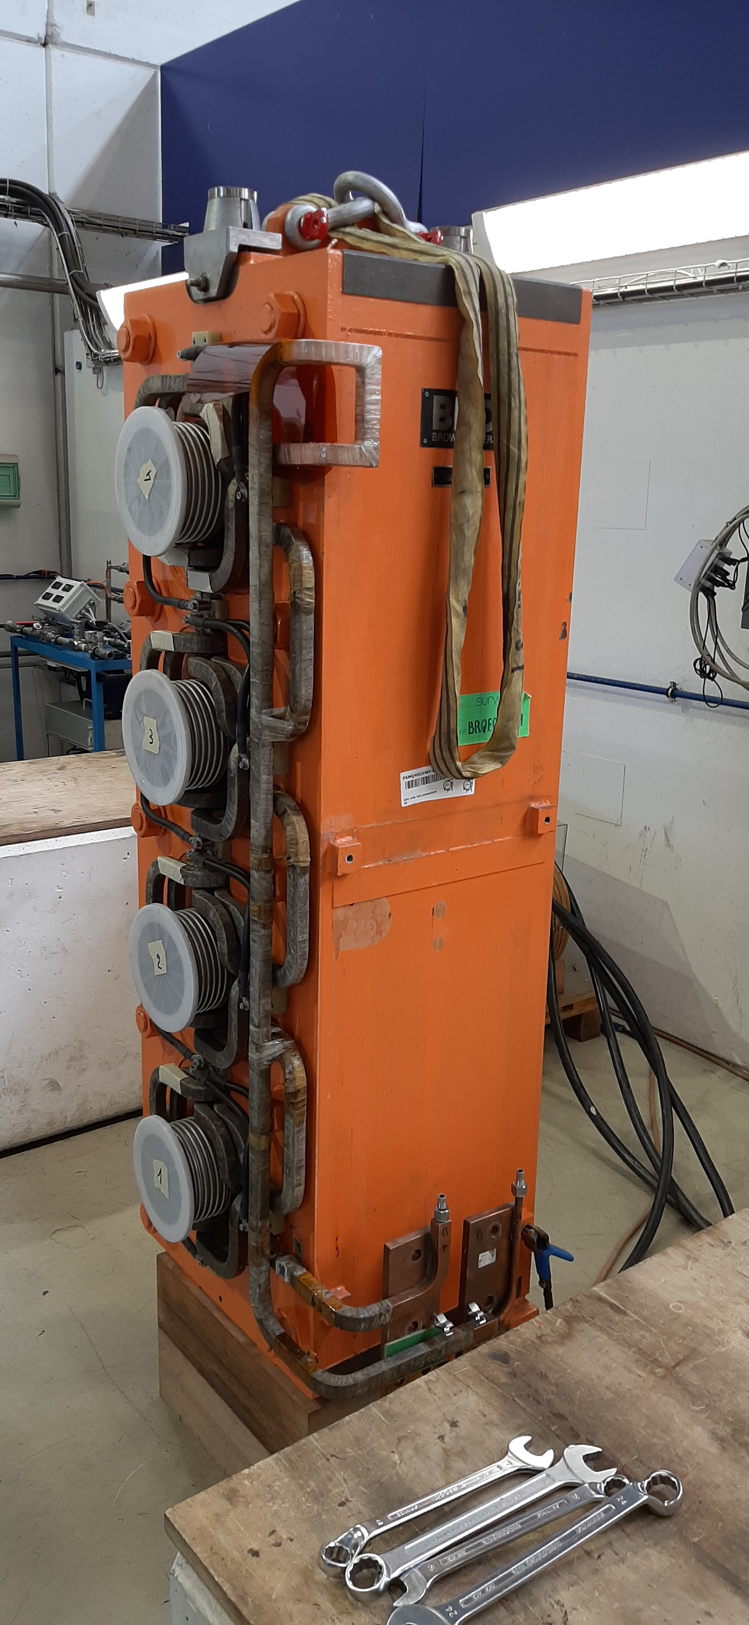
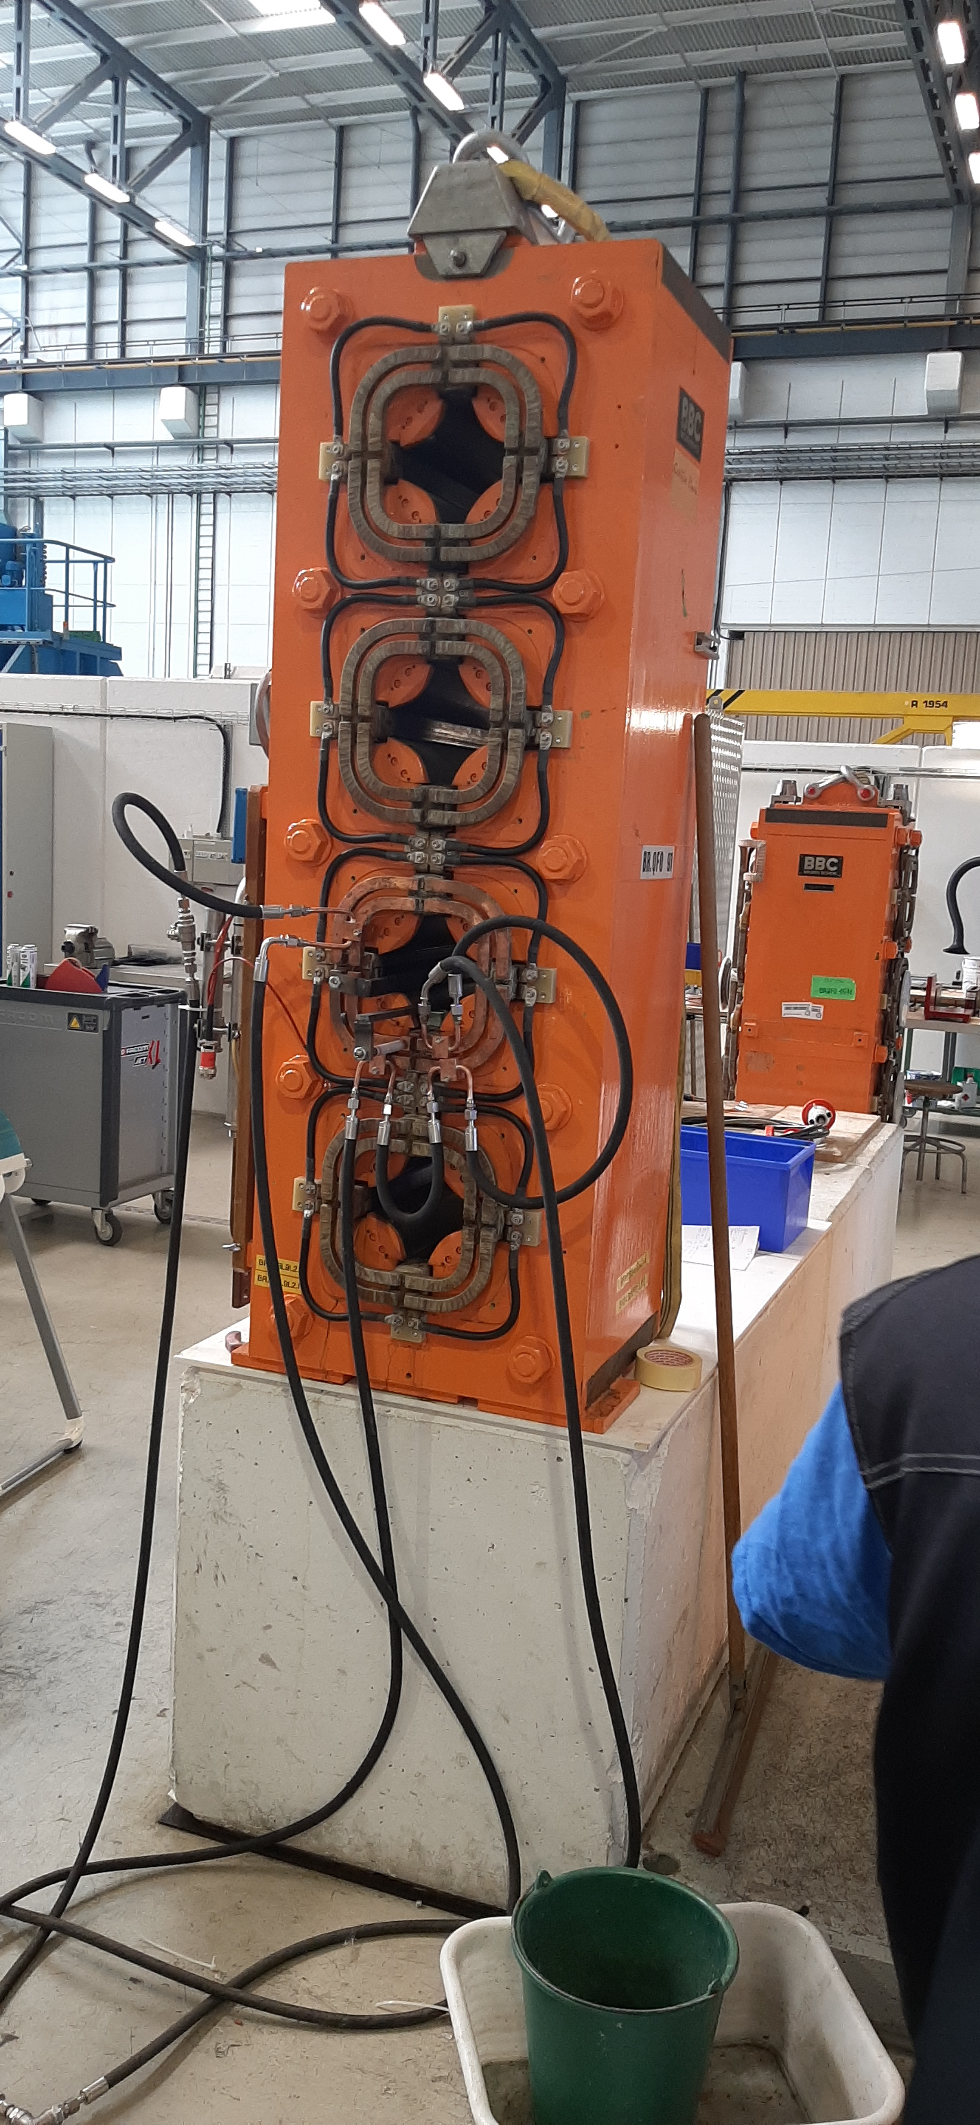
PSB Main Quadrupole
48 installed magnets of 4 types (from 1970’s)
5 Spare units
Laminated iron yoke, no split planes
Coil with 2 turns built up within the yoke
76 brazed connections
Insulation based on Mica/glass fiber wrap
VPI of the whole magnet after coil assembly
After 50 years of reliable operation, water leaks caused by selective corrosion of Cu at and adjacent to the Ag-Cu-P brazing.
Process enhanced by the presence of Sulphur in the cooling water.
Magnets are approaching the end of life and we shall consider replacing them all.

Slide 4
Design File (see update of Nacho)
EN-MME allocated additional external resources
Mock-up:
  Coil design ✓
  Bending tool, brazing jig, CNC jig ✓
Quadrupole magnet:
  3D CATIA design of yoke, coils, assembly (Input for EM FEA vs MM) ✓
  Yoke lamination drawing (press tool) ✓
  First design iteration based on archived drawings ✓
  Verification against spare magnets and reverse engineering as required
  As-built design file by Jul-23 Jan-24

Slide 5
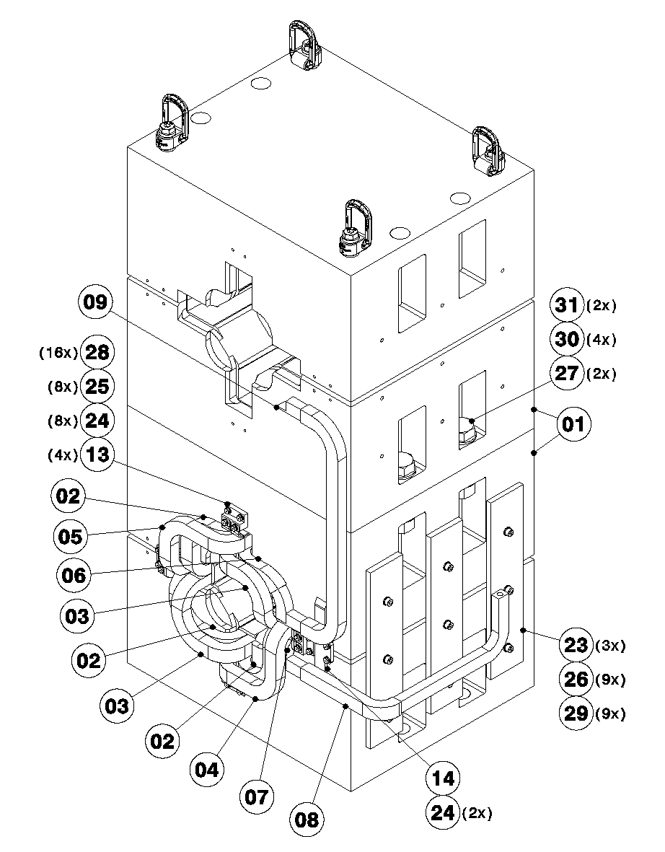
Mock-up: Coil assembly
(see update of Nacho)
Prerequisite for spare magnet stripping and renovation
Coil forming and preparation of parts & sub-assemblies incl. tooling
Representative brazing qualification samples (CT, SEM)
Connection end assembly of the coil
  Vacuum brazing
  Brazing JIG design
Insulation wrapping
Return end assembly of the coil in the yoke incl. trim circuit and ground insulation
  Brazing using SIL-FOS (as-built)
Insulation wrapping
VRTM, gelling with current through the coils
Disassembly of the coils and cleaning of the yoke

Slide 6
Proposed Strategy (Post-Review)
Post-review
Complete design file
Procurement of an autoclave
Procurement of material for 50 off magnets: iron sheets & Cu-conductor
Procurement of yoke laminations for min. 12 magnet assemblies
EN-MME to launch production of 12 yoke assemblies
Mock-up assembly to define the assembly and stripping process, VPI in industry
Complete renovation of a spare F-type magnet:
  Construction of all coil components
  Stripping of coils and cleaning the yoke (assessment of recycling the existing yoke assemblies)
  Analysis of ALL brazed connections
  Coil assembly and VPI
  Complete certification
Assembly of 12 new magnets, 4 of each F-type and 2 of each D-type, at CERN

Slide 7
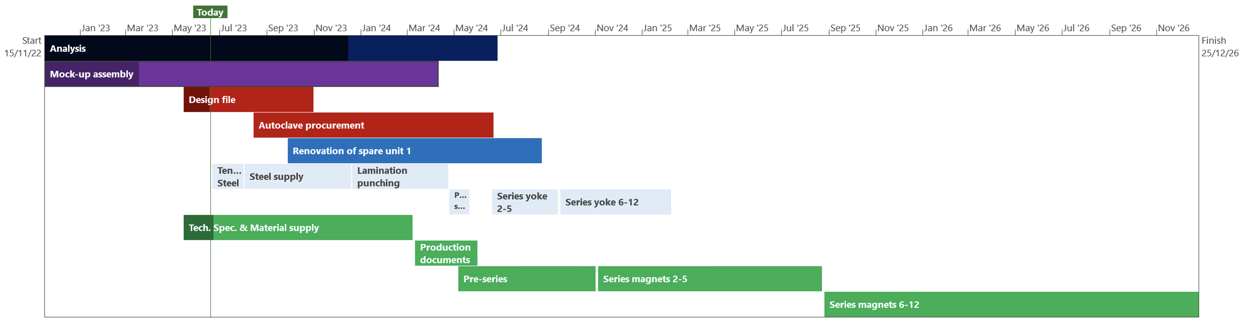
Project Time-line, 1+12 Magnets at CERN
Post-review
Magnet renovation
Steel & lams
Yoke assembly
Magnet production
Link to
MS Project GANTT (Full pdf)
T₀
+14 months
+18 months
+27 months
+42 months

Slide 8
Cost Estimate: Phase 1
Post-review
CERN:
Renovation of 1 unit
Production of 12 new units
Material for 50 units:
Cu-conductor
Iron sheets
Yoke laminations
Option as Phase 2 :
Industrial Contract:
Assembly of ~38 magnets

Slide 9
PSB Main Quadrupole: Strategy Proposal
In the present circumstances, TE-MSC-NCM does not have the resources for the in-house production of 12 magnets
It seems highly likely that all magnets are impacted and shall be replaced/renovated
Renovation of activated magnets is very labour-intensive and requires special measures if done outside of CERN
Proposed strategy is, therefore, the following:
  Renovation of one leaking spare unit at CERN;
  Industrial procurement of yoke laminations for 56 magnets including the supply of some 300 tons of steel;
  Procurement of Cu-conductors for 56 magnets to be provided as free-issue;
  Industrial procurement of 25-55 yoke assemblies;
  Assembly of up to 4 magnets at CERN using the new yoke assemblies;
  Industrial procurement of 25-55 magnets.

Slide 10
VPI or VARTM^{(*}
Full assembly dipped in resin followed by gelling locally around the conductor to maximise resin retention
After cleaning the excess of resin, curing in separate oven
Not clear which process was used for series magnets
VPI would ensure better impregnation within the wrapped conductor insulation, but requires investment in an autoclave
VARTM may provide adequate impregnation. Probably requires a new vacuum tank.
VPI currently not available at CERN and would provide added value also for other projects (HFM, HTS,..).
Autoclave lead-time 8-12 months, 5-700 kCHF.
^{*)} VPI – Vacuum Pressure Impregnation
VARTM – Vacuum Assisted Resin Tranfer Moulding

Slide 11
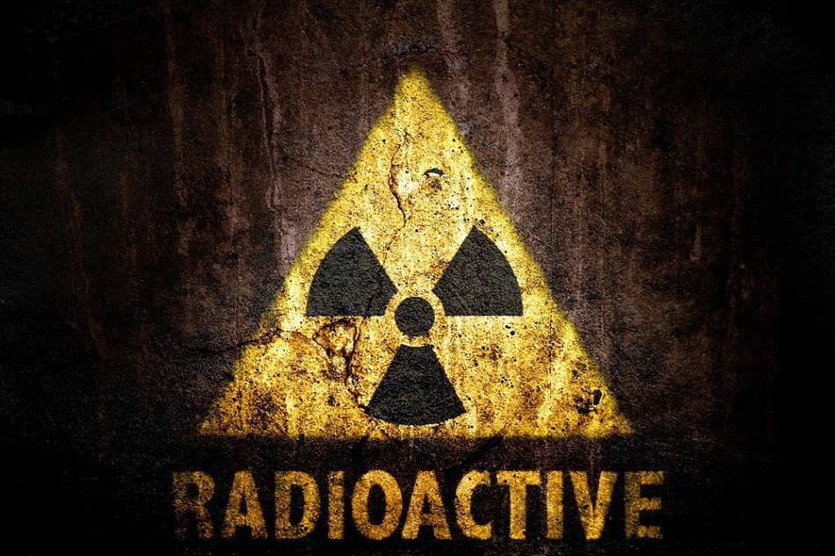
Renovation of 1 Spare Units
Activated magnets
  Shipping outside of CERN is complicated (possible?)
  Safety aspects related to dismounting the coils
  Very labour-intensive
Infrastructure
  Impregnation tooling (VRTM)
  Curing oven
Stripping and re-assembly process to validate with mock-up
Preparation of all coil parts, material, and procedures before stripping
Cost estimate 539 kCHF (incl. 150 kCHF for VRTM tooling)
Certified unit by (earliest) End-2024

Slide 12
Production of New Magnets
Tendering process (MS, IT, FC)
  Yoke laminations, including a supply of ~300 tons of steel ~1000 kCHF
  Yoke assembly 25-56 off ~850 ..1700 kCHF
  Magnet assembly 25-56 off ~4.52 .. 8.25 MCHF
CERN supplied:
  Conductor (56 off) ~430 kCHF
  Assembly of up to 4 magnets with new yokes
  Magnet certification

Slide 13
Project Time-line:
Analysis, Design file, Mock-up
Yoke laminations
Yoke assemblies
CERN Renovation &
production
Magnet production
Link to
MS Project GANTT (Full pdf)

Slide 14
Cost Estimate: 56 PSB Quads
CERN:
Renovation of 1 unit
Rebuilding 4 units
Cu-conductor
Certification
Contracts:
Iron & Yoke laminations
56 Yoke assemblies
Assembly of 52 magnets

Slide 15
Limited production at CERN, launch 3 main contracts ASAP (MS, IT, FC)
Reusing activated yokes is labour-intensive and entails special measures impacting the cost
Renovate 1 spare magnet after mock-up and preparation of components, tooling and procedures
Recommend to launch production of 25-56 new magnets
To coordinate with VSC

Slide 16
Complementary slides

Slide 17
Cost of Renovation 1 Magnet
Post-review

Slide 18
Production 56 Magnets
Yoke Assemblies by CERN
Does not include:
Engineering
Profit margin
Risk
…

