Slide 1
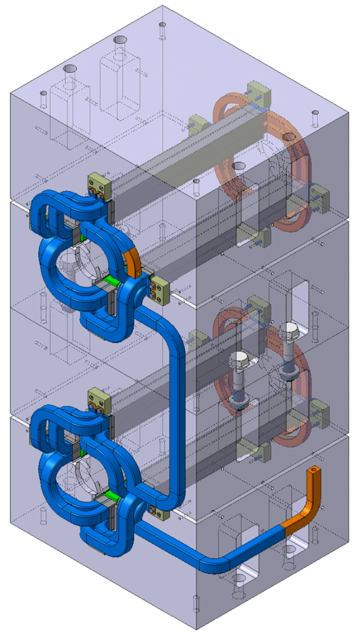
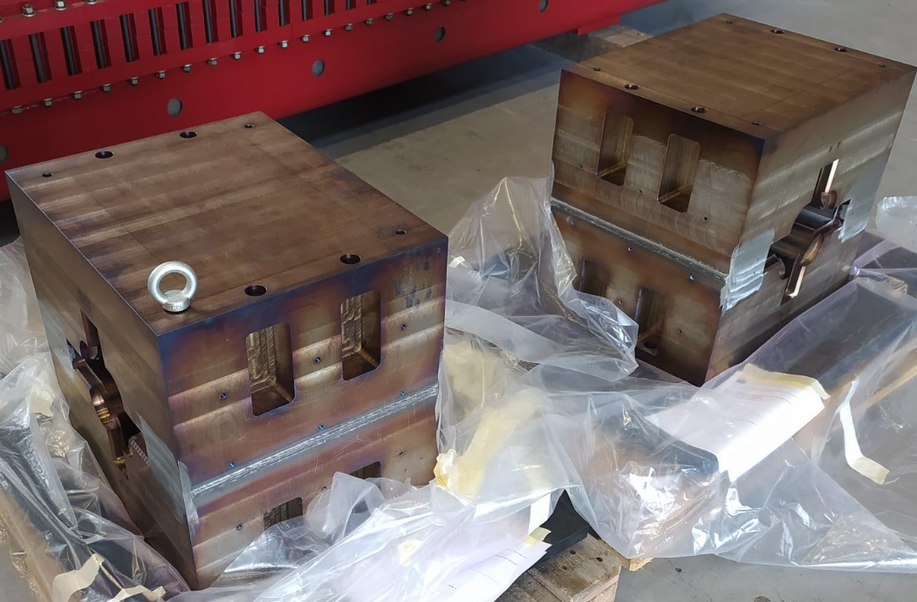
R12 Reconstruction of One Spare Magnet
A mock-up must be built to ensure the assembling + dismantling + 2nd assembling process.
  Mock-up’s main characteristics:
    2 apertures
    No poles
    Updated insulating cross-section
    Vacuum brazing integrated
On validation of the mock-up, completion of the magnet design file and production of the components the strip down of the first magnet can commence.

Slide 2
R12 Magnet Design File Status
The 3D designs corresponding to the ‘as-built’ for the four variants of the magnet are closed.
95% of the 2Ds are complete, it remains to complete the final assemblies which will be completed in January before approval process starts.
Once the mock-up has validated the process, the ‘new’ 3Ds & 2Ds will be prepared.
QD1
QD2
QF1
QF2

Slide 3
R4/R12 Mock-up Main Points
Design file
Raw material procurement
Conductor wrapping system
Conductor bending tooling
Conductor CNC machining jigs
Impregnation process
Vacuum brazing test
Induction brazing validation sample
Assembly procedure
Dismantling procedure

Slide 4
R4/R12 Mock-up Status
Mock-up design file will be released with the validation of each process.
Raw material status:
  Luvata Cu:
    15.1 x 18.5 mm² ⌀7 mm (delivered)
    19 x 24.65 mm² ⌀6 – ⌀7 mm (delivered)
  Samicapor® 366.58C 0.15 mm (delivered) (Mica tape)
  Fiberglass 36.70.20.220.6 ~0.15 mm (delivered)
  APX Cu:
    20 x 1 mm² (expected: December 2023)
  Connection Blocks (G11) (delivered)
  Slot Liners (0.13 mm Nomex 818) (delivered)
  Side Strips (0.5 mm G11) (delivered)
  Ground Strips (0.13 mm Nomex 818) (delivered)
  Base Strips (0.5 mm G11) (delivered)
  Filling Strips (0.2 mm – 2 mm G11) (delivered)
  Wedges (G11) (expected: January 2024)
Note: same raw material will be used for the reconstruction of the spare magnet.

Slide 5
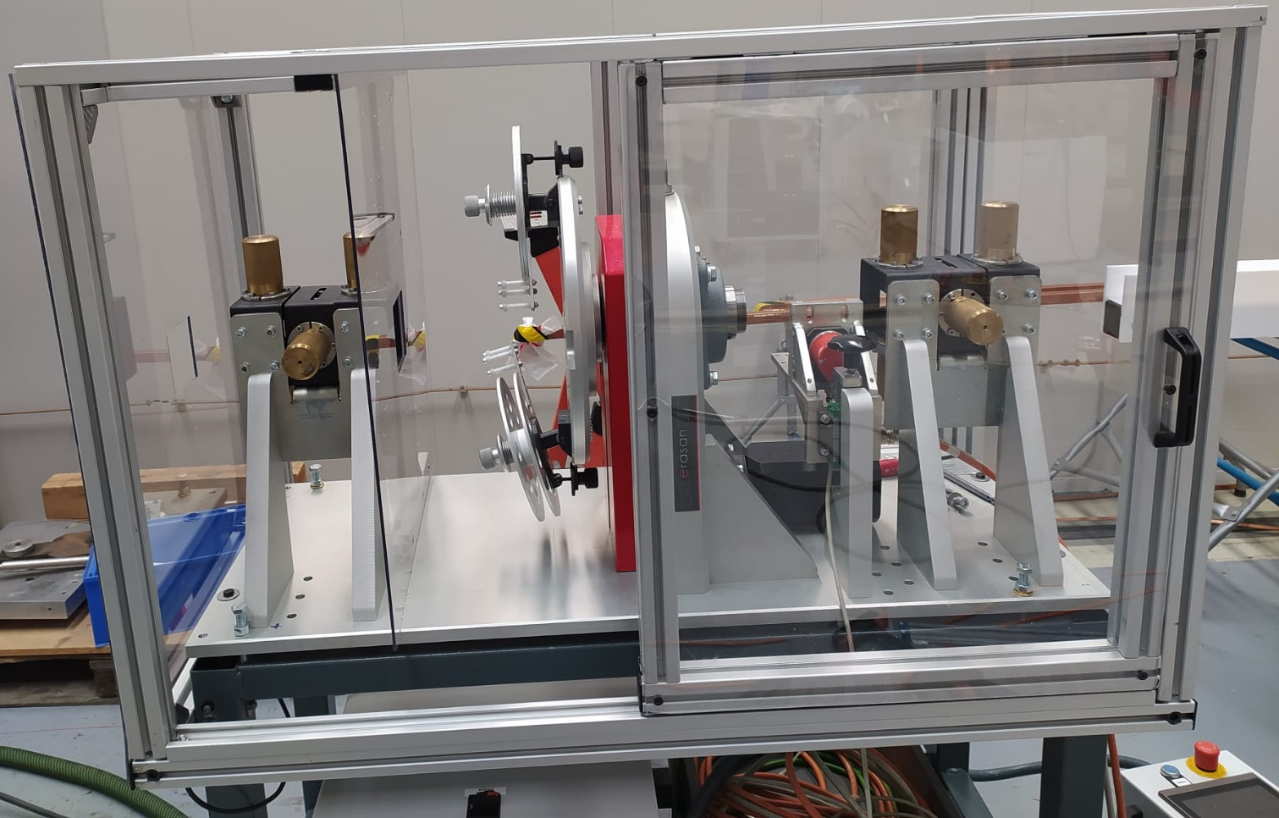
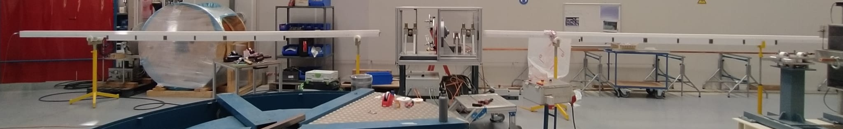
R4/R12 Tooling
Conductor wrapping system has been set-up and partially validated:
  15.1 x 18.5 mm² (validated)
  16 x 1 mm² (validated)
  19 x 24.65 mm² (to be validated; expected: January 2024)
  20 x 1 mm² (to be validated; expected: January 2024)

Slide 6
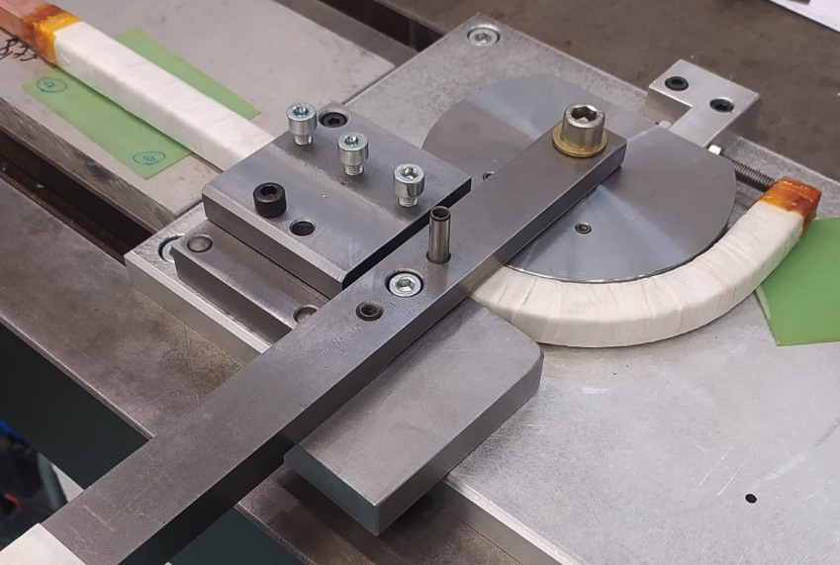
R4/R12 Tooling
Conductor bending tooling:
  R40 & R70 mm corresponding to corner conductors (validated).
  R23.5 mm (expected: January 2024).
  R25 & R38.5 & R40 mm (waiting for offer; expected: January 2024).
Conductor CNC machining jigs:
  1 of 4 under production.
  The section’s CNC machine carrousel is under reparation.
  The limited availability of the CNC responsible means we must find a solution to complete the on-going work and the rest of the jigs.

Slide 7
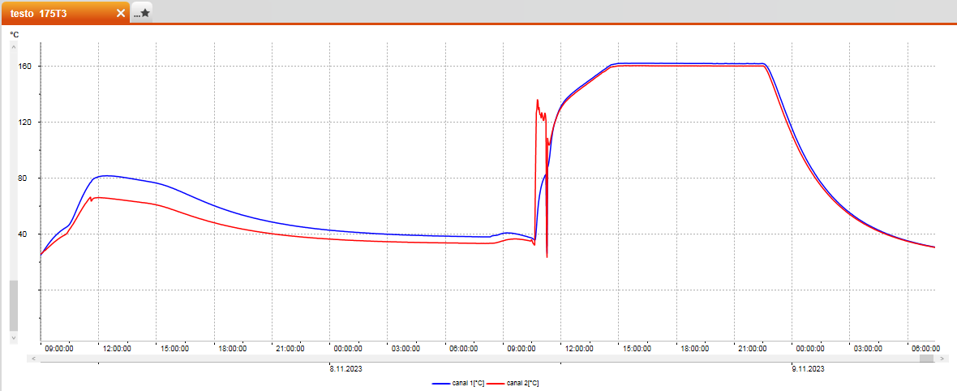
R4/R12 Impregnation System.1
Impregnation process:
  Sample is set-up in the tank where the impregnation will happen.
  Heating starts up to 80 °C.
  Vacuum for degassing starts (~1.4x10⁻² mbar).
  After 3 hours, temperature is dropped to 40 °C (vacuum maintained).
  Resin (Damisol 3420) is pre-heated a few hours before at 40 °C.
  Resin is degassed and stirred for 30 minutes (0.3 mbar).
  Prior to the impregnation, sample tank’s pressure is increase to ~1 mbar.
  Resin is injected and left soaking for 2 hours.
  Vacuum is broken, the sample is placed on a support to drip the extra resin and the sample is heated up to 130 °C for ~45 minutes (gelling).
  The sample is transported to the curing oven.
  Curing cycle starts: 10 minutes at 130 °C + a ramp from 130 °C to 160 °C (10 °C every hour, 3 hours in total) + 8 hours at 160 °C.
Courtesy of C. Urscheler (CERN TE-MSC)

Slide 8
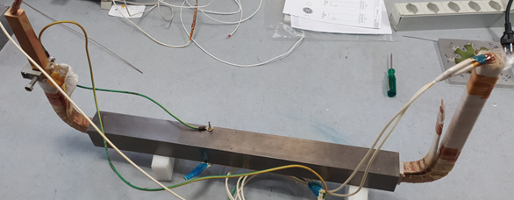
R4/R12 Impregnation System.2
Impregnation process:
  1st sample (455 mm long, 1 conductor):
    HV tests before and after thermal cycling (DC + AC + DC): no leakage current measured at 30 kV DC after thermal cycling.
    Cut in several sections to check impregnation quality.
    Cold and hot push-out tests will be performed (EN-MME-MM).
  2nd sample (455 mm long, 1 conductor): impregnated on 12/12/2023.
  The design of the mock-up impregnation tank compatible with the new 181 vacuum impregnation system is on-going (expected availability: February 2024).

Slide 9
R4/R12 Brazing Systems
Vacuum brazing test:
  Design file (validated).
  Samples manufactured (expected: January 2024).
  VB performed (expected: February 2024).
  EN-MME-MM analyses (expected: February 2024).
  Mock-up conductor production (expected: March 2024).
Induction brazing validation samples:
  Design file (expected: January 2023).
  ‘U – Yoke’ production (expected: January 2024).
  Conductor preparation i.e. wrapping and machining (expected: January 2024).
  Insulating materials preparation and assembly (expected: January 2024).
  Brazing (expected: February 2024).
  Validation (expected: February 2024).
  Polymer lab test (expected: February 2024).
  Validation (expected: March 2024).

Slide 10
R4/R12 Assembly and Strip Down Procedure
Assembly procedure:
  Waiting sample results to complete the definition.
  Not according to the original ‘as-built’ drawings.
Dismantling procedure:
  Waiting sample results to complete the definition.

Slide 11
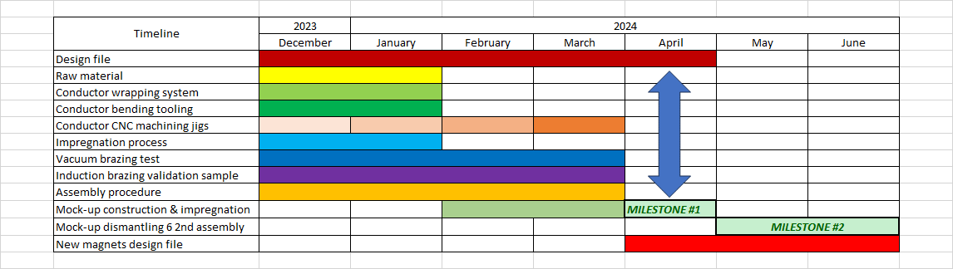
R4/R12 Schedule for rebuild after strip down

