Slide 1
RP recommendations for the PSB quads replacement strategy
PSB Task Force follow-up meeting
https://indico.cern.ch/event/1356657/
Philippe BERTREIX, Gérald DUMONT, Robert FROESCHL, Renaud MOURET, Fabio POZZI, Heinz VINCKE
14th December 2023
EDMS 3006442 v.1.0

Slide 2
Outline
Radiation survey on the PSB quads
Radioactive waste disposal aspects
Radioactive transport aspects
Operational radiation protection aspects
Conclusions

Slide 3
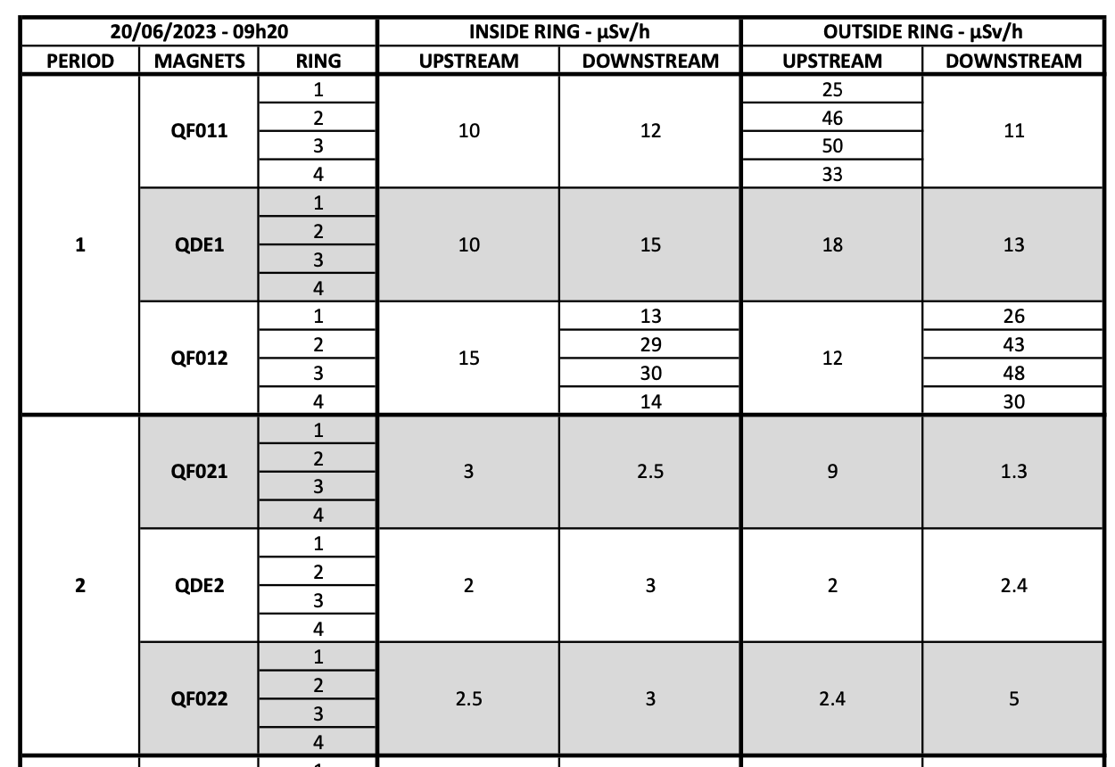
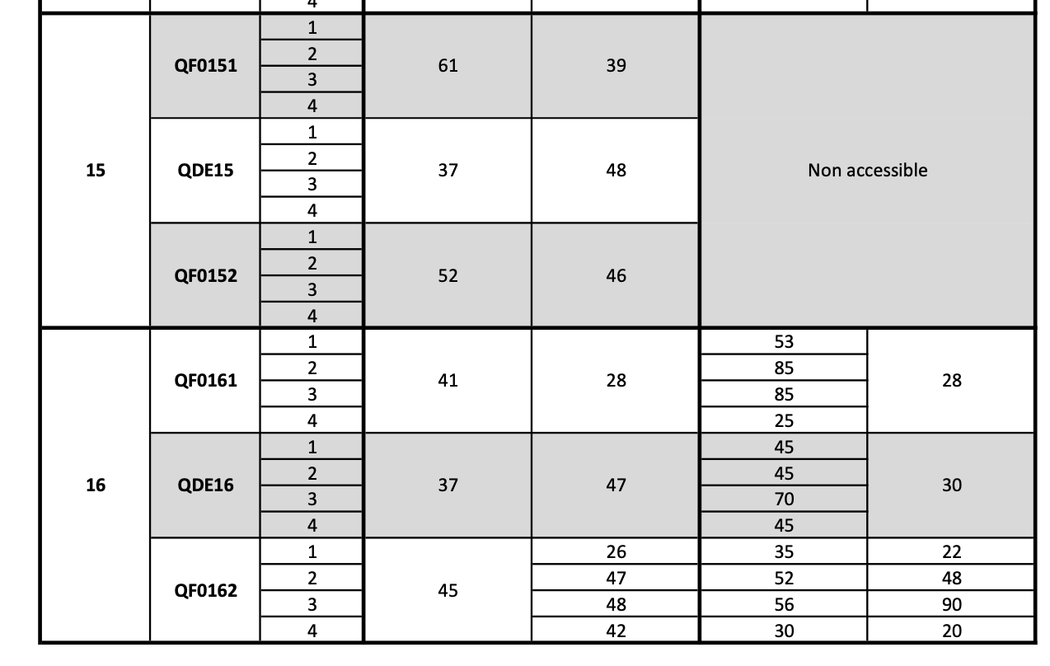
Radiation survey on the PSB quads
During ITS (20/06/2023) detailed radiation survey of the PSB quads at 40 cm distance
  Results used as baseline for considerations on radioactive transport and waste elimination
Beam | Cool-down
SFTPRO, TOF | 24 h
ISOLDE, EAST | 16 h
Other p+ beam | 3 h

Slide 4
Radioactive waste disposal
*Predicted radiological characterization of radioactive waste, based on data extracted from TREC, EDMS 2058249 v.2.1 (2023)
Preliminary RW classification (TFA vs FMA-VC) based on residual dose rate in contact with the element (boundary between TFA and FMA-VC set at 100 μSv/h)
  PSB quads: 60% TFA and 40% FMA-VC
The disposal cost of the 48 PSB quads is conservatively estimated to be about 500 kCHF (including cost of the transports to the final repository but not the CERN internal costs, which will depend on the elimination strategy and timeline)
 | Quantity | Volume | Mass
QFOs | 32 (2 x period) | 0.78 m³ | 5.6 tons
QDEs | 16 (1 x period) | 1.25 m³ | 3.2 tons

Slide 5
Radioactive transport
*It is assumed that the quads will be “dried” (otherwise transport requirements would change)
 | Quantity | Volume | Mass
QFOs | 32 (2 x period) | 0.78 m³ | 5.6 tons
QDEs | 16 (1 x period) | 1.25 m³ | 3.2 tons
Preliminary radioactive transport classification* based on radiation surveys results and operational experience (internal transport simplified approach ⇾ conservative)
  Different classifications (LSA-I, LSA-II, Type A) ⇾ different containers (IP1, IP2, Type A) (probably to be rented)
    For a dedicated project a tailored radioactive transport classification should be discussed but impact on the transport costs could be limited
Cost per radioactive transport conservatively estimated to be about 3.2 kCHF (to CHF – Villigen) or 3.0 kEUR (to FR – Morvilliers)
  Weight (max. 22 tons) and volume/surface limitation (5.9 m x 2.35 m)
    [3 QDEs] or [6 QFOs] or [3 QDEs and 1 QFO] or [1 QDE and 4 QFOs]
  Note de calage/arrimage probably needed: 1.5 kEUR per note per transport configuration (to be drafted only once if the transport configuration does not change)

Slide 6
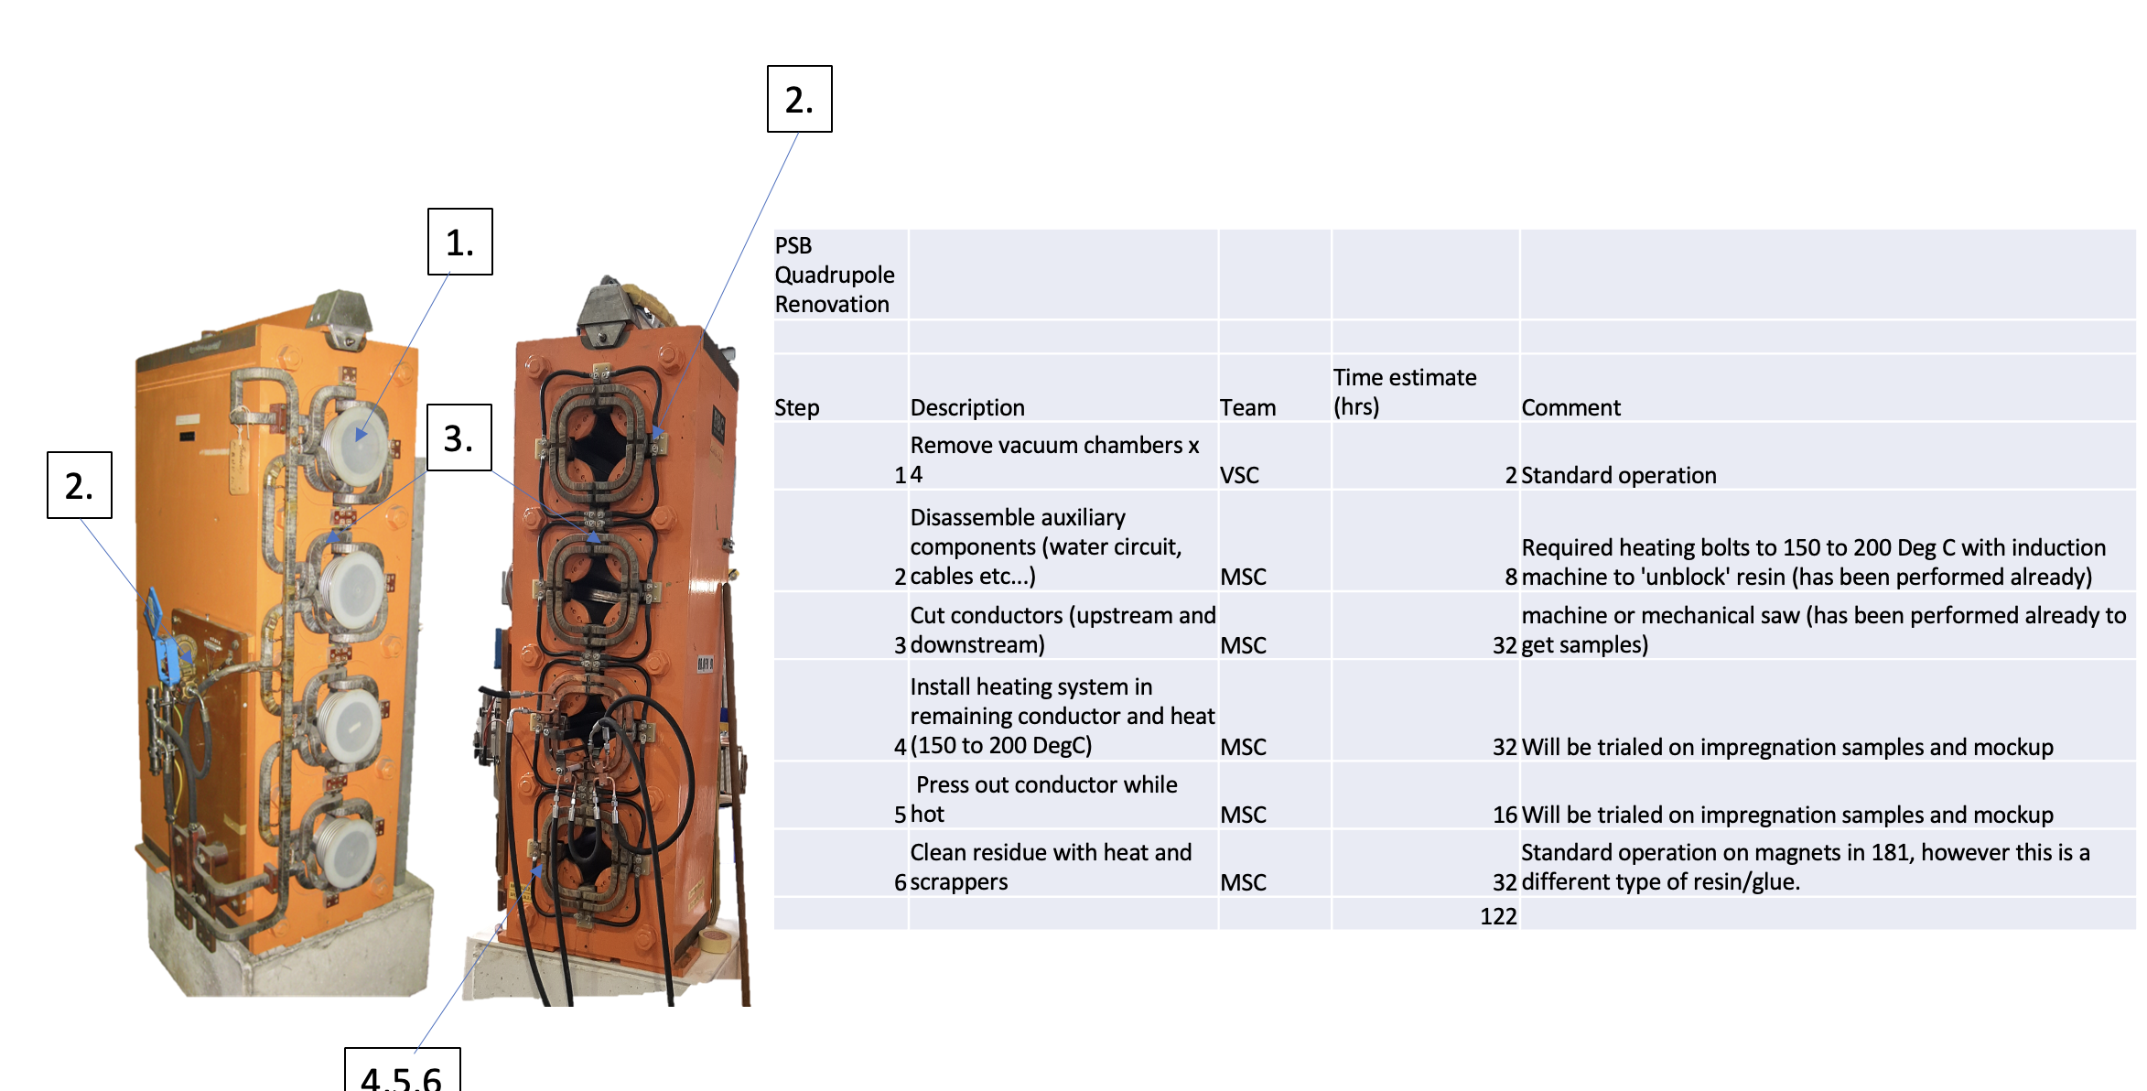
Operational RP aspects
*Courtesy of A. Newborough
Preliminary yoke dismantling procedure available*
  Most of the steps have already been performed in the past at CERN
  Other steps will be tested by TE-MSC beforehand
Workplace for such activities (b. 181) compliant with RP recommendations (already used in the past)
Residual dose rates from PSB quads are relatively low and should not pose issues in terms of individual/collective doses
  Activity will be spread over several years
  Estimates to be refined

Slide 7
Conclusions
Costs for radioactive waste elimination and transport of the PSB quads have been provided based on the available information (conservative estimates)
  Radioactive transport is feasible from a regulatory point of view but the main constraint could be to find a firm/company able/willing to machine radioactive items
RP preference for the reuse of the existing yokes to reduce the overall amount of radioactive waste produced during the PSB lifecycle
  Machining at CERN (e.g. b. 181) is acceptable from an RP standpoint based on residual dose rate and operational experience from similar past operations

