Slide 1

Chat with your Code
How can LLMs support Software Development
– a spark to start a discussion –

Slide 2
0. Agenda
Motivation
Solutions for Coding
Play around
Status
Next steps
Discussion

Slide 3
1. Motivation
Large Language Models (LLMs) like ChatGPT are the ‚hot topic‘ at the moment
Assistance for all kinds of tasks, respectively areas in life as
  Textual Applications
    Chatbot-supported Thesis Writing: An Autoethnographic Report
    How To Write Thesis Using ChatGPT
  Coding Applications
    Large Language Models for Software Engineering: A Systematic Literature Review
  Audiovisual Applications
    Image Processing DALL-E2
    Speech to text
LLMs currently mainly used as a tool
→ How can the software team at TE-MPE-CB profit of the toolbox LLMs offer?
Notes:
There exist a lot of „How-To‘s“

Slide 4

1. Motivation
Dean FPH, Prof. Hnilica, On The Abolition Of Bachelor’s Theses Interview With Forbes
Incoming freshmen joining our faculty in the winter semester of 2024/25 will no longer be required to write traditional written bachelor’s theses. Instead, they will be replaced by what is termed a “bachelor’s project.” This project can be completed in various ways, depending on the student’s preferences and capabilities. Options include undertaking a professional internship in combination with a detailed report from a foreign study stay, participating in a faculty research project, or executing a specific entrepreneurial project.
“The unexpectedly rapid implementation of AI in our lives came, signaling that it was time to change the system in a way that aligns with the faculty’s long-term strategy. This means approaching the conclusion of bachelor’s studies practically, providing much less room for plagiarism, and allowing students to take away far more useful experiences into their lives,” stated Dean FPH, Prof. Jiří Hnilica, in an interview with Forbes.
Jirí Hnilica, explains: “At the moment it is even more likely that a student will have their work done by a professional agency, not by AI.”
You can read the full interview here (sorry only in Czech language).

Slide 5
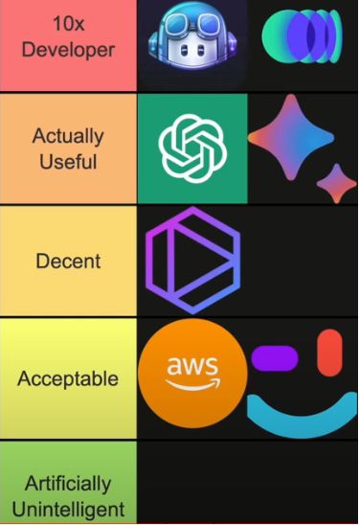
2. Commercially available coding agents
Copilot, Codium AI
ChatGPT, Google Bard
Tabnine
AWS Code Whisperer, Sourcegraph Cody
YouTube: I Tried Every AI Coding Assistant (Conner Ardman)
Notes:
Legal Issues

Slide 6
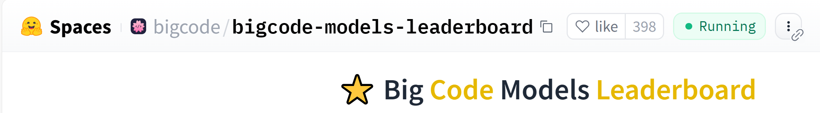
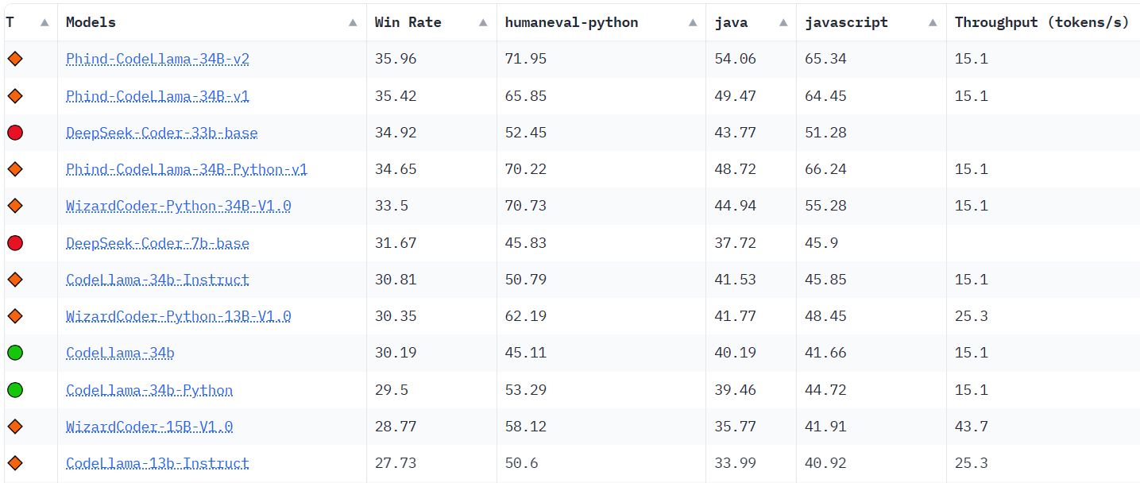
2. Open source coding models
Big Code Models Leaderboard (Huggingface)

Slide 7
2. Comparison of models
 | ChatGPT | Llama 2
price | depends | cheap
transparency | black box | code available
resource usage | intensive | efficient
model size | 8 x 220 B | 7 / 13 / 40 / 70 / 120 / 180 B
token | 32k (8k) | 2k (128k ext. YaRN)
modality | multi-modal | text-only
availability | commercial | non-commercial onlyl
language quality | sophisticated | not as powerful
https://www.labellerr.com/blog/llama2-vs-gpt-3-5-vs-gpt-4/

Slide 8
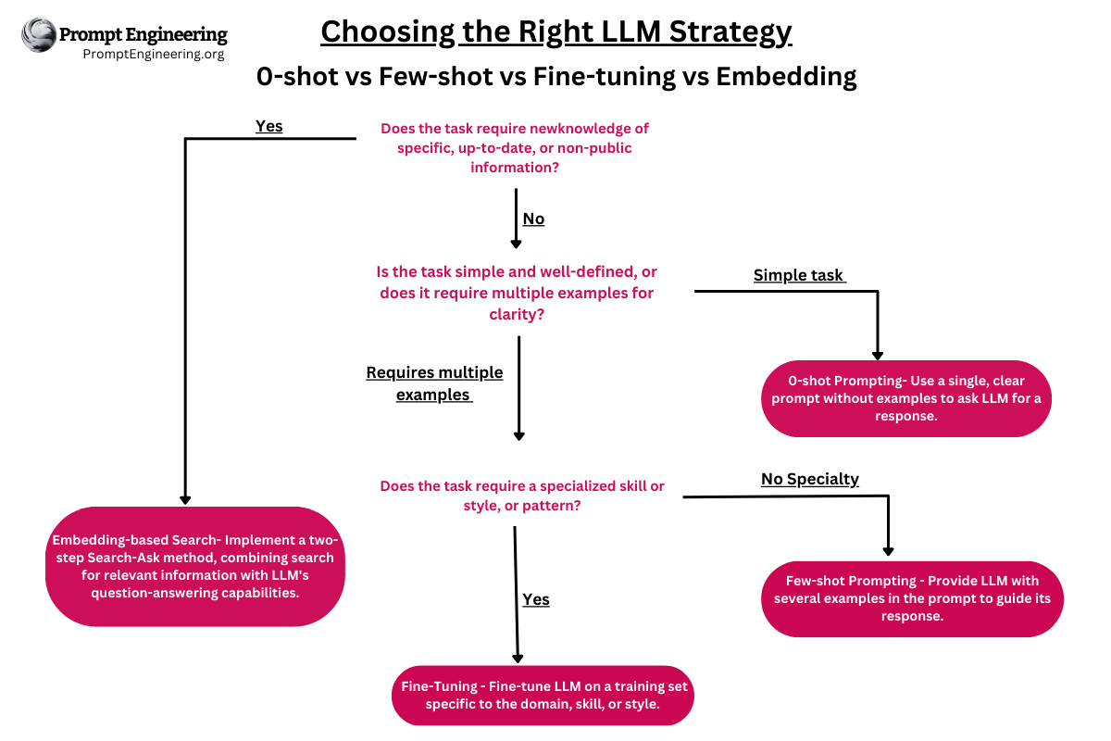
2. Recommendation of methods
Prompting
Embedding
Fine-Tuning
Master Prompt Engineering: LLM Embedding and Fine-tuning

Slide 9
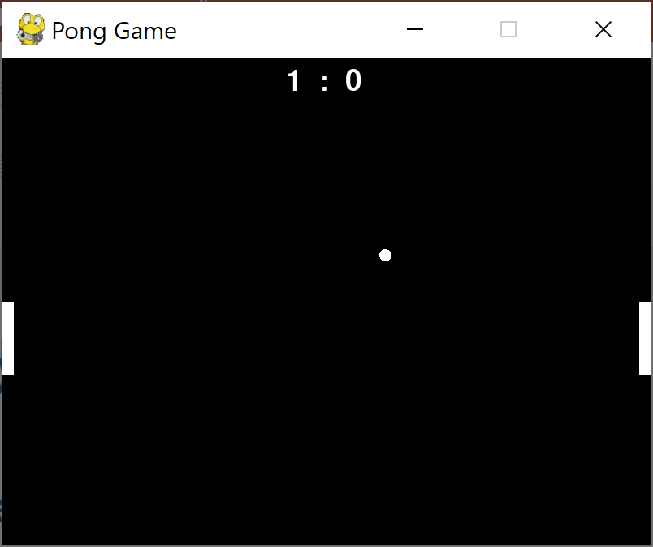
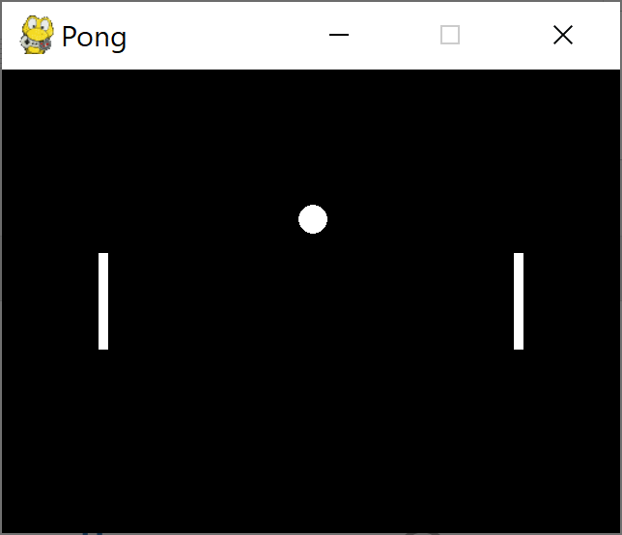
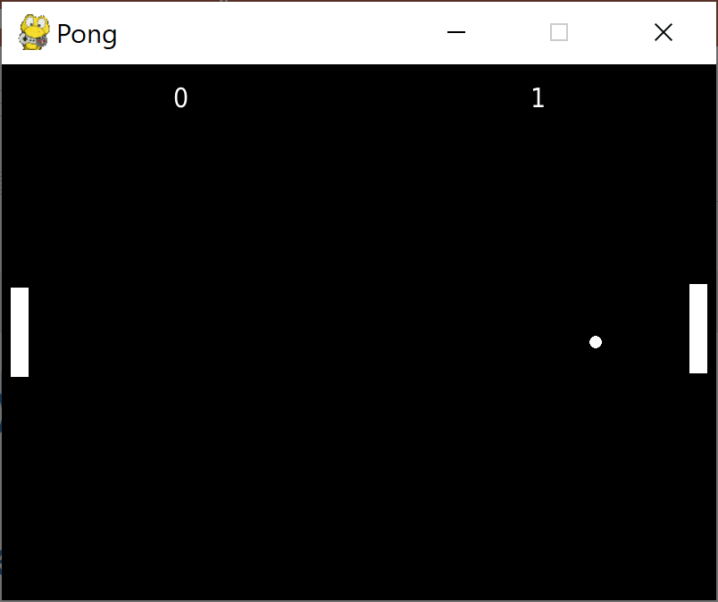
3. Play around
Write a pong game in python using pygame
GPT4 Phind-CodeLlama-34B magicoder-67b (openai.com) (other machine) (playground + improvements by GPT4)
Notes:
90 100 177

Slide 10
4. Status
VM g2.xlarge
Access gitlab via interface (python-gitlab api)
Crawl gitlab repo locally (os, walk, save)
Create Embeddings (json, csv, pickle)
Semantic search for code
Lessons learned
Machine too small for bigger models
Dependencies with old software e.g. CUDA versions

Slide 11
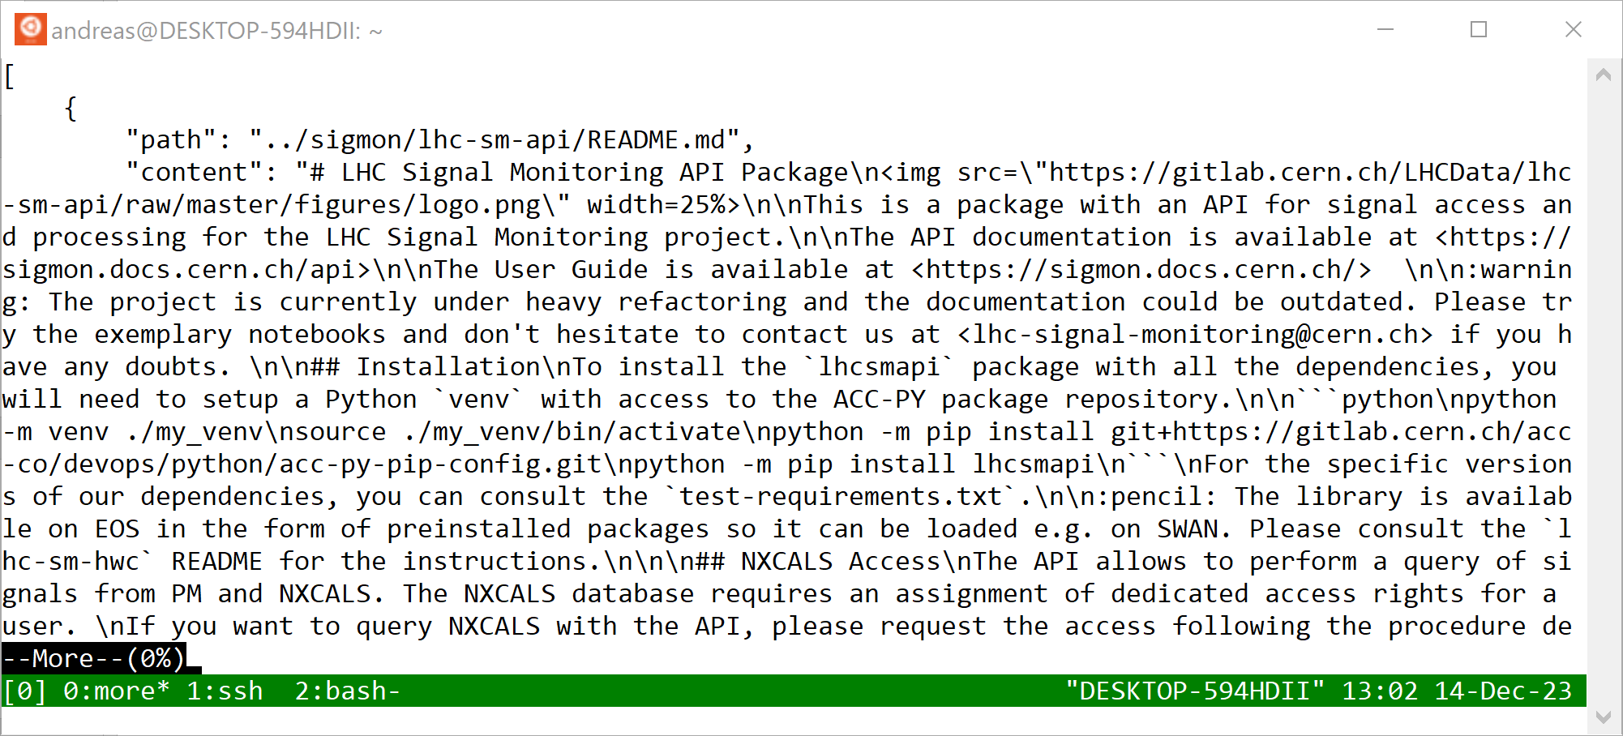
4. Status - Scraping
Path to information
Information

Slide 12
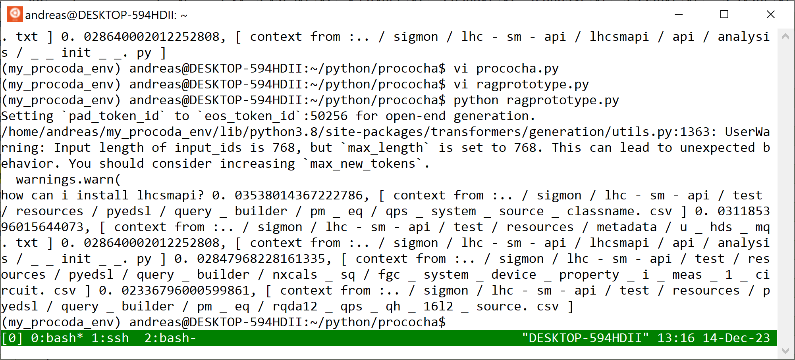
4. Status – Semantic Search
Question
Highest ranked answer

Slide 13
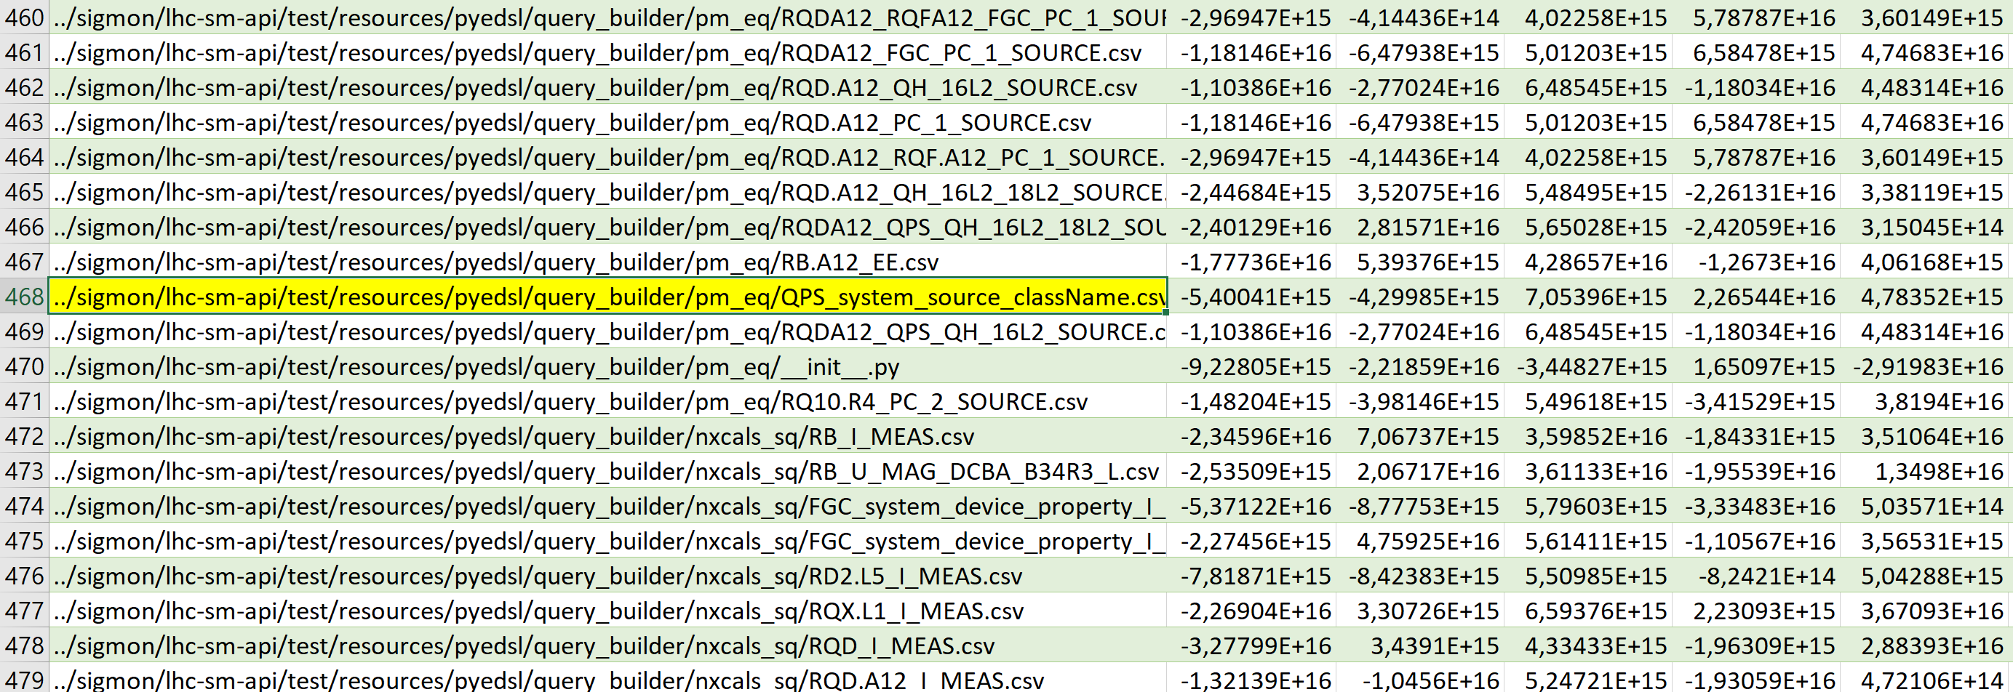
4. Status – Embedding
Highest ranked answer

Slide 14
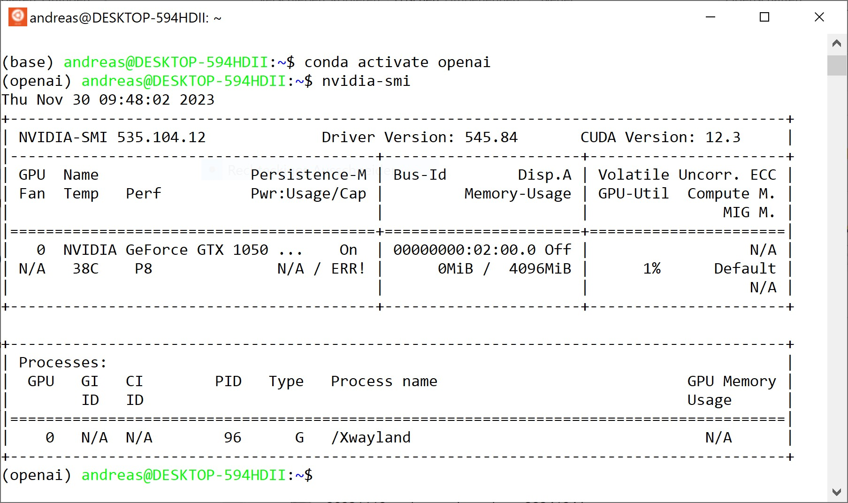
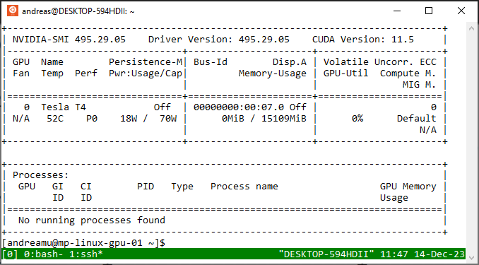
5. Next steps
Hardware and Software
  Local Nvidia Geforce GTX 1050,
  4 GB VRAM, 16 GB RAM
  VM Nvidia Tesla T4, g2.xlarge 16 GB VRAM, 16 GB RAM
  expected
  VM Nvidia Ampere A100,
  g4.p1.40g 40 GB VRAM, 120 GB RAM

Slide 15
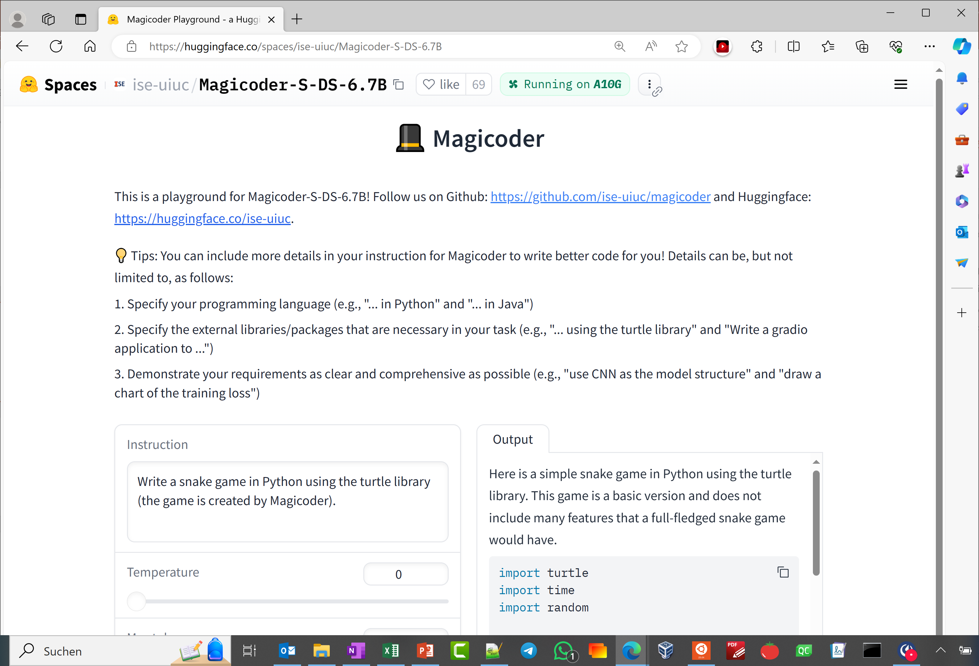
5. Next steps
Check and Improve Embeddings
Implement/Correct Semantic Search
Retrieval Augmented Generation
Scrape Full Directory
Fine-Tuning
ChatBot
Magicoder Playground - a Hugging Face Space by ise-uiuc

Slide 16
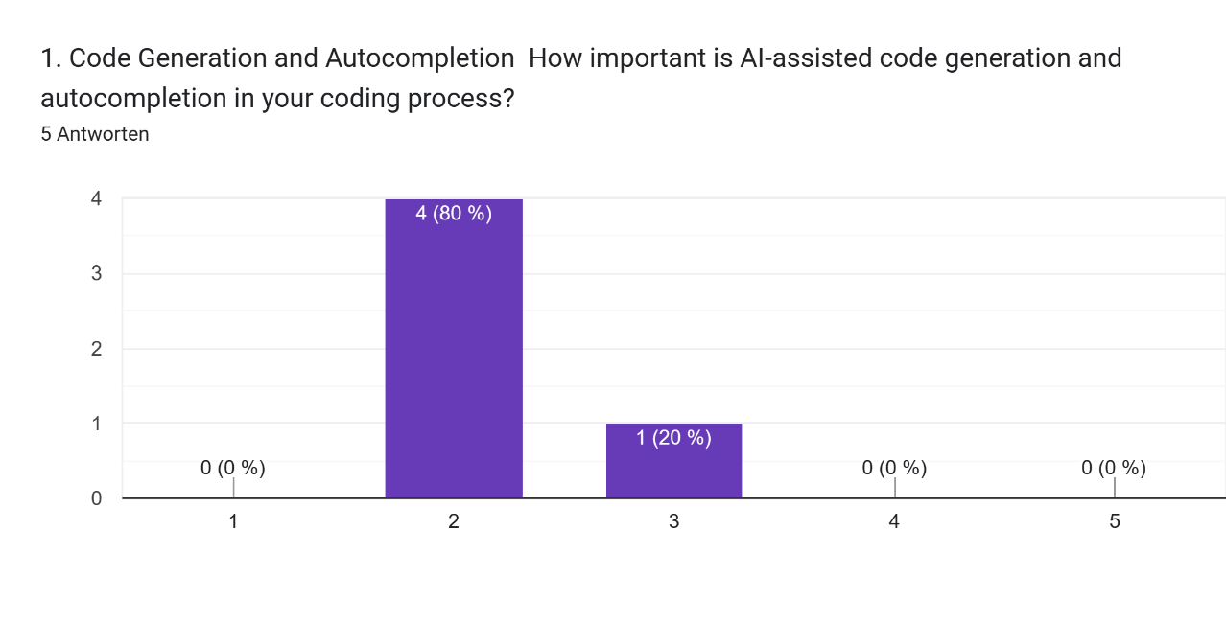
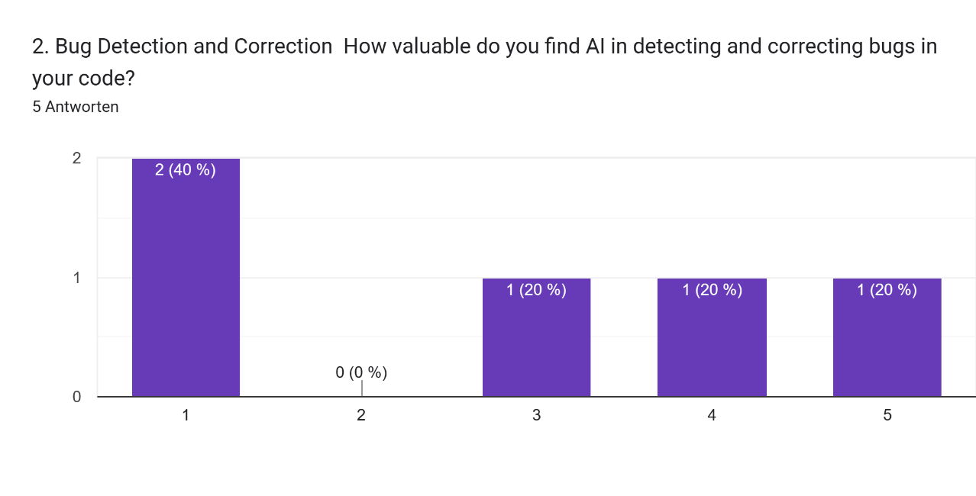
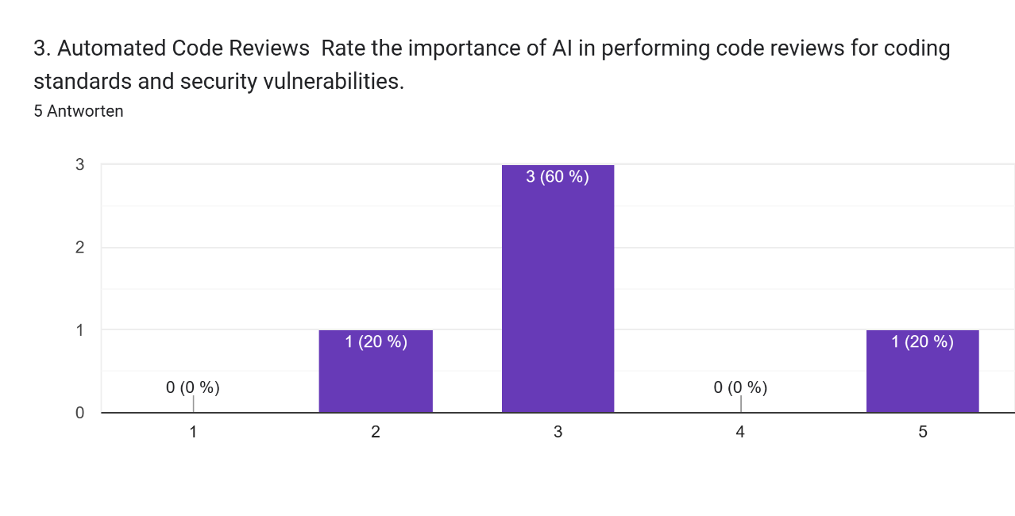
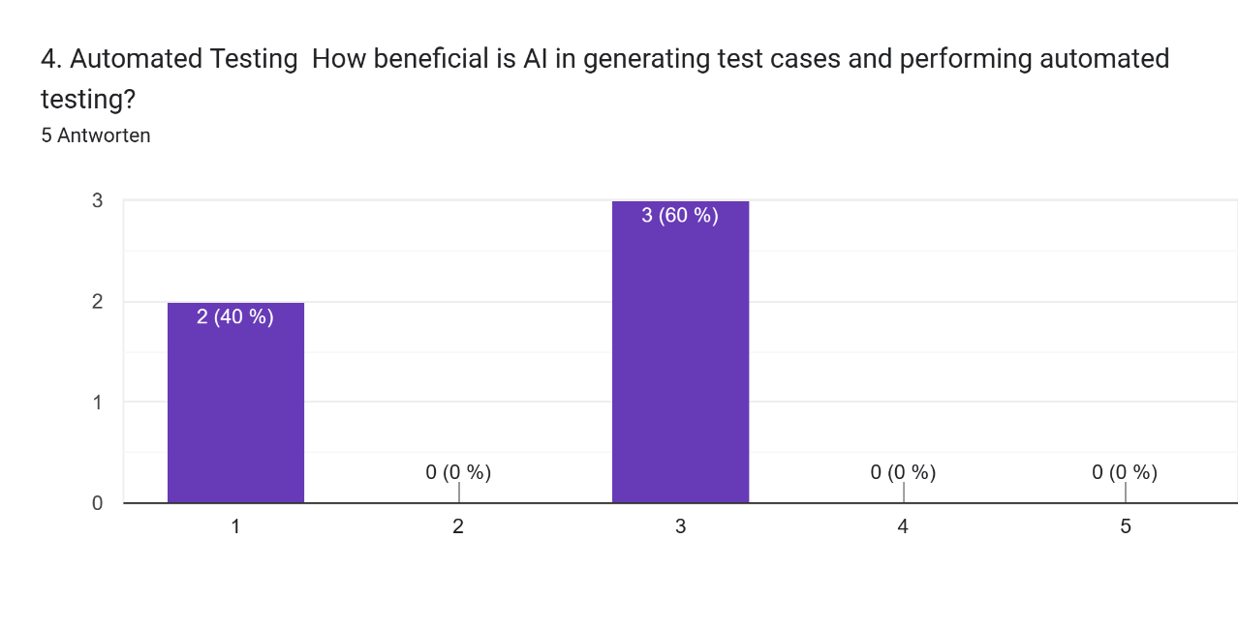
6. Discussion
Software Development Support with Large Language Models - Google Formulare
Notes:
Legal Issues

Slide 17
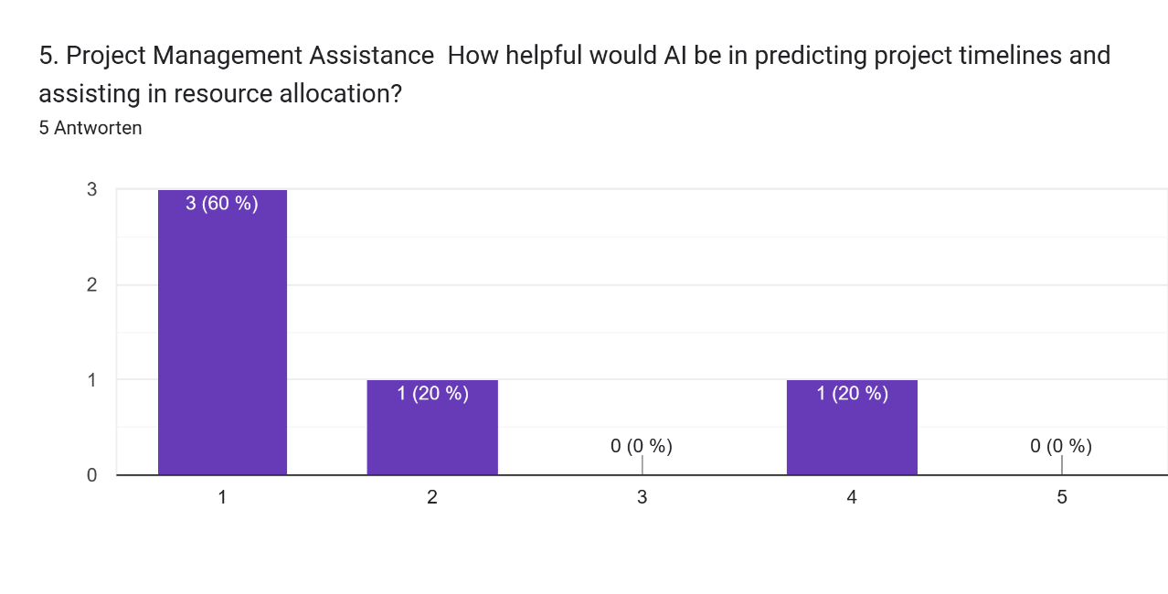
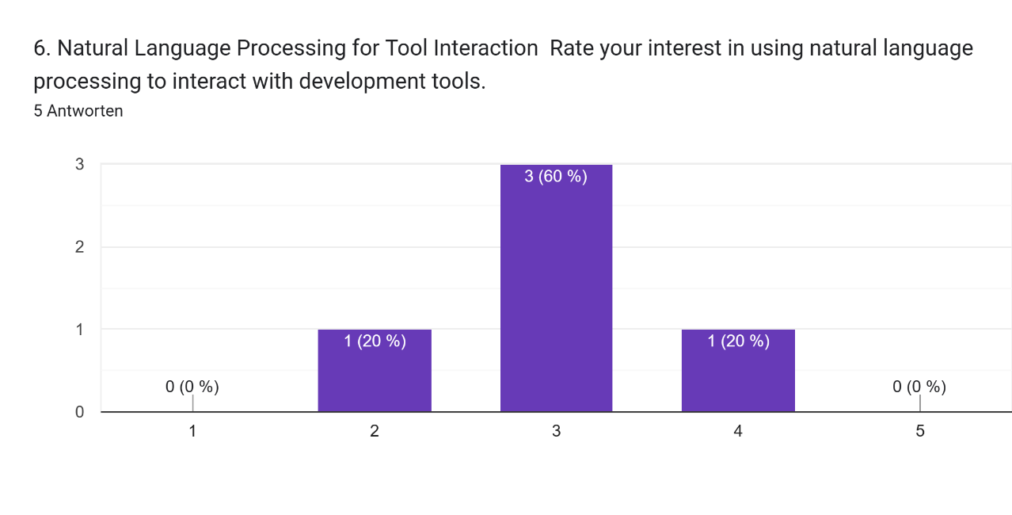
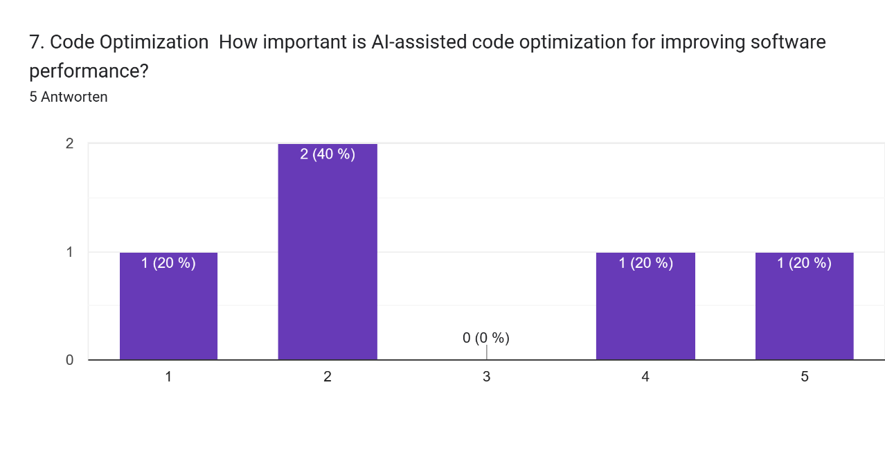
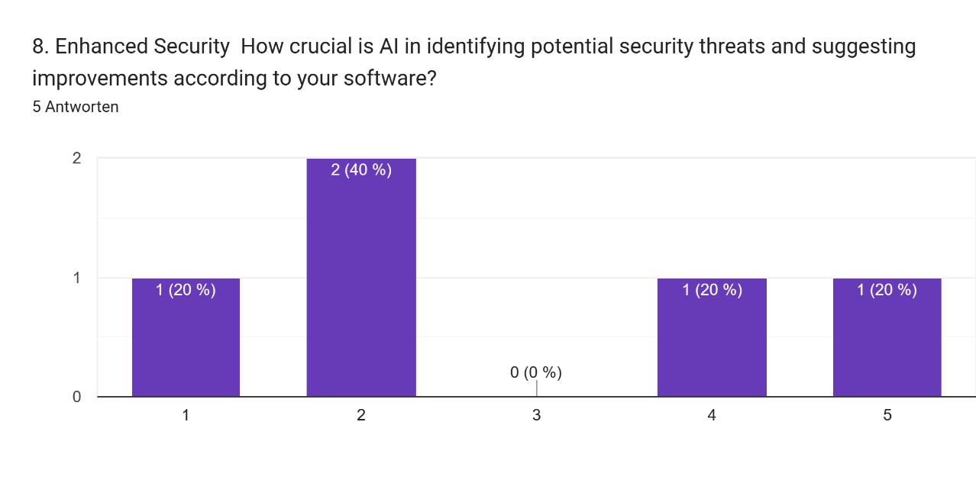
6. Discussion
Software Development Support with Large Language Models - Google Formulare
Notes:
Legal Issues

Slide 18
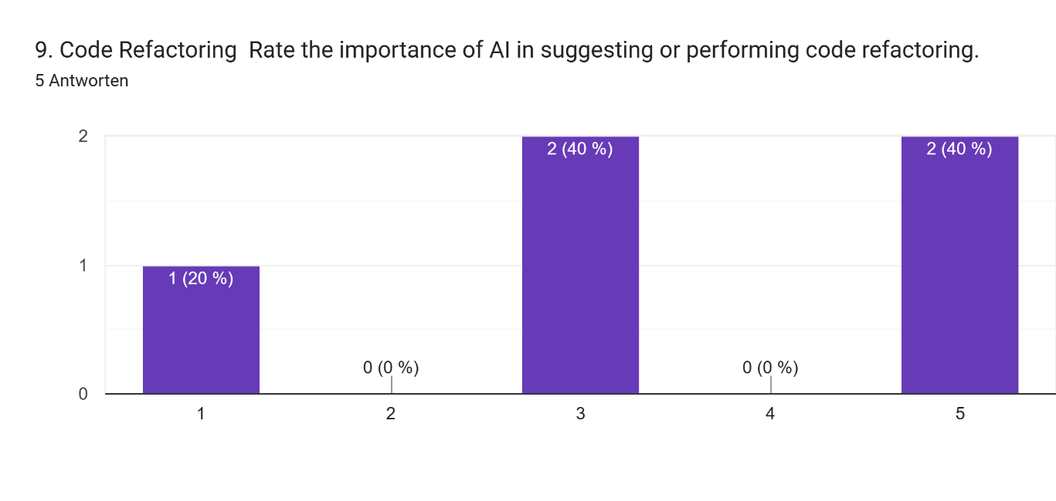
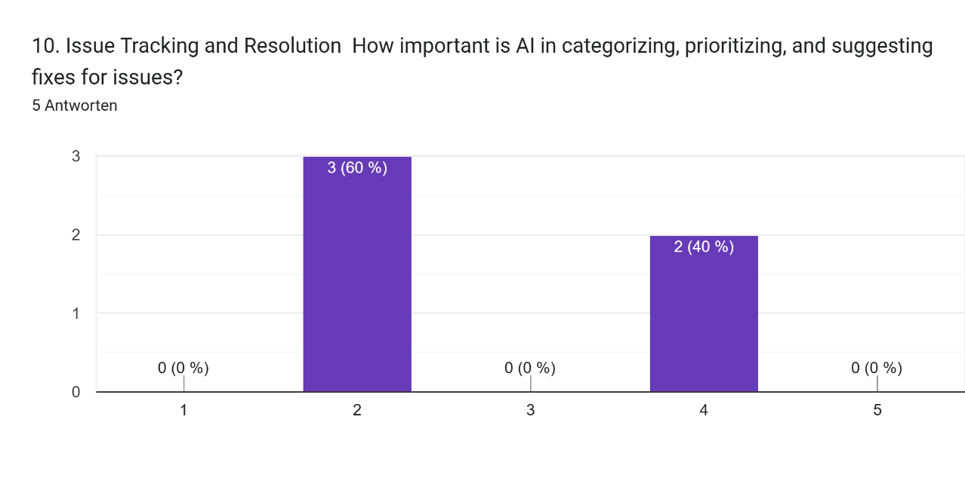
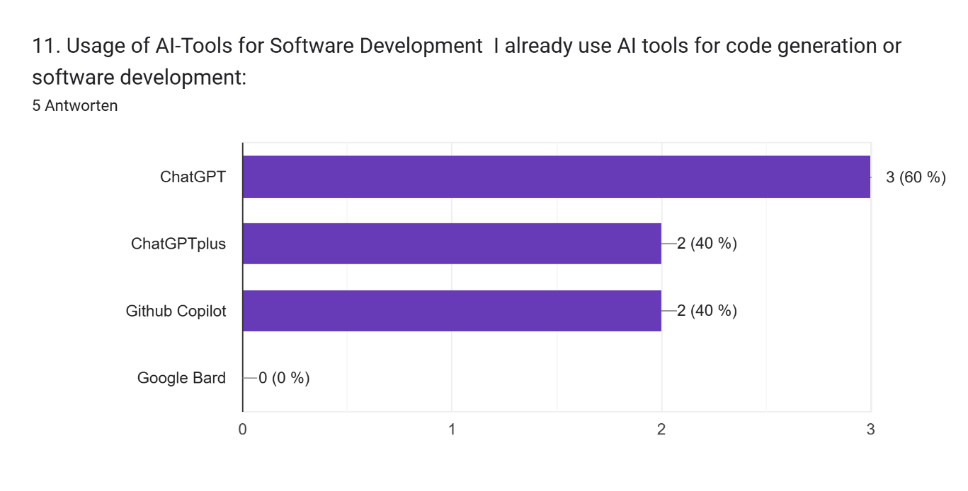
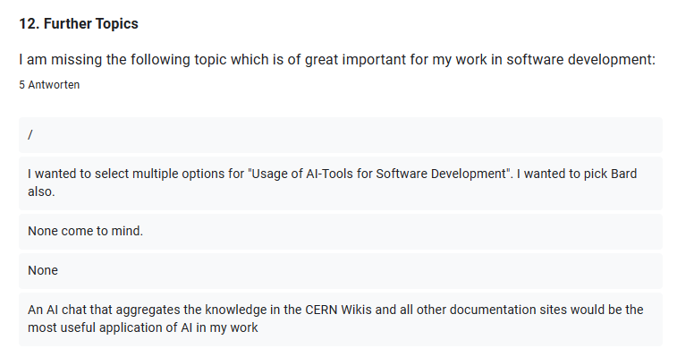
6. Discussion
Software Development Support with Large Language Models - Google Formulare
Notes:
Legal Issues

Slide 19
6. Discussion
The integration of Large Language Models (LLMs) into software engineering practices offers significant benefits, including streamlined workflows, improved accuracy, reduced manual effort, and enhanced collaboration.
However, it is important to remember that LLMs are designed to assist humans, not replace them, and domain-specific knowledge remains essential for achieving optimal results.
Questions & Help are very welcome!
5 Ways LLMs Can Empower Software Engineering

Slide 21
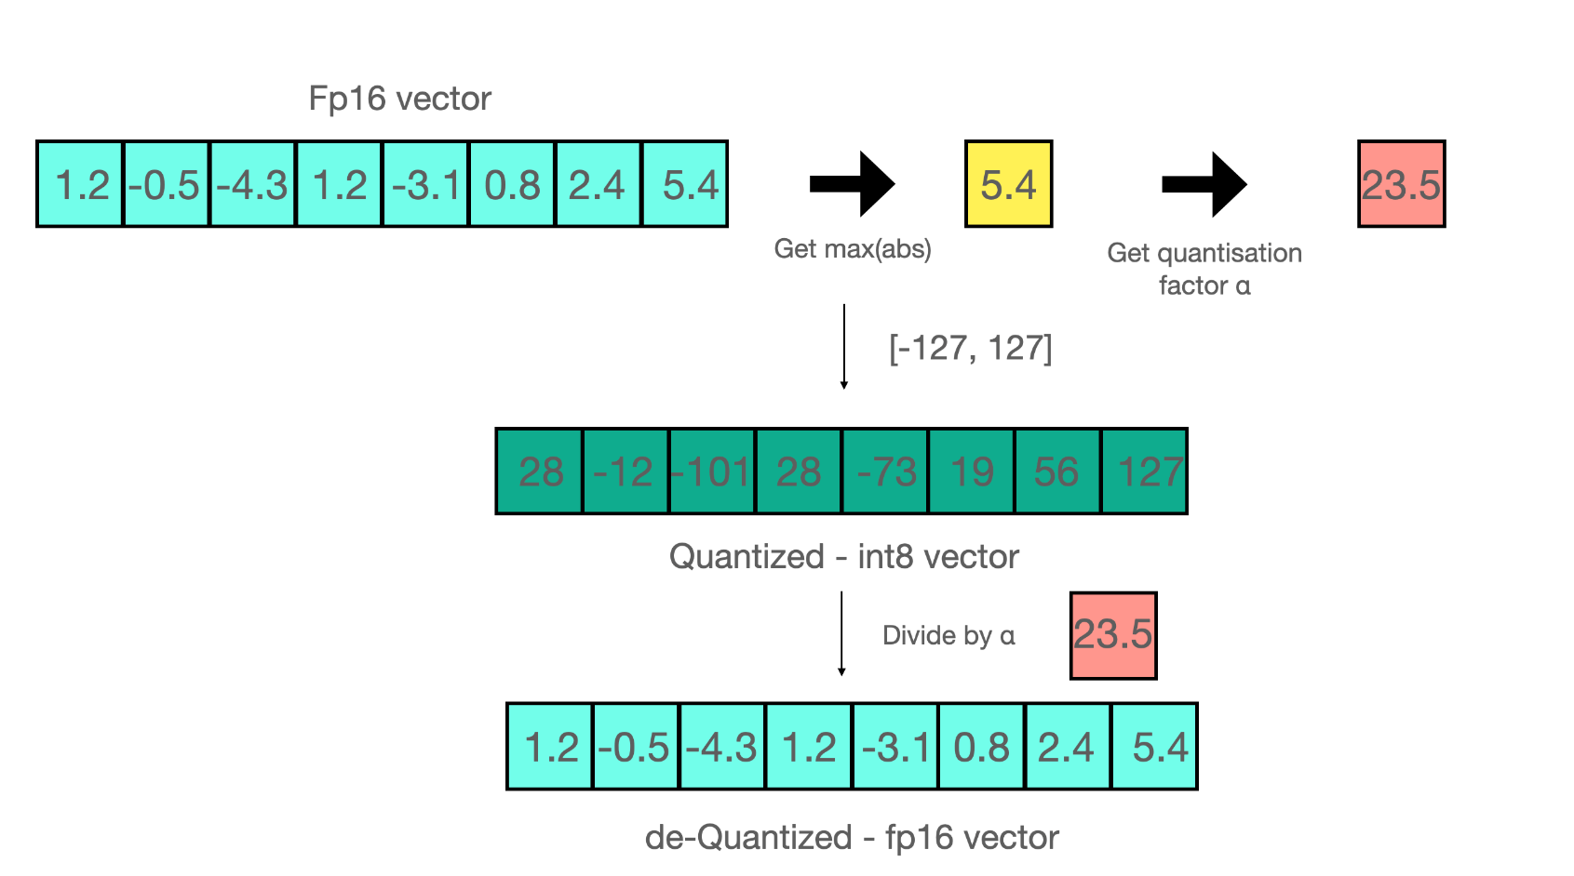
Backup - Quantization
To reduce the model size quantization is a use “the bloke” gguf models
Huggingface: A Gentle Introduction to 8-bit Matrix Multiplication...

