Slide 1
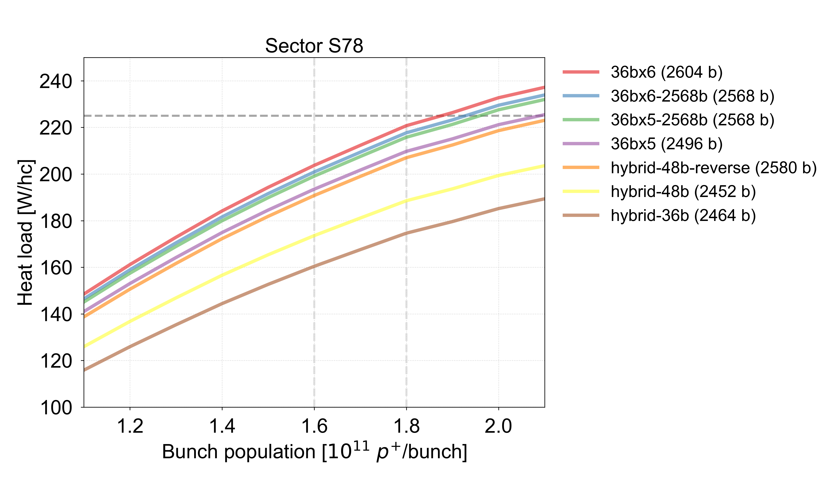
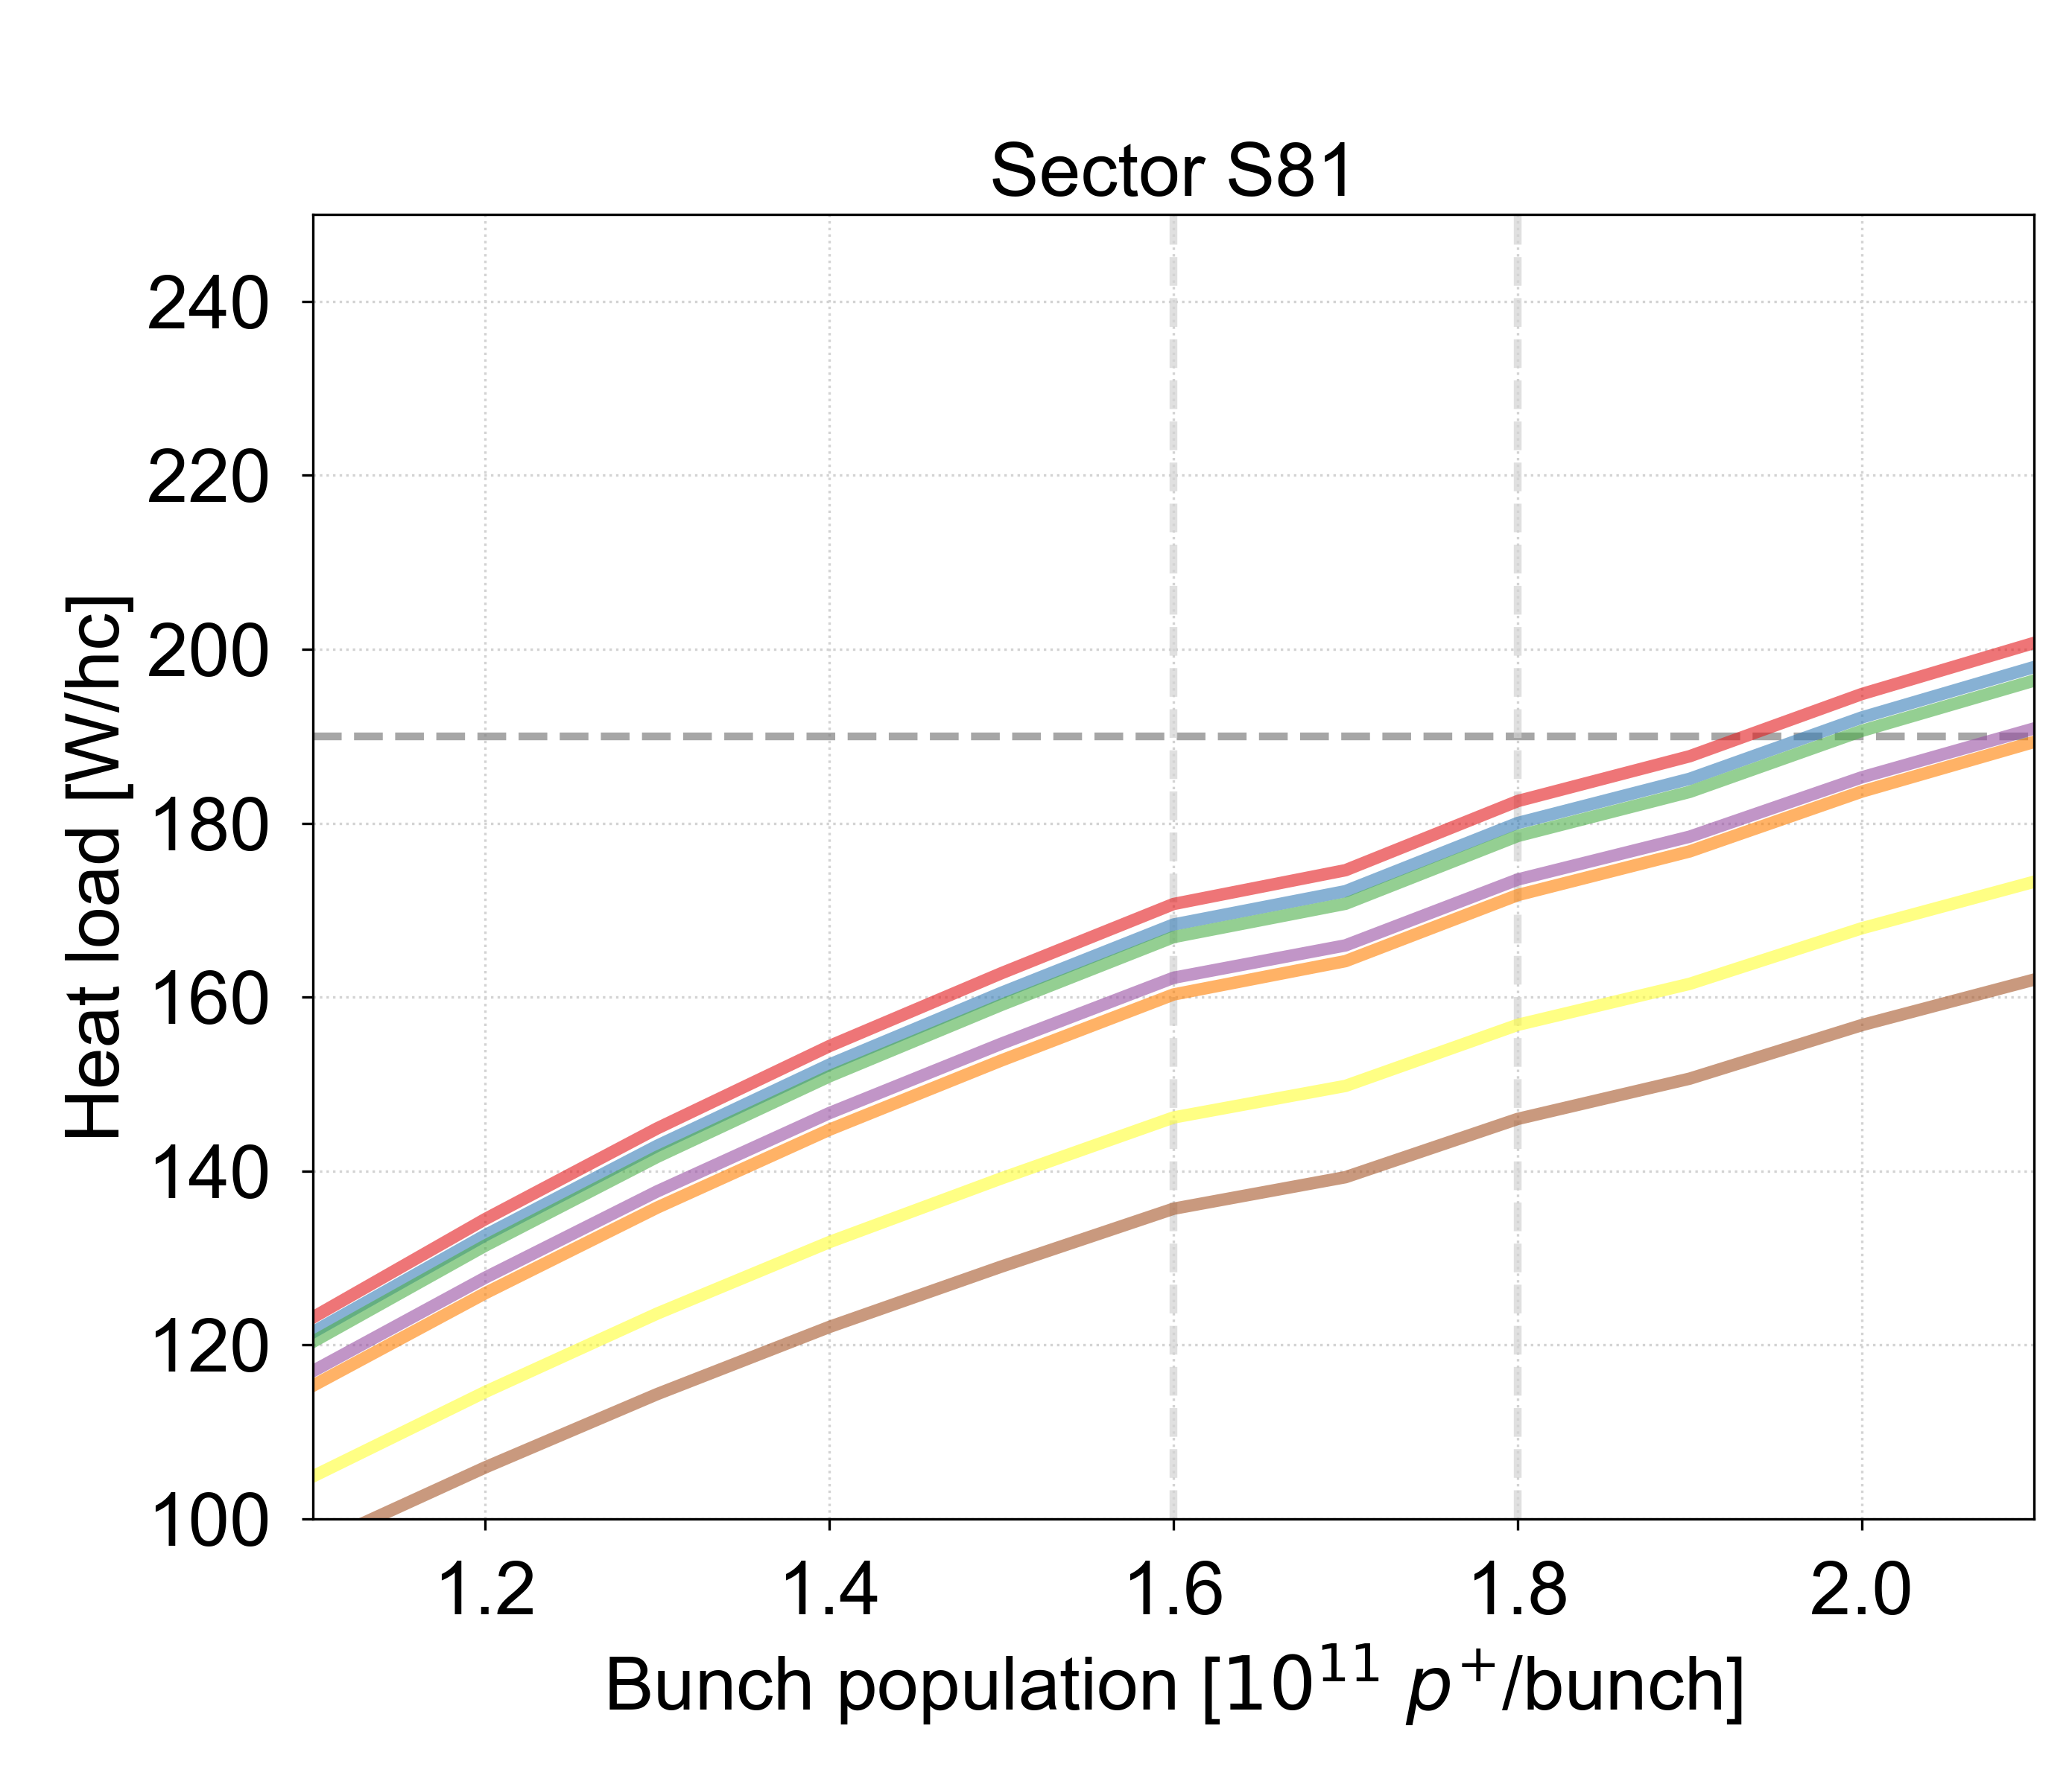
2024 filling schemes
Heat load comparison for possible 2024 filling schemes

Slide 2
2024 filling schemes
Heat load [W/hc]
 | N_{b} | Collisions IP1/5 IP2 IP8 | Collisions IP2 IP8 | IP8 | 1.6e11 p/b 1.8e11 p/b S78 S81 S78 S81 | S81 | 1.8e11 p/b S78 S81 | S81
6x36b | 2604 | 2592 | 2097 | 2095 | 204 (-21) | 171 (-19) | 221 (-4) | 183 (-7)
6x36b | 2568 | 2556 | 2132 | 2090 | 201 (-24) | 168 (-22) | 218 (-7) | 180 (-10)
5x36b | 2568 | 2556 | 1878 | 1848 | 199 (-26) | 167 (-23) | 216 (-9) | 179 (-11)
5x36b | 2496 | 2484 | 2121 | 2260 | 194 (-31) | 162 (-28) | 210 (-15) | 173 (-17) | IP8 optimised
Hybrid-48b-reverse | 2580 | 2568 | 1913 | 1956 | 191 (-34) | 160 (-30) | 207 (-18) | 172 (-18) | To be tested
Hybrid-48b | 2452 | 2440 | 1952 | 2240 | 174 (-54) | 146 (-44) | 189 (-36) | 157 (-33) | IP8 optimised
Hybrid-36b | 2464 | 2452 | 1889 | 2067 | 160 (-65) | 136 (-54) | 175 (-50) | 146 (-44) | 2023

