Slide 1

INSIGHTS FROM IFAST 2023
Presenter name: Thuy Do – PhD Candidate
Date: 1st February 2024

Slide 2




1- About myself
Thuy is a Ph.D. student in entrepreneurship education and innovation management.
Her thesis is about deep technologies (i.e., HEP) and the commercialization of deep technologies.
Her work has been associated with the European Commission for Nuclear Research (CERN), the Norwegian University of Science and Technology (NTNU), ESADE Business School, and TU Dublin.
I have also written some studies on the diffusion of digital and medical technologies to society, responsible innovation, and the transfer of deep technologies to innovative student entrepreneurs.
Originally from Hanoi, Vietnam –I moved to Norway in 2019 for my Master's study.
I enjoy working with people, and education is one of my key interests.
In this study, my interest lies in understanding the learning process and outcomes among student teams

Slide 3
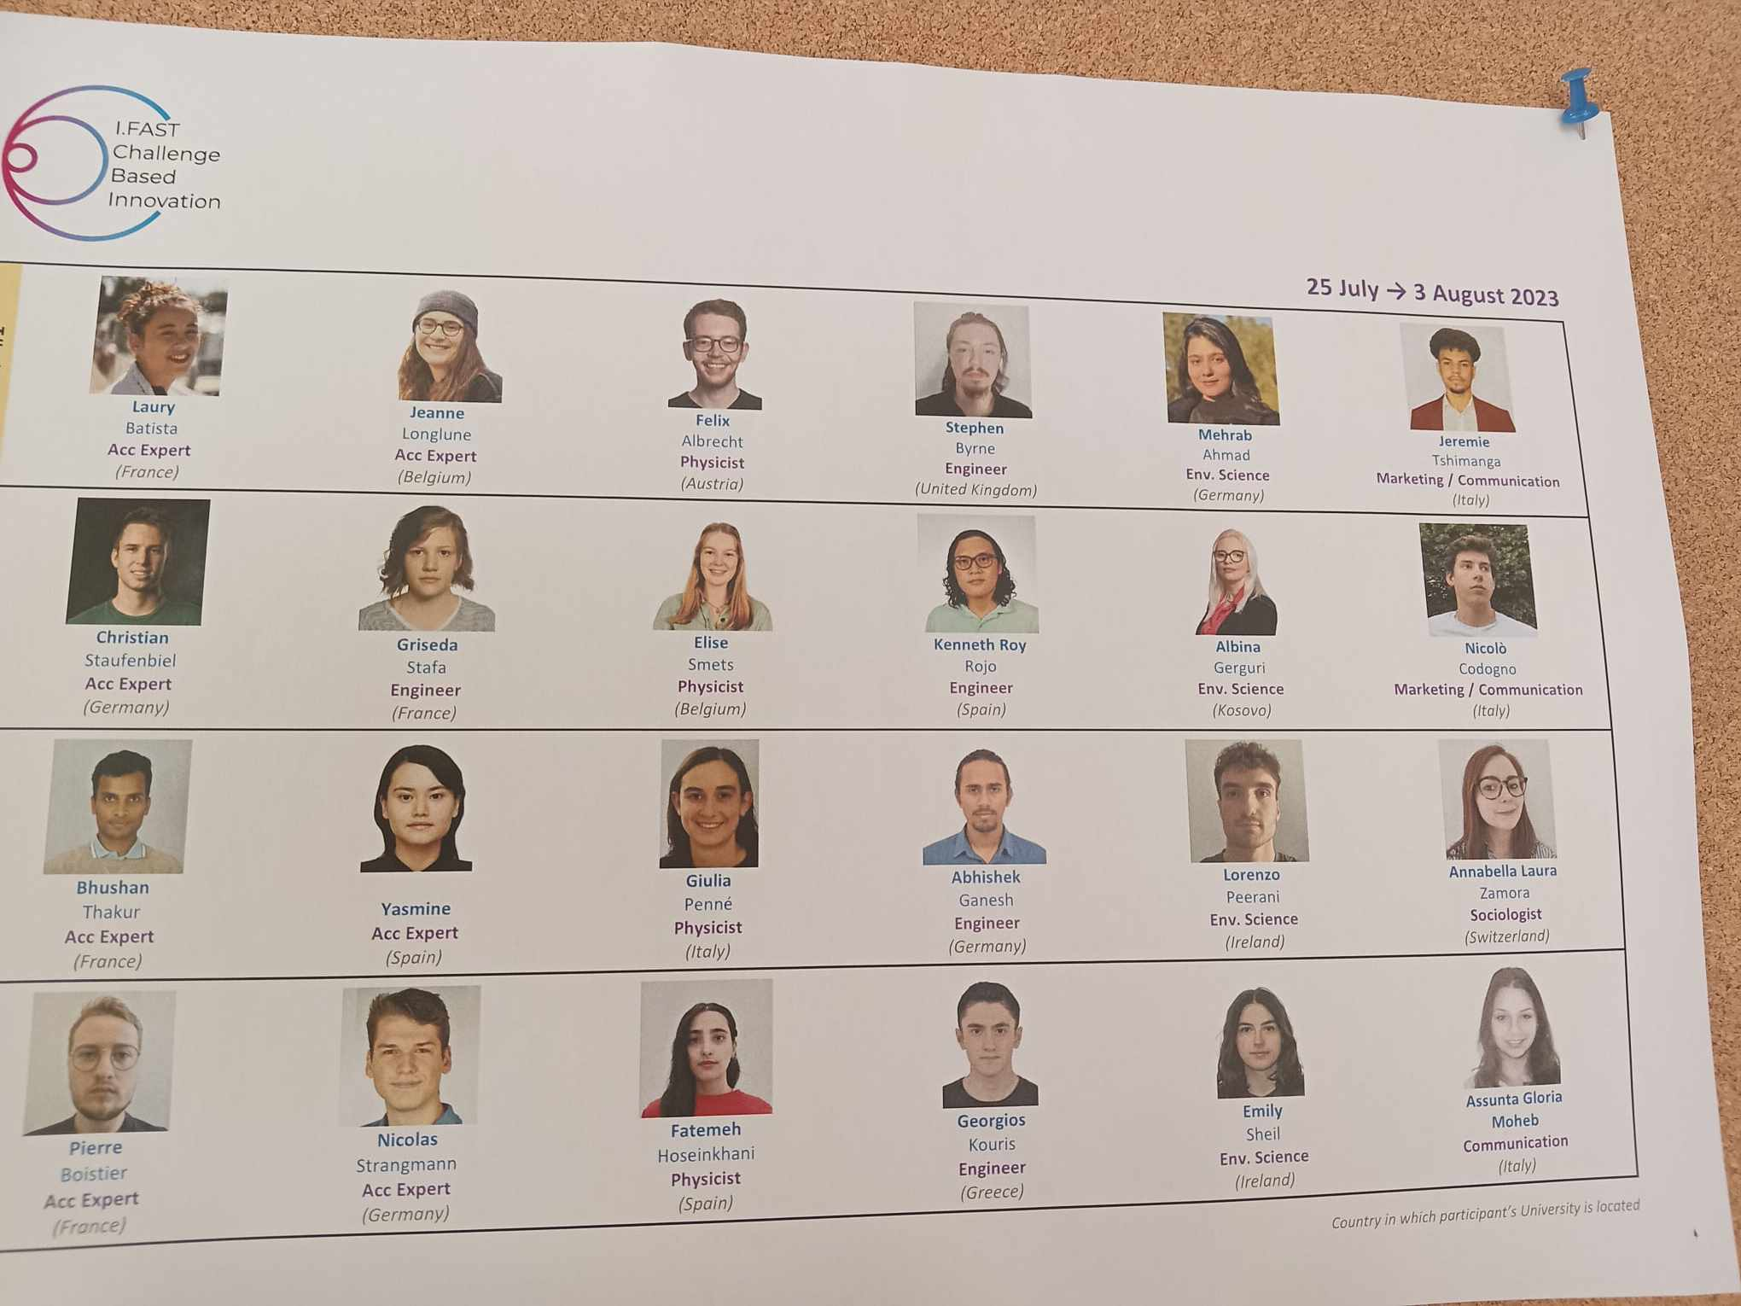

2- Introduction
TAKING A BREAK OR LASER FOCUS?
Creative thinking during team learning innovation
What we think learning is
What learning really is
STUDENTS ACTING ENTREPRENEURIAL

Slide 4
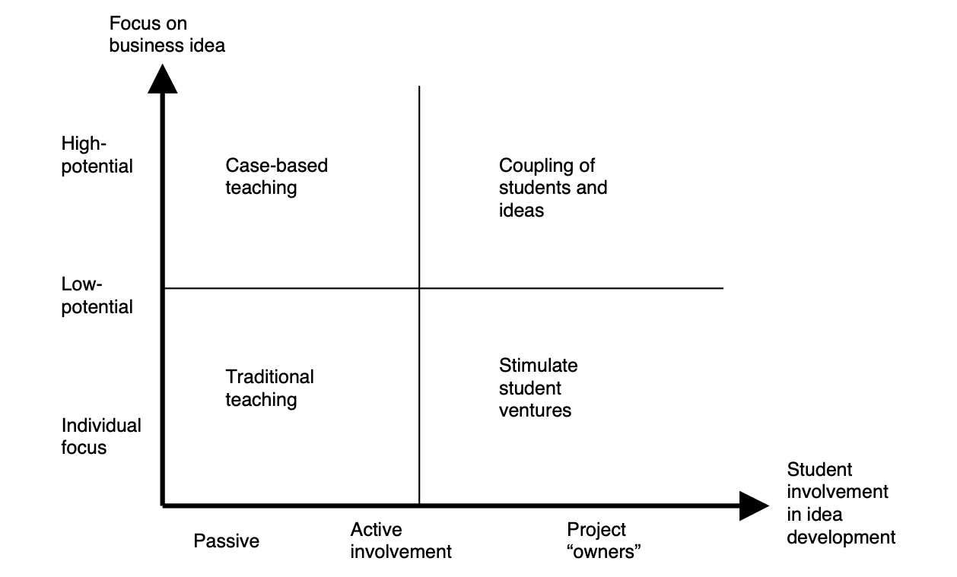
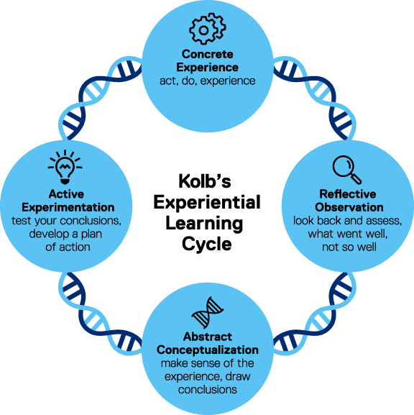
3- RQ: How do they learn, and what are the learning outcomes?
  How do student teams develop innovative ideas?
  What triggers, influences, supports, or hinders the ideation process?
Creative innovation (Heilman et al, 2003)
Divergent thinking
Novelty seeking
Creativity (Simon, 1958)
High motivation and persistence
Problem definition and formulation
Connectivity
(Rasmussen & Sørheim, 2006)
(Kolb, 1984)

Slide 5
4 – Research design
  Research context: 4 teams during IFAST 2023
  In-depth interviews with focus groups on the team process throughout the program (pre/ post in total of 8 interviews)
  Thematic analysis following Goia process (qualitative study)
Teams | Transcripts of empirical data | Ideas summary
Team 1 | 44 pages | Application for wind turbines
Team 2 | 50 pages | Solar panel recycle
Team 3 | 62 pages | Separation of fabric textiles
Team 4 | 42 pages | Pollen sterilization

Slide 6
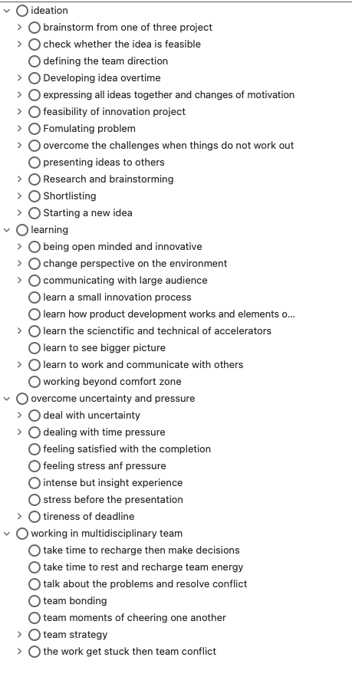
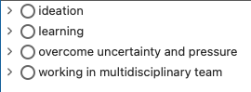
5- Data structure
“to be innovative because there are so many stuff that is actually not always communicated but that already exists”
Interview notes
Coding structure
Main themes and thematic analysis

Slide 7
6- Findings
  6.1 - How do student teams learn to develop innovative ideas?
  6.2- What are their learning outcomes?

Slide 8
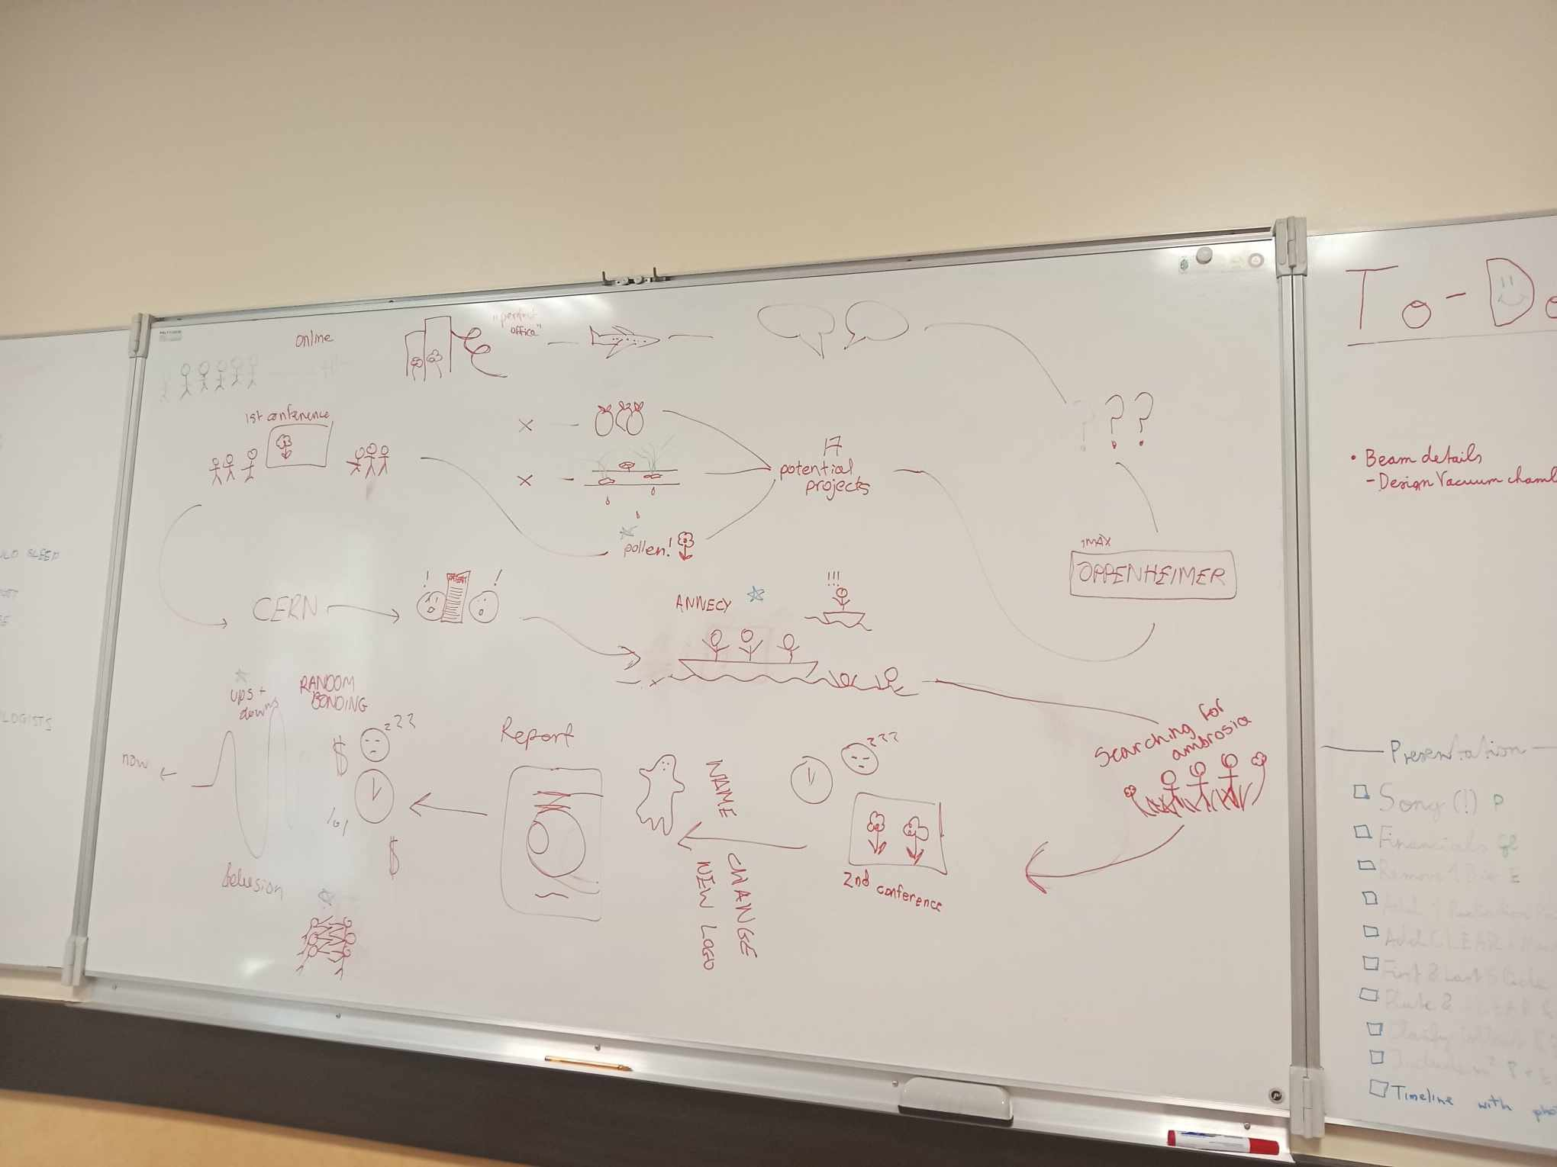
6.1 - Team description of their learning process
Can you describe your team process and specify the important learning events during the proess?
“I think this was part of the ups and downs. When we when we were all just mentally empty like we didn't have any brain juice left, But we motivate each other and we were all on the same wavelength on the report”
Team 4
Starting with applications of accelerators-> -> inspired by the use of sterilization using photon beams and energies -> thinking about pollen sterilization -> use external experts for advice -> narrowing from 16 different ideas-> three ideas-> find a company that looks different approach-> feeling demotivated by this but still pursuit the idea after encouragement from study advisor

Slide 9
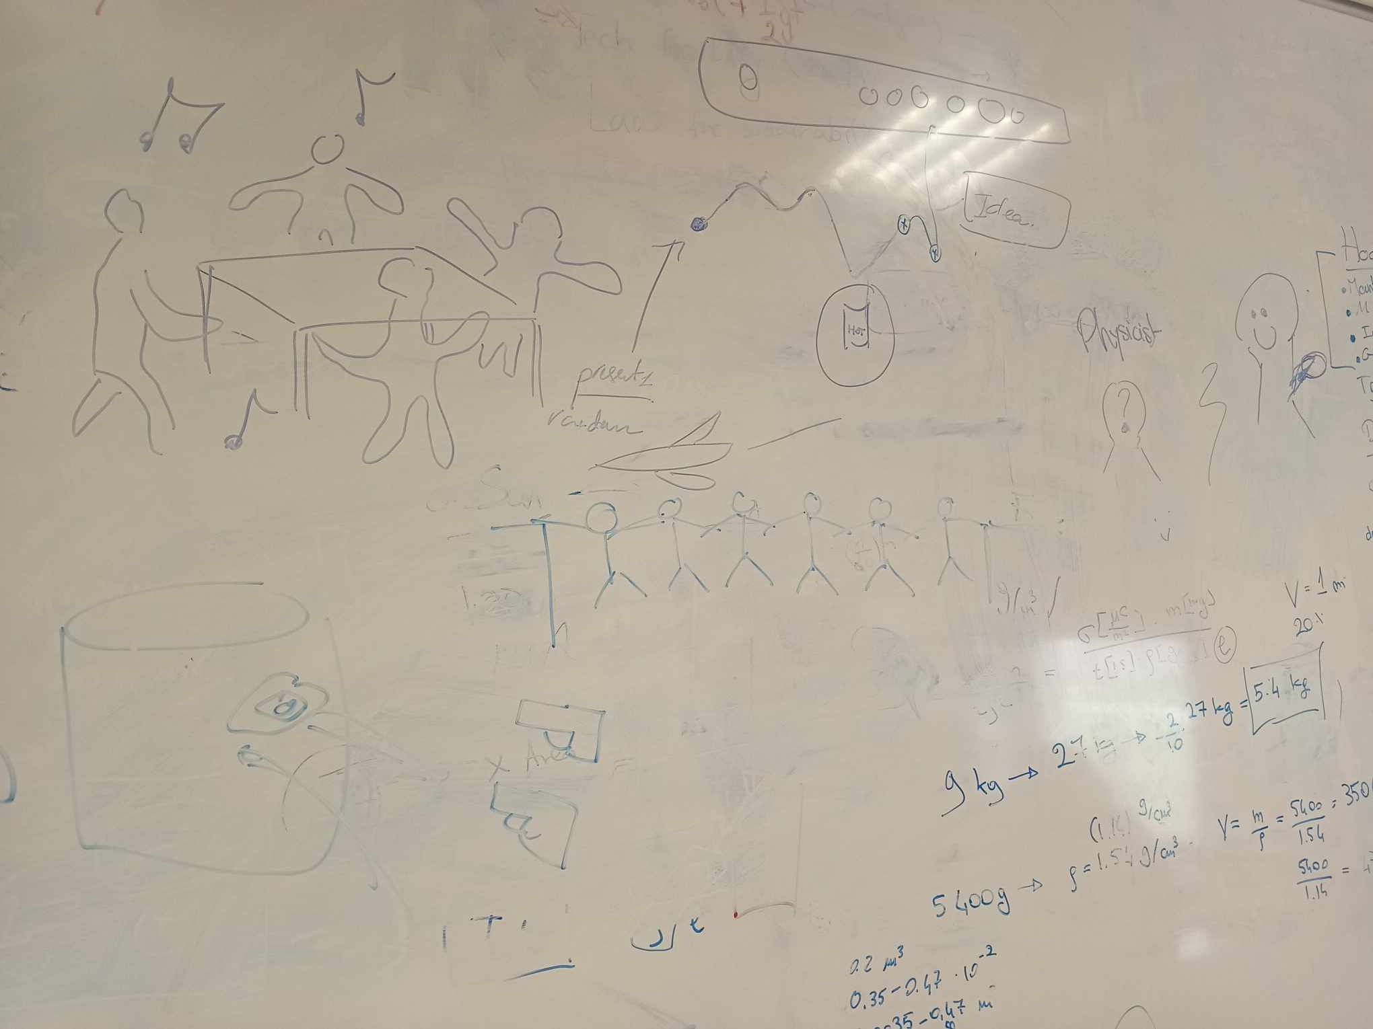
6.2 - Team description of their learning process
“It was super nice with the dancing after dealing with the pressure because of the first conference”
“We had a hot chocolate all together and sometimes we felt it was okay to take a break”
Thinking of separating plastic material -> link to fast fashion industry -> want to address a critical problem in everyday lives -> instead of recycling, focus on segregating -> voting + lectures support the decision-making process -> choose based on the novelty of idea -> some members want to change the directions -> trying to stay in the course of the idea and keeping each other motivated -> working for final report

Slide 10
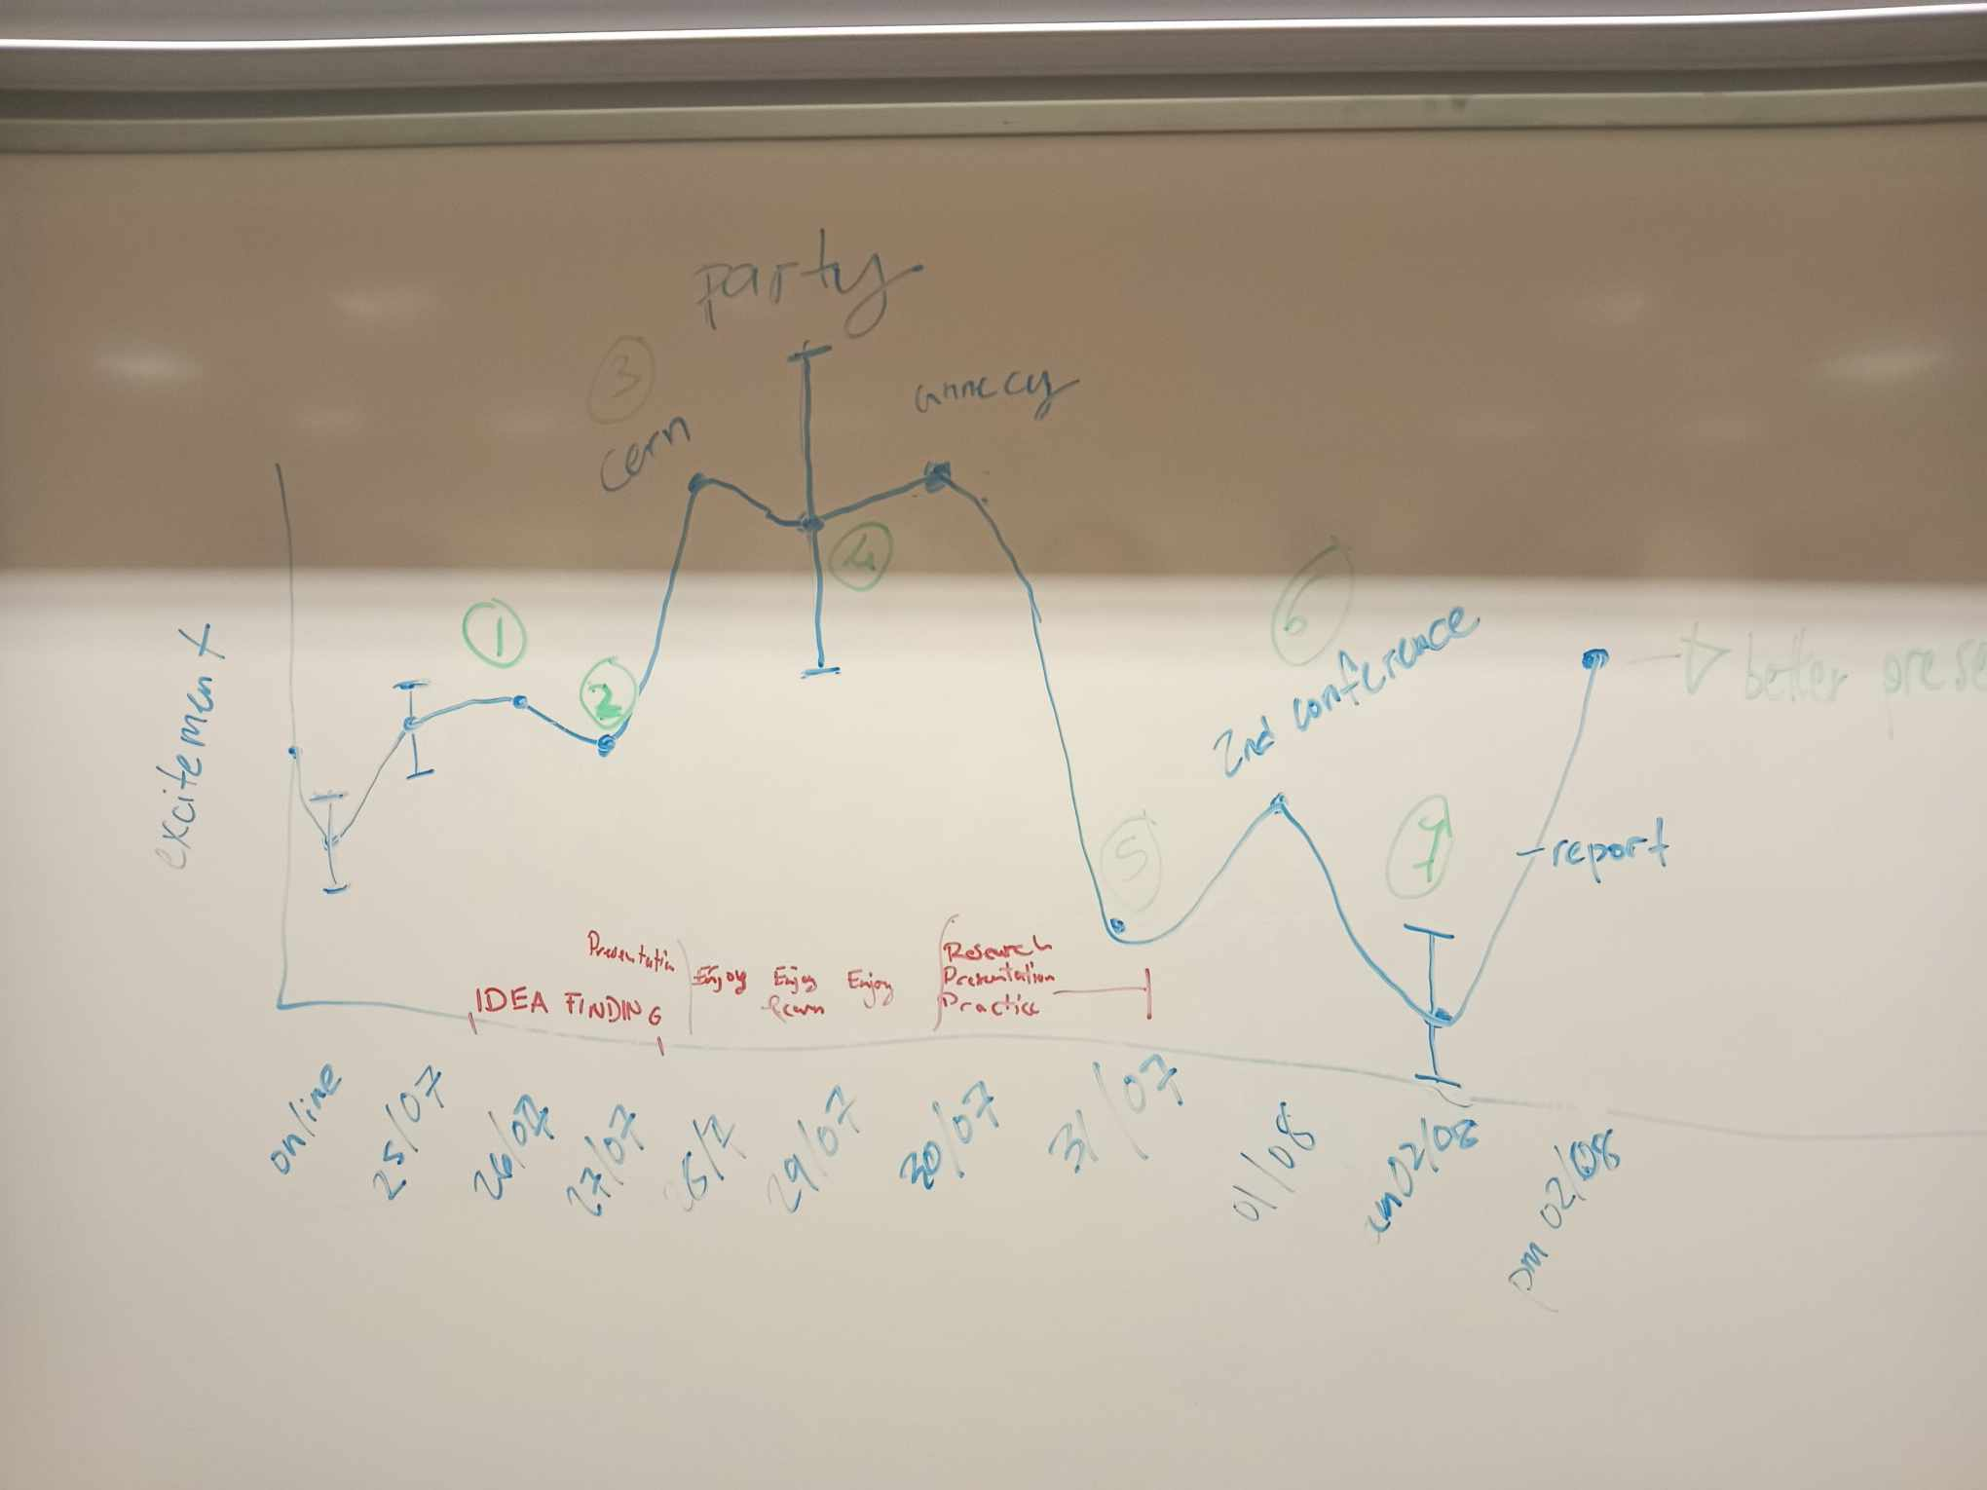
6.3 - Team description of their learning process
“We were a bit discouraged by the data that is not supportive of our idea and when somebody already did this, then we voted and it was pretty obvious, also this lecture of microplastics”
Team 2
Research papers -> Investigating different environmental problems -> Brainstorming from five different ideas -> Voting and making decisions on the lecture on microplastics -> Not very sure and confident about the ideas -> Move further with the feasibility of idea

Slide 11
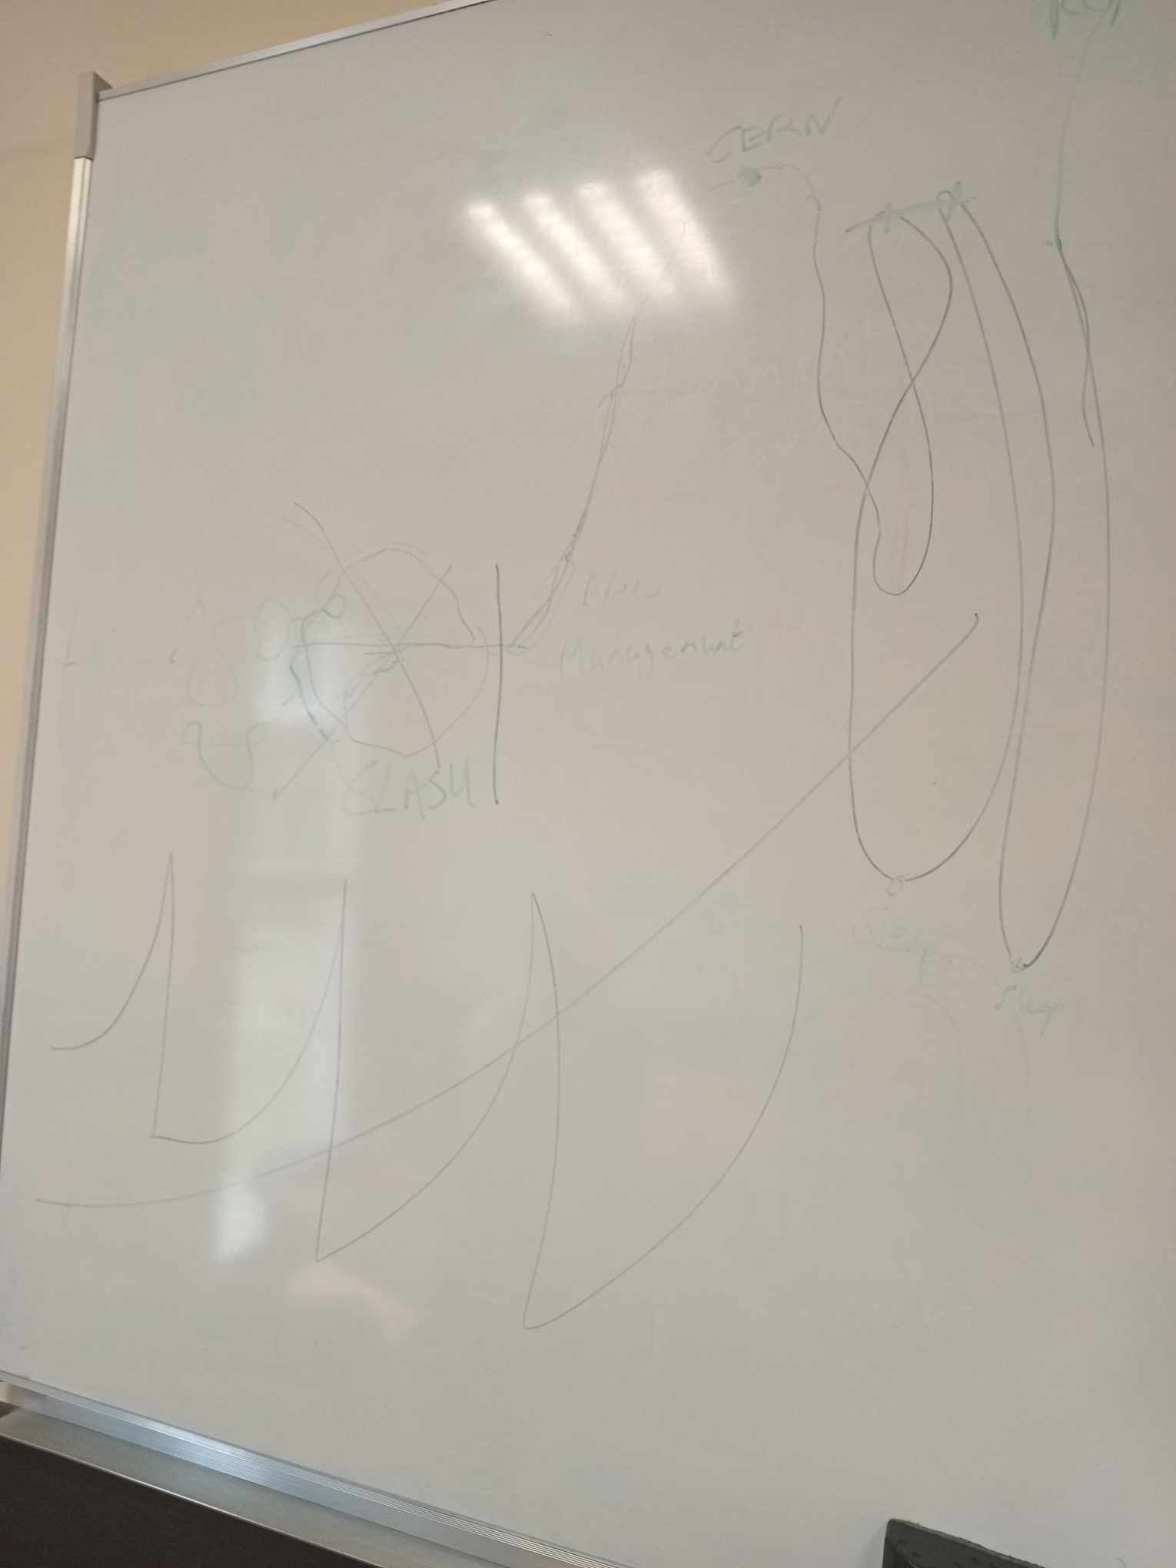

6.4 -Team description of their learning process
“Kind of before the kind of clash happened or when the clash happened, it was like we were kind of dragging it a little bit. So we were not really working as a team, and so we didn't know what would come, at least I. And then somehow we tried to communicate with eachother and it gets better after that”
Brainstorming -> choose among three projects on the board-> idea from phD project with ion implantation in nuclear steel -> time pressure to choose one idea -> conflict -> resume communication

Slide 12
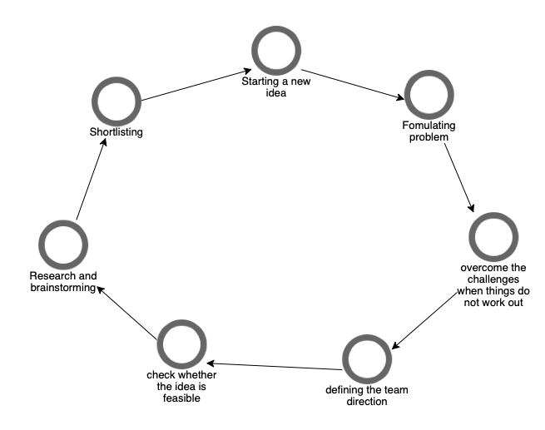
7 - Learning process
1
Taking a break from the group work helps facilitate the dynamics and bonding among the team members; having more creative ideas
Challenges?
2
The pressure due to uncertainty help the team to stay focused and consistent on their goals and ideas

Slide 13
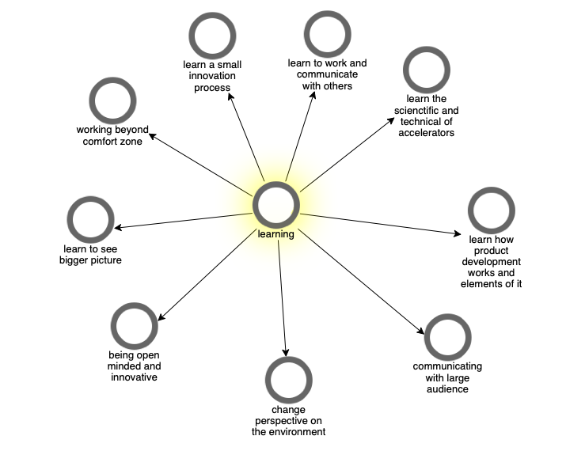
8- Learning outcomes
I learned so much about accelerators.
There's necessary knowledge involved in different aspects of how to build a product. That's which is one of the important parts and also how to sell the product, how to market the product and the economics of the.
I learned about sustainability and so yes, I learned how to open my mind. I learned how to I've grown also personally
I think a bit of an impact on me as well as an individual. I think next time I buy clothes I will look into all the materials
it's good to be around a multidisciplinary team because in my everyday life I go to my office with my research group. We're all nuclear chemists – that is all we talk about

Slide 14
9- Conclusion
The ability to be innovative during the learning process among student teams relies on the “time break” from work and the perseverance in dealing with high pressure throughout study.
Educators should facilitate a balance of two elements in the engineering education program.
Encouragement of students in learning about sustainability challenges has an impact on their awareness on sustainable issues while integration with business cases in the lecture

Slide 15
10-Implications
This study has an implication for the understanding of innovative thinking among multidisciplinary teams in an innovation process.
It has implications for the design of engineering education and integration of sustainability challenges into the study programme

Slide 16
Thank you and Question?

