Slide 1
W.R.A.P.
Project Overview
BE Seminar
Epameinondas Galatas

Slide 2
Motivation: GUI Strategy within ATS
Every application suffers from 2 potential risks:
Breaking
  Hardware changes (evolution / renovation)
  Incompatible execution environment
Difficult (if not impossible) to maintain & extend
  Dependencies unmaintained
  Hiring experts of older frameworks difficult
Result:
Impact on beam time.
Cannot adapt to changing needs and op requirements. Decreased efficiency
Solution: Streamline development and evolution of GUIs, anticipate problems
Notes:
You need to put it into the context of the GUI Strategy, you can take slides from the CTTB workshop.

Slide 3
Types of applications & users
Equipment experts need specific applications to configure, control, maintain, tune visualize, diagnose, and monitor equipment.
Operation crews need use-case-driven applications to operate, optimise, and supervise accelerators and automate repetitive tasks.
However:
OP also needs to diagnose, and monitor equipment. CCM contains some applications not developed for them. Usability suffers.
System specific applications, by equipment groups, can target OP.
Notes:
You need to put it into the context of the GUI Strategy, you can take slides from the CTTB workshop.

Slide 4
GUI development offering
The GUI strategy comes together with a GUI Development Offering. Key aims:
Keep under control the potentially huge expense due to obsolete technologies that would require rewrite of the applications
Reduce the cost of GUI developments in the long run, for both creation and maintenance of applications
Several coherent solutions:
2 no-code application platforms: WRAP (low-code tbd) & NavPy
2 application frameworks:
  Accsoft-Commons-Web (ACW) with Angular
  PyUI with PyQt and the Acc-Py distribution
Notes:
You need to put it into the context of the GUI Strategy, you can take slides from the CTTB workshop.

Slide 5
What is WRAP?
WRAP is a web-based rapid (GUI) application development platform (WRAP)
Reduce cost of developing new GUIs for the control system
  Low/no-code app development
  Abstract control system complexities (NXCALS, InCA, JAPC, CMW, etc.)
Guarantee low maintenance cost for created GUIs (technology evolution hidden by the platform)
Cater for operational and expert application needs
  equipment centric & operation centric applications
Notes:
You need to put it into the context of the GUI Strategy, you can take slides from the CTTB workshop.

Slide 6
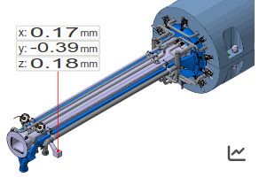
Project Scope
Application Specific
Complex
Domain Specific
Generic
Out of Scope
Widgets
Line chart
Specific
Timing Bar
General
Status Indicator
SSVG
Set
Widgets
Label
Simple
Notes:
That should go before the UI explanation

Slide 7
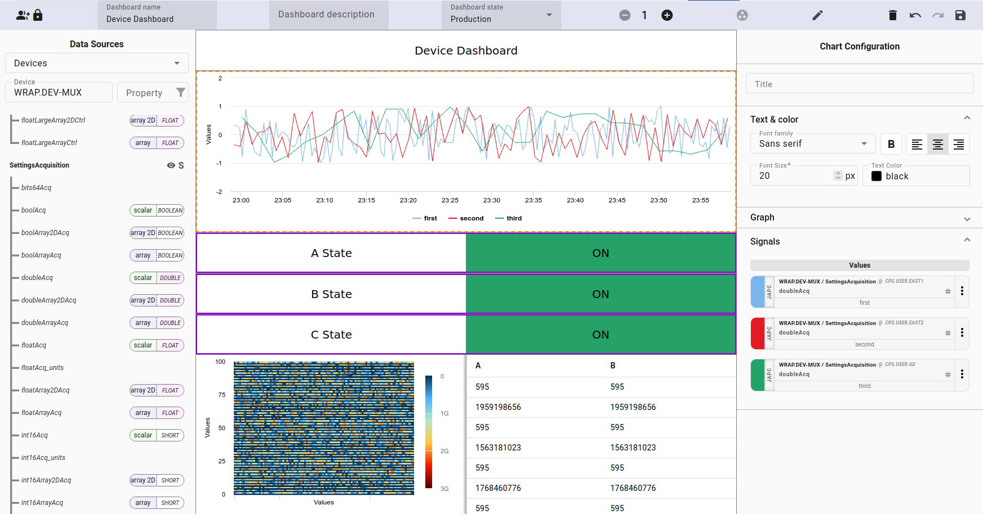
EXTERNAL DATA SOURCES
Device discovery via Controls Configuration Service (CCS)
Metadata via Injector Controls Architecture (INCA)
EXTENSIVE CUSTOMIZATION
Font sizes, colors, graph options, etc.
PERMISSIONS
Others can view, edit,
administrate
METADATA
Consolidated from low level
definition / high-level services
DATA SOURCE ASSIGNMENTS
Type-aware, slicing support

Slide 8
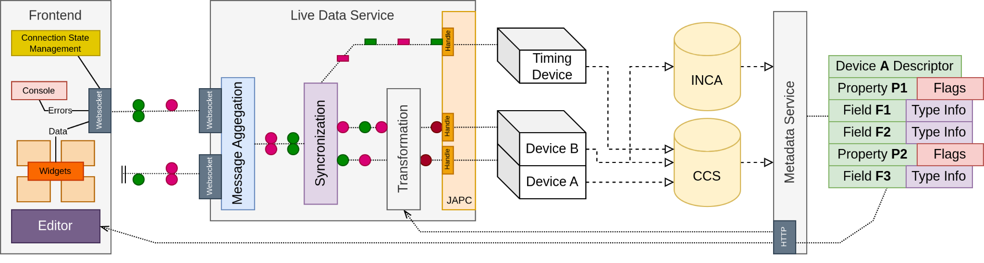
Data Model
Metadata must be reconstructed from multiple services (CCS, INCA, NXCALS)
  Not always straightforward, ex. No support for bit enum in INCA
  No single source of truth, differences based on device type
Notes:
Say that this is one of the typical challenge the application developers face and that WRAP wants to solve that for them so that they can focus on their need

Slide 9
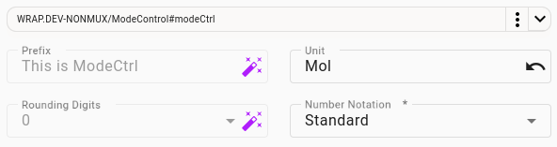
Static Metadata Integration
Widget is partly preconfigured with metadata
Metadata changes, the configuration updates on dashboard load
Fields that can be derived from metadata, can always also be explicitly set

Slide 10
Data Model
Data has to be synchronized, to guarantee coherency of updates
  Publish once per selector, explicit empty values for messages that are late / lost.

Slide 11
Data Model
Message aggregation through websocket, to make the data available

Slide 12
Note: Combining Data
Goal: Plot a parameter for the last N minutes, update based on live data.
Internally → Get last N minutes from NXCALS, subscribe to device property
Problem:
There may exist none or multiple variables tracking this data.
A filter might be set leading to information loss.
Historical data
Live data
1s rate limit
1s

Slide 13
Widgets - Visualization
 | Data Type | Scalar | 1D Array | 2D Array
Status Indicator | Any | Yes | Sliced | Sliced
Progress Bar | Numeric | Yes | Sliced | Sliced
Bit Enum | Bit enum | Yes | Sliced | Sliced
Chart | Numeric | Yes (with history) | Sliced | Sliced
Array Chart | Numeric |  | Yes | Sliced
Heatmap | Numeric |  | Yes (with history) | Sliced
Waterfall | Numeric |  |  | Yes
Data Grid | Any | Yes (multiple, optionally sliced) |  | Yes (optionally sliced)
SSVG | Dynamic | Yes | No | No
Timing Bar | None
Label | None
Date Time | None
Numeric = Number, Boolean, Enum

Slide 14
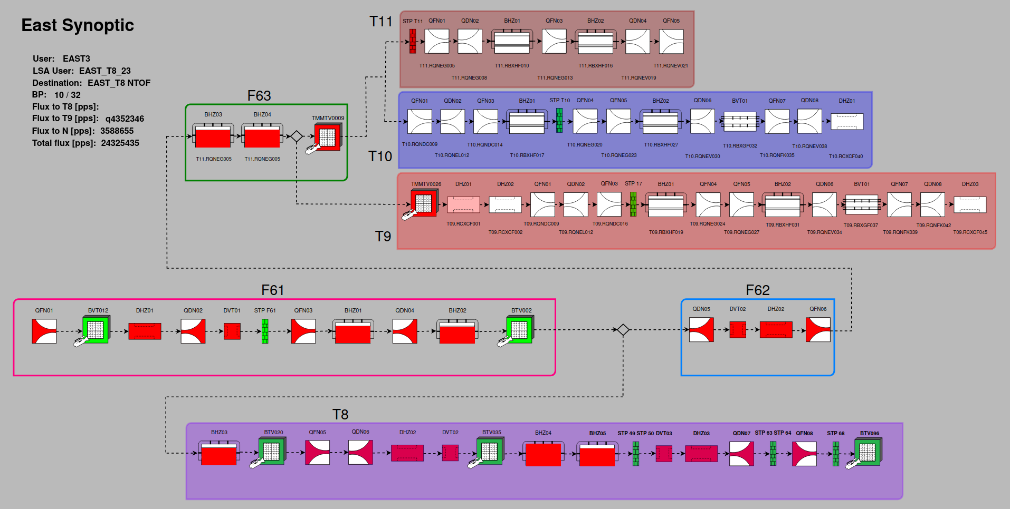
Extensibility: Custom visualizations
Stateful Scalable Vector Graphics (SSVG) files can be created by embedding metadata
on regular SVG files.
A static image file turns into
a dynamic custom widget.
Data acquisition options
can be applied like any
native widget.
Notes:
That’s early

Slide 15
Widgets - Control
 | Data Type | Scalar | 1D Array | 2D Array
Input | Number/String | Yes | Sliced | Sliced
Wheel Switch | Number | Yes | Sliced | Sliced
Combo Box | Enum | Yes | Sliced | Sliced
Toggle Group | Enum | Yes | Sliced | Sliced
Check Box | Boolean | Yes | Yes | Sliced
Bit Enum Set | Bit enum | Yes | Sliced | Sliced
Grid Set (tba) | Any | Yes (multiple, optionally sliced) |  | Yes (optionally sliced)
Button | Trigger

Slide 16
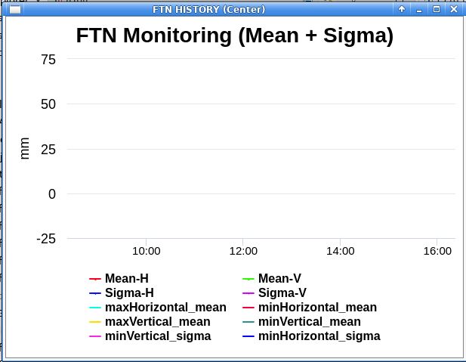
CCM Integration at CCC
WRAP is provided as a standalone application, packaged with electron.
No dependency on client’s web browser
Native application look & feel
Accessible through nfs: /acc/java/data/app/wrap/

Slide 17
Roadmap
All features, max possible performance, no advanced scripting
We target Python
Theming
Performance Optimizations
Dialogs
INSPECTOR Migration toolkit
Electron
New Tiling
Access out of GPN
Performance Review
Scripting Language Support
IDE Features
SET Widget Library
DSL Data Manipulation
2024
Stress Test
2025
Device Life-Cycle
SSVG Versioning
NOW
Correlations
Feature Complete
Missing function support, data processing, dialogs
Focus on ergonomics
Bulk edit, debug tools
Inspired from Grafana

Slide 18
Project Scope
Application Specific
Complex
Domain Specific
Generic
Out of Scope
Basic Scripting
Widgets
Line chart
Specific
Timing Bar
General
Status Indicator
SSVG
Set
Widgets
Label
Simple
Notes:
That should go before the UI explanation

Slide 19
Project Scope
Application Specific
Complex
Domain Specific
Generic
Advanced Scripting
Out of Scope
Widgets
Line chart
Specific
Timing Bar
General
Status Indicator
SSVG
Set
Widgets
Label
Simple
Notes:
That should go before the UI explanation

Slide 20

Closing Notes
Release notes: https://wikis.cern.ch/display/CD/W.R.A.P.-2023.4.0
Electron version info: https://wikis.cern.ch/pages/viewpage.action?pageId=252773401
You can join https://mattermost.web.cern.ch/gui/channels/wrap for:
→ Additional documentation announcements
→ Patch release announcements
→ Questions about general functionality
Please contact us for any problems or ideas at wrap-support@cern.ch

Slide 21
GUI development solutions - Platforms
From the outset, the platforms aim to build on the success of Inspector
Reduce the number of full-fledged specific applications
Facilitate the development thanks to no-code/low-code approach (domain focus)
Reduce the exposure to technology changes
WRAP
Web-based, available from anywhere (on CERN’s network - for now)
Integrated with high-level services (InCA/LSA, NXCALS, etc.)
High-level of customisation
NavPy
Desktop application, low-level access, available on 1st day of FEC development
Low-level tools for experts and diagnostics (cycle comparison, copy, etc.)
Flexible layout with many viewers
Notes:
You need to put it into the context of the GUI Strategy, you can take slides from the CTTB workshop.

Slide 22
GUI development solutions - Frameworks
The frameworks aim to facilitate the development thanks to:
Pre-selection and integration of technologies (Angular, Java, Spring Boot)
Integration with the Control System (RBAC, Timing, etc.) & libraries of widgets
Simplified software-engineering processes
PyUI based on PyQt
Desktop applications with acc-py
Acc-widgets for controls-aware widgets
Based on in-depth user interviews over the summer → clear plans for the this year
ACW based on Angular
Web-based applications
Angular (web front-end) & Java with Spring Boot (back-end)
Many generic components already available
Used in all recent BE-CSS web apps (TIMBER, AFT, Layout, ASM, CCDE, Checklists)
Notes:
You need to put it into the context of the GUI Strategy, you can take slides from the CTTB workshop.

Slide 23
Summarized GUI Strategy
WRAP accounts for most simple and/or general GUI needs
  Data sourced from the control system through devices
  Business logic aims to transform this data
Custom Web and python applications can be based on ACW and PyQt respectively
  Other datasource required ex. Database
  Business logic is more complex
Support for existing Java applications
Notes:
You need to put it into the context of the GUI Strategy, you can take slides from the CTTB workshop.

