Slide 1
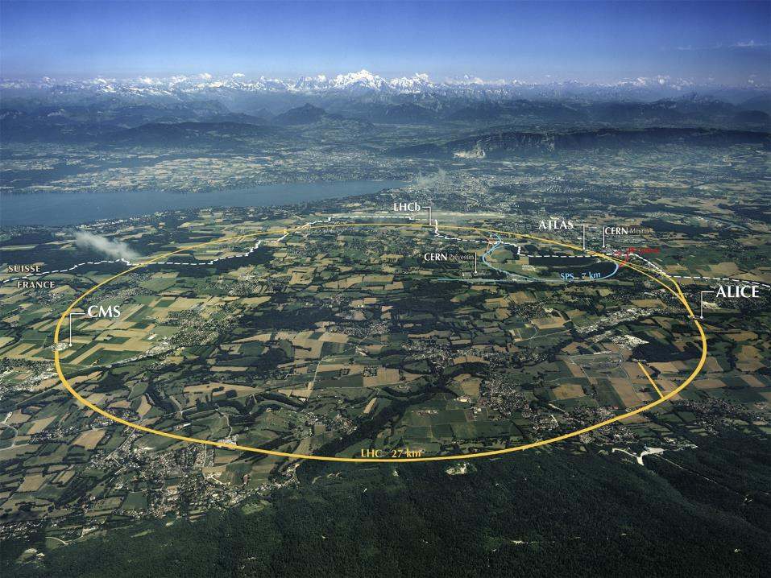
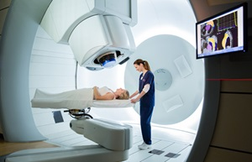

Development of innovative particle therapy technologies at CERN: the Next Ion Medical Machine Study
Maurizio Vretenar
CERN, ATS/DO Accelerator and Technology Projects and Studies
Joint Symposium CERN NIMMS & HUS & CERN Baltic Group: “Particle therapy technologies”, 15.01.2024

Slide 2
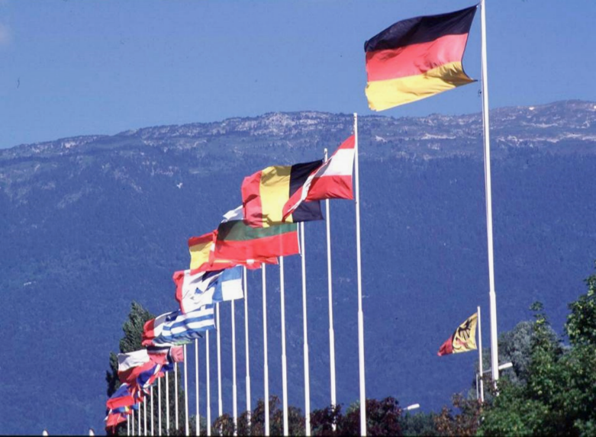
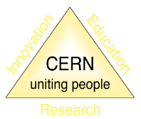
About CERN
CERN (“Conseil Européen pour la Recherche Nucléaire”) was founded in 1954 to promote “science for peace”.
Today an International Organisation with 23 member states, is the largest particle physics laboratory in the world.
~ 2600 staff
~ 1800 other paid personnel
~ 14000 scientific users
Budget (annual) ~ 1300 MCHF
Member States: Austria, Belgium, Bulgaria, Czech Republic, Denmark, Finland, France, Germany, Greece, Hungary, Israel, Italy, Netherlands, Norway, Poland, Portugal, Romania, Serbia, Slovak Republic, Spain, Sweden, Switzerland, United Kingdom
Associate Members: Cyprus, Estonia, Slovenia, Croatia, India, Latvia, Lithuania, Pakistan, Türkiye, Ukraine
Finland is a member state since 1991

Slide 3
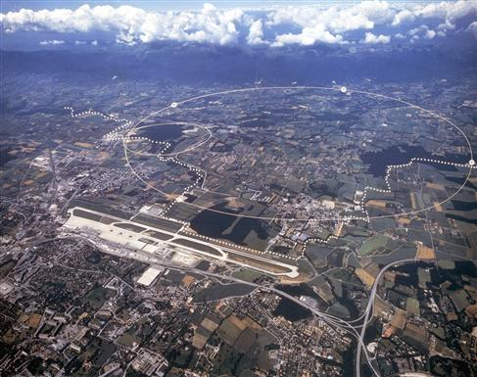

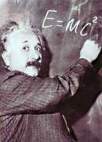


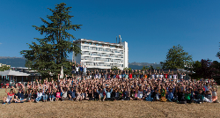
The mission of CERN
Push back the frontiers of knowledge
the secrets of the Big Bang …what was the matter like within the first moments of the Universe’s existence?
Develop new technologies for accelerators and detectors
Train scientists and engineers of tomorrow
Unite people from different countries
and cultures
The 27-km Large Hadron Collider (LHC), built and operated at CERN, is the largest particle accelerator in the world

Slide 4
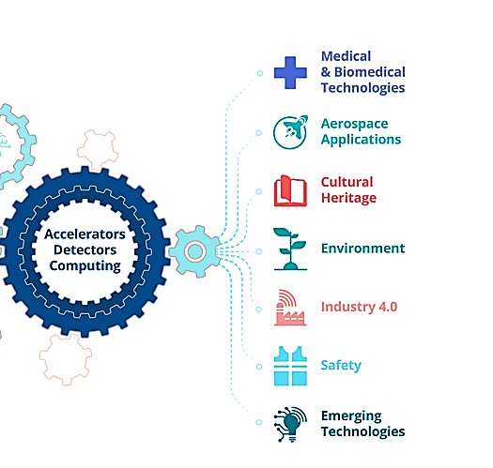
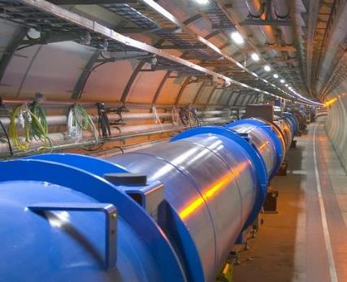
From the Large Hadron Collider to medicine
CERN and Society
Huge experience in all technologies related to acceleration and detection of particles
Engaged to maximise the return to society and to demonstrate the impact of major investments as the Large Hadron Collider.
MedTech is the main field of application of CERN technologies for the benefit of society.
The subatomic world made accessible using particle accelerators can lead to substantial advances in many fields of medicine: treatments with particles, isotopes, advanced diagnostics,…
Developing these technologies requires a strong collaboration across physics, biology, medicine - and CERN can provide a fertile collaborative ground for them to grow.

Slide 5
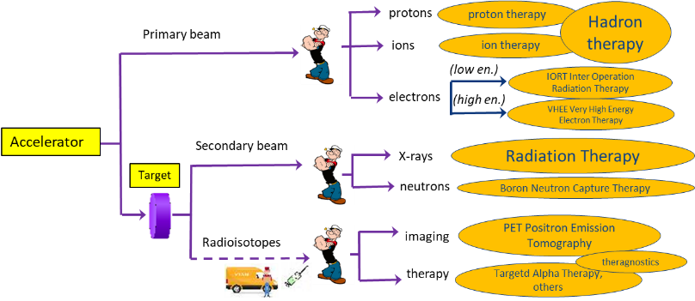
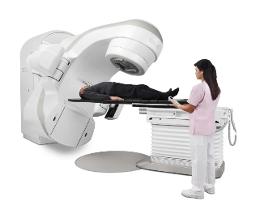
Particle accelerators, a formidable tool for medicine
Accelerators produce particles (photons, protons, ions) that can penetrate into the body to treat diseases and to observe internal organs without using surgical tools.
> 150
12
>300
0
≈ 14’000
15
≈ 1’500
0
Cancer treatment
Imaging
New cancer treatments
14,000 electron linear accelerators worldwide for X-ray therapy of cancer
Reference domains for the Baltic Advanced Particle Therapy Centre
5

Slide 6
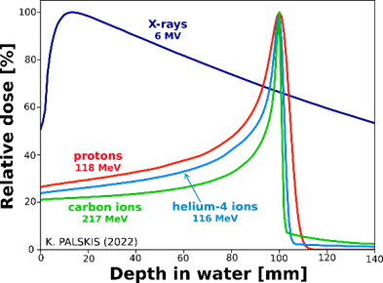
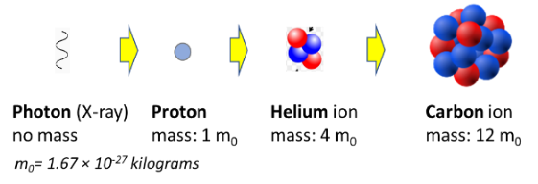
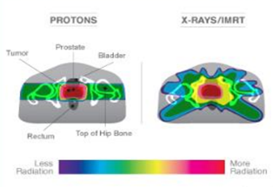
Treating cancer with particle beams
Comparison of dose for prostate cancer (protons vs. X-rays)
tumour position
Bragg peak:
Different from X-rays, protons and heavier ions deposit their energy at a defined (energy dependent) depth inside the tissues, minimising the dose to the organs close to the tumour.
Today only protons and carbon ions are licensed for treatment. Trials with helium ions (intermediate between the two) are starting at HIT Heidelberg.
Particle therapy recommended for cancers close to critical organs and paediatric. Many ongoing clinical trials to assess benefits for different types of cancer in terms of side effects and recurrencies.
Notes:
X-rays: atomic and molecular level – particles: atomic and subatomic level

Slide 7
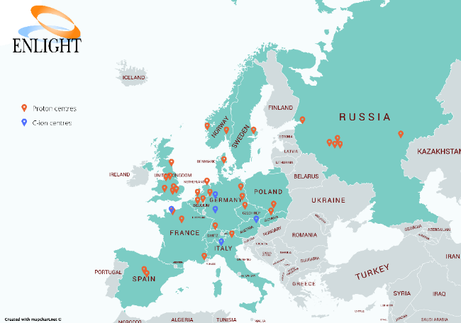
The EU particle therapy landscape
Most European countries are now equipped for particle therapy, and others are rapidly following (Spain has just signed a contract for 10 proton therapy centers).
Only two regions are not covered;
Baltic countries and Finland
South East Europe
Worldwide, >150 proton therapy centres, 12 carbon therapy
Particle therapy centres in Europe. Courtesy of ENLIGHT, 2020

Slide 8
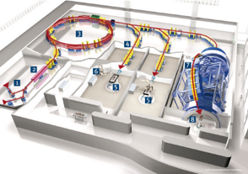
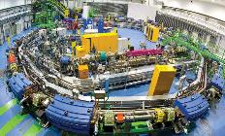
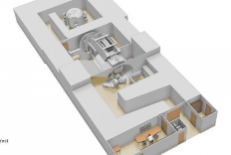
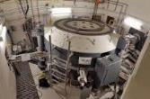
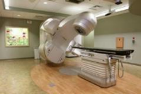

Comparing accelerator designs
Heavier ions are more effective because they deliver more energy to the tissues, but need more energy to enter the body → factor 2.8 in accelerator diameter from protons to carbon
courtesy IBA
Synchrotron, carbon ions
~5,000 m²
~250 M€
Cyclotron, protons
~500 m²
~40 M€
Commercially available Specially designed and built
Linac, X-rays
~50 m²
~few M€
Range to explore: compact synchrotron for light ions

Slide 9


The CERN Next Ion Medical Machine Study
Proton therapy is now commercial, and CERN, as an international organisation, cannot interfere with a mature commercial market.
Ion therapy is still in an early phase despite its advantages, limited by:
  Size and cost of the accelerator;
  Lack of experimental data.
New demands from the medical community and new opportunities from accelerator technologies can be integrated in a newly designed ion therapy facility.
Approval in 2019 of the Next Ion Medical Machine Study (NIMMS).
In line with CERN mission, the goal of NIMMS is to build on CERN expertise to develop a portfolio of technologies that can be used in a next generation facility, more than developing a single design (NIMMS as a «toolbox»).

Slide 10


NIMMS as an international collaboration
NIMMS is an international collaboration based at CERN to develop new technologies for the future generation of accelerators for cancer therapy with ions.
Building on the CERN experience in small accelerators and in accelerators for medicine;
Federating partners to develop innovative designs and technologies;
Partners can use the NIMMS technologies to assemble their own optimized facility.
NIMMS collaboration in 2023 (19 partners)
SEEIIST (South-East European International Institute for Sustainable Technologies)
TERA/TERA-CARE Foundation (Italy/CH)
Riga Technical University (Latvia)
GSI (Germany)
INFN (Italy)
CIEMAT (Spain)
Cockcroft Institute (UK)
University of Manchester (UK)
CNAO (Italy)
Imperial College (UK)
MedAustron (Austria)
U. Melbourne (Australia)
ESS-Bilbao (Spain)
Sarajevo University (Bosnia &H.)
University of Thessaloniki (Greece)
PARTREC (Netherlands)
TENMAK (Türkiye)
ITRE (Slovenia)
University of Malta
In 2022/23 NIMMS has supported:
8 PhD Students
3 Post-Docs
2 Master students
NIMMS Funding:
CERN Knowledge Transfer
SEEIST, RTU and TERA (personnel at CERN)
European projects HITRIplus and I.FAST
Donations

Slide 11
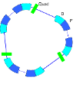






The four NIMMS Work Packages
Small synchrotrons
for particle therapy
Reduced dimensions with improved performance (injection, extraction)
2. Curved superconducting magnets
for synchrotrons and gantries
Canted Cosine Theta, NbTi or HTS
3. Superconducting gantries
Precise beam delivery on multiple angles
4. Linear accelerators for ions
Compact bent full-linac
Synchrotron injector with isotope production

Slide 12
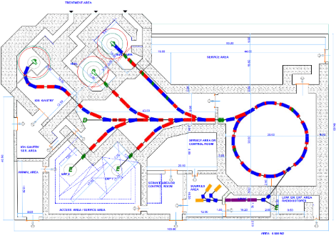
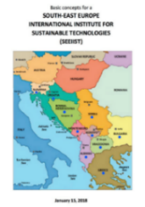
NIMMS supported designs: SEEIIST carbon ion therapy and research facility
Intensive design work in 2019/20 for a modern facility for research and therapy with protons and carbon ions
Innovative SEEIIST features:
Optimised for 50% research and 50% patient treatment (~400 patients/year);
Providing 20 times higher beam intensity for carbon ions than present facilities;
Equipped with flexible extraction for operation in FLASH mode;
Equipped with dual mode linear injector capable of producing radioisotopes for cancer imaging and therapy.
Multiple energy extraction (multiple flat-tops) for faster treatment.
SEEIIST (South East Europe International Institute for Sustainable Technologies): a new international partnership aiming at the construction of a new Research Infrastructure for cancer research and therapy in South East Europe (11 member countries).
Goals are to develop a new advanced design and to build international cooperation and scientific capacity in a region that will join EU but is less develop and still divided, in the line of “science for peace”.
Total 5,400 m² (including shielding)
Estimated cost (2020):
240 M€

Slide 13
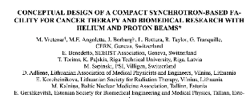
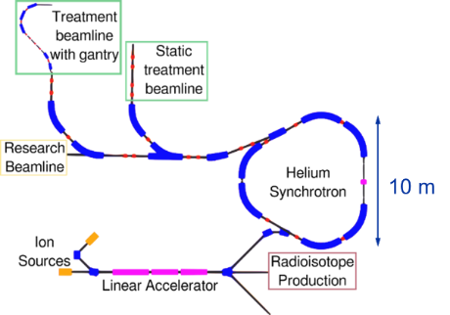

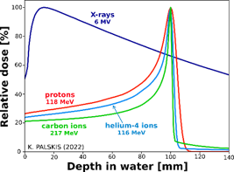
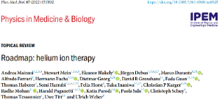
NIMMS supported designs: compact research and therapy facility with p and He
Recent interest in treatment with He beams:
reduced lateral scattering than protons
lower fragmentations than carbon
lower neutron dose
could treat some radioresistant tumours
well suited for FLASH treatment
First patient treated at Heidelberg, clinical trials in preparation
Conceptual design of a facility for research and therapy with protons and helium beams
2 beamlines treatment
1 beamline research.
Surface ~2,000 m2
Cancer treatment with protons or helium
Protons at higher energy for on-line radiography
Experimental programme with p, He, C, O.
FLASH extraction and mini-beams.
Parallel production of radioisotopes (e.g. 211At)
Heidelberg Ion Therapy, 2022

Slide 14
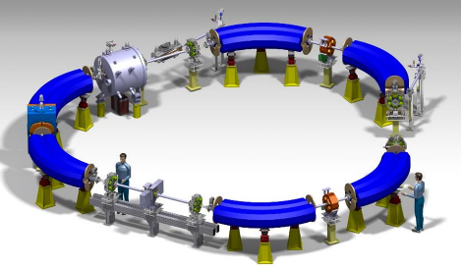
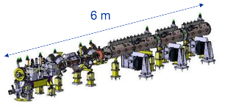
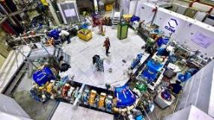
The accelerator elements of the facility
Ion linear accelerator for synchrotron injection and production of medical radioisotopes
Radioisotope | Usage
Scandium-43, 44 | Diagnostic – PET
Cobalt-57 | Diagnostic – SPECT
Copper-64 | Theranostic (β⁻)
Copper-67 | Theranostic (β⁻)
Indium-111 | Diagnostic – SPECT
Tin-117m | Theranostic (β⁻)
Samarium-153 | Theranostic (β⁻)
Rhenium-186 | Theranostic (β⁻)
Astatine-211 | Therapeutic (α)
Compact triangle-shaped synchrotron
Design is based on ELENA, a synchrotron for deceleration of antiprotons recently built at CERN
More details on the next presentations (Heli, Toms, Kristaps)

Slide 15
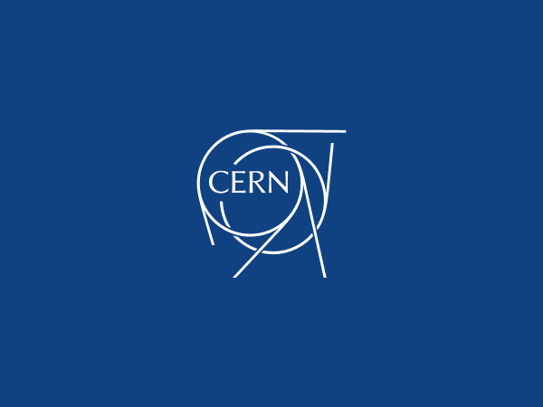
Thank you for your attention

