Slide 1

Overview of CERN Baltic Group and activities in the development of “Advanced Particle Therapy center for the Baltic states” initiative
Prof. Toms Torims
Convener of the working group
« Advanced Particle Therapy Center in the Baltic States »

Slide 2

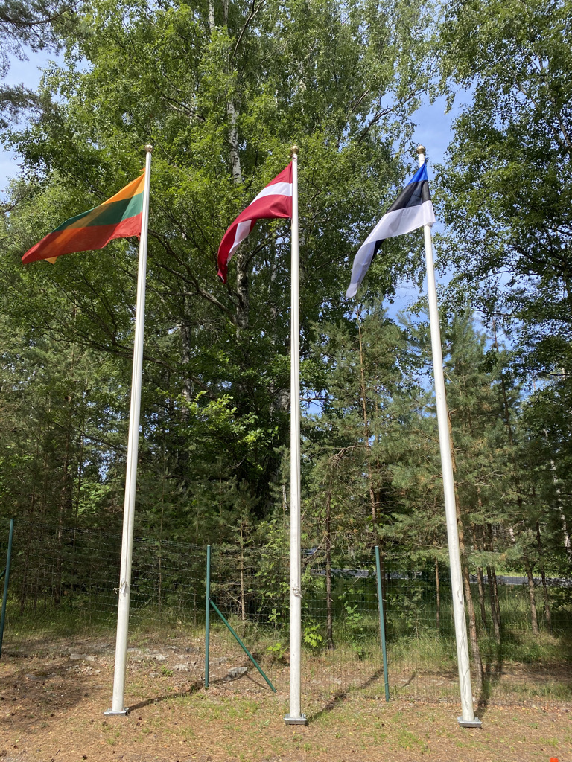

Science Diplomacy vis-à-vis CERN
Baltic style
Common system of values
One voice
Reliable and open
Many challenges = numerous opportunities
Notes:
Who are the Partners?
How CBG opperates?

Slide 3
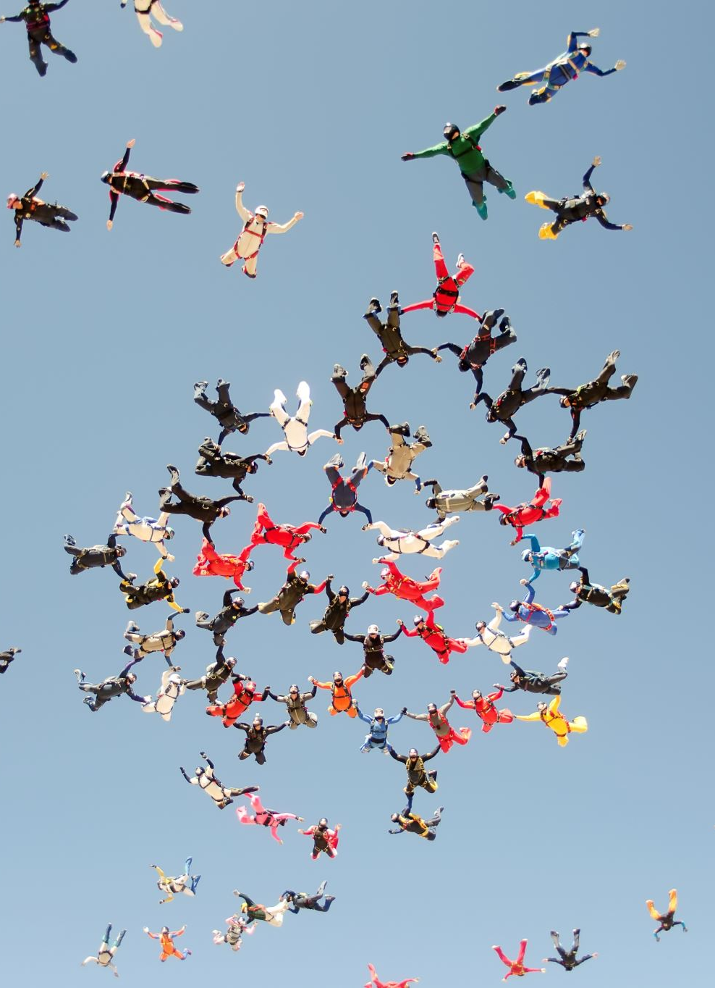
CBG objectives
Coordination of the Baltic research institutions activities towards CERN and related Collaborations/Experiments
Strengthening and development of Baltic High Energy Physics Community
Development of the Baltic international multidisciplinary masters/doctoral level study programme in High Energy Physics and Accelerator Technologies
The main principles:
transparency, honesty, sharing and collaboration

Slide 4



Regional dimension
Cooperation
In action
Exchange
Strong
Attractive
Trustful partners
Riga Technical University
University of Latvia
Tallinn University of Technology
National Institute of Chemical Physics and Biophysics
Vilnius University
Riga Stradins University
University of Tartu
Kaunas University of Technology
Vytautas Magnus University
Ventspils University of Applied Sciences
Lithuanian Energy Institute
Daugavpils University
Lithuanian University of Health Sciences
National Cancer Institute of Lithuania
Notes:
Who are the Partners?
How CBG opperates?

Slide 5
How it works?
General Meeting
Coordination Team & Secretariat
Study Program Group
Scientific and Technology Working Group Activities
General Meetings: Riga, Geneva, Tallinn, Vilnius, Kaunas
Regular work of the Coordination Team and Technical Coordination Meetings
Sub Group Activities and meetings
Industry engagement
∑ 60+ joint events
Well documented
Well coordinated
and strong together
- involving
- engaging
- recognising
- exchanging
- learning
- building
- community
- visibility
- goal
- connecting
- developing
- motivating
https://indico.cern.ch/category/10023/

Slide 6
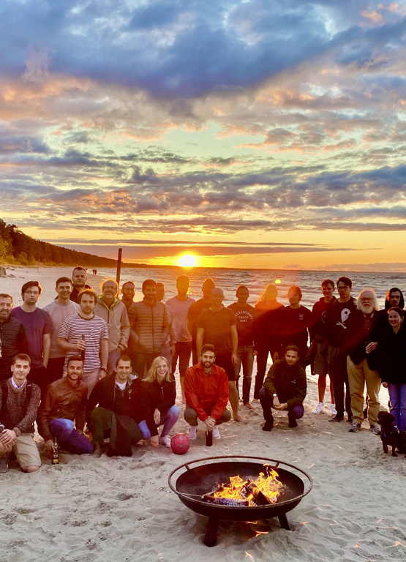
Success of CBG
Collaboration with Baltic Assembly
Joint/coordinated position vis-à-vis CERN
Strong and united position at CERN Council
Stakeholder engagement
Major regional events and conferences
Joint study programme
Flagship project Advanced Particle
Therapy Center for the Baltic States

Slide 7
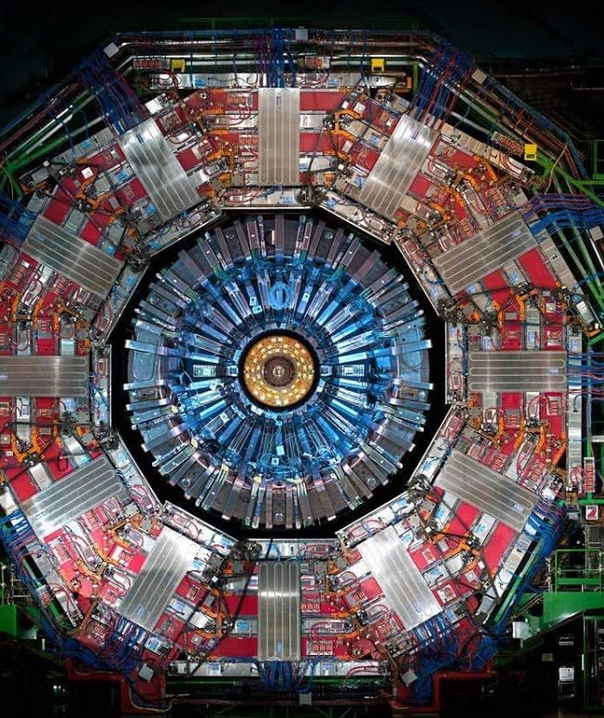
In the spirit of CERN
Knowledge
Transparent
Honest
United
Successful
Regional grasp

Slide 8

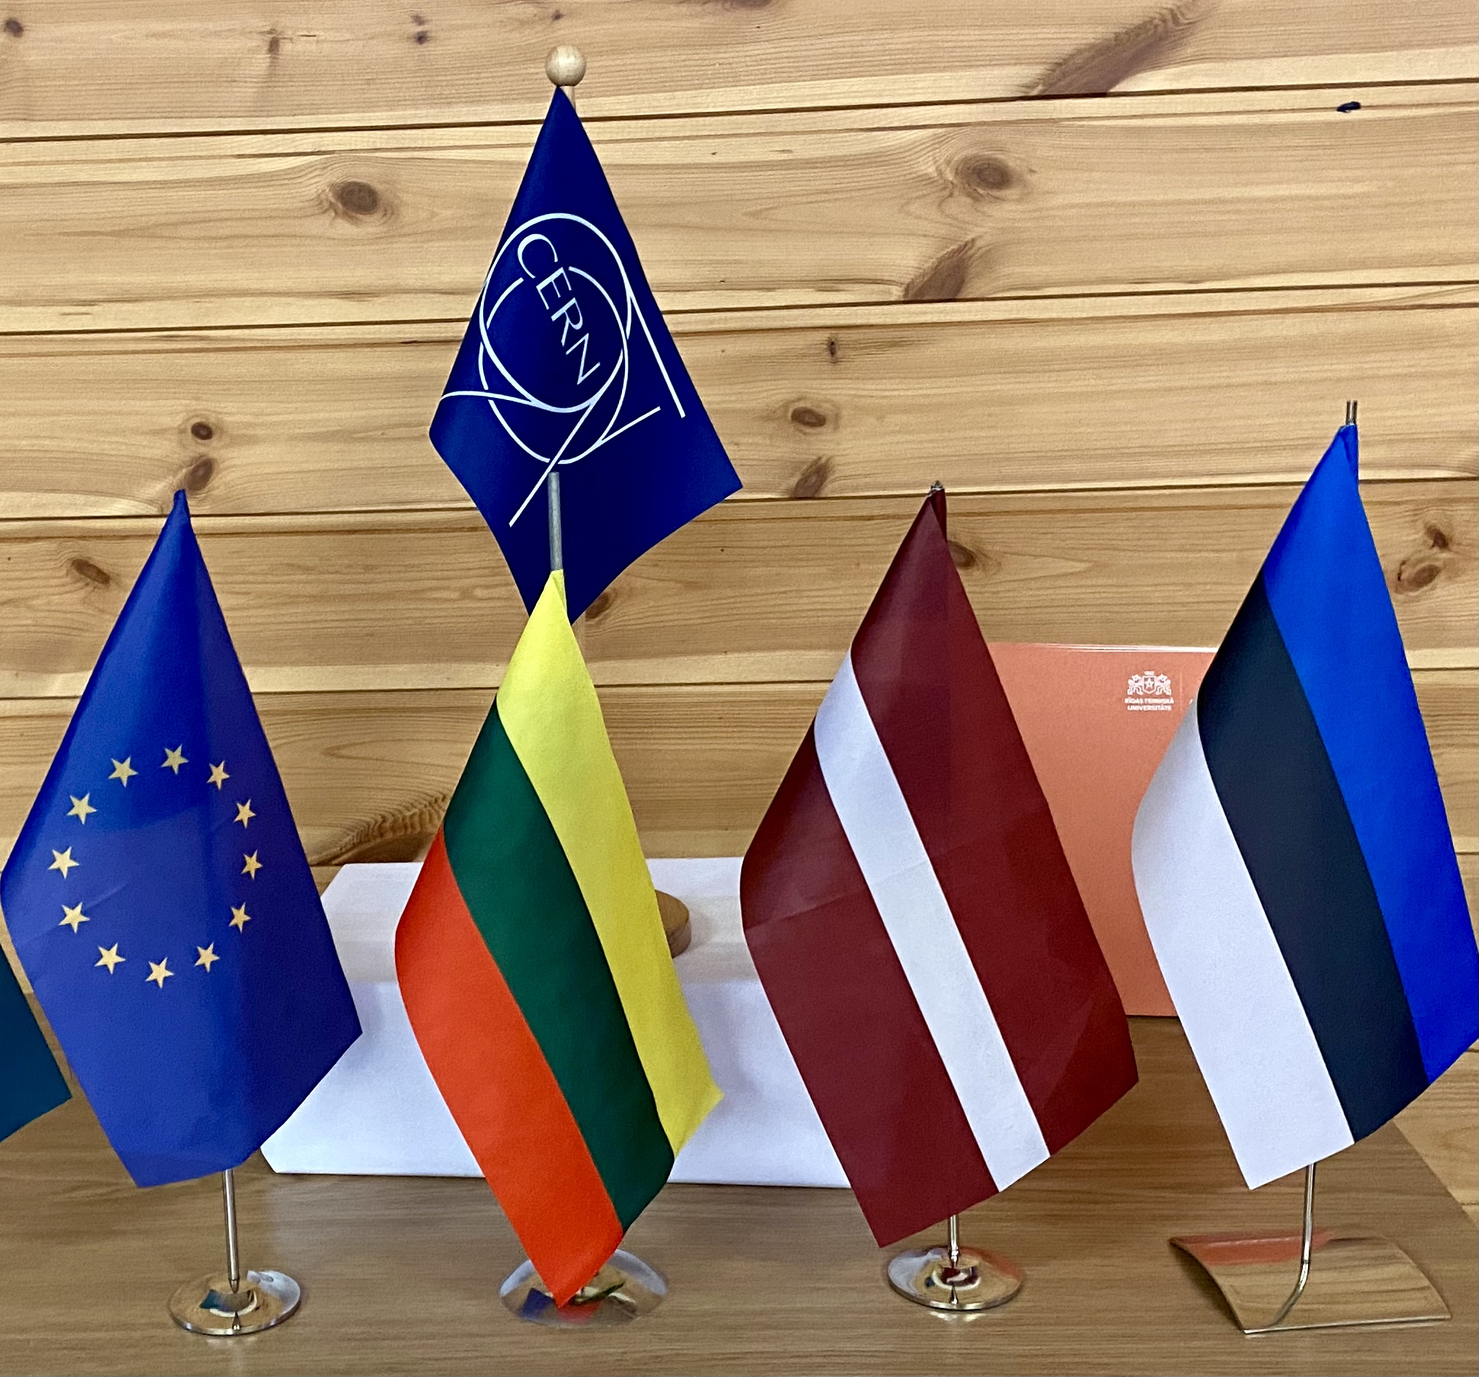



Science Diplomacy
Baltic style
CERN Baltic Group
We are strong together
Trust in science
Experience to be sheared

Slide 9
Advanced Particle
Therapy Center for the Baltic States

Slide 10
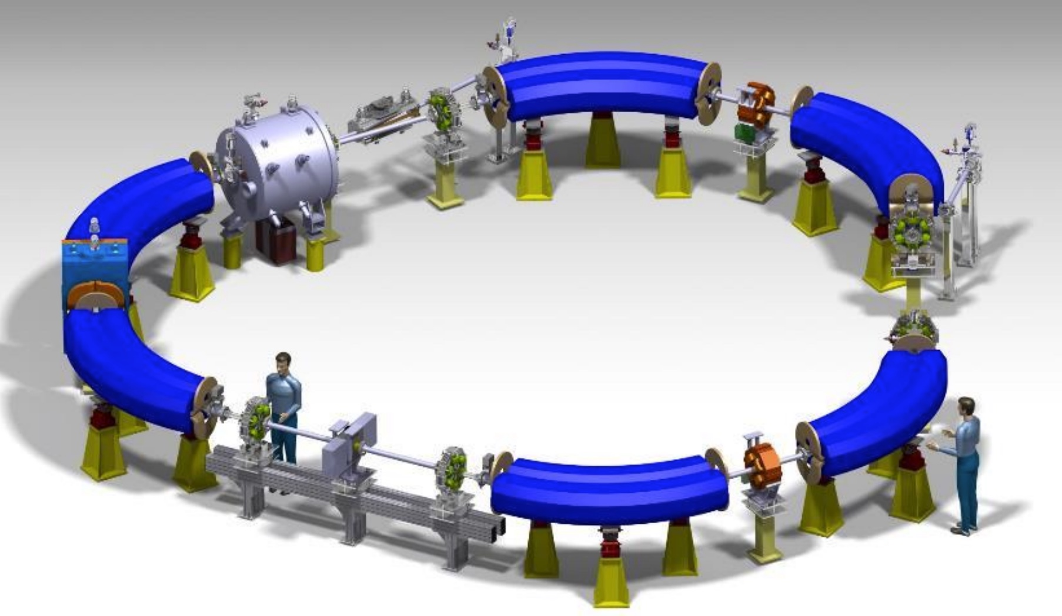
Advanced Technology developed at CERN
Experience
Expertise
Novel
Practical
EU priorities
Medical community
Supported

Slide 11
Flagship project for 3B
Advanced Cancer Therapy Center
Advanced concept
Regional Center
Advanced technology
Advanced medically
Advanced scientifically
Advancing collaboration between 3B
Advancing collaboration with CERN
Advancing multidisciplinary
Advancing STEM
Advancing quality of life in the 3B
Center of hope for the patients
Center of the technological development
Center to prevent brain-drain
Center of hope and education for young scientists, doctors, researchers, technical specialist
Center to push for the excellence
Own high-tech lab = regional research infrastructure
Center of gravity for the cooperation with CERN

Slide 12
Mandate
On April 12th 2022 within CERN Baltic Group 9th general meeting at CERN
the Advanced Particle Therapy Center in Baltic States Working Group
has been established

Slide 13
Partnership with CERN
Center would be done following NIMMS main idea – using the developed technologies within NIMMS collaboration in order to create a unique treatment center
Project has been already started in a framwork of working in close collaboration with NIMMS and CERN together in delivering the facility
The proposed project would be one of the leading in Baltic States porfolio of collaborations with CERN

Slide 14
Recap: Road to the initiative
April 12th, 2022
“Advanced Particle Therapy center for the Baltic States” working group established within the CERN Baltic group (CBG)
Convener: Prof. Toms Torims (RTU)
Vice-convener: Prof. Diana Adliene (KTU)
Spring 2022
Development of a dedicated conceptual design report
October 8th, 2021
CBG discussion with NIMMS collaboration on facility options
February 2022
NIMMS Helium synchrotron working group establishment with involvement of researchers from the CBG

Slide 15
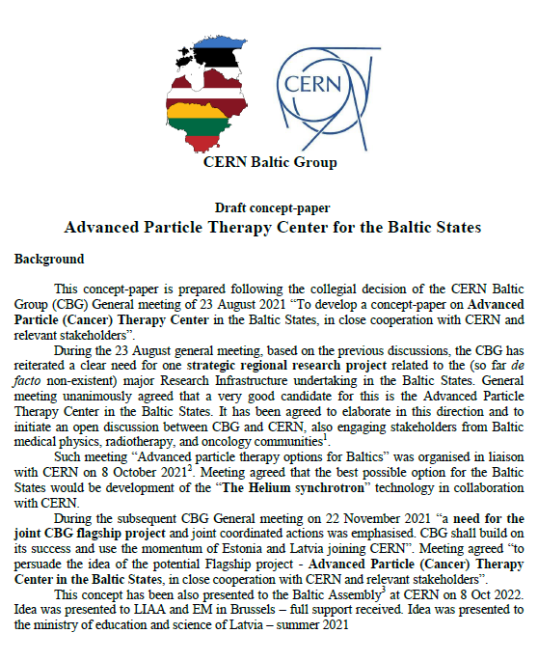
Important milestone of the project
A dedicated concept paper was developed

Slide 16
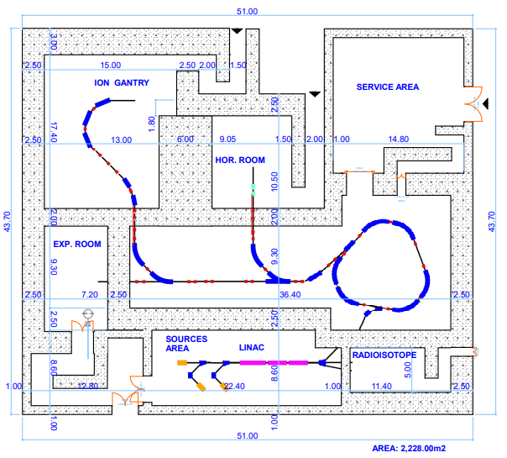
Facility initial plan
October 2022

Slide 17
Addressing medical community: professional societies
October 2022 Presentation at the 8th Baltic Radiology congress
January 2023 Presentation at Lithuanian Society of Radiation Therapy conference
March 2023 Presentation for Latvian Therapeutical Radiology Association
June 2023
Presentation at 19th Nordic-Baltic Conference on Biomedical Engineering and Medical Physics
Brief introduction to initiative ISRS Educational Course
Conceptual idea has been discussed with Baltic Nuclear Medicine Association
Seminars are foreseen with the 3 medical physicist associations in the Baltic States, as well participation in 16th International Conference & Workshop “Medical Physics in the Baltic States 2023”
General support on the conceptual idea and initiative with reasonable comments and thoughts – what should be explored in more depth

Slide 18
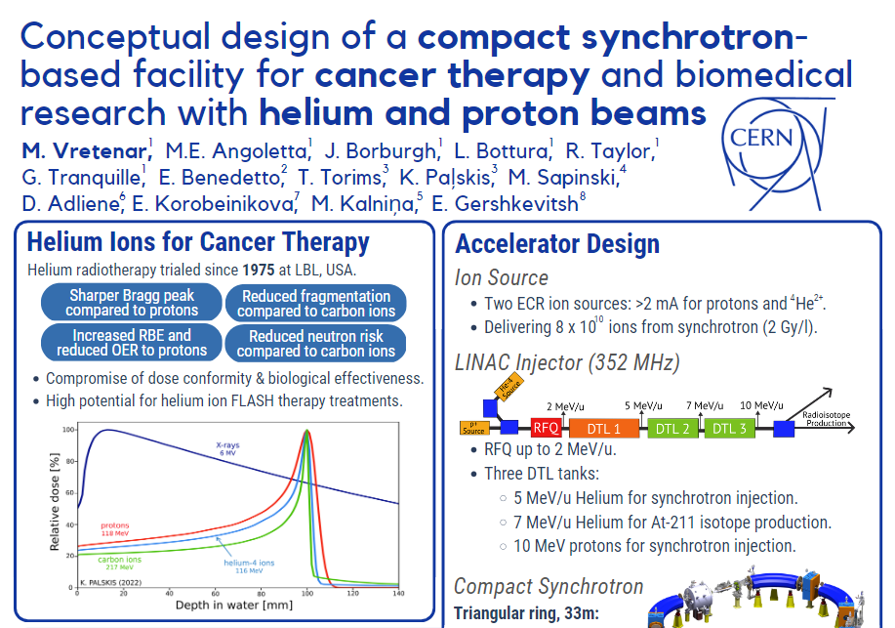
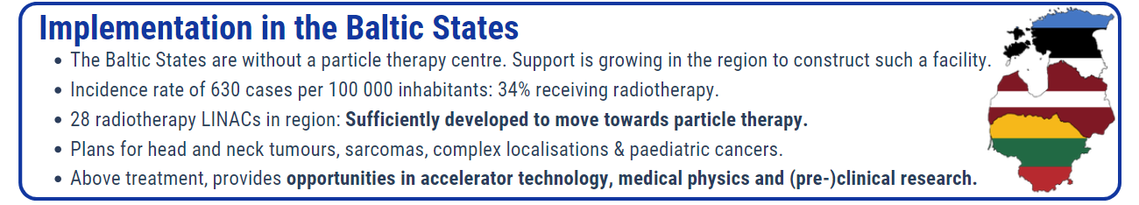
The scientific community perspective
March 2023 Enhanced Dialogue on R&I System with European Commision – presented as one of the scientific research facility initiatives in the region
May 2023 The helium synchrotron design status presented at IPAC’23
“CONCEPTUAL DESIGN OF A COMPACT SYNCHROTRON-BASED FACILITY FOR CANCER THERAPY AND BIOMEDICAL RESEARCH WITH HELIUM AND PROTON BEAMS” with a dedicated section on possible development and implementation of the design in the Baltic States “a facility for the baltic states”
Regular updates from working group at CBG General meetings
Courtesy of: NIMMS collaboration

Slide 19
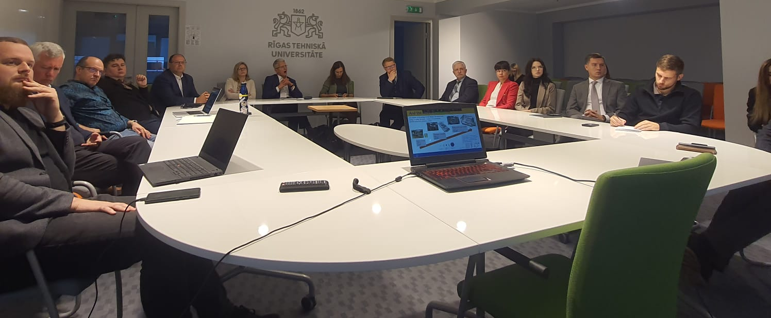
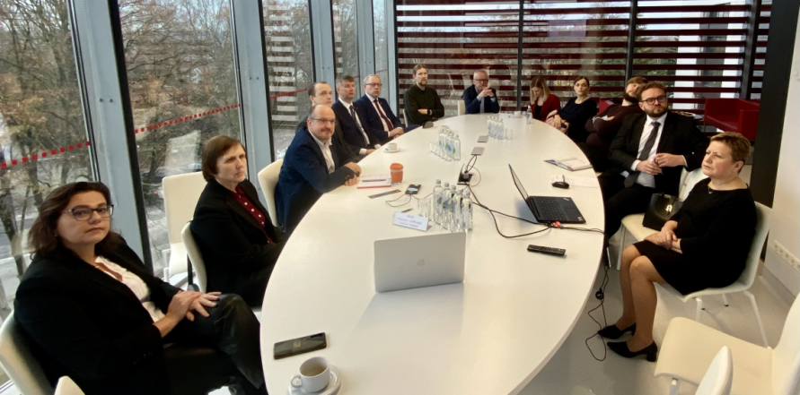
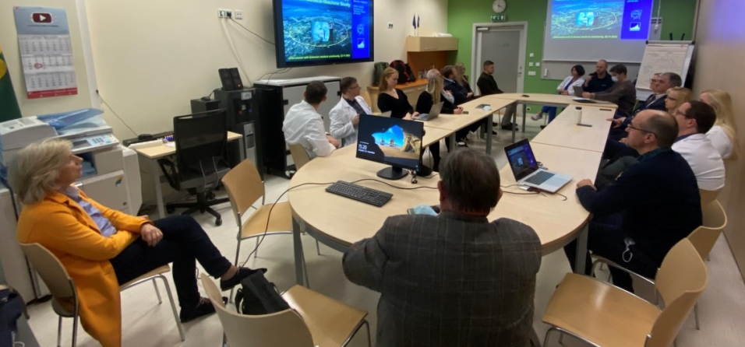



The bi-lateral meetings with medical and other stakeholders
Set-up of the events
Meeting relevant stakeholders in all 3 of the Baltic countries
Invitations to professional associations and societies of radiologists, nuclear medicine specialists, radiation oncologists and medical physicists as well as representatives of involved universities, research institutions and political bodies
Meetings were aimed to be in-person for maximum engagement
18th of October – Latvian stakeholders, Riga
16th of November – Lithuanian stakeholders, Kaunas
22nd of November – Estonian stakeholders, Tallinn
20 – 30 participants in each of the meetings

Slide 20
“Particle therapy - future for the Baltic States?”
Outcomes of this event will be covered more in depth in the next presentation!
A joint, dedicated workshop
“Particle therapy - future for the Baltic States? State-of-play, synergies and challenges”
Set-up of the event
Conceptually – workshop and discussion with professionals and experts representing professional societies from all 3 Baltic States
Invitations to professional associations and societies of radiologists, nuclear medicine specialists, radiation oncologists and medical physicists for nominated representatives
25th of May, 2023 at CERN
Main goals of the event:
  To bring together high-level professionals, experts and stakeholders from the Baltic States, nominated by the corresponding professional associations to discuss and work on ideas for development of key aspects of the initiative.
  To provide fact-based and scientifically driven reasoning for each of the key aspects of the initiative based on the afore mentioned stakeholder opinion.
  To build multi-disciplinary synergies between the different fields and specialties involved in cancer treatment and three Baltic States at large.
  To reach a joint consensus and vision of future development of the “Advanced Particle Therapy Center in the Baltic States” initiative based on the conclusions reached within the workshop.

Slide 21
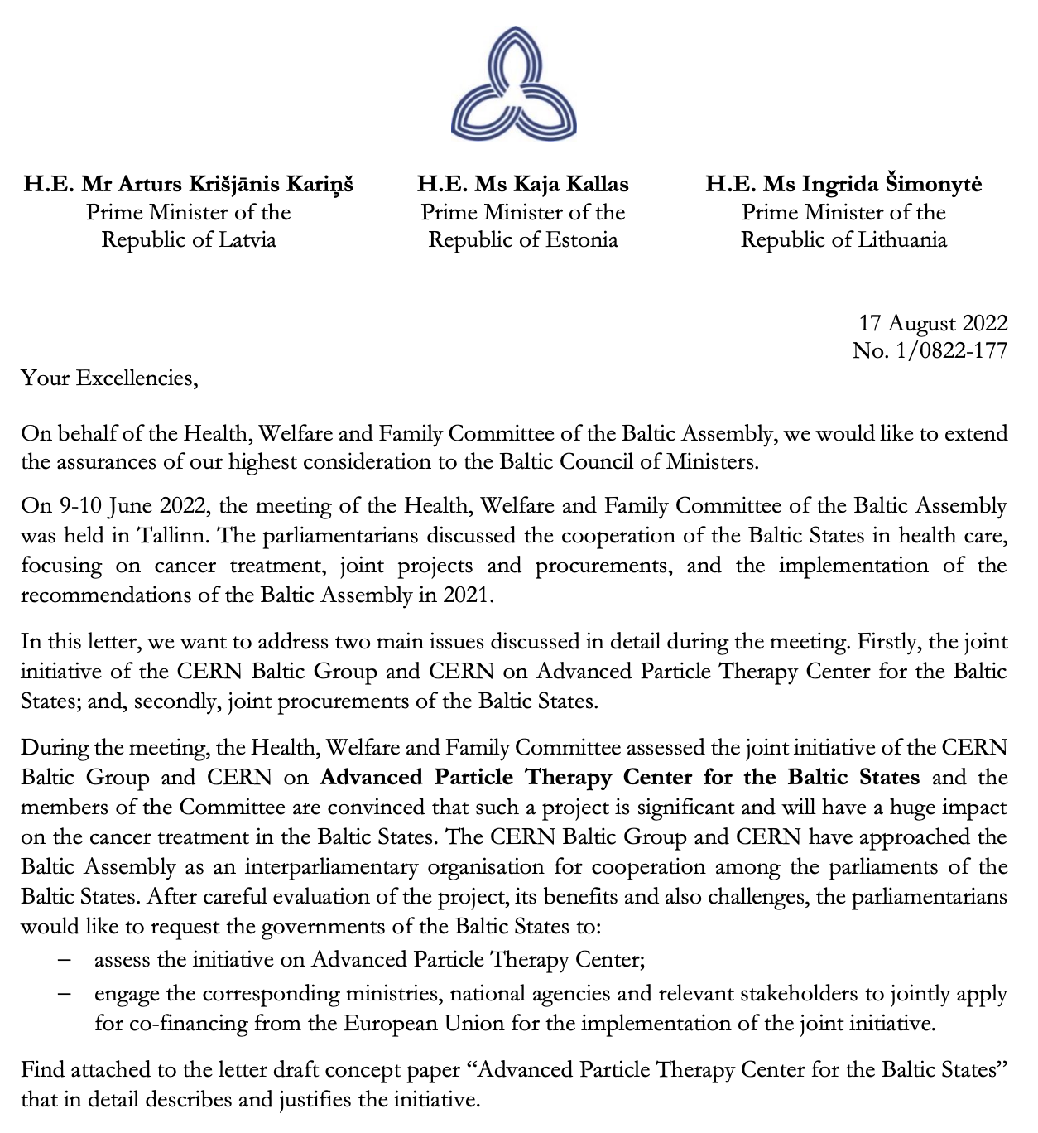
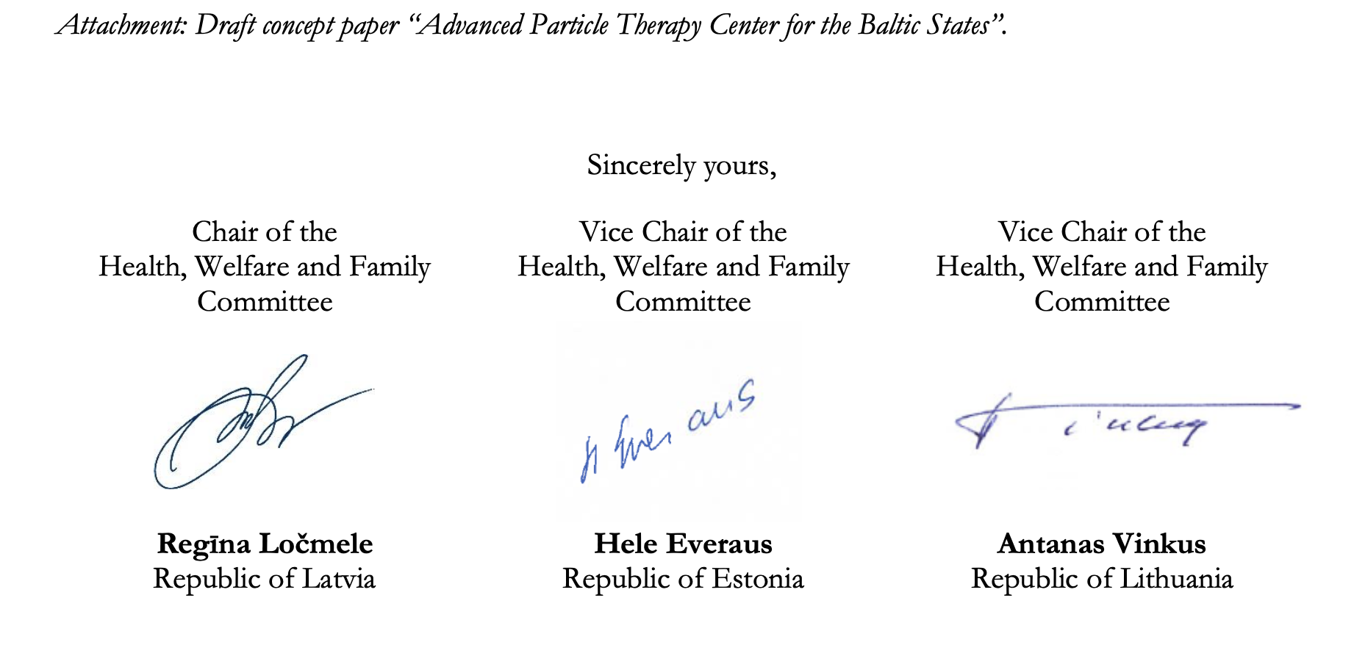
Strong support of the policy makers

Slide 22
Project financing

Slide 23
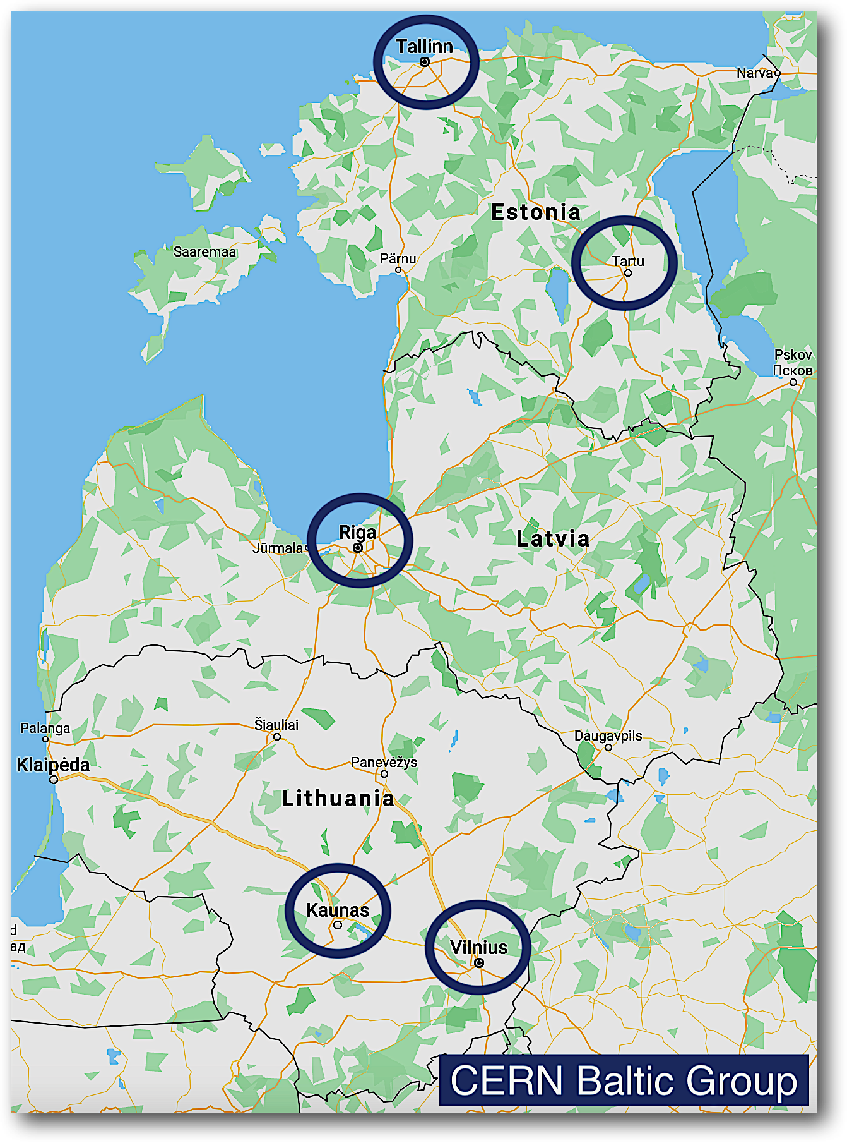
Site selection criteria
Clear and undivided support to the project from the national medical community at large (oncologists, radiologists, etc)
Strong and continuous political support: from the parliament, government, relevant ministries, and governmental agencies
Sustained Stakeholder engagement and participation in the project
The main site shall be integral part of the major oncology hospital. Physical proximity and access to the existing infrastructure is critical
Proximity to the international airport – max 50 km distance
Accessibility and servicing patients from all Baltic countries and beyond – accessible from the RailBaltica, its inter connections and major roads
Direct hosting facilities for the patients and their families
EC support for the chosen site

Slide 24




Future steps of the initiative
In order to proceed:
A full-scale feasibility study of the project
Clinical case and epidemiology
Technical aspects
Business case
Within the framework of CERN

Slide 25
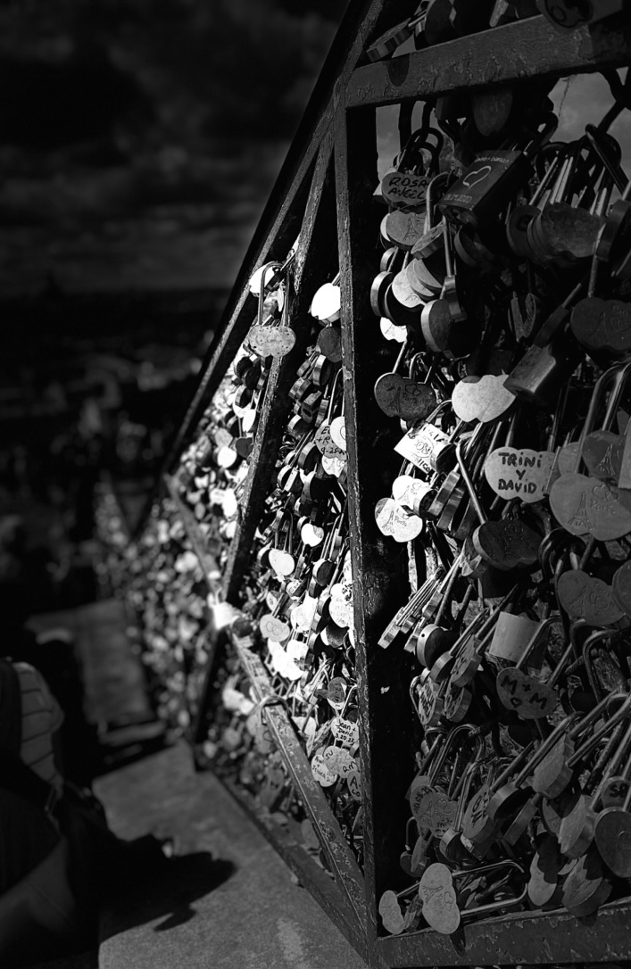
Take away
Visionary and long-term goals
Exciting and uniting
Flagship project for Baltics
Supported by CERN
Preventing brain-drain
Commercially viable
Goes hand in hand with development strategies of the Baltic States and overall EU priorities
Opportunity not to be missed…
Notes:
Your support is neede!

