Slide 1
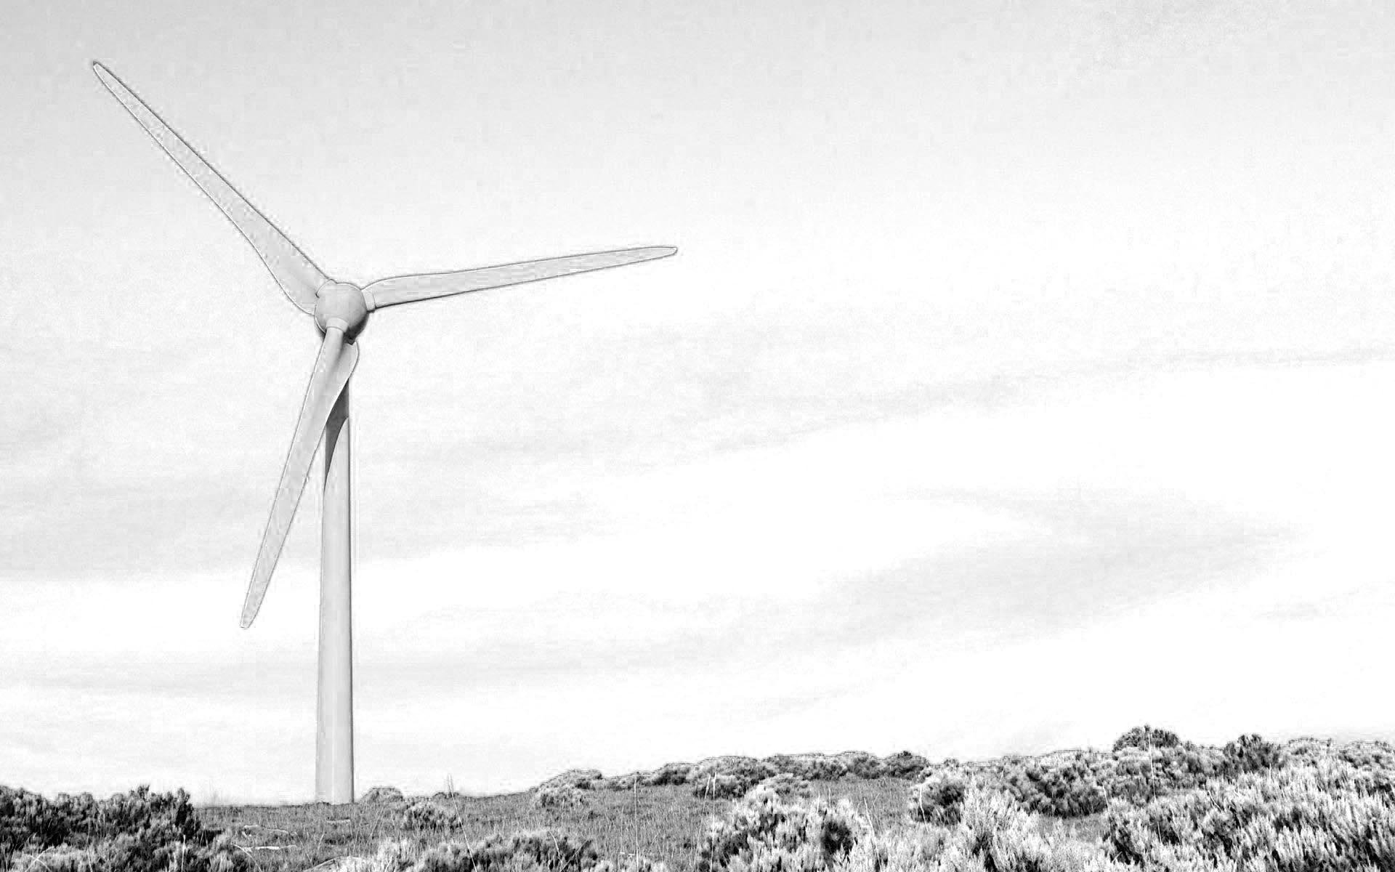
Sustainability of Particle Accelerators
Mike Seidel
Paul Scherrer Institute and EPFL, Switzerland
CERN Accelerator School – Introductory Course
September 30, 2024
Santa Susanna

Slide 2
Sustainability = Meeting the needs of the present without compromising the ability of future generations.
(one of many debated formulations)
efficient technologies
mobility &
business travel
green house gas emissions
research infrastructure system efficiency
energy related research
water consumption
waste management & recycling
energy procurement
office/lab energy consumption
grid energy consumption
use of materials and resources
heating & waste heat recycling

Slide 3
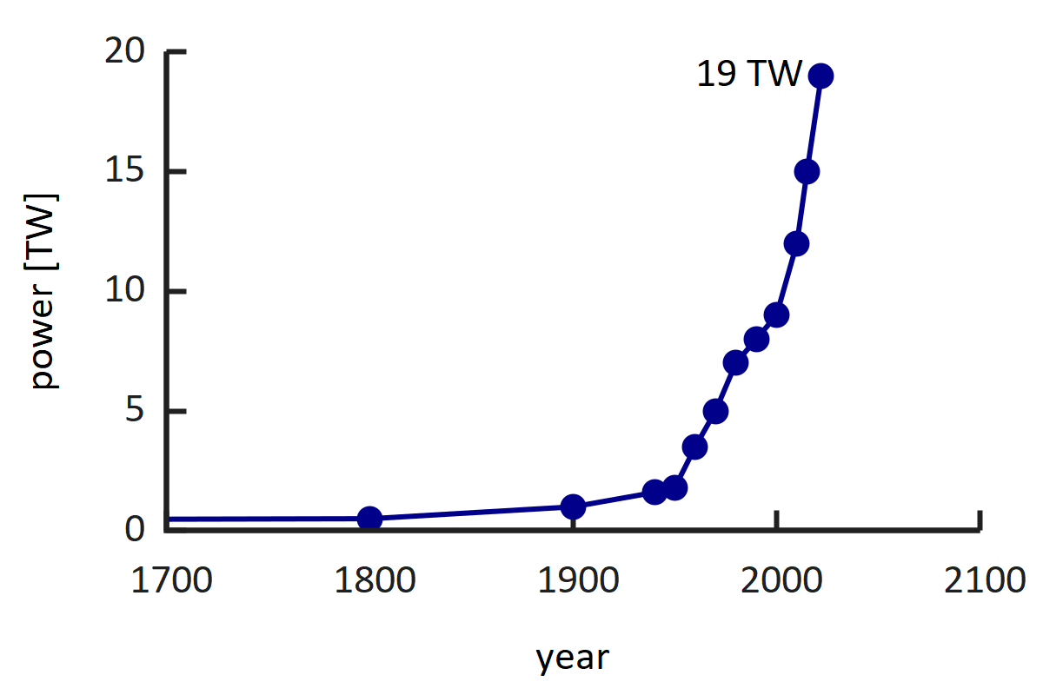
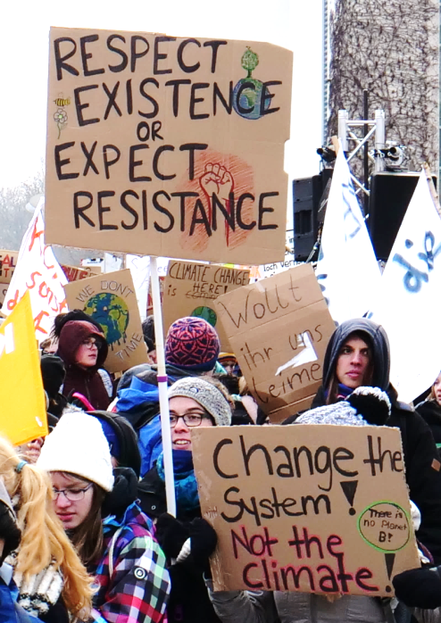
Energy Consumption - Motivation
The world energy consumption has been continuously rising, reaching ca 19 TW today.
As a science community we rather want to contribute to solutions and not be part of the problem.
includes all sources
example from nature:
the Earth-Moon system dissipates 3.8 TW power from the rotation energy of earth
[Williams, Boggs, 2016]
Tides
Earth
Moon
School Strike for Climate
Wikipedia

Slide 4



Community Activities on Sustainability
2014-17: EUCARD-2, WP Energy Efficient Accelerator Technologies
https://www.psi.ch/enefficient
2017–21: ARIES, Work Package Efficient Energy Management
https://www.psi.ch/aries-eem
2021–25: I.FAST, Work Package Sustainable Concepts
https://www.psi.ch/scat
→ consult websites for link collection to workshops and documentation
ICFA panel on sustainable accelerators, chair: Thomas Roser (BNL)
https://icfa.hep.net/icfa-panel-on-sustainable-accelerators-and-colliders/

Slide 5
Accelerator driven Research Infrastructures (RI)
primary beam
grid power
accelerator
conversion target
undulators/magnets
colliding beam insertion
…
radiation to
experiments
auxiliary systems
primary beam production
electrons
protons
ions
conversion to specific secondary radiation
X-rays
neutrons, muons, neutrinos
exotic particles
high level goal:
Science output per grid power, per operating/investment cost.

Slide 6
Accelerator Concepts and Technologies
[with emphasize on energy efficiency]
Proton Drivers with high intensity applications
Synchrotron Light Sources and FELs
Particle Colliders
concepts, RI‘s
Resonators and high Power RF Systems
Accelerator Magnets and Power Supplies
technologies
Cryogenic Systems
Component Cooling, Air Conditioning, Vacuum, Instrumentation … and other aux. systems

Slide 7
Efficient Accelerator Technologies

Slide 8
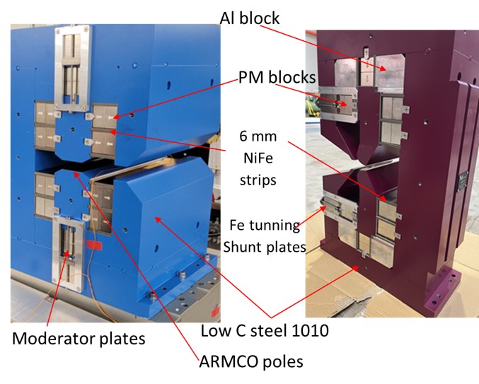
Accelerator Magnets with Permanent Magnet Material
Dipole and Quad for SLS2.0, S.Sanfilippo et al (PSI)
permanent magnets:
extremly compact → low emittance lattices
no power consumption
no cooling, thus no heat introduced, no vibrations from cooling loop
field tuning difficult
use of rare earth materials
B = 1.35 T g = -40.6 T/m

Slide 9
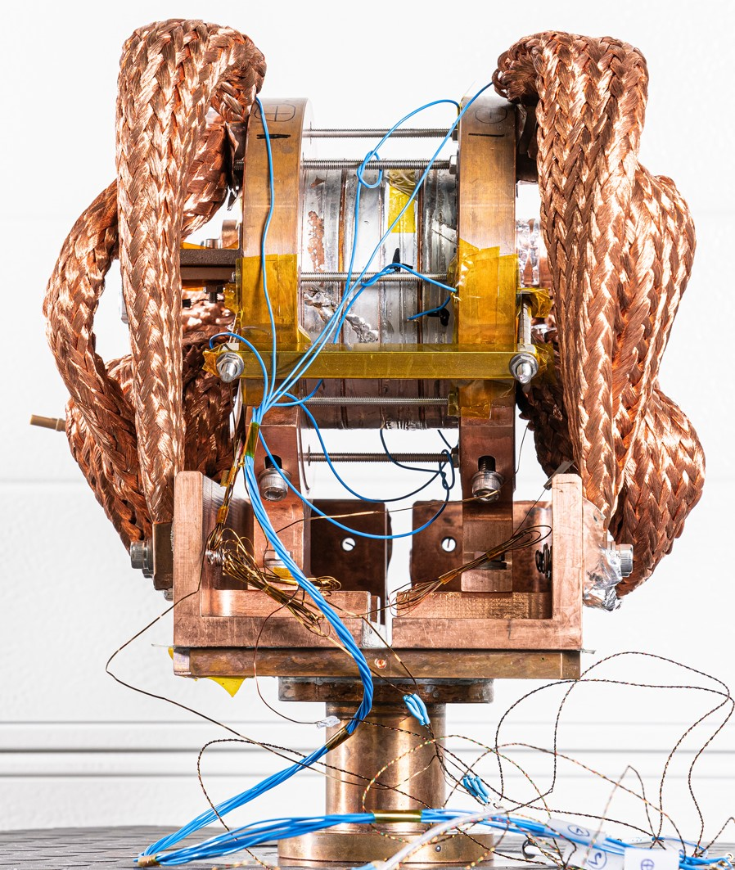
Accelerator Magnets with High Temperature Superconductor Coils
magnets with High Temperature Superconductor (HTS) coils:
medium fields for all applications (high fields in block config.)
ReBCO and Bi-2212 materials are studied
no ohmic losses, can replace power hungry large aperture dipoles/quads
cryogen free conduction-cooling possible (no He)
much improved cryogenic efficiency at elevated temperatures (e.g. 4.5K…15K instead 2K)
today expensive materials
field ramping and field quality difficult (wide tapes)
solenoid test magnet, 18T @ 12K
PSI/CHART, B.Auchmann et al

Slide 10
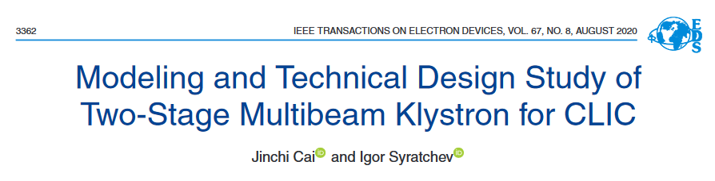
Efficient RF Power Sources
Klystrons, η>70% within reach
e.g. CLIC two stage multi-beam klystron, J.Cai, I.Syratchev, IEEE Trans, 2020
Example: study 1GHz for CLIC drive beam; 6 cavities, 30 beamlets; 25+140kV; η_{sat}=82%
Magnetron, R&D at various groups, η=60-80% within reach
e.g. Wang et al, J-Lab, IPAC 2019; A.Dexter, Lancaster U., LINAC-2014; B.Chase, Fermilab, JINST-2015
Solid state amplifiers (SSA) at various groups, η=60-90% depending of freq.
Example: SSA for Isotope production Cyclotron, 98.5MHz, 12x1kW units, η_{D}=93% (90% with regulation overhead)
Uppsala group, WP in I.FAST program
I.FAST efficient RF workshop, July 23-25, 2025, Toledo:
https://indico.cern.ch/event/1407353/

Slide 11
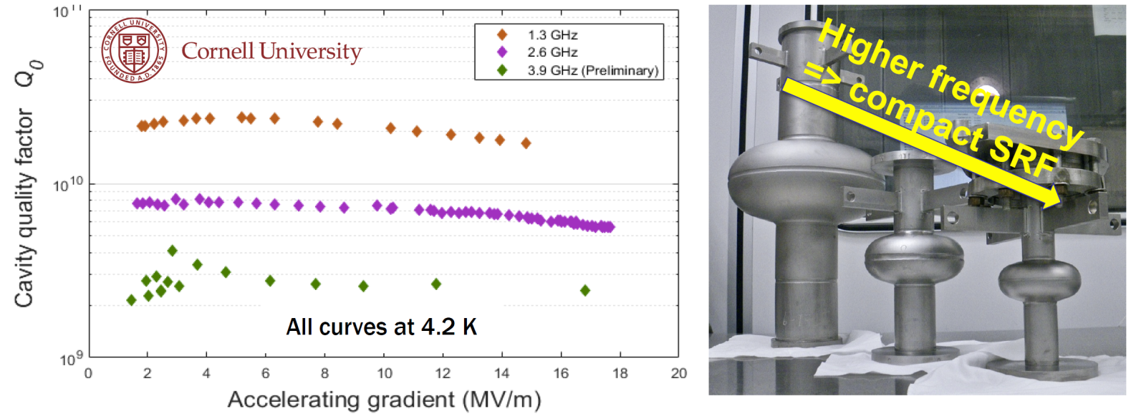
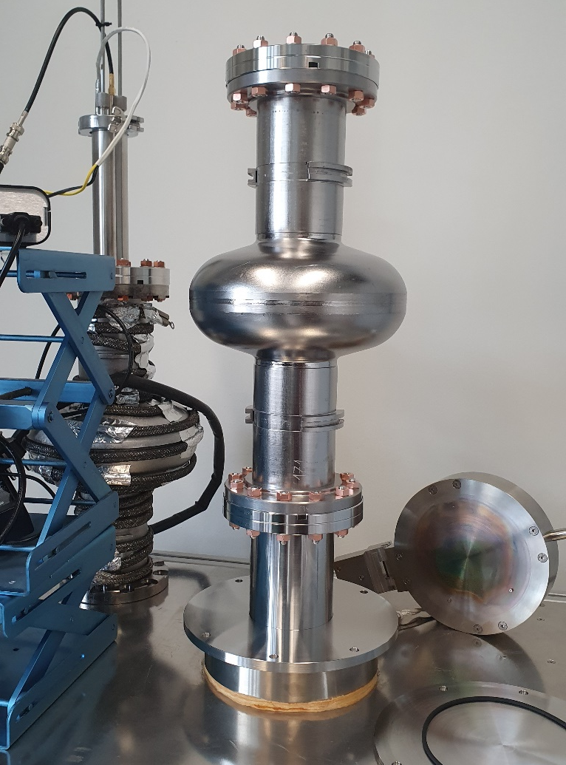
Technology R&D: Superconducting RF at higher temperature
promising R&D: Nb₃Sn coated cavities at Cornell
4.2 vs. 2.0K → efficiency
[M.Liepe, Cornell, IPAC‘19]
Cornell, FERMILAB
→ simplicity, cost, efficiency, smaller size
S Posen et al 2021 Supercond. Sci. Technol. 34 025007
record cw gradient in Nb₃Sn-coated, E_{acc} = 24 MV/m
SMART recipe leads to a T_{c} of 15.4 K on Nb-samples coated with 15 / 25 nm of AlN / NbTiN
DESY, Hamburg U.
aim for sustained SRF accelerator technology
10y Goal: >70 MV/m with a Q₀ of 1x10¹⁰ and at 4K
contact: M.Wenskat, DESY
To be published
G. Deyu et al., „Al₂O₃ coating of Superconducting Niobium Cavities with thermal ALD“, in preparation

Slide 12
Proton Driver Accelerators or: Best attainable Grid-to-Beam efficiency?

Slide 13
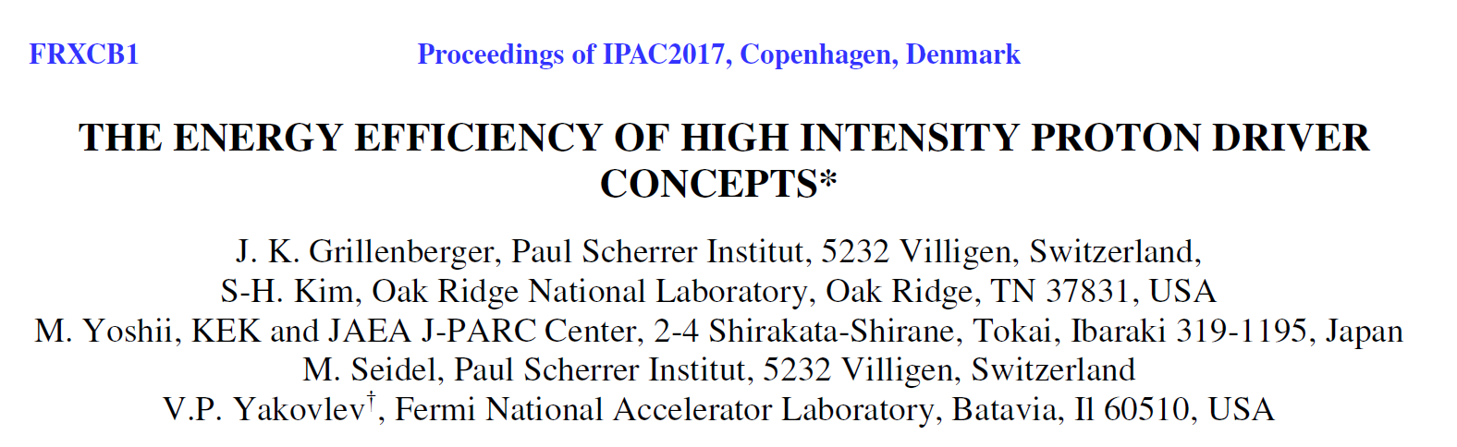
Comparison: Megawatt p-Drivers
Workshop: Efficiency of Proton Driver Accelerators, 2016, PSI
https://indico.psi.ch/event/3848/
Yakovlev, FNAL, invited talk, IPAC 2017
590 MeV, 1.4 MW
Megawatt class facilities operating today:
optimized for application, not efficiency
facility | accelerator type | Economy | Energy Reach | Power Reach | operational complexity | grid-to-beam Efficiency
SNS | superconducting linac | -- | ++ | ++ | ++ | 9%
J-PARC | rapid cycling synchrotron | ++ | ++ | - | - | 3%
PSI | isochronous cyclotron | + | -- | + | - | 18%

Slide 14
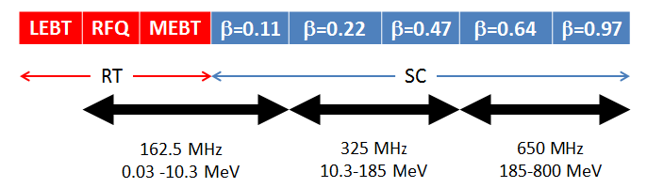
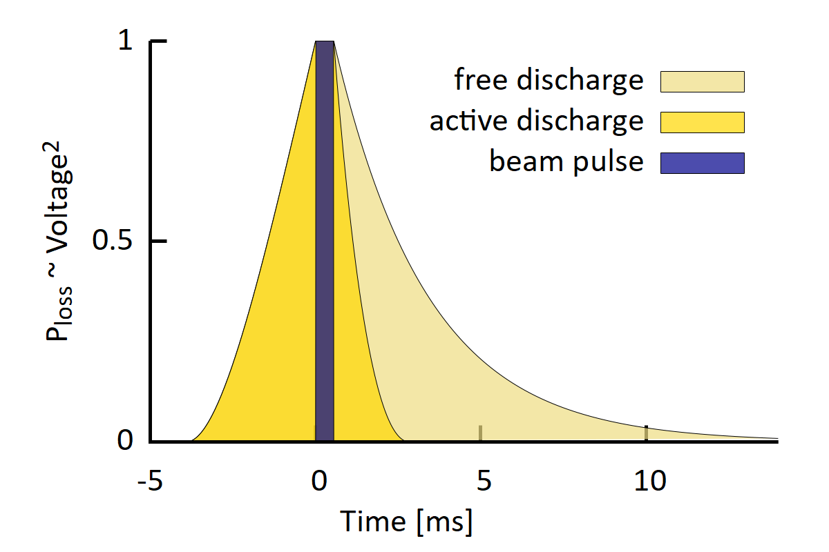
Superconducting Linac : High Efficiency Potential example: PIP-II design of Fermilab
PIP-II base parameters:
H⁻, 800MeV, 2.0mA, part of Fermilab complex
aim: neutrino production (1MW @ 60..120GeV)
CW operation as upgrade path
highest efficiency
not efficient in pulsed operation:
operating regime | avg. RF power | cryogenic power | avg. beam power | grid-to-beam Efficiency
PIP-II pulsed operation | 1.44MW | 1.19MW | 17.6kW | 0.7%
PIP-II CW operation | 9.10MW | 1.83MW | 1.60MW | 15%
[from presentation B.Chase, Y.Yakovlev, 2018]

Slide 15

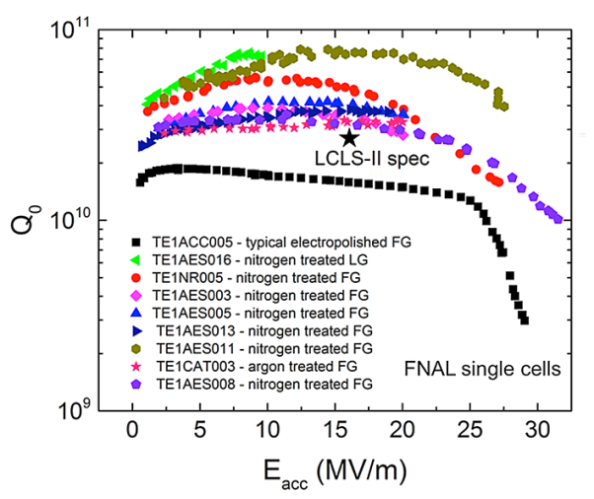
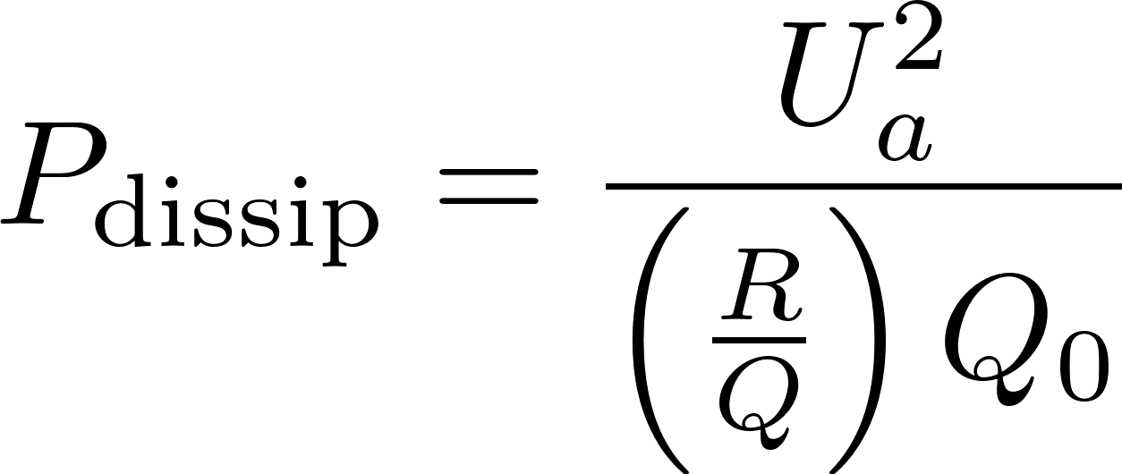
Low Loss Superconducting Resonators
high Q resonators, 1.3GHz, 2K, FNAL
[A.Grassellino, A.Romanenko et al, 2013]
10¹⁰
2×10¹⁰ s.c. resonator
Q₀ = quality factor
→ e-folding decay and resonance width
dissipated power:
10⁵
50‘000 Cu resonator
3‘000 church bell
example:
U_{a} = 20MV, (R/Q) = 609Ω, Q₀ = 2×10¹⁰, I_{b}=2mA
P_{dissip} = 33 W
P_{beam} = 40.000 W
1
but: cryogenic efficiency!

Slide 16
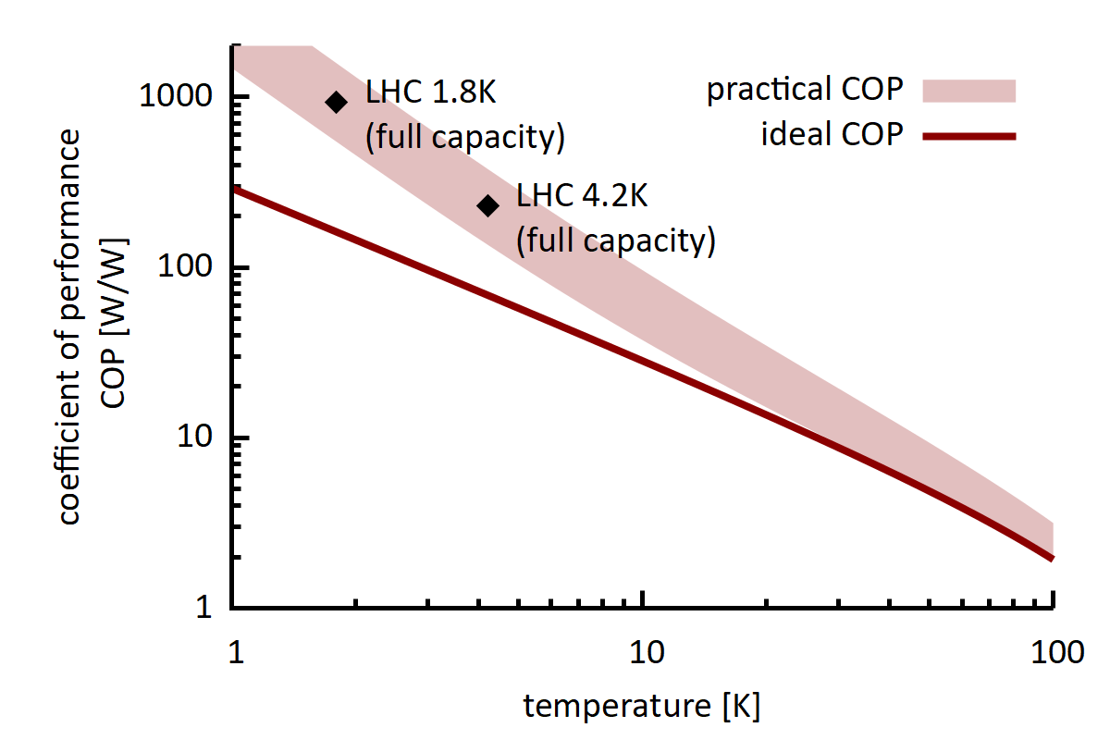
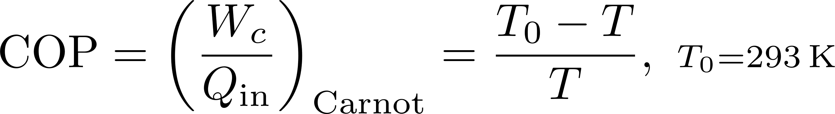

Cryogenic Efficiency
W_{c}
T₀ = 293K
Q_{in}
T = 2K
best possible coefficient of performance (COP):
factor 3!
W_{c} = amount of work required to remove heat Q_{in} at cold temperature T
[S.Claudet et al, CERN 2013]

Slide 17
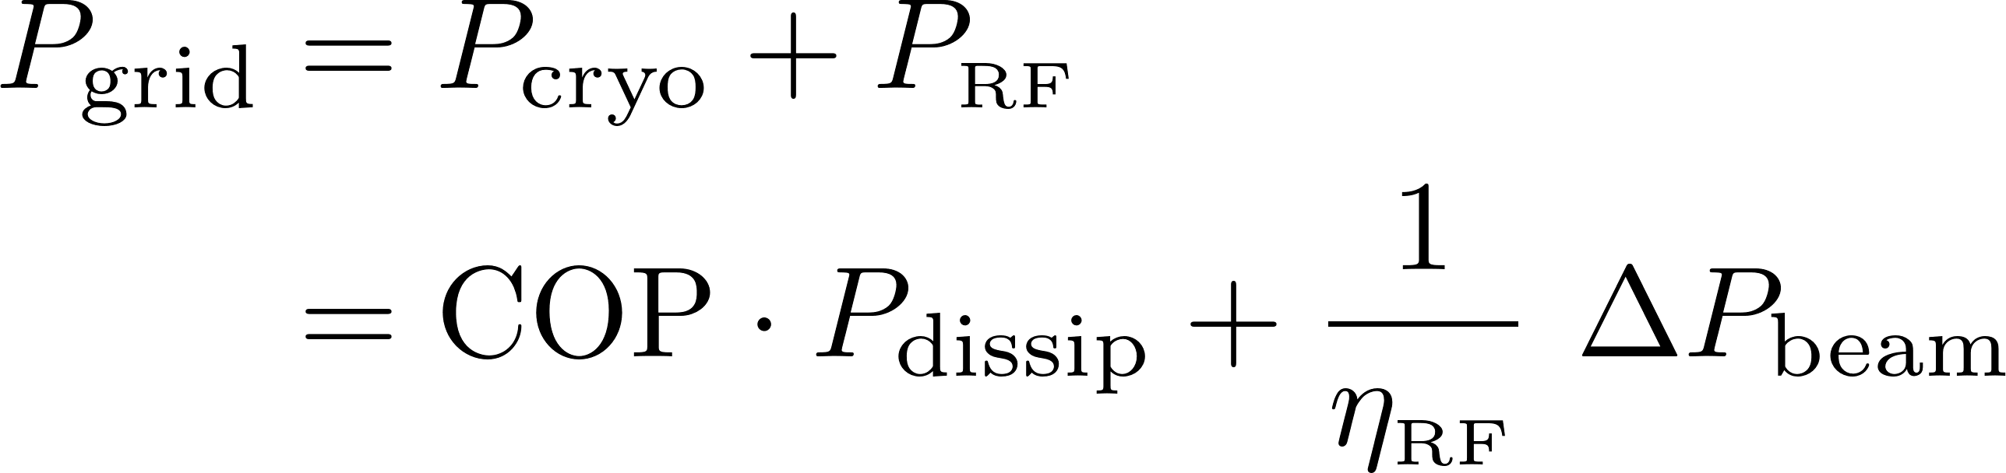

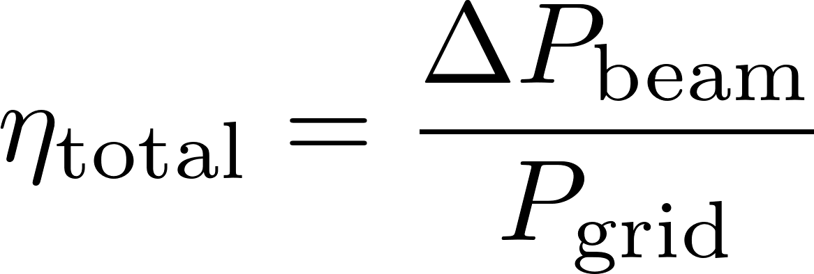
Powerflow s.c. Linac – Minimum System Example for a Single Cavity
power balance:
GRID
AC/DC/RF/guide
η_{RF} ≈ 0.4 .. 0.6
P_{RF}
cryogenics
COP ≈ 1000
P_{dissip}
beam
considered:
one 650MHz cavity
U_{a} = 20MV
l = 1.1m
ignored: cavity detuning, β<1, regulation overhead, aux. systems …
regime | I_{b} [mA] | Q₀ | η_{RF} | ΔP_{beam} [kW] | grid-to-beam Efficiency
TDR, CW | 2.0 | 2⋅10¹⁰ | 0.44 | 40.0 kW | 30%
high Q | 2.0 | 3⋅10¹⁰ | 0.44 | 40.0 kW | 33%
high current | 4.0 | 3⋅10¹⁰ | 0.65 | 80.0 kW | 50%
extrapolation

Slide 18
Light Sources

Slide 19
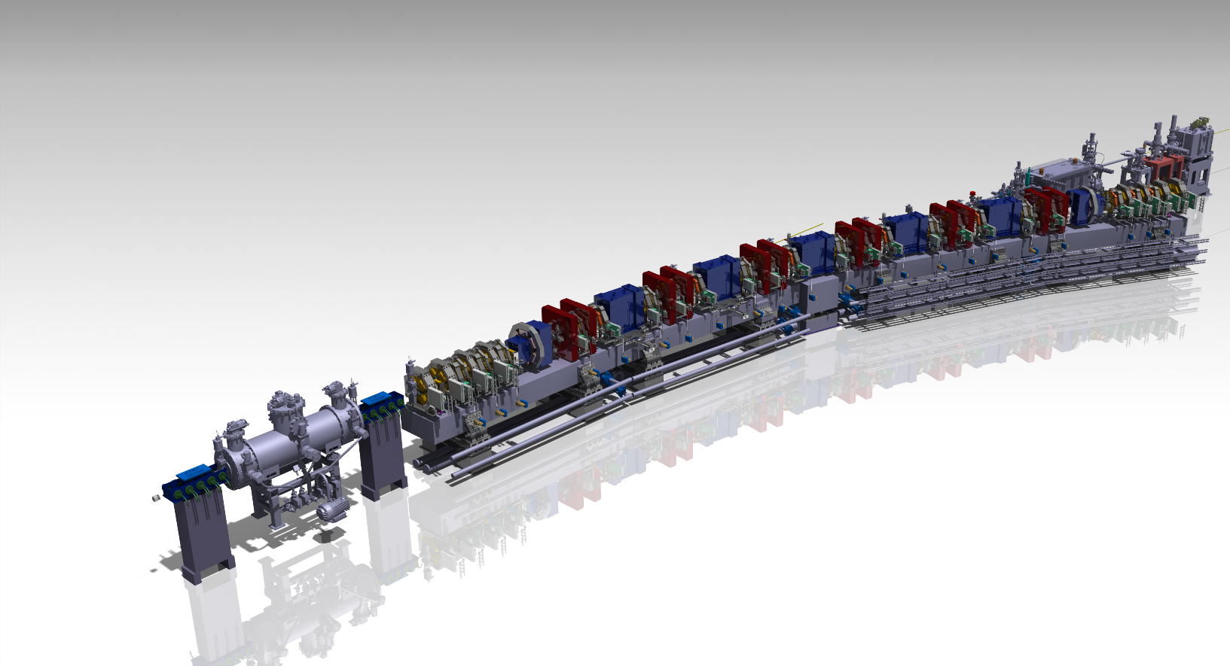
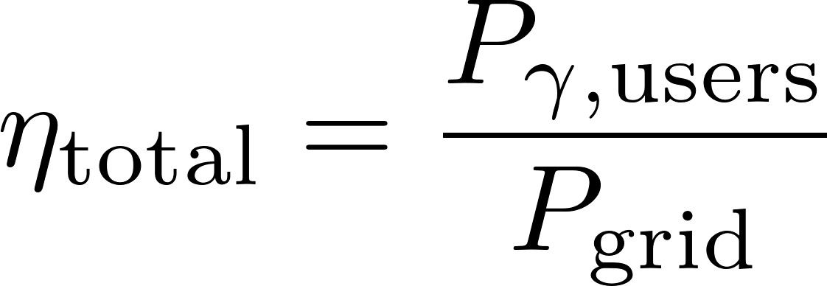
Synchrotron Light Sources and Free Electron Lasers
over the history ring light sources have improved the brilliance by more than 10 orders of magnitude, the last step is made using multi bend achromat lattices and miniaturization using permanent magnets
power consumption of ring light sources is in the range of a few Megawatt and often not a critical factor; however, s.c. FELs might use O(20MW)
the production of tailored radiation – spectral distribution, coherence, ultrashort pulses etc. is in the focus today
SLS2.0 magnet structure
GRID
AC/DC/RF/beam
radiation for users
possible efficiency measure:
unwanted radiation
magnets, AC, aux.systems…

Slide 20
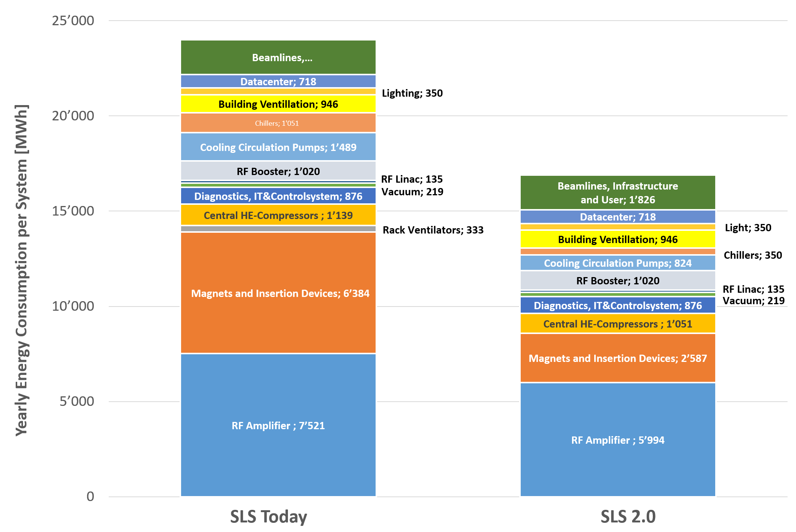
Example Swiss Light Source SLS and its Upgrade
More radiated X-ray power for users
Less electricity consumption
SLS → SLS2.0
E_{e-} 2.4 GeV → 2.7 GeV
P_{SR} 310 GeV → 365 kW
W_{elec}/y 24 GWh → 17 GWh
Key savings:
Electromagnets → Permanent magnets
Klystrons → Solid state amplifiers
standard pumps → modern pumps for cooling
-29 %
main RF power flow SLS2.0
AC power | 816 kW
DC power | 772 kW
RF power to beam | 488 kW
power to beam | 366 kW
dipole/undulator radiation | 275 kW / 91 kW
95%
63% SSA
75%
[M.Jörg, PSI]

Slide 21



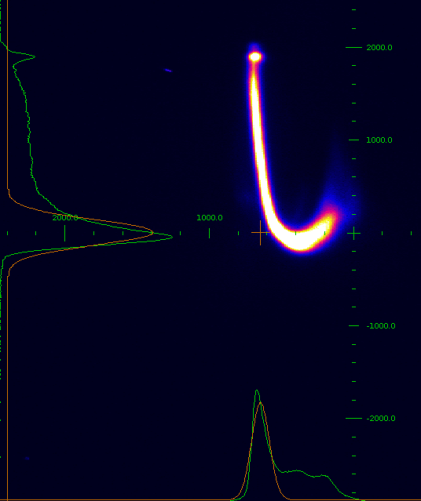
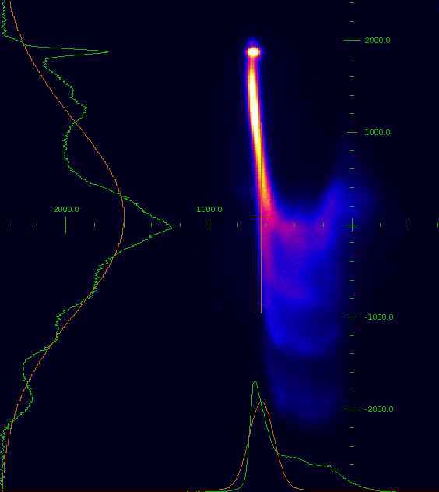
Free Electron Laser
streaked beam, SwissFEL
no lasing lasing
RF, Linac
FEL process
ρ ?
FEL: P_{γ} ∼ N² (coherence length)
energy loss, ΔE/E
best demonstrated energy extraction: ΔE/E = 30%
(E_{k}=65MeV, Laser seeded FEL)
O(10⁻³)
longitudinal, ∝ z², O(30μm)
Facility | Technology | P_{grid} (typ) | P_{beam} (typ) | Photon Power
SwissFEL | n.c., 6 GHz, pulsed | ≈ 3.0 MW | 100 W | up to 0.2 W
EXFEL | s.c., 1.3 GHz, pulsed | ≈ 10 MW | 40‘000 W | up to 40 W
Grid Power Consumption
(order of magnitude)
examples: n.c. / s.c.

Slide 22
Particle Colliders

Slide 23
Colliders - Concepts
Next generation: high Luminosity, high Energy reach needed
Energy Efficiency: Luminosity per Grid Power
m [MeV]
Ring
e⁺/e⁻
1000
p
particle mass impacts synchrotron radiation and beamstrahlung (collision)
→ scaling laws and grid power drivers are quite different for the concepts under discussion
Linear
e⁺/e⁻
100
μ
Ring
p/p
MuonC
μ⁺/μ⁻
10
1
e

Slide 24
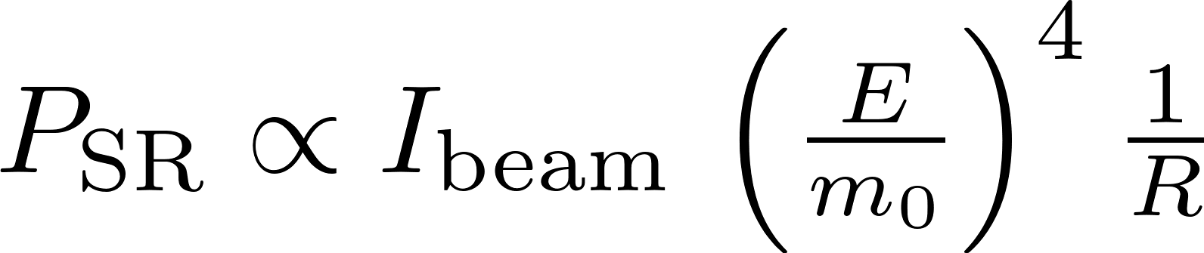


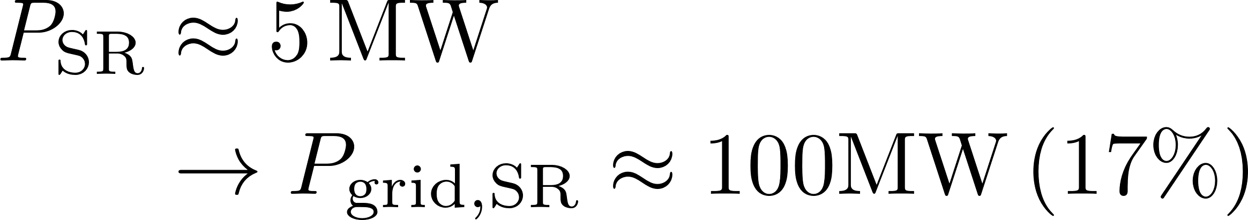
Colliders Types and Power Drivers
Ring
e⁺/e⁻
FCC-ee 240GeV:
P_{grid} = 273MW
+ beam recirculation
- synchrotron radiation
Linear
e⁺/e⁻
CLIC 380GeV (3.0TeV):
P_{grid} = 252MW (589MW)
ILC 250GeV (1TeV):
P_{grid} = 111MW (300MW)
+ no synchrotron radiation
- no recirc., small beam needed
power drivers: cryo (ILC) vs RF (CLIC)
MuonC
μ⁺/μ⁻
MAP 6.0TeV:
P_{grid} = 270MW
+ no Beamstrahlung-Limitation
- inefficient RCS, complexity
Ring
p/p
FCC-hh 100TeV:
P_{grid} = 580MW
+ high energy reach
- SR deposited @50K, cryogenics

Slide 25
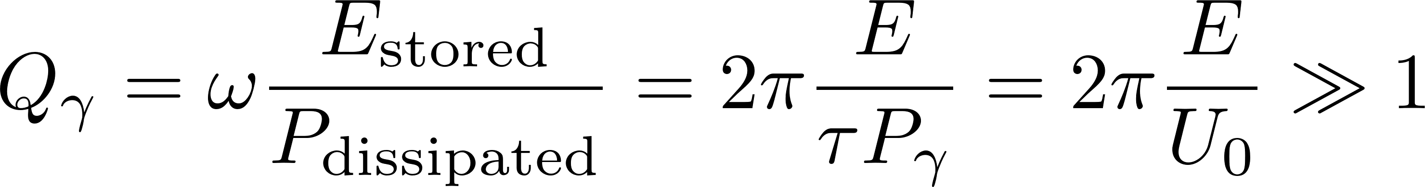
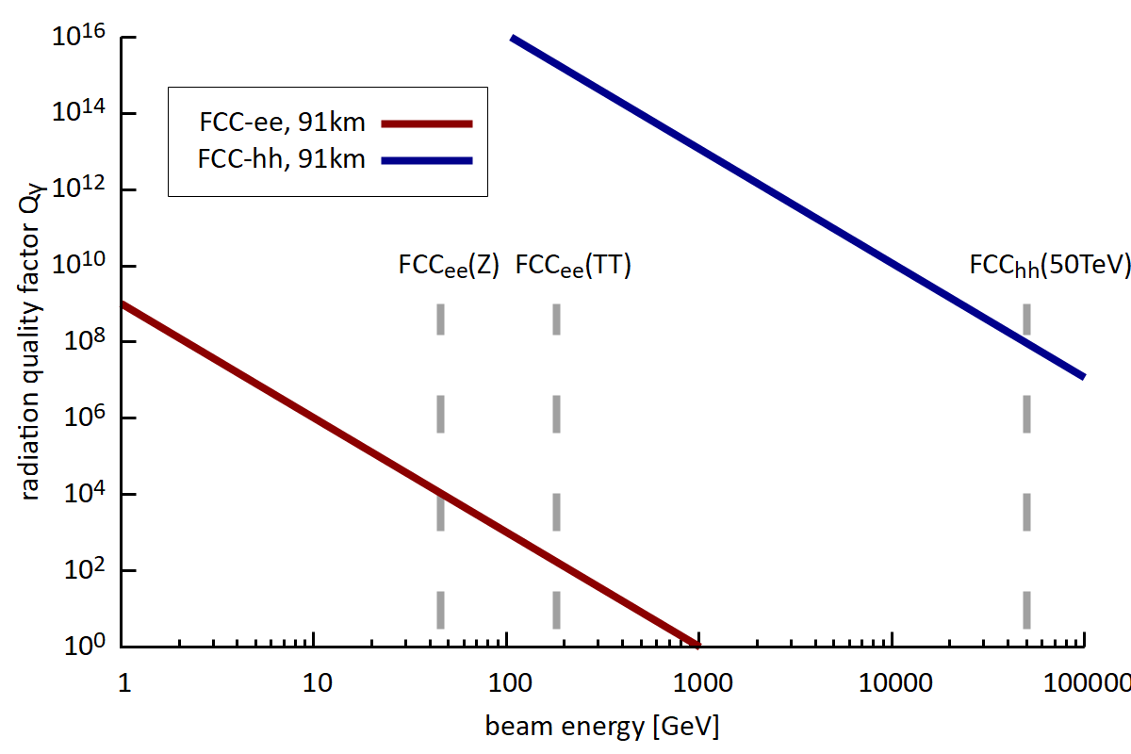
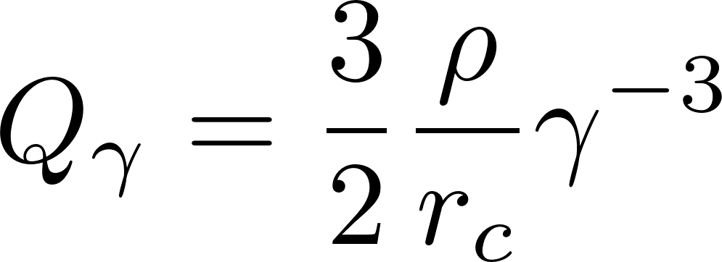
Ring Collider
energy recirculated, thus efficient concept
however, SR losses at higher energies
comment: for LHC burnup dominates beam loss (no SR)
quality factor storage ring:
= „decay time of beam energy in number of turns due to SR“
bending radius
classical particle radius

Slide 26
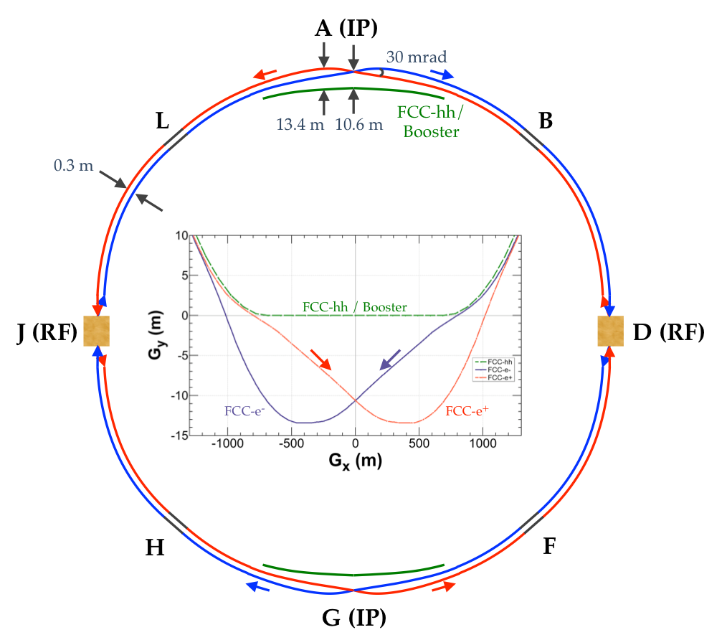
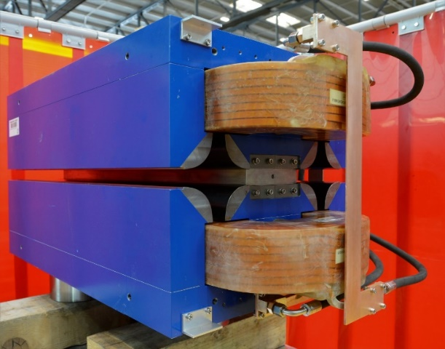
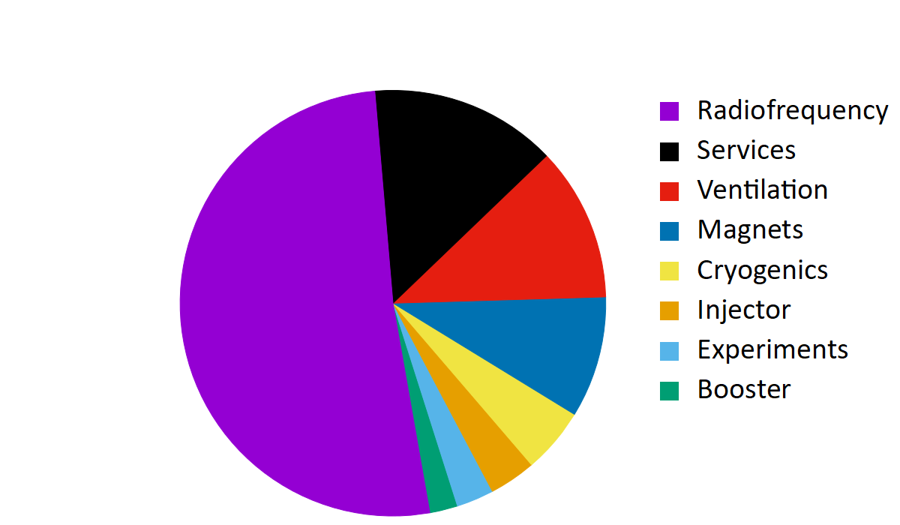
FCC-ee – Optimized Lepton Ring Collider
conceptual measures:
crab waist scheme (specific luminosity)
4 IP‘s instead 2
maximise bending field fill factor (next talk)
technology measures:
high-efficiency klystrons (HEIKA collaboration)
4.5 K s.c. cavities, high Q (400 MHz Nb/Cu)
twin apertue dipoles (50% savings of bends)
HTS quads and sextupoles, nested combined function magn.
91km
A. Milanese, Efficient twin aperture magnets for the future circular e⁺/e⁻ collider,
Phys. Rev. Accel. Beams 19, 112401 (2016)
K.Oide at al
similar as CERN total today
E_{cm} = 240 GeV (H)
P_{grid} = 273 MW
E_{grid}/y = 1.33 TWh
→ dominated by RF (compensating SR losses)

Slide 27
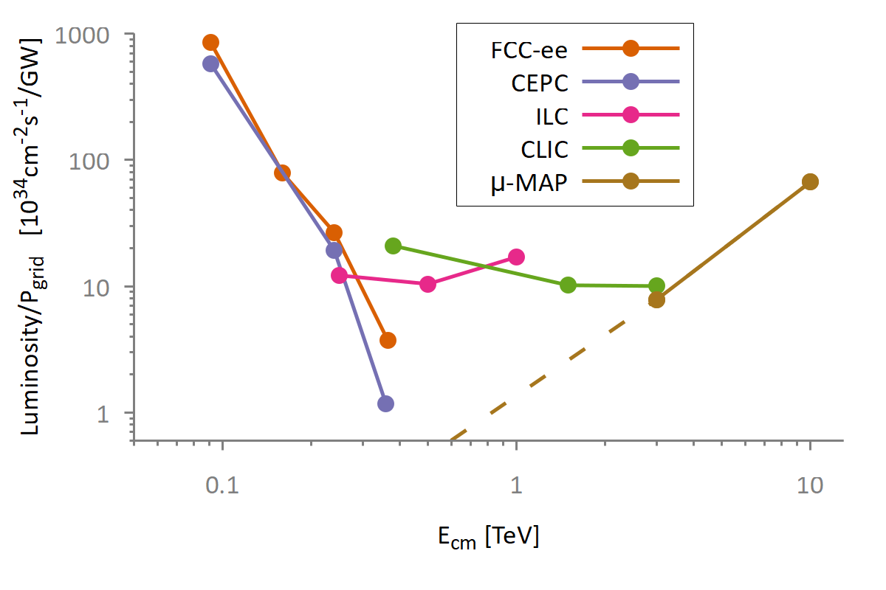
Overview Lepton Proposals
energy specific luminosity production:

Slide 28

Ring vs. Linear Collider
Ring Collider
beams circulate
Linear Collider
beams collide once
 | FCC-ee 365GeV | CLIC 380GeV
σ_{x} [nm] | 39‘000 | 150
σ_{y} [nm] | 69 | 2
σ_{z} [μm] | 2‘950 | 70
N [10⁹] | 264 | 5,2
f_{b} [kHz] | 118 | 17,6
P_{b}[MW] | 912 | 2.8
beam reused
synchrotron radiation dominated
equilibrium beamsize → collision parameters limited
beam used only once
no synchrotron radiation
ambitious collision parameters possible (no ring dynamics)

Slide 29
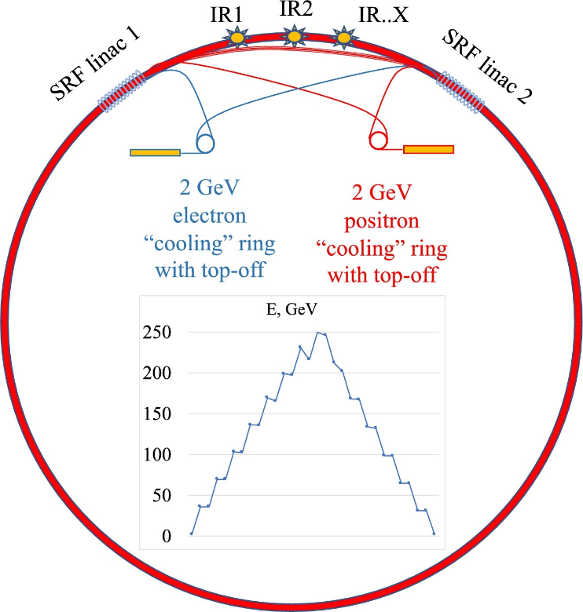
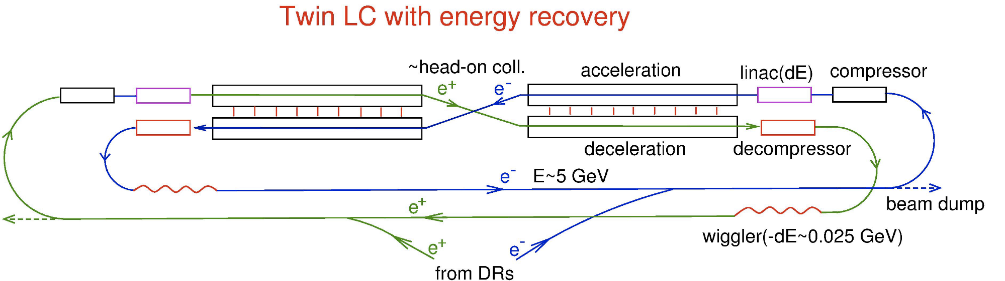
Combining Linear- and Ring-Collider using the ERL Concept
ERL
power circulates
two ERL proposals published:
1) Circular Energy Recovery Collider
V. Litvinenko, T. Roser, M. Llatas, Physics Letter B 804 (2020) 135394
multi turn ERL, modification FCC-ee
acceleration
I
P
P
I
2) Energy Recovery Linear Collider
V.I. Telnov 2021 JINST 16 P12025
twin s.c. linacs, beam recirculation, wiggler damping
deceleration
power recirculated, beam recirc. at low E
benefit from better collission parameters
→ high L per grid power, but higher investments & complexity

Slide 30



Muon Collider – Efficient at Highest Energies
Muon: E₀ = 106 MeV, τ_{μ} = 2.2 μs
mass x 200 compared to electrons:
low SR, low beamstrahlung during collisions!
Beamstrahlung in e+/e- collider, mitigation results in limitation of IP beam parameters and flat beams: σ_{x}>>σ_{y}

Slide 31
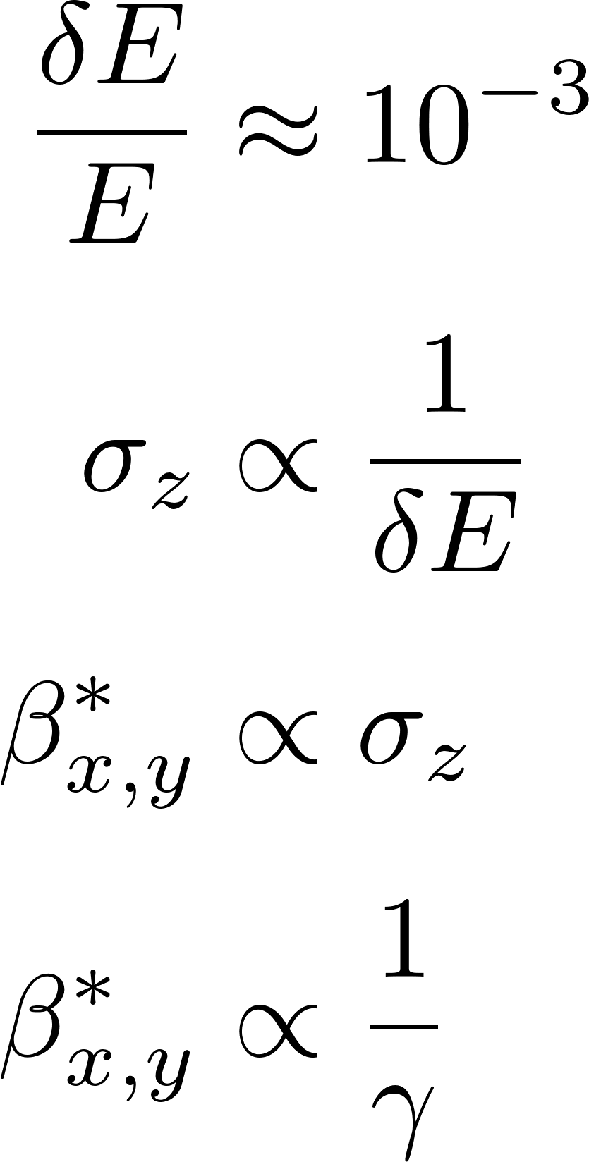
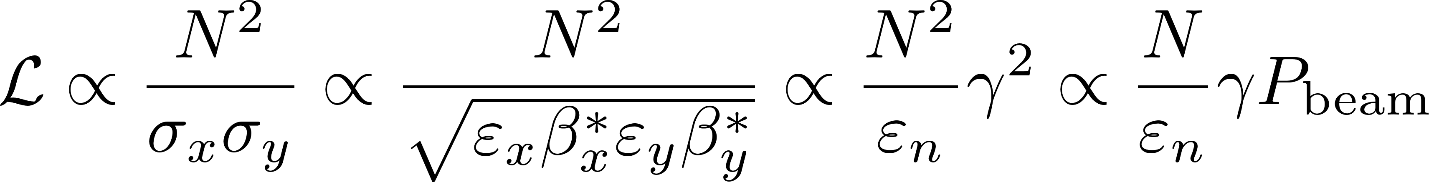
Energy scaling of the Muon Collider
particle physicists demand a fixed relative energy spread during collisions, across varying collision energies
with given longitudinal emittance the product of bunch length and energy spread is constant across energies
hourglass effect: length of IP waist and bunch length are of same order of magnitude (beta-function at IP)
the beam can be made smaller with increasing energy
thus L/P is increasing with energy*:
* the grid power is assumed roughly proportional to beam power

Slide 32
other aspects of sustainability
- rare earths, critical materials
- carbon footprint of components, construction, operation
- heat recovery
- carbon footprint of tunnel dominates

Slide 33
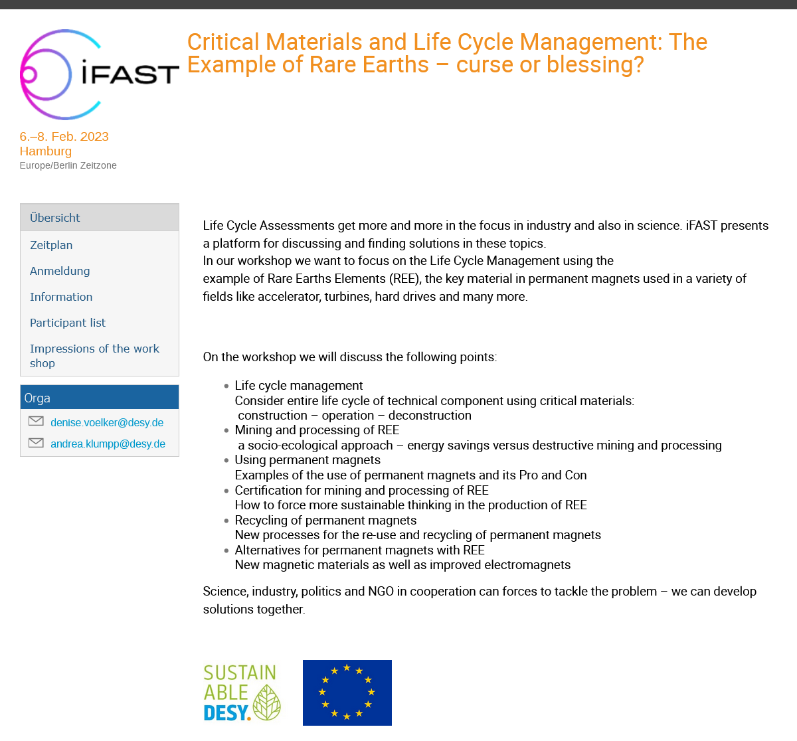
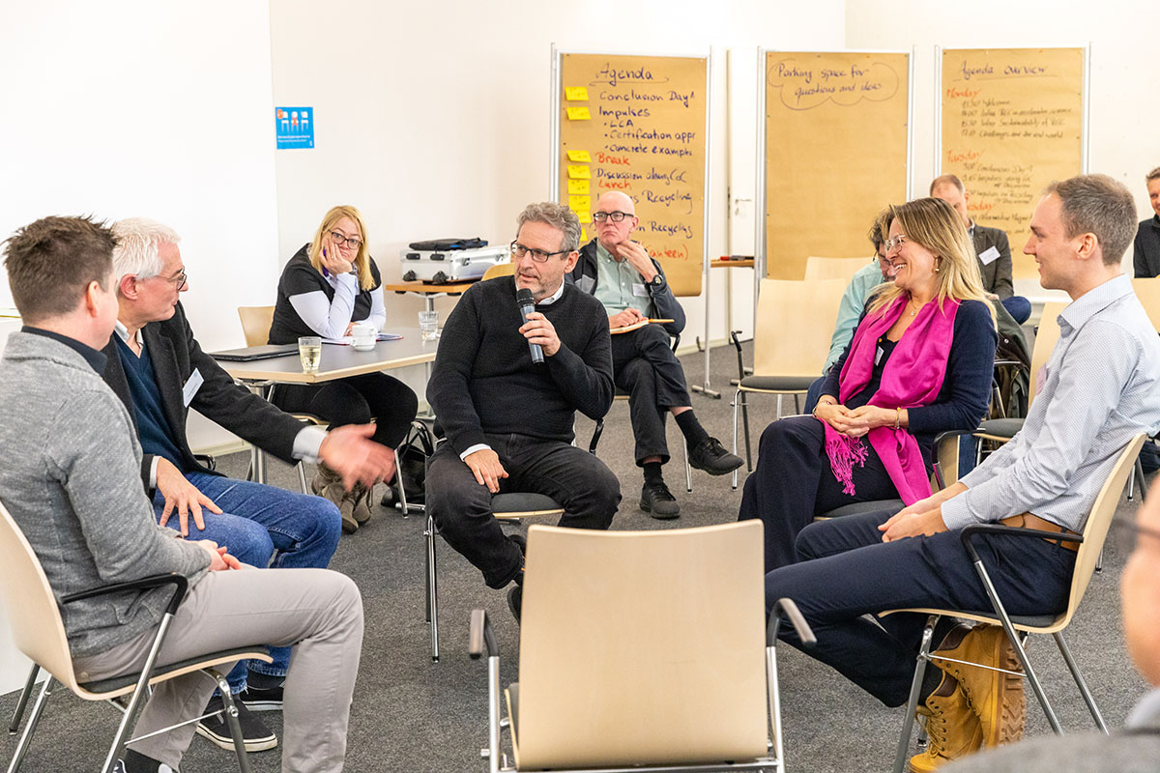
Topics:
rare earths: benefits and issues
assessing carbon footprint, env. impact, societal impact …
supply chains and certification
recycling
https://indico.desy.de/event/35655/

Slide 34
Petra Zapp (IEK-STE), excerpt: Comparison of Wind Generator Types
Influence of RE origin (ore type, mining location, specific site conditions) on environmental impacts per 1 kWh electricity generated by 3 MW wind power plant
2,5E-04
Electricity generation by DDPMSG with
aluminum
permanent Chinese RE normalized compared to
magnet produced
(Bayan Obo) has
from
higher
normalized impacts [PE]
2,0E-04
concrete
permanent magnet
environmental
impacts
1,5E-04
copper
U.S. Mountain Pass (→ 20%)
Mt. Weld (Aus) (→ 33%)
1,0E-04
cast iron, steel
stainless steel
5,0E-05
plastics & chemicals
Electricity generation by Australian DDPMSG is 8% better than by DFIG
0,0E+00
transport, energy & waste
DFIG
DDSG
DDPMSG DDPSMG DDPSMG
BO
magnet
MP
magnet
MW
magnet
DFIG: DDSG:
doubly-fed induction generator direct driven synchronous generator
A. Schreiber, J. Marx and P. Zapp: Comparative life cycle assessment of electricity generation by different wind turbine types; Journal of Cleaner Production 2019 Vol. 233 Pages 561-572
DDPMSG: electrically excited and direct drive permanent
magnet synchronous generator

Slide 35
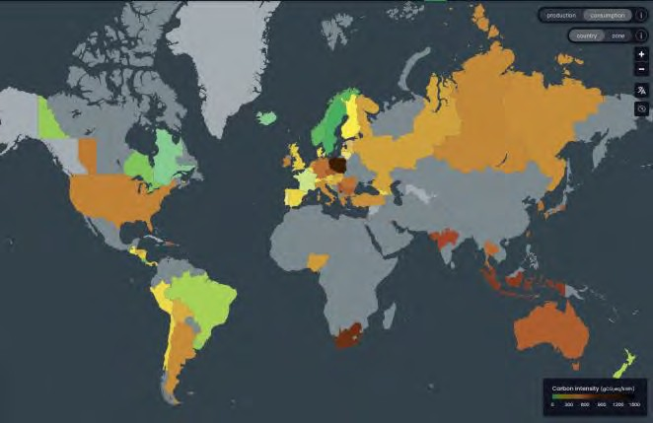
B.Shepherd (STFC): Electromagnet Operation vs. Manufacturing Footprint
600
500
400
300
200
100
0
Power usage at nominal operating point
  CLARA 1: 385 W
  CLARA 2: 2.01 kW
  FEBE: 3.72 kW
UK electricity carbon intensity 2022: 193 gCO₂e / kWh
(and improving every year!)
Carbon intensity
[gCO₂e/kWh]
2000
2005
2010
2015
2020
2025
Year
Highly dependent on fuel mix:
Sweden 21g; France 102g; USA 432g; Germany 481g; Switzerland 153g (source: Electricity Maps)
Assume operated for 5 years, 250 days per year, 16 hours per day
Total impact of operation (note: cooling not included)
CLARA 1: 1.49 tCO₂e
CLARA 2: 7.76 tCO₂e
FEBE: 14.4 tCO₂e
Much greater than manufacture impact
total impact over 5 years [tCO₂e]
6 8 10
0
2
4
12
14
16
CLARA 1
 |  |  | ma
nufacture operation
CLARA 2
FEBE
Ben Shepherd • Electromagnets vs Permanent Magnets • Rare Earth LCA workshop, 6-8 Feb 2023

Slide 36
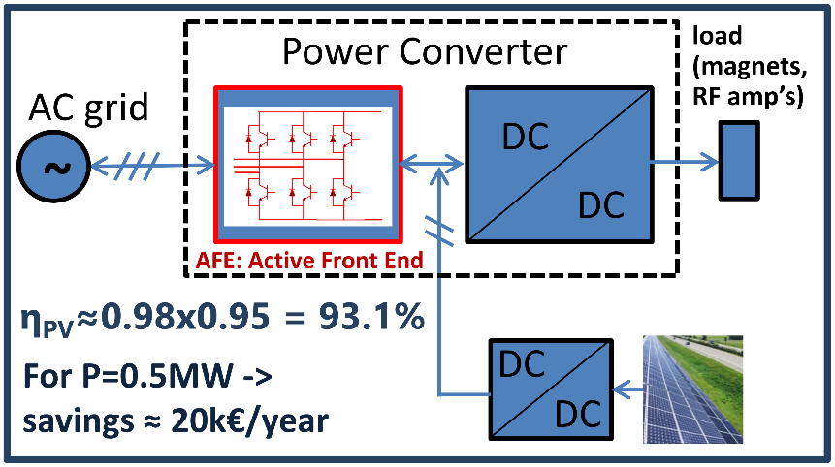
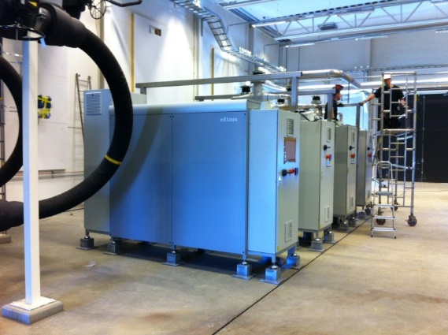
Supporting measures to increase sustainability of accelerators
photovoltaic energy production
Option: direct injection of DC power for accelerator systems
concept idea
DC injection of PV power
[C.Martins, ESS, I.FAST]
use of waste heat for heating, often limited by low temperature of cooling water
→ Use heat pumps to provide higher T at the expense of some additional grid power
heat pumps at MAX-4
[Björn Eldvall / E.ON,
Martin Gierow / Kraftringen]

Slide 37
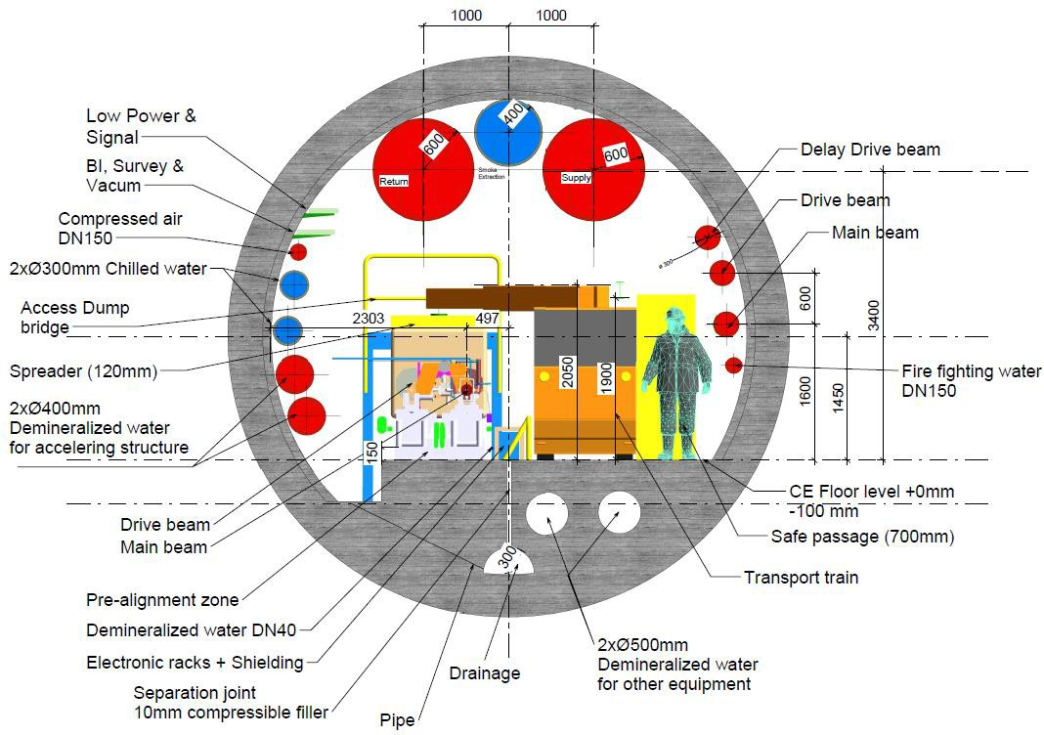
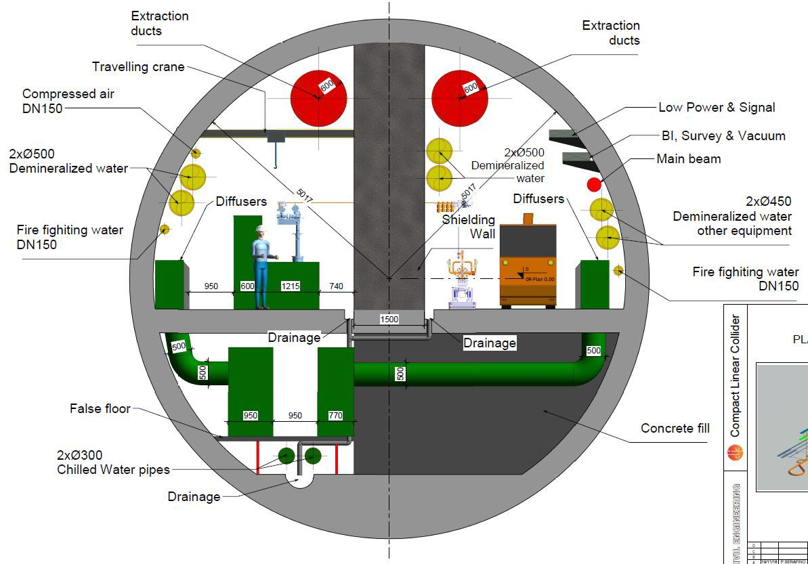
B.List et al: CLIC CO₂ Footprint, Tunnel Cross Sections
CLIC tunnel (drive beam option), 5.6m diameter
CLIC tunnel (klystron option), 10m diameter
My estimate: 12.4m² concrete
-> 31 t/m concrete
My estimate: 44.8m² concrete
-> 112 t/m concrete
5

Slide 38
The Future – Fluctuating Energy Sources
simulation: April 2050, sustainable energy system, Germany
production of power
solar, wind
release from storage
variation: x5!
full collider operation at times of high grid production
reduced operation or standby modes with fast L recovery otherwise
use of power
industry, traffic etc
energy storage
residual power
courtesy: FRAUNHOFER-INSTITUT FÜR SOLARE ENERGIESYSTEME ISE, Karlsruhe (2020)

Slide 39
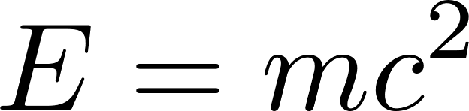
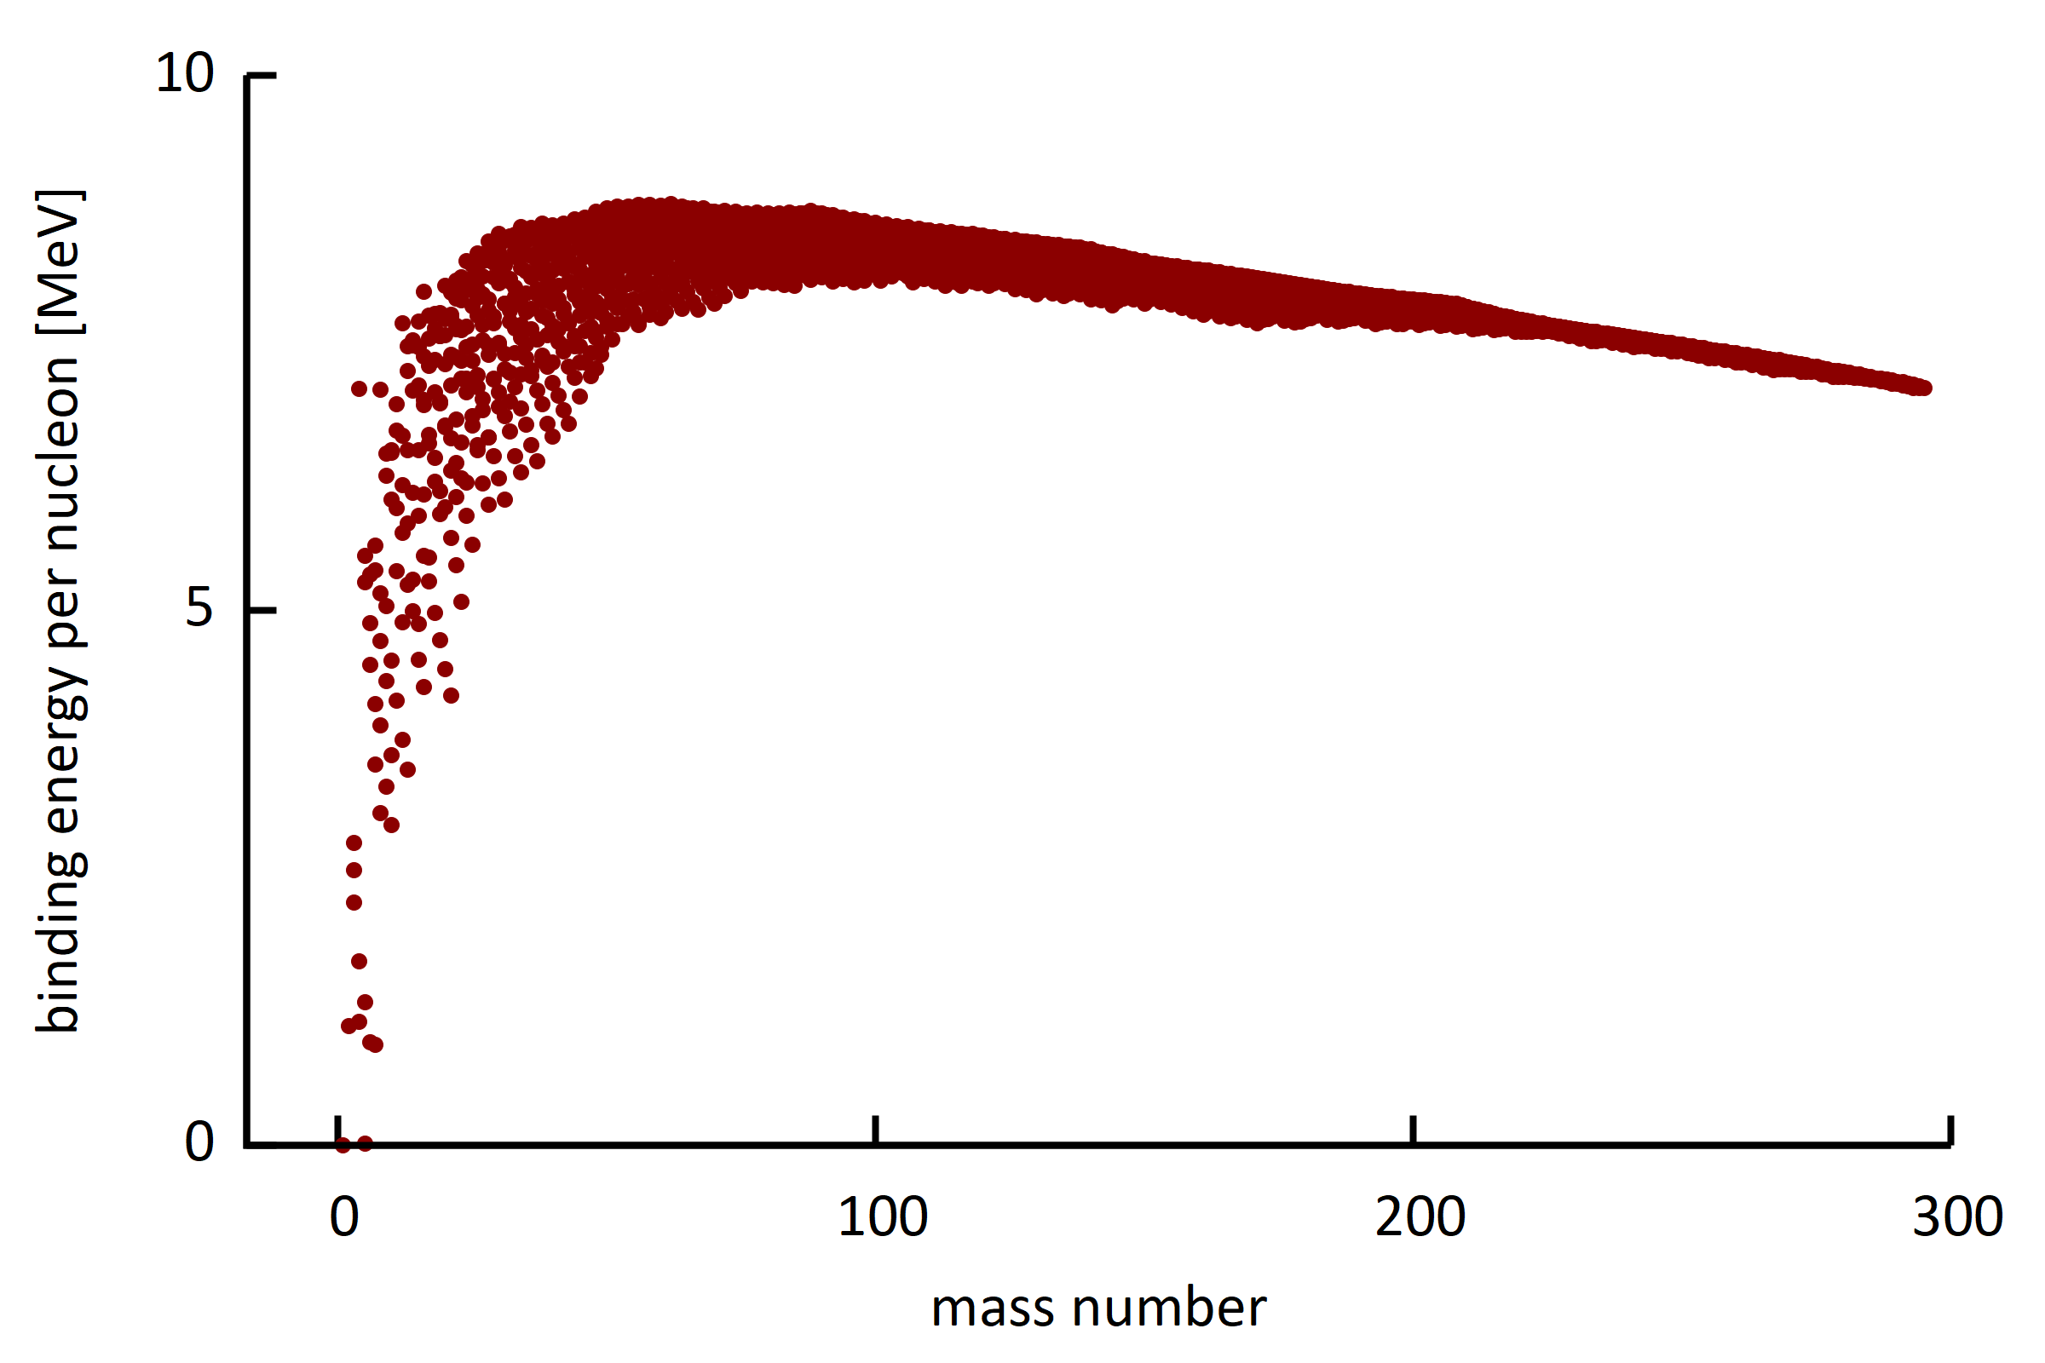
Comment on Energy Production (actually Conversion)
With accelerator driven systems (ADS) nuclear power can be made safer and more sustainable.
For fusion reactors synergetic R&D in the field of accelerators, like RF power generation, s.c. magnet - and vacuum technology.
binding energy of known isotopes
The Sun (:: wind, PV)
fusion reactor
fission reactor
radioactive decays (geothermal energy)

Slide 40
Summary Particle Accelerators
Grid to Beam
State of the art 20%, up to 50% reachable for s.c. linacs & high beam power; cyclotrons provide solutions for E<1GeV, e.g. ADS systems
Colliders
e+/e- ring collider is a powerful yet simple scheme; advanced efficient schemes include energy recovery collider and muon collider
fluctuating sustainable energy: E management / dynamic operation
→ use surplus energy for RIs
Technology
s.c. magnets & high Q cavities are efficient, higher temperature operation (HTS)
efficient RF sources, permanent magnets, heat recovery & photovoltaics
other: water & He consumption, critical materials, managed lifecycle, carbon footprint, energy procurement, advanced energy production

Slide 41
Thank you for your attention.
Many thanks for discussions and input:
V.Yakovlev (Fermilab), V.Ziemann (U.Uppsala),
M.Jörg (PSI), D.Schulte, F.Zimmermann (CERN).

