Slide 1

Applications of Accelerators
CERN Introductory Accelerator School
Santa Susana, Spain, 2024
Dr. Suzie Sheehy
@suziesheehy
suzie.sheehy@unimelb.edu.au
Notes:
What are accelerators used for?

Slide 2
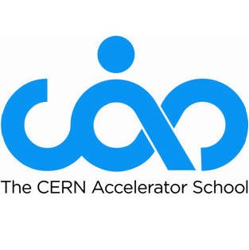
Copyright statement and speaker’s release for video publishing
The author consents to the photographic, audio and video recording of this lecture at the CERN Accelerator School. The term “lecture” includes any material incorporated therein including but not limited to text, images and references.
The author hereby grants CERN a royalty-free license to use his image and name as well as the recordings mentioned above, in order to post them on the CAS website.
The material is used for the sole purpose of illustration for teaching or scientific research. The author hereby confirms that to his best knowledge the content of the lecture does not infringe the copyright, intellectual property or privacy rights of any third party. The author has cited and credited any third-party contribution in accordance with applicable professional standards and legislation in matters of attribution.

Slide 3
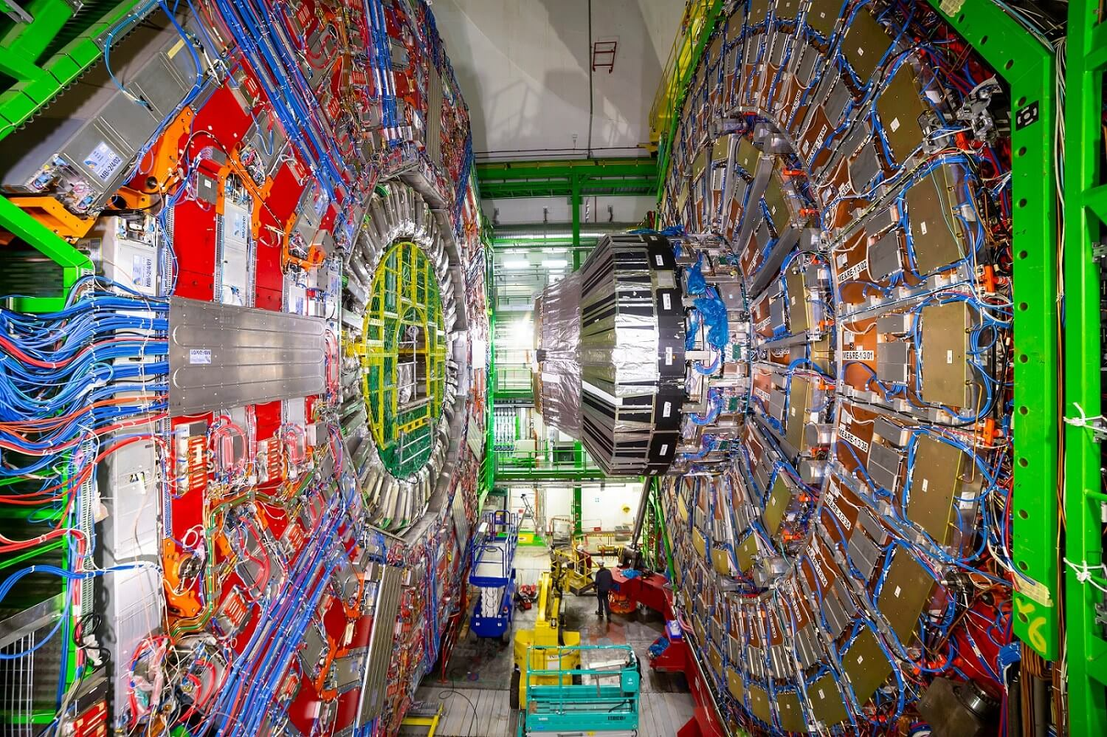
Where do breakthrough technologies come from?
Many innovations emerge from interplay between curiosity driven research and societal need
John Womersley, former CEO of STFC (UK) said:
“Particle physics is unreasonable. It makes unreasonable demands on technology. And when those technologies, those inventions, those innovations happen, they spread out into the economy, and they generate a huge impact.”
particle physics
vaccines, archaeology, etc…
proton therapy
radiotherapy, security
water, food, materials treatment, sterilisation
https://www.symmetrymagazine.org/article/october-2009/deconstruction-livingston-plot
Image: CMS, CERN
Notes:
Particle physics is a driver of new technologies. This was summed up nicely by John Womersley in the UK who said (quote).

Slide 4
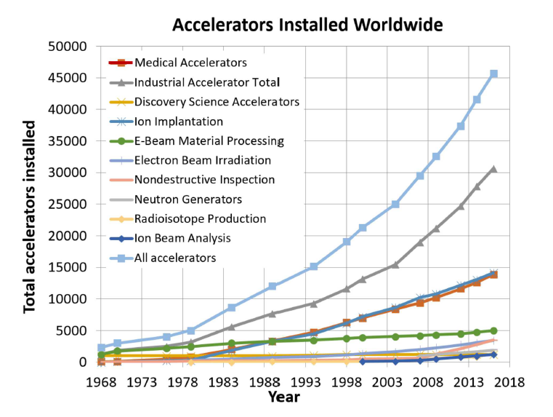
“The annual market for all medical and industrial accelerators described is estimated
to now be — US$5.0 Billion/year and growing at —4% per year over the past
decade, even during the recession” [2018]
Doyle, McDaniel, Hamm, The Future of Industrial Accelerators and Applications, SAND2018-5903B
Notes:
A roughly $5bn/year industry and growing at 4-5% per annum even during recession.

Slide 5
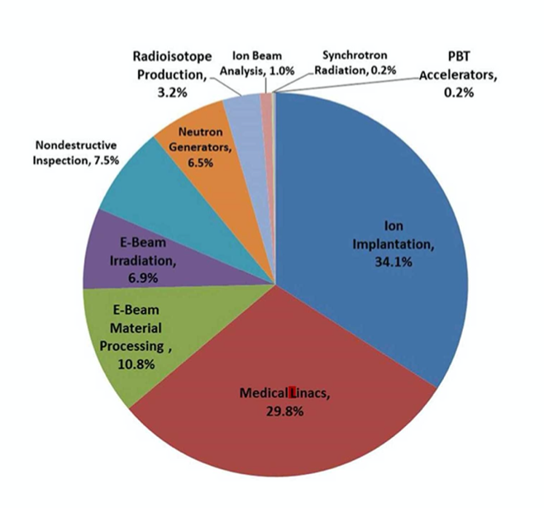
“A beam of particles is a very useful tool...”
Doyle, McDaniel, Hamm, The Future of Industrial Accelerators and Applications, SAND2018-5903B

Slide 6
Outline
Medical imaging and treatment
Industrial uses of accelerators
Sustainability & security applications
Historical & cultural applications
Large facilities: synchrotron light sources / neutron sources
Challenges for the future

Slide 7
1. Medical Applications

Slide 8

Notes:
As world population is growing and aging the global number of cancer deaths is increasing
But the age-standardised cancer death rate is decreasing: we are improving at treating cancer.

Slide 9
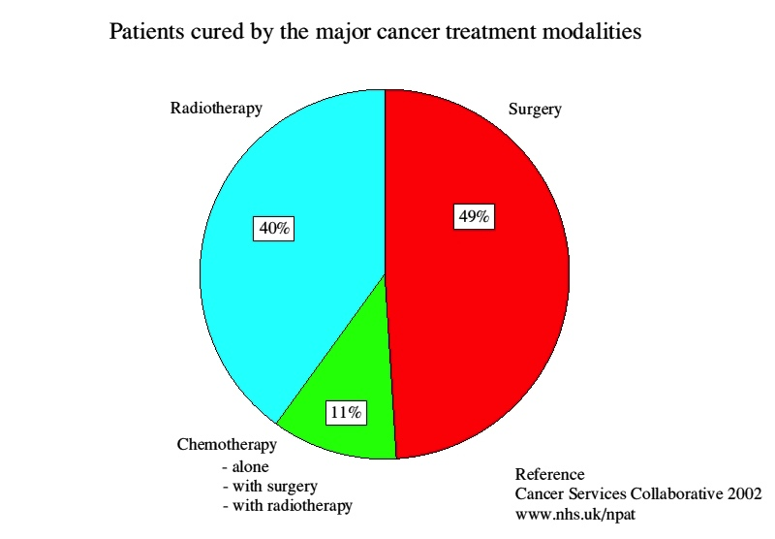

Slide 10
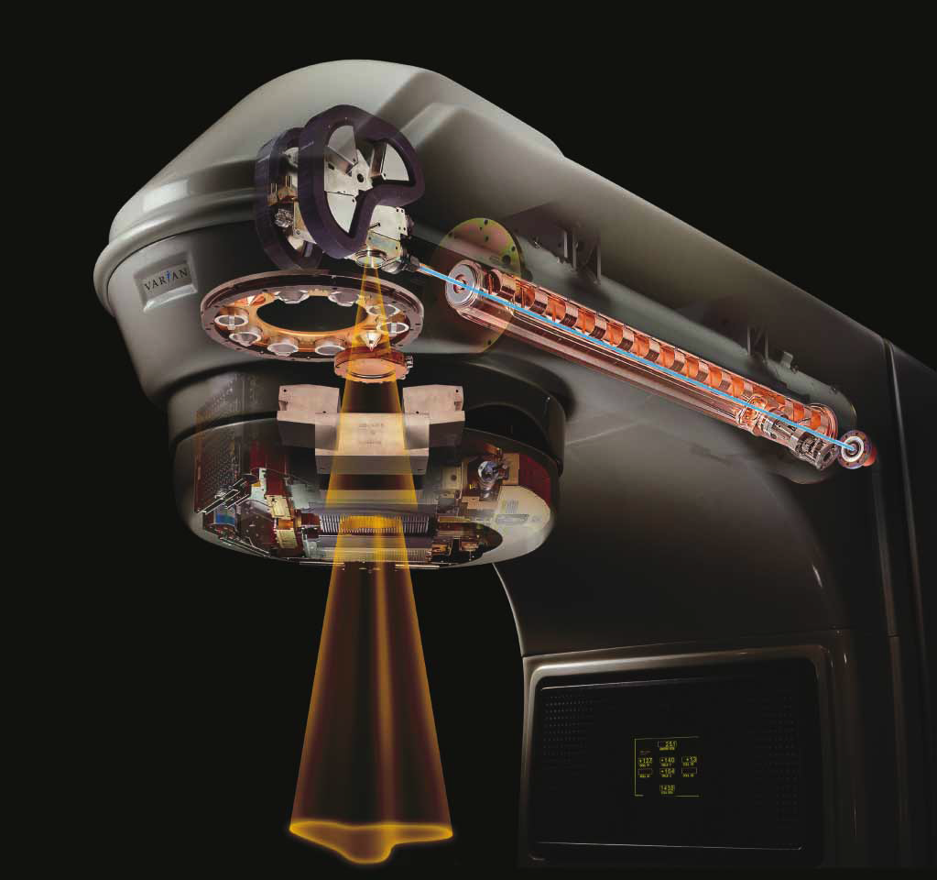
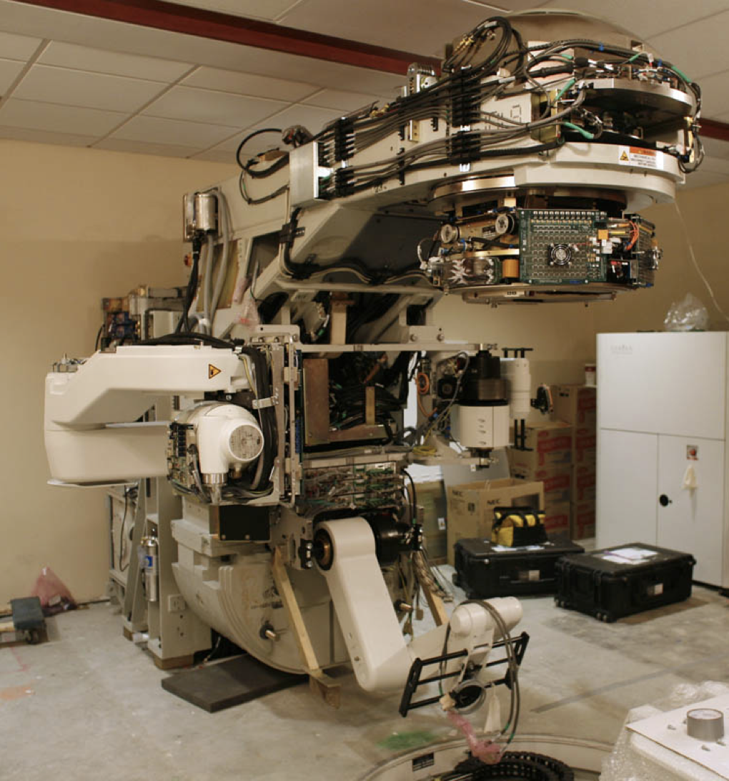
X-ray Radiotherapy (RT)
Around half of all cancer patients in HICs benefit from RT
Linac (S-band)
Achromatic Bend
Foil to produce x-rays
Collimation system
Image: copyright Varian medical systems
Notes:
The whole system rotates through 360 degrees around the patient

Slide 11
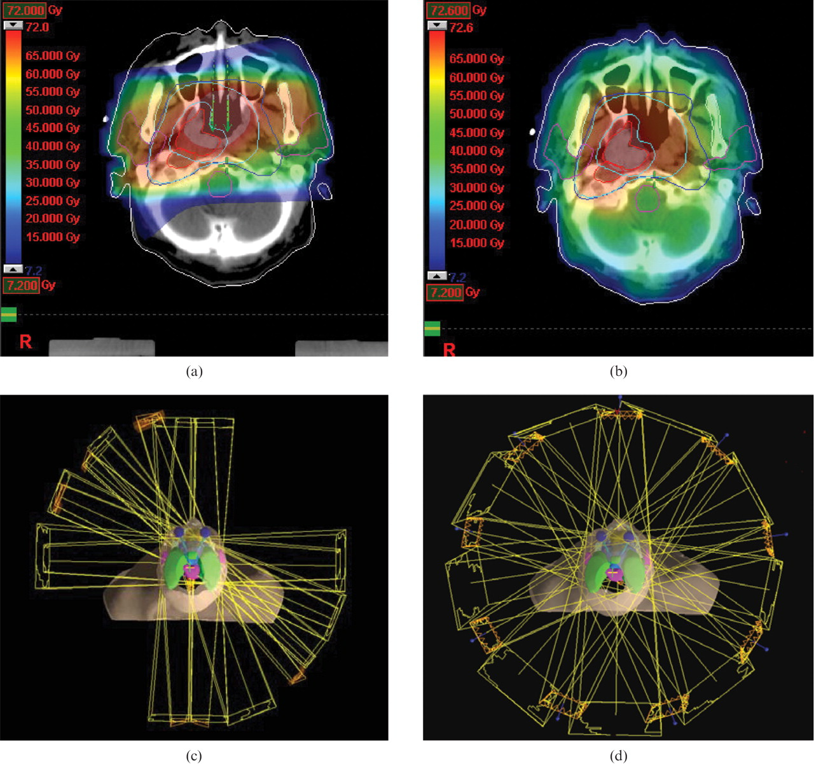

Slide 12
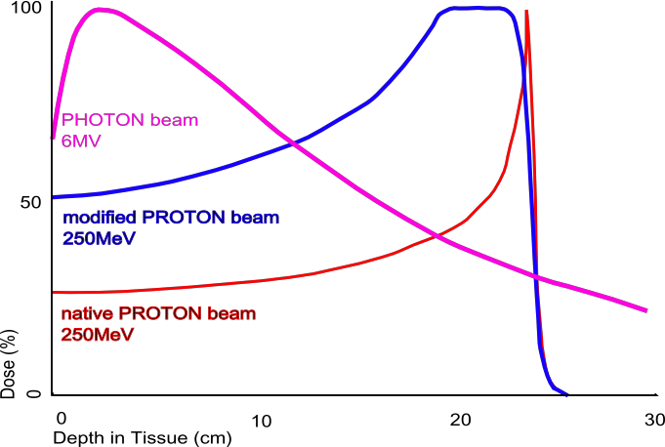
Charged Particle Therapy
Bragg Peak
    Greater dose where needed
    Less morbidity for healthy tissue
    Less damage to vital organs

Slide 13
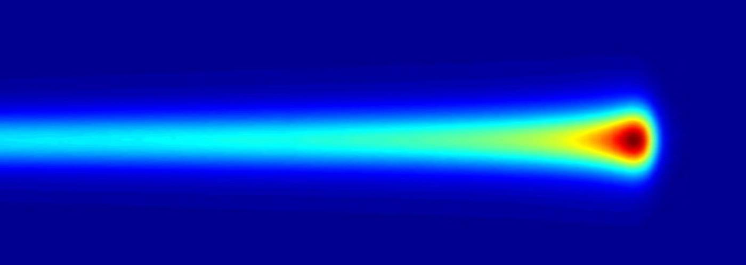
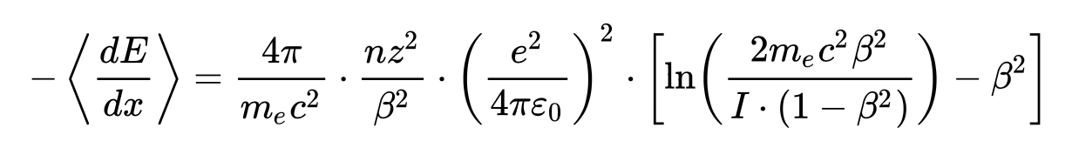
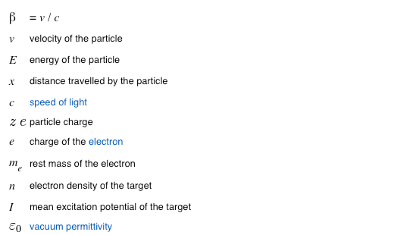
Energy loss in matter (+tissue)
High speed -> small energy loss
Low speed -> high energy loss

Slide 14
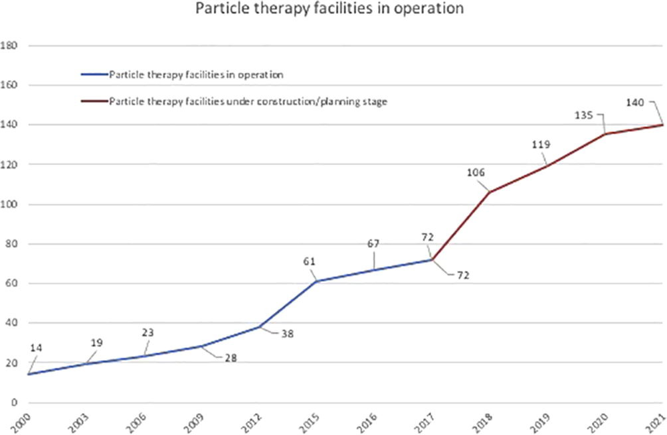
“More than 360'000 patients have been treated worldwide with particle therapy per end of 2022” – PTCOG 2022
https://www.thegreenjournal.com/article/S0167-8140(18)30146-4/fulltext

Slide 15
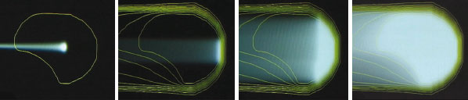
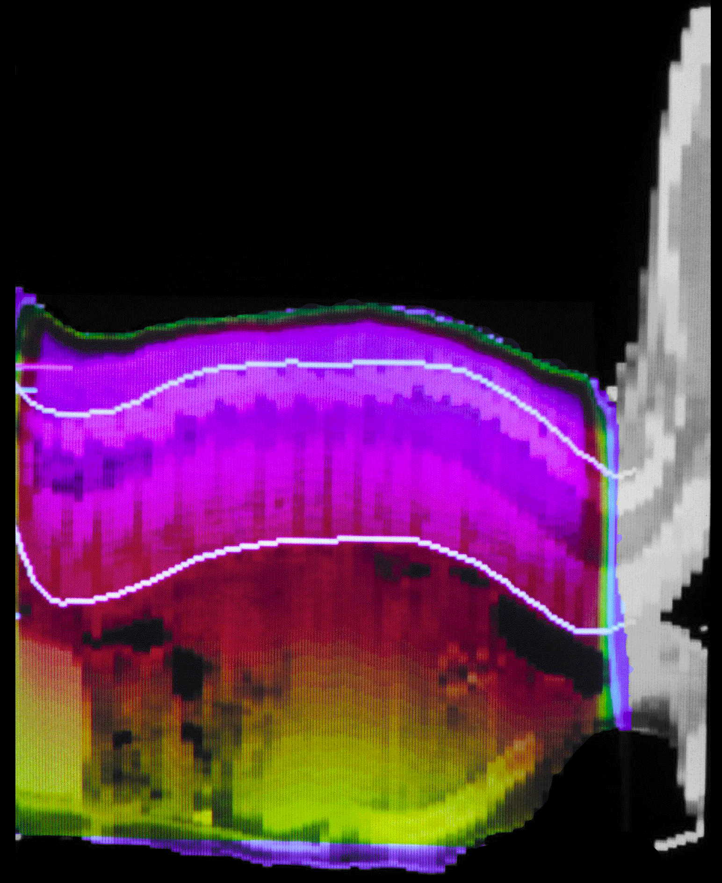
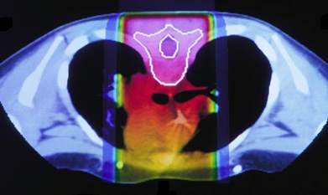
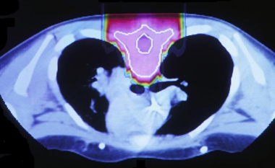
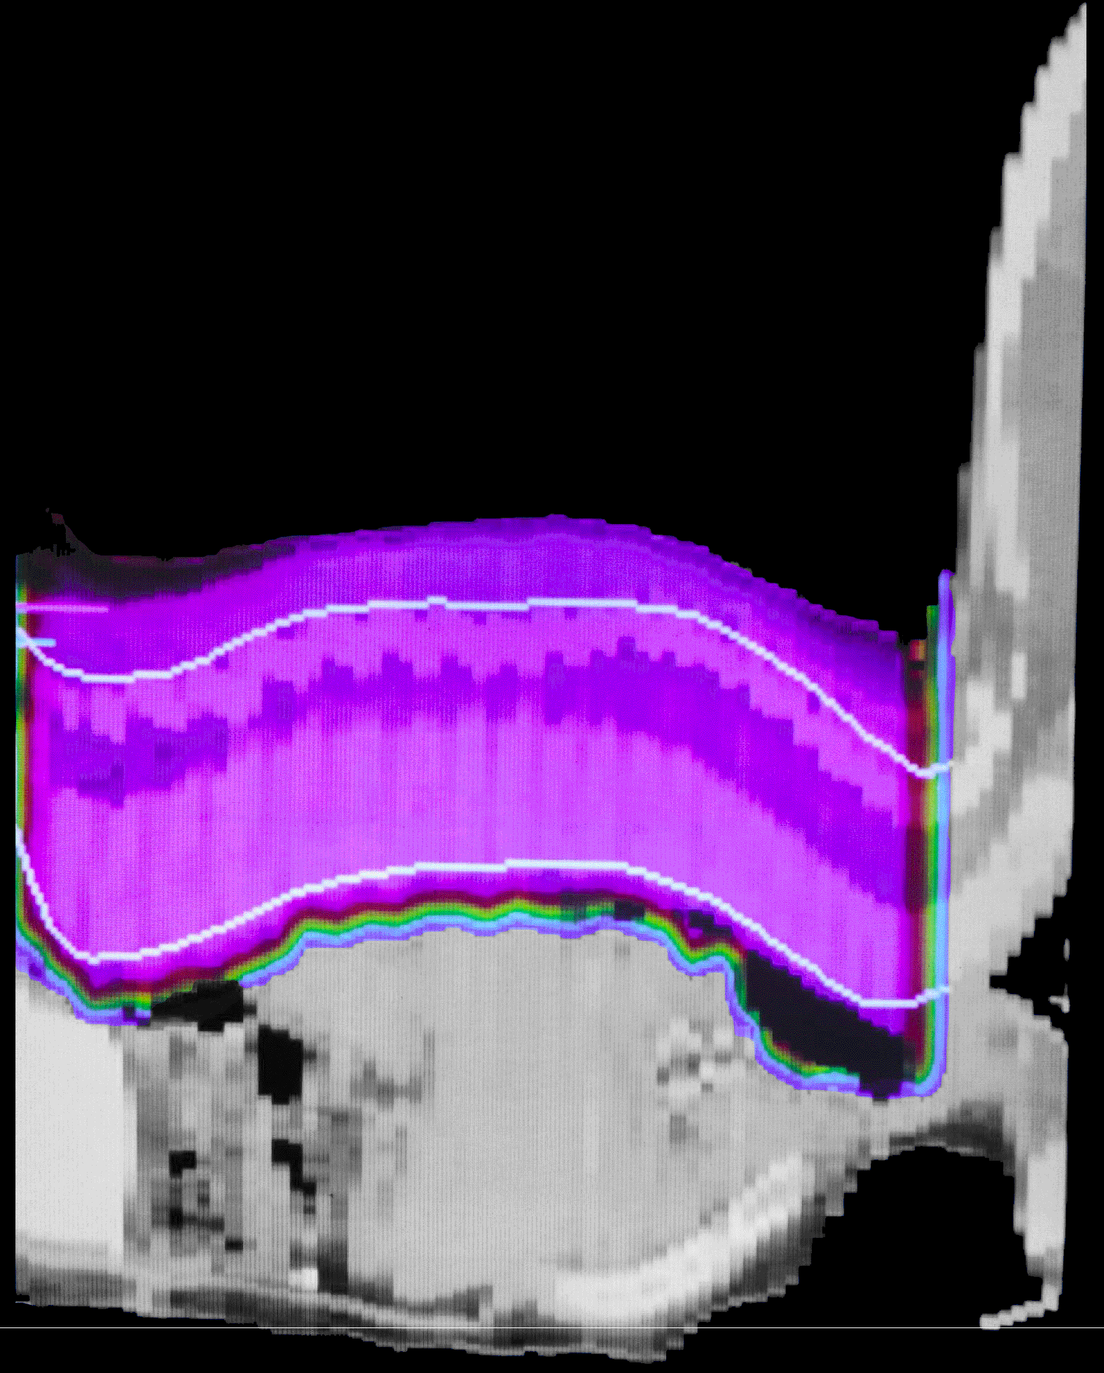
Proton & Ion therapy
  “Hadron therapy” = Protons and light ions
  Used to treat localised cancers
    Less morbidity for healthy tissue
    Less damage to vital organs
    Particularly for childhood cancers
With Protons
With X-rays
Notes:
Medulloblastoma – affects children, malignant brain tumour which is surgically removed. Afterwards, to prevent spread, want to sterilize the spine with radiation.
15

Slide 16
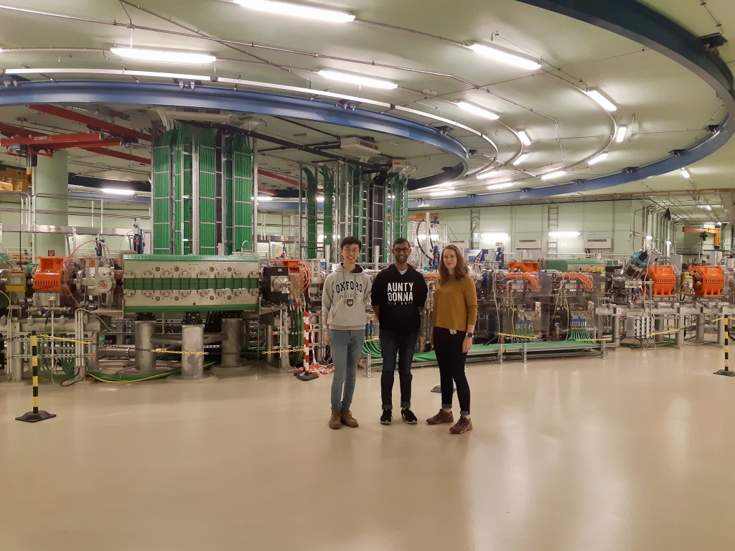
Challenges in Particle Therapy:
EFFICACY/QUALITY
COST/SIZE/EFFICIENCY
MedAustron: a facility which emerged from CERN study ‘PIMMS’.
A new CERN study ‘NIMMS’ is underway.

Slide 17
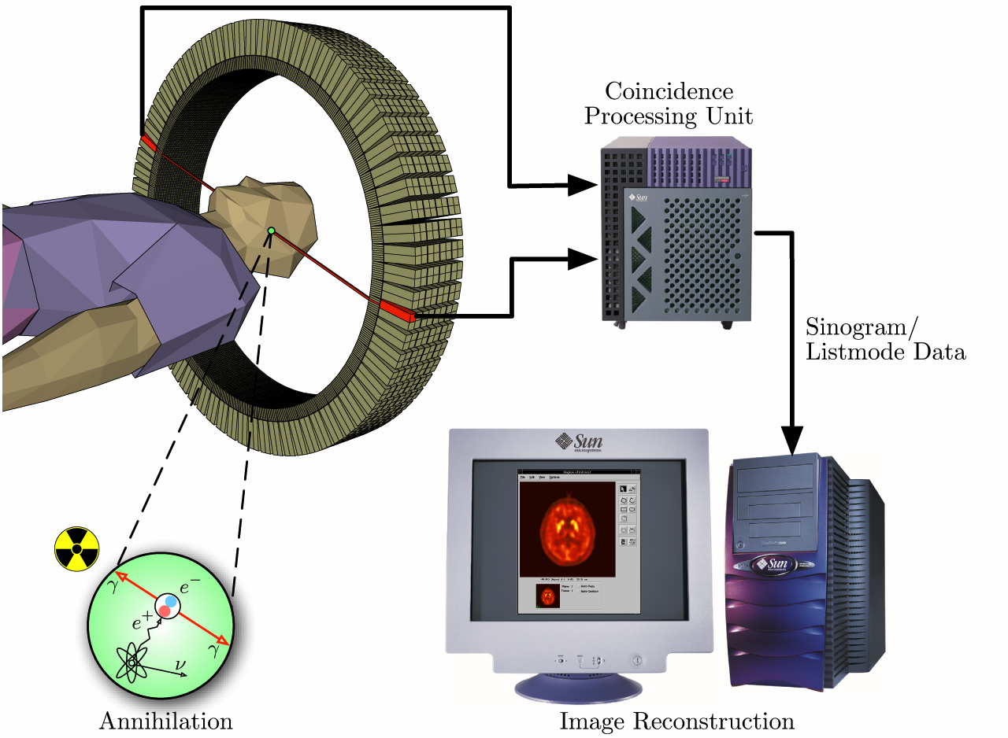
Radioisotope production
Accelerators (compact cyclotrons or linacs) are used to produce radio-isotopes for medical imaging.
7-11MeV protons for short-lived isotopes for imaging
70-100MeV or higher for longer lived isotopes
Positron emission tomography (PET) uses Fluorine-18, half life of ~110 min
Notes:
Right: normal metabolic function in the brain

Slide 18
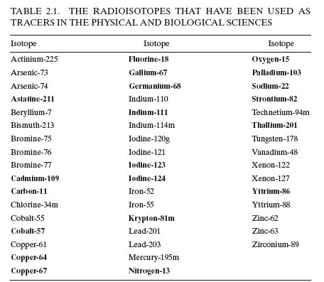
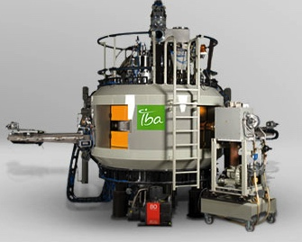
Radiopharmaceuticals
p, d, 3He, 4He beams
Isotopes used for PET, SPECT and Brachytherapy etc…

Slide 19
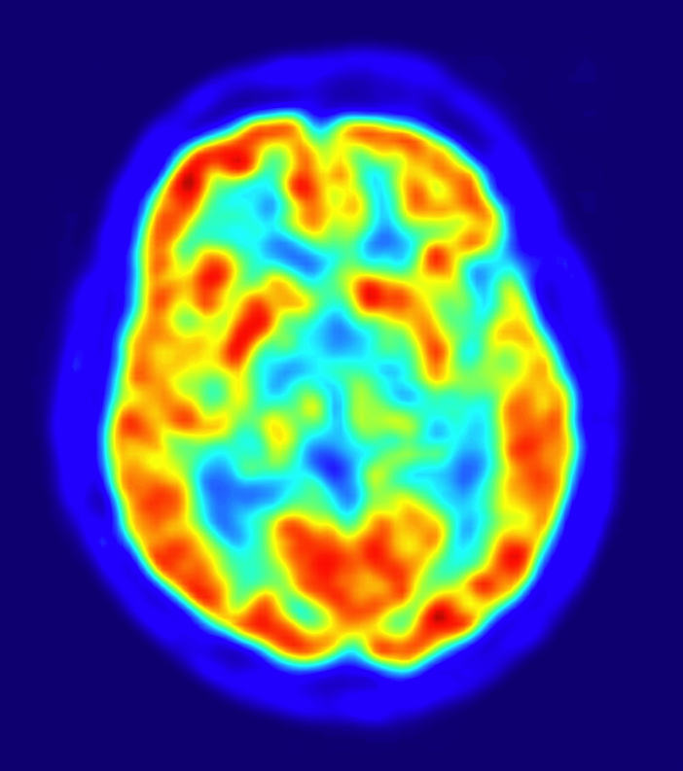
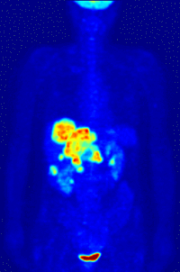
Fluorodeoxyglucose or FDG carries the F18 to areas of high metabolic activity
90% of PET scans are in clinical oncology

Slide 20
2. Industrial accelerators

Slide 21
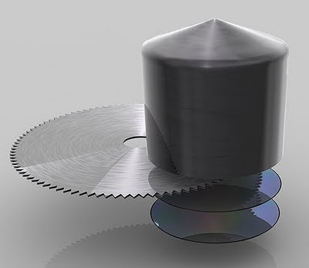
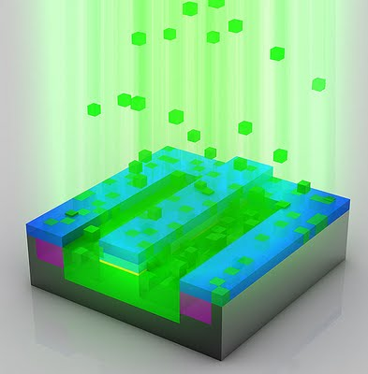
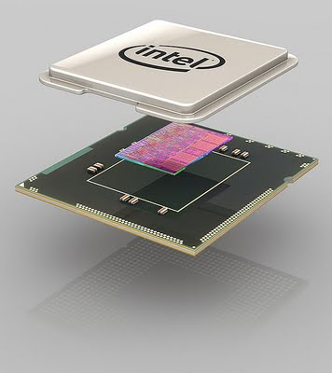
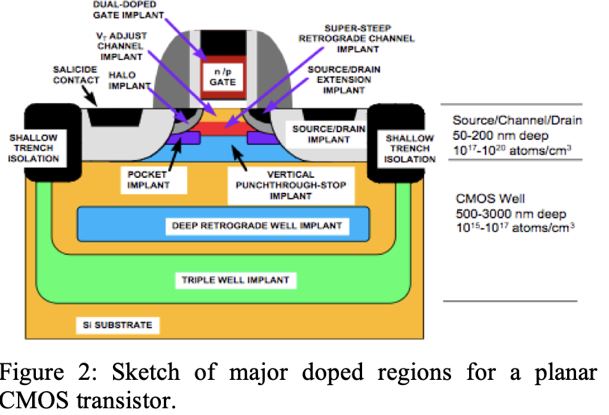
Ion implantation
Images courtesy of Intel
Accelerators keV->MeV are used to deposit ions in semiconductors.
Image: https://accelconf.web.cern.ch/pac2013/papers/weyb2.pdf

Slide 22
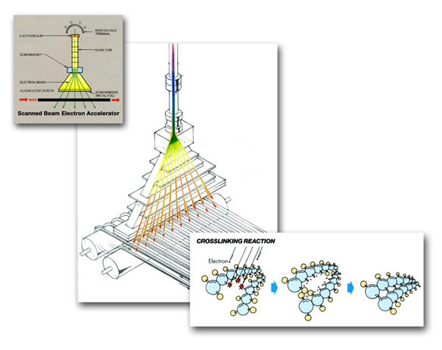

Electron beam processing
In the US, potential markets for industrial electron beams total $50 billion per year.
33% Wire cable tubing
32% Ink curing
17% shrink film
7% service
5% tires
6% other
http://rsccnuclearcable.com/capabilities.htm
When polymers are cross-linked, can become:
stable against heat,
increased tensile strength, resistance to cracking
heat shrinking properties etc

Slide 23
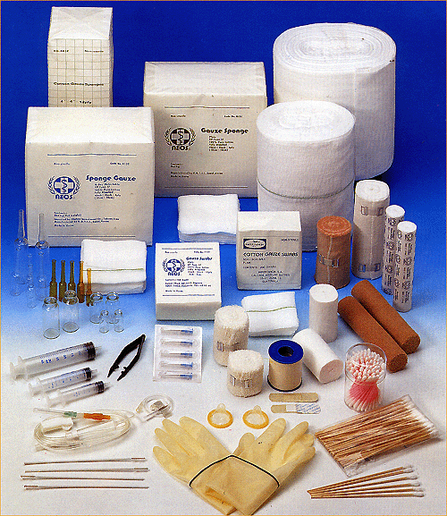
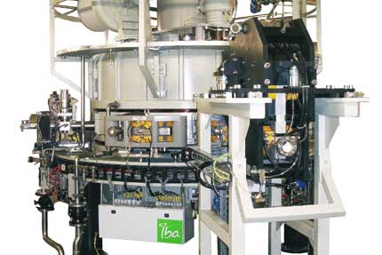
Equipment sterilisation
Manufacturers of medical disposables have to kill every germ on syringes, bandages, surgical tools and other gear, without altering the material itself.
E-beam sterilisation works best on simple, low density products.
Advantages: takes only a few seconds (gamma irradiation can take hours)
Disadvantages: limited penetration depth, works best on simple, low density products (syringes)
40-50% of all disposable medical products manufactured in North America are currently radiation sterilized, primarily at 60Co irradiation facilities. – Hamm & Doyle, 2018
The IBA rhodotron – a commercial accelerator used for e-beam sterilisation

Slide 24
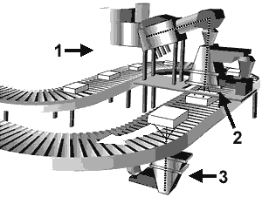

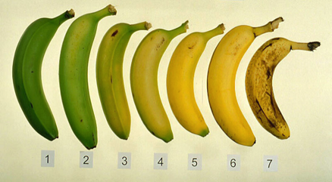
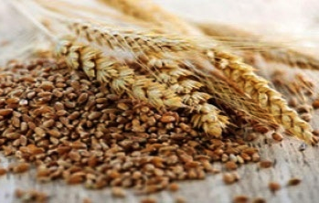


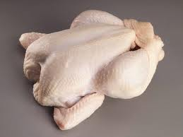
Food irradiation
‘Cold pasteurisation’ or ‘electronic pasteurisation’
Uses electrons (from an accelerator) or X-rays produced using an accelerator.
The words ‘irradiated’ or ‘treated with ionising radiation’ must appear on the label packaging.
Foods authorised for irradiation in the EU:
In the US all irradiated foods have this symbol
Lower dose
Higher dose
Notes:
By irradiating food, depending on the dose, some or all of the microorganisms, bacteria, viruses or insects present are killed.
Can be used at low doses to: delay food ripening, quarantine treatment
Medium doses to reduce of microbes& extend shelf life of meat, poultry and seafood (refrigerated & frozen), reduce microorganisms in spices to improve shelf lifeHigh dose applications: sterilize meat for NASA astronauts

Slide 25
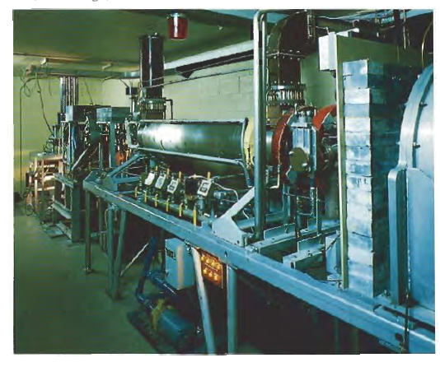
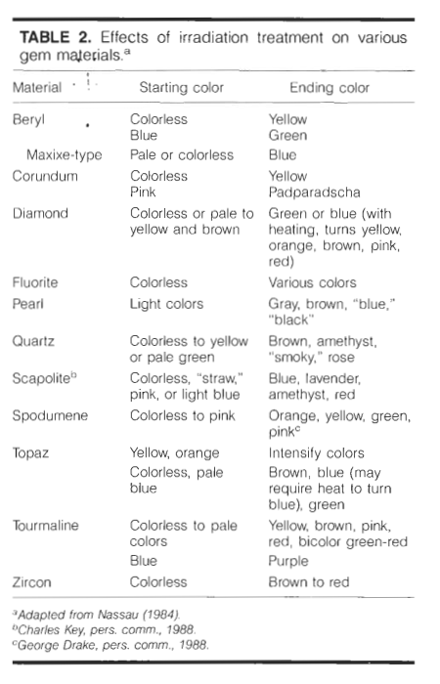
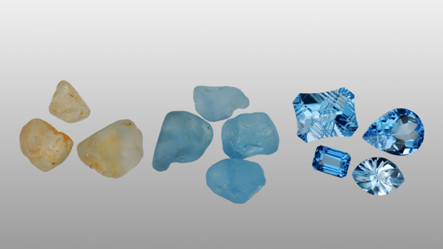
Gemstone Irradiation
http://www.nrc.gov/reading-rm/doc-collections/fact-sheets/irradiated-gemstones.html
http://www.symmetrymagazine.org/article/october-2009/cleaner-living-through-electrons
‘Irradation and Radioactivity’, Gems and Gemology, 1988
Notes:
Around 6 tonnes of topaz are irradiated each year. Almost none of the ‘blue’ topaz you’ll find on the market is natural.

Slide 26
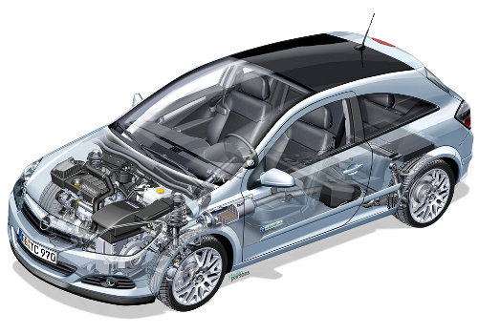
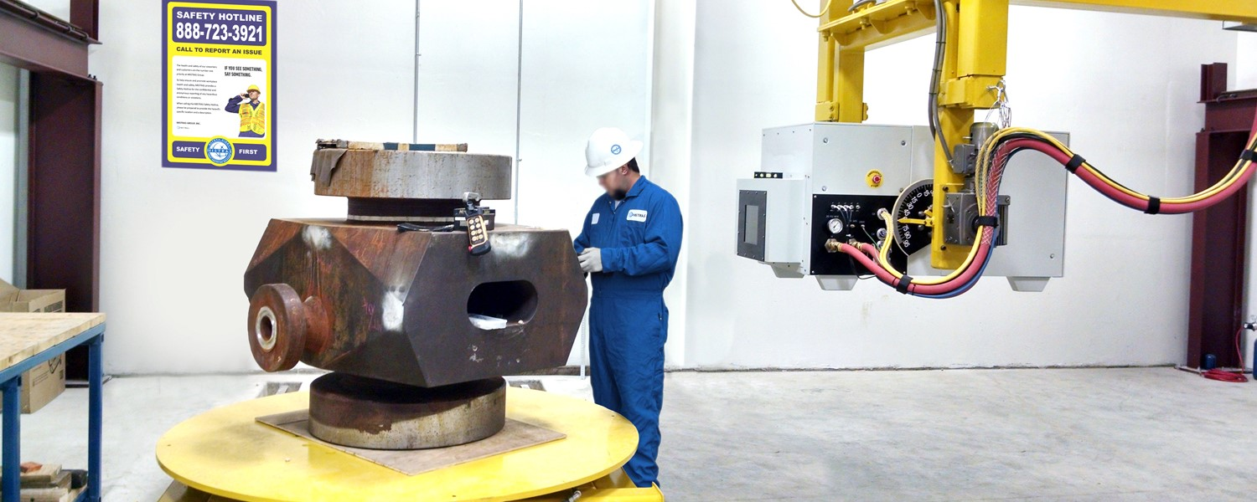
Other industrial uses
Non-destructive testing (weld integrity etc)
Hardening surfaces of artificial joints
Scratch resistant furniture
Hardening of tarmac
http://www.accelerators-for-society.org/case-studies/case-study-car.php
Image: https://www.mistrasgroup.com

Slide 27
3. Sustainability & Security Applications

Slide 28
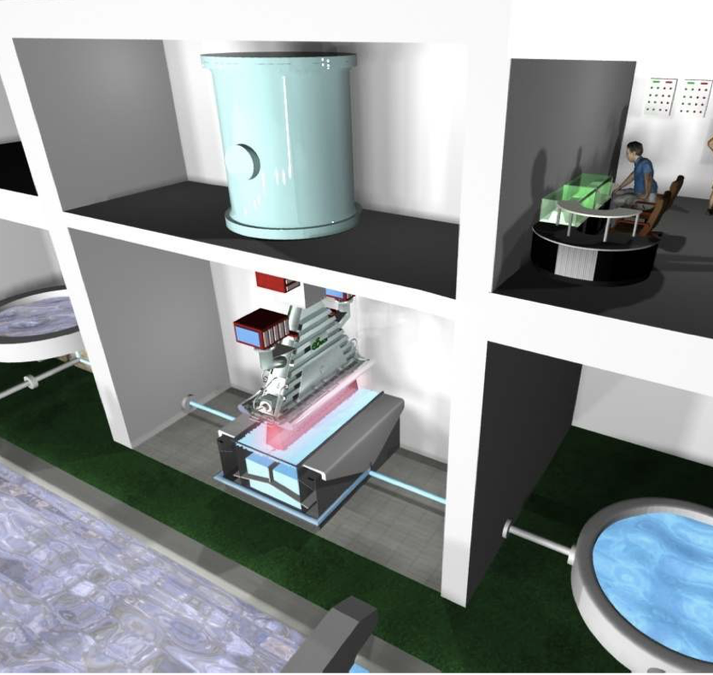
Wastewater Irradiation
Remove organic compounds and disinfect wastewater.
Can be used to treat/reclaim:
Textile Dyeing
Pharmaceutical
Petrochemical
Municipal Wastewater
Contaminated Underground Water
1 MeV, High Current, scanning system
Also used for removal of NO_{x} and SO_{x} from flue gas emissions
https://www-pub.iaea.org/MTCD/publications/PDF/P1433_CD/datasets/presentations/SM-EB-23.pdf
Notes:
Already being used in textile industries in Korea, Sri Lanka, Brazil etc.
Pharmaceutical and petrochemical industries (Pesticide, Explosives, Dyes etc.)
Reduction of certain chemicals can depend strongly on the dose. ~1 kGy to remove color, odor, disinfection and removal of some organic pollutants.
New project at JLAB to use SRF for this.

Slide 29
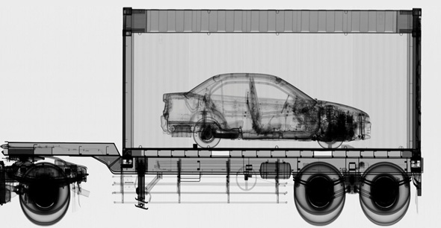
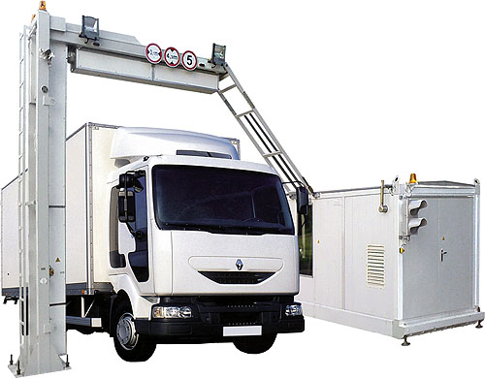
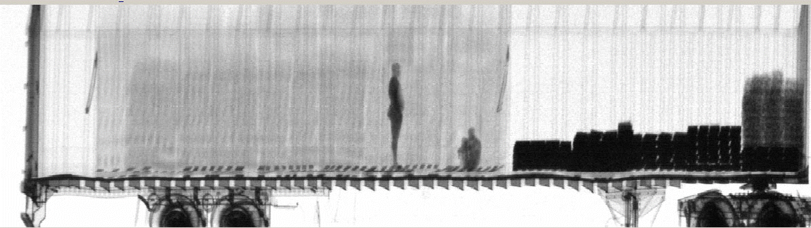
Cargo scanning
Cargo containers scanned at ports and border crossings
Accelerator-based sources of X-Rays can be far more penetrating (6MV) than Co-60 sources.
Container must be scanned in 30 seconds.
Image source: Varian medical systems
Image: dutch.euro

Slide 30
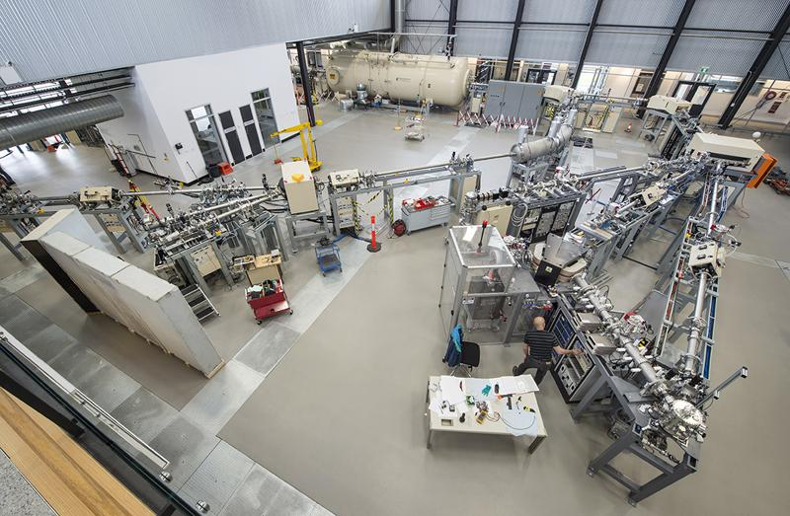
Ion beam analysis
Bombarding with ions excites materials, which give off characteristic bursts of x-rays, gammas etc = a ‘fingerprint’ for elemental analysis.
ANSTO Centre for Accelerator Science

Slide 31
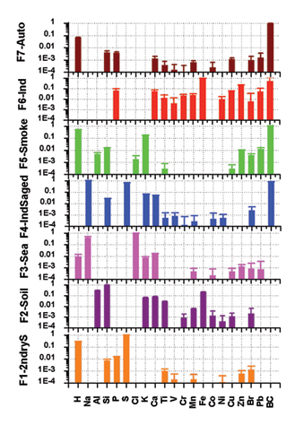
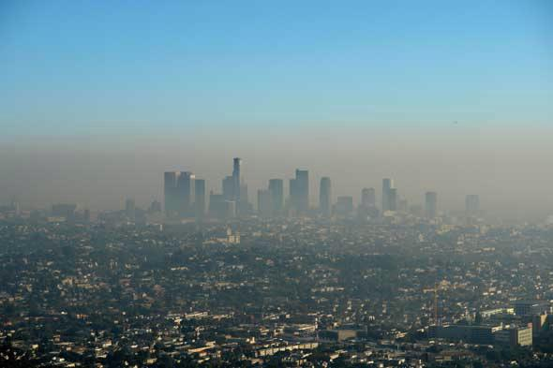
Studying Aerosols and Pollutants
“Using ion beam analysis methods, it is possible to not only determine the number of minute quantities of pollutants in the air but also to identify their sources,” - David Cohen, ANSTO
“up to half of the total sulfate air pollution in the greater Sydney region can be attributed to emissions from NSW’s eight coal-fired power stations” - ANSTO
https://www.ansto.gov.au/our-science/projects/aerosol-sampling-program/highlights-aerosol-sampling

Slide 32

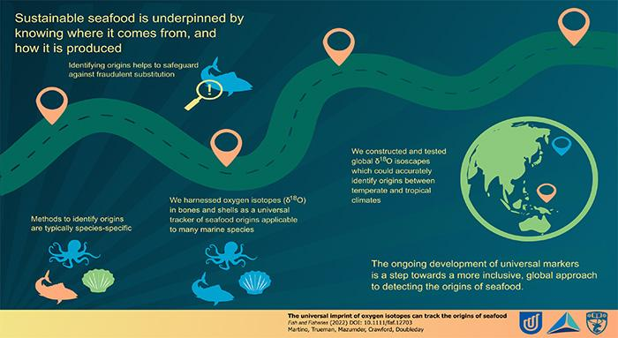
Emerging application: Food Provenance
O¹⁸ isotopes found in shells/bones used as a ’tracer’

Slide 33
4. Historical and cultural applications

Slide 34
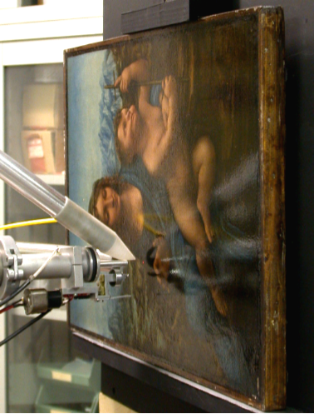
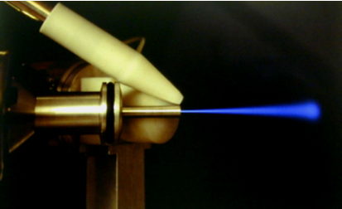
IBA techniques in art
Ion Beam Analysis (MeV) shows us the chemical composition of pigments used in paint
Backscattered radiation can give detailed analysis of atoms present in surface.
This allows art historians to compare them with paints available to artists like Leonardo da Vinci
Notes:
An ion beam (usually, though not exclusively, protons) with MeV energy is directed onto the surface. A variety of backscattered radiation can give a detailed analysis of the atoms present in the surface.

Slide 35





Accelerator Mass Spectrometry:
Radiocarbon Dating
For more accuracy, isolate C-14 from other isotopes
“AMS” = Accelerator Mass Spectrometry
Notes:
1) As plants uptake C through photosynthesis, they take on the ¹⁴C activity of the atmosphere.
2) Anything that derives from this C will also have atmospheric ¹⁴C activity (including you and I).
3) If something stops actively exchanging C (it dies, is buried, etc), that ¹⁴C begins to decay.
Accelerator mass spec can use very small sample sizes

Slide 36



Archaeology/Heritage
Using X-Ray induced fluorescence
A synchrotron X-ray beam at the SSRL facility illuminated an obscured work erased, written over and even painted over of the ancient mathematical genius Archimedes, born 287 B.C. in Sicily.
Pottery from Armenia, dating back to 1300 BC, is set up for a synchrotron experiment: accelerators have the advantage of being non-destructive
Image: Argonne National Laboratory
Notes:
LEFT: The collection of precise information on the molecular structure of chromosomes and their components can improve the knowledge of how the genetic code of DNA is maintained and reproduced
RIGHT: X-ray fluorescence imaging revealed the hidden text by revealing the iron contained in the ink used by a 10th century scribe, which had since been erased with lemon juice and written over. This x-ray image shows the lower left corner of the page.

Slide 37



X-rays also used to study art
This painting “Patch of grass” by Vincent van Gogh was the first one analysed by
a particle accelerator
Used X-ray fluorescence technique
Distribution of Hg (red) and Sb (yellow) pigment allowed a reconstruction of underlying image
It showed a portrait of
a woman underneath
https://www.symmetrymagazine.org/breaking/2008/07/30/particle-accelerator-reveals-hidden-van-gogh
Notes:
By directing synchrotron radiation onto 0.5 square mm ‘pixels’, it was possible to produce X-ray fluorescence intensity maps, reflecting the distribution of specific elements in the paint layers. In particular, the distribution of Hg mercury (red pigment) and Sb antimony (yellow pigment) allowed a reconstruction of the underlying image to be made.
Up to 1/3 of all Van Gogh paintings are thought to have other artworks underneath

Slide 38

5. Large Facilities:
Synchrotron Light Sources
Image courtesy of ESRF
Notes:
Synchrotron light sources that have begun operation in last 15 years

Slide 39




What is synchrotron radiation
Synchrotron radiation is emitted by charged particles when accelerated radially
Produced in synchrotron radiation sources using bending magnets, undulators and wigglers
Notes:
The choice of magnetic field and oscillatory period affects radiation produced
Altering the undulator gap will vary the harmonic energies.
Wiggler = incoherent but high flux, Undulator = coherent, tunable.

Slide 40

X-Ray crystallography
Protein crystallography is a standard technique at synchrotron light sources (Diamond light source has 5 beamlines devoted to it)
The hardest part is forming the crystal…
For some great overview videos of crystallography, see:
http://www.richannel.org/collections/2013/crystallography

Slide 41



Structural Biology
The main SARS-COV-2 protease from D. Owen, Diamond Light Source, UK
Reconstruction of the 3D structure of a nucleosome (DNA packaging) with a resolution of 0.2 nm
In 1990 scientists determined the structure of a strain of foot & mouth virus using Daresbury SRS.
More info:
https://cerncourier.com/a/synchrotrons-on-the-coronavirus-frontline/
Notes:
LEFT: The collection of precise information on the molecular structure of chromosomes and their components can improve the knowledge of how the genetic code of DNA is maintained and reproduced
RIGHT: X-ray fluorescence imaging revealed the hidden text by revealing the iron contained in the ink used by a 10th century scribe, which had since been erased with lemon juice and written over. This x-ray image shows the lower left corner of the page.

Slide 42

High flux = fast experiments
High brilliance – small divergence & partially coherent
High stability - submicron
Polarisation
Pulsed
Synchrotron radiation: microwaves to hard x-rays (user can select)
Notes:
High Flux: high intensity photon beam, allows rapid experiments or use of weakly scattering crystals;
High Brilliance (Spectral Brightness): highly collimated photon beam generated by a small divergence and small size source (partial coherence);
High Stability: submicron source stability
Polarisation: both linear and circular (with IDs)
Pulsed Time Structure: pulsed length down to tens of picoseconds allows the resolution of process on the same time scale

Slide 43

Hard condensed matter science
Applied material science
Engineering
Chemistry
Soft condensed matter science
Life sciences
Structural biology
Medicine
Earth and science
Environment
Cultural heritage
Methods and instrumentation
© CCLRC
Diffraction pattern from pea lectin
Notes:
List taken from ESRF website

Slide 44
5. Large Facilities
Neutron Spallation Sources

Slide 45






From Protons to Neutrons: Spallation Sources
Example: UK’s STFC ISIS neutron spallation source:
RFQ + linac + 800 MeV proton synchrotron
Notes:
There are also two muon beamlines

Slide 46


Slide 47

https://youtu.be/VESMU7JfVHU?t=21
‘Neutrons tell you where atoms are and what atoms do’
Notes:
Inside the instrument a material will be positioned for investigation. Neutrons travel into the material and are detected when they come out. The directions in which the neutrons emerge tell us about the arrangement of the atoms inside. This is called neutron diffraction. The amount of energy lost by the neutrons as they travel through the material tells us about the atomic dynamics , a technique called neutron spectroscopy.

Slide 48


Image courtesy ISIS, STFC.

Slide 49




Understanding infant lung structure
Natural lung surfactant allows oxygen into the bloodstream
Absence in premature babies causes breathing difficulties
ISIS mimicked change in lung capacity to discover how proteins and phospholipids act together
Helping to develop synthetic lung surfactants which can be more precisely targeted at clinical needs to help save babies’ lives
“ISIS is the premier place in the world to work with neutrons and liquid surfaces. In collaboration with the University of Queensland we were able to discover how proteins and phospholipids act together to enable lung function.”
  Dr Stephen Holt, ISIS neutron scientist

Slide 50
6. Future Challenges

Slide 51





A Global Challenge in Healthcare:
By 2035, 75% of cancer deaths worldwide will be in LMICs
Severe shortfall of LINACs & issues with machine failures
STELLA Collaboration Formed to Address this Issue

Slide 52



The Reliability Frontier

Slide 53



Intensity Frontier:
Materials testing for fusion
Source: IFMIF.org
“deuterium-tritium nuclear fusion reactions will generate neutron fluxes in the order of 10¹⁸ m⁻²s⁻¹ with an energy of 14.1 MeV that will collide with the first wall of the reactor vessel”
International Fusion Material Irradiation Facility (IFMIF)
40 MeV
2 x 125mA linacs
CW deuterons, 5MW each
Beams will overlap onto a liquid Li jet
To create conditions similar to in a fusion reactor
Photos: Pablo A (CAS 2024)
To de-risk IFMIF, first a test accelerator ‘LIPAc’ is being built in Japan.
Notes:
LIPAC = Linear IFMIF protoype accelerator

Slide 54



Intensity Frontier:
Accelerator Driven Systems
Transmutation of nuclear waste isotopes or energy generation
Thorium
Major challenges for accelerator technology in terms of beam power (>10MW) and reliability
https://myrrha.be/about-myrrha
Notes:
Thorium is 3 times as abundant on earth and we use all of it (not 0.71% like uranium)
Fertile not fissile, add neutrons from accelerator to create U233 (fissile)

Slide 55

Sustainability Frontier
Environmental Impacts
Electrical power
  Electromagnets → permanent magnets?
  Energy recovery linacs
  High temperature superconductors
Materials
  Rare metals often required
Gases:
  SF6, HFC, PFC tightly controlled
Recycle-ability?
Impacts on residents esp. indigenous populations
The SESAME facility has its own solar power plant
https://www.nature.com/articles/s41567-023-02117-0

Slide 56
A challenge to you:
What is the most ‘surprising’ application of an accelerator you can think of?

Slide 57


Crystal structure formation
Cadbury used X-rays from a particle accelerator to study how cocoa crystallises
Of the six possible crystal forms, the fifth (form V) produces the best quality chocolate
Notes:
I don ‘t suppose they were expecting this!

Slide 58


Detecting Wine Fraud
Use ion beam to test the bottle of “antique” wine – chemical composition of the bottle compared to a real one.
“In a recent and spectacular case, American collector William Koch sued a German wine dealer, claiming four bottles – allegedly belonging to former U.S. president Thomas Jefferson – purchased for 500,000 dollars, were fake. The case has yet to be settled.”
- http://www.cosmosmagazine.com

Slide 59

Next time someone asks you what accelerators are for…
“A beam of the right particles with the right energy at the right intensity can shrink a tumor, produce cleaner energy, spot suspicious cargo, make a better radial tire, clean up dirty drinking water, map a protein, study a nuclear explosion, design a new drug, make a heat-resistant automotive cable, diagnose a disease, reduce nuclear waste, detect an art forgery, implant ions in a semiconductor, prospect for oil, date an archaeological find, package a Thanksgiving turkey or…
…discover the secrets of the universe.”
-Accelerators for Americas Future Report, pp. 4, DoE, USA, 2011

