Slide 1



RF Systems
Christine.Vollinger@cern.ch
CAS - Introduction to Accelerator Physics
30 September 2024

Slide 2
Outline – Part 1
Introduction – what is RF for accelerators?
Simplified RF system and first RF-accelerator principles
Choice of parameters for an RF system
  Frequency and voltage
RF cavity types and accelerating fields in an RF cavity
  λ/2 or λ/4 resonator
  Principle of tuneable cavities

Slide 3
Introduction

Slide 4
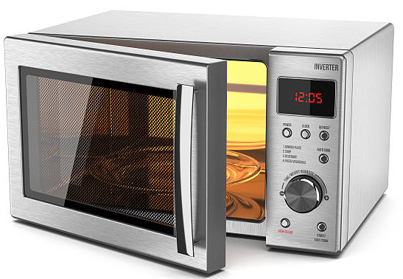

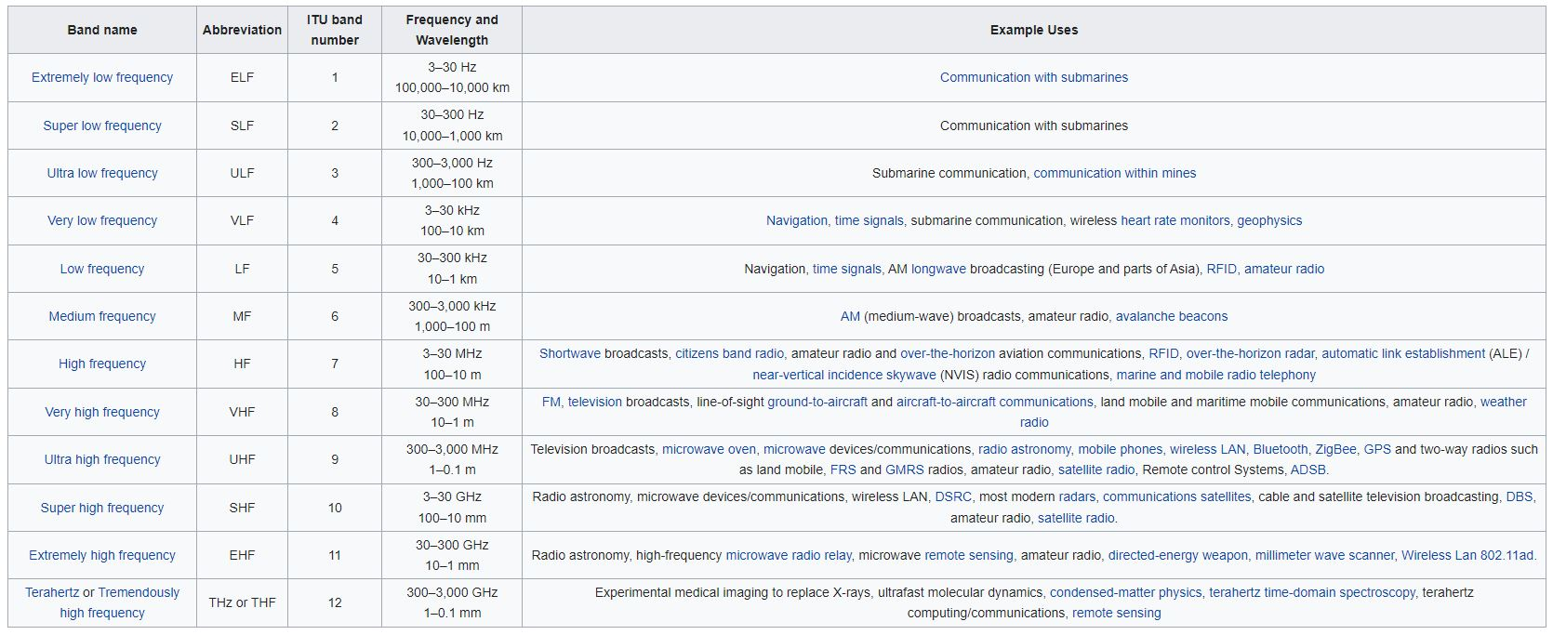
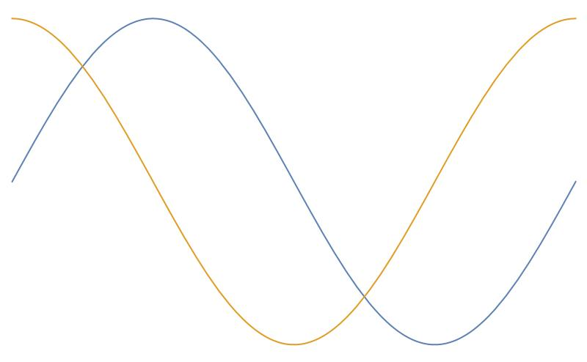

What is Radio Frequency (for accelerators)?
Frequency f and wavelength λ are inversely proportional:
Large frequency means small wavelength.
Hz “Hertz” is the unit of frequency: sec⁻¹
1 MHz = 10⁶ Hz (Megahertz)
1 GHz = 10⁹ Hz (Gigahertz)
“RF frequencies”
Wavelength
Frequency
“Microwave range”
“millimeter waves” (wavelengths in mm)
Source: en.wikipedia.org/wiki/Radio_spectrum
Speed of light in vacuum…
λ
Phase velocity “everywhere else”.
λ

Slide 5
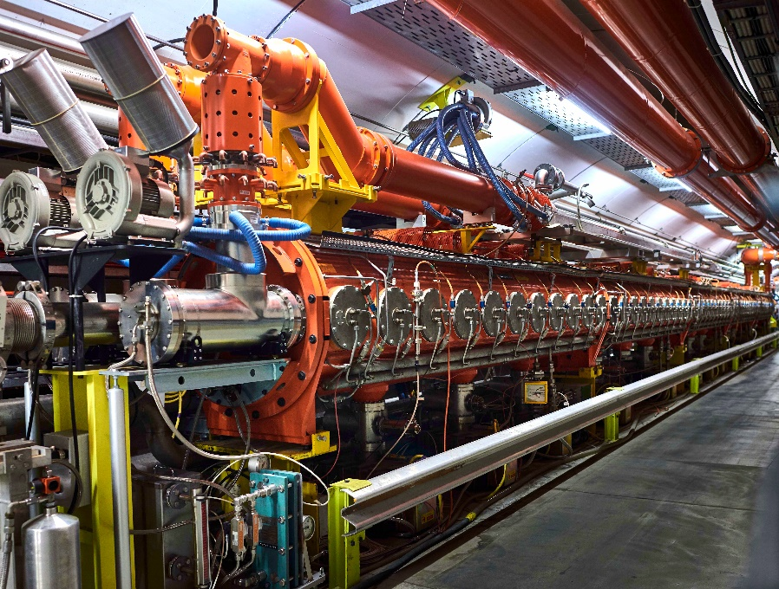
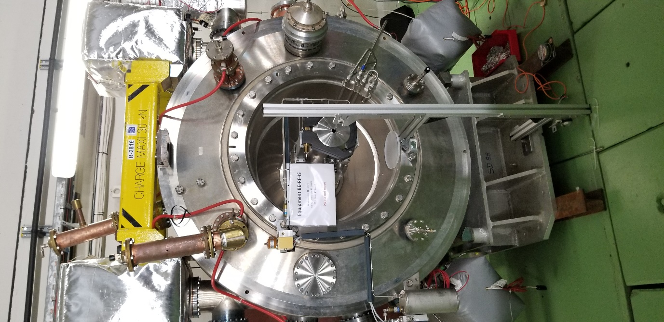
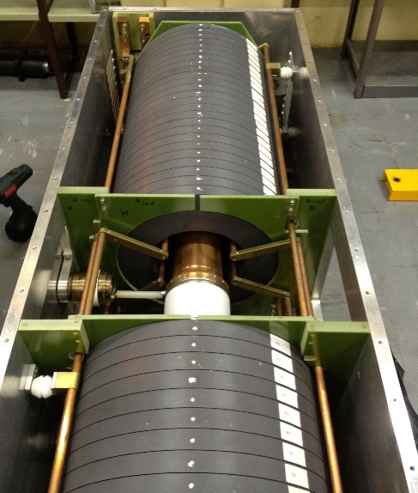
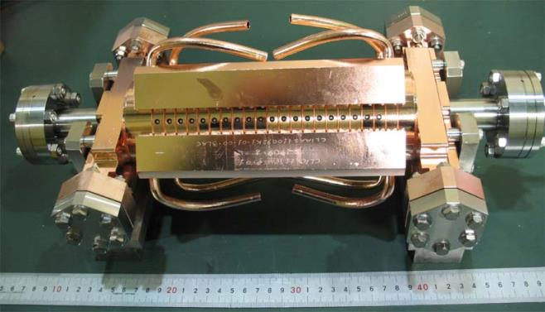
What is Radio Frequency (for accelerators)?
Source: en.wikipedia.org/wiki/Radio_spectrum
approx. 2 m
Travelling wave cavity, freq = 200 MHz
Total length: 12 & 16 m. (CERN SPS)
Accelerating Cavity, freq = 80 MHz
(CERN PS)
Ferrite Loaded Cavity,
freq = 3 – 8 MHz
(CERN PS Booster)
CLIC structure, freq = 12 GHz
All pictures © CERN

Slide 6
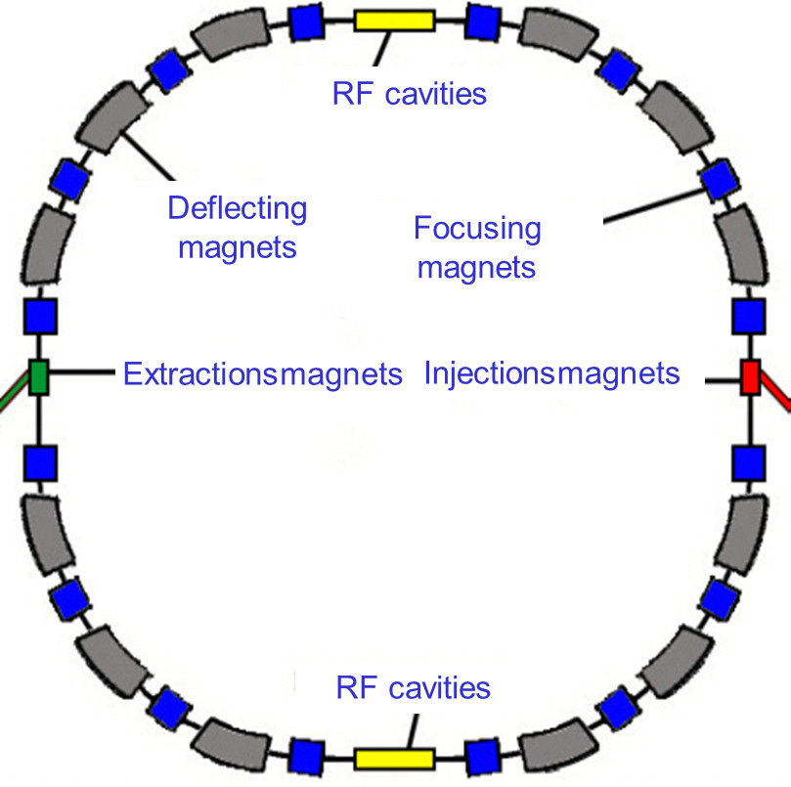
What is Radio Frequency (for accelerators)?
RF domain is huge!
The radiofrequency (RF) system does the actual acceleration - it transforms a string of magnets into an accelerator.
Cavity is the most visible part of an RF system
  On top of the RF system food chain
  Interacts directly with beam
  Provides acceleration and also RF manipulations, but
  also some unwanted effects (e.g. beam coupling
  impedance contribution)
  Cavity is no “stand-alone” element…
  … requires RF signals generated (LLRF system) to be operated successfully and power input to transfer energy to the beam.
Image from I. Shreyber
The LLRF system picks up a signal or several signals from the cavity pick-up and a signal from the phase reference line system to calculate the required amplitude and phase in the cavity.

Slide 7
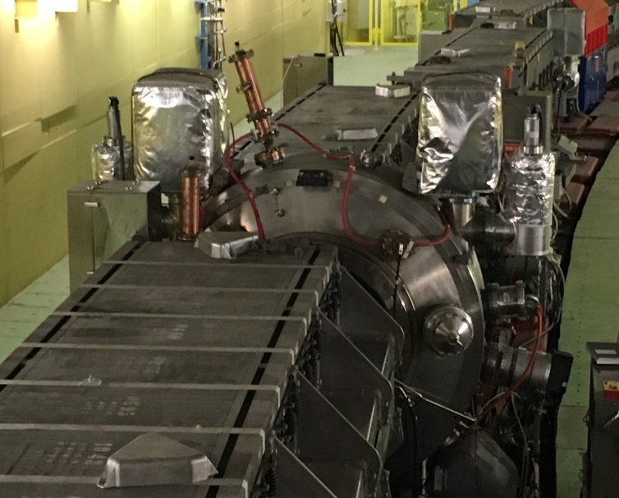
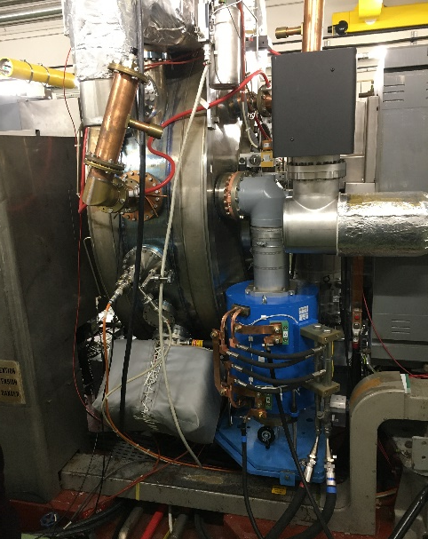

A simplified RF System
Low-level
RF system
High power
RF system
RF source
High power RF
waveguide or coaxial
distribution system
LLRF
High power
RF input coupler
RF field probe
signal
RF cavity resonator (“pillbox cavity”)
q
PS single cell cavity (“pillbox”)
v
beam
E
metallic beam pipe
Illustration from M. Wendt
Recall: Lorenz force will only accelerate if the E-field is synchronized with the beam (synchronicity condition).

Slide 8
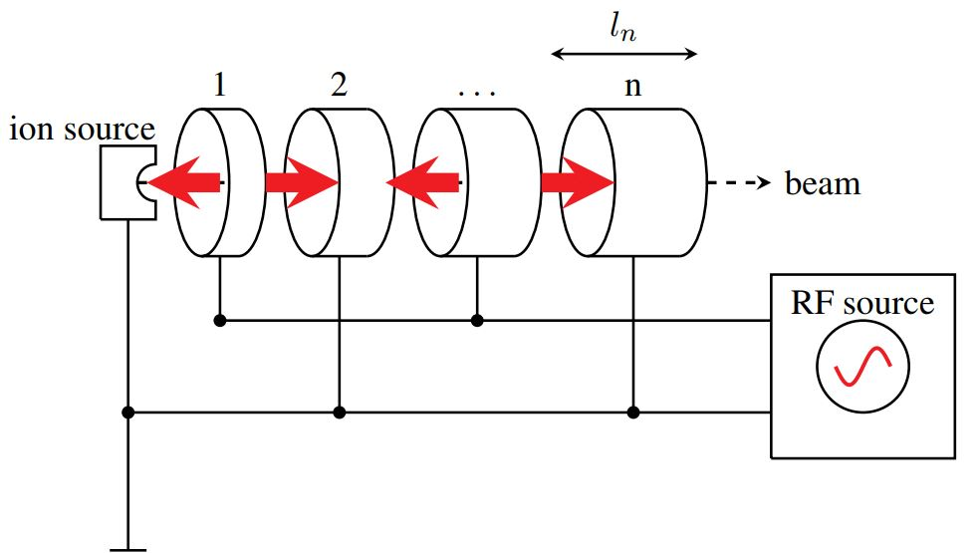
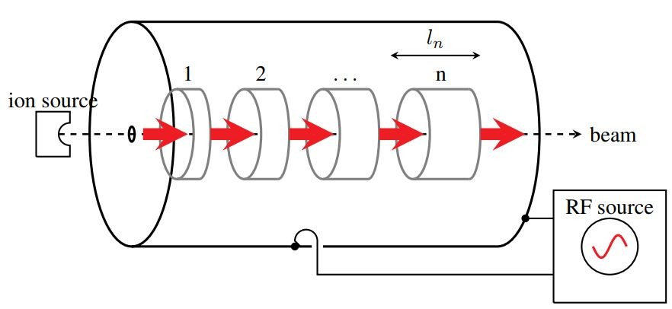
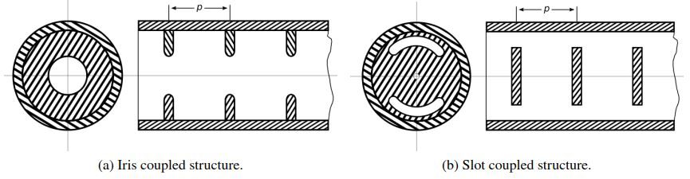
First accelerators – drift tube linacs type
Images: F. Gerigk, CAS Ebeltoft, Cavity Types, 2010
Alvarez-type linac (= drift-tube-linac)
Wideroe-type linac (= drift-tube-linac)
Pi-mode structure
0-mode structure
Naming: The name of the resonant mode is given by the phase advance between two consecutive cells.

Slide 9
RF system for high-energy accelerators
Accelerator type
Linear
Circular
(single pass)
(multi-pass)
Choice of RF parameters includes:
frequency (range), or: shall we apply high or low RF frequency?
Minimum voltage requirement, within limitations…
Electrons
Hadrons
Electrons
Hadrons
Compensate synchrotron radiation losses
Increase particle energy &
Sweep frequency with beam
Maximum RF voltage, constant velocity
Maximum RF voltage, variable velocity
f_{RF} = h · f_{rev}
*
L_{n} = v_{n} · T_{RF}
*Exceptions (rare) exist,
e.g. “fixed frequency” acceleration in SPS
L_{n} = Distance between two adjacent gaps

Slide 10
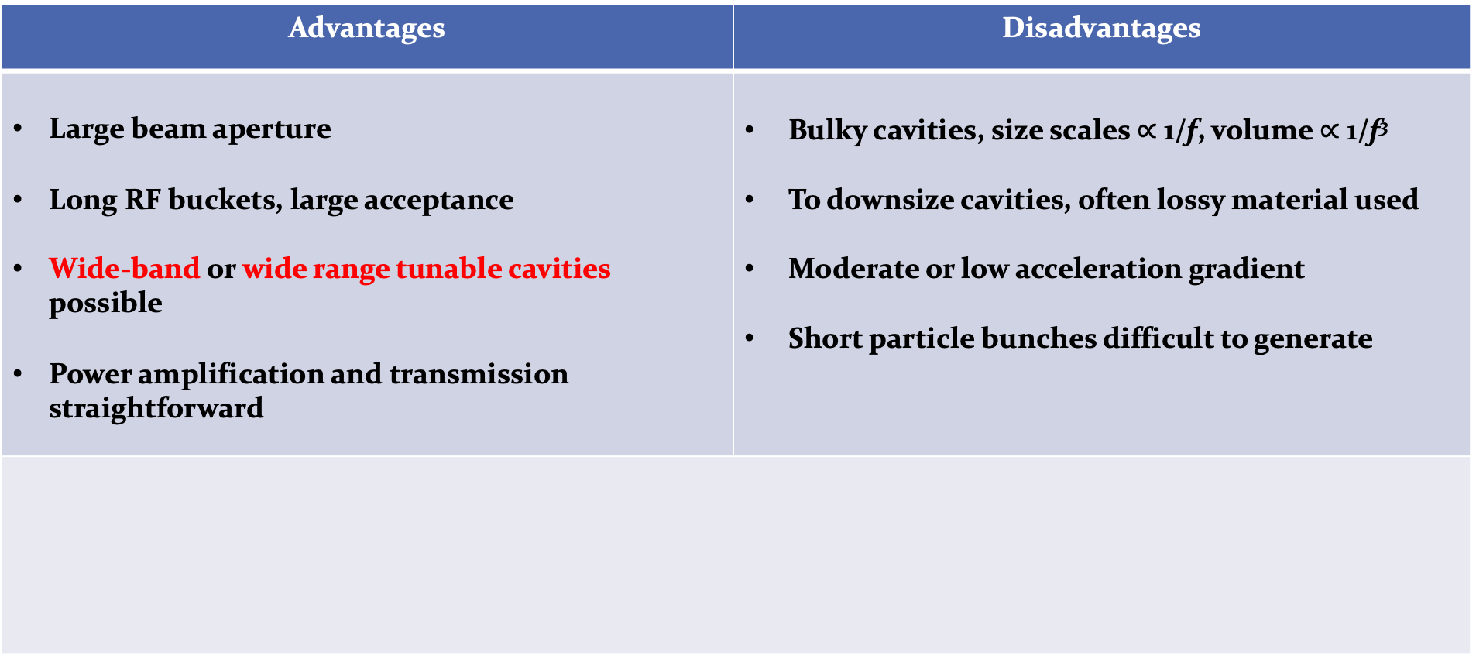
Why choose a low RF frequency?
Advantages | Disadvantages
Large beam aperture Long RF buckets, large acceptance Wide-band or wide range tunable cavities possible Power amplification and transmission straightforward | Bulky cavities, size scales $∝$ 1/f, volume $∝$ 1/f³ To downsize cavities, often lossy material used Moderate or low acceleration gradient Short particle bunches difficult to generate
Mainly electrons, some hadron linear accelerators
Cyclotrons
Low- and medium energy hadron synchrotrons
  RF frequencies
  below ~200 MHz for

Slide 11
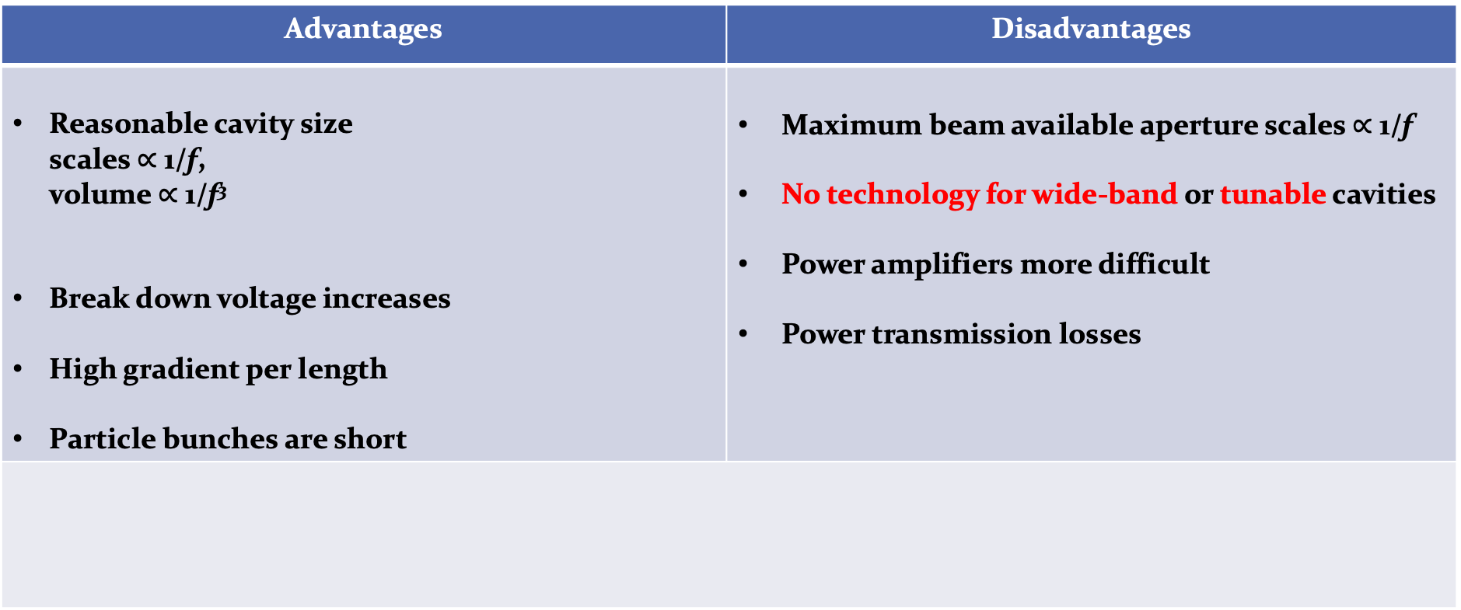
Why choose a high RF frequency?
Advantages | Disadvantages
Reasonable cavity size scales $∝$ 1/f, volume $∝$ 1/f³ Break down voltage increases High gradient per length Particle bunches are short | Maximum beam available aperture scales $∝$ 1/f No technology for wide-band or tunable cavities Power amplifiers more difficult Power transmission losses
  Linear accelerators
  Electron storage rings
  High energy hadron storage rings
  RF frequencies above
  ~200 MHz used for

Slide 12
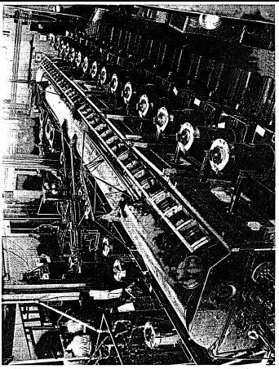
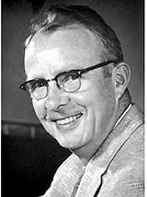
Small side remark:
Luis Alvarez and the Drift Tube Linac
The war effort forced to develop the competences and gave the components to go to higher frequencies (in the MHz – GHz range) .
Alvarez tried acceleration of a proton beam to the MeV range using the Wideröe principle.
He worked at MIT on radar during the war. In 1945, he had the tools and the competences to build his own accelerator.
The 1st Drift Tube Linac by L. Alvarez and his team at Berkeley, reaches 32 MeV in 1947.
Choice of Frequency :
Alvarez received from the US Army a stock of 2’000 (!) surplus 202.56 MHz transmitters, produced for a radar surveillance system.
26 were installed to power the DTL with a total of 2.2 MW.
They were soon replaced because unreliable, but this frequency remained as the standard linac frequency.
Following M. Vretenar,
RF CAS 2023

Slide 13
Some standard frequencies = your choice
If exact RF frequency not critical, choose standard value
Off-the-shelf RF components easily available in frequency ranges used by industry.
Exchange of developments and equipment amongst research laboratories.
Exchange expertise with colleagues from other labs!
Accelerator | Frequency
Hadron synchrotrons (PSB, PS, JPARC RCS, MR) | <10 MHz
Hadron accelerators and storage rings (RHIC, SPS) | ~200 MHz
Electron storage rings (LEP, ESRF, Soleil) | 352 MHz
Electron storage rings (DORIS, BESSY, SLS,…) | 499.6…499.8 MHz
Superconducting electron linacs and FELs (X-FEL, ILC) | 1300 MHz
Normal conducting electron linacs (SLAC) | 2856 MHz
High-gradient electron linac (CLIC) | 11.99 GHz

Slide 14
How to get to the electric field of this RF cavity?
Low-level
RF system
High power
RF system
RF source
High power RF
waveguide or coaxial
distribution system
LLRF
High power
RF input coupler
RF field probe
signal
RF cavity resonator (“pillbox cavity”)
PS single cell cavity (“pillbox”)
q
v
beam
E
metallic beam pipe
Illustration from M. Wendt

Slide 15
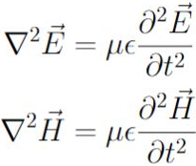




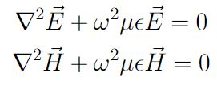


How to get to the electric field of this RF cavity?
“Just apply Maxwell’s Equations*…
... Simply superpose a forward and backward travelling wave to get a standing wave…
… terminate a waveguide with two conducting walls…
… use the EM-fields of a waveguide…
… cut the inner conductor of a coaxial line…”
or maybe not?
*for source-free, time-harmonic, linear, isotropic media.
Wave equation (=Helmholtz’ eq.)!
or
Propagation constant k
(or: phase constant, or wave number, or separation constant),
with unit 1/m
define

Slide 16
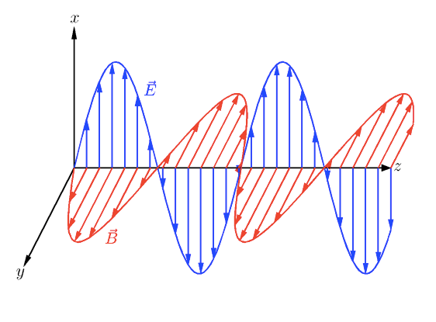
Basic Wave Equation – Plane wave
This is the equation to solve…
Simplest solution is: Plane wave (no variation in x and y). We assume propagation in z-direction:
Image from I. Shreyber
E⁺ and E⁻ denote the wave amplitudes for travelling in positive and negative z-direction.
Exponential function in frequency domain
Real part of e-function in time domain
wave travelling in positive z-direction
wave travelling in negative z-direction
If you don’t see this so quickly:
Keep the cosine argument constant to maintain a fixed point of the wave: for increasing time, z has to increase as well → this describes a propagation in positive z-direction.

Slide 17
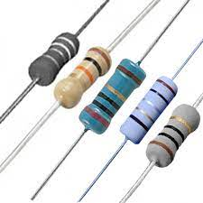
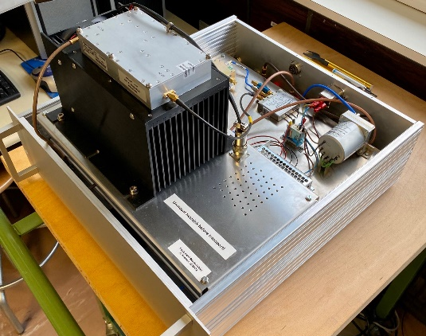
Basic Wave Equation – Plane wave
Plane wave = E-field and H-field are in phase.
In our equipment, boundary conditions lead to a phase difference in the EM-fields.
Image from I. Shreyber
Exponential function in frequency domain
Real part of e-function in time domain
In RF, almost all equipment sees EM-field effects, and needs to be treated accordingly.
This leads to Transmission Line Theory or Classical Field Theory concepts.

Slide 18
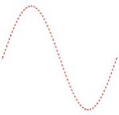
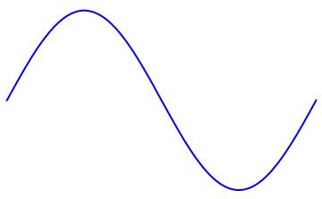

Basic Transmission Line Theory
i(z)
z
v(z)
dz
Consider a transmission line of a certain length aligned in z-direction.
Voltage and current along the line depend on z.
Their variation along the line depends on their wavelength.
Remember? High frequency comes with short wavelength.
We split the line in infinitesimal increments of length dz.
We model the length dz with lumped elements.
series resistor
series inductance
dz
parallel capacitance
parallel conductance

Slide 19




Basic Transmission Line Theory
i(z)
dz
v(z)
dz
R’ dz
L’ dz
i(z)
i(z+dz)
Consider a transmission line of length dz.
Voltage and current along the line depend on z.
We model the line length dz with lumped elements.
We express all lumped elements per unit length dz :
v_{R}(z)
v_{L}(z)
v(z)
v(z+dz)
G’ dz
C’ dz
resistance in [Ω/m]
inductance in [H/m]
conductance in [S/m]
capacitance in [F/m]

Slide 20







Basic Transmission Line Theory
dz
R’ dz
L’ dz
i(z)
i(z+dz)
v(z)
v_{R}
v_{L}
v(z+dz)
mesh rule
G’ dz
C’ dz

Slide 21
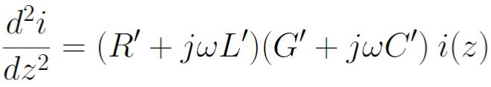





Basic Transmission Line Theory
Transmission line equations
2nd derivative
& combine…
This equation, we know already!
Mathematically, it is the same type as the one-dimensional, scalar Helmholtz’ equation for EM-fields.
phase constant
attenuation constant
Complex propagation constant

Slide 22
Transmission Lines and Waveguides
Waves in unbounded media.
Two categories of electromagnetic waves
Waves confined by material boundaries, so-called guided waves.

Slide 23
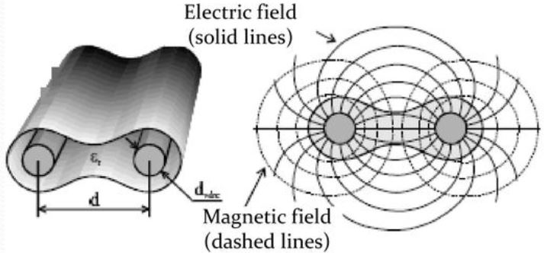
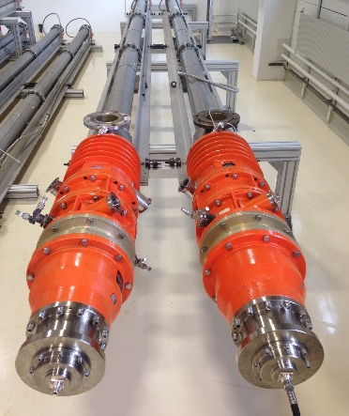
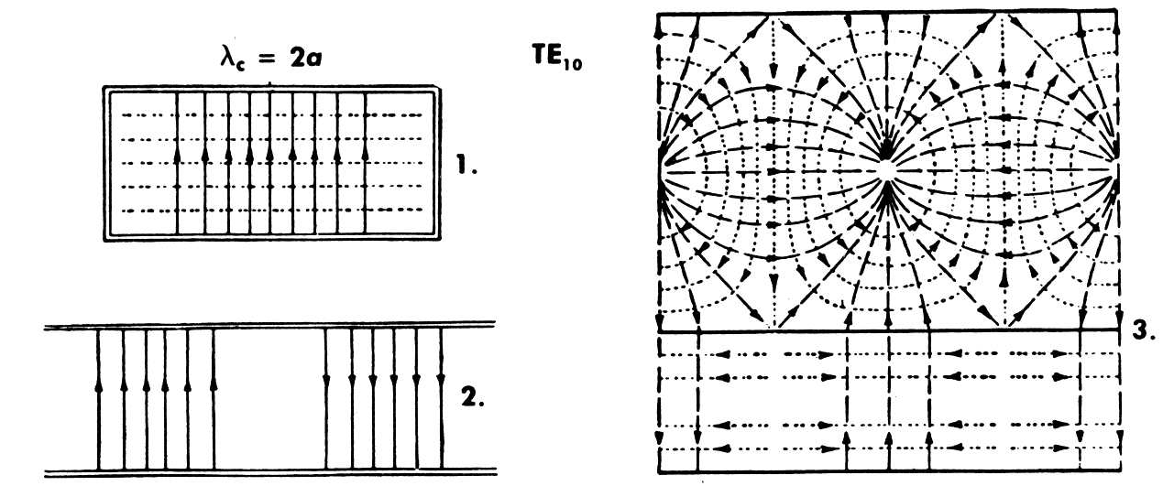
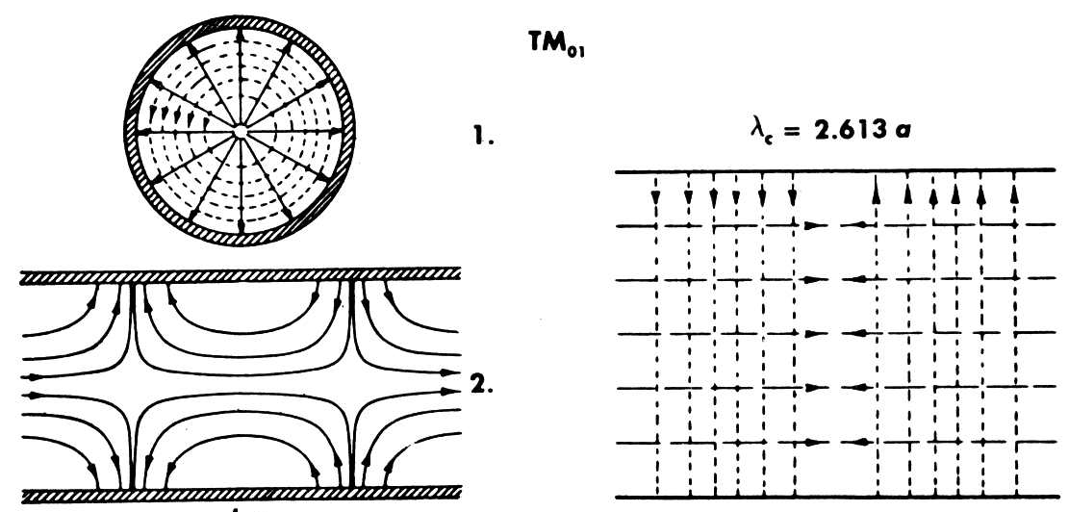
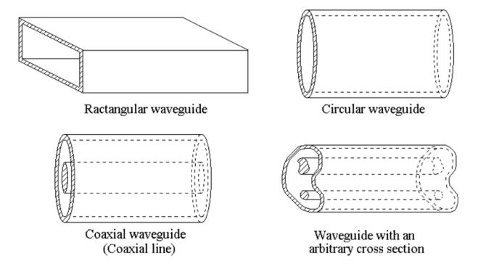
Transmission Lines and Waveguides
Wave patterns in guided wave systems depend on the number of conductors used.
“Open” two-wire system (TEM)
Coaxial line (TEM)
TEM-propagation = 2 conductor system
E-field ---H-field
Source: Ma, Electromagnetic Waves and Applications Part III, univ. lecture
Picture: Coaxial loads for the SPS 200 MHz cavity © CERN
Uniform waveguides rectangular, round, random cross-section (all non-TEM)
E-field
---H-field
Source: Saad, Microwave Engineers Handbook, vol. 1, Artech House
Source: Zhang, Electromagnetic Theory for Microwaves and Optoelectronics, 2nd ed., Springer

Slide 24
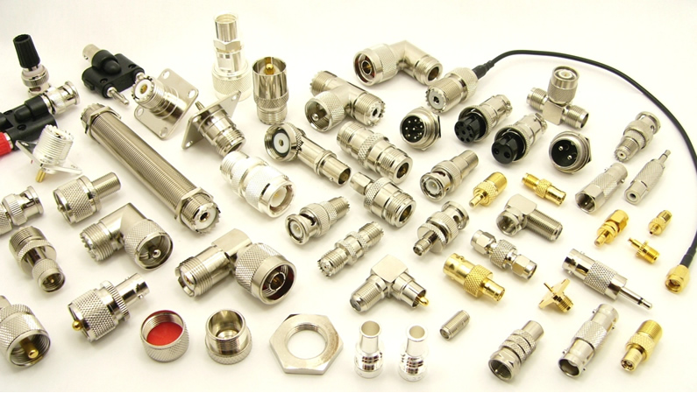
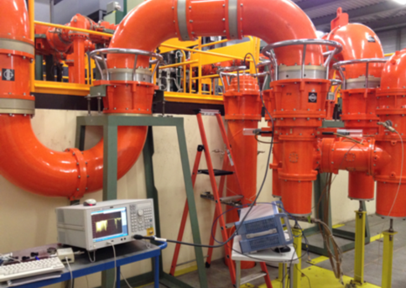
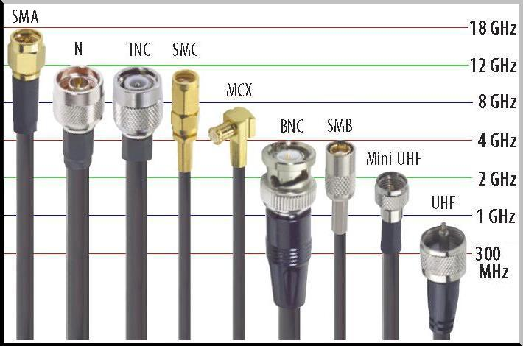
Coaxial Lines
Usually operated in TEM mode, but also carries waveguide modes if the frequency is sufficiently high.
Different coaxial cables are used for measurements, or for power transport to the cavity. They need to be optimized for their purpose.
Source: www.winpoint.com.tw
SPS 200 MHz cavity feeder line.

Slide 25
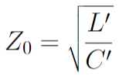
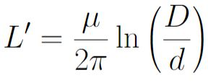
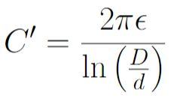
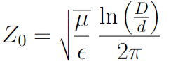


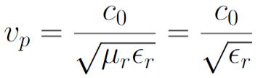


Coaxial Line in TEM-mode
E-field ---H-field
Characteristic impedance for a lossless line:
From textbook, we look up (calculated from electrostatic equations…):
d
D
Usually, there is low-loss dielectric between inner and outer conductor.
Coax characteristic impedance
with low-loss dielectric
Full shielding properties is making the coaxial line very popular for RF measurement equipment.
How about: we use a coaxial line for acceleration?

Slide 26
From Coaxial Line to RF Cavities
in low frequency range
E-field
---H-field
Frequency below ~10 MHz gives an RF wavelength largely above >30 m
With classical cavity (pillbox design), we would need huge cavities → not suited for accelerators
Line resonators: λ/2 or λ/4 resonator
E-field
E-field
λ/2 resonator
Beam orientation
λ/4 resonator
Electric Short
Electric Short
Electric Open
Electric Short
Beam orientation
Beam orientation

Slide 27
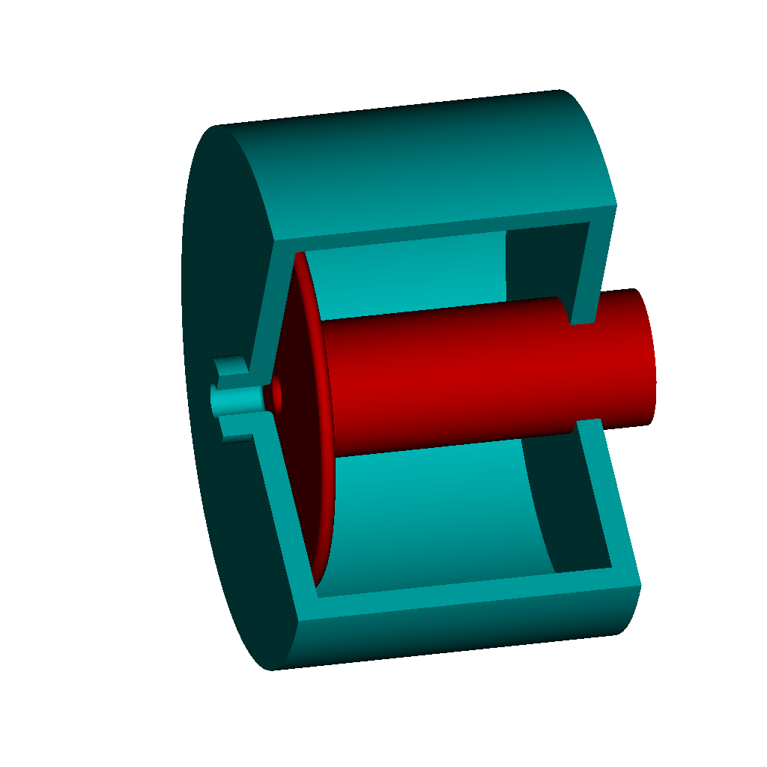
QW-Cavities in low frequency range
E-field
Beam orientation
λ/4 resonator
Electric Open
Electric Short
Ceramic gap = Electric Open
This side acts like a capacitor, we speak of capacitive loading.
Still rather long geometry, 7.5 m at 10 MHz
Image: H. Damerau

Slide 28
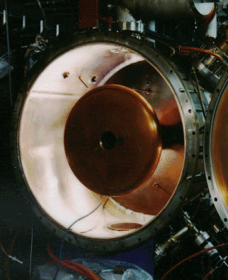
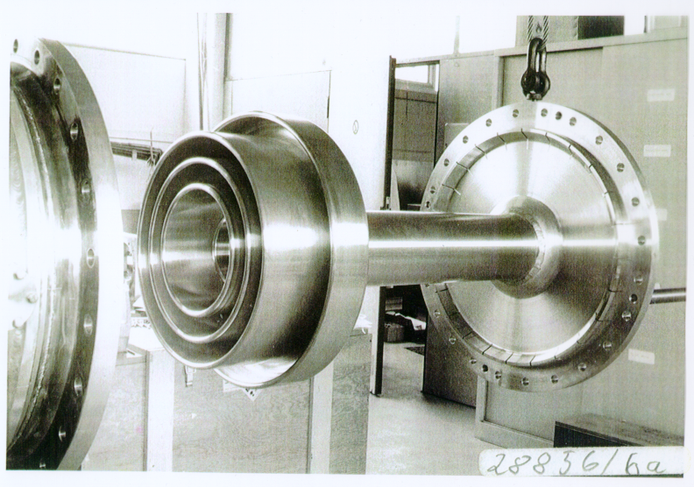
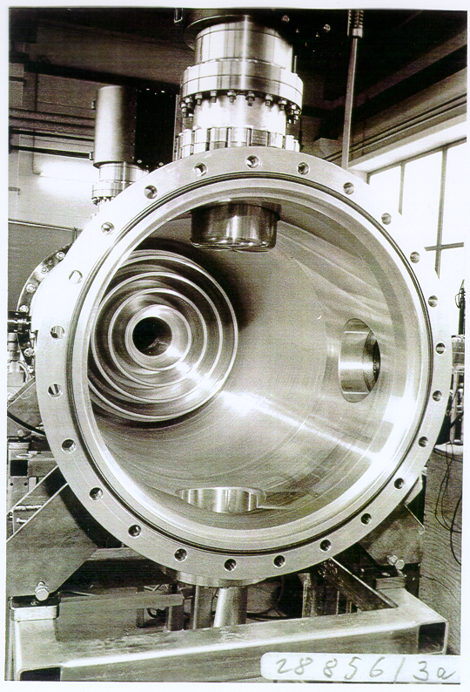
Capacitive loading in real world
Add capacitor at gap of cavity to shorten the resonator
NSLS, 52.88 MHz
DESY PIA, 10.4 MHz, inner cond.
Outer cond.
~1 m
M. Nagl
Significantly reduces cavity size (recall: at 10 MHz, QW is 7.5m)
Fixed frequency only
Adds small losses due to capacitor
Advantage: entire cavity in vacuum

Slide 29

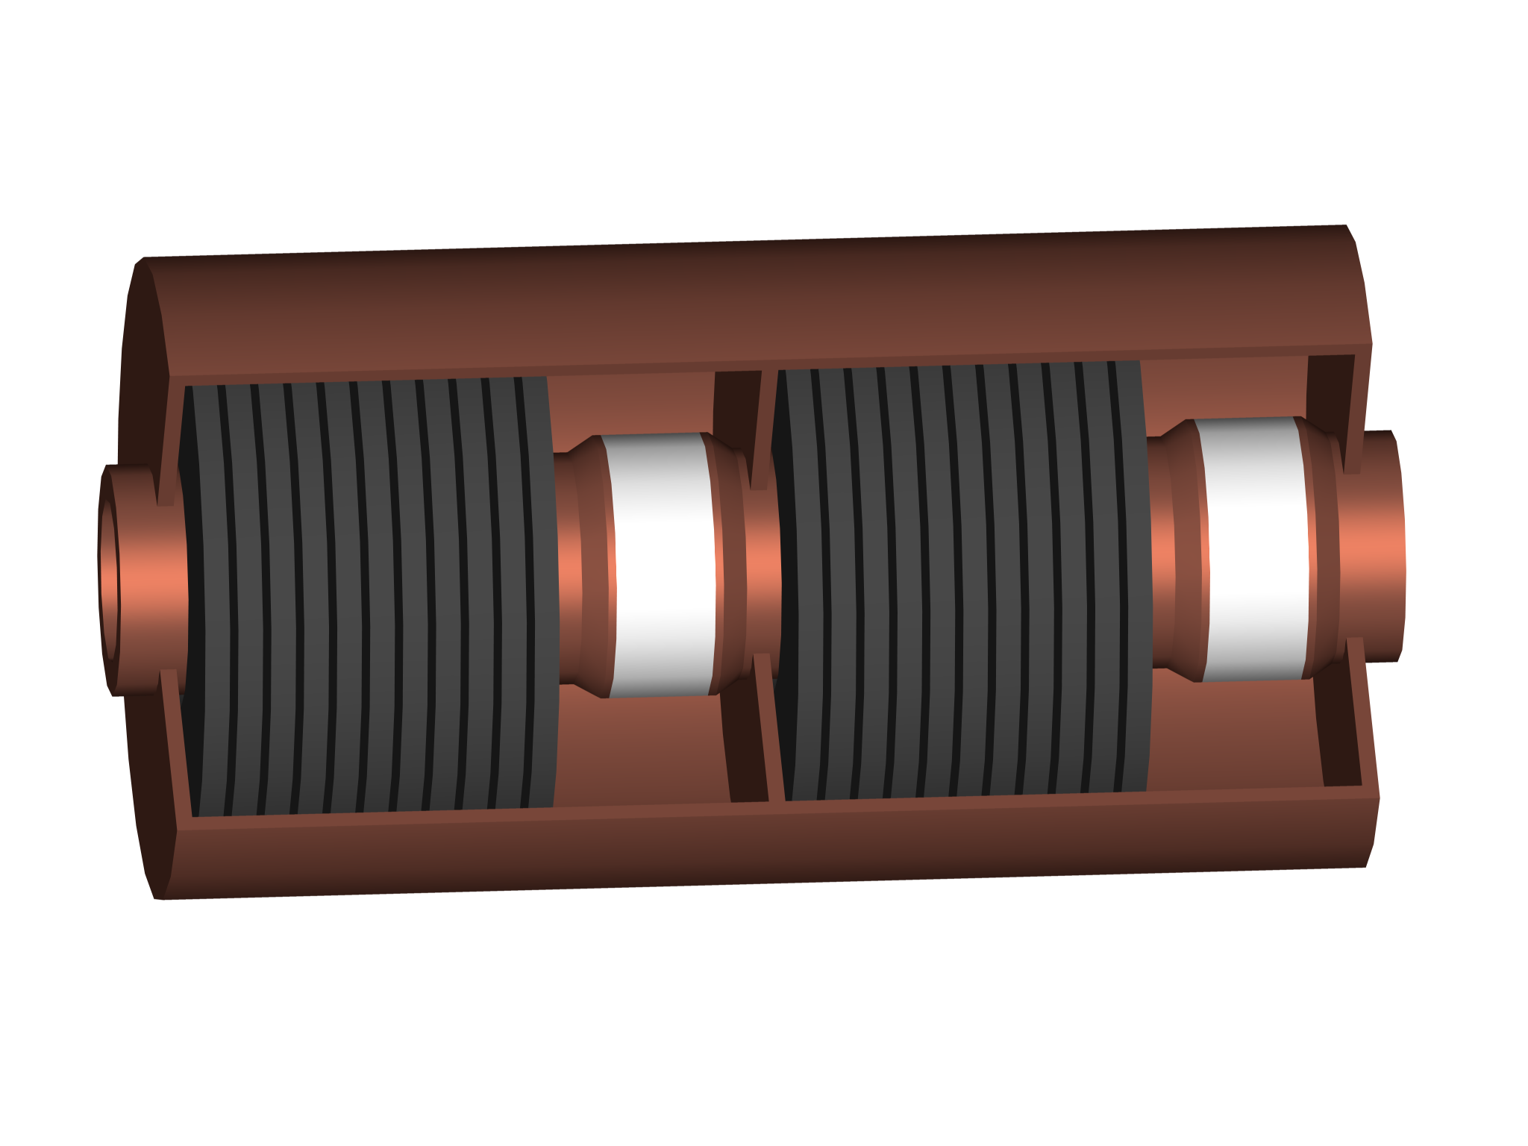
RF cavities in low frequency range
Generally: with same geometric length, the frequency goes down,
if inductance or capacitance goes up.
Leads to an increase in electrical length.
Add more capacitive or inductive loading
resonance frequency
Images: H. Damerau
Plate
capacitor
Ferrite inductivity
(also allows frequency tuning)

Slide 30
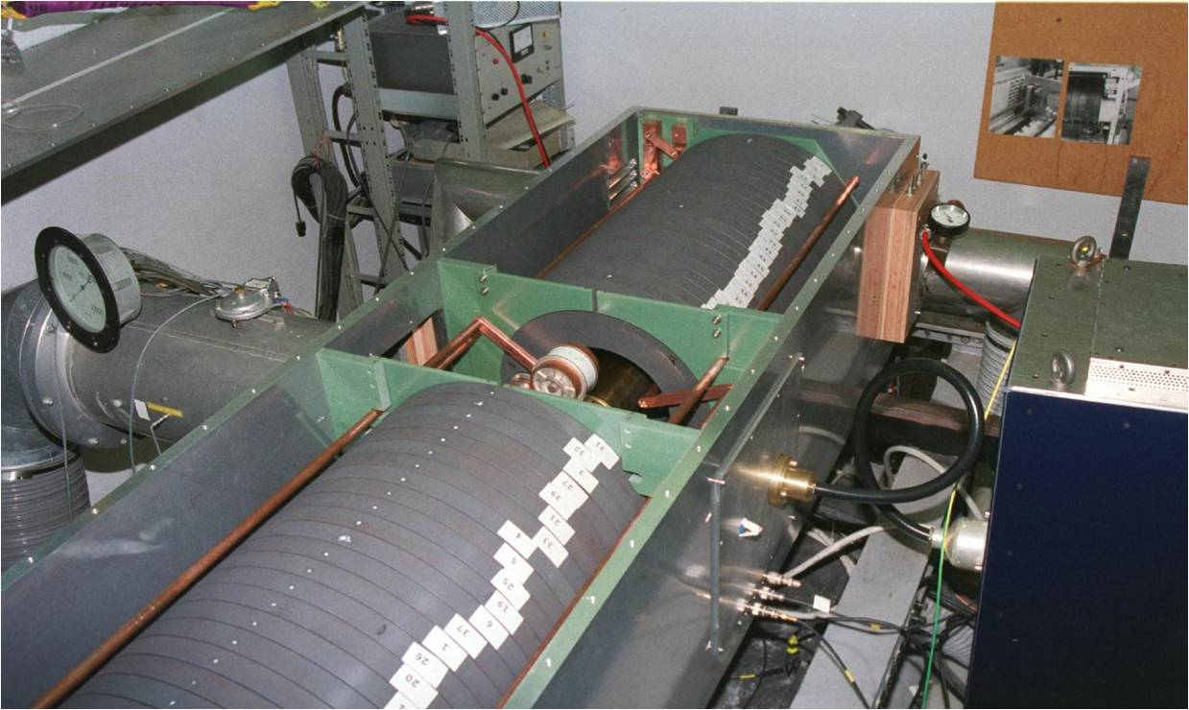
Tunable cavities – example (former) PSB
Makes use of spinnel ferrites.
Tuning via external magnetic field.
So-called “figure-of-eight” biasing
(= parallel biasing)
Cavity, operating 8-12 MHz
Ferrite material is lossy and brings the Q of the cavity down.
Q₀ = 50
PSBooster Cavity, below 20 MHz
Beam vacuum pipe with ceramic gap.

Slide 31
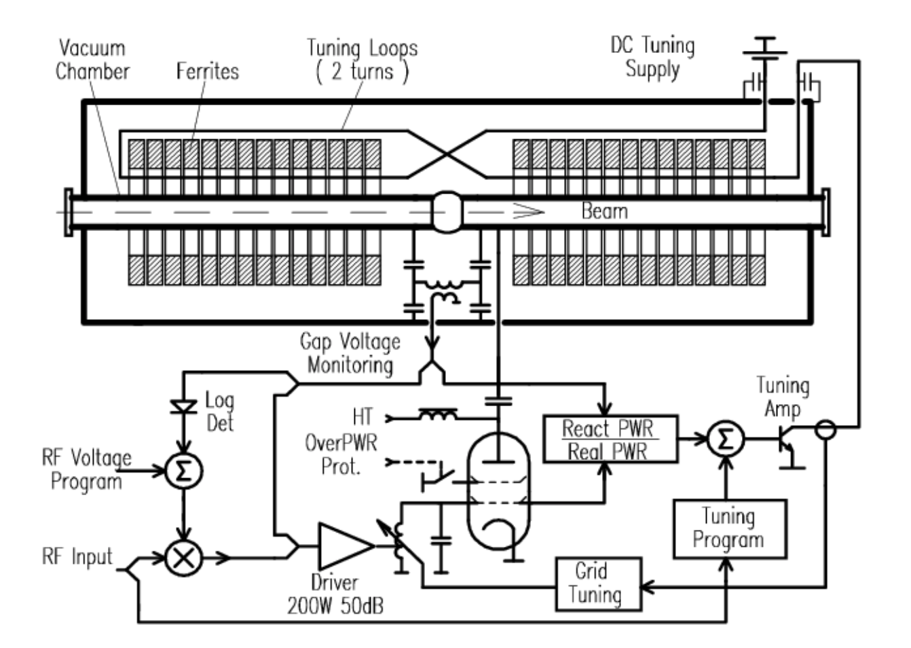
Tunable cavities – figure-of-eight biasing

Slide 32
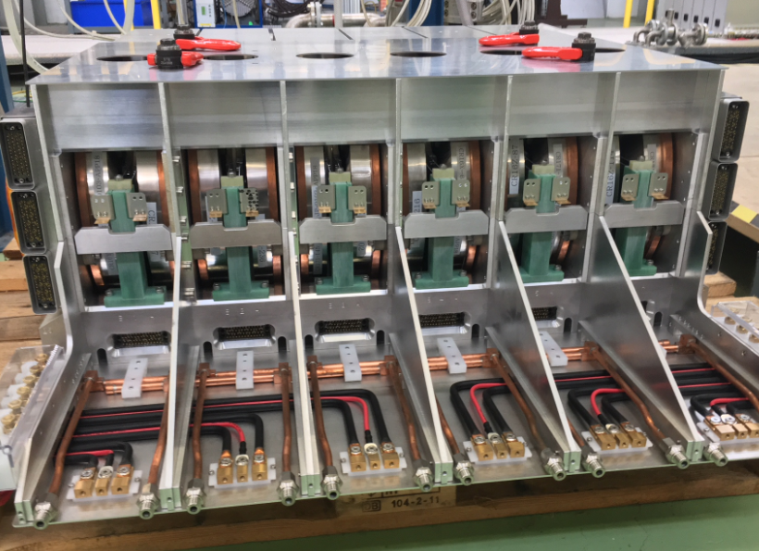
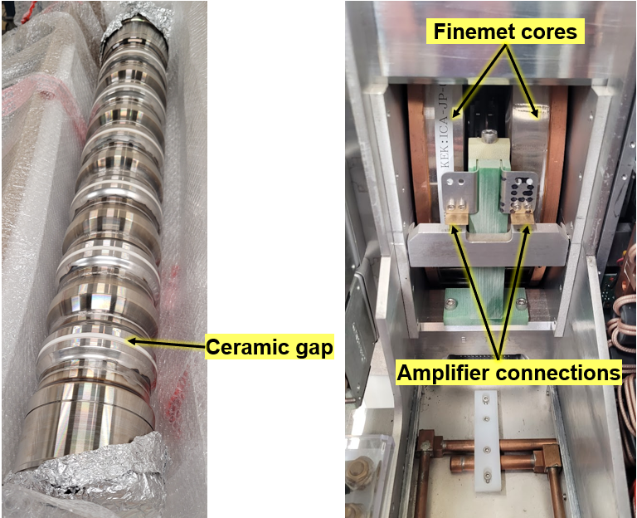
Tunable cavities – the PSB finemet cavity
Image: M. Paoluzzi
CERN PSB Finemet cav., 0.6-18 MHz

Slide 33
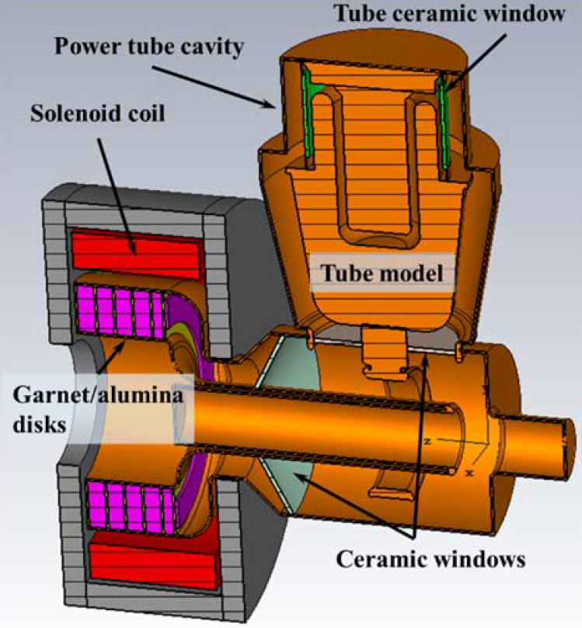
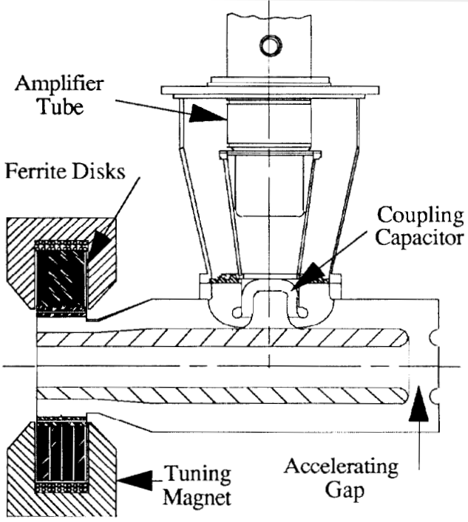
Tunable cavities – higher frequencies
These cavities work with perpendicular biasing, and new type of low loss ferrites (garnet).
FNAL Booster 2nd harmonic,
76 MHz – 106 MHz, 100 kV
SSC Low Energy Booster,
~47 MHz to 60 MHz
C. C. Friedrichs et al., PAC91, p. 1020
R. L. Madrak, IPAC16, p. 130

Slide 34
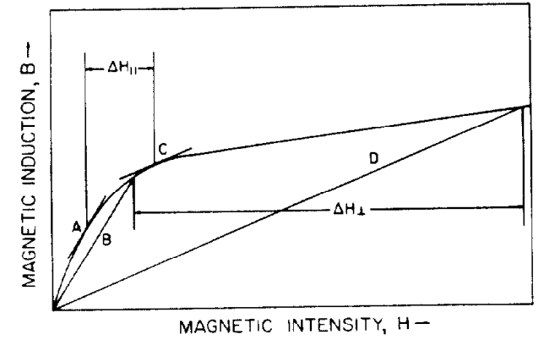
Tunable cavities at higher frequencies
From: Smythe, IEEE, TNS [3]
Parallel bias
(= H_{mag,bias} is parallel H_{RF})
Perpendicular bias
(= H_{mag,bias} is perpendicular H_{RF})
Garnets are ferrites with a magnetic field-dependent relative permeability.
Exposed to a (slowly varying) magnetic field, their µ-value covers a certain range until they saturate.
Problems are the garnet outgassing (cannot be in vacuum), the limited Q-value of the the cavity due to material losses and the rather large H-fields needed.

Slide 35



Can that also work on a single-gap cavity?
Perp. bias
Par. bias

Slide 36






Can that also work on a single-gap cavity?
Resonance peaks due to different magnetic bias fields
tuning range

Slide 37


Applying the tuning principle to a single-gap cavity
Coupler to cavity
Support structure

Slide 38
QW-Cavities in low frequency range
E-field
λ/4 resonator
Electric Open
Electric Short
Ceramic gap = electric Open
This side acts like a capacitor, we speak of capacitive loading.
Beam orientation

Slide 39




QW-Cavity at HIE-Isolde (CERN)
Small side-remark for mechanical engineers:
New technology came with unforeseen problems: the inner conductor was made hollow for weight reasons, but then started to vibrate heavily.
Suggested solution: filled with heavy SS-spheres which work as suppressors.
Accelerator for radioactive ion beams of REX-Isolde at CERN.
100 MHz superconducting Nb on Cu structure.
6 MV with Q > 5 x 10⁸
Consisting of 4 cryomodules with 5 cavities each.
Image: A. Roy, APAC 2007, THYMA04
Images: F. Gerigk, CERN

Slide 40

Exotic TEM-Cavity (Spoke Cavity)
Spoke cavities are made of 1…n combined
λ/2 –wave TEM cavities.
Typically, they have 1…3 spokes and are superconducting.
Used for lower to medium beta.
Reference: E. Zaplatin et al: “Triple Spoke Cavities at FZJ” EPAC 2004
Image: F. Gerigk, RF CAS Berlin 2024.

Slide 41
End of Part 1!

Slide 42

From Waveguide to Cavity…
Just apply Maxwell’s Equations*…
... superpose a forward and backward travelling wave to get a standing wave…
… terminate a waveguide with two conducting walls…
… use a waveguide for acceleration
… cut the inner conductor of a coaxial line…

Slide 43
RF components:
Waveguide and Cavity

Slide 44


Waveguides
Circular waveguide
Arbitrarly shaped
cross-section waveguide
Rectangular waveguide
Source: Zhang, Electromagnetic Theory for Microwaves and Optoelectronics, 2nd ed., Springer
Waveguides are hollow metallic tubes with uniform cross-sections of different shapes.
The metallic waveguide is a completely enclosed system without any radiation loss.
Waveguides present a one-conductor system, so no TEM-mode propagation is possible.
Propagation happens in TE-mode (Transverse-Electric) and TM-mode (Transverse-Magnetic).
Waves are following the waveguide shape, even if it is bend.
Propagating waves need to fulfill boundary conditions on the waveguide walls.
Images: www.pasternak.com

Slide 45
Cavity resonators
Microwave resonators can be built from waveguides by closing the open ends.
We can build an RF-resonator or a cavity.
Source: Zhang, Electromagnetic Theory for Microwaves and Optoelectronics, 2nd ed., Springer
A cavity stores electric and magnetic energy inside the hollow body.
The frequency of the electromagnetic field resonance depends on the cavity dimensions.
Same as with the rectangular and the circular waveguide, the electromagnetic field needs to fulfil the boundary conditions on the resonator walls. The field builds up in resonant modes.
Cavities that are used for the acceleration of particles in our accelerators are mostly of a cylindrical and flat shape. This is why we call them pillbox cavities.
We will later see how resonances can be excited in cavities by feeding RF-signal in, and how such a cavity can be used in accelerators for particle acceleration.

Slide 46

Cavity Resonators and Q-value (1/2)
Resonators are classified by their quality factor Q.
The quality factor (or Q-value) can be used as a measure of “how well the cavity is resonating”.
define
= unloaded Q
High Q-value is desired in accelerating cavities; Q-value is one of the accelerator efficiency figures-of-merit.
Q-value reduces e.g. due to the power dissipated in the metallic walls or other loss mechanisms.
The connection of the cavity resonator to the outer world will reduce its Q-value as well
(we say “it loads” the cavity with an additional loss mechanism).

Slide 47


Cavity Resonators and Q-value (2/2)
Example: measurements taken on the PS 80MHz pillbox cavity
We tested this cavity for Q-deterioration and shifting of its fundamental mode (~80 MHz).
Q-values obtained from 3-dB-measurement (see dashed red lines).
→ Plot on the top has a higher Q-value than the plot below.

Slide 48


Rectangular Waveguides (1/4)
z
TE-modes
b
a > b
x
y
TE-modes are characterized by a zero electric field in propagation direction. The electric field is in the transverse plane, only.
a
Source: Zhang, Electromagnetic Theory for Microwaves and Optoelectronics, 2nd ed., Springer
Each mode has a cut-off frequency:
TE₁₀-mode is the mode with the lowest cut-off frequency:
The mode with the lowest cut-off frequency is called the dominant mode.
Note that if n=m=0, all field components become zero, there is no TE₀₀ mode.
A waveguide is called overmoded, if more than one mode is propagating in the waveguide at the same time.

Slide 49


Rectangular Waveguides (2/4)
z
TM-modes
b
a > b
x
y
TM-modes are characterized by a zero magnetic field in propagation direction. The magnetic field is in the transverse plane, only.
a
Source: Zhang, Electromagnetic Theory for Microwaves and Optoelectronics, 2nd ed., Springer
Also in this case, each mode has a cut-off frequency (identical to TE):
TM₁₁ has as cut-off frequency:
There is no TM₀₀-mode, neither do TM₀₁ or TM₁₀ exist. For n=m=0, all field components become zero.
Note that TE₁₀-mode remains the dominant mode, it is the mode with the lowest cut-off frequency.

Slide 50

Rectangular Waveguides (3/4)
Field pattern for TE₀₁-mode
z
What do we actually see?
View from front
(x/y-plane)
x
y
Side view narrow
(y/z-plane)
o E-field ---H-field
Side view broad
(x/z-plane)
Wall currents and displacement
currents inside the waveguide.
source: Zinke/Brunswig, Hochfrequenztechnik, 5th ed., Springer

Slide 51




Rectangular Waveguides (4/4)
Fundamental and higher waveguide modes and field patterns for TE-modes
TE₁₀-mode
TE₁₁-mode
TE₂₁-mode
Simulaton pictures: courtesy E. Jensen, field pattern source: Pozar, Microwave engineering, 4th ed., Wiley

Slide 52


Dispersion (1/3)
Dispersion generally denotes frequency dependent behaviour.
Best known example is dispersive media, changing its characteristics as a function of frequency.
magnetic loss tangent, frequency dependent as well
Transmission lines and waveguides also show dispersive behaviour.
Except: coaxial line!
Source: Ferroxcube Data Handbook

Slide 53
Dispersion (2/3)
If phase velocity and attenuation of a transmission line or wave guide are constants that do not change with frequency, THEN the phase of a signal that contains more than one frequency will not be distorted (= no dispersion).
If the phase velocity is different for different frequencies, THEN the line is dispersive.
This means that individual components of a wave will not maintain their original phase relationship when they propagate.
We will experience a signal distortion if the signal contains more than one frequency.
Dispersion = no single phase velocity can be attributed to the signal as a whole.
Different v_{p} means that some signal components travel faster than others.
If dispersion is small, a group velocity can be defined: v_{g}.
Group velocity = speed at which a signal propagates and at which power is transported.

Slide 54

Dispersion (3/3)
Comparison of Transmission lines and waveguides
Source: Pozar, Microwave engineering, 4th ed., Wiley

Slide 55








Dispersion Diagram for Waveguides
general dispersion relation
dispersion relation
of waveguide
Tangent at point on the dispersion curve
Source: Zhang, Electromagnetic Theory for Microwaves and Optoelectronics, Springer
v_{g} is zero at cut-off frequency
v_{g} is smaller than c₀
v_{p} can be larger than c₀
From origin to point on the dispersion curve
β is propagation constant (!)

Slide 56
Rectangular Cavity Resonators (1/3)
From the field pattern of the TE10-mode in the rectangular waveguide → imagine that the resonant field in a rectangular resonator will build up in a similar way.
y
z
E-field
x
Waveguide TE₁₀-mode
The field is building up in a standing wave pattern, using sine and cosine functions.
From the boundary condition on the resonator wall, the electric field has to be zero, thus we can see multiples of electric field maxima.
The mode indices are counting the maxima of the field along one axis (we see either a TE_{xyz} or a TM_{xyz}- mode).
The mode shown is a TE₁₀₁-mode.
Source: Pozar, Microwave engineering, 4th ed., Wiley

Slide 57




Rectangular Cavity Resonators (2/3)
Formulae for a rectangular resonator:
Source: Pozar, Microwave Engineering, 4th ed., Wiley
resonant wavelength:
Resonant frequencies for TE_{mnl}-mode and TM_{nml}-modes:
Q-value for TE₁₀₁:
c
c
Electric field variation
for TE₁₀₁ and TE₁₀₂ modes
(counting the number of “zeros” along the length)
TE₁₀₁-mode is the lowest resonant mode, hence the dominant mode in this resonator.

Slide 58


Rectangular Cavity Resonators (3/3)
y
For the case a=c, the formulae simplifies strongly.
z
E-field
x
resonant wavelength:
Q-value for TE₁₀₁:
b
a
c
If you had to use this resonator, where would you connect the vacuum pipe?

Slide 59





Circular (round) Waveguides (1/4)
Like all transmission lines, also the circular waveguide is characterized by a propagation constant, an attenuation constant and a characteristic impedance.
These quantities are derived by field theory analysis.
Propagation is usually assumed in z-direction.
R
z
Source: Pozar, Microwave Engineering, 4th ed., Wiley
= 1st root of Bessel function of first type
= 2nd root of Bessel function of first type
= 1st root of derivative of Bessel function of first type
Notes:
In 1897, the physicist John William Strutt, better known as Lord Rayleigh gave the mathematical proof that wave propagation in waveguides must be possible. This was a novum as until then, people believed that two conductors would be necessary for the transfer of electromagnetic energy. Rayleigh also gave the theory of the TE- and TM-mode patterns and the cut-off frequency, he was, however, not able to provide experimental proof at the time. The waveguide was then essentially forgotten again until the 1930s.

Slide 60





Circular (round) Waveguides (2/4)
z
R
For a perfect conducting tube (no resistive attenuation) with radius R, we obtain propagation constants
for the TE-mode and the TM-mode:
→ Roots of the Bessel-function for TM-mode
→ Roots of the derivative of the B.F. for TE-mode
This leads to the cut-off frequencies for the different modes:
Notes:
In 1897, the physicist John William Strutt, better known as Lord Rayleigh gave the mathematical proof that wave propagation in waveguides must be possible. This was a novum as until then, people believed that two conductors would be necessary for the transfer of electromagnetic energy. Rayleigh also gave the theory of the TE- and TM-mode patterns and the cut-off frequency, he was, however, not able to provide experimental proof at the time. The waveguide was then essentially forgotten again until the 1930s.

Slide 61





Circular (round) Waveguides (3/4)
Waveguide modes and field patterns
1st mode is TE₁₁. Electric field is transverse.
Mode has 2 polarisations (orientations of the electrical field).
2nd mode is TM₀₁. Magnetic field is transverse.
Simulaton pictures: courtesy E. Jensen, source pictures and chart: Pozar, Microwave engineering, 4th ed., Wiley

Slide 62



Circular (round) Waveguides (4/4)
Waveguide modes and field patterns
3rd mode is TE₂₁.
Electric field is transverse
4th mode is TM₁₁. Magnetic field is transverse.
Next higher modes? Not important right now…
6th mode is TE₃₁.
Electric field is transverse.
Further field plots can e.g. be found here: Lee, Lee and Chuang, Plot of Modal Field Distribution in Rectangular and Circular Waveguides. IEEE, Trans. Microwave Theory and Techniques, Vol. MTT-33, no. 3, March 1985
Simulaton pictures: courtesy E. Jensen, source pictures and chart: Pozar, Microwave engineering, 4th ed., Wiley

Slide 63

Pillbox Cavity Resonator (1/4)
We obtain a cylindrical cavity resonator by shortening the circular waveguide at both ends.
z
→ TE₁₁₁-mode is the dominant TE-mode for a cylindrical cavity.
TM₀₁₀-mode is the dominant TM-mode for a cylindrical cavity.
TM₀₁₀-mode mode is used for acceleration as it has a large electric field along the z-axis.
E_{z}
-B_{θ}
FINE. What’s the problem?

Slide 64

Pillbox Cavity Resonator (2/4)
The problem is the mode chart.
Mode chart is a resonant chart for a general cylindrical cavity that shows the excited modes as a function of cavity dimensions.
1st TE-mode is TE_{111 (useless for acceleration)}
1st TM-mode is TM₀₁₀,
and shows up as first mode for ratios (2R/h)² > 1
(2Rf)²
The cavity needs to be flat to provide
the accelerating mode.
E_{z}
(2R/h)²
h
R
Source: Pozar, Microwave engineering, 4th ed., Wiley

Slide 65



Pillbox Cavity Resonator (3/4)
E_{z}
Pillbox cavity is flat compared to a “long” cylindrical cavity.
If the cavity is of a pillbox shape, all is easy!
E_{z}
Mode used for acceleration is TM010.
Resonant frequencies for TE_{nml}-mode:
Resonant frequency for TM_{nml}-modes:
h
a
Roots of B.F.
Note that the TM₀₁₀- mode is independent of the cavity height h
(until the TE₁₁₁ mode shows up, roughly at 2a/h=1).

Slide 66








Pillbox Cavity Resonators (4/4)
E_{z}
TM₀₁₀
For the case of the TM₀₁₀-mode, when we have no dependence on cavity height, we can use simpler formulae for the wavelength:
E_{z}
h
And we can use the Q-calculation (equally simplified!):
a
Skindepth:
Accelerator-figure-of-Merit:
For small arguments of Sinus-function
Source: Pozar, Microwave Engineering, 4th ed., Wiley

Slide 67



Example “true” Pillbox Cavity
Electric field, TM₀₁₀-mode
Magnetic field, TM₀₁₀-mode
E. Jensen
Cavity from DORIS Storage ring (1970-ish, very early electron/positron collider)
Accelerating Cavity, freq = 80 MHz
(CERN PS)

Slide 68



Pillbox Cavity Design Feature
In practice, a “pure” pillbox cavity is not very efficient for acceleration.
A simple shape modification can be done by using so-called “nose cones”.
Nose cone is a protrusion on the cavity wall that causes a concentration of the electrical field in the gap.
Source: Puglisi,
RF-CAS 92, CERN
Enhancement of E-field
Nose cones also help to improve the Transit-time factor…
Source: Puglisi,
RF-CAS 92, CERN
Inside PS 80 MHz cavity

Slide 69



Transit Time Factor (1/2)
accelerating gap
transit-time factor:
particle with velocity v
energy gained in time-varying RF-field
T =
energy gained in a DC field of voltage V₀
Particle in the harmonic time-varying field will see less energy gain compared to a constant DC field.
This is called transit-time effect and is described by a factor T (transit-time factor).
Distance the particle travelled in one RF-period; β=v/c

Slide 70

Transit Time Factor (2/2)
gap length
Transit time factor
= constant
(as it is for an ideal pillbox cavity!)
To achieve max. energy gain from this formulae, we want that T = 1 → g = 0
Leads to design request: gap as small as possible.
But other considerations as: risk of RF electric breakdown also impact on optimum gap geometry.
Note that it is assumed that the particle does not change velocity along the gap length.

Slide 71

Limits to maximum gradient
Surface electric field in vacuum
1000
E. Jensen
500
Wang & Loew,
SLAC-PUB-7684, 1997
200
100
E_{crit} [MV/m]
50
Kilpatrick 1957,
f in GHz, E_{crit} in MV/m
20
10
0.01
0.1
1
10
100
f [GHz]
…
High frequencies preferred for large gradient.
Today also other criteria are used, e.g. considering local field quantity,
see: Grudiev et al., PRAB #102001 , 2009

Slide 72




Accelerator efficiency figures-of-merit (1/2)
Several figures-of-merit are commonly used to characterize accelerating cavities:
energy stored in the resonator
Q-value
unloaded Q₀ - measure of the resonance quality
energy dissipated in the resonator
Shunt impedance [MΩ]
measure of effectiveness to produce an
axial voltage V₀
Design goal is a high shunt impedance
Effective Shunt impedance [MΩ/m]
Measure of effectiveness per unit power loss to deliver energy to a particle
“R-over-Q” [Ω]
Measure of cavity acceleration efficiency
at a given frequency – geometry dependent only!

Slide 73
Accelerator efficiency figures-of-merit (2/2)
Typical values for different cavities:
Cavity type | R/Q | Q₀ | R
Ferrite loaded cavity (low frequency, rapid cycling) | 4 kΩ | 50 | 200 kΩ
Room temperature copper cavity (type 1 with nose cone) | 192 Ω | 30 * 10³ | 5.75 MΩ
Superconducting cavity (type 2 with large iris) | 50 Ω | 1 * 10¹⁰ | 500 GΩ

Slide 74







Cavity equivalent circuit (1/4)
At frequency near resonance, the cavity resonator can be modeled by a lumped-element circuit.
For a cavity with the desired high shunt impedance, only a parallel resonant circuit is suited
→ require to model a large voltage.
V
R
C
L
power to the resonator
circuit
input impedance
lossy resistor
lossless resonator
Power dissipated in the resistor:
Energy stored in capacitor:
Energy stored in inductor:

Slide 75




Cavity equivalent circuit (2/4)
At frequency near resonance, the cavity resonator can be modeled by a lumped-element circuit.
For a cavity with the desired high shunt impedance, only a parallel resonant circuit is suited
→ require to model a large voltage.
resonance case is:
V
R
C
L
power to the resonator
circuit
Power dissipated in the resistor:
☺
trivial!

Slide 76


Cavity equivalent circuit (3/4)
At frequency near resonance, the cavity resonator can be modeled by a lumped-element circuit.
resonance frequency
unloaded Q
R in equivalent circuit == shunt impedance in cavity
C and L in equivalent circuit == resonance mechanism
V
R
C
L

Slide 77

Cavity equivalent circuit (4/4) – Cavity loading
Connecting the cavity to the outer world…
resonance frequency
parallel capacitance and inductance
unloaded Q
Z_{shunt} ⇨
ideal transformer
Generator impedance
(generally complex due to matching requirement)
Z_{g}
R
C
L
So-called: Cavity loading (inductive in this case)
⇦ Z_{i}
coupling loop
to generator (RF amplifier)
Beam is usually modelled as a current source and sees a (generally complex) Z_{shunt}.
Via the transformer, the coupling to the cavity can be adjusted to “matching”.
In practice, we would rotate our coupling loop to modify the coupling strength.

Slide 78




What about this R/Q-criteria?
Charged particle experiences cavity gap as capacitor
Design goal: to reduce beam loading, aim for cavity geometry with small R/Q
Cavity
Beam induced voltage
q

Slide 79


Example: 400 MHz cavities in LHC
Very high beam currents, need to reduce beam loading in RF cavities
Shunt impedance R, is high but small R/Q is needed
→ Could be achieved with superconducting cavities in LHC
Bell shape: R/Q ~ 44 Ω, 400 MHz
2×8 cavities, 5.3 MV/m
~o

Slide 80
Principles of coupling power
into a cavity

Slide 81


Coupling power into a cavity
Attach inductivity or capacitance of resonator, or combined
Coupling loop forms transformer with resonator inductivity
L
R
C
RF power
L_{c}
M
Main coupler
PSI cyclotron
~1 MW at 50 MHz
By far the most common method, allows also to adopt the matching.
L. Stigelin

Slide 82

Coupling power into a cavity
Attach inductivity or capacitance of resonator, or combined
Capacitive divider to gap to
transform generator impedance
to cavity shunt impedance
Advantage: allows to DC isolate the
coupler (if required by amplifier).
Disadvantage: coupling is fixed.
Beam also couples
capacitively via the gap
L
R
C
C_{c}
Beam
RF power
Coupler of CERN PS 40 MHz
Coupler forms one half of capacitor with the gap

Slide 83


Capacitive (electric) coupling
Coupling through an electric antenna
Electrical coupler to space
Power coupler of LHC cavities
300 kW at 400 MHz
https://en.wikipedia.org/wiki/Transmitter_Solt
2 MW at 540 kHz
Used to transmit radio broadcast in Hungarian language around the world.
*claims to have reached Michigan…
Coupler antenna transmits directly into the cavity

Slide 84
End of part 2

Slide 85
Travelling wave cavities
(Extra!)

Slide 86


Travelling vs. Standing wave
Just because we have a multi-cell structure, this does not mean that we are having a travelling wave cavity!
travelling wave
standing wave

Slide 87
Disc-loaded circular waveguide (1/2)
Disc-loaded waveguide is a circular metallic waveguide with periodically added metallic discs and holes for particle passage and for coupling of the cells.
We speak of a coupled-cavity chain structure.
EM-fields need to fulfill boundary conditions on the metallic discs.
Disc-loaded waveguide can operate in travelling-wave as slow wave structure or in standing-wave mode.
In standing wave mode, the cells present a “concatenation” of TM₀₁₀-mode “pillbox”-type cavities.

Slide 88
Disc-loaded circular waveguide (2/2)
Source: Kramer, Studies of HOM-couplers for the Upgrades Travelling Wave Acceleration System in the CERN SPS, PhD, CERN-THESIS-2019-371
Different coupling mechanisms between the individual cells exits, either on the side or in the center.
We speak of iris-coupled-structure and slot-coupled-structure.
For slot-coupled-structures, the center opening for the beam can be very small and is often ignored in the EM-calculations.
Example: 0-mode structure in standing wave (SW) … can be derived from pillbox TM₀₁₀-mode.

Slide 89





Example of Pi-mode Cavities (SW, 2/3)
How does this look in reality?
Slot-coupled-structure (PIMS)
at CERN
Drift tube structure, CERN
Picture of Linac1, CERN
Note that a ‘cell’ is not necessarily a pillbox-type shape. In drift tube structures, a cell is the area between two drifttubes and looks in principle like a pillbox with nose cones.
sources: P. Bourquin et al., Development Status of the Pi-mode Accelerating Structure (PIMS) for LINAC4, Proc. Of LINAC08, Canada.
C. Plostinar (ed.), Comparative Assessment of HIPPI Normal Conducting Structures, CARE-report-2002-0771

Slide 90


Example of Pi-mode Cavities (SW, 3/3)
Slot-coupled-structure (PIMS) at CERN
PIMS cell
PIMS test set-up
Completed LINAC4, CERN
Picture sources: CERN cds
R. Wegner et al., Linac4 PIMS Construction and First Operation, IPAC2017, Copenhagen.
P. Bourquin et al., Development Status of the Pi-mode Accelerating Structure (PIMS) for LINAC4, Proc. Of LINAC08, Canada

Slide 91


Slow wave structure (1/7)
source: G. Dome, RF Systems: Waveguides and Cavities, aip-conf-proc.153-1296
Slow wave structures work in the range of v_{p}< c₀.
The addition of discs inside the cylindrical waveguide induces multiple reflections between the discs and results in a change of the dispersion curve.
The disc-loaded structure can then be used in travelling wave mode.
The dispersion curve changes from continuous to splitting up into different modes which are slowed down. We speak of pass-bands. These modes are separated by stopbands.

Slide 92

Slow wave structure (2/7)
Dispersion Curves, phase- and group velocity for FW and BW wave in periodic structure.
Forward wave (FW)
v_{g} and v_{p} point in the same direction.
Backward wave (BW)
v_{g} and v_{p} point in the opposite direction.
For the advanced RF-fans:
1. All guided modes in common transmission lines, metallic and dielectric waveguides are forward waves.
2. For transmission lines of “high-pass filter” type, the phase constant β decreases with increasing frequency.
3. “High-pass filter” type lines are modelled with a distributed series capacitance and a shunt inductance
(i.e., opposite of what we did in the transmission line modelling!).
4. Forward and backward type of waves – this makes no difference for the direction of the beam.
Source: Zhang, Electromagnetic Theory for Microwaves and Optoelectronics, Springer

Slide 93

Slow wave structure (3/7)
Dispersion diagram of periodic structure (uniform waveguide is shown for orientation)
Dispersion diagram shows the periodicity of the structure.
For a given mode, there is a limited pass band of possible frequencies.
The passbands are separated by
stopbands where the specific
mode cannot propagate.
At both ends of the passband, the group velocity is zero and wave propagation stops.
source: M. Weiss, Introduction to RF Linear Accelerators.
When group velocity and phase velocity are in the same direction, we speak about forward waves, if they are in different direction, we speak about backward waves. This has nothing to do with the direction of the particle travelling.

Slide 94

Slow wave structure (4/7)
The request to fulfill the periodic boundary conditions leads to the concept of space harmonics (instead of wave modes).
Space harmonics are closely connected the so-called Floquet Theorem (we will not cover this here).
The Floquet Theorem describes the relation between the phase constant of the n-th space harmonic and is a fundamental theorem of periodic structures.
Source: Zhang, Electromagnetic Theory for Microwaves and Optoelectronics, Springer

Slide 95


Slow wave structure (5/7)
As was shown before, drift tubes can be used instead of separating discs to slow down the EM-field. The theory for drift tubes is very similar to calculating a slot-coupled structure. Just imagine that the slot is very large.
Inside view of the SPS travelling wave structure © CERN.
In travelling wave (TW) mode, the field propagates through each cell.
The phase advance per cell (distance between the discs, or periodic spacing of drift tubes) determines the length of the cell:
Remember? was already introduced for the single gap cavity as distance that a particle travels during one RF-period.

Slide 96

Slow wave structure (6/7)
The only missing component for our travelling wave system are the input and output couplers.
These have to be matching the structure to avoid that standing waves are building up inside the periodic structure.
Often, higher order modes (HOMs) are building up in the structure due to the finite length
(end covers are put there).
Note that a matching network is used to obtain the travelling state. This network is only matching the fundamental mode and not the HOMs!
I.e. the fundamental mode is travelling, others might be travelling, partially travelling or standing modes.

Slide 97

Slow wave structure (7/7)
SPS 200 MHz travelling wave cavity (16m long).
Backward wave structure
Water cooled coaxial load
RF OUT side
RF IN side
Drift tube
with water cooling
beam direction
© CERN

Slide 98




Example: 200 MHz TWC of SPS (1/3)
courtesy: E. Montesinos, CERN
Cavity is part of the LHC injector chain and was upgraded recently and equipped with new power amplifiers to reach a higher accelerating voltage.
The cavity was entirely modelled in CST, so that we could well see the fields of the fundamental and the HOMs.
Modelling in CST
(P. Kramer, CERN)
Single cell CST model with symmetries
(no HOM coupler)
Electric field of fundamental mode in the
Cross-section
Surface currents on the
Drift tube
E-field in a cell with HOM-coupler (22π/33 mode)

Slide 99


200 MHz TWC of SPS (2/3)
courtesy: E. Montesinos, CERN
Single cell CST model with symmetries
(no HOM coupler)
Electric field of fundamental mode in the
Cross-section

Slide 100

200 MHz TWC of SPS (3/3)
courtesy: E. Montesinos, CERN
Cavity is part of the LHC injector chain and was upgraded recently and equipped with new power amplifiers to reach a higher accelerating voltage.
A number of HOMs are developing, mostly as standing wave and these were taken out by HOM-couplers.
Most harmful was the mode at 630 MHz, each section of the cavity has a number of these Hom couplers installed:
Modelling in CST
(P. Kramer, CERN)
Schematic illustration
E-field pick-up probe

Slide 101
630 MHz - HOM Couplers
courtesy: E. Montesinos, CERN

Slide 102
End of the extra part!

Slide 103
Many thanks to
Frank Gerigk, Erk Jensen, Heiko Damerau, Maurizio Vretenar, Manfred Wendt
who all kindly provided material to this presentation!

