Slide 1


Longitudinal
Hands-on Calculations
RF System Design
H. Damerau, L. Intelisano,
F. Tecker, M. Zampetakis
CERN
Introduction to Accelerator Physics
30 September 2024

Slide 2
Agenda of the afternoon
14h50 – 15h20 Introduction to exercises
15h20 – 15h50 RF system design
Coffee break
16h20 – 16h35 Intermediate wrap-up
16h35 – 17h40 RF system design
17h40 – 18h25 Discussion on solutions of exercises

Slide 3
Outline
Introduction
  Interaction between beam and RF system
Design of RF systems
  Design flow and constraints
  Examples of RF systems at CERN
Summary

Slide 4
Introduction

Slide 5
Study interaction between beam and RF
Complementary approaches for the same problem
(Semi-)Analytical | Numerical: tracking
Describe particle motion by differential equations Continuous trajectories of particle motion Deduce useful parameters for stable acceleration: RF bucket Synchrotron frequency Stable phase ... | Track particle parameters from turn to turn Profit from discretization of motion: turn-by-turn No notion of RF bucket, synchrotron, stable phase, etc. Follow ensemble of particles to study evolution of bunch
Classical introduction of longitudinal beam dynamics | Flexible brute-force approach

Slide 6
Study interaction between beam and RF
Complementary approaches for the same problem
(Semi-)Analytical | Numerical: tracking
Describe particle motion by differential equations Continuous trajectories of particle motion Deduce useful parameters for stable acceleration: RF bucket Synchrotron frequency Stable phase ... | Track particle parameters from turn to turn Profit from discretization of motion: turn-by-turn, RF station-by-RF station No notion of RF bucket, synchrotron frequency, stable phase, etc. Follow ensemble of particles to study evolution of bunch
Classical introduction of longitudinal beam dynamics | Flexible brute-force approach

Slide 7
Study interaction between beam and RF
Complementary approaches for the same problem
(Semi-)Analytical | Numerical: tracking
Describe particle motion by differential equations Continuous trajectories of particle motion Deduce useful parameters for stable acceleration: RF bucket Synchrotron frequency Stable phase ... | Track particle parameters from turn to turn Profit from discretization of motion: turn-by-turn, RF station-by-RF station No notion of RF bucket, synchrotron frequency, stable phase, etc. Follow ensemble of particles to study evolution of bunch
Classical introduction of longitudinal beam dynamics | Flexible brute-force approach
Today
Tomorrow afternoon

Slide 8
Objectives of longitudinal hands-on
Design RF system (upgrade)
  LongitudinalHandsOnRFSystemCalculations_empty.ipynb
  Study boundary conditions
  Derive requirements for RF system
  Choose main components
  Compare with existing facilities
Play with longitudinal beam dynamics
  LongitudinalHandsOnTracking_empty.ipynb
  Build your own particle tracker
  Understand motion of particles in
  longitudinal phase space
  Transition from single particle motion to evolution
  of an entire bunch

Slide 9
RF system design

Slide 10
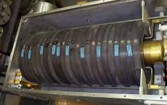
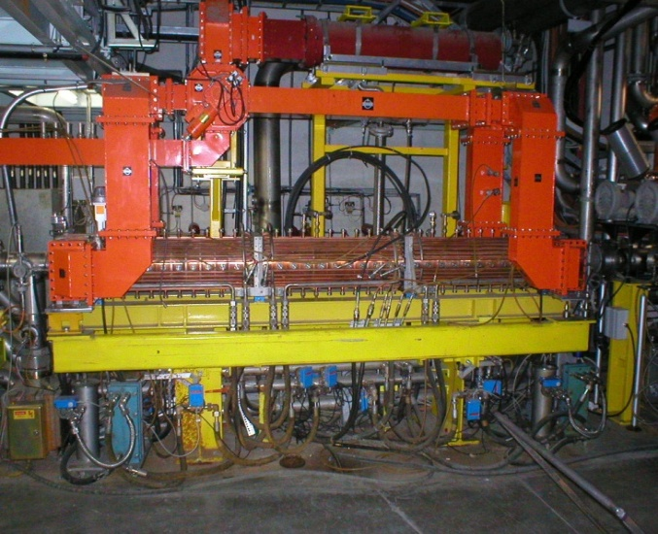
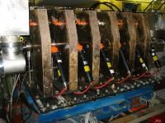
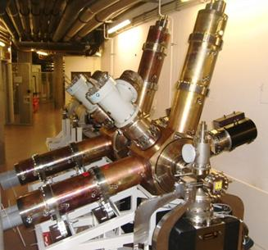
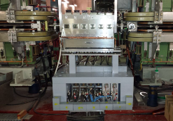
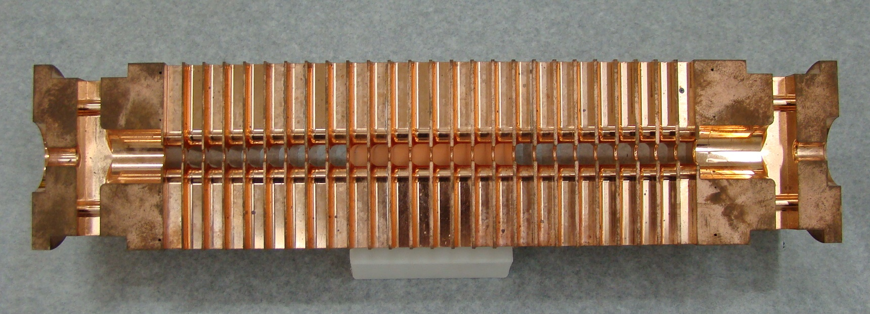
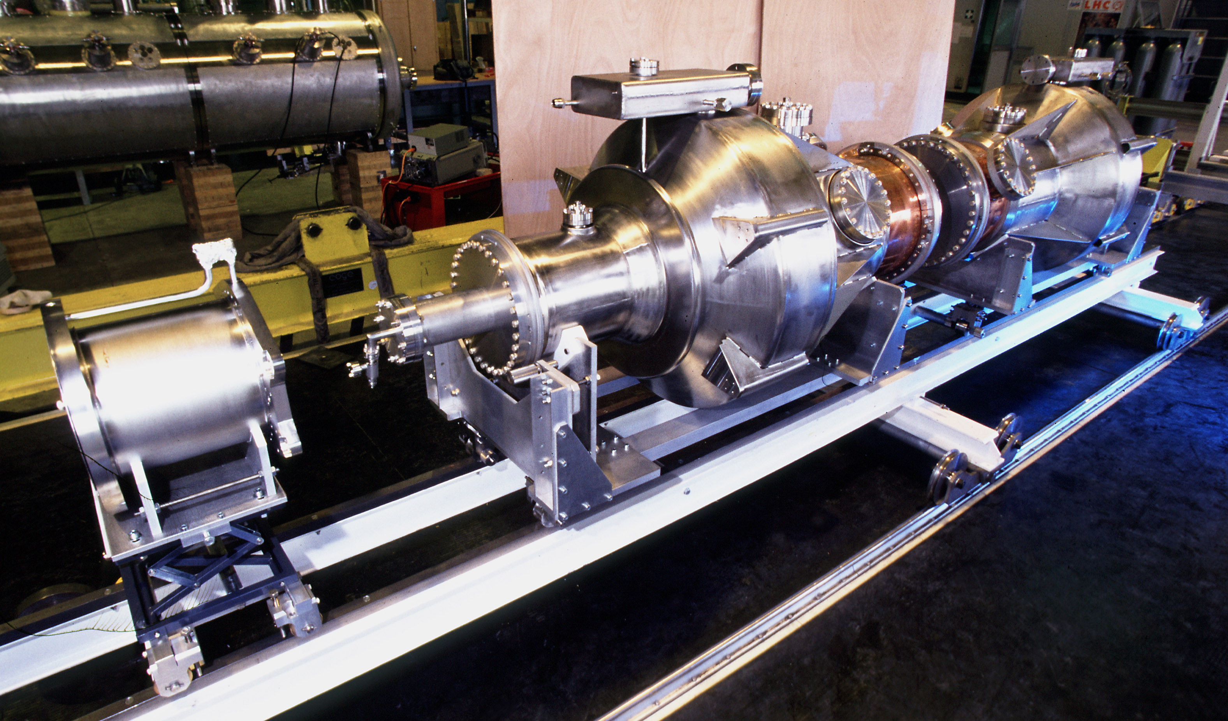

Introduction
What to do to design an RF system?
How to choose the right one?

Slide 11
Simplified design work flow
Accelerator and
beam parameters
Ramp rate limitations
Magnetic cycle, B(t)
  Revolution frequency swing
  Voltage gain per turn during cycle
  Harmonic number, RF frequency range
  Voltage program during the cycle
  Choice of RF system: number of cavities, type, …

Slide 12
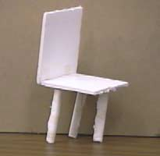

RF parameters of existing accelerators
Try to follow design choices of existing accelerator
  Can we understand the arguments?
  Are the choices reasonable?
Good design?
Accelerators at CERN
Linac2/4 | 50 MeV → 160 MeV
PS Booster | 1.4 GeV/2 GeV
PS | 26 GeV/c
SPS | 450 GeV/c
LHC | 7 TeV
Intensity with 25 ns | 1.3 · 10¹¹ ppb → >2 · 10¹¹ ppb

Slide 13
Proton Synchrotron

Slide 14
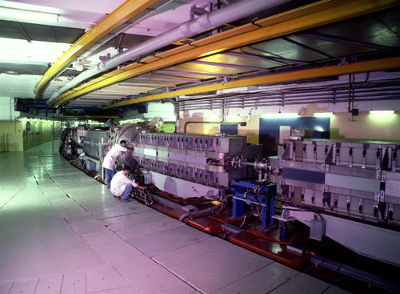
Example: RF System for CERN PS
Attention
  Present RF system designed in ~1969
  Not the same energy range as today
Parameter | Value
Circumference, 2πR | 2π ∙ 100 m = 628 m
Acceleration time, t_{cycle} | 1 s
Maximum ramp rate, dB/dt | 2.3 T/s
Injection energy, E_{kin} | 45 MeV
Flat-top energy, E_{tot} | initially 28 GeV
Revolution frequency at injection, f_{rev,inj} | 143 kHz
at flat-top, f_{rev,FT} | 477 kHz
Relative frequency swing | 3.33

Slide 15
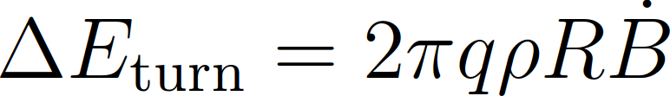
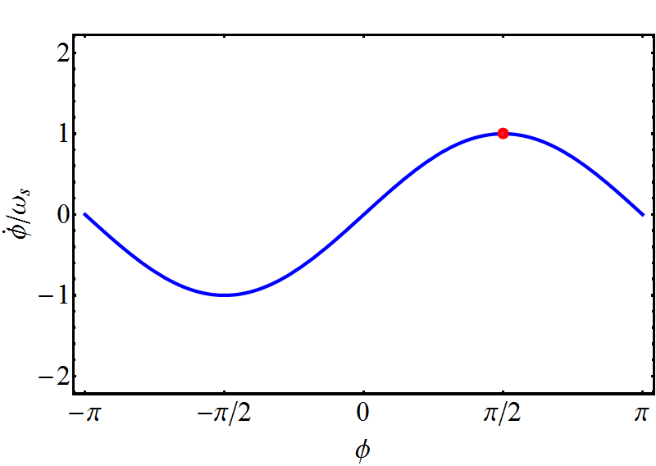
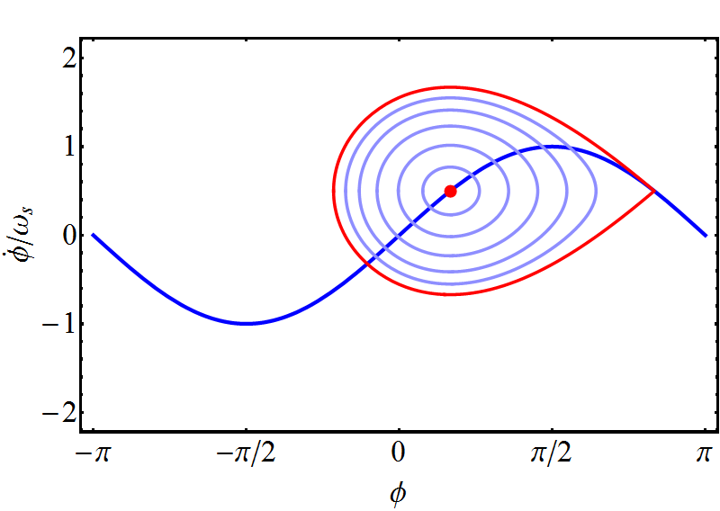
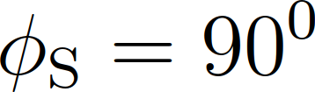
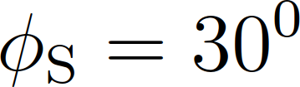
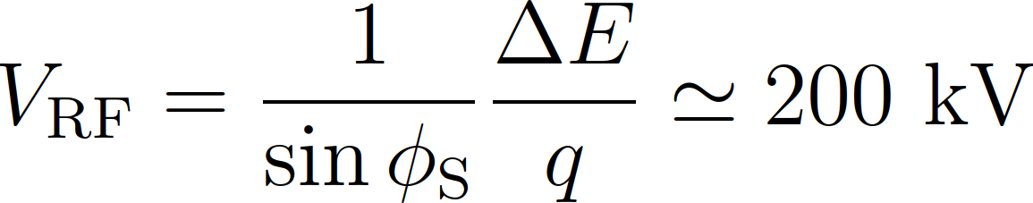
Example: CERN PS - choice of RF voltage
Energy gain per turn defined by size and ramp rate
At 2.3 T/s ramp rate: ~100 keV gain per turn
Just sufficient to accelerate synchronous particle
Over-voltage for bucket area:

Slide 16
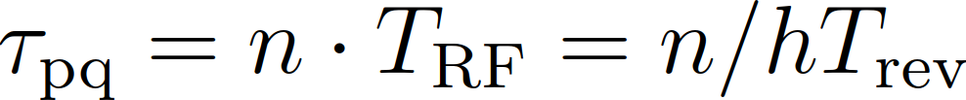
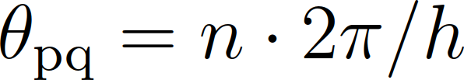
Example: CERN PS - choice of RF harmonic
Operate RF stations in phase with respect to beam
Use common RF signal
2
Time of flight, τ_{nm} between RF cavities:
Multiple of RF period
τ₁₂
1
τ₂₃
θ₁₂
θ₂₃
3
RF
RF stations must be located an multiples of 2π/h

Slide 17
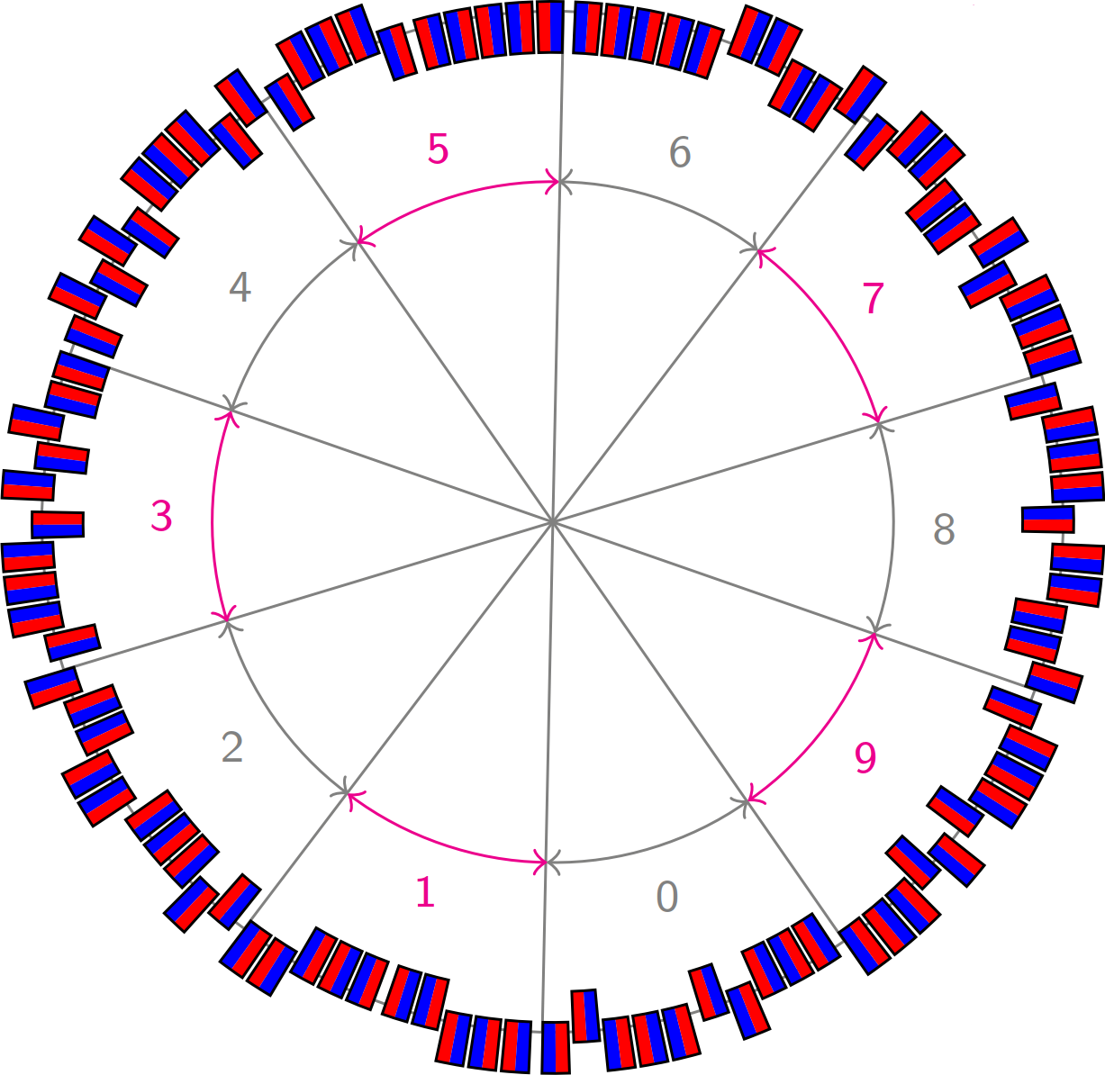
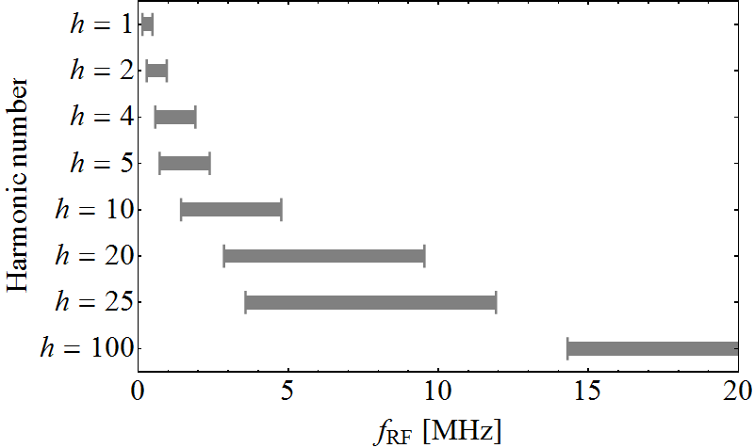
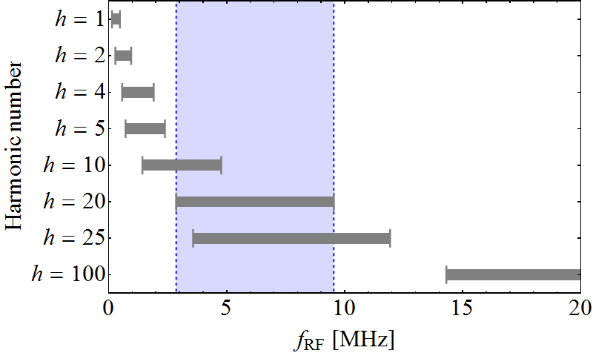
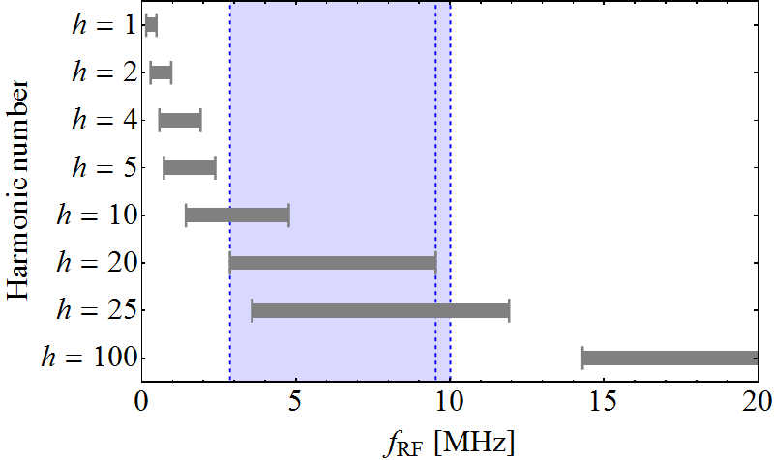
Example: CERN PS - choice of harmonic
Main elements: 100 bending magnets
100 possible location for RF stations in-between
100 = 2 ∙ 2 ∙ 5 ∙ 5, hence divisible by 2, 4, 5, 10, 20, 25, 50
Distribute total RF voltage over many cavities
Possible harmonic numbers 20 or 25
→ h = 20 retained

Slide 18
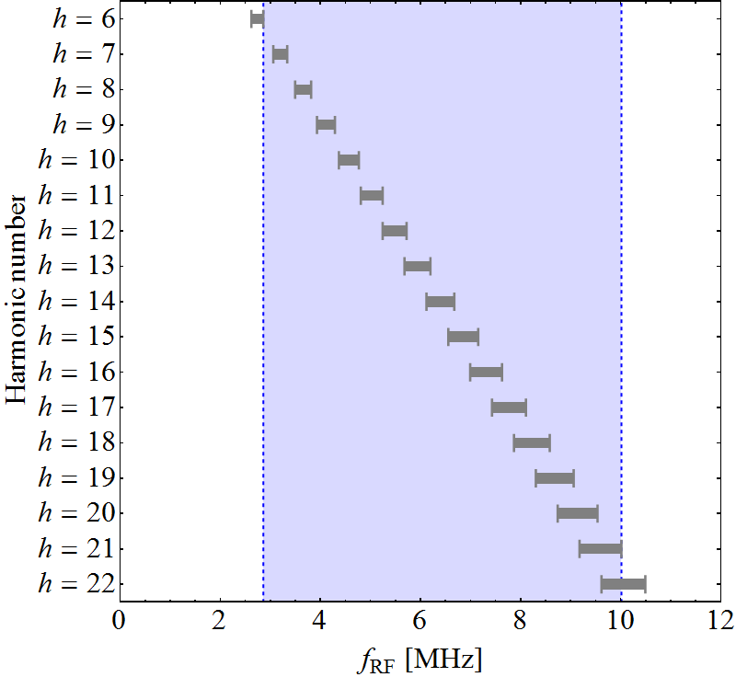
Example: CERN PS choice of harmonic
Distance between RF stations: multiples of 2π/20
No need to use common RF with today’s technology
Injection energy at 2 GeV (1.4 GeV) → 5% (10%) swing
Early design choices based on h = 20
Today’s flexibility

Slide 19
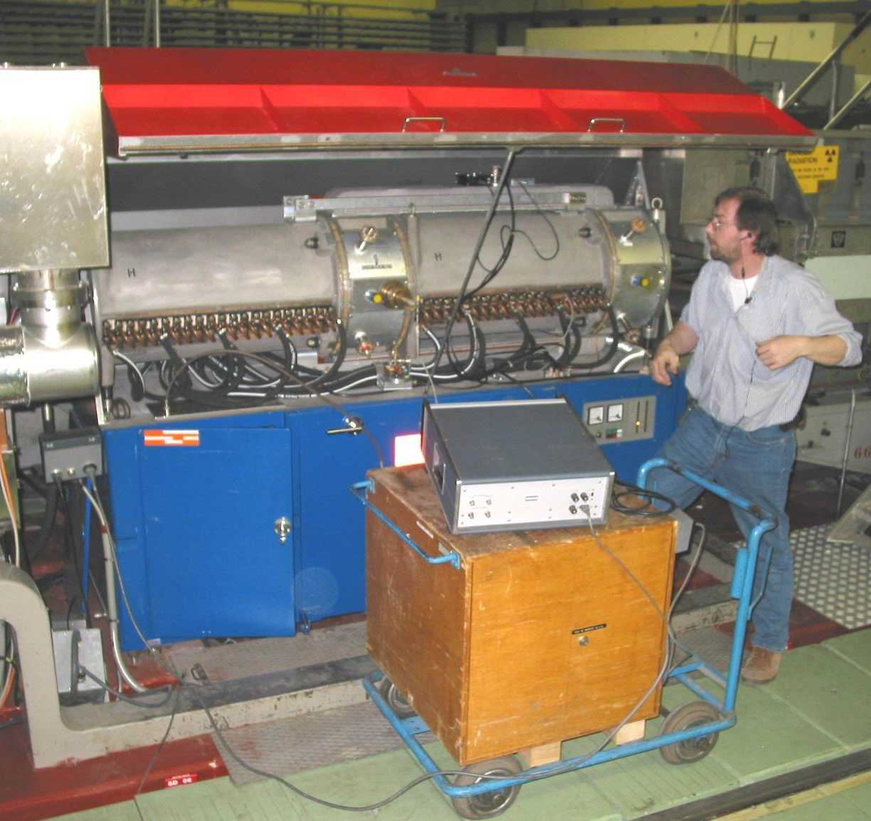
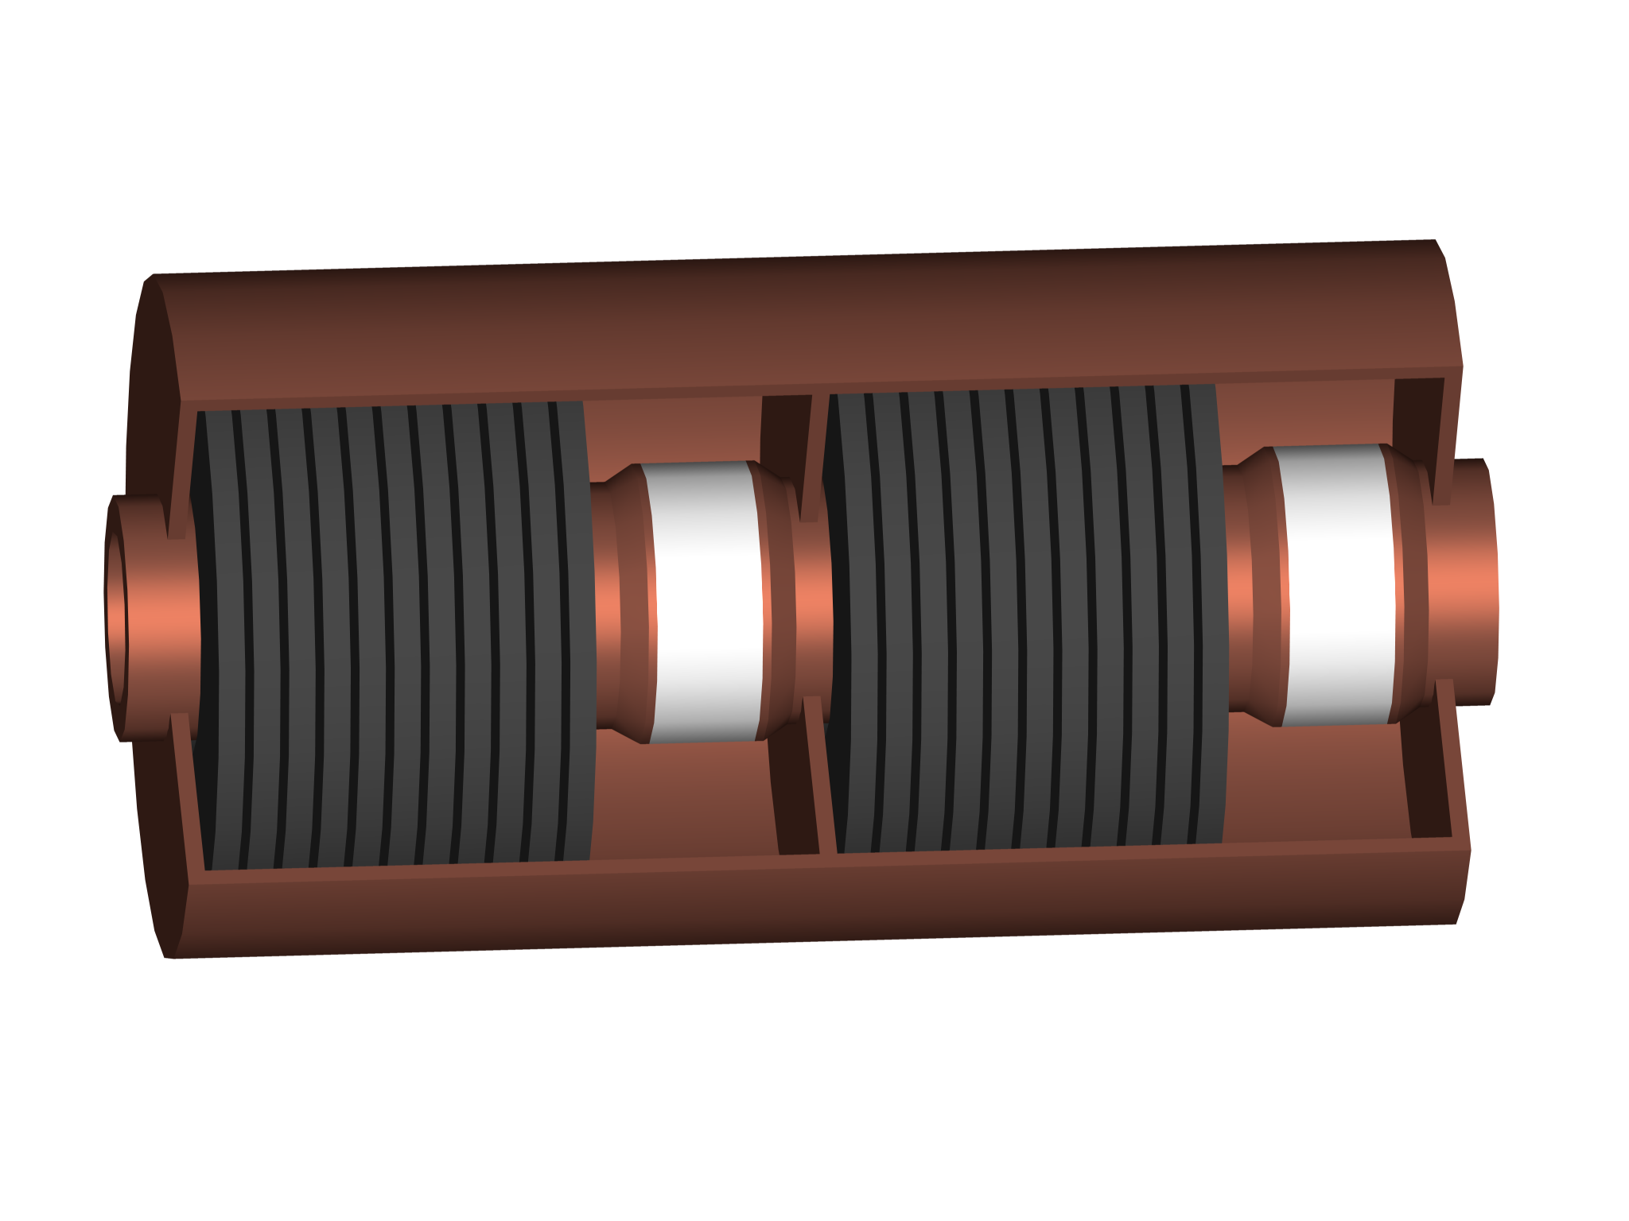
Example: CERN PS choice of cavity
RF system parameters:
Distribute voltage over 10 RF stations: 20 kV/cavity
Parameter
Harmonic, h | 7…, 20, 21
Frequency, f_{RF} | 2.8-10 MHz
Voltage, V_{RF} | 10 (+1) × 20 kV
Shortened λ/4 coaxial resonators with ferrite tuning
10 kV
10 kV
Beam
Beam
Ferrite stacks for shortening and tuning
Accelerating
gaps

Slide 20
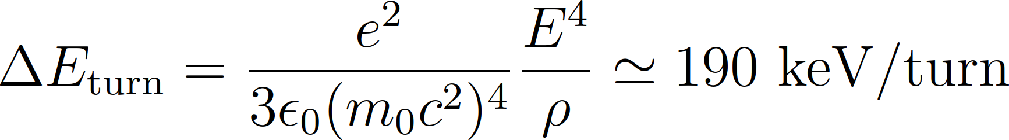
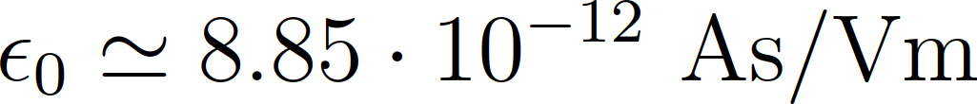
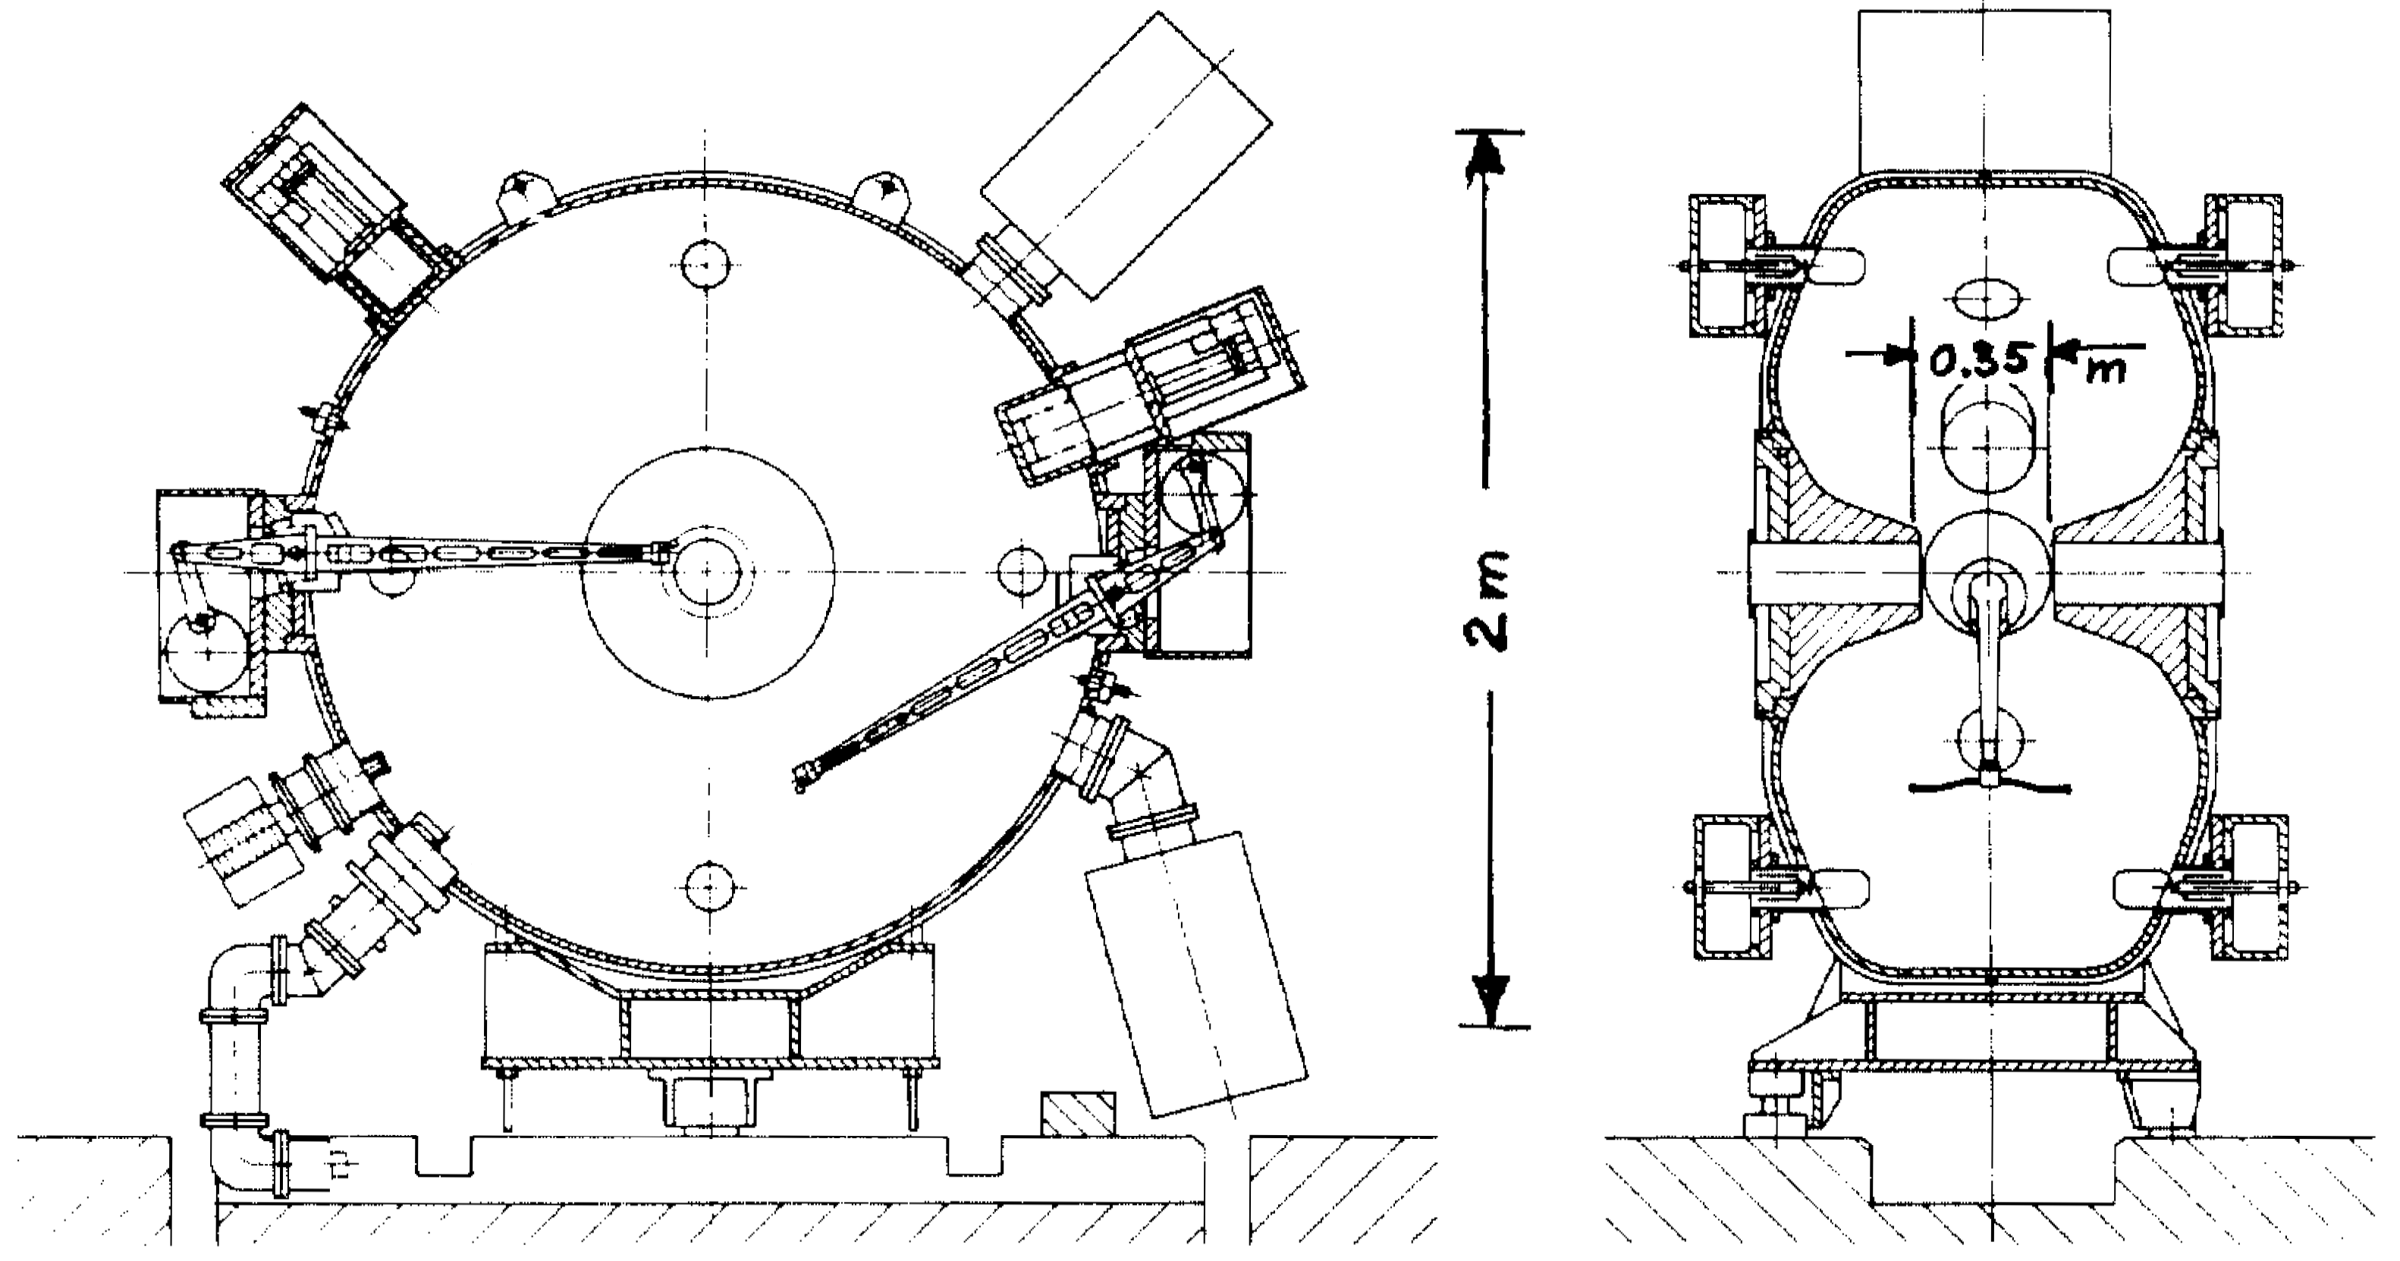
Electrons in the PS
As an injector of LEP electrons were accelerated
in the PS to E = 3.5 GeV
Is the RF system for acceleration of protons usable?
Bucket area too small and bunches too long at 3.5 GeV
Optimized RF system for electron acceleration
Parameter
Harmonic, h | 240
Frequency, f_{RF} | 114 MHz
Voltage, V_{RF} | 1 MV
(5 × more than 10 MHz cavities)

Slide 21
PS Booster

Slide 22
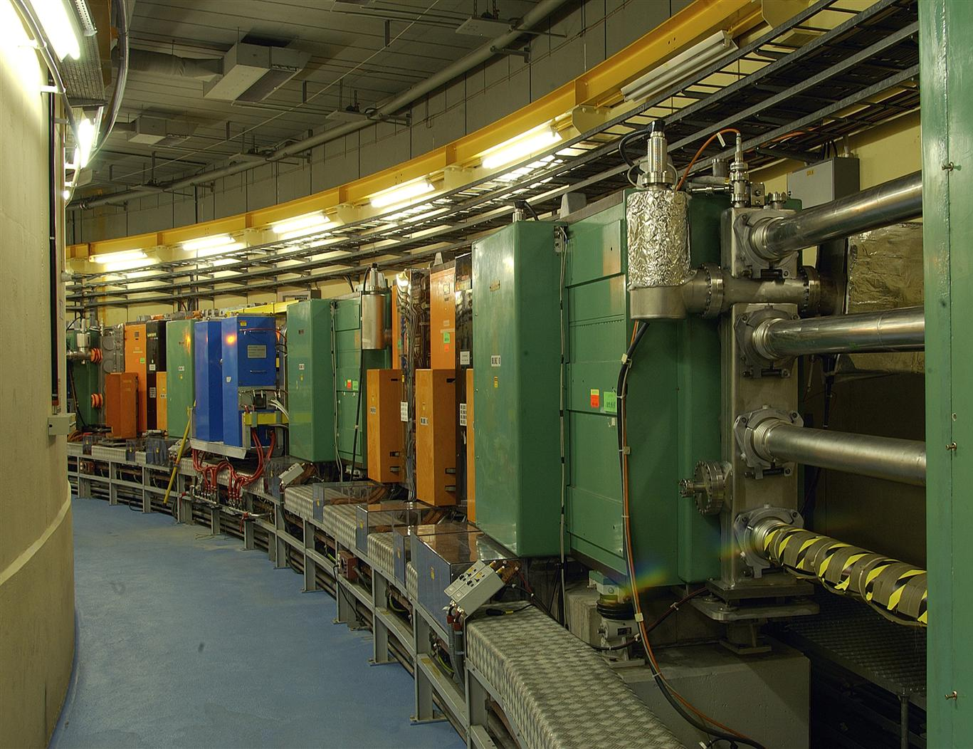
Example: RF System for CERN PS Booster
PS injector synchrotron
  2πR_{PSB} = 2πR_{PS}/4
  Sandwich of 4 rings
  Total length as PS circumference
Parameter | Value
Circumference, 2πR | 2π ∙ 25 m = 157 m
Acceleration time, t_{cycle} | ~0.5 s
Maximum ramp rate, dB/dt | 2.3 T/s
Injection energy, E_{kin} | 50/160 MeV
Flat-top energy, E_{kin} | 0.8/1.0/1.4/2.0 GeV
Revolution frequency at injection, f_{rev,inj} | 0.6/1 MHz
at ejection, f_{rev,ej} | 1.81 MHz
Relative frequency swing | 3

Slide 23
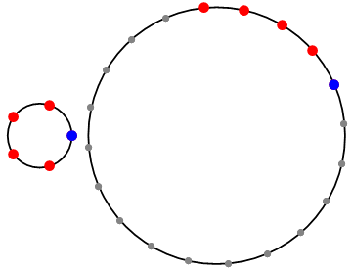
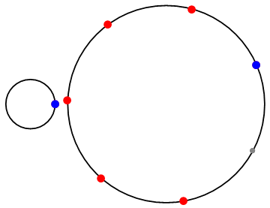
Example: CERN PS Booster (PSB)
Circumference 2πR_{PSB} = 2πR_{PS}/4 = 157 m
Initial design as PS injector
f_{RF,PSB} = f_{RF,PS}
h_{PSB} = h_{PS}/4 = 5
Modifications as pre-
injector to LHC:
Parameter
Harmonic, h | 1 or/and 2
Frequency, f_{RF} | 0.6/1…1.8 MHz
Voltage, V_{RF} | 8…20 kV

Slide 24
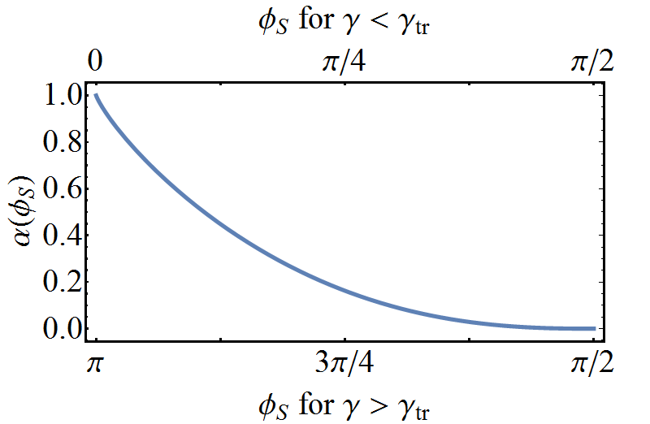
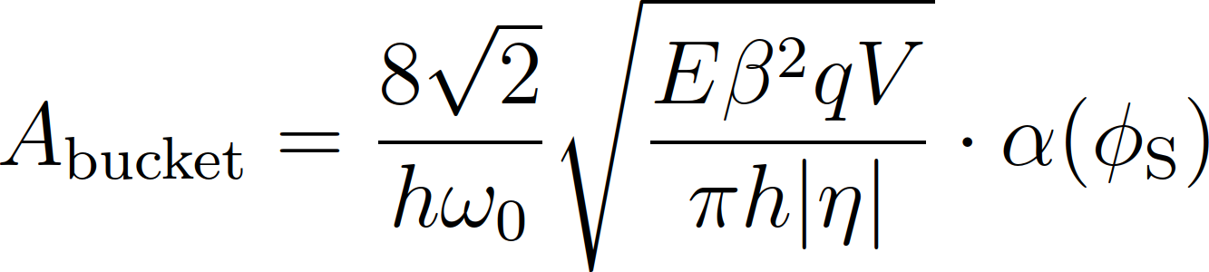
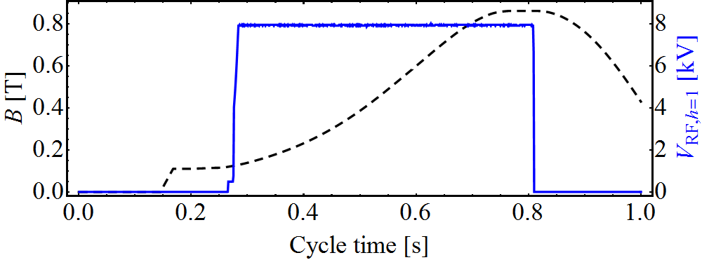
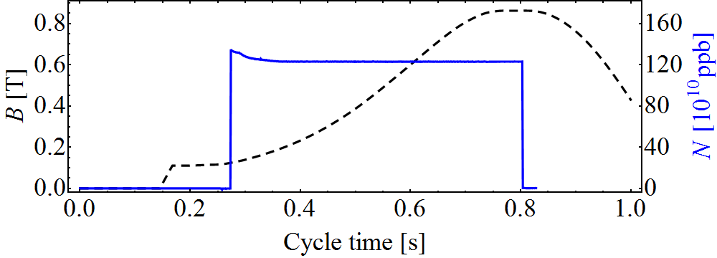
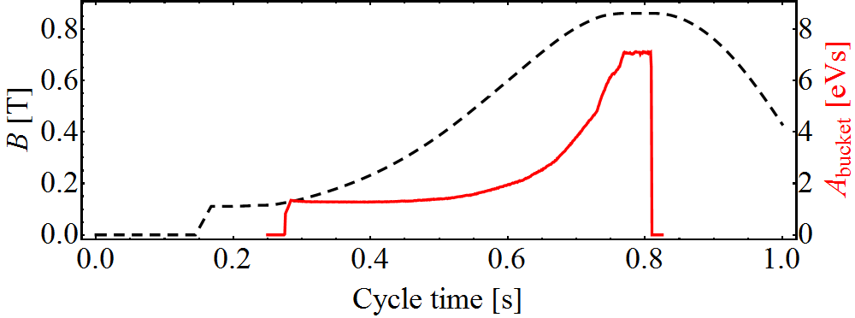
Example: CERN PSB (single harmonic, h = 1)
Bucket area:
Depends on:
Bending field, B and ramp rate dB/dt
RF voltage, V
Bending field and RF voltage
Beam intensity
Bucket area

Slide 25
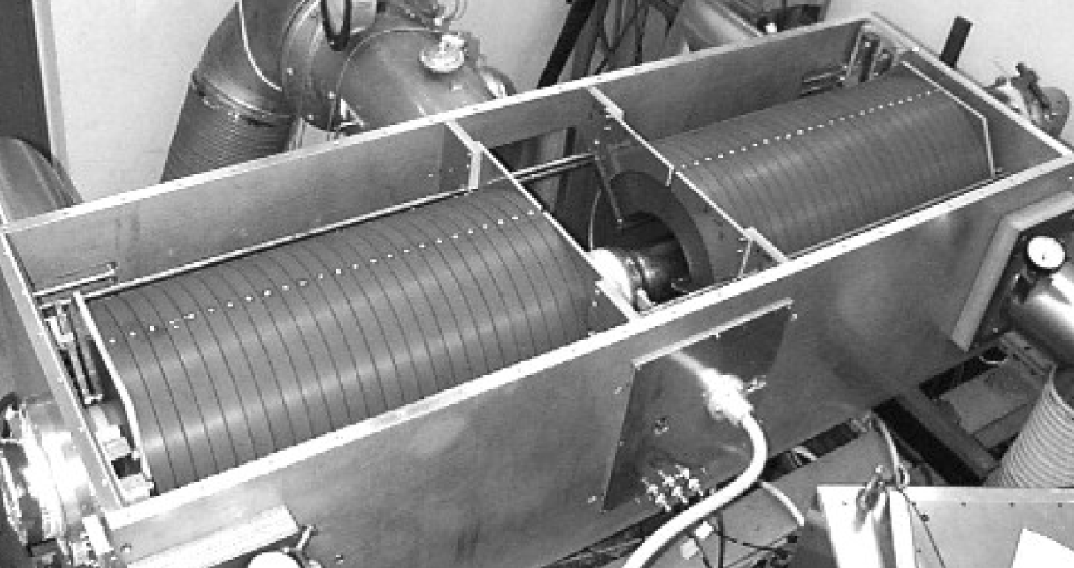
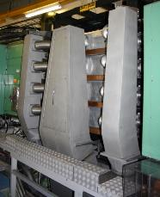
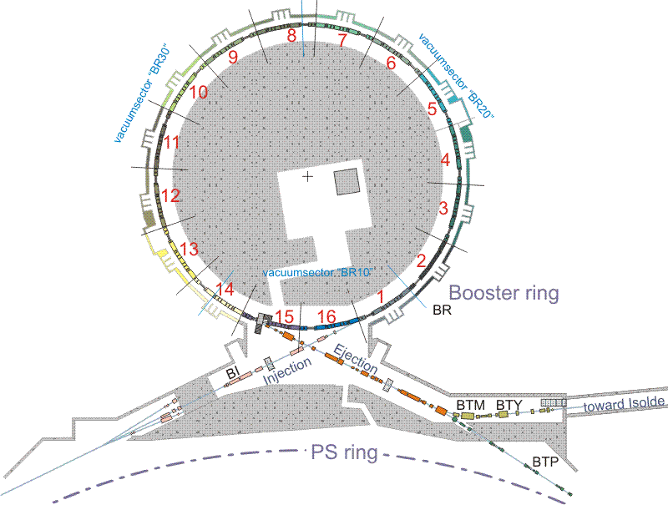
RF systems in the PS Booster
0.6 – 1.8 MHz, 8 kV
7
10
PSB
5
Acceleration and splitting
1.2 – 3.8 MHz, 8 kV
13
6 – 16 MHz
Controlled longitu-dinal blow-up
Acceleration and splitting
4 rings with 3 cavities
PS Booster RF systems based on tuned ferrite cavities

Slide 26
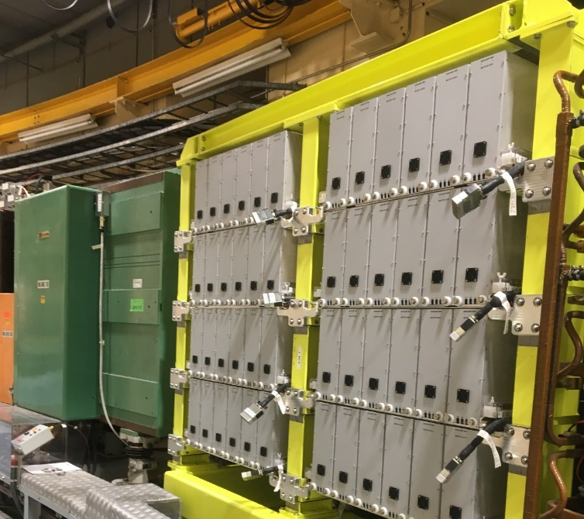
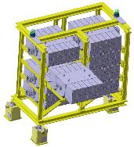
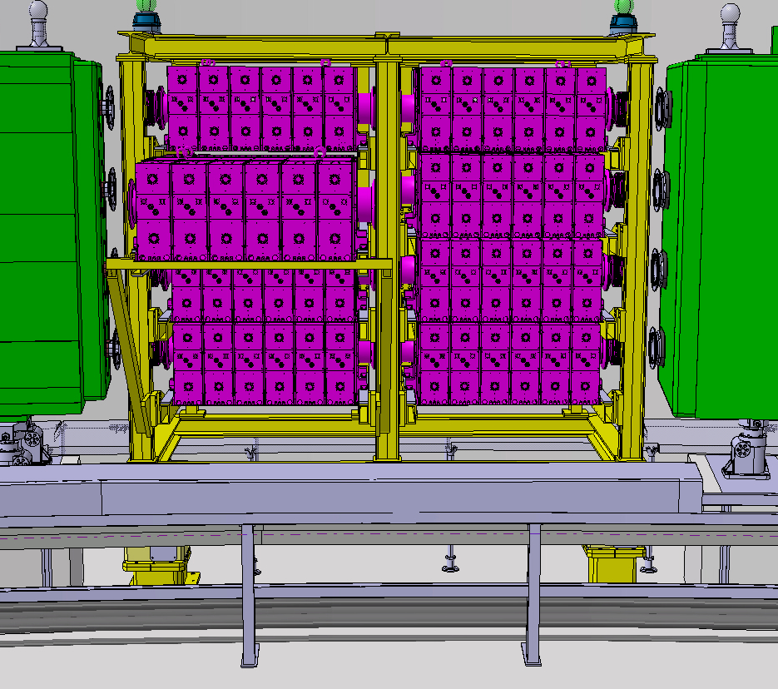
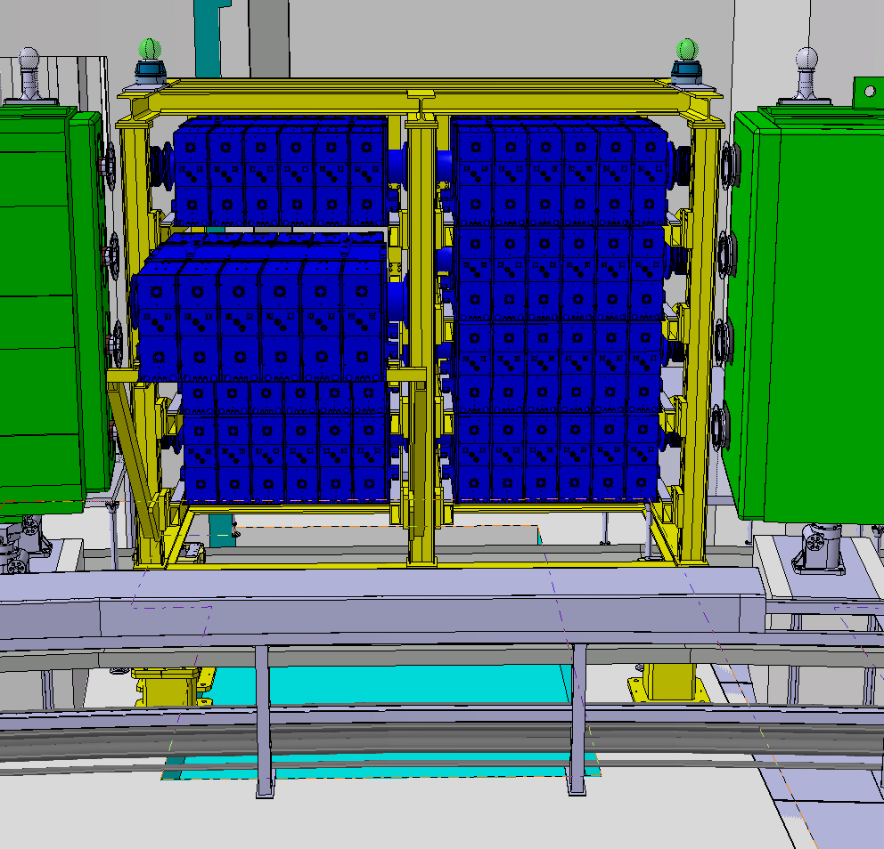
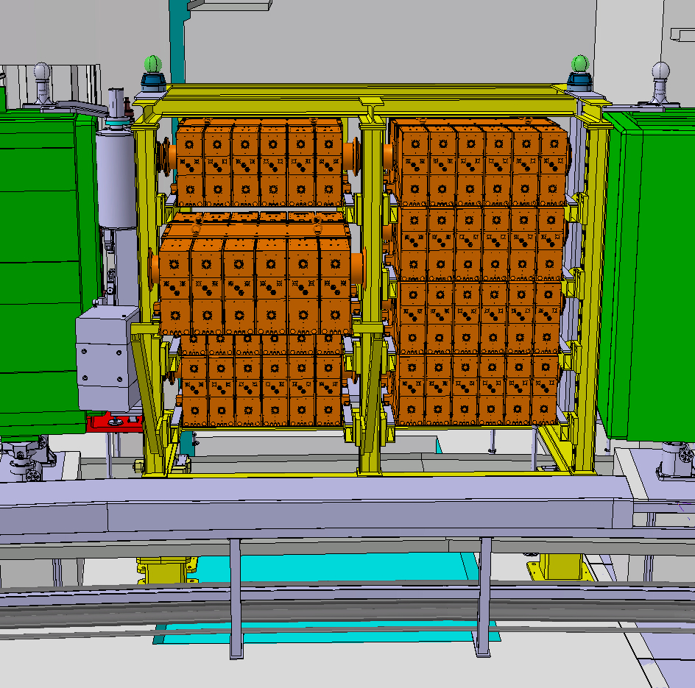
RF systems in the PS Booster after upgrade
7
10
Collaboration with KEK/JPARC
PSB
5
13
New wide-band cavities covering h = 1, 2, and higher
Based on innovative Finemet material
Much increased flexibility

Slide 27
Super Proton Synchrotron

Slide 28
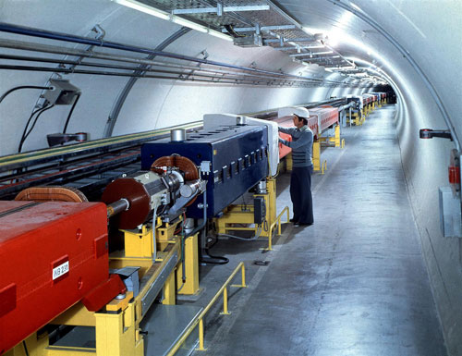
Example: RF System for CERN SPS
Needs significantly more
RF voltage: several MV
Parameter | Value
Circumference, 2πR | 2π ∙ 1.1 km = 6.91 km
Acceleration time, t_{cycle} | ~4 s
Maximum ramp rate, dB/dt | ~0.74 T/s
Injection Energy, E_{tot} | initially 10 GeV
Flat-top energy, E_{tot} | 450 GeV
Relativistic beta, β = v/c at injection | 0.9955885
at flat-top | 0.9999978
Relative frequency swing | 0.44%

Slide 29

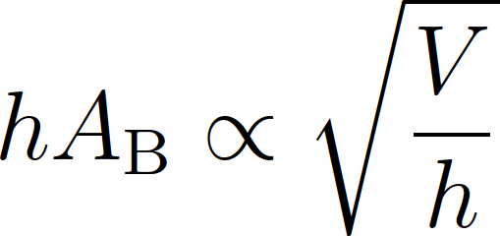
Example: SPS - choice of RF harmonic
Harmonic number should be multiple of
Revolution frequency ratio of PS and SPS | 11
Acceleration harmonic in the PS | 20
Super-periodicity of SPS | 6
Looking for multiples of 660
h | 660 | 1320 | 1980 | 2640 | 3300 | 3960 | 4620 | 5280 | 5940
f_{RF} [MHz] | 29 | 57 | 86 | 115 | 143 | 172 | 200 | 229 | 258
Lower RF frequency | Higher RF frequency
Total bucket area: Insufficient at inj. for h > 5500 | Mechanically smaller cavities
 | Higher shunt impedance easier to achieve → power efficiency
Magnetic tuning only possible at f_{RF} < 100 MHz) | Higher breakdown voltages
Y

Slide 30
Example: SPS choice of RF cavities
Requirements:
How to build such an RF system?
Cavity resonator would need tuning or low Q < 1/0.44% ≈ 230
Parameter
Harmonic, h | 4620
Frequency, f_{RF} | 200 MHz
Bandwidth, Δf_{RF} | 0.44%
Voltage, V_{RF} | Few MV
Mechanically
tuned cavity
Travelling wave
structure
Avoid cycling
mechanics in vacuum
High voltage in
moderate bandwidth

Slide 31
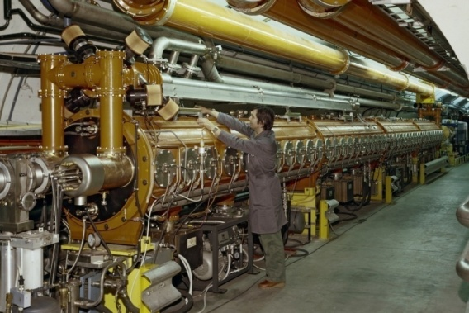
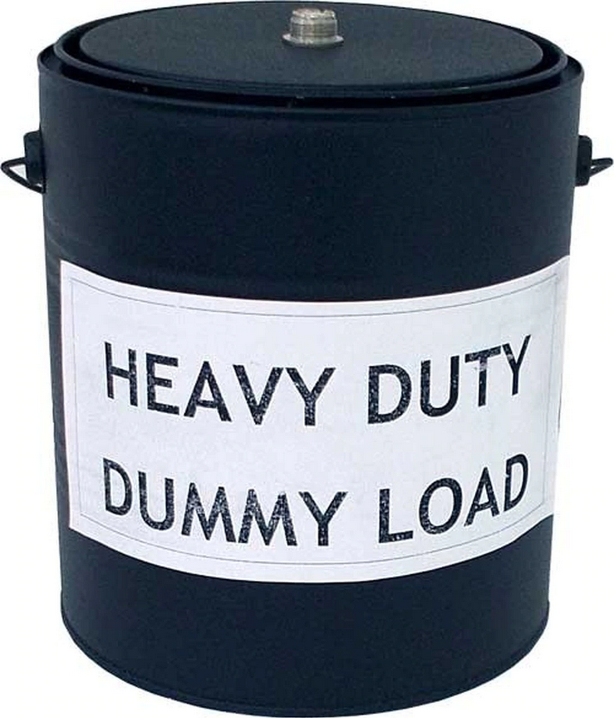
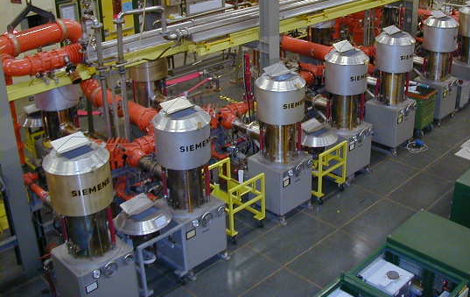
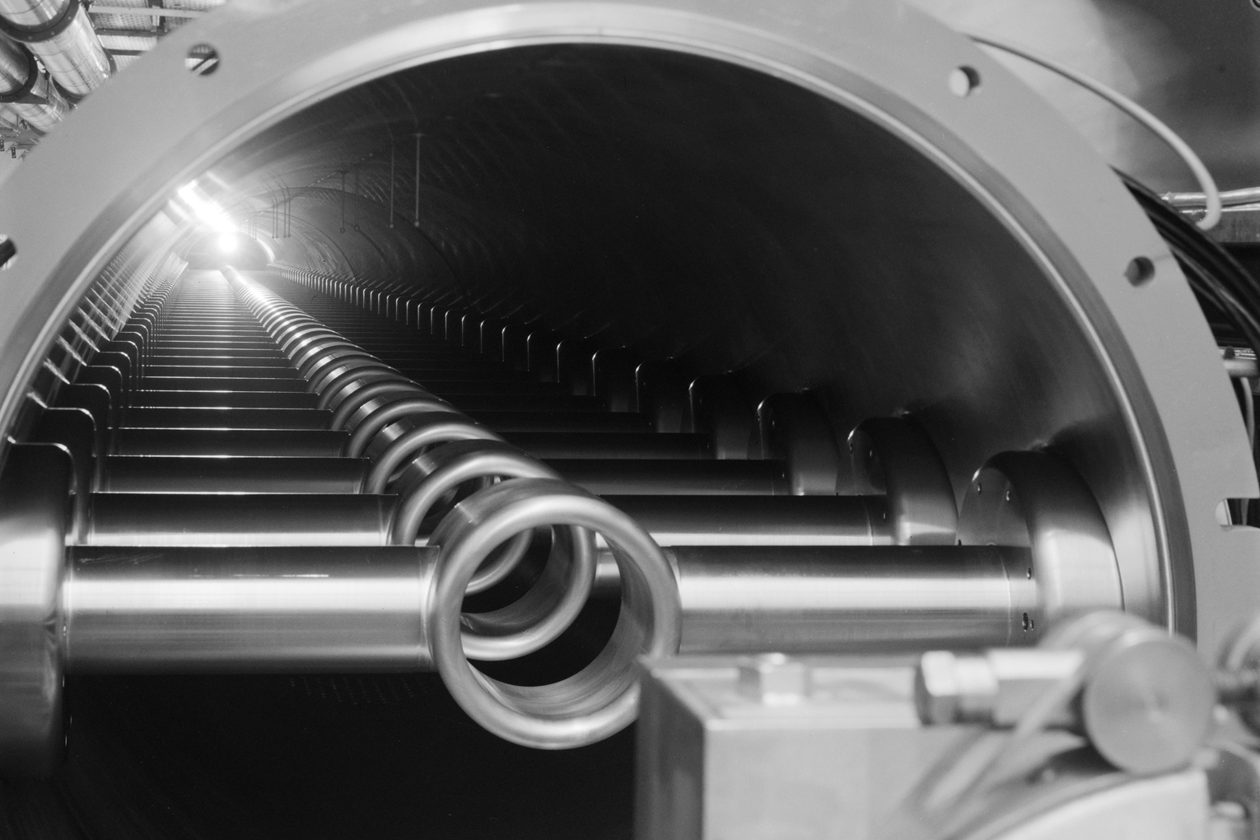
Example: SPS travelling wave cavities
Multi-cell structure operated as a waveguide
Sufficient bandwidth without mechanically moving parts
Travelling wave structure always matched to amplifier
Beam takes power it needs from the waveguide
P_{load} = P_{in} – P_{beam} – P_{loss}
Beam
RF power
RF power

Slide 32
Large Electron Positron
and Hadron Colliders

Slide 33
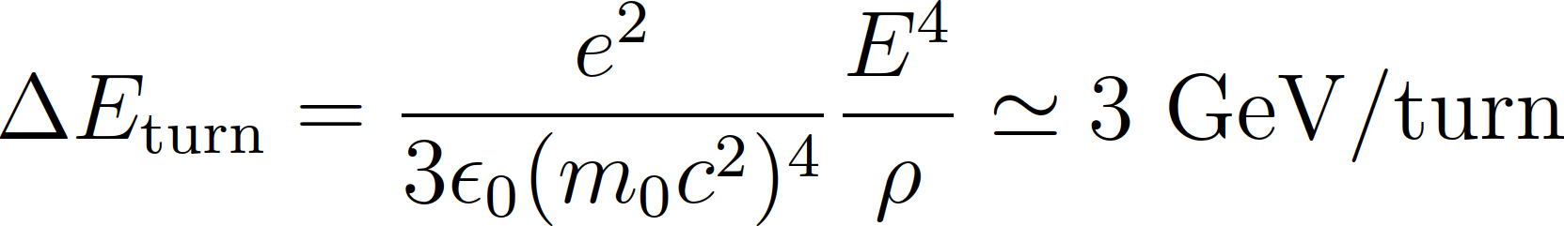



Ex.: RF against synchrotron radiation in LEP
LEP energy was entirely dominated by synchrotron radiation
At E = 100 GeV:
About 3 % of beam energy
lost each turn
RF voltage and beam energy

Slide 34

Example: LHC
LHC maximum energy and ramp rate limited by super-conducting bending magnets: 20 minutes ramp time
Average energy gain per turn only ΔE_{turn} ≈ 500 keV/turn
Revolution frequency stays almost constant
RF voltage required to keep
bunches short
Superconducting cavities chosen
to reduce beam induced voltage
(small R/Q)
8× per beam
Parameter (per beam)
Harmonic, h | 35640
Frequency, f_{RF} | 400.8 MHz
Voltage, V_{RF} | 16 MV

Slide 35
Summary
Design of RF system for circular accelerator
    Start from accelerator parameters
    Define RF parameters based on beam requirements
    Chose RF system
  Mostly several design options are possible

Slide 36





Helpful hints
SI units for particle mass (kg), energy (J) and momentum (kg m/s) not very common
Accelerator physicists love electron volts (eV)
Mass and energy | Momentum
 | SI units | Electron volts
Proton rest mass | 1.67 ∙ 10⁻²⁷ kg | 938 MeV
Electron rest mass | 9.11 ∙ 10⁻³¹ kg | 511 keV
Proton beam momentum at β = 0.5 | 2.90 ∙ 10⁻¹⁹ kg m/s | 542 MeV/c

Slide 37


…is your friend!
You will design an RF system (upgrade)
Protons accelerator: Upgrade of CERN SPS to 1.3 TeV
Electron storage ring: Energy and current upgrade

Slide 38
A big Thank You
to all colleagues providing support, material and feedback
Simon Albright, Maria-Elena Angoletta, Philippe Baudrenghien, Thomas Bohl, Wolfgang Höfle, Erk Jensen, Alexander Lasheen, Elena Shaposhnikova, Frank Tecker, Daniel Valuch, Manfred Wendt, Jörg Wenninger
and many more…

Slide 39
Thank you very much for your attention!

Slide 40
References
D. Boussard, Design of a Ring RF System, CERN SL/91-2 (RFS, rev.), 1991, http://cds.cern.ch/record/1023436/files/CM-P00065157.pdf
E. Regenstreif, The CERN Proton Synchrotron, pt. 1, CERN-59-26, https://cds.cern.ch/record/214352/files/CERN-59-29.pdf
CERN, The 300 GeV Programme, CERN/1050, 1972, https://cds.cern.ch/record/104068/files/CM-P00077738-e.pdf
G. Arduini, E. Shaposhnikova, J. Wenniger, Acceleration Cycles for the LHC Proton Beams in the SPS, CERN AB-Note-2006-018, 2006, http://cds.cern.ch/record/951985/files/ab-note-2006-018.pdf
R. W. Assmann, M. Lamont, S. Myers, A Brief History of the LEP Collider, CERN-SL-2002-009-OP, 2002, https://cds.cern.ch/record/549223/files/sl-2002-009.pdf

