Slide 1
CAS – Introduction to Accelerator Physics
Collective effects
Part I: Multiparticle systems
with contributions from F. Asvesta, H. Bartosik, E. De La Fuente Garcia, G. Kotzian, G. Rumolo, M. Schenk, L. Sito, C. Zannini and many more

Slide 2
Context and outline
Collective effects in the physics of particle accelerators and beam dynamics is yet another very important topic, as it determines the ultimate performance of many machines. These effects become increasingly important as the beam intensities are pushed towards the limits.
In terms of the physics, they are challenging to deal with due to their self-consistent nature – instead of having to handle the particle dynamics within a fixed environment, the particle distribution actually affects and changes the environment, which in turn impacts the particle distribution and so on.
We will have a look at some important collective effects mostly phenomenologically, trying to give an intuitive picture and showing some real world examples. The main topics that we will discuss are:
Multiparticle dynamics
  Moving from single particles to multiparticle systems
Space charge effects
  Direct and indirect and space charge
Wake fields
  Longitudinal and transverse wake fields and impedances
Instabilities
  Coupled bunch and single bunch instabilities in the transverse and the longitudinal planes

Slide 3
We will briefly revise the single particle representation and dynamics and then move to multi-particle systems and their representation. We will discuss some features of multi-particle dynamics in absence of collective effects such as decoherence and filamentation.
Finally, we will look at direct space charge as a first real collective effects.
Part I: Multi-particle effects – direct space charge
  Multi-particle systems and their representation
  Incoherent and coherent motion
  Space charge

Slide 4
We will briefly revise the single particle representation and dynamics and then move to multi-particle systems and their representation. We will discuss some features of multi-particle dynamics in absence of collective effects such as decoherence and filamentation.
Finally, we will look at direct space charge as a first real collective effects.
Part I: Multi-particle effects – direct space charge
  Multi-particle systems and their representation
  Incoherent and coherent motion
  Space charge

Slide 5
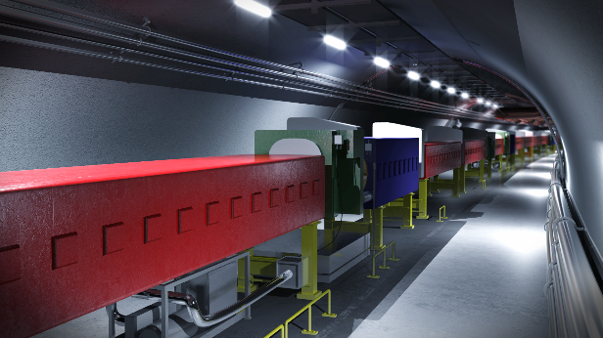
Single particle dynamics
We have already seen and learned about single particle dynamics…
We can say that single particle dynamics treats the interaction of individual particles with external force fields generated by machine elements:
  Slow magnets to generate guiding fields
  Fast magnets for injection and extraction
  RF cavities for bunching and shaping of
  longitudinal phase space
  …
Characteristics of single particle dynamics:
  External force fields
  Independent of any given phase space configuration of multi-particle ensembles!

Slide 6






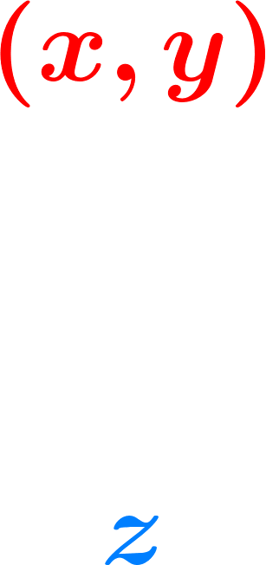

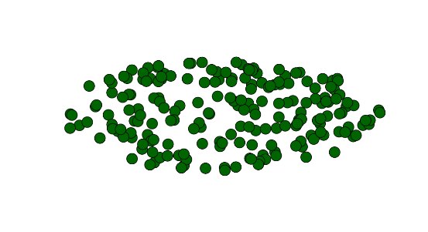
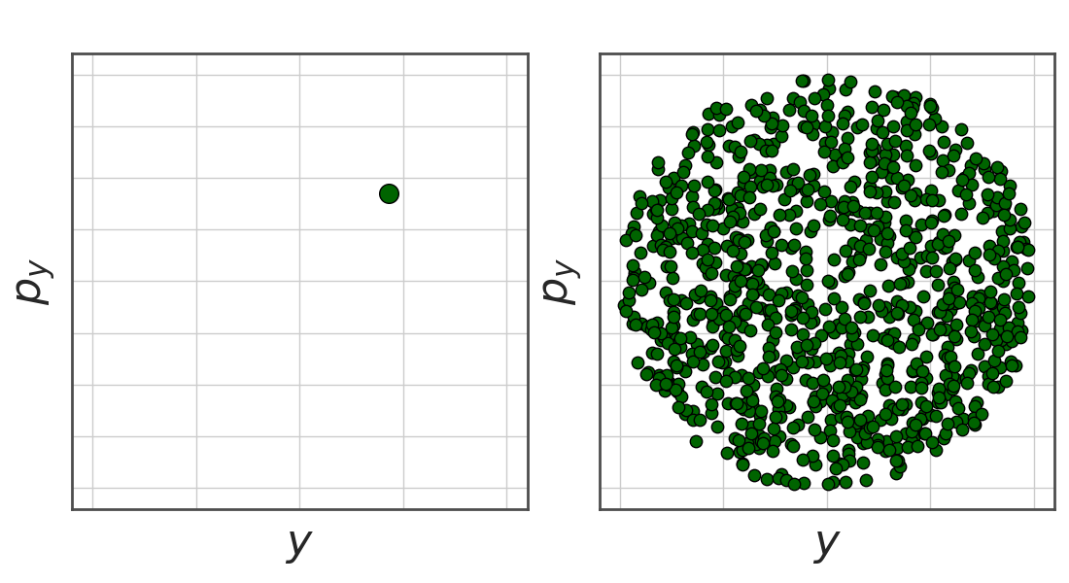

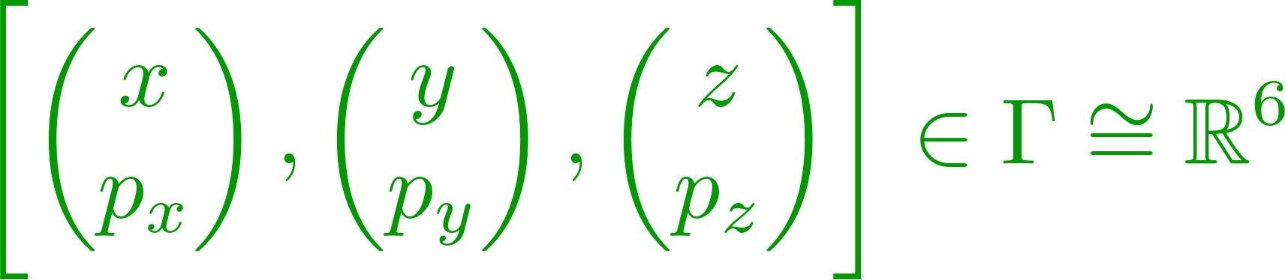
Single particle dynamics – reminder coordinates
Accelerator coordinates:
  Position along the accelerator
  Accelerator circumference
Bunch coordinates
  Position transverse with respect to orbit
  Position longitudinal with respect to reference (synchronous) particle
Phase space coordinates
  Representation of particles as unique state in phase space

Slide 7
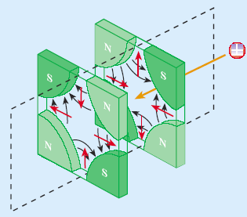
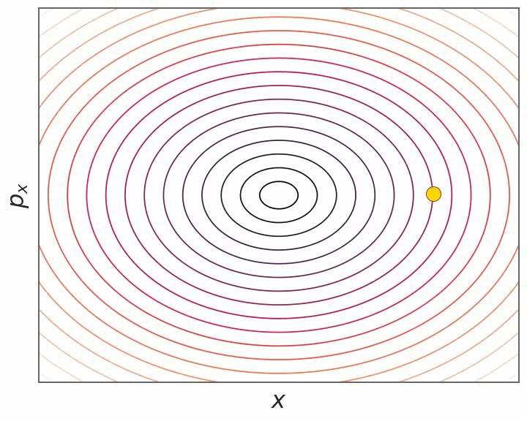
Single particle dynamics – transverse
Characteristics of single particle dynamics:
  External force fields
  Independent of any given multi-particle system phase space configuration!
Examples of single particle dynamics:
  Transverse focusing → Hill’s equation and betatron motion

Slide 8
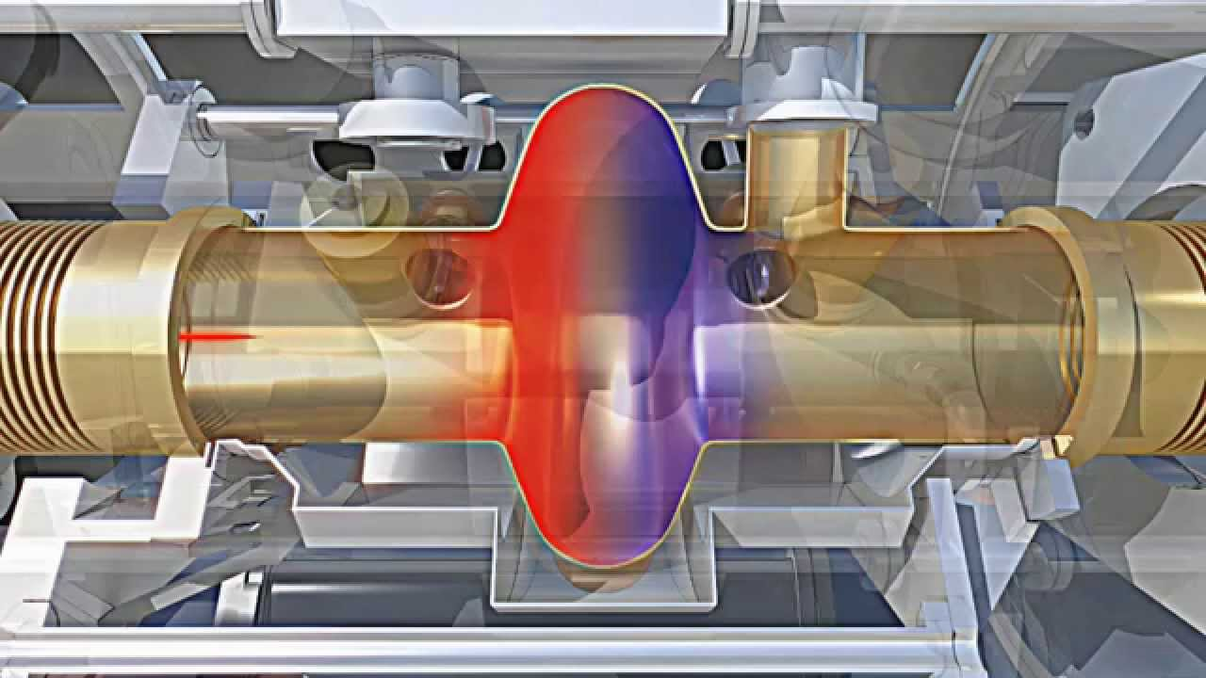
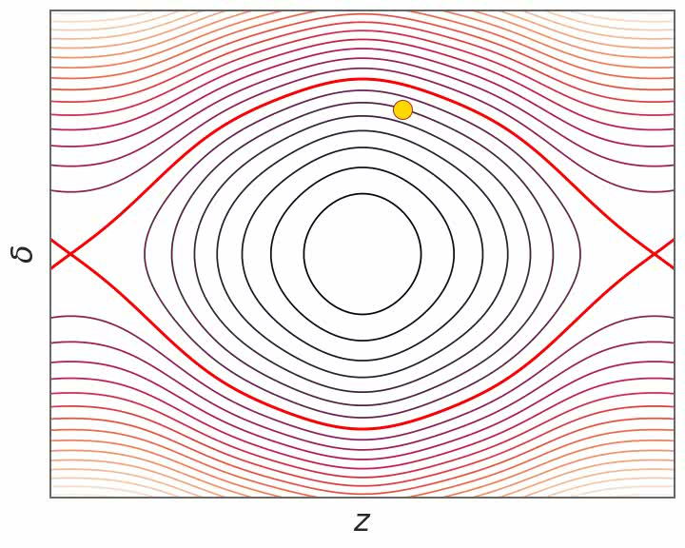
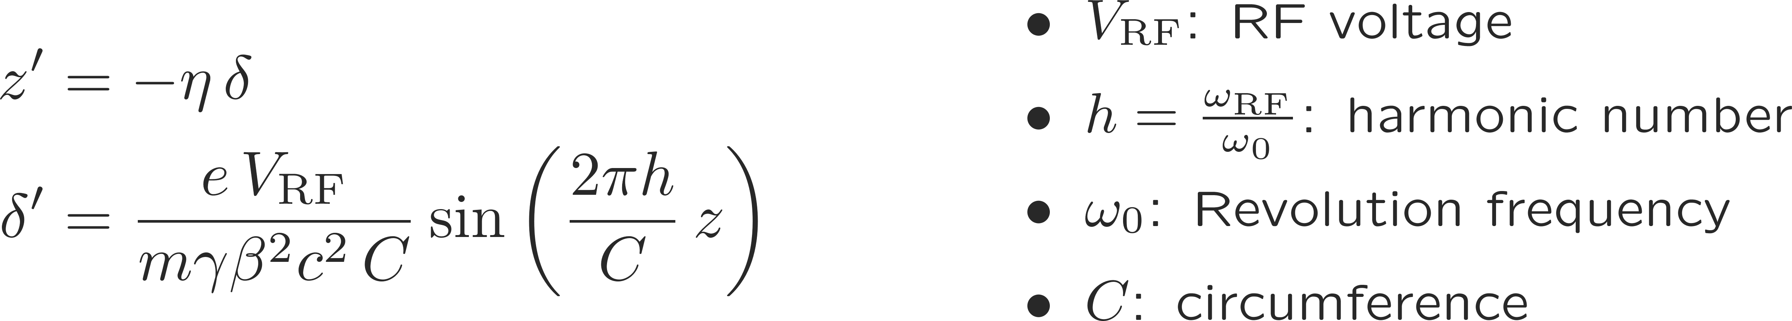
Single particle dynamics – longitudinal
Characteristics of single particle dynamics:
  External force fields
  Independent of any given multi-particle system phase space configuration!
Examples of single particle dynamics:
  Longitudinal focusing → Pendulum equation and synchrotron motion

Slide 9
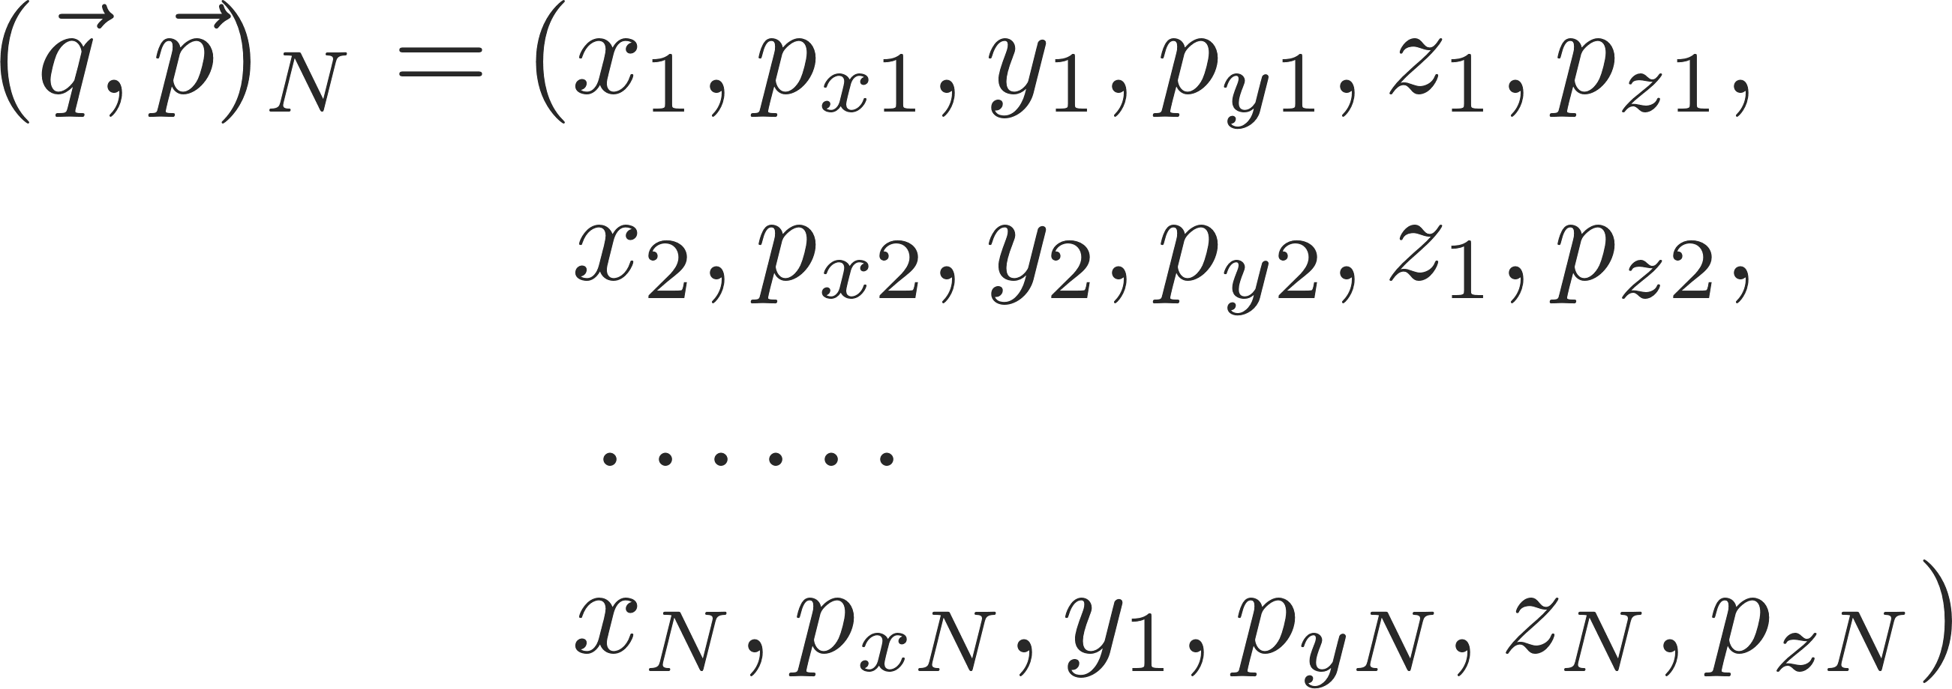

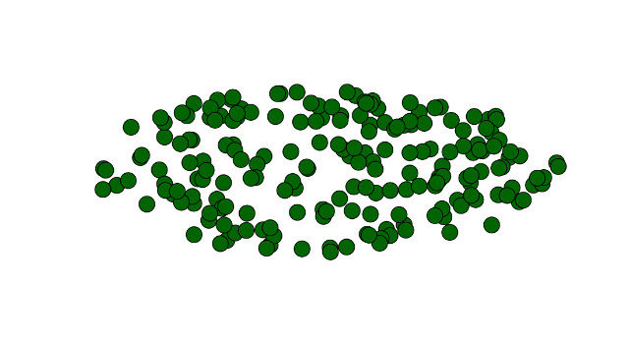
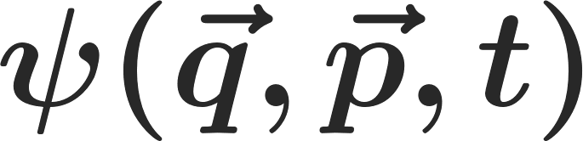
Multi-particle dynamics – state representation (theory)
Representation of a single particle state:
Representation of a multi-particle state:
The multi-particle state is conveniently represented by a probability density function Ψ – which neglecting correlations can be reduced (BBGKY) to the single particle distribution function

Slide 10
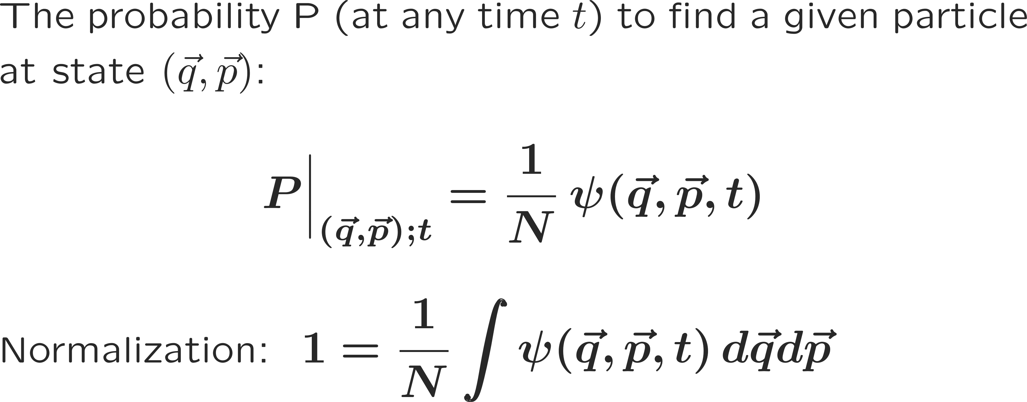
Multi-particle dynamics – state representation (theory)
Representation of a single particle state:
Representation of a multi-particle state:
The multi-particle state is conveniently represented by a probability density function Ψ – which neglecting correlations can be reduced (BBGKY) to the single particle distribution function

Slide 11
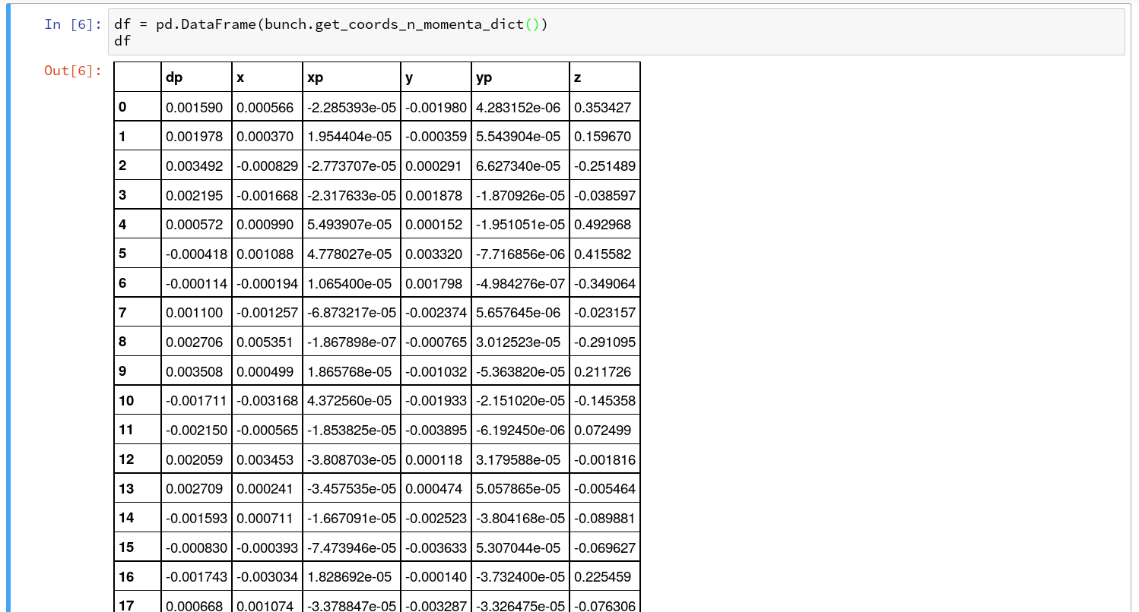
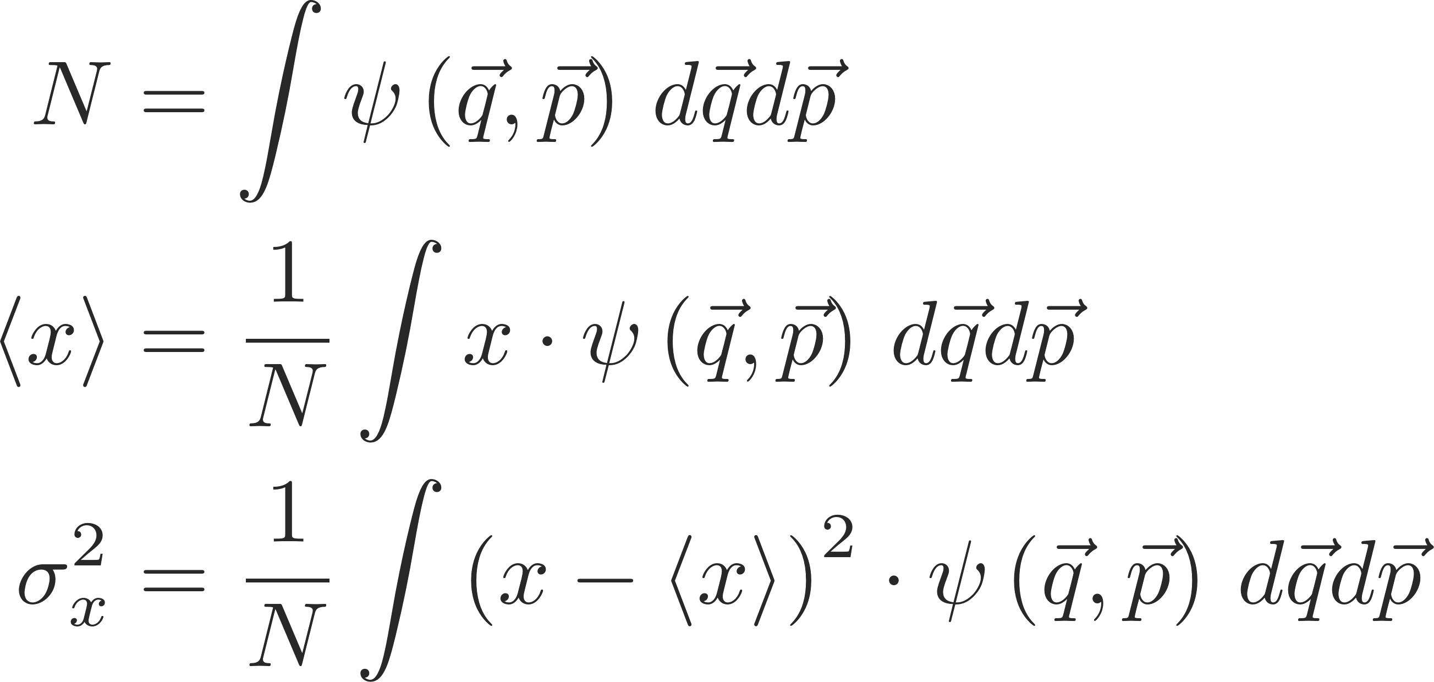
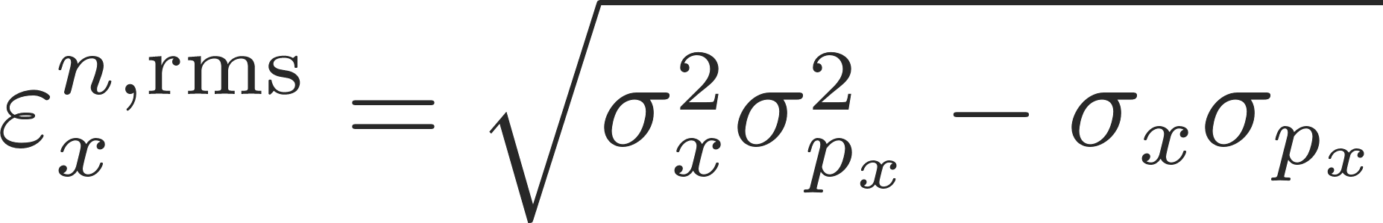
Multi-particle dynamics – state representation (numerics)
Representation of a single particle state:
A multi-particle ensemble is characterized by its macroscopic statistical properties, i.e.:
One of the most important parameters to characterize the quality of a particle bunch is the (normalized) statistical emittance – it is a measure of the particle bunch size in phase space.

Slide 12
Multi-particle dynamics – state representation (numerics)
Representation of a single particle state:

Slide 13
Multi-particle dynamics – state representation
Representation of a single particle state:
We have seen three ways of representing multi-particle states:
Graphically → best for intuition
Theoretically → very good for analytical calculations to gain theoretical insights and, e.g., scaling laws
Numerically → very good to deploy in numerical simulations to study generic and realistic cases
Let’s continue with just few more words on the theoretical description of multi-particle states before moving back to more practical examples.

Slide 14
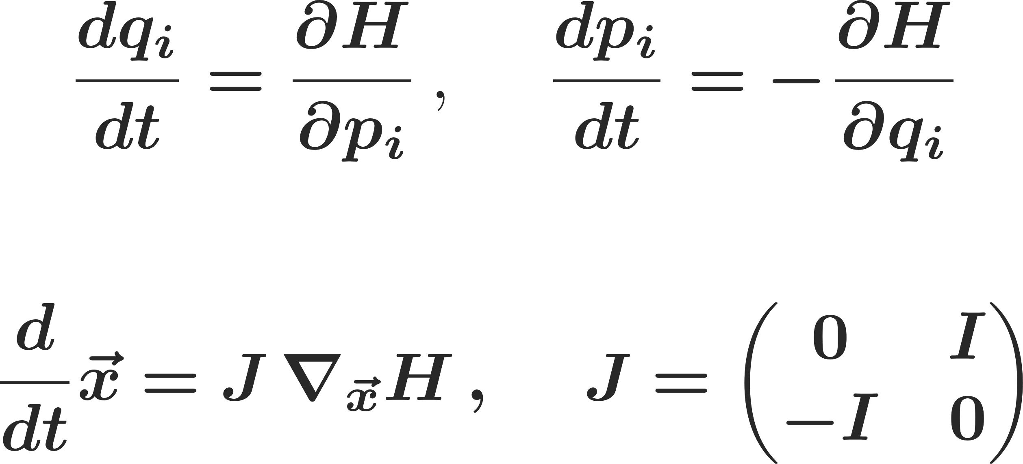
Multi-particle dynamics – Hamilton equations of motion
Representation of a single particle state:
Miraculously, the motion of particles in a particle accelerator happens according to the Hamilton equations of motion:
This has important consequences on the possible degrees of freedom for the motion of any particle ensemble in phase space – or also the evolution of the emittance of a particle bunch…
This is to be accepted as fundamental physics; it is not really further derivable
sometimes also more
compactly written as

Slide 15
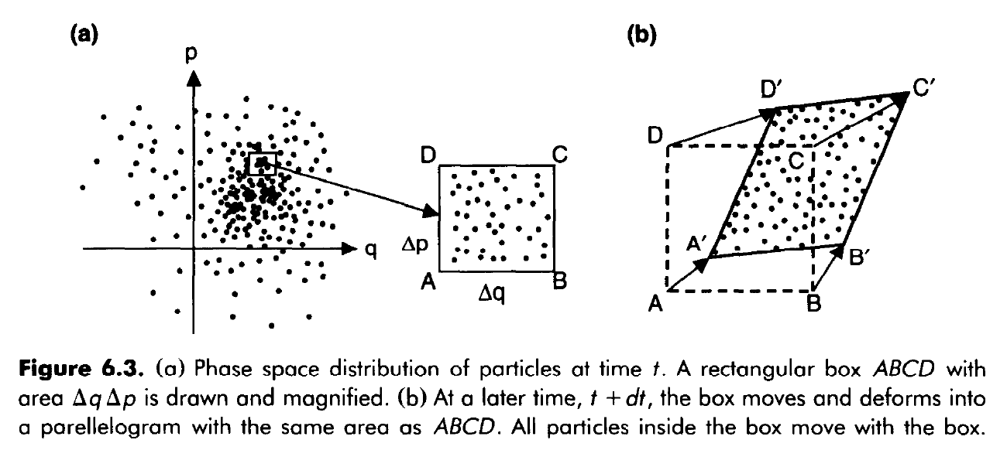
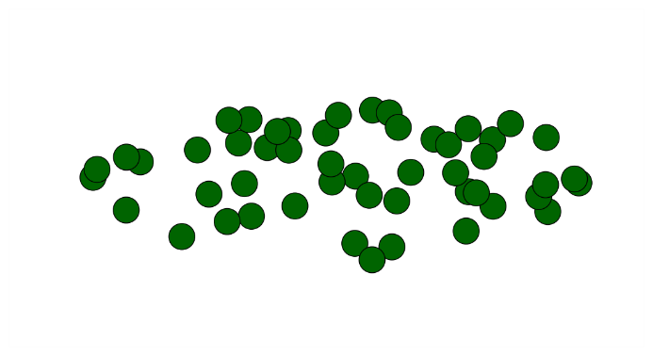
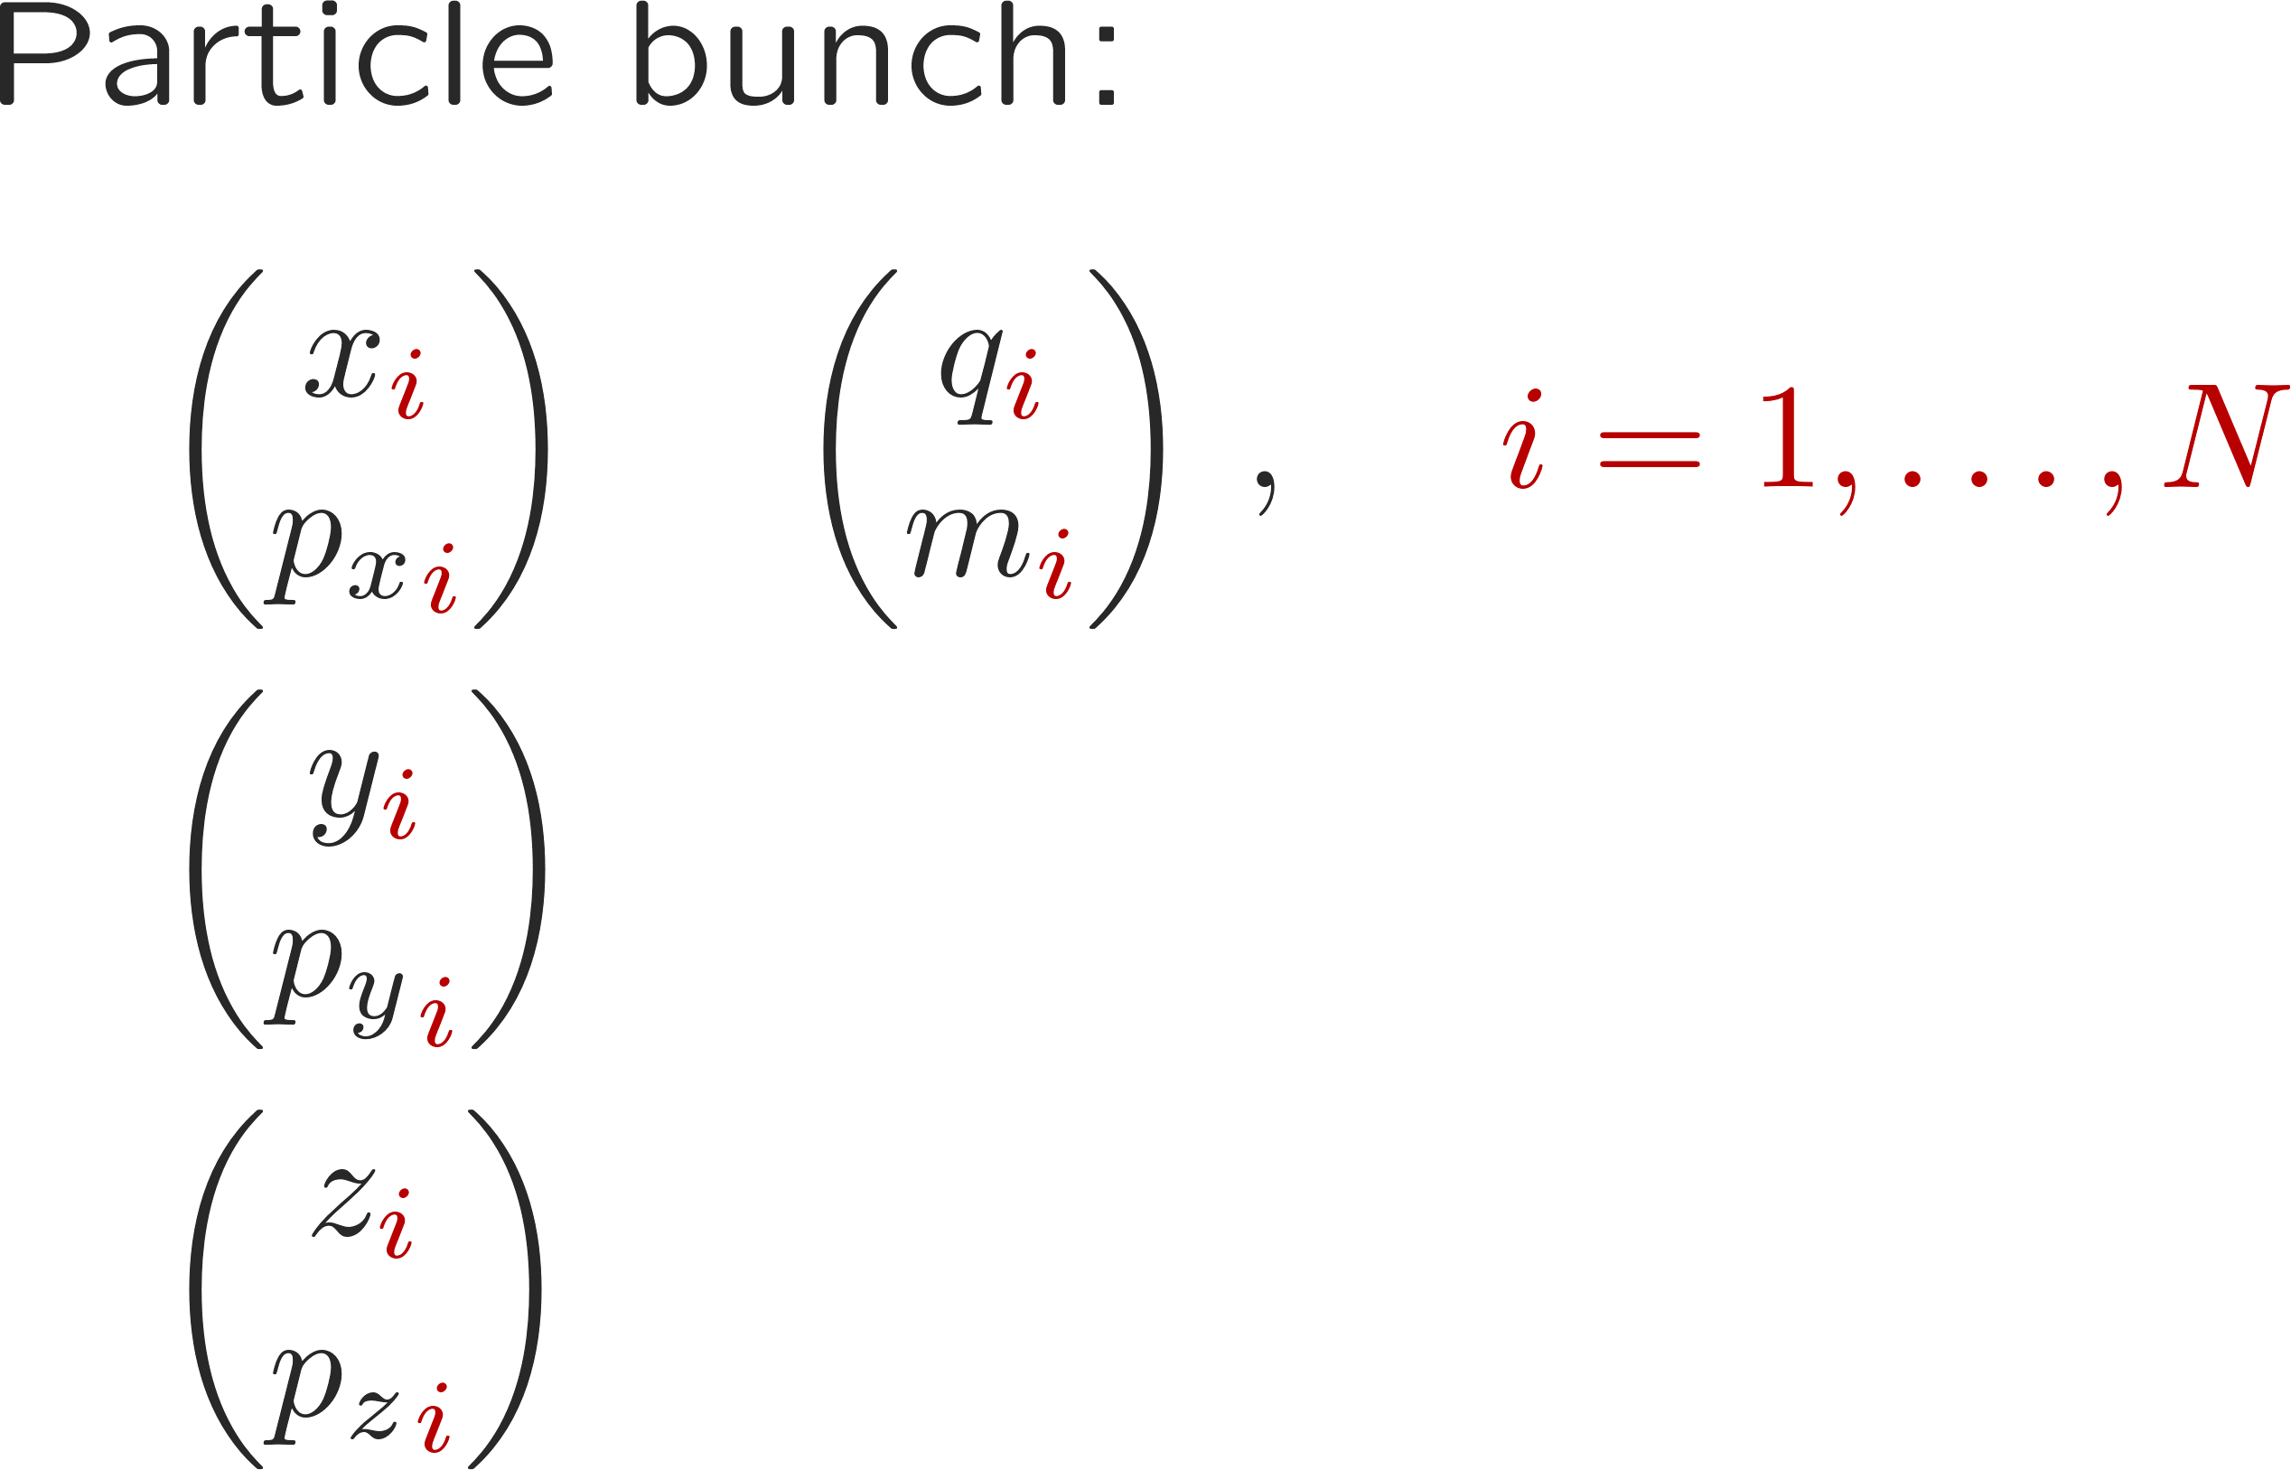
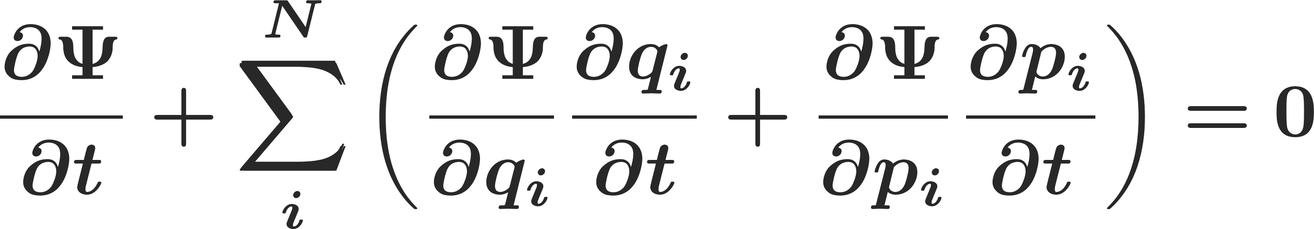
Remark: multi-particle dynamics – Liouville’s theorem
… in an accelerator environment, the multi-particle system moves in phase space like an incompressible fluid
Liouville’s Theorem*:
i.e., the occupied phase space density remains constant.
Representation of a multi-particle ensemble in phase space
Particlenumber
(*) Follows from just two physics assumptions:
Conservation of number of systems
Hamilton equations of motion
See, e.g.,
https://cds.cern.ch/record/572817?ln=de or
http://www.damtp.cam.ac.uk/user/tong/dynamics/four.pdf
Phase space
coordinates

Slide 16
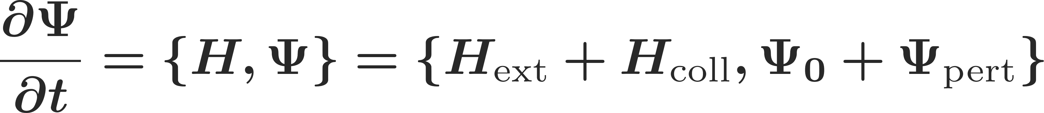
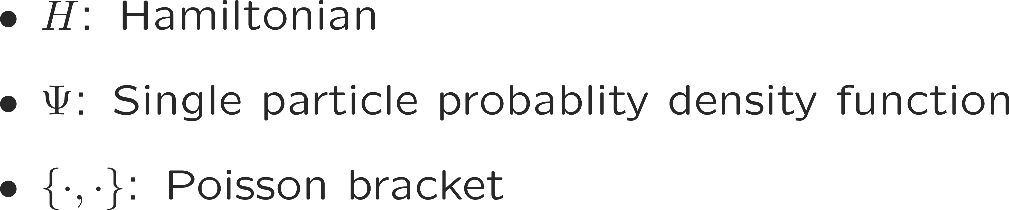
Remark: multi-particle dynamics – Liouville’s theorem
… in an accelerator environment, the multi-particle system moves in phase space like an incompressible fluid
Liouville’s Theorem*:
i.e., the occupied phase space density remains constant.
Representation of a multi-particle ensemble in phase space
From Liouville’s theorem, we can immediately write down the Vlasov equation which often forms the basis of any analytical computations of collective effects:
If we know these magic functions H (and we in fact mostly do), most of the collective behavior of the beam can be calculated (see, e.g., N. Mounet “Direct Vlasov Solvers” at the Numerical Methods for Analysis, Design and Modelling of Particle Accelerators, Thessaloniki (Greece)).
Particlenumber
(*) Follows from just two physics assumptions:
Conservation of number of systems
Hamilton equations of motion
See, e.g.,
https://cds.cern.ch/record/572817?ln=de or
http://www.damtp.cam.ac.uk/user/tong/dynamics/four.pdf
Phase space
coordinates

Slide 17
We have very briefly reviewed single particle representation and dynamics in a particle accelerator. We have then introduced the concept of multi-particle systems and their representation in phase space.
Two very fundamental and important points are the definition of the statistical emittance as a measure of the particle bunch quality and Liouville’s theorem which describes the motion of a multi-particle system in phase space.
Let’s now discuss some peculiarities of multi-particle system dynamics – in particular, we will discuss incoherent and coherent motion. We will not yet be touching collective effects.
Part I: Multi-particle effects – direct space charge
  Multi-particle systems and their representation
  Incoherent and coherent motion
  Space charge

Slide 18
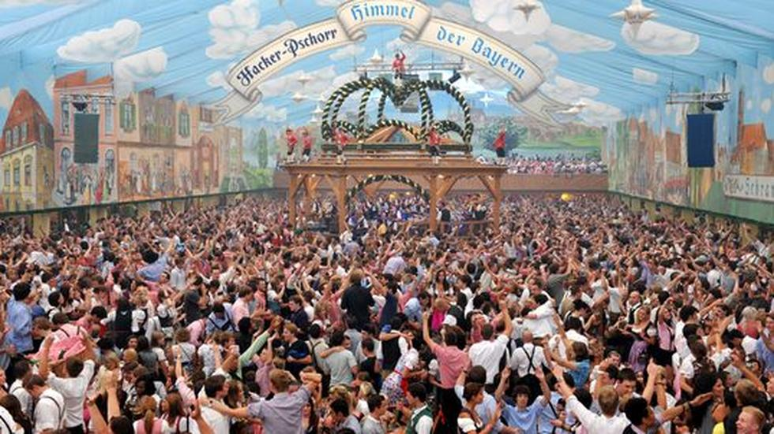
Incoherent vs. coherent motion
When considering multi-particle systems we need to differentiate between incoherent ("microscopic") and coherent ("macroscopic") motion
Incoherent motion

Slide 19

Incoherent vs. coherent motion
When considering multi-particle systems we need to differentiate between incoherent ("microscopic") and coherent ("macroscopic") motion
Coherent motion

Slide 20
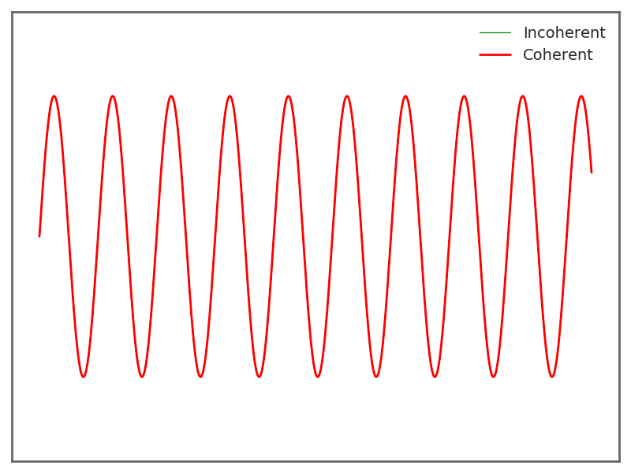
Incoherent vs. coherent motion – model
A single particle
→ incoherent is identical to coherent motion
Coherent – macroscopic quantities:

Slide 21
Incoherent vs. coherent motion – model
Five particles – in phase
→ incoherent is same as coherent motion
Coherent – macroscopic quantities:

Slide 22
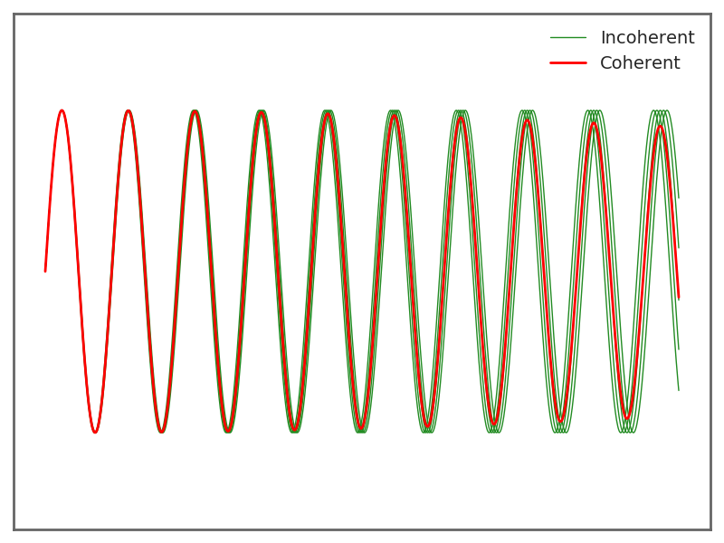
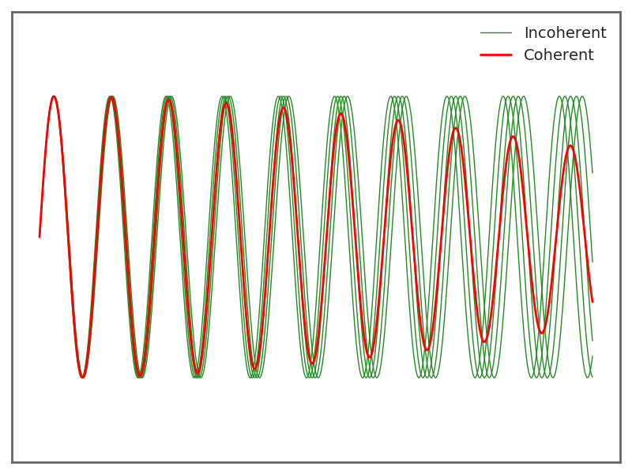
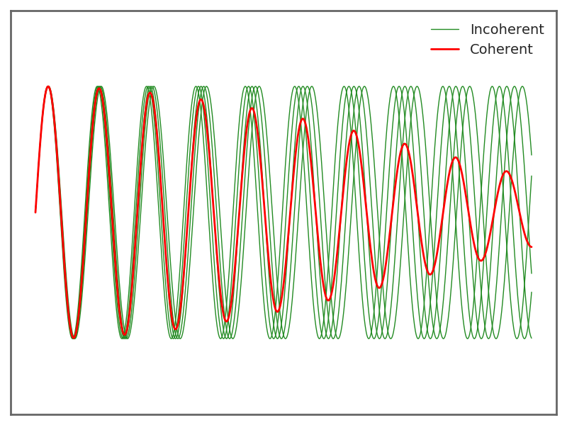
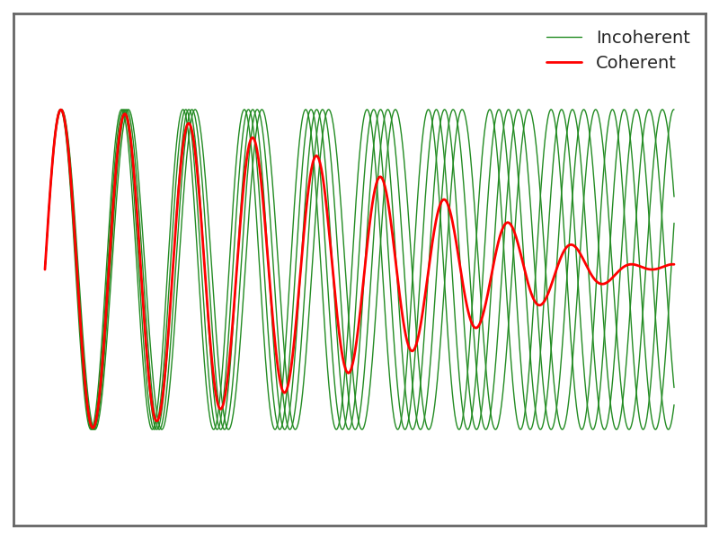
Incoherent vs. coherent motion – model
Five particles – in phase but detuned
→ decoherence of coherent motion
Coherent – macroscopic quantities:

Slide 23
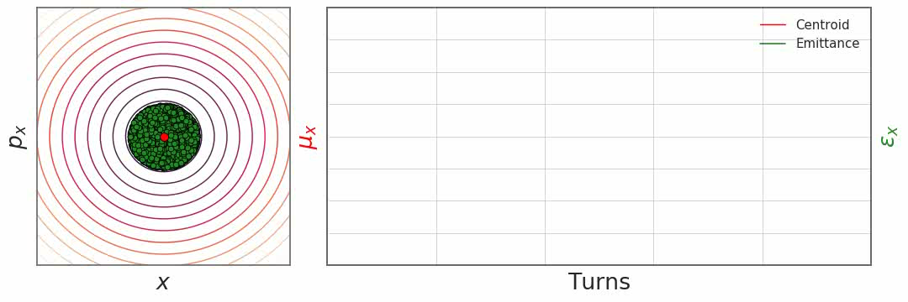
Incoherent vs. coherent motion – simulation
Let’s observe a system of five hundred particles:
  Although each and every individual particle performs more or less large oscillations around the orbit, a coherent motion is hardly visible – for a matched injection.

Slide 24
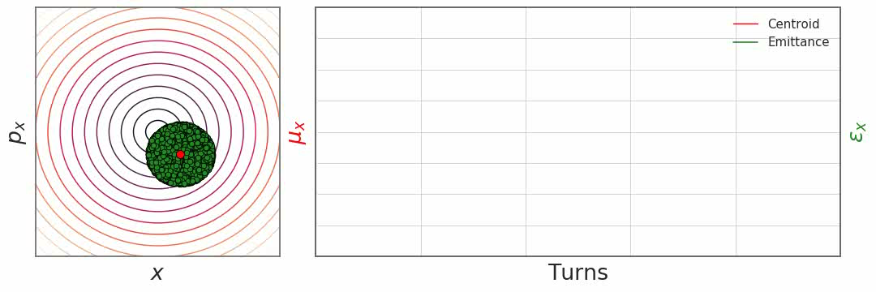
Incoherent vs. coherent motion – simulation
Let’s observe a system of five hundred particles:
  For an offset injection, all particles move around the orbit at a constant tune and, at the same time, a clear and strong coherent motion is observed.

Slide 25
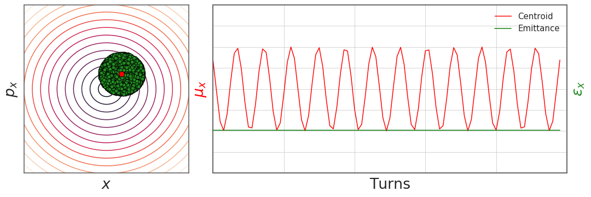
Incoherent vs. coherent motion – simulation
Let’s observe a system of five hundred particles:
  For an offset injection, all particles move around the orbit at a constant tune and, at the same time, a clear and strong coherent motion is observed.

Slide 26
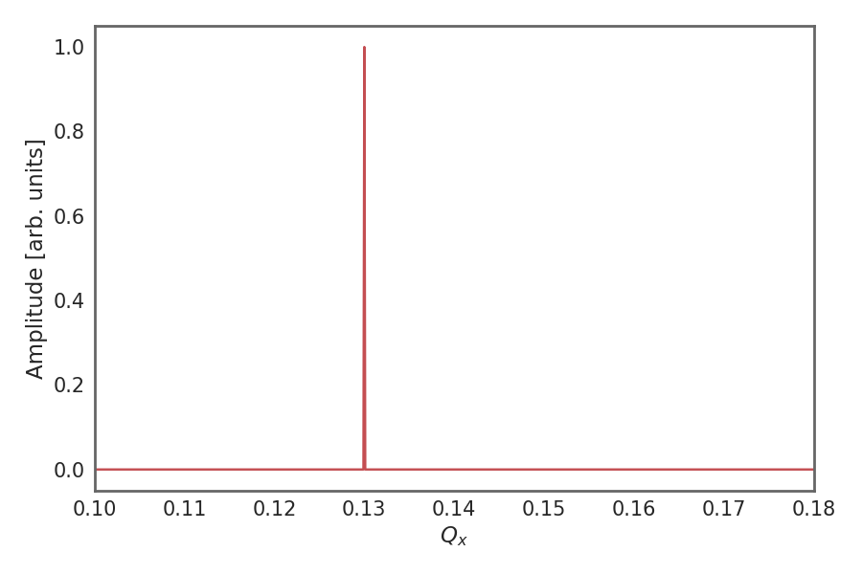
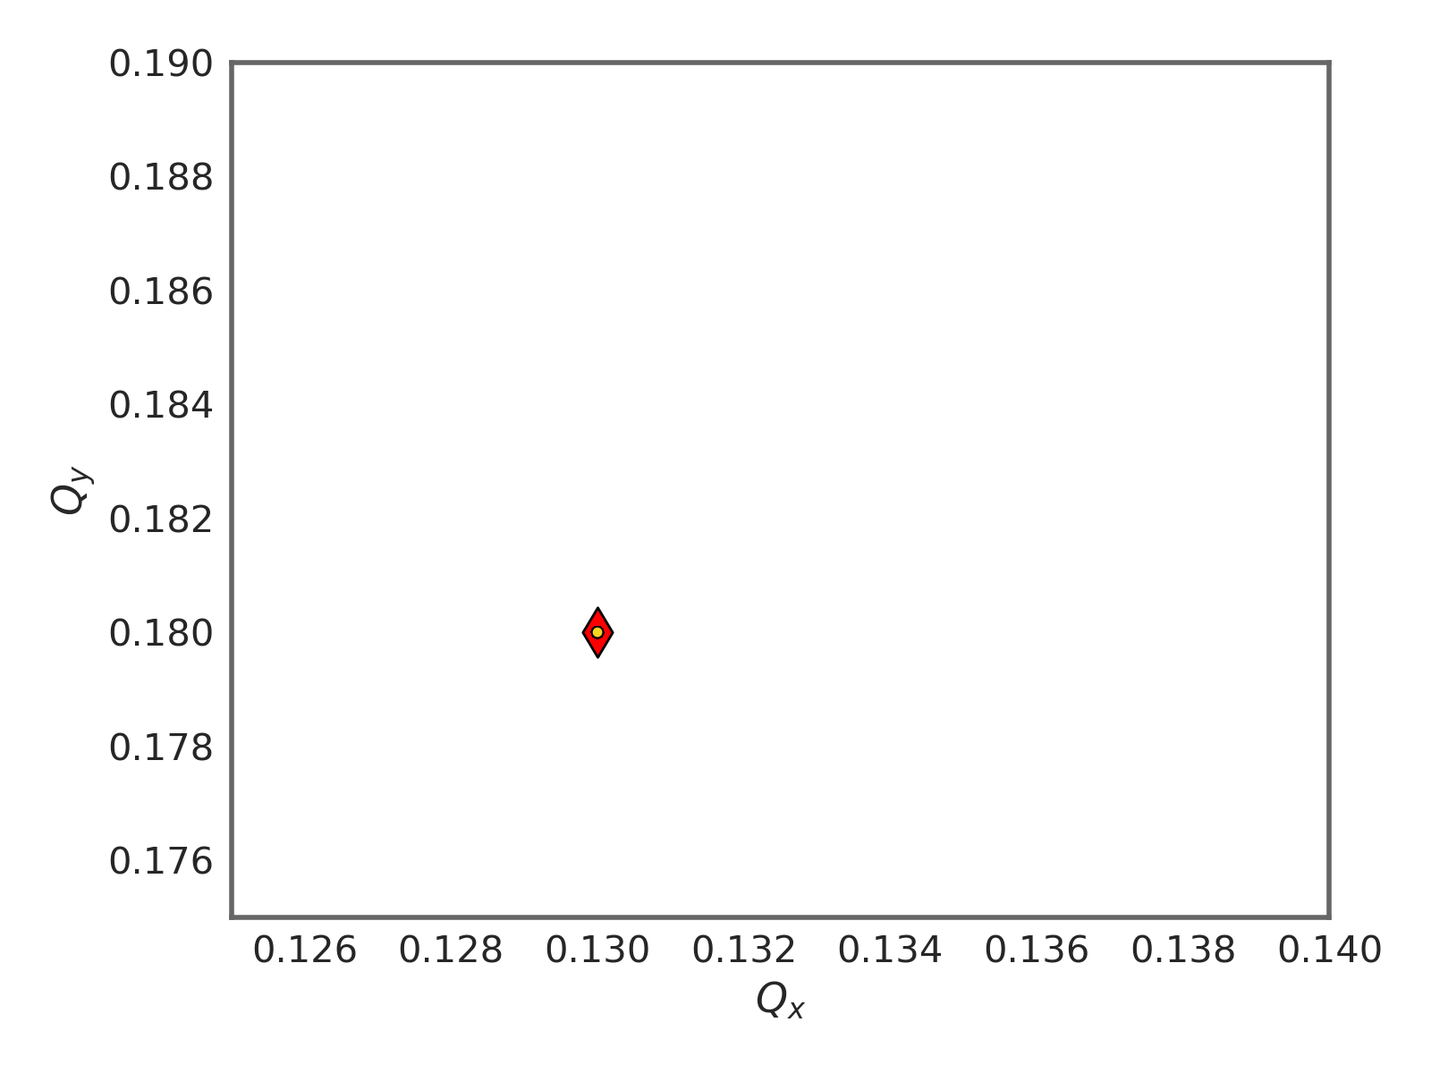
Incoherent vs. coherent motion – simulation
Let’s observe a system of five hundred particles:
  When offset, all particles move around the orbit at a constant tune and a clear and strong coherent motion is observed.
A frequency analysis of the coherent (red) line shows a clear single tune line
A frequency analysis of each particle shows that all particles are oscillating at the same tune – together with the coherent line.

Slide 27
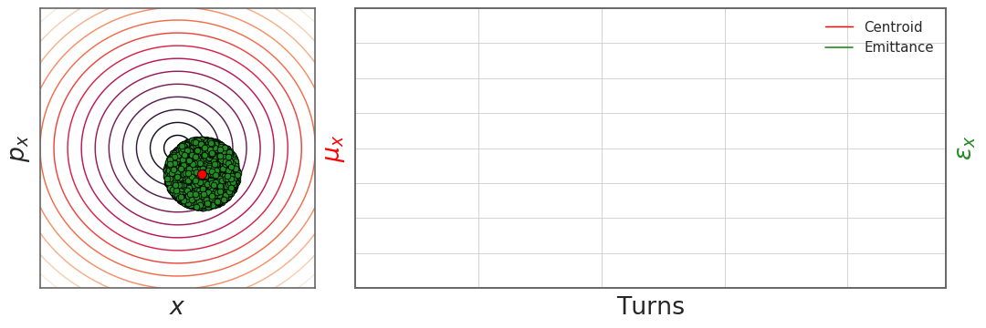
Incoherent vs. coherent motion – octupoles
Let’s observe a system of five hundred particles:
  When offset and in the presence of non-linearities (detuning with amplitude), all particles move around the orbit at different tunes. As a consequence, we can observe filamentation of the bunch in phase space. The bunch decoheres and the emittance increases.
faster
slower

Slide 28
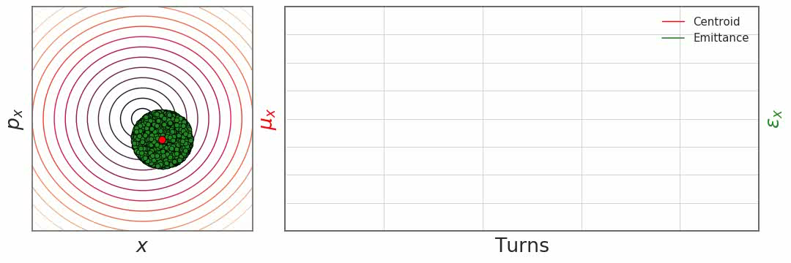
Incoherent vs. coherent motion – octupoles
Let’s observe a system of five hundred particles:
  When offset and in the presence of non-linearities (detuning with amplitude), all particles move around the orbit at different tunes. As a consequence, we can observe filamentation of the bunch in phase space. The bunch decoheres and the emittance increases.

Slide 29
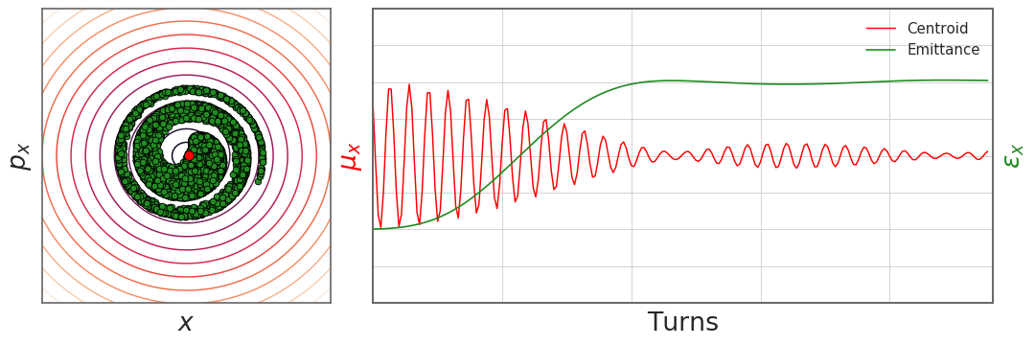
Incoherent vs. coherent motion – octupoles
Let’s observe a system of five hundred particles:
  When offset and in the presence of non-linearities (detuning with amplitude), all particles move around the orbit at different tunes. As a consequence, we can observe filamentation of the bunch in phase space. The bunch decoheres and the emittance increases.

Slide 30
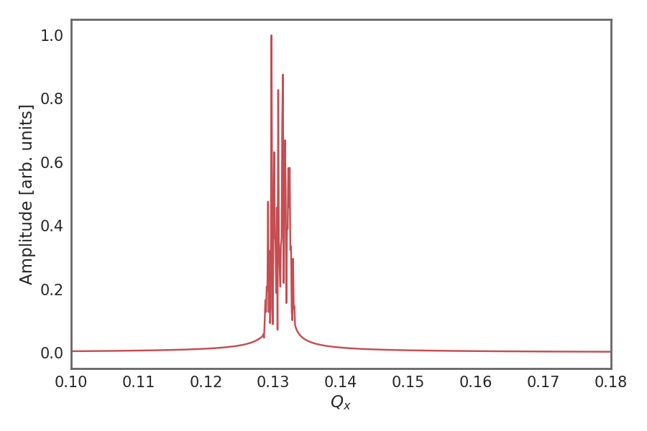
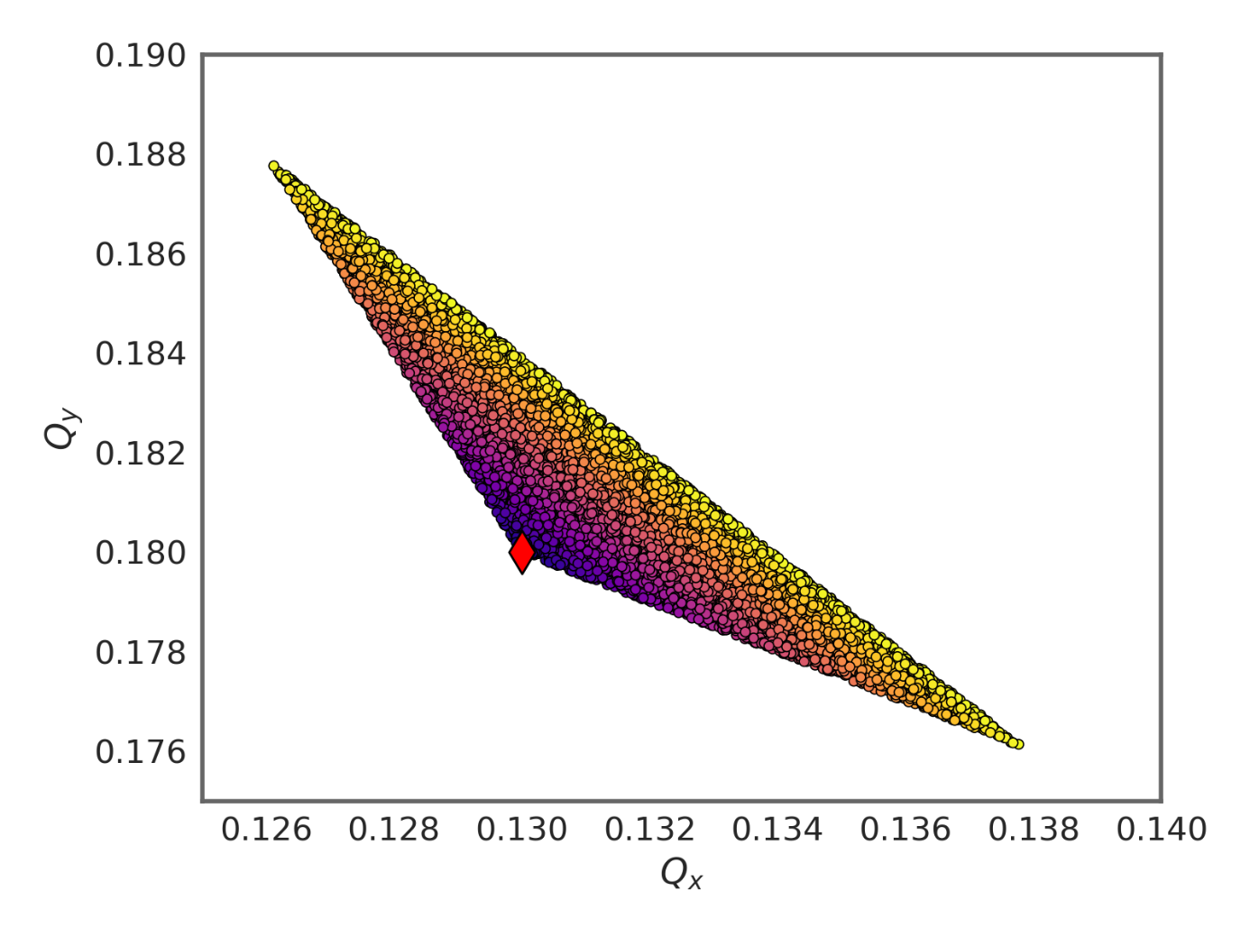
Incoherent vs. coherent motion – octupoles
Let’s observe a system of five hundred particles:
  When offset and in the presence of non-linearities (detuning with amplitude), all particles move around the orbit at different tunes. As a consequence, we can observe filamentation of the bunch in phase space. The bunch decoheres and the emittance increases.
A frequency analysis of the coherent (red) line shows a strong spread of several tune lines
A frequency analysis of each particle shows that all particles are oscillating at different tunes – dispatching from the coherent tune and forming the tune footprint in tune space

Slide 31
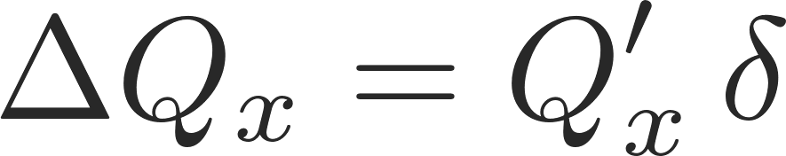
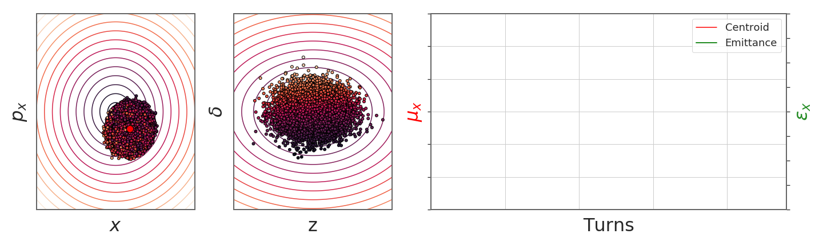
Incoherent vs. coherent motion – chromaticity
Let’s observe a system of five hundred particles:
  When offset and in the presence of chromatic effects (detuning with energy offset), all particles move around the orbit at different tunes. However, this detuning is not constant, but changes as the particles undergo synchrotron motion. As a result, the bunch decoheres but then recoheres.
faster
slower

Slide 32
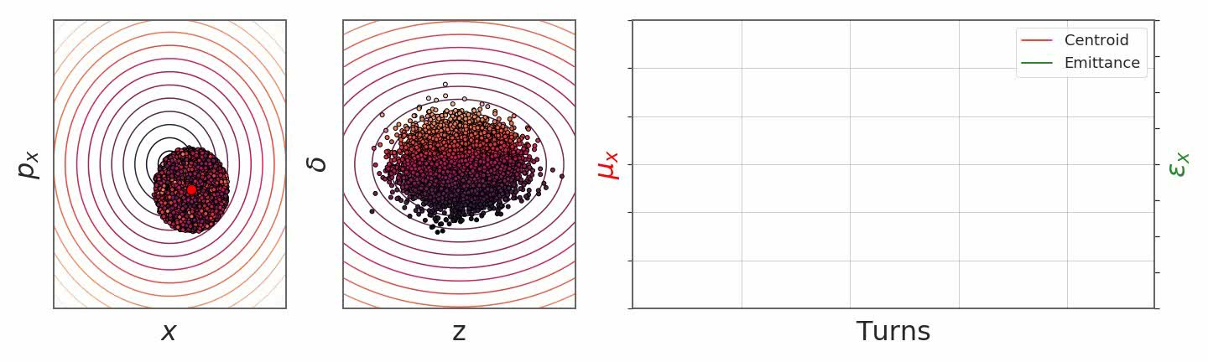
Incoherent vs. coherent motion – chromaticity
Let’s observe a system of five hundred particles:
  When offset and in the presence of chromatic effects (detuning with energy offset), all particles move around the orbit at different tunes. However, this detuning is not constant, but changes as the particles undergo synchrotron motion. As a result, the bunch decoheres but then recoheres.

Slide 33
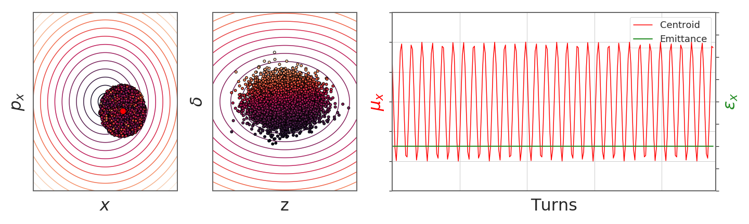
Incoherent vs. coherent motion – chromaticity
Let’s observe a system of five hundred particles:
  When offset and in the presence of chromatic effects (detuning with energy offset), all particles move around the orbit at different tunes. However, this detuning is not constant, but changes as the particles undergo synchrotron motion. As a result, the bunch decoheres but then recoheres.

Slide 34
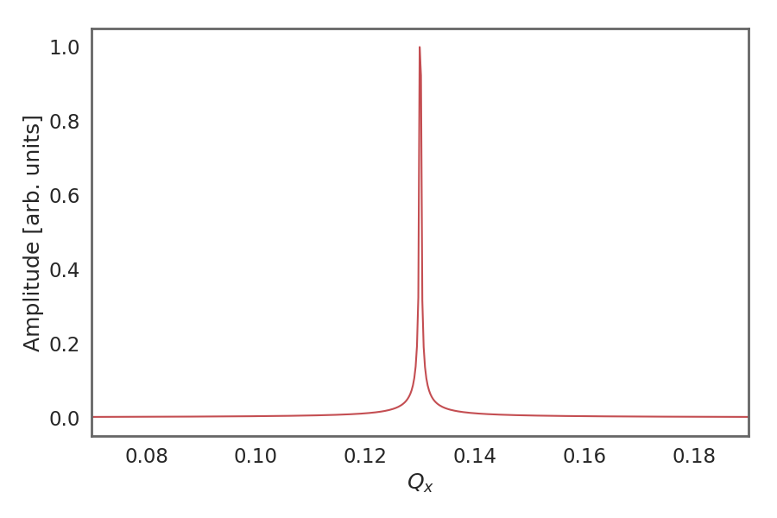
Incoherent vs. coherent motion – chromaticity
Let’s observe a system of five hundred particles:
  When offset and in the presence of chromatic effects (detuning with energy offset), all particles move around the orbit at different tunes. However, this detuning is not constant, but changes as the particles undergo synchrotron motion. As a result, the bunch decoheres but then recoheres.
A frequency analysis of the coherent (red) line shows a clear single tune line

Slide 35
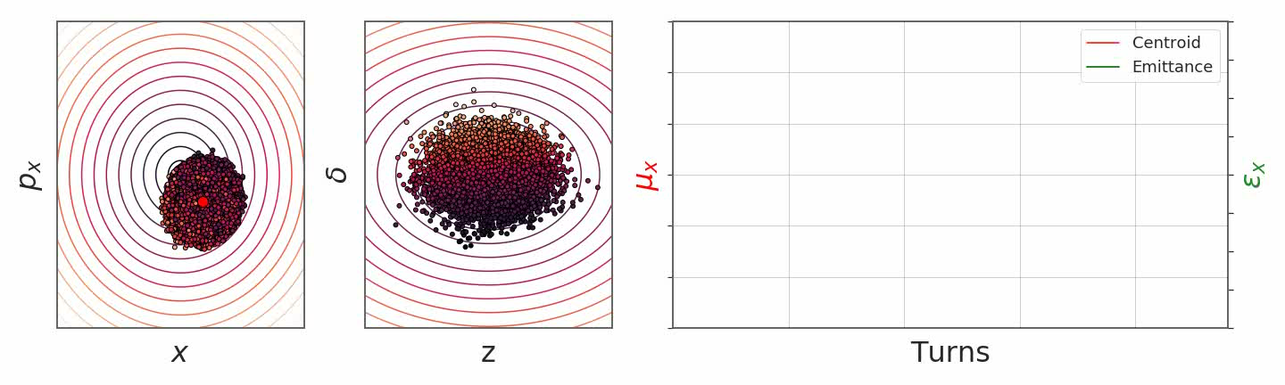
Incoherent vs. coherent motion – chromaticity
Let’s observe a system of five hundred particles:
  When offset and in the presence of chromatic effects (detuning with energy offset), all particles move around the orbit at different tunes. However, this detuning is not constant, but changes as the particles undergo synchrotron motion. As a result, the bunch decoheres but then recoheres.

Slide 36
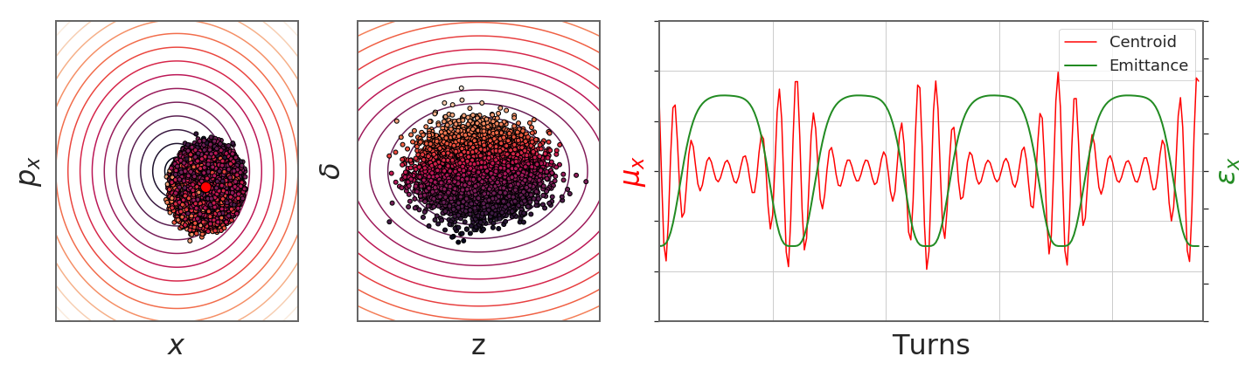
Incoherent vs. coherent motion – chromaticity
Let’s observe a system of five hundred particles:
  When offset and in the presence of chromatic effects (detuning with energy offset), all particles move around the orbit at different tunes. However, this detuning is not constant, but changes as the particles undergo synchrotron motion. As a result, the bunch decoheres but then recoheres.

Slide 37
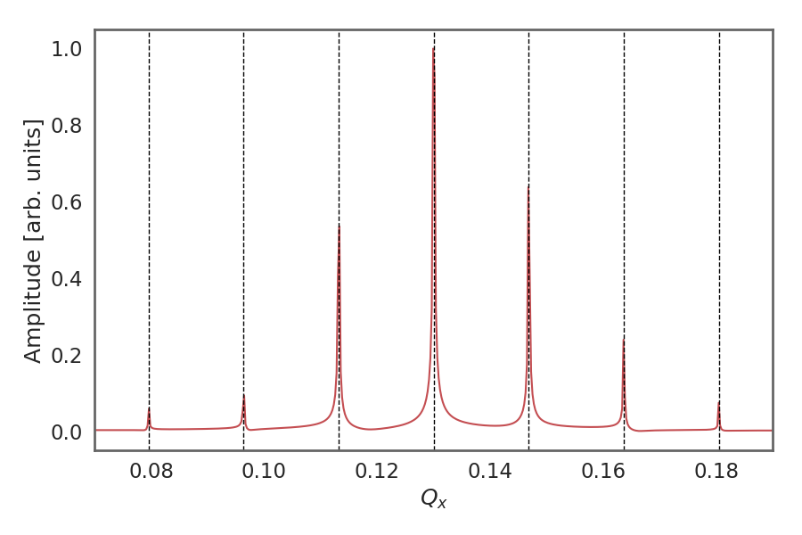
Incoherent vs. coherent motion – chromaticity
Let’s observe a system of five hundred particles:
  When offset and in the presence of chromatic effects (detuning with energy offset), all particles move around the orbit at different tunes. However, this detuning is not constant, but changes as the particles undergo synchrotron motion. As a result, the bunch decoheres but then recoheres.
A frequency analysis of the coherent (red) line shows, by virtue of the modulation with the synchrotron tune, the characteristic synchrotron sidebands.
Qs

Slide 38
Sources and impact of transverse nonlinearities
We have learned or we may know from operational experience that there are a set of crucial machine parameters to influence beam stability – among them amplitude detuning and chromaticity
Amplitude detuning
  Controlled with octupoles – provides (incoherent) tune spread
  Leads to absorption of coherent power into the incoherent spectrum → instability mitigation
Chromaticity
  Controlled with sextupoles – provides chromatic shift of bunch spectrum wrt. impedance
  Changes interaction of beam with impedance
  Damping or excitation of headtail modes

Slide 39
We have seen the difference between incoherent and coherent motion. For single particles, these are identical. However, for multi-particle systems and their dynamics there are important differences.
In this context, we have seen effects such as decoherence, filamentation and emittance blow-up. We have learned about the concept of the tune footprint.
So far, we have never taken into account any interaction among the particles. We have therefore not yet seen any collective effects. We will now look at a first collective effects which is intuitively very natural to grasp: the direct space charge effect.
Part I: Multi-particle effects – direct space charge
  Multi-particle systems and their representation
  Incoherent and coherent motion
  Direct space charge

Slide 40
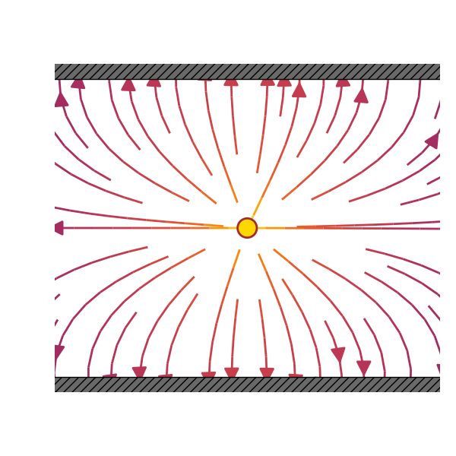
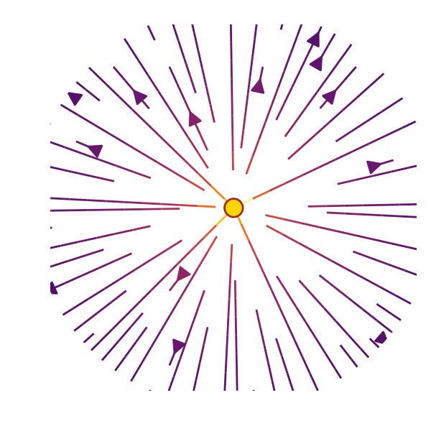
Single particle dynamics – reminder coordinates
A beam of charged particles induces electromagnetic fields when circulating inside the vacuum chamber.
These self induced fields depend on:
  beam current (intensity) and particle distribution (← collective forces!)
  geometry and material of the surrounding vacuum chamber and machine elements
When we talk about space charge we think about
Space charge effects:
cause tune shifts (transverse and longitudinal both incoherent (direct) and coherent (direct and indirect))
can result in longitudinal instability (negative mass instability)
Direct space charge:
Interaction of charged particles in free space
Indirect space charge:
Interaction with image charges and currents induced in perfect conducting walls and ferromagnetic materials close to the beam pipe

Slide 41


Two point charges with same velocity
Consider two point charges with the same charge q and with same velocity v₁=v₂=v on parallel trajectories
  In the rest frame, we know already the electric and magnetic fields generated by a “source” particle.
  The force on the “test” particle is given by the Lorentz force.
The attractive magnetic force tends to compensate the repulsive electric force
  At rest the two particles experience only the repulsive Coulomb force
  When travelling with velocity v the particles represent two parallel currents which attract each other by the induced magnetic field
  The forces become equal at the speed of light and thus cancel
Using the correct Lorentz transforms one can compute the fields in the lab frame generated by a source particle with velocity v
→ Lorentz force acting on the test particle

Slide 42

Example: coasting beam with uniform charge density

Slide 43

Example: coasting beam with uniform charge density

Slide 44



Example: coasting beam with uniform charge density

Slide 45
Example: coasting beam with uniform charge density
Direct space charge is like a defocusing quadrupole…
… however, direct space charge is always defocusing in both planes, while quadrupole is focusing in one and defocusing in the other plane

Slide 46



Direct space charge tune shift
Since the uniformly charged coasting beam acts like an additional quadrupole, it will contribute to the normal transverse focusing with an additional quadrupole focusing term:
  Hill’s equation
  Extra focusing term:
  Tune shift:
Linear force Classical particle radius
Beam envelope
Tune shift of a particle subject to the direct space charge fields of a uniform charge distribution

Slide 47
We have seen space charge as a first real collective effect. We learned that there is the direct and the indirect space charge effect. We looked at the case of a circular uniformly charged coasting beam to study an example of the direct space charge effect. We learned that the induced direct space charge fields induce tune shifts on witness particles.
We are ready to summarize our findings from this first lecture…
Let’s see now what are the implications of such direct space charge tune shifts and why these are usually bad for the stable operation of an accelerator.
Part I: Multi-particle effects – direct space charge
  Multi-particle systems and their representation
  Incoherent and coherent motion
  Space charge

Slide 48
In this lecture, we have learned about the dynamics and the representation of multiparticle systems. We have seen how we differentiate between incoherent and coherent motion. Linked to this, we looked at the phenomenon of filamentation with decoherence and emittance blow-up.
We also discussed a first collective effect – direct space charge. We saw that direct space charge, for the case of a uniform coasting beam, leads to a shift of the tune of all witness particles.
Next, we will see the space charge induced tune footprint and look at some mitigation methods that can be put in place against direct space charge. Finally, we will discuss some of the effects of indirect space charge.
Part I: Multi-particle effects – direct space charge
  Multi-particle systems and their representation
  Incoherent and coherent motion
  Space charge

Slide 49

End part 1

Slide 51
Backup

Slide 52


Single particle dynamics – frozen models
Characteristics of single particle dynamics:
  External force fields
  Independent of any given multi-particle system phase space configuration!
Examples of single particle dynamics:
  Frozen models → Bassetti-Erskine formula and tune footprint
M. Bassetti and G.A. Erskine, “Closed expression for the electrical field of a two-dimensional Gaussian charge”, CERN-ISR-TH/80-06 (1980)

Slide 53


Multi-particle dynamics – state generation
Initial conditions of the beam/particles
In practice, we can use random number generators to create random distributions of coordinates and momenta for a numerical representation of a bunch
Example transverse Gaussian beam in the SPS with normalized emittance of 2um (0.35 eVs longitudinal)
Notes:
Animates this

Slide 54




Direct space charge tune shift
After some reshuffling we notice some of the fundamental properties of the direct space charge tune shift:
is negative, because space charge transversely always defocuses
is proportional to the line density and thus to the number of particles in the beam
decreases with energy like $1/(βγ^{2})$ (when expressed in terms of normalized emittance) and therefore vanishes in the ultra-relativistic limit
does not depend on the local beta functions or beam sizes but is inversely proportional to the normalized emittance (here the emittance includes all particles!)
The direct space charge force for a beam with uniform charge distribution is linear in x and y
→ results in a direct space charge tune shift
We derive the general expression for the space charge induced tune shift in the vertical plane
Linear force Classical particle radius
Generalized Hill’s equation

Slide 55
Space charge and incoherent vs. coherent motion
Incoherent motion
  The beam consists of many particles, each of which moves inside the beam with its individual betatron amplitude, phase, and even tune (under influence of direct space charge) – amplitude and phase are distributed at random over all particles
  An outside observer (using a beam position monitor) does not see any of this random betatron motion – beam and source of the direct space-charge field do not move
Coherent motion
  A static beam given a transverse fast deflection starts to perform betatron oscillations as a whole – the source of direct space charge is now moving and individual particles continue their incoherent motion around the common coherent trajectory
  In the accelerator environment, the coherently oscillating beam induces image charges/currents which are oscillating as well – this leads to a coherent tune shift

Slide 56




Quick summary of steps for solving numerically
Tracking one full turn including the interaction with wake fields:
Initialise a macroparticle distribution with a given emittance
Update transverse coordinates and momenta according to the linear periodic transfer map – adjust the individual phase advance according to chromaticity and detuning with amplitude
Update the longitudinal coordinates and momenta according to the leap-frog integration scheme
Update momenta only (apply kicks) according to wake field generated kicks
Repeat turn-by-turn…
Wakefield

