Slide 1
A first taste of
Non-Linear Beam Dynamics
Hannes Bartosik
Accelerator and Beam Physics group
Beams Department
CERN
CERN Accelerator School
Introduction to Accelerator Physics 2024
Spain
22 September – 05 October 2024

Slide 2
Copyright statement and speaker’s release for video publishing
The author consents to the photographic, audio and video recording of this lecture at the CERN Accelerator School. The term “lecture” includes any material incorporated therein including but not limited to text, images and references.
The author hereby grants CERN a royalty-free license to use his image and name as well as the recordings mentioned above, in order to post them on the CAS website.
The author hereby confirms that to his best knowledge the content of the lecture does not infringe the copyright, intellectual property or privacy rights of any third party. The author has cited and credited any third-party contribution in accordance with applicable professional standards and legislation in matters of attribution. Nevertheless the material represent entirely standard teaching material known for more than ten years. Naturally some figures will look alike those produced by other teachers.

Slide 3
Purpose of the lecture
Introducing aspects of non-linear dynamics
  Eﬀects of nonlinear perturbations
    Resonances, tune shifts, dynamic aperture
  Mathematical tools for modelling nonlinear dynamics
    Power series (Taylor) maps and symplectic maps
  Analysis methods
    Normal forms, frequency map analysis
Illustrate methods and tools for a simple example of an accelerator
  Storage ring

Slide 4
Aim of the 1st Lecture
Provide an introduction to some of the key concepts of nonlinear dynamics in particle accelerators
Describe some of the sources of nonlinearities
Outline some of the tools used for modelling
Explain the signiﬁcance and potential impact of nonlinear dynamics in some accelerator systems

Slide 5
From Linear to Non-linear

Slide 6
From Linear to Non-linear
Particle motion through linear components such as drifts, dipoles and quadrupoles can be represented by linear transfer maps
For example, in a drift space of length , the horizontal coordinate and the (scaled) horizontal momentum from initial position 0 to a final position 1 are
Note that the horizontal momentum is
where is the relativistic factor, is the rest mass of the particle,
is the horizontal velocity, and is the reference momentum

Slide 7
From Linear to Non-linear
Linear transfer maps can be written in terms of matrices and for example for a drift space of length
In general, a linear transformation can be written as
where the phase space vectors are
The transfer matrix and the vector are constants, i.e. they do not depend on

Slide 8
From Linear to Non-linear
The transfer matrix for a section of beamline can be found by multiplying the transfer matrices for the accelerator components within that section
For periodic beamlines (i.e. a beamline constructed from a repeated unit), the transfer matrix for a single period can be parameterised in terms of the Courant–Snyder parameters and the phase advance :
S₁
S₂
S₃
…
S_{n-1}
from s₀ to s₁
S₀
S_{n}
from s₀ to s₂
from s₀ to s₃
from s₀ to s_{n}

Slide 9
From Linear to Non-linear
The characteristics of the particle motion can be represented by a phase space portrait showing the co-ordinates and momenta of a particle after an increasing number of passes through full periods of the beamline

Slide 10
From Linear to Non-linear
If the transfer map for each period is linear, then the phase space portrait is an ellipse with area
The action characterises the amplitude of the betatron oscillations – it is invariant
The shape of the ellipse is described by the Courant–Snyder parameters
The rate at which particles move around the ellipse (phase advance per period) is independent of the betatron action

Slide 11
From Linear to Non-linear
Nonlinearities in particle dynamics can come from a number of diﬀerent sources, e.g.
  Stray ﬁelds in drift spaces
  Higher-order multipole components in dipoles and quadrupoles
  Higher-order multipole magnets (sextupoles, octupoles...) used to control various properties of the beam;
  Electromagnetic fields generated by a bunch of particles, acting on individual particles within the same or another bunch (space-charge forces, beam-beam eﬀects...)
The eﬀects of nonlinearities can be quite dramatic
It is paramount to have some understanding of nonlinear dynamics for optimising the design and operation of many accelerator systems

Slide 12
Non-linear transfer maps and effects of non-linearities

Slide 13
Nonlinear transfer map: sextupole
As example, consider the vertical field component in a sextupole (i.e. a nonlinear) magnet:
with the beam rigidity and the normalized sextupole gradient
In “thin lens” approximation, the deﬂection of a particle passing through the sextupole of length is
The thin lens transfer map for the sextupole is

Slide 14
Power series representation
A nonlinear transfer map can be represented as a power series
The coeﬃcients are components of the transfer matrix
The coeﬃcients of the higher-order (nonlinear) terms are conventionally represented by (2nd order), (3rd order) and so on…
The values of the indices correspond to components of the phase space vector:

Slide 15
Example of a
periodic system:
a simple storage ring

Slide 16
A simple storage ring
As example, consider the transverse dynamics in a simple storage ring, assuming:
  The storage ring is constructed from some number of identical cells consisting of dipoles, quadrupoles and sextupoles.
  The phase advance per cell can be tuned from close to zero, up to about 0.5×2π.
  There is one sextupole per cell, which is located at a point where the horizontal beta function is 1 m, and the alpha function is zero.
  Usually, storage rings will contain (at least) two sextupoles per cell, to correct horizontal and vertical chromaticity. To keep things simple, we will use only one sextupole per cell.

Slide 17
Linear dynamics in a storage ring
The chromaticity, and hence the sextupole strength, will normally be a function of the phase advance
To investigate the nonlinear eﬀects of sextupoles, we shall keep the sextupole strength ﬁxed, and change only the phase advance
We can assume that the map from one sextupole to the next is linear, and corresponds to a rotation in phase space through an angle equal to the phase advance (as we assumed β_{x} = 1 m, and α_{x} = 0):
Again to keep things simple, we shall consider only horizontal motion, and assume that the vertical co-ordinate
Recall that in “thin lens” approximation, the deﬂection of a particle passing through the sextupole of length is

Slide 18
Nonlinear transfer map: sextupole
The map for a particle moving through a short sextupole can thus be represented by a “kick” in the horizontal momentum:
Let us choose a ﬁxed value and look at the eﬀects of the maps for diﬀerent phase advances.
For each case, we construct a phase space portrait by plotting the values of the dynamical variables after repeated application of the map (rotation + sextupole) for a range of initial conditions.
First, let us look at the phase space portraits for a range of phase advances from 0.2 × 2π to 0.5 × 2π

Slide 19
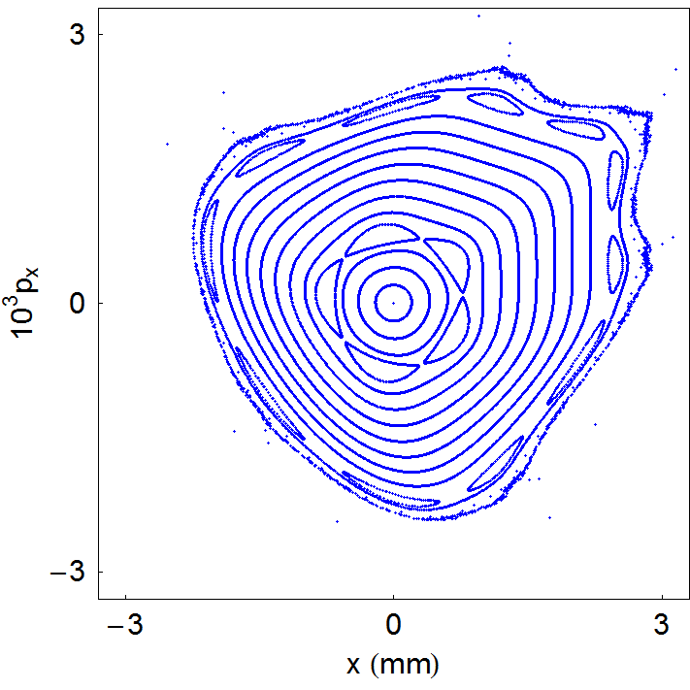
Example of a simple storage ring

Slide 20
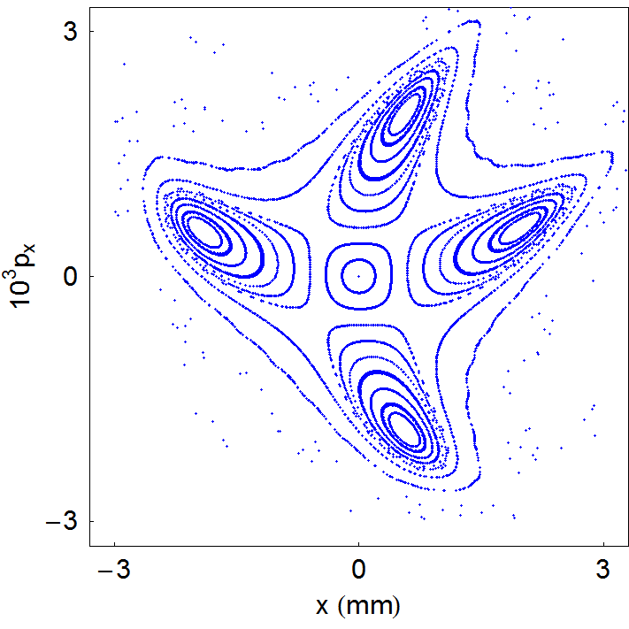
Example of a simple storage ring

Slide 21
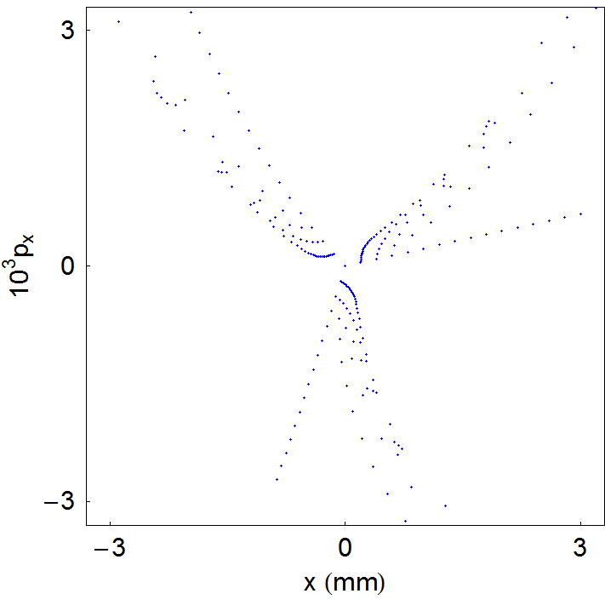
Example of a simple storage ring

Slide 22
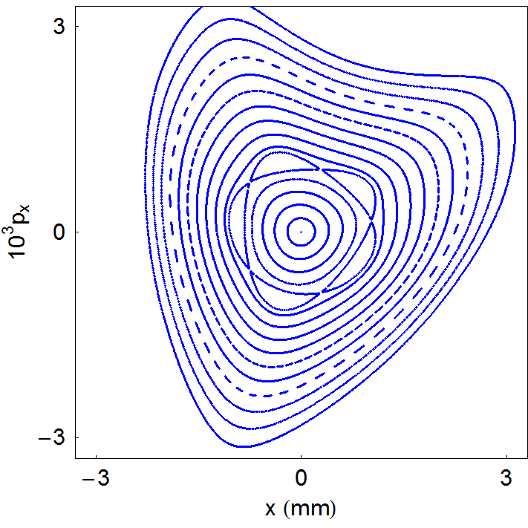
Example of a simple storage ring

Slide 23
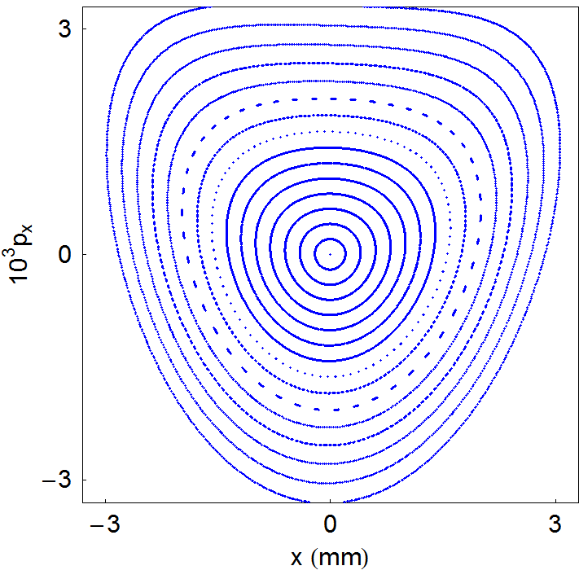
Example of a simple storage ring

Slide 24
Some observations
There are interesting features in these phase space portraits to which it is worth drawing attention:
  For small amplitudes (small x and p_{x}), particles trace out closed loops around the origin: this is what we expect for a linear map
  As the amplitude is increased, “islands” appear in phase space: the phase advance (for the linear map) is often close to m/p where m is an integer and p is the number of islands
  Sometimes, a larger number of islands appears at larger amplitude
  Usually, there is a closed curve that divides a region of stable motion from a region of unstable motion. Outside that curve, the amplitude of particles increases without limit as the map is repeatedly applied
  The area of the stable region depends strongly on the phase advance: for a phase advance close to 2π/3, it appears that the stable region almost vanishes altogether
  As the phase advance is increased towards π, the stable area becomes large, and distortions from the linear ellipse become small

Slide 25
Eﬀect of phase advance on nonlinear dynamics

Slide 26
Effect of phase advance
An important observation is that the eﬀect of the sextupole in the periodic cell depends strongly on the phase advance across the cell
We can start to understand the signiﬁcance of the phase advance by considering two special cases:
  Phase advance equal to an integer times 2π
  Phase advance equal to a half integer times 2π

Slide 27
Integer tune
  Let us consider ﬁrst a phase advance equal to an integer times 2π. In that case, the linear part of the map is just the identity
The combined eﬀect of the linear map and the sextupole kick is:
Clearly, the horizontal momentum will increase without limit
There are no stable regions of phase space, apart from

Slide 28
Half-Integer tune
Now consider what happens if the phase advance of a cell is a half integer times 2π, so the linear part of the map is just a rotation through π
If a particle starts at the entrance of a sextupole with and , then at the exit of that sextupole:
Then, after passing to the entrance of the next sextupole, the co-ordinates will be:

Slide 29
Half-Integer tune
Finally, after passing through the second sextupole:
In other words, the momentum kicks from the two sextupoles exactly cancel each other
The resulting map is a purely linear phase space rotation by π.
In this situation, we expect the motion to be stable (and periodic), independent of the amplitude

Slide 30
Impact of phase advance
The eﬀect of the phase advance on the sextupole “kicks” is similar to the eﬀect on perturbations arising from dipole and quadrupole errors in a storage ring
In the case of dipole errors, the kicks add up if the phase advance is an integer, and cancel if the phase advance is a half integer

Slide 31
Impact of phase advance
In the case of quadrupole errors, the kicks add up if the phase advance is a half integer times 2π
Higher-order multipoles drive higher-order resonances but the eﬀects are less easily illustrated on a phase space diagram

Slide 32
Resonances

Slide 33
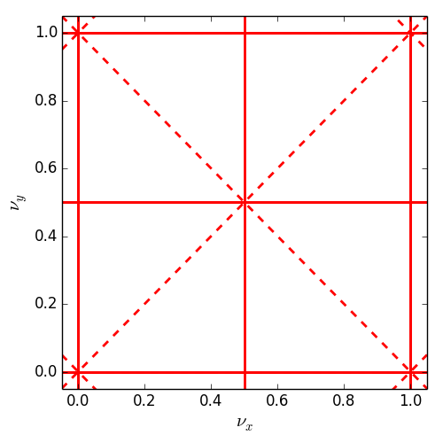
Resonances
If we include vertical as well as horizontal motion, then we find that resonances occur when the tunes satisfy
where m_{x}, m_{y} and l are integers; resonance is of order |m_{x}| + |m_{y}|
Resonances up to order 2
normal resonances
(= even m_{y})
skew resonances
(= odd m_{y})

Slide 34
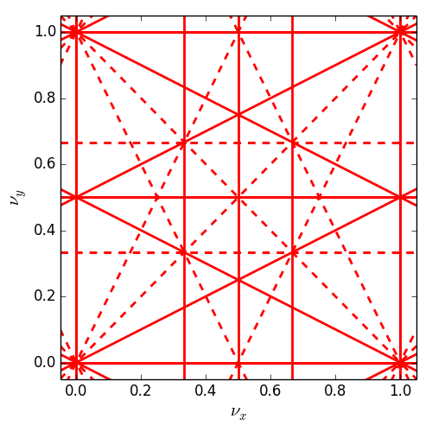
Resonances
If we include vertical as well as horizontal motion, then we find that resonances occur when the tunes satisfy
where m_{x}, m_{y} and l are integers; resonance is of order |m_{x}| + |m_{y}|
Resonances up to order 3
normal resonances
(= even m_{y})
skew resonances
(= odd m_{y})

Slide 35
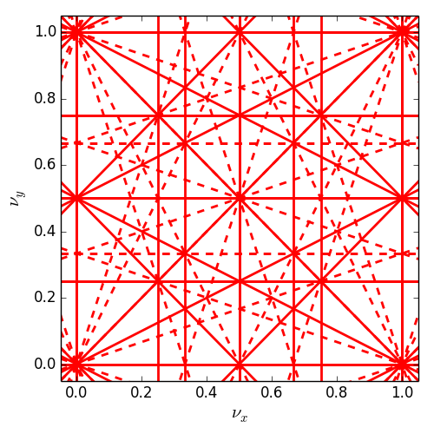
Resonances
If we include vertical as well as horizontal motion, then we find that resonances occur when the tunes satisfy
where m_{x}, m_{y} and l are integers; resonance is of order |m_{x}| + |m_{y}|
Resonances up to order 4
normal resonances
(= even m_{y})
skew resonances
(= odd m_{y})

Slide 36
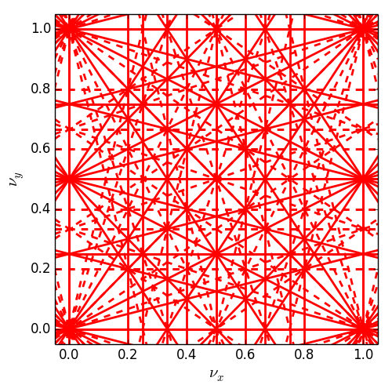
Resonances
If we include vertical as well as horizontal motion, then we find that resonances occur when the tunes satisfy
where m_{x}, m_{y} and l are integers; resonance is of order |m_{x}| + |m_{y}|
Resonances up to order 5
normal resonances
(= even m_{y})
skew resonances
(= odd m_{y})

Slide 37
Conclusions and Summary

Slide 38
Some conclusions
Nonlinear eﬀects can limit the performance of an accelerator system
Sometimes the eﬀects are small enough that they can be ignored
In many cases, a system designed without taking account of nonlinearities will not achieve the speciﬁed performance
If we analyse and understand the nonlinear behaviour of a system, then, we may be able to devise means of compensating any adverse eﬀects

Slide 39
Summary
Nonlinear eﬀects can arise from a number of sources in accelerators, including stray ﬁelds, higher-order multipole components in magnets, space-charge, ...
The transfer map for a nonlinear element (such as a sextupole) may be represented as a power series in the initial values of the phase space variables
The eﬀects of nonlinearities in accelerator systems vary widely, depending on the type of system in which they occur (e.g. a periodic accelerator)
In some cases, nonlinear eﬀects can limit the performance of an accelerator system. In such cases, it is important to take nonlinearities into account in the design of the system

Slide 40
BACK UP

Slide 41
Nonlinear eﬀects in
a bunch compressor

Slide 42
Bunch compressors
A bunch compressor reduces the length of a bunch, by performing a rotation in longitudinal phase space
Bunch compressors are used, for example, in free electron lasers to increase the peak current

Slide 43
Bunch compressors
The RF cavity is designed to “chirp” the bunch, i.e. to provide a change in energy deviation as a function of longitudinal position
within the bunch
The energy deviation of a particle with energy from a reference energy is deﬁned as:
The transfer map for the RF cavity in the bunch compressor with voltage and frequency is:

Slide 44
Bunch compressors linear dynamics
Neglecting synchrotron radiation, the chicane does not change the energy of the particles. However, the path length depends on the energy of the particle.
If we assume that the bending angle in a dipole is small:
The bending angle is a function of the energy of the particle:

Slide 45
Bunch compressors linear dynamics
The change in the co-ordinate is the diﬀerence between the nominal path length, and the length of the path actually taken by the particle
Hence, the chicane transfer map can be written:
where is the nominal bending angle of each dipole in the chicane, and is given by
Clearly, the complete transfer map for the bunch compressor is nonlinear, but how important are the nonlinear terms?

Slide 46
Bunch compressors linear dynamics
To understand the eﬀects of the nonlinear part of the map, we will study a speciﬁc example
First, we will “design” a bunch compressor using only the linear part of the map
The linear part of a transfer map can be obtained by expanding the map as a Taylor series in the dynamical variables, and keeping only the ﬁrst-order terms
After ﬁnding appropriate values for the various parameters using the linear transfer map, we shall see how our design has to be modiﬁed to take account of the nonlinearities

Slide 47
Bunch compressors linear dynamics
To ﬁrst order in the dynamical variables, the map for the RF cavity can be written:
with
The map for the chicane is
with

Slide 48
Bunch compressors linear dynamics
As a speciﬁc example, consider a bunch compressor for the International Linear Collider (ILC)
Two constraints determine the values of and
  The bunch length should be reduced by a factor 20
  There should be no “chirp” on the bunch at the exit of the bunch compressor
With these constraints, we ﬁnd (see Appendix):

Slide 49
Bunch compressors linear dynamics
We can illustrate the eﬀect of the linearised bunch compressor map on phase space using an artiﬁcial “window frame” distribution:
The rms bunch length is reduced by a factor of 20 as required, but the rms energy spread is increased by the same factor, because the transfer map is symplectic, so phase space areas are conserved under the transformation

Slide 50
Bunch compressors non-linear dynamics
Let’s apply now the full nonlinear map for the bunch compressor.
We need first to make some assumptions for the RF voltage and frequency, and the dipole bending angle and chicane length in order for the coefficient and to have the appropriate values

Slide 51
Bunch compressors non-linear dynamics
As before, we illustrate the eﬀect of the bunch compressor map on phase space using a “window frame” distribution:
Although the bunch length has been reduced, there is signiﬁcant distortion of the distribution: the rms bunch length will be signiﬁcantly longer than what we are aiming for
To reduce the distortion, we need to understand where it comes from
In the phase space shown above, we see a quadratic dependence of the final particle position on the initial particle position .

Slide 52
Bunch compressors non-linear dynamics
Consider a particle entering the bunch compressor with initial phase space co-ordinates and . We can write the co-ordinates and of the particle after the RF cavity to 2nd order in and :
The co-ordinates of the particle after the chicane are (to 2nd order):
If we combine the maps for the RF and the chicane, we get:

Slide 53
Bunch compressors non-linear dynamics
In order to eliminate the strong non-linear distortion, we have to eliminate the second term, i.e.
By expanding the original map,
as a Taylor series in , we find that for small angles:
Now, it remains to determine , i.e. the coefficient for the second-order dependence of the energy deviation on longitudinal position

Slide 54
Bunch compressors non-linear dynamics
The map of the energy deviation
contains only odd order terms unless the RF cavity is operated out of phase, i.e.
The ﬁrst and second order coeﬃcients in the transfer map for the energy deviation are:
and

Slide 55
Bunch compressors non-linear dynamics
Recall that and
We also obtain
By imposing , we have that
Using the expressions
and
the voltage and phase are determined as
and

Slide 56
Bunch compressors non-linear dynamics
As before, we illustrate the eﬀect of the bunch compressor on phase space using a “window frame” distribution, using the parameters determined above, to try to compress by a factor 20, while minimising the second-order distortion:
The dominant distortion now appears to be 3rd order, and looks small enough that it should not signiﬁcantly aﬀect the performance

