Slide 1



Particle motion in Hamiltonian Formalism I
Yannis PAPAPHILIPPOU
Accelerator and Beam Physics group
Beams Department, CERN
CERN Accelerator School
Introduction to Accelerator Physics
Santa Susanna, Spain
September 22nd – October 5th, 2024

Slide 2
Copyright statement and speaker’s release for video publishing
The author consents to the photographic, audio and video recording of this lecture at the CERN Accelerator School. The term “lecture” includes any material incorporated therein including but not limited to text, images and references.
The author hereby grants CERN a royalty-free license to use his image and name as well as the recordings mentioned above, in order to post them on the CAS website.
The material is used for the sole purpose of illustration for teaching or scientific research. The author hereby confirms that to his best knowledge the content of the lecture does not infringe the copyright, intellectual property or privacy rights of any third party. The author has cited and credited any third-party contribution in accordance with applicable professional standards and legislation in matters of attribution.

Slide 3
Purpose
The objective is finding methods to derive and solve (integrate) equations of motion, in order to describe the evolution (dependence with “time”) of a system (“particle”)
Introduce formalism of theoretical (classical) mechanics for analysing motion in general (linear or non-linear) dynamical systems, including particle accelerators
Connect this formalism with concepts already studied in the introductory CAS (matrices for transverse motion, synchrotron motion, invariants,…)
Prepare the ground for approaches followed for studying non-linear particle motion in accelerators (in the advanced CAS)

Slide 4
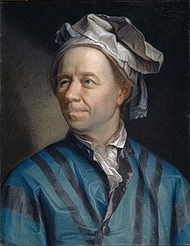
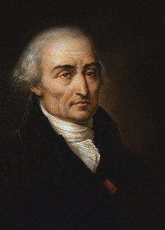
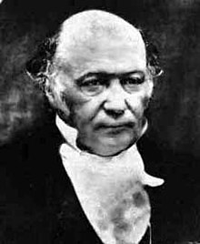
Principles of classical mechanics
Some key concepts of classical (analytical) mechanics reviewed in this lecture, including
  Integrals of motion
  Integration by quadrature
  Period and Frequency
  Hamilton’s principle
  Lagrangian, Euler-Lagrange equations
  Hamiltonian, Hamilton’s equations
  Canonical variables, Symplecticity
  Poisson brackets
  Canonical transformations
Euler
Lagrange
Hamilton

Slide 5
Equations of motion
Notes:
Tabor 53-54

Slide 6
Reminder: Newton’s law
The motion of a “classical” particle in a force field is described by Newton’s law:
with the position
the momentum
the force
the corresponding potential
It is essential to solve (integrate) the differential equation for understanding the evolution of the physical (dynamical) system

Slide 7
Reminder: Harmonic oscillator
A linear restoring force (Harmonic oscillator) is described by
with
u
u

Slide 8
Reminder: Harmonic oscillator
A linear restoring force (Harmonic oscillator) is described by
The solution obtained by substitution
with

Slide 9
Reminder: Harmonic oscillator
A linear restoring force (Harmonic oscillator) is described by
The solution obtained by substitution
  through the characteristic polynomial , which yields the general solution
with the ”velocity”
with

Slide 10
Reminder: Harmonic oscillator
A linear restoring force (Harmonic oscillator) is described by
The solution obtained by substitution
  through the characteristic polynomial , which yields the general solution
with the ”velocity”
Note that a negative sign in the differential equation provides a solution described by hyperbolic sine/cosine functions
Note also that for no restoring force , the motion is unbounded
with

Slide 11
Matrix solution
The amplitude and phase depend on the initial conditions
The solutions can be re-written thus as

Slide 12
Matrix solution
The amplitude and phase depend on the initial conditions
The solutions can be re-written thus as
or in matrix form

Slide 13
Matrix solution
The amplitude and phase depend on the initial conditions
The solutions can be re-written thus as
or in matrix form
By replacing and , this becomes the solution of a quadrupole (see Transverse Linear Beam Dynamics lectures)

Slide 14
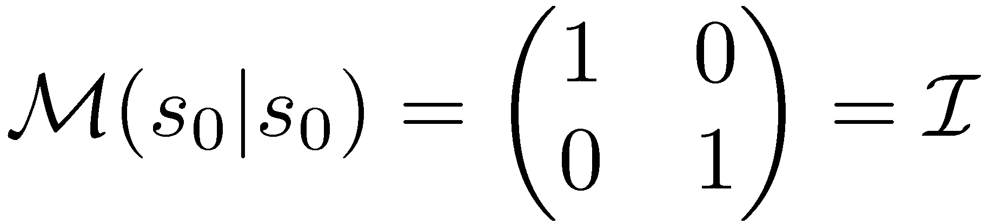
Matrix formalism
General transfer matrix from s₀ to s
Note that
which is always true for conservative systems (”energy” is constant)
Note also that

Slide 15
Matrix formalism
General transfer matrix from s₀ to s
Note that
which is always true for conservative systems (”energy” is constant)
Note also that
The general solution can be built by a series of matrix multiplications
S₁
S₂
S₃
…
S_{n-1}
from s₀ to s₁
S₀
S_{n}
from s₀ to s₂
from s₀ to s₃
from s₀ to s_{n}
(see Transverse Linear Beam Dynamics lectures)

Slide 16
Integral of motion
Rewrite the differential equation of the harmonic oscillator as a pair of coupled 1st order equations

Slide 17
Integral of motion
Rewrite the differential equation of the harmonic oscillator as a pair of coupled 1st order equations.
  By dividing the two sides of the equations, they can be combined to provide
  or
  with an integral of motion
  identified as the mechanical energy of the system

Slide 18
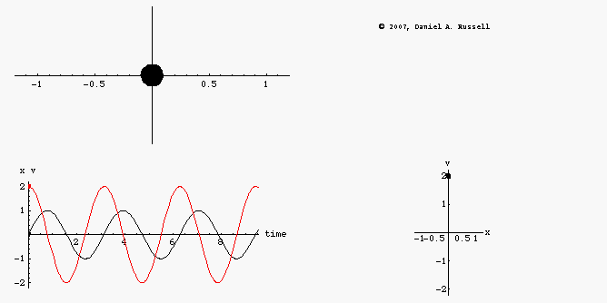
Integral of motion
The equation describes in general an ellipse in phase space
see link
Solving the previous equation for , the system can be reduced to a first order equation

Slide 19
Integration by quadrature
The last equation can be solved as an explicit integral or “quadrature”
  , yielding
  or the well-known solution

Slide 20
Integration by quadrature
The last equation can be solved as an explicit integral or “quadrature”
  , yielding
  or the well-known solution
Note: Although the previous route may seem complicated, it becomes more natural when non-linear terms appear, where an ansatz of the type is not applicable

Slide 21
Integration by quadrature
The last equation can be solved as an explicit integral or “quadrature”
  , yielding
  or the well-known solution
Note: Although the previous route may seem complicated, it becomes more natural when non-linear terms appear, where an ansatz of the type is not applicable
The ability to integrate a differential equation is not just a nice mathematical feature, but deeply characterizes the dynamical behavior of the system described by the equation

Slide 22
Frequency of motion
The period of the harmonic oscillator is calculated through the previous integral after integration between two extrema (when the velocity vanishes), i.e. :

Slide 23
Frequency of motion
The period of the harmonic oscillator is calculated through the previous integral after integration between two extrema (when the velocity vanishes), i.e. :
The period (or the frequency) of linear systems is independent of the integral of motion (energy)

Slide 24
Frequency of motion
The period of the harmonic oscillator is calculated through the previous integral after integration between two extrema (when the velocity vanishes), i.e. :
The period (or the frequency) of linear systems is independent of the integral of motion (energy)
Note that this is not true for non-linear systems, e.g. for an oscillator with a non-linear restoring force
The integral of motion is and the
integration yields

Slide 25
Frequency of motion
The period of the harmonic oscillator is calculated through the previous integral after integration between two extrema (when the velocity vanishes), i.e. :
The period (or the frequency) of linear systems is independent of the integral of motion (energy)
Note that this is not true for non-linear systems, e.g. for an oscillator with a non-linear restoring force
The integral of motion is and the
integration yields
This means that the period (frequency) depends on the integral of motion (energy) i.e. the maximum “amplitude”

Slide 26
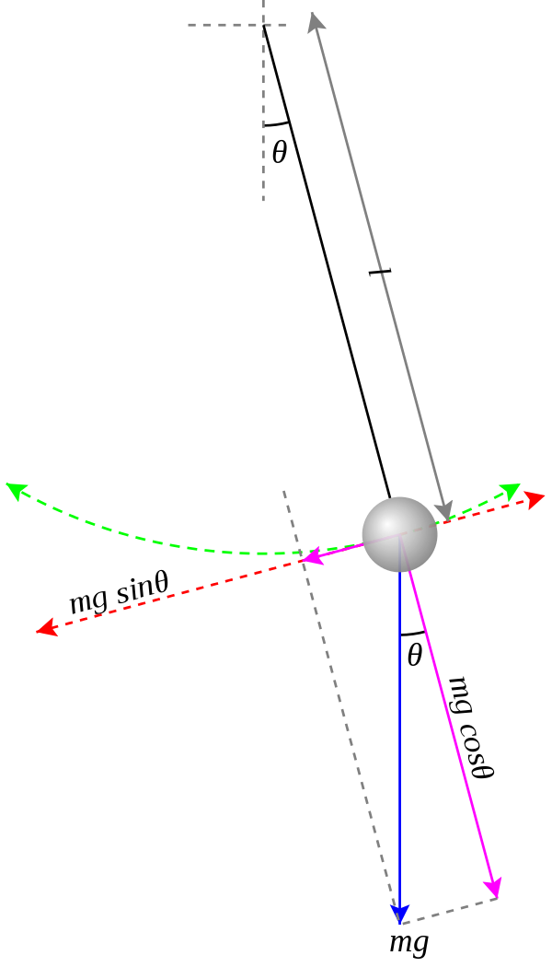
The pendulum
An important non-linear equation which can be integrated is the one of the pendulum, for a string of length L and gravitational constant g
For small displacements it reduces to a harmonic oscillator with frequency
By appropriate substitutions, this becomes the equation of synchrotron motion (see Longitudinal beam dynamics lectures)

Slide 27
Solution for the pendulum
The integral of motion (scaled energy) is
and the quadrature is written as assuming that for

Slide 28
Solution for the pendulum
The integral of motion (scaled energy) is
and the quadrature is written as assuming that for
Using the substitutions with , the integral is
and can be solved using Jacobi elliptic functions:
with “ ” representing the Jacobi elliptic sine

Slide 29
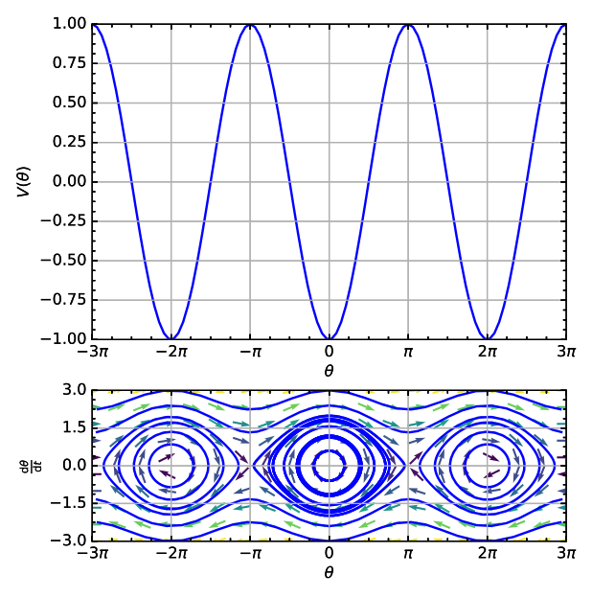
Solution for the pendulum
Minima and maxima of the potential correspond to stable and unstable fixed points

Slide 30
Period of the pendulum
For recovering the period, the integration is performed between the two extrema, i.e. and , corresponding to and

Slide 31
Period of the pendulum
For recovering the period, the integration is performed between the two extrema, i.e. and , corresponding to and
The period is i.e. the complete elliptic integral multiplied by four times the period of the harmonic oscillator

Slide 32
Period of the pendulum
For recovering the period, the integration is performed between the two extrema, i.e. and , corresponding to and
The period is i.e. the complete elliptic integral multiplied by four times the period of the harmonic oscillator
By expanding with , the “amplitude” dependence of the frequency becomes apparent

Slide 33
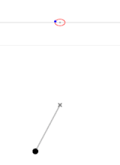
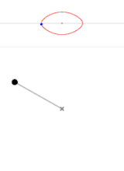
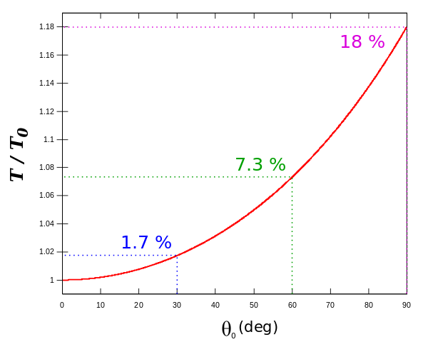
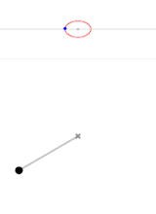
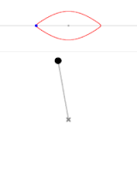
Period of the pendulum
The deviation from the linear approximation becomes important at large amplitudes
The dependence of frequency with amplitude (spread) is useful for (Landau) damping (“beam”) instabilities

Slide 34
Langrangian and Hamiltonian
Notes:
Tabor 53-54

Slide 35
Lagrangian formalism
Describe motion of particles in q_{n} coordinates (n degrees of freedom) from time t₁ to time t₂
It can be achieved by the Lagrangian function with the generalized coordinates and the generalized velocities
Notes:
Tabor 53-54

Slide 36
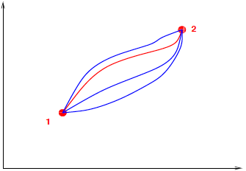
Lagrangian formalism
Describe motion of particles in q_{n} coordinates (n degrees of freedom) from time t₁ to time t₂
It can be achieved by the Lagrangian function with the generalized coordinates and the generalized velocities
The Lagrangian is defined as , i.e. difference between kinetic and potential energy
The integral defines the action
Hamilton’s principle: system evolves so as the action becomes extremum (principle of stationary action)
Notes:
Tabor 53-54

Slide 37
Euler- Lagrange equations
By using Hamilton’s principle, i.e. , over some time interval t₁ and t₂ for two stationary points (see appendix), the following differential equations for each degree of freedom are obtained, the Euler-Lagrange equations
Notes:
Tabor 53-54

Slide 38
Euler- Lagrange equations
By using Hamilton’s principle, i.e. , over some time interval t₁ and t₂ for two stationary points (see appendix), the following differential equations for each degree of freedom are obtained, the Euler-Lagrange equations
In other words, by knowing the form of the Lagrangian, the equations of motion can be derived
Notes:
Tabor 53-54

Slide 39
Lagrangian mechanics
For a simple force law contained in a potential function, governing motion among interacting particles, the (classical) Lagrangian is (or as Landau-Lifshitz put it “experience has shown that…”)
For velocity independent potentials, Lagrange equations become i.e. Newton’s equations.
Notes:
Tabor 53-54

Slide 40
From Lagrangian to Hamiltonian
Some disadvantages of the Lagrangian formalism:
  No uniqueness: different Lagrangians can lead to same equations
  Physical significance not straightforward (even its basic form given more by “experience” and the fact that it actually works that way!)
Note: The (relativistic) Lagrangian is very useful in particle physics (invariant under Lorentz transformations)
Notes:
Tabor 48-52

Slide 41
From Lagrangian to Hamiltonian
Some disadvantages of the Lagrangian formalism:
  No uniqueness: different Lagrangians can lead to same equations
  Physical significance not straightforward (even its basic form given more by “experience” and the fact that it actually works that way!)
Note: The (relativistic) Lagrangian is very useful in particle physics (invariant under Lorentz transformations)
Lagrangian function provides in general second order differential equations (coordinate space)
Already observed advantage to move to system of first order differential equations, which are more straightforward to solve (phase space)
Derived by the Hamiltonian of the system
Notes:
Tabor 48-52

Slide 42
Hamiltonian formalism
The Hamiltonian of the system is defined as the Legendre transformation of the Lagrangian where the generalised momenta are
Notes:
Tabor 53-54

Slide 43
Hamiltonian formalism
The Hamiltonian of the system is defined as the Legendre transformation of the Lagrangian where the generalised momenta are
The generalised velocities can be expressed as a function of the generalised momenta if the previous equation is invertible, and thereby define the Hamiltonian of the system
Notes:
Tabor 53-54

Slide 44
Hamiltonian formalism
The Hamiltonian of the system is defined as the Legendre transformation of the Lagrangian where the generalised momenta are
The generalised velocities can be expressed as a function of the generalised momenta if the previous equation is invertible, and thereby define the Hamiltonian of the system
Example: consider
From this, the momentum can be determined as which can be trivially inverted to provide the Hamiltonian
Notes:
Tabor 53-54

Slide 45
Hamilton’s equations
The equations of motion can be derived from the Hamiltonian following the same variational principle as for the Lagrangian (“stationary” action) but also by simply taking the differential of the Hamiltonian (see appendix)
Notes:
Tabor 53-54

Slide 46
Hamilton’s equations
The equations of motion can be derived from the Hamiltonian following the same variational principle as for the Lagrangian (“stationary” action) but also by simply taking the differential of the Hamiltonian (see appendix)
These are indeed equations describing the motion in the “extended” phase space
Notes:
Tabor 53-54

Slide 47
Properties of Hamiltonian flow
The variables are called canonically conjugate (or canonical) and define the evolution of the system in phase space
These variables have the special property that they preserve volume in phase space, i.e. satisfy the well-known Liouville’s theorem
The variables used in the Lagrangian do not necessarily have this property
Notes:
Tabor 53-54

Slide 48
Properties of Hamiltonian
The variables are called canonically conjugate (or canonical) and define the evolution of the system in phase space
These variables have the special property that they preserve volume in phase space, i.e. satisfy the well-known Liouville’s theorem
The variables used in the Lagrangian do not necessarily have this property
Hamilton’s equations can be written in vector form with and
The matrix is called the symplectic matrix
Notes:
Tabor 53-54

Slide 49
Poisson brackets
Crucial step in study of Hamiltonian systems is identification of integrals of motion
Consider a time dependent function of phase space. Its time evolution is given by
where is the Poisson bracket of with
Notes:
Tabor 48-52

Slide 50
Poisson brackets
Crucial step in study of Hamiltonian systems is identification of integrals of motion
Consider a time dependent function of phase space. Its time evolution is given by
where is the Poisson bracket of with
If a quantity is explicitly time-independent and its Poisson bracket with the Hamiltonian vanishes (i.e. commutes with ), it is a constant (or integral) of motion (as an autonomous Hamiltonian itself)
Notes:
Tabor 48-52

Slide 51
Canonical transformations
Notes:
Tabor 53-54

Slide 52
Canonical Transformations
Find a function for transforming the Hamiltonian from variable to , so system becomes simpler to study
Transformation should be canonical (or symplectic), so that Hamiltonian properties (phase-space volume) are preserved
Notes:
Tabor 54-62

Slide 53
Canonical Transformations
Find a function for transforming the Hamiltonian from variable to , so system becomes simpler to study
Transformation should be canonical (or symplectic), so that Hamiltonian properties (phase-space volume) are preserved
These “mixed variable” generating functions are derived by
A general non-autonomous Hamiltonian is transformed to
Notes:
Tabor 54-62

Slide 54
Canonical Transformations
Find a function for transforming the Hamiltonian from variable to , so system becomes simpler to study
Transformation should be canonical (or symplectic), so that Hamiltonian properties (phase-space volume) are preserved
These “mixed variable” generating functions are derived by
A general non-autonomous Hamiltonian is transformed to
One generating function can be constructed by the other through Legendre transformations, e.g.
with the inner product defined as
Notes:
Tabor 54-62

Slide 55
Preservation of Phase Volume
A fundamental property of canonical transformations is the preservation of phase space volume
This volume preservation in phase space can be represented in the old and new variables as
Notes:
Tabor 54-62

Slide 56
Preservation of Phase Volume
A fundamental property of canonical transformations is the preservation of phase space volume
This volume preservation in phase space can be represented in the old and new variables as
The volume elements in old and new variables are related through the Jacobian
Notes:
Tabor 54-62

Slide 57
Preservation of Phase Volume
A fundamental property of canonical transformations is the preservation of phase space volume
This volume preservation in phase space can be represented in the old and new variables as
The volume elements in old and new variables are related through the Jacobian
These two relationships imply that the Jacobian of a canonical transformation should have determinant equal to 1
Notes:
Tabor 54-62

Slide 58
Examples of transformations
The transformation , which interchanges conjugate variables is area preserving, as the Jacobian is
Notes:
Tabor 54-62

Slide 59
Examples of transformations
The transformation , which interchanges conjugate variables is area preserving, as the Jacobian is
On the other hand, the transformation from Cartesian to polar coordinates is not, since
Notes:
Tabor 54-62

Slide 60
Examples of transformations
The transformation , which interchanges conjugate variables is area preserving, as the Jacobian is
On the other hand, the transformation from Cartesian to polar coordinates is not, since
There are actually “polar” coordinates that are canonical, given by for which
Notes:
Tabor 54-62

Slide 61
Summary of Lecture I
2nd order dif. equations of motion from Newton’s law (configuration space) can be solved by transforming them to pairs of 1st order ones (in phase space)
Natural appearance of invariant of motion (“energy”)
Non-linear oscillators have frequencies which depend on the invariant (or “amplitude”)
Connected invariant of motion to system’s Hamiltonian (derived through Lagrangian)
Shown that through the Hamiltonian , the equations of motions can be derived
Poisson bracket operators are helpful for discovering integrals of motion
Canonical (or symplectic) transformations are necessary for preserving the phase space-volume

Slide 62
Appendix

Slide 63
Derivation of Lagrange equations
The variation of the action can be written as
Taking into account that , the 2nd part of the integral can be integrated by parts giving
The first term is zero because so the second integrant should also vanish, providing the following differential equations for each degree of freedom, the Lagrange equations
Notes:
Tabor 53-54

Slide 64
Derivation of Hamilton’s equations
The equations of motion can be derived from the Hamiltonian following the same variational principle as for the Lagrangian (“least” action) but also by simply taking the differential of the Hamiltonian
Notes:
Tabor 53-54

Slide 65
Derivation of Hamilton’s equations
The equations of motion can be derived from the Hamiltonian following the same variational principle as for the Lagrangian (“least” action) but also by simply taking the differential of the Hamiltonian or
By equating terms, Hamilton’s equations are derived
These are indeed equations describing the motion in the “extended” phase space
Notes:
Tabor 53-54

Slide 66
Poisson brackets’ properties
The Poisson brackets between two functions of a set of canonical variables can be defined by the differential operator
Notes:
Tabor 48-52

Slide 67
Poisson brackets’ properties
The Poisson brackets between two functions of a set of canonical variables can be defined by the differential operator
From this definition, and for any three given functions, the following properties can be shown bilinearity
anticommutativity
Jacobi’s identity
Leibniz’s rule
Poisson brackets operation satisfies a Lie algebra
Notes:
Tabor 48-52

Slide 68
Preservation of Phase Volume
A fundamental property of Hamiltonian systems is the preservation of phase space volume as they evolve
Let’s have a system evolving from after time . By Taylor-expanding and using Hamilton’s equations we have:
Differentiating, we have
Multiplying the two equations
Notes:
Tabor 54-62

