Slide 1
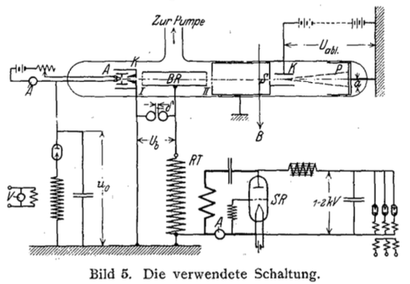
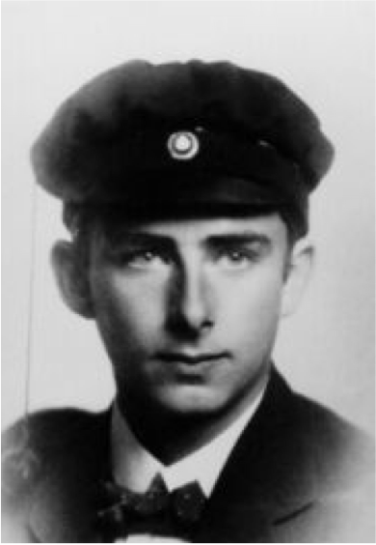
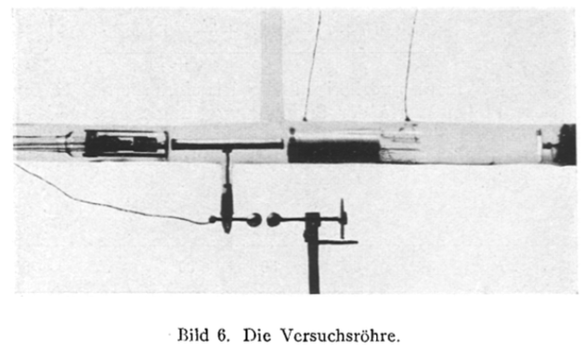
Few words on Accelerators
The CERN Accelerator Complex
Acceleration using RF
Rolf Wideroe – Thesis (1926)
First resonant accelerator
Ilias Efthymiopoulos Ph.D. – Accelerators Physics Group (ABP)
ATSOA – 03.06.2024, CERN

Slide 2
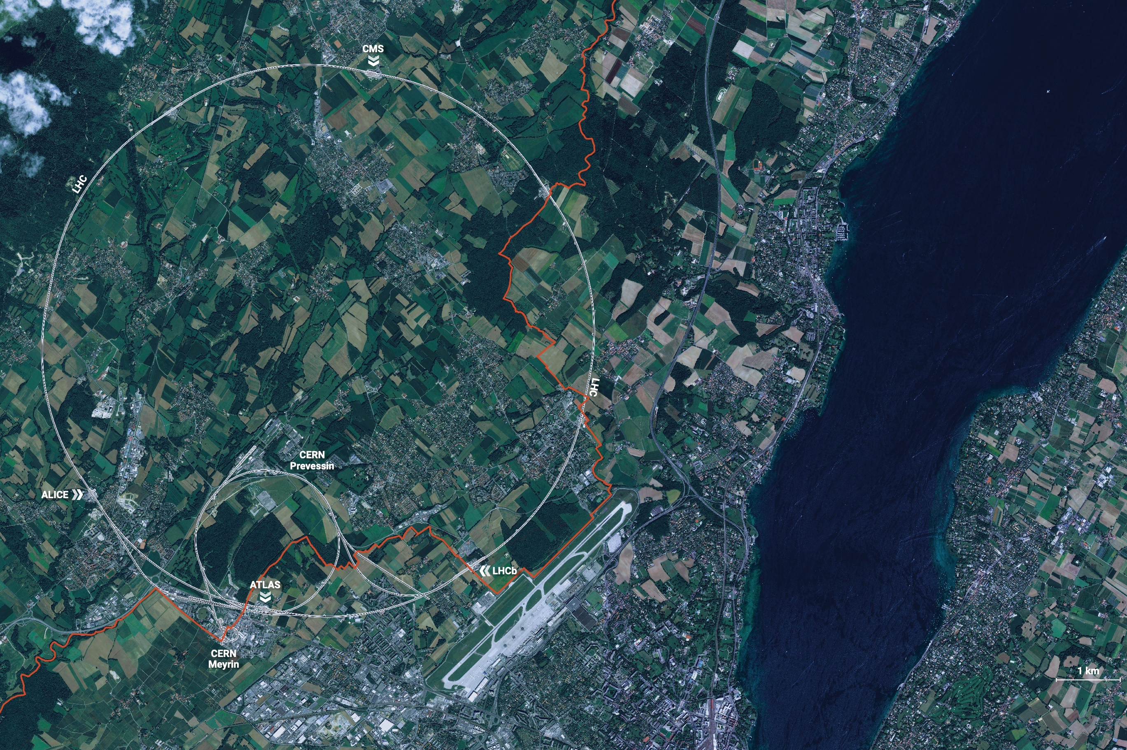
The CERN
CERN is the world’s biggest laboratory
for particle physics.
CERN’s mission: explore the origins of matter using high-energy particles, understand the fundamental particles and laws
Pillars in CERN’s mission
  Research
  Technology & Innovation
  Education & Training
  Collabration (world – wide)

Slide 3
What are the accelerators?
The accelerators or strictly speaking
the charged particle accelerators
Are electromechanical systems “machines” capable of producing high-energy particle beams

Slide 4
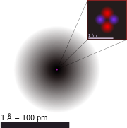
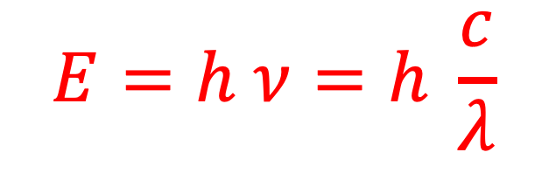
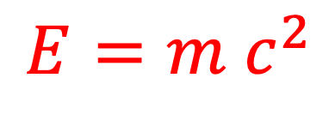
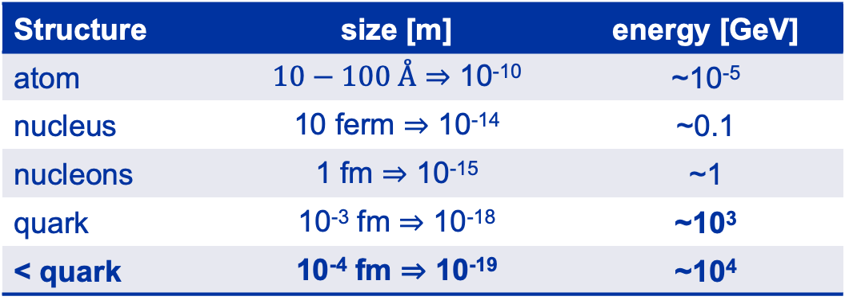
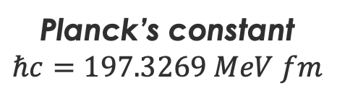
Why do we need high-energy?
$$E=m c^{2}$$
To create new particles
To probe and study the structure of matter
$$E=h ν=h \frac{c}{λ}$$
Planck’s constant
$$ℏc=197.3269 MeV fm$$
Structure | size [m] | energy [GeV]
atom | $10−100$Å ⇒ 10⁻¹⁰ | ~10⁻⁵
nucleus | 10 ferm ⇒ 10⁻¹⁴ | ~0.1
nucleons | 1 fm ⇒ 10⁻¹⁵ | ~1
quark | 10⁻³ fm ⇒ 10⁻¹⁸ | ~10³
< quark | 10⁻⁴ fm ⇒ 10⁻¹⁹ | ~10⁴
Energy of LHC!

Slide 5
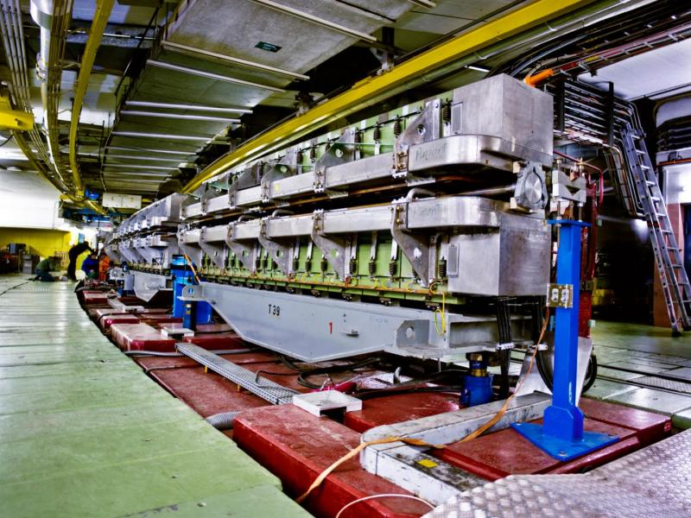

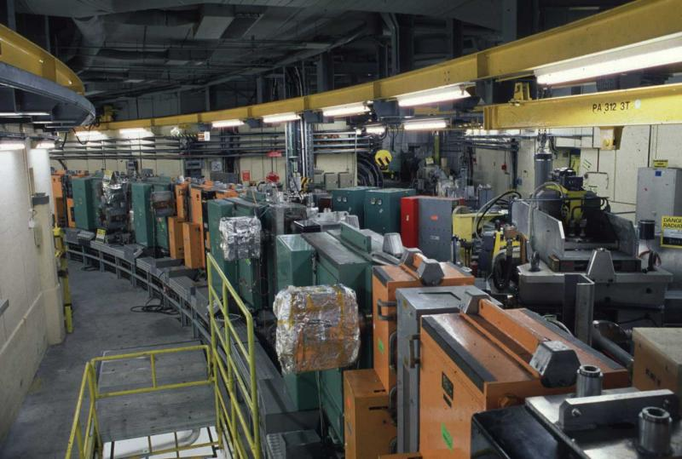
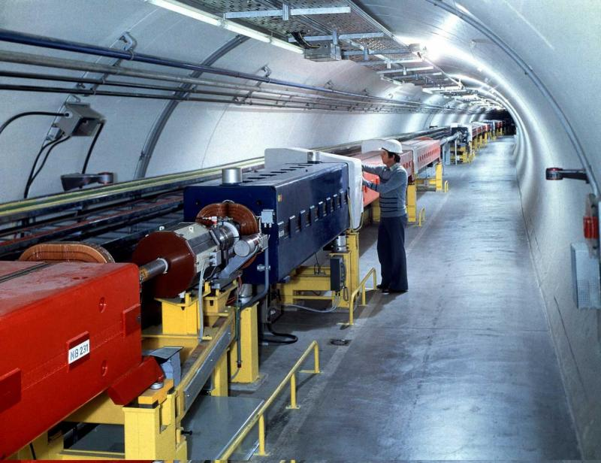
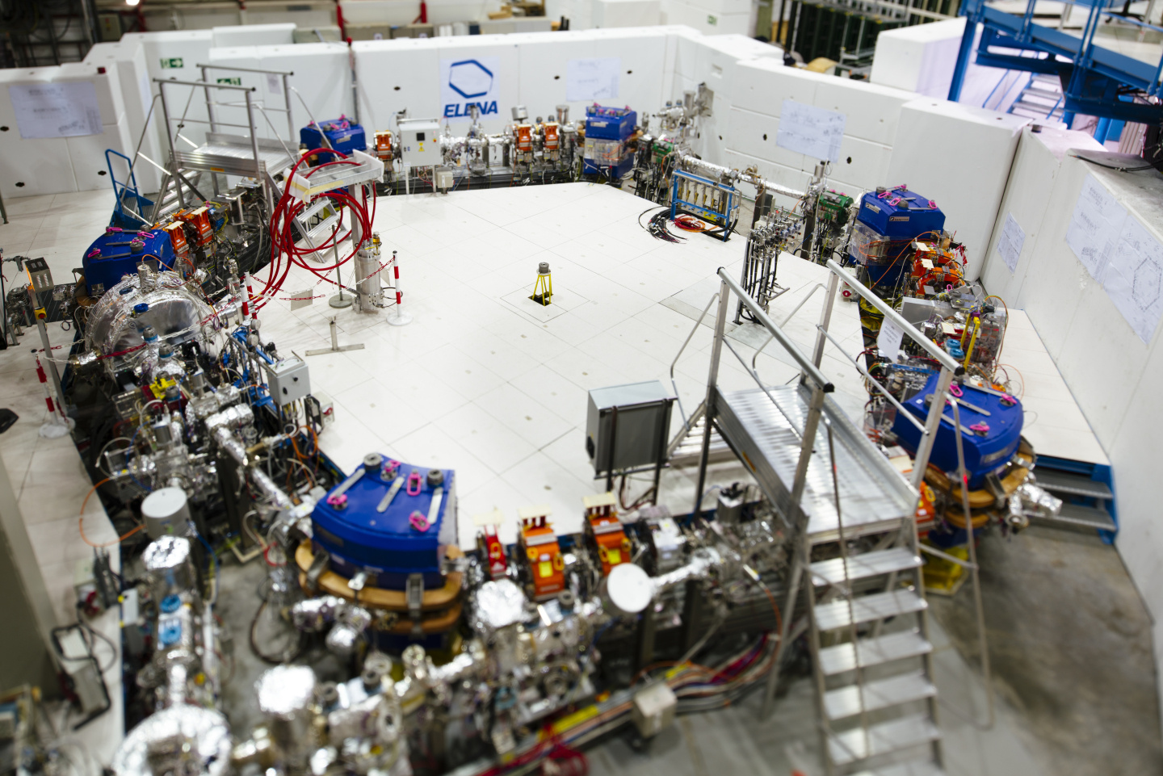
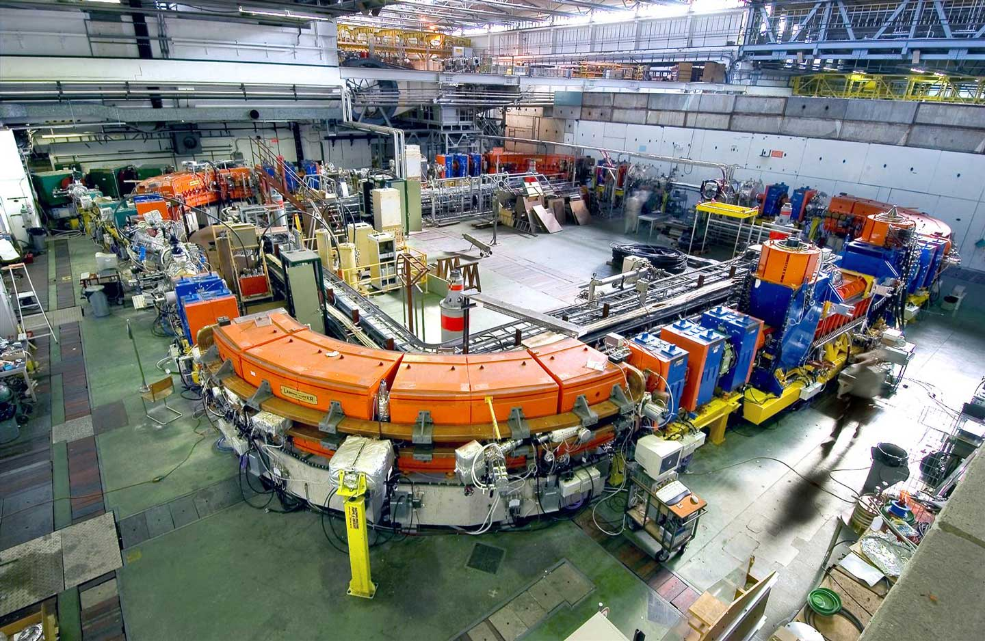
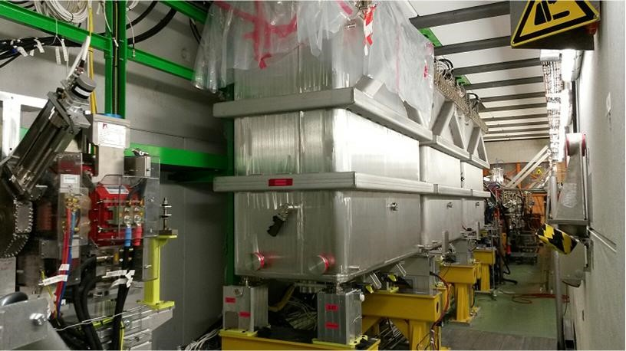
The CERN Accelerator Complex

Slide 6
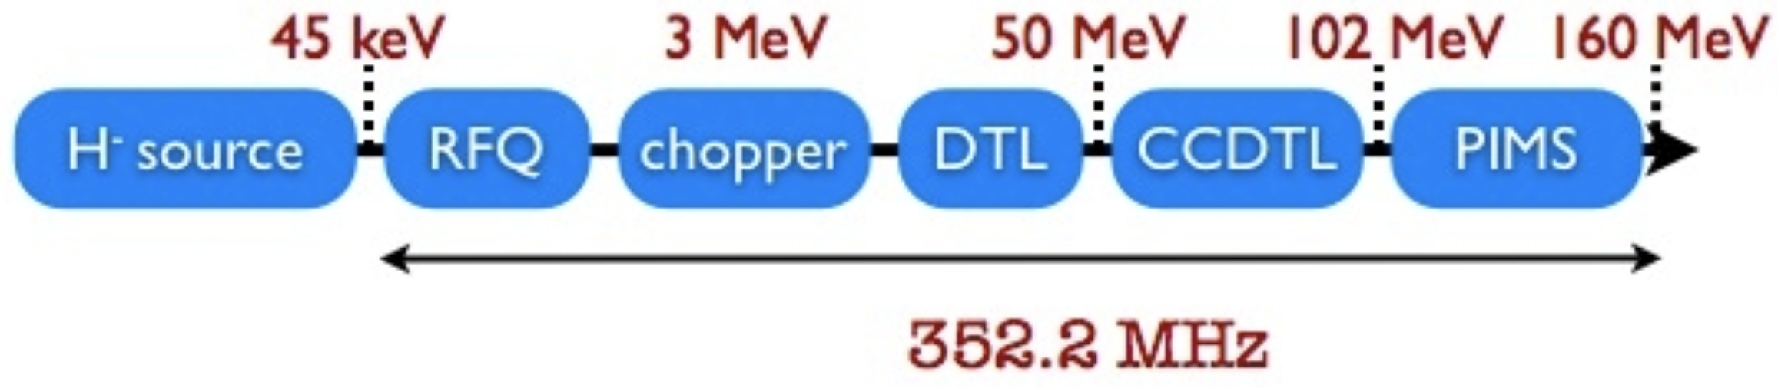
The LINAC 4
Proton source and linear acceleration
H⁻ ion source at 45 keV
Accelerates beam up to 160 MeV
The chopping scheme allows removing some of the Linac bunches to make the beam fit into the PS Booster RF buckets
Pulse rate 1.2 s

Slide 7
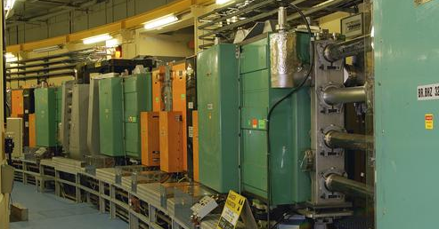
The LINAC 4
Proton acceleration
1st Synchrotron with 4 superposed rings
Circumference of 157 m
Proton energy from 160 MeV to 2 GeV
Can cycle every 1.2 s
Each ring will inject over multi-turns, using charge exchange injection
Before stripping foil
Behind stripping foil
x’
x’
+
+
-
+
+
+
+
+
-
-
-
+
+
+
+
-
+
+
-
+
+
+
+
+
+
-
+
-
+
x
+
+
+
+
+
x
+
-
+
+
+
+
-
+
+
+
+
+
-
+
+
+

Slide 8
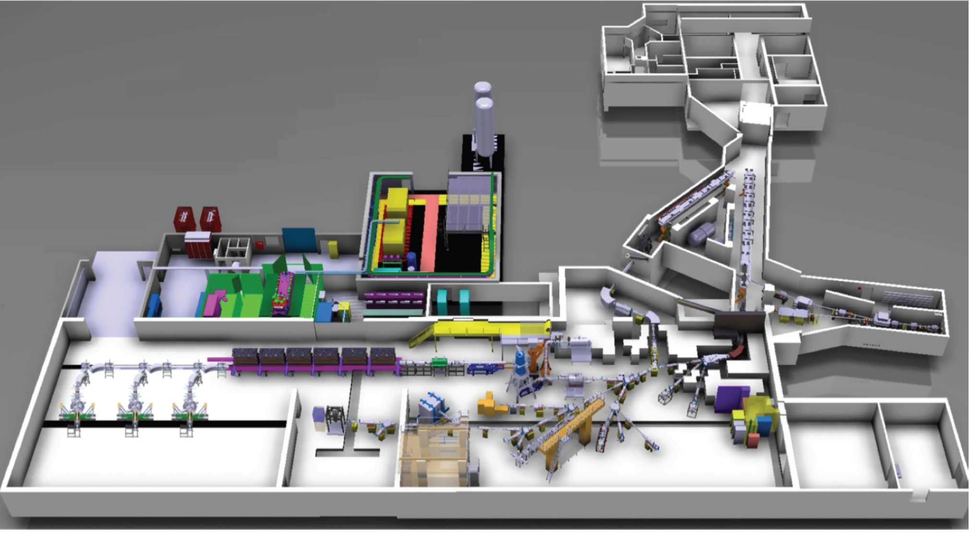
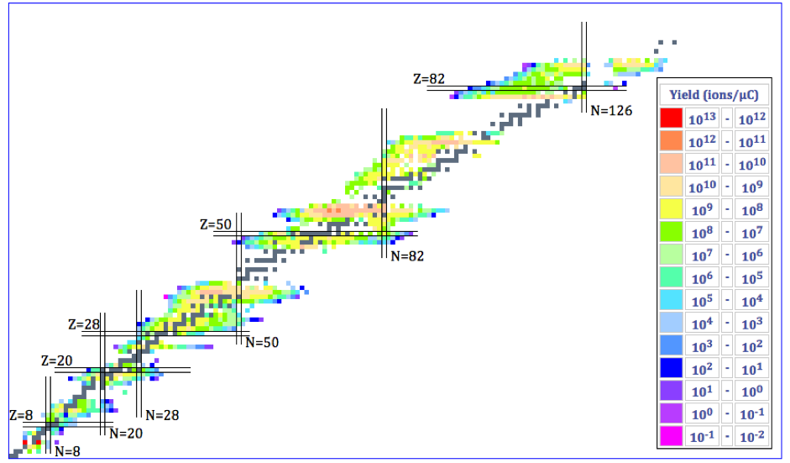
The ISOLDE Facility
Radioactive Ion Beam production and Acceleration

Slide 9
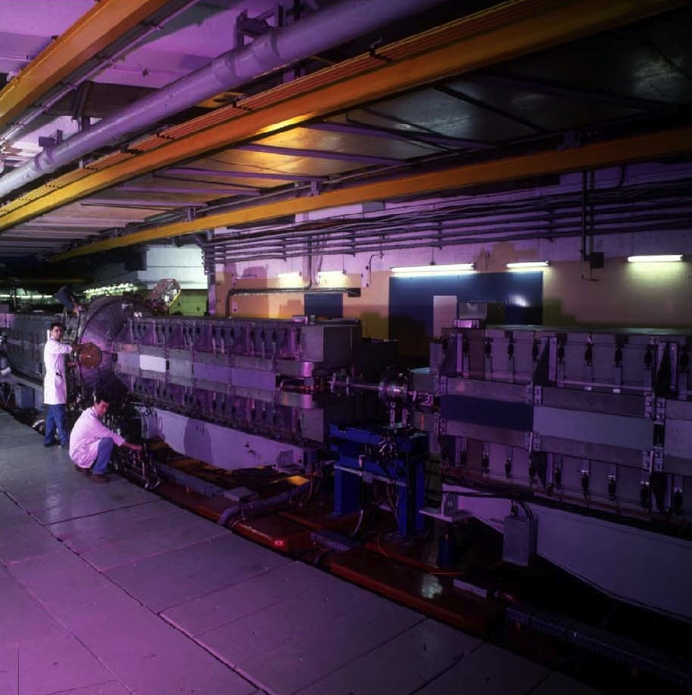
The PS
Proton & ion acceleration
The oldest operating synchrotron at CERN
Circumference of 628m
  4 x PSB circumference
Increases proton energy from 2 GeV to max. 26 GeV
Cycle length ranges from 1.2s to 3.6s
Many RF systems allow for complex RF gymnastics
Various types of extractions:
  Fast extraction
  Multi-turn extraction (MTE)
  Slow extraction

Slide 10
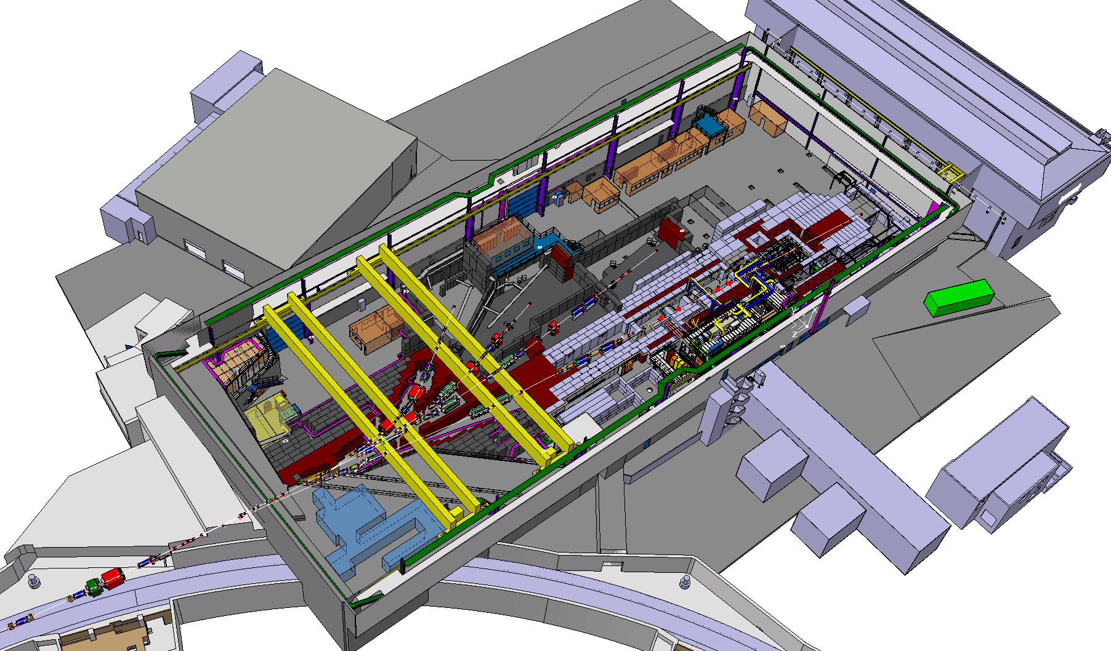
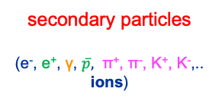
The PS East Area
Proton extraction – secondary beams, experiments
Particle Beams
Reduction ~10⁴ in beam flux each time
Initial beam
(e⁻, p)
secondary particles
(e⁻, e⁺, γ, $\overline{p},$ π⁺, π⁻, Κ⁺, Κ⁻,..
ions)
tertiary particles
(μ⁺, μ-, neutrinos, …)
(W, Be, Pb,..)
target
target
or
decay

Slide 11
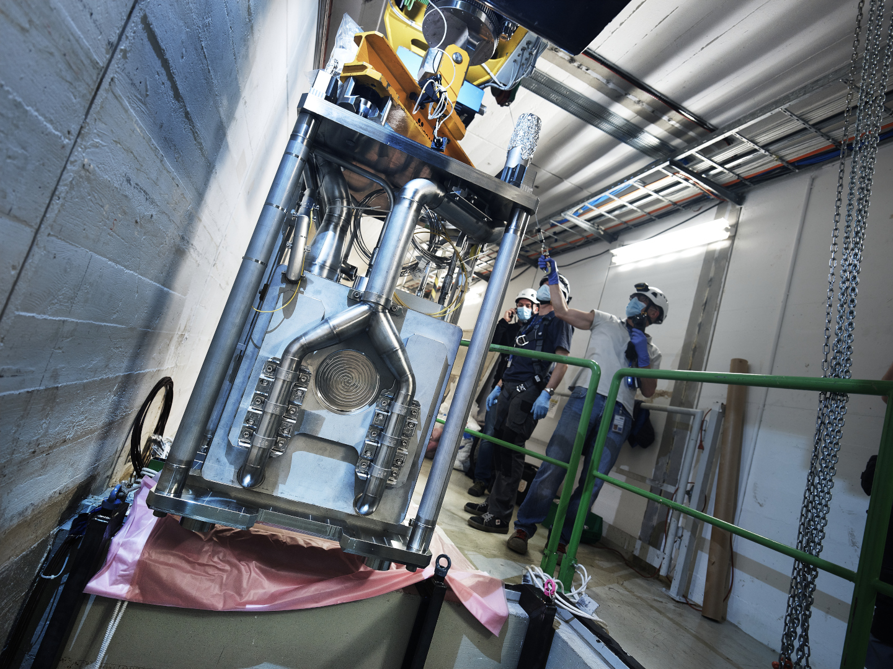
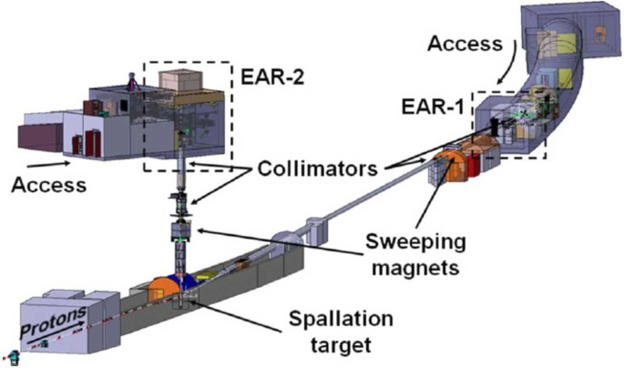
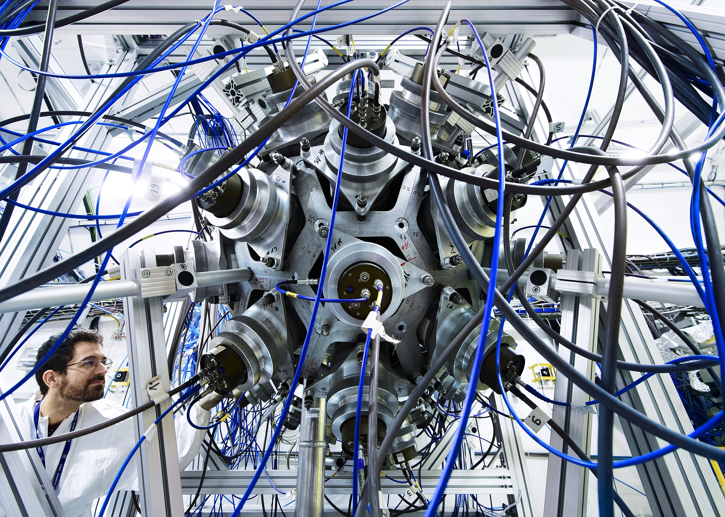
The nTOF
Proton extraction – neutron beam
Study neutron-nucleus interactions (cross-sections)

Slide 12
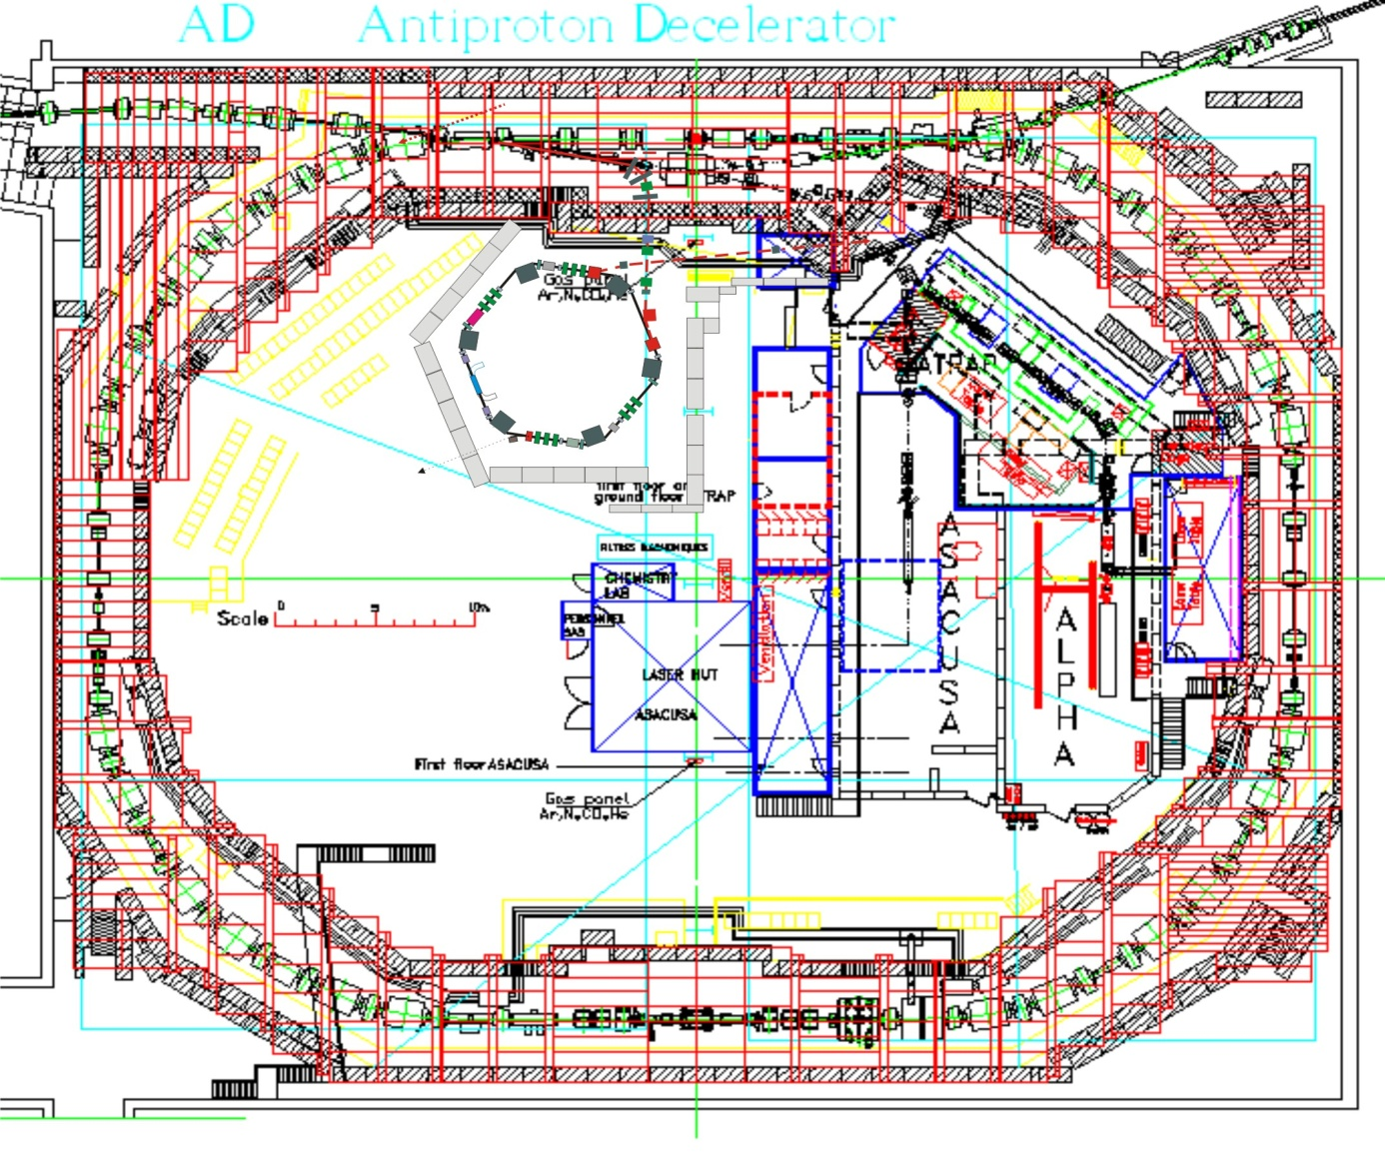
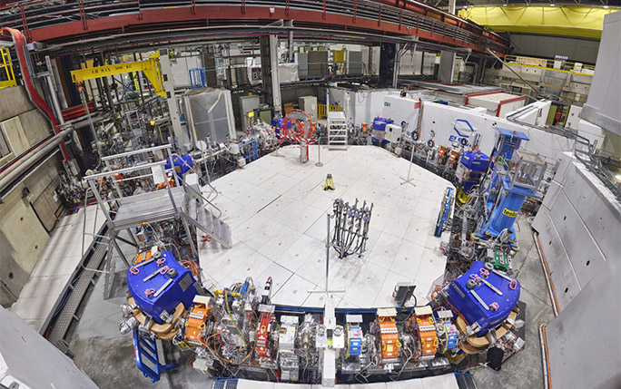
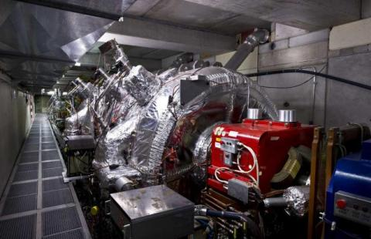
The Antimatter Factory (AD – ELENA)
Anti-proton beams - deceleration
Receives fast extracted proton beam from PS at 26 GeV/c on a target
Every million protons yields about one usable antiproton at 3.5 GeV/c.
AD decelerates beam in stages down to 5.3 MeV
ELENA will further decelerate down to 100 keV
Experiments:
  ASACUSA, ALPHA, AEGIS, BASE, GBAR, PUMA

Slide 13
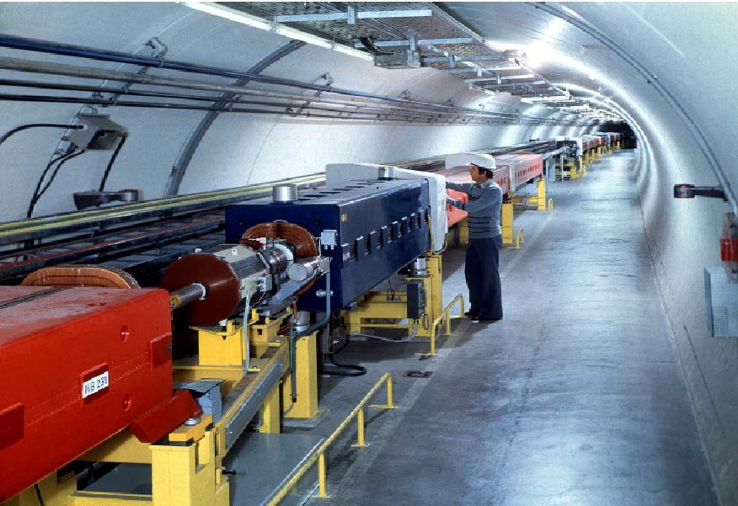
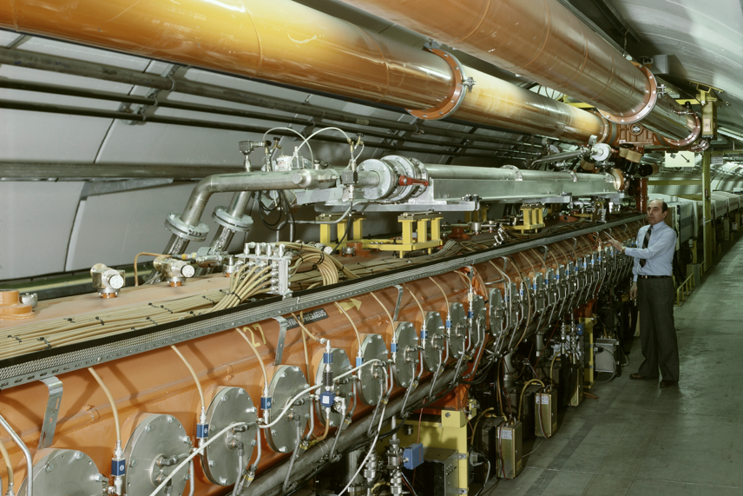
The SPS
Proton & Ion acceleration
The first synchrotron in the chain at ~30m under ground
Circumference of 6.9 km
  11 x PS circumference
Increases proton beam energy up to 450 GeV with up to ~5x10¹³ protons per cycle
Provides slow extracted beam to the North Area and fast extracted beam to LHC, AWAKE and HiRadMat

Slide 14
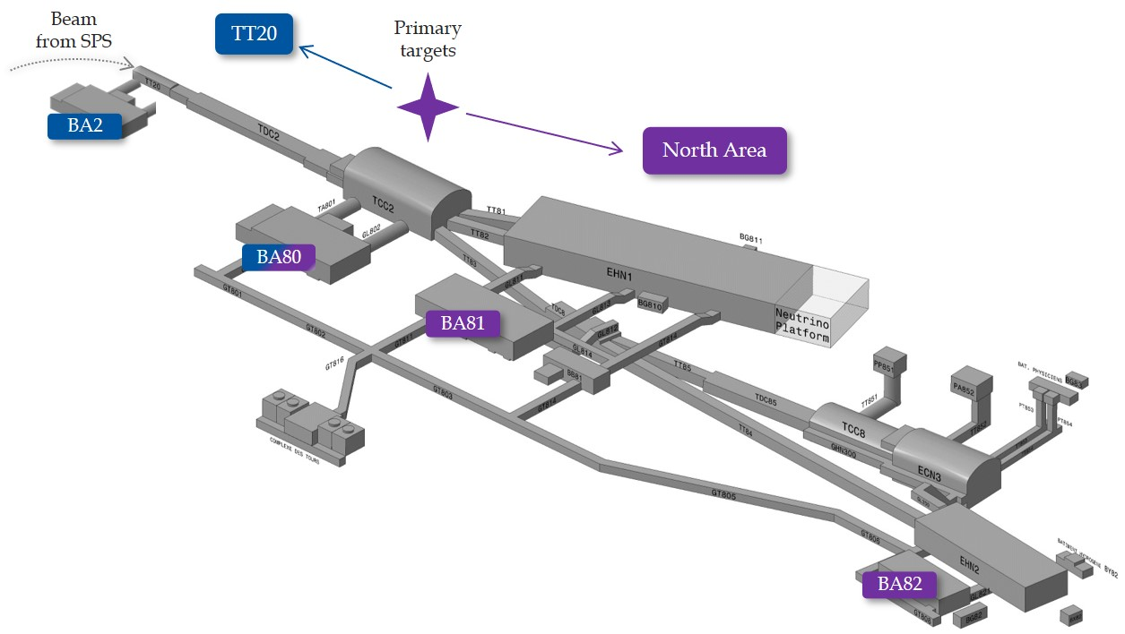
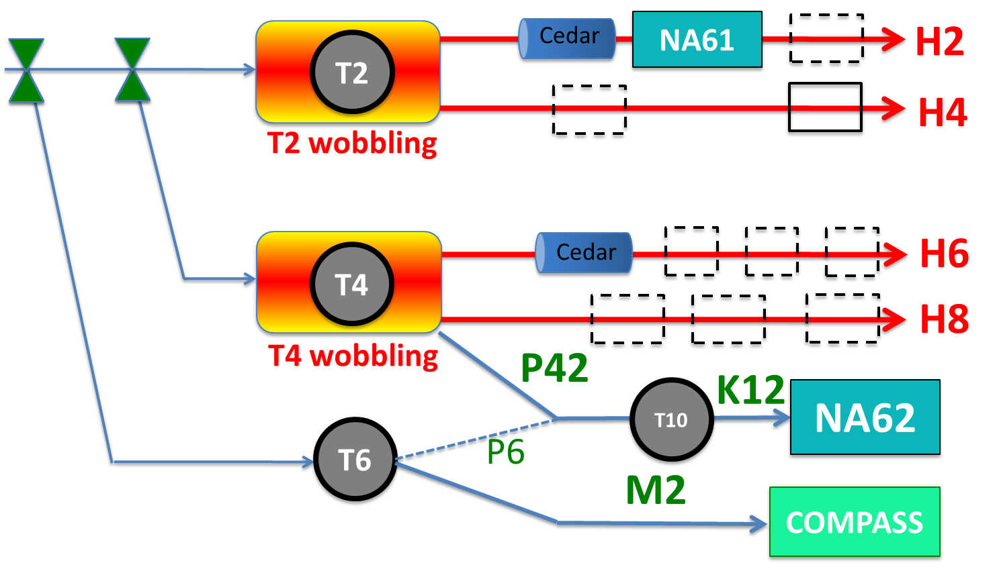

The SPS North Area
Particle beams – Fixed target experiments
Fixed target physics:
$$E_{CM}=\sqrt{2E_{b}m_{T}c^{2}}$$

Slide 15
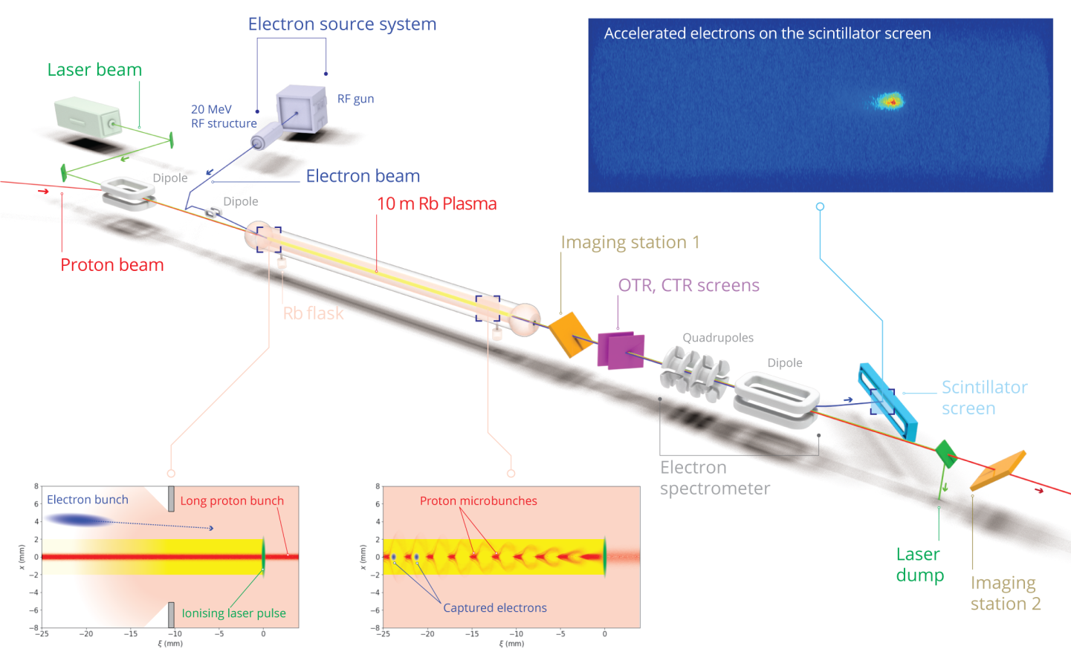
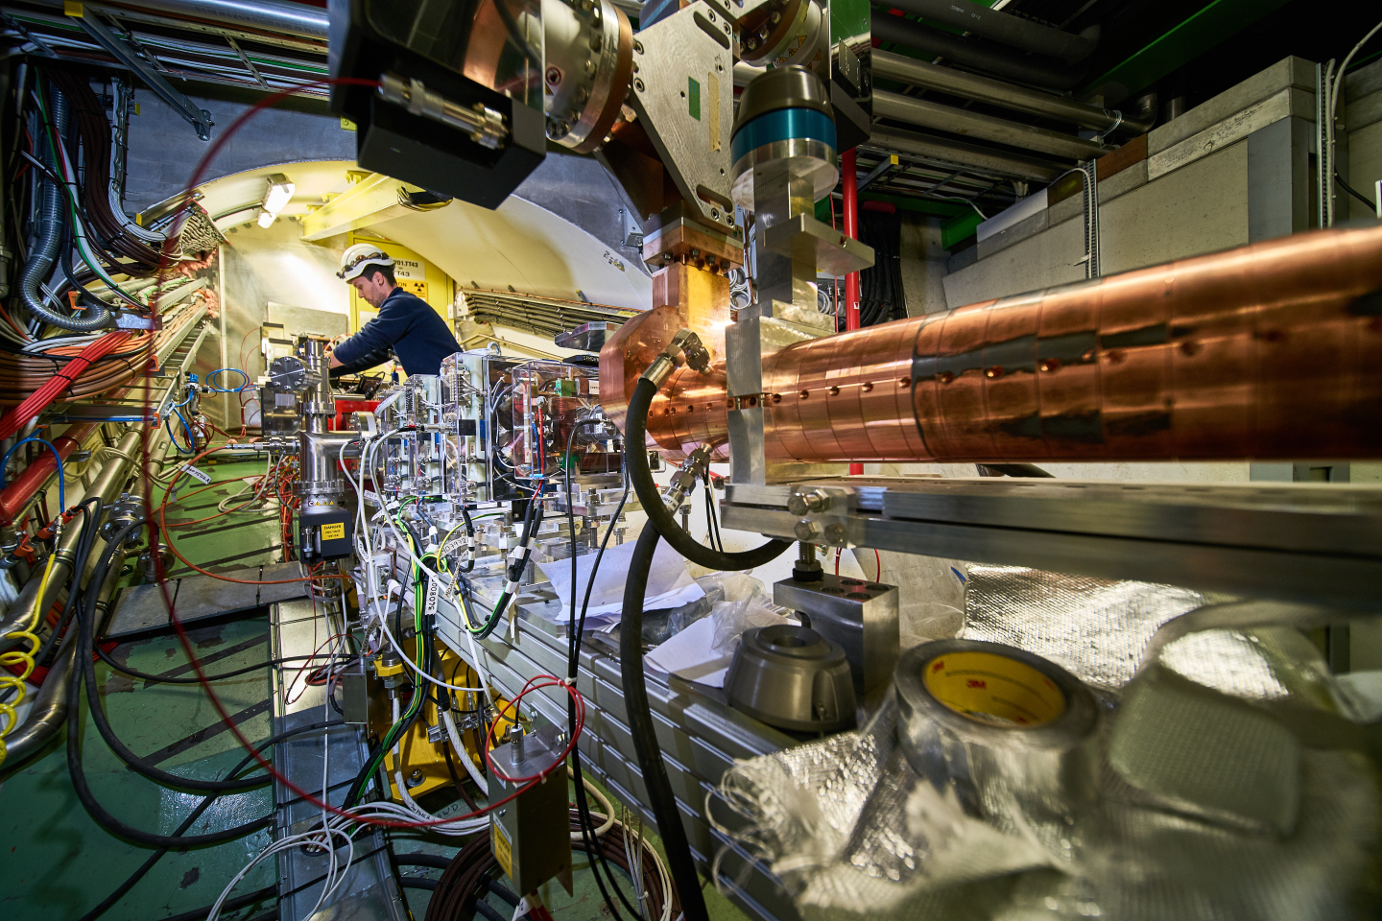
The AWAKE Facility
Plasma wake field acceleration R&D

Slide 16
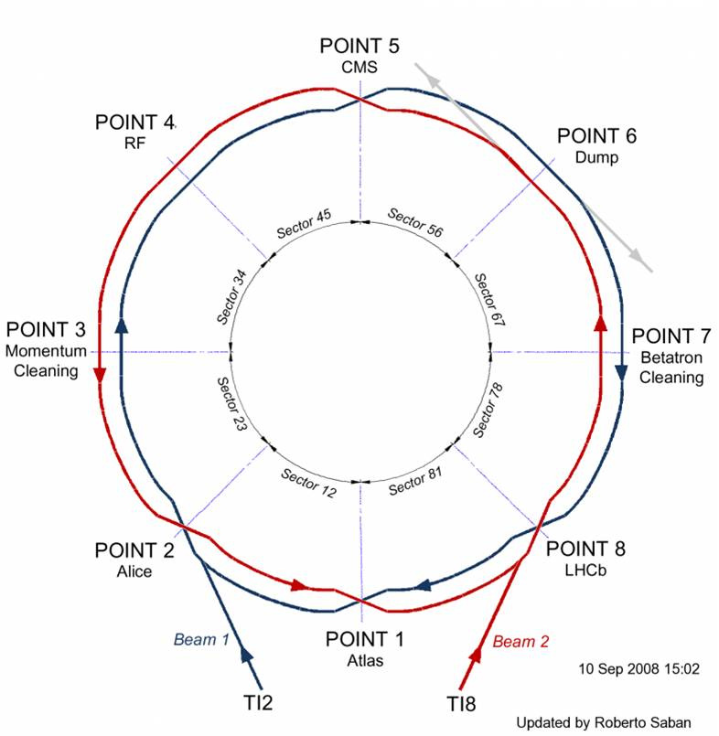
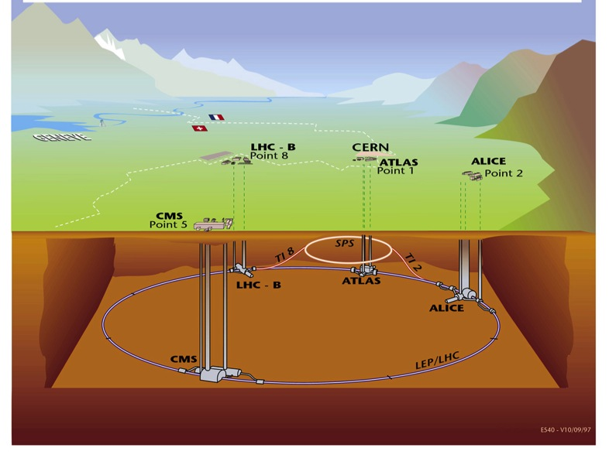
The LHC
Proton & ion beam collider
Situated on average ~100 m under ground
Four major experiments
Circumference 26.7 km
Two separate beam pipes going through the same cold mass 19.4 cm apart
150 tons of liquid helium to keep the magnets cold and superconducting

Slide 17
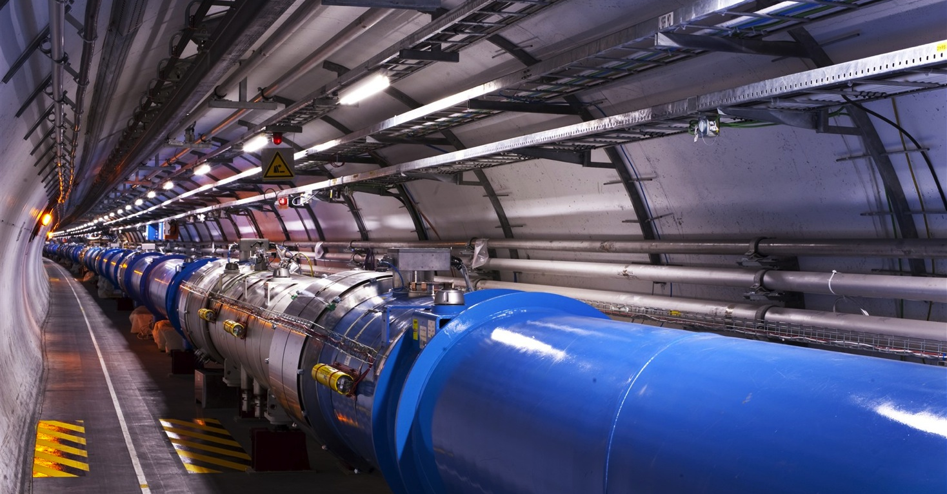
The LHC
Proton & ion beam collider
1232 main dipoles of 15 m each that deviate the beams around the 27 km circumference
858 main quadrupoles that keep the beam focused
6000 corrector magnets to preserve the beam quality
Main magnets use superconducting cables (Cu-clad Nb-Ti)
12’000 A provides a nominal field of 8.33 Tesla
Operating in superfluid helium at 1.9K
LHC vacuum :
LHC : ~ 10⁻⁷ – 10⁻¹⁰ Pa ⇒ 4×10⁶ – 4×10⁹ atoms/cm³
air density: ~3×10¹⁹ atoms/cm³

Slide 18
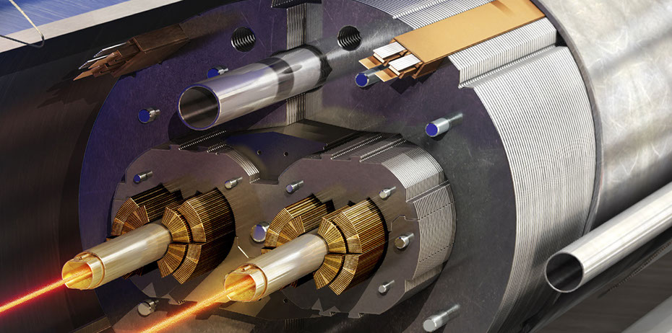
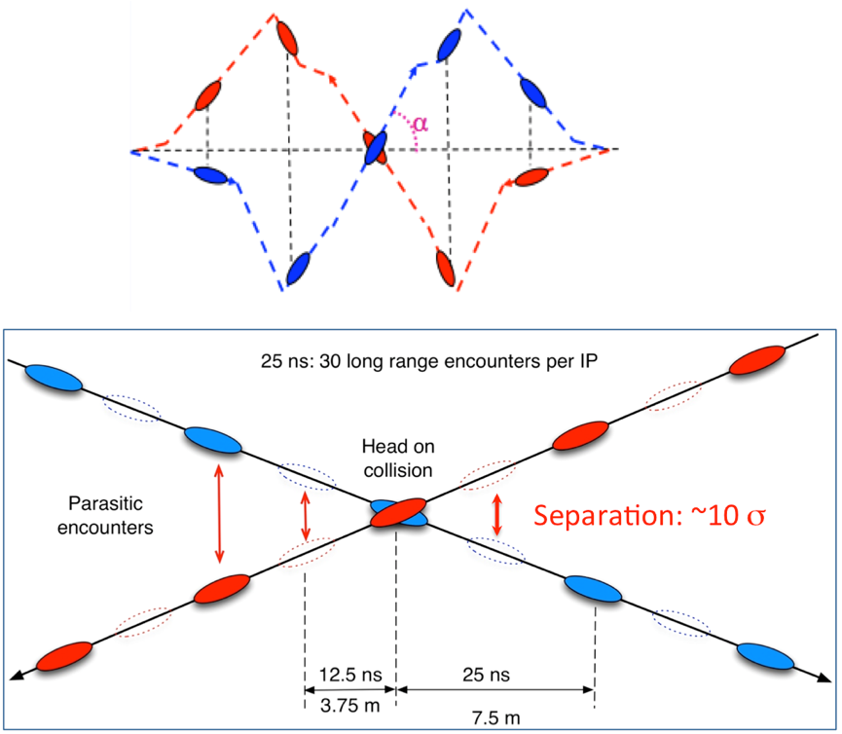
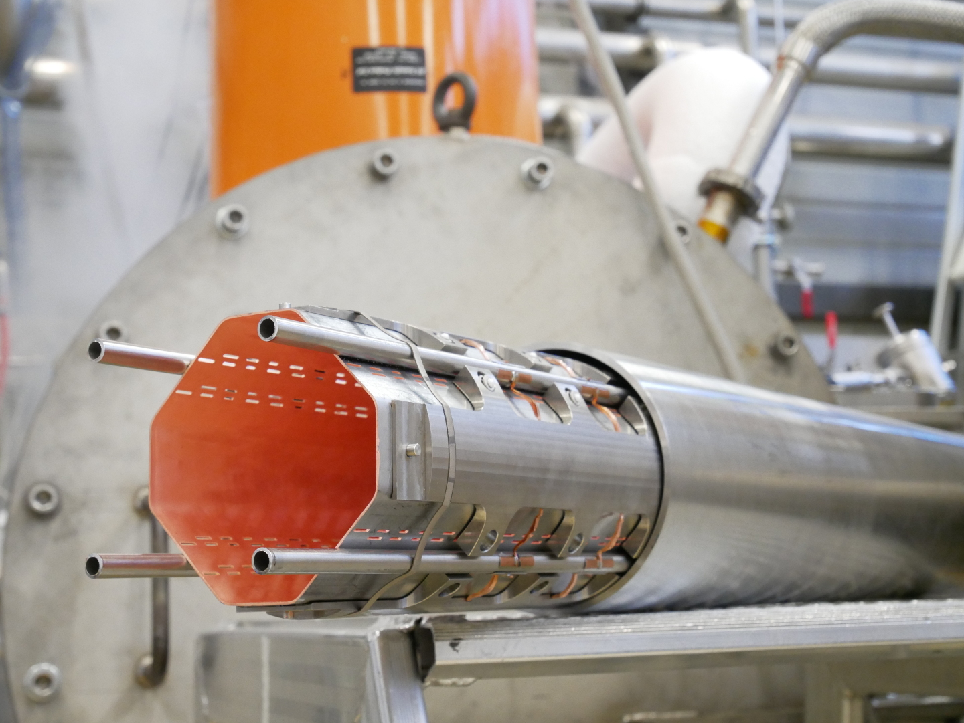
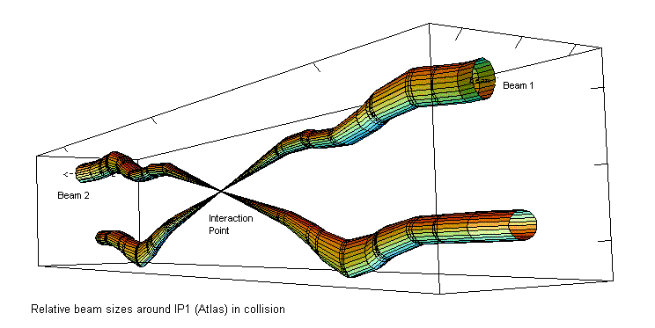
The LHC
Proton & ion beam collider
Beam collisions
LHC vacuum :
~ 10⁻⁷ – 10⁻¹⁰ Pa or
4×10⁶ – 4×10⁹ atoms/cm³
air density: ~3×10¹⁹ atoms/cm³

Slide 19
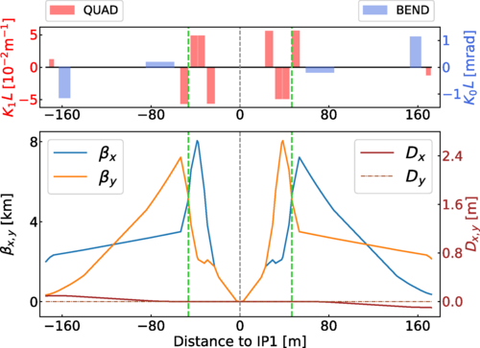
The LHC
LHC Beam Collisions and Luminosity
In a collider the figure of merit for the performance is the Luminosity
Events in experiment
cross-section for the process under stydy
the physics!
beam luminosity
accelerator
Protons/bunch
bunches
Kinematic of the collision
transverse beam size
geometry of the collision
geometry of collision
(impact parameter)

Slide 20
The LHC
Operation beam cycle
= Field in main magnets
= Beam 1 intensity (current)
= Beam 2 intensity (current)
Time
6.8 TeV
Luminosity half-time
450 GeV
Injection
Ramp
Squeeze
&
Adjust
Stable beams for physics
Dump
&
Ramp down

Slide 21
The LHC
Operation – beam filling in injectors
To LHC clock-wise or counter clock-wise
= Field in main magnets
= Proton beam intensity (current)
450 GeV
= Beam transfer
SPS
26 GeV
PS
1.4 GeV
PSB
Time

Slide 22
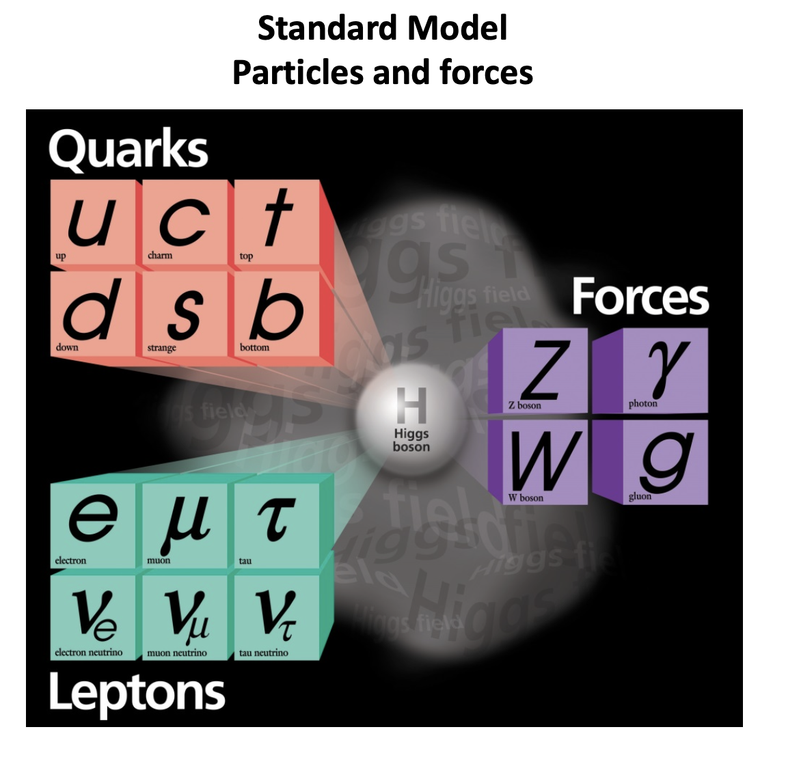
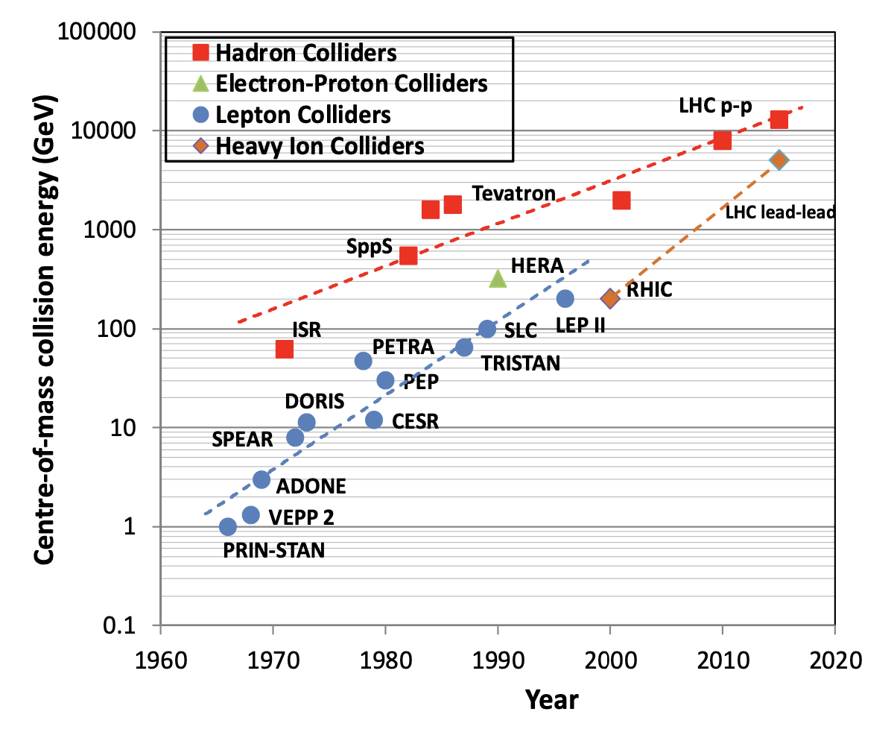
The evolution of accelerators
…the past
The accelerators played a pivotal role in the foundation of the Standard Model
SppS
W,Z bosons
LHC
Higgs
PETRA
gluon
Tevatron
t-quark
SPEAR
c-quark
τ-lepton

Slide 23
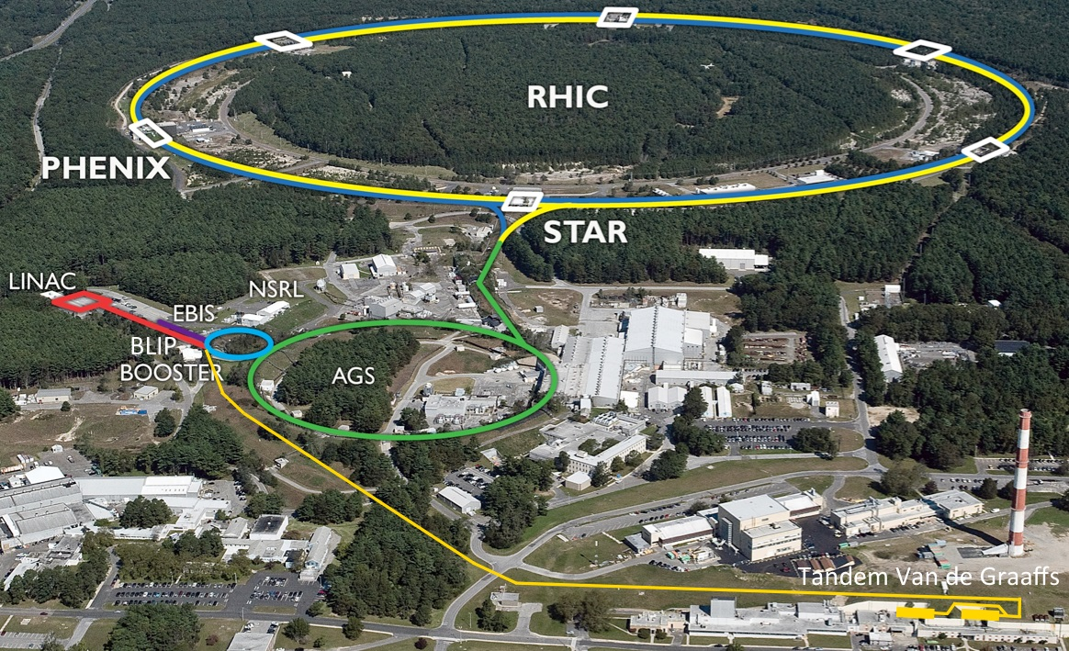
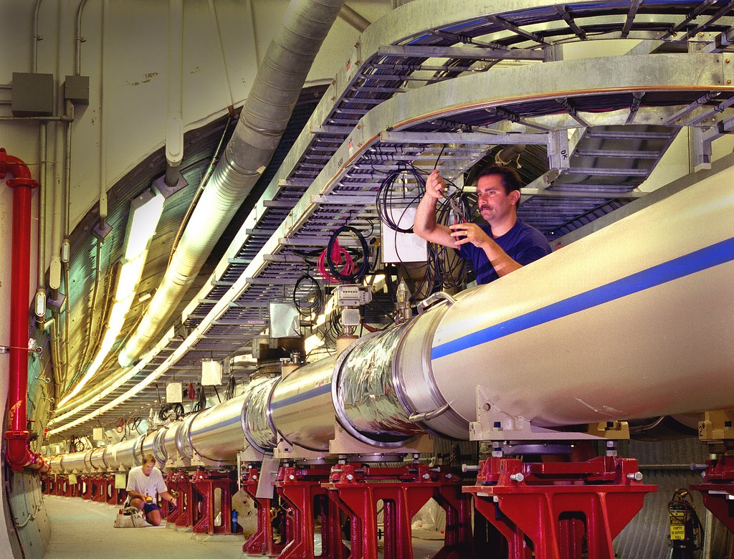
The evolution of accelerators
… the present
Brookhaven National Lab (BNL) - USA
First use of super-conducting cables in the design of magnets, access to high-magnetic fields
Ion collider (Au, Cu, … ions) energies up to 100 GeV/u
Length ~4 km, 1740 magnets
4 experiments (BRAHMS, PHENIX, PHOBOS, STAR)
Basic research for quark-gluon plasma as part of the creation of the Universe
Plans for the construction and operation of EIC – Electron-Ion collider

Slide 24
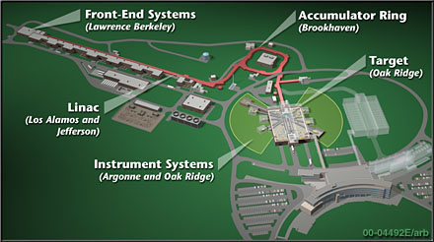
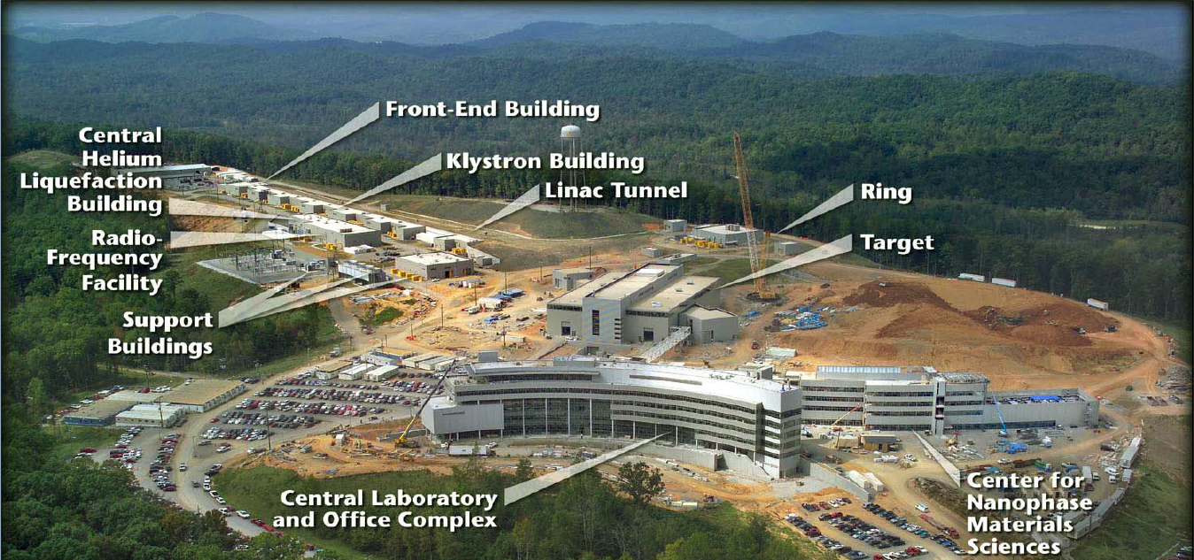
The evolution of accelerators
… the present
Spallation Neutron Source (SNS), Oak Ridge - USA
  Η- source (p+2e)
  300m linear accelerator with superconducting RF
  accumulator ring (1 MW)
  Liquid mercury (Hg) target
Scattering experiments with neutron beams, material studies, nano-materials, …

Slide 25
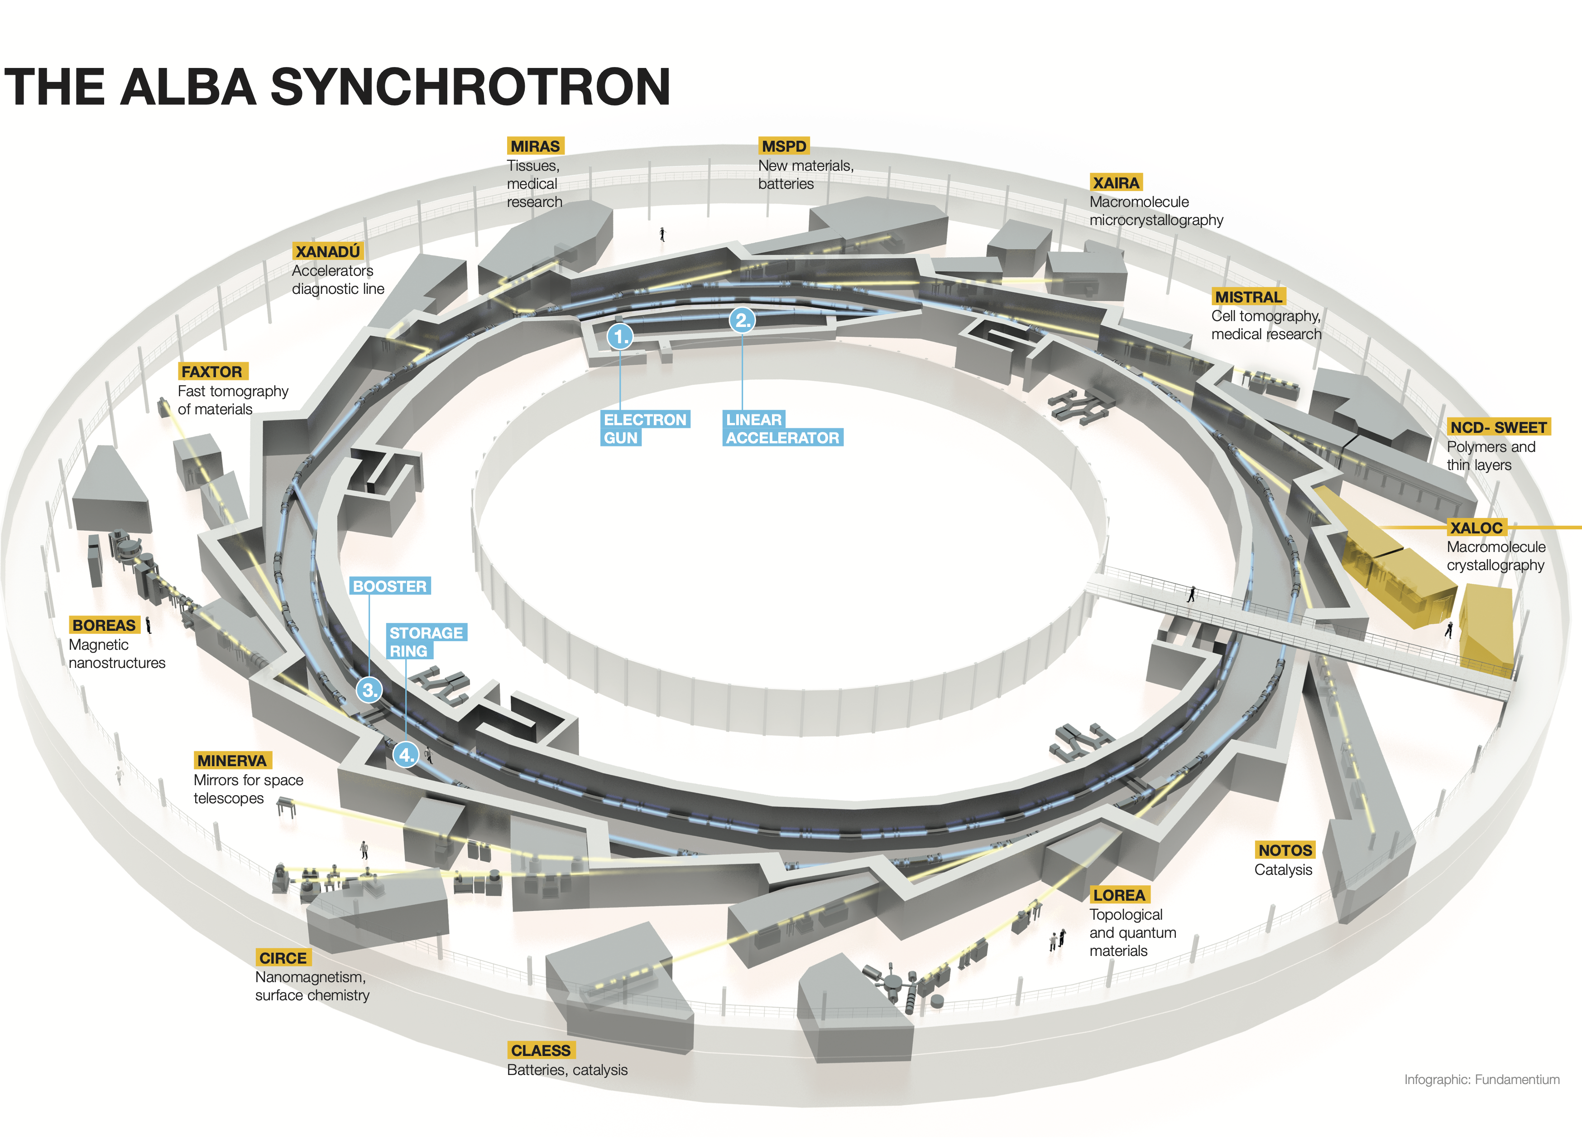
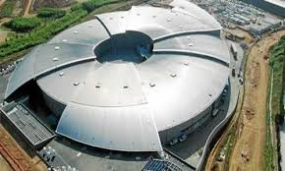
The evolution of accelerators
… the present
ALBA Synchrotron Light Facilities – Barcelona Spain
3rd generation synchrotron light, the newest center in the Mediterranean
3 GeV electron beams, 270m long ring
Experiments with soft και hard Χ-rays
Studies for bio-technology, material science, nano-technology
6’000 beam hours/year for the experiments, 2’000 users/year from Universities, Research Centers, and Industry.
  65% users from Spain, 35% from other countries

Slide 26


The evolution of accelerators
The Livingston diagram
The Livingston graph shows the evolution of accelerators in the past century
Until the end of 20th century, the achieved energy increased by an order of magnitude every 6-10 years
New technologies emerge to replace or complement older ones
But:
The beam energy is not the only performance figure for the accelerator evolution
The beam intensity, beam size or brightness are also importan parameters, depending on the application
Energy
/year

Slide 27

The evolution of accelerators
CERN – the HL-LHC upgrade
The HL-LHC will use new technologies to provide 10 times more collisions than the LHC.
Two fronts:
  higher bunch intensity up to 2.1e11 ppb
  crab crossing scheme
Higher luminosity would give access to rare phenomena, greater precision and discovery potential.
HL-LHC will start operating in 2028 and run until 2041.

Slide 28





The evolution of accelerators
CERN – the high-energy frontier
stage 1: FCC-ee (Z, W, H, $\text{t}\overline{\text{t}}$) as Higgs factory, electroweak & top factory at highest luminosities
stage 2: FCC-hh (~100 TeV) as natural continuation at energy frontier, pp & AA collisions; e-h option
highly synergetic and complementary physics programme, common civil engineering and technical infrastructures
FCC integrated project allows the start of a new, major facility at CERN within a few years of the end of HL-LHC
- 2040
2045 - 2060
2070 - 2095

Slide 29




The evolution of accelerators
… the future
Linear electron accelerator with plasma wake-field technology as Higgs factory: $e^{+}e^{−}→H Z$ (CM ~216 GeV)
Advantages: acceleration with small energy spread in energy, small emittances
Challenges: acceleration of positron, multiple plasma cells, integrated luminosity
W.P. Leemans & E. Esarey, Physics Today, March 2009

Slide 30


The evolution of accelerators
… the future
Muon Collider
Variable center of mass from Z, H (~200 GeV) up to 10 TeV – clear path for higher energies !
Advantages : no synchrotron radiation losses for muons, optimized energy consumption
Challenges : required development of several new technologies for the production of the muon beams, the emittance reduction and fast acceleration

Slide 31






Οι επιταχυντές σήμερα
… πέρα από την φυσική των σωματιδίων
>35’000 επιταχυντές σε λειτουργία σε όλο τον κόσμο:
  44% για ραδιο-θεραπεία
  41% για εμφύτευση ιόντων
  9% για βιομηχανικές εφαρμογές
  4% ερευνα στις χαμηλές ενέργειες
  1% παραγωγή ισοτόπων για θεραπεία
  <1% έρευνα
Θεραπεία καρκίνου
Ανάπτυξη ημι-αγωγών
Υλικά: αποστείρωση, χρονολόγηση με C, επεξεργασία αερίων διύλησης
Υλικά: μικρο-ανάλυση, φασματογράφοι μάζας, PIXE (particle-induced X-ray emission)
PET και SPECT απεικόνισης
Γραμμικός επιταχυντής ηλεκτρονίων για ράδιο-θεραπεία
To Rhodotron της ΙΒΑ για την παραγωγήή ισχυρών δεσμών ηλεκτρονίων
Επιταχυντής tandem για έρευνα υλικών και εργα τέχνης
Εμπορικό σύστημα για εμφύτευση ιόντων
Cyclotron προτονίων για παραγωγή ραδιο-ισοτόπων

Slide 32
For the slides I used images and text from past presentations from collegues, past CAS or JUAS schools, publications and information from web and Wikipedia. Many thanks to all.
In case of questions contact met in my e-mial: Ilias.Efthymiopoulos@cern.ch

