Slide 1
Particle Accelerators and Beam Dynamics
Accelerator & Technology Sector
Beams Department
Accelerator Beam Physics Group
Foteini Asvesta
Eurolabs 2024

Slide 2
Disclaimer
Based on:
Y. Papaphilippou : “Introduction to Accelerators”
Summer student lectures:
  B. Holzer, V. Kain, and M. Schaumann
CERN accelerator school (CAS):
  F. Tecker: “Longitudinal beam dynamics”
  S. Sheehy: “Applications of accelerators”
Joint Universities Accelerator School (JUAS):
  F. Antoniou, H. Bartosik and Y. Papaphilippou: “Linear imperfections” and “nonlinear dynamics”
Books:
  K. Wille: “The Physics of Particle Accelerators”
  S.Y. Lee: “Accelerator Physics”
  A. Wolski: “Beam Dynamics in High Energy Particle Accelerators”
Images: cds.cern.ch

Slide 3
Overview
Introduction to Accelerators
  Applications
  Accelerator types (historic overview)
  Accelerator performance indicators & examples
  Synchrotrons
Accelerator beam dynamics

Slide 4

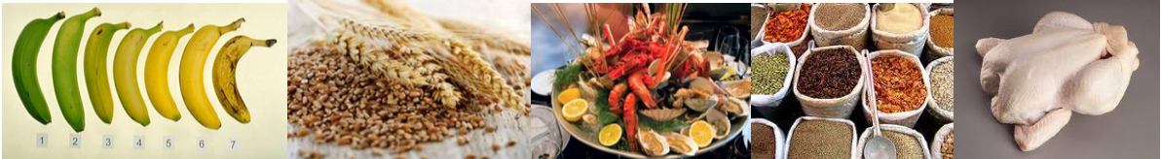
Why accelerators?
Industry
Material studies and processing
Food sterilization
Ion implantation
World wide about ~30,000 particle accelerators are in operation with a large variety of applications.
‘Cold pasteurization’ – before packaging
The large majority is used in industry
and medicine:
  Industrial applications: ~20,000*
  Medical applications: ~10,000*
*Sources:
A. W. Chao, World Scientific Revies of Accelerator Science and Technology
A. Faus-Golfe, The brave new world of accelerator application
APAE report, Applications of particle accelerators in Europe
S. Sheehy, Applications of accelerators, CAS 2014

Slide 5
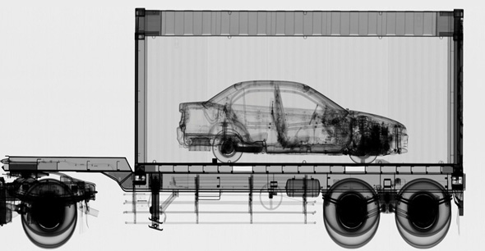
Why accelerators?
Security
Airports & boarders
Nuclear security
Imaging
World wide about ~30,000 particle accelerators are in operation with a large variety of applications.
Cargo containers scanned at ports and border crossings.
Accelerator-based sources of X-Rays can be far more penetrating (6MV) than Co-60 sources.
Container must be scanned in 30 seconds.
The large majority is used in industry
and medicine:
  Industrial applications: ~20,000*
  Medical applications: ~10,000*
*Sources:
A. W. Chao, World Scientific Revies of Accelerator Science and Technology
A. Faus-Golfe, The brave new world of accelerator application
APAE report, Applications of particle accelerators in Europe
S. Sheehy, Applications of accelerators, CAS 2014

Slide 6
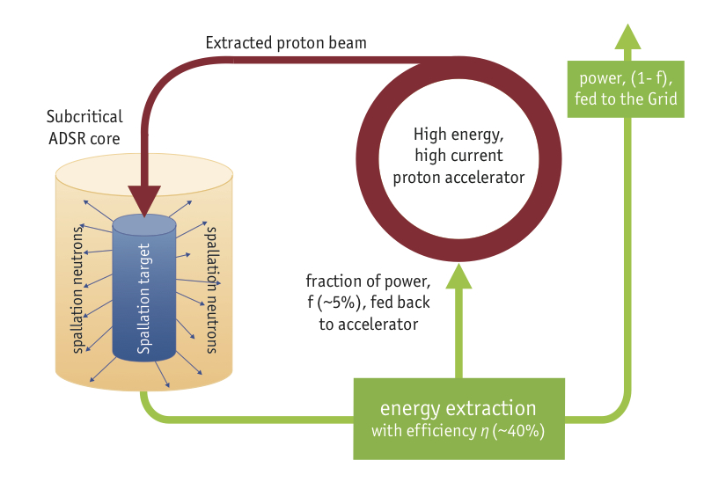
Why accelerators?
Energy
Destroying radioactive waste
Energy production
Nuclear fusion
Thorium fuel amplifier
World wide about ~30,000 particle accelerators are in operation with a large variety of applications.
The large majority is used in industry
and medicine:
  Industrial applications: ~20,000*
  Medical applications: ~10,000*
Accelerator Driven System (ADS)
Transmutation of nuclear waste isotopes or energy generation
*Sources:
A. W. Chao, World Scientific Revies of Accelerator Science and Technology
A. Faus-Golfe, The brave new world of accelerator application
APAE report, Applications of particle accelerators in Europe
S. Sheehy, Applications of accelerators, CAS 2014

Slide 7
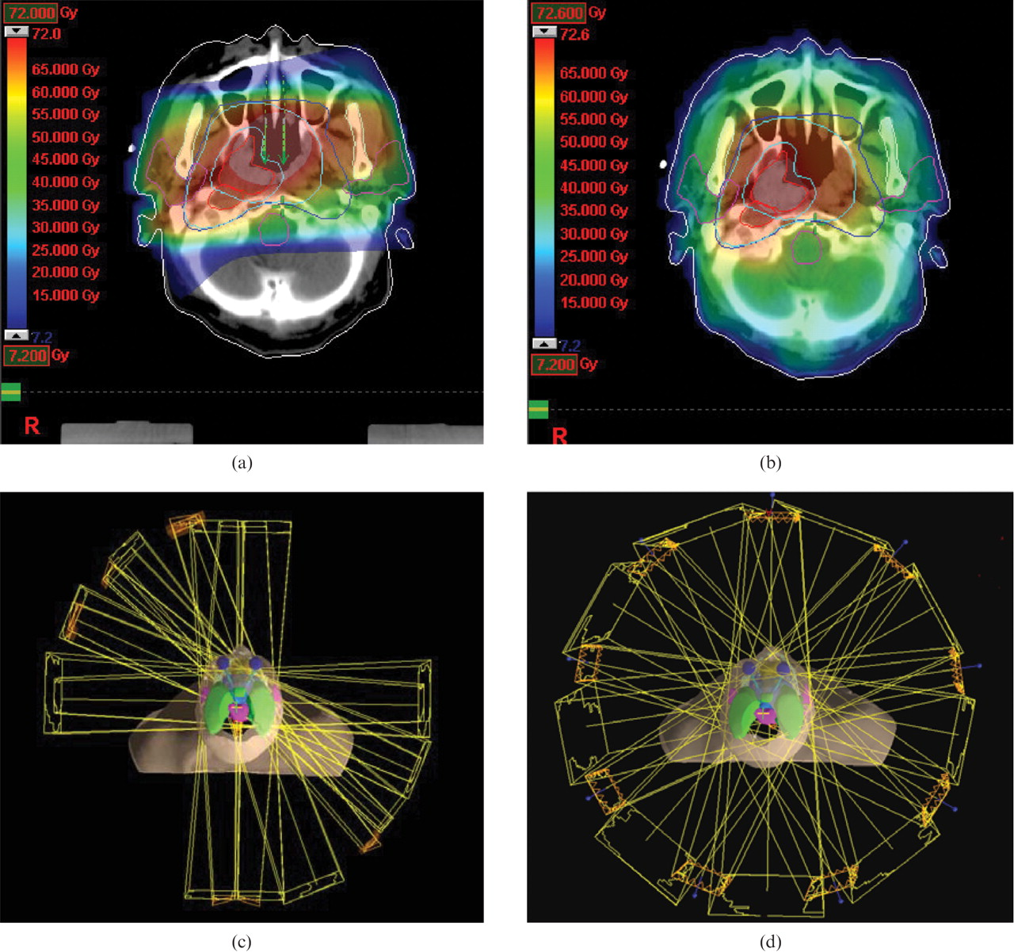
Why accelerators?
Health
Diagnostic and imaging
X-rays
Cancer therapy
Radioisotope production
Ions
Photons
World wide about ~30,000 particle accelerators are in operation with a large variety of applications.
Dose
Photons
Ions
The large majority is used in industry
and medicine:
  Industrial applications: ~20,000*
  Medical applications: ~10,000*
*Sources:
A. W. Chao, World Scientific Revies of Accelerator Science and Technology
A. Faus-Golfe, The brave new world of accelerator application
APAE report, Applications of particle accelerators in Europe
S. Sheehy, Applications of accelerators, CAS 2014

Slide 8
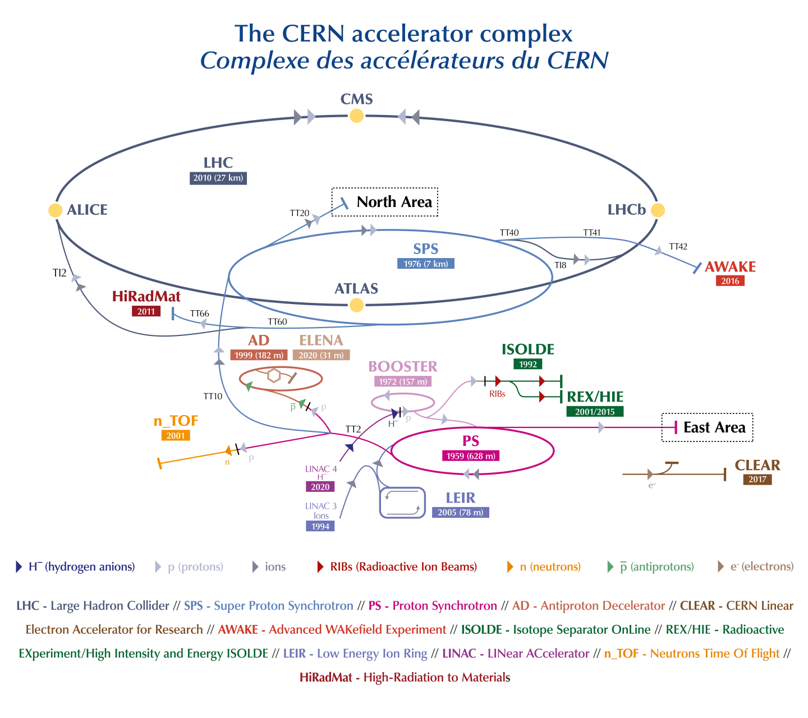

Why accelerators?
Less than a fraction of a percent is used for
Research!
  Particle Physics
  Storage rings & Colliders
  Material science
  Light sources
  R&D
World wide about ~30,000 particle accelerators are in operation with a large variety of applications.
The large majority is used in industry
and medicine:
  Industrial applications: ~20,000*
  Medical applications: ~10,000*
*Sources:
A. W. Chao, World Scientific Revies of Accelerator Science and Technology
A. Faus-Golfe, The brave new world of accelerator application
APAE report, Applications of particle accelerators in Europe
S. Sheehy, Applications of accelerators, CAS 2014

Slide 9
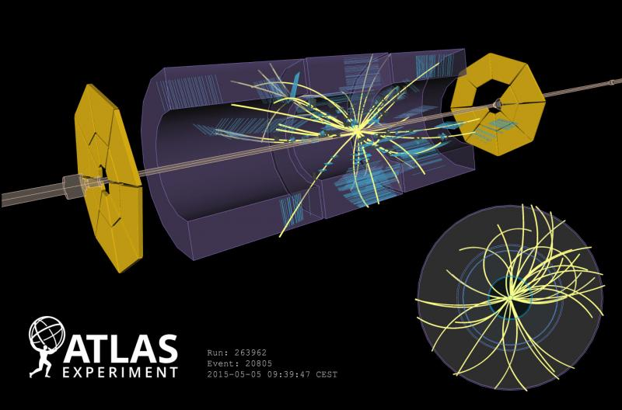
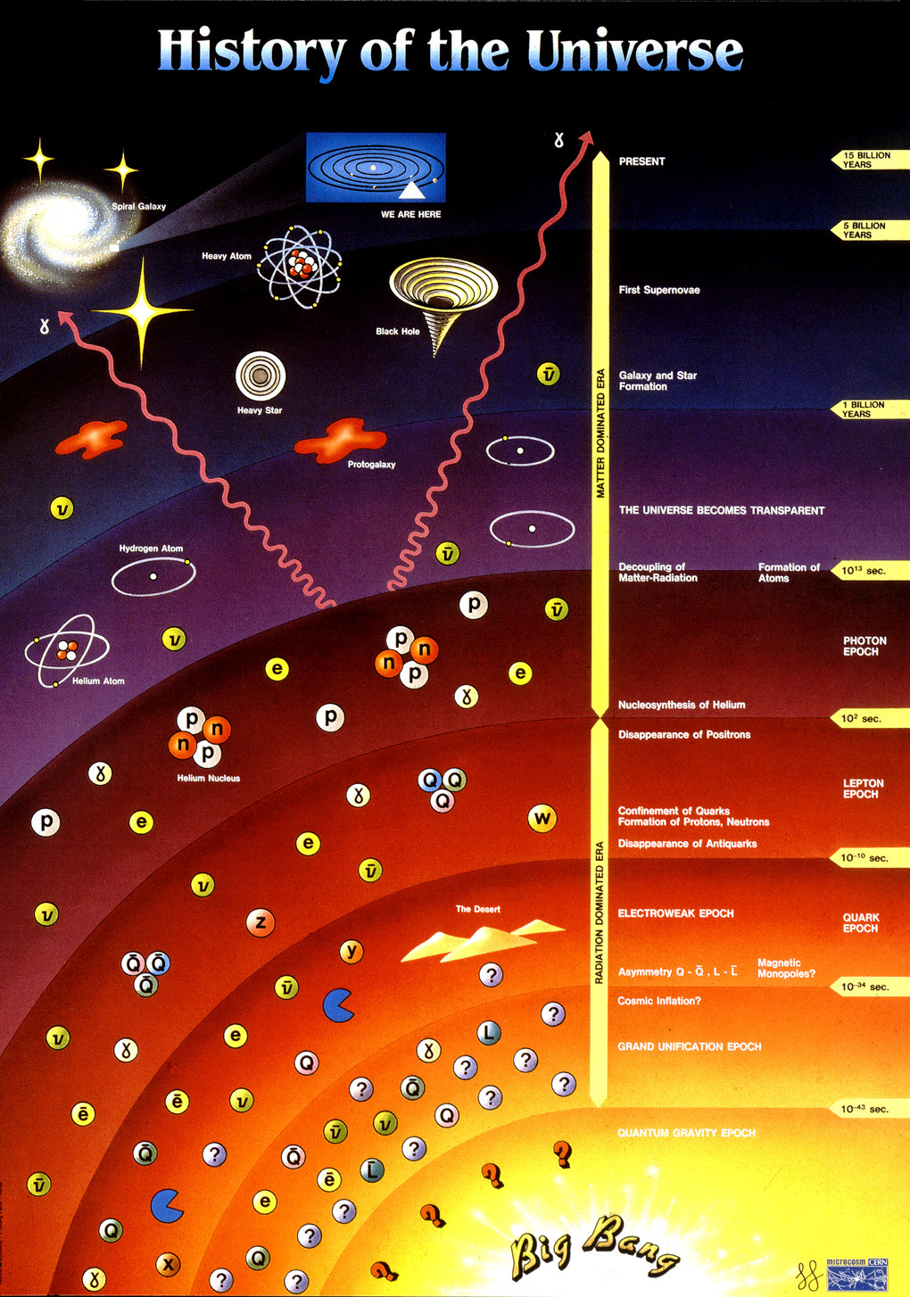
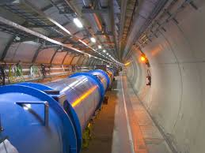
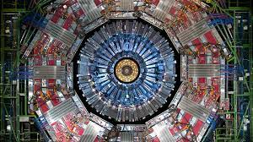
Accelerators at CERN
Full complex of Accelerators to give energy to particles.
Understand the laws of physics and
Reveal the history of the universe
CMS
Particles produced in the collisions are observed in the detectors
Protons collide in the LHC in the detectors of the large experiments

Slide 10
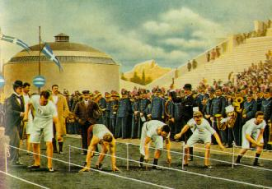
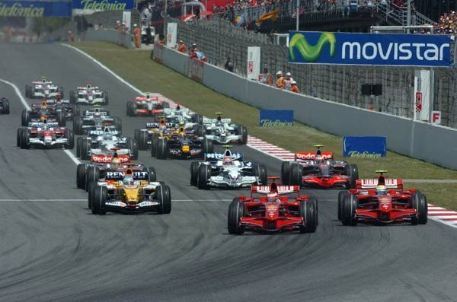
History of Accelerators
Race for higher energies

Slide 11

Electrostatic Accelerators
The simplest of Accelerators! (cathode ray tubes – screens...)
  Particle source – blue electrode, acceleration in an electric fiels, exit – red electrode.
  Achieved energies depend on the applied voltage.
  Current increases exponentially for large voltages creating arcs and discharge (Corona formation)
V_{max}~ MV
Corona
formation
I
Sum
Ohmic
Ion current

Slide 12
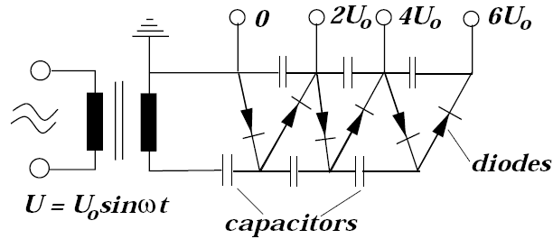
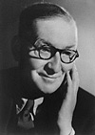
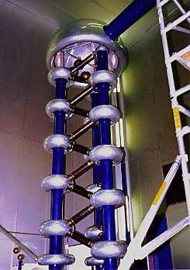
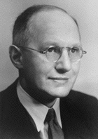
Voltage multipliers
Problem: Achieve higher voltages to push to higher energies
Cockcroft and Walton(1932) developed a cascade generator based on multiple rectifiers
Operating principle – Greinacker circuit
  AC power supply
  2N diods (one-way current “switch”) so that the maximum voltage on each couple of capacitors goes to 2V₀, 4V₀, 6V₀, …,2NV₀
  Voltages ~MV can be achieved for beams of ~100s of mA
Cockcroft and Walton used such an accelerator to split lithium nuclei producing helium nuclei. (Nobel prize 1951)
Fermilab cascade generator
Greinacker Circuit

Slide 13
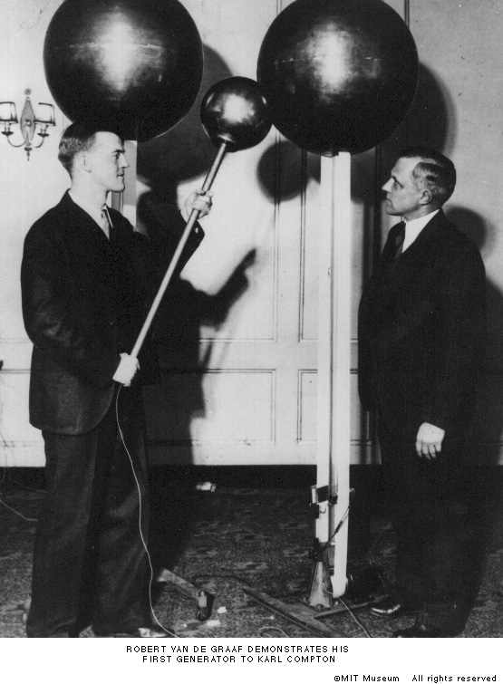
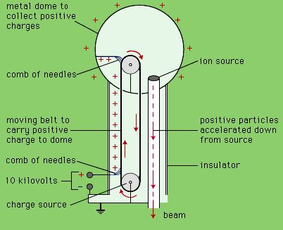
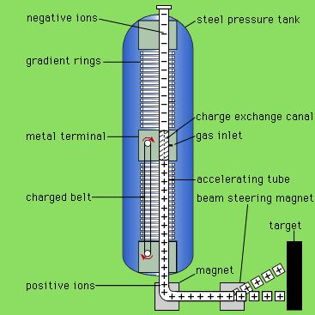
Van de Graaff Generator (1930)
Charges are accumulated through a moving belt charging the dome.
Higher voltages can be achieved within a pressure tank – Paschen’s law: Break down voltage depends on gas pressure & gap
Possibility to double the voltage (Tandem)
  Negative charge ions accelerated from 0 to V
  Electrons absorbed from a gas and are accelerated again (from V to 0)

Slide 14
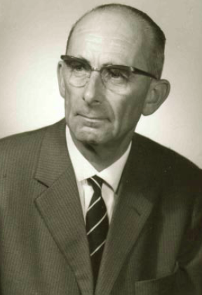
Linear accelerators (LINAC)
Ising’s Original idea (1924), first built by Wideröe (1928) and first high energy linac (1.3MeV) built by Sloan and Lawrence (1931)
Line of drift tubes alternatingly connected to high frequency (RF) power supplies
Particles accelerated in the gaps, but insulated in the tubes (no field – act as a Faraday cage)
As the voltage changes sign, the particles are accelerated every time they enter a gap
The length of the tubes, increases with acceleration for a given/constant frequency up to the relativistic limit
Synchronization to the field is achieved via phase focusing
Beams (1933) first linac with waveguides. Hansen and Varian brothers (1937) invented the klystron (up to 10GHz)

Slide 15
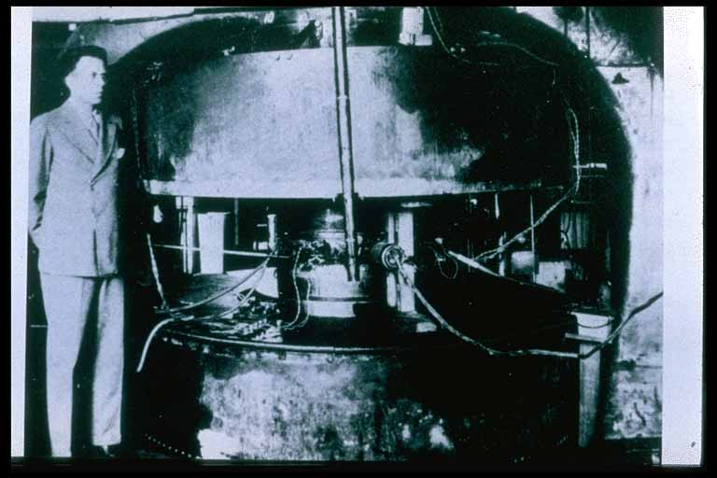
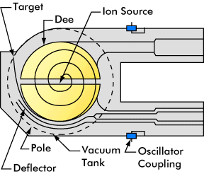
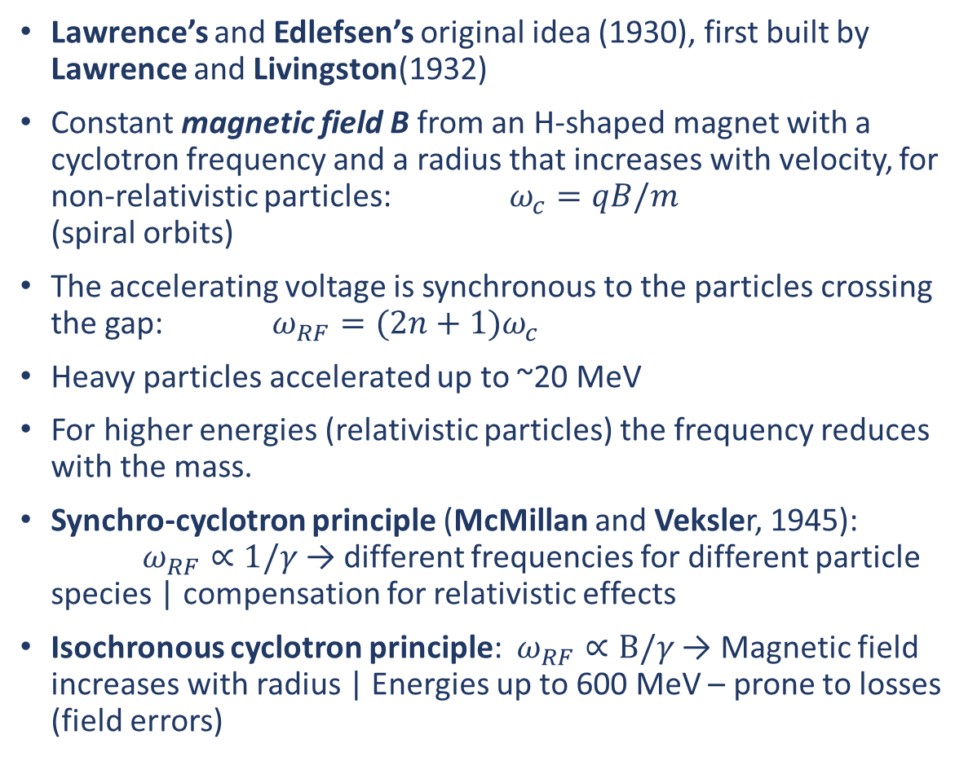
Cyclotron
Lawrence’s and Edlefsen’s original idea (1930), first built by Lawrence and Livingston(1932)
Constant magnetic field B from an H-shaped magnet with a cyclotron frequency and a radius that increases with velocity, for non-relativistic particles: $ω_{c}=qB/m$ (spiral orbits)
The accelerating voltage is synchronous to the particles crossing the gap: $ω_{RF}=(2n+1)ω_{c}$
Heavy particles accelerated up to ~20 MeV
For higher energies (relativistic particles) the frequency reduces with the mass.
Synchro-cyclotron principle (McMillan and Veksler, 1945): $ω_{RF}∝1/γ$→ different frequencies for different particle species | compensation for relativistic effects
Isochronous cyclotron principle: $ω_{RF}∝Β/γ$→ Magnetic field increases with radius | Energies up to 600 MeV – prone to losses (field errors)
Lawrence
Berkley Cyclotron (1.2 MeV)

Slide 16
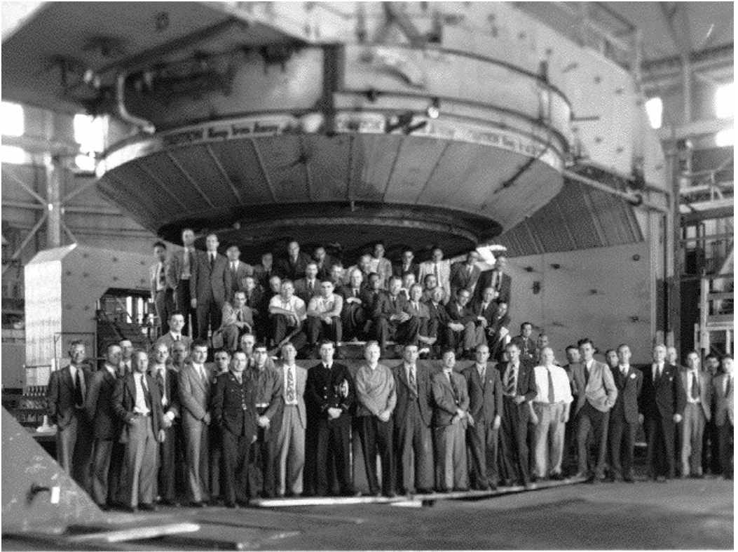
Cyclotron
Lawrence
Berkley Cyclotron (1.2 MeV)
184-inch cyclotron:
1 single dipole with 467 cm diameter
Berkeley campus, 1942

Slide 17
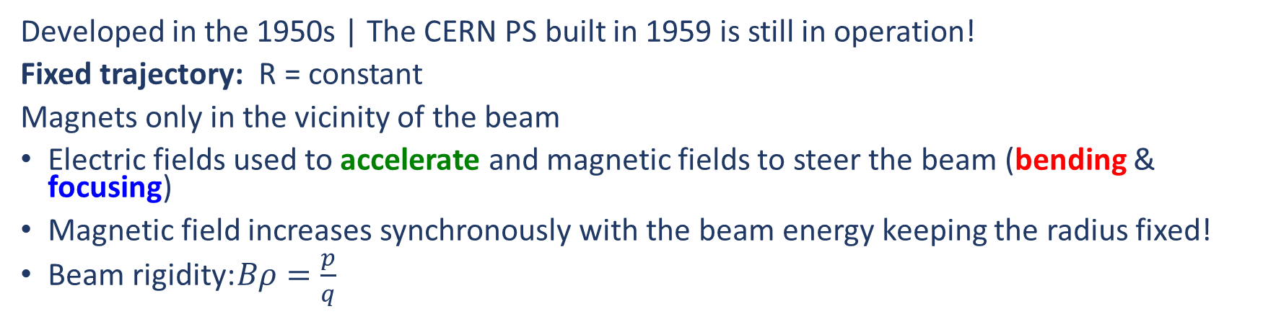
Synchrotron
Dipole magnets
to bend the beam
Could we further push the energy?
Colliders
Two beams circulating at the Synchrotron’s energy
The beams are brought to collision
energy at the centre of mass gets double
Quadrupole magnets
to focus the beam
RF cavities
to accelerate the beam
Developed in the 1950s | The CERN PS built in 1959 is still in operation!
Fixed trajectory: R = constant
Magnets only in the vicinity of the beam
Electric fields used to accelerate and magnetic fields to steer the beam (bending & focusing)
Magnetic field increases synchronously with the beam energy keeping the radius fixed!
Beam rigidity: $Bρ=\frac{p}{q}$

Slide 18
Livingston Plot – evolution of energy reach
The Livingston plot shows an exponential increase of energy with time
Energy is increased by one order of magnitude each 6-10 years
New technologies replace the old ones to achieve higher energies, until saturation. By then new technological advancements allow replacing the existing ones
And the process continues…
Energy is not the only relevant figure of merit:
  Beam intensity
  Beam emittance (size)

Slide 19
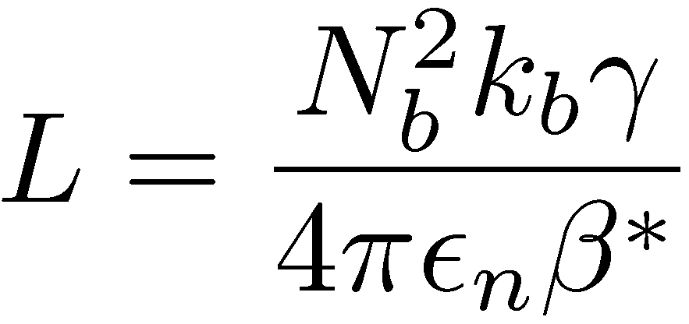
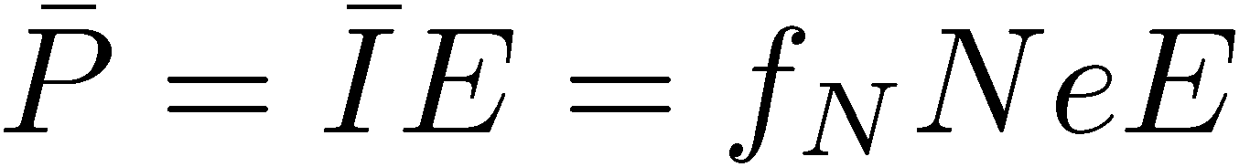
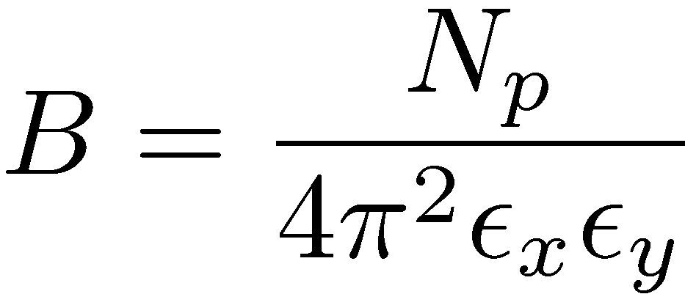
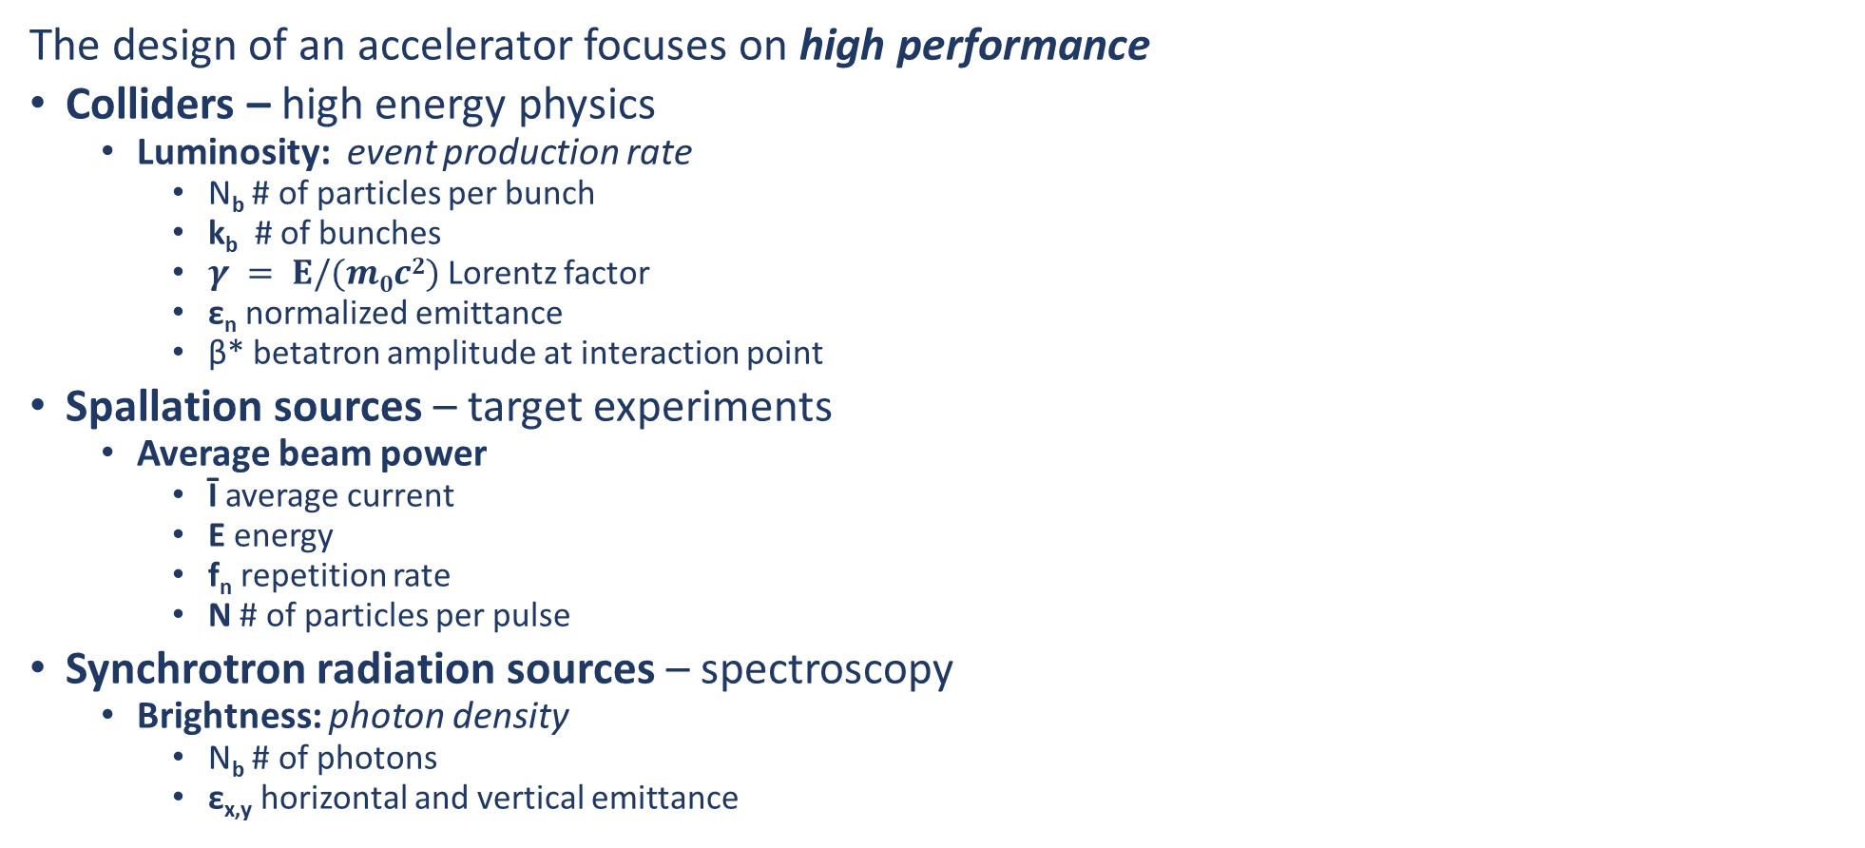
Accelerators and performance indicators
The design of an accelerator focuses on high performance
Colliders – high energy physics
  Luminosity: event production rate
    Ν_{b} # of particles per bunch
    k_{b} # of bunches
    $γ = Ε/(m0c2)$Lorentz factor
    ε_{n} normalized emittance
    β* betatron amplitude at interaction point
Spallation sources – target experiments
  Average beam power
    Ī average current
    Ε energy
    f_{n} repetition rate
    Ν # of particles per pulse
Synchrotron radiation sources – spectroscopy
  Brightness: photon density
    Ν_{b} # of photons
    ε_{x,y} horizontal and vertical emittance
Energy
Intensity
Beam size

Slide 20
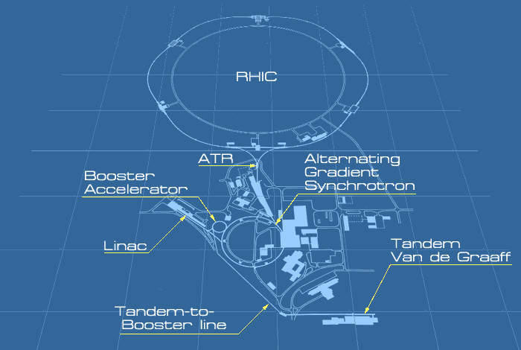
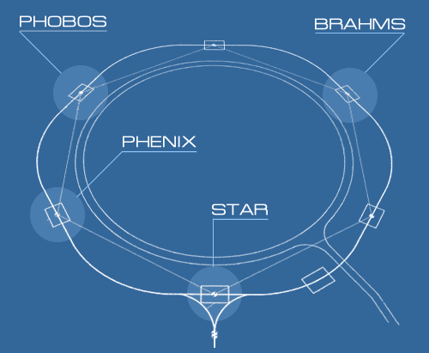
Relativistic Heavy Ion Collider (RHIC - BNL)
Ion collider (gold, copper and polarized protons) with energies up to 100 GeV/u
The beams are counter-rotated in a 2.4 mile (~4km) storage ring driven by 1740 superconducting dipoles
The beams collide at 6 points in 4 of which the detectors of the 4 main experiments (BRAHMS, PHENIX, PHOBOS, STAR) are placed
The main purpose of the accelerator is the production, detection and study of quark - gluon plasma

Slide 21
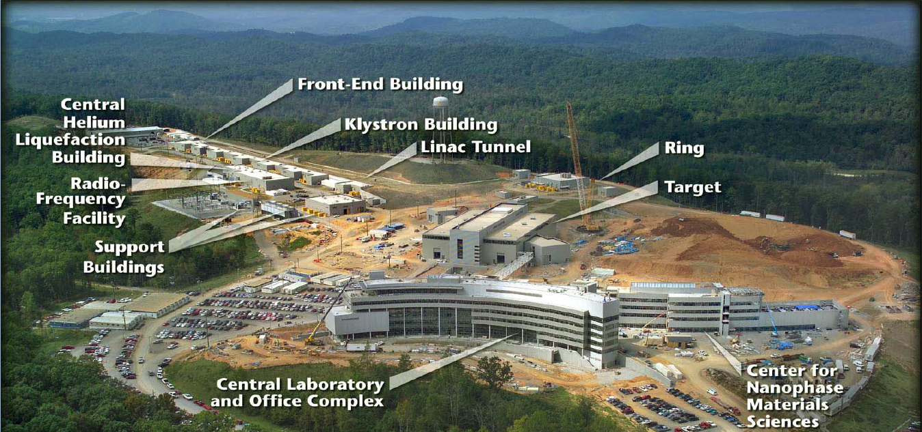
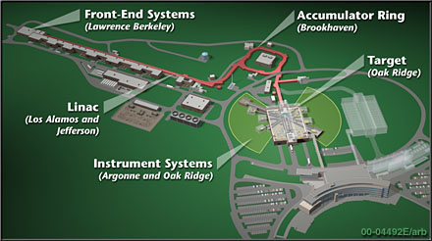
Spallation Neutron Source (SNS - ORNL)
Collaboration project of 6 laboratories (LBNL, LANL, JLAB, BNL, ANL, ORNL)
Spallation Neutron Source with a power of 1.4 MW
The complex includes an H⁻ source, a 300m linear accelerator, with superconducting RF cavities, a proton accumulator ring with a perimeter of 248m and a liquid mercury target for the production of neutrons.
The main purpose is neutron scattering spectroscopy experiments at 24 stations (magnetic structure of materials, nanotechnology, etc.)

Slide 22
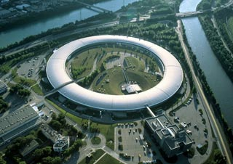
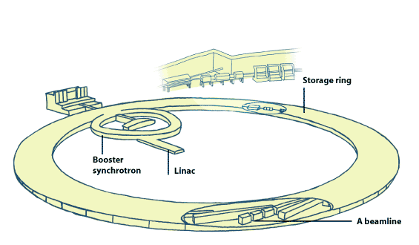
European Synchrotron Radiation Facility (ESRF)
The first and brightest 3rd generation synchrotron radiation source in Europe
50 experimental beamlines using "hard" X-rays produced by interfering magnetic elements (magnetic amplifiers and oscillators) and dipole magnets
3500 users/year from 14 member states perform X-ray spectroscopy experiments for materials science, chemistry, biology, geology, medicine, archaeometry, etc.
The complex includes a linear electron accelerator, a 300-meter booster synchrotron and an 844-meter storage ring.
The storage ring shows record availability of 98% with an average time between outages of more than 2 days.

Slide 23
CERN Accelerator Complex
CERN Proton chain
LINAC-4 160MeV (H-)
Proton Synchrotron Booster 2GeV
Proton Synchtrotron 26GeV
Super Proton Synchrotron 450 GeV
Large Hadron Collider 7Tev
CERN Ion chain
LINAC-3
Low Energy Ion Ring
Proton Synchtrotron
Super Proton Synchrotron
Large Hadron Collider
Other facilities & experiments: n_TOF, ISOLDE, East Area, North Area, HiRadMat, AWAKE, CLEAR (electrons), AD & ELENA (Antiprotons)

Slide 24
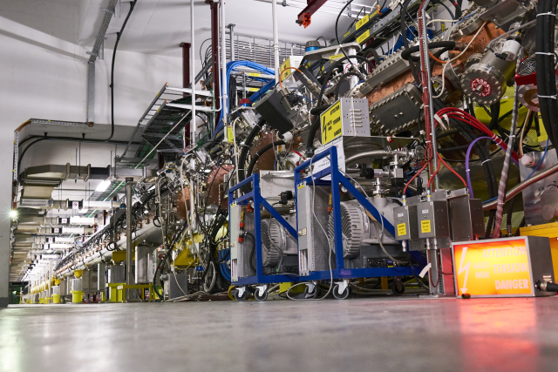
CERN Accelerator Complex – Linac 4
Linac 4
Linac 4: Linear Accelerator 4
CERN’s newest accelerator
1st run: 2019
Main purpose: to increase the injection energy of the PSB to 160 MeV.

Slide 25
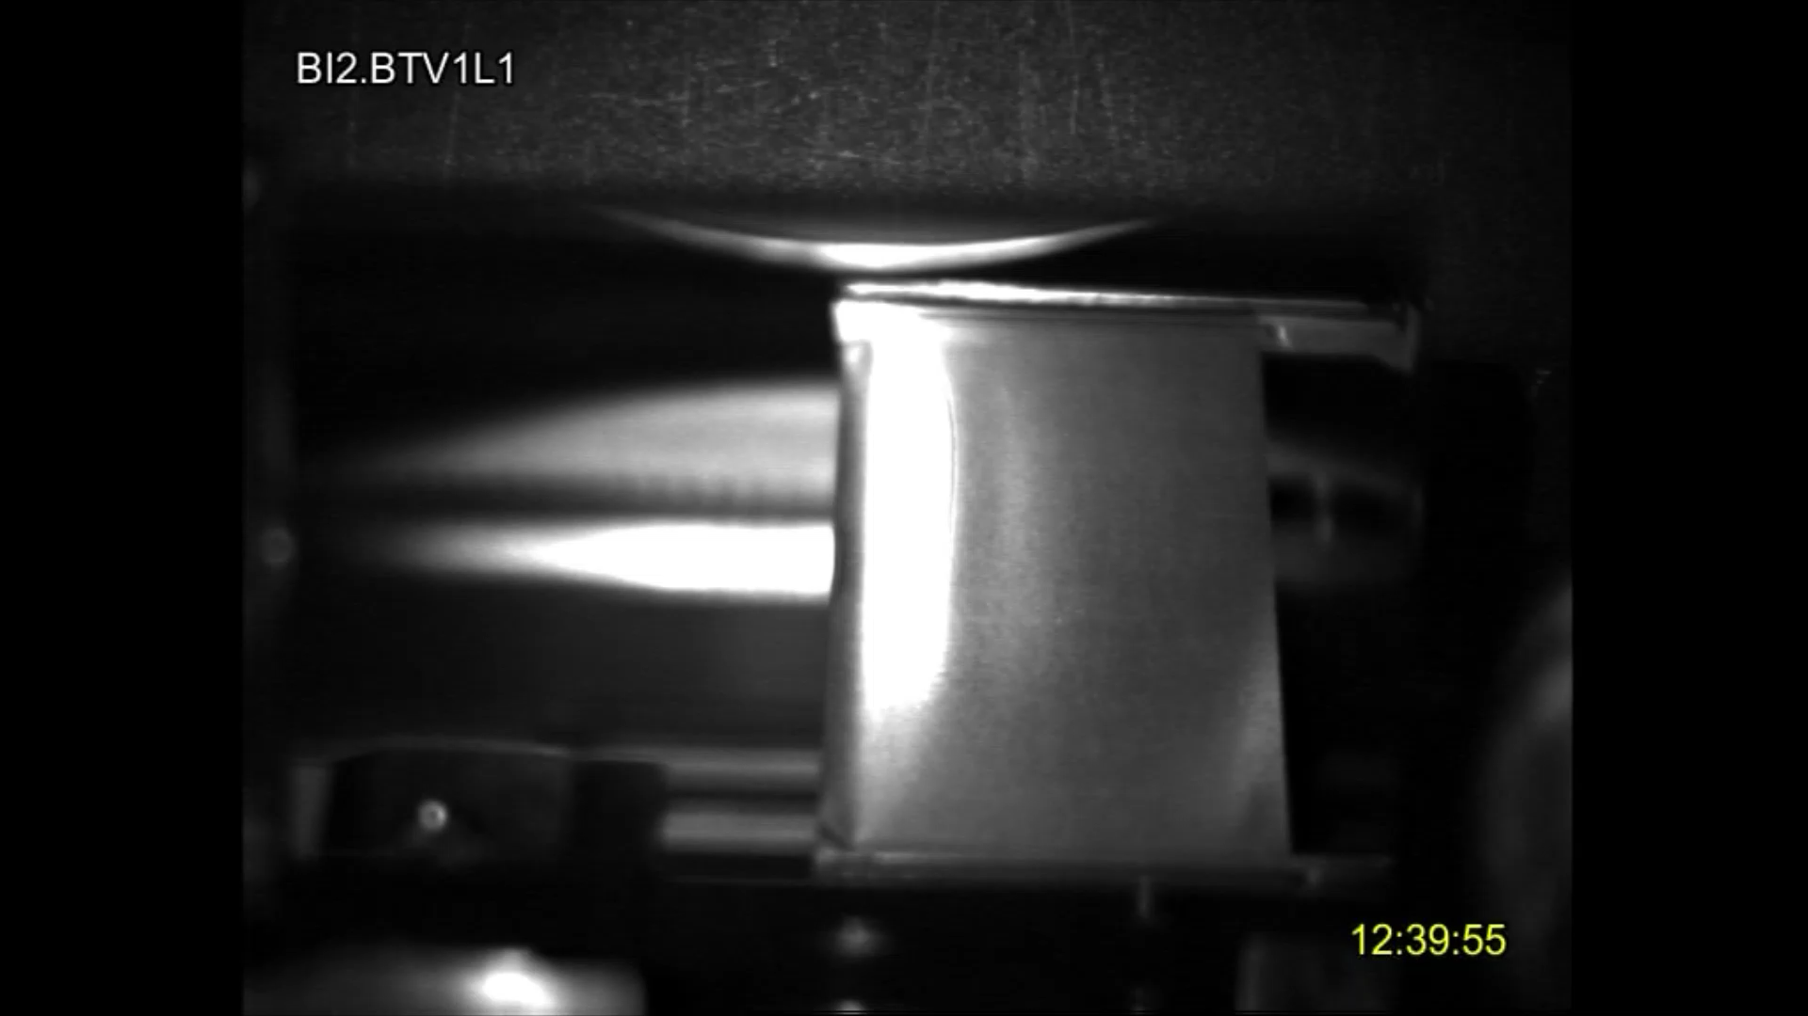
CERN Accelerator Complex – Linac 4
Linac 4
Linac 4: Linear Accelerator 4
CERN’s newest accelerator
1st run: 2019
Main purpose: to increase the injection energy of the PSB to 160 MeV.
It accelerates negative hydrogen ions, H⁻, to 160 MeV.
H⁻ beam guided through a stripping foil at PSB injection to produce the protons: “Charge exchange injection”.

Slide 26
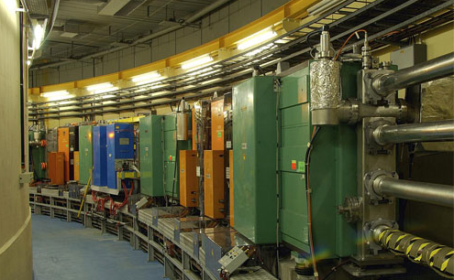
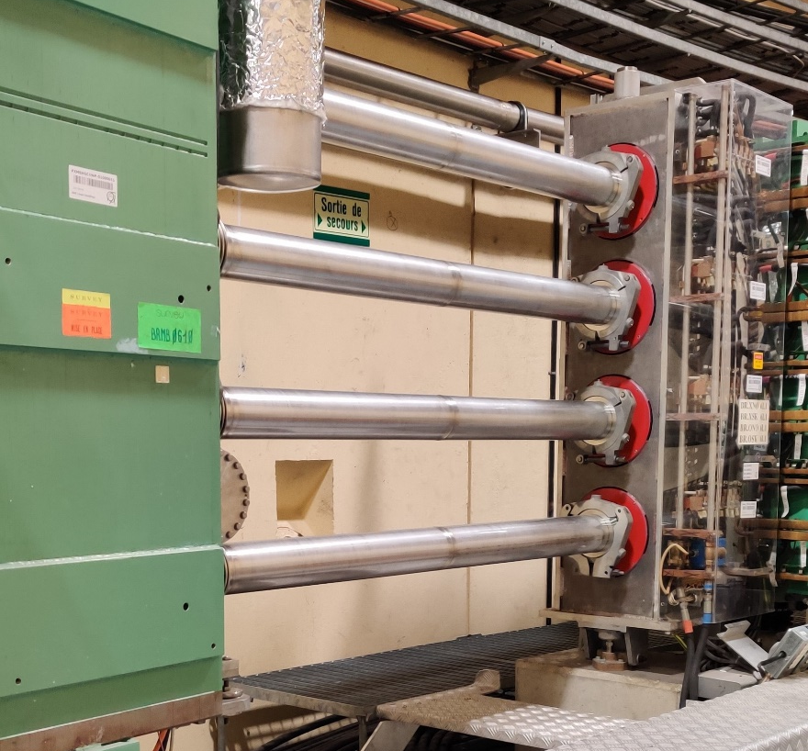
CERN Accelerator Complex
PSB
PSΒ: Proton Synchrotron Booster
The first circular accelerator of the Complex
1st run: 1972
Main purpose: to increase the number of protons that PS can accelerate.
It comprises 4 superposed rings
Essentially, they are 4 different synchrotrons with common characteristics (magnets, etc.)

Slide 27
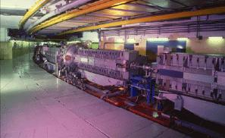
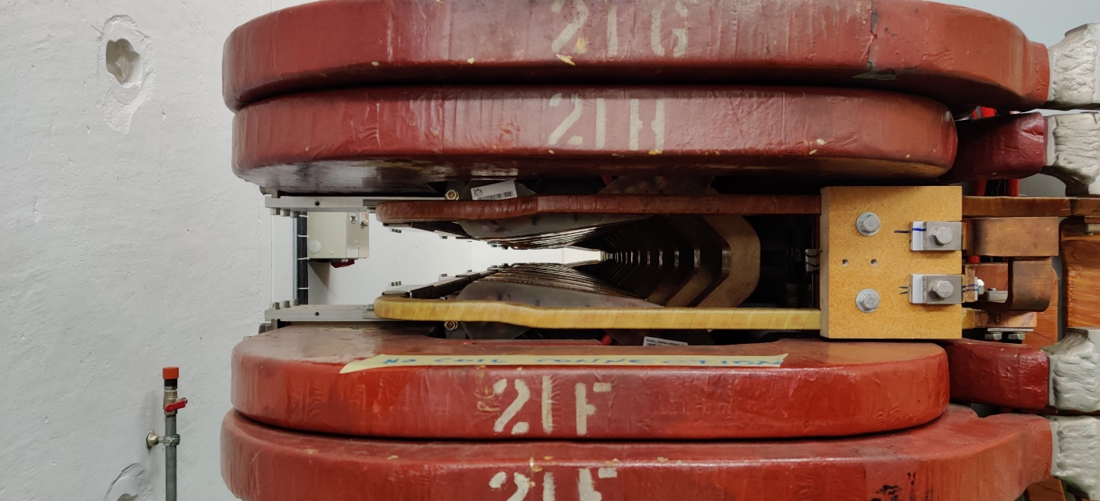
CERN Accelerator Complex
PS: Proton Synchrotron
CERN’s first accelerator
1st run: 1959
Even today it accelerates beams (protons and ions) for the LHC and other CERN experiments
PS
Consists of 100 combined function magnets
The same magnet bends and focuses the beam!

Slide 28
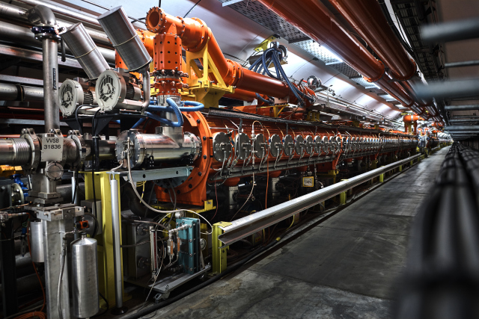
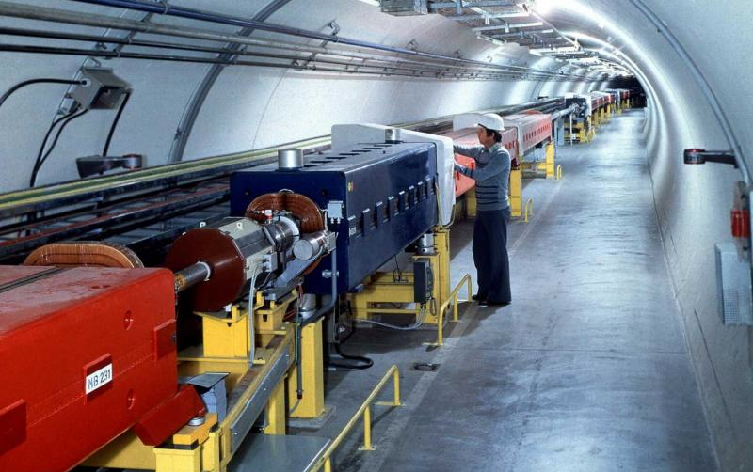
CERN Accelerator Complex
SPS: Super Proton Synchrotron
The 2nd larger accelerator at CERN with a circumference of 7km
1st run: 1976
Discovery of the W and Z bosons during its operation as a collider
Today it operates as an accelerator producing beams (protons and ions) for the LHC and other CERN experiments
SPS

Slide 29

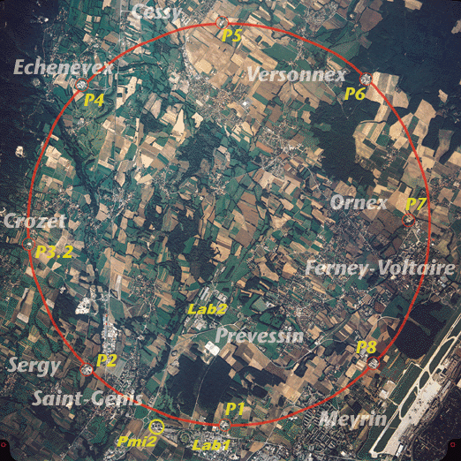
CERN Accelerator Complex
LHC: Large Hadron Collides
The largest accelerator at CERN with a circumference of 26.7km
1st run: 2008
The beams rotate in opposite directions driven by 1232 superconducting dipoles, 14.3m long with up to 8T field in temperatures of -271.3℃
Operates with protons and ions
LHC

Slide 30
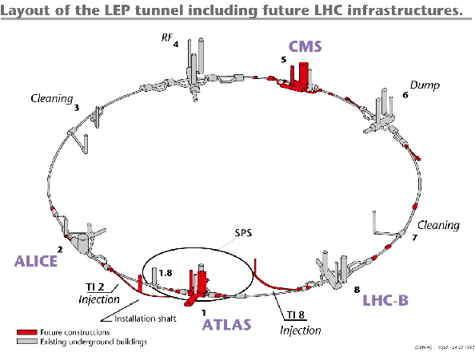
CERN Accelerator Complex
There are 8 interaction points, 4 of which the detectors of the main experiments (ATLAS, CMS, ALICE, LHC-B) are placed
The main purpose: the production, detection and study of Higgs bosons (revealing the mass acquisition mechanism)
LHC

Slide 31
CERN Accelerator Complex
CERN Proton chain
LINAC-4 160MeV (H-)
Proton Synchrotron Booster 2GeV
Proton Synchtrotron 26GeV
Super Proton Synchrotron 450 GeV
Large Hadron Collider 7Tev
CERN Ion chain
LINAC-3
Low Energy Ion Ring
Proton Synchtrotron
Super Proton Synchrotron
Large Hadron Collider
Other facilities & experiments: n_TOF, ISOLDE, East Area, North Area, HiRadMat, AWAKE, CLEAR (electrons), AD & ELENA (Antiprotons)
Vast majority:
circular machines
→ synchrotrons

Slide 32
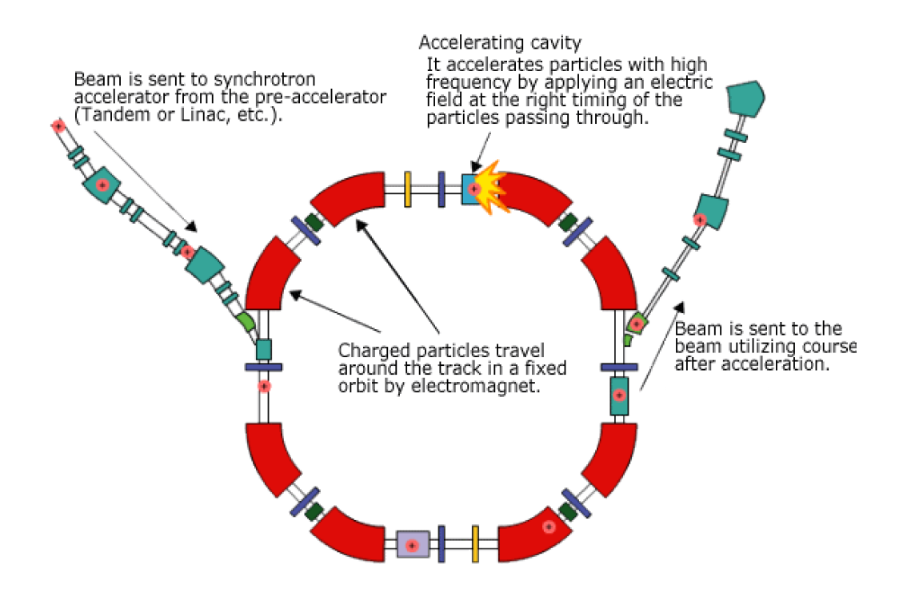
Main principles of a Synchrotron
The beam needs to be controlled to allow:
Long storage times
Preservation of beam quality
Focusing allows better control:
  Phase focusing | RF cavities
  Weak focusing | Dipoles
  Strong focusing | Quadrupoles

Slide 33
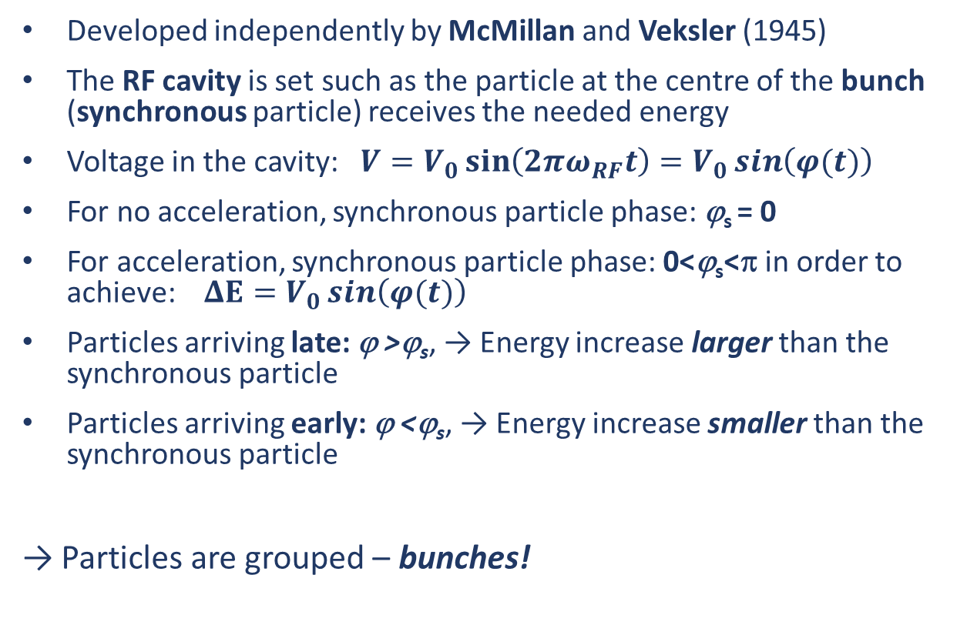
Phase focusing
Developed independently by McMillan and Veksler (1945)
The RF cavity is set such as the particle at the centre of the bunch (synchronous particle) receives the needed energy
Voltage in the cavity: ${V=V}_{0}\sin\left(2πω_{RF}t\right)=V_{0}\sin\left(φ(t)\right)$
For no acceleration, synchronous particle phase: ϕ_{s} = 0
For acceleration, synchronous particle phase: 0<ϕ_{s}<π in order to achieve: $ΔE=V_{0}\sin\left(φ(t)\right)$
Particles arriving late: ϕ >ϕ_{s}, → Energy increase larger than the synchronous particle
Particles arriving early: ϕ <ϕ_{s}, → Energy increase smaller than the synchronous particle
Particles are grouped – bunches!
Lawrence
Berkley Cyclotron (1.2 MeV)

Slide 34
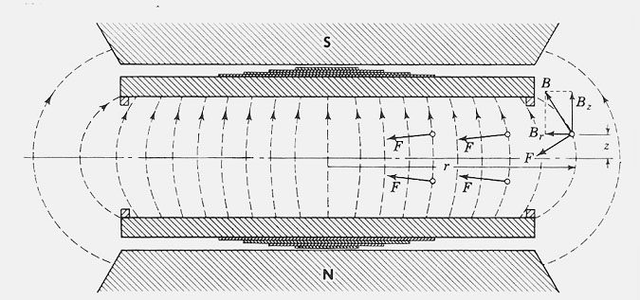
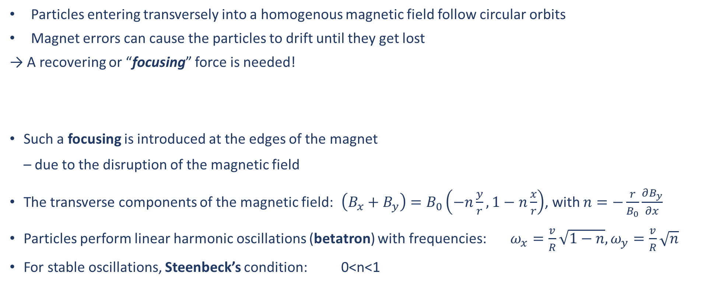
Weak focusing
Particles entering transversely into a homogenous magnetic field follow circular orbits
Magnet errors can cause the particles to drift until they get lost
A recovering or “focusing” force is needed!
Such a focusing is introduced at the edges of the magnet
– due to the disruption of the magnetic field
The transverse components of the magnetic field: $\left(B_{x}+B_{y}\right)=B_{0}\left(−n\frac{y}{r}, 1−n\frac{x}{r}\right)$, with $n=−\frac{r}{B_{0}}\frac{∂B_{y}}{∂x}$
Particles perform linear harmonic oscillations (betatron) with frequencies: $ω_{x}=\frac{v}{R}\sqrt{1−n},ω_{y}=\frac{v}{R}\sqrt{n}$
For stable oscillations, Steenbeck’s condition: 0<n<1
Lawrence
Berkley Cyclotron (1.2 MeV)

Slide 35
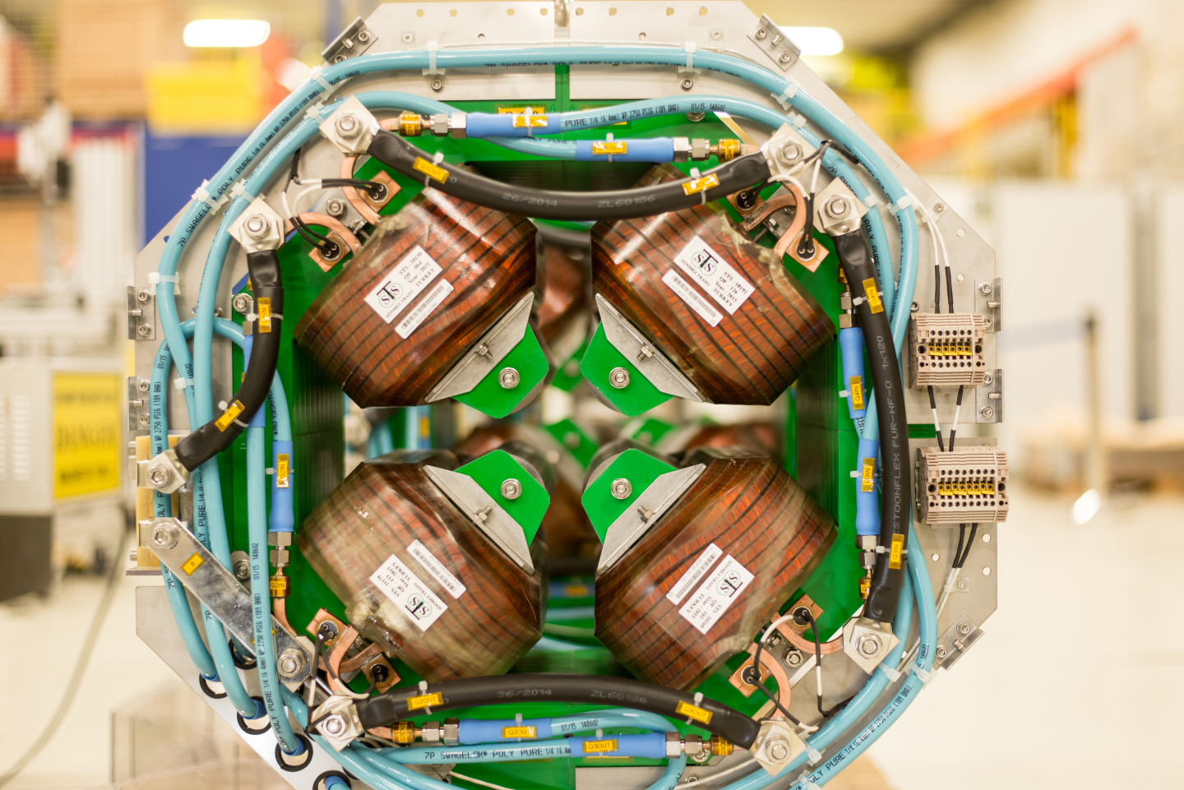
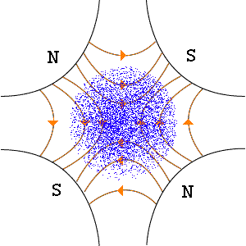
Strong focusing
Principle developed independently by Christofilos (1950) and Courant, Livingston and Snyder (1953)
No fields can have a focusing effect in both transverse planes of motion.
Focusing elements (quadrupoles): act as focusing in one plane but defocusing in the other
A sequence of such focusing and defocusing fields can give an overall strong focusing
The force is proportional to the distance from the axis of the beam
A succession of focusing and defocusing elements allow the particles to follow stable trajectories, performing small betatronic oscillations around the circular periodic orbit

Slide 36



Building Blocks of a Synchrotron
Main components:
Dipole Magnets: Bending
Quadrupole Magnets: (De-)Focusing
Higher order magnets: Corrections
RF cavities: Acceleration

Slide 37
How do particles move under the influence of these elements?
Transverse & Longitudinal Beam Dynamics

