Slide 1
Particle Accelerators and Beam Dynamics
Accelerator & Technology Sector
Beams Department
Accelerator Beam Physics Group
Foteini Asvesta
Eurolabs 2024

Slide 2
Disclaimer
Based on:
Y. Papaphilippou : “Introduction to Accelerators”
Summer student lectures:
  B. Holzer, V. Kain, and M. Schaumann
CERN accelerator school (CAS):
  F. Tecker: “Longitudinal beam dynamics”
Joint Universities Accelerator School (JUAS):
  F. Antoniou, H. Bartosik and Y. Papaphilippou: “Linear imperfections” and “nonlinear dynamics”
Books:
  K. Wille: “The Physics of Particle Accelerators”
  S.Y. Lee: “Accelerator Physics”
  A. Wolski: “Beam Dynamics in High Energy Particle Accelerators”
  H. Wiedemann: “Particle Accelerator Physics”
Images: cds.cern.ch

Slide 3
Overview
Introduction to Accelerators
Accelerator beam dynamics
  Transverse beam dynamics
    Optics functions
    Tune and resonances
  Longitudinal beam dynamics
    Acceleration
    Synchrotron motion

Slide 4
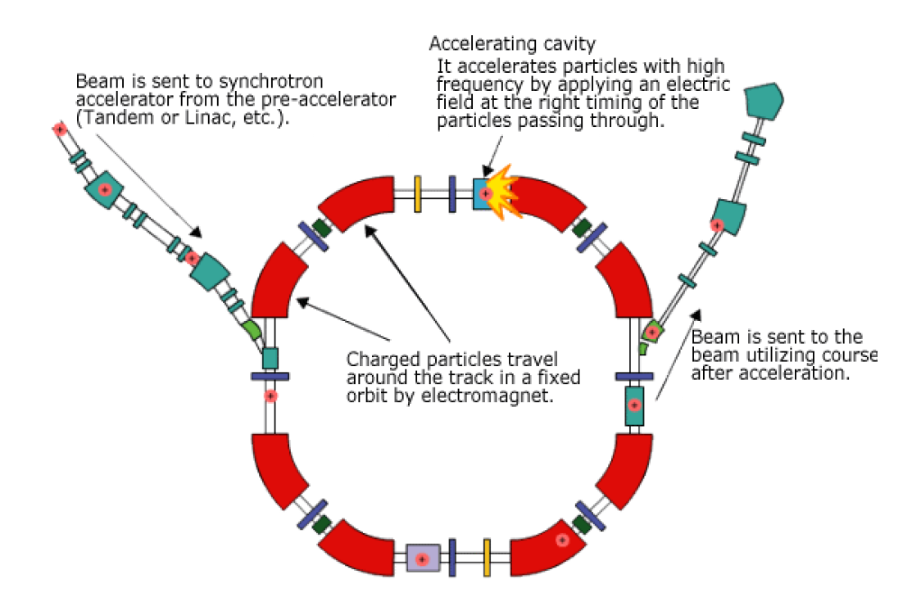
Reminder – Synchrotron
The most common accelerator
Fixed beam trajectory | magnetic field changes synchronous to the energy
Magnets around the beam path to control the motion | bending (dipoles) & focusing (quadrupoles)
Electric fields used to accelerate (RF cavity) the beam

Slide 5
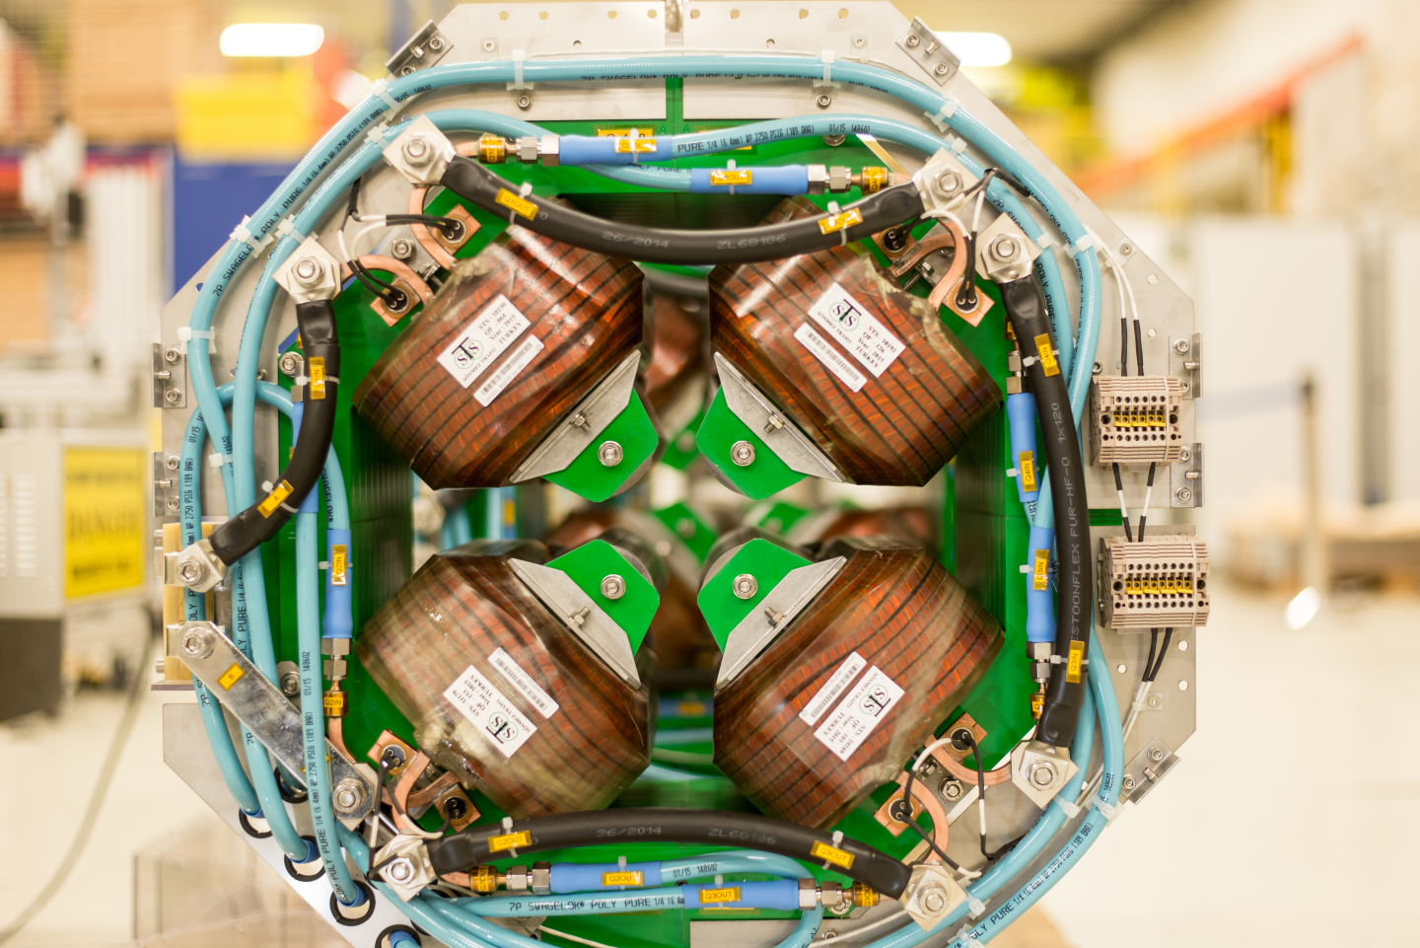
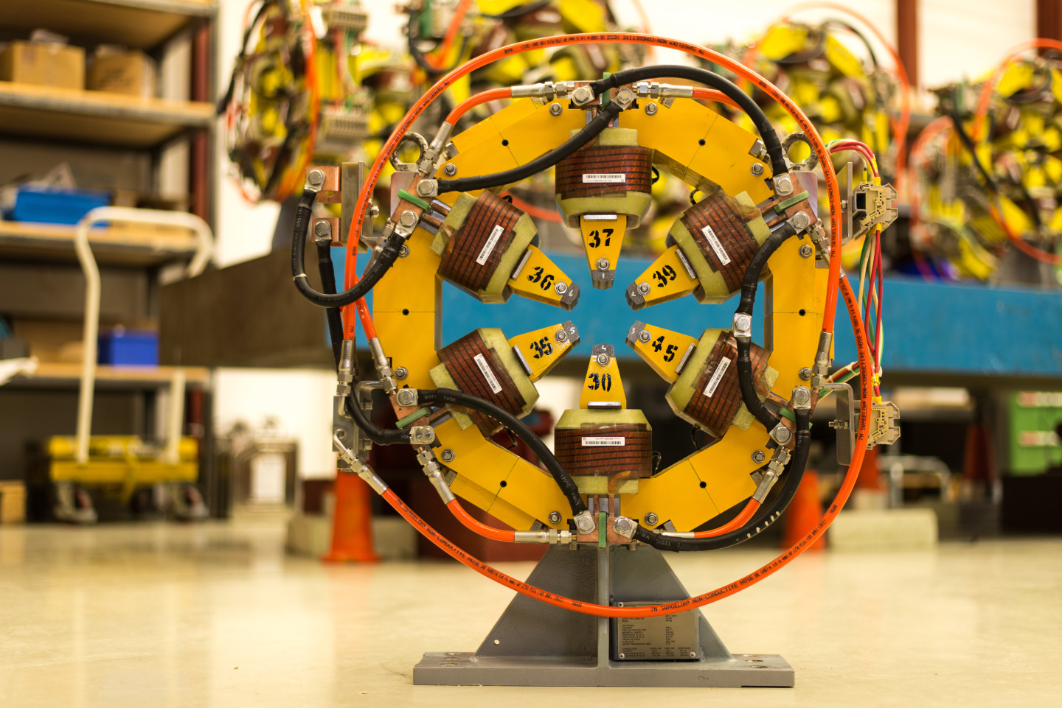
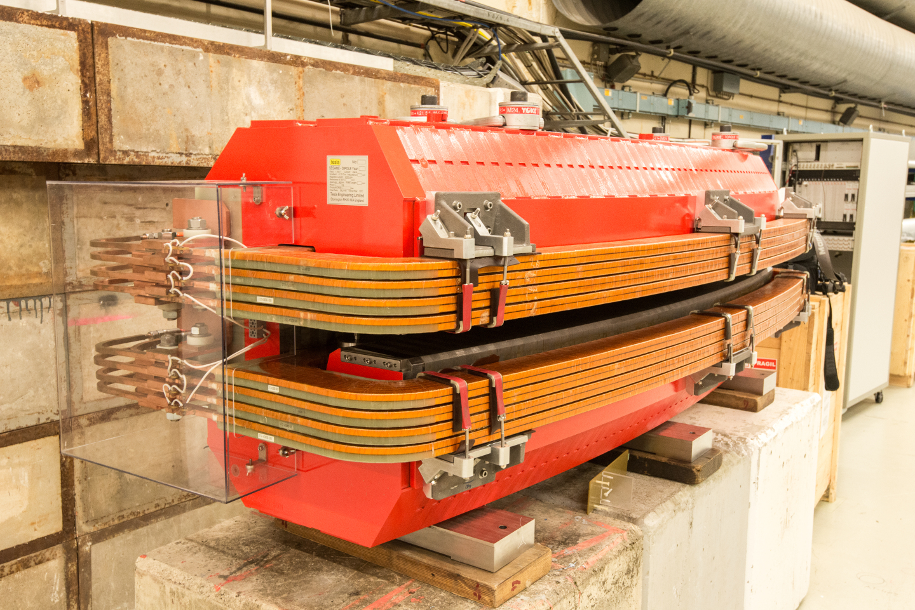
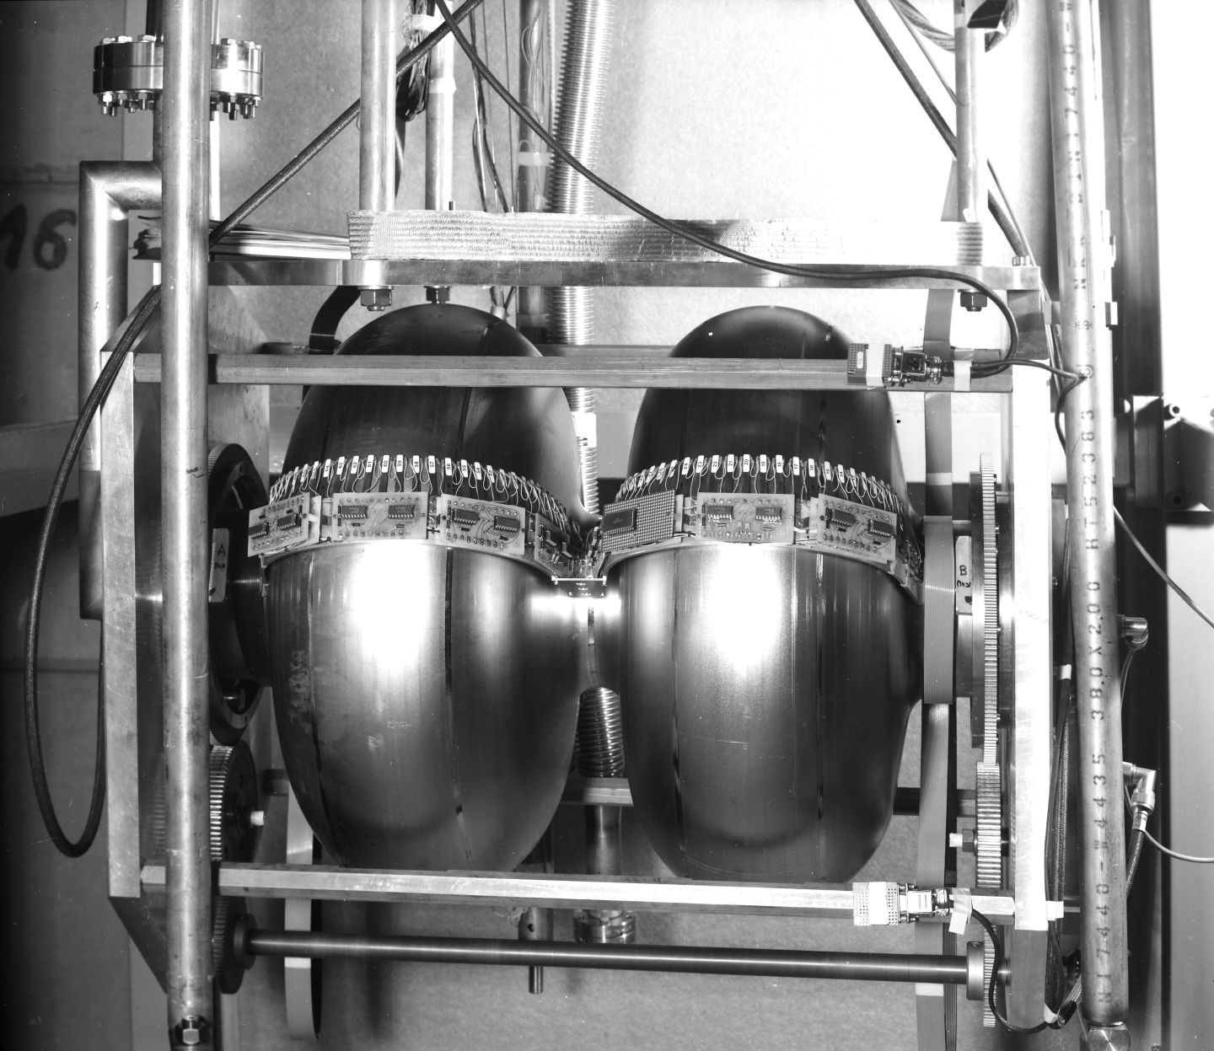
How do particles move under the influence of these elements?
Transverse & Longitudinal Beam Dynamics
Charges in electromagnetic fields

Slide 6
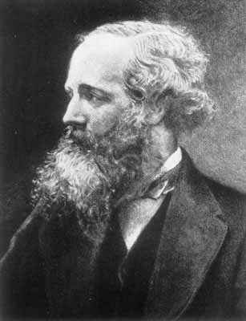
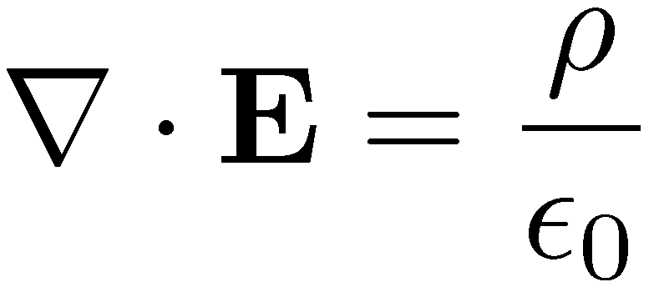
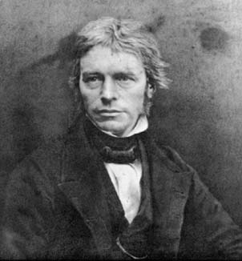
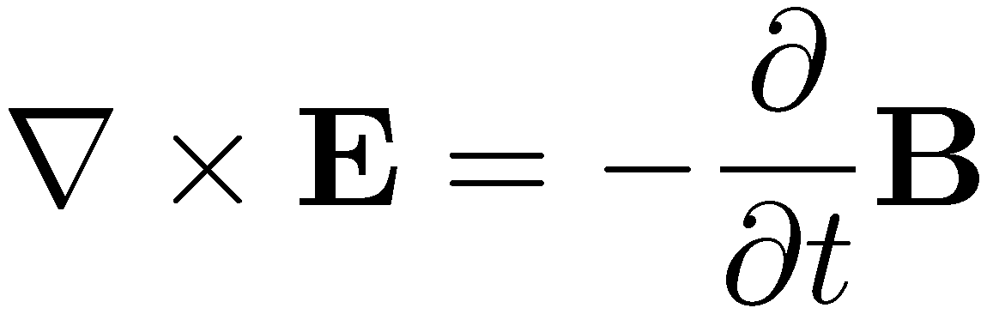
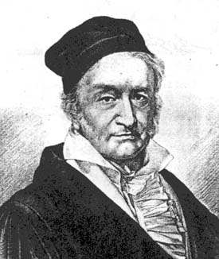
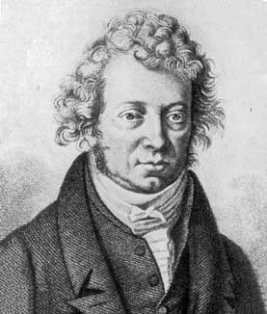
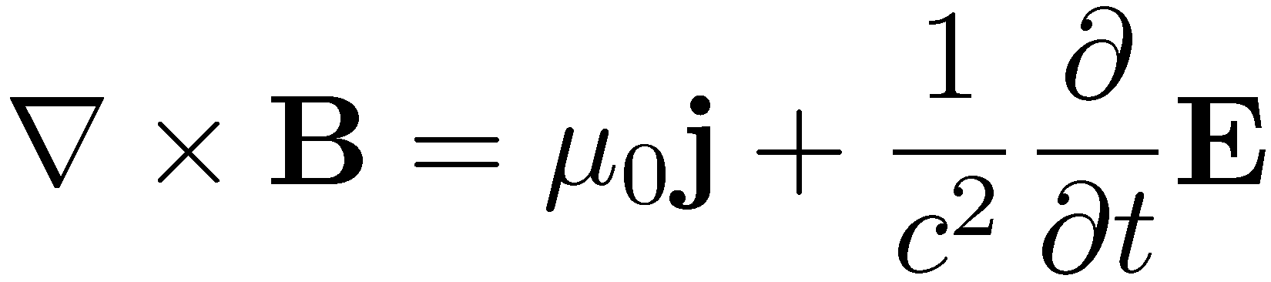
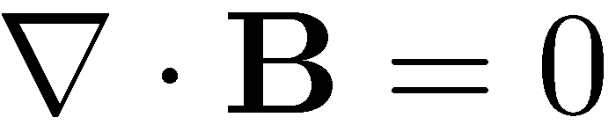
Maxwell’s equations for electromagnetism
Gauss law for electricity
electric field diverges from electric charges
Faraday’s law of induction
changing magnetic fields produce electric fields
Gauss law for magnetism
no isolated magnetic poles
Ampere-Maxwell law
changing electric fields and currents produce circulating magnetic fields

Slide 7
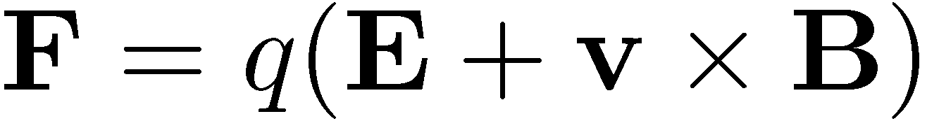
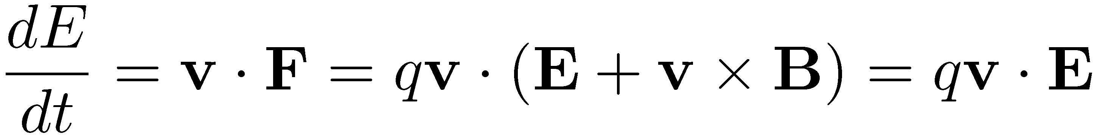
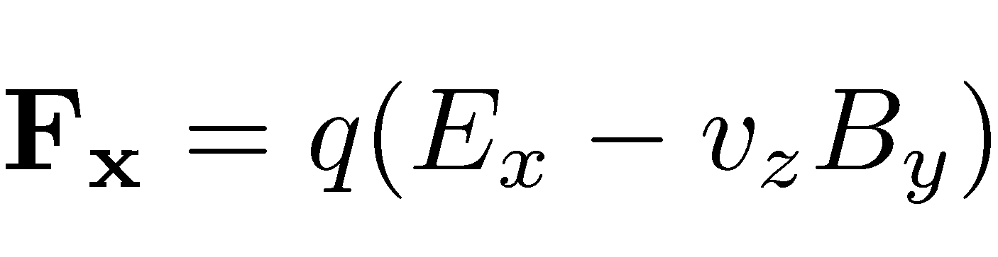
Lorentz force
Force acting on charged particles moving under the influence of electromagnetic fields
Kinetic energy (T) change is caused by the electric field – acceleration
Horizontal component of the Lorentz force (particle moving on the longitudinal plane
For high energy (relativistic limit): υ_{z} ≈ c & υ_{z}Β_{y}>> Ε_{x} (1 Τ corresponding to 300 ΜV/m)
  Magnetic fields much more efficient for steering

Slide 8

Transverse motion – Field expansion
y
In a synchrotron we want to study particles on the design orbit
Magnetic fields are present all along s
The magnetic field at the vicinity of the particle can be expanded as:
x
s
design orbit
ρ
$$\frac{e}{p}B_{y}\left(x\right)={\frac{e}{p}B}_{y0}+\frac{e}{p}\frac{{dB}_{y}}{dx}x+\frac{1}{2!}\frac{e}{p}\frac{d^{2}B_{y}}{{dx}^{2}}x^{2}+\frac{1}{3!}\frac{e}{p}\frac{d^{3}B_{y}}{{dx}^{3}}x^{3}+…=\frac{1}{r}+kx+\frac{1}{2!}mx^{2}+\frac{1}{3!}ox^{3}+…$$
Linear terms
Higher order terms
Dipole
Quadrupole
Sextupole
Octupole
$$…$$
Sufficient terms for a synchrotron

Slide 9
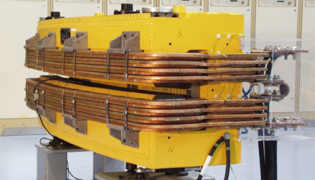
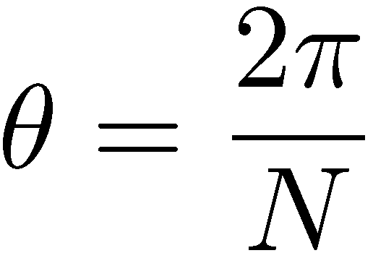
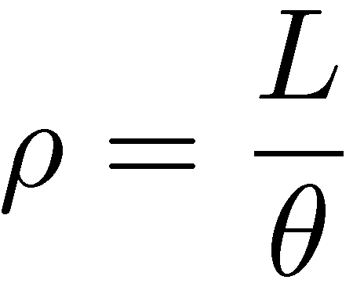
Transverse motion – Dipoles
In a circular accelerator of energy E, with N dipoles, each of length L
Bending angle:
Bending radius:
Dipole field:
Choosing a dipole magnetic field: the length is determined (and vice versa)
For higher fields, smaller and fewer dipoles can be used
Ring circumference (cost) depends on field selection
L
B
θ
ρ

Slide 10
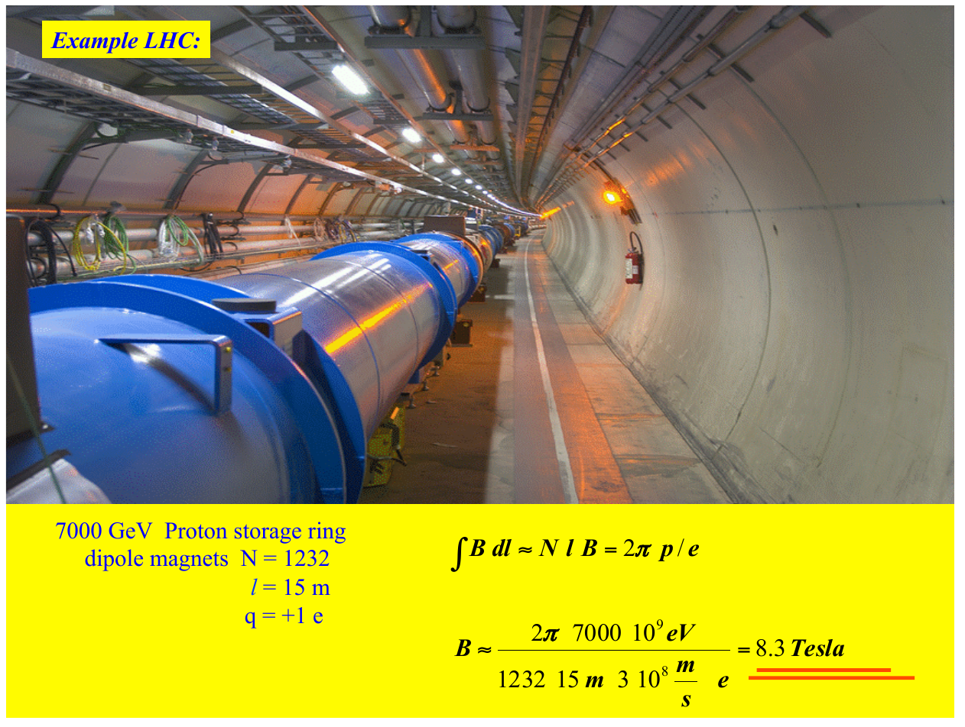

Slide 11
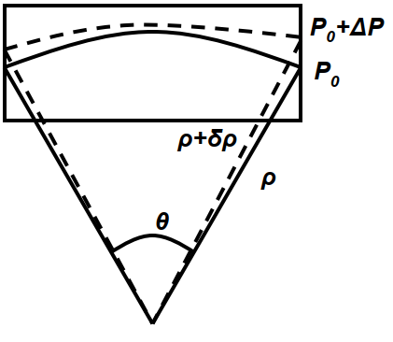

Transverse motion – Dispersion
Reminder:
From the RF cavities | bunches formation:
  The particles forming a bunch have a spread of momenta around the reference particle
  Off-momentum particles (Δp/p, with respect to the reference)
From the beam rigidity (& dipole field):
  The synchrotron has a constant radius if the field follows the momentum
  Off-momentum particles:
The off-momentum particles follow a different orbit than the reference!
The different orbit when Δp/p = 1 is called: Dispersion

Slide 12
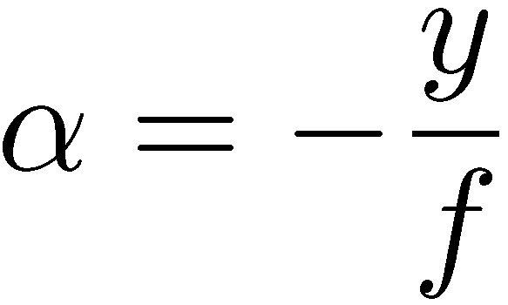
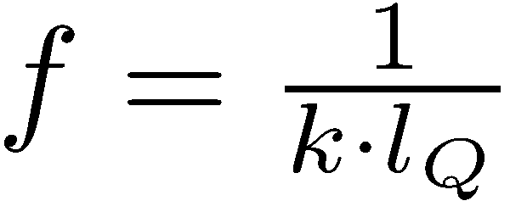
Transverse motion – Quadrupoles
Quadrupoles can have a focusing effect similar to lenses, where:
Quadrupole with field:
and force: ,
Acts as a lens with focal length:
focal point
α
y
direction of force
f
Reminder:
Quadrupoles with a focusing effect in one plane have a defocusing in the other

Slide 13
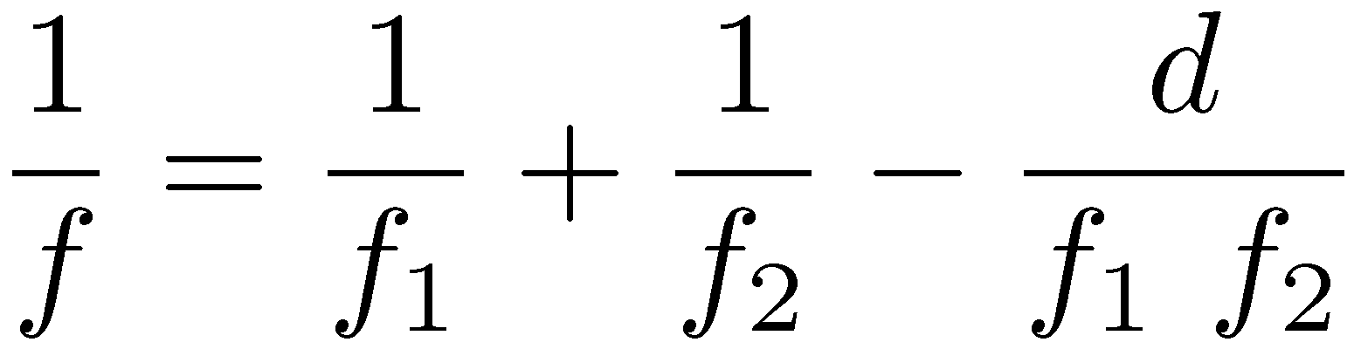
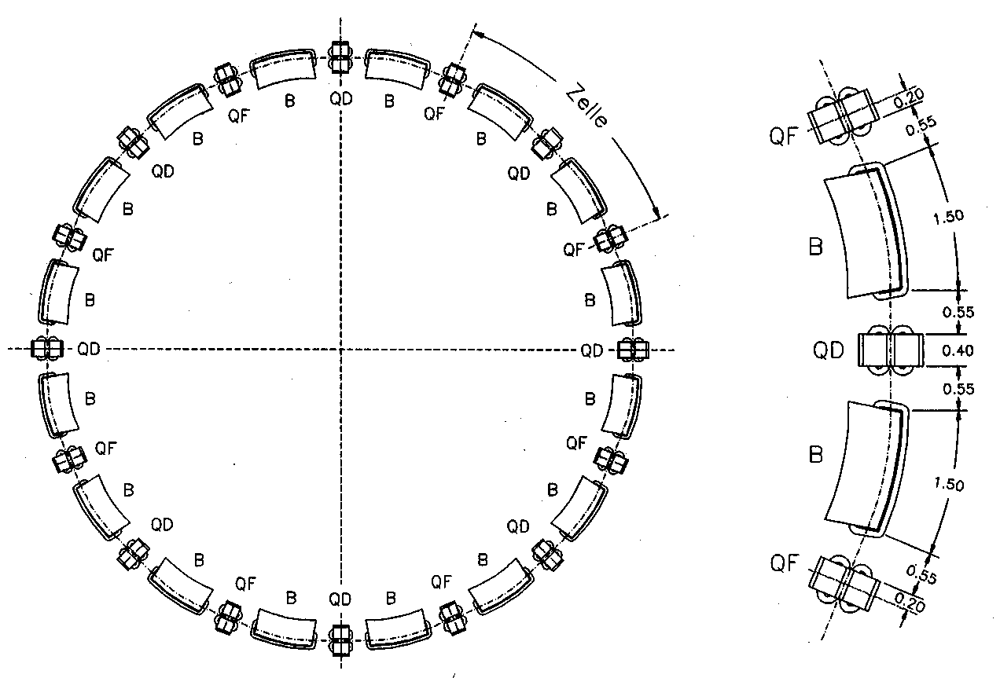
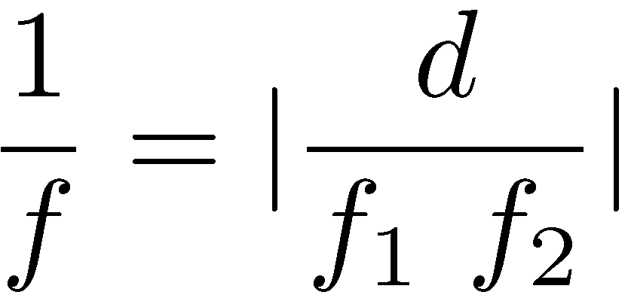
Transverse motion – FODO
Alternating gradient focusing:
Alternating focusing and defocusing lenses can have an overall focusing effect
Combination of lenses with focal lengths, f₁ and f₂ in a distance d gives a focal length:
if f₁ = -f₂, we get an overall focusing effect:
FODO structure
“Cell” of alternating focusing and defocusing elements (along with drifts, dipoles etc)
Structure repeats itself giving a strong periodicity in the ring

Slide 14
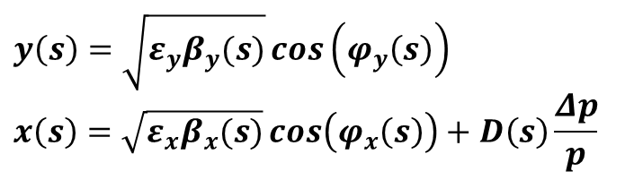
Transverse motion – FODO
The equations of motion moving along the FODO structure:
Dispersive contribution
Quadrupole contribution
(strong focusing)
Dipole contribution (weak focusing)
Setting and we obtain Hill’s equations, with K_{x,y}(s) depending on the position s and K_{x,y}(s+L) = K_{x,y}(s) periodic functions, where L is the periodicity
Solutions describe a quasi harmonic oscillation, where amplitude, phase (and dispersion) depend on the position s in the ring
$$y\left(s\right)=\sqrt{ε_{y}β_{y}(s)}\cos\left(φ_{y}\left(s\right)\right)$$
$$x\left(s\right)=\sqrt{ε_{x}β_{x}(s)}\cos\left(φ_{x}\left(s\right)\right)+D\left(s\right)\frac{Δp}{p}$$

Slide 15
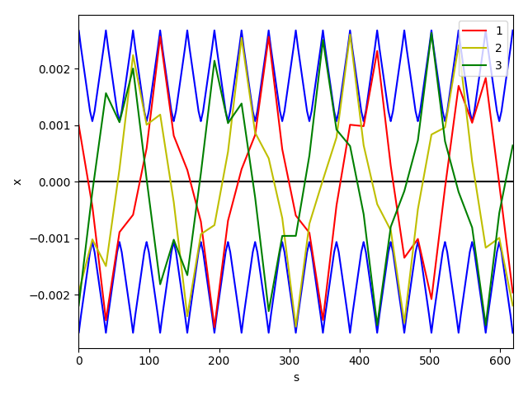
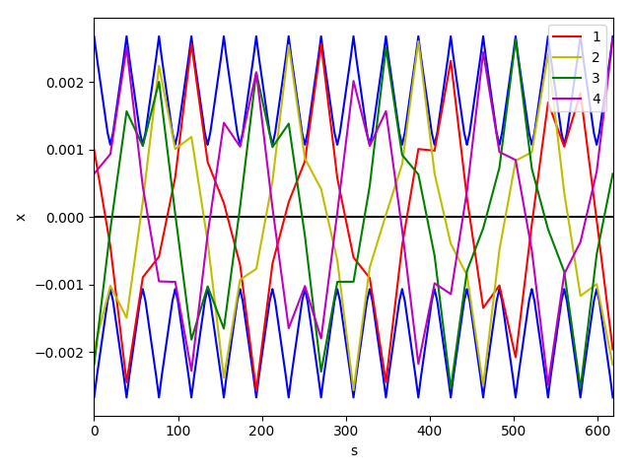
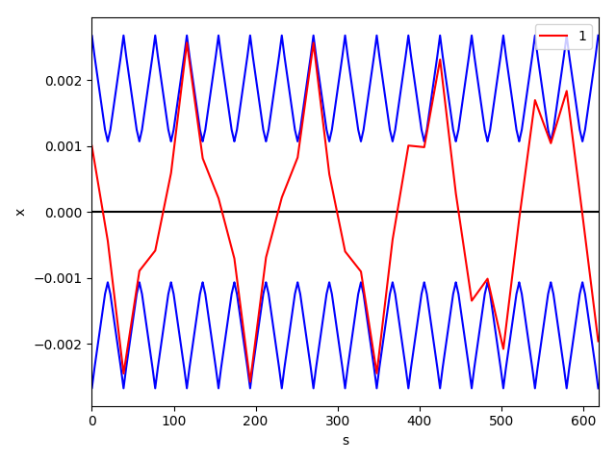
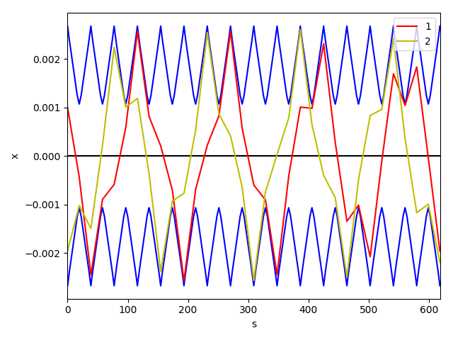
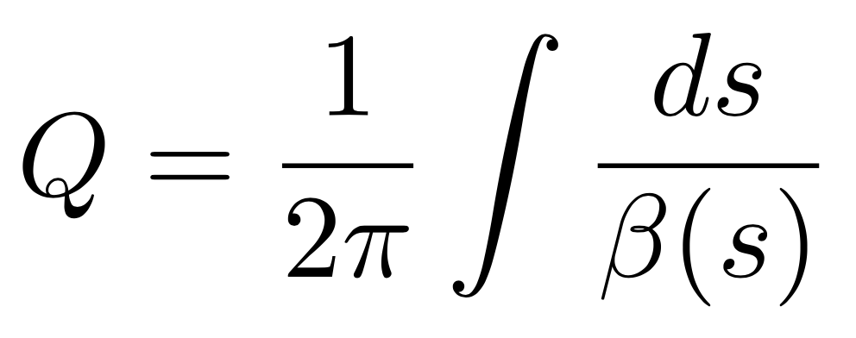
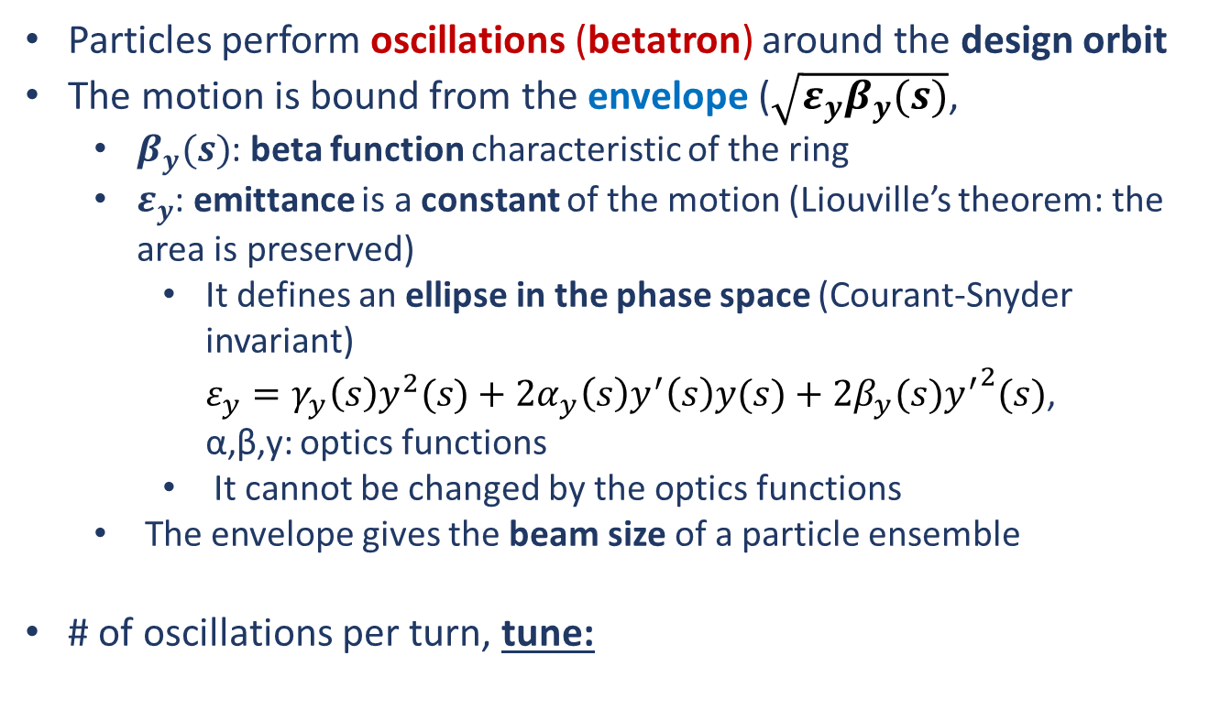
Transverse motion – betatron oscillations
Particles perform oscillations (betatron) around the design orbit
The motion is bound from the envelope ($\sqrt{ε_{y}β_{y}(s)}$,
  $β_{y}(s)$: beta function characteristic of the ring
  $ε_{y}$: emittance is a constant of the motion (Liouville’s theorem: the area is preserved)
    It defines an ellipse in the phase space (Courant-Snyder invariant)
    $ε_{y}=γ_{y}{\left(s\right)y}^{2}(s)+2α_{y}\left(s\right)y^{′}\left(s\right)y(s)+2β_{y}(s){y^{′}}^{2}(s)$,
  α,β,y: optics functions
    It cannot be changed by the optics functions
  The envelope gives the beam size of a particle ensemble
# of oscillations per turn, tune:
y[m]
s [m]

Slide 16
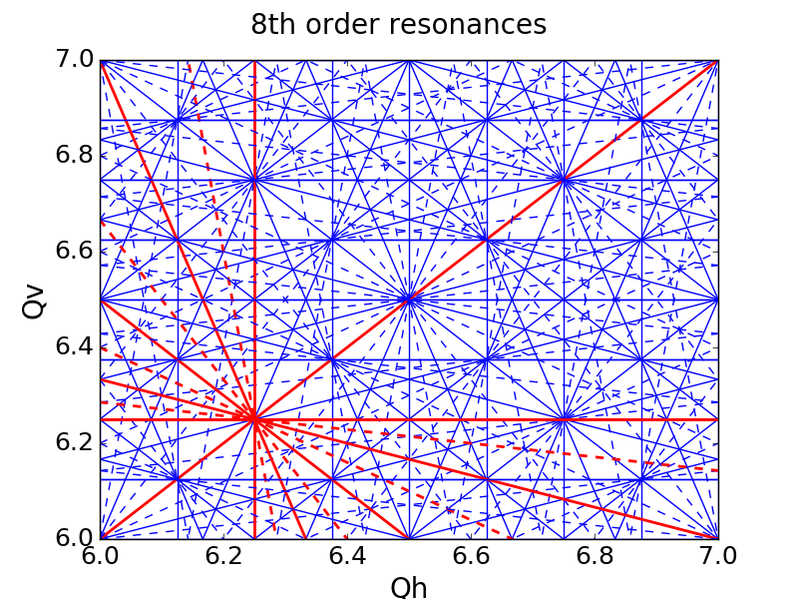
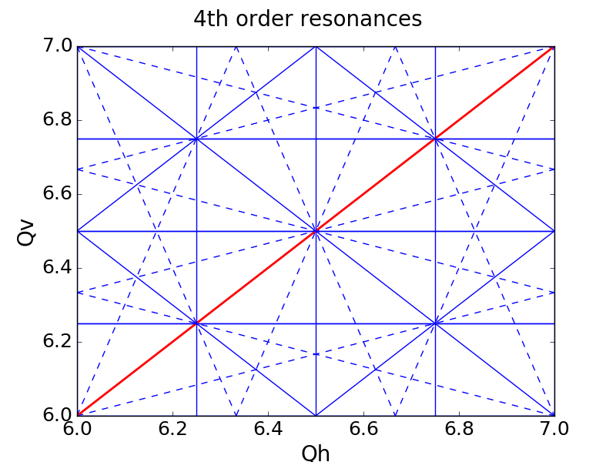
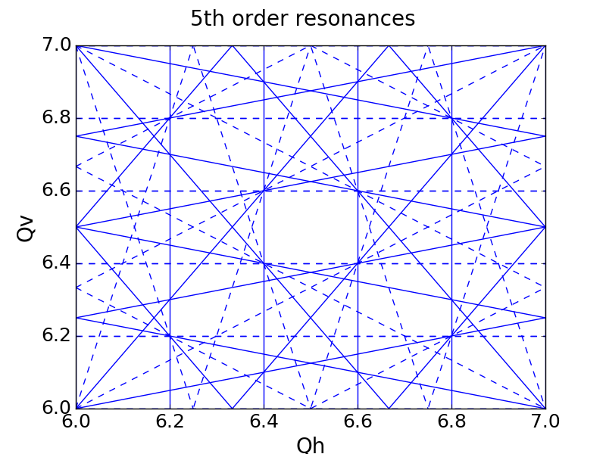
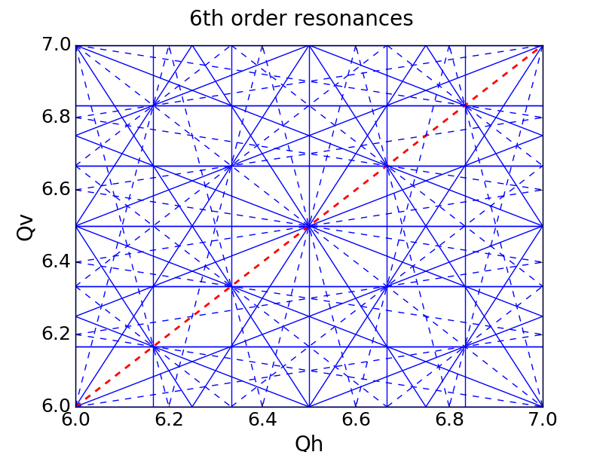
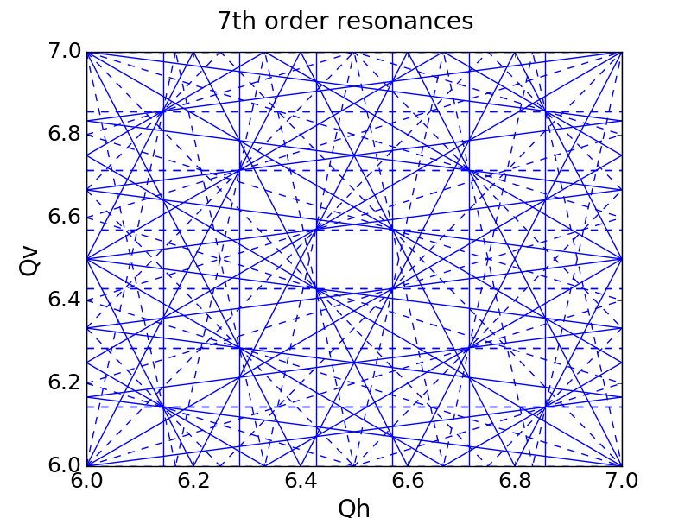
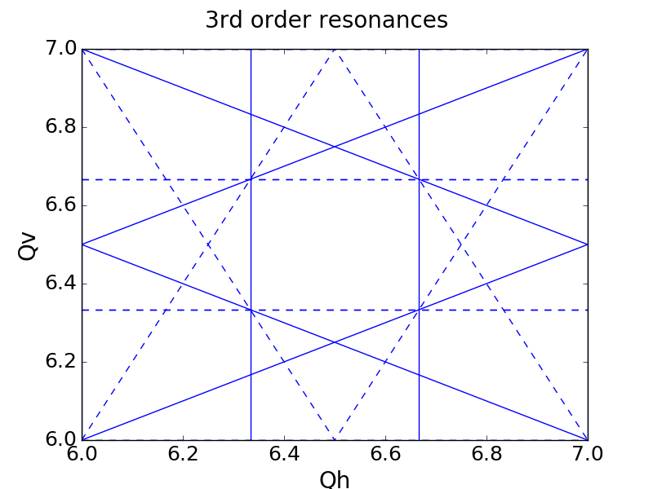
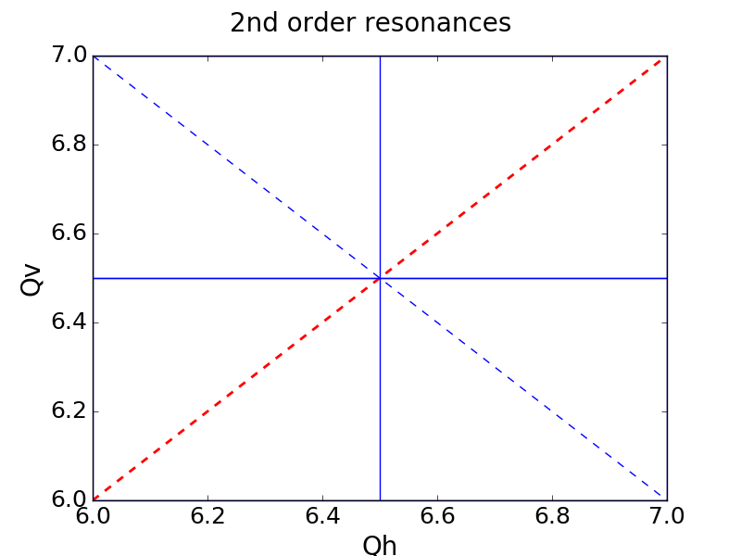
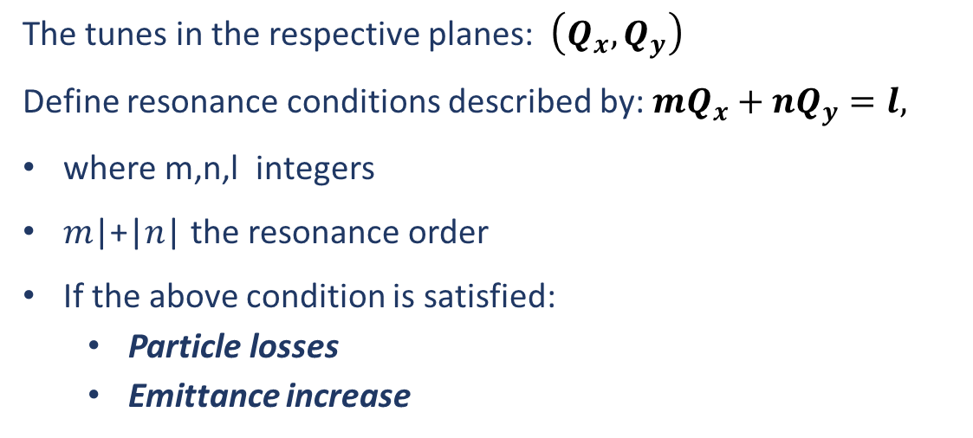
Resonances
The tunes in the respective planes: $\left(Q_{x},Q_{y}\right)$
Define resonance conditions described by: $mQ_{x}+nQ_{y}=l,$
where m,n,l integers
𝑚|+|𝑛| the resonance order
If the above condition is satisfied:
  Particle losses
  Emittance increase
Resonances | Machine Periodicity
Magnetic Field Component
 | Systematic | Non Systematic
Skew
Normal

Slide 17


Magnetic Field Component
Normal components become skew when rotated by half the rotation symmetry
Normal Quadrupole
$45°$ Rotation
Skew Quadrupole
Normal Sextupole
$30°$ Rotation
Skew Sextupole
Plots from:
T. Satogata et al., "Magnets and Magnet Technology", USPAS2013

Slide 18
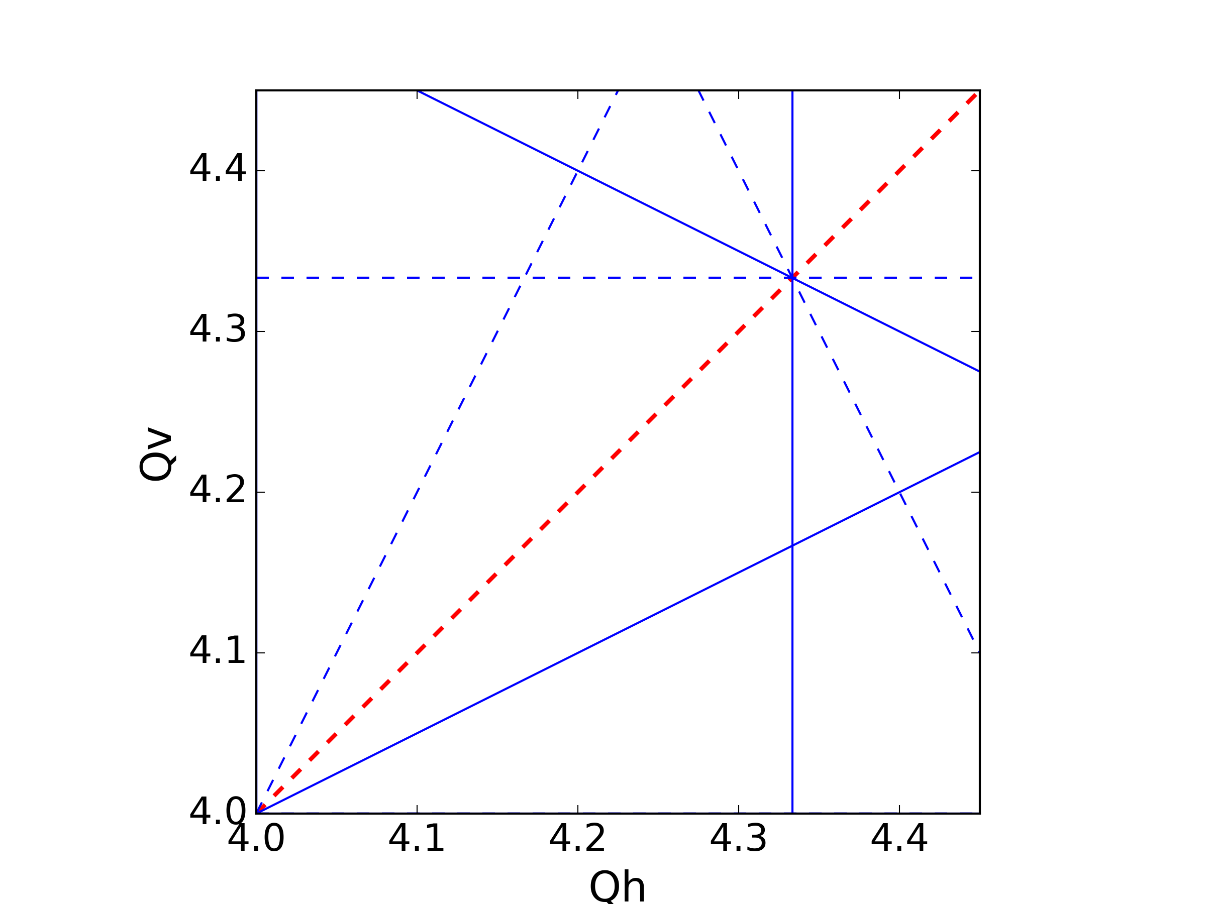
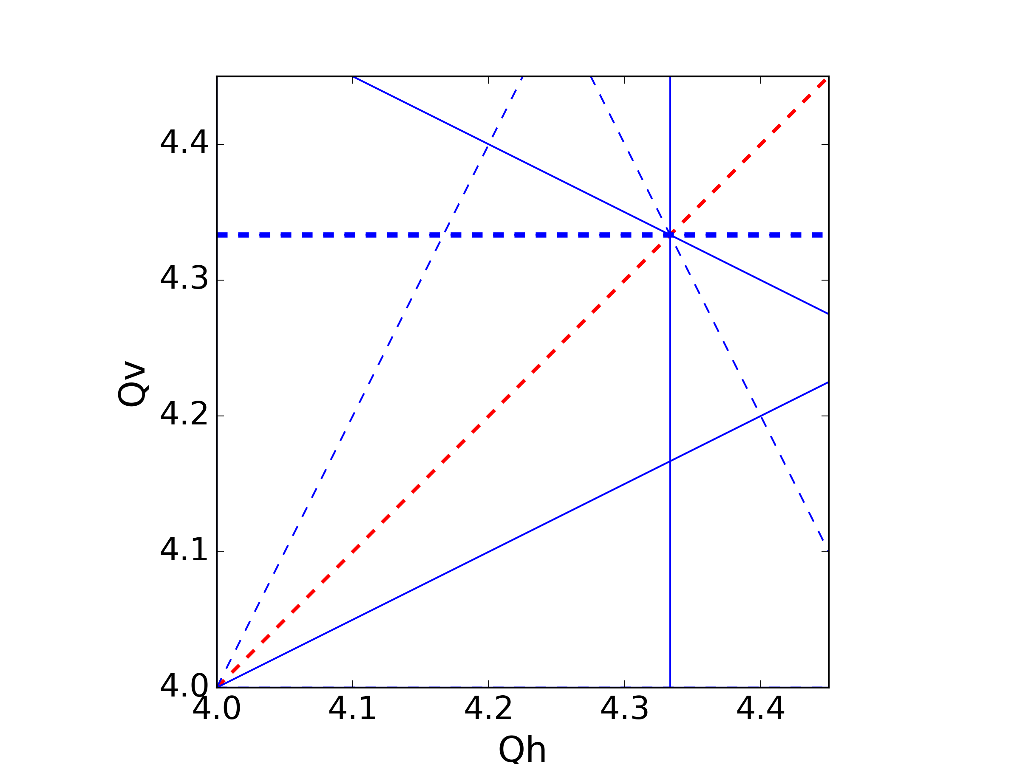
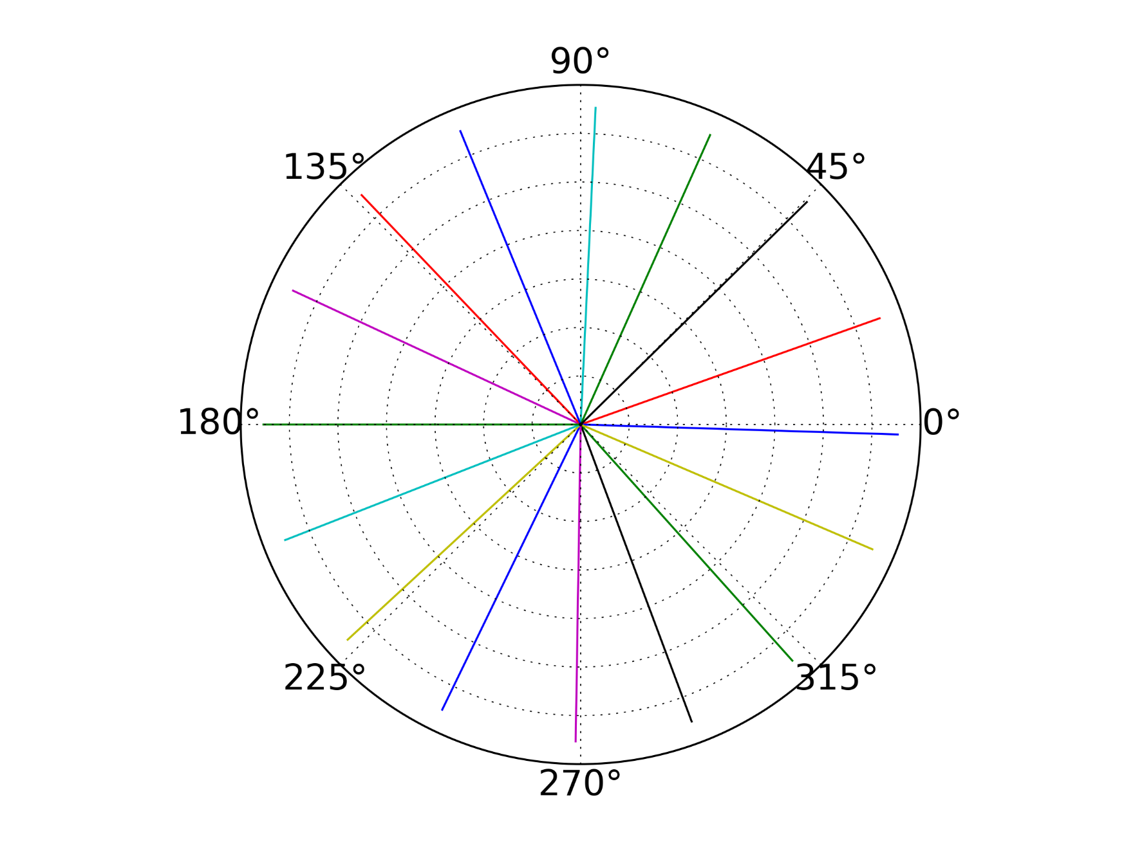


Machine Periodicity
Non-Systematic Resonance
$$3Q_{v}=13$$
$16$ cells
The errors cancel out due to the periodicity

Slide 19
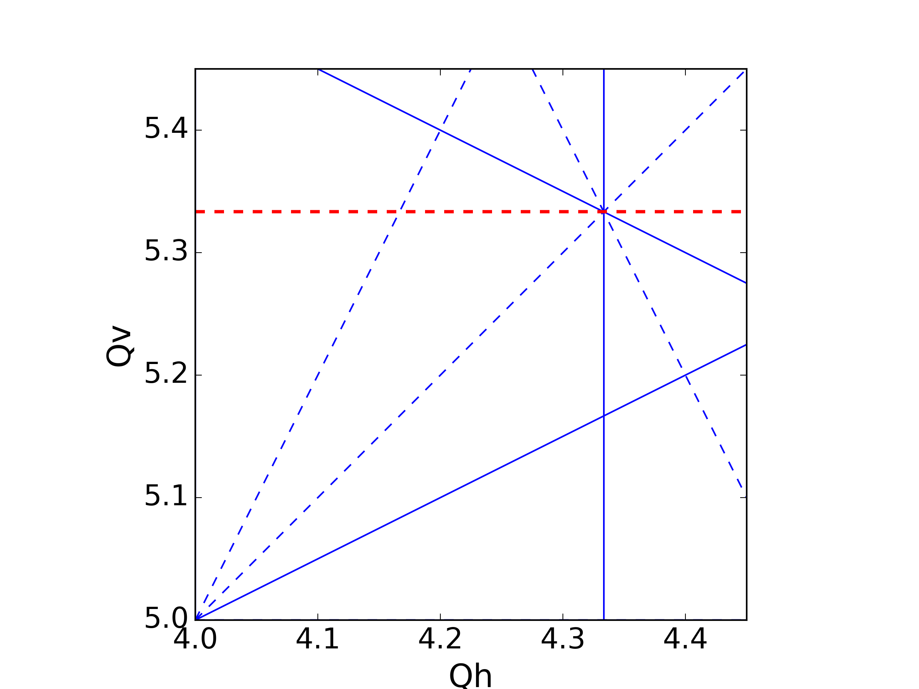
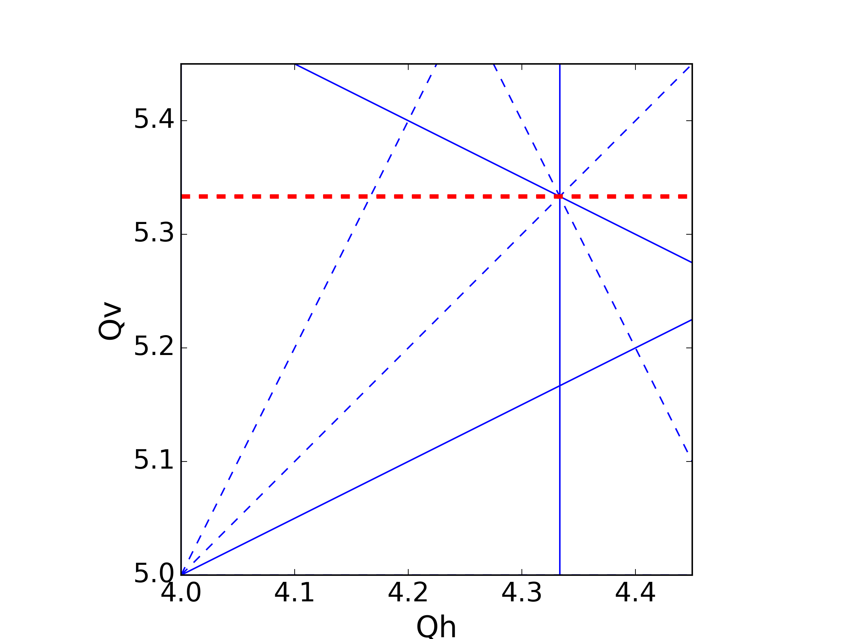
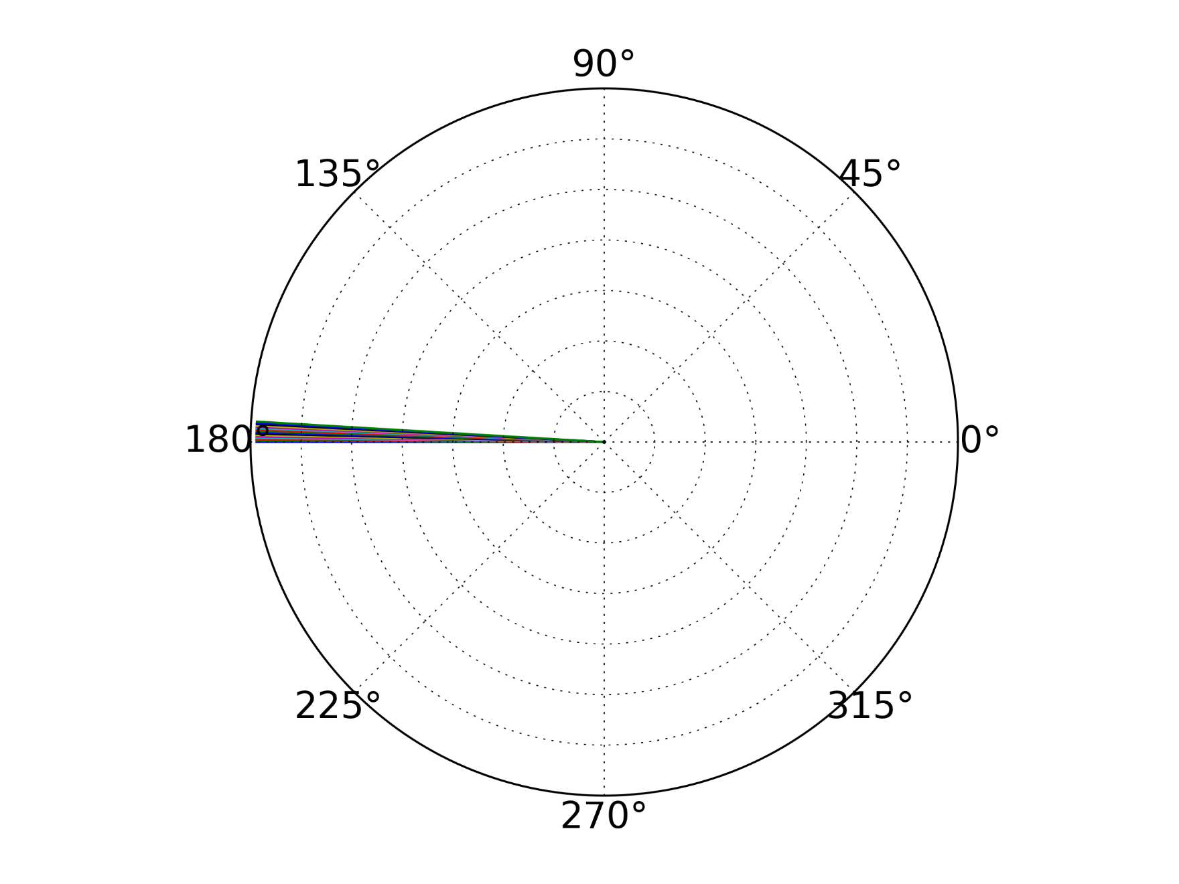


Machine Periodicity
Systematic Resonance
$16$ cells
$$3Q_{v}=16$$
The errors sum up – strong resonance

Slide 20
Transverse motion – betatron resonances
Under normal conditions the emittance is preserved turn after turn:
Observing the phase space turn-by-turn we get the emittance ellipse
In the presence of a strong resonance:
Emittance of a particle on the 1st turn
Emittance increases on the 2nd turn
Emittance increases further on the 3rd turn
Emittance (and amplitude) will keep increasing until the particle is lost
x’
x
Mitigation measures:
Careful tune choice – avoid resonance condition
Higher order elements – corrections to cancel the effect of the resonance

Slide 21
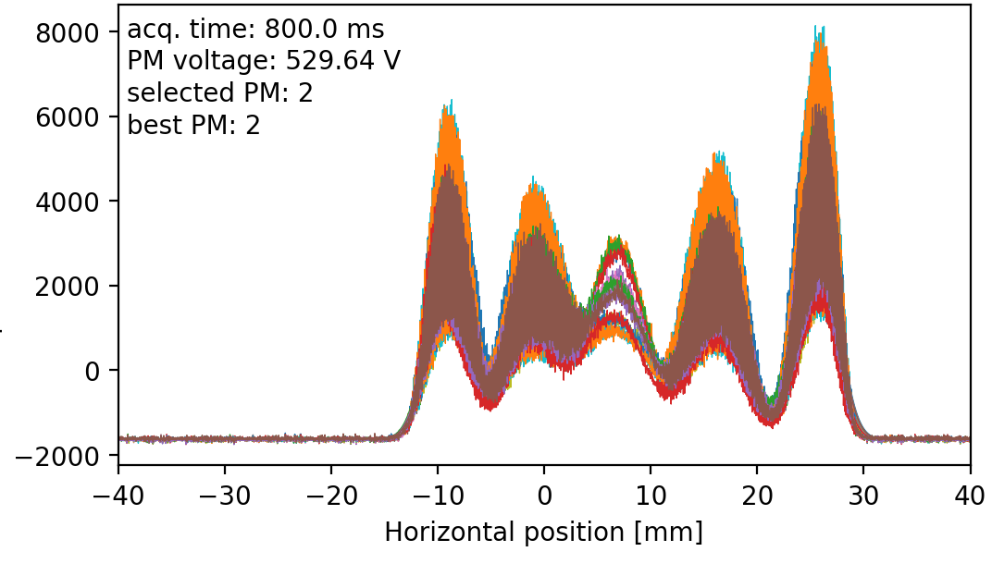
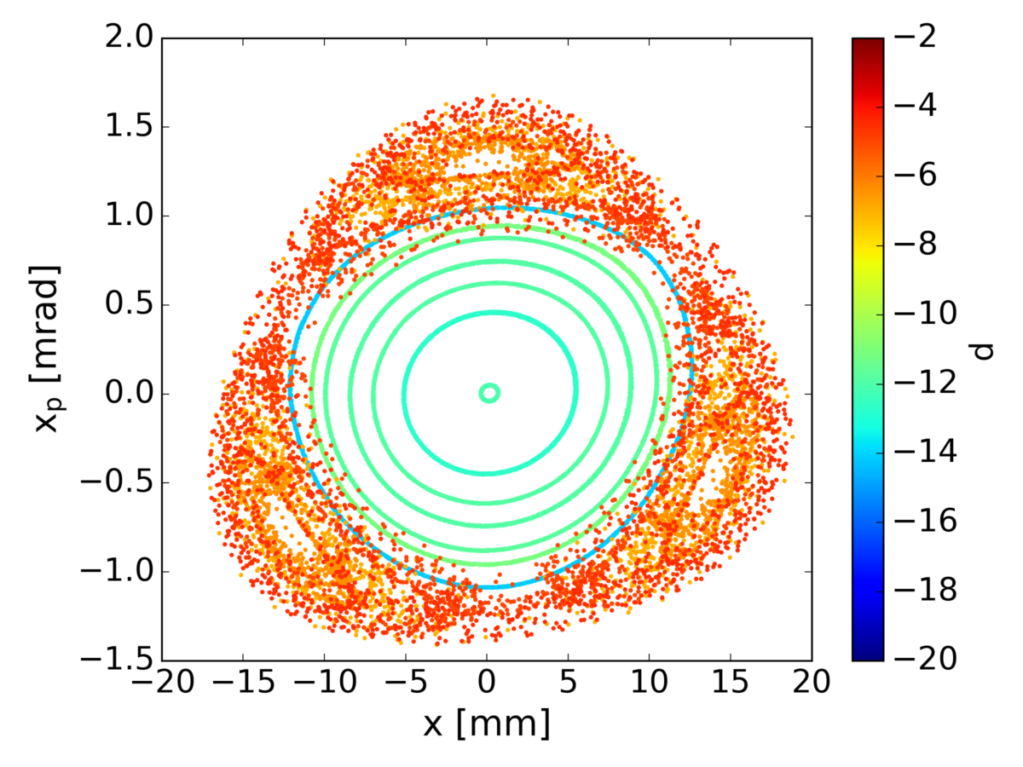
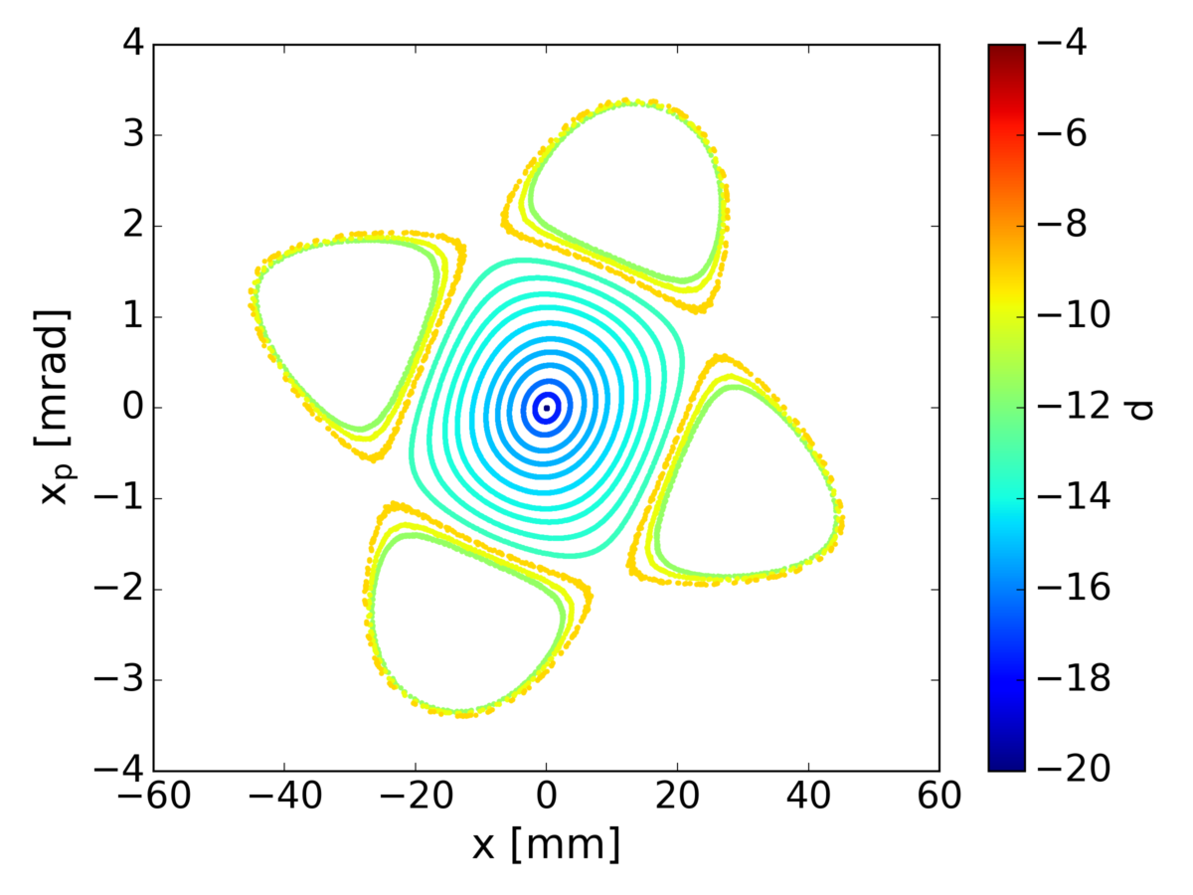

Transverse motion – phase space
Used in PS Multi-Turn-Extraction
The phase space gets distorted in the vicinity of driven resonances
Changing our tune to approach a resonance:
  Starting with well defined ellipses
  Approaching the resonances – forming islands depending on the resonance order
Profile (projection in x) measurements
3rd Order
4th Order
8th Order

Slide 22



Longitudinal motion - Acceleration
Reminder:
Acceleration in a synchrotron is achieved in the RF cavities, using a voltage V
During operations, we have a synchronous RF phase for which the energy gain fits the increase of the magnetic field at each turn. → condition for constant radius
Energy gain per turn:
synchronous phase:
RF synchronism - frequency must be on the revolution frequency (1 turn around the ring):
E
B
Bending
magnet
R=C/2π
injection
extraction
ρ
h (integer): harmonic number
number of RF cycles per revolution
Defines the maximum number of bunches in the synchrotron (available RF buckets)

Slide 23


Longitudinal motion – f_{RF} and φ_{s} change
During acceleration “ramping” energy & the magnetic field are changing:
The revolution frequency changes: $ω(B,R_{s})$
From the synchronism condition RF frequency needs to follow (using ):
Similarly, the phase, φ_{s} needs to follow
From Bρ:
Can be omitted at the relativistic limit where B >>

Slide 24

Longitudinal motion – Dispersion effects
Reminder:
Off-momentum particles follow a different orbit than the design: Dispersion
The orbit length is different – the momentum compaction factor shows the variation of the orbit length with respect to the variation of the momentum:
From different momentum, different velocity & different path: different time (& revolution frequency) to arrive to the RF cavity – slip factor, variation of the revolution frequency with respect to the variation of the momentum:
$$α_{c}=\frac{{dR}/R}{{dp}/p}$$

Slide 25




Longitudinal motion – Dispersion effects
The revolution frequency change depends both on the orbit and velocity change:
For :
Finally, we get the relation between momentum compaction and slip factor:
The energy in which $η=0$, is called transition energy:
Below $γ_{t}$ (η>0) the arrival at the cavity depends on the velocity
At $γ_{t}$ (η=0) the velocity change and the path length change compensate each other
Above $γ_{t}$ (η<0) the arrival at the cavity depends only on the path length
$$η=\frac{1}{γ^{2}}−α_{c}$$
$$γ_{t}=\frac{1}{\sqrt{α_{c}}}$$

Slide 26


Longitudinal motion – Phase stability
Reminder:
Phase focusing: bunches are formed as particles arriving at the cavity before or after the synchronous particle are “brought closer” to it
This stands for $φ_{s}<π/2$ as:
  M₁ & N₁ will move towards P₁ => stable
  M₂ & N₂ will go away from P₂ => unstable
This behaviour is true below transition
(velocity dominates)
energy
gain

Slide 27

Longitudinal motion – Phase stability
Since:
Below $γ_{t}$ (η>0) the arrival at the cavity depends on the velocity
Above $γ_{t}$ (η<0) the arrival at the cavity depends only on the path length
The behaviour for the phase stability is reversed around transition crossing
energy
gain
Stable synchr. Particle for η < 0
above transition
η > 0
early
late

Slide 28
Longitudinal motion – Transition crossing
Change of stable phase implies:
Crossing transition during acceleration makes the previous stable synchronous phase unstable.
The RF system needs to make a rapid change of the RF phase, a “phase jump”.
Such a manipulation is needed at the CERN PS

Slide 29

Longitudinal motion – Synchrotron oscillations
Operating below transition & at constant energy (and B)
Synchronous phase φ₀=0
Particle with a φ>φ₀: particle gets accelerated and moves towards φ₀
Particle with a φ<φ₀: particle gets decelerated and moves towards φ₀
Particles will start performing oscillations around the synchronous particle
V_{RF}
B
$$<γ_{t}$$
φ₂
φ₀
B
φ₁
700th revolution period
600th revolution period
300th revolution period
400th revolution period
500th revolution period
100th revolution period
200th revolution period
800th revolution period

Slide 30

Longitudinal motion – Phase space
1
φ
2
φ₂
φ₀
φ₁
φ_{s}
Acceleration (γ<γ_{t})
No symmetricity (B$≠$const)
No Acceleration
stable region
stable region
separatrix
unstable region
separatrix
unstable region

Slide 31

Takeaways
Transverse motion
Longitudinal motion
Synchronism: RF frequency needs to be locked to revolution frequency
During acceleration the phase and frequency need to adjust to the energy & B increase
Path length changes with momentum – momentum compaction factor
Frequency changes with momentum – slip factor
Phase stability depends on transition energy
Phase jump to cross transition
Particles perform oscillations around φ_{s} called synchrotron
Transverse motion
The beam moves in FODO structure
Particles perform oscillations around the design orbit called betatron
Turn-by-turn the ellipse formed in the phase space is called emittance
The number of betatron oscillations in 1 turn is called tune
Emittance remains constant for “normal” conditions
In the presence of resonances in the tune space, the emittance increases
The beam size is defined as $\sqrt{ε_{y}β_{y}(s)}$

