Slide 1
Particle Accelerators and Beam Dynamics
Accelerator & Technology Sector
Beams Department
Accelerator Beam Physics Group
F. Asvesta, T. Prebibaj,
based on: H. Bartosik, D. Gamba, Y. Papaphilipou
Eurolabs 2024

Slide 2
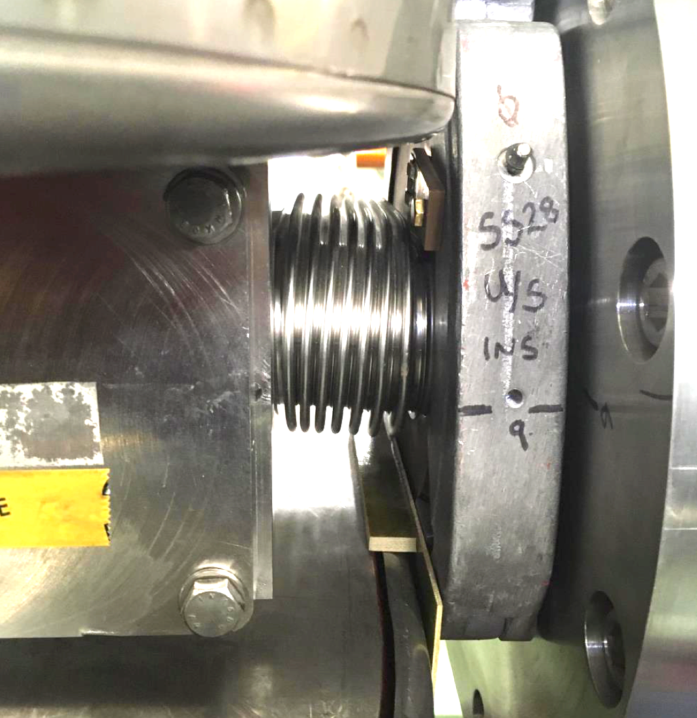
Outline
Introduction
Closed orbit distortion (steering error)
  Beam orbit stability
  Imperfections leading to closed orbit distortion
Optics function distortion (gradient error)
  Imperfections leading to optics distortion
  Tune-shift and beta distortion due to gradient errors
Coupling error
  Coupling errors and their effect
  Coupling correction
Summary

Slide 3
Outline
Introduction
Closed orbit distortion (steering error)
  Beam orbit stability
  Imperfections leading to closed orbit distortion
Optics function distortion (gradient error)
  Imperfections leading to optics distortion
  Tune-shift and beta distortion due to gradient errors
Coupling error
  Coupling errors and their effect
  Coupling correction
Summary

Slide 4
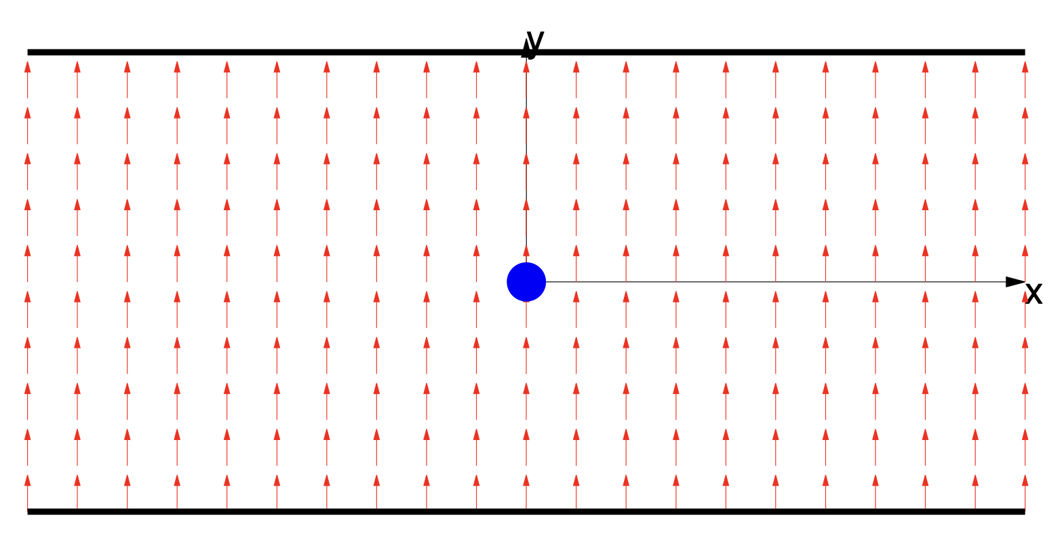
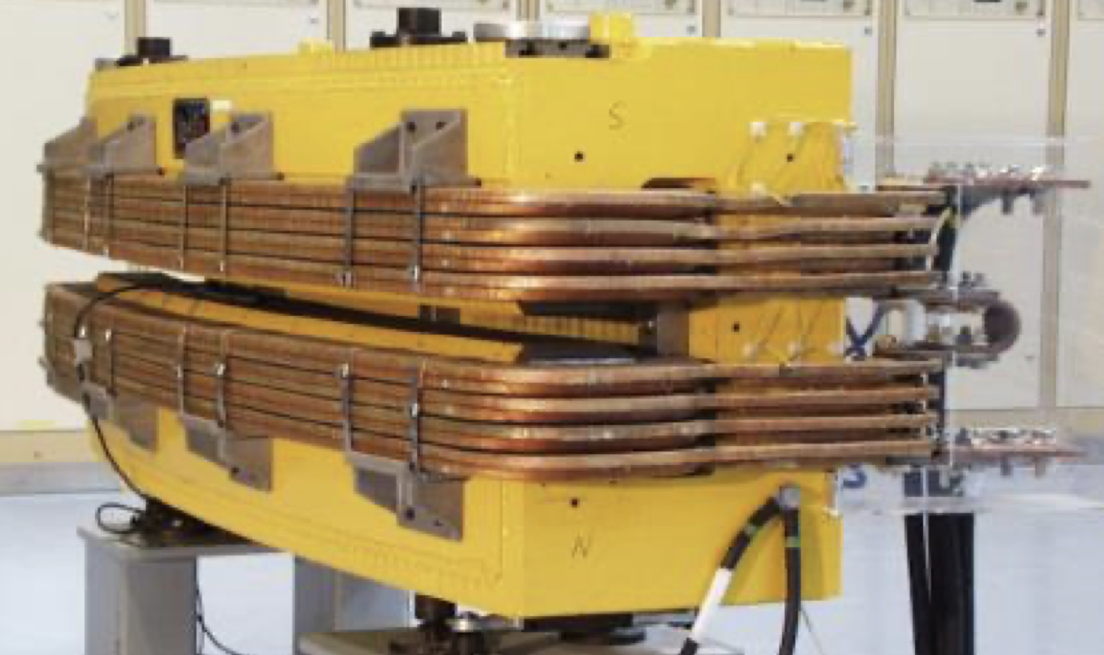
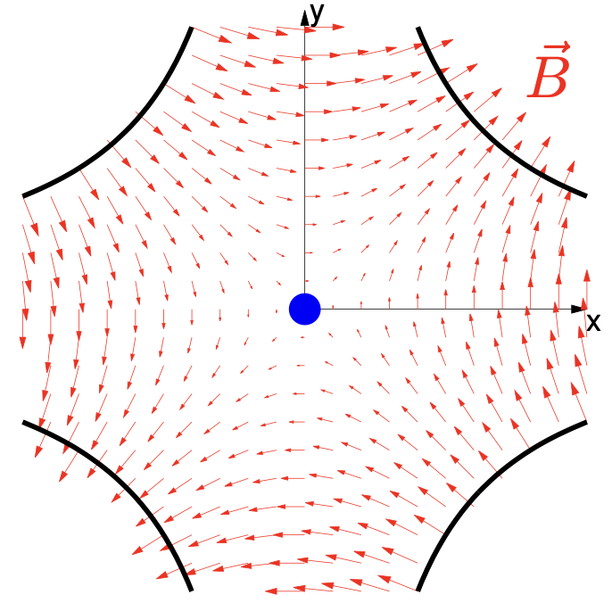
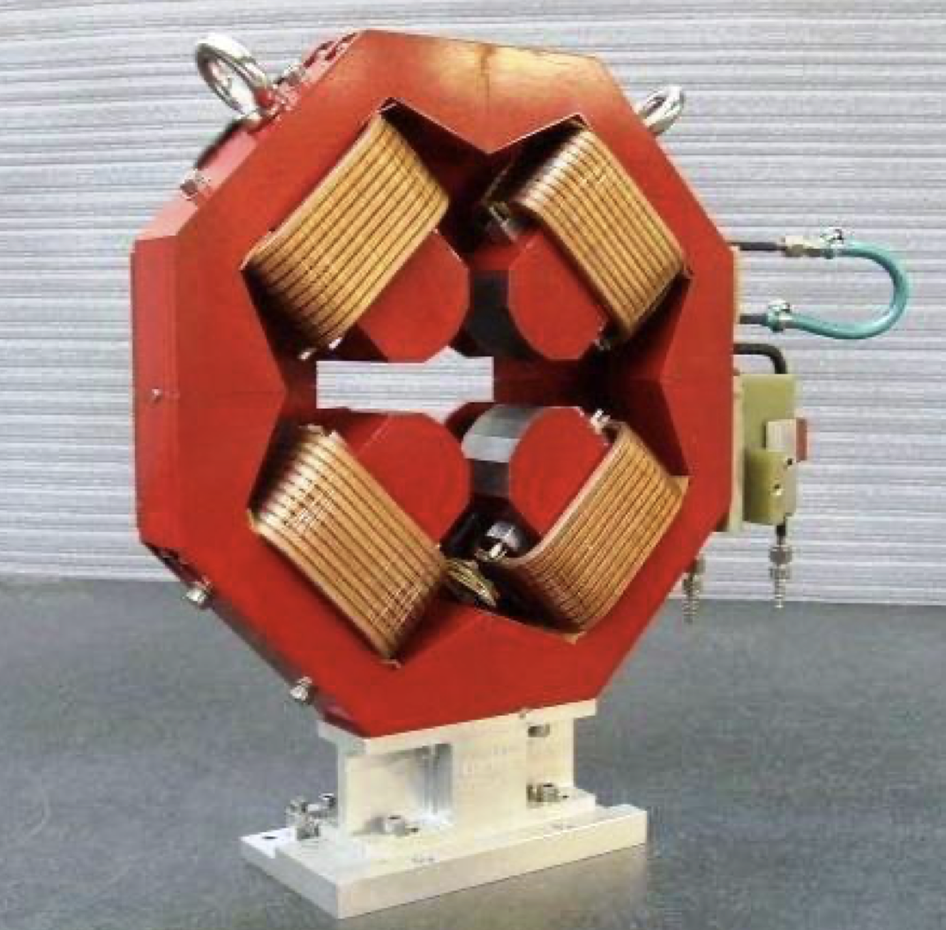
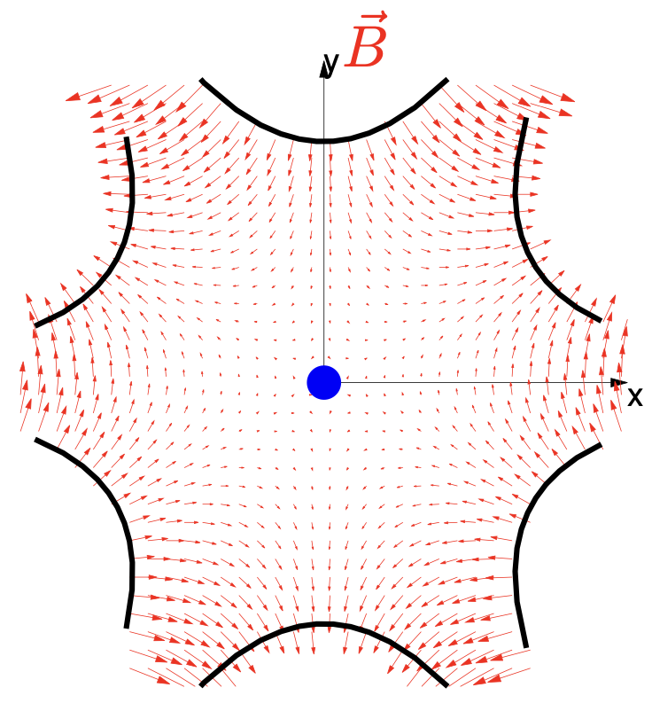
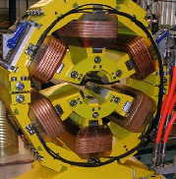
Basics: accelerator lattice
An accelerator is usually build using a repetition of basic ‘cells’
A simple FODO cell usually contains:
  Dipole magnets to bend the beams
  Quadrupole magnets to focus the beams
  Beam position monitors (BPM) to measure the beam position
  Small dipole corrector magnets for beam steering
  (Sextupole magnets to control off-energy focusing)
Quadrupole
(focussing)
Quadrupole
(de-focussing)
Sextupole
Dipole corrector
Dipole
Dipole
beam
Beam position monitor
Schematic of a ½ cell (not to scale)

Slide 5
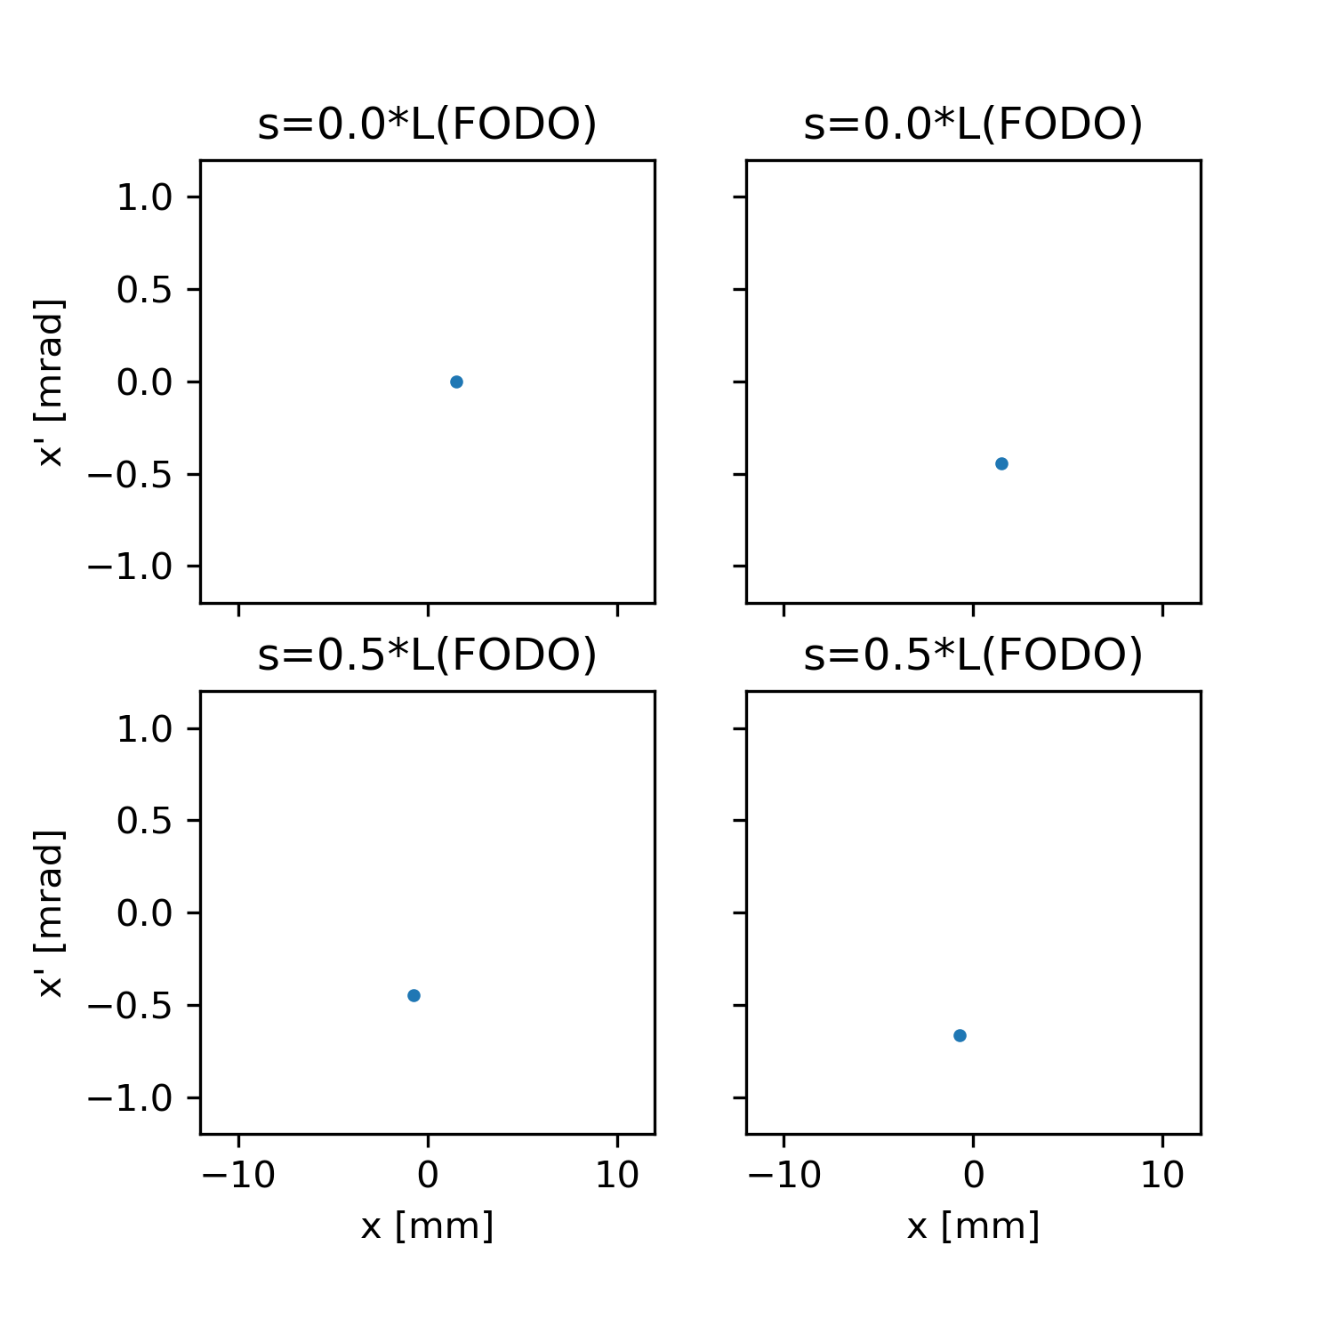
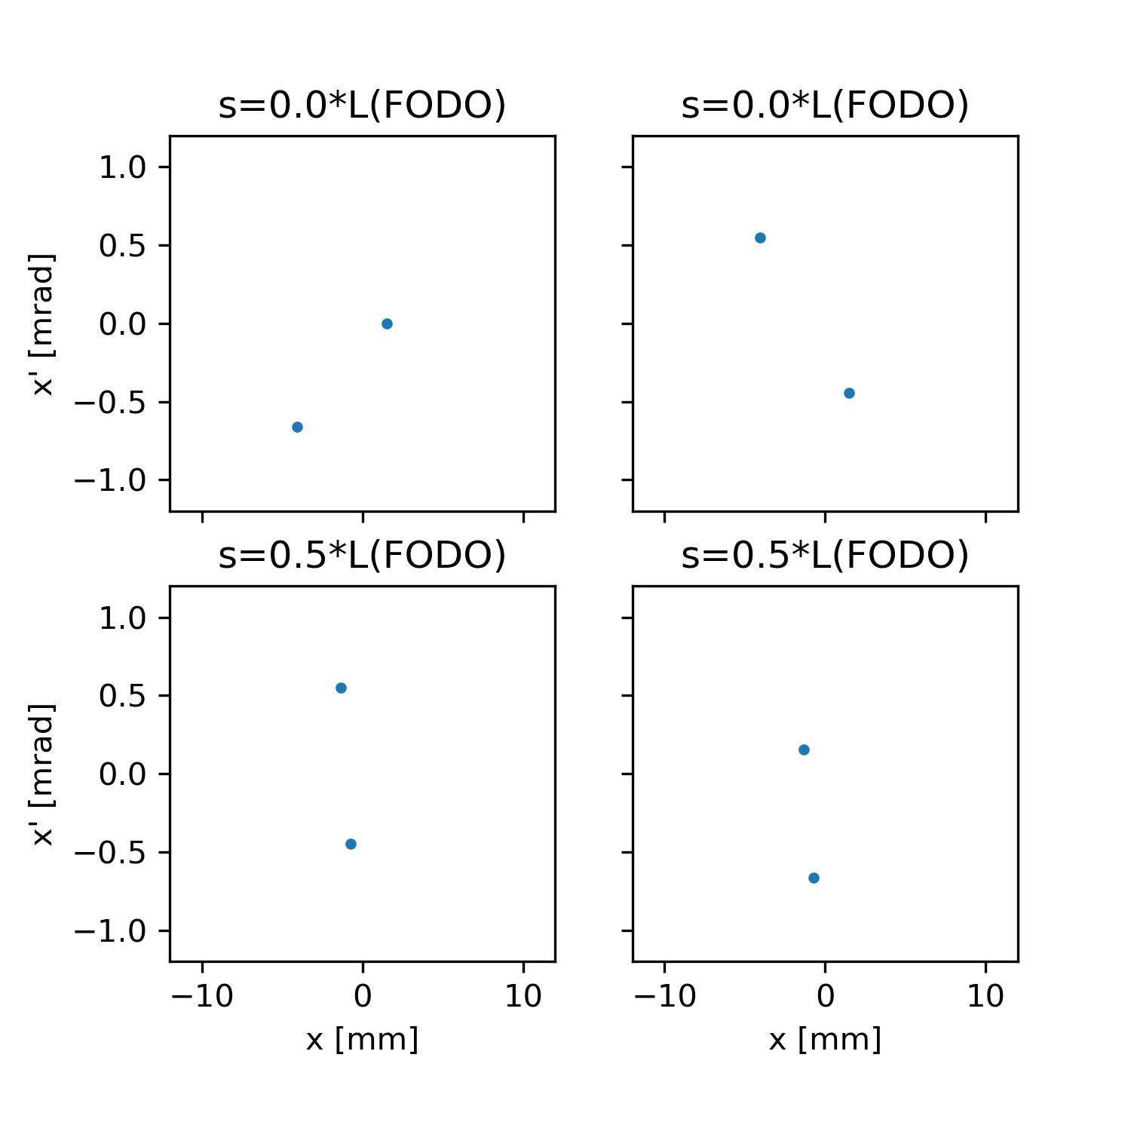
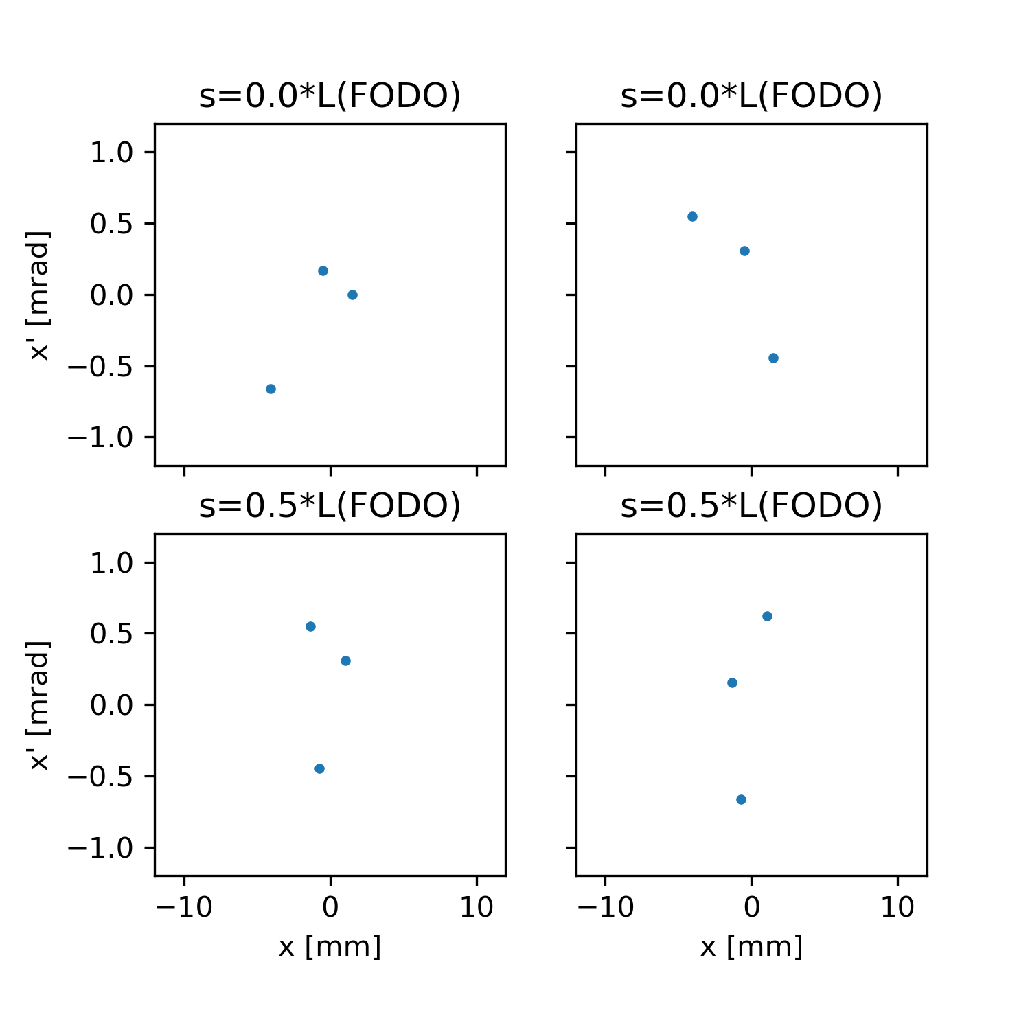
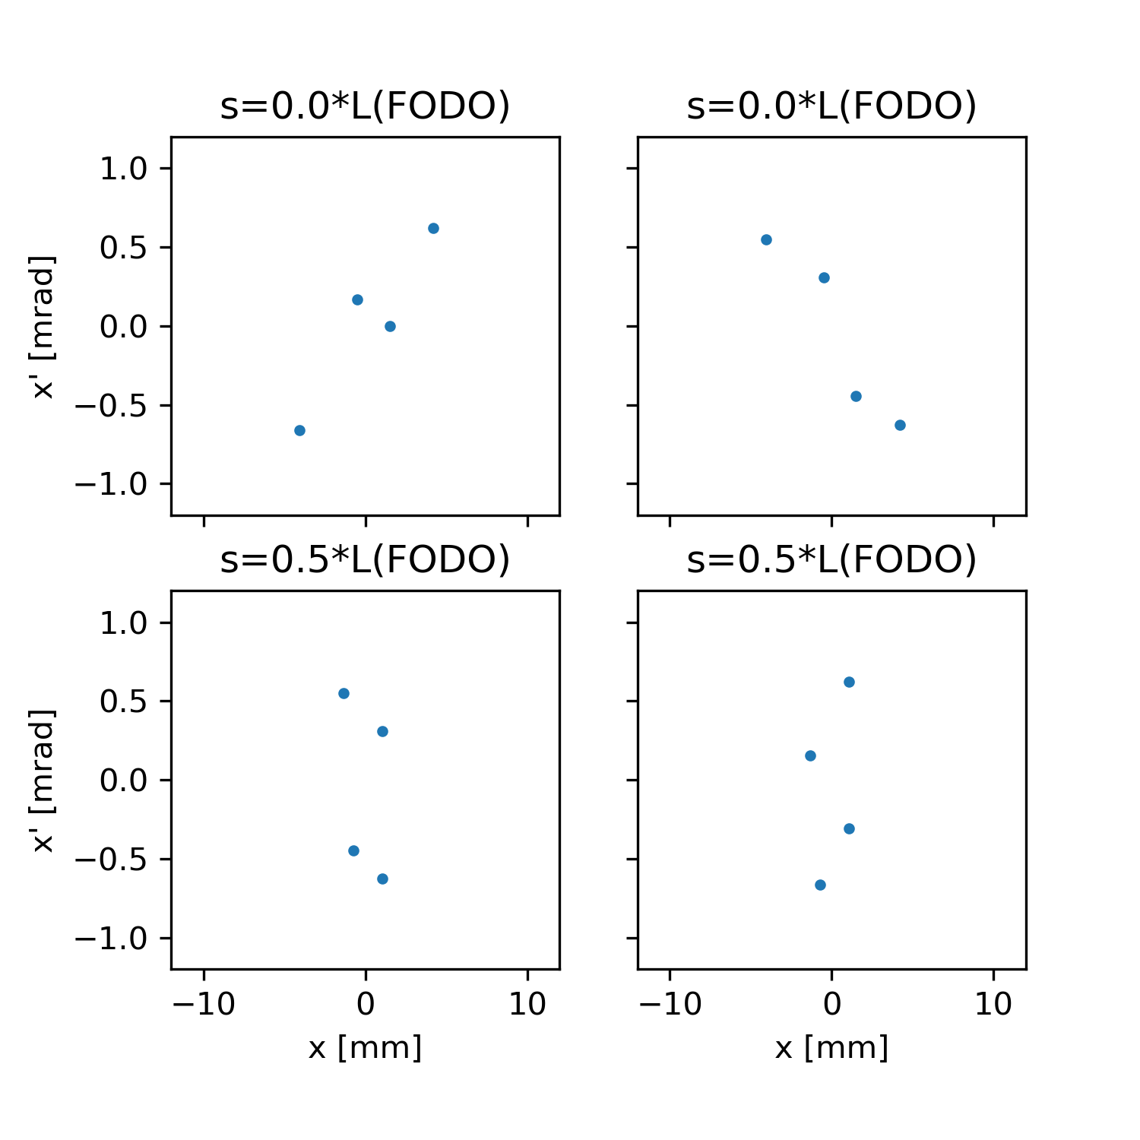
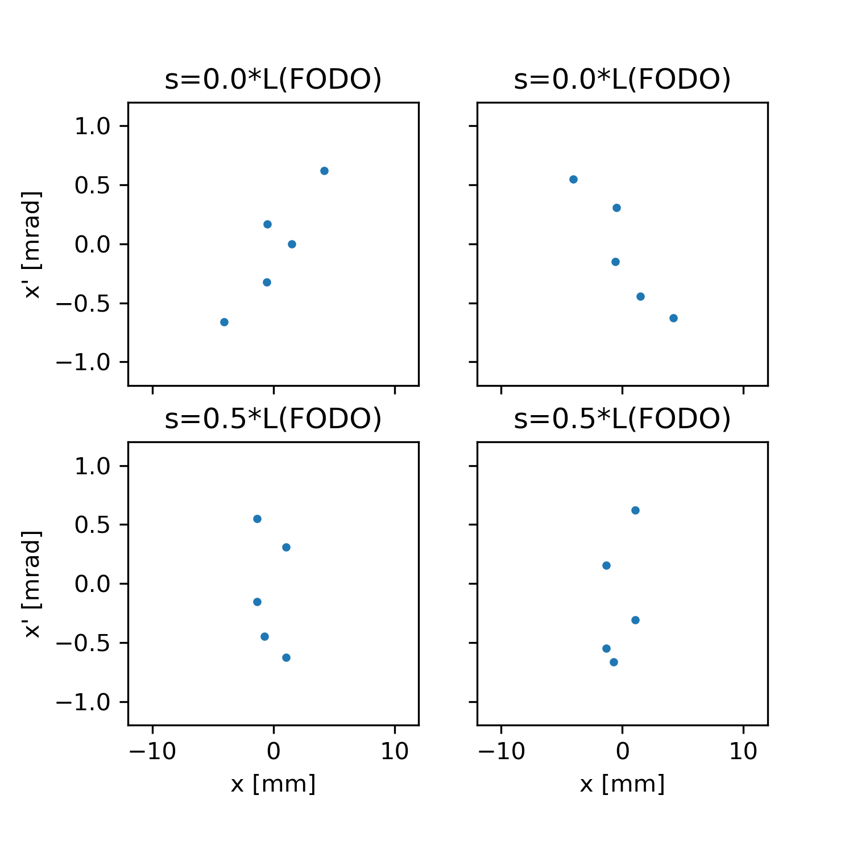
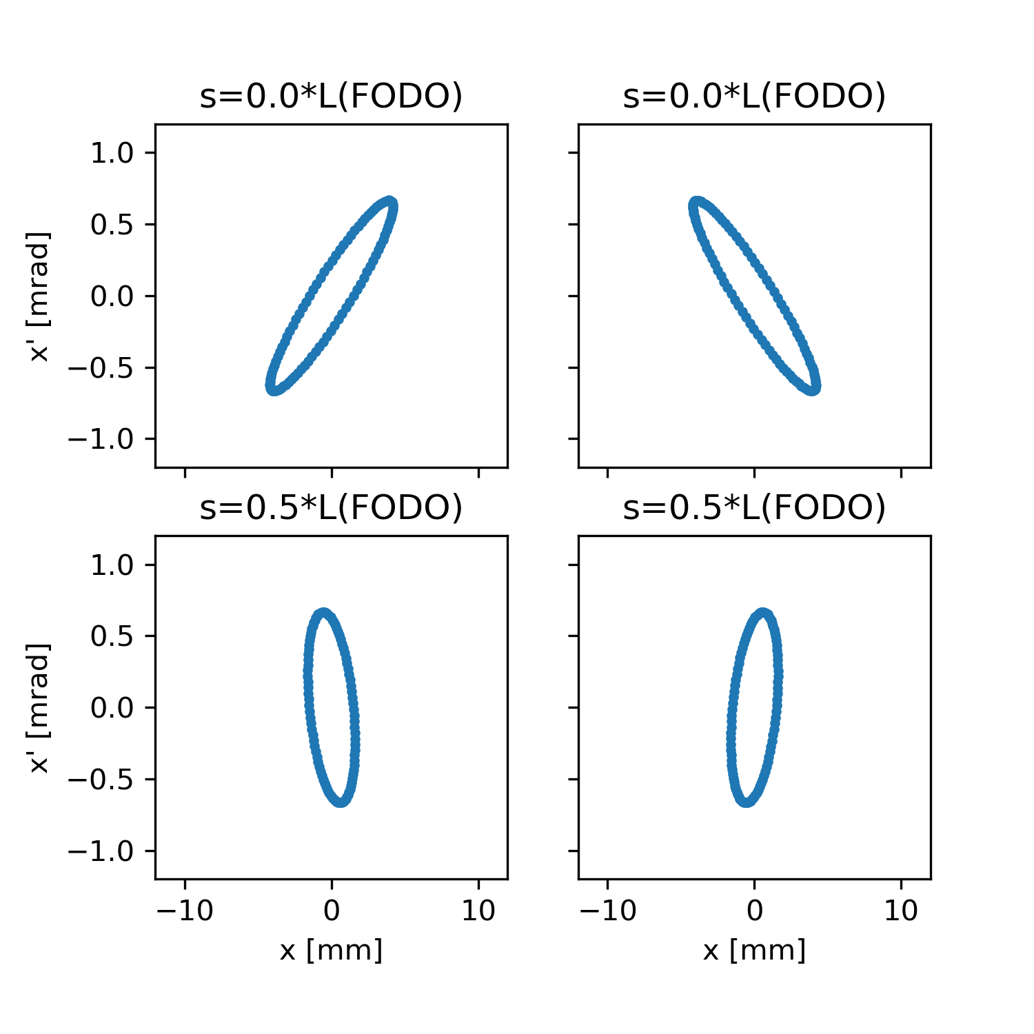
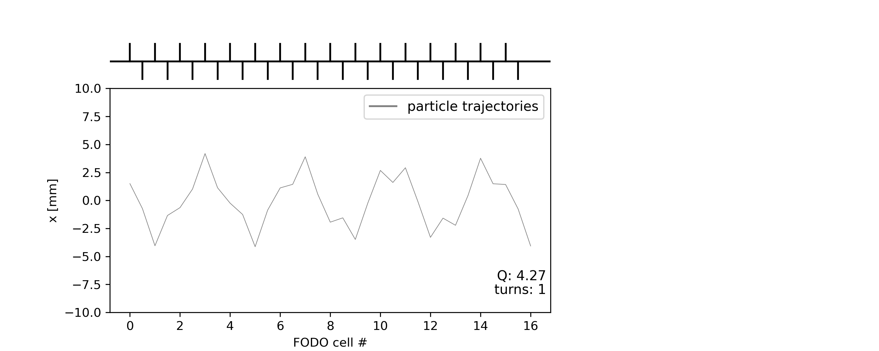
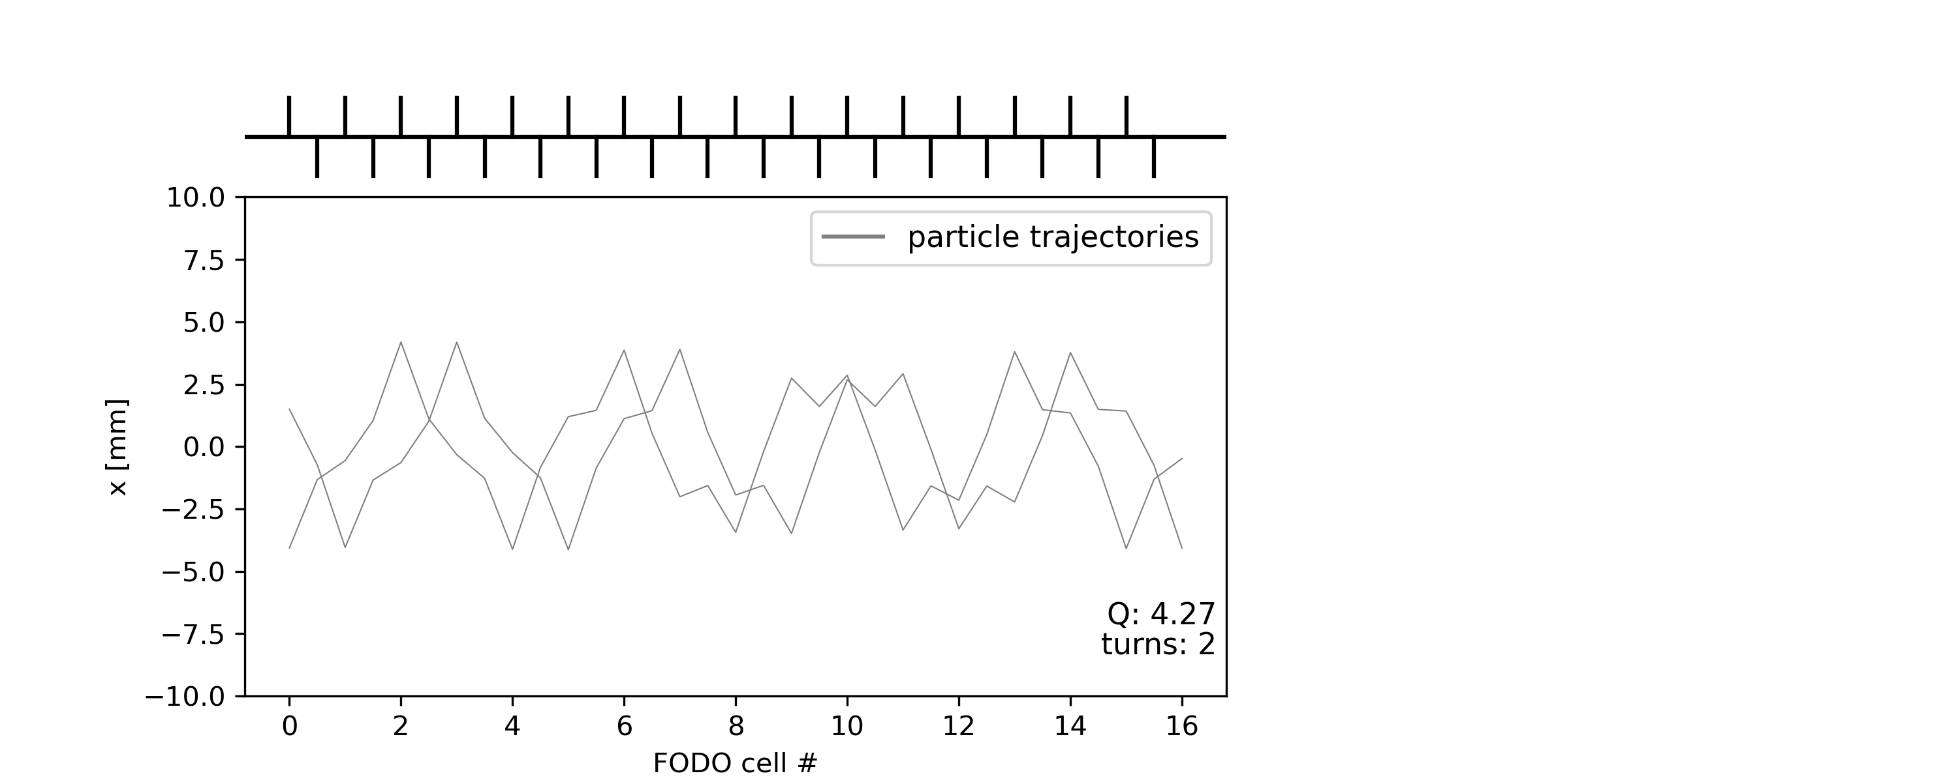

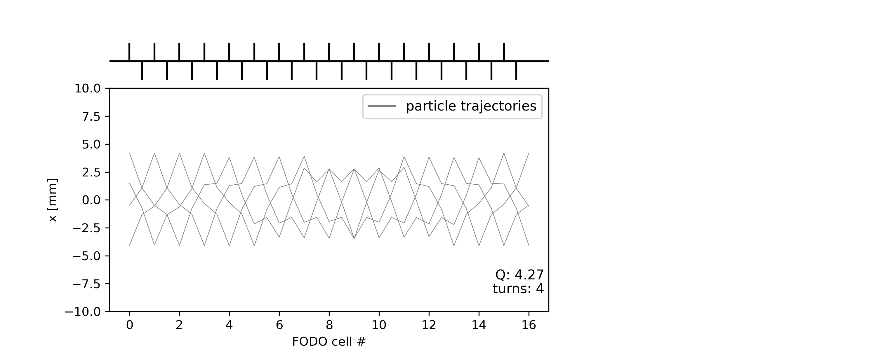

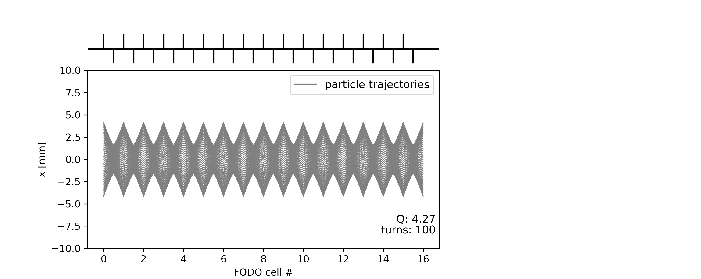
Toy FODO lattice – no errors
Tracking a single particle, for many turns
A)
B)
A) Before foc. quad.
B) After foc. quad.
C)
D)
Starting point
C) Before defoc. quad.
D) After defoc. quad.
Element by element “tracking” till completion of one turn…
… and start a new turn

Slide 6
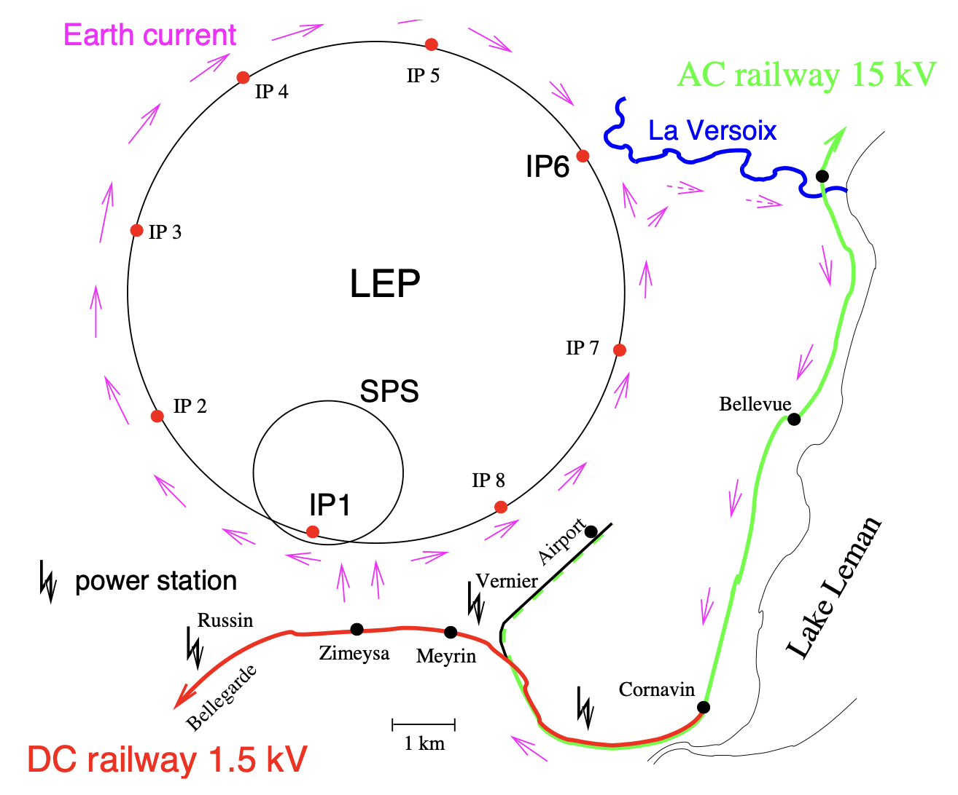
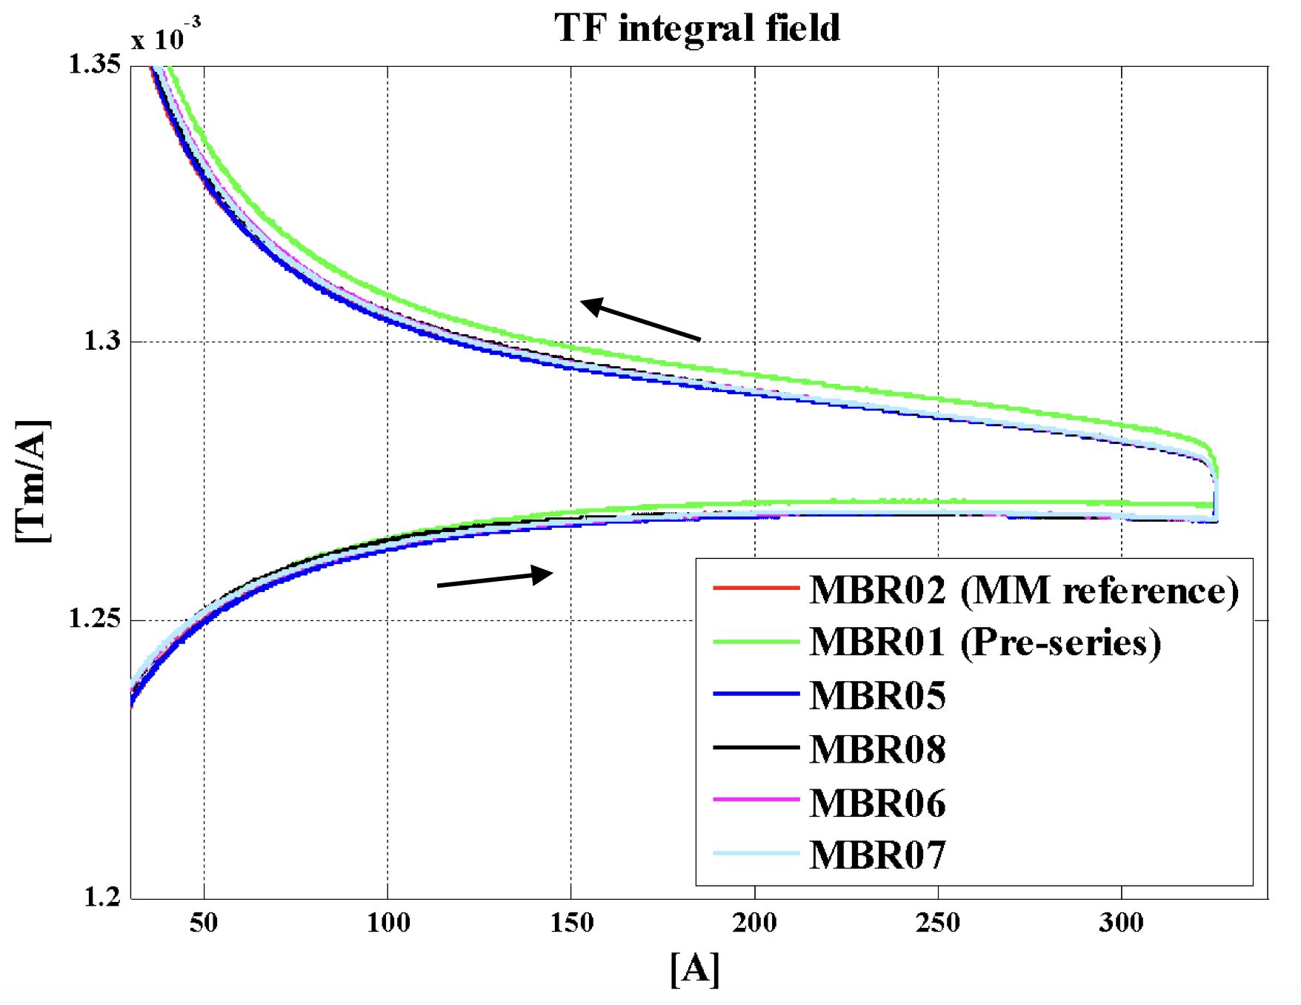
From model to reality - fields
  The physical units of the machine model defined by the accelerator physicist must be converted into magnetic fields and eventually into currents for the power converters that feed the magnet circuits.
  Imperfections (= errors) in the real accelerator optics can be introduced by uncertainties or errors on:
    Actual beam momentum, magnet calibration and hysteresis, power converter regulation, …
Magnet strength
Actual magnet current
Actual field seen by the beam
Magnetic field (gradient)
Requested current
Beam momentum
Magnet
Calibration/hysteresis curve (transfer function)
Power converter
Additional effects, e.g. eddy currents
Earth currents flowing over the LEP vacuum chamber that were generated by the DC railway line near Geneva
Example of the ELENA main dipoles hysteresis curve

Slide 7
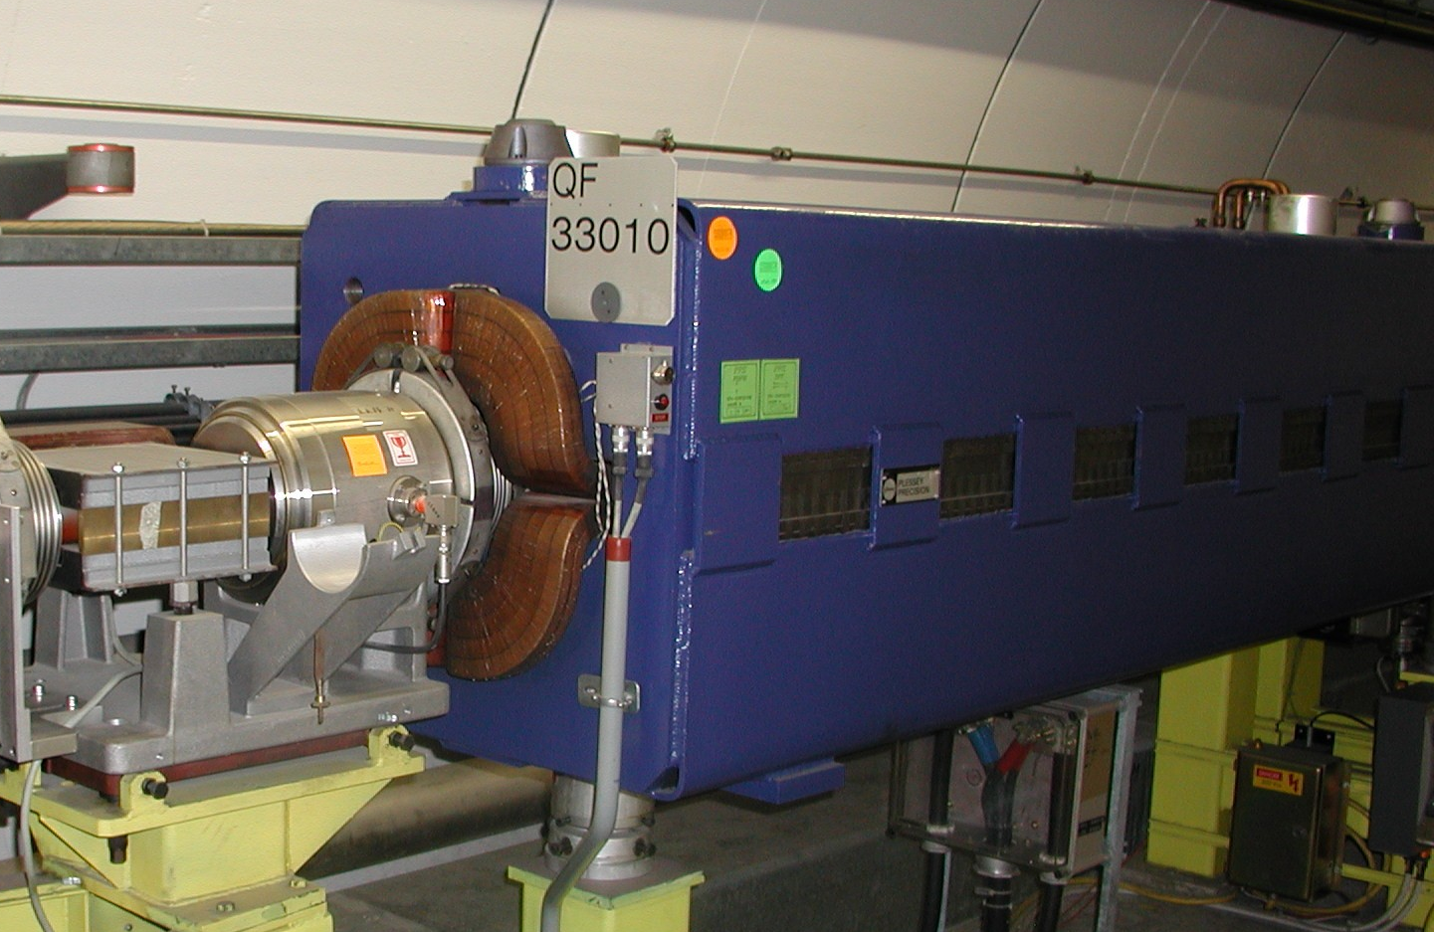
From model to reality - alignment
  To ensure that the accelerator elements are in the correct position the alignment must be precise – to the level of nanometer for the CLIC final focusing !
    For CERN hadron machines we aim for accuracies of about 0.1 mm.
  The alignment process implies:
    Precise measurements of the magnetic axis in the laboratory
    with reference to the element alignment markers used by the
    survey group.
    Precise in-situ alignment (position and angle) of the element
    in the tunnel.
  Alignment errors are a common source of imperfections

Slide 8
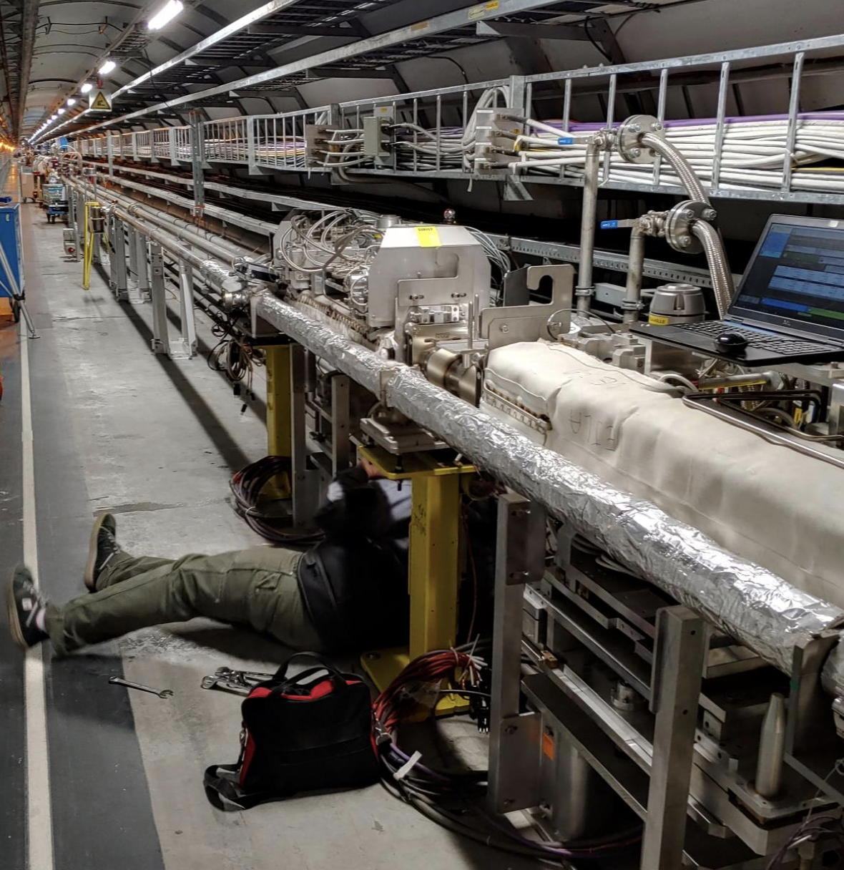
Outline
Introduction
Closed orbit distortion (steering error)
  Beam orbit stability
  Imperfections leading to closed orbit distortion
Optics function distortion (gradient error)
  Imperfections leading to optics distortion
  Tune-shift and beta distortion due to gradient errors
Coupling error
  Coupling errors and their effect
  Coupling correction
Summary

Slide 9
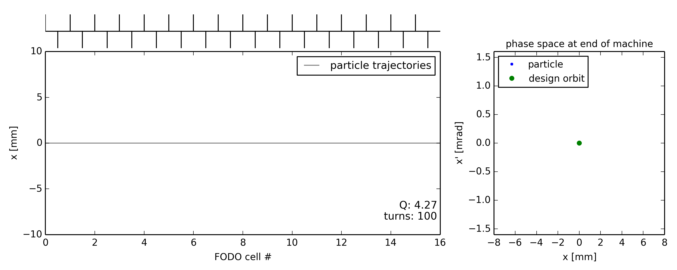
Illustration of closed orbit distortion
Ideal machine toy model (no errors)
  Particle injected on the design (or reference) orbit … remains on the design orbit turn after turn
Starting point with (x=0, x’=0)

Slide 10
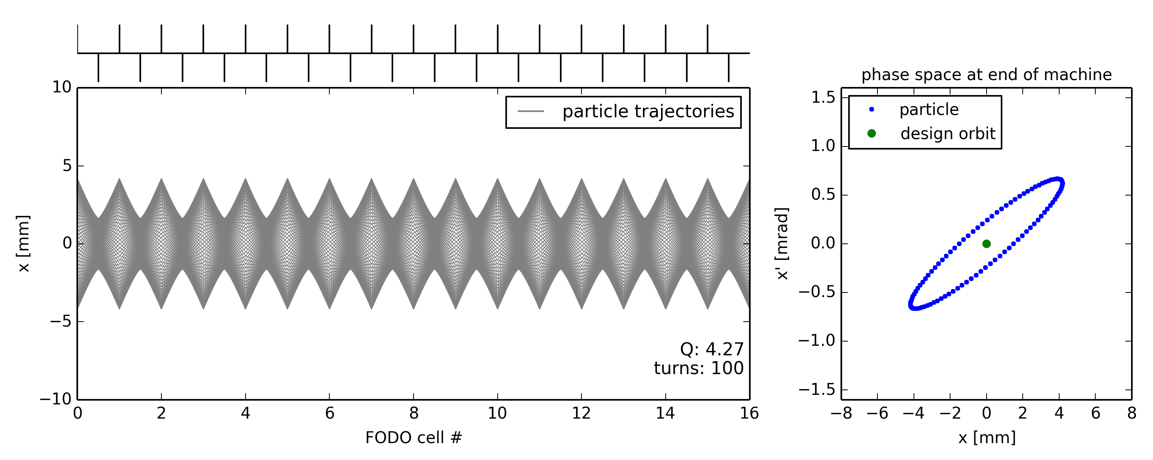
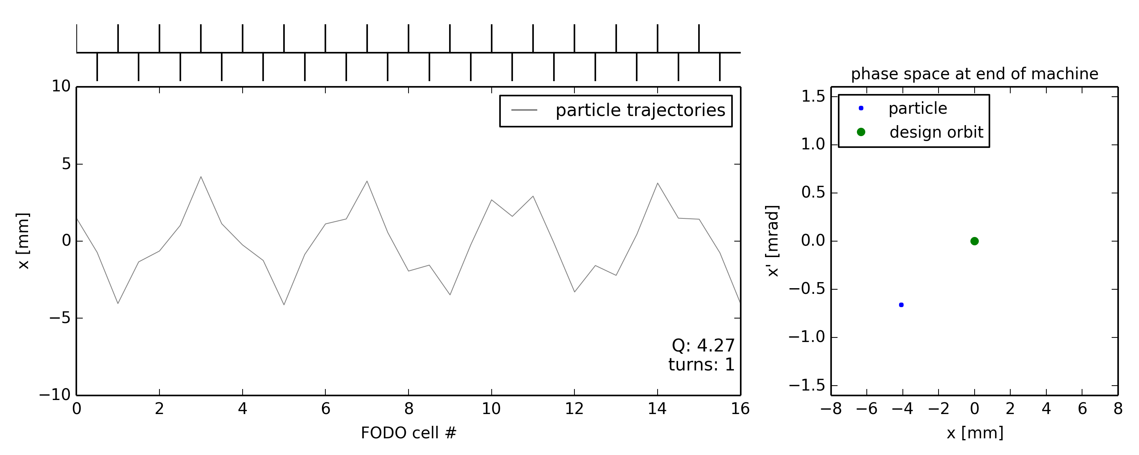
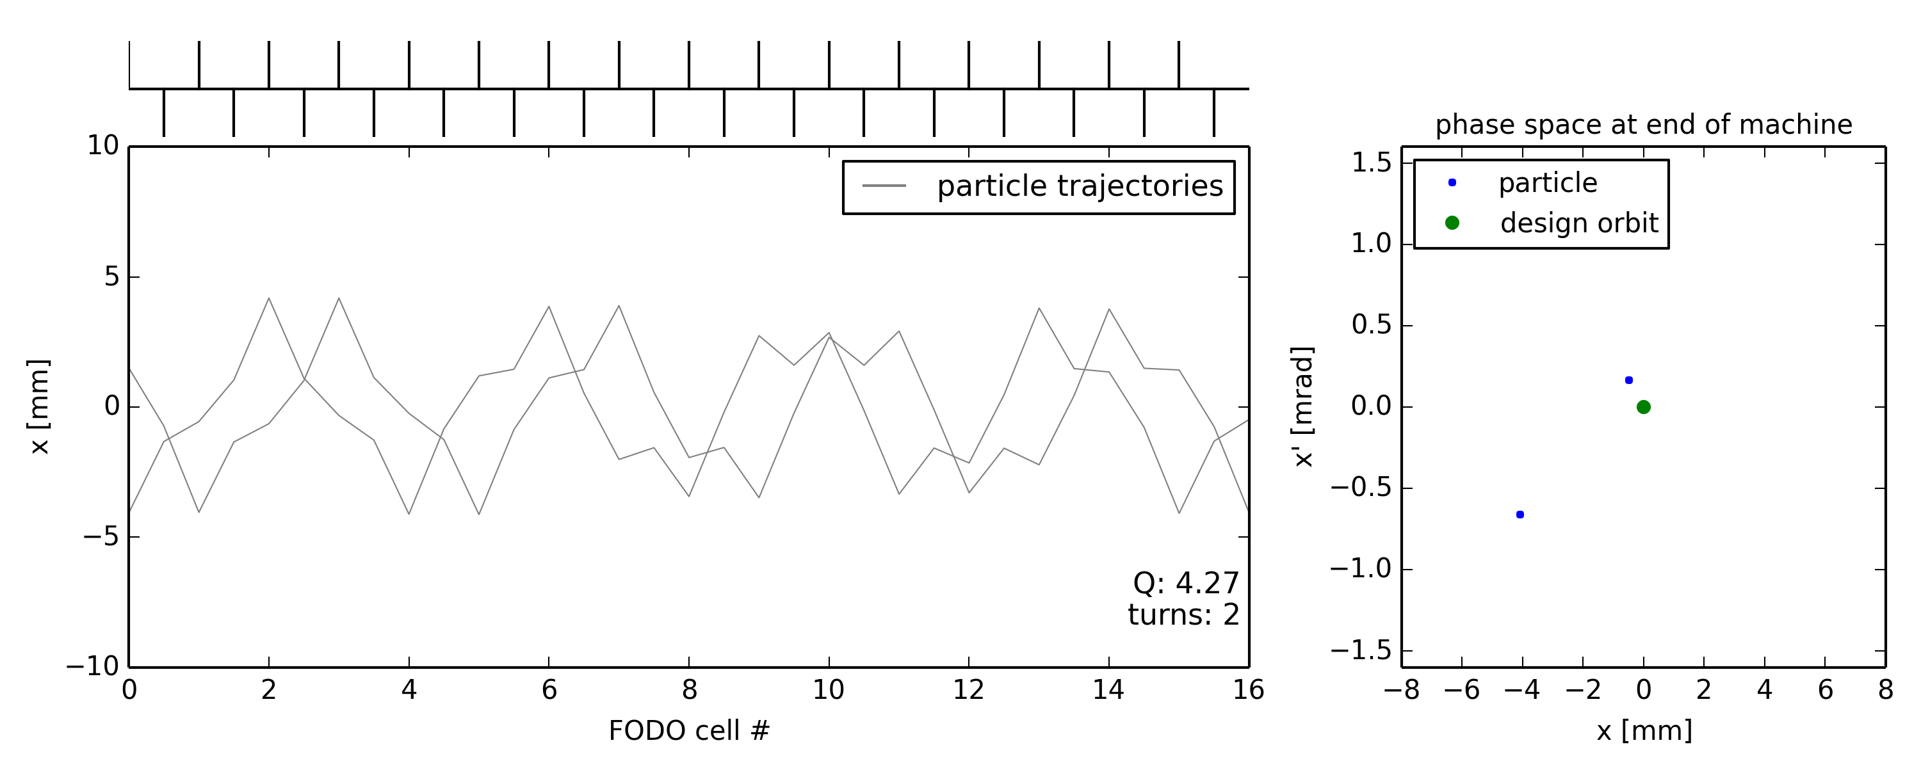
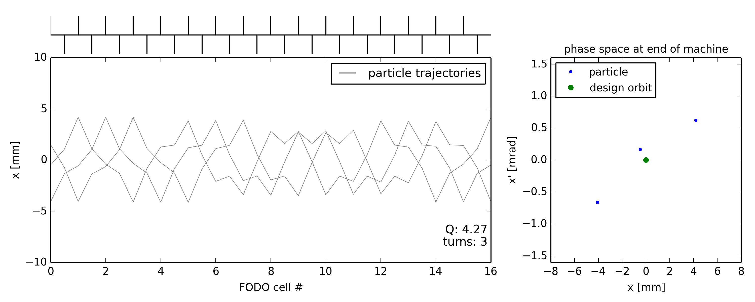
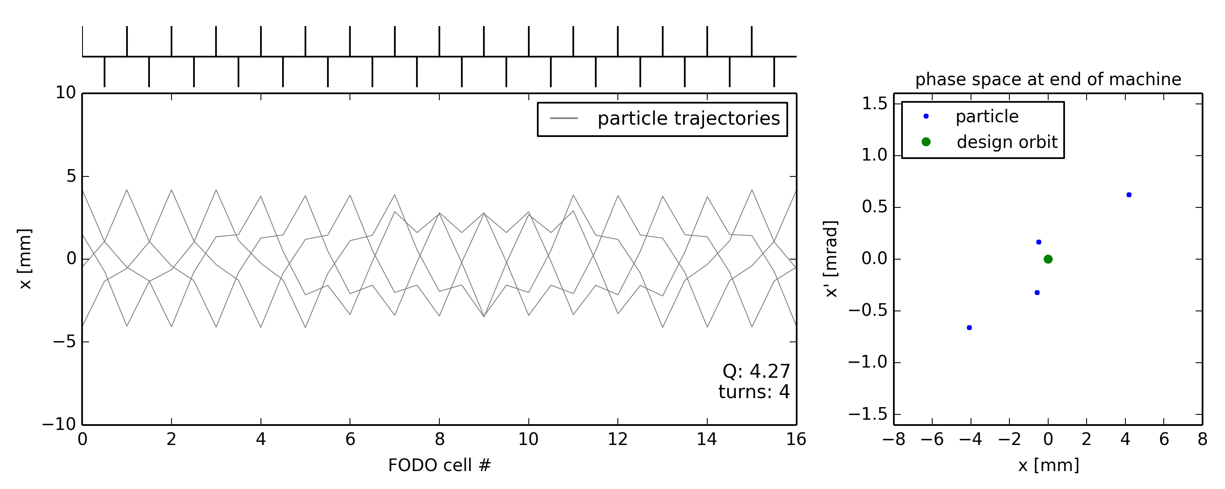

Illustration of closed orbit distortion
Ideal machine toy model (no errors)
  Particle injected on the design (or reference) orbit … remains on the design orbit turn after turn
  Particle injected with offset …

Slide 11
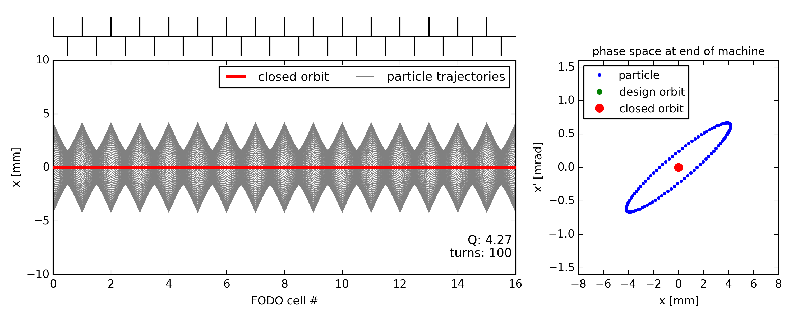
Illustration of closed orbit distortion
Ideal machine toy model (no errors)
  Particle injected on the design (or reference) orbit … remains on the design orbit turn after turn
  Particle injected with offset … performs betatron oscillations around the closed orbit which is the same as the design orbit as long as there are no imperfections

Slide 12
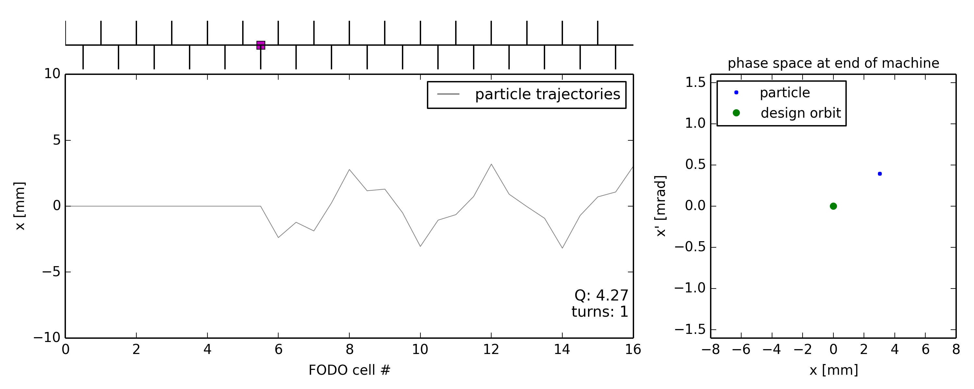
Illustration of closed orbit distortion
Ideal machine toy model with dipole error (unintended deflection) somewhere
  Particle injected on the design orbit … receives dipole kick every turn
Dipole error location

Slide 13
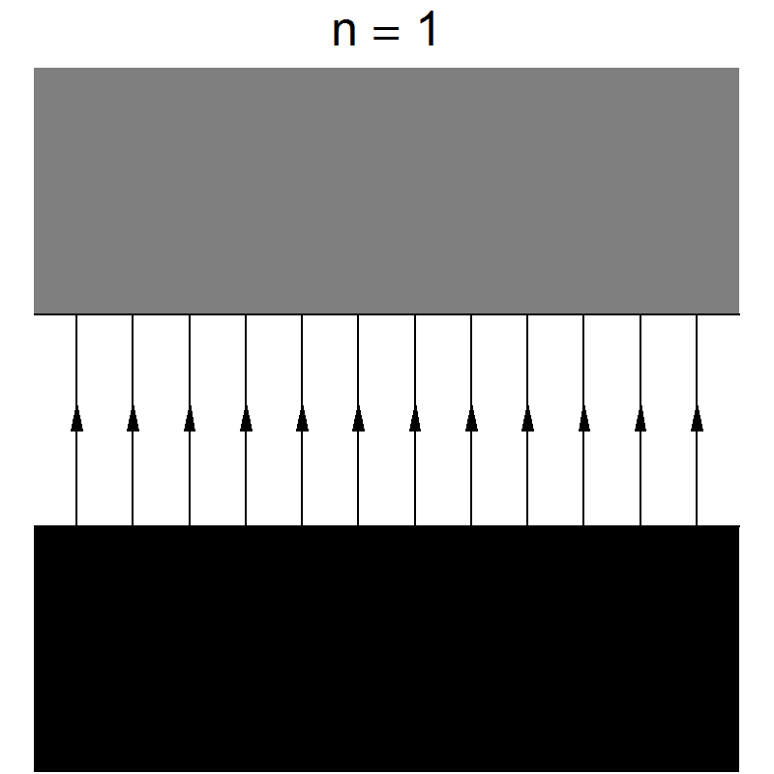
Sources of unintended deflections
Field error (deflection error) of a dipole magnet
  This can be due to an error in the magnet current or in the calibration table (measurement accuracy etc.)
  The imperfect dipole can be expressed as the ideal one + a small error
A small rotation (misalignment) of a dipole magnet has the same effect, but (mostly) in the “other” plane
imperfect dipole
ideal dipole
small dipole
error
→ horizontal kick
=
+
tilted dipole
ideal dipole
small dipole
error
→ vertical kick
𝜙
=
+

Slide 14
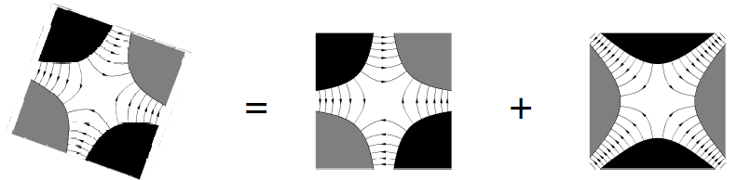
Misalignments causing feed-down
Horizontal misalignment of a quadrupole magnet
  Equivalent to perfectly aligned quadrupole plus small dipole

Slide 15
Misalignments causing feed-down
Horizontal misalignment of a quadrupole magnet
  Equivalent to perfectly aligned quadrupole plus small dipole
=
+
quadrupole dipole
horizontal offset creates horizontal (normal) dipole

Slide 16
Misalignments causing feed-down
Vertical misalignment of a quadrupole magnet
  Equivalent to perfectly aligned quadrupole plus small dipole
=
+
quadrupole dipole
vertical offset creates vertical (skew) dipole

Slide 17
Misalignments causing feed-down
Vertical misalignment of a quadrupole magnet
  Equivalent to perfectly aligned quadrupole plus small dipole
=
+
quadrupole dipole
vertical offset creates vertical (skew) dipole

Slide 18

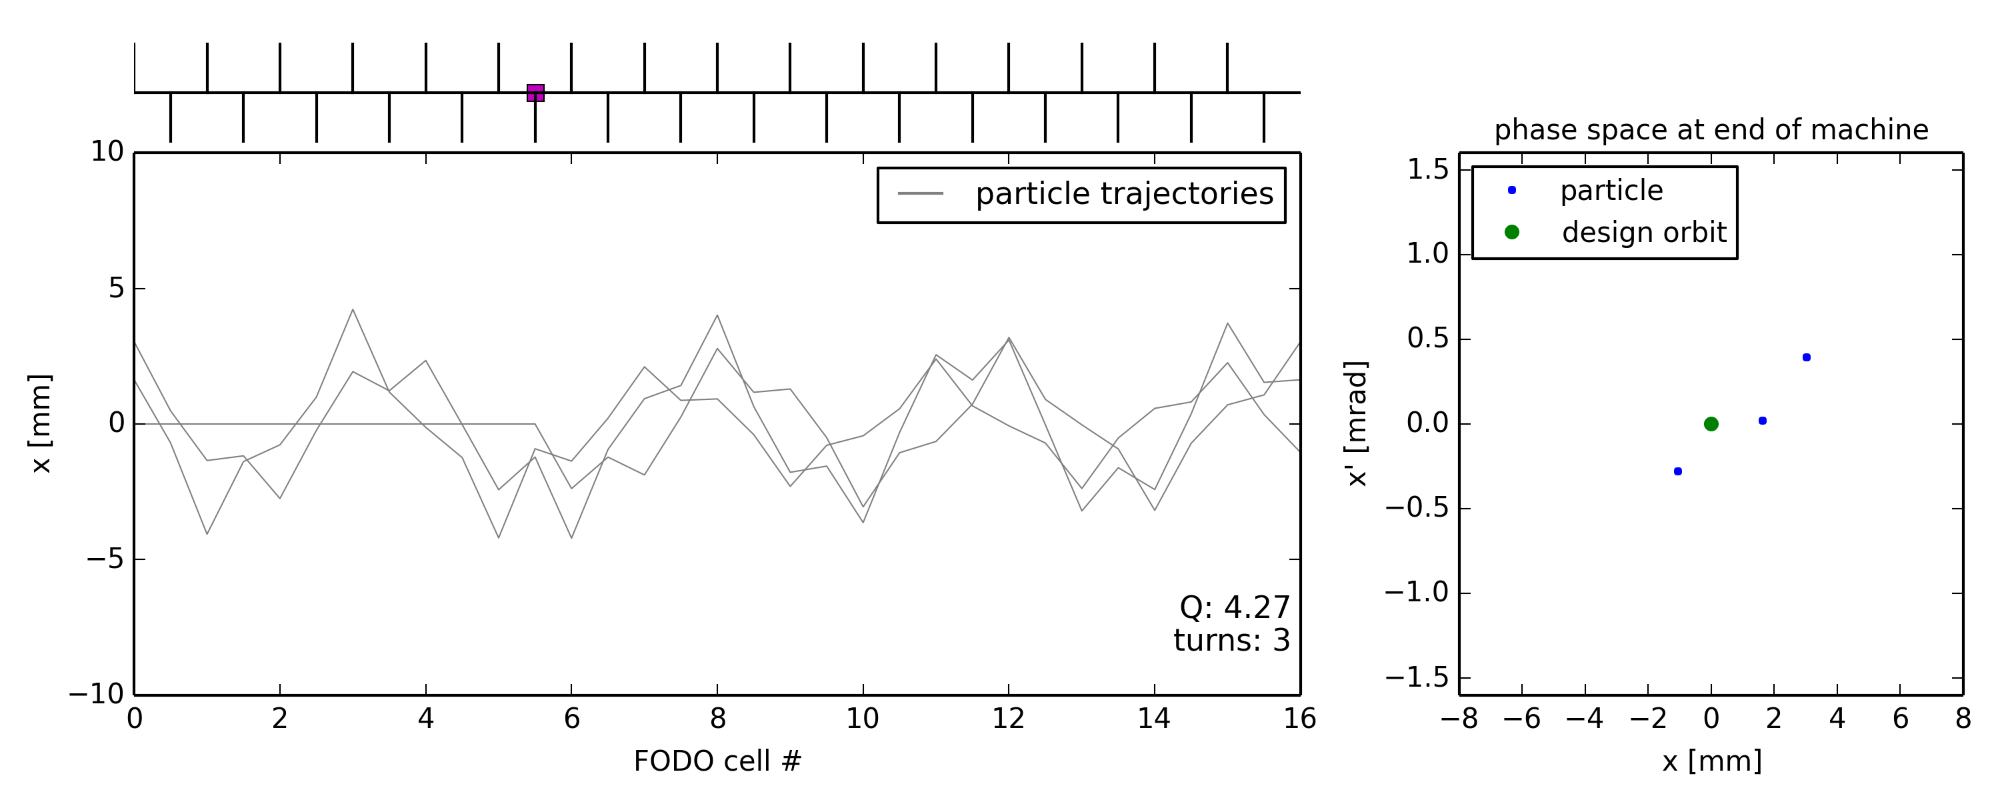
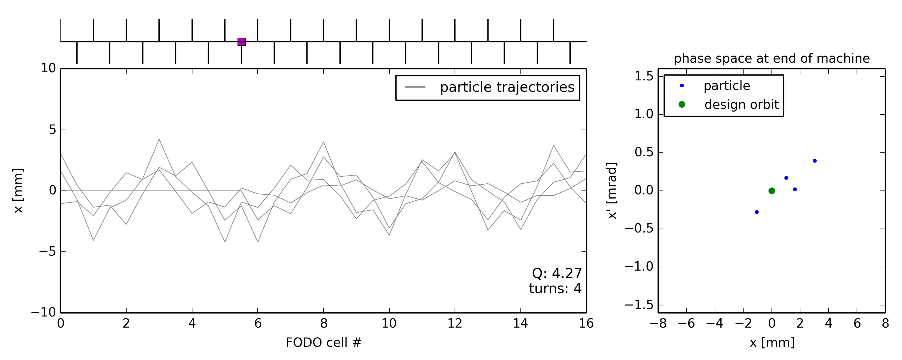
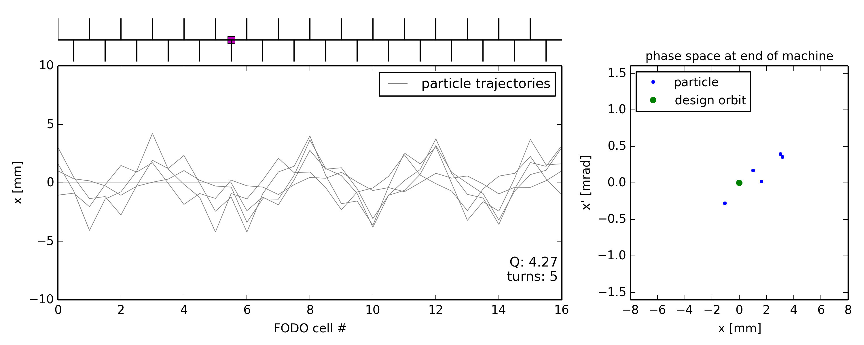
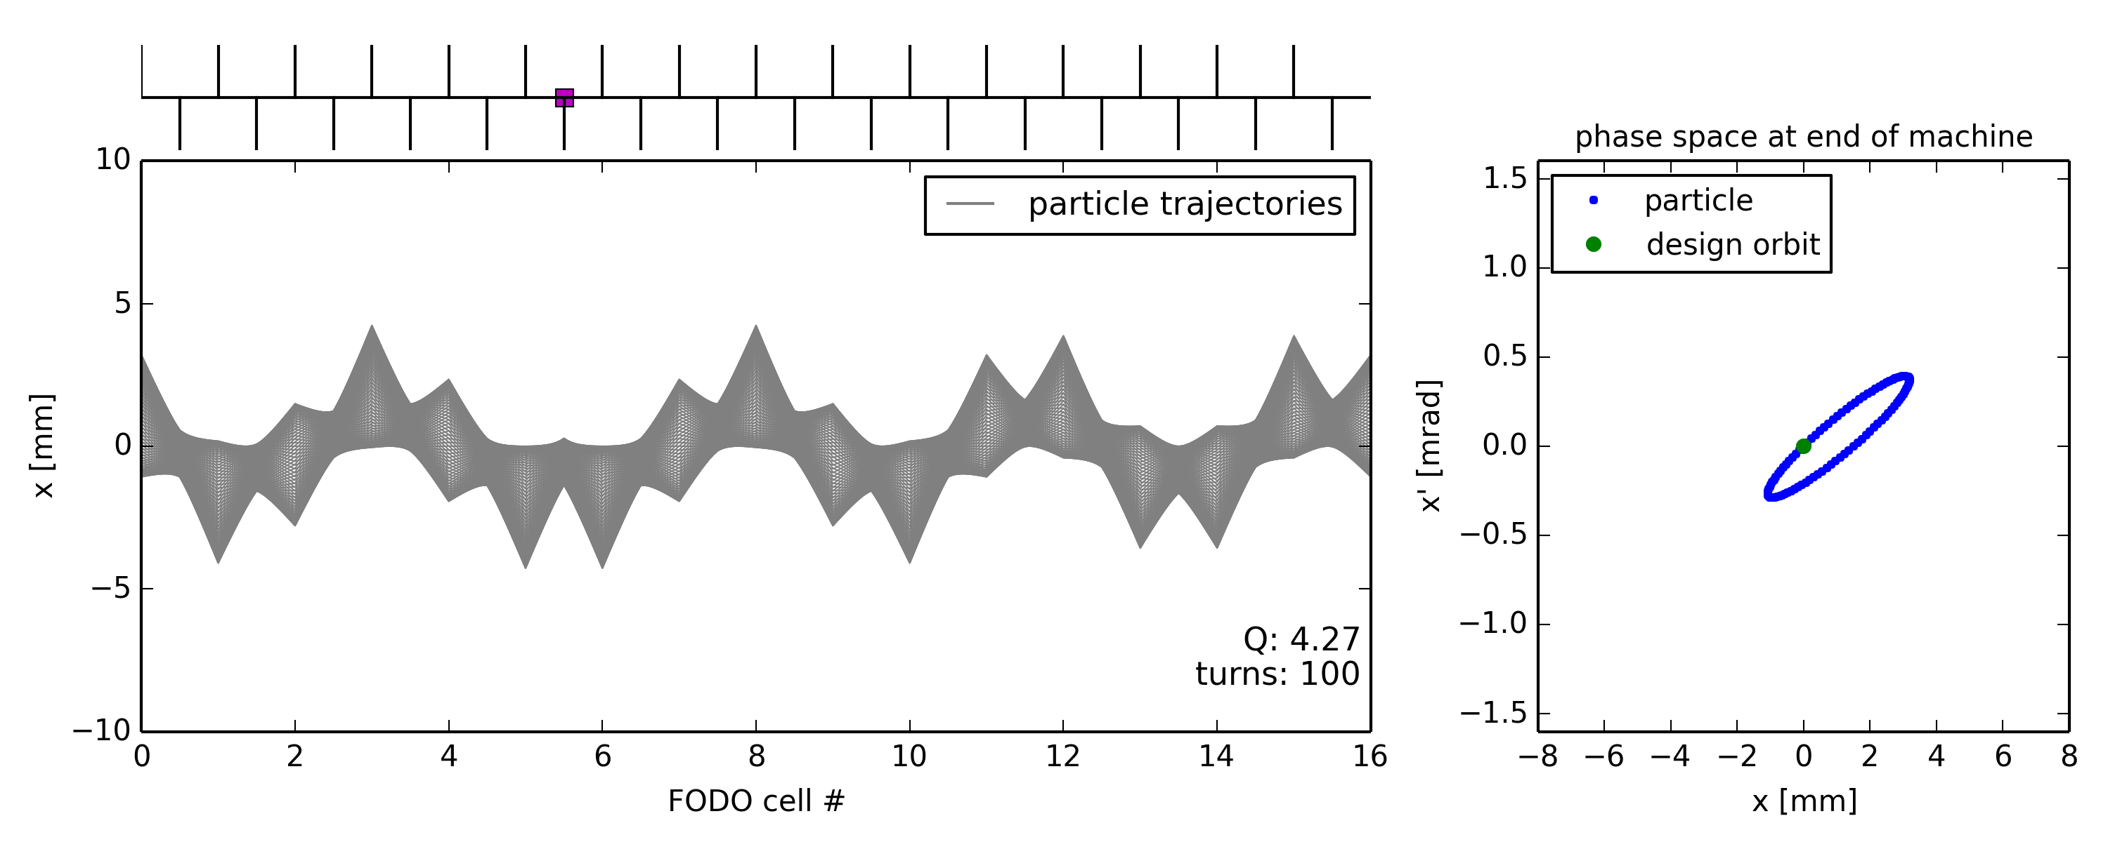
Illustration of closed orbit distortion
Ideal machine toy model with dipole error (unintended deflection) somewhere
  Particle injected on the design orbit … receives dipole kick every turn
Dipole error location

Slide 19
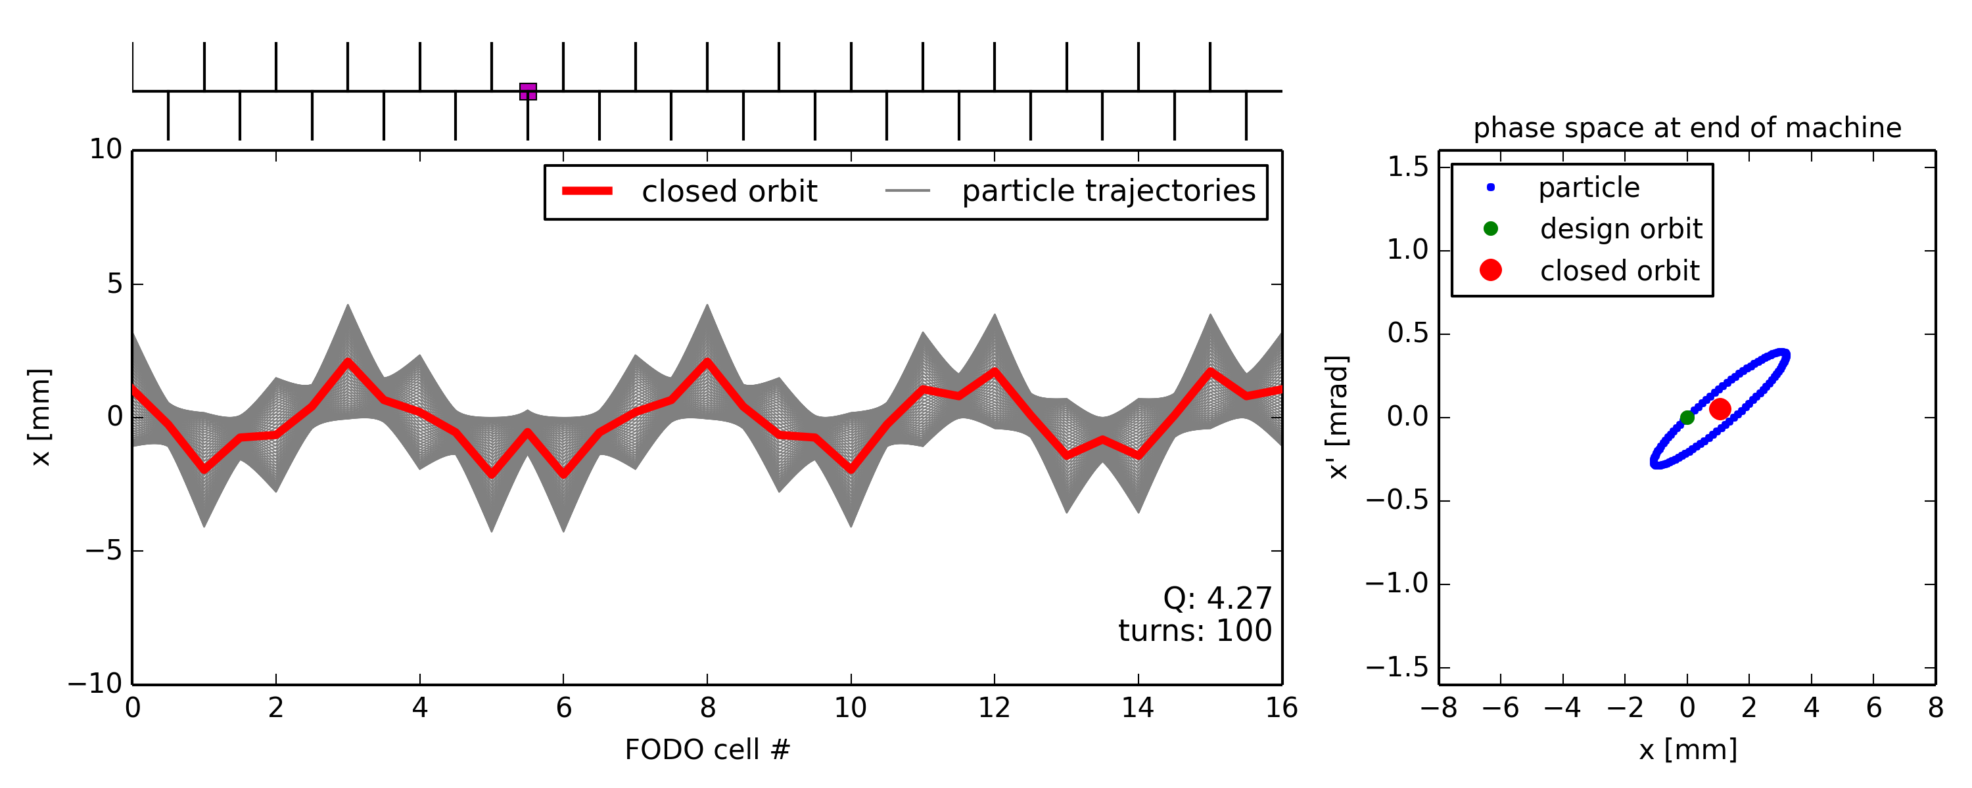
Illustration of closed orbit distortion
Ideal machine toy model with dipole error (unintended deflection) somewhere
  Particle injected on the design orbit … receives dipole kick every turn … and consequently performs betatron oscillation around a distorted closed orbit

Slide 20
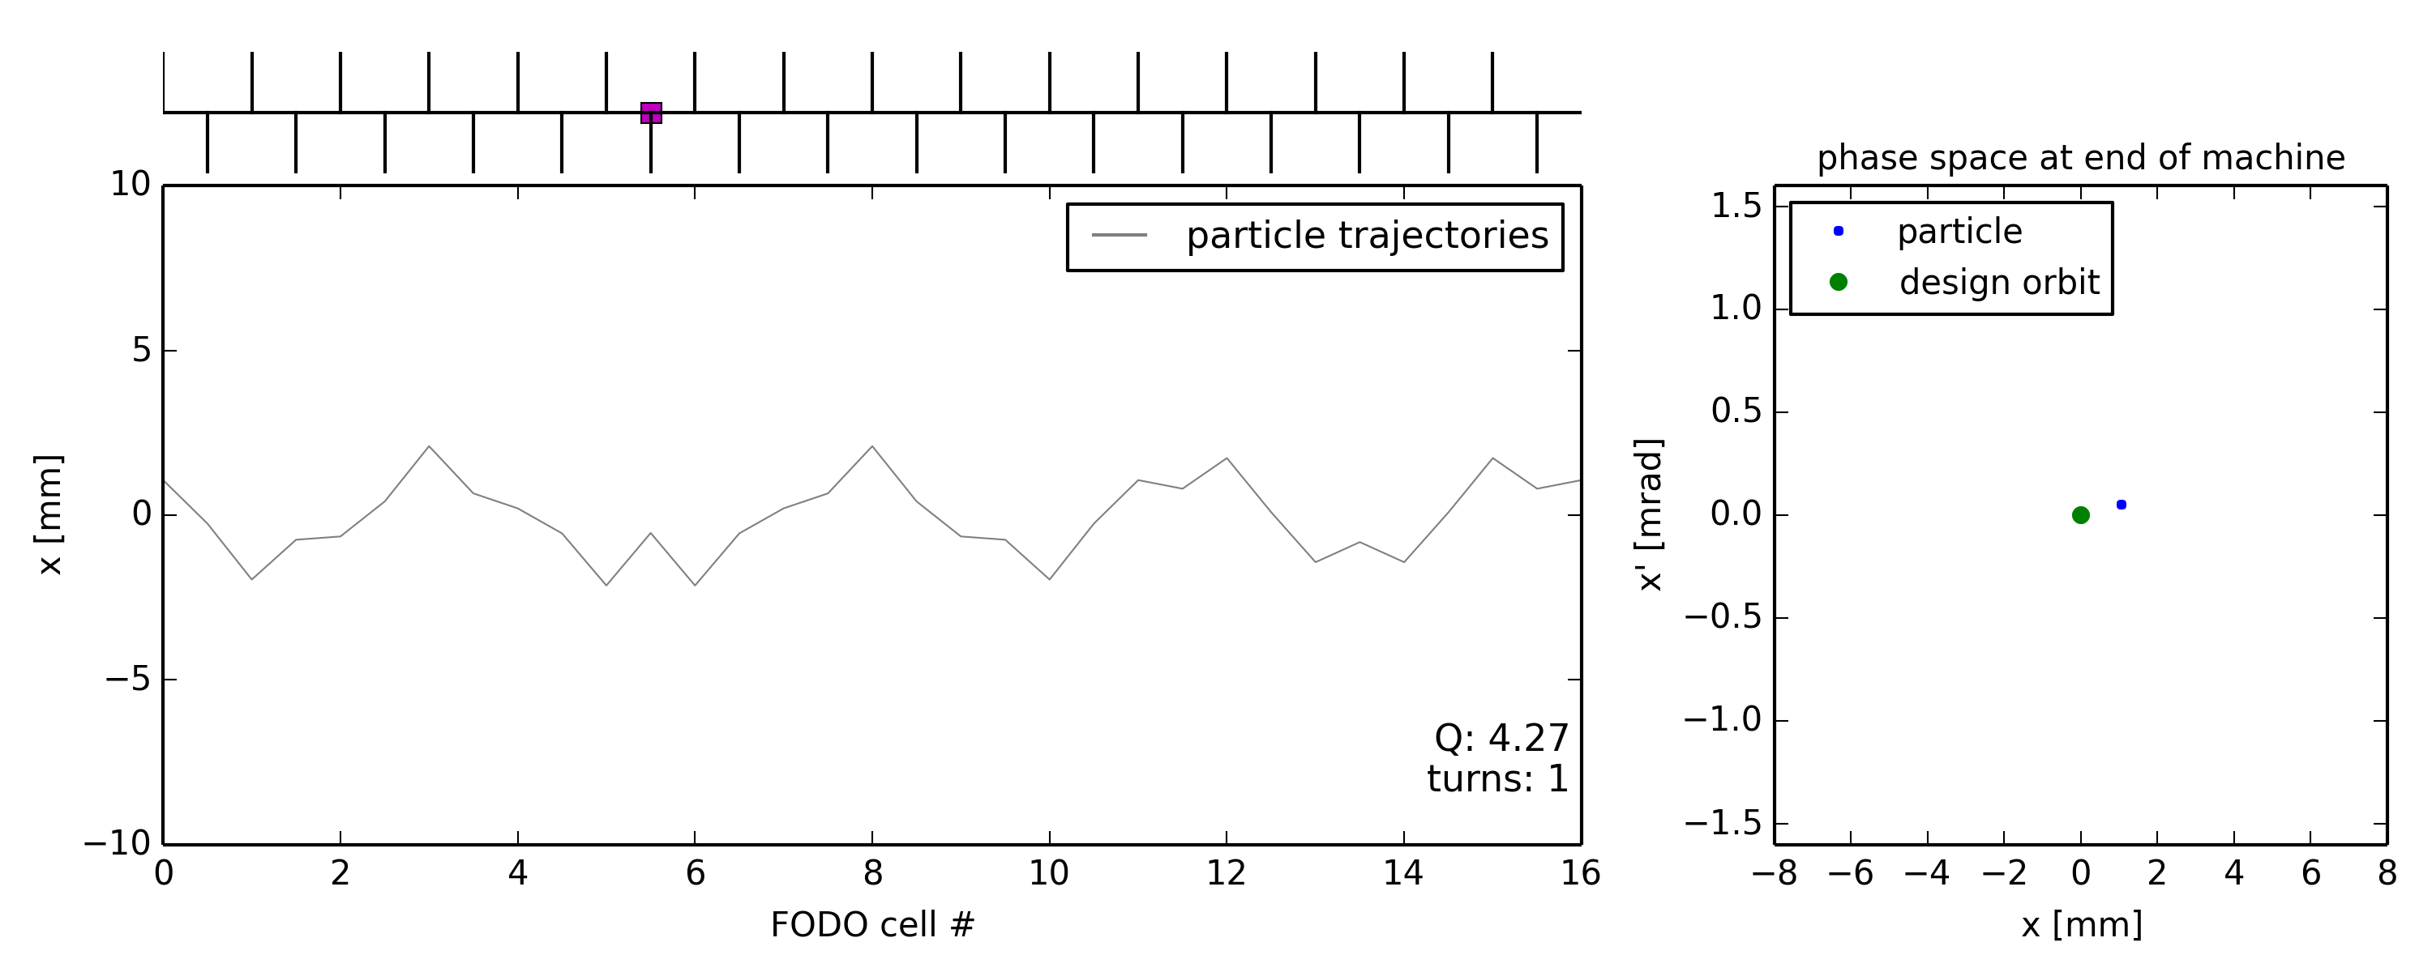
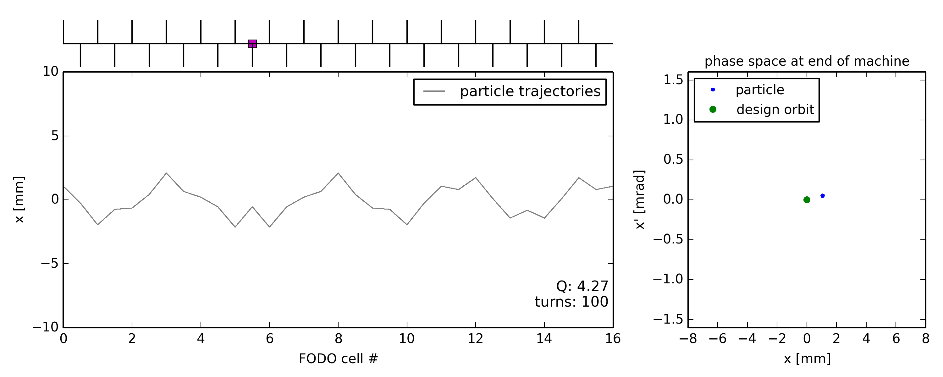
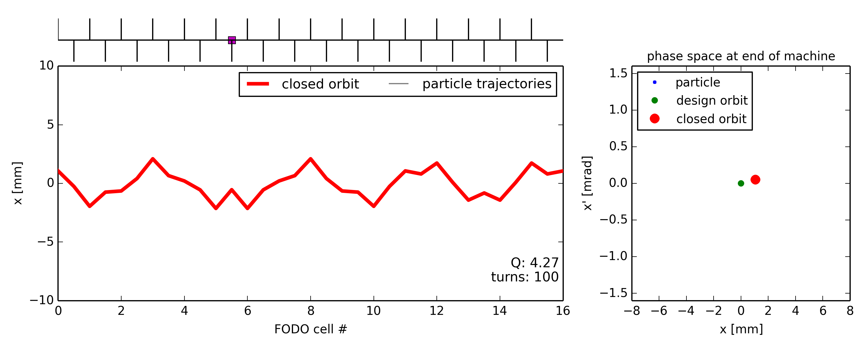
Illustration of closed orbit distortion
Ideal machine toy model with dipole error (unintended deflection) somewhere
  Particle injected on the design orbit … receives dipole kick every turn … and consequently performs betatron oscillation around a distorted closed orbit
  Particle injected onto distorted closed orbit remains on closed orbit
Starting point on closed orbit coordinates
Same particle coordinates after one(all) turn(s)

Slide 21
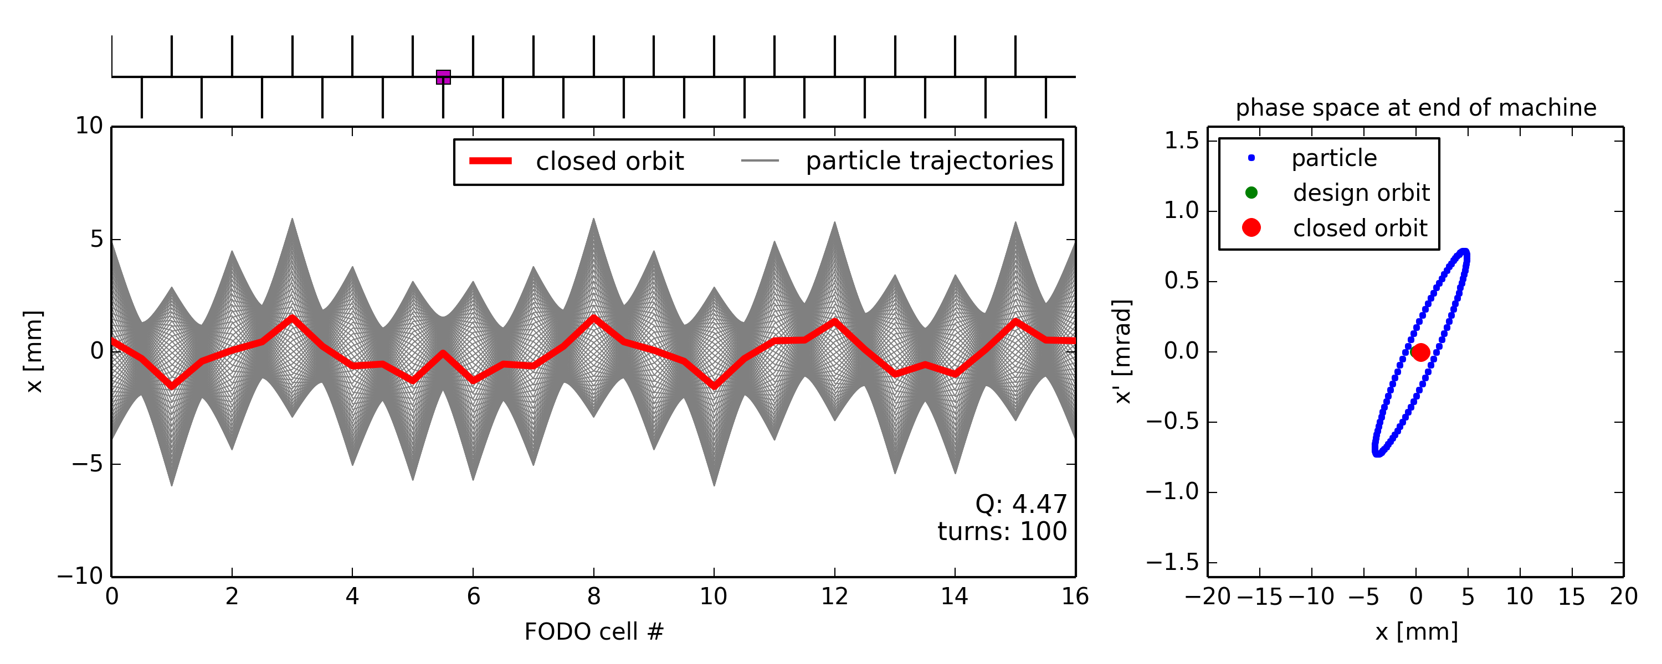
Single dipole kick vs. tune
Notes:
Add the case with tune = 4.5

Slide 22
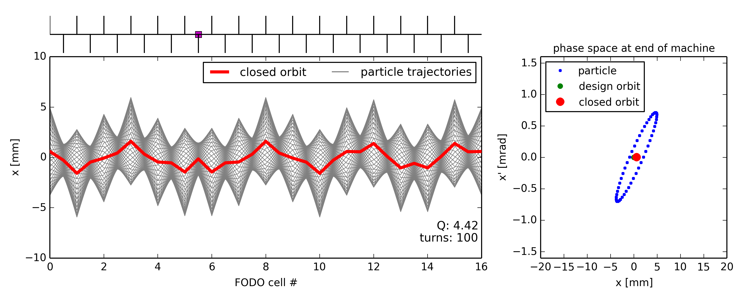
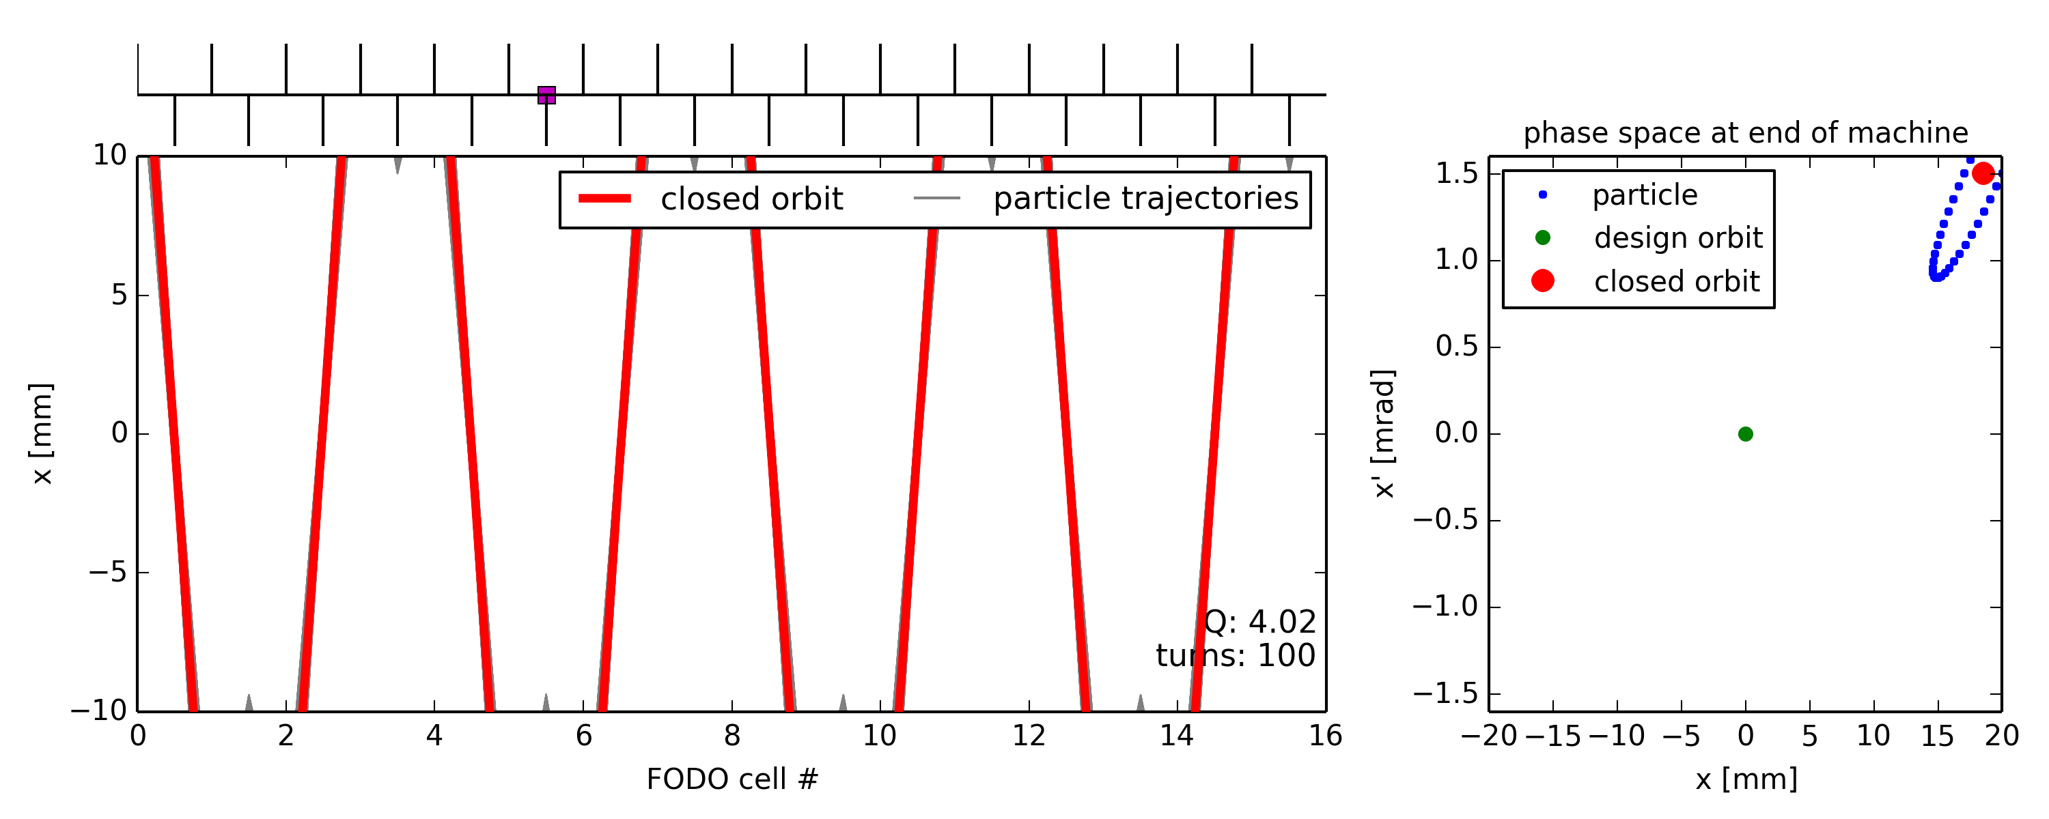

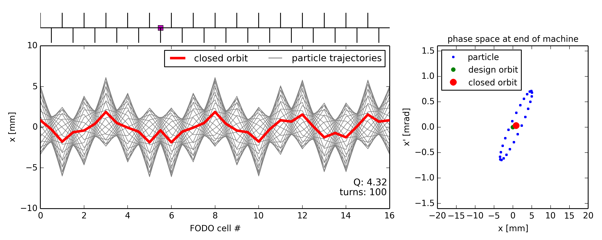
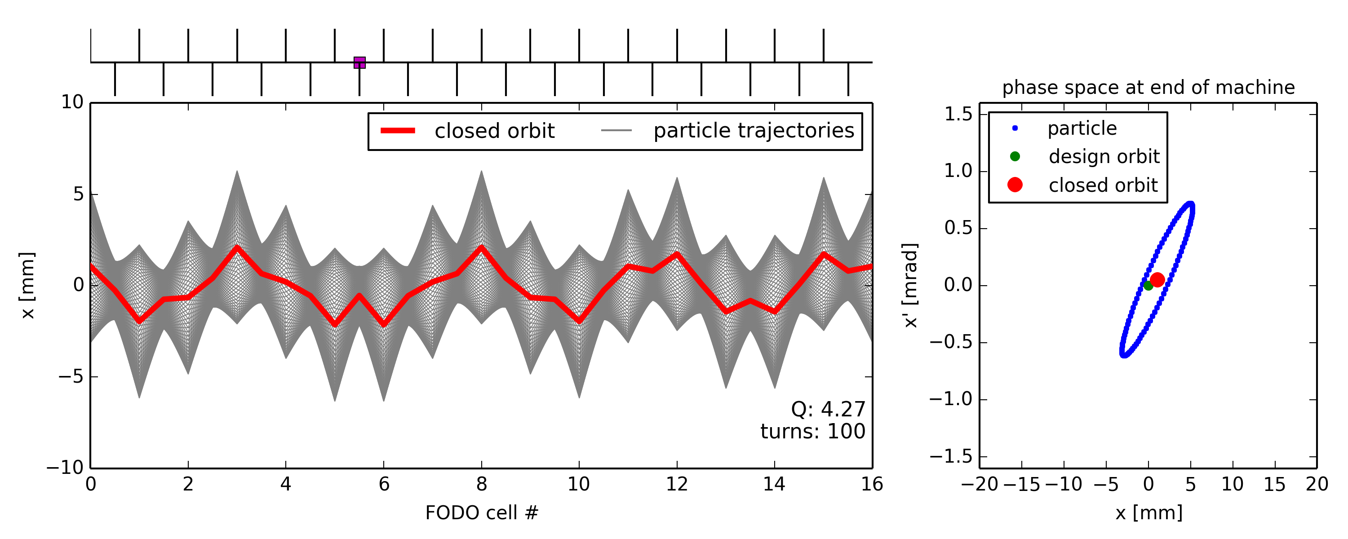
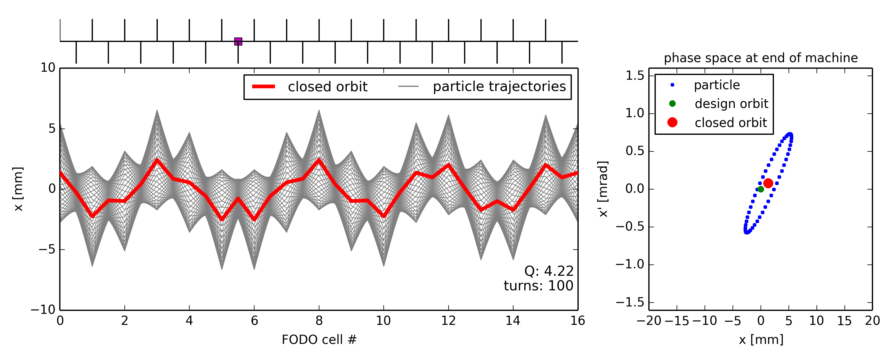
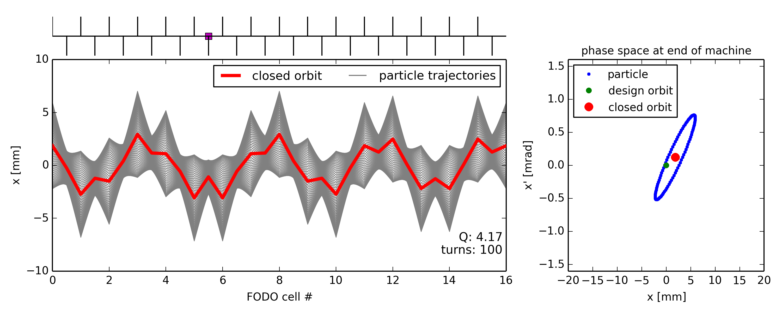
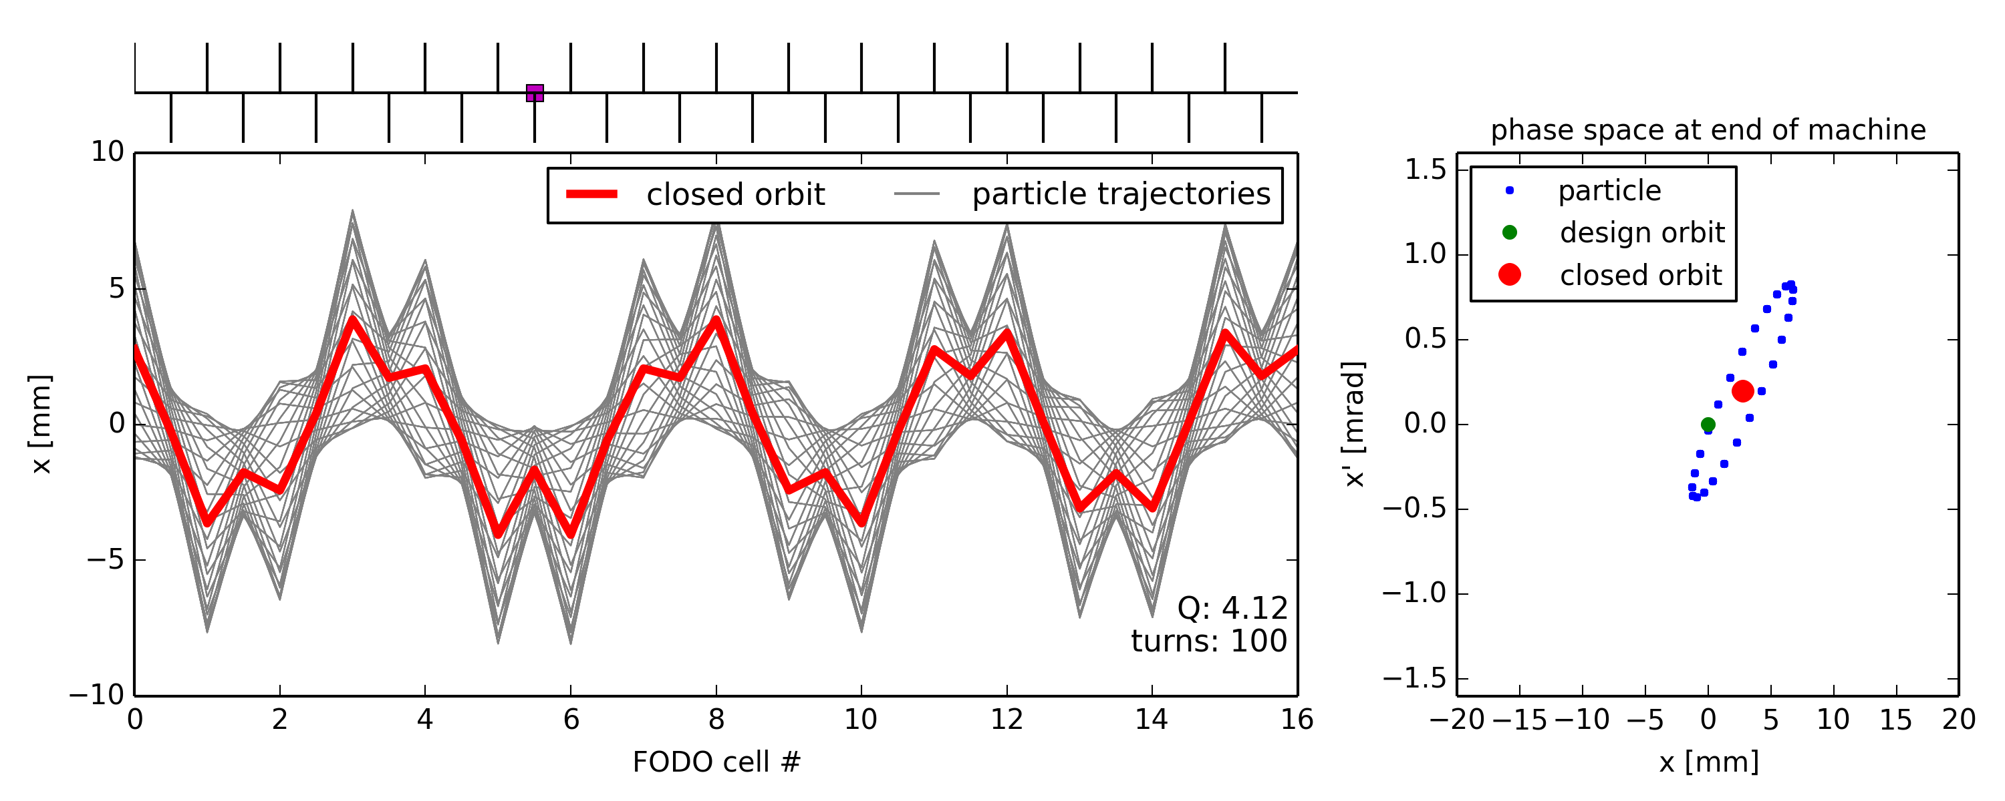
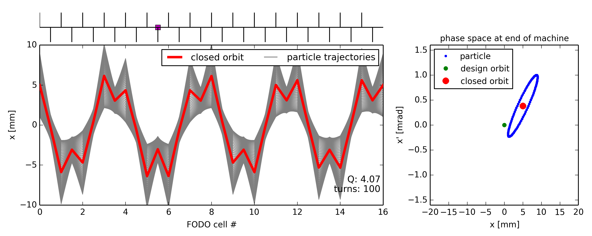
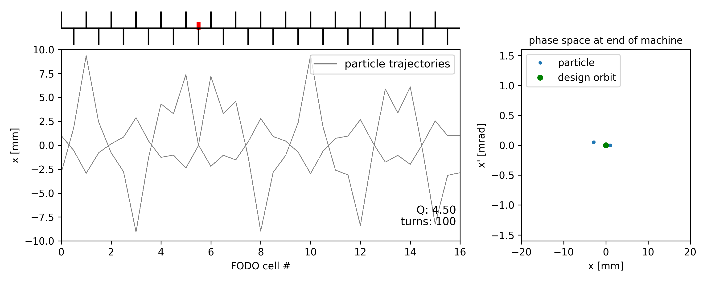
Single dipole kick vs. tune
  Note: the closed orbit distortion propagates with the betatron phase advance (e.g. single kick induces 4 oscillations for a tune of Q=4.x)
  Closed orbit distortion is most critical for tunes close to integer → closed orbit becomes unstable (but beam size not affected)
… closed orbit ill-defined

Slide 23
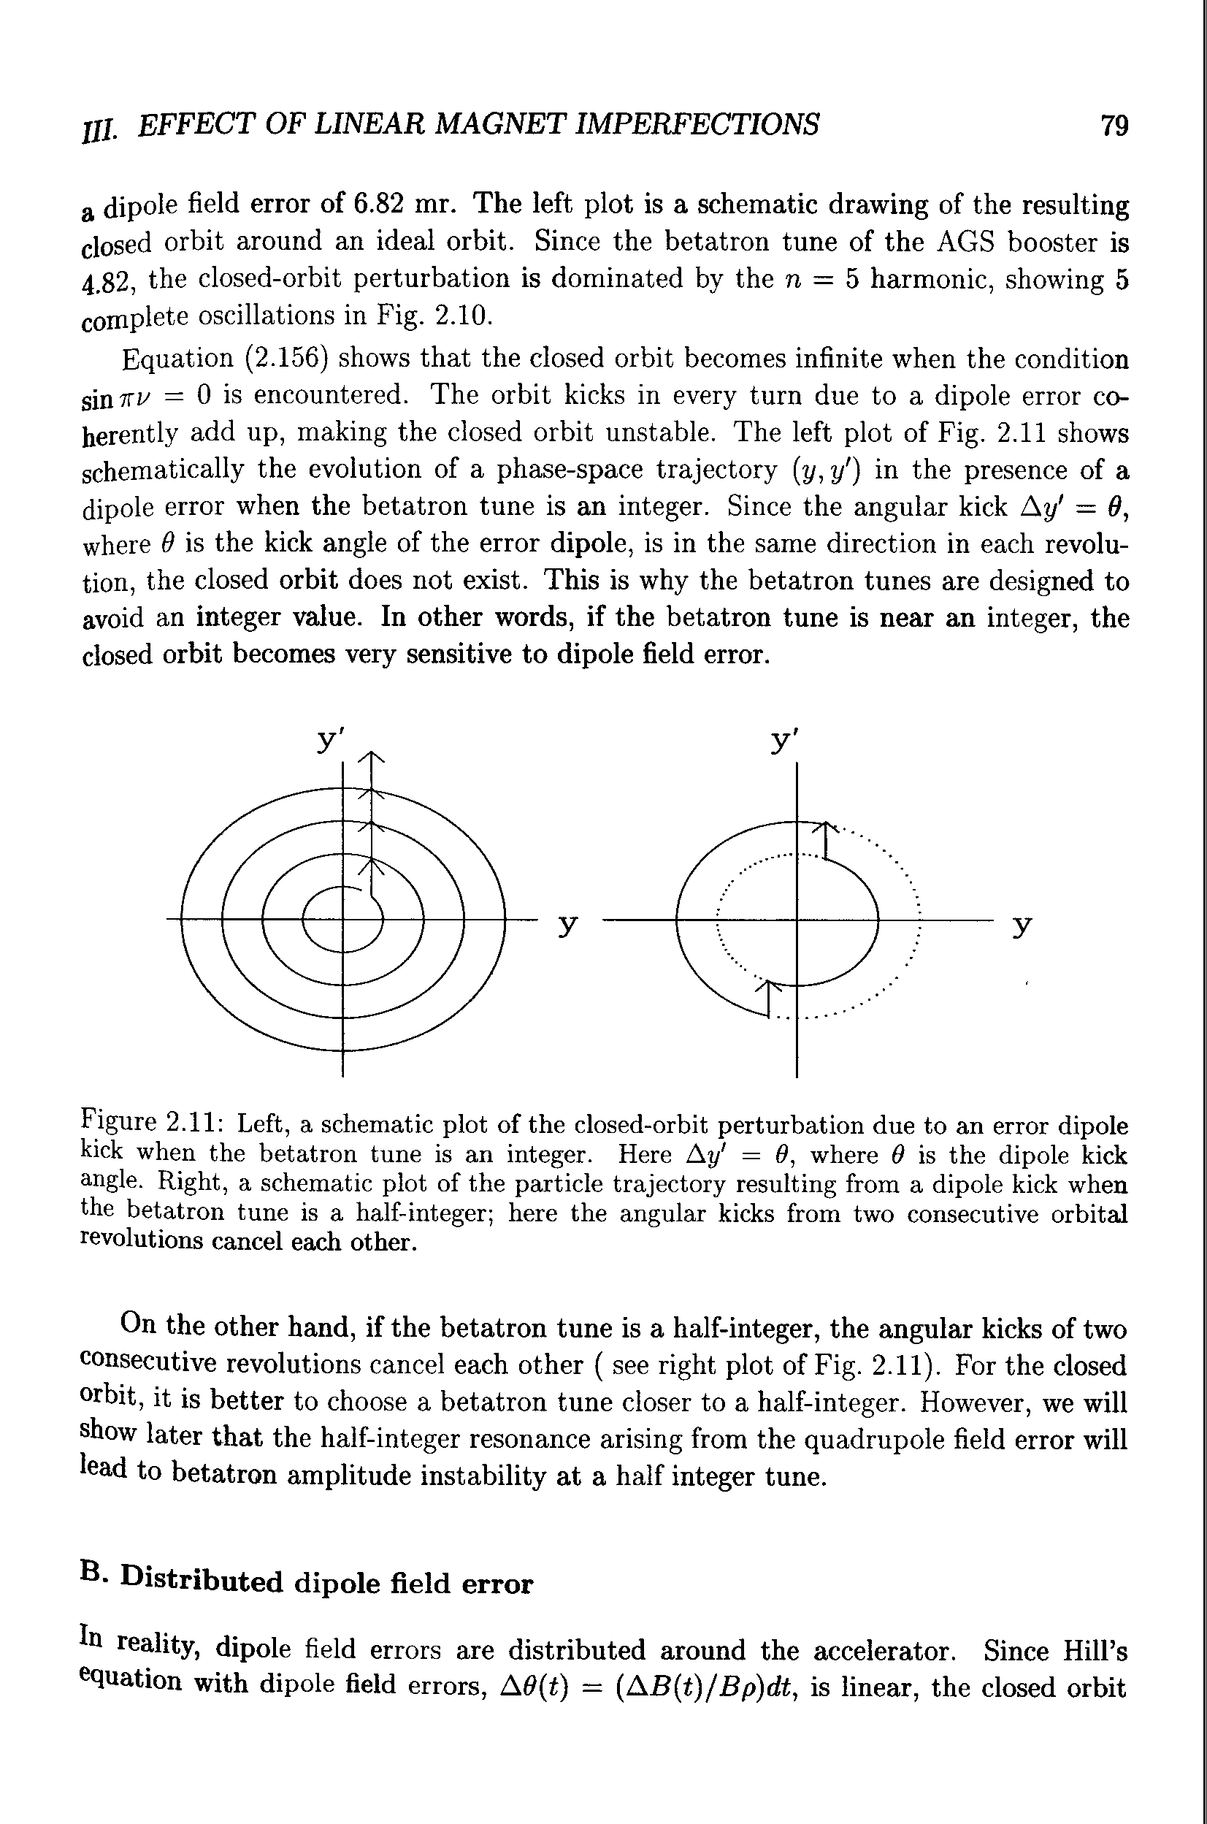
Integer and half integer resonance
  Dipole kicks add-up in
  consecutive turns for Q = n
  Integer tune excites orbit
  oscillations (resonance)
    orbit becomes unstable!
  Dipole kicks get cancelled in consecutive turns for Q = n+1/2
  Half-integer tune cancels orbit
  oscillations
u'
u'
u
u

Slide 24





Closed orbit examples
Example of horizontal closed orbit for a machine with tune Q = 6.x
The kink at the location of the deflection (→) can be used to localize the deflection (if it is not known) → can be used for orbit correction.
Q = 6.1
Q = 6.2
Q = 6.5
Q = 6.7
Q = 6.9

Slide 25


Closed orbit bumps
Often it is needed to steer the closed-orbit away from the nominal trajectory in a localized part of a synchrotron
  Injection / extraction
  Local orbit correction (or steering around local aperture restrictions)
Standard bump configurations exist
  π-bump (with 2 correctors)
  3 and 4-corrector bumps
example of 2-corrector bump
dipole
septum
local orbit bump
dipole
example of 3-corrector bump
unperturbed closed orbit

Slide 26
Closed orbit bumps
Often it is needed to steer the closed-orbit away from the nominal trajectory in a localized part of a synchrotron
  Injection / extraction
  Local orbit correction (or steering around local aperture restrictions)
Standard bump configurations exist
  π-bump (with 2 correctors)
  3 and 4-corrector bumps
example of 2-corrector bump
dipole
septum
fast kick
extraction
dipole
example of 3-corrector bump
unperturbed closed orbit

Slide 27

Closed orbit correction: MICADO
  The problem of correcting the orbit deterministically came up a long time ago in the first CERN machines.
  B. Autin and Y. Marti published a note in 1973 describing an algorithm that is still in use today (but in JAVA/C/C++ instead of FORTRAN) at ALL CERN machines: MICADO*
(Minimization of the quadratic orbit distortions)

Slide 28



MICADO – how does it work?
  The intuitive principle of MICADO is rather simple:
    It requires a model of the machine
    It computes for each orbit corrector what the effect (response) is expected to be on the orbit
…

Slide 29


MICADO – how does it work?
  MICADO compares the response of every corrector with the raw orbit in the machine
  MICADO picks the corrector that has the best match with the raw orbit, i.e. that will give the largest improvement to the rms orbit deviation
  The procedure can be iterated to the second-best corrector and so on, until the orbit is good enough (or as good as it can be)
…

Slide 30



MICADO – LHC Orbit example
  The raw orbit at the LHC can have huge errors, but the correction (based partly on MICADO) brings the deviations down by a factor 20
Uncorrected horizontal orbit of ring 1
LHC vacuum chamber
50 mm
34 mm
MICADO
& Co
44 mm
Corrected horizontal orbit of ring 1
50 mm
At the LHC a good orbit
correction is vital !

Slide 31

Outline
Introduction
Closed orbit distortion (steering error)
  Beam orbit stability
  Imperfections leading to closed orbit distortion
Optics function distortion (gradient error)
  Imperfections leading to optics distortion
  Tune-shift and beta distortion due to gradient errors
Coupling error
  Coupling errors and their effect
  Coupling correction
Summary

Slide 32


Illustration of optics distortion
Ideal machine toy model with regular FODO lattice and quadrupole error at the end of circumference
  Particle injected with offset performs betatron oscillations but gets additional focusing from quadrupole error
    There is a tune-shift (additional de-/focusing)
    Beam envelope is distorted around the machine … “beta-beating”
Quadrupole error location
Note the change of the ellipse shape!
Note the change of the actual machine tune!

Slide 33






Optics distortion vs. tune
  For which configuration quadrupole errors have biggest impact on optics?
    Close to integer and half integer tunes → envelope (or beam size) becomes unstable

Slide 34

Quadrupole error in phase space
  Therefore, integer tunes and half integer tunes need to be avoided for machine operation to avoid beam envelope becoming unstable due to quadrupole errors
  Recall: for integer tunes dipole errors drive the closed orbit unstable, but for half integer tunes they have minimum effect
Q = n (integer)
→ kicks from quadrupoles add up (same as for kicks from dipoles)
Q = n/2 (half integer)
→ kicks from quadrupoles also add up
(while kicks from dipoles cancel)

Slide 35


Example: LHC optics corrections
  At β*=40cm, the bare machine has a beta-beat of more than 100%
  After global and local corrections, β-beating was reduced to few %
R. Tomas et al.
before and after local correction
after final corrections

Slide 36

Outline
Introduction
Closed orbit distortion (steering error)
  Beam orbit stability
  Imperfections leading to closed orbit distortion
Optics function distortion (gradient error)
  Imperfections leading to optics distortion
  Tune-shift and beta distortion due to gradient errors
Coupling error
  Coupling errors and their effect
  Coupling correction
Summary

Slide 37

Coupling errors
  Coupling may result from rotation of a quadrupole, so that the field contains a skew quadrupole component
  A systematic vertical offset in a sextupole has the same effect as a skew quadrupole.
    For a displacement of the field becomes
tilted quadrupole
normal quadrupole
skew quadrupole
φ
skew quadrupole

Slide 38


Normal vs. skew quadrupole
normal quadrupole
horizontal force depends on horizontal position (and likewise for vertical)
skew quadrupole
horizontal force depends on vertical position (and vice versa)
→ resulting forces couples the motion in the two planes

Slide 39

Closest tune approach
Tune measurement in the CERN PS
  Coupling makes it impossible to approach the tunes below
  where is the coupling coefficient
  The coupling coefficient can be measured by trying to approach the tunes and measure the minimum distance
programmed Q_{y}
minimum tune separation
quadrupole setting changed dynamically during storage time
programmed Q_{x}
tune peaks from both planes visible in Fourier spectra of horizontal and vertical motion
programmed Q_{y}
minimum tune separation
programmed Q_{x}

Slide 40



Closest tune approach
Tune measurement & coupling correction in the CERN PS
Measured Tunes
+ coupling correction
Measured Tunes
Set Tunes
Using
Skew Quads

Slide 41
Summary of linear imperfections
  Linear imperfections, such as magnet misalignments and field errors, are unavoidable in a real accelerator, but they can be corrected to some extent as summarized in this table:
Error | Effect | Cure
fabrication imperfections | unwanted multipolar components | better fabrication / multipolar correctors coils
transverse misalignments | feed-down effect | better alignment / correctors
dipole kicks | orbit distortion / residual dispersion | corrector dipoles
quadrupole field errors | tune shift, beta-beating | trim special quadrupoles
quadrupole tilts | coupling x − y | better alignment / skew quads
power supplies | closed orbit distortion / tune shift / modulation | improve power supplies and their calibration

Slide 42

Interlude: multipole expansion
Multipole expansion of transverse magnetic field
  Start from the general expression for the transverse magnetic field in terms of multipole coefficients
Normal components (“upright” magnets)
Skew components (magnets rotated by )
Note that: and:
e.g. The magnetic field normal sextupole is
…
…
Notes:
\mathbf{B}(x, y) &= B_y(x, y) + i B_x (x, y) \\
&= \sum_{n=0}^{\infty}(B_n + i A_n)(x+i y)^n

Slide 43
Feed-down from multipoles
  Let’s explicitly write the vertical/horizontal field as the sum of all multipole components
  A horizontal offset (-𝛿x) in a normal(skew) magnet of order n creates normal(skew) feed-down components at y=0 of all lower orders!:
normal
skew
dipole quadrupole sextupole octupole
(normal)
2(n+1)-pole 2(n+1)-pole 2n-pole 2(n-1)-pole dipole
(skew)
Notes:
B_y = B_0 + B_1x - A_1y + B_2(x^2-y^2) - 2A_2 xy + B_3(x^3-3 xy^2) - A_3 (- y^3 + 3x^2y) + \dots
B_x = A_0
+ A_1x + B_1y
+ A_2(x^2-y^2) + 2B_2 xy
+ A_3(x^3-3 xy^2) + B_3 (-y^3 + 3x^2y) + \dots
B_y(y\!=\!0) = B_n \bar{x}^n = B_n(x+\delta x)^n = B_n (x^n +n\delta x x^{n-1} + \tfrac{n(n-1)}{2}\delta x^2 x^{n-2} +\dots + (\delta x)^n)
B_x(y\!=\!0) = 0
B_x(y\!=\!0) = A_n \bar{x}^n = A_n(x+\delta x)^n = A_n (x^n +n\delta x x^{n-1} + \tfrac{n(n-1)}{2}\delta x^2 x^{n-2} +\dots + (\delta x)^n)
B_y(y\!=\!0) = 0

Slide 44
Feed-down from multipoles
  Let’s explicitly write the vertical/horizontal field as the sum of all multipole components
  A vertical offset (-𝛿y) in normal(skew) magnets of order n results in alternating skew(normal) and normal(skew) feed-down components for x=0 of all lower orders!, as can be worked out looking at n-order terms are defined (for x=0):
    E.g. n even, normal magnet:
normal
skew
dipole quadrupole sextupole octupole
    for n = even for n = odd
Odd exponent,
i.e. it must be a skew component
normal
Even exponent, i.e. a normal component again …
Notes:
B_y(y\!=\!0) = B_n \bar{x}^n = B_n(x+\delta x)^n = B_n (x^n +n\delta x x^{n-1} + \tfrac{n(n-1)}{2}\delta x^2 x^{n-2} +\dots + (\delta x)^n)
B_x(y\!=\!0) = A_n \bar{x}^n = A_n(x+\delta x)^n = A_n (x^n +n\delta x x^{n-1} + \tfrac{n(n-1)}{2}\delta x^2 x^{n-2} +\dots + (\delta x)^n)
B_y(x\!=\!0) = i^n B_n (y+\delta y)^n =
i^n B_n (y^n +n\delta y y^{n-1} + \tfrac{n(n-1)}{2}\delta y^2 y^{n-2} +\dots + (\delta y)^n)

Slide 45

Multipole expansion
Multipole expansion of transverse magnetic field
  Start from the general expression for the transverse magnetic flux in terms of multipole coefficients
  In some cases it is more convenient to use “normalized” components:
  so that:
e.g. normal quad
e.g. skew quad
Normal components
(“upright” magnets)
Skew components
(magnets rotated by )
Normalized normal components
Normalized skew components

Slide 46
Feed-down from multipoles
  Explicitly: the vertical field is the sum of all multipole components
Feed-down: lower order field components from misalignments
  Systematic horizontal offset in normal (skew) magnets creates normal (skew) feed-down components as seen with at y=0:
  Systematic vertical offset in normal magnets results in alternating skew and normal feed-down components (and vice-versa for skew magnets), as can be worked out from
dipole quadrupole sextupole octupole
2(n+1)-pole 2n-pole 2(n-1)-pole dipole
    for n = even for n = odd

