Slide 1
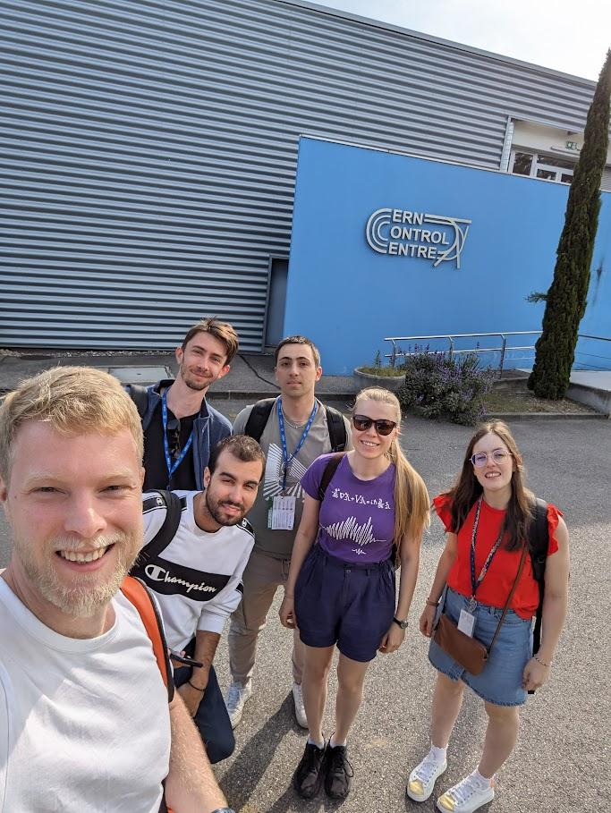
Group A: who we are and what we learned
ATSOA 2024

Slide 2

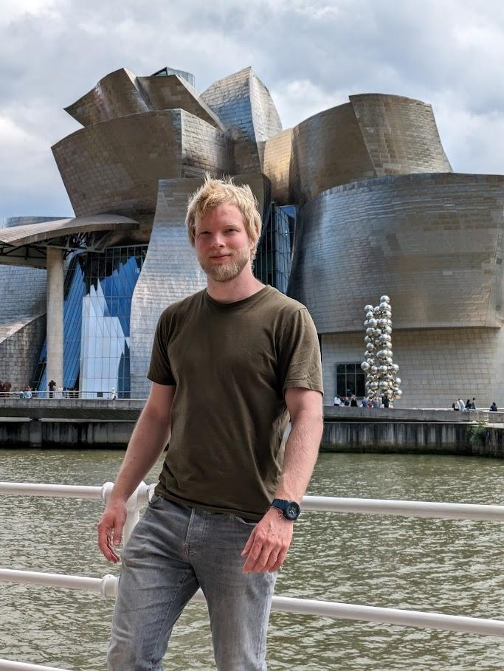
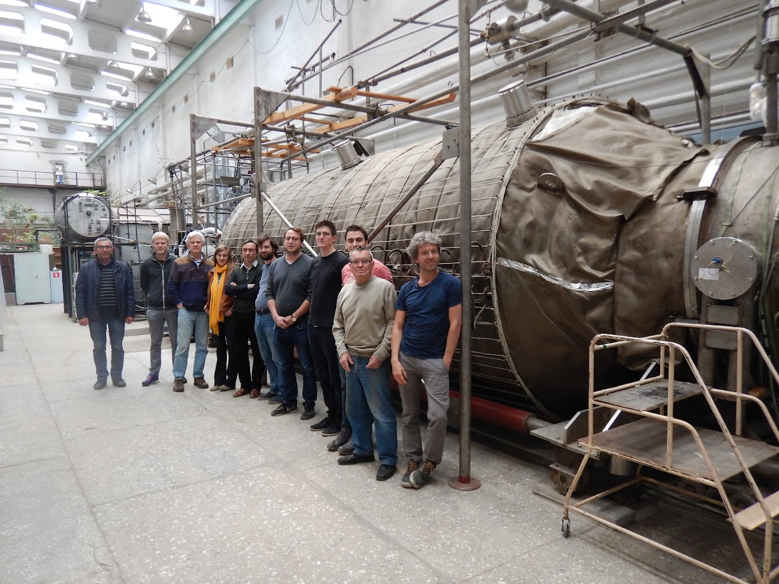
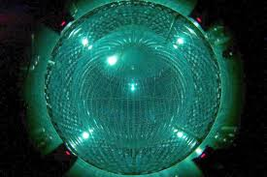
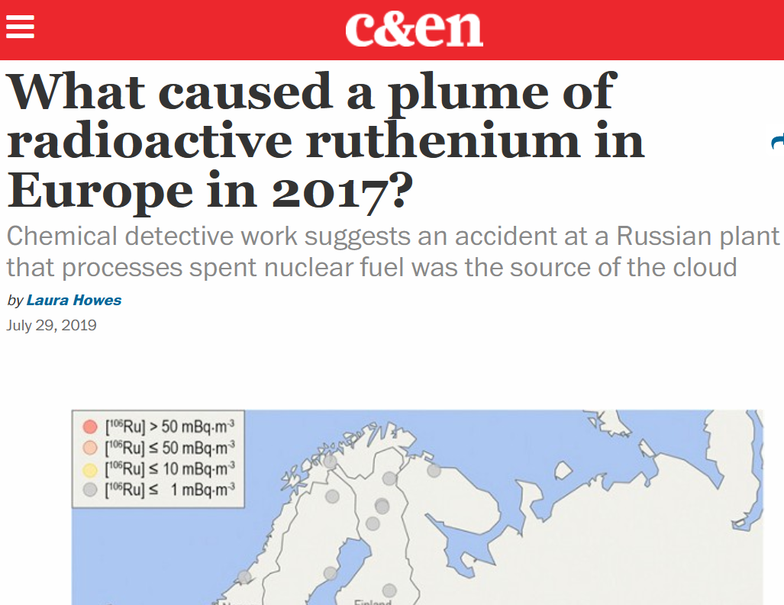
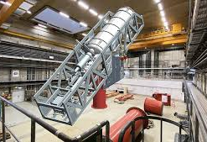
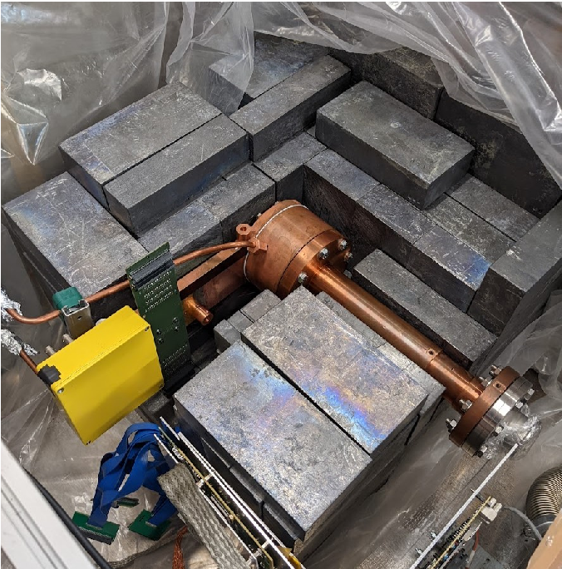
Konrad Altenmüller
Accelerator physicist at ESS Bilbao
Previously in astroparticle physics
PhD about sterile neutrinos at TUM Munich / Université Paris-Saclay
Postdoc in BabyIAXO (axion dark matter) at University of Zaragoza

Slide 3
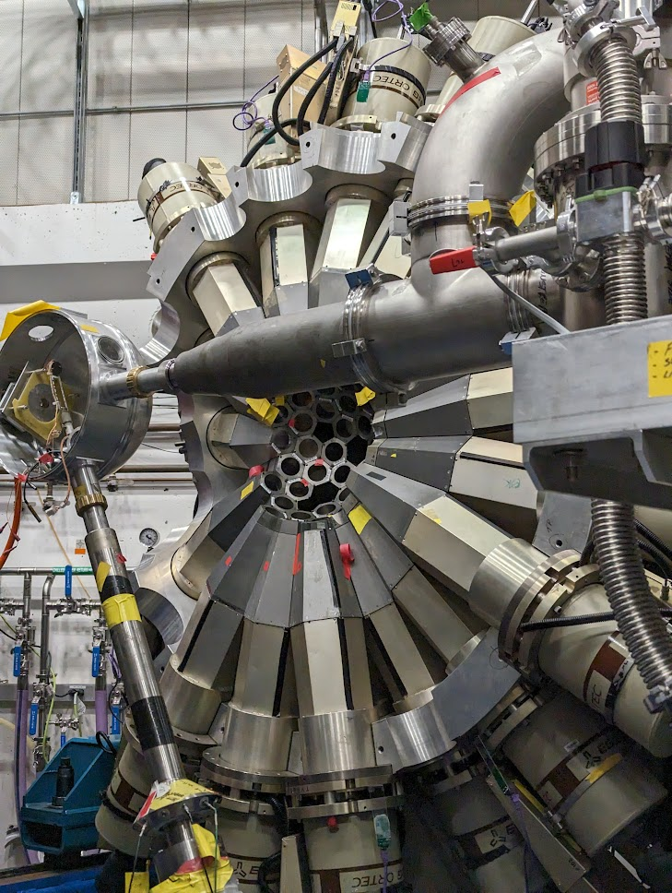
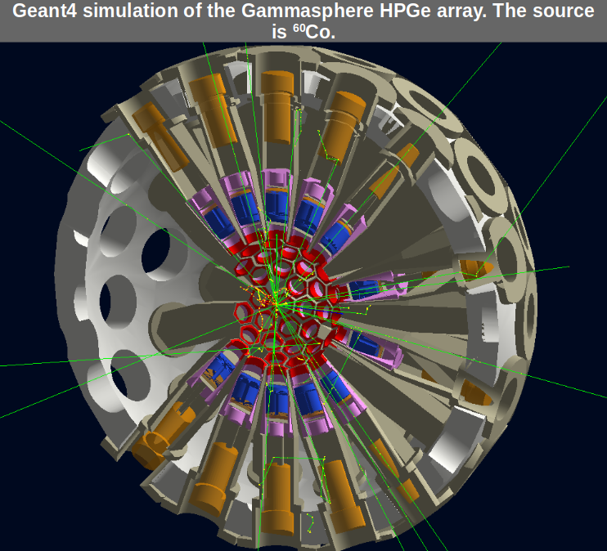
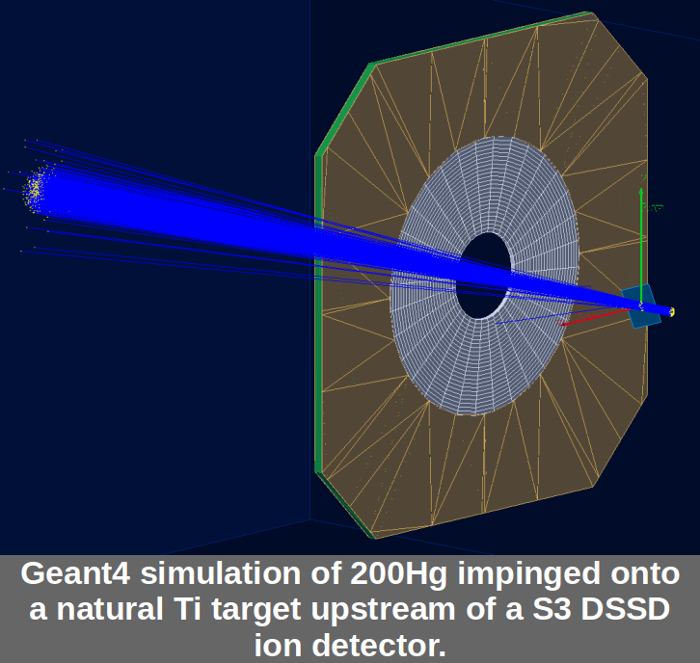

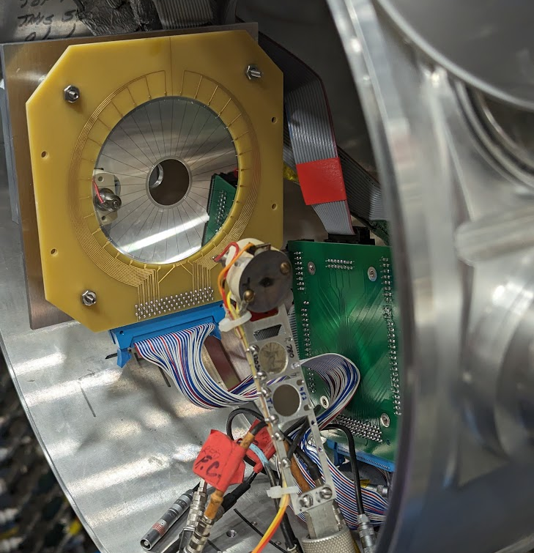


Greg gw00431@surrey.ac.uk
1st year PhD at University of Surrey
Experimental nuclear physics: Nuclear structure (Coulomb excitation)
Background in Geant4 sims, not accelerators!

Slide 4



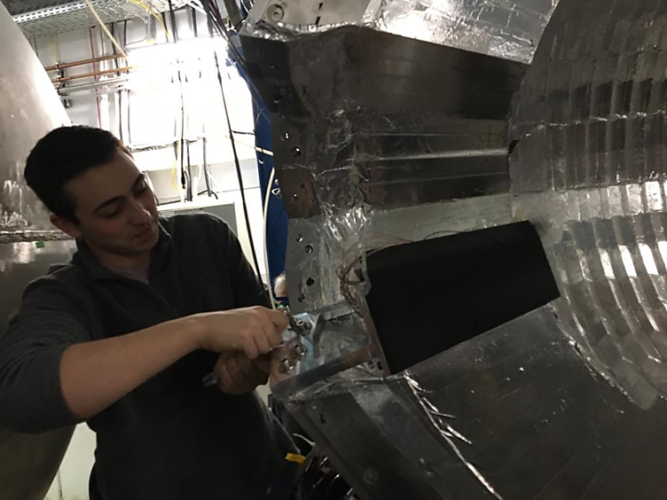
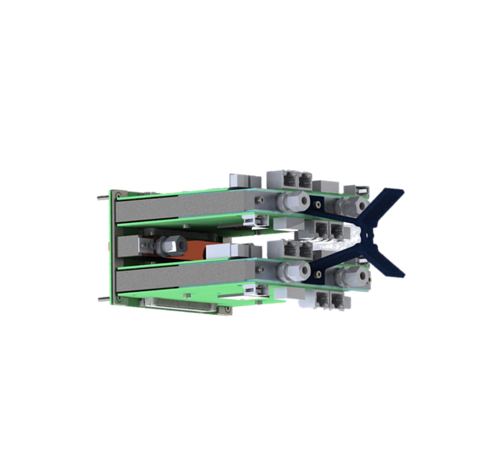
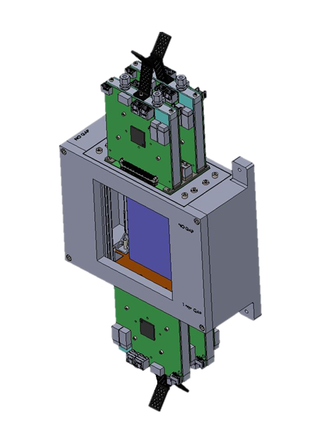
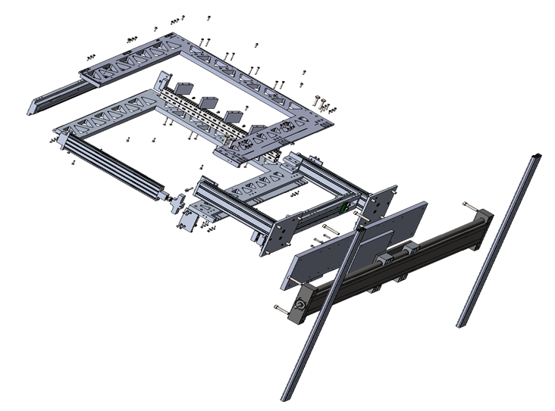
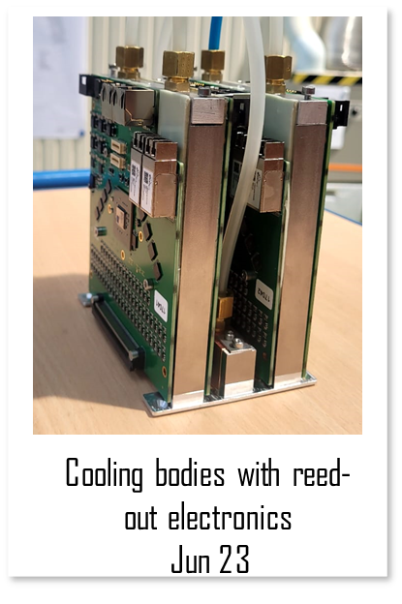
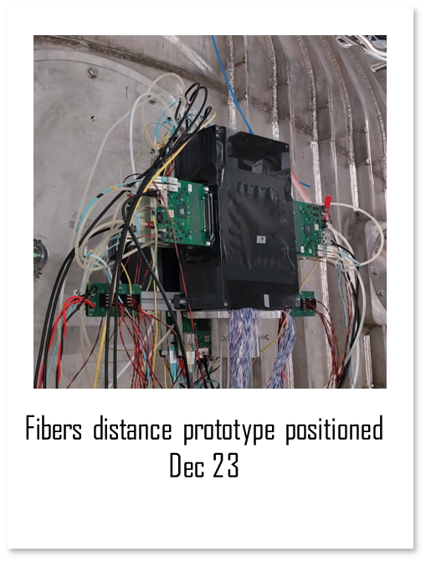
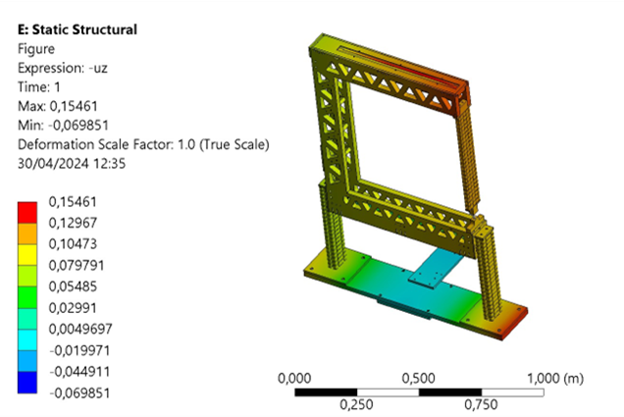
Pablo - My Background
Industrial engineer - Specialized on mechanical engineering (UVigo)
Currently Phd student - developing mechanics and cooling system for the new generation of SiPMs based detectors in R3B (GSI-Fair)

Slide 5
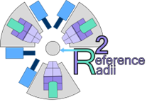


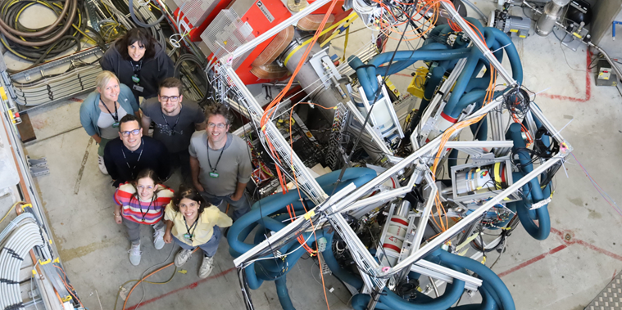
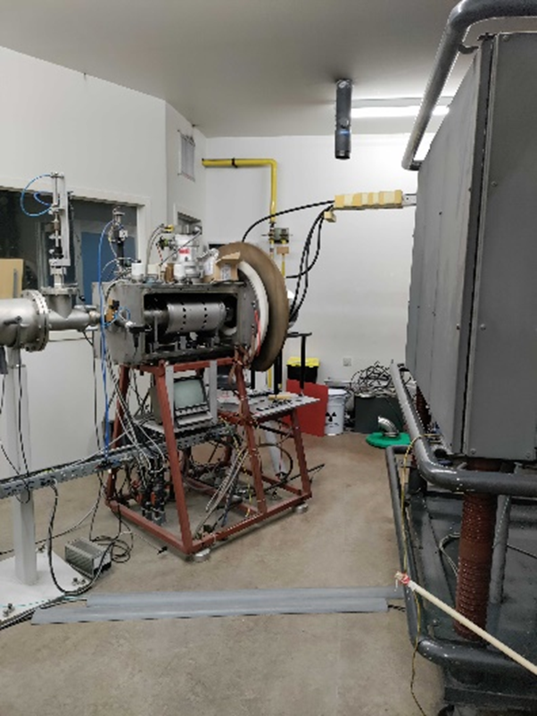
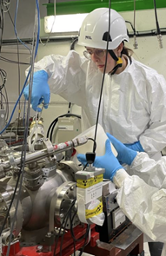
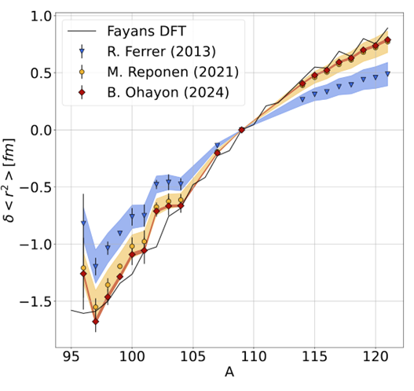
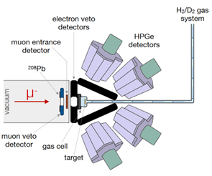
Marie

Slide 6
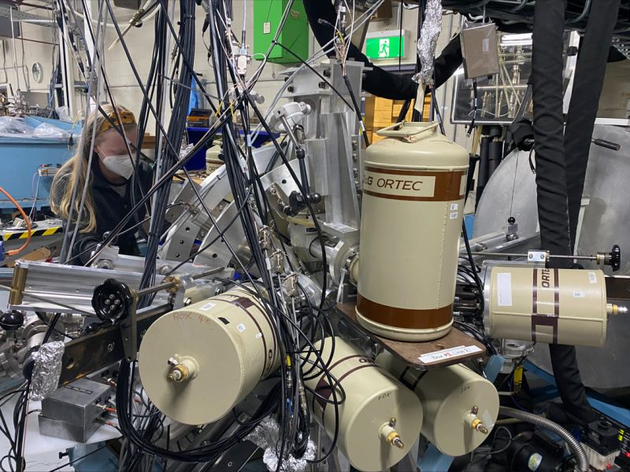
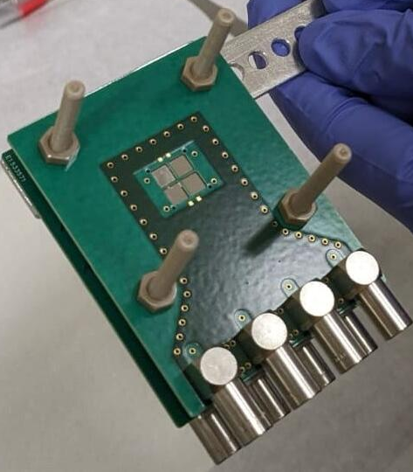
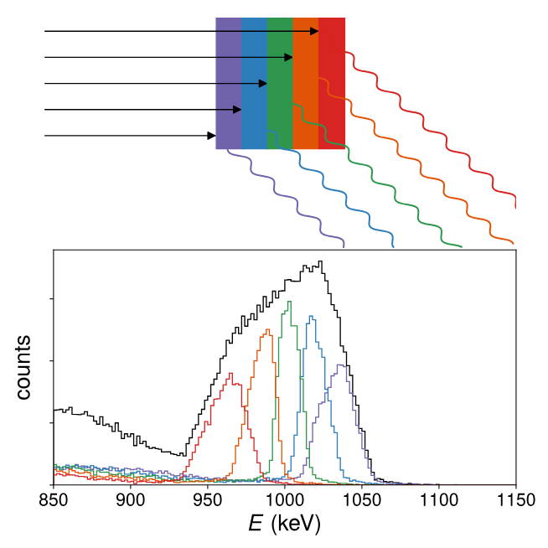

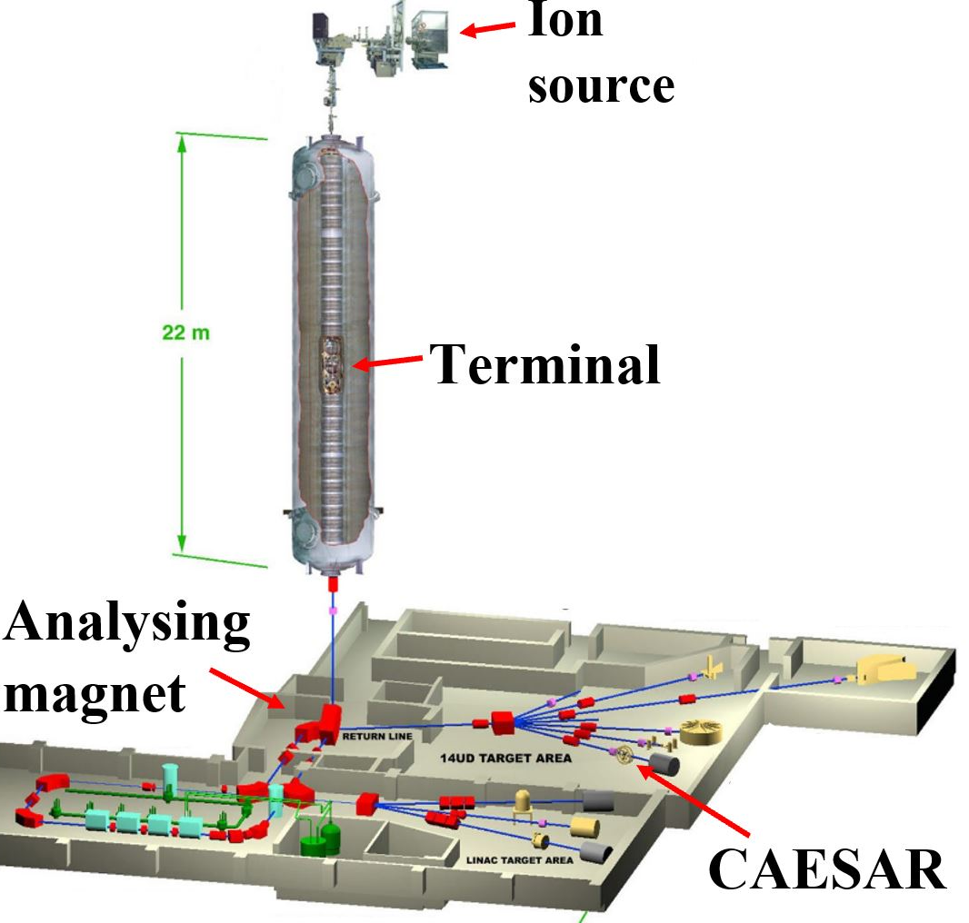
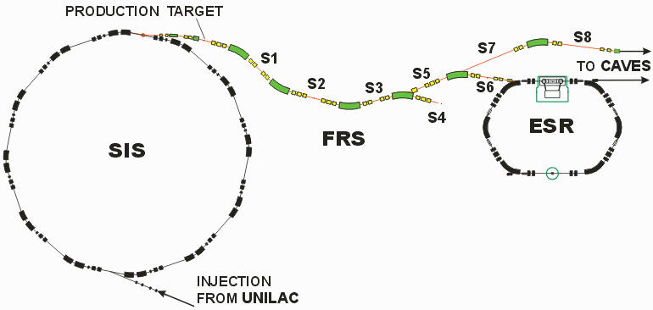

Undergrad/Honours @ANU
PhD @GSI (Started Sept 2023)

Slide 7
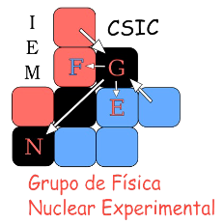


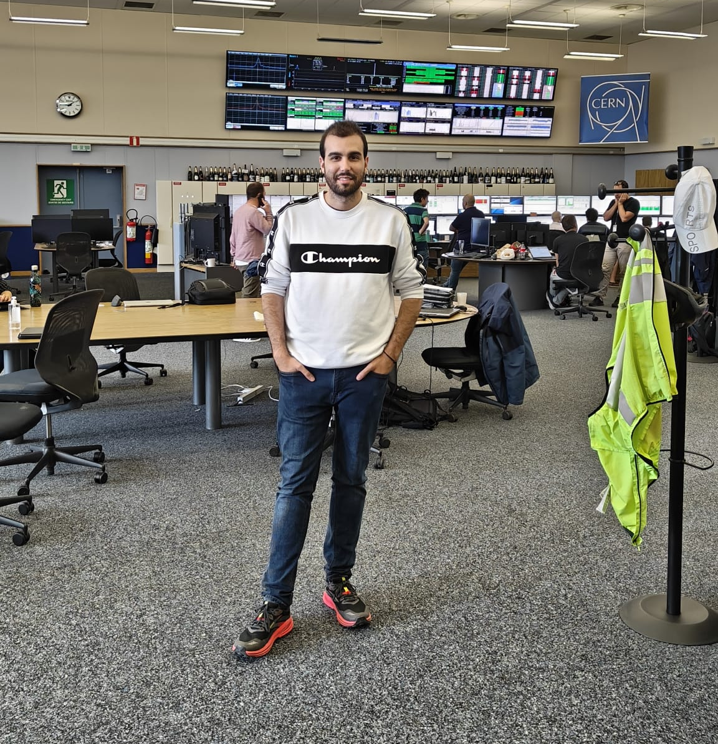
Vicente: Where do I come from?
Nuclear Physicist.
Last year PhD student:
  Nuclear Reactions with Astrophisical interest: CMAM, Madrid local facility (5 MV Tandem)
  Near Coulomb barrier elastic scattering of ¹⁵C: SEC (HIE-ISOLDE), CERN.
Contact: vicente.garcia@uam.es

Slide 8
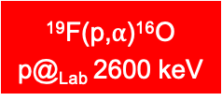
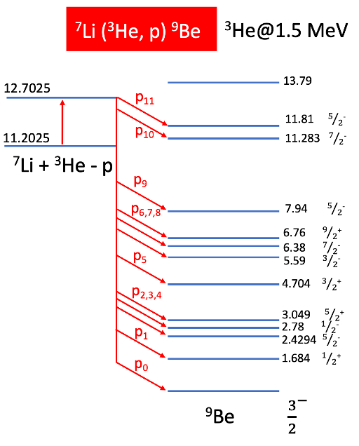
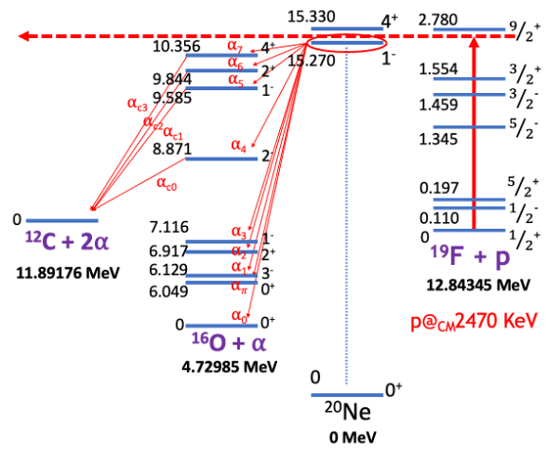
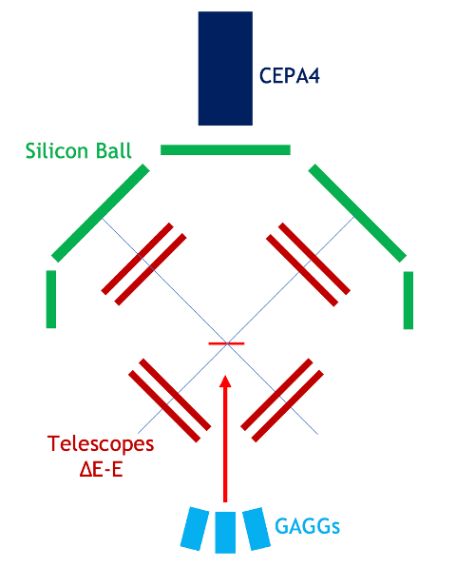
Vicente: Where do I come from?
Nuclear Physicist.
Last year PhD student:
  Nuclear Reactions with Astrophisical interest: CMAM, Madrid local facility (5 MV Tandem).

Slide 9
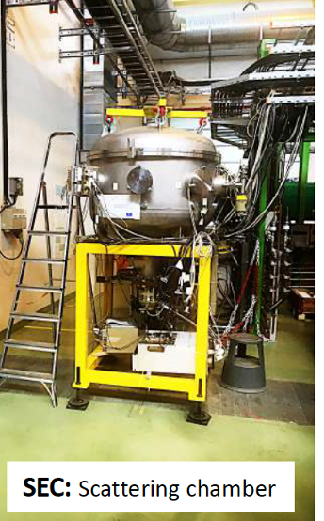
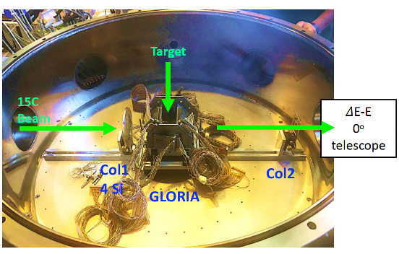
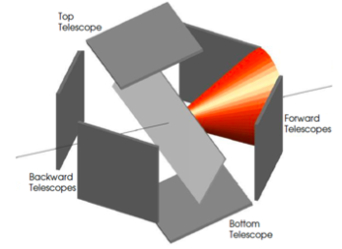
Vicente: Where do I come from?
Nuclear Physicist.
Last year PhD student:
  Nuclear Reactions with Astrophisical interest: CMAM, Madrid local facility (5 MV Tandem).
  Near Coulomb barrier elastic scattering of ¹⁵C: SEC (HIE-ISOLDE), CERN.

Slide 10
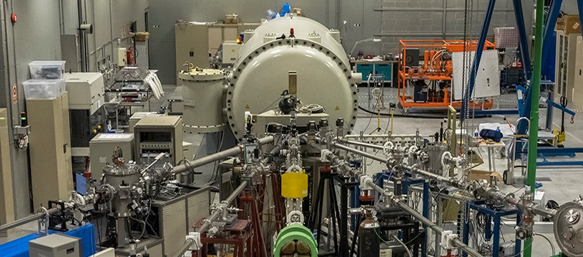
Vicente: Where do I come from?
Nuclear Physicist.
Last year PhD student:
  Nuclear Reactions with Astrophisical interest: CMAM, Madrid local facility (5 MV Tandem).
  Near Coulomb barrier elastic scattering of ¹⁵C: SEC (HIE-ISOLDE), CERN.
Research & Development Engineer at CMAM (UAM).
  Nuclear Studies.
  Materials Analisys and Research.
  Medical Physics Research.
  Technical work and development.
  RP Supervisor.
  Beam operator.
Contact: vicente.garcia@uam.es

Slide 11


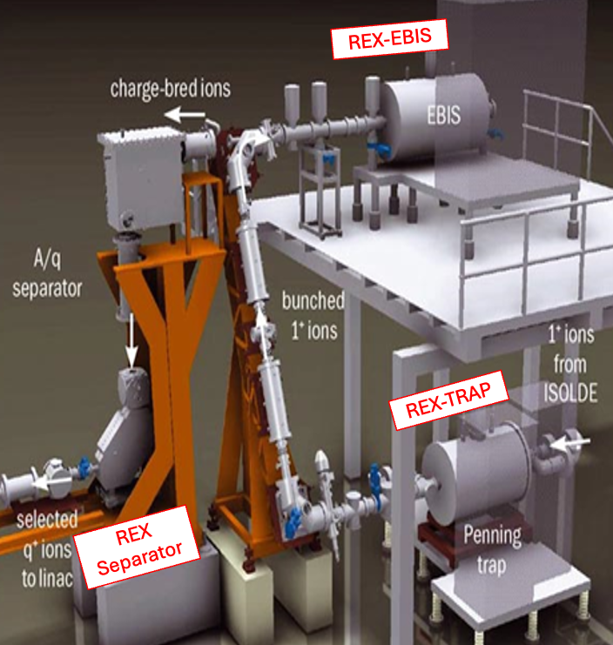

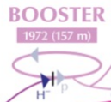
Vicente: What do I take from ATSOA?
  Basic and advanced knowledge of ion beam tuning, mass separating and beam optics.
  Highlight: REX-EBIS
  Electron beam tuning and optics.
  Highlight: solution to get homogeneous beam and application to medical therapy.
  Complex beam tuning and sophisticated beam diagnostic.
  Highlight: beam injection.

Slide 12
Vicente: What do I take from ATSOA?
  Basic and advanced knowledge of ion beam tuning, mass separating and beam optics.
  Highlight: REX-EBIS
  Electron beam tuning and optics.
  Highlight: solution to get homogeneous beam and application to medical therapy.
  Complex beam tuning and sophisticated beam diagnostic.
  Highlight: beam injection.

Slide 13
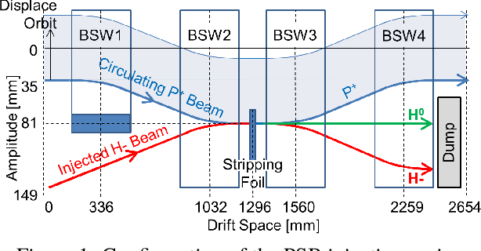
Vicente: What do I take from ATSOA?
  Basic and advanced knowledge of ion beam tuning, mass separating and beam optics.
  Highlight: REX-EBIS
  Electron beam tuning and optics.
  Highlight: solution to get homogeneous beam and application to medical therapy.
  Complex beam tuning and sophisticated beam diagnostic.
  Highlight: beam injection.
Contact: vicente.garcia@uam.es

Slide 14
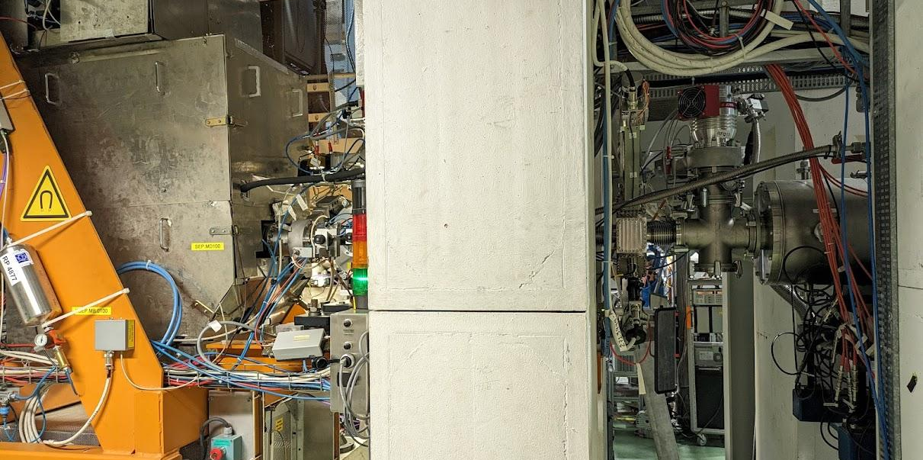
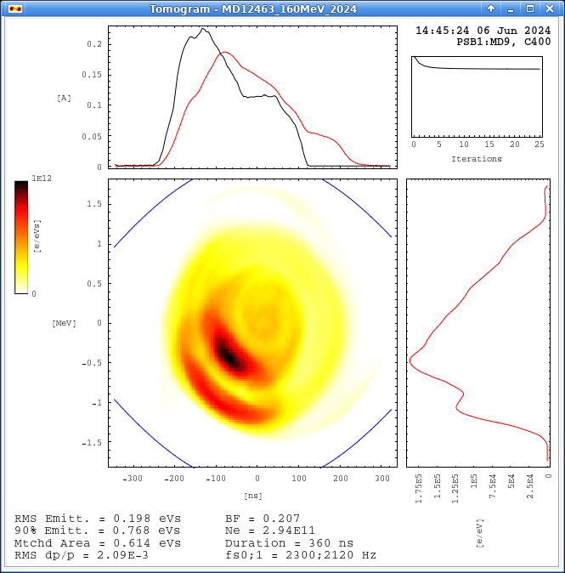
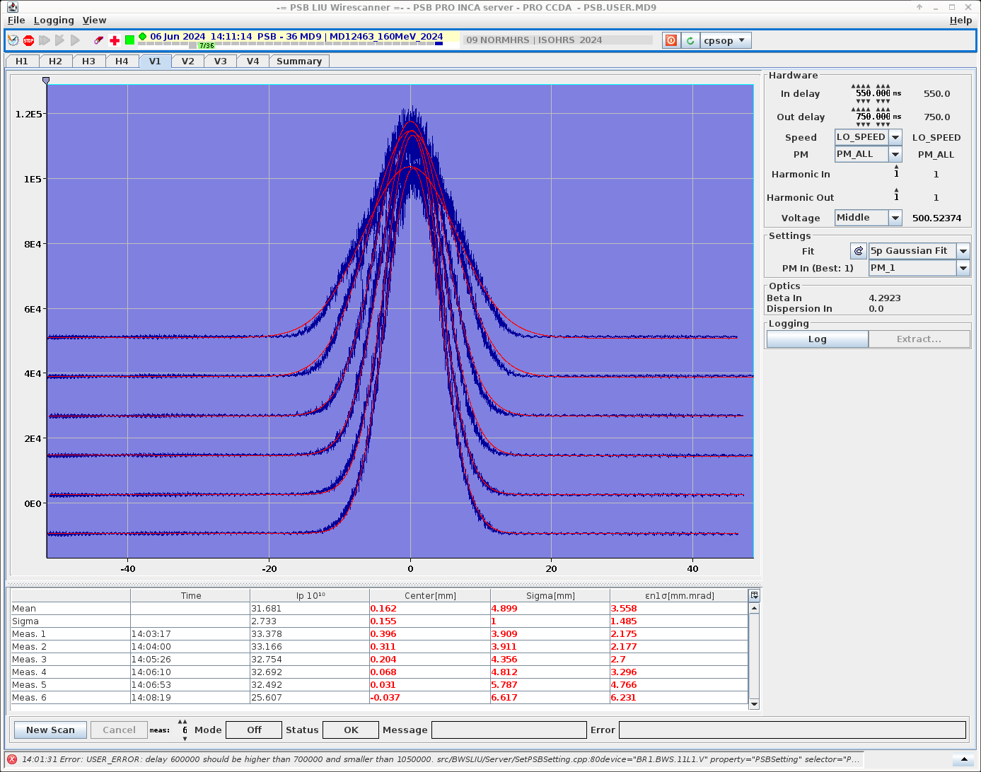
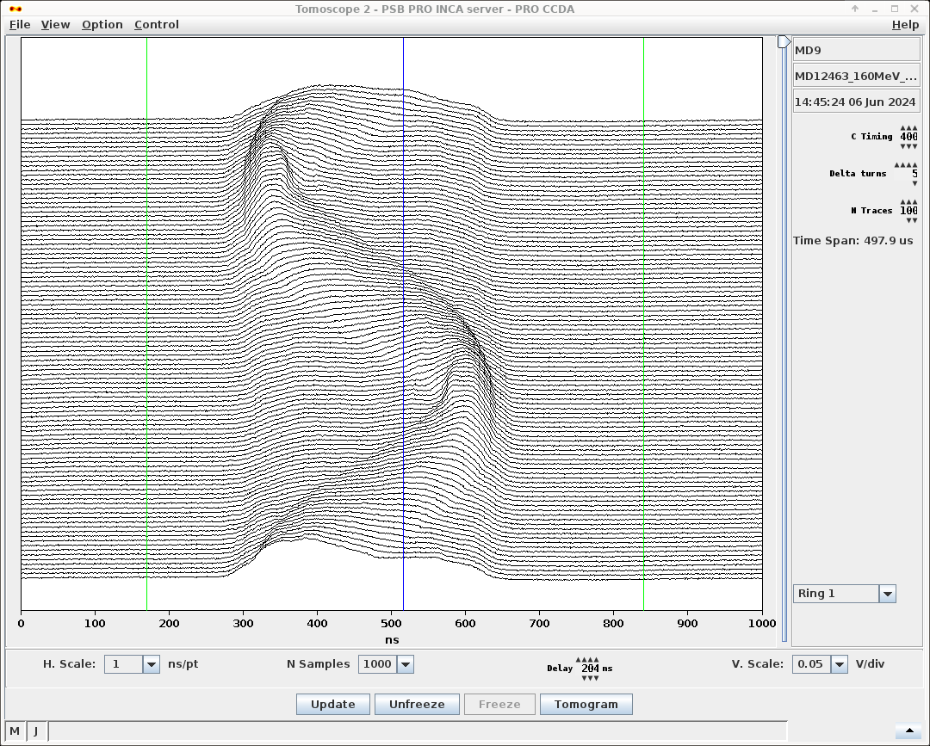
Konrad - what I learned
X-suite with very nice tutorial / template
Seeing the spot at ISOLDE where to put the multiharmonic buncher I’m working on
Impressive beam diagnostics at PSB: wire scanner, beam position monitors, tomograph

Slide 15
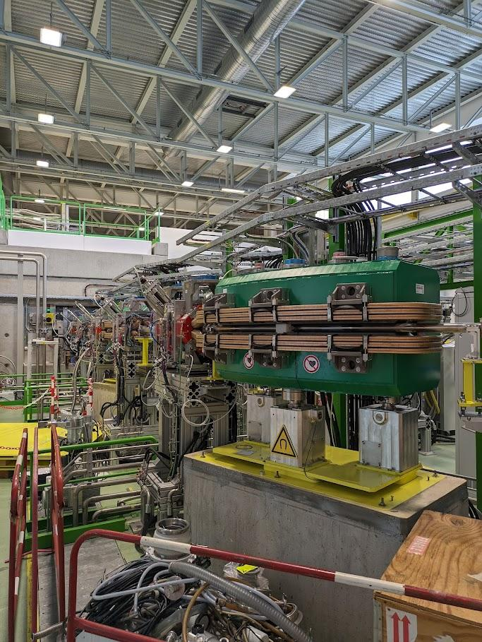
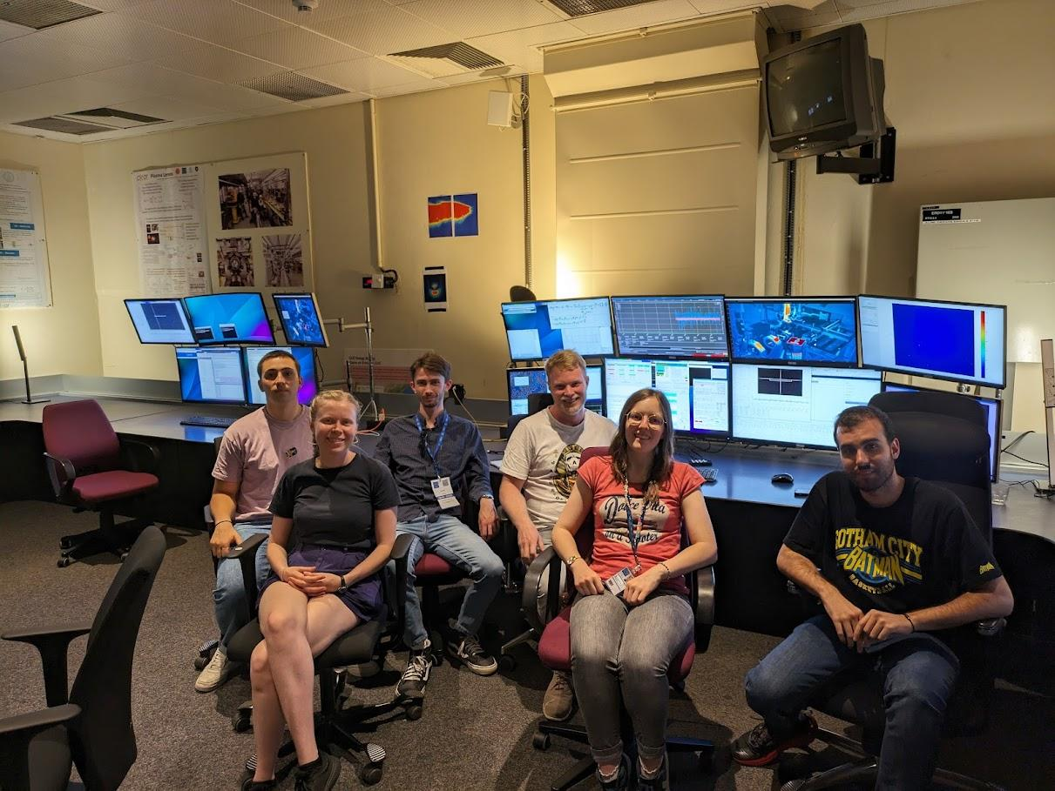
Take away:
Better understanding of beam dynamics:
How imperfections of the hardware and intrinsic
effects change the dynamics
The necessary hardware to control the beam
The control processes during operation
Many ideas for our accelerator in Bilbao!
New connections and
motivation!

Slide 16
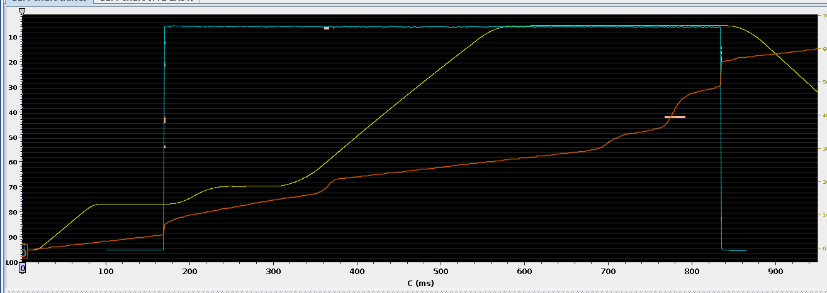
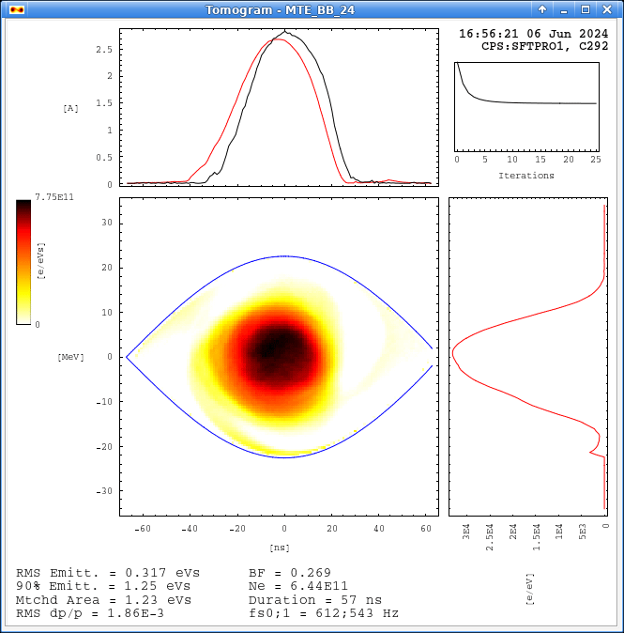

Injection
PBS

Slide 17


Acceleration
PBS

Slide 18

Acceleration
PBS

Slide 19

Flat top
PBS

Slide 20

Flat top

Slide 21



HI-ISOLDE

Slide 22




HI-ISOLDE

Slide 23



HI-ISOLDE
CLEAR

Slide 24

HI-ISOLDE
Blue mystery boxes
CLEAR

Slide 25






Greg - What did I learn from this week
User beams don’t magically appear Many A/Qs are contaminated EBIS + separator have to be very finely configured (charge state distribution) | Wide use cases of e⁻ beams Gaussian shaped scatterer + Gaus beam = flat beam afterwards | Super cycles being so dynamic Ring 1 is the best Clarified the accelerator concepts covered in the lectures
No logo? :(

Slide 26


Martha - what I learnt and what I thought was cool
A/Q scan
ways around A/Q contaminants
Electrostatic elements for low energy
Cool that it is stand-alone
scatterer
optical cable
very convenient YAG screens
Synchrotron tune, resonances, emittance
(the most new content for me)
Has the best coffee

Slide 27



Pablo - My take aways

Slide 28

Pablo - My take aways

Slide 29
Pablo - My take aways

Slide 30






