Slide 1

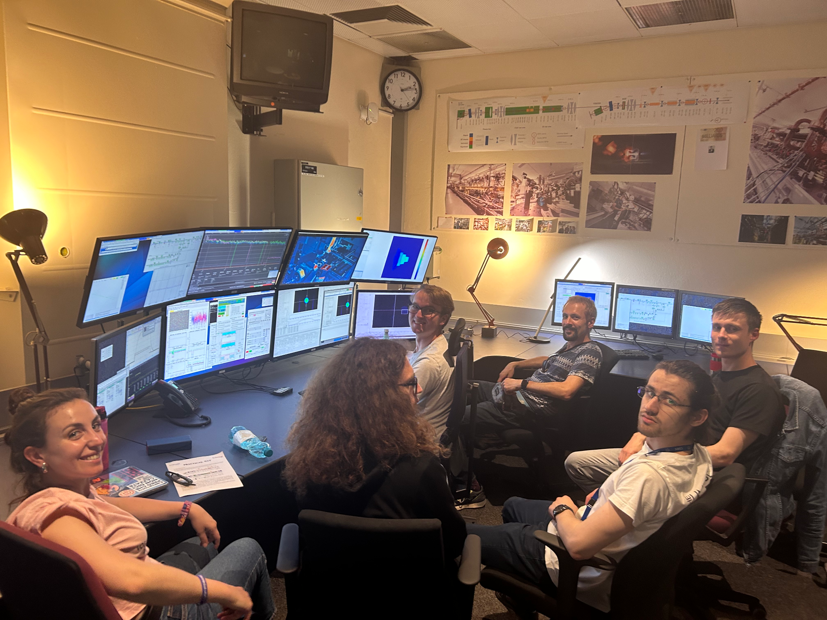
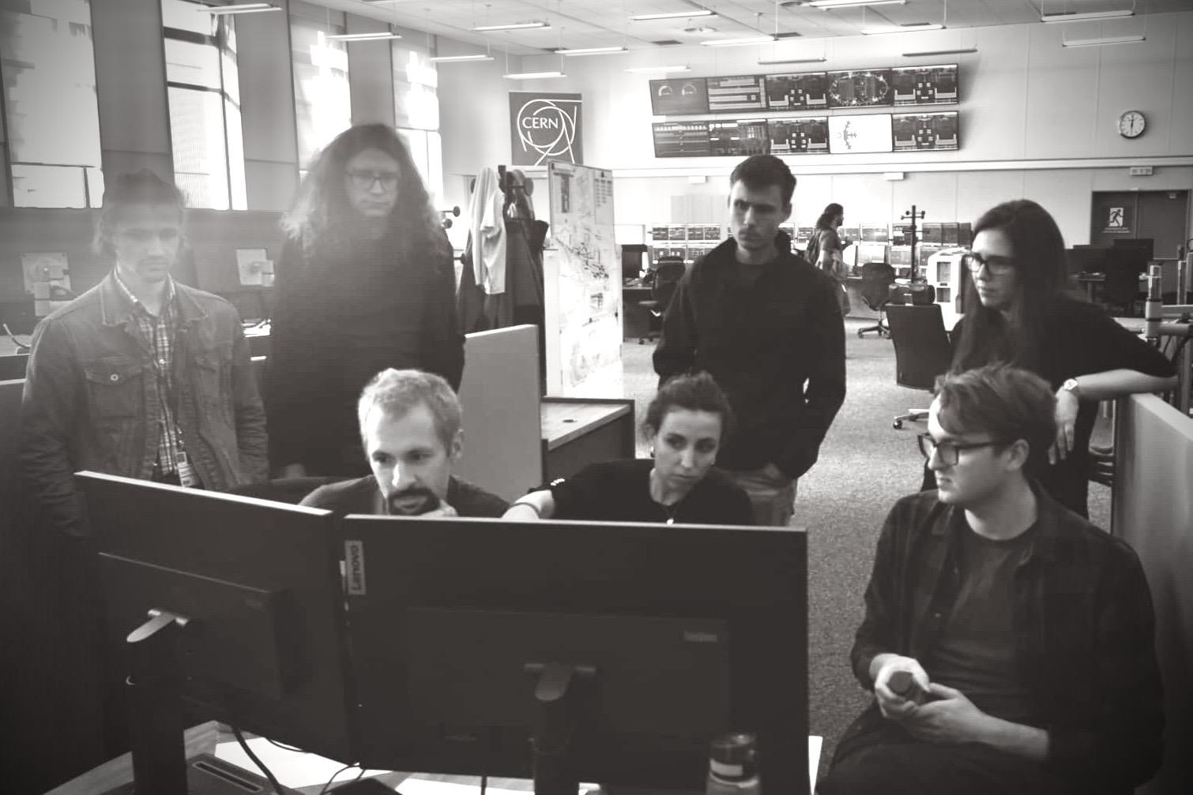
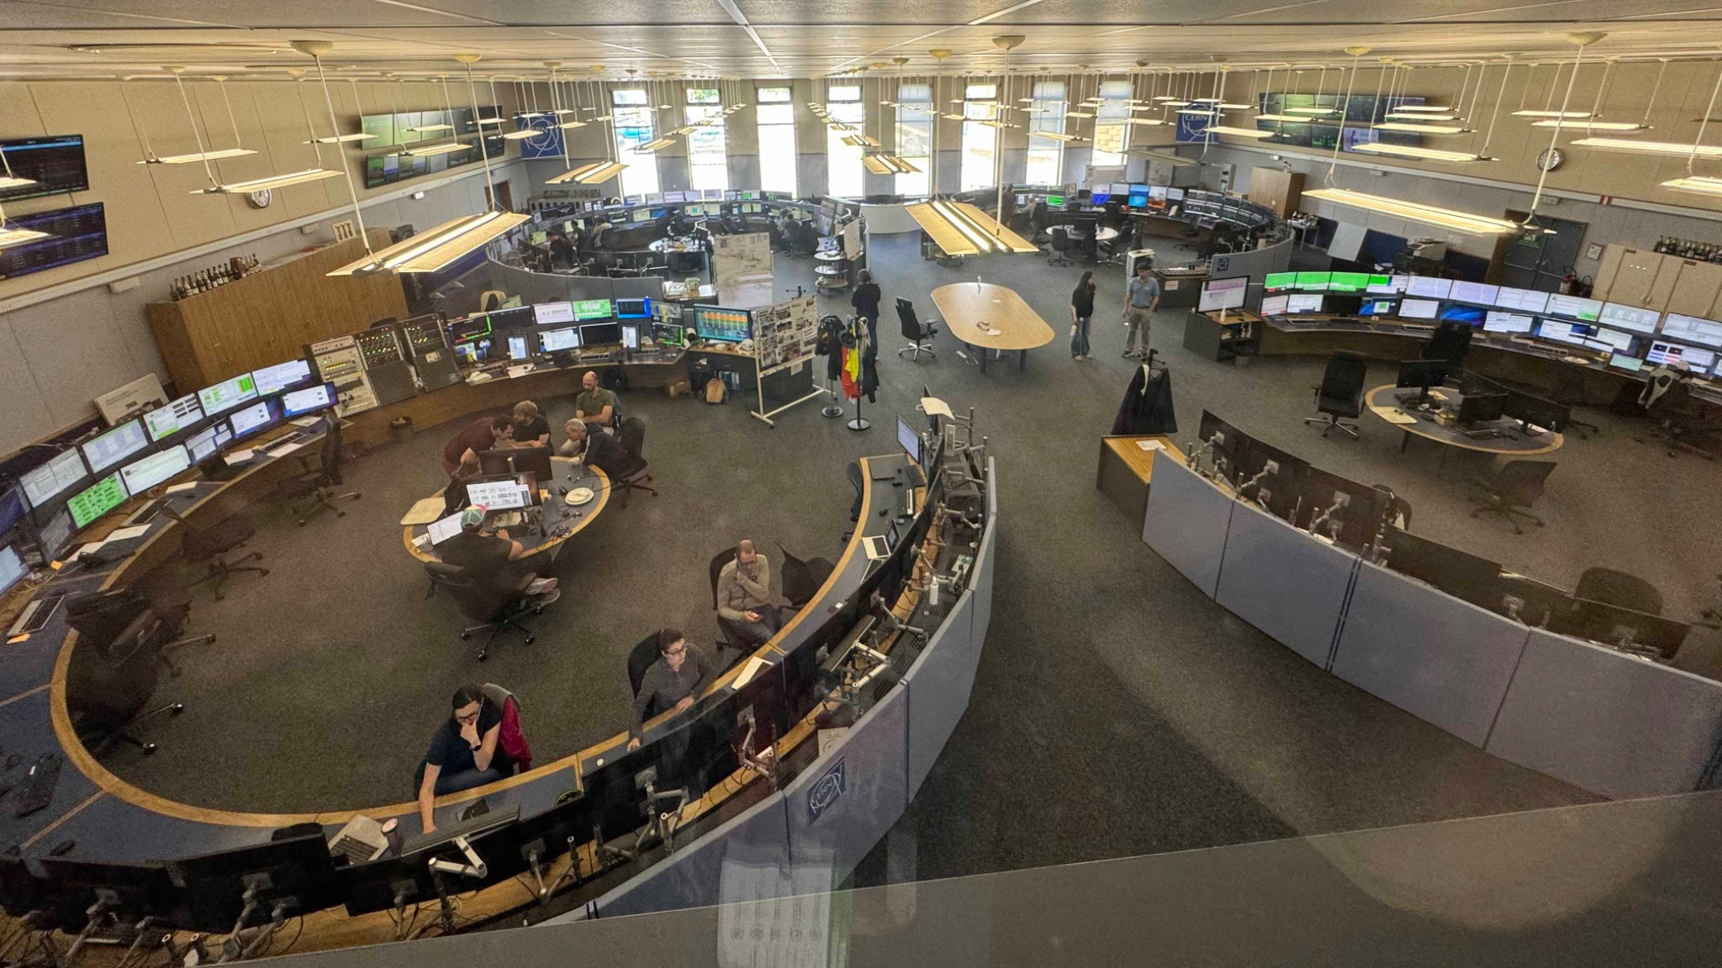
Group B:
Take home lessons
Advanced Training School on Operation of Accelerators
M. Coman, E. Diociaiuti, A. Fomin, C. Lehmann, A.G. Stoica, P. Schoch

Slide 2

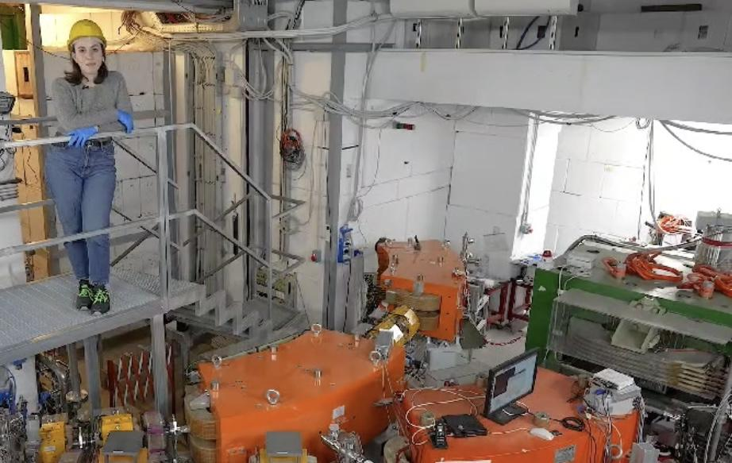
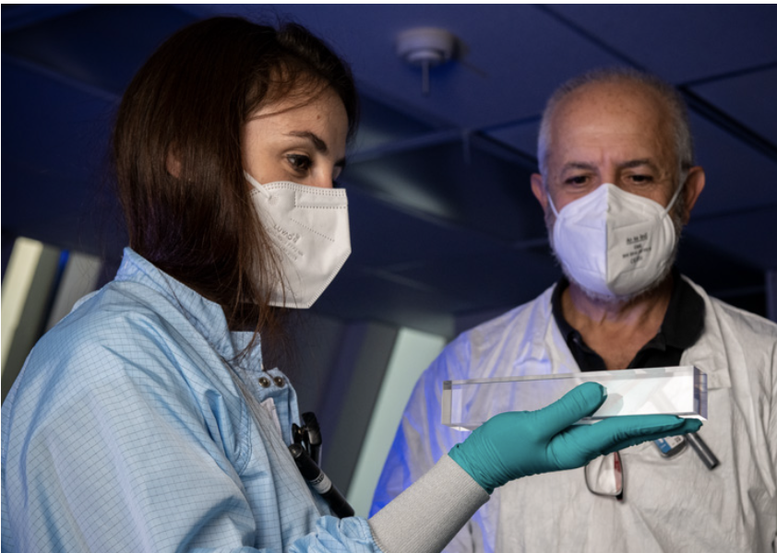
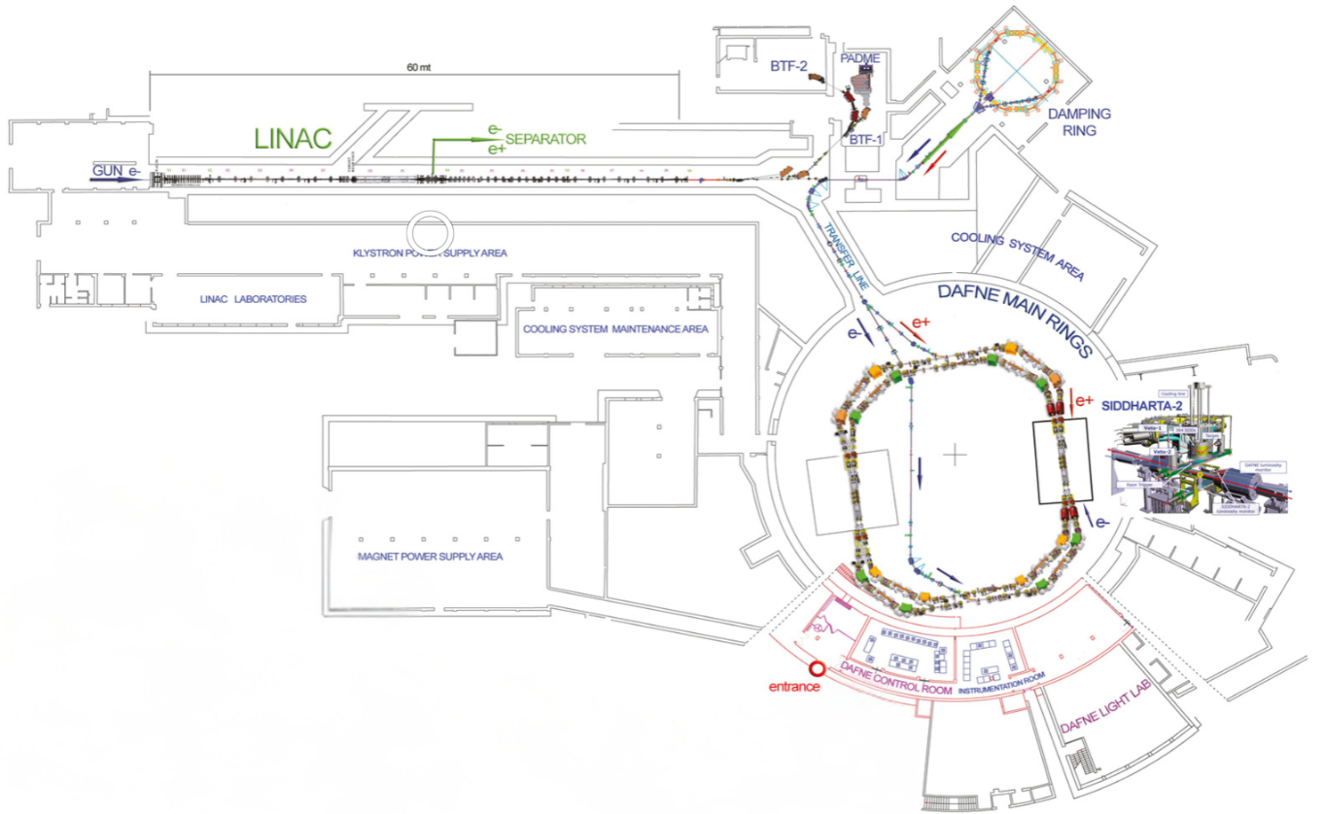
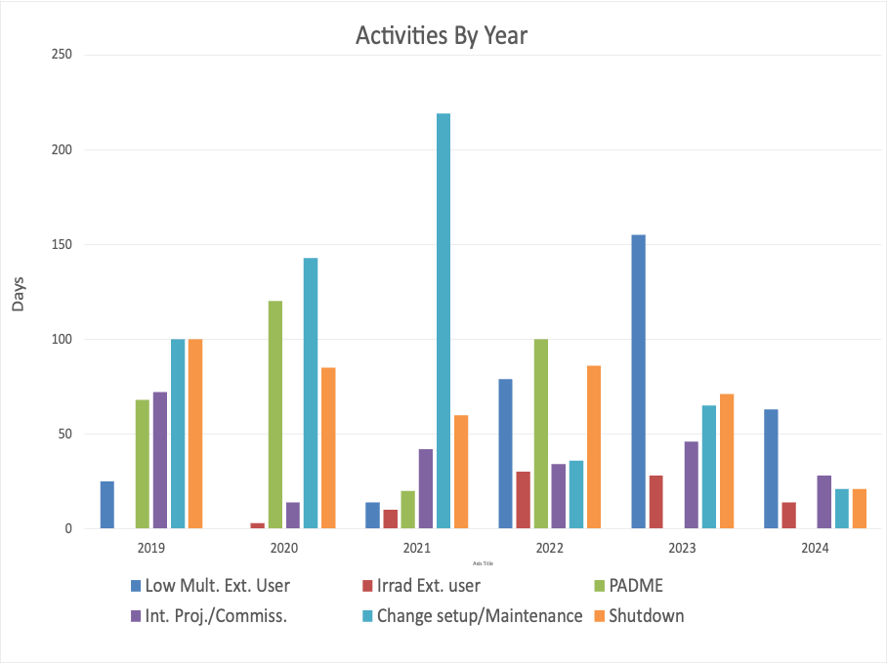
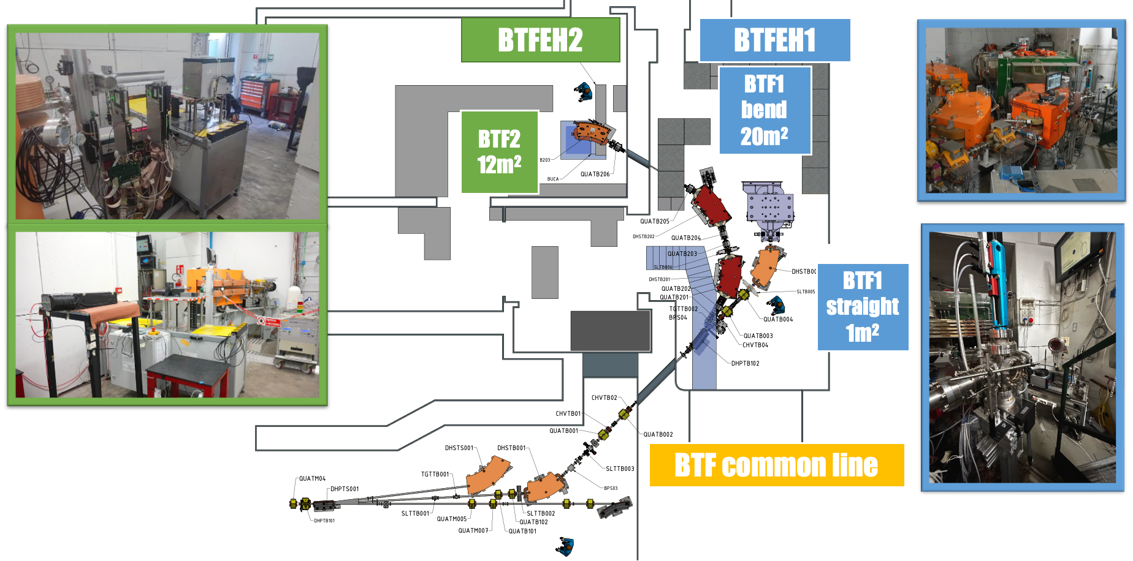
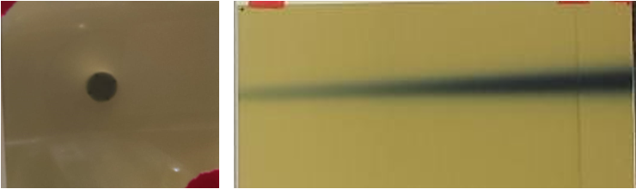
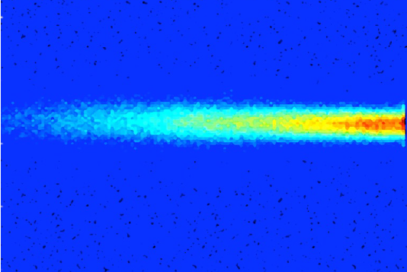
Eleonora Diociaiuti
PhD 2020: “Study of the Mu2e sensitivity to μ− → e+ conversion process” + 3 year on post-doc on the same topic
September 2023 switched to accelerators working @
the Beam Test Facility of LNF
  provides external user e-/e+ beam from 1 particle/bunch up to 1e10 particles/bunches with energy from 25 MeV up to 700 (e-) and 500 MeV (e+)
  ~35 week/year with external/internal users
FLASH VHEE scientific Needs explored in BTF this year
Control Imaging Systems
Certified dosimetry in FLASH regime
New beam fluorescence measurement in air
510 MeV, 1e10 particles/bunch
150MeV 1k particle/bunch
eleonora.diociaiuti@lnf.infn.it

Slide 3
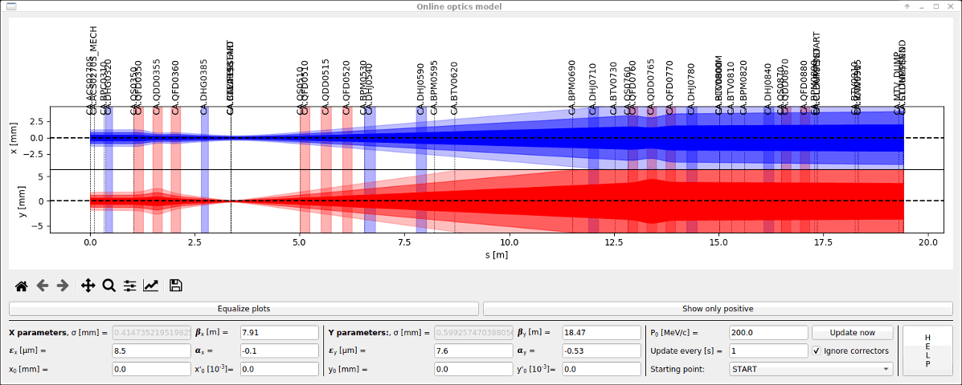
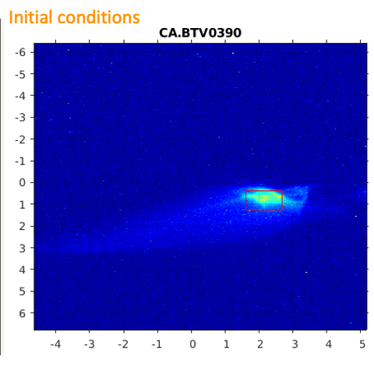
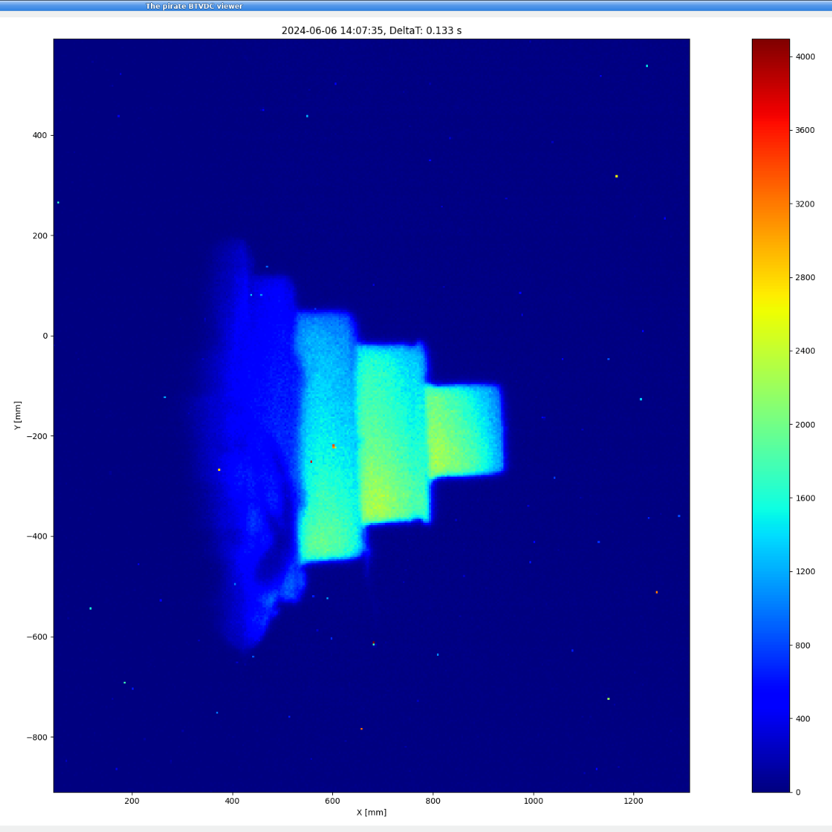
A lot of new concepts learned! Thanks
Being relatively new to the accelerator field the entire week was extremely helpful for me - both “theory” and hands-ond
Because of the similarities with my day-by-day activity CLEAR hands-on was super precious
  Possibility to run the accelerator starting from scratch
  optimization of electron beam dimensions
  model of the optics to check the focus position
  FLASH studies

Slide 4

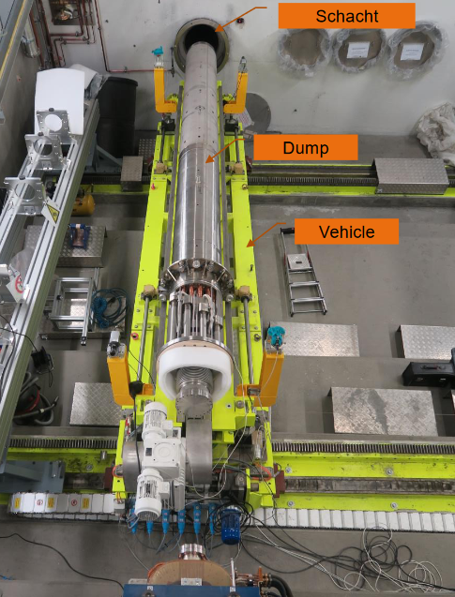
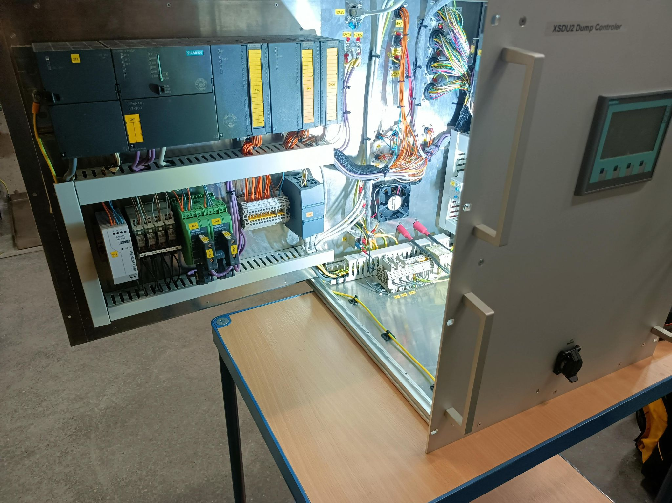
DESY - Philipp Schoch
Education, Expertise, and Role:
Electrical Engineering (Automation & Robotics)
  PLCs, Microcontrollers, GUI Development
  Radioactive Protection, SQL for Quality Reports
XFEL Dump Team: Overheat prevention, instrument/PLC maintenance, Operate FLASH Accelerator
Side Projects: Kicker Powersupply GUI, Dump Sweeper Monitor, Kathode polishing machine, OP-ShiftBoard
DESY, Hamburg, Germany:
PETRA III: 2.3 km, 6 GeV, Synchrotron radiation source.
FLASH: 315 m, Up to 1.25 GeV, Free-electron laser.
European XFEL: 3.4 km, 17.5 GeV, Ultra-short X-ray flashes.

Slide 5
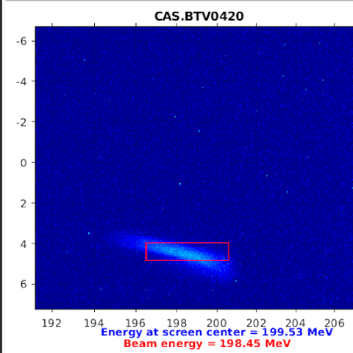
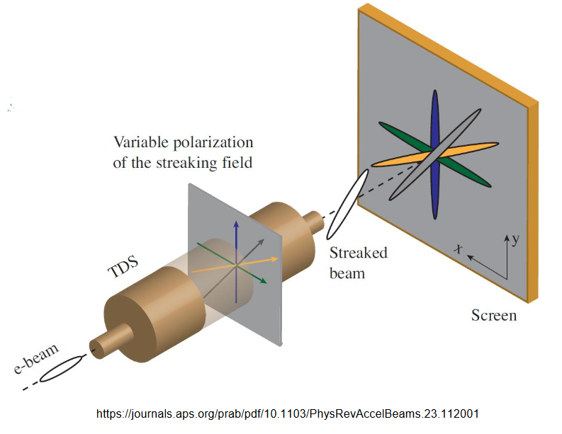
How this school helps me to be a better FLASH Operator
Running FLASH LINAC:
I often operate the FLASH accelerator, but we haven’t a structured school for this.
CLEAR is Smaller:
Similar to FLASH, but about 10 times smaller.
Seeing everything at a smaller scale helped me understand the basics better.
Working with CLEAR gave me a deeper understanding of FLASH
RF Deflecting Structure:
Measures bunch length.
Helps with phase space diagnostics.

Slide 6
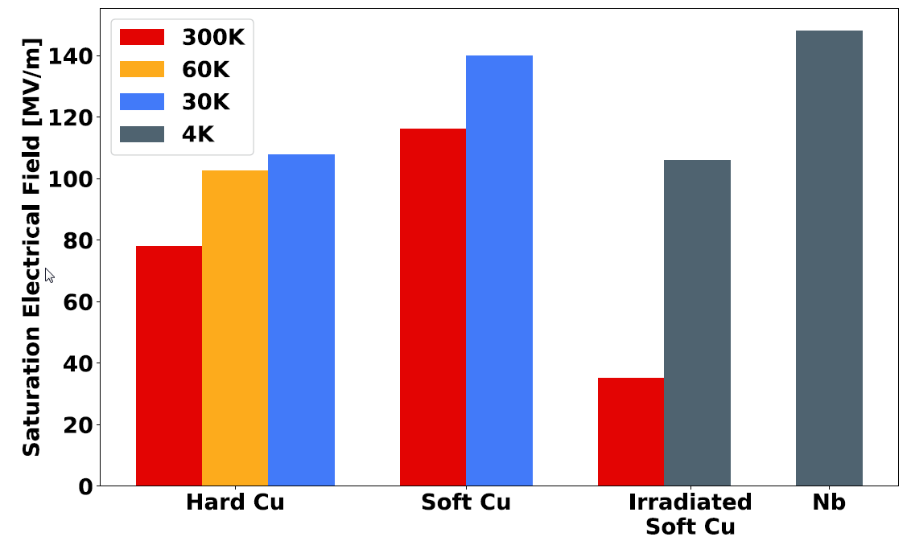
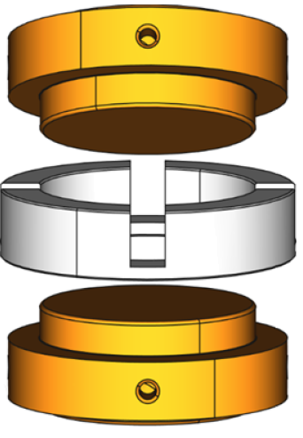
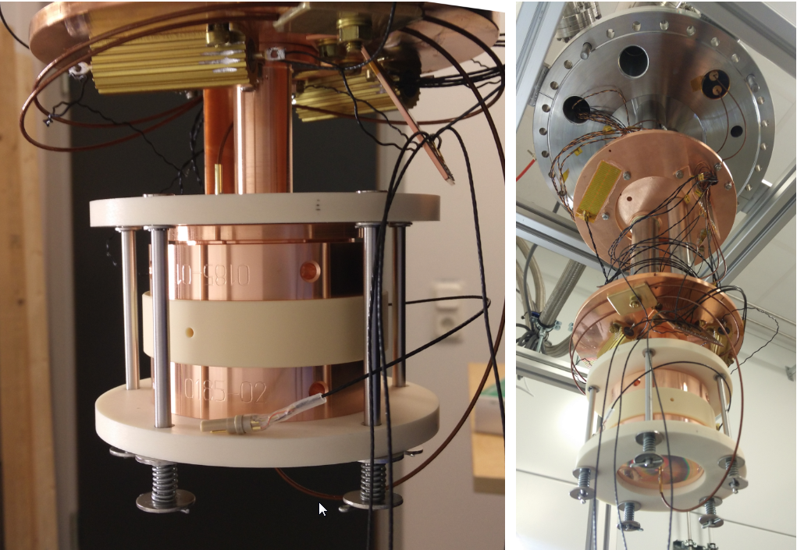
Mircea Coman - My Background
PhD student in Uppsala, FREIA laboratory
Vacuum arc breakdowns studies: Theory predicts strong dependence on temperature → cryogenic experiments
Field emission and vacuum arcs limit the maximum achievable accelerating field
At FREIA laboratory, different aspects of surface conditioning are studied in a cryogenic, DC system for different materials (Cu, Nb, Ti, so far)
Surface resistivity RF measurements in cryogenic conditions to track down changes in crystallographic defect density underneath the metal surface

Slide 7
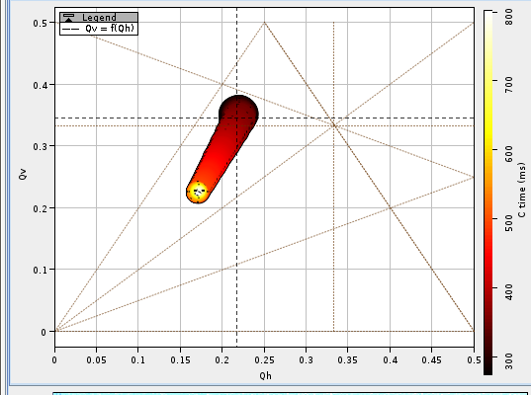
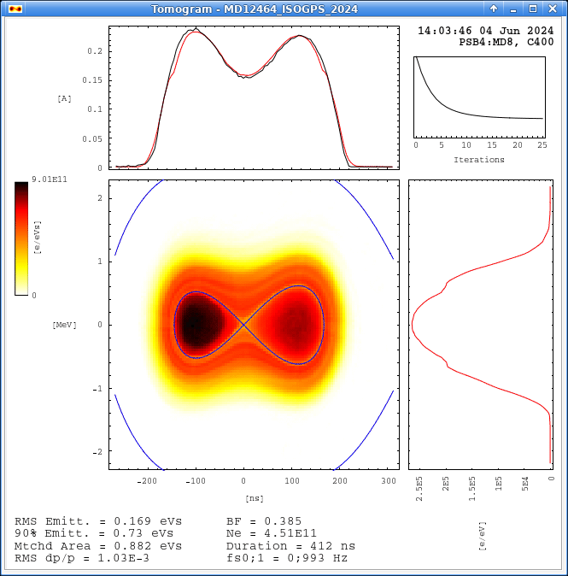
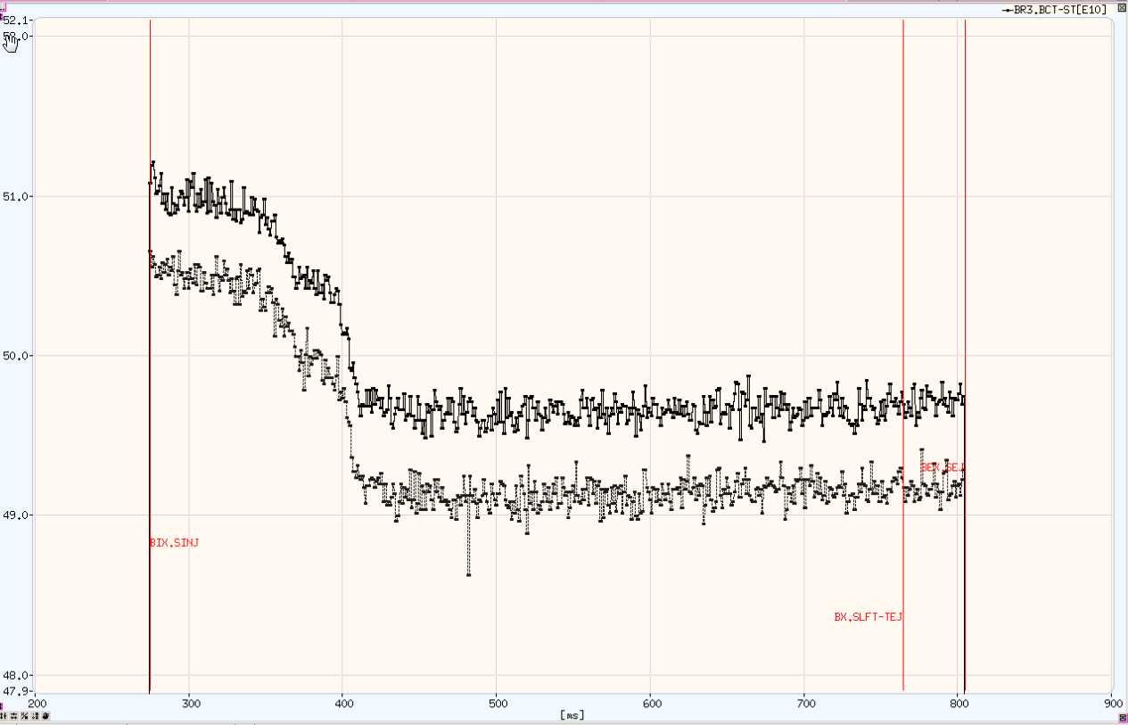
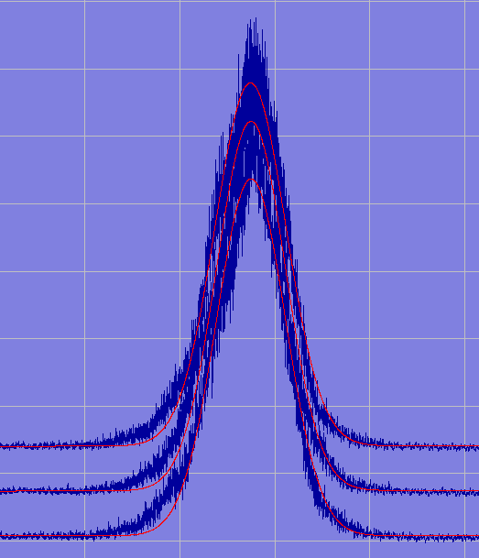
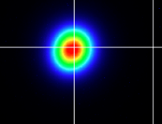
Mircea Coman - My takeaways
Even if I did not work so far directly with accelerators, it was an interesting experience to see how they are operated
Connect theory with hands on practice
  Beam profile measurements
  Setting and measuring the tune
  The effects of a resonance on the beam
  RF gymnastics

Slide 8



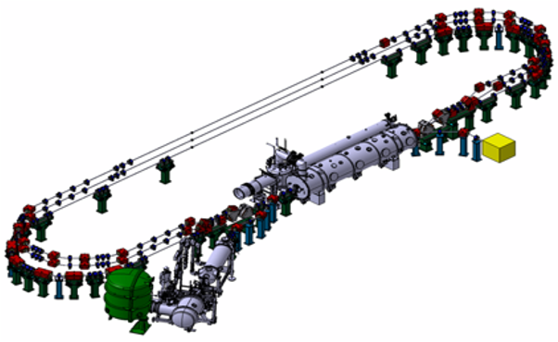
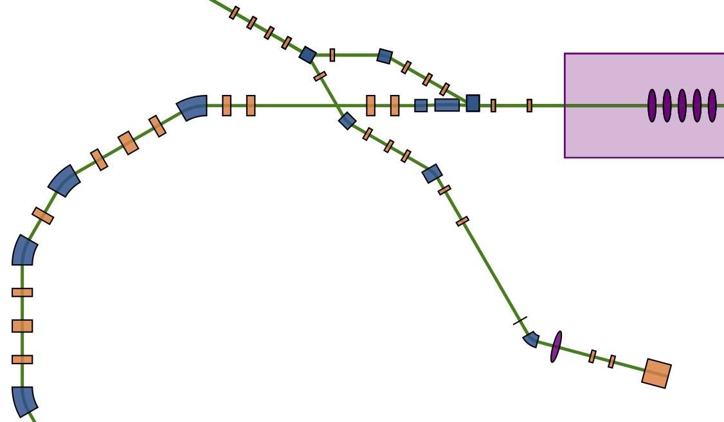
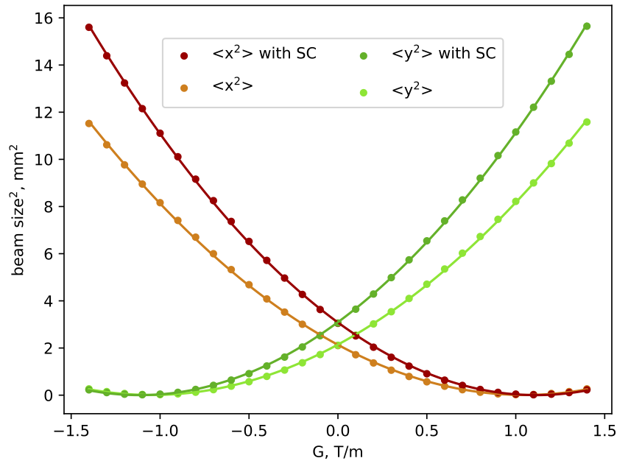
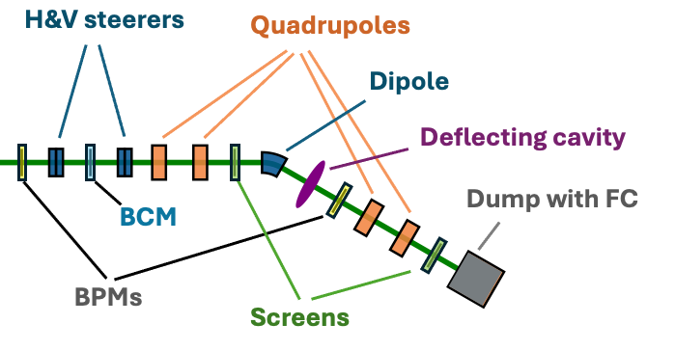
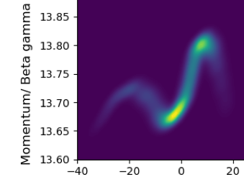
Alex Fomin PERLE at IJCLab (Orsay, France)
Powerful Energy Recovery Linac for Experiments
lattice design of “Single Turn” & “250 MeV” versions
optics matching: 2 low-β IPs, M56=0 and space-charge
beam dynamics studies: space-charge and CSR
beam diagnostics, tolerances and correction schemes
demonstrator facility for the LHeC
89 MeV
171 MeV
253 MeV
30 m
Quad-scan with SC
Dump at 7 MeV
SRF cavities: 802 MHz, ± 82 MeV
3 accelerating + 3 decelerating passes
250 MeV✖️20 mA = 5 MW (~95 % RF → 250 kW)
Injection: 7 MeV, 500 pC, 40 MHz
Space-Charge dominated beam

Slide 9
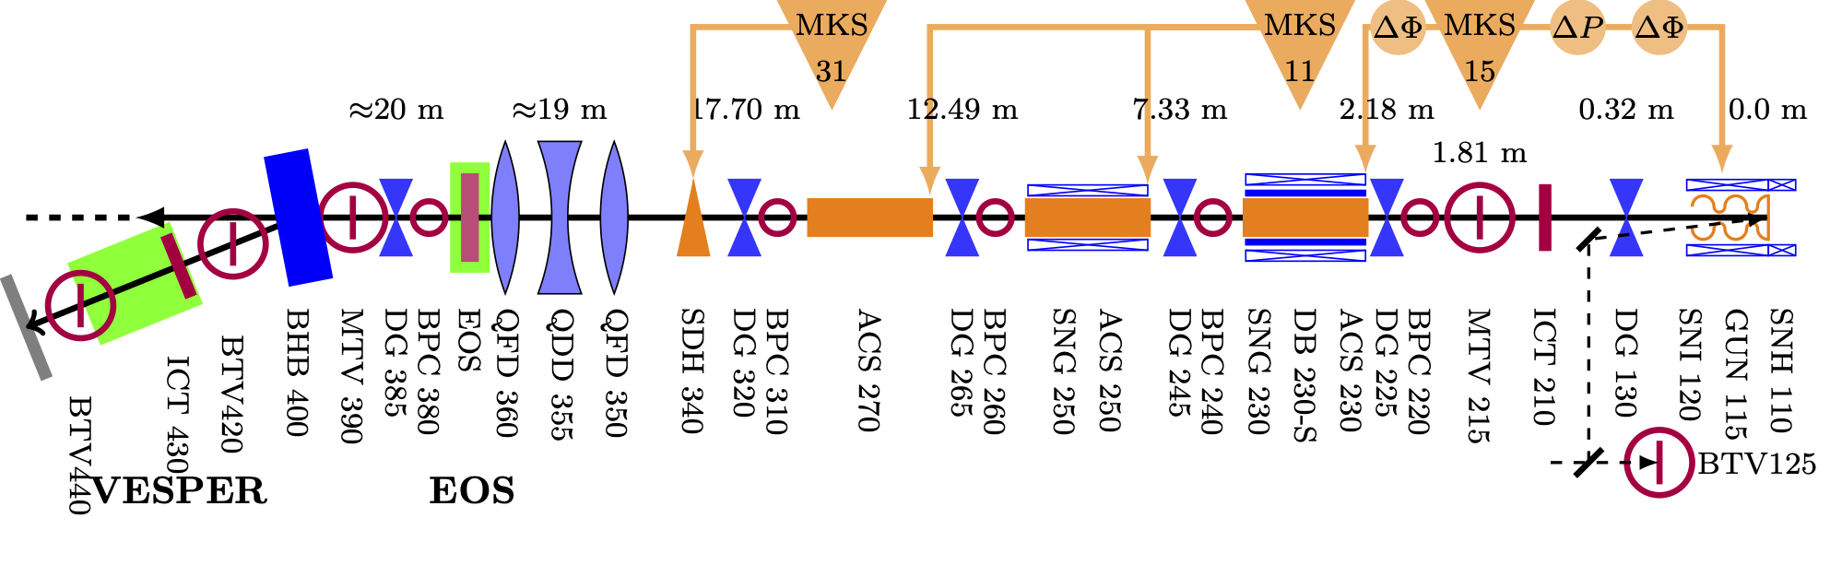
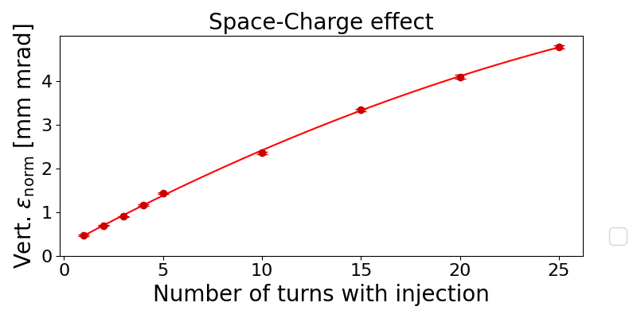
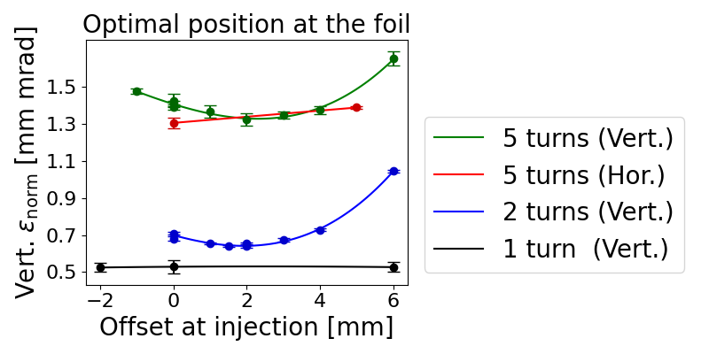
Alex Fomin Take home lessons:
PERLE layout: merger & diag.
CLEAR layout ( < 4.5 MeV part )
shorter merger → less space charge
( vs better diagnostics & control )
saw “in flesh” and played with the diagnostic line
similar to one we design for PELRE (but without SC )
CLEAR layout ( diagnostics )
more SC in Vert.
Measurements with Space Charge effect at PS Booster
Quad-scan with SC
Injection (Offset)
less SC
less SC in Vert.
more SC
???
not enough painting ???
Qv=4.23 Qh=4.17

Slide 10
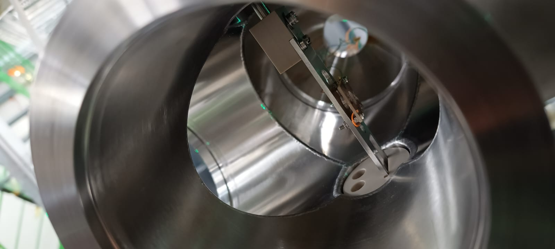
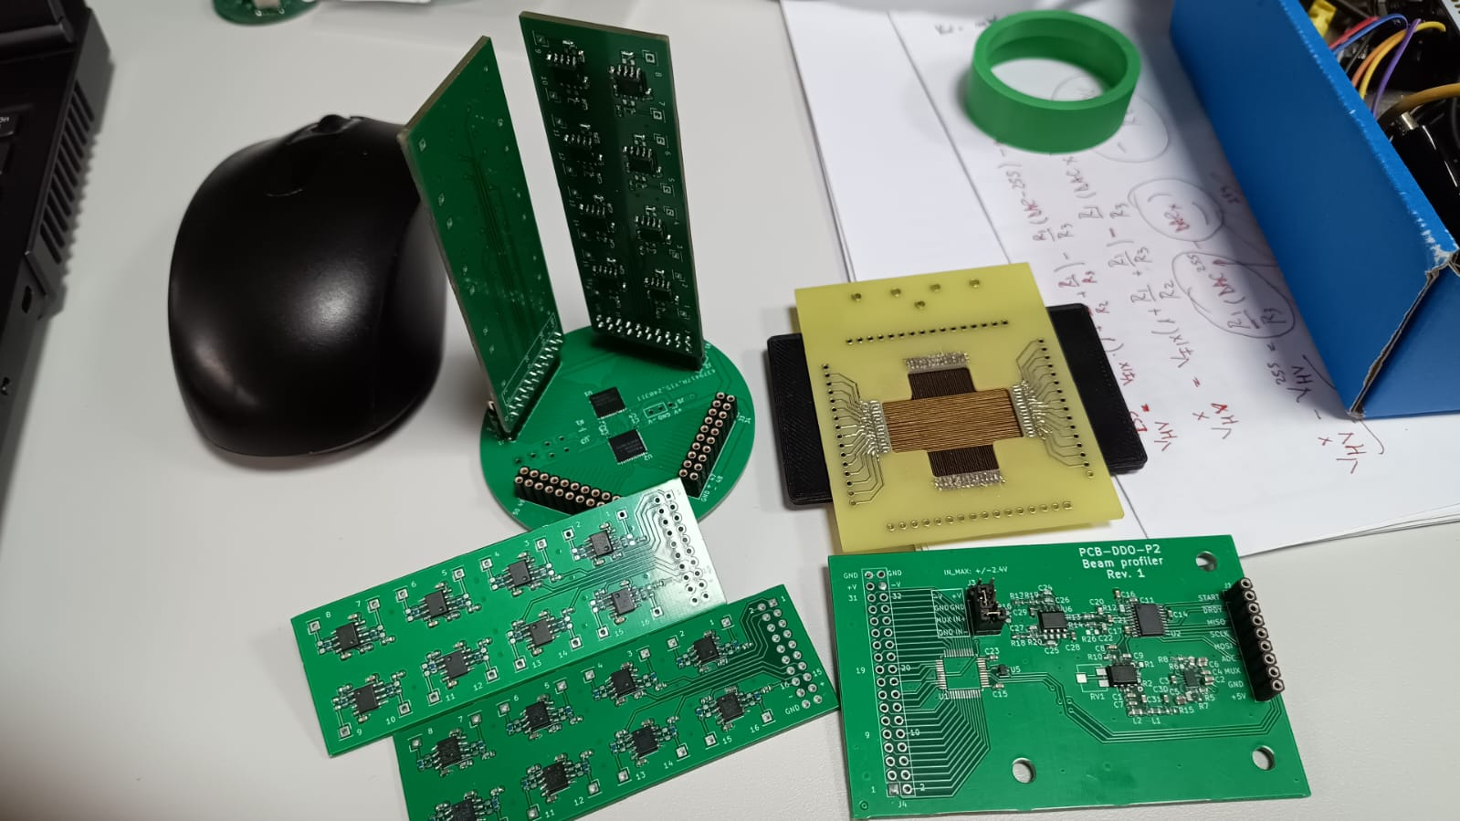
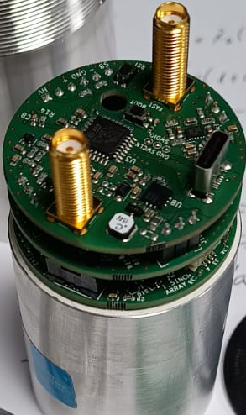
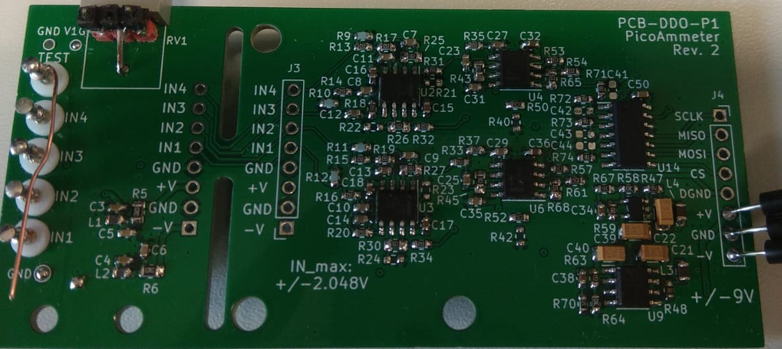
Alexandru-Gabriel Stoica
-PhD student and research assistant at IFIN-HH/Electronics Lab
-SiPM detector development
-Ion beam simulation with SIMION
-I operate the TANDEM@9MeV when pulsed beam is needed

Slide 11
New knowledge and ideas
- from PSB: working principle, resonances, diagnostics
- from CLIC: - medical applications
- how to obtain an evenly distributed dose
- bunch length measurements using RF field
- optic fiber to locate the losses

Slide 12



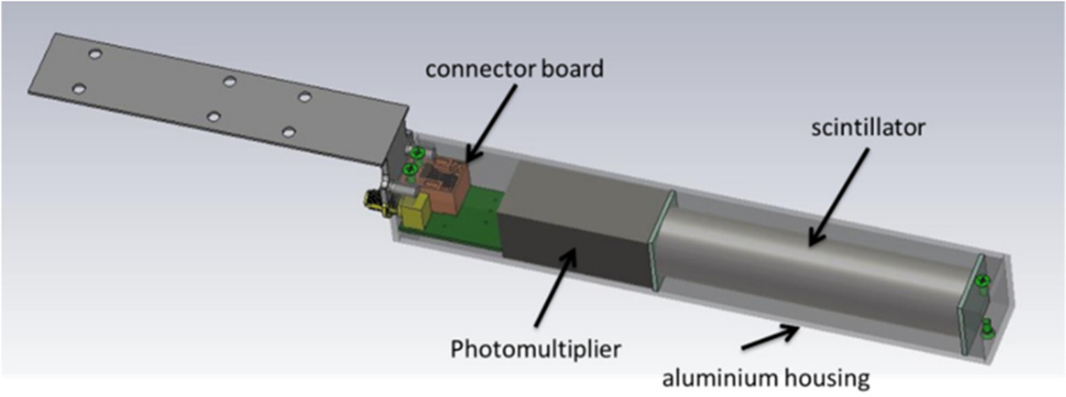
Corey Lehmann
Currently studying a DPhil at University of Oxford in Accelerator Physics within JAI
Researching within the Diagnostics group at Diamond Light Source
Designing automatic fault detection using Beam Loss Monitors and Machine Learning techniques

Slide 13
My Takeaways
I’ve studied multiple courses in accelerator physics theory. This was my first time seeing most of these phenomena in reality!
Highly recommend for anyone who have studied a course in accelerator physics.
PSB:
Measuring tunes
Measuring chromaticity
Measuring emittance
Crossing resonances
Mismatched injections
CLEAR:
Beam steering
Improving beam uniformity
Quadrupole scan for twiss parameters
RF tuning

Slide 14
Thanks to everyone who helped organise this school!
Advanced Training School on Operation of Accelerators
M. Coman, E. Diociaiuti, A. Fomin, C. Lehmann, A.G. Stoica, P. Schoch

