Slide 1
WP12: Societal Applications
WP12.1 - A Strategy for Implementing Novel Societal Applications of Accelerators (Rob Edgecock, HUD)
WP12.2 - Design of advanced electron accelerator plant for biohazards treatment (Andrzej Chmielewski, INCT)
WP12.3 - Design of Internal RF Ion Source for Cyclotrons (Daniel Gavela Perez, CIEMAT)
Presentation on behalf of all members of the WP

Slide 2
Status
Task 12.1: Completes in M48
  Report on progress
Task 12.2: Completed, final report in Trieste
Task 12.3: Completed, final report

Slide 3
Objectives
Task 12.1: A Strategy for Implementing Novel Societal Applications of Accelerators
  Study some new and important societal applications of accelerators with the aim of developing roadmaps for their innovation: novel forms of radiotherapy for cancer treatment, reduction of environmental pollution, new imaging techniques, improved methods for radioisotope production.
  - Develop a strategy to deliver these roadmaps.
  - Study the barriers which discourage the use of accelerators in industry.

Slide 4
12.1 Sub-Tasks
Sub-task 1. Coordination and Communication (Rob Edgecock - HUD)
Sub-task 2. Novel forms of radiotherapy (Angeles Faus-Golfe - CNRS)
Sub-task 3. Environmental applications of electron beams
(Toms Torims – RTU Andrzej Chmielewski - INCT)
Sub-task 4. Accelerator imaging
(Graeme Burt - ULANCS)
Sub-task 5. Accelerator production of radioisotopes for imaging and therapy (Concepcion Oliver – CIEMAT Diego Obradors-Campos)
Sub-task 6. Barriers to accelerator adoption by industry (Andrzej Chmielewski – INCT Andrea Sagatova – STU)

Slide 5
12.1 Deliverable and Milestones
D12.1 | Strategy for Implementing Novel Societal Applications of Accelerators | HUD | R | M28 | Done
MS57 | Projects identification for development funding | 12.1 | M10 | Abstract of proposals | Done
MS58 | Completion of strategy documents for each application area | 12.1 | M40 | Report

Slide 6
WP12 - Societal Applications
Task 12.1 - A Strategy for Implementing Novel Societal Applications of Accelerators
Sub-task 2. Novel forms of Radiotherapy
Angeles Faus-Golfe
CNRS

Slide 7
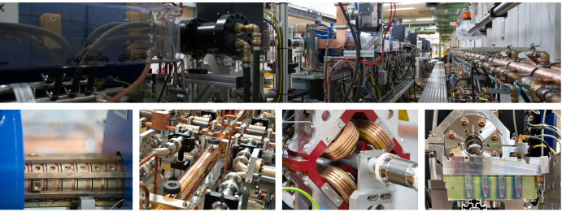

Task 12.1
Sub-Task 2
Novel forms of Radiotherapy (CNRS)
Study the novel forms of RT for cancer treatment with the aim of developing a roadmap for the innovation (Mini-beams with e-/p, FLASH RT, cost-effective ion RT, BNCT, combined RT, flexible machines..)
Develop a strategy to deliver a roadmap (brainstorming writing meeting/workshop with identified experts, accelerator dedicated workshop…)
Study the barriers which discourage the use of these new techniques in industry in collaboration with medical doctors as users
A follow up of VHEE2017 and VHEE2020
VH2023 @ DESY 11-13 July 2023
https://indico.desy.de/event/38194/
The list of topics explored:
VHEE Current State of the Art
Treatment Planning, Modelling and Imaging
VHEE current conventional facilities at intermediate (Flastron IC , Antwarpen..) and high (CLEAR, CLARA, ARES, PITZ, ..) energies
VHEE current non-conventional facilities LPA (DRACO, LOA)
VHEE planned future facilities (DEFT, FRIDA,...)
Accelerators R&D and Technologies: distributed coupling, cryogenic copper, millimetric waves or THz sources...
Industries involved
Publication of a Research topic “Challenges in VHEE RT” in

Slide 8
WP12 - Societal Applications
Task 12.1 - A Strategy for Implementing Novel Societal Applications of Accelerators
Sub-task 3. Environmental Applications
Andrzej Chmielewski (INCT) and Toms Torims (RTU)

Slide 9

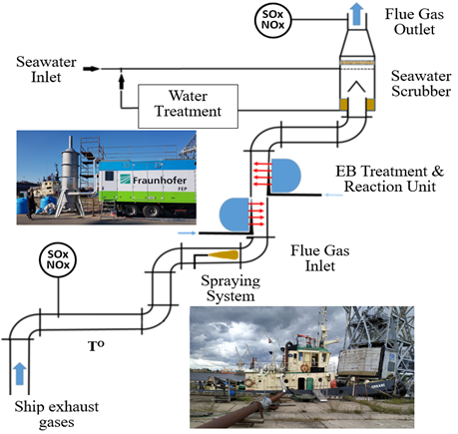
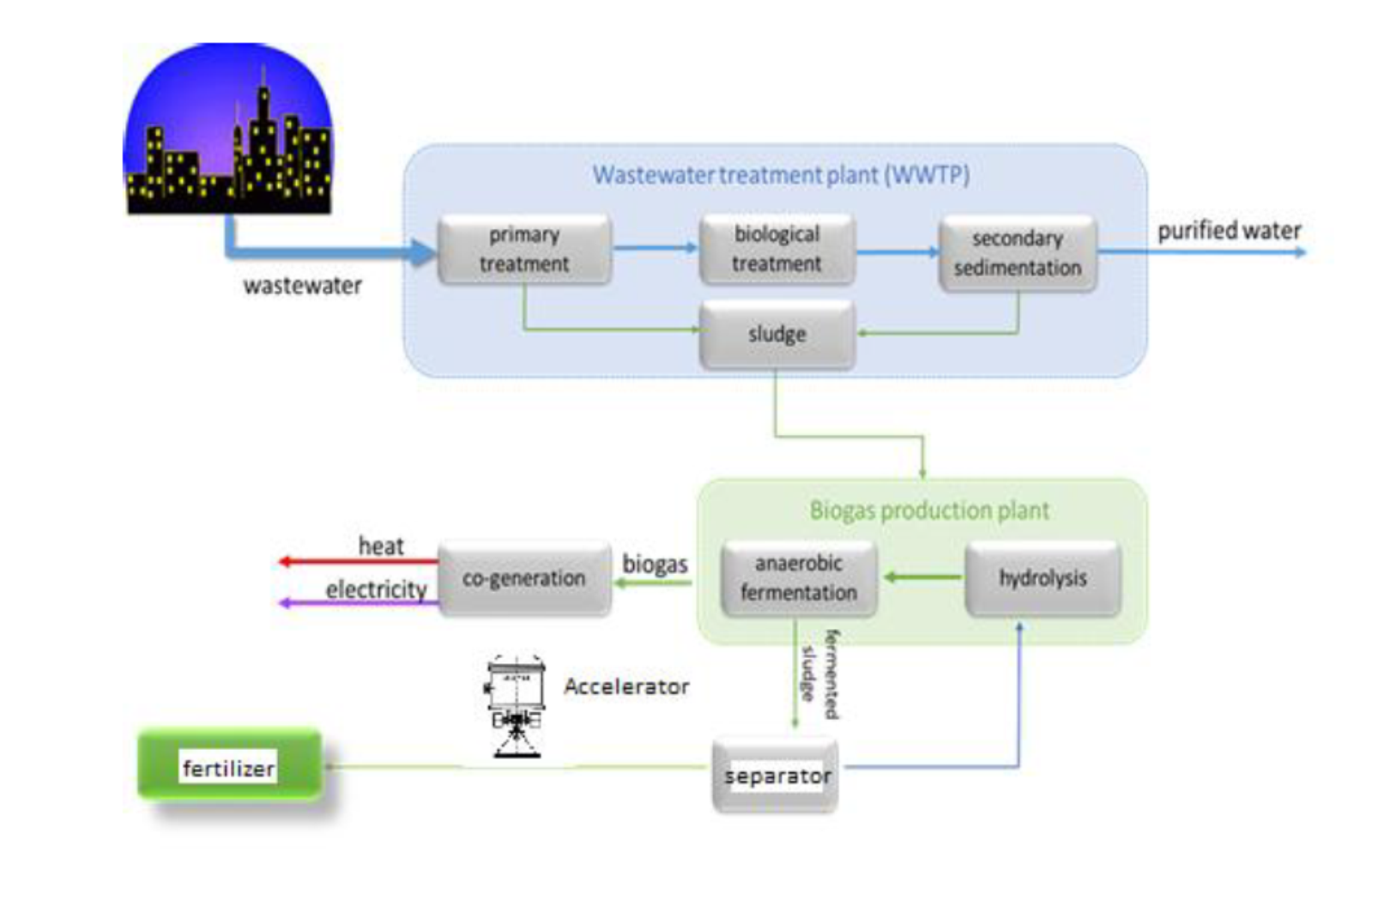
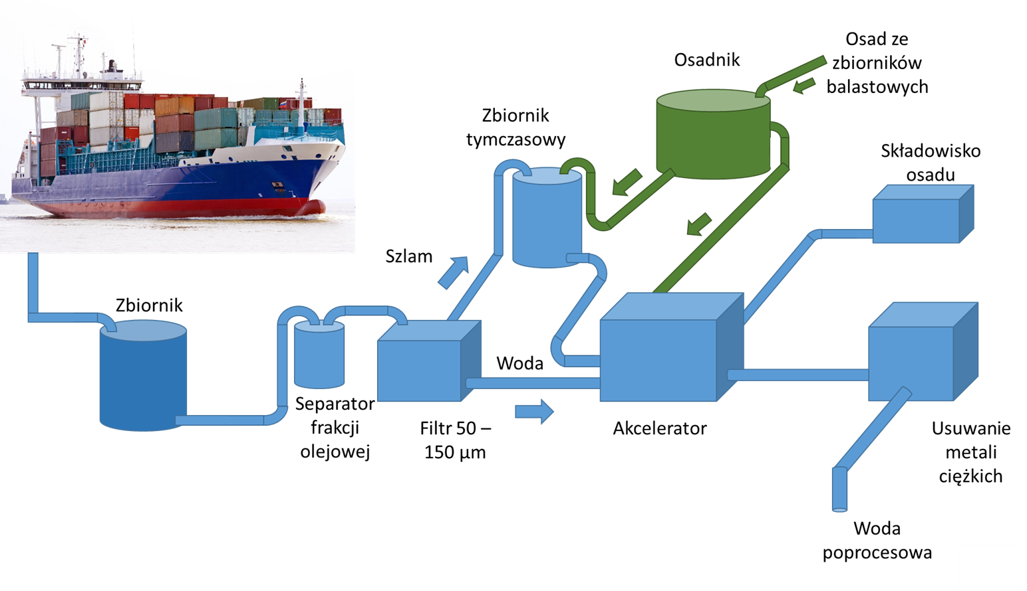
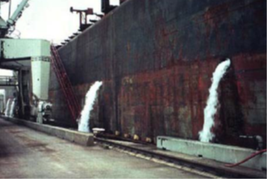
Environmental applications of electron accelerators
ARIES Diesel off-gas purification I.FAST Excess WWPT sludge hygenization ARIES Balast water TRL 5. Technology validated TRL 4. Technology is validated in lab pur. & hygenization
in relevant industrial environment TRL 4. Technology is
validated in lab

Slide 10
What next with the results ?
1.Application of E-beam radiation for wastewater treatment may ensure future smart cities with sustainable water resources management.
2.Accelerators are needed for all these technologies.
Collaboration with China - „Advanced treatment for typical antibiotic pharmaceutical wastewater by electron-beam radiation (Acronim: TAPEB)” INCT - Tsinghua University (CHN), 36 months, 2024.01.04-2027.04.01; Total project cost: 1,032.746 EUR
They are transformer accelerators manufacturers
China
They built industrial eb wstwater treatment plant

Slide 11
EuroLabs - developing industrial application of electron beams of energy up to 10 MeV. – support of I.FAST – technology transfer
ID | Description | Key participants | Access Units (h) | Status^{(*)}
1 | Crosslinking of self-assambled fatty acids on copper by electron beam irradiation | Ruder Bośkovic institute, Croatia | 25 | Completed (December 2023)
 | Crosslinking of self-assambled fatty acids on copper by electron beam irradiation | Ruder bośkovic institute, Croatia | 25 | Apporved (III Q 2024)
2 | One-electron oxidation of S-adenosyl methionine | ICP, Univ. Paris Saclay, France | 25 | Completed (March 2023)
3 | Effect of ionizing irradiation on dried fruits | National Centre of NuclearSciences and Technologies CNSTN, Tunisia | 15 | Completed (February2024)
4 | One-electron oxida/on of S-adenosyl methionine | ICP, Univ. Paris Saclay, France | 15 | Completed (November 2023)
5 | Irradiation engineering of biopolymer-based formulation for wound management and targeted drug delivery devices | University of Palermo, Italy | 50 | Submitted, planned May 2024
6 | Bioactivity of irradiated foods by low energy e-beam | Instituto Superior Técnico, Universidade de Lisboa, Portugal | 25 | Submitted, planned June 2024
7 | Influence of 10 MeV accelerated electrons on structure and properties of sheep wool fibres as a potential component for preparation of polymer-based composite materials | Institute of Chemical Physics, University of Latvia | 25 | Submitted, planned May 2024
 |  | Total | 205

Slide 12
Other activities – BTS24 – I.FAST program support
EURO-LABS Basic Training School on Accelerators 2024 BTS24, June 18-27, 2024,
to be organized at HIL and INCT, Warsaw, Poland.
Heavy Ion Laboratory with the U200-P cyclotron providing a heavy ion beam together with Institute of Nuclear Chemistry and Technology with electron accelerators invites students to BST24, which will take place in Warsaw on June 18-27, 2024. 15 - 20 students will be selected and will perform experiments with heavy ion and electron beams as well as with radioactive sources to get basic knowledge and develop skills on use of detectors, electron beam control and dosimetry.
Details will be published in February on the HIL website (https://www.slcj.uw.edu.pl/en/bts24/).

Slide 13
WP12 - Societal Applications
Task 12.1 - A Strategy for Implementing Novel Societal Applications of Accelerators
Sub-task 4. Accelerator Imaging
Graeme Burt
University of Lancaster

Slide 14
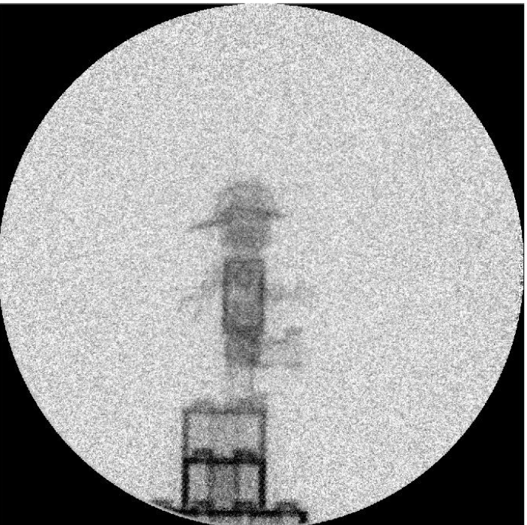
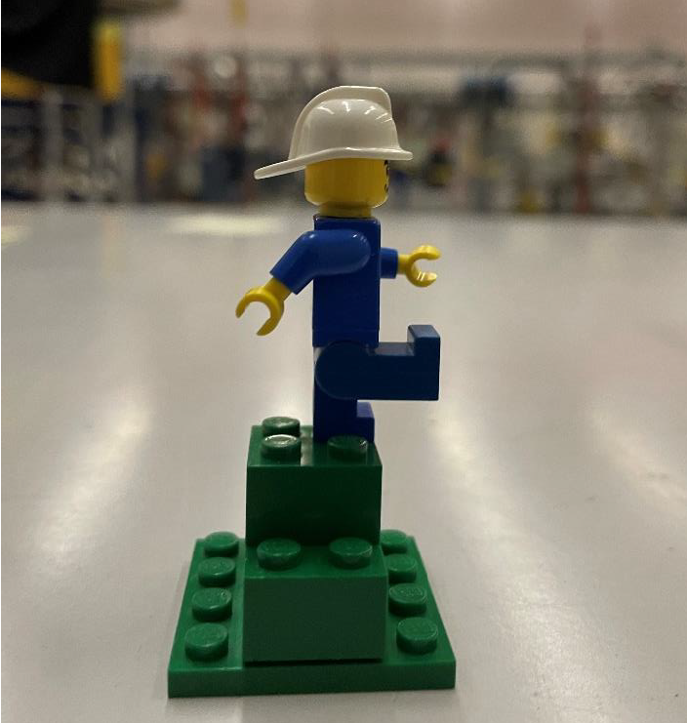
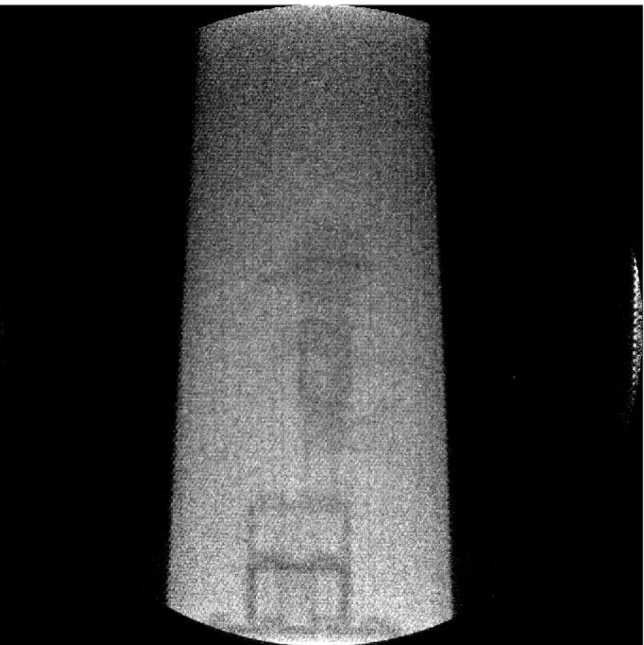
Task 12.1
Sub-Task 4
Accelerators for Imaging
First mini-project has been completed
Project proposal: multi-energy fast neutron images(Dynaxion)
Fast neutron imaging is a growing field of interest for non-destructive testing (NDT) and security screening. Due to its high penetration capabilities and specificity for certain elements it is able to make images of items that no other imaging techniques (such as X-ray imaging) can.
This project has two main aims:
Produce high quality fast neutron images of relevant objects to enhance the adoption of this imaging technique,
Show that using multiple energies for the imaging of objects will provide additional information about the contents of the object, similarly as multi-energy imaging with X-rays.
Unfortunately, soon after this Dynaxion failed to find sufficient funding to build a prototype and declared bankruptcy
Top: Neutron image of the Lego man
Bottom: Neutron image of the lego man inside a steel casing

Slide 15

WP12 - Societal Applications
Task 12.1 - A Strategy for Implementing Novel Societal Applications of Accelerators
Sub-task 5. Accelerator production of radioisotopes for imaging and therapy
D. Obradors & C. Oliver
April 2023

Slide 16

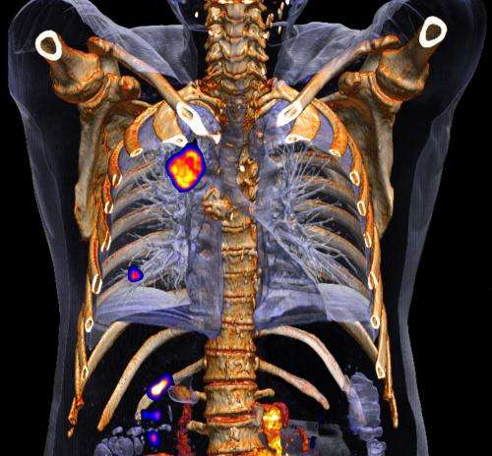

Task12.1.5: Performed activities
  Attendance at the following seminars and meetings:
    2023 Isotope User meeting managed by U.S. Department of Energy Isotope Program focused in four sessions of the the following emerging alpha and beta emitters:
      Cerium-134
      Astatine-211
      Lead-203/212
  Continuous market research/analysis to get a view of an important points related to the emerging radioisotopes, trends, and identify synergies with respect to the demand of these radionuclides and accelerator technology that will require innovations to reduce cost and increase the capability of production methods in an efficient manner. Important to note:
  225Ac stands out as a promising Targeted Alpha Therapy candidate due to its 9.9-day half-life, which makes it well-suited for antibody targeting.
  There is a projected shortage of 225Ac supply. Through the 229Th/225Ac generator system only a few select global research institutions have the required capacities. ORNL (USA), ITU (Germany), IPPE (Russia), no more than 70GBq per year.
  Initial study has been done by TRIUMF Laboratory

Slide 17


Task12.1.5: Performed activities
  Several research efforts have been dedicated to exploring avenues to increase the production:
  1. Moderate energy proton interactions with 226Ra (via nuclear transmutation).
  2. Subjecting 226Ra to high-intensity gamma radiation (through photonuclear channels).
  3. High-energy proton interactions with 232Th (via spallation).
  226Ra targets for (1) and (2) purposes presents substantial challenges due to the scarcity of the isotope and associated safety risks, which complicate target fabrication, irradiation, and recycling. The issues of radon emanation and the emission of high-energy gamma rays from its descendants further exacerbate these challenges and is a significant disadvantage.
  (3) It does not carry excessively high radioactivity, presents fewer radiological risks, and is readily accessible as a target material. High-energy protons (60-140 MeV) have the potential to yield significant amounts of 225Ac, but only a limited number of existing accelerators can achieve this efficiently with the required current and energy for large-scale production.
  High-current and high energy superconducting H⁺₃ cyclotron has the potential to be a valuable tool in generating isotopes essential for medical treatments, research, and various other scientific applications.
  Initial study has been done by TRIUMF Laboratory

Slide 18
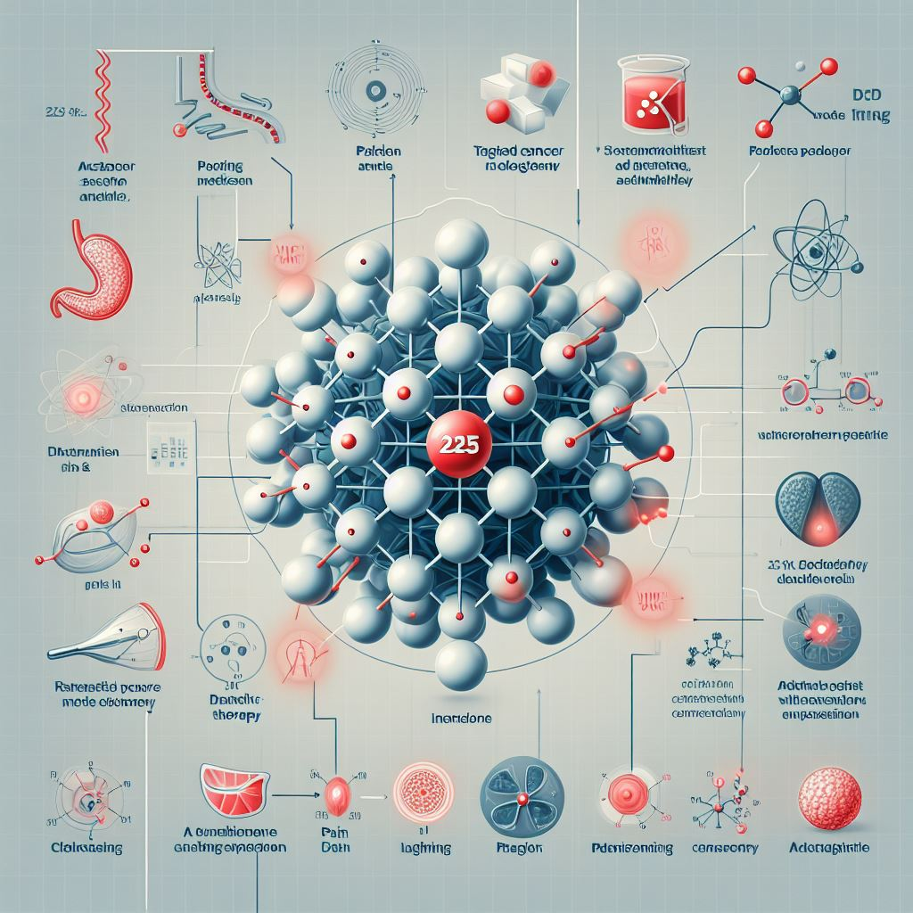


Task12.1.5: Next steps
  Continuous research/analysis of particle accelerators technology, programmes and projects related to emerging radionuclides into medical diagnostics and treatment.
Regular monitoring and continuous analyses of the radiopharmaceutical market and needs, identifying new developments and trends.
    9th International Symposium on Medical Radioisotopes, April 26, 2024, Belgium
    European Cyclotron Progress Meeting, ECPM2024
RI users survey: To understand the isotope production needs and potential supply shortages in the next years. With this information we will gain a clearer understanding of future market demand and how the particle accelerators can better serve industrial and research entities by taloring isotope production to meet their expressed needs to define new challenges or common dificulties.
  Webinar / Workshop / (funding dependency) : Radiopharmaceutical market and future trends. Several topics could be covered including development, production, and uses of diagnostic, therapeutic and theragnostic radioisotopes as well as issues related to their production.
International cooperation is encouraged and collaborations are welcome.

Slide 19
WP12 - Societal Applications
Task 12.1 - A Strategy for Implementing Novel Societal Applications of Accelerators
Sub-task 6. Barriers to accelerator adoption by industry
Andrzej Chmielewski (INCT) and Andrea Sagatova (STU)

Slide 20
Sub-Task 6: Barriers to accelerator adoption by industry
Ecological applications, that demand high power and great electrical efficiency, and inexpensive accelerators, are related to more complex situations. The solutions that use superconducting systems offered some optimism, but their benefits and drawbacks were not fully explored on an industrial scale. They may not achieve their predicted efficiency ratings because they require magnet cooling systems. The problem might be made better by using sources of clean energy to generate the electricity needed to power accelerators.
No manufacturers of transformer or high energy efficiency accelerators in Europe.
Andrzej G. Chmielewski. Radiation technologies: The future is today.
Radiation Physics and Chemistry 213 (2023) 111233

Slide 21

IFAST Task 12.3. Internal Ion Source for Cyclotrons. Concept
Magnetic field
A new concept of internal ion source based on RF for cyclotrons: Change DC voltage of conventional Penning ion source to a RF voltage
Expected advantages of RF ion source versus Penning:
Lower cathode wear (sputtering). Less maintenance time, irradiation and cost. Cathode is heated by RF currents, no need for ions impact.
Lower electron energies (~ 10 eV) -> better efficiency of producing H⁻, leading to reduction of H₂ flow needed and better vacuum in the cyclotron.
No high voltage
Anode
Cathodes
Extraction
V
Plasma
CONVENTIONAL PENNING ION SOURCE
Electrode
Magnetic field
Electrodes 1
~
Extraction
RF power
Plasma
RF quarter wave cavity
PROPOSED RF ION SOURCE

Slide 22
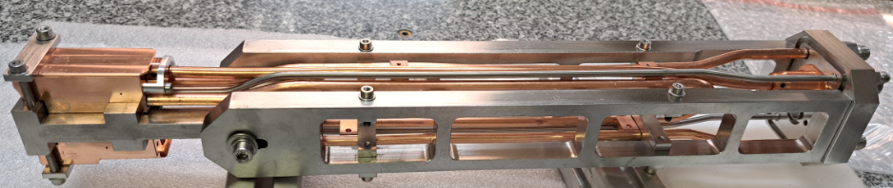
IFAST Task 12.3. Internal Ion Source for Cyclotrons. Concept
Innovative concept
Potential commercial application, mostly oriented to medical cyclotrons
Simple concept, with relatively easy implementation on existing commercial products
Partnership industry (General Electric, Cyclomed) – labs (Ciemat)
I.FAST Task 12.3 objective:
  Design & manufacture a first demonstrator prototype
  Perform its experimental characterization (plasma production and beam extracted)

Slide 23
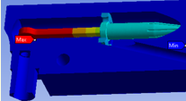
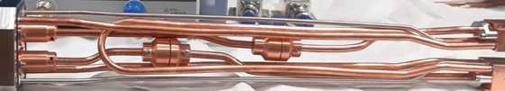
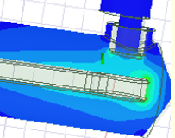
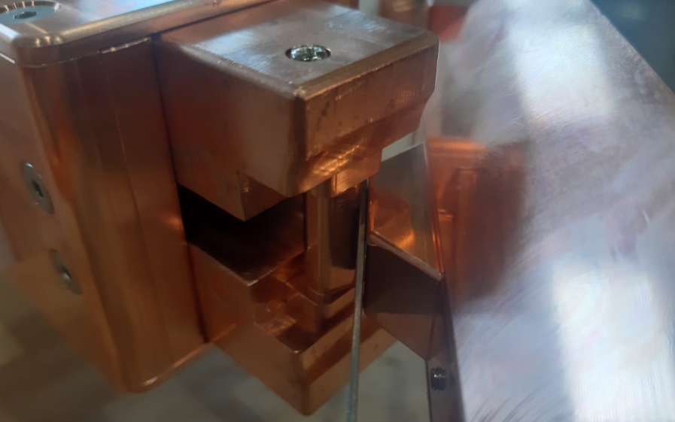
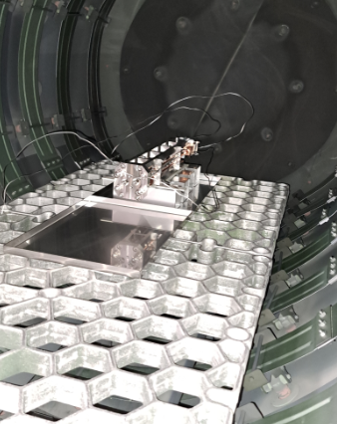
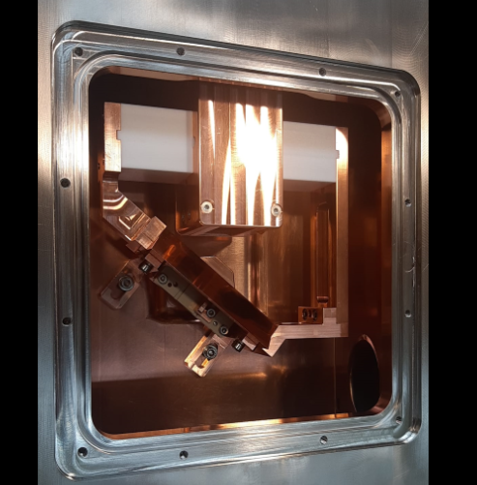
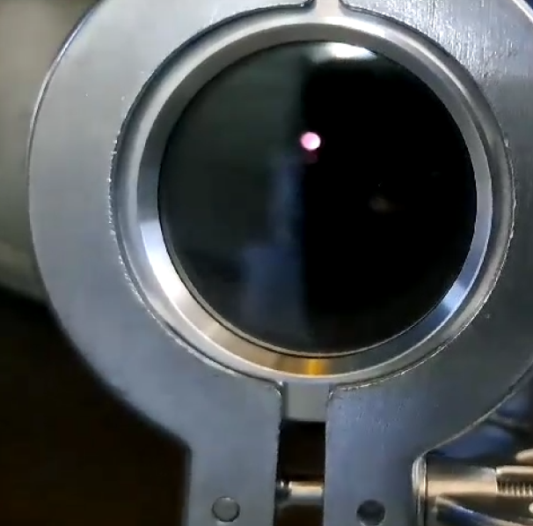
IFAST Task 12.3. Internal Ion Source for Cyclotrons. Progress
Task progress from may’2021 to nov’2023
Definition of specifications for the ion source prototype
Calculations and simulations to arrive at a conceptual design
Development of a detailed mechanical design
Welding tests
Fabrication of all ion source components and toolings
Bending of the cooling and hydrogen tubes for the ion source
Brazing of the ion source
TIG welding of the RF feedthrough
Low power RF tests
Development and fabrication of RF cable connections in vacuum side to correct connection problem.
Fabrication and assembly of ion source test bench (IST)
IST extraction cavity conditioning
Ion source high power test on IST
First plasma production
Deliverable of the task (final report) submitted on nov’23

Slide 24
IFAST Task 12.3. Internal Ion Source for Cyclotrons. Plasma production
An initial demonstration of plasma production was performed with copper cathodes, 0.8 Tesla dipole field
RF power for plasma ignition: 70 W, 50% reflected power, 2 kV at each cathode
Plasma is kept for long time, even stopping hydrogen Flow (no extraction), until RF power goes down to about 2 W, 400 V at each cathode

Slide 25
IFAST Task 12.3. Internal Ion Source for Cyclotrons. Conclusions
Task 12.3 was finished with the delivery of the final report
Plasma ignition was demonstrated in the prototype
Damaged connections in the ion source have been found due to overheating and not good connection. New connections have been redesigned and they are currently being fabricated
When prototypoe is available again the plan is to perform:
  Plasma characterization with spectroscopy análisis
  Extracted beam analysis

