Slide 1
Task 8.6 Superconducting ReBCO cable
I.FAST 3rd annual meeting, 18.04.24
T. Winkler (GSI) on behalf of task 8.6 members

Slide 2

WP/Task structure and objectives
Design Parameters for a round, high current, low AC loss HTS ReBCO cable
Application: fast ramped, high field accelerator magnets
Milestone: M24 (https://doi.org/10.5281/zenodo.7995185)
Deliverable: M32 (https://doi.org/10.5281/zenodo.10697495)
Members:
  Institute of Electrical Engineering (IEE), Slovak Academy of Sciences, Slovakia
  ILK Dresden, Germany
  GSI, Germany
  EMS Chair, University of Twente (UT), Netherlands

Slide 3
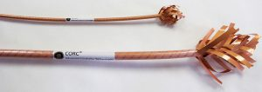
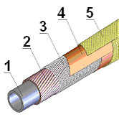
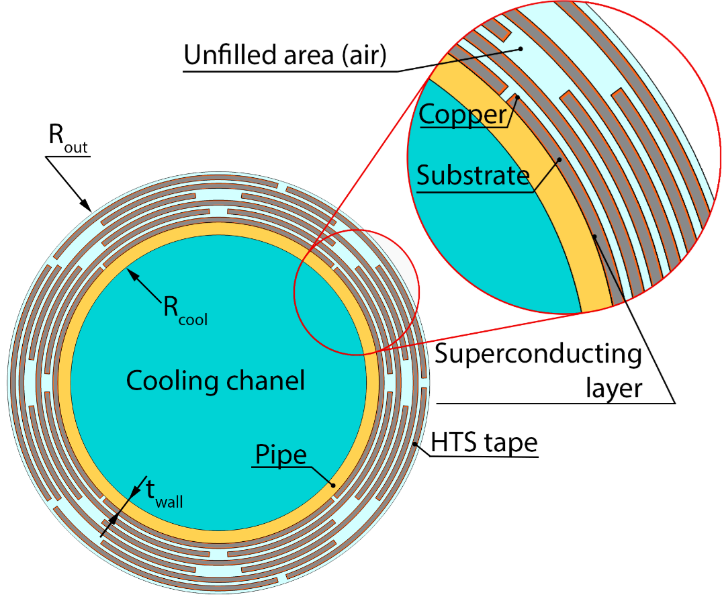
Cable layout
CORC by ACT, advancedconductor.com
Starting point:
SIS100 cable (GSI/JINR) (LTS)
CORC/CORT type cable (ACT/IEE) (HTS)
Idea: use good direct cooling properties, and windability of SIS100 cable and apply it to HTS

Slide 4
Magnet Design
Mechanics
HTS Cable
Cooling
AC loss
AC loss and the cooling capacity are the main focus of year 2

Slide 5
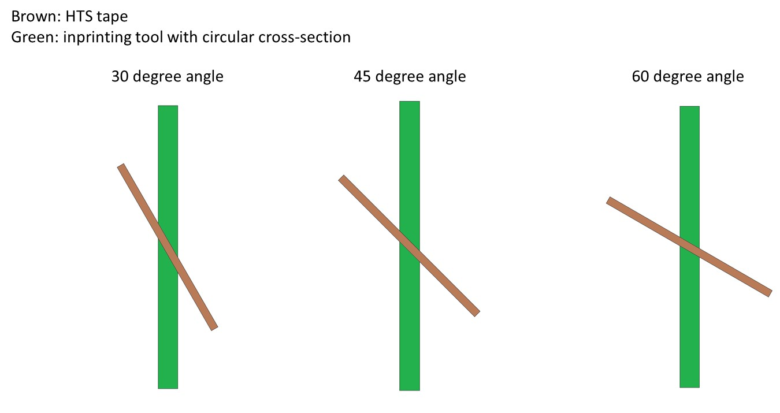
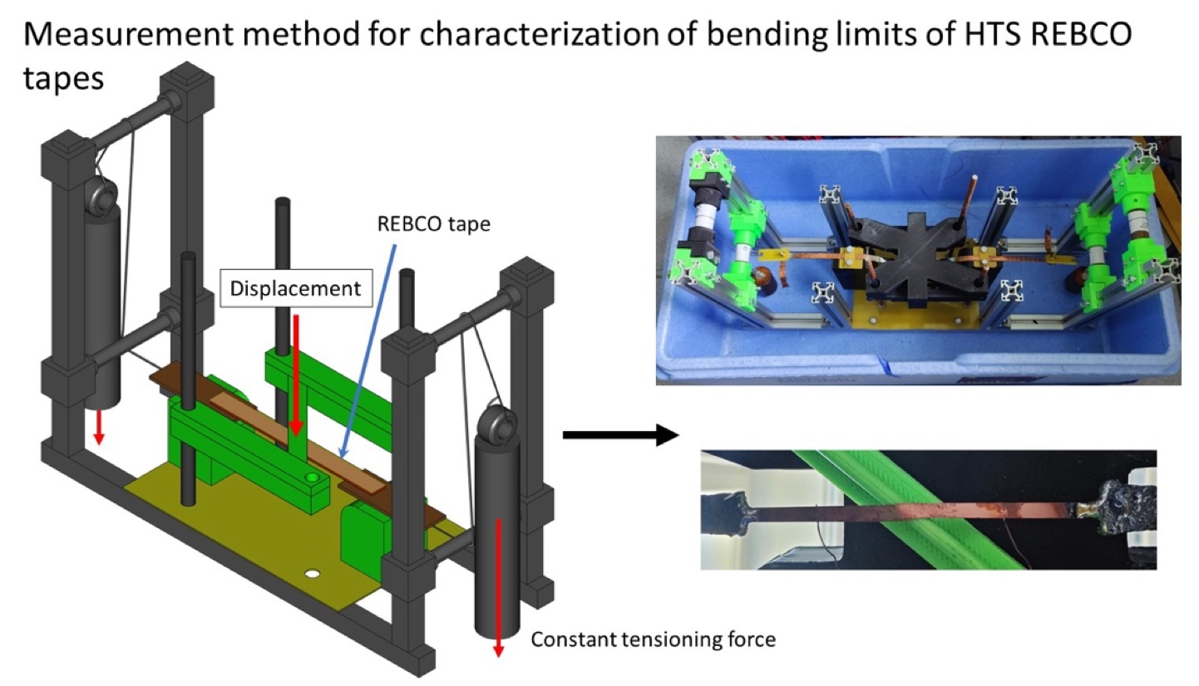
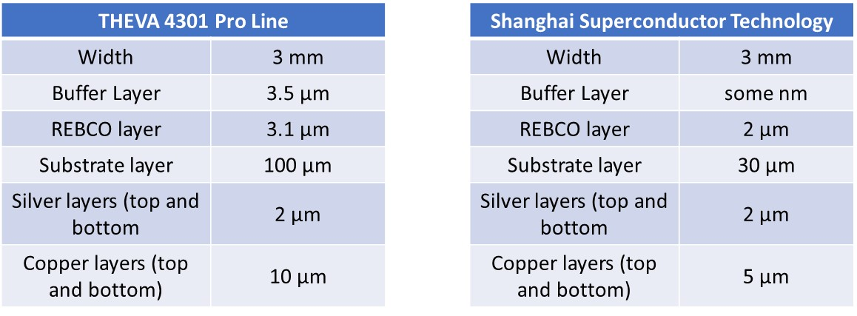
HTS tape mechanics

Slide 6
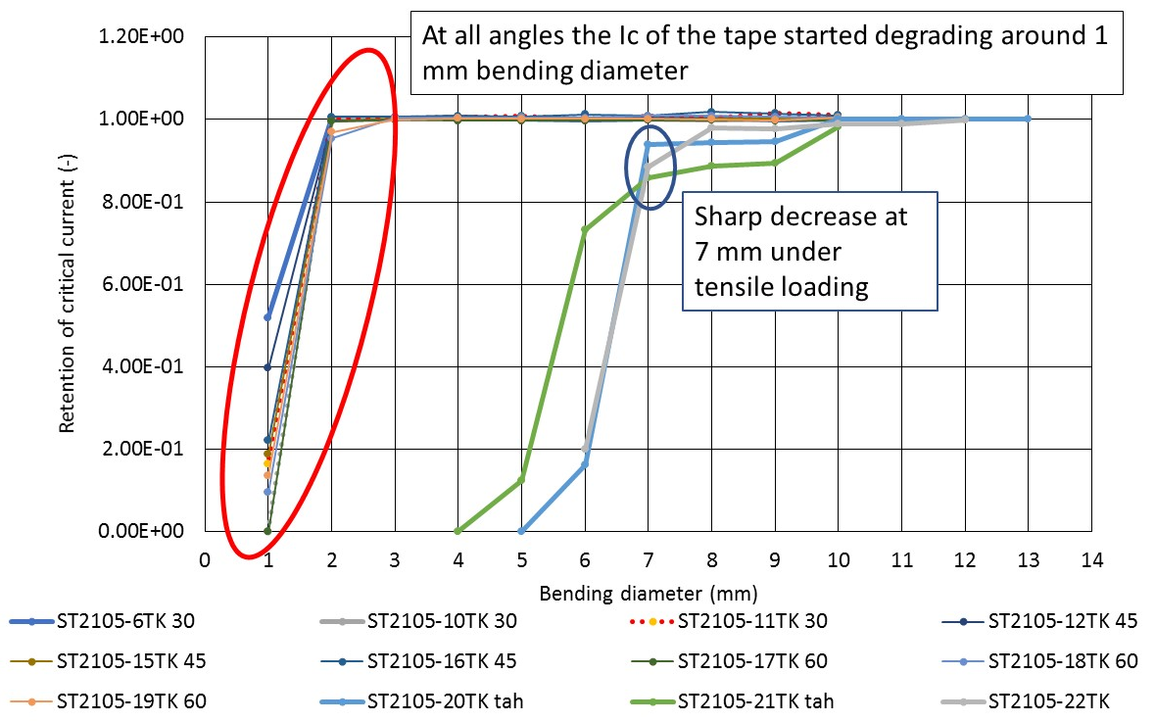
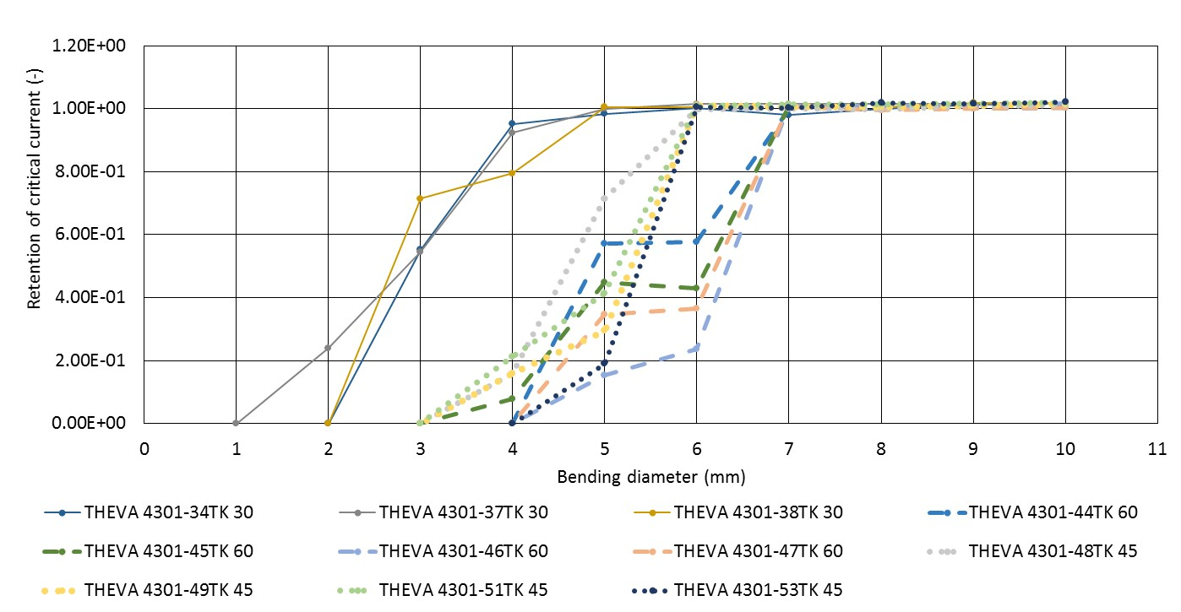
HTS tape bending - results

Slide 7
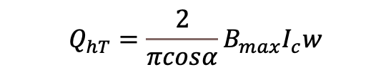
AC loss and cooling - striation
From last years meeting:
AC loss for a ramp from 1.9 T to 7.5 T:
373 W/m
Extending the ramp from 1 sec to 10 sec and introducing 0.5 mm wide filaments:
4.6 W/m
$$Q_{hT}=\frac{2}{πcosα}B_{max}I_{c}w$$
factor of 80 reduction

Slide 8
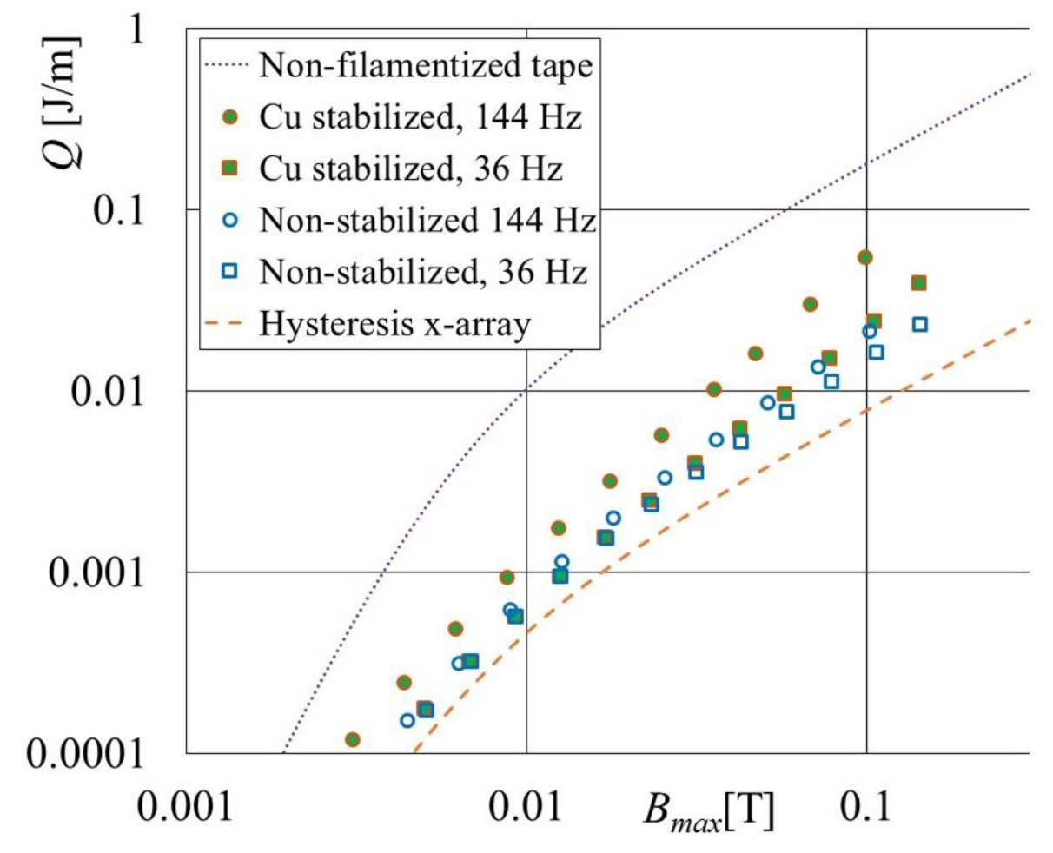
AC loss – tape striation
Sample:
230 mm length, 10 mm former diameter,
12 mm wide tape with 19 filaments
wf = 0.5 mm wide, gaps of wg = 0.1 mm
lay angle ⍺ = 67 degrees
Additional coupling loss for the Cu stabilized sample
https://doi.org/10.1109/TASC.2024.3364133

Slide 9
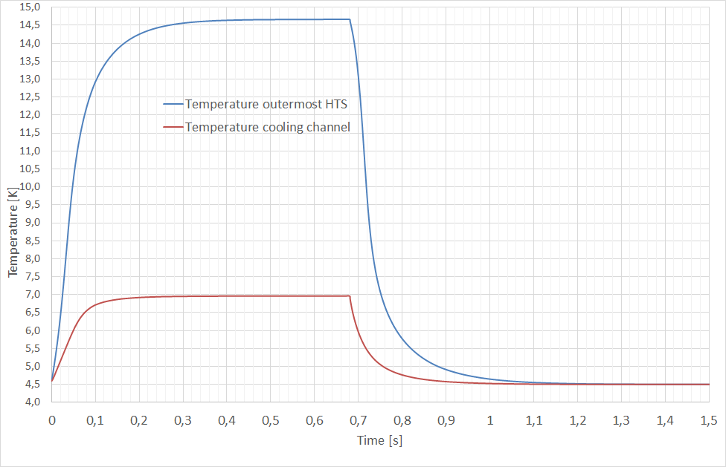
Cooling
Simulation accounts for:
heat transfer coefficient He to pipe wall,
”effective” thermal conductivity of tape stack
Radial temperature for a short cable piece
Heat load 27 W/m

