Slide 1






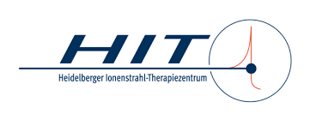

IFAST Prototyping Activity
REX Resonant EXtraction Improvement
Work Package 5 Task 3
3rd Annual Meeting / 18th April 2024
Peter Forck & Rahul Singh (GSI) on behalf of the consortium

Slide 2
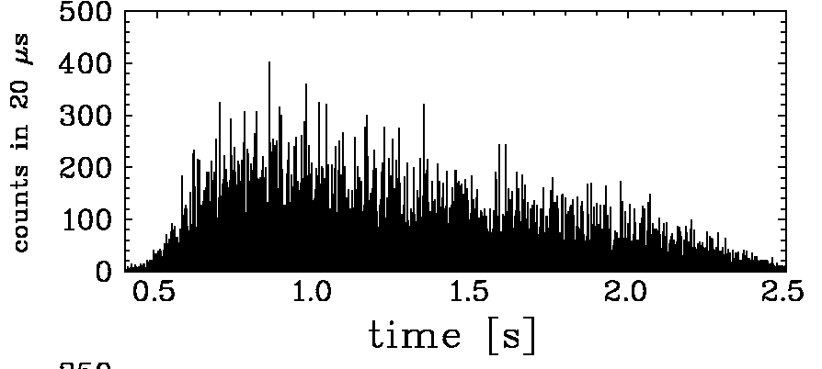
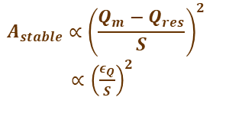
Challenge for slow Extraction from Synchrotrons
Slow extraction: Gentle beam excitation at third order resonance
Beam physics: Extraction as ‘slow losses’ for 1 … 10 s
Particle crosses stability boarder sequentially
Exponential amplitude growth during ‘transit time’
≈ 50 … 1000 turns to reach septum for extraction
Example: C⁶⁺ at 300 MeV/u at GSI
Quad. scan, un-bunched beam
2 s extraction
called ‘spill’
Problem: Sensitivity to any unintended resonance condition, e.g.:
Change of tune: unintended quadrupole current ripple
Stochastic amplitude excitation of ‘knock-out’ extraction
Stored beam horizontal phase space at electrostatic septum
Mitigation research within IFAST-REX:
1. Beam physics:
Reduction of beam sensitivity by non-standard excitation methods
⇒ Extensive simulation of extraction process
x’
Knock-out extraction:
Transverse excitation
diffusion of core to separatrix
Signal-induced fluctuations
separatrix
ele.-stat. septum
thickness
$$A_{stable}∝{\left(\frac{Q_{m}−Q_{res}}{S}\right)}^{2}$$
$∝{\left(\frac{ε_{Q}}{S}\right)}^{2}$
2. Technical installations:
Improved power supplier for magnets
Novel transverse excitation for knock-out extraction
⇒ Non-standard current measurement and rf-excitation control
x
extr.
channel
Unintended quadrupole current ripple
⇒ tune ripple
⇒ bursts extracted
3. Validation:
Experimental validation at the facilities
⇒ Tailored improvements for IFAST-REX facilities
transit time T_{transit}
last spiral step x_{step}
after 3 turns
Sextupoles: non-linear fields
Ion’s amplitude growth per turn
⇔ T_{transit} & x_{step}

Slide 3
Working Groups
Topic: Workshare structure within the entire project:
Working Group 1: Power supplier ripple measurement novel transformer combination
chair Frank Stulle (Bergoz Instrumentation) → hardware deliverable, Milestone 20 (month 24) reached
Working Group 2: Optimized rf-amplifier and control of knock-out extraction
chair Eike Feldmeier (HIT) → hardware deliverable, Milestone 20 (month 24) reached
Working Group 3: Simulation and experimental verification for slow extraction
chair Francesco Velotti (CERN)
Working Group 4: Innovative detectors and data acquisition for slow extraction
chair Peter Forck (GSI)
However:
At the advanced project phase, participants collaborate across the WGs to enable success.

Slide 4


Experiment: Knock-out Extraction Signal Spectrum Dependence
Topic: Spill micro-structure dependence for knock-out extraction
by HIT & GSI with contributions by CERN and MedAustron
Excitation spectrum influences:
Separatrix crossing
Diffusion from the beam towards core
Horizontal tune at HIT Q_{x}= 1.6789 at end of acceleration
Excitation close to tune & harmonics f_{ex,i} = Q_{ex,i} x f_{rev}
Signal | Q_{ex,1} | Q_{ex,2} | Q_{ex,3} | ΔQ_{ex}
1 | -- | 0.327 | - | 0.009
3 | 0.321 | 0.327 | 1.327 | 0.001
$$q_{x}=\frac{1}{3}$$
$$q_{x}=\frac{1}{3}$$
Result: Strong dependence on excitation spectra
Optimization performed in 2023 (HIT, GSI, MedA)
Versatile signal generation
Large power and bandwidth from amplifier
Improvement by multi-band excitation !
E.C. Cortes Garcia et al. IPAC’22 &
E.C. Cortes Garcia et al. NIM A 167137, 2022
P. Niedermayer el. al. IPAC’23

Slide 5
Experiment: Control of Knock-out Excitation
Topic: Spill micro-structure dependence for knock-out extraction
by GSI with contributions by HIT, CERN and MedAustron
Systematic for excitation types: Tests at COSY (FZ-Jülich) ⇒ Significant influence systematically investigated
Noise at baseband
Noise at 3 bands
Noise at baseband plus sine at two harmonics
P. Niedermayer, R. Singh.,
Scientific reports, under review

Slide 6
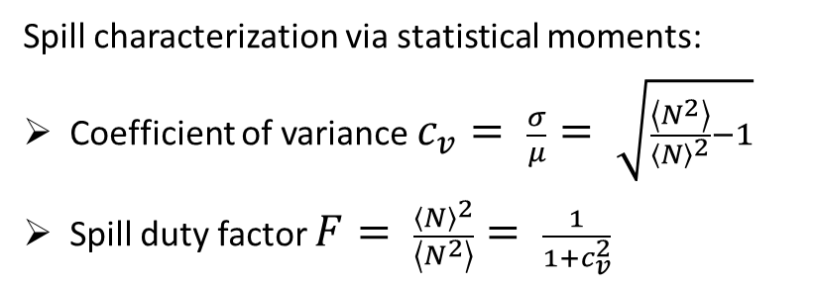
Experiment: Investigation of Extraction Signal Type
Topic: Spill micro-structure dependence for knock-out extraction
by GSI with contributions by HIT, CERN and MedAustron
Systematic for excitation types: Tests at COSY (FZ-Jülich) ⇒ Significant influence systematically investigated
Noise at baseband
Noise at 3 bands
Noise at baseband plus sine at two harmonics
Spill characterization via statistical moments:
Coefficient of variance $c_{v}= \frac{σ}{μ}= \sqrt{\frac{\left\langle N^{2}\right\rangle }{{\left\langle N\right\rangle }^{2}}−1}$
Spill duty factor $F= \frac{{\left\langle N\right\rangle }^{2}}{\left\langle N^{2}\right\rangle }= \frac{1}{1+c_{v}^{2}}$
Large fluctuation,
‘bad spill’
small fluctuation,
‘good spill’
Such systematic comparison performed for the first time!
P. Niedermayer, R. Singh.,
Scientific reports, under review

Slide 7
Experiment: Investigation of Extraction Signal Type
Topic: Spill micro-structure dependence for knock-out extraction
by GSI with contributions by HIT, CERN and MedAustron
Systematic for excitation types: Tests at COSY (FZ-Jülich) ⇒ Significant influence systematically investigated
Noise at baseband
Noise at 3 bands
Noise at baseband plus
sine at two harmonics
Large fluctuation,
‘bad spill’
small fluctuation,
‘good spill’
However: Different rf excitation power required
Noise++ is good compromise
Large power from rf-amplifier (typ. 2x400 W), see below
Such systematic comparison performed for the first time!
P. Niedermayer, R. Singh.,
Scientific reports, under review

Slide 8
Simulation: Investigation of Extraction Signal Type
Topic: Spill micro-structure dependence for knock-out extraction
by GSI with contributions by HIT, CERN and MedAustron
Normalized horizontal phase space:
Particle density shortly before extraction
Simulations by Xsuite and explanation
Simulation: Single particle tracking (COSY parameters)
Beam dynamics: Non-linear Kobayashi-Hamiltonian
as representation of particle transverse energy
Normalization to separatix value H_{sep}
Distance to separatix and dynamic evolution
Results:
Prior to extraction, distance from separatrix varies
Crossing separatrix depends on excitation type
Large distance and fast crossing preferred
Less sensitive to separatrix variation
Less sensitive power supply ripple
Better spill micro-structure achieved
Normalized Hamiltonian 5 ms prior to extraction:
power supply
ripple
P. Niedermayer, R. Singh.,
Scientific reports, under review

Slide 9

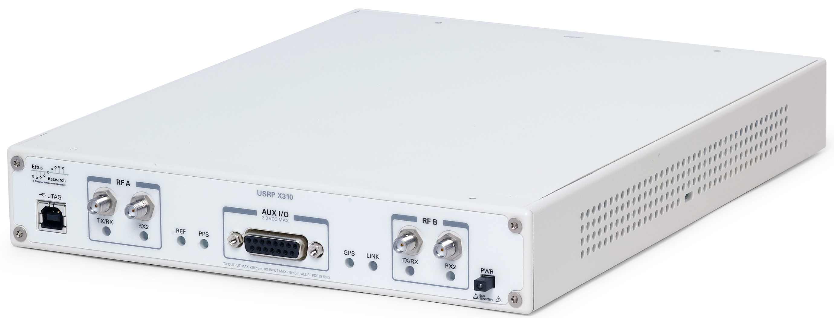

Experiment: Control of Knock-out Excitation
Signal chain
Topic: Technical realization for ko extraction control
by GSI and HIT, with contributions by MedAustron
PC
DSP with GNU Radio
beam
control
Control hardware: Universal Software Defined Radio USRP:
Low-cost commercial hardware
High performance ADC & DAC
Highly customizable due to large FPGA
Software:
Flow-graph design by as Open Software
Very complex signals generation exp. tests with reasonable effort
Shift of several application to FPGA
⇒ Latency after trigger significantly improved
⇒ Contribution to GNU-based software by GSI
stripline
kicker
data
rev. freq.
USRP
ADC/DAC with FPGA
180°
excitation
signals
trigger
180⁰ spitter
ampl.
Signal generation (GSI,MedA,HIT)
Collaboration efforts at GSI and MedAustron, for test at HIT (due to legal issues) ⇒ Operational at GSI (& HIT), tests at MedAustron
Milestone for rf-control exceeded (month 24)
Universal software defined radio
USDR Ettus X310
DAC: 16 bit, 200 MS/s
Analog bandwidth: > 100 MHz
Max. output voltage 1.8 V
FPGA: 400k cells, clock rate 200 MHz
P. Niedermayer and R. Singh, IBIC’22 & ‘23

Slide 10
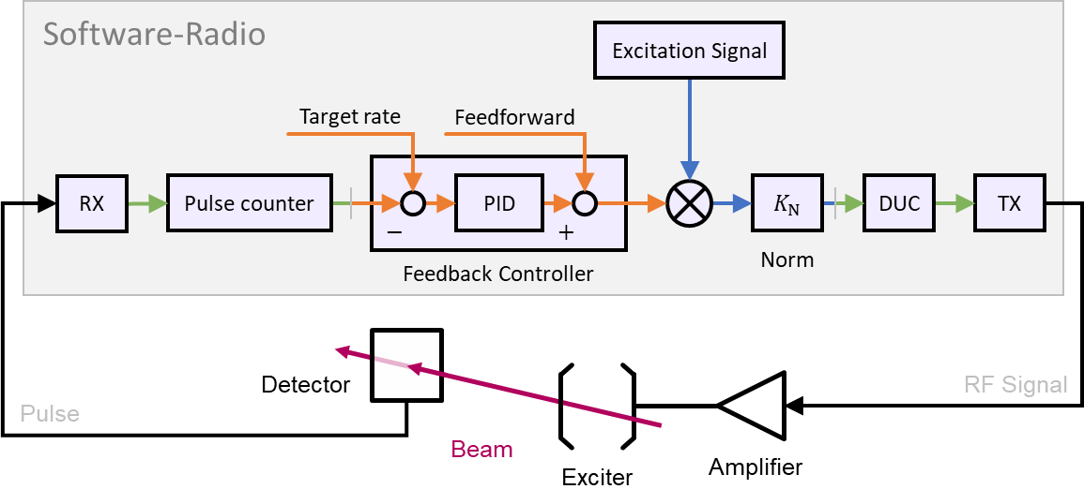
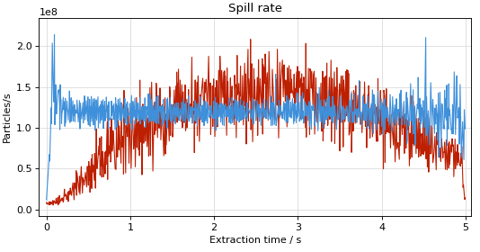
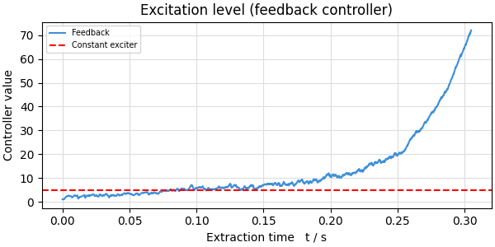
Experiment: Extension for Control of Knock-out Excitation
Topic: Feedback for macro-spill improvement
by GSI with contributions by HIT
Technology can be further used for feedback on 1 ms range
Control hardware & software: Feedback loop on USRP:
Shift of several application to FPGA
Latency significantly improved to 30 µs
300 Hz overall bandwidth achieved
⇒ Contribution to GNU-based software by GSI
2
without feedback
with feedback
feedback exciter power
rf-power evolution
⇒ large rf-power required
Particle rate [10⁸/s]
1
Controller value [arb.u.]
Commissioning at GSI in Nov. 2023
constant exciter power
0
0
1
2
3
4
5
Extraction time [s]
Extraction time [s]

Slide 11
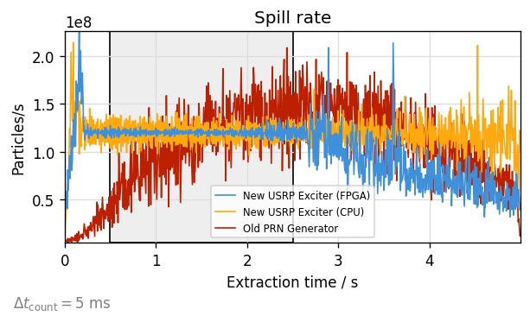
Experiment: Extension for Control of Knock-out Excitation
Topic: Feedback for macro-spill improvement
by GSI with contributions by HIT
GSI: Feedback plus improved Noise++:
Significant improvement for micro- & macro spill achieved
Automated parameter optimization successfully tested
In first operational stage at GSI now
HIT: Feedback plus improved Phase Shift Keying BPSK:
Comparable system at HIT in operation
However, less performant due medical device requirements
Technology can be further used for feedback on 1 ms range
Control hardware & software: Feedback loop on USRP:
Shift of several application to FPGA
Latency significantly improved to 30 µs
300 Hz overall bandwidth achieved
⇒ Contribution to GNU-based software by GSI
Milestone & deliverable for rf-control exceed
2
Automated optimization
using PyBOBYQA algorithm
Particle rate [10⁸/s]
coeff. of variance c_{v} @5ms
1
0
0
1
2
3
4
5
Steps (= required extraction cycles)
Extraction time [s]

Slide 12
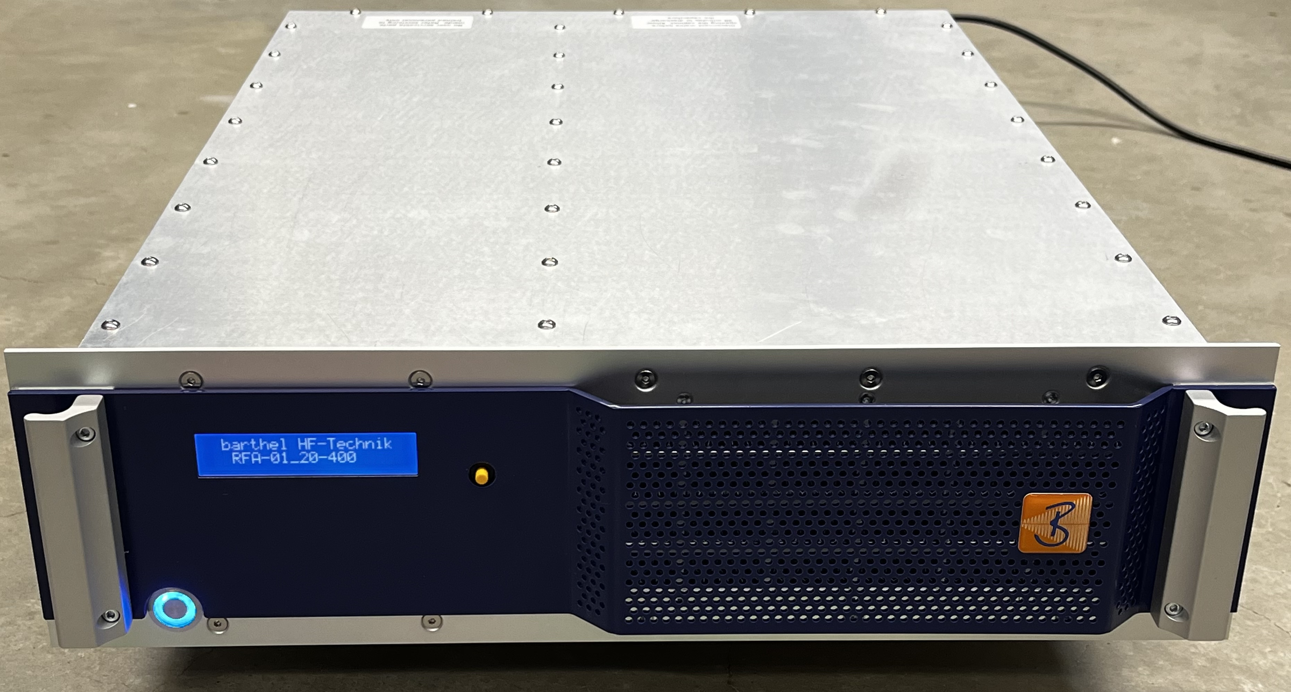
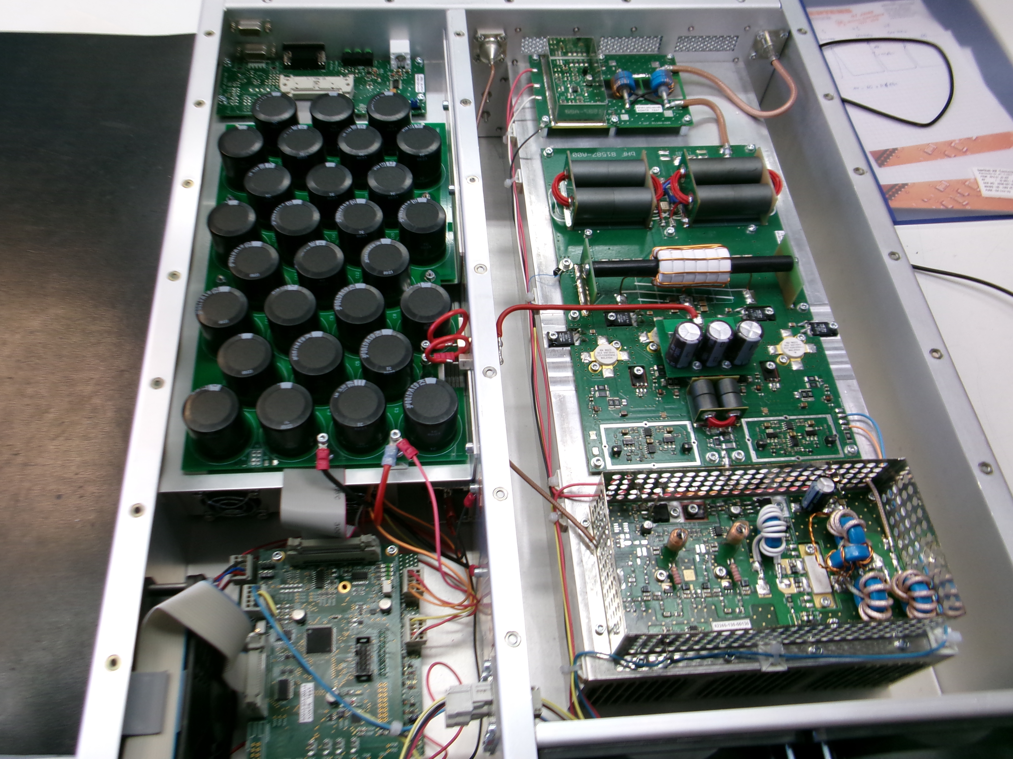
RF Power Amplifier (WG 2): Achievements
Technical development by company Barthel HF Technik plus GSI & HIT
Topic: Technical realization for knock-out amplifier:
High power required (due to broadband exc. & feedback)
Higher voltage by pure capacity load (instead 50 Ω)
Immunity against reflection for capacitive load
Achieved parameters | Value | Remark
Frequency range | 0.1 … 20 MHz | Broadband !
Output power | 500 W | Lager power
Gain | 56 … 58 dB | Flatness 2 dB !
Input impedance | 50 Ω
Input reflection VSWR | < 1.2:1
Output impedance | 50 Ω
Electrode capacitive load | 50 pF | Total power reflection
Output reflection VSWR | < 3:1
Mechanics, cooling | 19" rack, air
PC
DSP with GNU Radio
Signal chain
beam
control
data
stripline
kicker
rev. freq.
USRP
ADC/DAC with FPGA
180°
excitation
signals
trigger
180⁰ spitter
ampl.

Slide 13
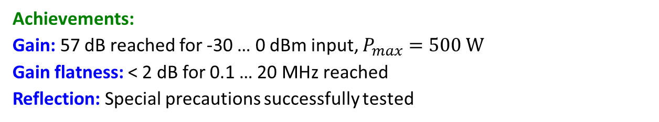

RF Power Amplifier (WG 2): Achievements
Technical development by company Barthel HF Technik plus GSI & HIT
Topic: Technical realization for knock-out amplifier
Gain flatness: $\frac{P_{out}}{P_{in}}$ versus $P_{in}$ for 0.1 … 20 MHz
Achievements:
Gain: 57 dB reached for -30 … 0 dBm input, $P_{max}=500 W$
Gain flatness: < 2 dB for 0.1 … 20 MHz reached
Reflection: Special precautions successfully tested
frequency
[MHz]
2dB
30 dB
Status:
Prototype delivered, now under test at HIT
2nd amplifier produced in fall 2024
Actual TRL 6; expected final TRL 7 (only TRL 6 promised)
⇒ Final milestone D5.3 for month 46 almost reached
PC
DSP with GNU Radio
Signal chain
beam
control
data
stripline
kicker
rev. freq.
USRP
ADC/DAC with FPGA
180°
excitation
signals
trigger
180⁰ spitter
ampl.

Slide 14
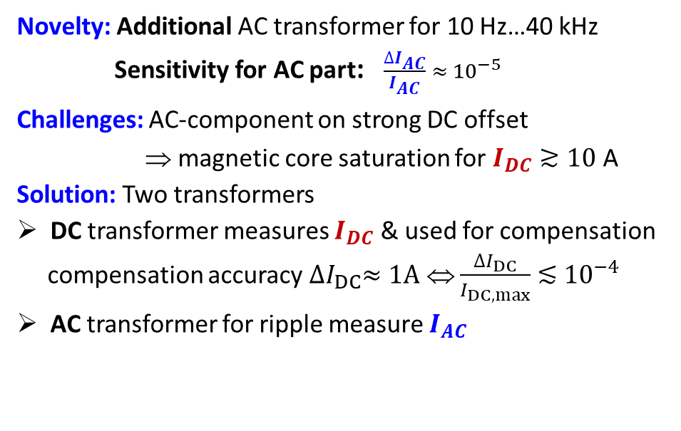
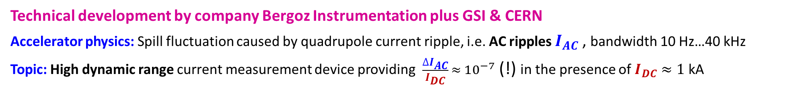
Transformer for Power Supplier (WG 1): Solutions and Achievements
Technical development by company Bergoz Instrumentation plus GSI & CERN
Accelerator physics: Spill fluctuation caused by quadrupole current ripple, i.e. AC ripples $I_{AC}$, bandwidth 10 Hz…40 kHz
Topic: High dynamic range current measurement device providing $\frac{∆I_{AC}}{I_{DC}} ≈{ 10}^{−7}$ (!) in the presence of $I_{DC}≈1$ kA
Methodology: Production of large dynamic range AC current measurement device by company Bergoz
Novelty: Additional AC transformer for 10 Hz…40 kHz
Sensitivity for AC part: $\frac{∆I_{AC}}{I_{AC}} ≈{ 10}^{−5}$
Challenges: AC-component on strong DC offset
⇒ magnetic core saturation for $I_{DC}≳10$A
Solution: Two transformers
DC transformer measures $I_{DC}$ & used for compensation
compensation accuracy ${∆I}_{DC}≈1A$ ⇔ $\frac{{∆I}_{DC}}{I_{DC,max}}$ $≲$ ${10}^{−4}$
AC transformer for ripple measure $I_{AC}$
IFAST-REX deliverable
split-core
DC transformer
additional
AC transformer
magnet current
(= DC & AC ripple)
ACCT
electronics
-
A
+
D
Compensation
winding for DC
DC meas.
digital
output
magnet
power supplier
digital control

Slide 15
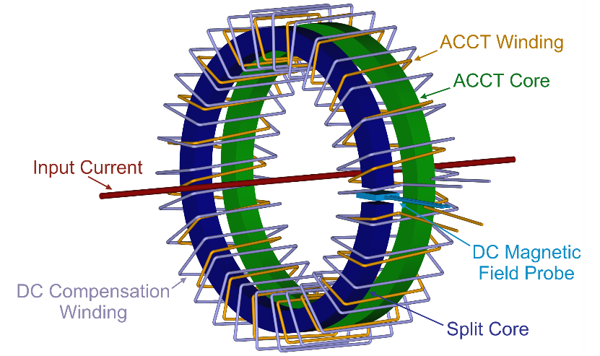
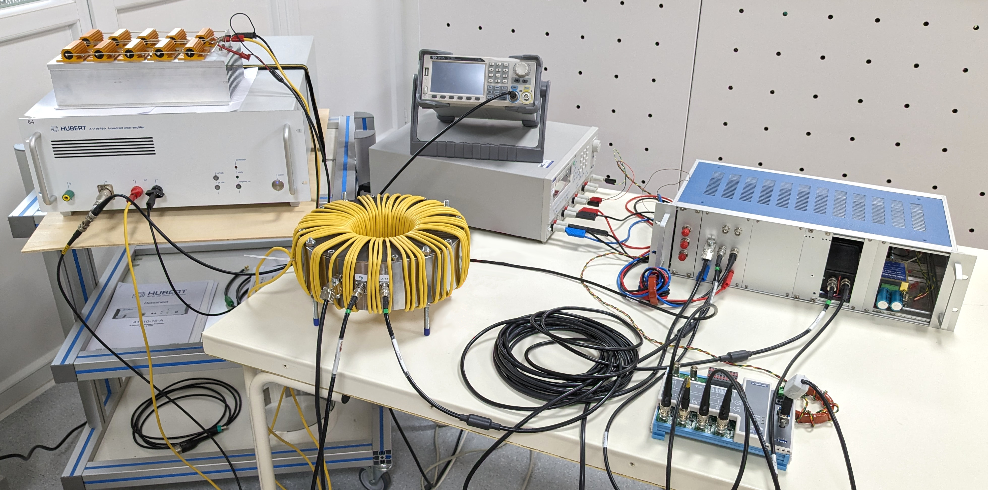
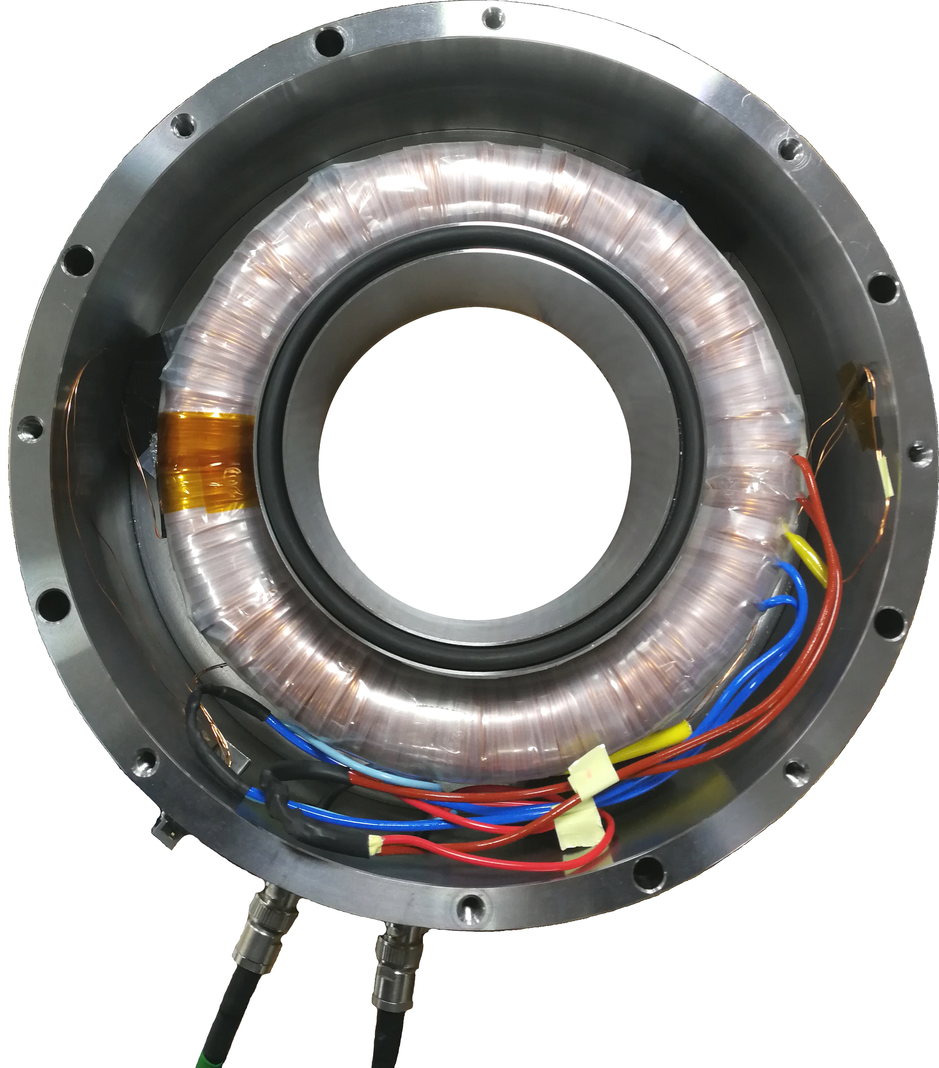
Transformer for Power Supplier (WG 1): Realization
Technical development by company Bergoz Instru. plus GSI & CERN
Development: Prototype by Bergoz as novel device
DC part: Split core of 1500 windings
Standard Hall probe Honeywell SS495A1
for AC transformer mag. saturation compensation
AC part: Core with 1500 windings
Analogue part comparable to beam current ACCT
Present achievements → prototype design:
Test at Bergoz:
up to 400 A_{DC}
plus ~10⁻³ power supply ripple
260 mm
Signal generator
110 mm
Feedback
Power Supply
Prototype electronics
Power amplifier
with load
Prototype sensor
60 turns primary
24bit ADC
Windings:
1500 turns

Slide 16
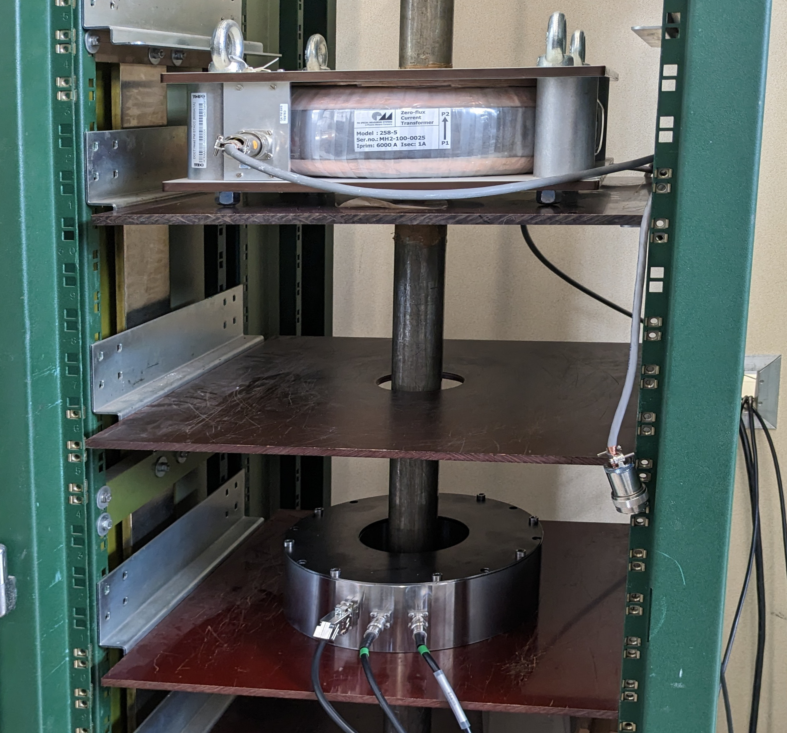
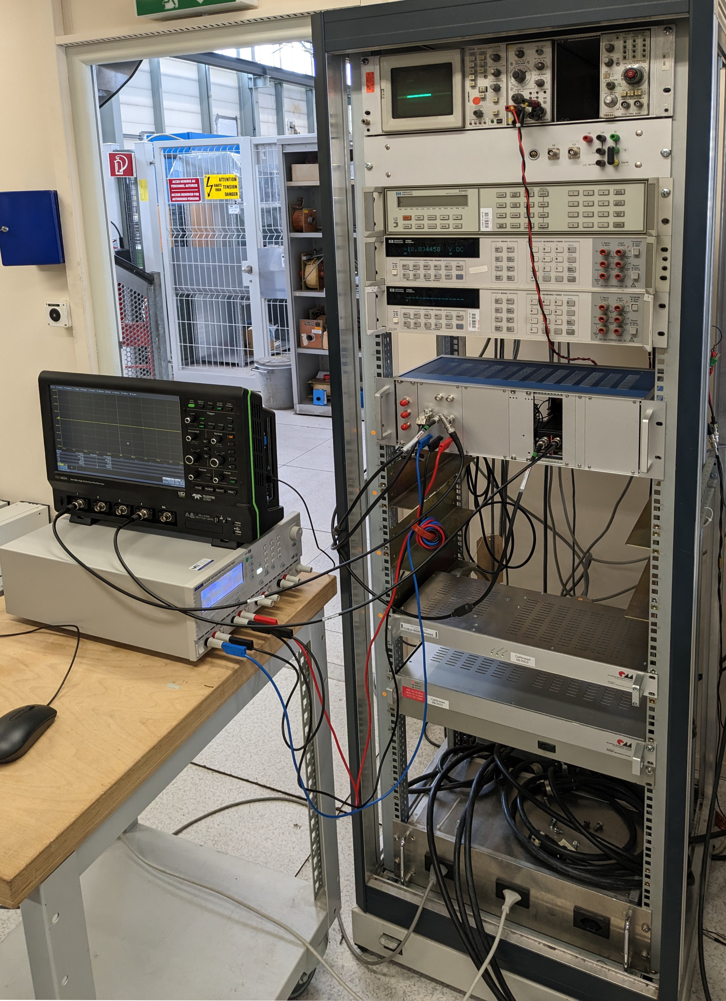
Transformer for Power Supplier (WG 1): Realization
Technical development by company Bergoz Instru. plus GSI & CERN
Development: Prototype by Bergoz as novel device
DC part: Split core of 1500 windings
Standard Hall probe Honeywell SS495A1
for AC transformer mag. saturation compensation
AC part: Core with 1500 windings
Analogue part comparable to beam current ACCT
Present achievements → prototype design:
Test at Bergoz:
up to 400 A_{DC}
plus ~10⁻³ power supply ripple
AND
Test at CERN in 2023:
up to 5 kA_{DC} with typical power supplier
Precision voltmeters
Reference fluxgate DCCT
Prototype sensor
Prototype electronics
Reference fluxgate DCCT electronics

Slide 17
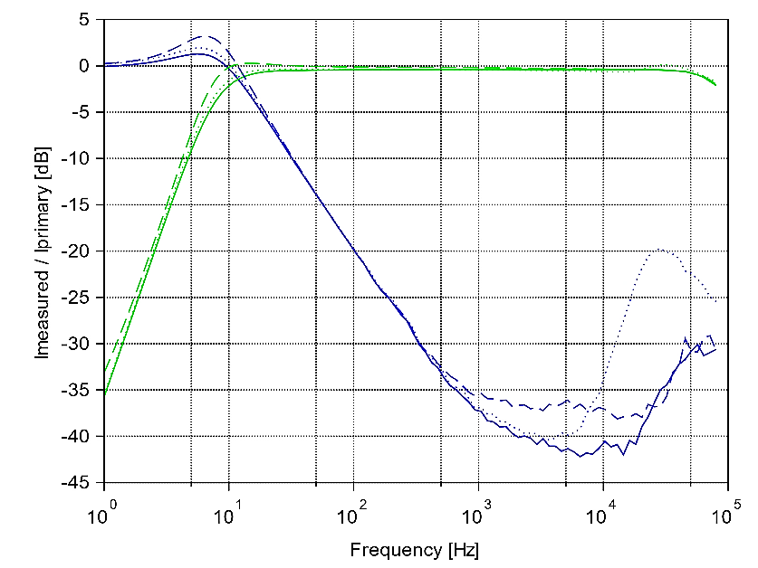
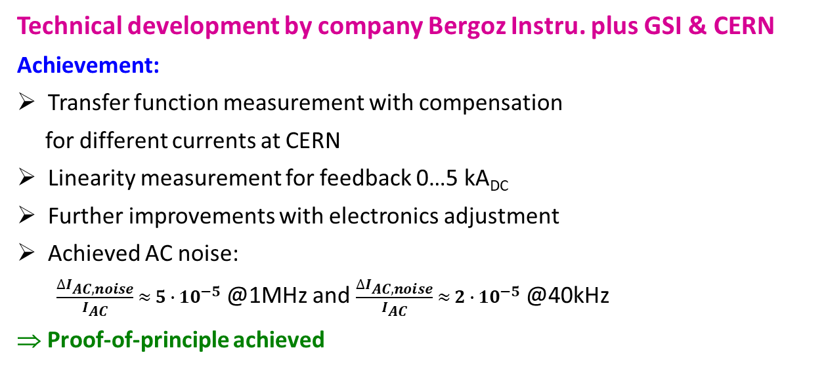
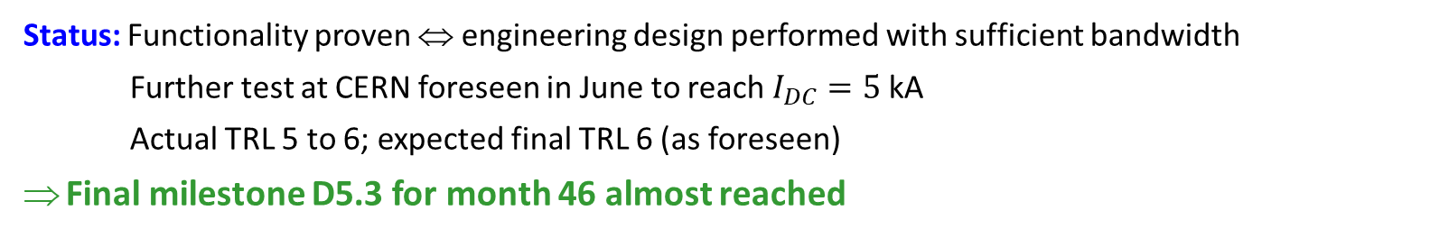
Transformer for Power Supplier (WG 1): Achievements
5
Technical development by company Bergoz Instru. plus GSI & CERN
Achievement:
Transfer function measurement with compensation
for different currents at CERN
Linearity measurement for feedback 0…5 kA_{DC}
Further improvements with electronics adjustment
Achieved AC noise:
$\frac{∆I_{AC,noise}}{I_{AC}} ≈{ 5 ∙ 10}^{−5}$ @1MHz and $\frac{∆I_{AC,noise}}{I_{AC}} ≈{ 2 ∙ 10}^{−5}$ @40kHz
⇒ Proof-of-principle achieved
0
AC response:
0 A_{DC} (solid)
-10
2.5 kA_{DC} (dashed)
5.0 kA_{DC} (dotted)
improvement
expected
-20
Transfer function I_{meas} / I_{prim} [dB]
DC feedback:
-30
0 A_{DC} (solid)
2.5 kA_{DC} (dashed)
5.0 kA_{DC} (dotted)
-40
10⁰
10¹
10²
10³
10⁴
10⁵
Frequency [Hz]
New electronics: Better DC compensation, expected, test at CERN pending
Status: Functionality proven ⇔ engineering design performed with sufficient bandwidth
Further test at CERN foreseen in June to reach $I_{DC}=5$kA
Actual TRL 5 to 6; expected final TRL 6 (as foreseen)
Final milestone D5.3 for month 46 almost reached

Slide 18
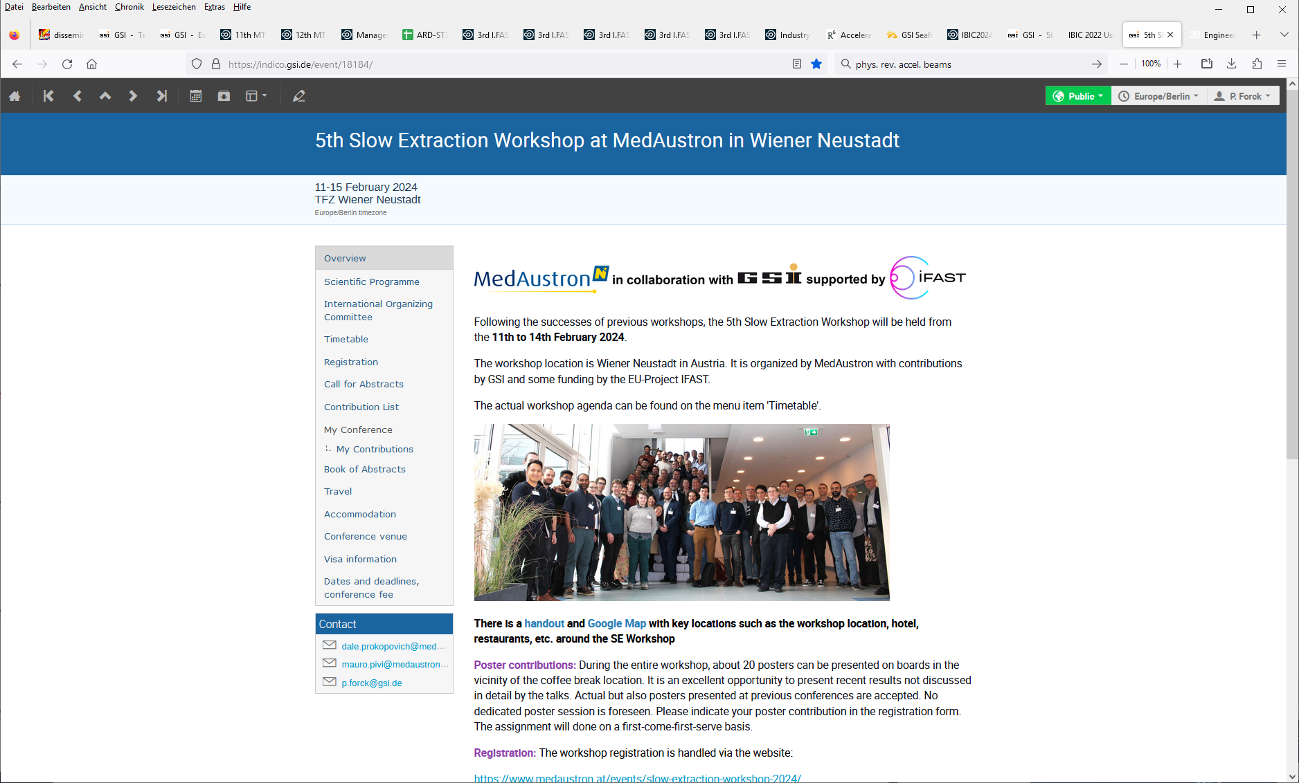
Slow Extraction Workshop 2024
Organized by MedAustron & GSI, sponsored by IFAST
Goal: Expert meeting for all aspects of slow extraction
Frame: International workshop started 2016 at GSI
Date: 11th to 15th Feb. 2024 in Wiener Neustadt, Austria
Subjects: Facility Overview, Spill Ripples & Beam Quality,
Hardware and Machine Protection,
Managing Extraction Efficiency, Septa Development,
Optimization & Machine Learning, MedAustron tour
Program: 60 talks, 7 discussions, 1 tutorial, 10 posters
Participants: 63 from Europe, US, Japan, China
https://indico.gsi.de/event/18184/
Result:
All major experts participated
Very intense discussion and knowledge transfer
Recognition of IFAST-REX contribution
Follow-up workshop at BNL mid 2025

Slide 19
Status and Summary for IFAST-REX
Novel transformer (WG 1):
Successful proof-of-principle, specification almost reached, optimization almost finished by industry
Knock-out extraction control and amplifier (WG 2):
Rf-amplifier manufactured; speciality: broadband gain-flatness & immunity against reflections suited for capacitive load
Control by versatile capability of SDR implemented, contributions to GNU-based software
Experiments, simulation, and interpretation:
Ground-breaking experiments performed with dedicated excitation and feedback & broad to operational usage
Further experiments performed at several facilities, significant improvements demonstrated and operational
e.g. CERN & MedAustron: Empty bucket channelling, COSE, rf-knock-out; CERN & GSI: Diagnostics improvements
Usage of Xsuite by most members ⇒ advantage for networking
Network with intensive discussion between participants
Publications with IFAST acknowledgement: 7 conformance proceeding, 3 referred papers in 2023-24
Milestone MS20 reached and reported in May 2023 (month24)
On very good track for Deliverable D5.3 in Feb. 2025 (month46)
IFAST-REX contributes significant to technical developments and networking !

Slide 20
The valuable work of all collaborators are warmly acknowledged
Thank you for your attention

Slide 21
Backup slides

Slide 22
Further successful Activities related to Spill Micro-Structure 2023-24
CERN:
Empty bucket channeling extraction at SPS in operation
Test of knock-out extraction at SPS
Improved beam instrumentation at PS and SPS transfer lines
GSI:
Commissioning of 80 MHz cavity for short bunch generation
Novel Cryogenic Current Comparator for extracted currents 10 nA < 1 µA with 110 kHz bandwidth
Tune measurement and simulations for stored beams close to 3rd order resonance
HIT:
Multiband knock-out excitation for clinical routine operation
Tune measurement and simulations for stored beams close to 3rd order resonance
MedAustron:
Test and comparison of various excitation signals for knock-out extraction
Implementation of empty bucket channeling
SEEIIST:
Participation in several experiments

Slide 23


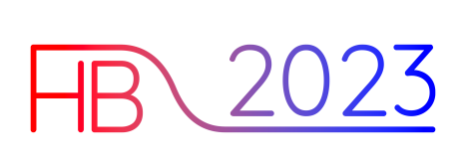


Dissemination including IFAST-REX Acknowledgement 2023-24
IPAC 2023:
P. Forck et al. (entire IFAST-REX consortium), ‘IFAST-REX: An initiative for the mitigation of beam current fluctuations in slow extraction’
J. Yang, P. Forck, R. Singh, S. Sorge (GSI), ‘Study on spill quality and transit times for slow extraction from SIS18’
P. Niedermayer, R. Singh, G. Franchetti, E. Cortés García, E. Feldmeier, T. Haberer (GSI, HIT),
‘Investigation of micro spill in RF KO extraction using tailored excitation signals’
F. Kühteubl et al. (MedAustron, CERN), ‘Investigating alternative extraction methods at MedAustron’
T. Bass, E. Johnson, M. Fraser, Y. Dutheil, P. Arrutia Sota, S. Gibson (CERN, University Oxford, Royal Holloway London),
‘Benchmarking simulations of slow extraction driven by RF transverse excitation at the CERN Proton Synchrotron’
IBIC 2023:
Contributed Talk: P. J. Niedermayer, R. Geißler, R. Singh (GSI), ‘Software Defined Radio Based Feedback System for Transverse Beam Excitation’
HB 2023:
Invited Talk: E.C. Cortés García, E. Benedetto, E. Feldmeier, T. Haberer, M. Hun, P. Niedermayer, R. Singh, R. Taylor (HIT, GSI, CERN, SEEIIST),
‘Spectral modification for BTF-based tune measurements close to a 3rd-order resonance’
Refereed publications:
P. Niedermayer, R. Singh (GSI), ‘Excitation Signal Optimization for Minimizing Fluctuations in Knock Out Slow Extraction’,
Scientific Reports, under review
E.C. Cortes Garcia, P. Niedermayer, R. Singh, R. Taylor, E. Benedetto, E. Feldmeier, M. Hun, T. Haberer (HIT, GSI, CERN, SEEIIST),
‘Interpretation of the horizontal beam response near the third integer resonance’, in preparation for Phys. Rev. Accel. Beams
Philipp Niedermayer, Rahul Singh (GSI), ‘Excitation of nonlinear second order betatron sidebands for Knock Out slow extraction at the 1/3 resonance’,
in preparation for Phys. Rev. Accel. Beams

Slide 24
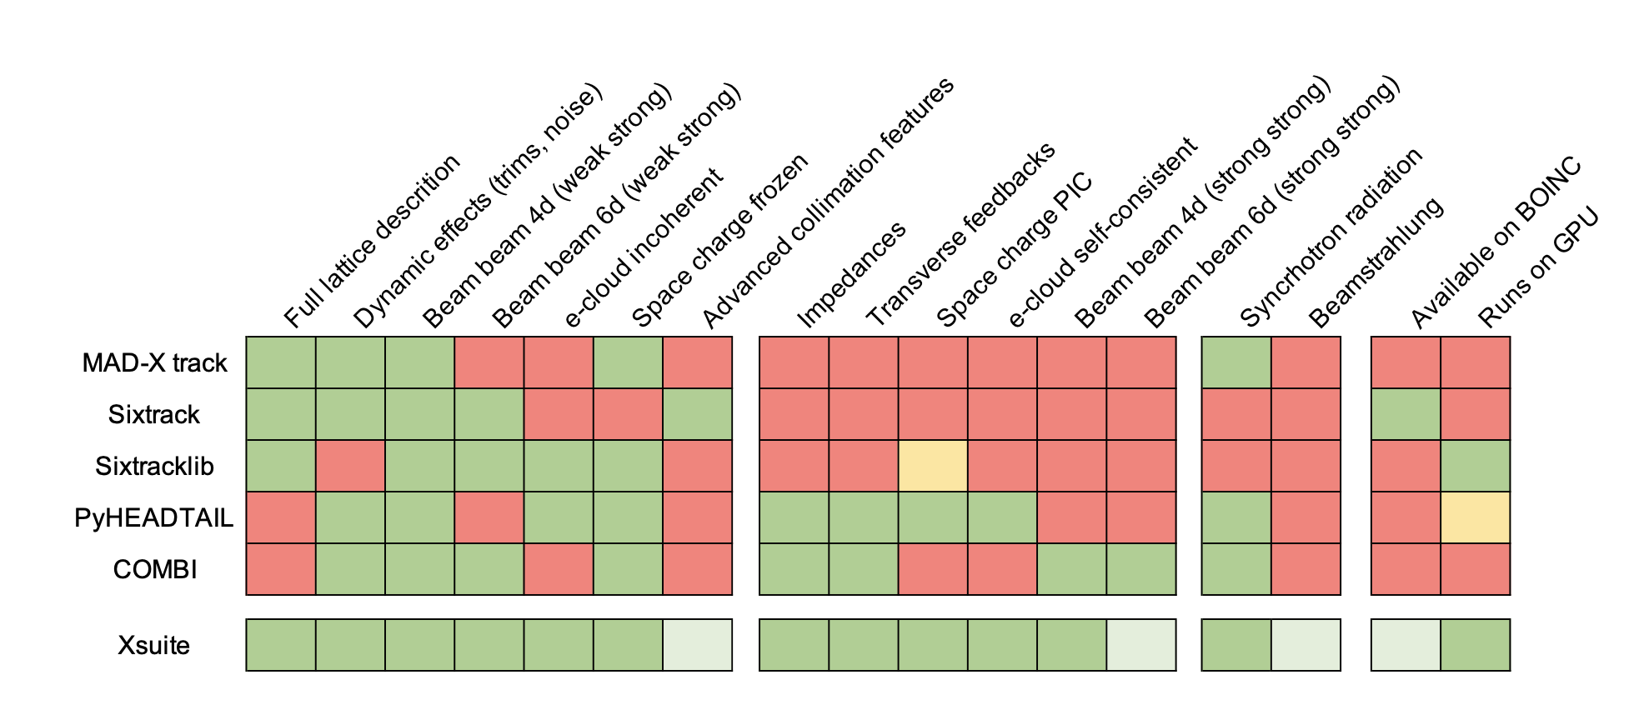


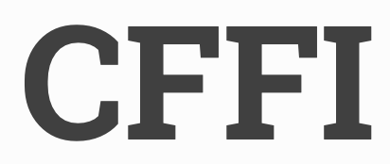





Simulation: Usage of Xsuite
Available
In development
Topic: Development at CERN with general purpose applications
Introduction by R. De Maria and G. Iadarola (CERN) for particle tracking
Not available
Experimental
Xpart
generation of particles distributions
Xtrack
single particle
tracking engine
Xfields
EM fields from particle ensembles
Xdeps
Dependency manager,
deferred expressions
Physics modules
Xcoll
Collimation methods
Xobjects
interface to different computing plaforms
(CPUs and GPUs of different vendors)
Advantage:
Combines several tasks
Input from other codes
Operated on GPUs
Contribution to additional modules
Lower level libraries
Hardware: CPU & GPU
Nowadays, used almost exclusively for slow extraction simulation
⇒ Intensive exchange between experts

Slide 25
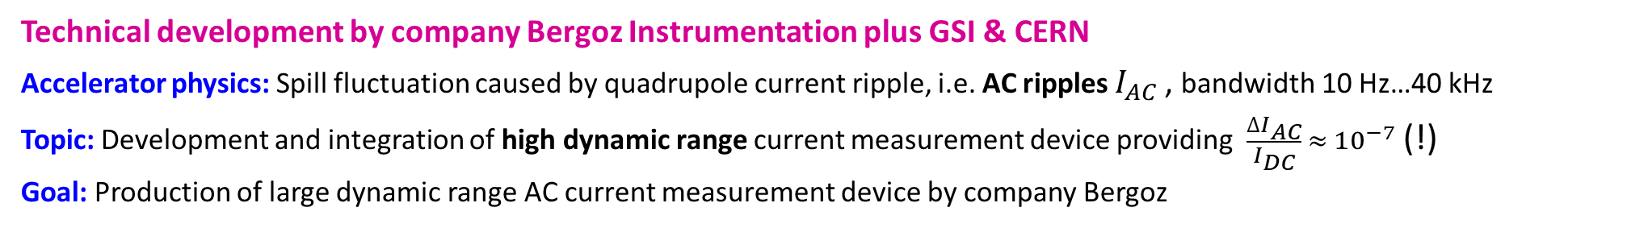
Transformer for Power Supplier (WG1): Specification
Technical development by company Bergoz Instrumentation plus GSI & CERN
Accelerator physics: Spill fluctuation caused by quadrupole current ripple, i.e. AC ripples $I_{AC}$, bandwidth 10 Hz…40 kHz
Topic: Development and integration of high dynamic range current measurement device providing $\frac{∆I_{AC}}{I_{DC}} ≈{ 10}^{−7}$ (!)
Goal: Production of large dynamic range AC current measurement device by company Bergoz
Methodology: Test device produced by Bergoz
Parameter for additional control | Main Quad SIS100
Magnet current specification
DC current min. I_{DC,min} & max. I_{DC,max} | 1 kA & 10 kA
DC current ramp gradient r_{I} | 6000 A/s
Ramp time Δt | 0.1 … 1 s
AC modulation rel. min. I_{AC,min}/I_{DC} & max. I_{AC,max}/I_{DC} | 10⁻⁴ & 10⁻²
AC modulation absolute min. I_{AC,min} max. I_{AC,max} | 0.1 & 100 A
Measurement requirements
Measurement duration t_{tot} | 20 s
Bandwidth f_{min} … f_{max} | 10 Hz … 40 kHz
Total dynamic range l | >120 dB
Measurement resolution flat-top relative ΔI_{AC}/I_{DC} | 10⁻⁷
Measurement uncertainty U_{I} | 0.1% - 1 %

