Slide 1
Thinking… inside the box?
How to solve problems creatively and apply that into your daily work
Catarina Batista & Romain Muller

Slide 2
Problem definition lunch!

Slide 3
How might we…?
Think about challenges related to the products or processes inside your team/department.
Brainstorm them in your groups and document them (sticky notes, whiteboards…)
Write them in the form of “How might we…“ questions.
These questions help us identify opportunities for design and should be broad enough to allow us to explore multiple solutions.

Slide 4
How might we…? - Examples
Problem | Users aren't aware of our product offerings.
How might we… | How might we increase awareness of the full product offerings?

Slide 5
How might we…? - Examples
Problem | Communication between product teams is slow.
How might we… | How might we make communication between product teams effortless?

Slide 6
World Café
Make up your team based on the most diverse role models in the room.
Brainstorm about the challenges.
Switch back teams again, now looking for the people you usually work with.
Build on the challenges identified on the round before.

Slide 7
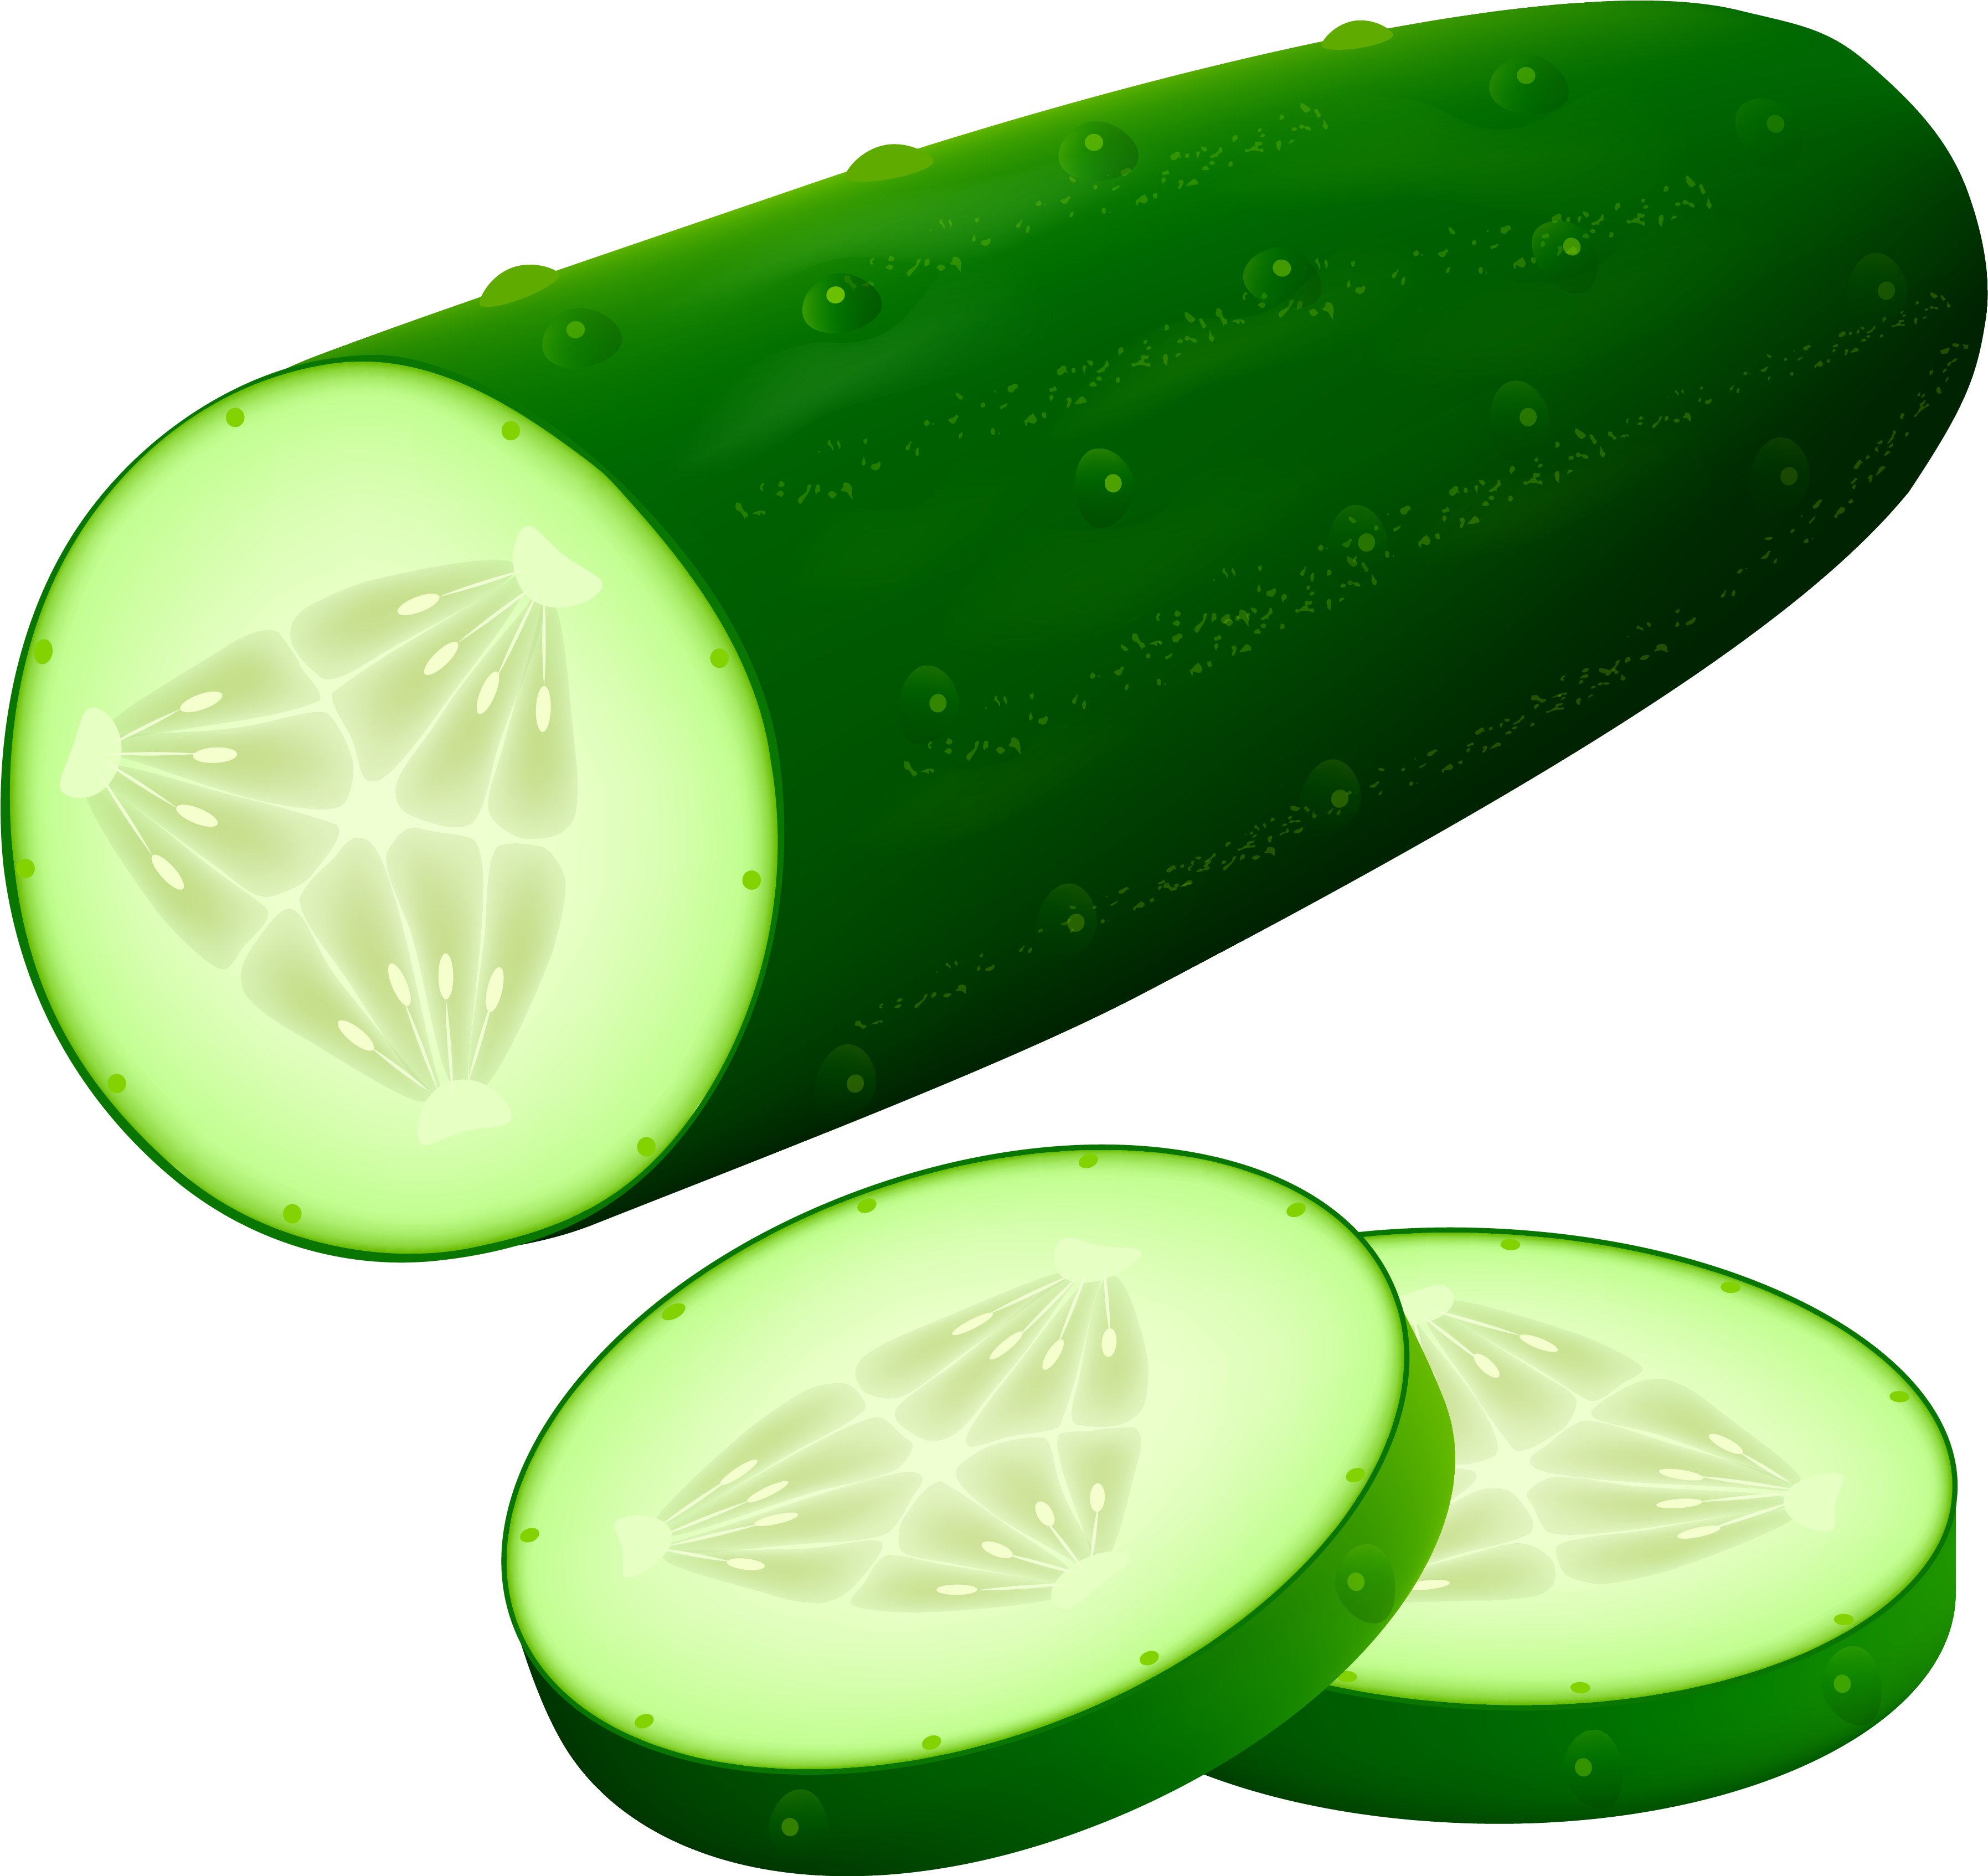
Some Methods of Lateral Thinking
Random Entry Idea Generating Tool
involves picking a random word (usually a noun) or an image and following its associations until you find new ideas that can be applied to your problem.
https://randomwordgenerator.com/
De Bono, Edward (1992)¹⁰

Slide 8
How might we make communication between product teams effortless?
Weekly spa day for updating
Create daily lunches instead of stand up meetings
Make a communal garden for team building
Monthly farm retreats for strategy planning
…
De Bono, Edward (1992)¹⁰
Notes:
Random Entry Idea Generating Tool
The thinker chooses an object at random, or a noun from a dictionary and associates it with the area they are thinking about. De Bono exemplifies this through the randomly-chosen word, "nose", being applied to an office photocopier, leading to the idea that the copier could produce a lavender smell when it was low on paper.

Slide 9

Some Methods of Lateral Thinking
Provocation Idea Generating Tool
A statement that we know is wrong or impossible but is used to create new ideas. Provocations can be set up using any of the provocation techniques—wishful thinking, exaggeration, reversal, escape, distortion, or arising.
De Bono, Edward (1992)¹⁰

Slide 10
How might we increase awareness of the full product offerings?
Choose technique.
Exaggeration.
2. Reframe initial statement.
How might we make every CERN employee aware of all the functionalities of all our products?
3. Ideate!
De Bono, Edward (1992)¹⁰
Notes:
Random Entry Idea Generating Tool
The thinker chooses an object at random, or a noun from a dictionary and associates it with the area they are thinking about. De Bono exemplifies this through the randomly-chosen word, "nose", being applied to an office photocopier, leading to the idea that the copier could produce a lavender smell when it was low on paper.

Slide 11
How might we increase awareness of the full product offerings?
Choose technique.
Reversal.
2. Reframe initial statement.
How might we make it more difficult for people to be aware of our products?
3. Ideate!
De Bono, Edward (1992)¹⁰

Slide 12
How might we increase awareness of the full product offerings?
Choose technique.
Distortion.
2. Reframe initial statement.
How might we make it so that people do not need our products at all?
3. Ideate!
De Bono, Edward (1992)¹⁰

Slide 13
Rules for Ideation
Defer judgement.
Encourage wild ideas!
Build on the ideas of others (use “and” instead of “but”)
Stay focused on the topic.
Only one conversation at a time.
Be visual.
Go for quantity.

Slide 14
Time to act it out!

Slide 15
Taking it back ”into the box”

Slide 16
How can you apply your learnings back into your daily work?
Think of one action based on your experience from today that…
…you can do as a team
…you can apply in your individual work
…you can apply to your strategy

Slide 17
Thank you!
Catarina Batista
catarina.batista@cern.ch
Romain Muller
romain.muller@cern.ch

