Slide 1
Beam Tracking
Detectors
For charged particles
Transmission detectors
Event by event (≠ monitoring)

Slide 2
Why measure the ion trajectory ?
Information about the reaction process
→ angular distributions, velocity
Identification of the particle
→ curvature radius in a magnetic field gives momentum
^{unknown distribution}
Incoming
beam
With a perfect beam
➔ track only the outgoing particles
v₀
θ₀
(x₀,y₀)
perfect beam
θ₁
θ₁
Incident angle
Position of vertex
Velocity
Scattering angle
Target
What?
Determine the trajectories of ions before the interaction point
→ positions + time of flight
Need a transmission detector, with position and time measurement on an event by event basis

Slide 3
Ion-matter interaction
(Mainly electromagnetic)
enough to detect the ion
BUT
not too much, not to perturb its trajectory
active layer
ion after
θ_{f} = θ_{i} + δθ
E_{i} = E_{i} - ΔE + δE
Q_{f} = Q_{i} + δQ
ion before (θ_{i} , E_{i}, Q_{i})
dead layer
Energy losses ΔE
Energy straggling δE
Angular straggling δθ
Charge exchange δQ
can be calculated and corrected
in the active layer ➔ gives the detection signal
Stochastic processes
➔ error on measurement
Stochastic process
➔ charge state distribution for E_{i} < 50MeV/u

Slide 4
Losses, Straggling and Detection Set-up
Material | 500MeV/u | 50MeV/u | 5MeV/u
2mm BC400 (scintillating plastic) | ΔE = 227MeV δE = 0.08MeV/u δθ = 0.4mrad | 1385 0.11 3.5 | Stopped ! Rg=70µm
0.2mm Silicon (solid state detector) | 42 0.04 0.27 | 185 0.03 2.4 | Stopped ! Rg=46µm
1cm Ar at 1bar (gas detector) | 13 0.023 0.17 | 57.8 0.01 1.5 | Stopped ! Rg=7mm
10cm C₄H₁₀ at 10mbar (low pressure detector) | 0.29 0.003 0.014 | 1.28 0.002 0.11 | 6.02 0.002 1.14
1µm Mylar© foil (window) | 0.14 0.002 0.01 | 0.64 .001 0.10 | 2.9 0.001 0.93
0.2µm carbon foil (emissive foil) | 0.02 0.0008 0.004 | 0.087 0.0006 0.035 | 0.39 0.0005 0.34
⁴⁰Ca
Slowed down BEAM and tracking activity at GSI
by
Plamen Boutachkov
e.g. HISPEC/DESPEC @ GSI : 3 to 150 A.MeV

Slide 5
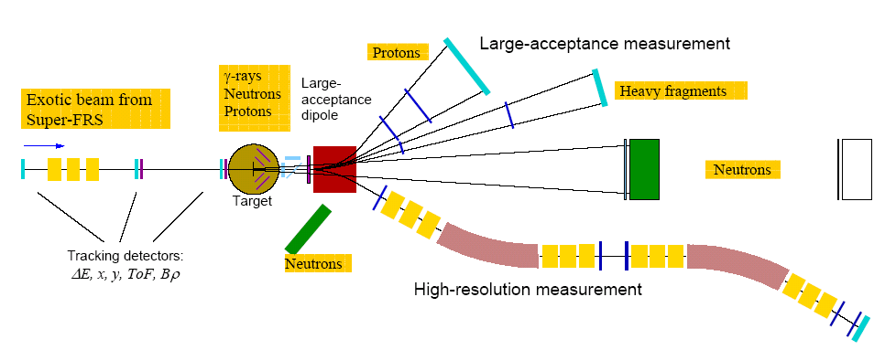
Relativistic regime : 500MeV/u
Diamond tracking for R³B @ FAIR
(2013+)
Sources:
R.Gernhäuser (TU-München)
The super FRS will provide
heavy ions with ~700MeV/u
Measurement of all kinematic variables in a HI reaction
Different tasks: High resolution tracking in the super FRS,
radiation hard (SFRS) 10⁶ cm⁻¹ s⁻¹
2 x TOF (SFRS – target) (reaction products)

Slide 6
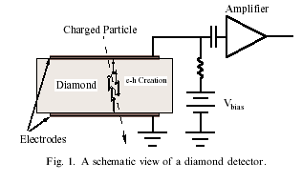
Short characteristics of CVD diamond detectors
Diamond as a detector material
low capacitance
low noise
good heat conductivity
  ( 5 x higher than Cu )
large band gap of 5.5 eV
small signal (< half of a Si of similar size)
high charge carrier velocity saturation
fast pulse response time
Diamond Crystal production
chemical vapour deposition (CVD)
commercial production
polycrystalline diamonds (PCD)
  thickness 50-500µm
  max size ~ 5x5cm2
  price ? (100 euro/det.)
single crystal diamond (SCD)
  smaller (max 25x25 mm2)
  better performance (energy resolution)
  more expensive (5xPCD)
Cr-Au foil ~0.1μm
Diamond detectors performance
very fast timing
pulse risetime: 200 ps
width: 2ns (PCD) 5ns (SCD)
operating voltage 1 V/μm
radiation hardness
-Tests with 2x10¹⁵ p/cm² did not show any significant deterioration of a sig./noise
-pumping effect (PCD) : improvement with increasing dose
position resolution
below 10μm can be achieved with strip detectors X and Y
efficiency
70%PCD-100% SCD
Diamonds as TOF detectors
  tests with 1GeV/u U beam resulted in TOF of σ=20 ps
Source: M. Gorska (GSI)

Slide 7
Virtues & Flaws of diamond detectors
☺
- Radiation hard (>2.15p/cm²)
- low occupation time ➔ high counting rate 10⁷pps
- ultra fast signal ➔ time resolution σ = 30ps
- reasonable energy resolution σ = 17keV (single crystal)
☹
- small size, biggest in use 60x40mm² [PCD, Cave A @ GSI]
- thickness > 50µm ➔ restricted to high energy
- require high speed electronics
- single crystals have better performances but
are smaller (few mm²) ➔ Mosaic detector ?
➔ very promising technique, lot of developments

Slide 8
Relativistic regime : 500MeV/u
KaBes on the NA48 exp @ CERN (in use)
The micromegas TPC
B. Peynaud, NIM A 535 (2004) 427
Study of CP violation by the simultaneous detection of K⁺ and K⁻
Need to measure trajectories to obtain the momentum of individual Kaons (~60GeV/c)

Slide 9
Time projection Chamber with Micromegas
Drift (-HT 2)
Drift Region
h=6cm
v_{e-} = 8cm/µs
Drift time
=
Y position
Gaz
(Here: Ne(79%)+C2H6(11%)+CF4(10%) )
the electrons have a constant velocity in the drift zone
i⁺
E ~ 900V/cm
ionization
point
e⁻
Amplification gap
< 100 μm
Mesh (-HT 1)
E ~ 50 kV/cm
strips
A fast avalanche occurs in the short gap
➔ fast electron signal
➔ no signal from the drifting ions because of the shielding mesh
charge readout
Each strip gives an independent time signal
➔ high counting rate
2 orthogonal detectors required to have X and Y

Slide 10
KaBes drift chambers for real
Performances
Time resolution = 0.7 ns (σ)
Spatial res. of 70 μm
40 MHz, expected up to 1GHz
Efficiency close to 100 %
Drift
field
Amplification
region

Slide 11
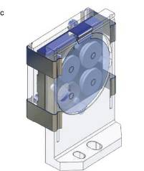
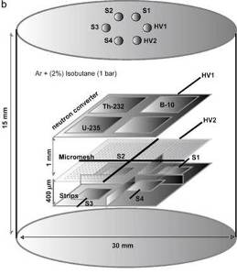
Virtues & Flaws of Micromegas TPC
☺
- Radiation hard
- Very high counting rate : up to 10⁹pps !
Very good position resolution < 100µm
Bulk micromegas : robust and easy to build
☹
- 1 direction only
- Moderate energy resolution (~10%)
- Need an independent time signal for trigger
Micromegas Technology
by
Thomas Papavangelou
Micromegas gas detectors have a wide range of applications since the “drift zone” can include a converter that produce electrons from any kind of initial radiation
e.g. piccolo micromegas
for neutron detection
J. Pancin & al. NIMA 592 (2008) 104

Slide 12
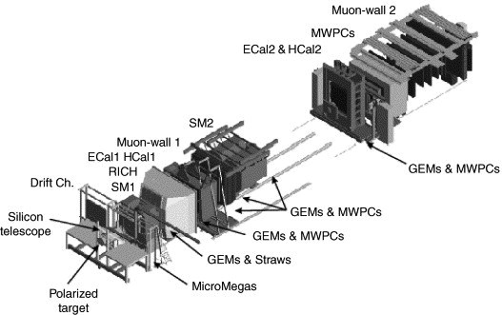
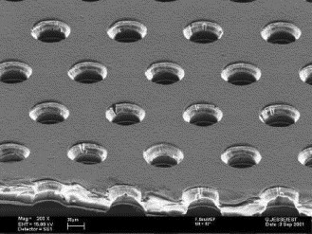
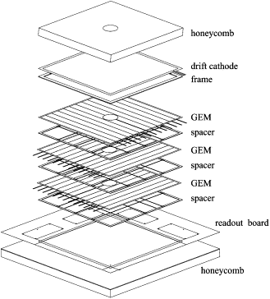
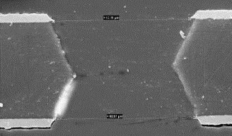
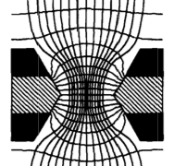
Relativistic muons
GEMs in the COMPASS experiment @ CERN
Gas Electron Multipliers
140µm
70µm
Copper →
Kapton→
50µm
Copper →
Ar + CO₂ mixture
Readout → X and Y

Slide 13
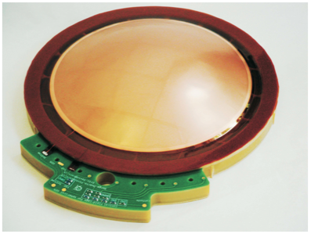
Virtues & Flaws of GEM
☺
Radiation hard
Large size (>1m²)
- Very high counting rate : 10⁵Hz/mm²
- Excellent position resolution σ ~ 40µm
☹
Moderate gain (~30-50) but several stages can be added
Dead zones due to spacers
Poor energy resolution (~27%)
High capacitance ➔ strong discharges
Gas Electron Multiplers
by
Serge duarte Pinto
Spherical GEM
for parallax correction !

Slide 14
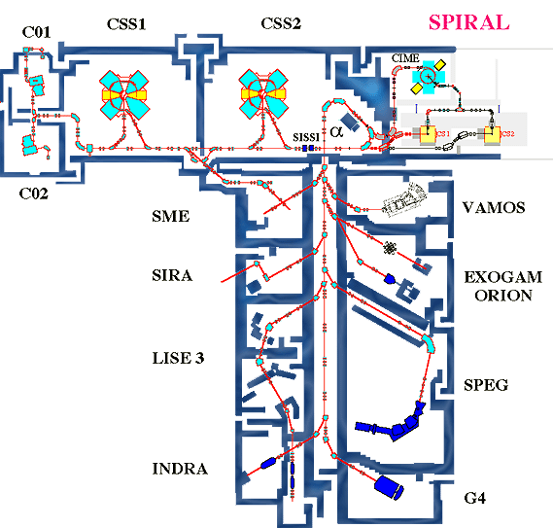
Intermediate energy : 50MeV/u
CATS detectors at GANIL, Caen (in use)
In Beam low pressure MWPC
Beam
Tracking
Detectors
proton target
(polypropylene)
Fragmentation
¹²C→^{10,11}C+…
recoiling p
Target point
¹¹C identification
with a spectrometer

Slide 15
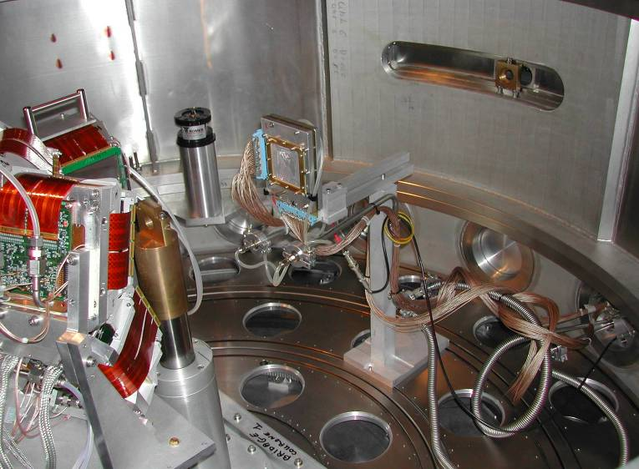
7cm
BEAM
2nd tracking detector
Target

Slide 16
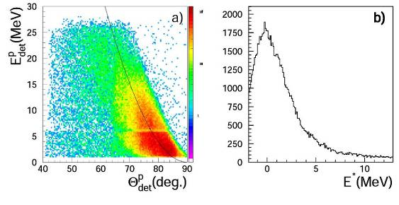
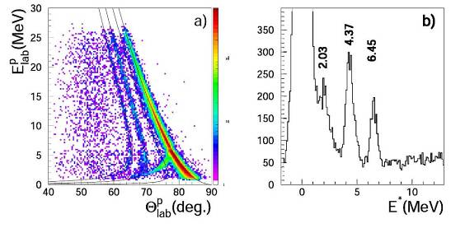
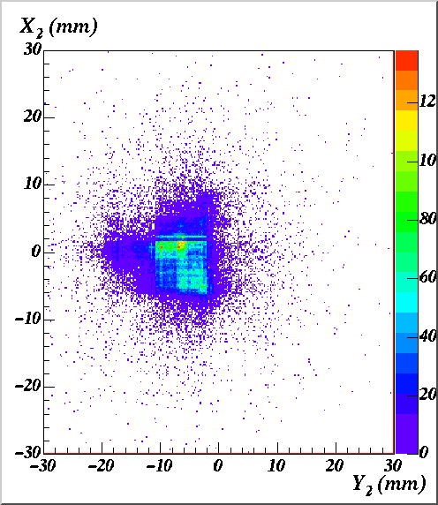
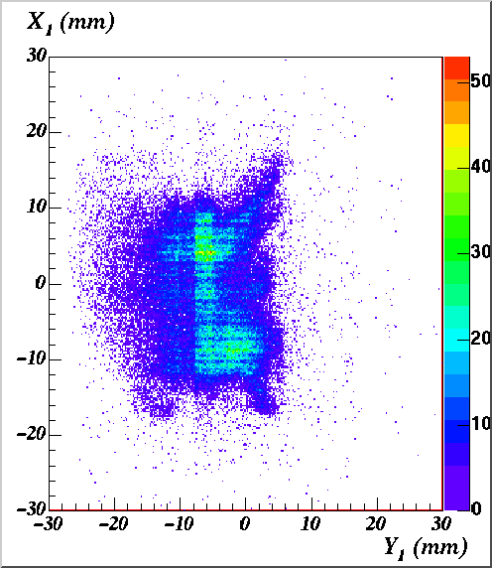
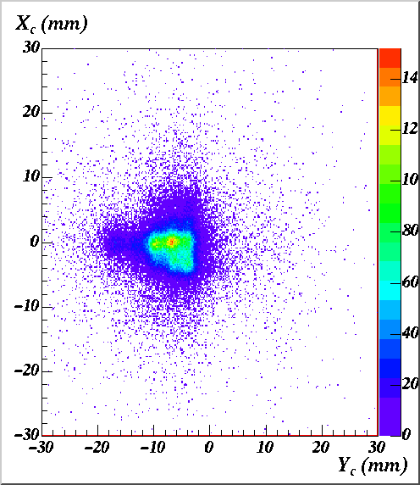
Effect of trajectory reconstruction
¹¹C+p → ¹¹C+p’ 40.6 MeV/u
C. JOUANNE
(SPHN) PHD 2002
Without
Beam Tracking
¹¹C
¹¹C
E*
Θ^{p}
Proton
E^{p}
LOW Pressure Gas detectors
by
Julien Pancin
1.5m
upstream
reconstructed
on target
With
Beam Tracking
0.5m
upstream
Large Beam emittance ~10π mm.mrad (hor+vert)

Slide 17
Virtues & Flaws of in-beam low pressure MWPC
☺
- fast signal ➔ good time resolution σ = 100ps
- good position resolution σ = 100µm
- high detection efficiency (~100%)
- large size available (>100cm²)
- cheap and can be repaired
- Thin : ~5µm of Mylar (from windows and cathodes)
☹
- vulnerable to discharge : rate ~ 10⁵pps
- 1.5µm windows required ➔ E_{ion} > 10MeV/u
- fragile and delicate to use

Slide 18
Very low Energy regime : 5MeV/u
e.g.: SPIRAL/SPIRAL2 radioactive beams
(in use / 2014)
Tracking at
Focal plane
Target
point
Beam

Slide 19
Emissive foil Detectors
Emissive foil
(Mylar+Al, Carbon)
Very low thickness
< 1µm foil
Ions
Secondary
electrons
B
E
Secondary emission
- low energy electrons (few eV)
- depends on the material (CsI…)
- surface process
- proportional to dE/dx
Electron detector :
Micro-channel plate
Gaseous detector
Scintillator
…

Slide 20
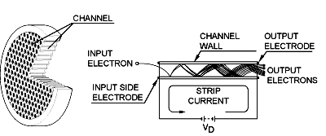
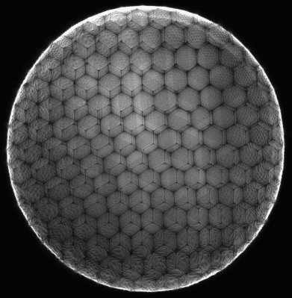
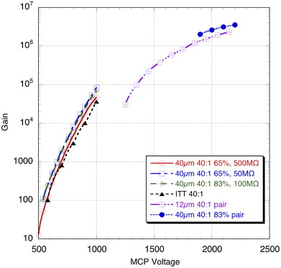
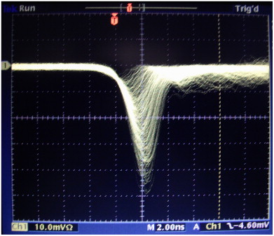
Micro Channel Plates
ϕ=10-40µm
<10cm
0.4-3mm thickness
Borosilicate MCP developments 20x20cm² !
- Superposition of resistive and photo-emissive (Al₂O₃) atomic layers
- Similar gain as standard MCP
Micro Channel plates
by
Michael Pfeiffer
- Fast signals
- Poor uniformity (±10%)
paired MCP
single MCP
O.H.W. Siegmund & al.
NIMA 639 (2011) 165
2ns

Slide 21
Low Pressure Gas Detector
LOW Pressure Gas detectors
by
Julien Pancin
Focal plane size : 10 x 40 cm²
A. Drouart & al, NIM A579, ( 2007) p1090

Slide 22
Virtues & Flaws of Emissive foil detectors
☺
- Detector as thin as it can be ( down to 20µg/cm²)
- Fast signal ➔ good time resolution σ < 100ps
☹
Poor sensitivity to high energy, light ions
Moderate position resolution σ~600µm
Require high electric field and/or magnetic field
Characteristics depend on the secondary electron detector
- gas detector : large size
- micro channel plate : high counting rate
- scintillating plastic : easy to use

Slide 23
Conclusions
Beam tracking requires
➔ low thickness not to perturb the incoming ion
➔ good position and time resolution
➔ cope with high flux of particles
Technique | Regime MeV/u | σ(time) ps | σ(pos.) µm | Max rate Hz
Diamonds | 500 | 30 | 10 (strip) | 10⁷
Atm. pressure | 500 | 700 | <100 | 10⁸
Low pressure | 50 | 500 | 150 | 10⁵
Emissive foils | 5 | 100 | 500 | 10⁶⁻⁷

Slide 24
Thank you
for your
Attention
Enjoy the next talks !

Slide 25
Losses & Straggling : estimations
Energy loss : Bethe-Bloch formula
dE/dx = k x (ρZ/A) x (z/β)² x (correction factors)
➔ fairly known…
Projectile charge state and velocity
Material charge density
Stragglings
Empirical formulae
Energy: D. Guillemaud-Mueller & al, IEEE 33 (1986)343
Angle: R. Anne & al., NIM B 34 (1998) 295
<δθ²> = 0.250Z x (Z+1) x (z/A)²/β⁴ [T. Joy, NIM 106 (1973) 237]
Monte Carlo Code
SRIM (Ziegler & al.)
Projectile charge, mass and velocity
Material atomic number
Charge exchange
Also very empirical…
V.S. Nikolaev et I.S. Dimitrev Phy Let 28A (1968) 277
K. Shima & al., At Data and Nuc Data Tables 34 (1986)357 et 51 & (1992) 173
K. Shima, N. Kuno, M. Yamanouchi Phys Rev A 40 (1989)
R.N. Sagaiadak, A.V. Yeremin NIM B93 (1994) 103

Slide 26
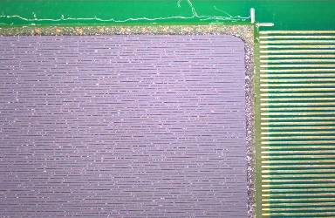
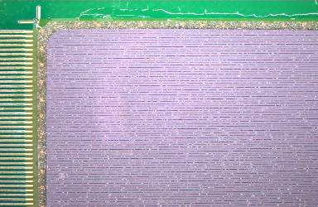
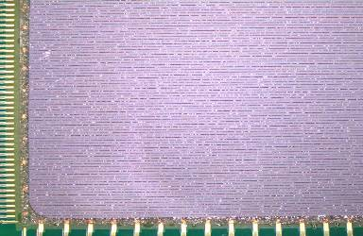
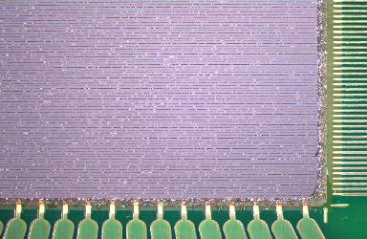
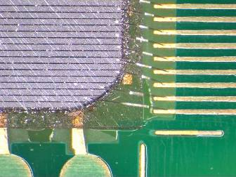
Current developments : Larger Area Single crystal
4 prototypes produced
2 operational
lithography under control
Frontside:
128 strips
170 μm wide 20 μm gap
Backside:
16 strips
25.4 mm
M.Boehmer, TU Muenchen, PhD Thesis (2006)

Slide 27
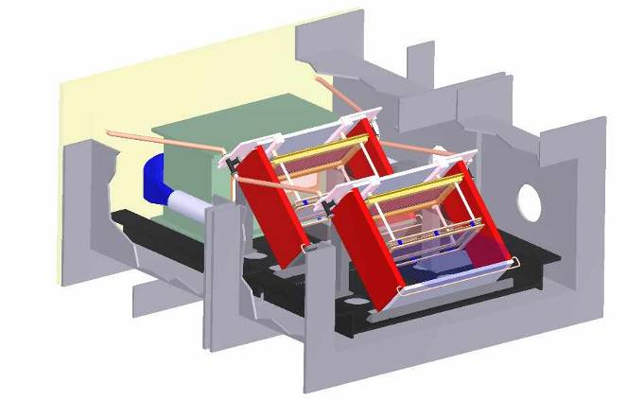
Se⁻D in VAMOS

Slide 28
Results of tests & experiments
Ions | E (MeV/A) | dE/dx (MeV/mm) | Efficiency | Time resolution (FWHM ps)
Heavy Fission frag. Average Z~53 | 0.6 | 13800 | 100% | 250
Light fission frag. Average Z~45 | 1 | 13200 | 100% | 250
⁷⁶Ge | 2 | 10500 | 100% | 500
²⁴Mg | 12 | 1050 | 85% | 800
¹²C | 10 | 320 | 75% | 1000
Alpha | 1.5 | 160 | 40%(70%*) | 1200*
Conclusions
Detector able to cope with a few 10 ³pps (limited by electronics dead time)
theoretical limit ~10⁷pps or more ?
Spatial resolution : 1-2mm
Time resolution : 1.5ns (light ions) to 300ps (heavy ions Z>40)
Total thickness in the beam : 0.6μm Mylar foil = 75μg/cm²

Slide 29
Beyond Conclusions...
Residual gas detectors
For a vacuum in the beam line ~10⁻⁶mbar
⁴⁰Ar @ 3A.MeV looses 23eV/cm
➔ need higher pressure ~10⁻³ mbar
but difficult to contain
Can be replaced
by a more
Sensitive/rapid
device
Existing residual gas detector @10⁻⁶mbar with MCP
(Barabin & al. EPAC2004)

