Slide 1
MICROMEGAS TECHNOLOGY
Thomas Papaevangelou
IRFU, Centre d’Etudes de Saclay, Gif sur Yvette CEDEX, France
6th DITANET Topical Workshop on Detection Techniques
Centro Nacional de Aceleradores - CNA
Seville , Spain

Slide 2
Outline
Description
  Technology, meshes
  Bulk Micromegas
  Microbulk
  Micromegas on a chip
  Resistive
Performance
  Gain, stability and uniformity
  Resolution
  Sparks
Applications and examples
  Particle Physics
  Nuclear Physics
  Applied science

Slide 3
The detector

Slide 4
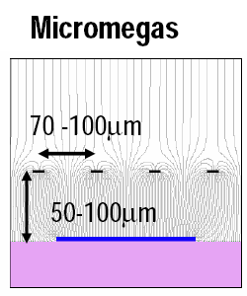
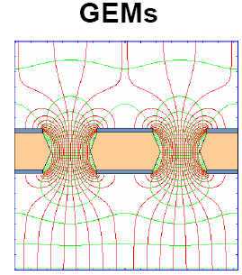
Micro Pattern Gaseous Detectors (MPGD)
Best technology for gaseous detector readout:
Micro Pattern Gaseous Detectors
more robust than wires
no E×B effect
fast signal & high gain
low ion backdrift
better ageing properties
easier to manufacture
lower cost
big surfaces
Talk by Serge Duarte Pinto
Notes:
Giomataris et.al., NIM A376 (1996) 29
F. Saul, NIM A386 (1997) 531

Slide 5
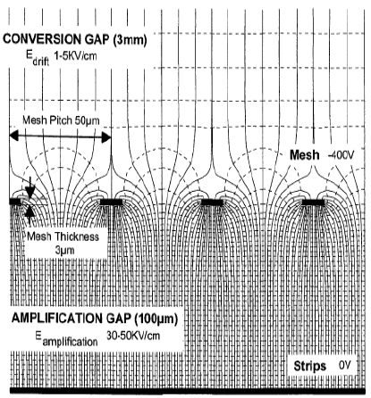
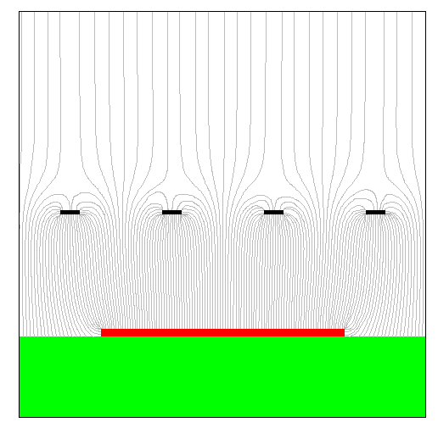
Micromegas Concept
Drift field
typical 10²⁻³ V/cm
γ
Two-region gaseous detector:
Conversion region
  Primary ionization
  Charge drift
Amplification region
  Charge multiplication
  Readout layout
    Strips (1/2 D)
    Pixels
Separated by a Micromesh
➔Very strong and uniform electric field
Amplification field
typical 10⁴⁻⁵ V/cm
Amplification
gap: 50-100 μm
MICROMEsh GAseous Structure
Giomataris, Charpak (1996)
Y. Giomataris et al., NIM A 376 (1996) 29
In 1st Micromegas
Fishing line spacers have been used
metallic micromesh (typical pitch 50μm)
sustained by 50-100 μm pillars
simplicity
single stage of amplification
fast and natural ion collection
discharges non destructive
Mesh signal
Pixels / strips
signals

Slide 6
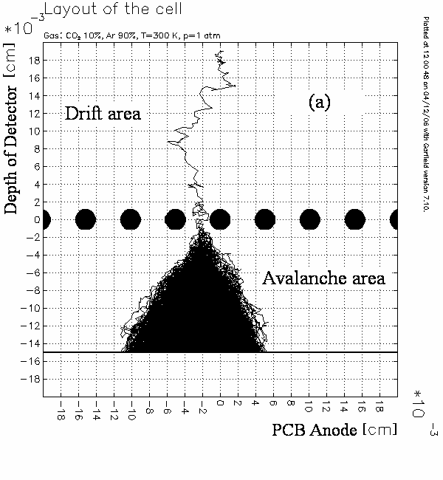
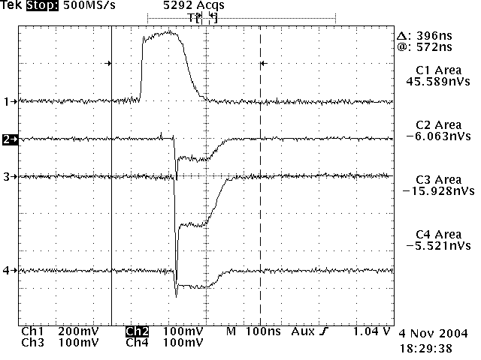
Micromegas Concept
The multiplication takes place in high E field (> 20 kV/cm)
between the anode (strips, pads) and the mesh in one stage
small size (50-100 μm)
fast signals (< 1 ns)
short recovery time (~150 ns)
high rate capabilities (> MHz)
high gain (up to 10⁵ or more)
A GARFIELD simulation
of a Micromegas avalanche
(Lanzhou university)
micromesh signal
strip 1
strip 2
strip 3

Slide 7
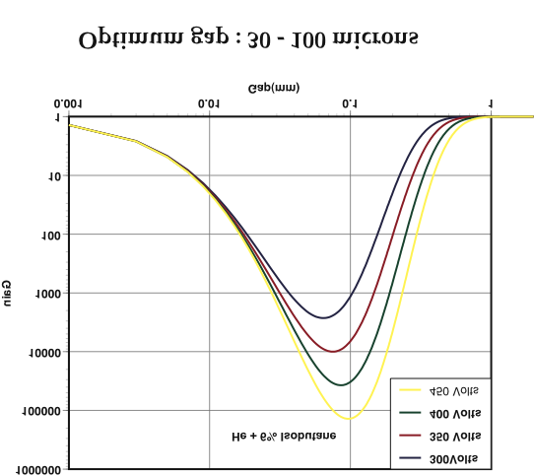
Virtue of the small gap
Parallel plate detector gain:
Townsend coefficient α:
Gain variation:
E₁
The gain variation exhibits
a minimum for :
d = V/Bp
E₁> E₂
Ref: Y. Giomataris, NIM A419, p239 (1998)
E₂
Stable gain – non sensitive to flatness defects or temperature and pressure variation
➔ good energy resolution
V

Slide 8
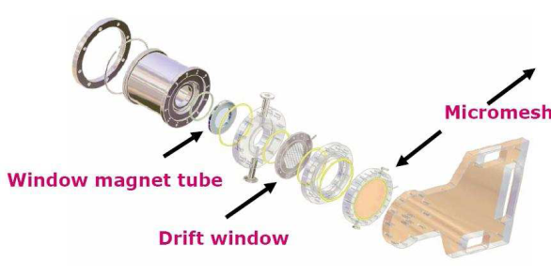
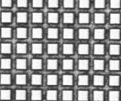
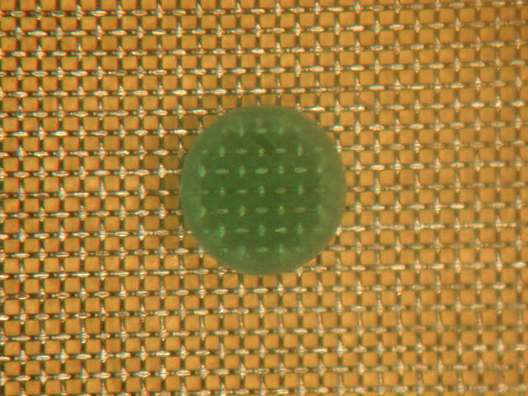
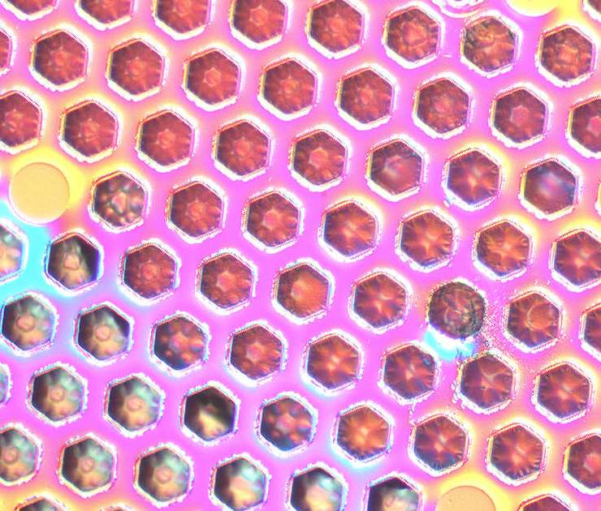
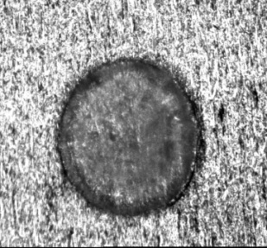
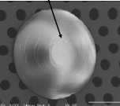
Micromegas technology
Meshes
Many different technologies have been developped for making meshes
(Back-buymers, CERN, 3M-Purdue, Gantois, Twente…)
Exist in many metals: nickel, copper, stainless steel, Al,… also gold, titanium, nanocristalline copper are possible.
Electroformed
Chemically etched
Wowen
Deposited by vaporization
Laser etching, Plasma etching…
Pillars
200 μm
Can be on the mesh (chemical etching) or on the anode (PCB technique with a photoimageable coverlay).
Diameter 40 to 400 μm

Slide 9
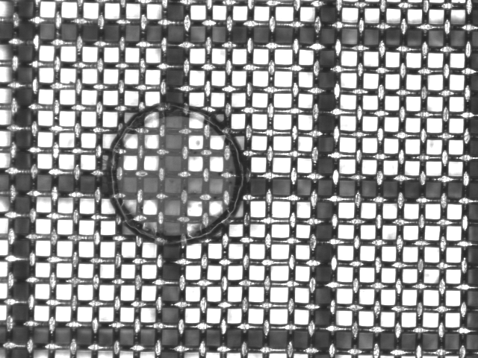
Bulk Micromegas technology
pad
Readout plane + mesh all in one
Woven Inox mesh 30 µm
pillar
vacrel 128 µm
Well established technique
Readout pads
  Result of a CERN-Saclay collaboration (2004)
  Bulking: Process to encapsulate the mesh on a PCB (mesh = stretched wires)
  Motivations for using bulk Micromegas
  the mesh is held everywhere:
  the mesh is held everywhere
  robustness , closed to dust
  can be segmented
  repairable
  large area detectors feasible and robust!
Base Material
FR4
Lamination of Vacrel
Photo-imageable
polyamide film
Positioning of Mesh
Stainless steel
woven mesh
Encapsulation
Border frame
Development
Spacer
Contact to Mesh
I. Giomataris et.al., NIM A560 (2006) 405

Slide 10
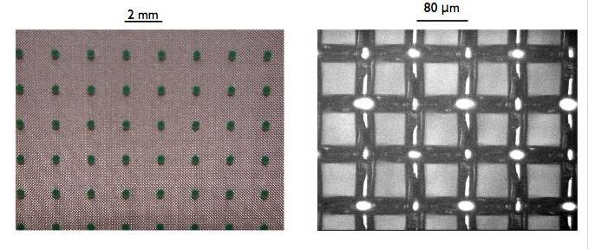
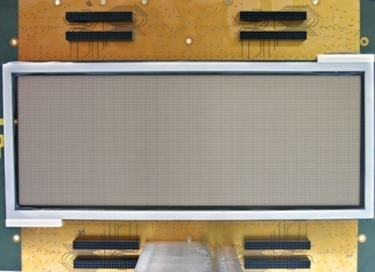
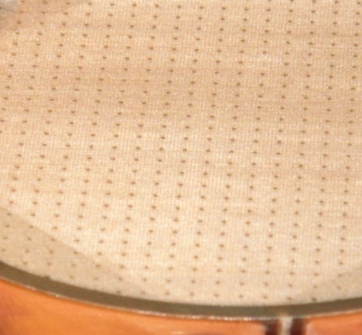
Bulk Micromegas technology
pad
Bulk Micromegas: The pillars are attached to a woven mesh and to the readout plane
  Typical mesh thickness 30 μm, gap 128 μm
  Uniformity, robustness, lower capacity, easy fabrication, no support frame, small surrounding dead region ➔
  Large area detectors feasible and robust!
  Curved surfaces
  Mass production!
  Mesh thickness & bigger gap: some disadvantages in special applications:
  Good but limited energy resolution (~18% @ 6keV)
  Restrictions on support material
  More sensitive to pressure variations
pillar

Slide 11
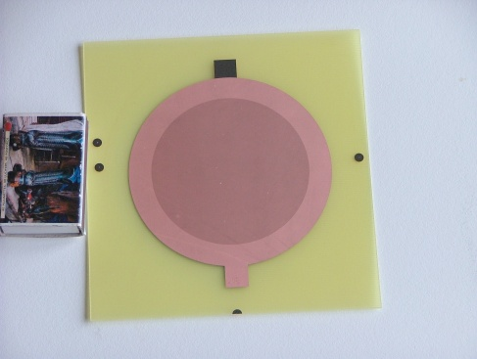
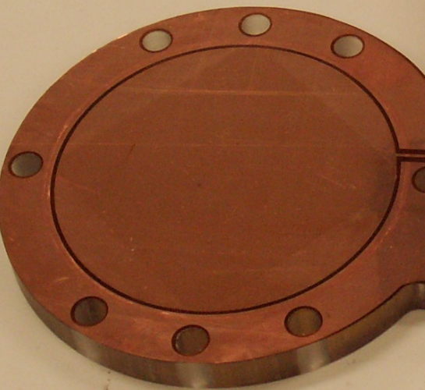
Microbulk Micromegas technology
Micromesh
5µm copper
Readout plane + mesh all in one
Kapton 50 µm
Readout pads
An I. Giomataris and R. De Oliveira idea
Microbulk Technology
  The pillars are constructed by chemical processing of a kapton foil, on which the mesh and the readout plane are attached. Mesh is a mask for the pillars!
  Typical mesh thickness 5 μm, gap 50/25 μm
  The advantages of a bulk micromegas but with enhanced performance.
  In addition: uniformity, clean materials, stability
  Energy resolution (down to 10% FWHM @ 6 keV)
  Low intrinsic background & better particle recognition
  Low mass detector
  Very flexible structure
  Higher capacity
  Fabrication process complicated
  Fragility / mesh can not be replaced
Lower capacitance
Under development

Slide 12
Microbulk Micromegas technology
Micromesh
5µm copper
Readout plane + mesh all in one
Kapton 50 µm
Readout pads
An I. Giomataris and R. De Oliveira idea
Microbulk Technology
  The pillars are constructed by chemical processing of a kapton foil, on which the mesh and the readout plane are attached. Mesh is a mask for the pillars!
  Typical mesh thickness 5 μm, gap 50/25 μm
  A microbulk has all the advantages of a bulk micromegas but with enhanced performance.
  In addition: uniformity, clean materials, stability
  Energy resolution (down to 10% FWHM @ 6 keV)
  Low intrinsic background & better particle recognition
  Low mass detector
  Very flexible structure
  Higher capacity
  Fabrication process complicated
  Fragility / mesh can not be replaced
Lower capacitance
Under development
Microbulk radiopurity:
➔ mostly Cu & Kapton
Measured with HPGe at Canfranc:
raw material (double clad kapton foil)
samples from old CAST detectors
S. Cebrian et al., Astropart. Phys 34 (2011) 354-359
Results in μBq/cm² | ²³²Th | ²³⁵ U | ²³⁸U | ⁴⁰K | ⁶⁰Co
Microbulk | <9.3 | <13.9 | 26.3±13.9 | 57.3±24.8 | <3.1*
Kapton-Cu foil | <4.6* | <3.1* | <10.8 | <7.7* | <1.6*
Cu-Kapton-Cu foil | <4.6* | <3.1* | <10.8 | <7.7* | <1.6*
*Level obtained from the Minimum Detectable Activity of the detector

Slide 13
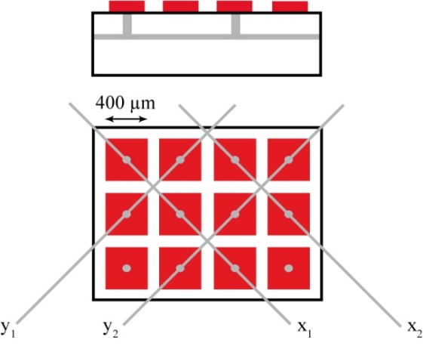
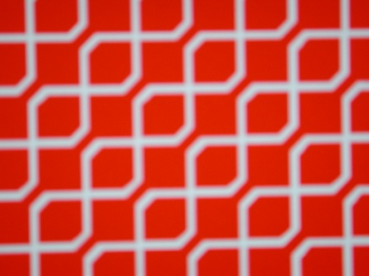
Building a 2D Microbulk
Kapton foil (50 μm), both side Cu-coated (5 μm)
Construction of readout strips/pads (photolithography)
Attachment of a single-side Cu-coated kapton foil (25/5 μm)
Construction of readout lines
Capton Etching & Vias construction
2nd Layer of Cu-coated kapton
Photochemical production of mesh holes
Kapton etching & Cleaning
2 types of 2D readout schemes:
Square pads connected through 2 extra layers
Combination of “strips” and pads connected through one extra layer:

Slide 14
Microbulk mesh types
A “standard” for 50 μm gap: 30 μm holes placed in 100 μm pitch
Alternative: hexagonal arrangement for better optical transparency
Pillars: Areas without holes & full etching underneath normal holes
  Less material / capacity

Slide 15
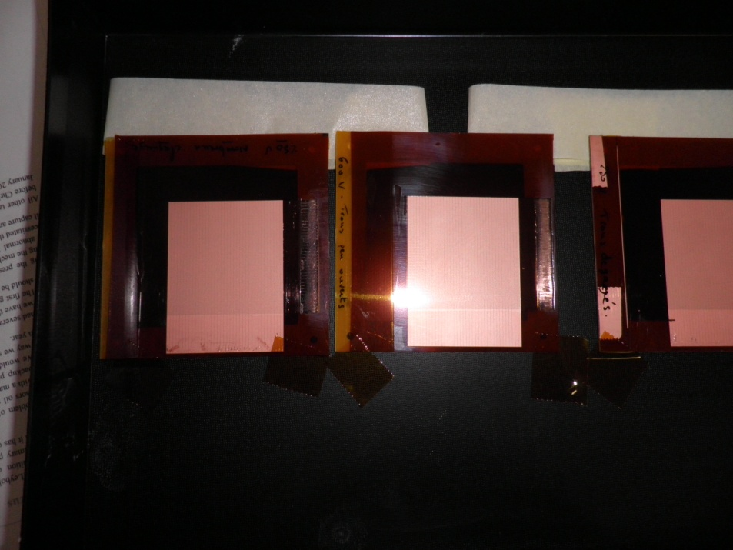
Segmented mesh microbulk
Motivation:
Production simplification
Mass minimization
Large surfaces possible
“Real” XY
Ideal for:
Low mass neutron beam profilers/detectors
Large area low background detector
Challenges:
Etching of a segment foil
No mesh trigger
➔ AGET electronics
First prototypes !

Slide 16
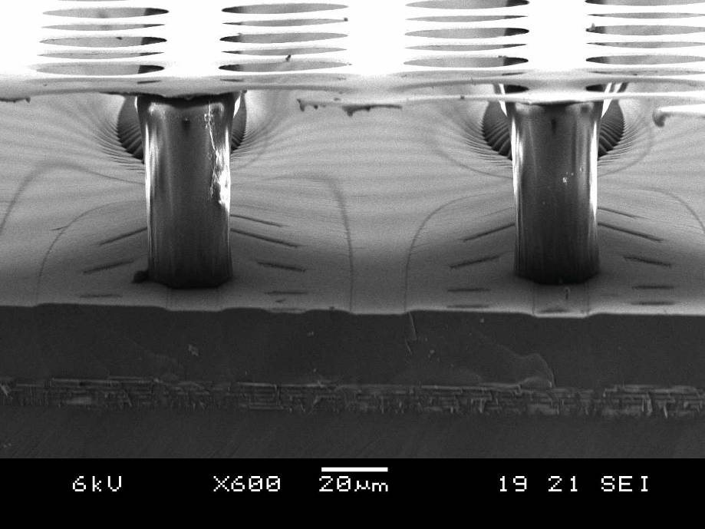
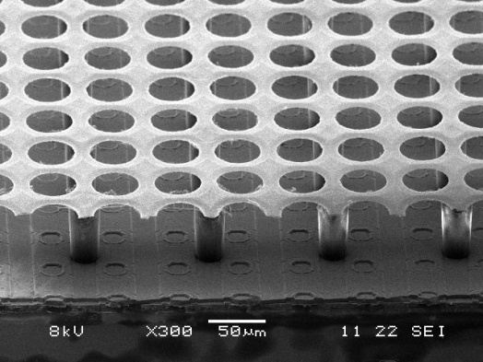
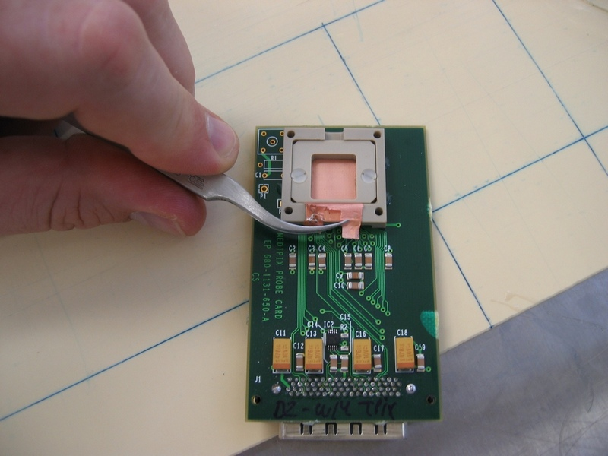
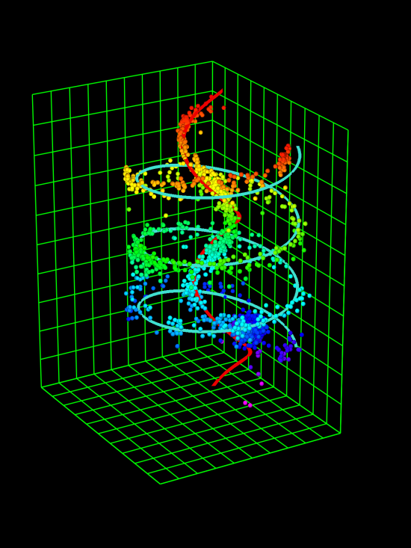
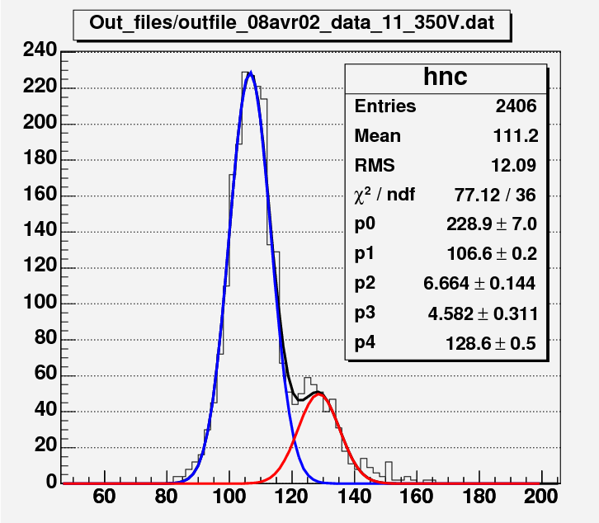
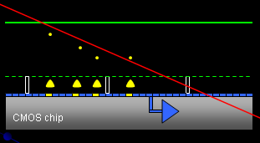
Micromegas + micro-pixels
surface: 1.4 x 1.6 cm²
Matrix of 256 x 256
pixel size: 55 x 55 µm²
InGrid technology
Medipix2
M. Cambell et al, NIMA540(2005)295
M. Chefdeville et al., NIMA556(2006)490
P. Colas et al., NIMA535(2004)506
Great resolution
Single electron counting!!
Gas On Slimmed SIlicon Pixels (GOSSIP)
Under study for ATLAS SLHC tracker
I. Giomataris
H. Van der Graaf, J. Timermans et al.
Notes:
16

Slide 17
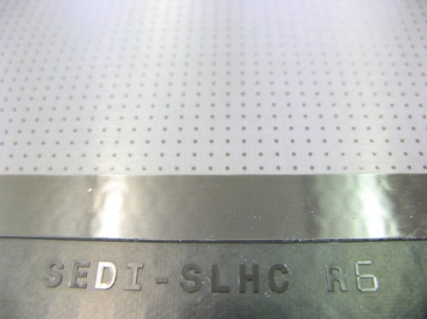
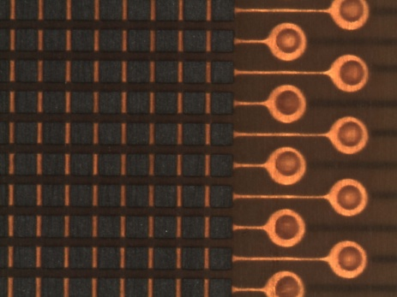
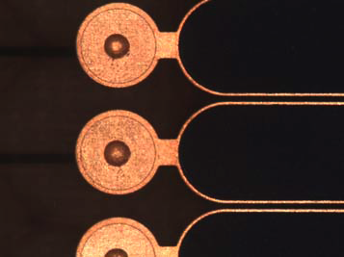
Micromegas with resistive strips
Electrode de dérive
5 mm
Protection against sparks
and/or
spread of the charge
M. Dixit et al., NIM A518 (2004), 721
Micro-grille
128 µm
Film résistif (kapton) ou pâte
(1k-500MΩ/☐)
Isolant (prepreg – 75 µm)
Anodes
Different technologies of resistive films developped @ CERN (R. de Oliveira)
Characteristics:
Resistive strips connected to the ground
Thin insulating layer between of the resistive and readout strips
AC coupling of signals
Sparks are neutralized through the resistive strips to the ground
Resistive kapton (2 MΩ/☐)
Resistive paste (250 MΩ/ ☐)
Resistive Pads
(a few tens of kΩ/☐)
Resistive strips (400 kΩ/ ☐)

Slide 18
General performance

Slide 19
Gain curves for argon mixtures
iC₄H₁₀
CO₂, CH₄
C₂H₆
Micromegas Mesh : 50 μm gap of 10x10 cm² size

Slide 20
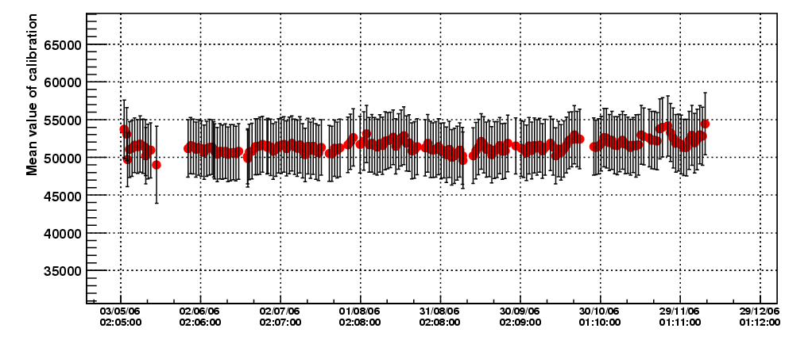
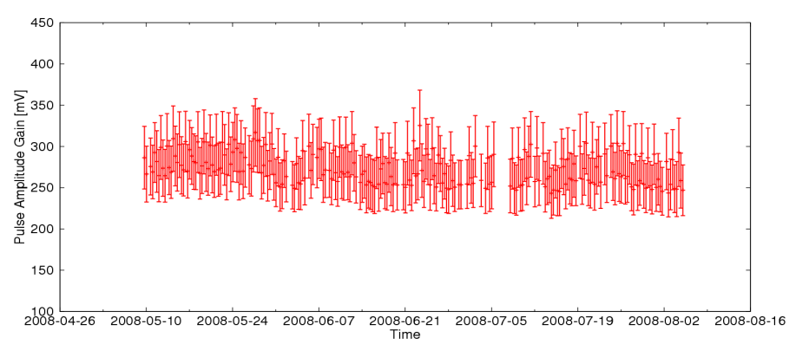
Gain stability
Conventional Micromegas (2006)
Micromegas in CAST
(2003-2011):
Excellent long term stability!
Microbulk (2011)
2% Isobutane
Bulk (2008)
Change Vmesh
From 320->324V

Slide 21
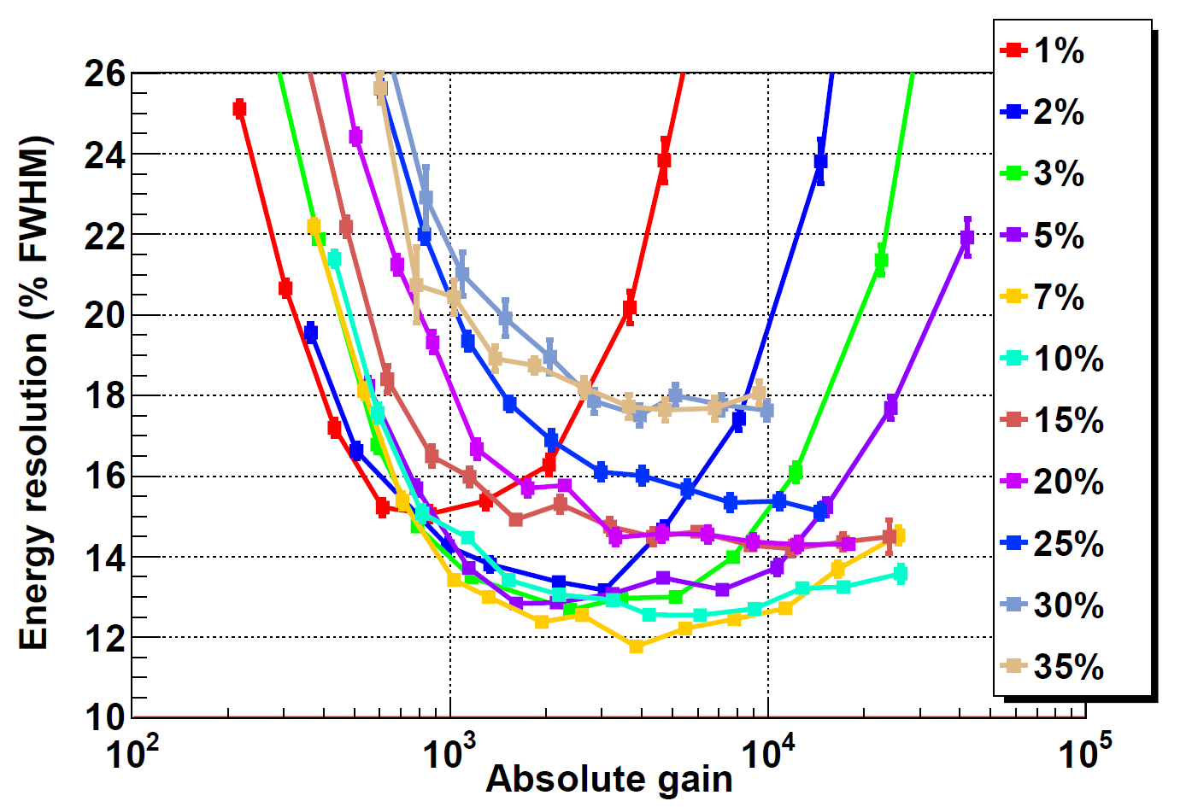
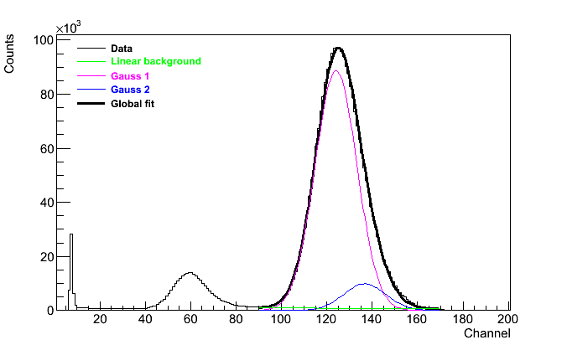
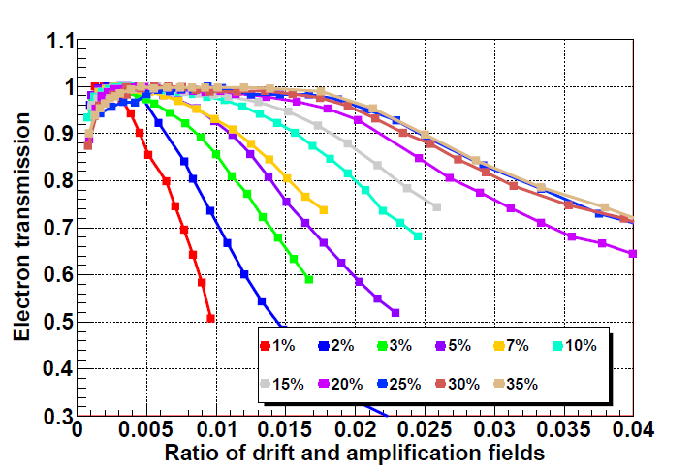
Energy resolution
Microbulk: energy resolution
optimum for gain ~5x10³ (Argon)
Bulk: ⁵⁵Fe Calibration with Ar – 5% isobutane
@ 1 bar FWHM @ 6 keV = 17.6 %
Microbulk: electron transmission
for Argon mixtures
Microbulk: ⁵⁵Fe Calibration with Ar – 5% isobutane
@ 1 bar FWHM @ 6 keV = 11.5 %

Slide 22
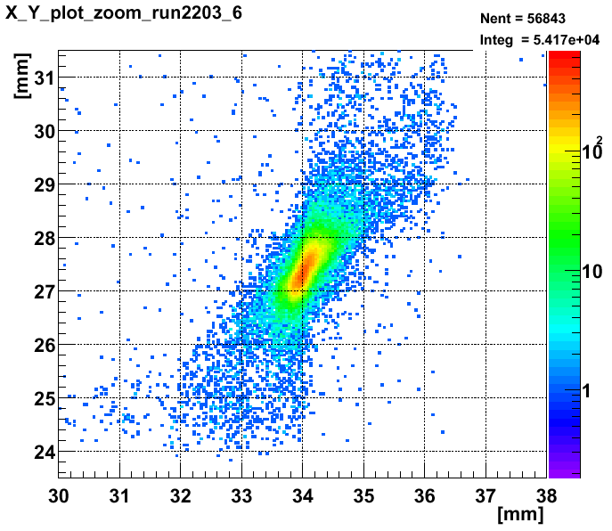
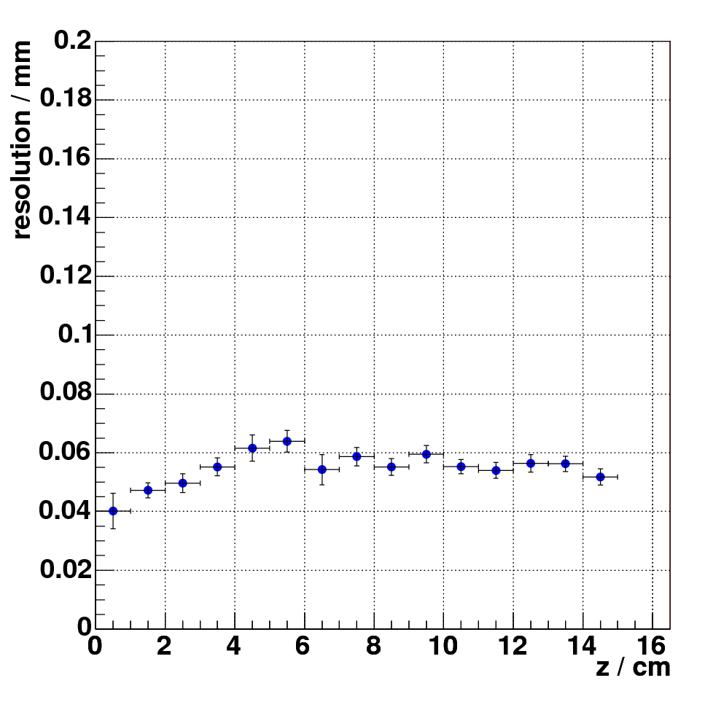
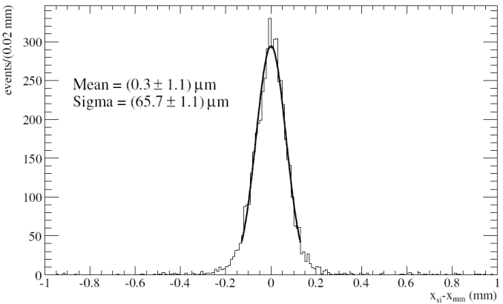
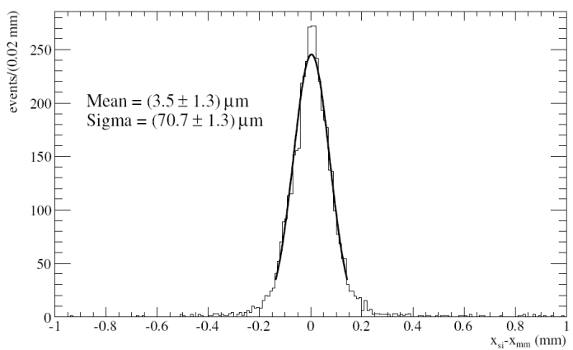
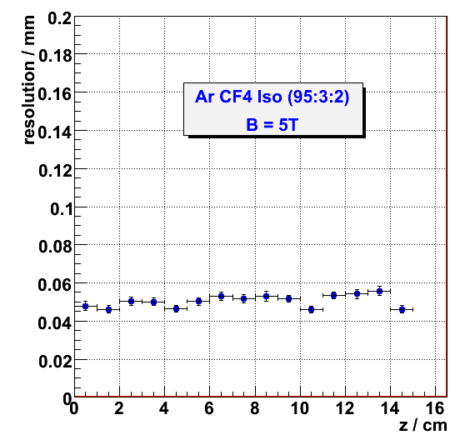
Spatial resolution
Resolution in the pressence of a magnetic field
→ σ ~ 50 µm independent of the drift distance
Conventional Micromegas calibration @ Panter with X-Ray telescope
Bulk: Spatial resolution measurements for the MAMA project (sLHC)
σ_{μΜ} = (24±7) µm .25 mm pitch
Ar Iso (95:5)
B = 5T
Microbulk: Image taken using a collimator with the words “axion cast”
σ_{μΜ} = (36±5) µm, .5 mm pitch

Slide 23
Radiation hardness
No space charge effect in radiation > 30 mC/mm² > 25 LHC years
High rate capability with 8 keV x-rays
10⁶/mm²/s
G. Puill, et al., IEEE Trans. Nucl. Sci. NS-46 (6) (1999)1894.

Slide 24
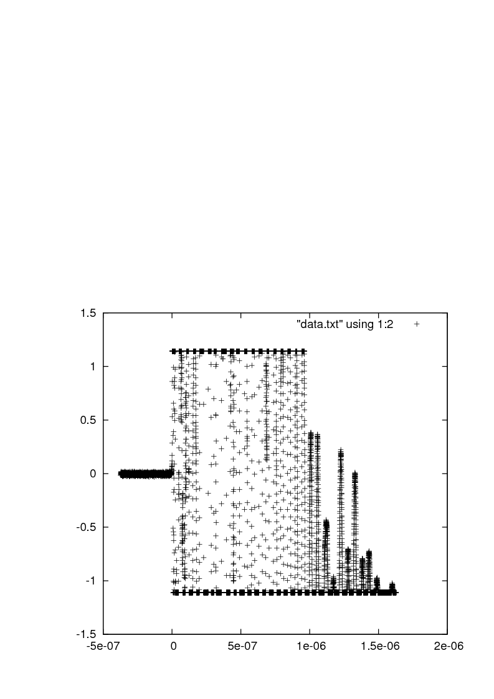
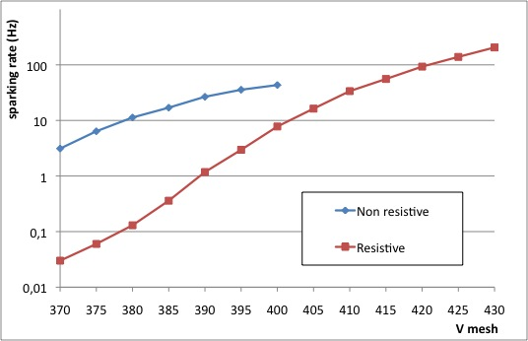
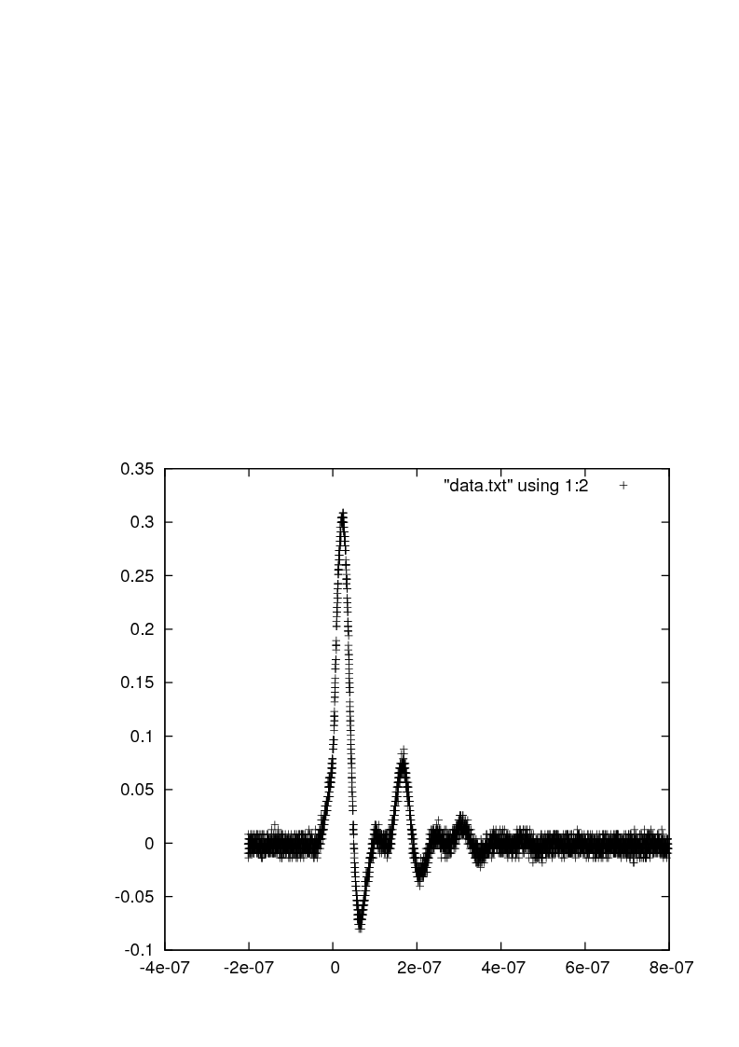
Sparking probability
Spark probability ~ 5.10⁻⁹ (He+10% isobutane @ gain ~ 10000)
Limitations due to sparks:
Dead time (up to 1 ms for mesh recharging )
Electronics destruction→ protection by diodes and decoupling capacitances
Detector damages→ Sparks not destructive!
Delbart et al., NIM A478 (2002), 205-209
SPARK in a Standard Bulk
Possibilities:
Resistive anode
Segmented mesh
Double stage amplification
Sparks are reduced by the use of resistive anodes
Topology of the sparks is very different: smaller in amplitude and shorter in time
The effect in dead time in resistive detectors is probably much smaller
SPARK in a resistive detector

Slide 25
Applications - Examples

Slide 26
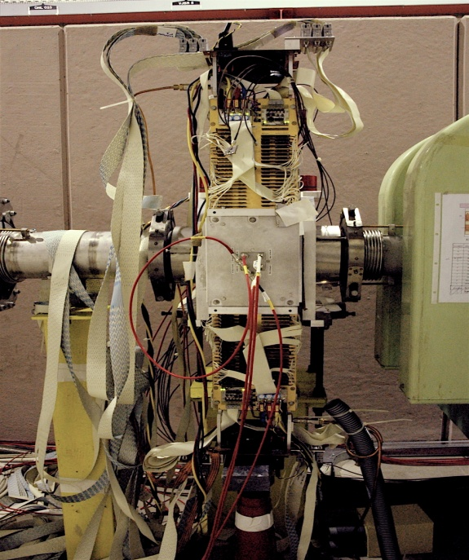
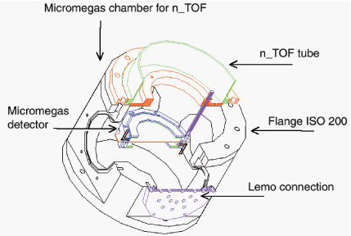
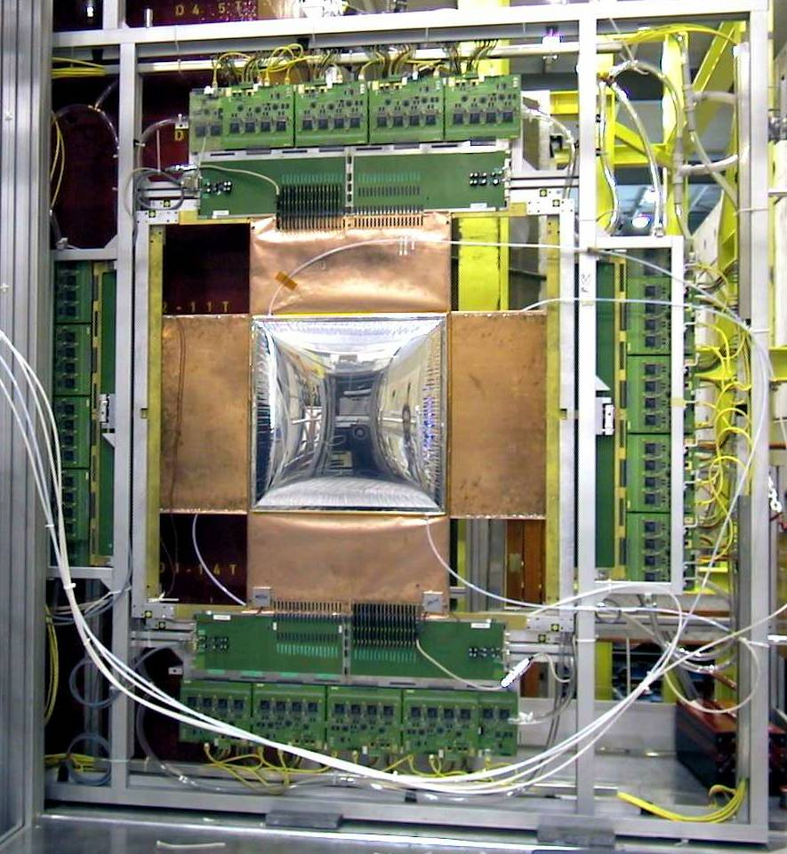
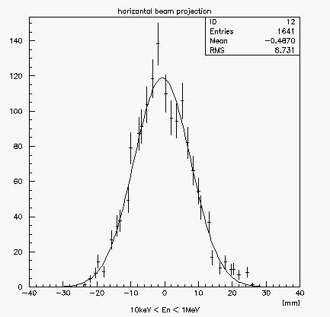
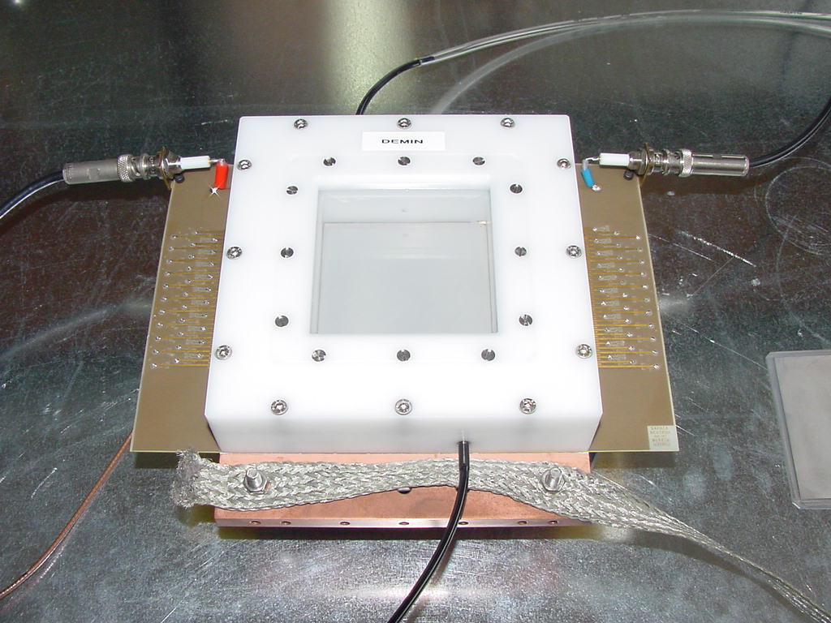
Conventional Micromegas applications
COMPASS
40x40 cm² Micromegas
NA48
High rate, high resolution
N-TOF
Micromégas Concept for Laser MégaJoule
Piccolo in Casaccia reactor

Slide 27
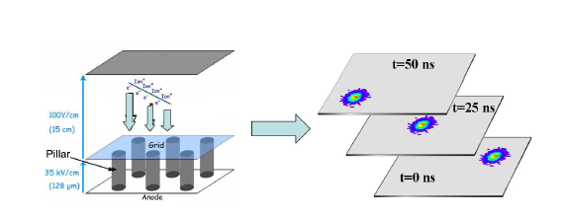



Applications of Bulk Micromegas
Prototype directional dark mater TPC: MIMAC (Micro-TPC Matrix of Chambers)
T2K
CLAS 12
Recoils from 144 keV
neutrons in 100 mbar Isobutane
F. Mayet et al. J. Phys. Conf. Ser. 179:012011, 2009
C. Grigon et al. JINST 4:P11003,2009.
First prototype: 3 cm × 3 cm with a
2 D readout with 200 µm pitch pixels (128 in each direction)
Next step 10 cm × 10 cm with 200 µm pitch to be tested in February
(512 in each direction)

Slide 28





Application of Bulk Micromegas
N_TOF beam profiler:
 6x6 cm² (2x106 strips, 0.5 mm pitch)
 drift gap = 4 mm
converter: ¹⁰B₄C enriched in ¹⁰B, 2 μm and 24 nm
 Ar + (10%)CF4 + (2%) iC4H10
Y
X
96 Y strips
96 X strips

Slide 29



Applications of Bulk Micromegas
CLAS 12: flexible structure
T2K: large area
1 of the 3 TPCs of near detector of T2K experiment in Japan
S. Anvar et al. NIM A602:415-420, 2009
J. Bouchez et al. NIM A574:425-432,2007
CLAS12 (Jefferson Lab) : Micromegas central and forward tracker
P. Konczykowski et al. NIM A612:274-277,2009

Slide 30






Towards large detectors: ATLAS @ sLHC
Scope
Phase I: 10³⁴ cm^{‐2} s^{‐1} Complement present CSC 32 x 1 m²
Phase II: L = 10³⁵ cm^{‐2} s^{‐1} 400 chambers of 1–2 m²
I. Giomataris

Slide 31



The bulk lab @ SEDI, CEA Saclay
Oven
Vacuum press
laminator
Mesh stretching

Slide 32






Microbulk application
NEXT : a gas Xenon neutrino TPC
Excellent energy resolution essential
Microbulk studies with
Ar & Xe gas at high
pressures
2νββ
Q value
0νββ
Test with Xe @ 2 bar
<4.5% @ 4.75 bar
Test with ²⁴¹Am alpha source: 0.7% FWHM @ 5.4 MeV
Ar 2% iso
@ 4,75 bar
0,7%
12 cm × 12 cm
Pads ~ 8 mm²

Slide 33




Microbulk application
n_TOF
Low mass online neutron flux monitor:
Minimize beam perturbation and induced background
Cover a wide energy range
Drift Cathode (1):
25 μm coppered (1 μm) Kapton
+ 1.5 μm of B-10
Drift Cathode (2) :
1.5 μm aluminised (~ nm) mylar
+ 1 mg U-235 (99.94%)
Micromesh + Anode strip:
Micro-Bulk (5 μm Cu)
+ 50 μm Kapton (with 70500 holes )
+ 5 μm Cu )
Fission chamber for σ_{f}
Fission tagging for σ_{γ}
Fission fragment angular distribution

Slide 34






Microbulk application
Micromegas detectors in CAST: low background
Continuous improvement of Micromegas detectors inside CAST experiment.
2008: 3 Micromegas (Microbulk technology) installed in 3 of the 4 CAST magnet apertures, replacing traditional Micromegas and TPC
 | Typical rates
TPC | 85 counts/h (2-12 keV)
MM | 25 counts/h (2-10 keV)
CCD | 0.18 counts/h (1-7 keV)
New Microbulk MM | 1-2 counts/h (1-7) keV
Sunrise side detector
Sunset side detectors

Slide 35

Microbulk application: Ultra Low Background
1 week with ¹⁰⁹Cd source
0.2 Hz trigger rate
0.005 Hz trigger rate
First approach to final background limited only by intrinsic radioactivity (from microbulk, chamber materials, inner shielding):
< 2·10⁻⁷ counts keV⁻¹ cm⁻² s⁻¹ [2-7 keV] (~1 count/day)
This result shows that background levels >20 times lower that current CAST MM nominal background are possible via shielding improvement.

Slide 36




Microbulk application: Ultra Low Background
Helioscope prospects
I. Irastorza et al., JCAP 1106 (2011) 013
New magnet
X-ray optics
Low background Micromegas

Slide 37






The ILC TPC project
ILC TPC with Micromegas,
L = 4.6 m, D = 3.4 m
Large International collaboration
Ion feed back supression
No ExB effect
~ 40 μm average!!
Pad size 2x6 mm
1st TPC prototype
ILC TPC prototype
with Micromegas
Event in DESY test beam
I. Giomataris

Slide 38




Micromegas in radiography
Neutron imaging: Beam tests at the Orphee
Nuclear plant 3x10⁸ thermal neutrons/cm²/s
⁶Li converter : 50 µm
Conversion gap : 400 µm
Amplification gap : 50 µm
Self-supported 50 mm micromesh
SUBATECH beta imager
Spatial resolution
Hole diameter (µm) | s +/- D s (µm)
400 | 58 +/- 5
300 | 57 +/- 19
200 | 63 +/- 8
160 | 43 +/- 4
Tumor
F. Jeanneau, Proc. SPIE 4785, 214 (2002)
γ-ray scanner

Slide 39















Micromegas for forest fire detection
FORFIRE: Developement of a solar blind detector sensitive to UV (200 – 250 nm)
The project received a European subsidy of 1.1 million € within the framework of the FP7 program-Small and Medium Enterprises.
Micromegas detector + solid photocathode (CsI)
Single electrons seen
By FORFIRE Micromegas
Q.E & Sensitivity
Photodiode Q.E.(200nm)≈70%
FORFIRE Q.E.(200nm)≈1%
However
Photodiode minimum signal ≈ 5 pA ➔
Photodiode minimum sensitivity ≈
  5×10⁷ photons
FORFIRE minimum sensitivity ≈
  5×10² photons

Slide 40
Summary
Micromegas is a state-of-the-art MPGD
The different manufacturing techniques offer characteristics that make the detector attractive for a vast field of applications. Noting:
Excellent energy – spatial - time resolution
Low mass detectors
Radiation hardness
Low background
Uniformity
Flexible structures
Time Stability
Large areas
Ongoing research on
Resistive layers
Capacitance reduction
Mesh optimization
Further material decrease
  Spark protection
Optimization of the manufacturing techniques (will) allow standardized production.
Large area detectors
Mesh segmentation
  New “real” X-Y structure
Mass production

Slide 41
END

Slide 42
Backup slides

Slide 43
Nuclear Physics/Particle Physics needs
Tracking of charged particles in high energy (NP/PP) and high intensity beam (NP) (ex: 3×10⁷ particles/s from 200 GeV muon beam)
High spatial resolution better than 100 μm in (NP: small/PP: large) volume
Ageing of the detector limited (NP/PP)
Low noise and full efficiency (NP/PP)
High rate (NP)
Limited incident track scattering (NP/PP)
High mean atomic number <Z> to use the gas as a target (NP)
Fast readout signal and fast electronics (NP/PP)
Low material and low cost (NP/PP)

Slide 44



CAST: a helioscope “a la Sikivie”
Axions would be produced in the Sun’s core and re-converted to x-rays inside an intense magnetic field. P. Sikivie, Phys. Rev. Lett. 51, 1415–1417 (1983)
Axion properties
neutral pseudoscalar
practically stable, very low mass,
very low interaction cross-sections
  excellent candidates for dark matter
Axions couple to photons
L_{αγ} = g_{αγ} (E•B) a
CAST is using a prototype superconducting LHC dipole magnet able to track the Sun for about 1.5 hours during Sunrise and Sunset.
Operation at T=1.8 K, I=13,000A, B=9T, L=9.26m
Low X-ray background detectors required to observe a signal.
Expected signal
X-Ray excess during tracking
at 1-10 keV region
CAST sensitivity per detector
0.3 counts/hour for
g_{aγγ}= 10⁻¹⁰ GeV⁻¹ and A = 14.5 cm²

Slide 45

CAST microbulk energy resolution
⁵⁵Fe Calibration with Ar – 2.3% isobutane @ 1.43 bar
Illumination of whole area from ~ 0.7 m distance
FWHM @ 6 keV = 15.5 %
CAST expected signal:
1-10 keV X-rays
Detector characteristics:
6x6 cm² active area
106x106 strips, 550 μm pitch
3 cm drift
5 μm mylar window with strongback
1.43 bar Ar – 2.3% isobutane (non flammable)
⁵⁵Fe Calibration with Ar – 5% isobutane @ 1 bar
Collimated source to avoid border effects
FWHM @ 6 keV = 11.5 %

Slide 46

Low background
CAST is in phase II since 2005.
Changing buffer gas density changes axion mass sensitivity
➔ new discovery potential for each setting.
Alignment with the sun for ~1 hour per setting demands detector background ~0 counts/hour
How the low background is achieved:
Offline analysis
  Particle identification
  Readout scheme
  Energy resolution & short signal risetime
Low radioactivity materials
Shielding for external radiation (archeological Pb + Cu + Cd + Polyethylene + Nitrogen flushing). Compact size!

Slide 47


TimePix/Micromegas chambers
Windows for X-ray sources
Saclay
  Micro-TPC
  standard Micromegas
  amorphous-Silicon protection
  against discharges
  6 cm height field cage
Cover
Windows for
β sources
Field cage
Micromegas
mesh
Medipix2/TimePix chip

Slide 48


InGrid: Integrated GEM/Micromegas Grid
Integrate a GEM or Micromegas detector directly on a chip …
Grid
Walls
Si wafer + GEM
Grid
Pillars
Si wafer + Micromegas
NIKHEF
(MESA+, Univ. Twente)

Slide 49


InGrid: Integrated GEM/Micromegas Grid
Integrate a GEM or Micromegas detector directly on a chip …
… using wafer post-processing :
The substrate could be:
  naked or patterned wafer of Si
  readout chip
photo-resist
substrate
Deposit photo-resist & UV exposure
  define the amplification gap (tens of μm)
  define the grid support (pillars/walls)
Deposit metal & pattern
  define the grid geometry
Develop unexposed photo-resist
  cleaning
20 μm pitch
50 μm pitch
NIKHEF
(MESA+, Univ. Twente)

Slide 50


New
n-TOF: Trasparent Micromegas Micro-bulk for neutron beam monitoring
Drift Cathode (1) = 25 μm coppered (1 μm) Kapton +
1.5 μm of B-10
Drift Cathode (2) = 1.5 μm aluminised (~ nm) mylar +
1 mg U-235 (99.94%)
Micromesh + Anode strip = Micro-Bulk (5 μm) +
50 μm Kapton (with 70500 holes ) + 5 μm Cu )
Count rate for 1 mg of U-235

Slide 51


Neutron beam profiler for n-TOF
S. Andriamonje et al.,Nucl.Instrum.Meth.A481:120-129,2002
J. Pancin et al., Nucl.Instrum.Meth.A524:102-114,2004
Neutron reaction rate
n + ⁶Li → ³H + α
n-TOF beam profile
Low gamma sensitivity

Slide 52


Micromégas application to neutron tomography
⁶Li converter : 50 µm
Conversion gap : 400 µm
Amplification gap : 50 µm
Self-supported 50 mm micromesh
Beam tests at the Orphee Nuclear plant
3 10⁸ thermal neutrons/cm²/s
Image of the Gd mask
Spatial resolution
Hole diameters
Hole diameter (µm) | s +/- D s (µm)
400 | 58 +/- 5
300 | 57 +/- 19
200 | 63 +/- 8
160 | 43 +/- 4
Next step : 2D neutron imaging
F. Jeanneau, Proc. SPIE 4785, 214 (2002)

Slide 53

Micromégas Concept for Laser MégaJoule and ICF Facilities
M. Houry et al., NIM,557(2006)648
The γ insensitivity of Micromégas applied to neutron spectroscopy
on Inertial Confinement Fusion experiments
2mm CH₂ converter
Time response < 500 ps
65 strips (1.6 mm pitch)
Gas In
HV1
HV2
Microstrips
Microstrips
< 15 cm >
Gas Out
Ref: CEA/DIF/DCRE/SDE M. Houry
DEMIN group (CEA/DIF/DCRE and DAPNIA)

Slide 54


Piccolo Micromegas
Nuclear reactor in-core neutron measurement
J. Pancin et al., NIMA, 592(2008)104
Succesfully tested at the CELINA 14 MeV neutron source facility at CEA-Cadarache
Drift electrode
Challenges
Very small Micromegas
Seal detector
High radiation resistance
High temperature
Large dynamic range

Slide 55

Energy resolution
F_{e} = 0.13-0.17
F_{g} = 0.7-0.9 for wire chamber
But F_{g} for Micromegas is certainly lower ~0.3-0.5
Primary
fluctuations
(Fano factor)
Fluctuations
in the gain

