Slide 1
A Longitudinal Density Monitor for the LHC
ADAM JEFF
DITANET International Conference
November 2011, Sevilla

Slide 2
Aim
Longitudinally profile the entire LHC beam with 50ps time resolution and high dynamic range.
Contents
Motivation
Description of the system
Signal Correction methods
Results & comparison with existing instruments
Scheme for even higher dynamic range

Slide 3
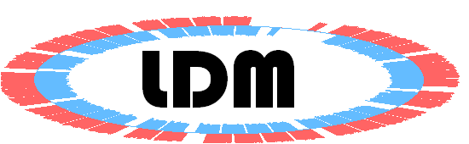
What is it for?
 | Protons | Lead Ions
Maximum beam energy (2010-11) | 3.5 TeV | 3.5 x 82 TeV / ion
Revolution period | 89 μs
RF period | 2.5 ns
Minimum bunch spacing | 25 ns | 100 ns
Maximum number of bunches | 2808 | 592
Bunch population (ultimate) | 1.7 x 10¹¹ | 8.2 x 10⁹ charges [10⁸ ions]
9 out of 10 buckets should be empty…
…but they’re not.
Satellite bunches are important…
Current & luminosity normalisation
Machine protection (e.g. satellites in kicker window)
Experiment background
Satellite - main collisions used in the low-luminosity IPs

Slide 4
Single photon Counting
LHC turn clock
Arrival time
TDC
synchrotron light
APD
Electrical pulse
Single photon counting is used to achieve a high dynamic range:
> 10⁵ with 15 minutes integration

Slide 5
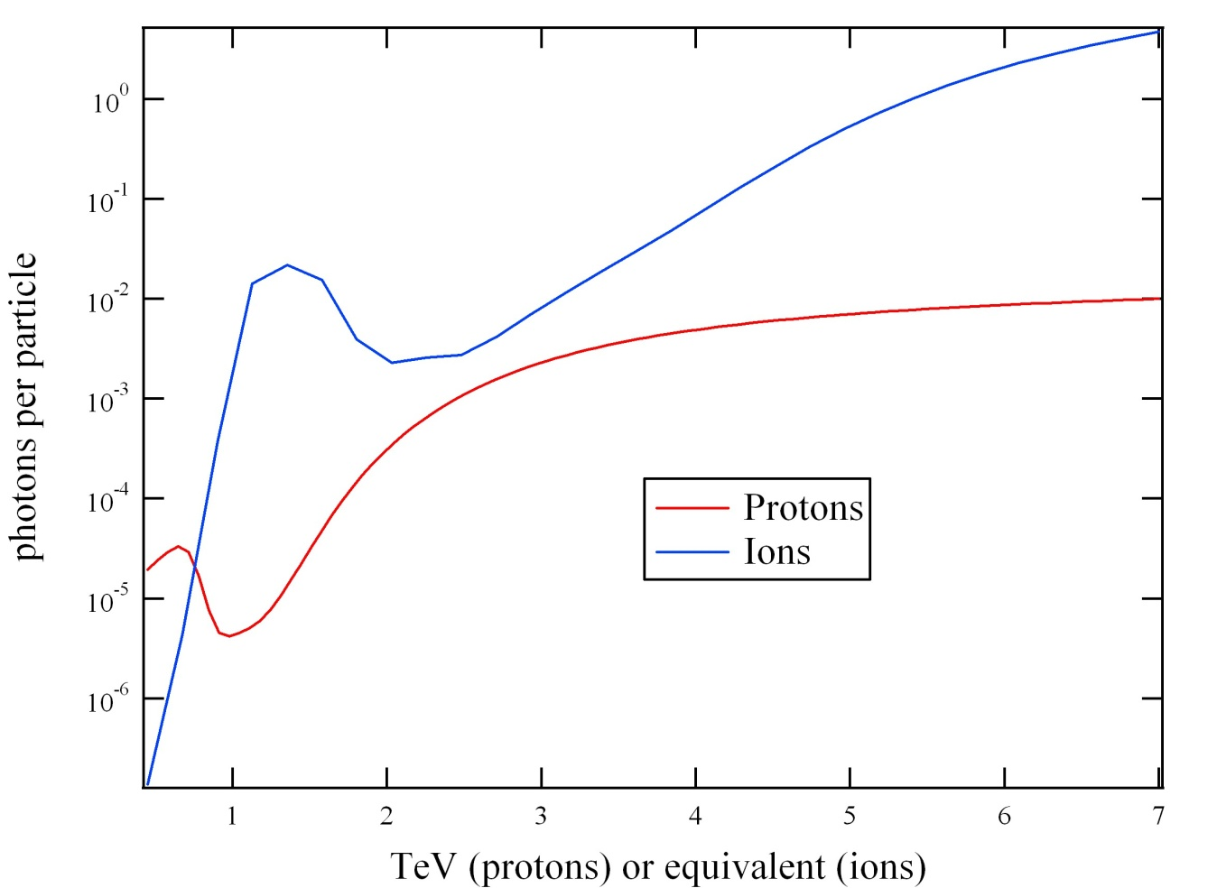
Synchrotron light from protons…
… and even lead ions!
Undulator
Dipole
Dedicated undulator for diagnostics gives visible light at injection

Slide 6
Optical layout
Undulator
Dipole
Proton beam
Synchrotron light
Optical table
AGM
TOP VIEW
LDM
Fast camera
Slow camera
Focus trombone
LDM receives 7% of collected light

Slide 7
Instrument response

Slide 8
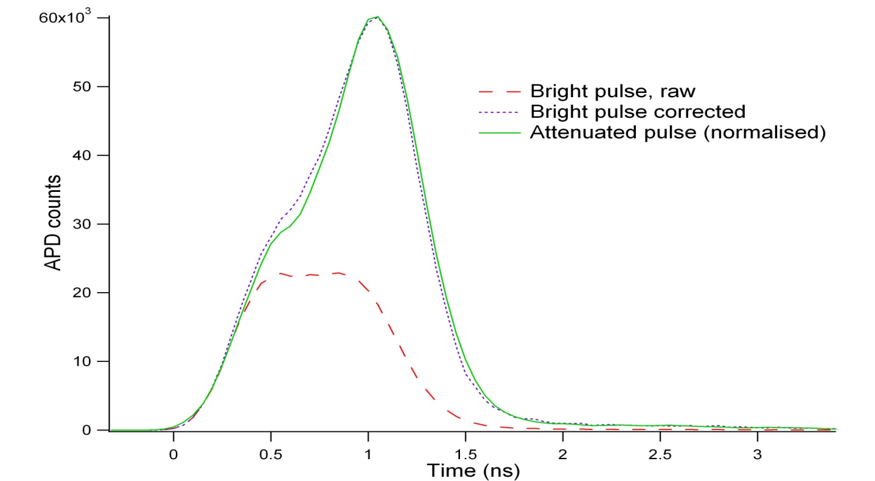
Deadtime Correction
Deadtime correction is essential
  to restore the true bunch shape
  to measure satellites following the main bunch
Lab test with pulsed LED

Slide 9
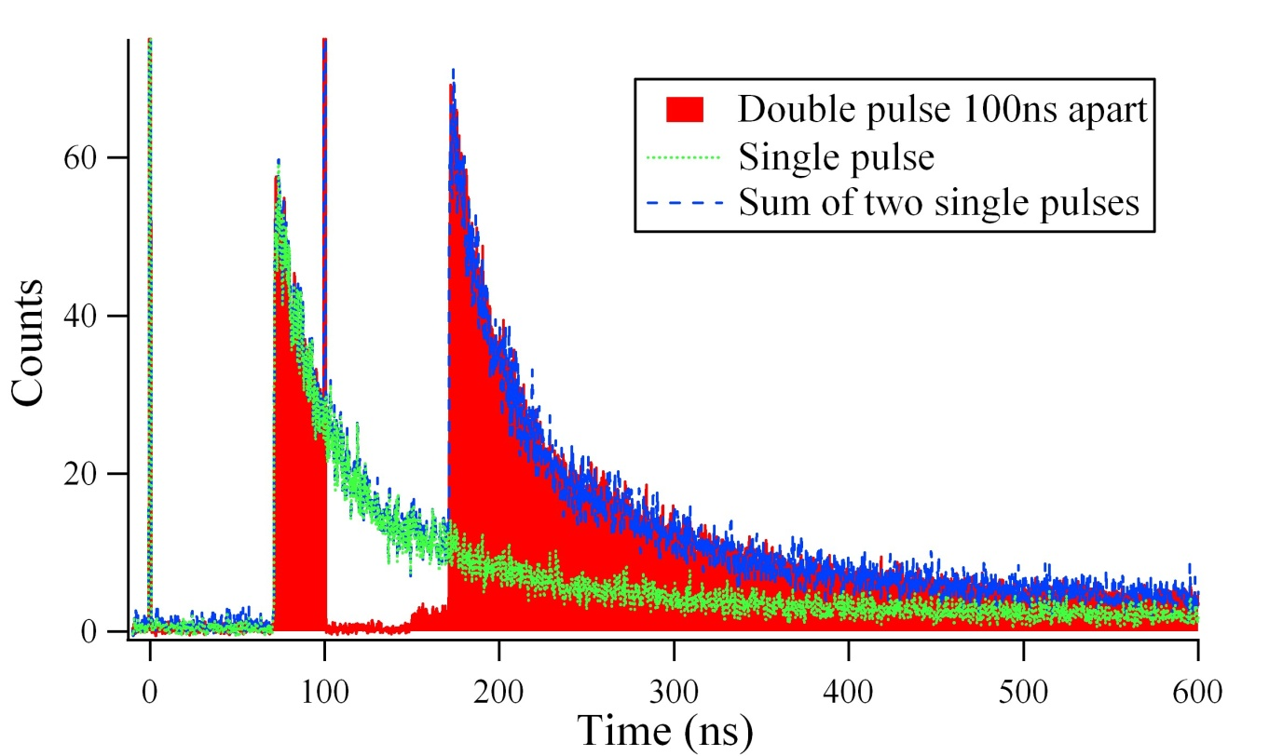
Afterpulse Correction
Afterpulses occur due to charge carriers trapped in the silicon
Start at end of deadtime but continue for many μs
Fit by sum of multiple exponentials
Afterpulses are additive

Slide 10
Results

Slide 11
Results

Slide 12
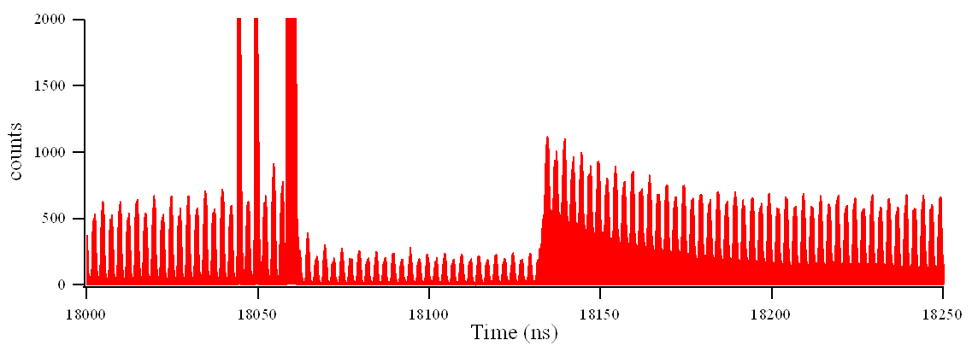
Main bunch
Satellites
Ghost bunches
Afterpulsing
Deadtime

Slide 13
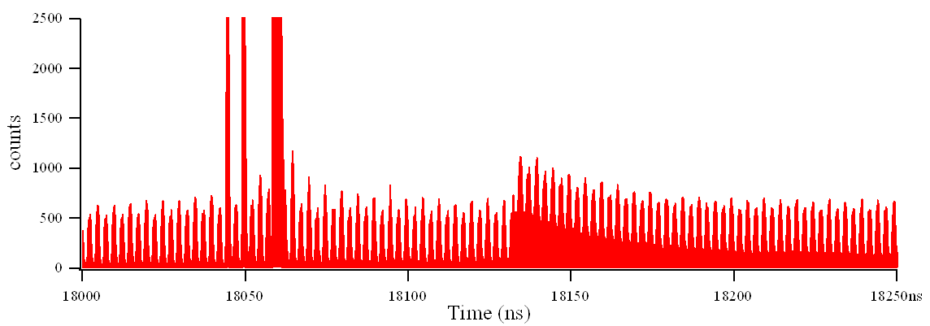
Corrected for deadtime

Slide 14
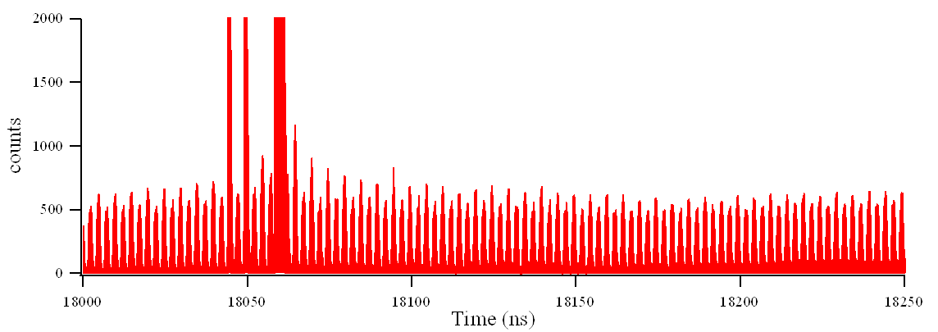
Corrected for deadtime
Corrected for deadtime and afterpulsing

Slide 15
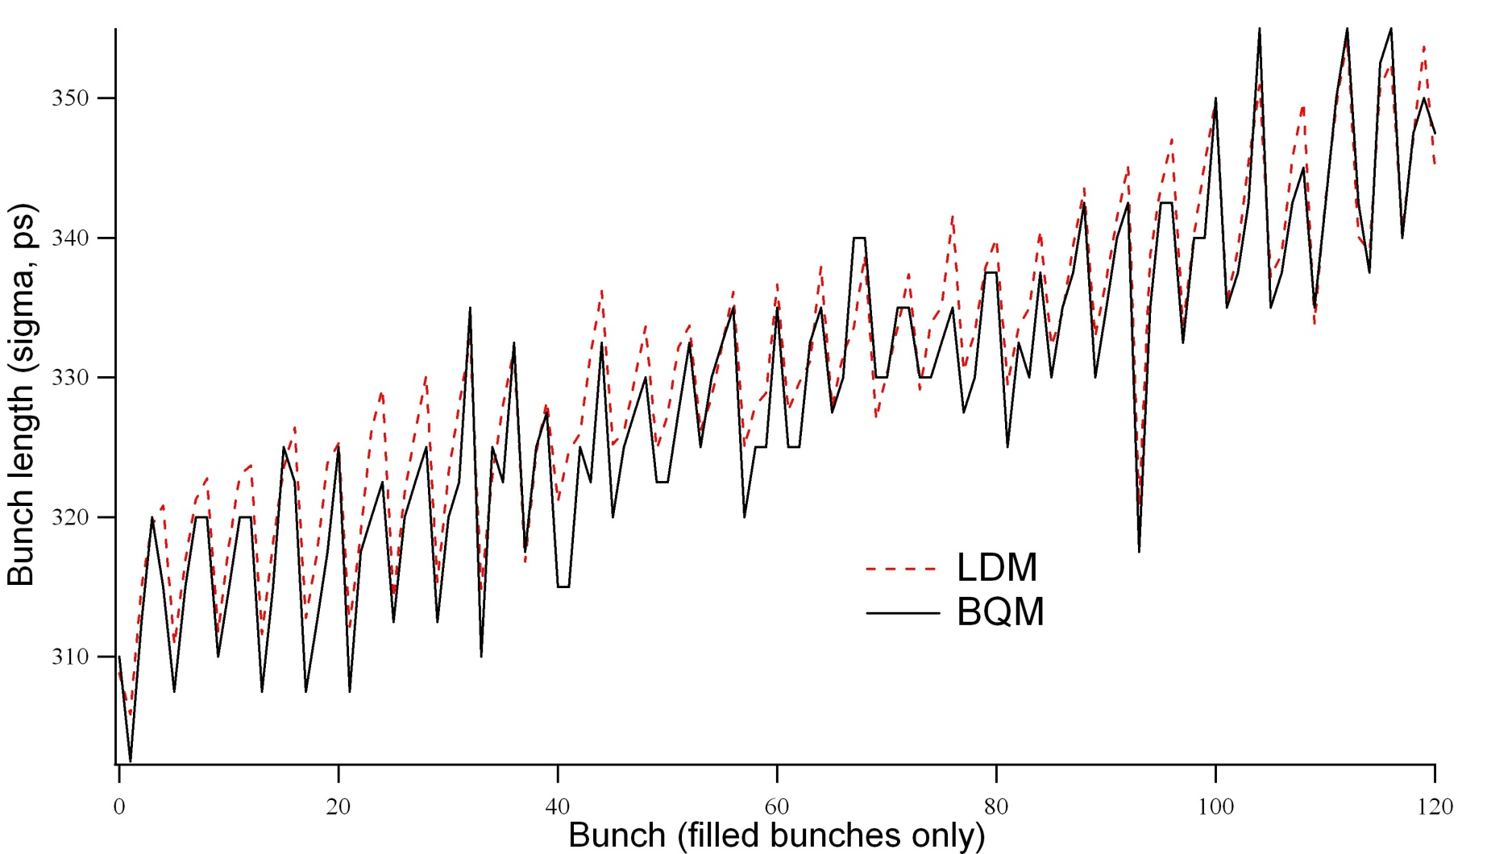
Bunch lengths

Slide 16
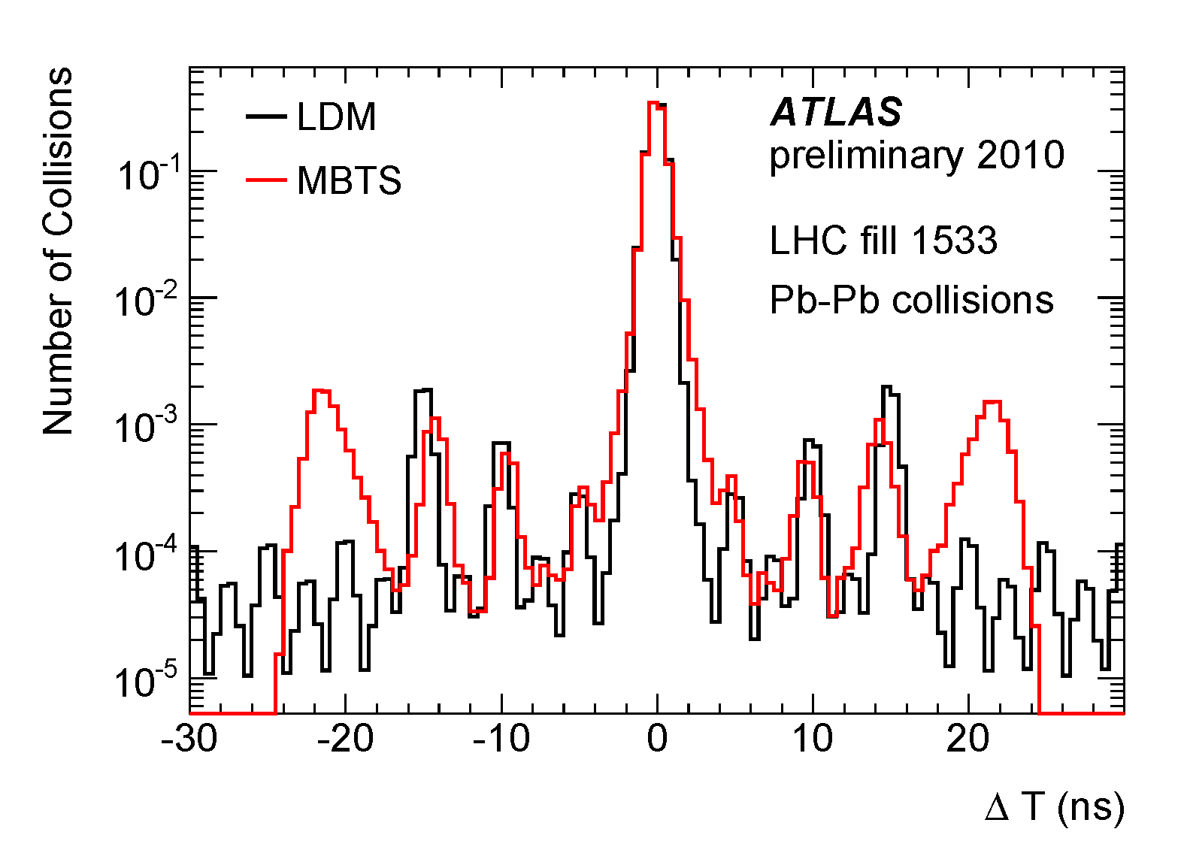
Satellite Fraction
Beam halo events
With thanks to Beate Heinemann for MBTS the plot

Slide 17
High-DR scheme
Gated APD gets about 1% of the light on the extraction mirror
Free-running APD gets about 10⁻⁶ of the light on the extraction mirror

Slide 18
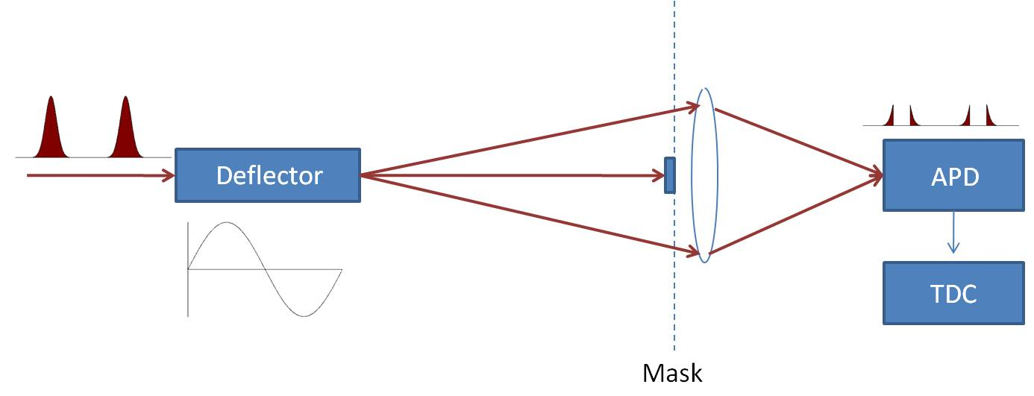
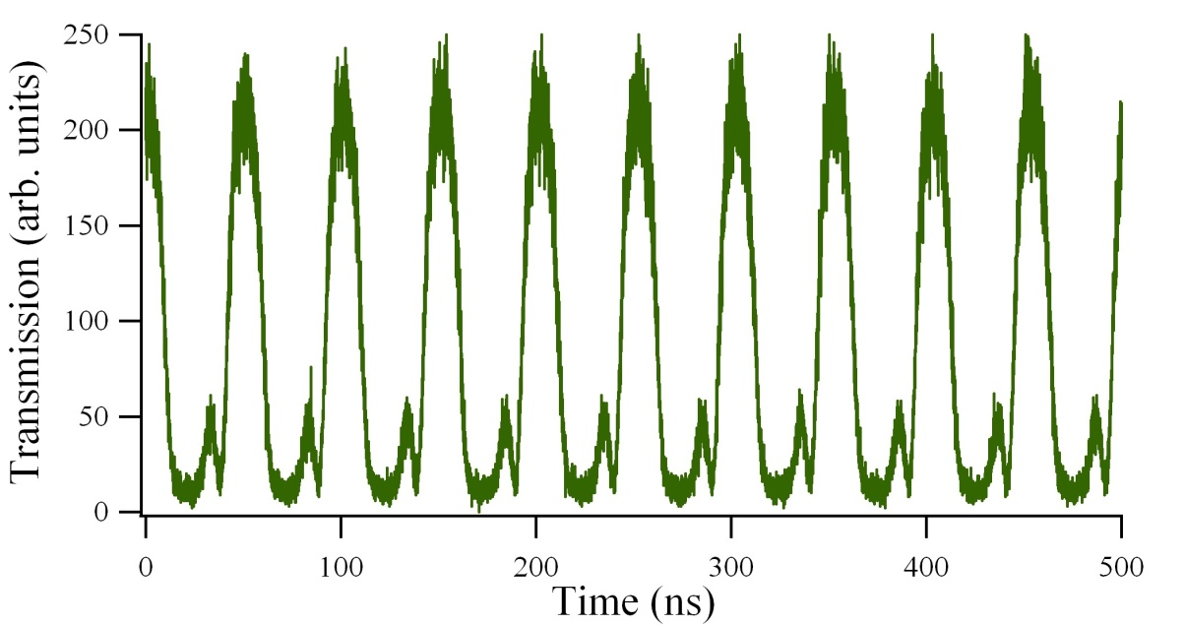
Optical gating
Electro-optic deflector maps longitudinal profile onto transverse plane
First lab test:
Extinction ratio 20:1
Limited by diffraction & driver

Slide 19





Thanks for your attention

Slide 21
Spare slides

Slide 22
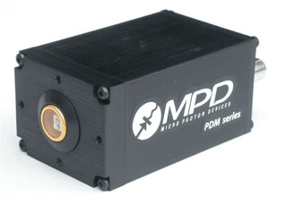
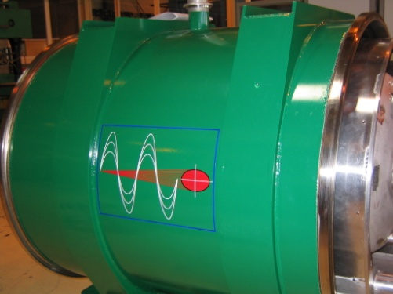
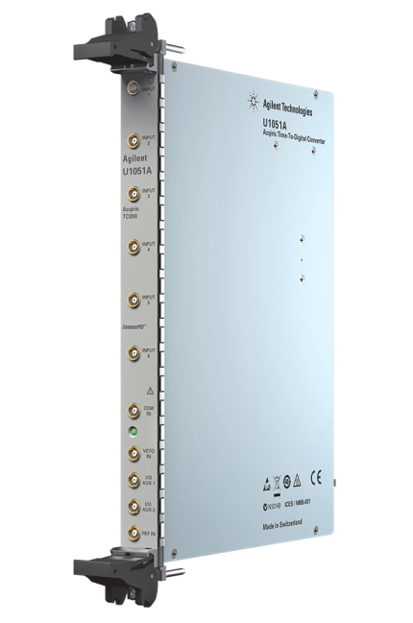
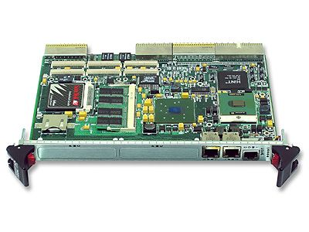
Schematic
Geiger-mode Avalanche photodiode converts photon to electrical pulse
Synchrotron light from undulator and dipole
Time to Digital converter records pulse arrival time
cPCI computer makes histogram and corrects for APD dead-time and afterpulsing

Slide 23
Bunch currents

Slide 24
Linearity / offset wrt BCT
Fit for nominal bunches only
Statistical errors only

Slide 25
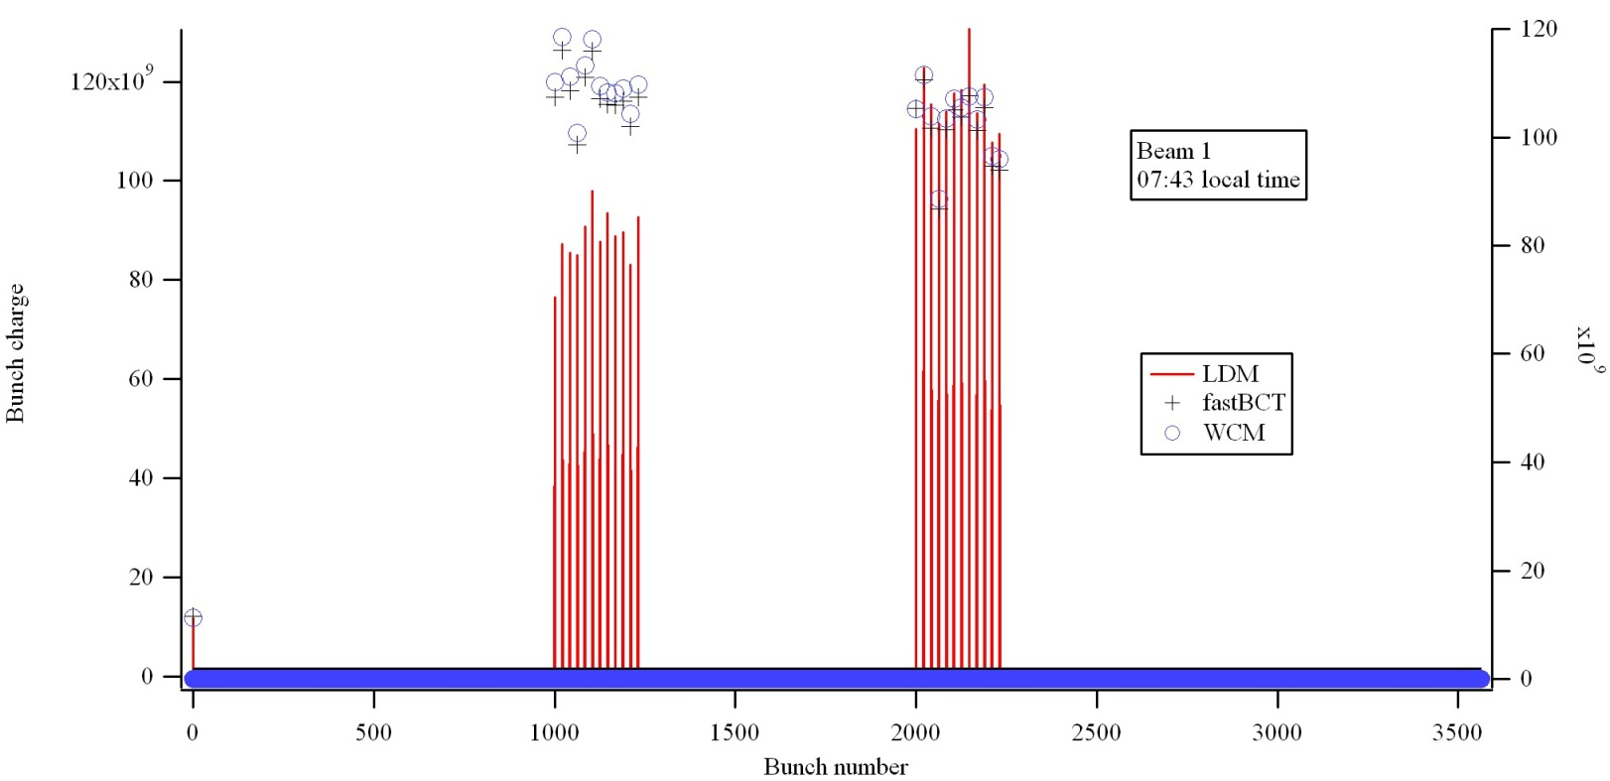
Emittance dependence
MD with one group of low-emittance bunches and one group with large emittance

Slide 26
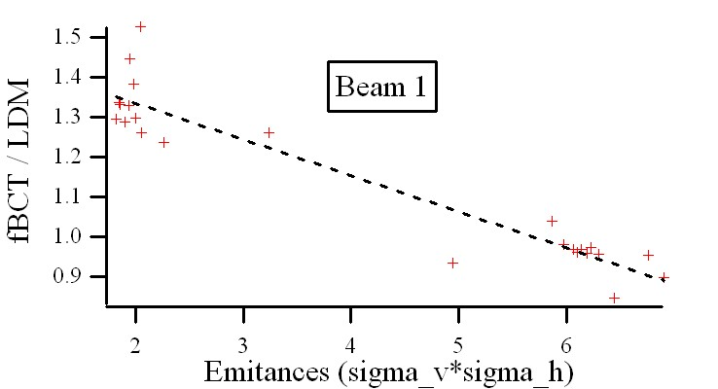
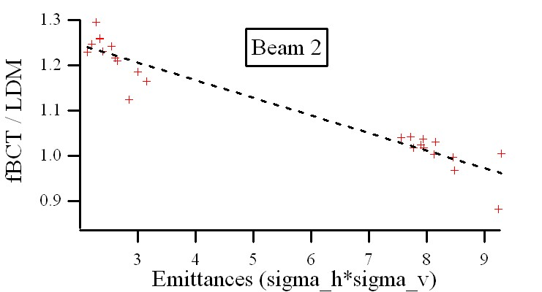
Emittance dependence
Active area of APD is only 50 microns
Samples only part of the beam spot
Slope depends on steering of the LDM
Can be corrected with an optical diffuser

