Slide 1





Cavity Beam Position Monitor (BPM) for future linear colliders such as CLIC.
N Joshi, S Boogert, A Lyapin, et al.
Nirav.Joshi.2009@live.rhul.ac.uk
Royal Holloway University of London,
A Morgan, G Rehm et. al.
DIAMOND light source, RAL, UK.
DITANET international conference, Nov 9, 2011, at Sevilla

Slide 2
Outline
Introduction to Cavity BPM system.
Requirements for future linear collider, such as CLIC.
Design and Electromagnetic simulation. (RHUL - NLS/DIAMOND)
RF testing (RHUL - NLS/DIAMOND)
Effect of temperature variation.
Study of wake field in cavity BPM for CTF3
BPM signal processing in single bunch mode and calibration. (RHUL-ATF)
Signal overlaping from multi- bunches (RHUL-ATF).
Conclusions and future work

Slide 3
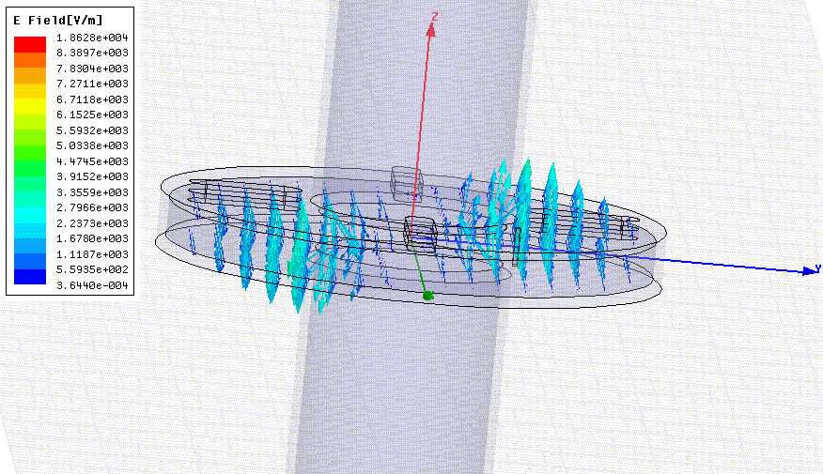
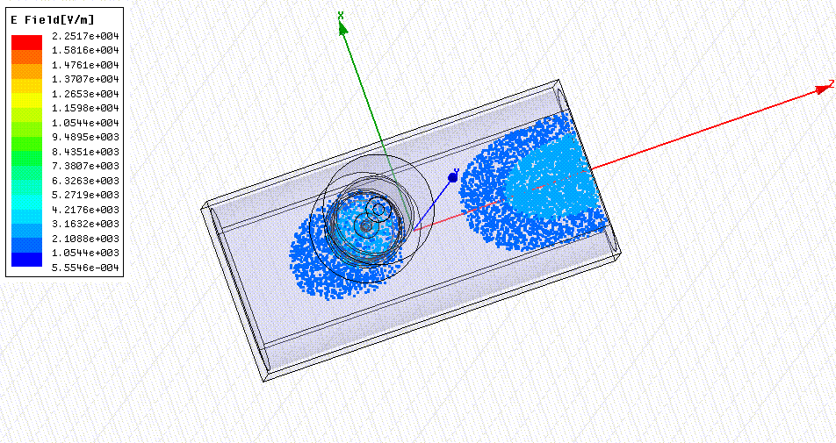
RF cavity BPM

Slide 4
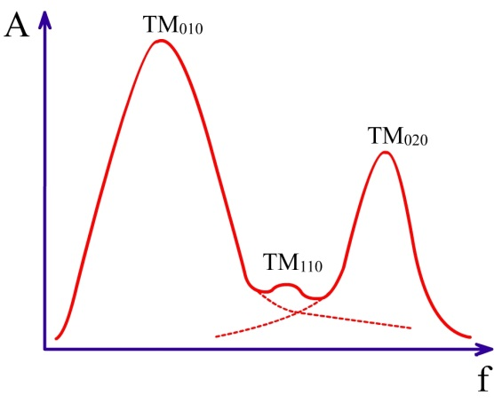
RF cavity BPM : Fundamental equations
Transverse Resonance mode frequency:
Internal Quality factor:
Loaded quality factor:
Typical power spectrum of modes excited inside the resonance cavity.
Decay time constant:
Normalized
shunt impedance
Voltage induced by position offset:

Slide 5
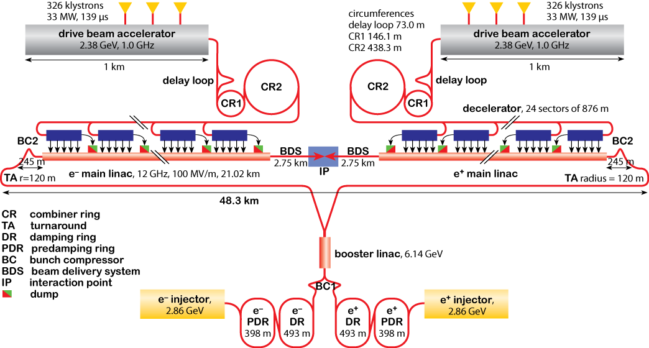
Proposed Compact Linear Collider (CLIC)
Main linac Parameter
Overall two linac length | 48.4 km | I_{pulse} | 1.5 A
Centre of mass energy | TeV | Number of bunches / pulse | 312
Beam power | 14 MW | Bunch separation | 0.5 ns
Machine RF frequency | 12 GHz | Bunch length | 44 μm

Slide 6
Cavity BPM for CLIC
BPM requirements for CLIC main Linac
Resolution | 50 nm
Drift tube diameter | 8 mm | Upper limit on frequency
Measurement band width | 20 MHz | Orbit bit correction for bunches at tail of bunch train.
Number of BPM required | ~ 4776
Proposed total number of BPM in main linac: ~4776
=> Lower cost per cavity.
=> Simple design, without tuning to reduce vacuum failure as well as
human labour cost.
=> Increase XY isolation by adequate asymmetry.
Bunch separation = 0.5 ns ,
=> Signal overlapping between multi-bunches.
=> Lower the Q, less accurate cavity parameter measurements.
Beam current = 1.5 A
=> Higher coupling, higher wall current, more heat , more wake for follwing bunches.

Slide 7
EM simulation codes
Electromagnetic (EM) simulation codes.
Advanced Computational Electromagnetic-3P (ACE3P) suit, SLAC, USA.
Parallel, higher order, finite element based electro-magnetic code. I used following codes
Omega3P : Eigen mode solver to find normal modes of the cavity.
T3P : Time domain solver to calculate transient response.
S3P : S-parameter solver for transmission properties.
GdfidL :
3D EM simulation code written in Fortran.
Finite difference time domain (FDTD) solver at core.
Uses orthogonal mesh to discretise the geometry.
Runs on serial and parallel machine.
Solvers:
Eigen-mode solver
Time domain solver

Slide 8
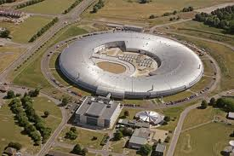
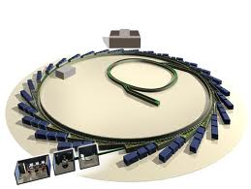
Cavity BPM project for NLS/DIAMOND light source at RAL, UK
Science disciplines utilizing DIAMOND light source.
Chemistry
Cultural heritage
Earth science
Engineering
Environmental science
Life science
Physics and material science
Major parameters:
Accelerated particle : e⁻
Particle energy : 3GeV
Circumference : 561.6 m
Beam current : 300 mA
Bunch repetition rate: 500kHz

Slide 9
DIAMOND BPM: RF design and simulation
BPM development project at DIAMOND¹:
BPM cavity with beam pipe and
coupler with feed-through
Waveguide coupler with feed-through
Basic design considerations :
LO source synchronization and maximum IF frequency. (20 MHz)
There should be enough number of IF oscillations between two consecutive bunches.
Energy decay time of the cavity.
Vacuum compatibility of materials and shapes.

Slide 10
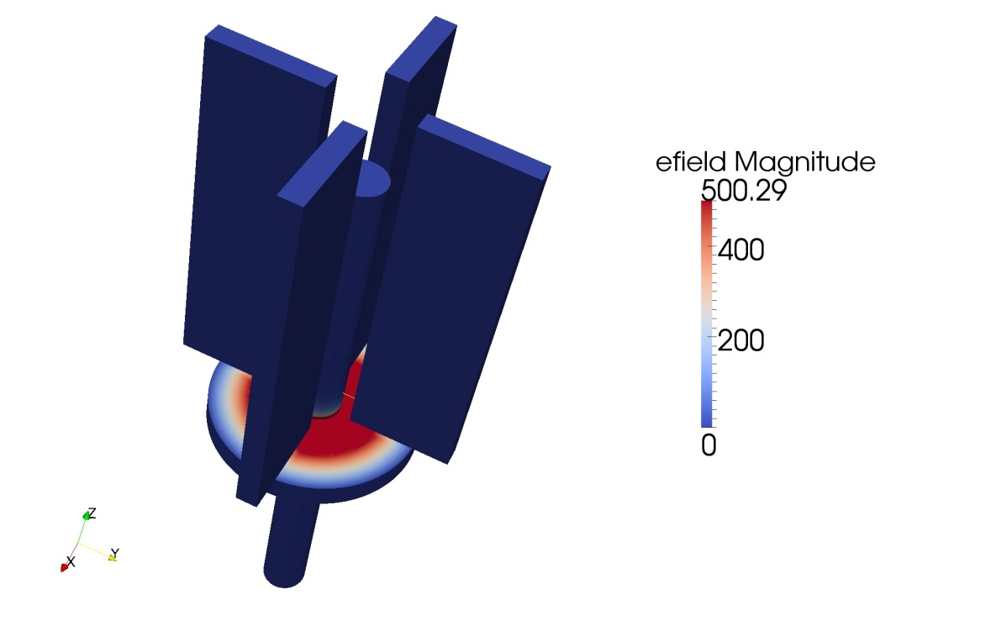
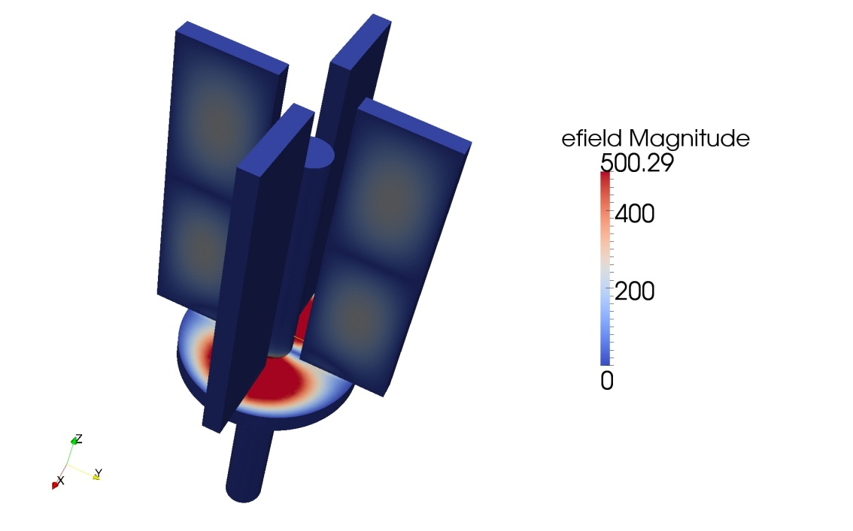
DIAMOND Cavity BPM: simulation
Eigen mode solution : Monopole
Monopole frequency : 4.5 GHz
Monopole reduction by waveguide
f_{cut-off (Waveguide )} > f_{monopole (Cavity)}
Eigen mode solution : Dipole
Dipole frequency : 6.47 GHz
Dipole coupling into the waveguide
f_{cut-off (Waveguide )} < f_{dipole (Cavity)}

Slide 11
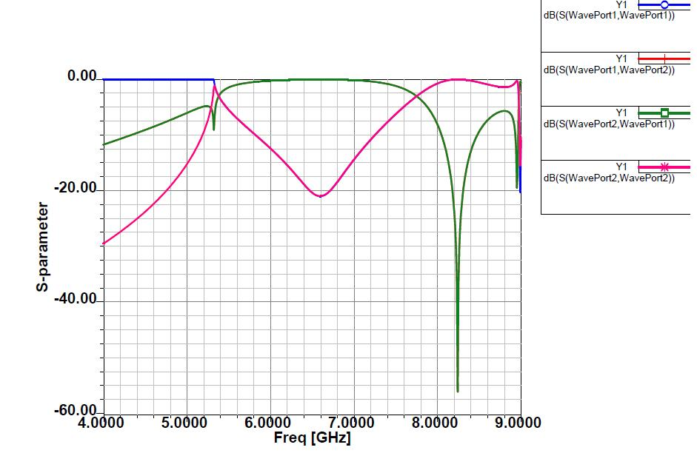
DIAMOND Cavity BPM: simulation
Waveguide coupler

Slide 12
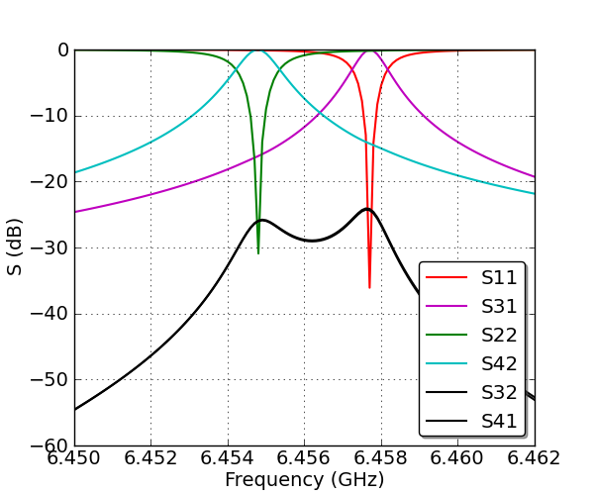
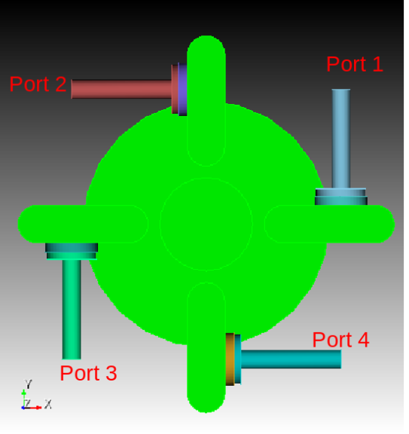
DIAMOND Cavity BPM: simulation
S-parameter simulation

Slide 13
DIAMOND Cavity BPM: simulation
DIAMOND BPM simulation results
Monopole frequency | 4.5 GHz
Monopole suppression | < -55 dB
Dipole frequency | 6.457 GHz
Frequency separation between X and Y position data | 3 to 5 MHz
X and Y plane isolation | ~ 25 dB
Q_{L} (or Decay time constant τ) Y-plane | ~3000 (0.073 μs)
Amplitude pollution from previous bunch at 500Khz bunch repetition frequency | < 5 %
Cavities were fabricated with FMB Berlin.

Slide 14
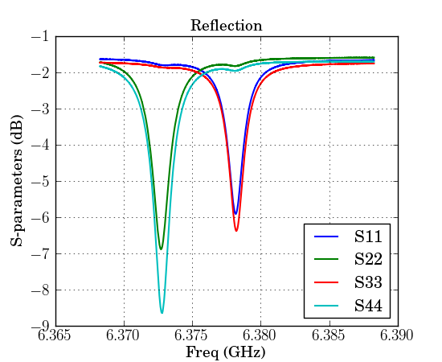
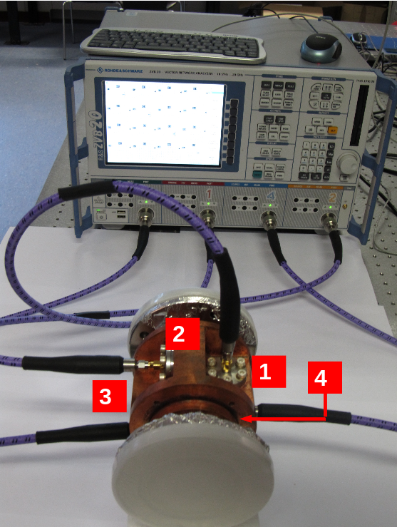
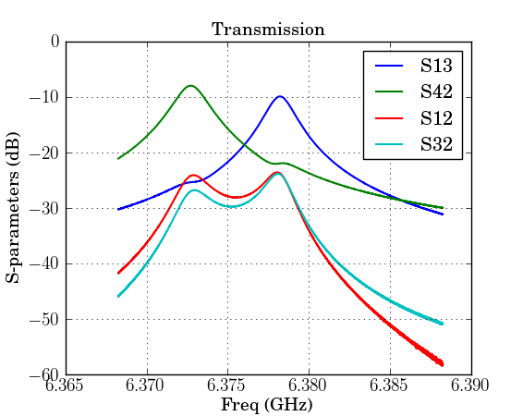
DIAMOND Cavity BPM: RF Measurements (S-Parameters)
Peak Frequency S11: 6.376GHz
Peak Frequency S22: 6.371GHz
Coupling loss: ~ -10 dB
XY isolation : ~ -15 dB
Monopole supresion: > - 55 dB
Q_{load} : 2892

Slide 15
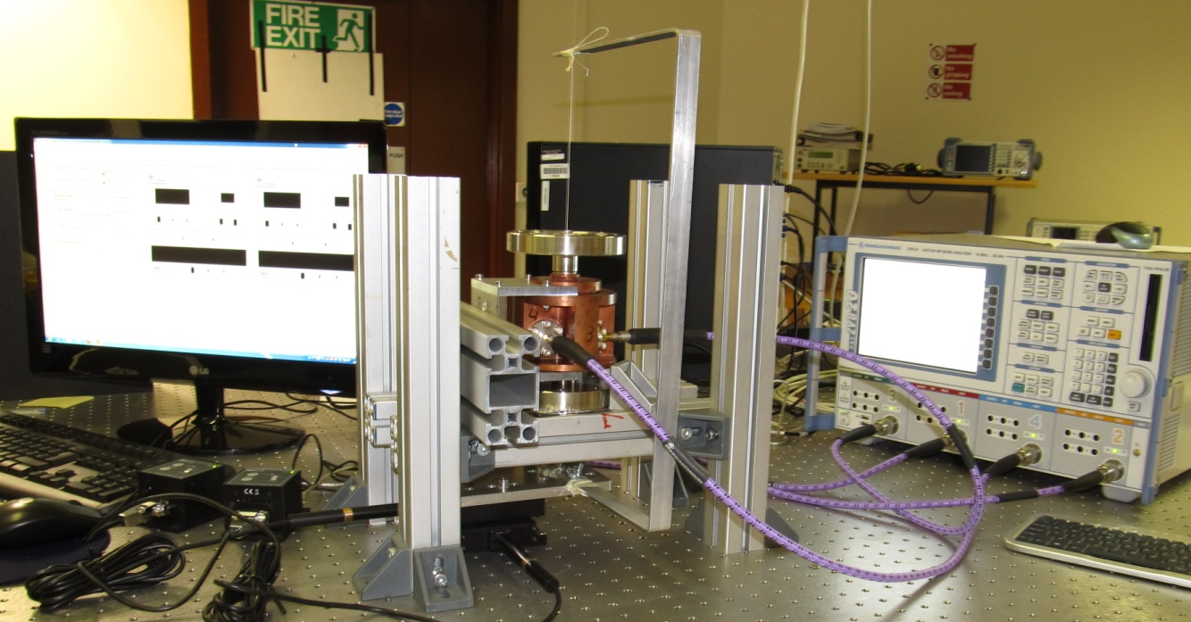
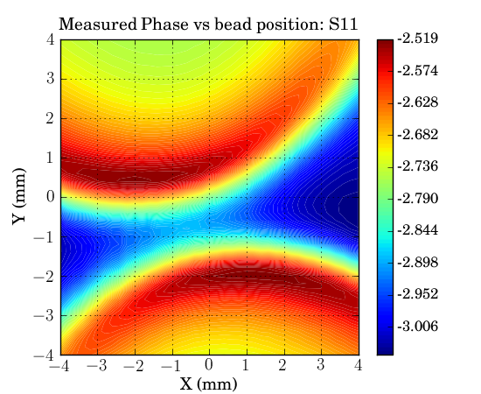
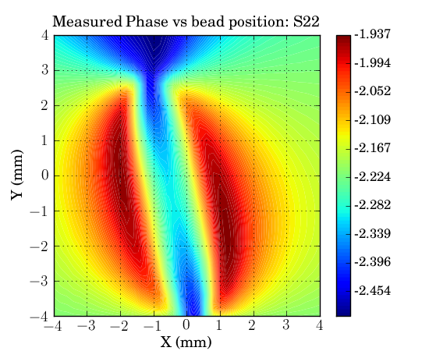
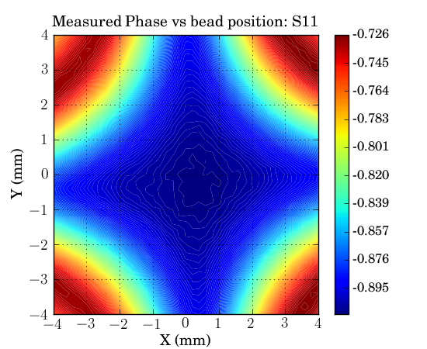
DIAMOND Cavity BPM: RF Measurements (Mode orientation)
+- (4 x 4 mm) scan with step size of 0.2 mm.
Movers and VNA were remote controled and synchonised using USB and VISA over LAN.
All S-parameters are recorded during single frequency sweep
6400 S-para files were processed in parallel mode on cluster.
Rotation agrees with isolation.
Dipole : Rotation angle= ~13°
Quadrupole: Rotation angle: ~2°

Slide 16
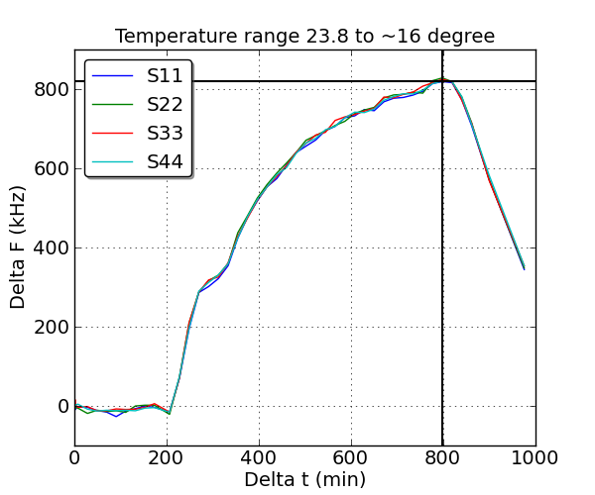
Effect of temperature variation
Cavity frequency : ~ 6.376 GHz
Change in peak frequency over night with time.
AC was left on over night which cooled the room.
Cavity resonance frequency increases due to shrinking by cooling.

Slide 17
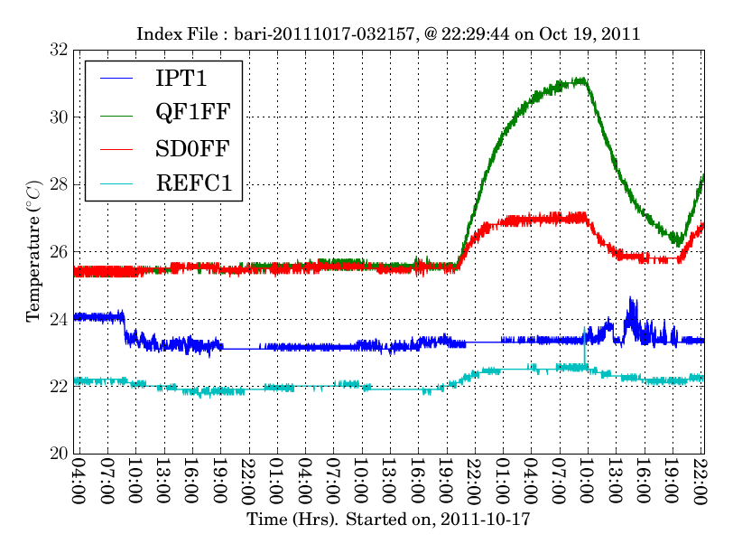
Effect of temperature variation at ATF2
Cavity MQF1FF frequency : ~ 2.888 GHz
Cavity mounted at the end of the sextupole magnet with high current during operation.
Temperature change: 7 °C.
Temperature variation in all other cavities are less then 1 °C.
Cavity frequency changes approximately by 48 kHz / °C

Slide 18
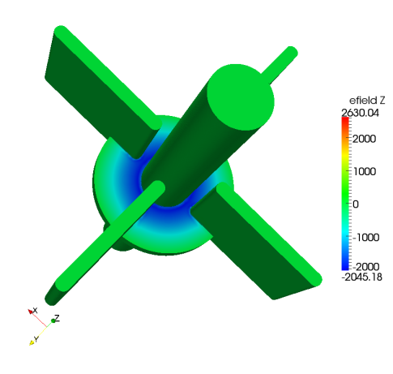
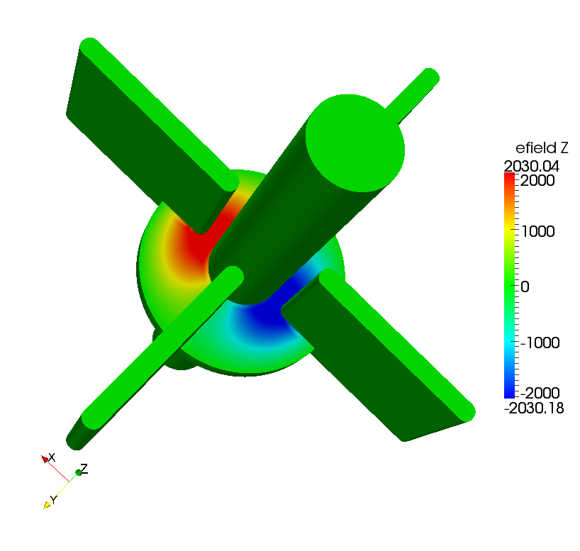
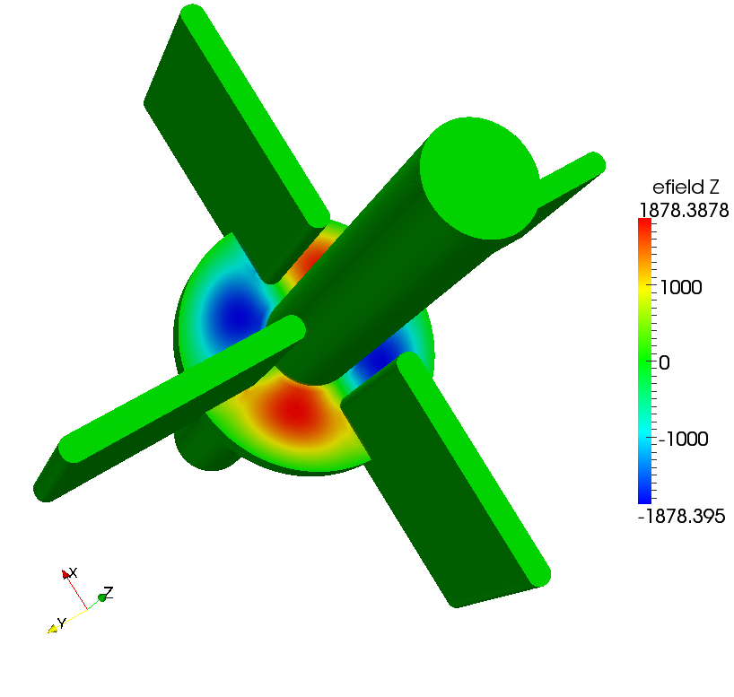
Cavity BPM for CTF3 and Wake field study.
Cavity BPM designed and fabricated by Fermilab and CERN.
Eigen mode simulation using Omega3P
Monopole:
Frequency : 11.14 GHz
Q₀ : 421.96
R/Q _{1mm} : 46.41 Ω
Dipole:
Frequency : 14.988 GHz
Q₀ : 517.89
R/Q_{1mm} : 3.4 Ω
Quadrupole:
Frequency : 20.34 GHz
Q₀ : 572.62
R/Q_{1mm} : 0.058 Ω

Slide 19
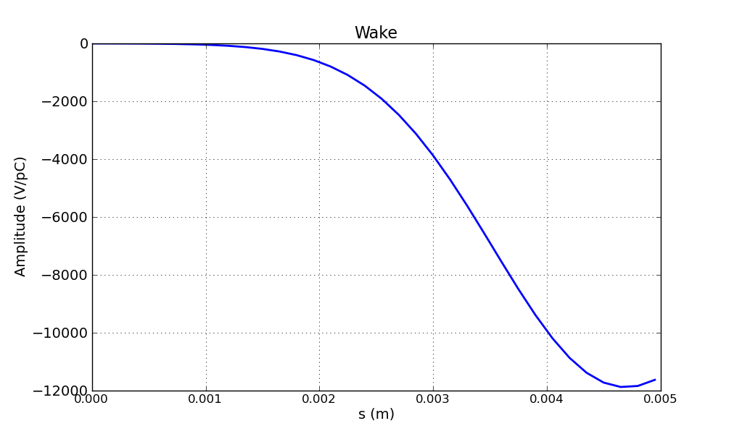
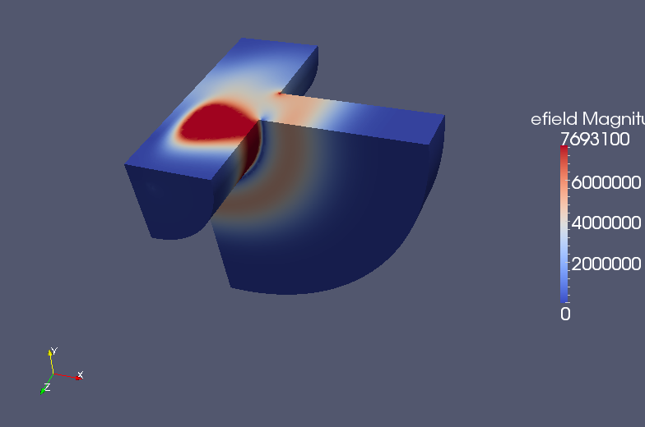
Cavity BPM for CTF3 and Wake field study.
Bunch parameter:
Bunch lenght σ = 1.0mm
Effective length = 4 σ
Bunch charge = 6.0 nC
Field recording rate = 4ps
Postprocessing (Paraview)
Individial E and H components can be examined.

Slide 20
Data analysis and System calibration: ATF2, Japan
ATF machine layout
35 BPM at various places on ATF2 linac.
ATF in Multi-Bunch (train) Mode
Parameter | Value | Unit
Number of bunches N_{b} | 3
Bunch separation t_{b} | 154 | ns
Linac (S-band) | 1.3 | GeV
Characteristic beam size | 5 to 10 | μm

Slide 21
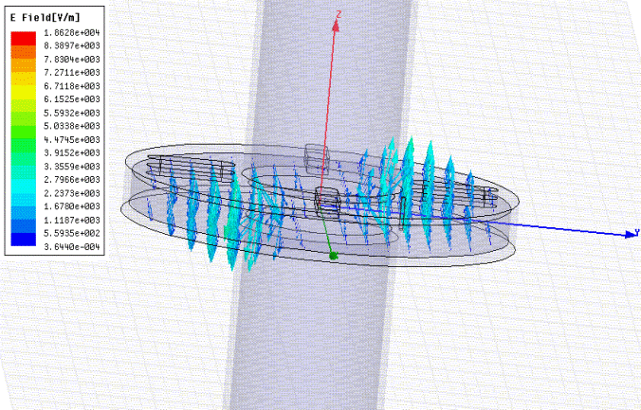
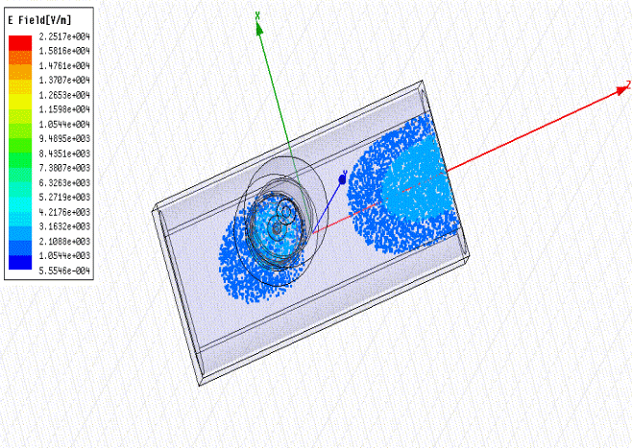
ATF2 Cavity BPM system + DSP
Dipole Cavity Parameters
Parameter | Value | Unit
Number of position cavities | 32 ( +4 ) | C-Band (S-Band)
Number of reference cavities | 4 ( + 1) | C-Band (S-Band)
Dipole frequency f | 6.4235 | GHz
Decay constant τ | 151 | Ns
Single bunch Resolution (with jitter) | 5 | μm

Slide 22
Data analysis and System calibration
Digital signal processing

Slide 23
Data analysis and System calibration
System calibration
BPM system resolution ~ 5 μm (with jitter).
After eliminating the noise due to beam jitter, position resolution of 25 nm is already been demonstrated.

Slide 24
Multi-bunch analysis
In case of closely spaced bunches, next bunch arrives before the energy induced in cavity by previous bunches has decayed.
Signal pollution due to overlap will give errornous measurements, hence should be subtraced using following equation.
Colour convention
Bunch 1: RED
Bunch 2: Green
Bunch 3: Blue

Slide 25
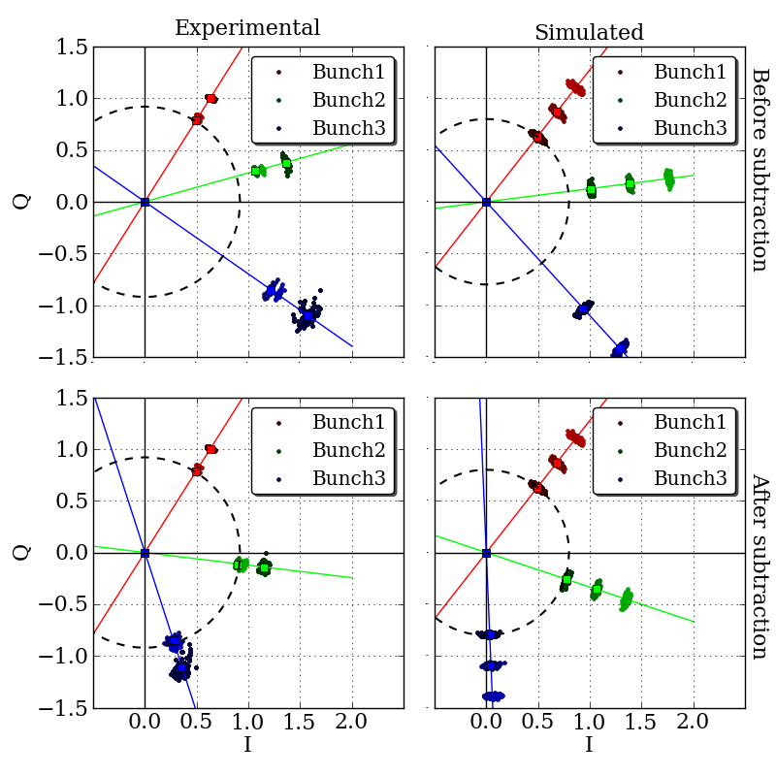
Multi-bunch analysis
IQ Phasors:
After subtraction:
Phasors for all three bunches have similar magnitude.
Even phase differnce, due to frequency difference in dipole and reference cavity.

Slide 26
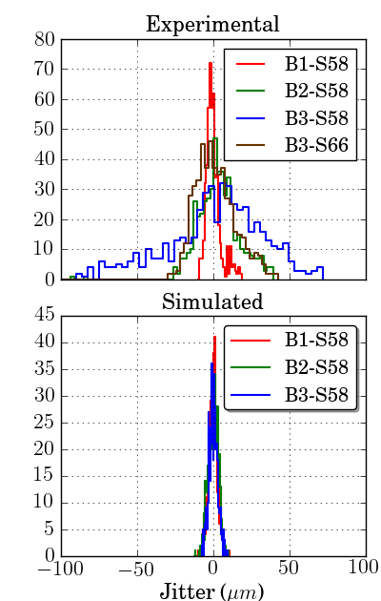
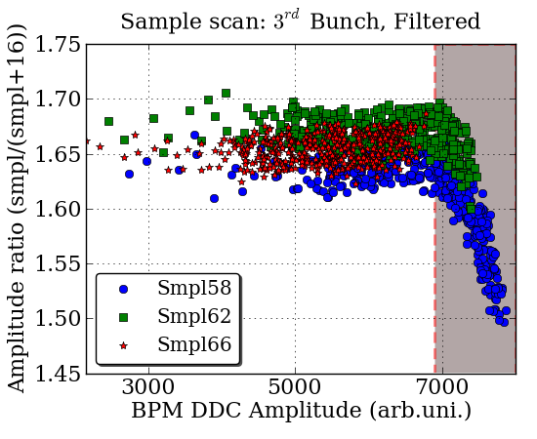
Multi-bunch analysis
The increase in jitter of third bunch after subtraction as due to saturation of electronics.
Jitter spread could be less than that of the second bunch, that is 10 μm.
Resolution in multibunch mode could not be reduced in to nano meter scale, as the beam jitter could not be subtracted effectively due to lack of strong correlation.

Slide 27
CLIC BPM: Signal simulation
Multi bunch study is very important for as CLIC BPM would have to deal with signal overlap from several bunches, and signal may not be as clean as the fish shape bellow.
Q_{L}=300

Slide 28
Conclusions and future work
A cavity BPM has been designed , simulated for NLS/DIAMOND light source. RF characteristics and mode orientation were examined for the same, and the cavity is ready to be tested with beam during next few months.
A method to remove signal pollution from closely spaced bunches is being develope and tested on beam data.
Effect of temperature change on cavity has been studied..
More data is needed for multibunch study, and temperature characteristics analysis which will be acquired soon.

Slide 29
Thank you

