Slide 1
1B1 bulk Nb status

Slide 2
Objectives
Produce an Nb/Nb cavity without Q-slope
1 cavity produced for FNAL – using baseline Nb/Cu recipe
Presence of Q-slope

Slide 3
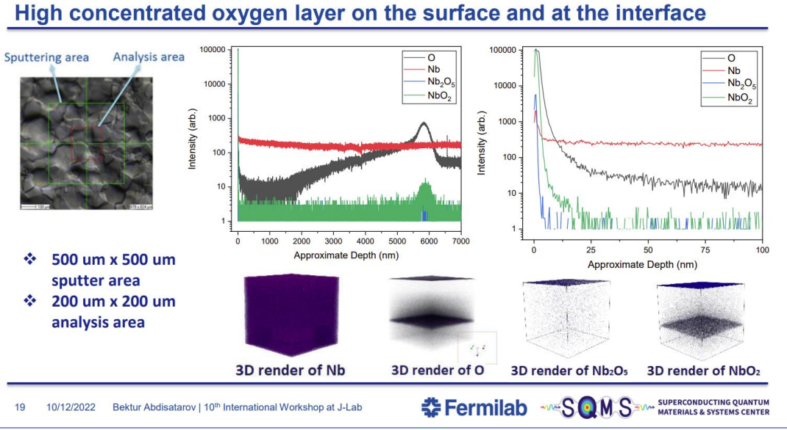
Presence of interfacial oxide

Slide 4
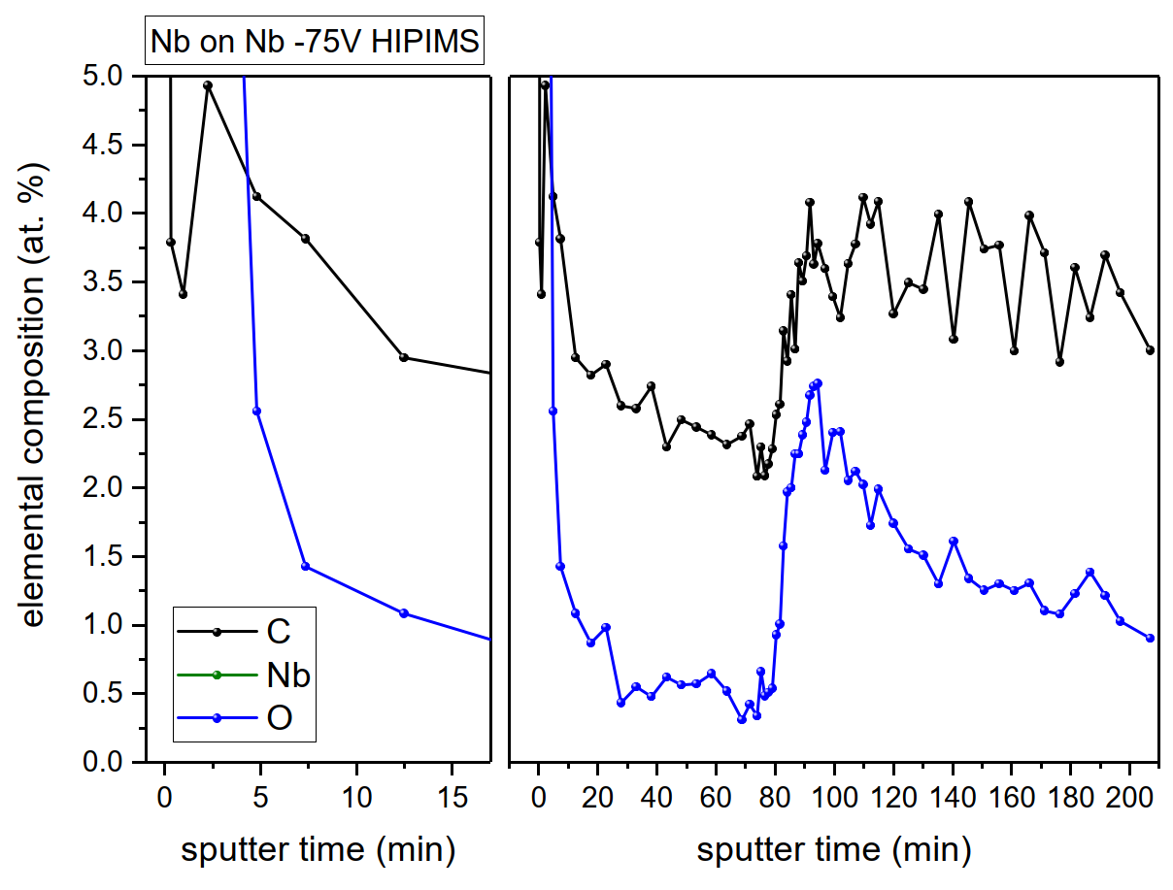
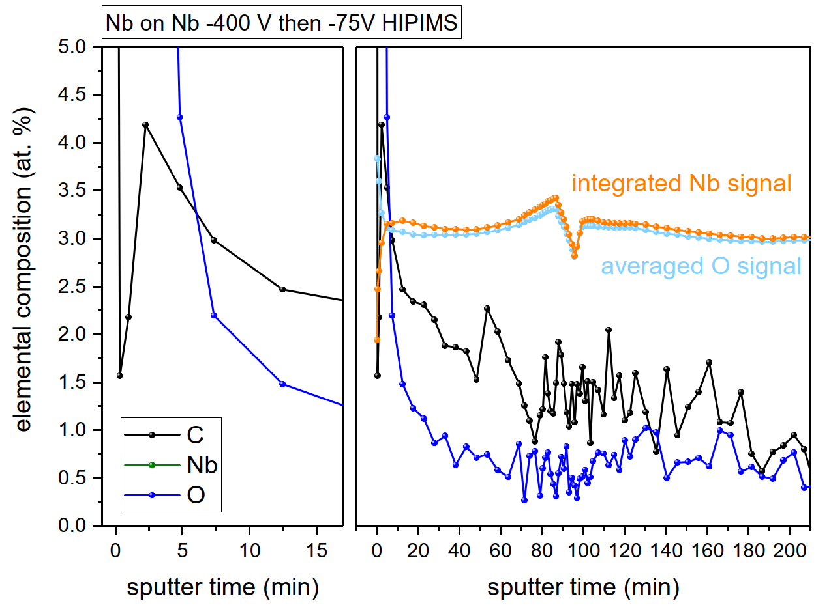
Original recipe New recipe
Suppression of interfacial oxide

Slide 5
Current Status
1B1 coated with the new recipe
HPRed – No peel-off
Cavity in b.118
NW78/CN100 adapters are to be removed (needed for other cavities)
Suggestion:
  Remove adapters in b.252
  Close the cavity in a clean environment
  New HPR in SM18 followed by RF ancillaries assembly
  RF test (Where? Cryolab / SM18…)

Slide 6
KEK cavities

Slide 7
Status
Cu cavities with NW78 flanges ☹
Delivered at CERN
Delayed because of defects
  Surface dents observed (impact of ebeam tooling)
  Al inclusions left over (ebeam tooling)
Surface mechanical polishing by MME done
Currently in b.107 for NaOH treatment (Al dissolution)
Objective: Start EP and coating in Jan24 asap

Slide 8
Proposal

Slide 9
400 MHz PC04

Slide 10
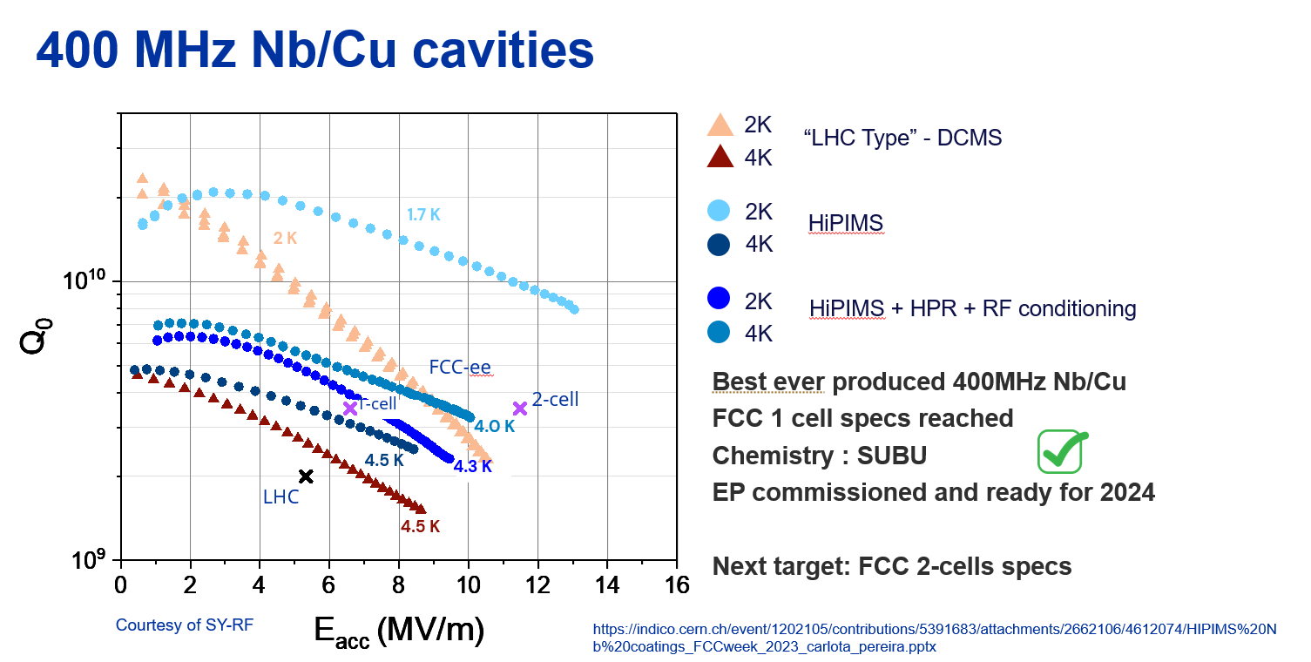
Status
Last coating in 2022
Last RF test in 2023 - Nb/Cu flanges + HPR in SM18

Slide 11

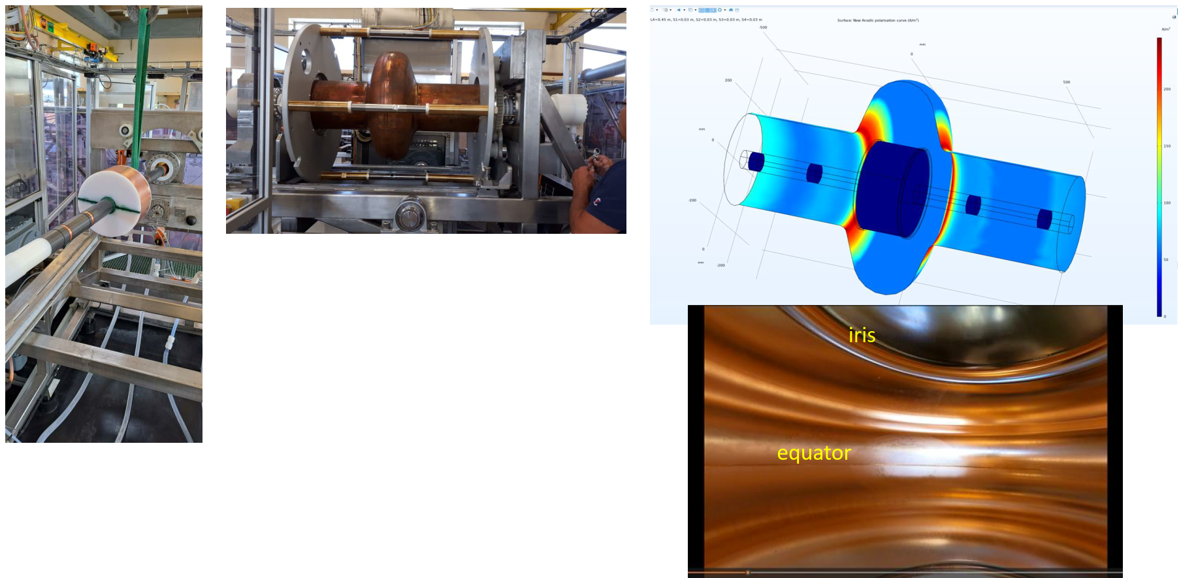
Status
New HiPIMS power supplies received
EP setup commissioned in b.118 (on simplified geometry)

Slide 12
Status
Planning is obviously packed (KEK cavities)
Switching from 1.3GHz to 400MHz requires efforts
New cathode (DC bias) : not available yet
Suggestion:
  Wait for Feb to start planning PC04 rework (stripping / EP / coating)
  Question: Can we perform an optical inspection on the new bench in the meantime?
    Yes: where? When? How long?
    No: « Basic » inspection

