Slide 1
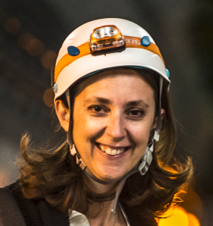

On behalf of Katy Foraz,
Head of the EN Department,
Welcome
to all of you!

Slide 2



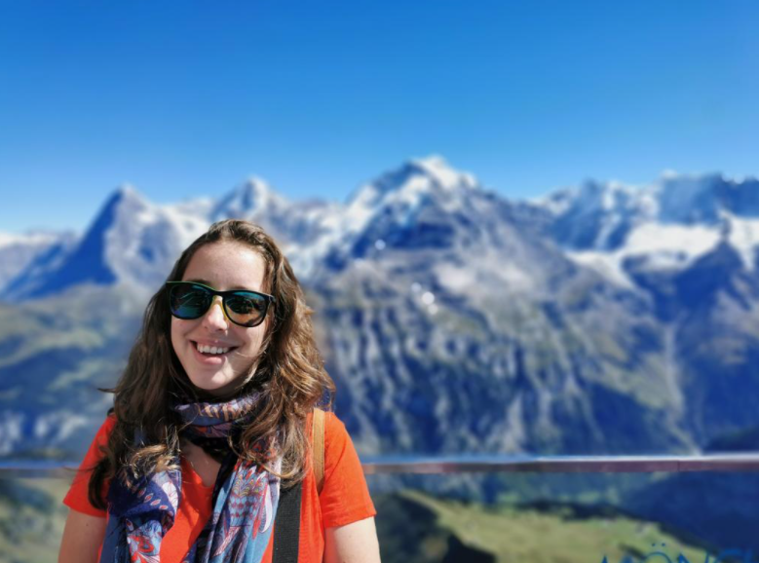

EN Dept. Administrative Office
EN Dept. Administrative Officer:
Rachelle Decreuse-Michaud
73375 54/3-009
EN Dept. Administrative Office:
Louisa Catherall
73621 35/1-009
en.dep.dao@cern.ch
Welcome to the EN Department 2

Slide 3
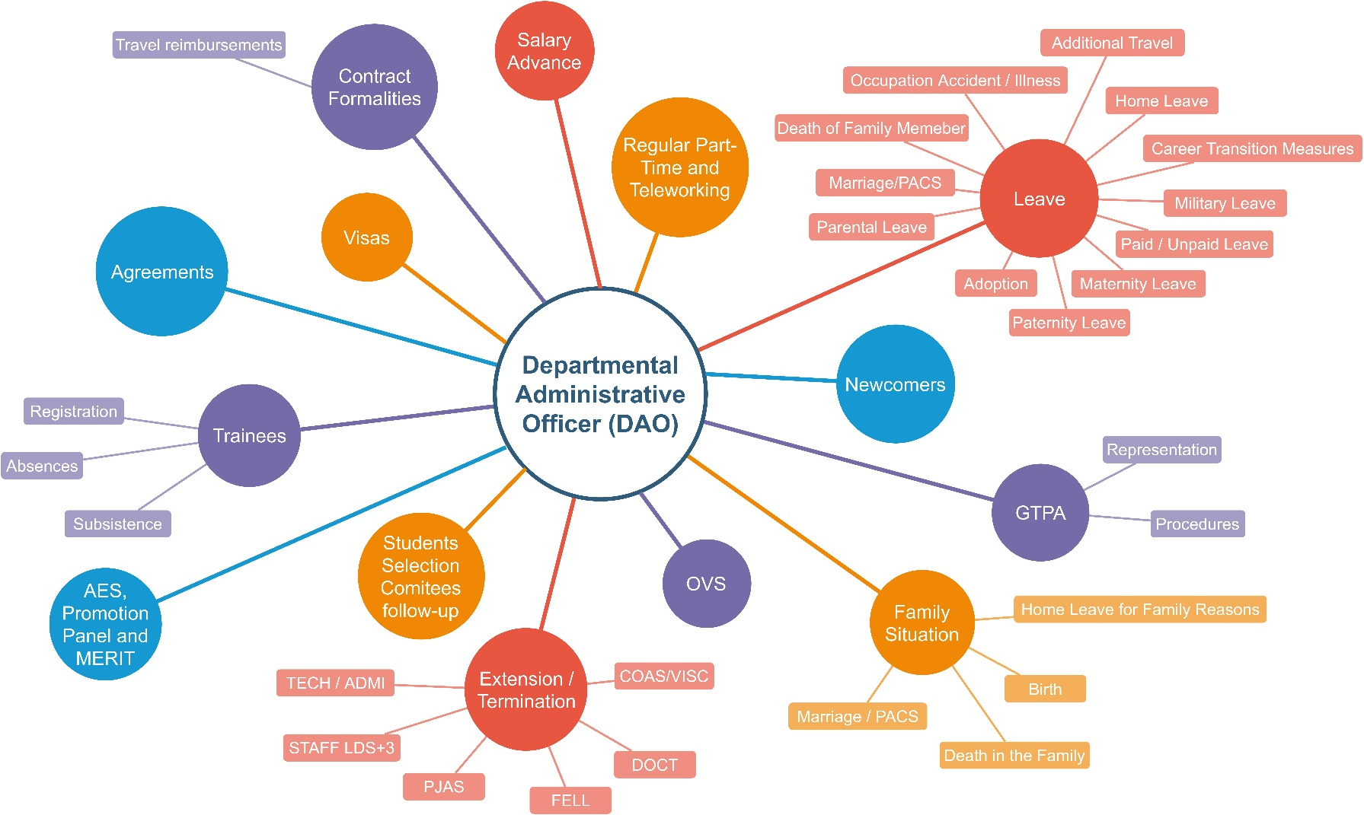
Main activities of the DAO Office
en-dao.web.cern.ch
Welcome to the EN Department 3

Slide 4
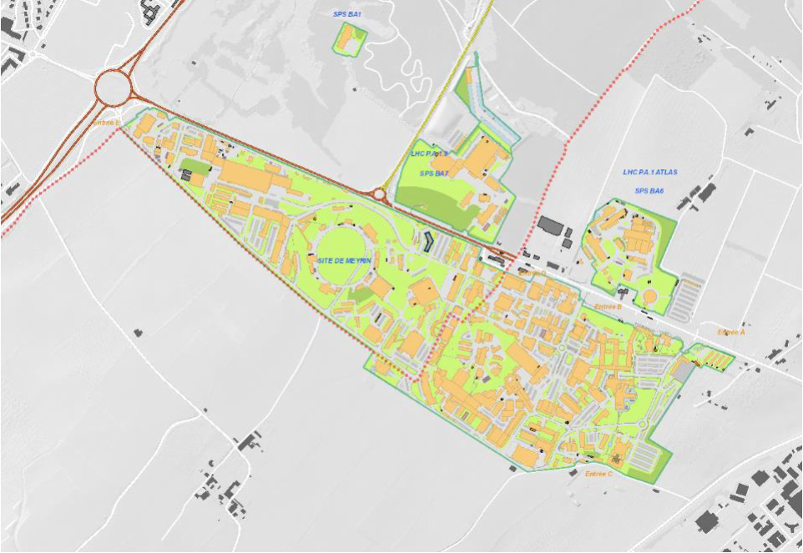
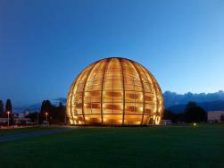

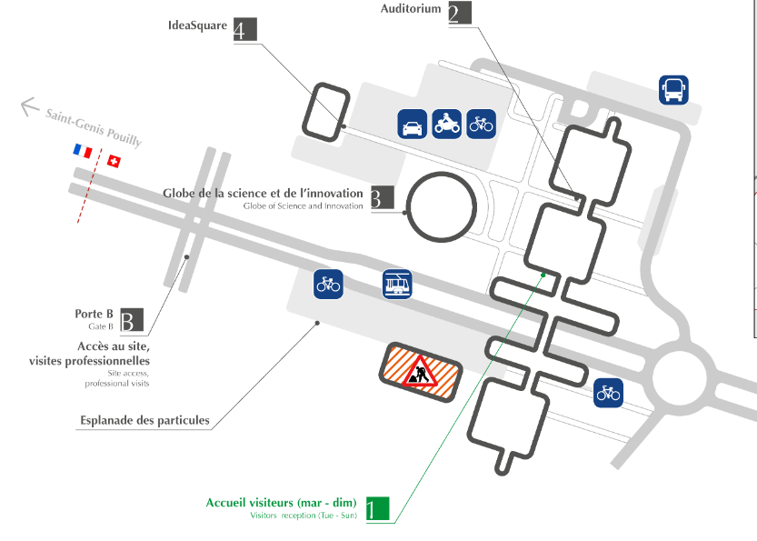



Meyrin Site
Building 54
EN Dept. HQ
EN-DHO
Globe
Portail de la Science
Building 55
Building 33
CERN Maps http://maps.cern.ch
Welcome to the EN Department 4

Slide 5


Your office
EN Logistics
Locks and keys
Inventory
Office moves
Renovation works
Office furniture
Laurent 62808
Marie-Christine 63230
en.dep.facilities@cern.ch
Welcome to the EN Department 5

Slide 6

Your computer
EN Desktop
Purchase
Installation
Troubleshooting
Advice
Inventory
ATS-Desktop@cern.ch
Gaëtan 169807
Jérôme160077
Welcome to the EN Department 6

Slide 7




Your official travels
EN Travels
• Duty Travel Request
(Conferences, firm visits)
en-dep.travels@cern.ch
Official travel request
Marie-Christine 63230
Or your GAO (in the absence of Marie-Christine)
Welcome to the EN Department 7

Slide 8






Other support services
CERN General Support
service-desk@cern.ch
77777
PrinterSupport
printer.support@cern.ch
CAD(CATIA SmarTeam) Support
catia.support@cern.ch
CAE WorkstationSupport
cae-workstations.support@cern.ch
Welcome to the EN Department 8

Slide 9






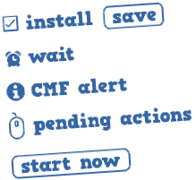
Computing account & Software
NICE account= CERN Computing Account
NICE password
2 passwords
EDH authorization password
CMFto install and remove software
Welcome to the EN Department 9

Slide 10



BYOD Policy at CERN
“bring your own device”
Permitted, but in compliance with CERN computing rules
Operational Circular No. 5
https://security.web.cern.ch/security/rules/en/
CERN web-based applications from outside
NICE desktop from outside Terminal Server
Welcome to the EN Department 10

Slide 11
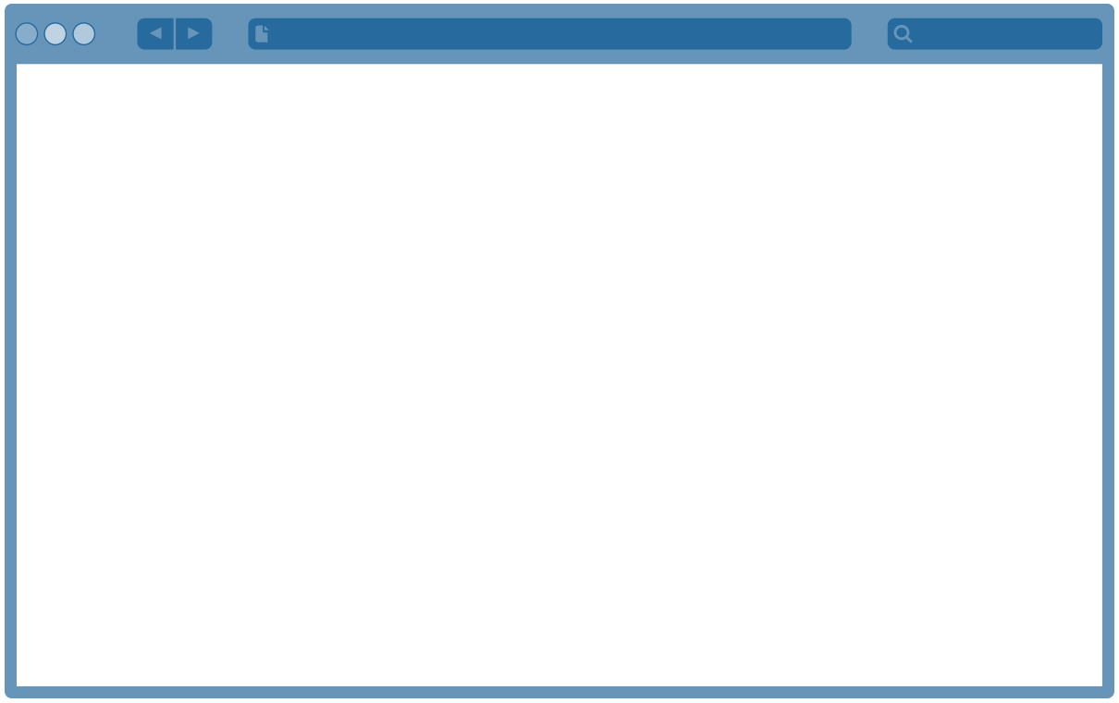
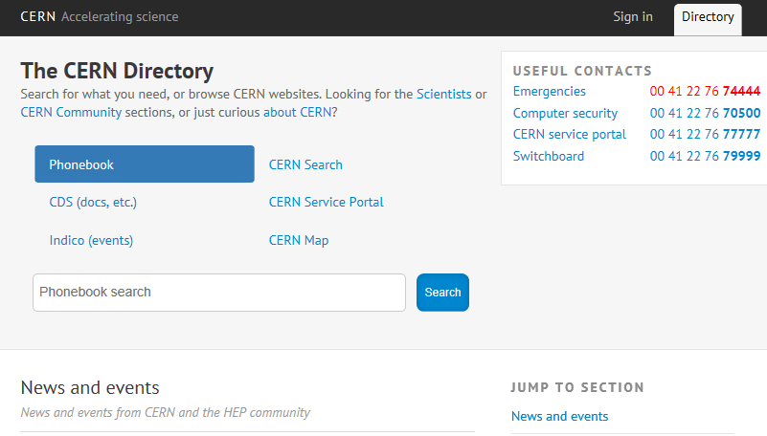

CERN Directory →Entry point
•Dept. websites
•Project websites
•Web applications
•Maps, access
•Documents
•Working at CERN
•Life at CERN
•Etc. http://cern.ch/directory
Welcome to the EN Department 11

Slide 12

CERN Learning Hub
https://lms.cern.ch
Obligatory courses at CERN:
(to be done prior to the 1st day of contract)
Computer Security
Emergency Evacuation
Radiation Protection – Awareness
Safety at CERN
Data Privacy Basics
Check other mandatory courses per status here!
Welcome to the EN Department 12

Slide 13
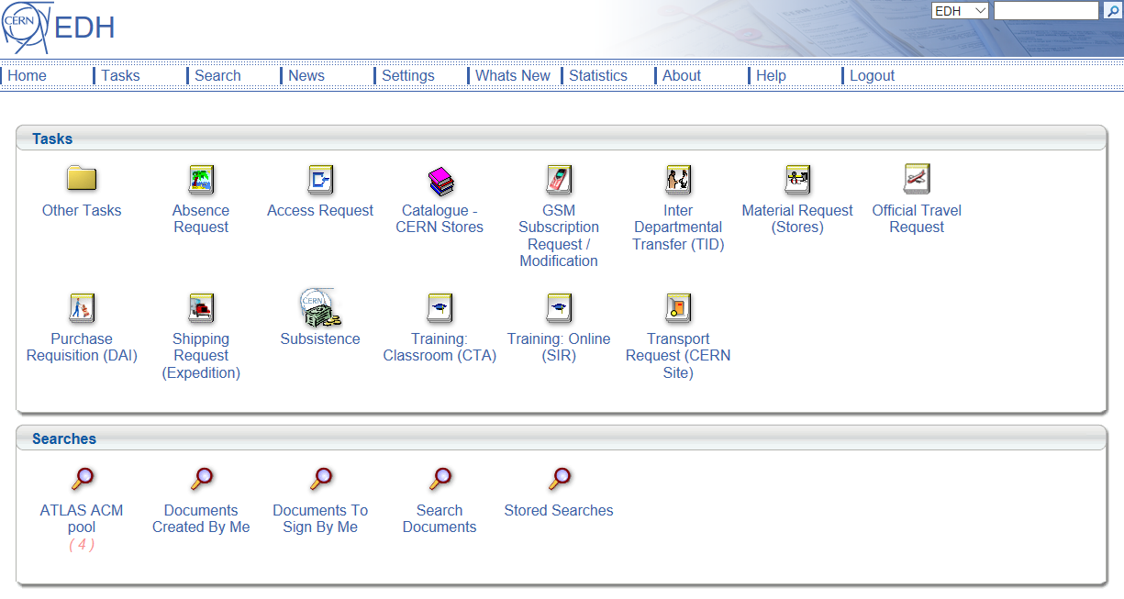

EDH= Electronic Document Handling
Administration forms
with approval routing:
•Absence request
•Official travel request
•Training request
•Access request
•CERN Stores catalogue
•Etc.
http://edh.cern.ch
NICE login + password +
EDH authorization password
Welcome to the EN Department 16

Slide 14



Leaves→Absence Request in EDH
Annual Leaves
30 days / year
(2.5days / month)
Leave year:
from 1stOctober
to 30thSeptember
Special Leaves
Home leaves
Additionaltravels
Leaves forfamily
events
Arrivaltravels
Your DAO
Welcome to the EN Department 15

Slide 15
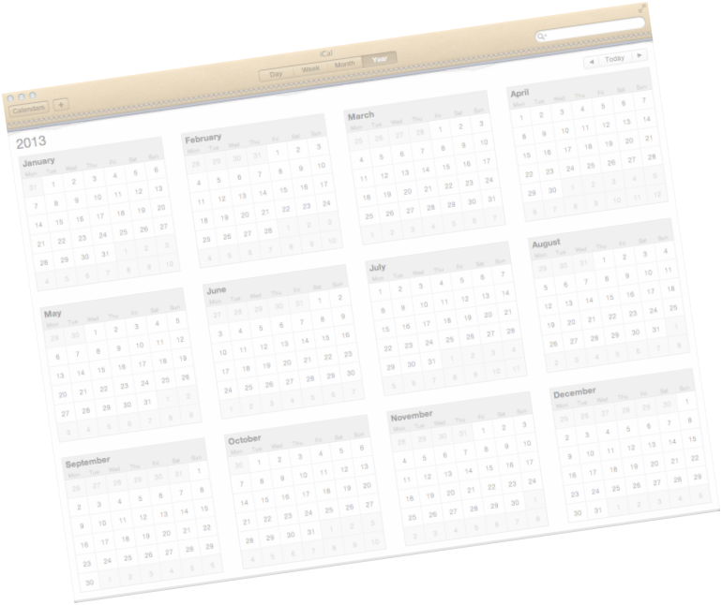
Working Hours and Days
Working Days:
Monday
Tuesday
Wednesday
Thursday
Friday
Friday, 29 March (Good Friday)
Monday, 1 April (Easter Monday)
Wednesday, 1 May
Thursday, 9 May (Ascension day)
Monday, 20 May (Whit Monday)
Thursday, 5 September ("JeûneGenevois")
Public Holidays
CERN closes for two weeks at the end of the year
Saturday 21 December 2024 until Sunday 5 January 2025 inclusive
(without deduction of annual leave)
Welcome to the EN Department 14

Slide 16


Working Hours and Days
Official CERN Working Hours
Normal Working Hours
Specific Authorization (outside Normal Working Hours)
Welcome to the EN Department 13

Slide 17






And if I am sick…
Inform
your GAOor
your Supervisor
CERN
Medical Service
Building 57
(Meyrinsite)
Monday-Friday
08:00 - 12.30
13.30 - 17:00
Welcome to the EN Department 17

Slide 18
Group Administrative Officer (GAO)
Meet your GAO!
GROUP |  | GAO | CONTACT
Access & Alarms (AA) | → | Melat Haile | en.aa.sec@cern.ch
Accelerator Coordination & Engineering (ACE) | → | Sandra Benoît-Godet | sandra.benoit@cern.ch
Cooling & Ventilation (CV) | → | Louisa Catherall | en-dep-cv-secretariat@cern.ch
Electrical Engineering (EL) | → | Leslie Falcon (Laura in the absence of Leslie) | en-dep-el-secretariat@cern.ch
Handling Engineering (HE) | → | Justine Lacousse | justine.lacousse@cern.ch
Information Management (IM) | → | Sandra Benoît-Godet | sandra.benoit@cern.ch
Mechanical & Materials Engineering (MME) | → | Galina Jaouni | mme.sec@cern.ch
Planning, Administration & Safety (PAS) | → | Justine Lacousse | Justine.lacousse@cern.ch
Welcome to the EN Department 18

Slide 19




What shall I do next?
Permanent access card →building 55
Bank account → IBAN starting with CH
→ EDH → Bank Details
+ en.dep.dao@cern.ch
Permanent local address → EDH
French card application
via CERN Service Portal
Welcome to the EN Department 19

Slide 20
Points of contact
In case of any additional questions/concerns regarding the following topics, please contact:
SUBJECT |  | PoC | CONTACT
Absences, trainings, travels | → | Supervisor | individual
Administrative matters, leaves | → | DAO Office | en.dep.dao@cern.ch
Absences, administrative matters | → | GAO | individual
Official travels | → | Travel Coordinators | en-dep.travels@cern.ch
Pension Fund | → | CERN Pension Fund | pension-benefits@cern.ch
Computer troubleshooting | → | EN Computing Support | ATS-Desktop@cern.ch
Welcome to the EN Department 20

Slide 21
Useful links
CERN Campus App today
https://backend.pocketcampus.org/get_app.php?app=pccern
Engineering Department:
https://en.web.cern.ch/
Admin e-guide:
https://admin-eguide.web.cern.ch/
Attestation portal:
(employment, training, remuneration and subsistence attestation, tax certificate)
https://cern.service-now.com/service-portal?id=attestation
CERN Phonebook:
https://phonebook.cern.ch/
Maps:
http://maps.cern.ch
Welcome to the EN Department 21

Slide 22


Newcomers Tasks Timeline
FAQ
To be found at Indico…
Welcome to the EN Department 22

Slide 23

Thank you / Merci

Slide 24
BACK UP SLIDES

Slide 25
Head of Department: K. Foraz
Deputy: M. Nonis
Access and Alarms
(EN-AA)
GL: P. Ninin
DGL: R. Nunes
Accelerator Coordination & Engineering
(EN-ACE)
GL: J.-P. Tock
DGL: S. Chemli
Planning, Administration & Safety
(EN-PAS)
GL: M. Nonis
DGL: S. Knoops
Cooling & Ventilation
(EN-CV)
GL: I. Ruehl
DGL: S. Deleval
Information Management
(EN-IM)
GL: D. Widegren
DGL: J. de Jonghe
Electrical Engineering
(EN-EL)
GL: J. De Voght
DGL: M. Parodi
DGL: D. Ricci
Handling Engineering
(EN- HE)
GL: C. Colloca
DGL: C. Bertone
Mechanical & Materials Engineering
(EN-MME)
GL: S. Atieh
DGL: D. Perini
Department Head Office
(EN-HDO)
Assistant: J. Madden
EN Department
Operation
  Infrastructure
  Accelerators
Projects
  Consolidation
  Upgrades
  New facilities
  Design & Manufacturing
Studies
Welcome to the EN Department 25

Slide 26




Insurance
MPE
MPAt
Other
MPA
CHIS
CERN Health
Insurance Scheme
Partners Healthcare
for CERN MPA
http://cern.ch/usersoffice
Welcome to the EN Department 26

Slide 27
STAFF, FELL, GRADs
Are automatically affiliated: STAFF and FELLOW.
When: as of the 1st day of contract.
Family members: family members of STAFF and FELLOW are automatically affiliated to the CHIS on a compulsory basis.
Fill in a CHIS – Spouse Health Insurance and Professional Income Declaration (SHIPID) to declare the health situation of your spouse. An employment attestation is available on HRT:
  https://hrt.cern.ch/hrt/EmploymentAttestation
Membership to the CERN health insurance scheme (CHIS) is compulsory. CERN pays 7.83% of the monthly remuneration and the member pays 4.86%. Further information can be found on the CHIS pages or by contacting uniqa.assurances@cern.ch.
Welcome to the EN Department 27

Slide 28
ADMIN, DOCT, SUMM, TECH
Are automatically affiliated if they are not covered by LAMal: ADMIN, DOCT, SUMM and TECH.
When: as of the 1st day of contract.
Family members: family members of ADMIN, DOCT, TECH and SUMM are automatically affiliated to the CHIS on a compulsory basis.
An employment attestation is available on HRT:
  https://hrt.cern.ch/hrt/EmploymentAttestation
Membership to the CERN health insurance scheme (CHIS) is compulsory*. CERN pays 7.83% of the monthly basic allowance and the member pays 4.86%. Further information can be found on the CHIS pages or by contacting uniqa.assurances@cern.ch.
* Unless the students are subject to compulsory health insurance in Switzerland (Lamal), in which case CERN shall nevertheless insure them against occupational illnesses and accidents. The students concerned should submit their Lamal insurance certificate to the HR programme coordinator.
Welcome to the EN Department 28

