Slide 1
Integration News
03.04.2024
F. Valchkova-Georgieva & Dieudonne Adrien Ngo'O Ella

Slide 2
03.04.2024
F. Valchkova-Georgieva & Dieudonne Adrien Ngo'O Ella
  Integration topics:
  Integration of RF sectoin point L

Slide 3
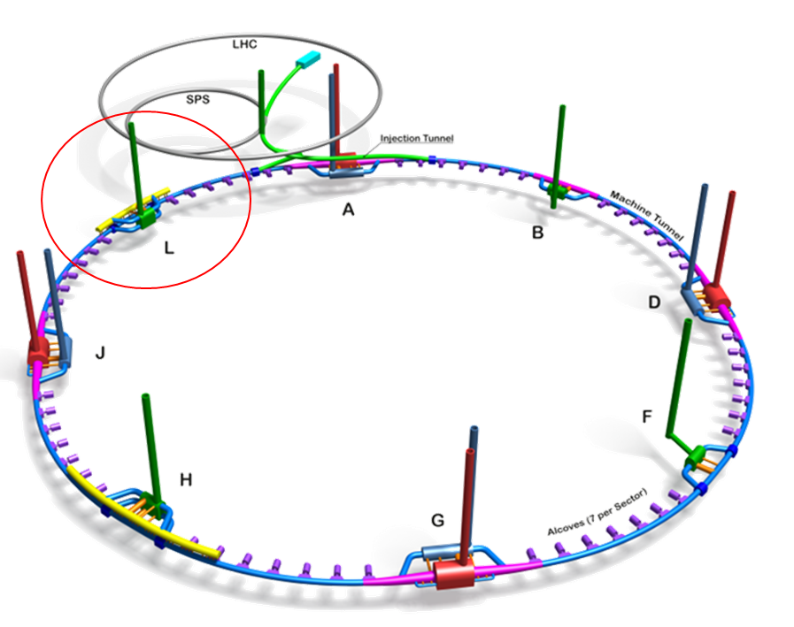
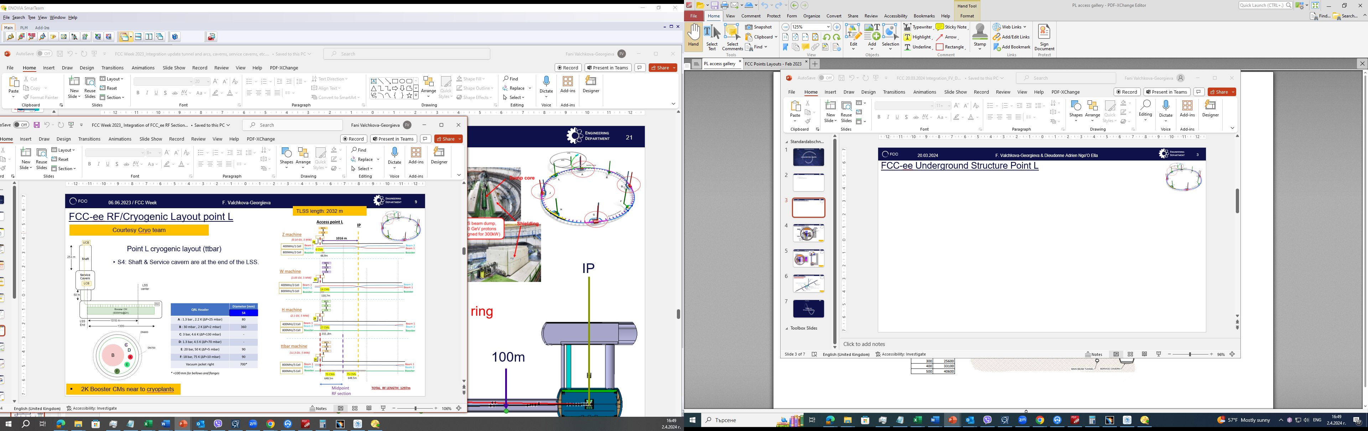
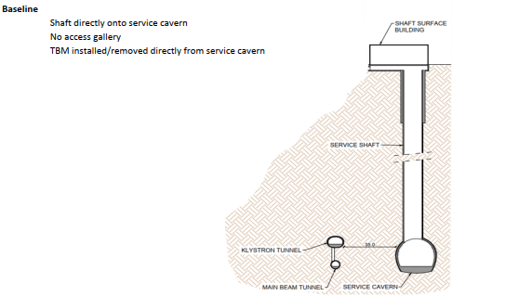
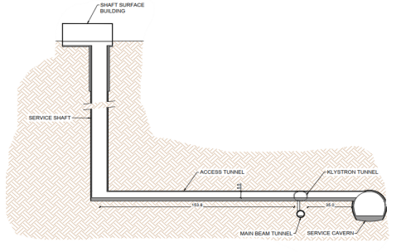
03.04.2024
F. Valchkova-Georgieva & Dieudonne Adrien Ngo'O Ella
  FCC-ee Underground Structure Point L
FCC WEEK 2023
New Baseline

Slide 4
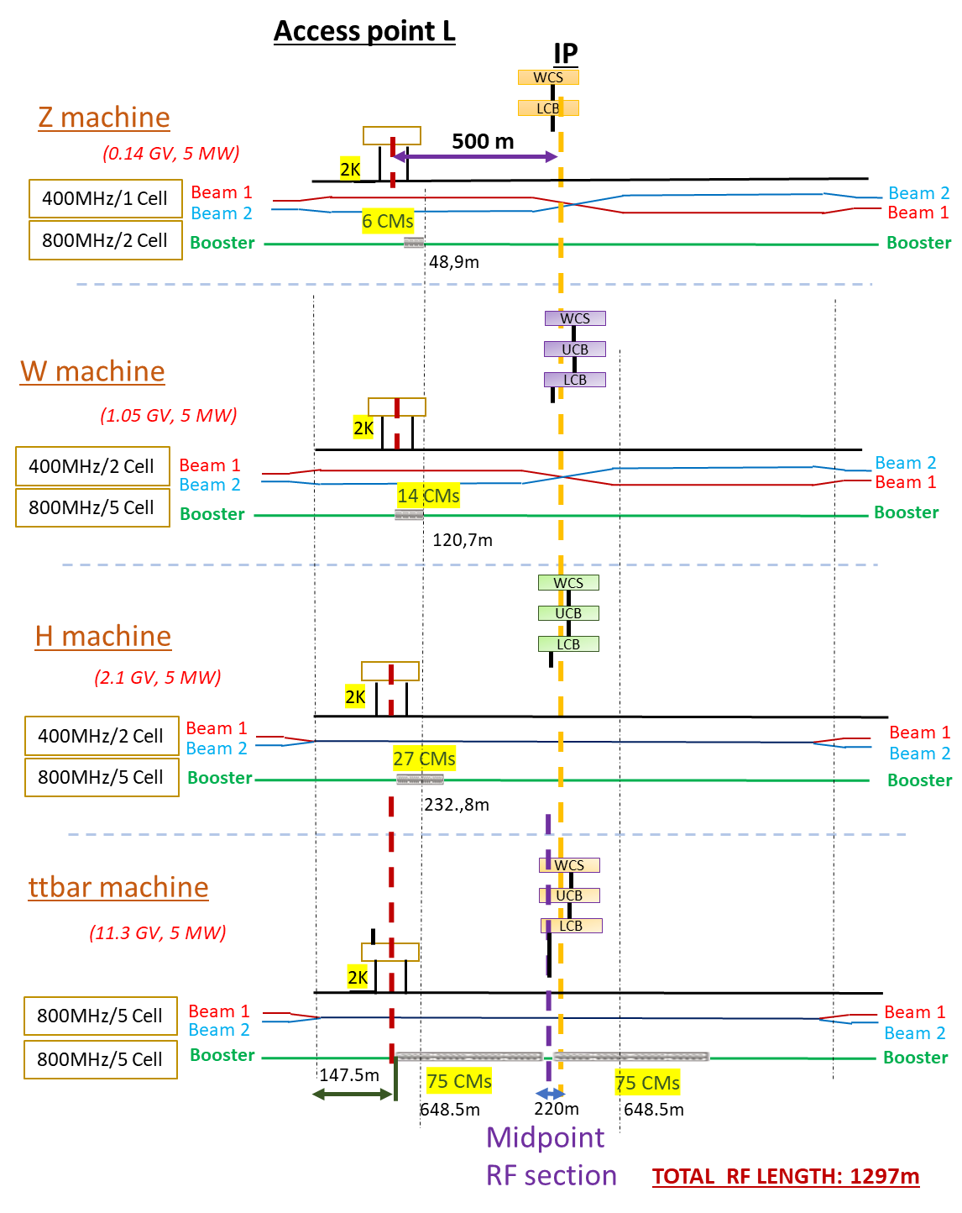
03.04.2024
F. Valchkova-Georgieva & Dieudonne Adrien Ngo'O Ella
  FCC-ee Underground Structure Point L
New Baseline
New QRL Size ?

Slide 5
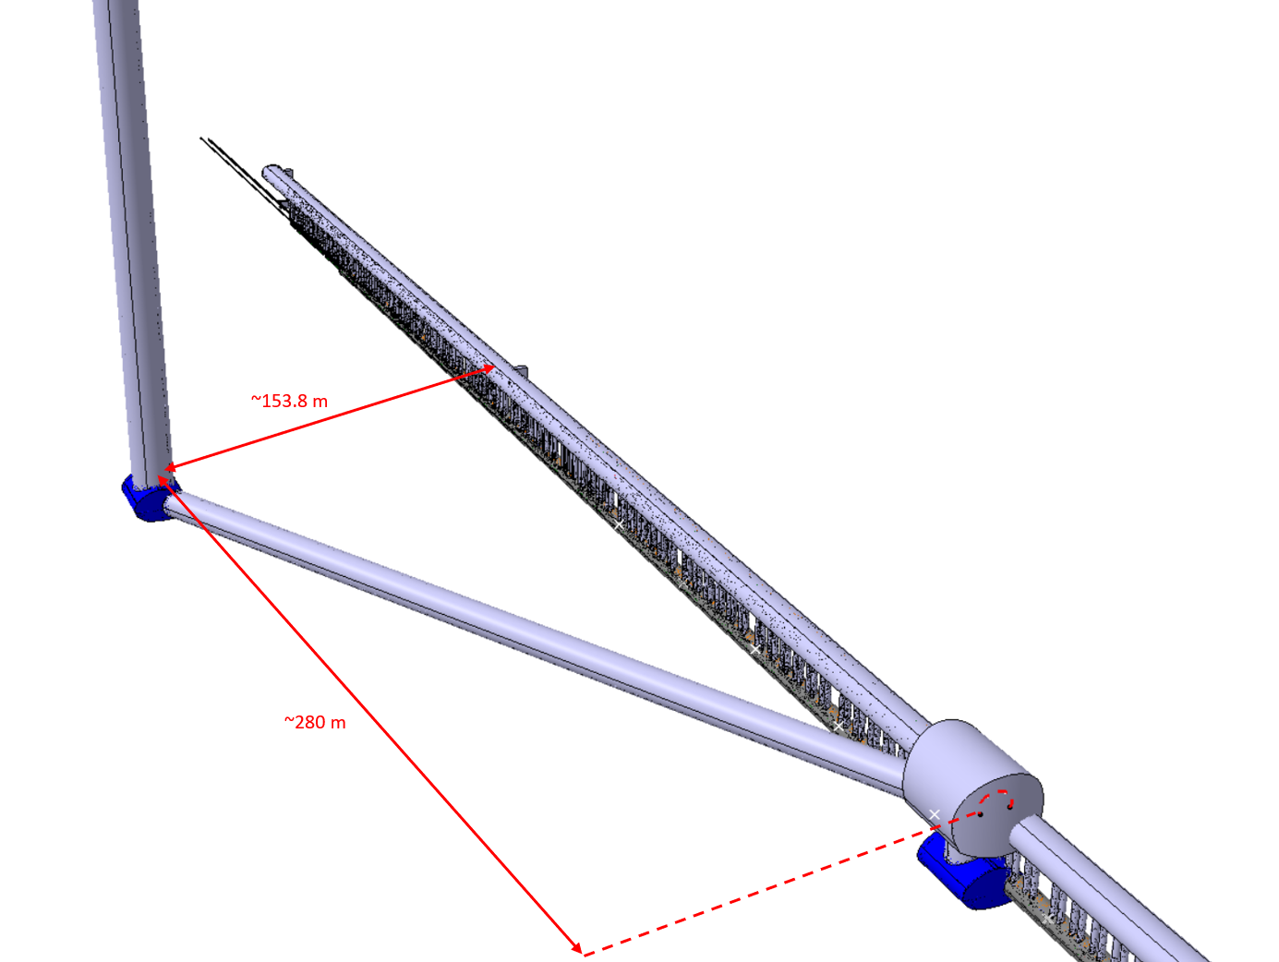
03.04.2024
F. Valchkova-Georgieva & Dieudonne Adrien Ngo'O Ella
  FCC-ee Underground Structure Point L
Collider Center

Slide 6
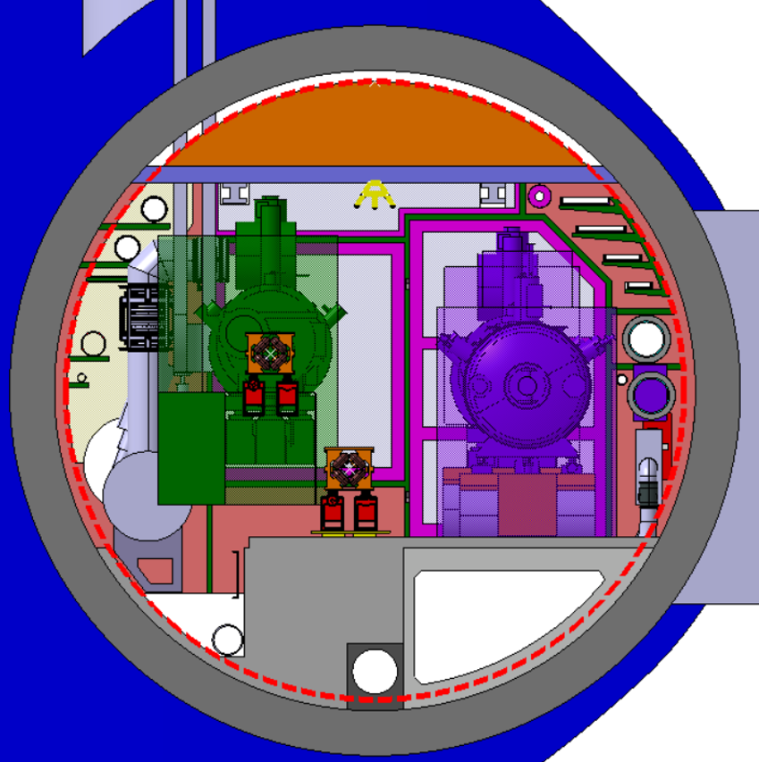
03.04.2024
F. Valchkova-Georgieva & Dieudonne Adrien Ngo'O Ella
  FCC-ee Underground Structure Point L
4 Cable trays:
2 DC Cable trays
Chilled water
DN300
Cable tray
Raw water
DN350
Collider Center

Slide 7
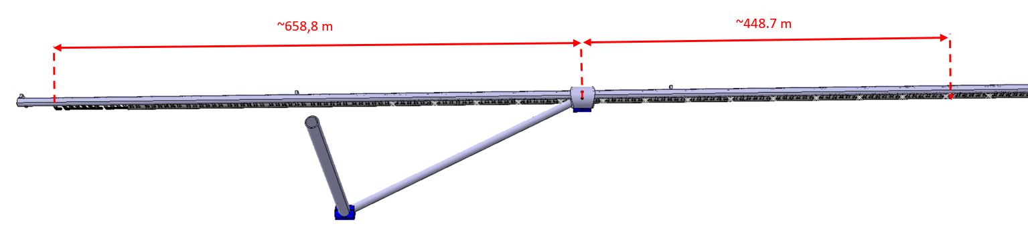
03.04.2024
F. Valchkova-Georgieva & Dieudonne Adrien Ngo'O Ella
  FCC-ee Underground Structure Point L
Collider Center

Slide 8
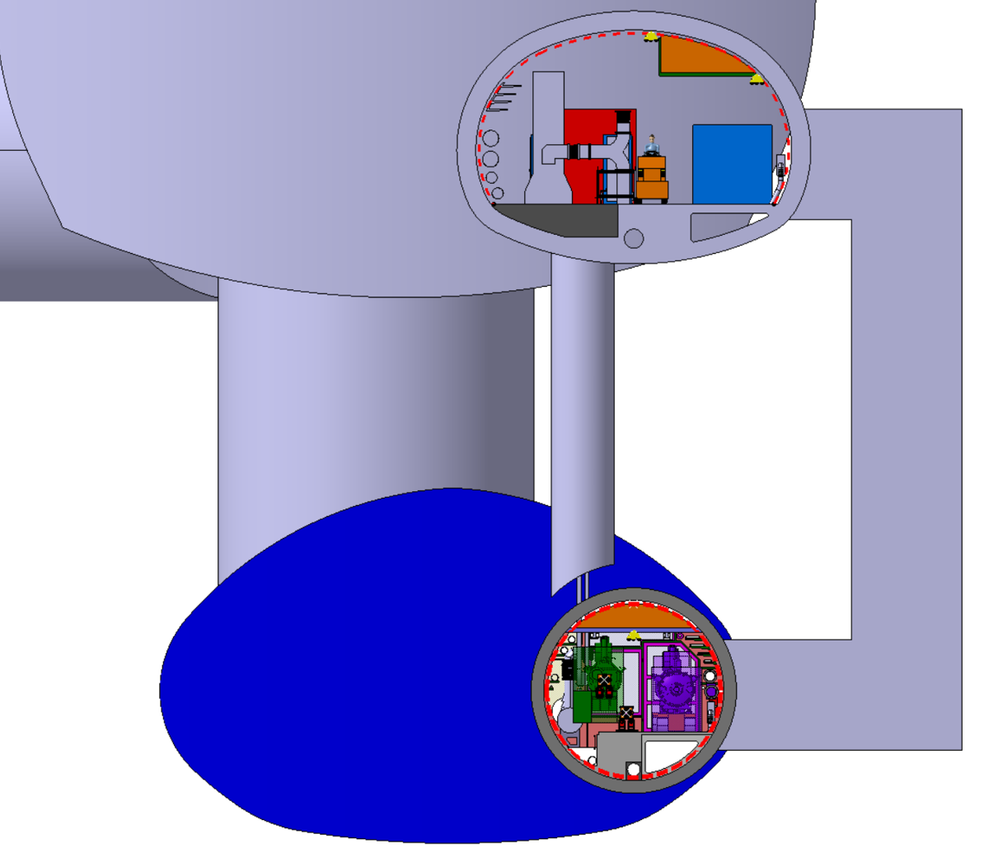
03.04.2024
F. Valchkova-Georgieva & Dieudonne Adrien Ngo'O Ella
  FCC-ee Underground Structure Point L
Collider Center

Slide 9
Thank you for your attention.
F. Valchkova-Georgieva
9

