Slide 1
Integration of BI systems
S. Mazzoni for the FCC BI team

Slide 2
Overview of BI systems
Measurement of transverse profile needs long (100s of metres) extraction lines (EL). A lab / hatch hosts diagnostics at the end of EL
Polarimeter requires accessible laser lab and ‘short’ laser transport line. Discussions ongoing in EPOL WG
Beamstrahlung extraction and dump already in integration study
All considerations preliminary!

Slide 3
Transverse profile
transverse profile of beam measured via synchrotron radiation
Visible or X-ray SR produced by dipole or insertion device and extracted in long (100s metres) line.
Object in intermediate position: pinhole (imaging), double slits or similar (interferometry)
Hatch / lab at end of line for diagnostics. Services (data, power), access not during beam
Initial BI estimation: one TP per beam in ring. From optics community: one TP per beam per IP (ideal)

Slide 4
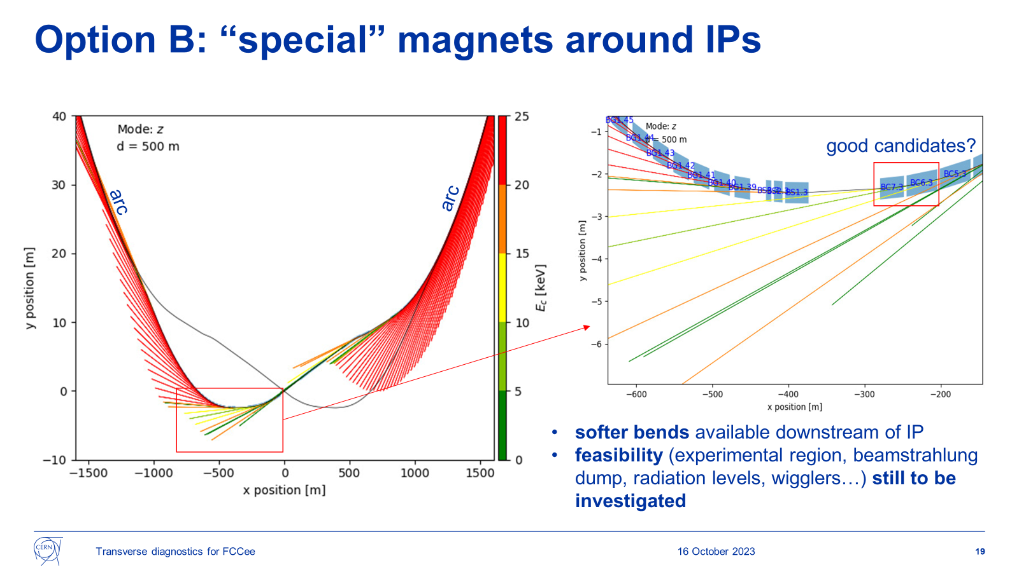
Option: soft dipoles around IP
D. Butti

Slide 5
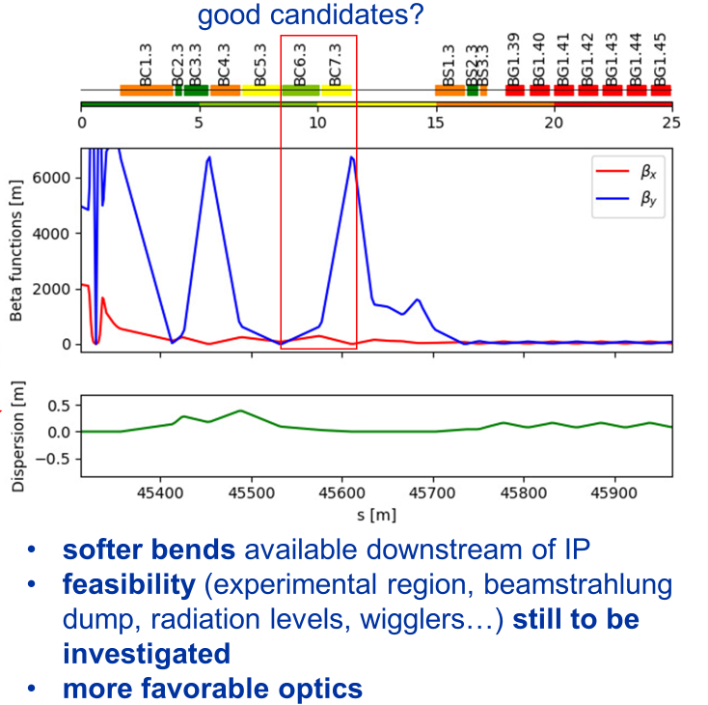
Option: soft dipoles around IP
D. Butti

Slide 6
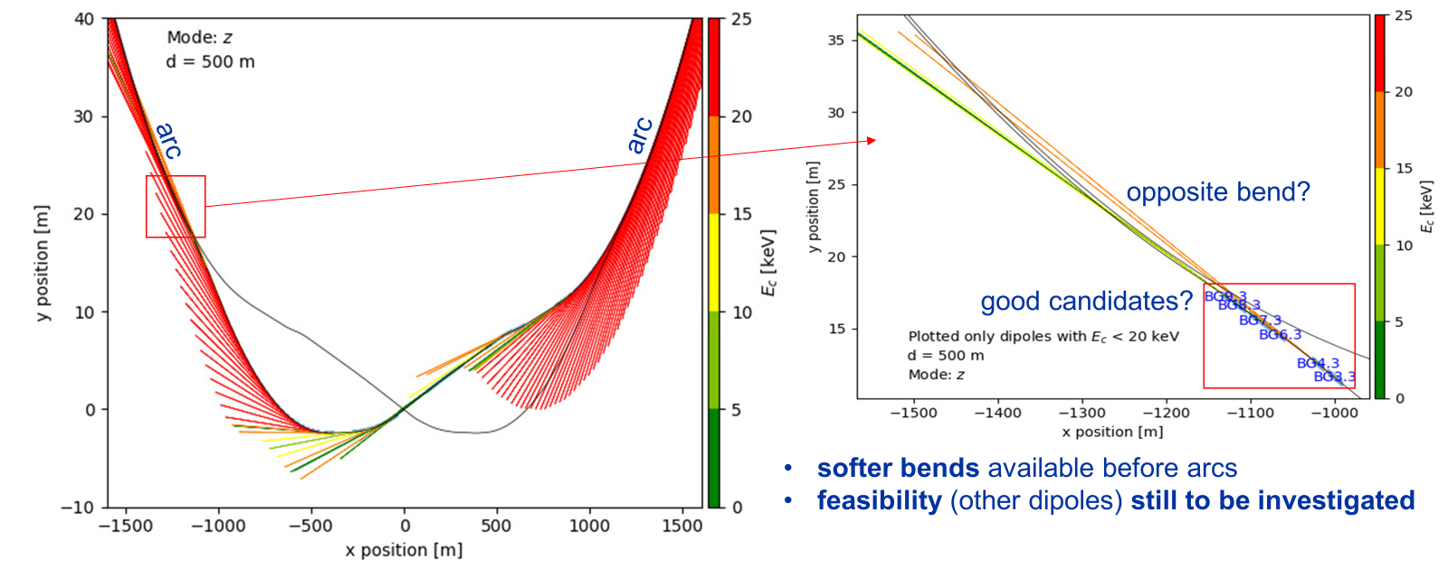
Other options are still being considered…

Slide 7
Consideration for transverse profile
at present location, number, choice of technique for transverse profile are all still undefined! 3-year study (ALBA, U. Milan) started in 2024. Need to discuss how to provide inputs in compatibility with integration study timeline!
longitudinal profile: if visible SR used will use the same infrastructure

Slide 8
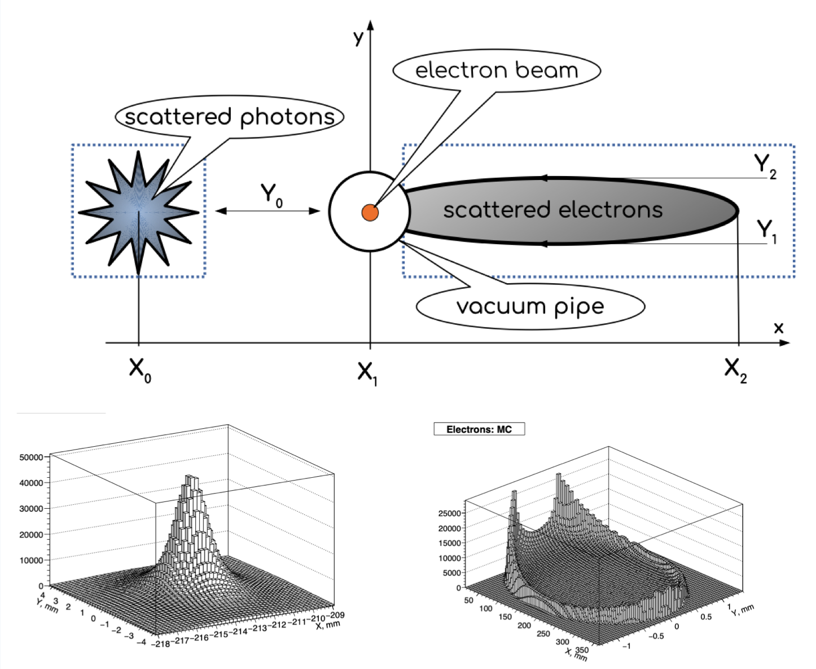
Polarimeter
Polarimeter needed for center-of-mass energy calibration. Based on analysis of scattered photons and electrons from laser-beam interaction (inverse Compton scattering)
Impact on integration:
  laser room accessible during beam operation
  limitations on length of laser transport line
Two integration options at present

Slide 9
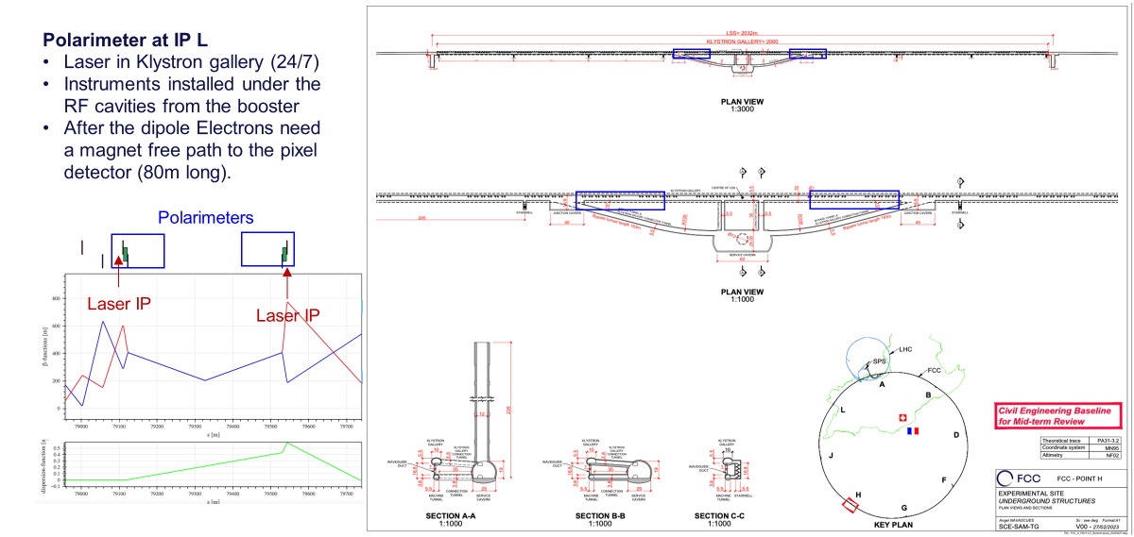
Option 1: single polarimeter in RF point L
R. Kieffer

Slide 10
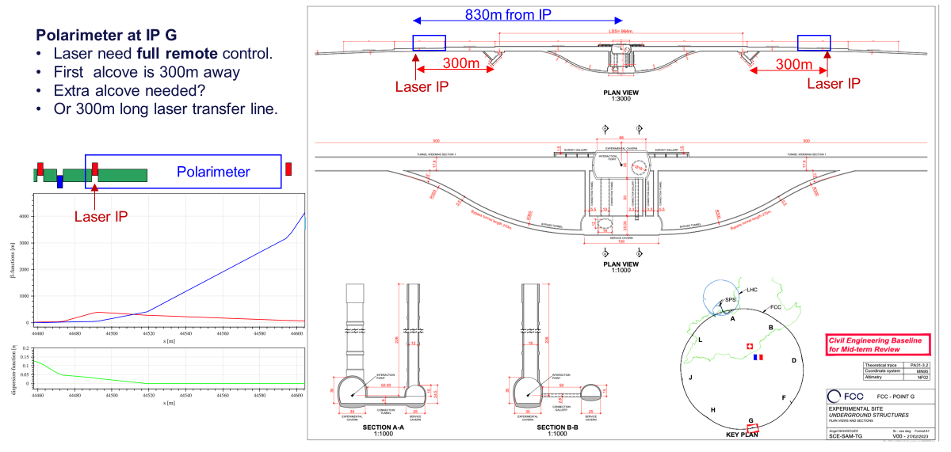
Option 2: polarimeter per each IP
R. Kieffer

Slide 11
Summary
First BI inputs to FCC integration study: preliminary!
transverse profile: several options still open: need to agree on approach. Timeline for BI studies not compatible with integration (?). BI contact: Daniele Butti
polarimeter: two options being evaluated in EPOL WG. BI contact; Robert Kieffer
Beamstrahlung already integrated in FCC design. Follow-up. BI contact: Robert Kieffer

