Slide 1
Integration News
17.04.2024
F. Valchkova-Georgieva & Dieudonne Adrien Ngo'O Ella

Slide 2
17.04.2024
F. Valchkova-Georgieva & Dieudonne Adrien Ngo'O Ella
  Integration topics:
  Integration of RF sectoin point L
  Integration of RF sectoin point H
  To come:
  30th April:
  Integration of FCC-ee Experiment point ( PA&PD)
  Integration of Big and Small Alcove
  15 May:
  Integration of FCC-ee point B
  Update integration of RF sections

Slide 3
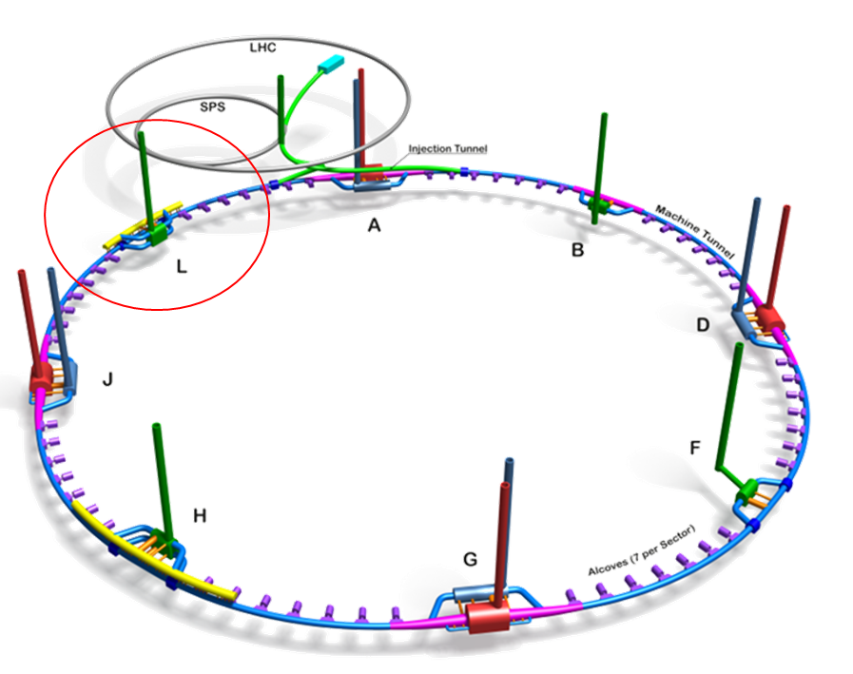
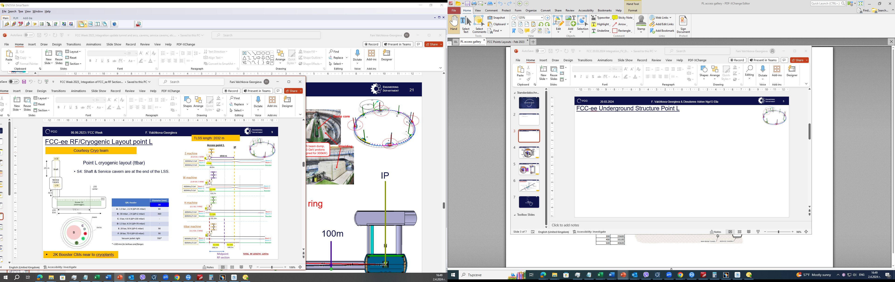
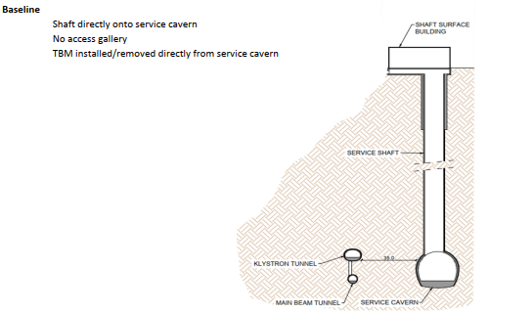
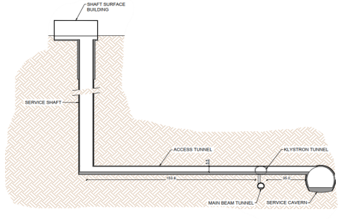
17.04.2024
F. Valchkova-Georgieva & Dieudonne Adrien Ngo'O Ella
  FCC-ee Underground Structure Point L
FCC WEEK 2023
New Baseline

Slide 4
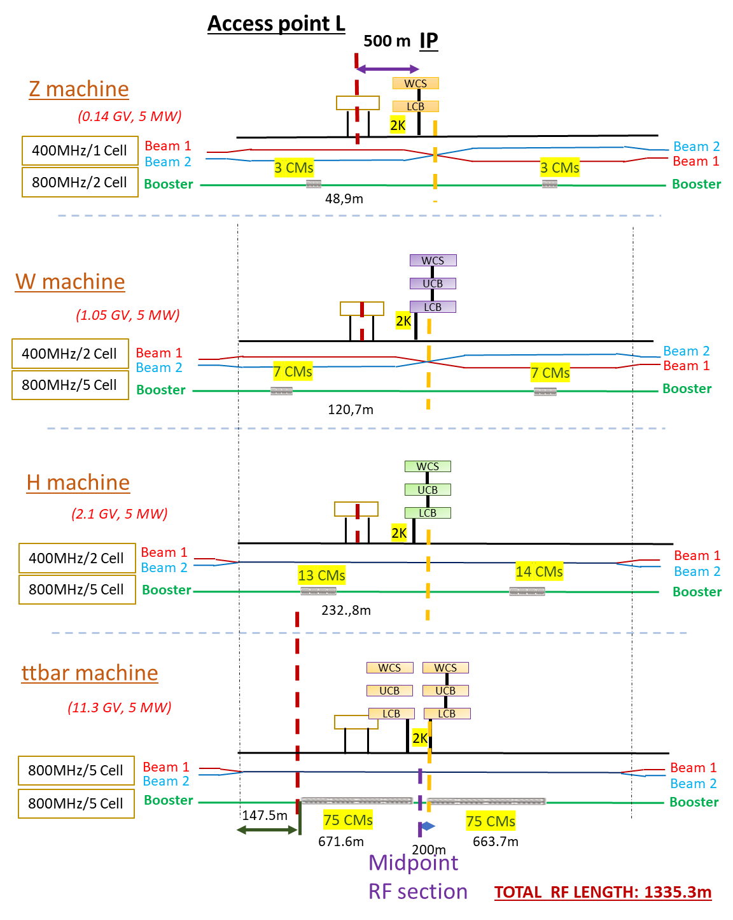
17.04.2024
F. Valchkova-Georgieva & Dieudonne Adrien Ngo'O Ella
  FCC-ee Underground Structure Point L
New Baseline
New QRL Size ?

Slide 5
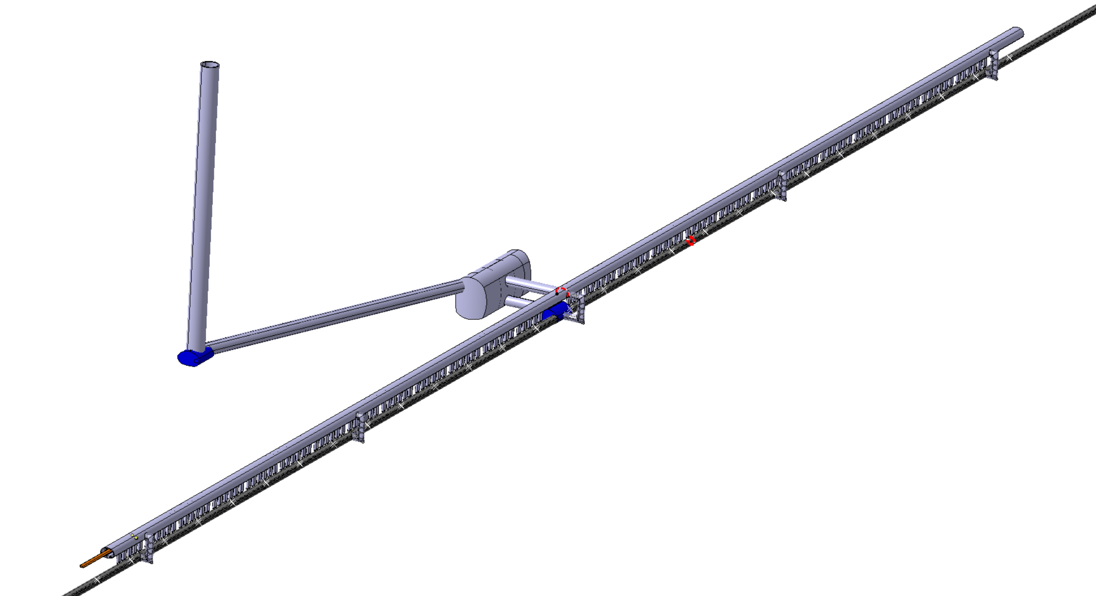
17.04.2024
F. Valchkova-Georgieva & Dieudonne Adrien Ngo'O Ella
  FCC-ee Underground Structure Point L
Service Shaft
ø9,5m Connection Tunnel
Service Cavern
(60x25m)
ø7m Connection Tunnels
(Cavern/Klystron Gallery)
5 Evacuation staircase
(each 225 m)
Junction Cavern
IP
Collider Center
Klystron Gallery
Junction Cavern
Machine tunnel

Slide 6
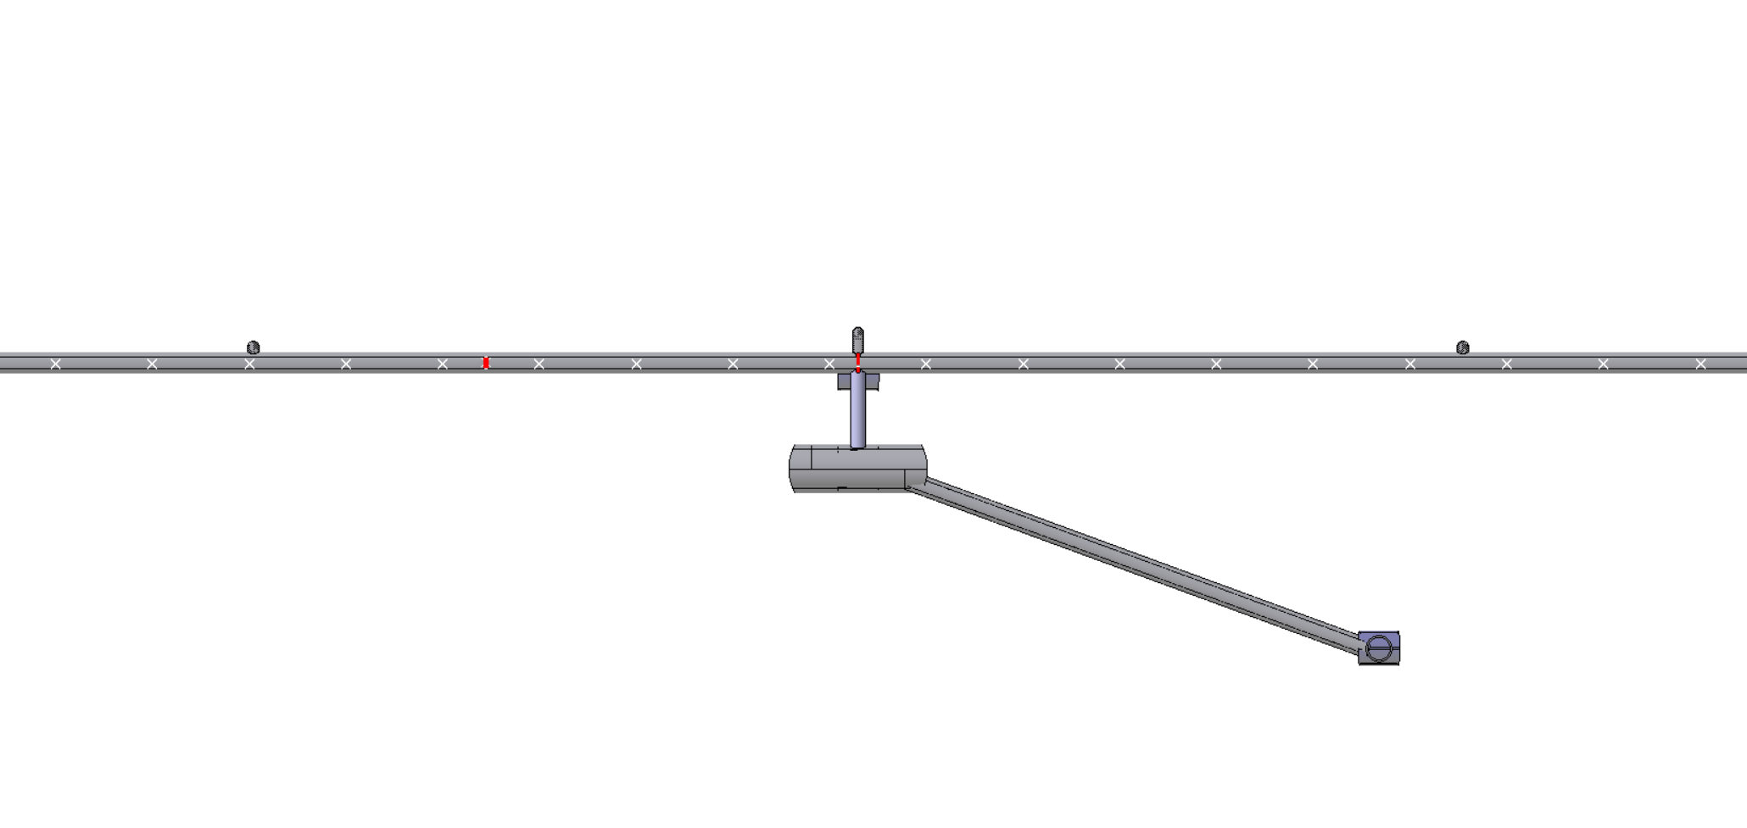
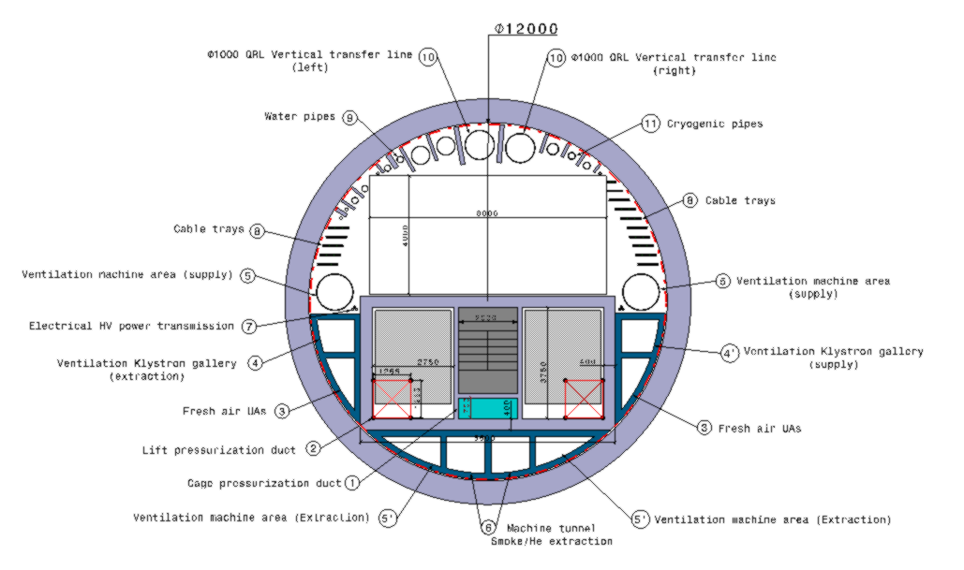
17.04.2024
F. Valchkova-Georgieva & Dieudonne Adrien Ngo'O Ella
  FCC-ee Underground Structure Point L
Collider Center
35m
153,8m
Service Shaft
8000
250m
4000
LCB (lower cold box)
dimensions: 13x6x6 m (LxWxH)
- weight: 42 tonnes

Slide 7
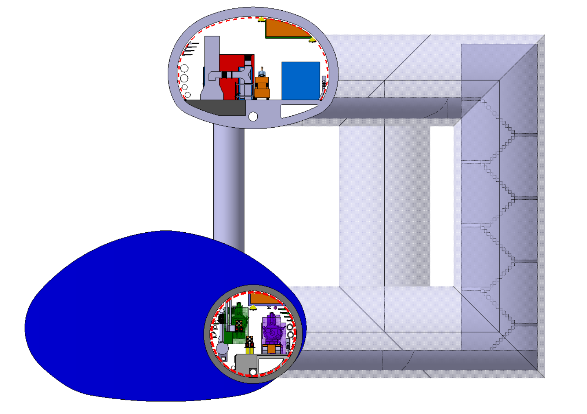
17.04.2024
F. Valchkova-Georgieva & Dieudonne Adrien Ngo'O Ella
  FCC-ee Underground Structure Point L
Collider Center
10m

Slide 8
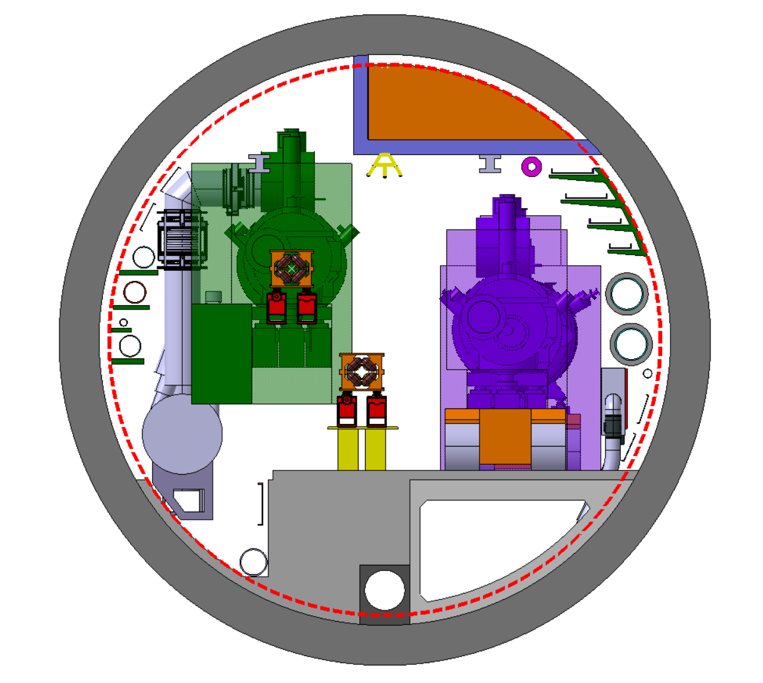
17.04.2024
F. Valchkova-Georgieva & Dieudonne Adrien Ngo'O Ella
  FCC-ee Underground Structure Point L
Smoke/He extraction
S=1.098m2 instead of S=1.946m2
4 Cable trays:
2 Cable tray
Chilled water
DN300
1,03m
0,98m
2 Cable tray
1 Cable tray
Raw water
DN350
2,03m
Collider Center

Slide 9

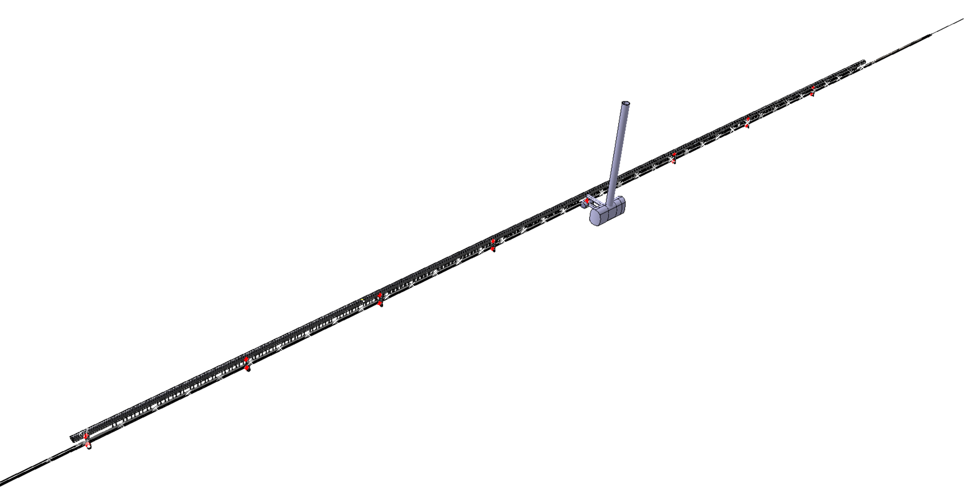
17.04.2024
F. Valchkova-Georgieva & Dieudonne Adrien Ngo'O Ella
  FCC-ee Underground Structure Point H
Service Shaft
ø7m Connection Tunnels
(Cavern/Klystron Gallery)
8 Evacuation staircase
(each 250 m)
IP
Service Cavern
(60x25m)
Junction Cavern
Collider Center
Klystron Gallery
Machine tunnel

Slide 10
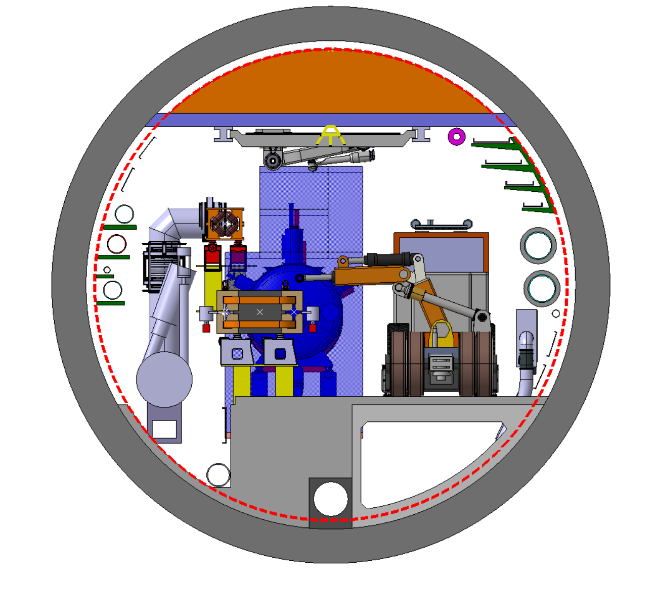
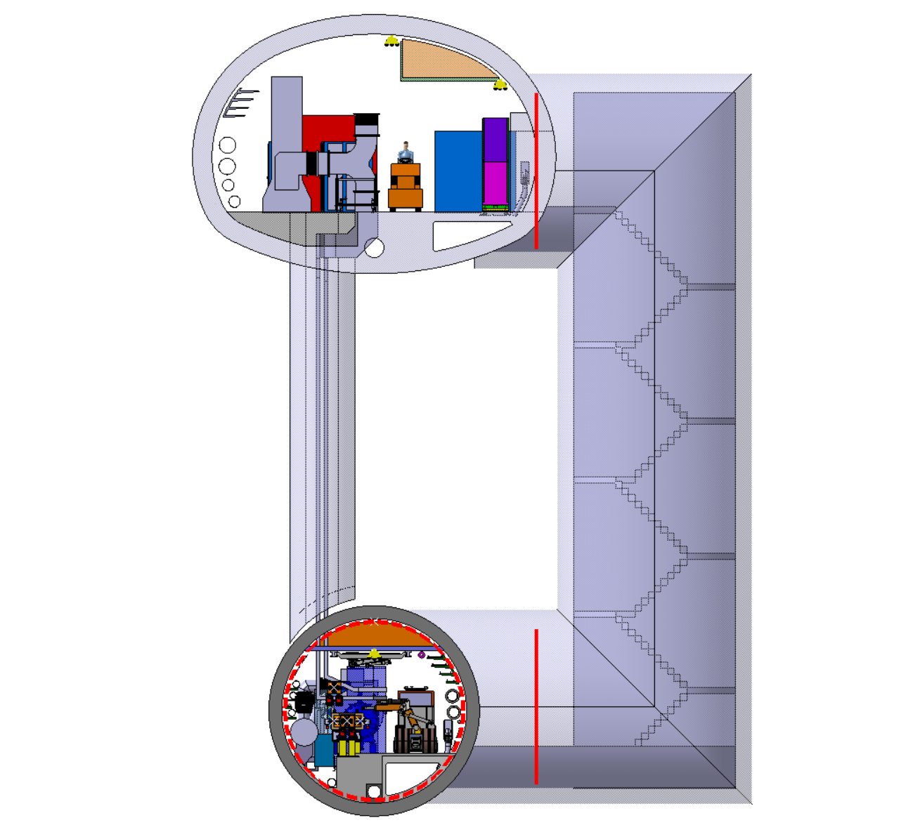
17.04.2024
F. Valchkova-Georgieva & Dieudonne Adrien Ngo'O Ella
  FCC-ee Underground Structure Point H
4 Cable trays:
2 Cable tray
Chilled water
DN300
1,03m
0,98m
2 Cable tray
1 Cable tray
Raw water
DN350
1,8m
Collider Center

Slide 11
Thank you for your attention.
17.04.2024
F. Valchkova-Georgieva
11

