Slide 1
FCC Polarimeter integration
FCC Integration meeting, 17th april 2024
Robert Kieffer
Space for additional logos
Robert Kieffer on behalf of the CERN BI group

Slide 2
Outline
Robert Kieffer
Space for additional logos
Location of the polarimeter on the FCC lattice and associated civil engineering
More about the Laser IP, associated hutch, and extraction lines.

Slide 3
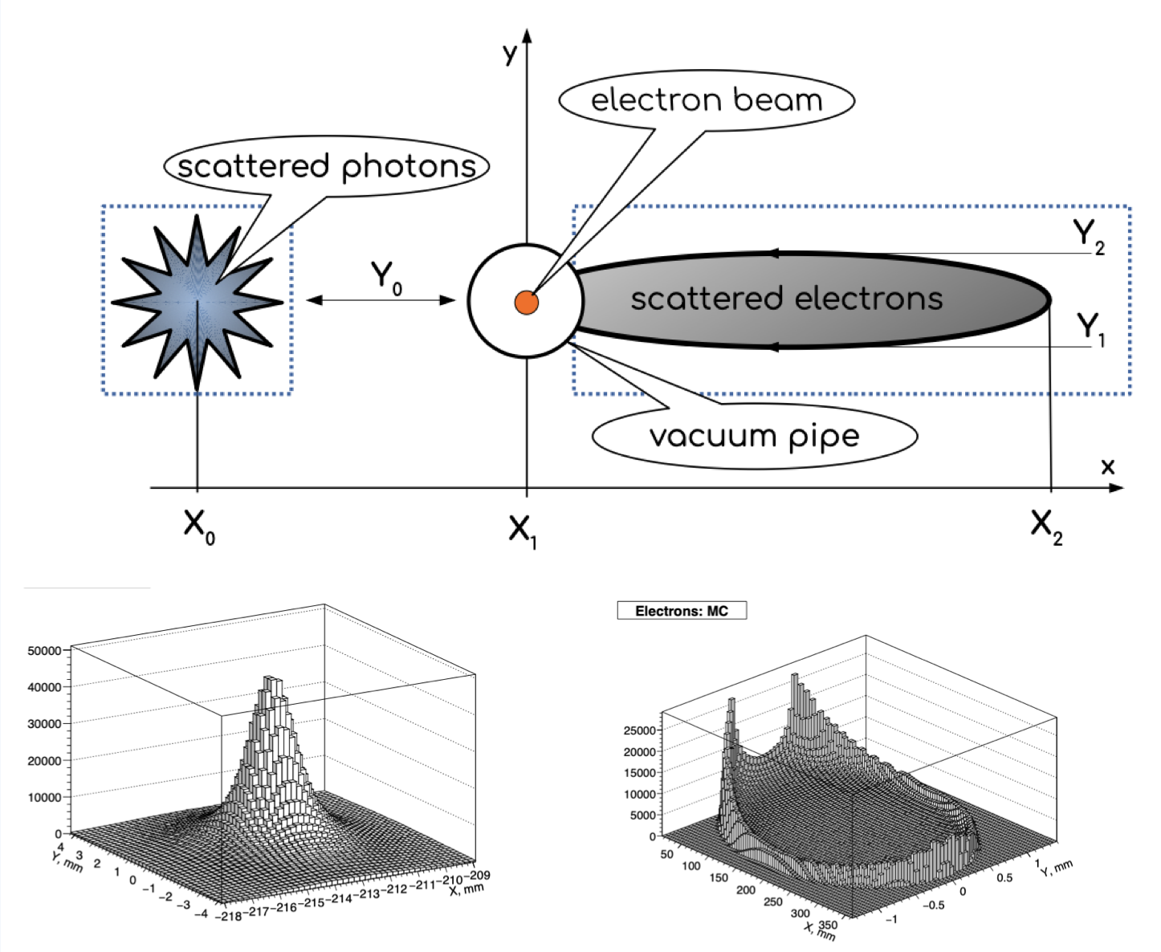
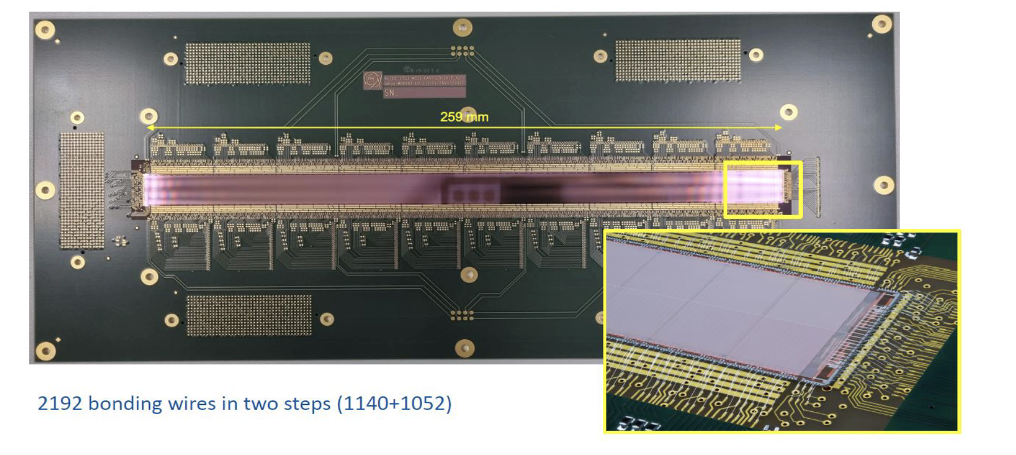
FCCee Polarimeters
From N.Muchnoi
Robert Kieffer
Space for additional logos
At 100 m from LIP
Aim
Centre of mass energy calibration is obtained from the resonant depolarization scans RDP.
Complementary use of the polarimeter for precise longitudinal polarization probing on physics bunches.
Free spin precession (looks difficult to achieve).
Implementation needs
Dedicated powerful laser and adapted hutch
Laser Compton chamber LIP
Spectrometer magnet stuffed with Hall sensors
Compton electron/photon extraction line chamber
Particle sensors 100m from LIP (for separation)
Polarizing wigglers to speedup polarization buildup.
RF kickers to apply resonant depolarization RDP scans.
Main constraints
Space available for beam separation and to install sensors
Lattice configurations (beam e+ , beam e-, booster)
Multiple sources of backgrounds (SR, thermal photons,..)
Laser hutch need to be accessible 24h/7d while running
Minimum impact to the experiments from Compton products
239 mm
389 mm
8 x 10 mm²
350 x 3 mm²
25 cm Monolitic pixel sensor from Alice
Would fit the whole profile at 65 m from LIP

Slide 4
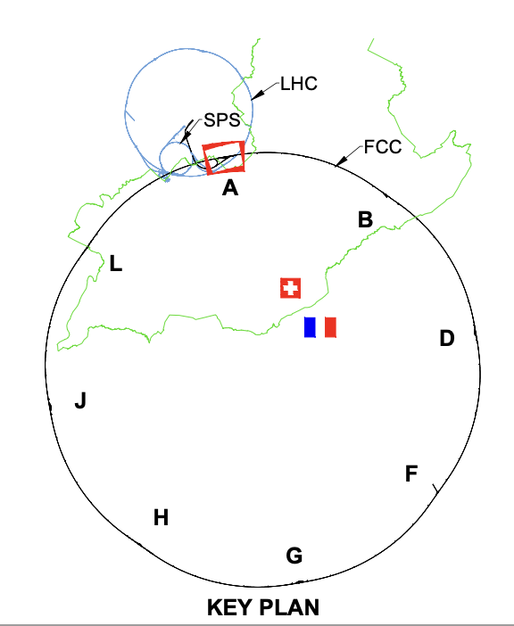
FCCee Polarimeters
Robert Kieffer
Space for additional logos
Base line: a single polarimeter per beam (2 total)
Instrument location: both ends of LSS on each experimental IP A
Laser room should have a 24/7 access to insure availability.
Needs dedicated laser hutch and access tunnels
Energy at IPs is inferred from one measurement point.
Energy loss (Tapering), along the ring induce systematic errors on the energy inferred at each IP.
Redundancy option : four polarimeters per beam (8 total)
Instrument location: both ends of LSS on each experimental IP points A D G J
Each exp. IP would need dedicated hutch and access tunnels
Energy calibration done at each IP, reduced systematic errors.
Other option under study: one polarimeter per beam (2 total)
Instrument location: at the center of the RF section in point L
Only possible for Z and W, since the beam path is changed for H and ttbar, and the cryomodule will probably take all the available space. => Not preferred option
Laser hutch in Klystron galleries (space unavailable for H, tttbar)

Slide 5
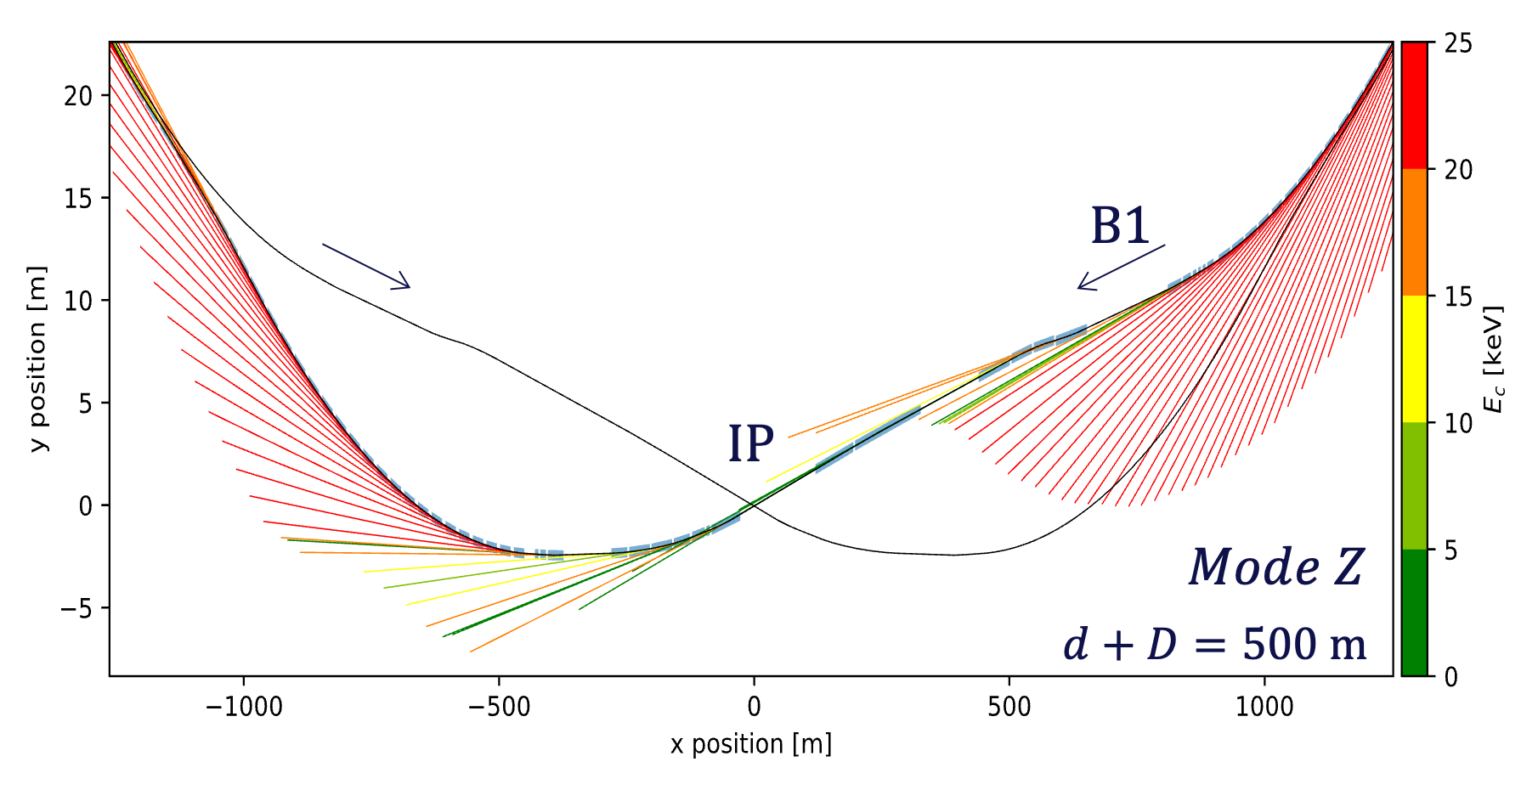
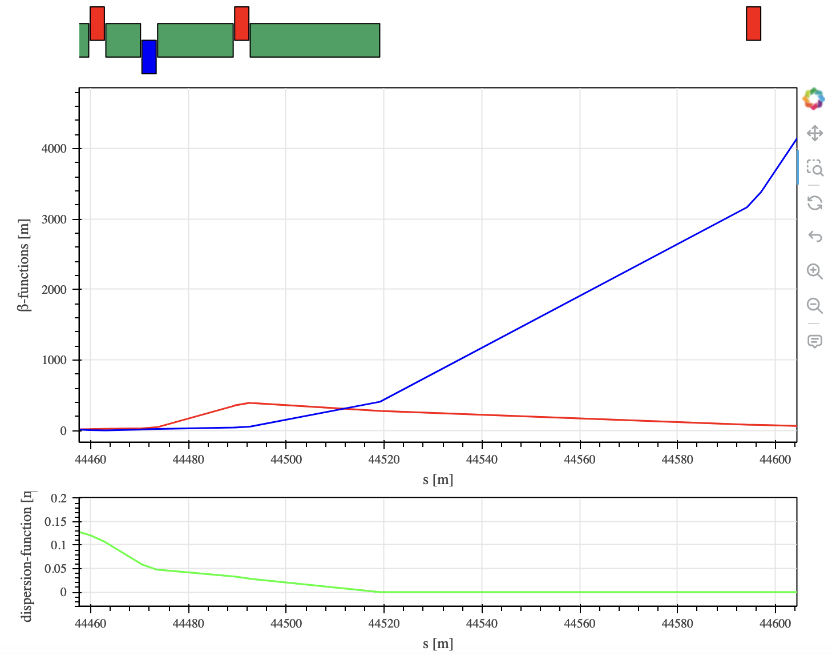
FCCee Polarimeters baseline in Experimental IP A
Robert Kieffer
Space for additional logos
BL1.4
Polarimeter
Survey plot from Daniele Butti
Laser IP
Laser IP
Laser IP
Synchrotron Radiation fan shows a potentially strong contamination from SR in the compton gammas extraction line.

Slide 6
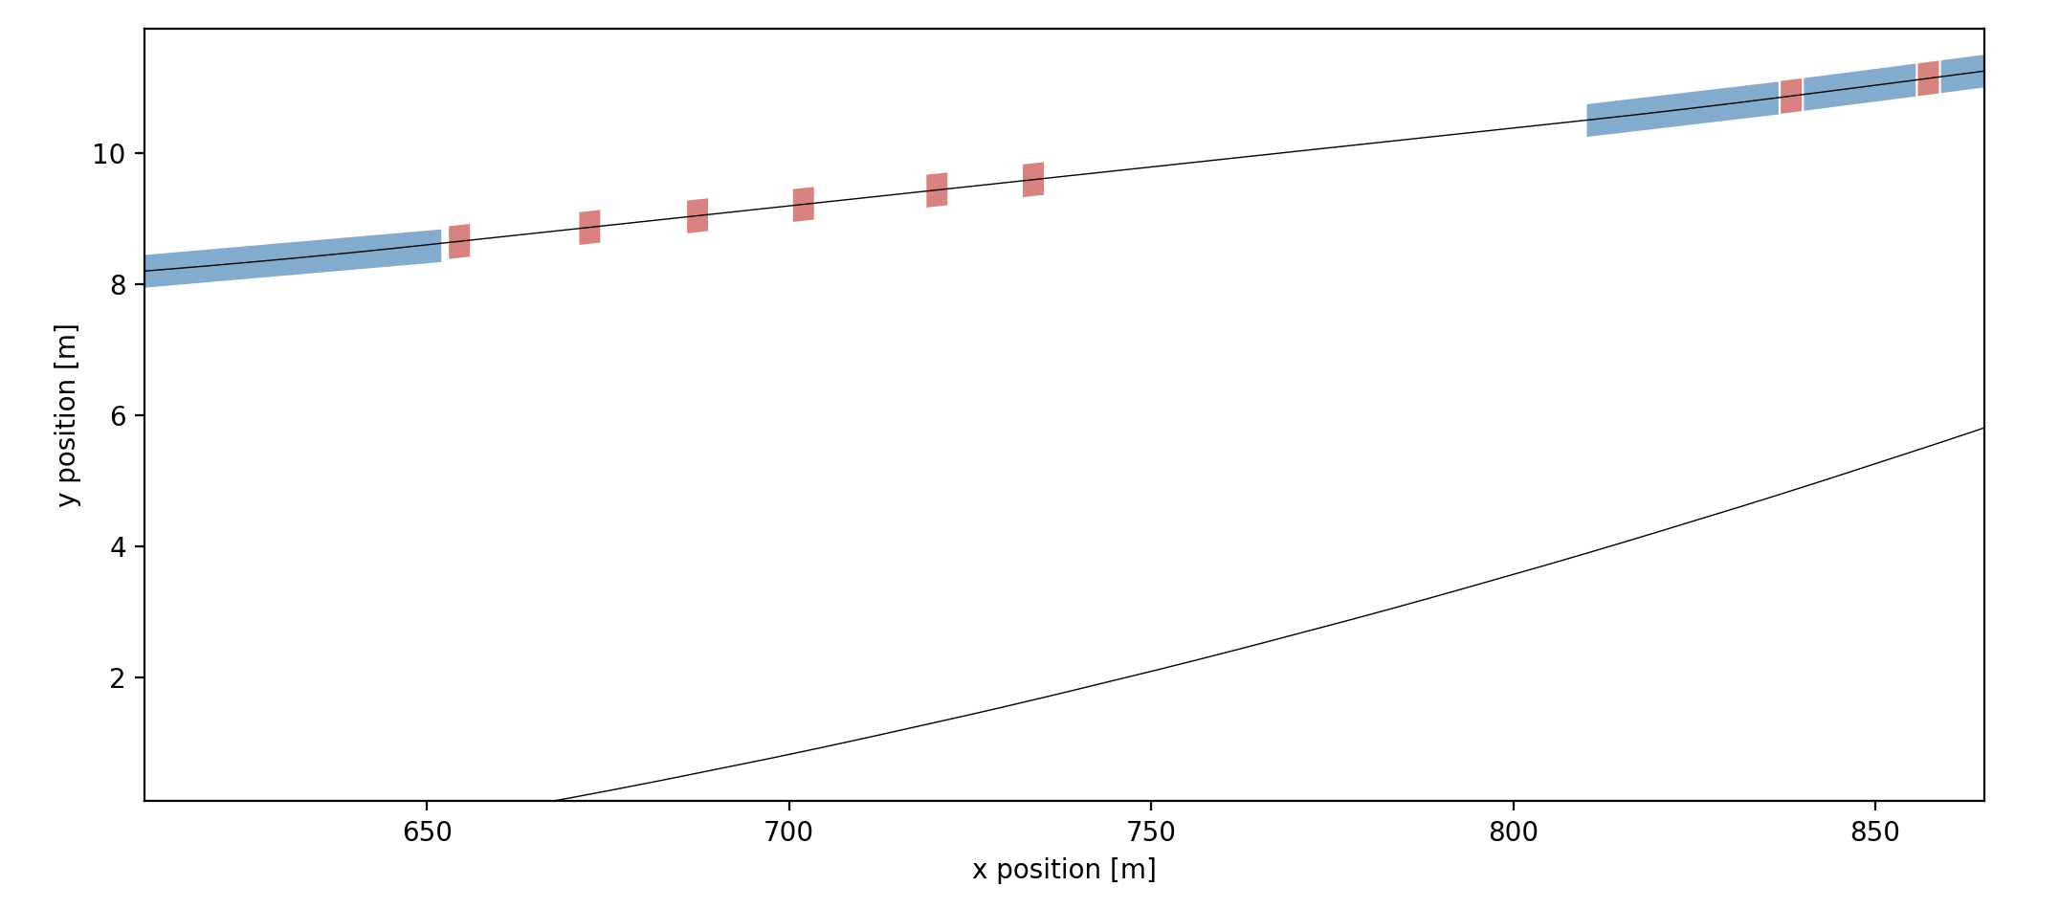
FCCee Polarimeters baseline in Experimental IP A
Space for additional logos
Robert Kieffer
Electrons
BL1.4
Photons
100 m propagation distance
Laser IP
7m between beams

Slide 7
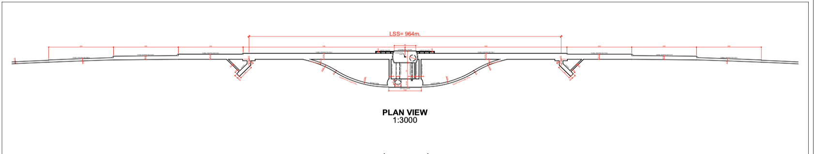
FCCee Polarimeters baseline in Experimental IP A
Robert Kieffer
Space for additional logos
Laser IP
830m from IP
Laser IP
830m from IP
Laser hutch
Accessible 24h/7d
Laser hutch
Accessible 24h/7d
Extra tunnel or bypass tunnel elongated
Extra tunnel or bypass tunnel elongated
The base line is to use the magnet BL1.4 as spectrometer on each beam, followed by 75m of free beam propagation to separate the compton photons and compton electrons from the main beam.
In order to insure full time availlabilty of the RDP energy calibration the Laser hutch need to be accessible 24h/7days.
The transport line between the Laser hutch and Laser IP need to be bellow 50 meters lenght.
As few mirror folds and view ports as possible to maintain a good laser circular polarisation.
Only one experimental IP need such extra civil engeenering since the base line is for one polarimeter per beam. Point A would be the best choice for a faster response in case of failure.

Slide 8

FCCee Polarimeters baseline in Experimental IP A
Robert Kieffer
Space for additional logos
Laser IP
830m from IP
Laser IP
830m from IP
Laser hutch
Accessible 24h/7d
Laser hutch
Accessible 24h/7d
Extra tunnel or bypass tunnel elongated
Extra tunnel or bypass tunnel elongated
First option
Pro:
- Close to LIP
Cons:
- Need a longer bypass tunnel
positrons
electrons
FCC main tunnel
Laser IP
Emerg. Exit
TOP VIEW
Small diameter hole for laser transport
Ideally < 20m long
Optical table
Laser hutch would need precise climate control.
Access tunnel 800 m long
Accessible while machine runs
Laser hutch 8x5m² ?

Slide 9

FCCee Polarimeters baseline in Experimental IP A
Robert Kieffer
Space for additional logos
Laser IP
830m from IP
Laser IP
830m from IP
Another (less preferred) option
Pro:
Reduce tunnel cost
Accessible all the time
Cons:
Long vertical laser line
Need extra surface baraques (800m from main pit)
Two of them are needed
Laser hutch would need precise climate control.
Laser
Surface
Small diameter weel for laser transport
150m deep (not the best)
SIDE VIEW
Laser IP
FCC main tunnel
positrons
electrons

Slide 10
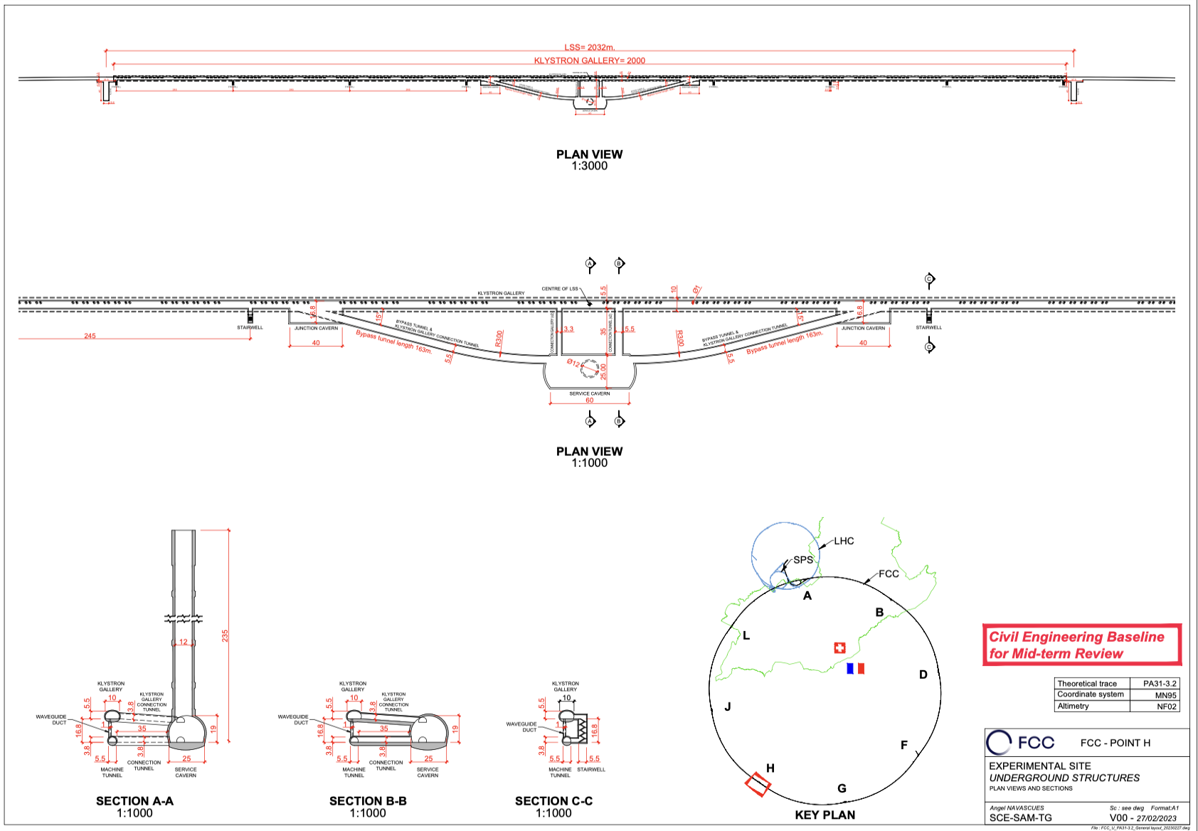
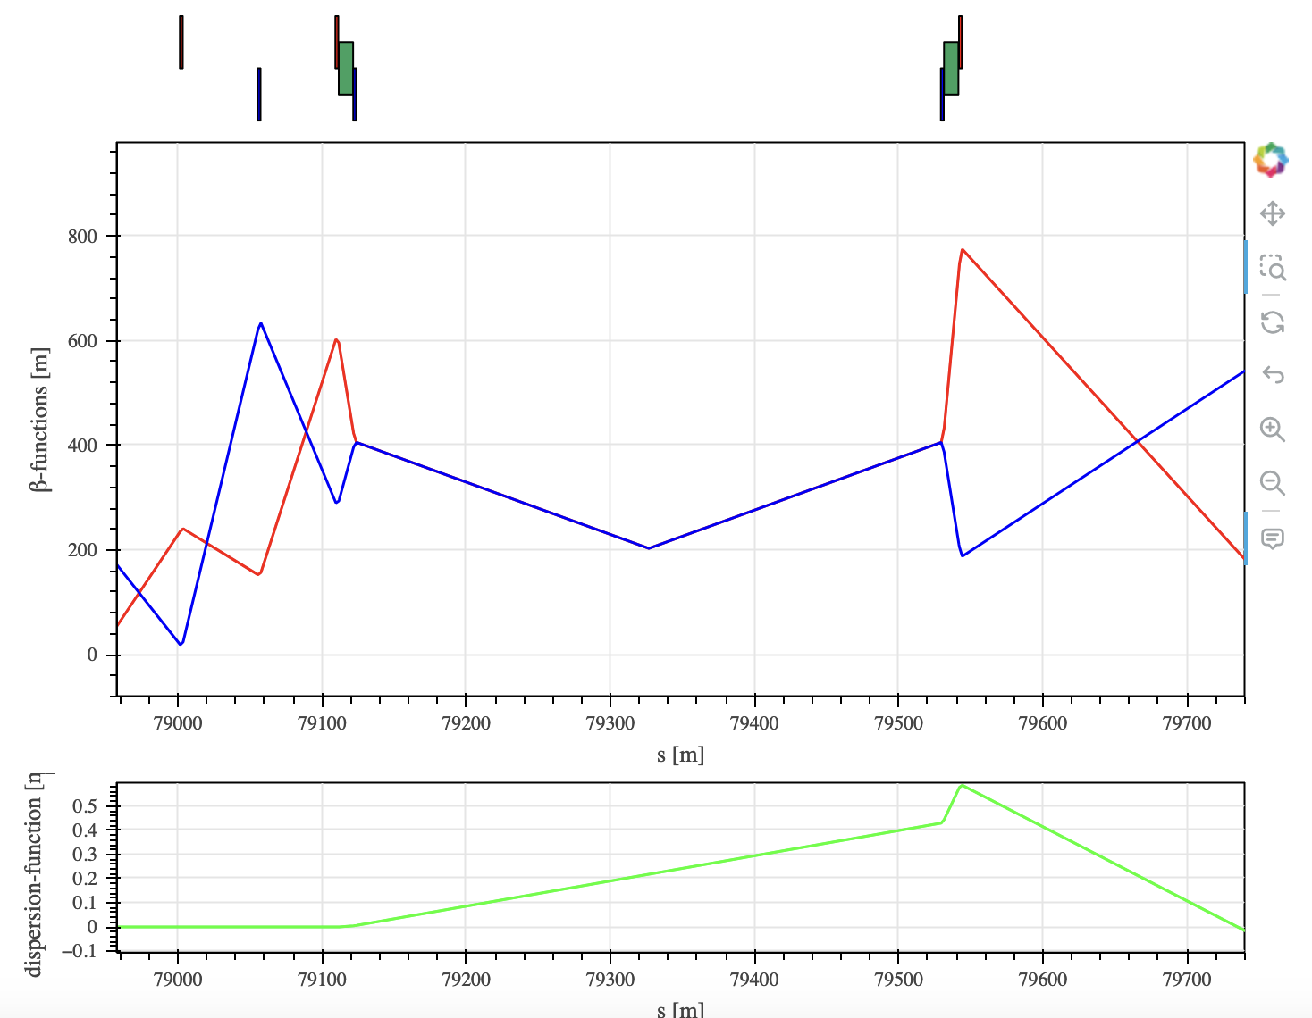
Space for additional logos
Other option : FCCee Polarimeters in point L
Robert Kieffer
Polarimeter at IP L
Laser in Klystron gallery
Instruments installed close to the RF cavities from the booster
After the dipole Electrons need a magnet free path to the pixel detector (80m long).
Polarimeters
Laser IP
Laser IP

Slide 11
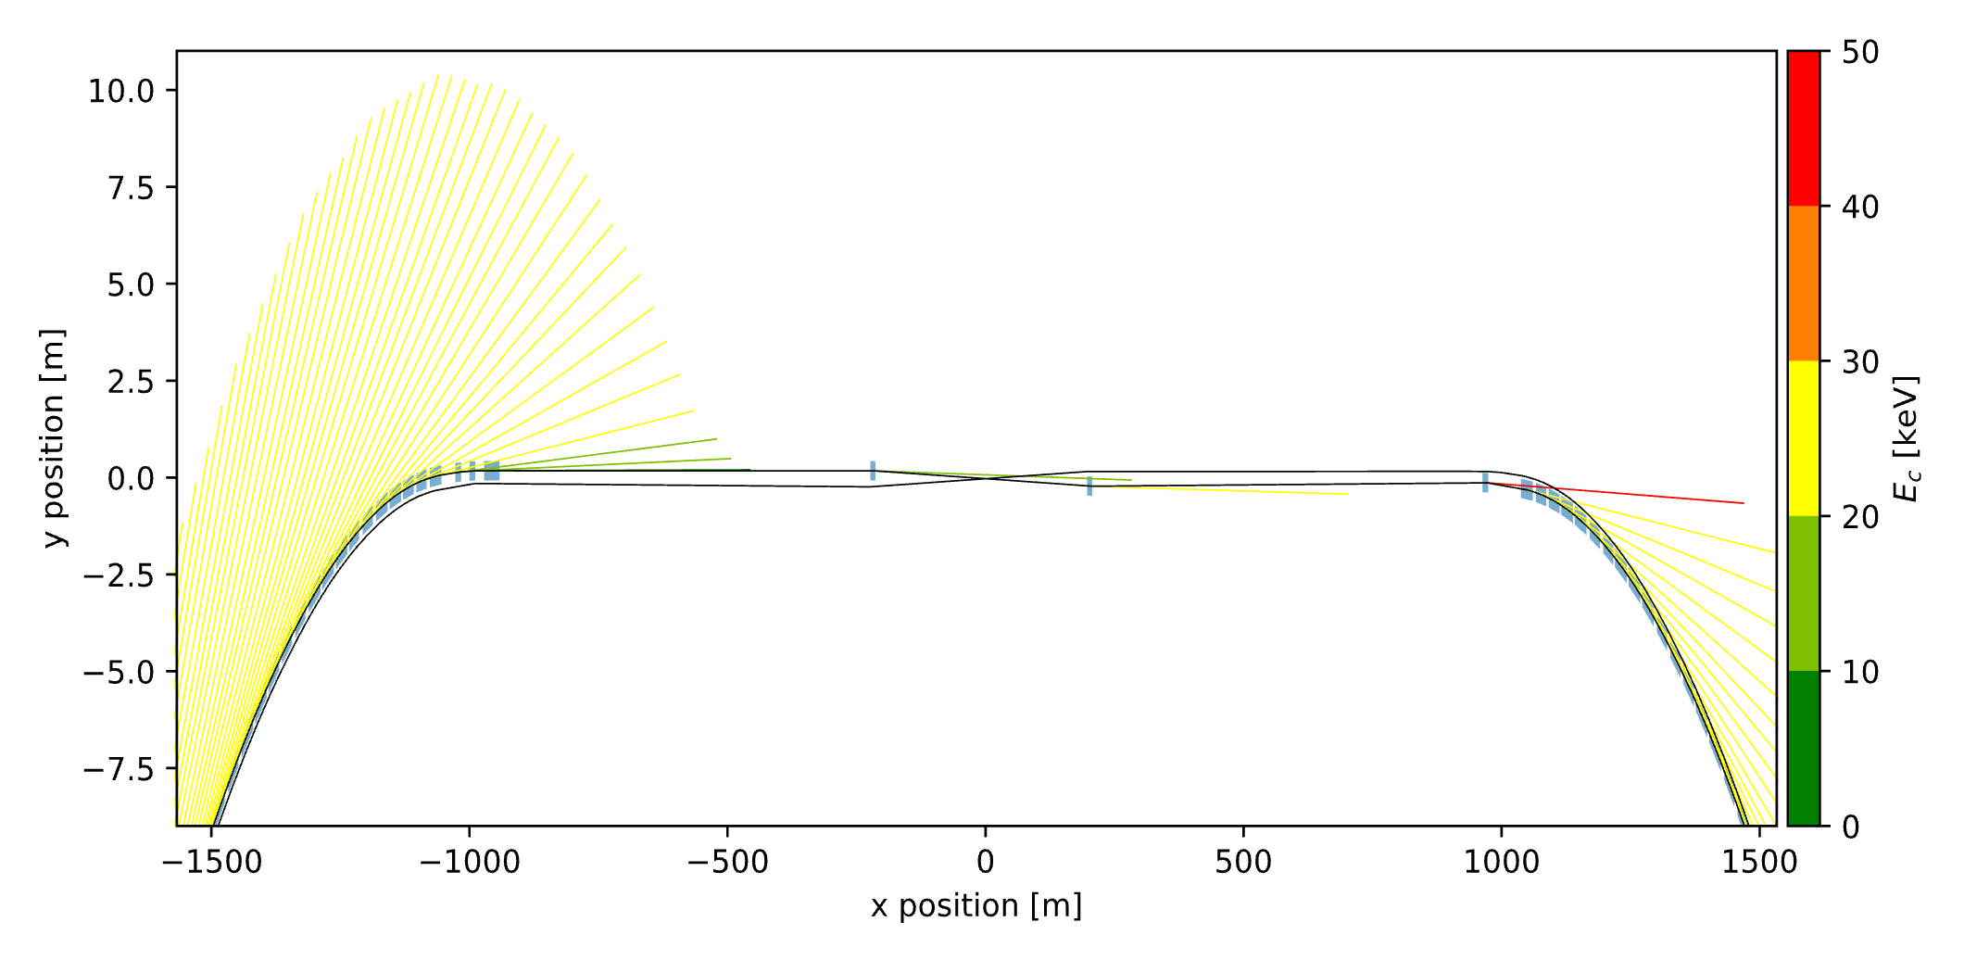


Other option : FCCee Polarimeters in point L
Robert Kieffer
Space for additional logos
Polarimeter at IP L (RF booster)
Laser in Klystron gallery (24/7 access)
Instruments installed under the RF cavities from the booster.
After the dipole, electrons need a magnet free path to the pixel detector.
NOT OK for Higgs and ttbar !!!
Survey plot from Daniele Butti
$$Mode Z$$
Polarimeters
Laser IP
Laser IP
$$RF straight section$$

Slide 12
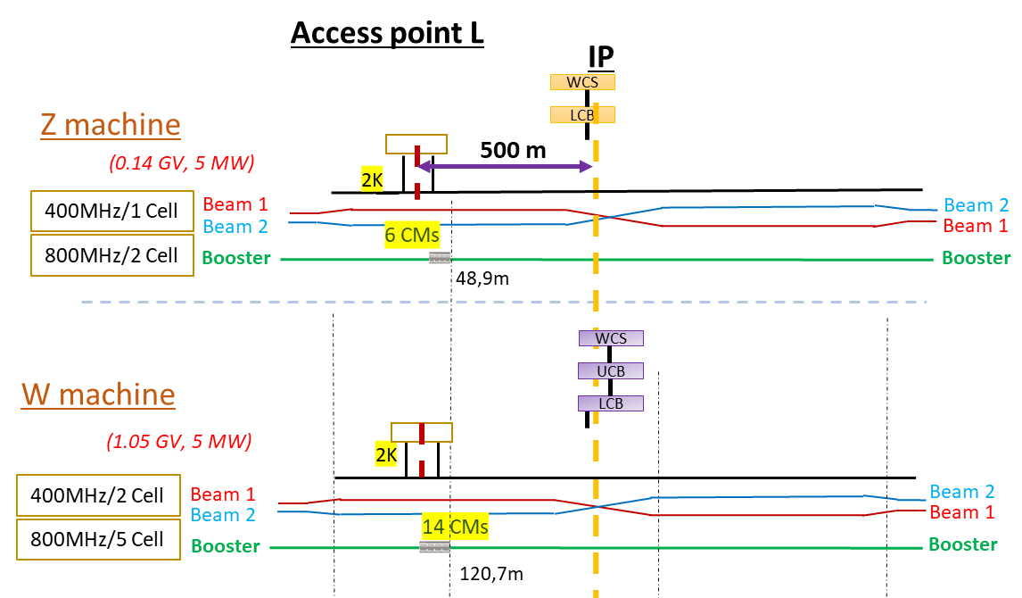
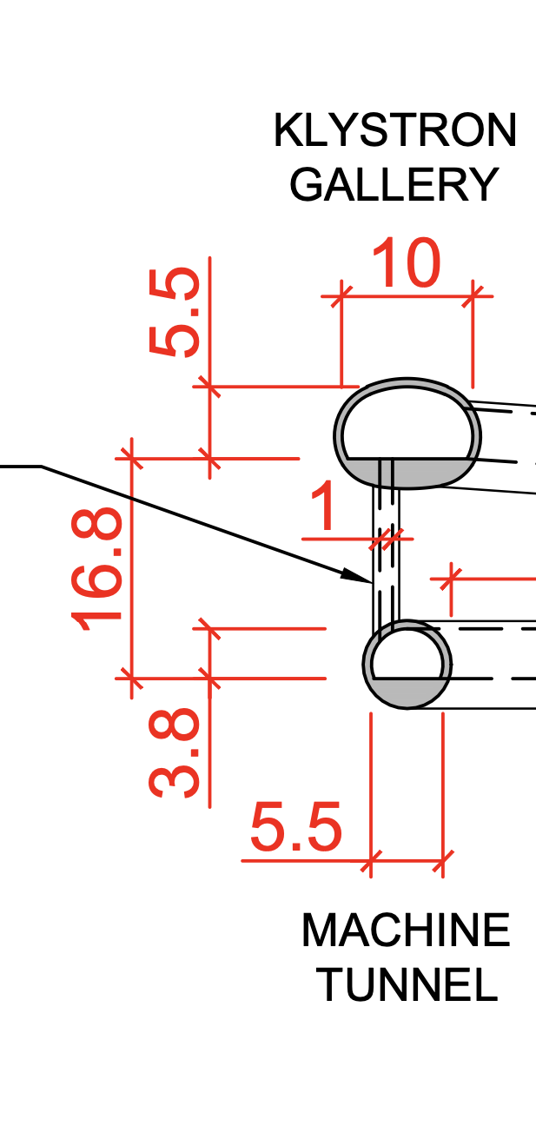
Other option : FCCee Polarimeters in point L
Robert Kieffer
Space for additional logos
Would stand far enough
from Cryo Modules
Laser hutch
NOT OK for Higgs and ttbar !!!
Laser duct
Laser IP

Slide 13
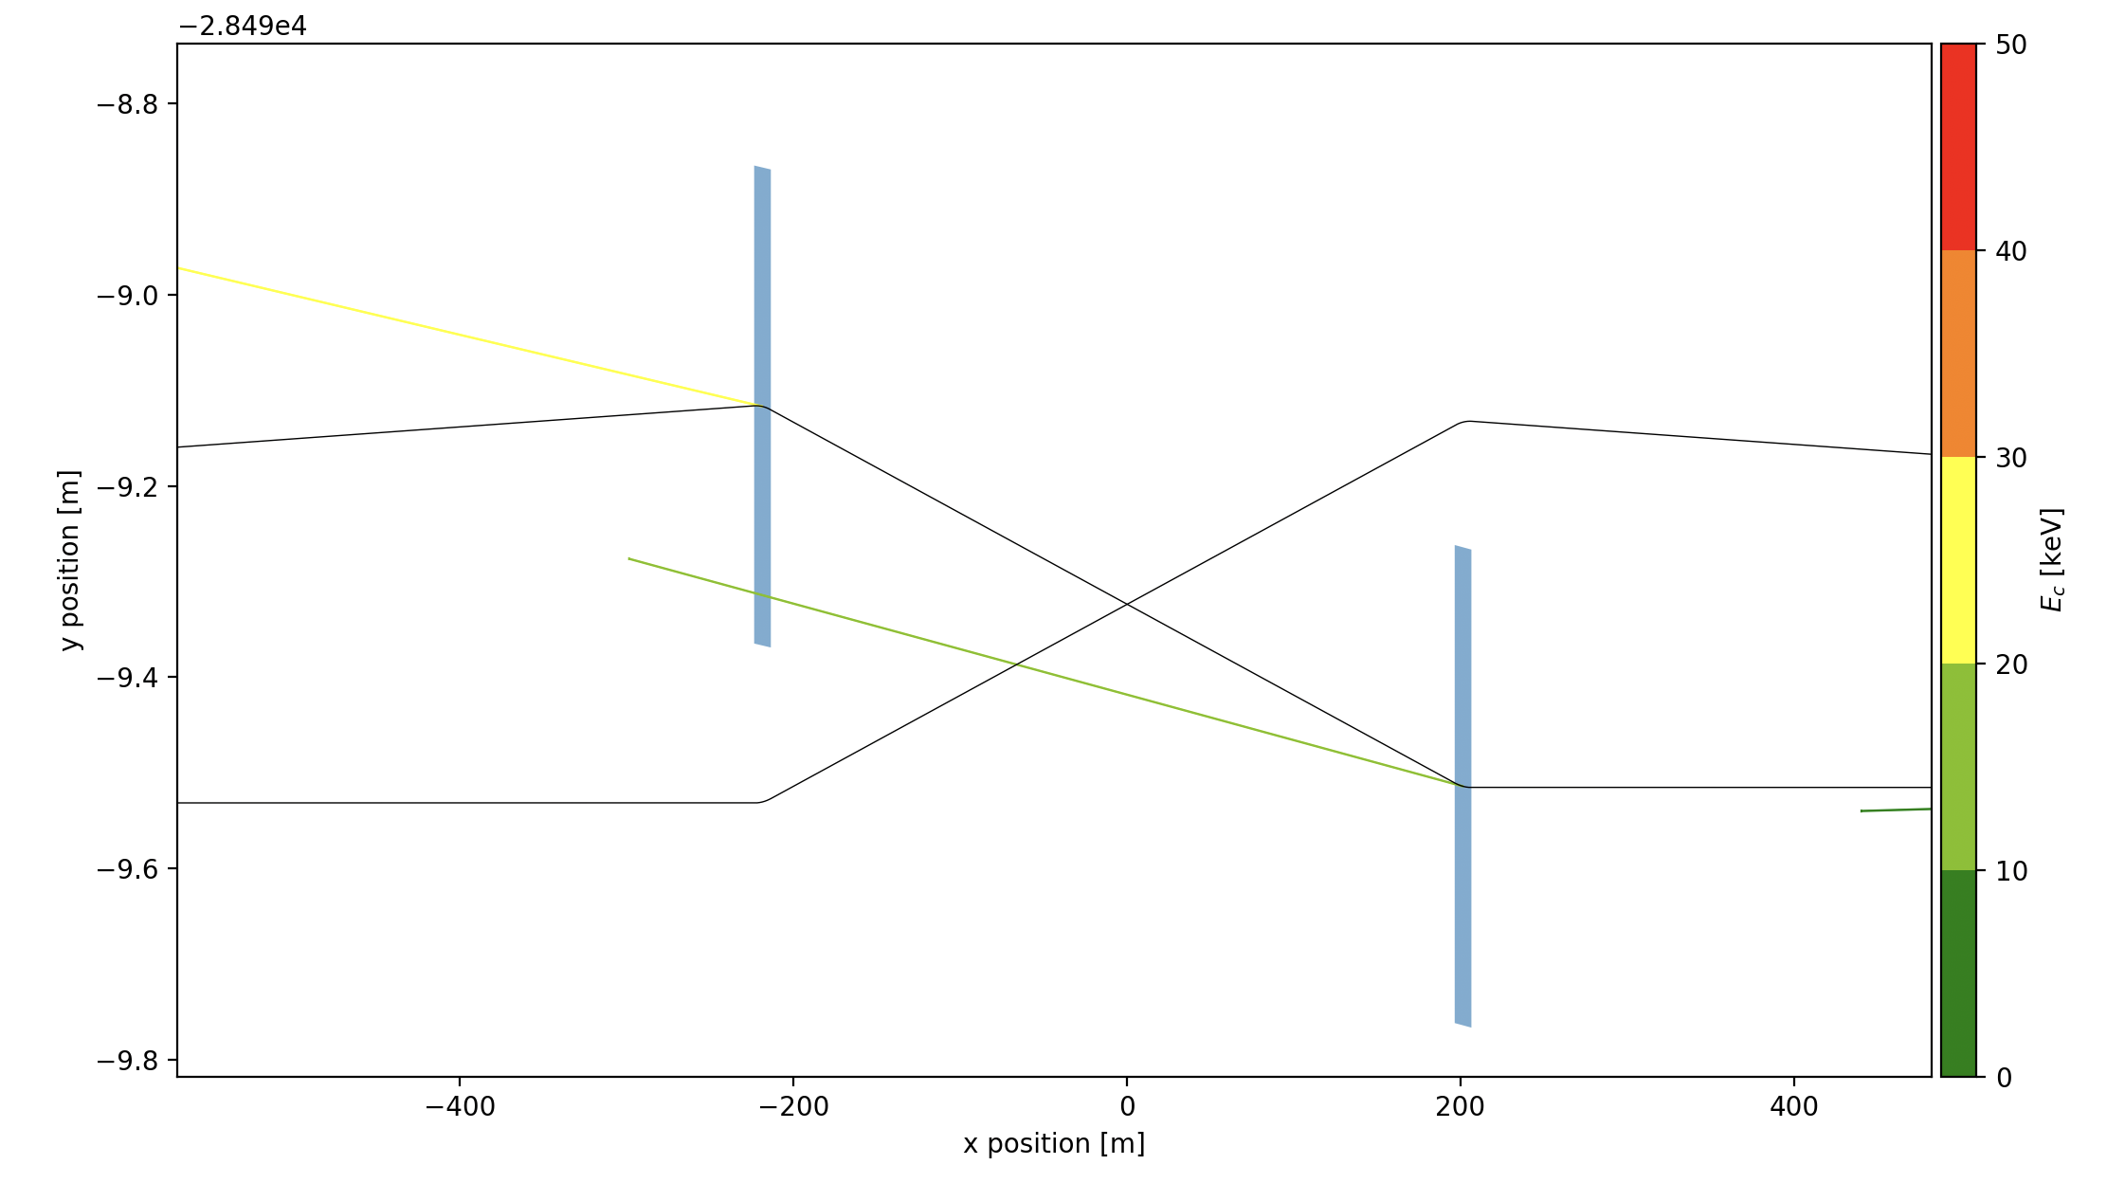
Other option : FCCee Polarimeters in point L
Space for additional logos
Robert Kieffer
In that case the distance between beam pipe is a bit small, enlarging it 10-20cm would allow this option. (Specially if the pipes are round, without winglets)
Photons
Photons
Electrons
Positrons
30cm
30cm

Slide 14
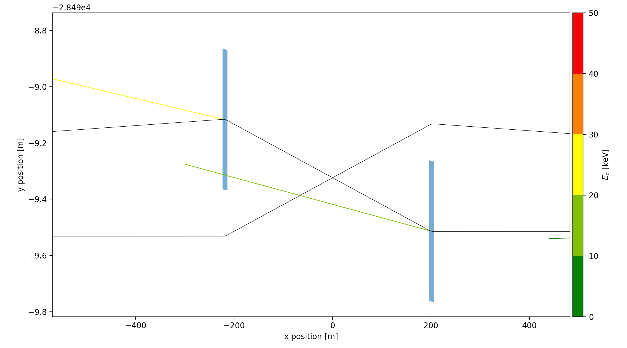
Other option : FCCee Polarimeters in point L
Space for additional logos
Robert Kieffer
Would work if the two beam pipes are vertically bumped for crossing
At the crossing
Electrons
B1
70mm ?
Electrons
B2
Positrons
Positrons
30cm
30cm
Electrons
B1
70mm ?
Positrons
B2
Round beam pipe ?
60mm inner diam ?
70mm outer diam ?
Photons
Photons

Slide 15
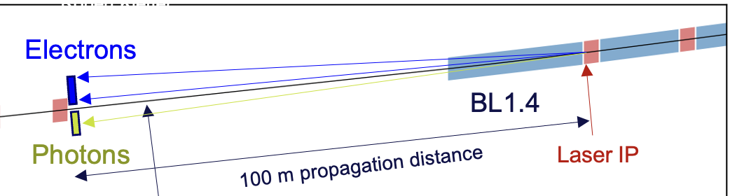
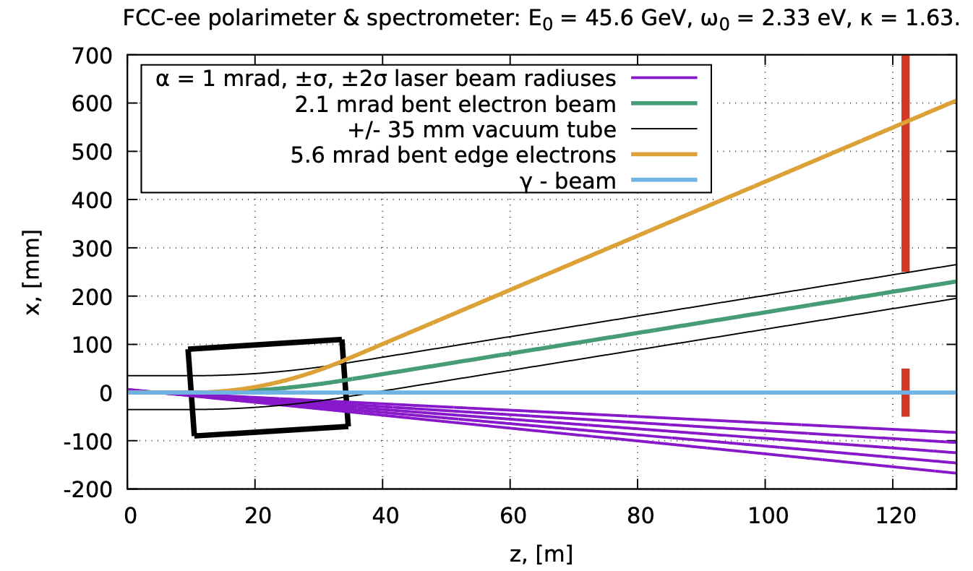
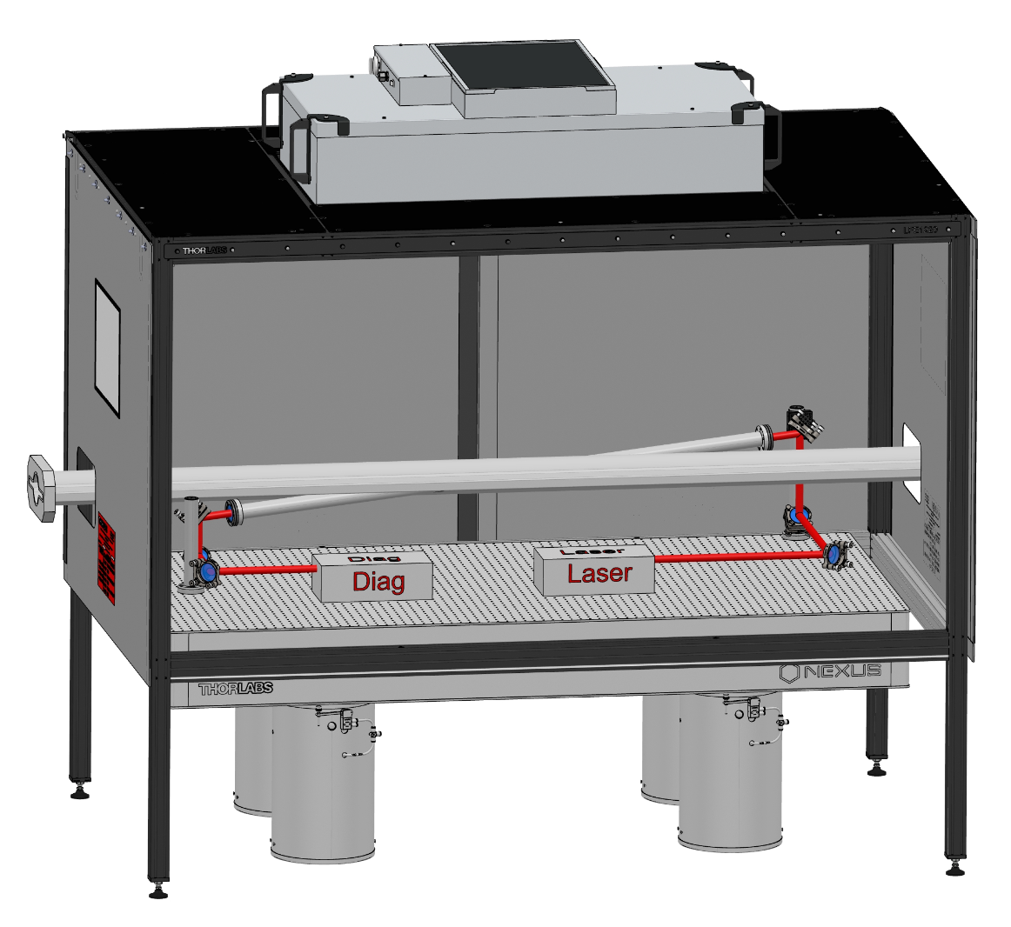
Laser interaction (LIP) and Extraction chambers
Robert Kieffer
Space for additional logos
Initial proposal by Nikolai was a ns pulse Q-switched laser at a very small angle (1mrad). Need to be inserted about 50m downstream the LIP
Quid of the laser extraction for diagnostics after the LIP to confirm the quality of the circular polarization, and alignment. Many magnets are present upstream.
Could we aim for a larger scattering angle? (ps Ytterbium modelock laser )
It would help the integration!
SuperKEKB polarimeter laser interaction chamber
DOI 10.1088/1748-0221/18/10/P10014

Slide 16
Laser interaction (LIP) and Extraction chambers
Robert Kieffer
Space for additional logos
Original design from Nikolaï with very small laser/beam angle
Long LIP chamber
Electrons
sensor
In vacuum mirror
Laser IP
Extraction chamber
Beam
26m Separation Dipole
Fold mirror
Photons
sensor
View Port
Long ovoid holes for laser input/output, bad in terms of wake fields
From/To Laser hutch
Design close to the SuperKEKB one with large laser/beam angle
Short LIP chamber
Electrons
sensor
In vacuum
mirror
Laser IP
Extraction chamber
Beam
26m Separation Dipole
Much smaller ovoid holes for laser input/output
Photons
sensor
View Port
Fold mirror
Tapering to reduce wake fields
From/To Laser hutch

Slide 17
Conclusions
Robert Kieffer
Space for additional logos
The base line location for the two polarimeters is in IP A at the end of the straight sections.
The exact location for the laser IP need to be determined very soon. But it will be between 820 and 850 m from the IP A.
The associated Laser Hutch is then also located about the same distance from the IP
The RF points appear to be a no-go since the polarimeter is expected to be used at all energies, and the additional cryomodules for (Higgs and ttbar) will take all the space available and will generate too much noise.

Slide 18
Thank you for your attention.
Date / Name of the event
Name of the speaker/author
Space for additional logos
18

