Slide 1
Integration News
30.04.2024
F. Valchkova-Georgieva

Slide 2
  Integration topics:
  FCC-ee Regular Arc
  FCC-ee Underground Structure at point A
  FCC-ee beamstrahlung dump at point A
  FCC Small Alcove with Small Layby
  FCC Small Alcove with Big Layby
  FCC Big Alcove
  Integration of RF sectoin point H

Slide 3
F. Valchkova-Georgieva
  FCC-ee Regular arc

Slide 4
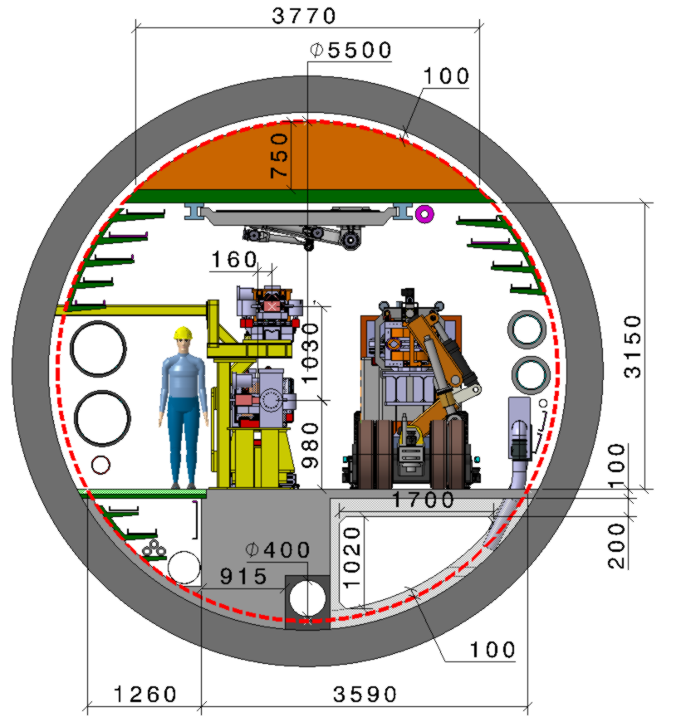
F. Valchkova-Georgieva & Dieudonne Adrien Ngo'O Ella
  Integration of FCC-ee machine elements (regular arc)
Machine tunnel 5.5m in diameter
He/Smoke extraction
5 Cable trays:
5 DC Cable trays
Leaky feed
4 Cable trays:
4 DC Cable trays
Chilled water
DN300
Magnet vehicle
Transport space reservation
2.2m x 2.25m (LxH)
Demineralized water
DN550
3 Cable trays:
3 DC cable trays
Compressed air
DN80
HV Cable
2 Cable tray:
2 Fibre optic Cable trays
Raw water
DN350
Collider Center

Slide 5
F. Valchkova-Georgieva
  FCC-ee Underground Structure at point A

Slide 6
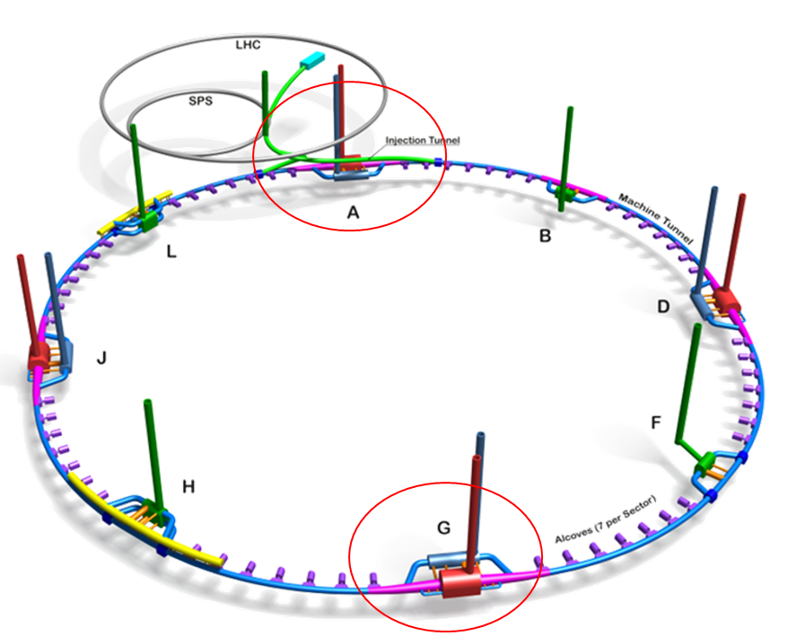
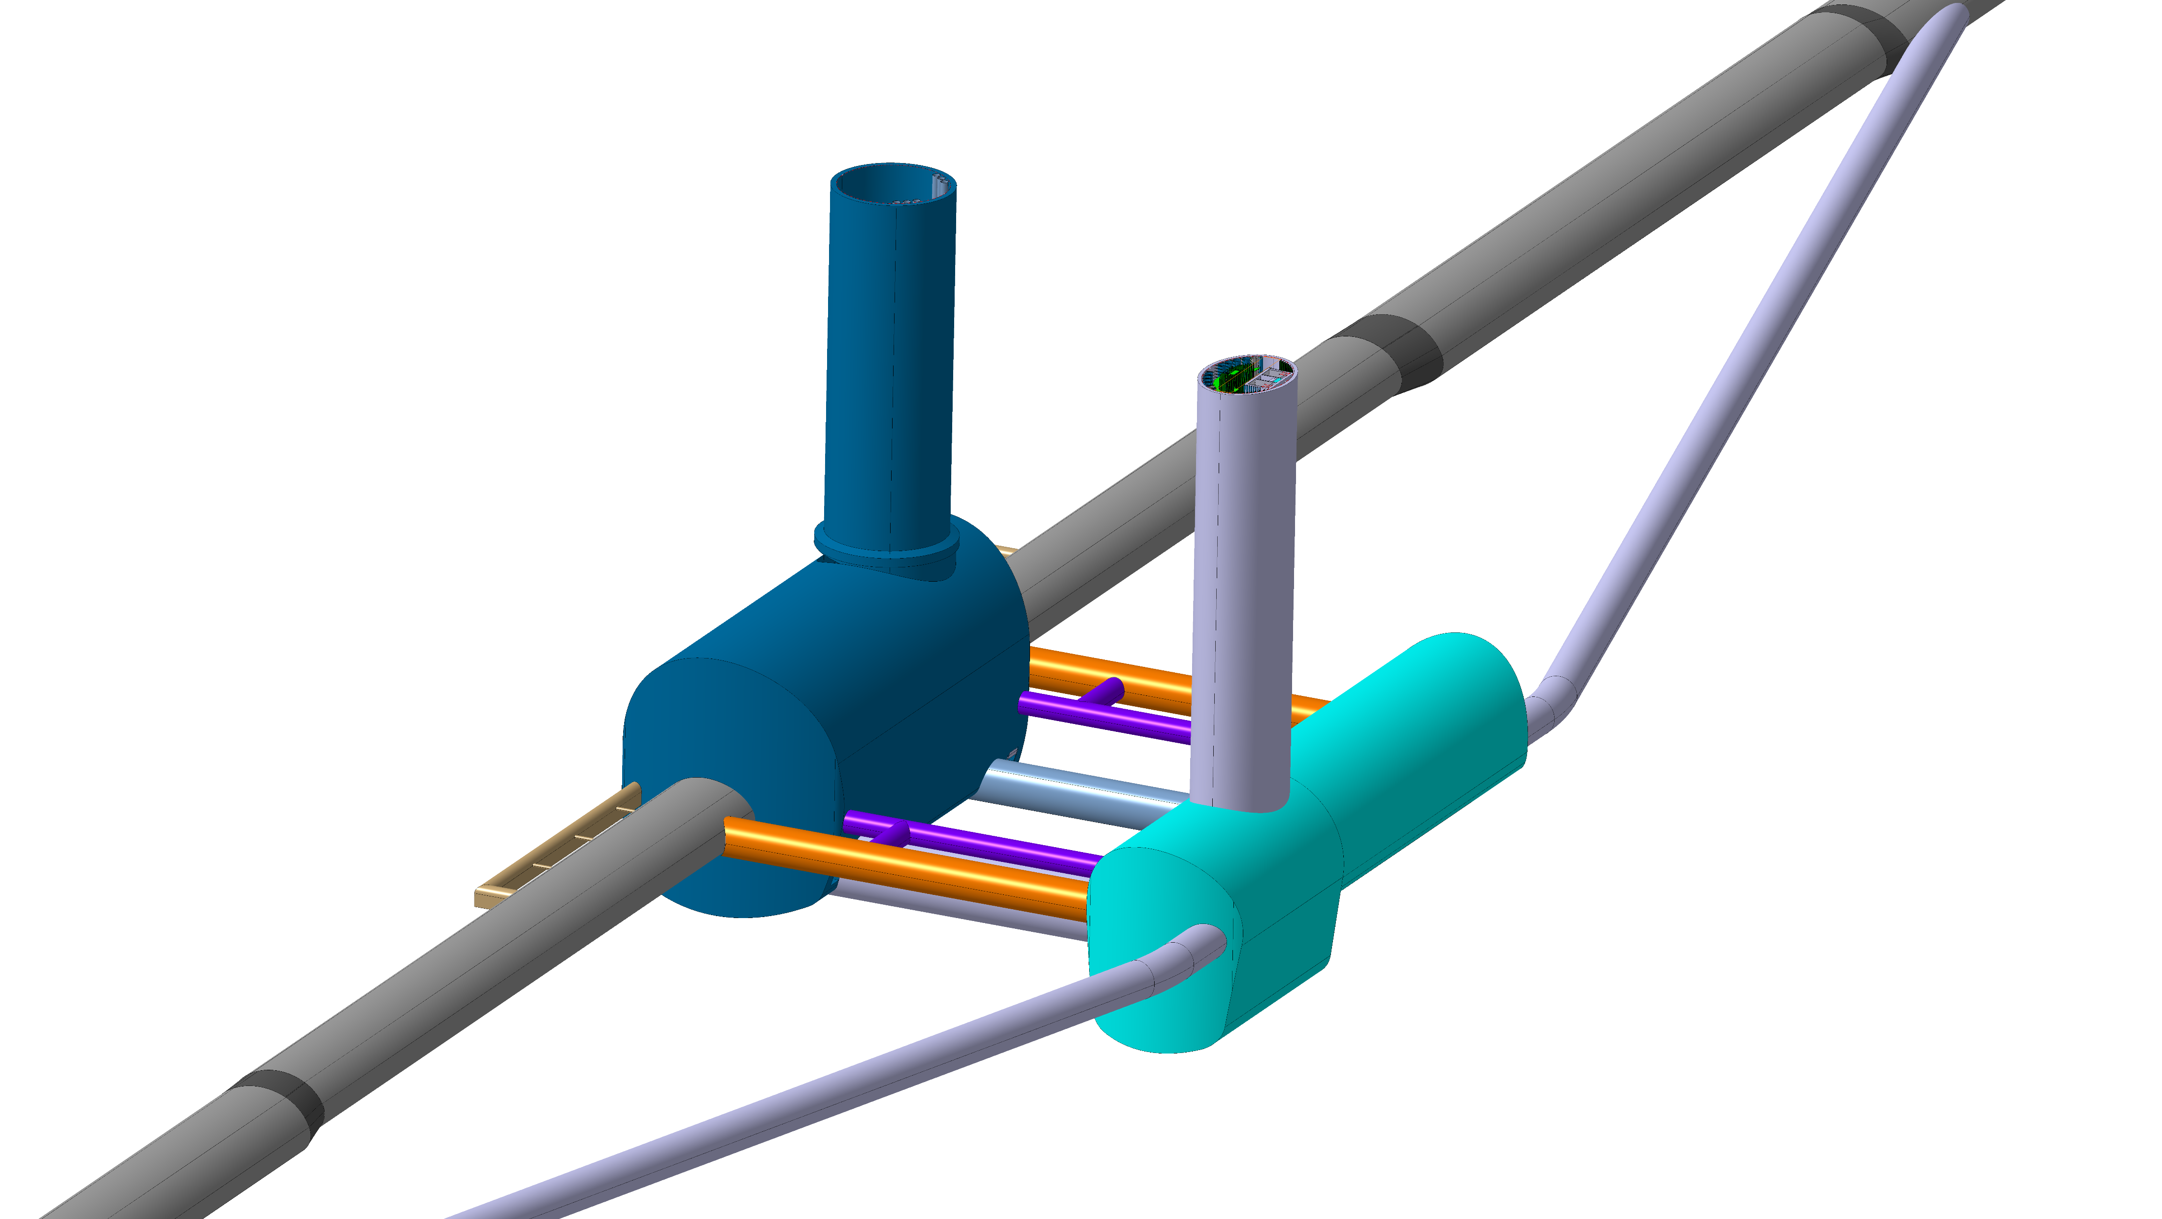
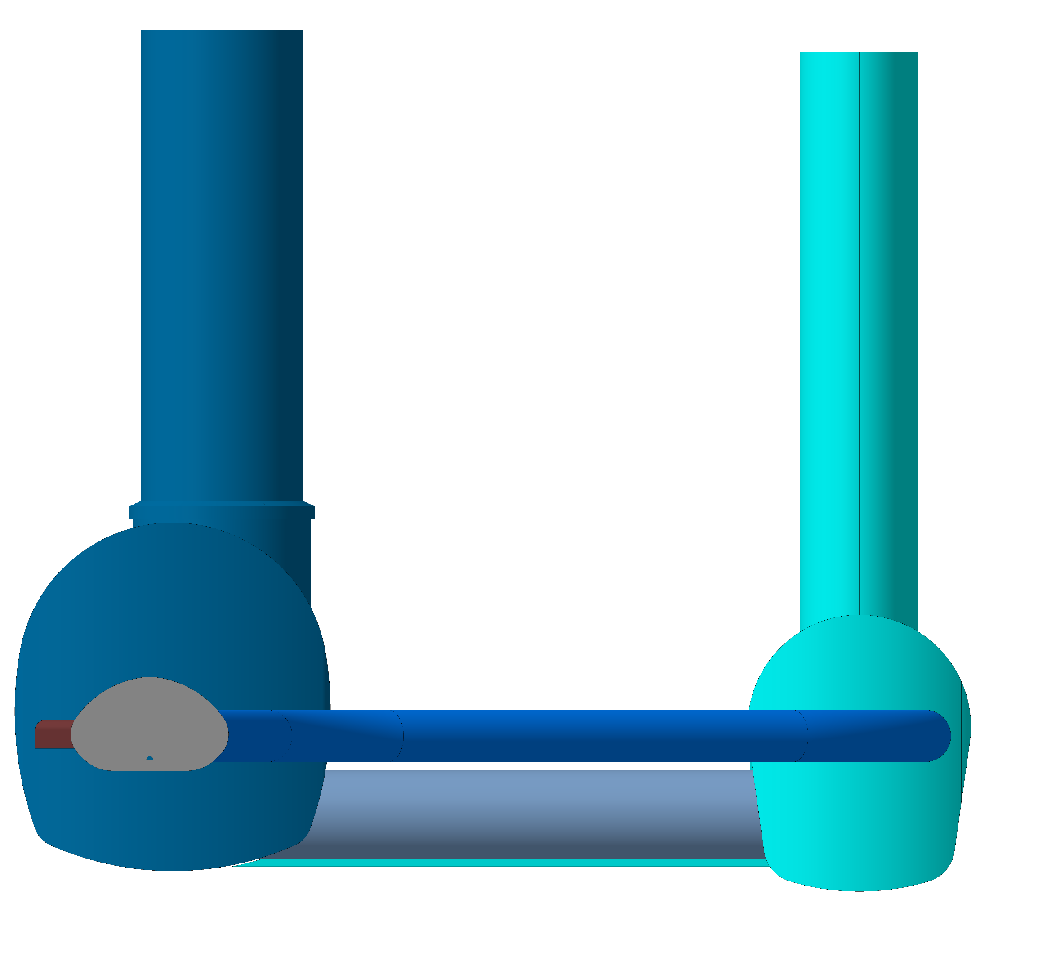
F. Valchkova-Georgieva
  FCC-ee Underground Structure at point A
Experimental Shaft ø18m
2 x Evacuation
connection tunnel
Experiment Cavern
Bypass tunnel ø 5.5m
Survey Gallery
Machine tunnel
Elliptical Service Shaft
Service Cavern
Connection tunnel ø 5.5m
Connection tunnel ø 10m

Slide 7
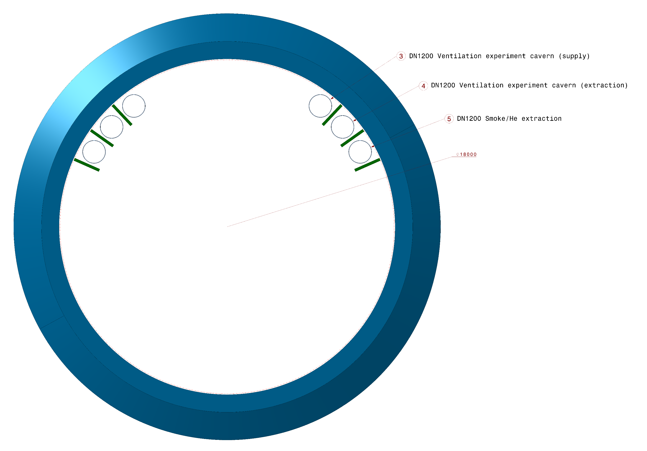
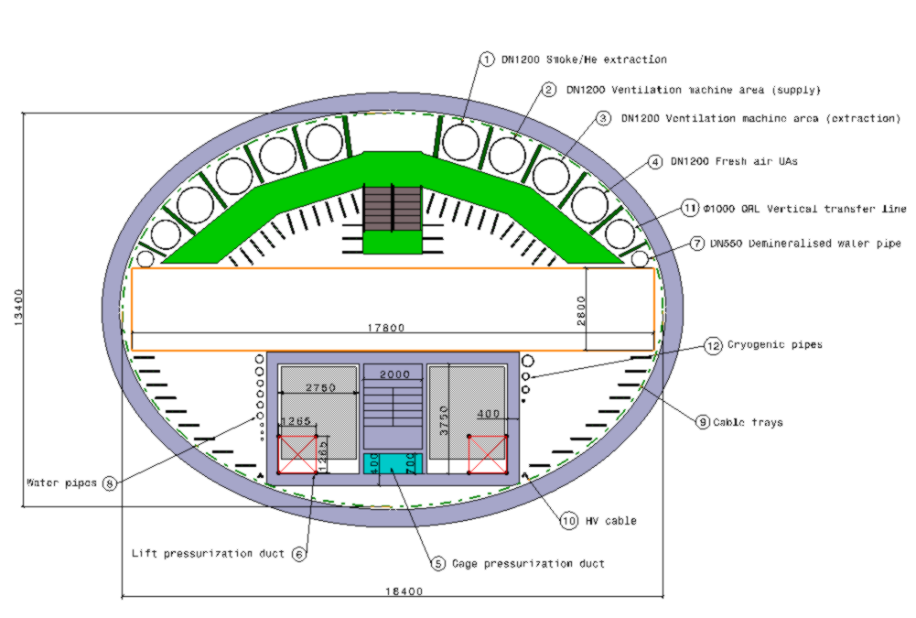
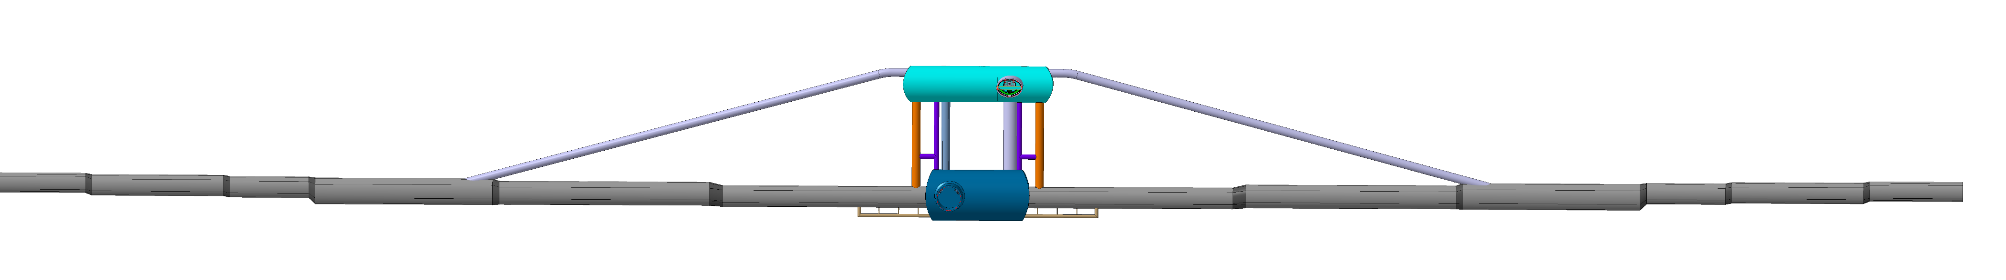
F. Valchkova-Georgieva
  FCC-ee Underground Structure at point A
Experiment Shaft
Elliptical Service Shaft
1.7 km

Slide 8
F. Valchkova-Georgieva
  FCC-ee beamstrahlung dump at point A

Slide 9
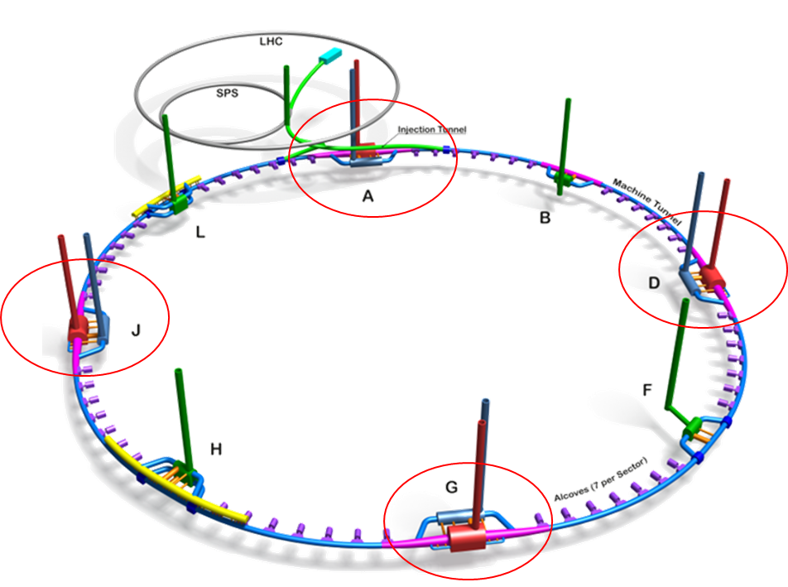
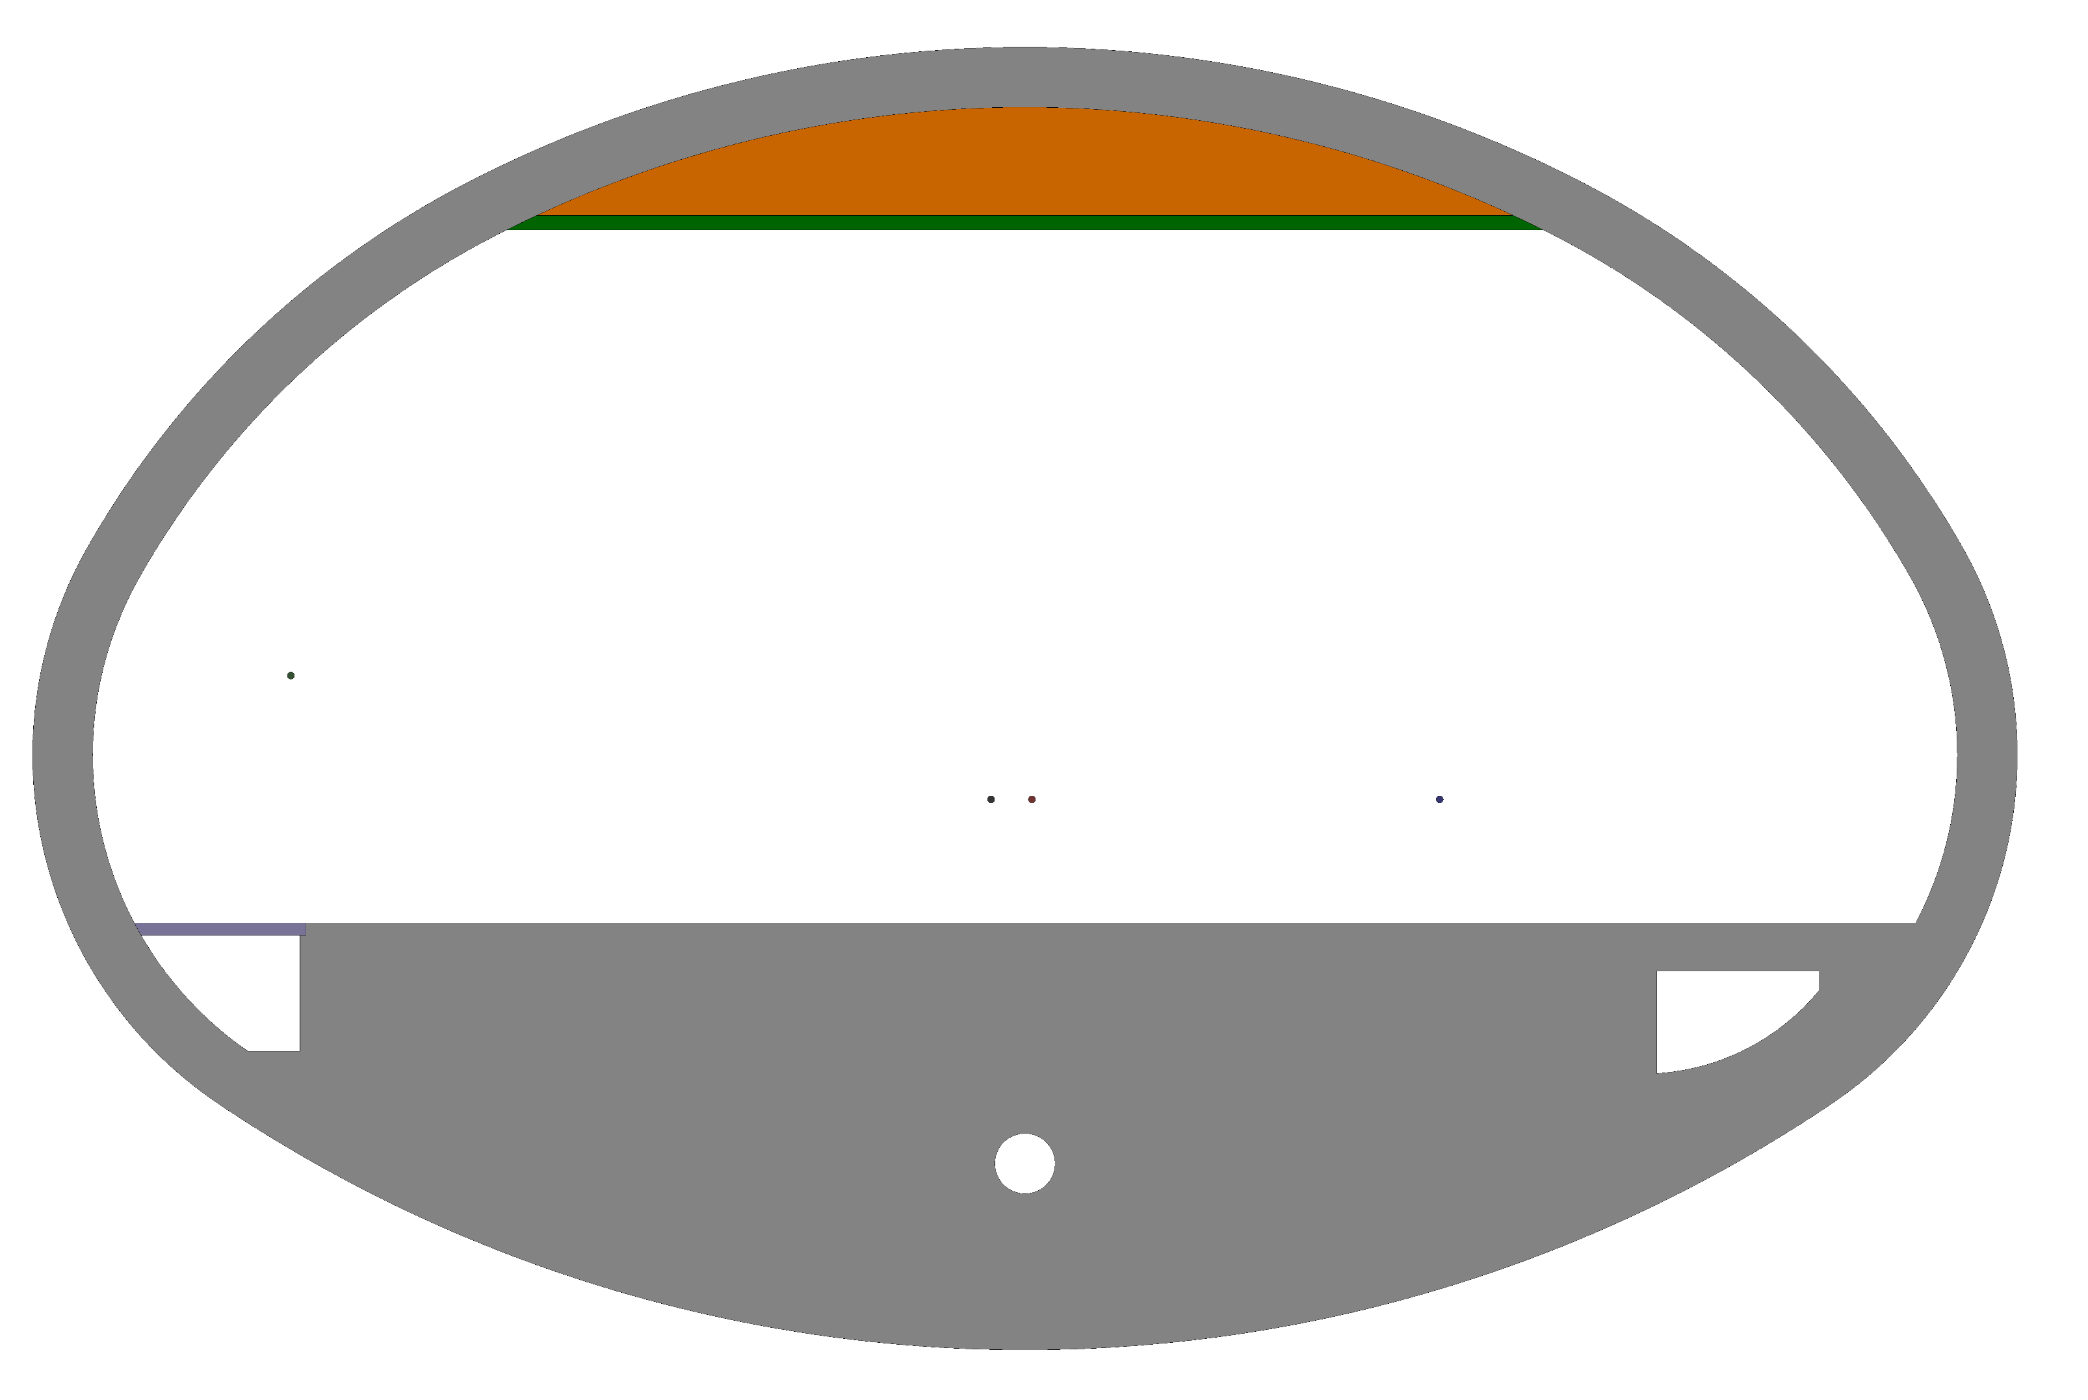
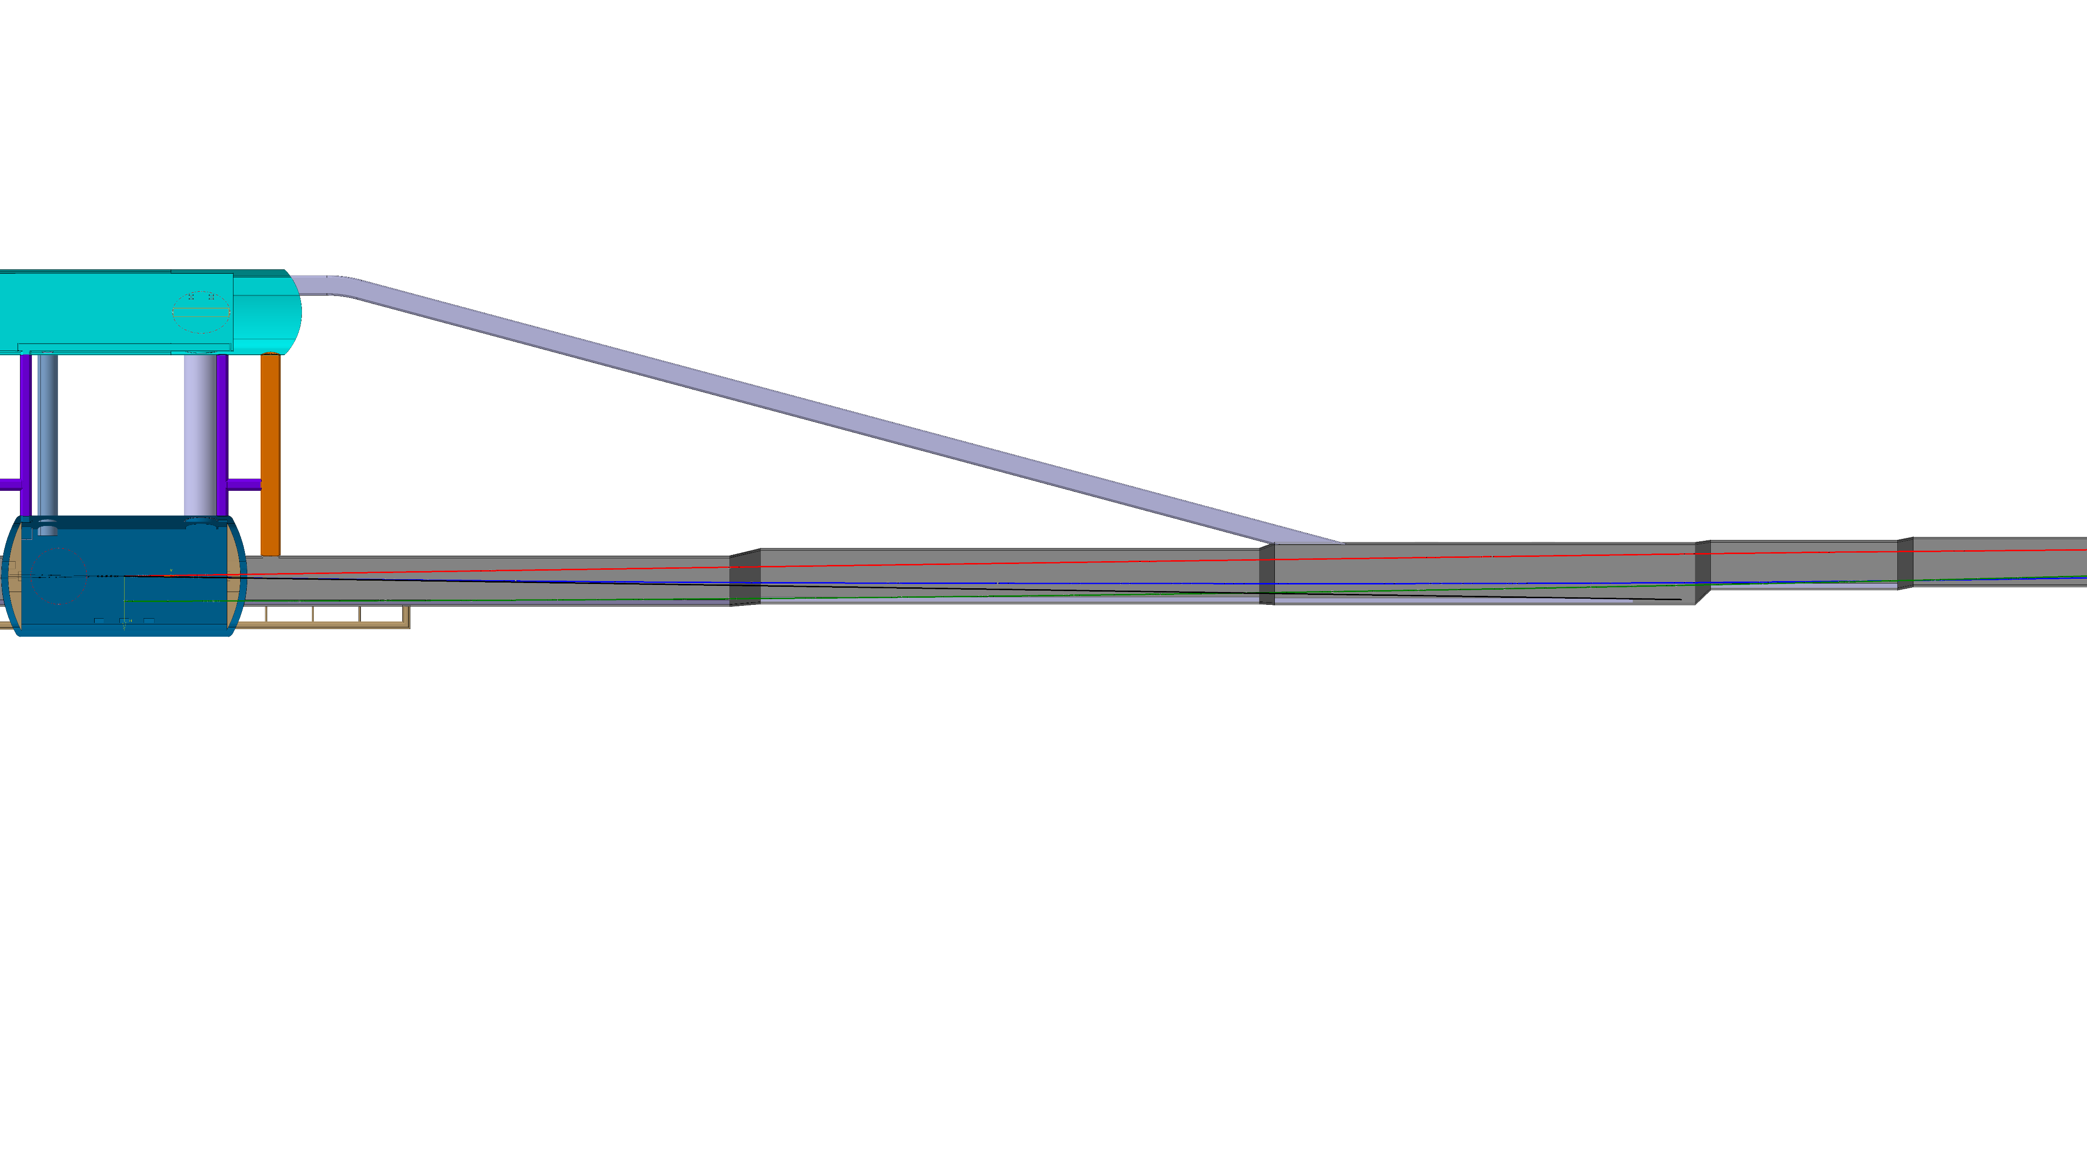
F. Valchkova-Georgieva
  FCC-ee beamstrahlung dump integration at point A
Beamstrahlung
5.73m
6160.7mm
3390.7mm
E+ ring
Booster ring
339.4mm
2.01m
0.98m
E- ring
IP
14.8m
125m

Slide 10
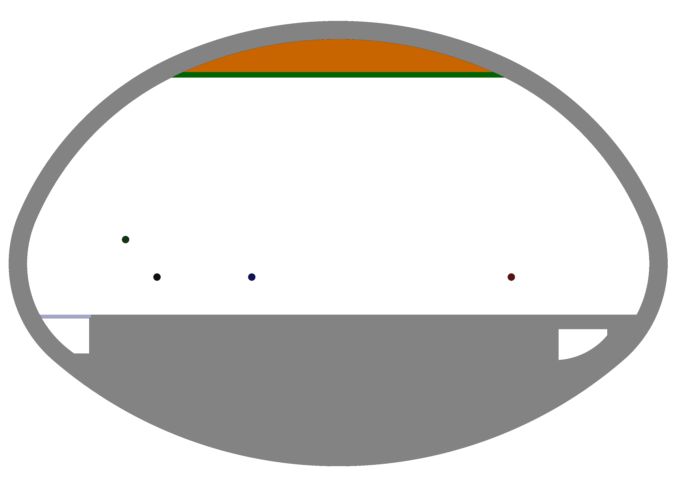
F. Valchkova-Georgieva
  FCC-ee beamstrahlung dump integration at point A
Beamstrahlung
6.51m
3467.5mm
7132mm
E+ ring
2603.2mm
Booster ring
2.01m
0.98m
E- ring
IP
16.4m
330m

Slide 11
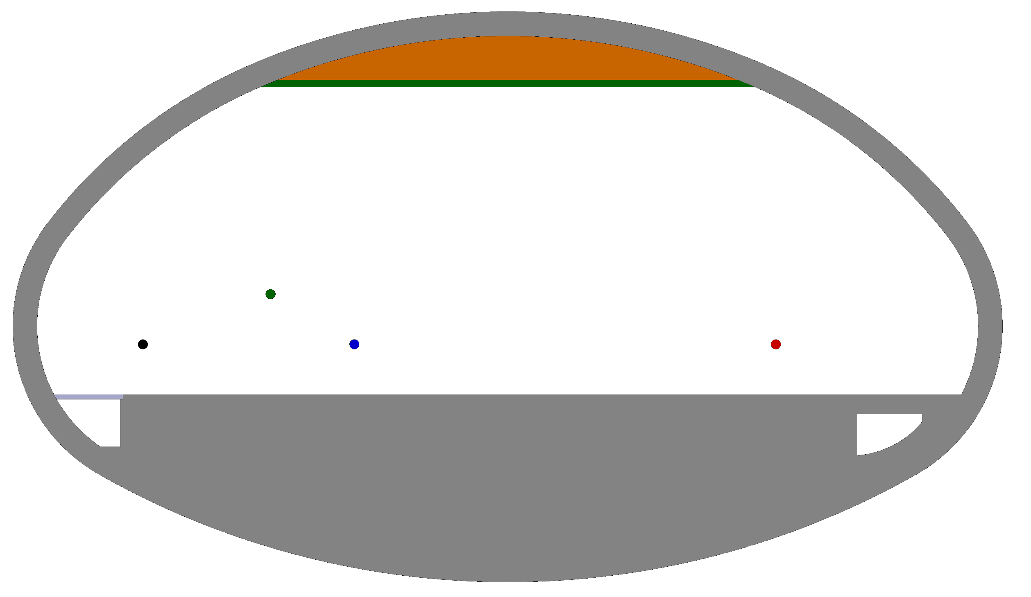
F. Valchkova-Georgieva
  FCC-ee beamstrahlung dump integration at point A
Beamstrahlung
1720mm
6.3m
8640mm
E+ ring
4340mm
0.98m
E- ring
Booster ring
IP
18.6m
443m

Slide 12
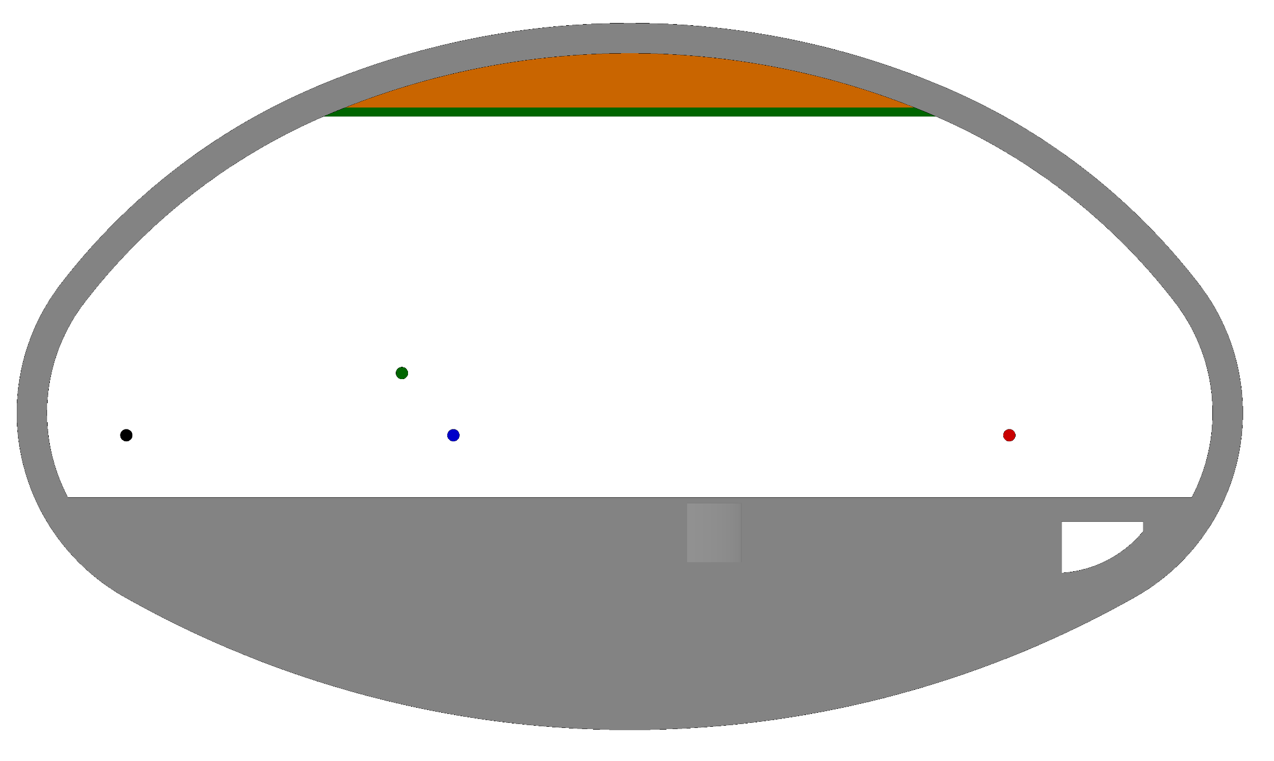
F. Valchkova-Georgieva
  FCC-ee beamstrahlung dump integration at point A
Beamstrahlung
4563.5mm
9419.9mm
6.3m
E+ ring
5415.4mm
0.98m
E- ring
Booster ring
IP
18.6m
500m

Slide 13
F. Valchkova-Georgieva
  Integration of FCC alcove and transport Layby

Slide 14
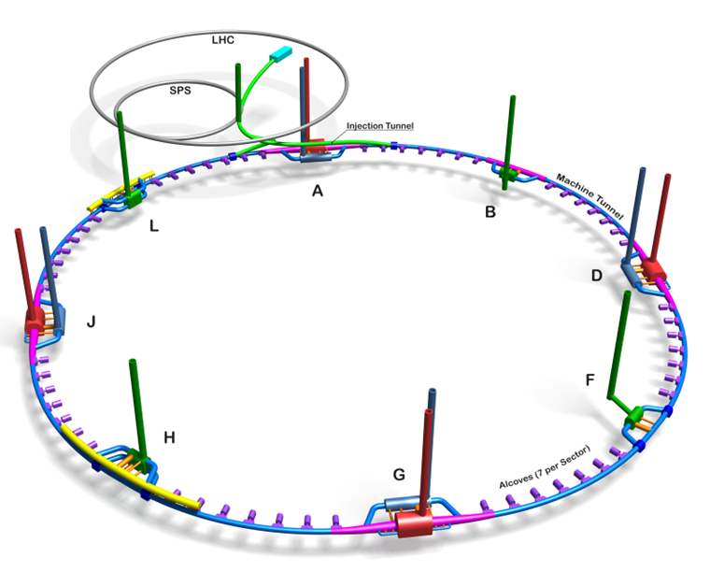
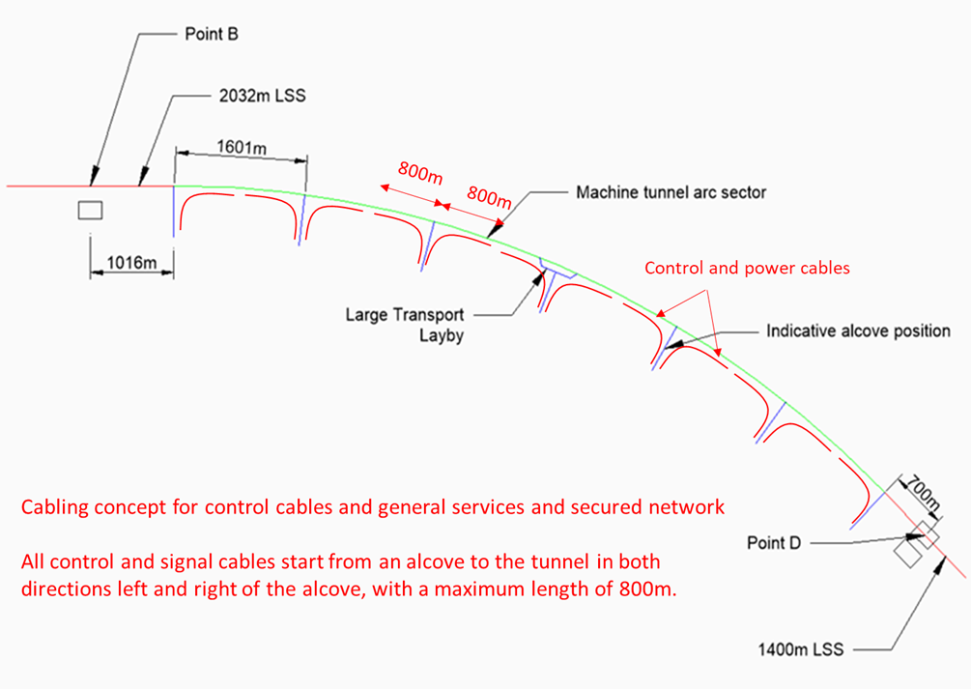
F. Valchkova-Georgieva
  FCC Alcove and transport Layby integration
Courtesy Jean-Paul Burnet
Schematic of the principle of cabling from the alcoves

Slide 15
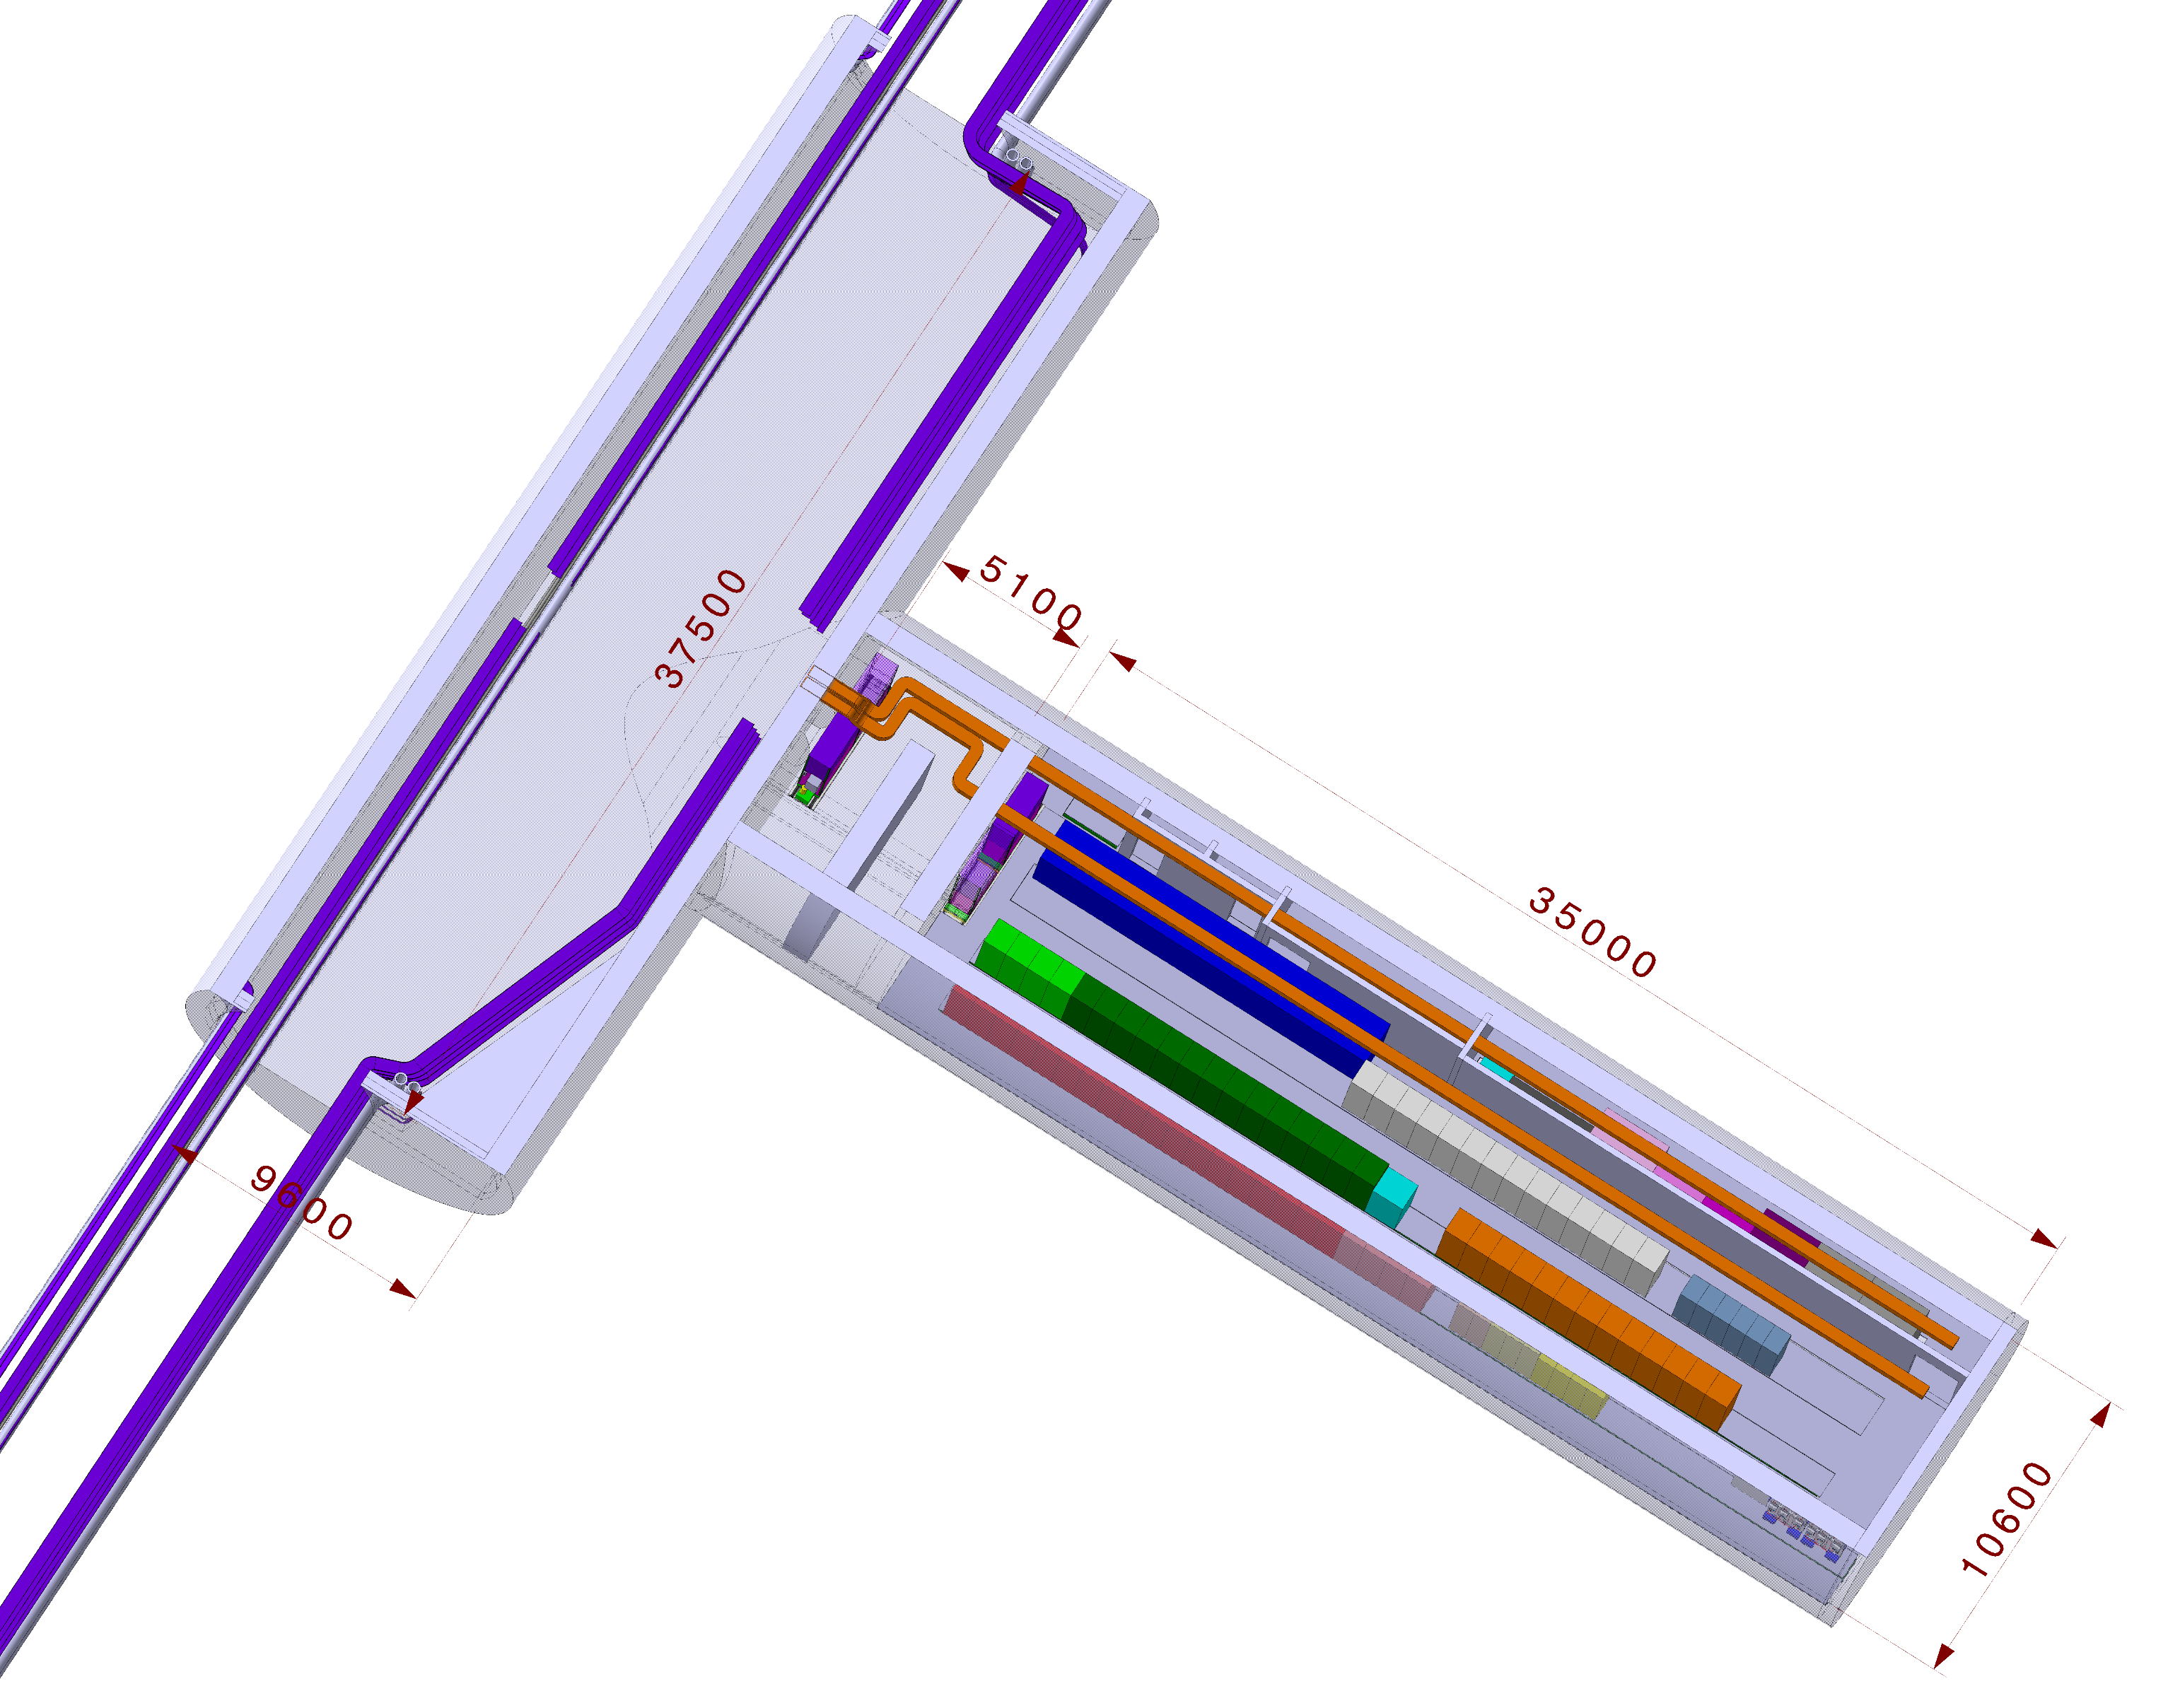
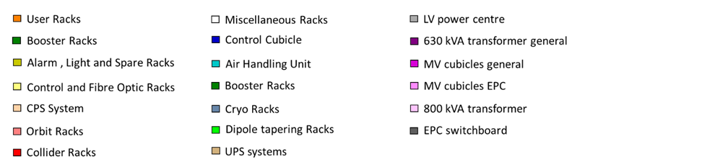
F. Valchkova-Georgieva
  FCC Small Alcove with Small Layby
Fire detection’s equipment
Indicate the position of different electrical equipment in the FCC Alcove in the arc

Slide 16
F. Valchkova-Georgieva
  FCC Small Alcove with Big Layby
Fire detection’s equipment
Indicate the position of different electrical equipment in the FCC Alcove in the arc

Slide 17
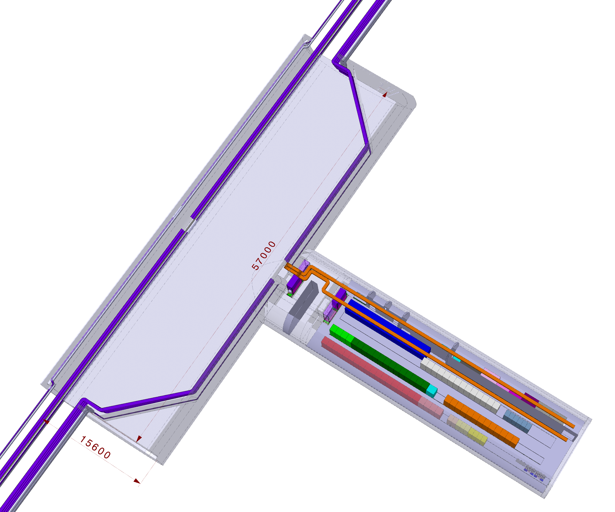
F. Valchkova-Georgieva
  FCC Small Alcove with Big Layby
Fire detection’s equipment
Indicate the position of different electrical equipment in the FCC Alcove in the arc

Slide 18
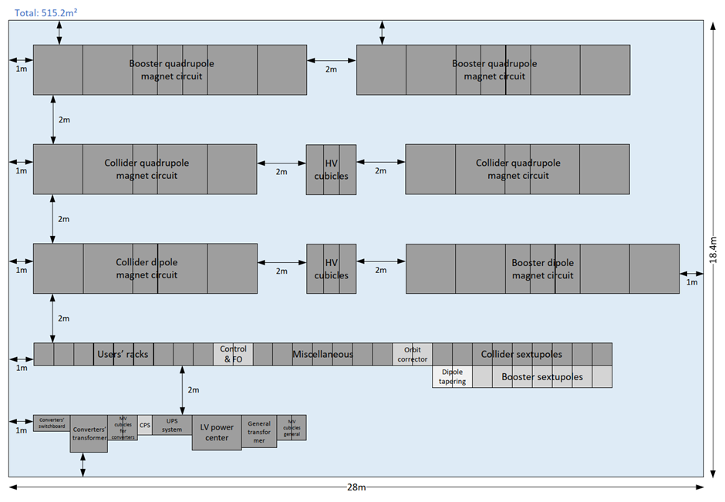
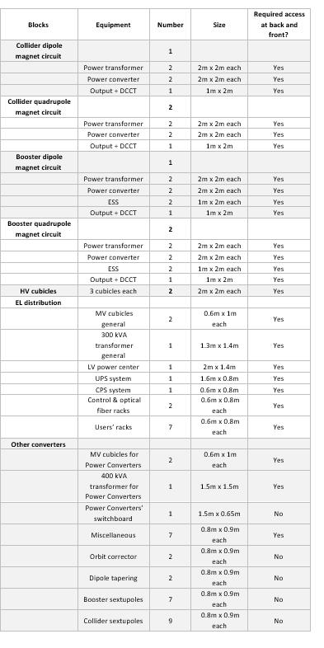
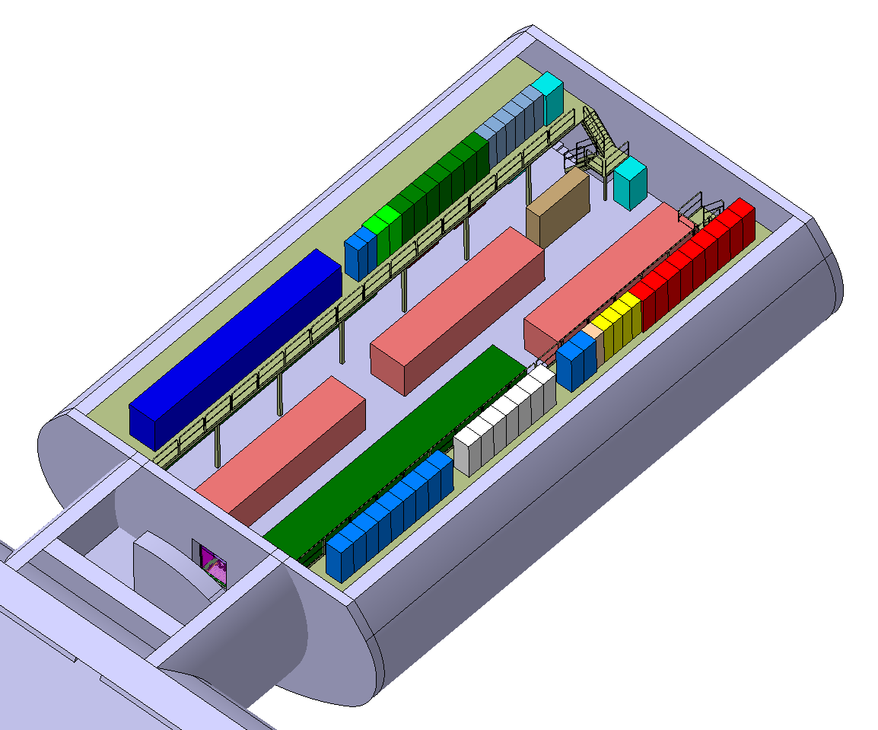
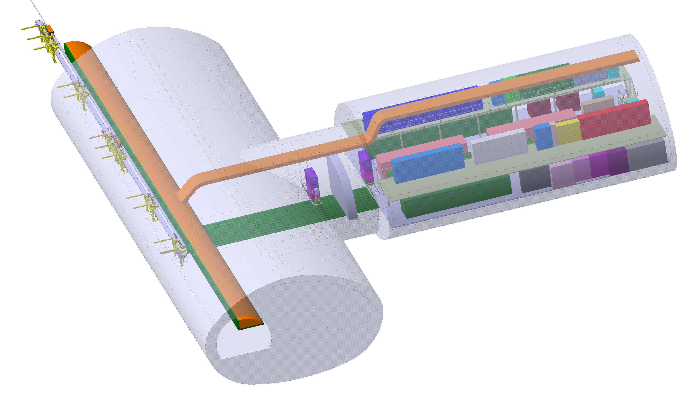
F. Valchkova-Georgieva
  Integration of FCC-ee Big Alcove
CV Air Handling Unit
Cryo Racks
18m
CV Control Cubicle
29m

Slide 19
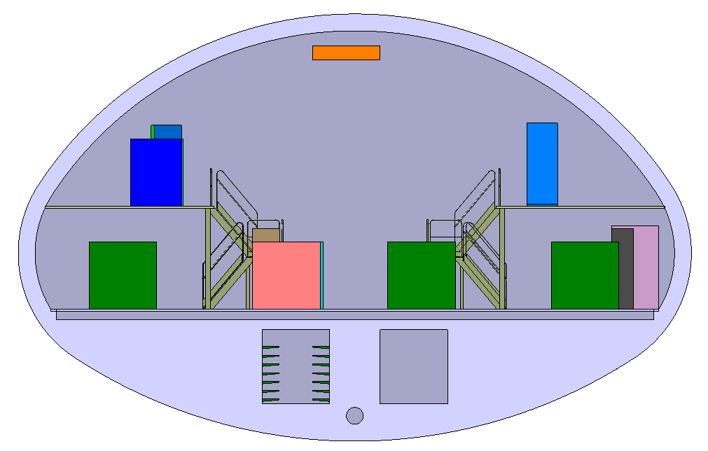
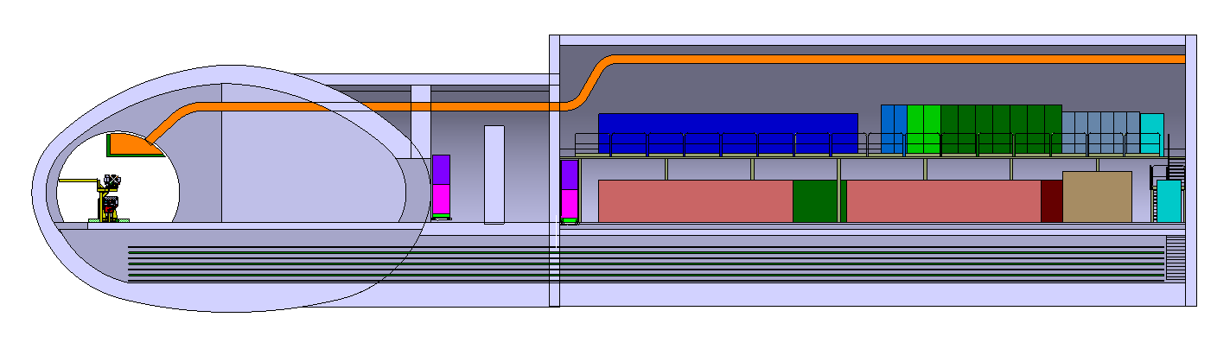
F. Valchkova-Georgieva
  Integration of FCC-ee Big Alcove
8.5m
3m
2.2m
2.5m
Smoke extraction
Passage for cable trays
Evacuation passage
Passage for cable trays

Slide 20
F. Valchkova-Georgieva
  Integration of FCC-ee RF section point L

Slide 21
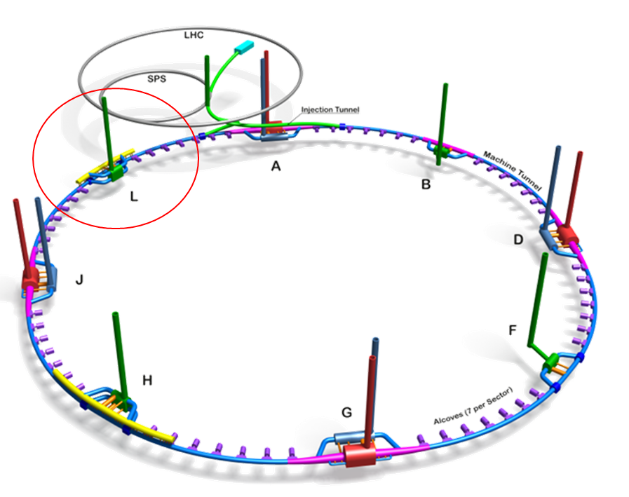
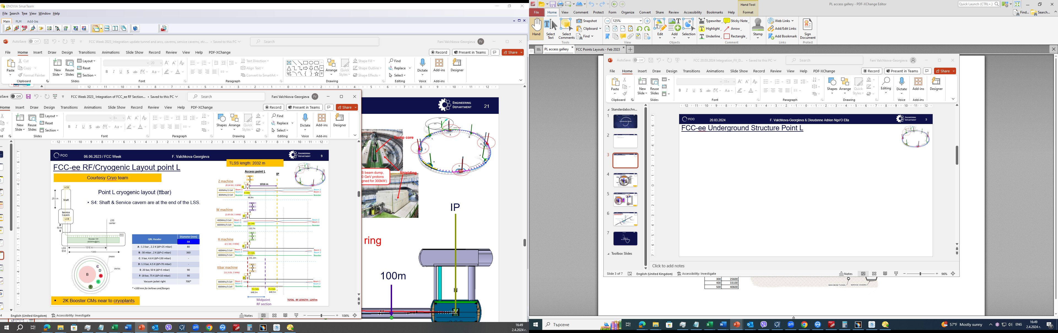
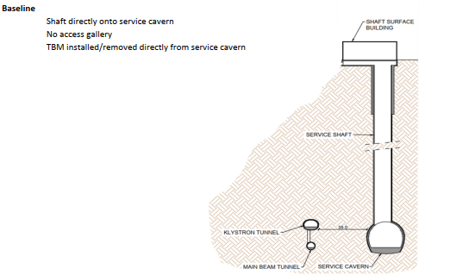
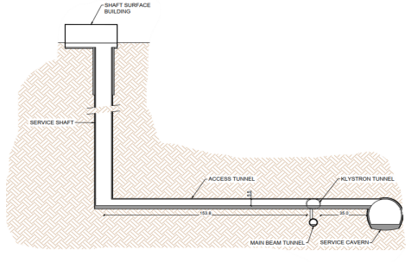
  FCC-ee Underground Structure Point L
FCC WEEK 2023
New Baseline

Slide 22
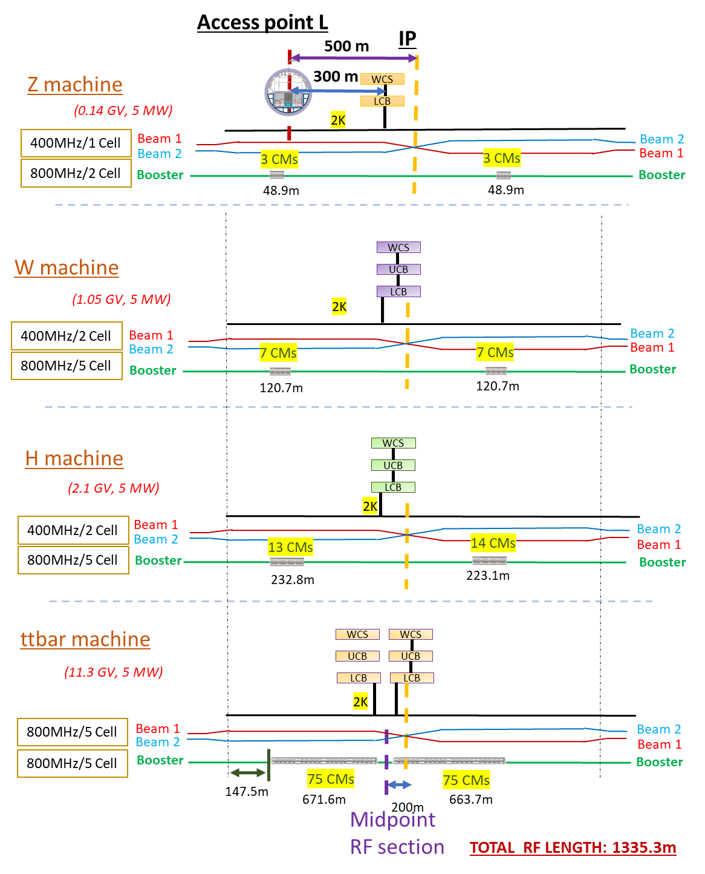
New Baseline
  FCC-ee Underground Structure Point L
New QRL Size ?

Slide 23
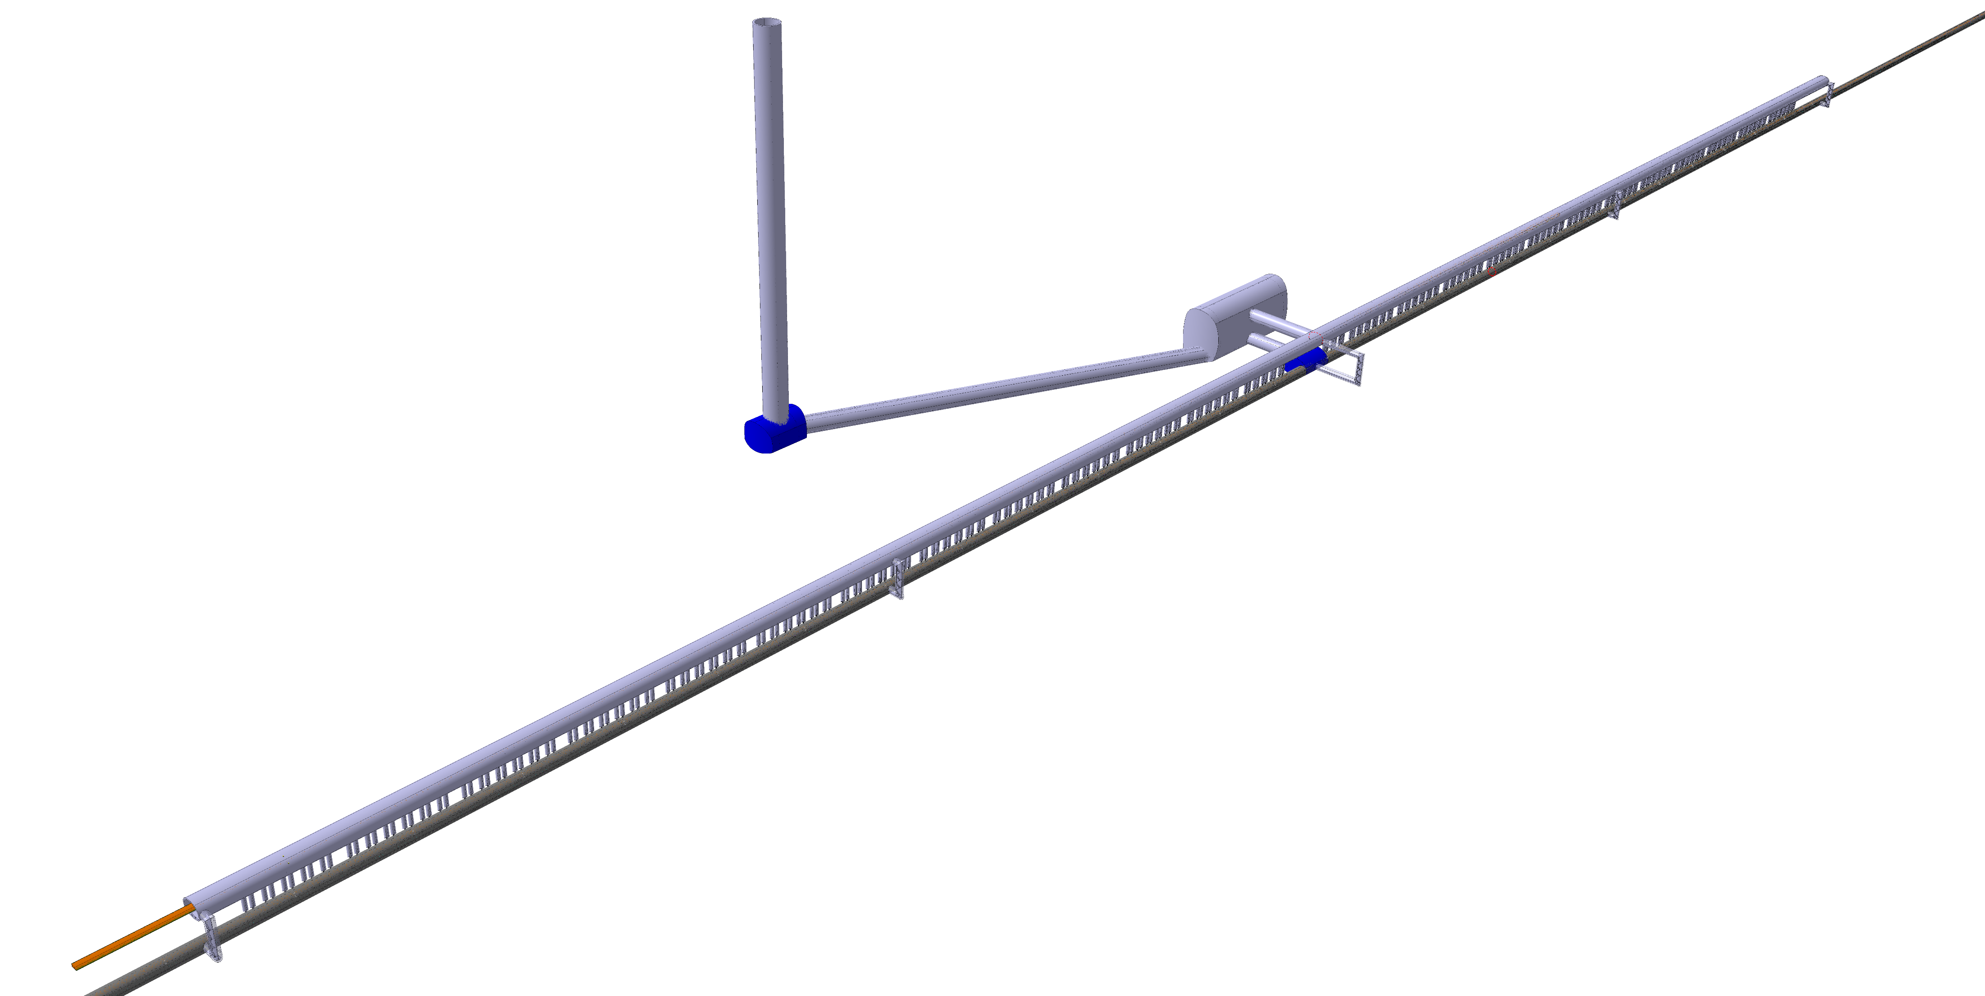
  FCC-ee Underground Structure Point L
Service Shaft
ø7m Connection Tunnels
(Cavern/Klystron Gallery)
Service Cavern
(60x25m)
Midpoint RF section
4 Evacuation staircase
(each 225 m)
Junction Cavern
IP
Evacuation staircase with lift
ø9,5m Connection Tunnel
Junction Cavern
Klystron Gallery
Collider Center
Machine tunnel

Slide 24
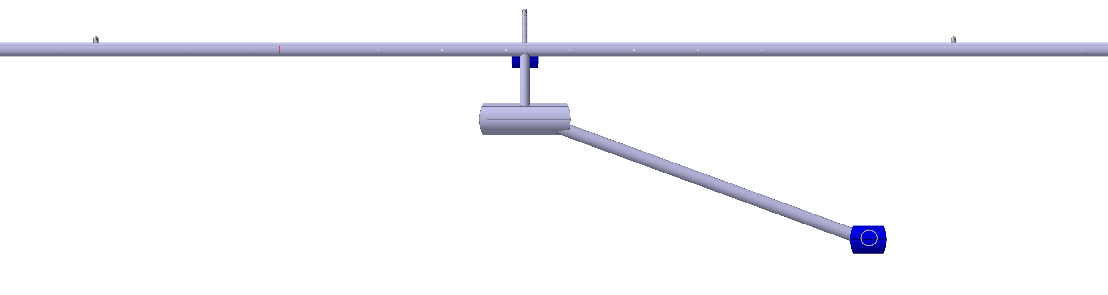
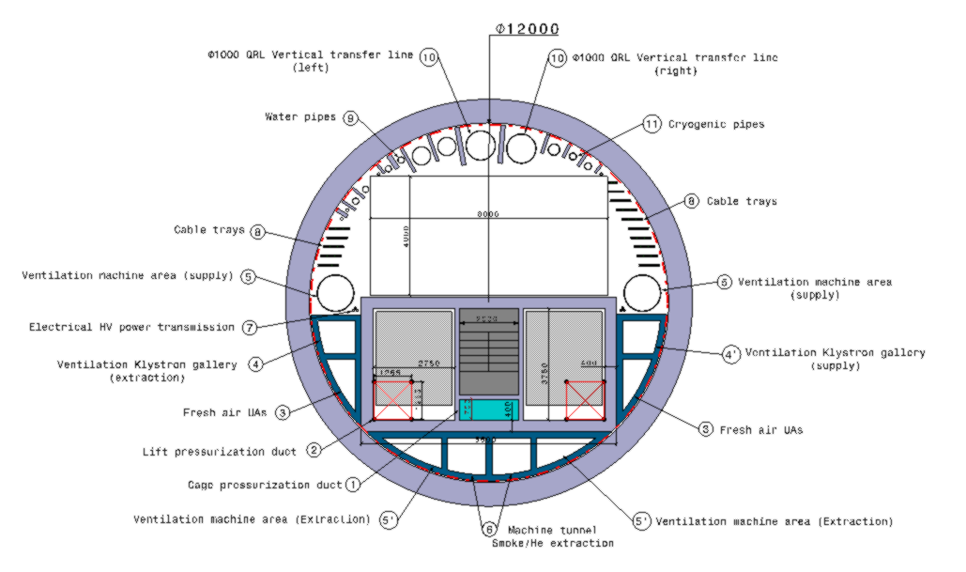
  FCC-ee Underground Structure Point L
Collider Center
IP
Midpoint RF section
200m
300m
35m
153,8m
Service Shaft
8000
250m
4000
LCB (lower cold box)
dimensions: 13x6x6 m (LxWxH)
- weight: 42 tonnes

Slide 25
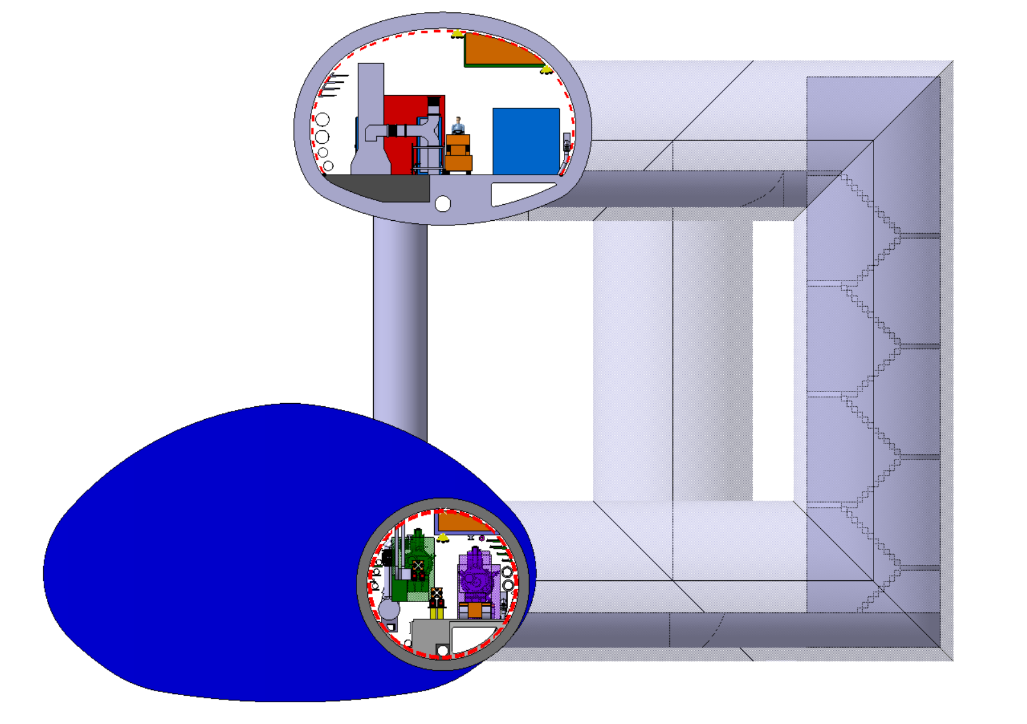
  FCC-ee Underground Structure Point L
Collider Center
10m

Slide 26
Thank you for your attention.
F. Valchkova-Georgieva
26

