Slide 1
Integration News
15.05.2024
F. Valchkova-Georgieva

Slide 2
  Integration topics:
  FCC-ee Regular Arc
  FCC-ee Underground Structure at point A
  FCC-ee Service Shaft point A ( Alternative)
  FCC-ee beamstrahlung dump at point A
  FCC Small Alcove with Small Layby
  FCC Small Alcove with Big Layby
  FCC Big Alcove
  FCC-ee Underground Structure at point B

Slide 3
F. Valchkova-Georgieva
  FCC-ee Regular arc

Slide 4
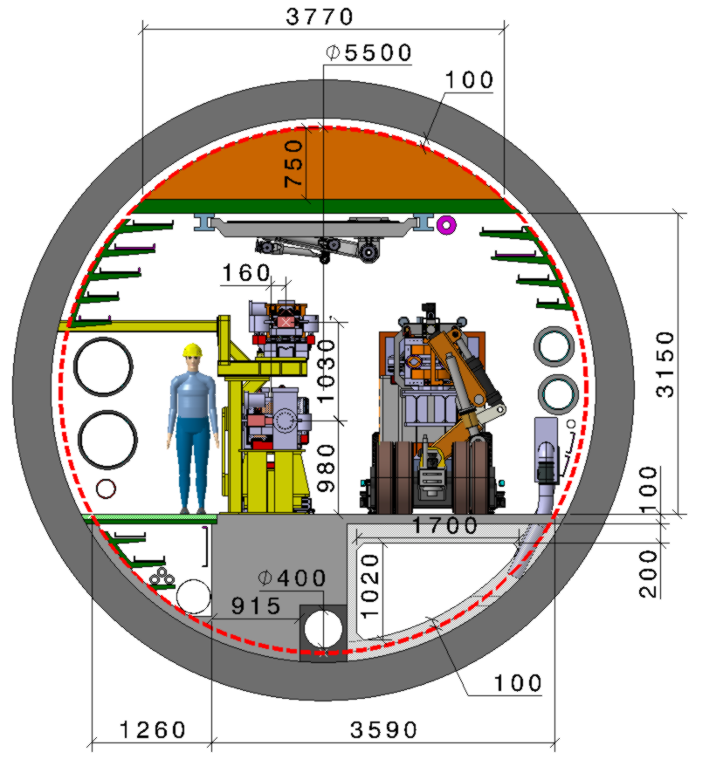
F. Valchkova-Georgieva & Dieudonne Adrien Ngo'O Ella
  Integration of FCC-ee machine elements (regular arc)
Machine tunnel 5.5m in diameter
He/Smoke extraction
Leaky feed
5 Cable trays
4 Cable trays
Chilled water
DN300
Magnet vehicle
Transport space reservation
2.2m x 2.25m (LxH)
Demineralized water
DN550
3 Cable trays
Compressed air
DN80
HV Cable
2 Cable tray
Raw water
DN350
Collider Center

Slide 5
F. Valchkova-Georgieva
  FCC-ee Underground Structure at point A

Slide 6
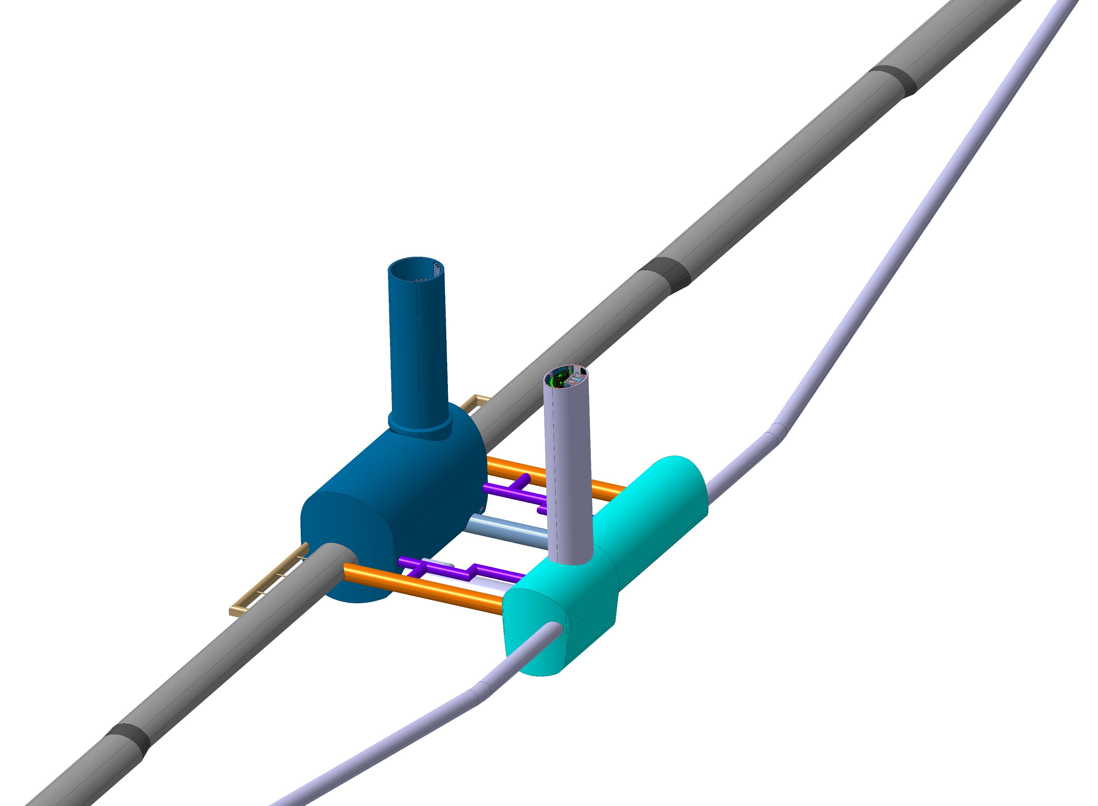
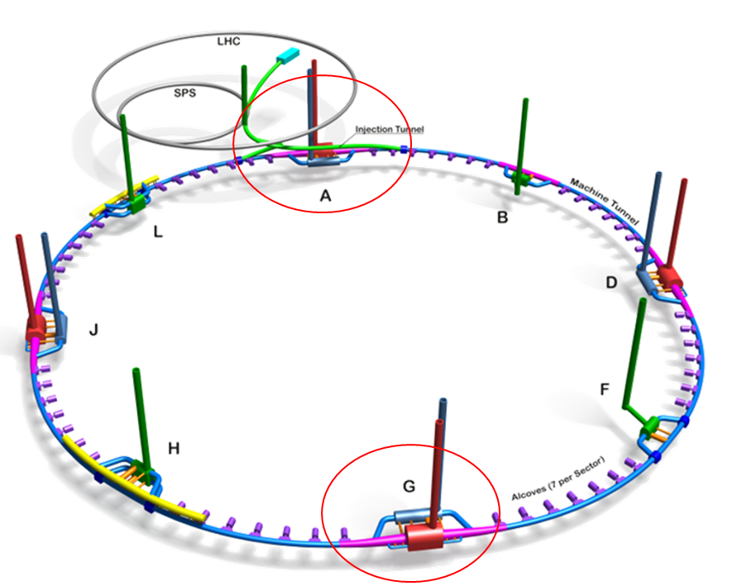
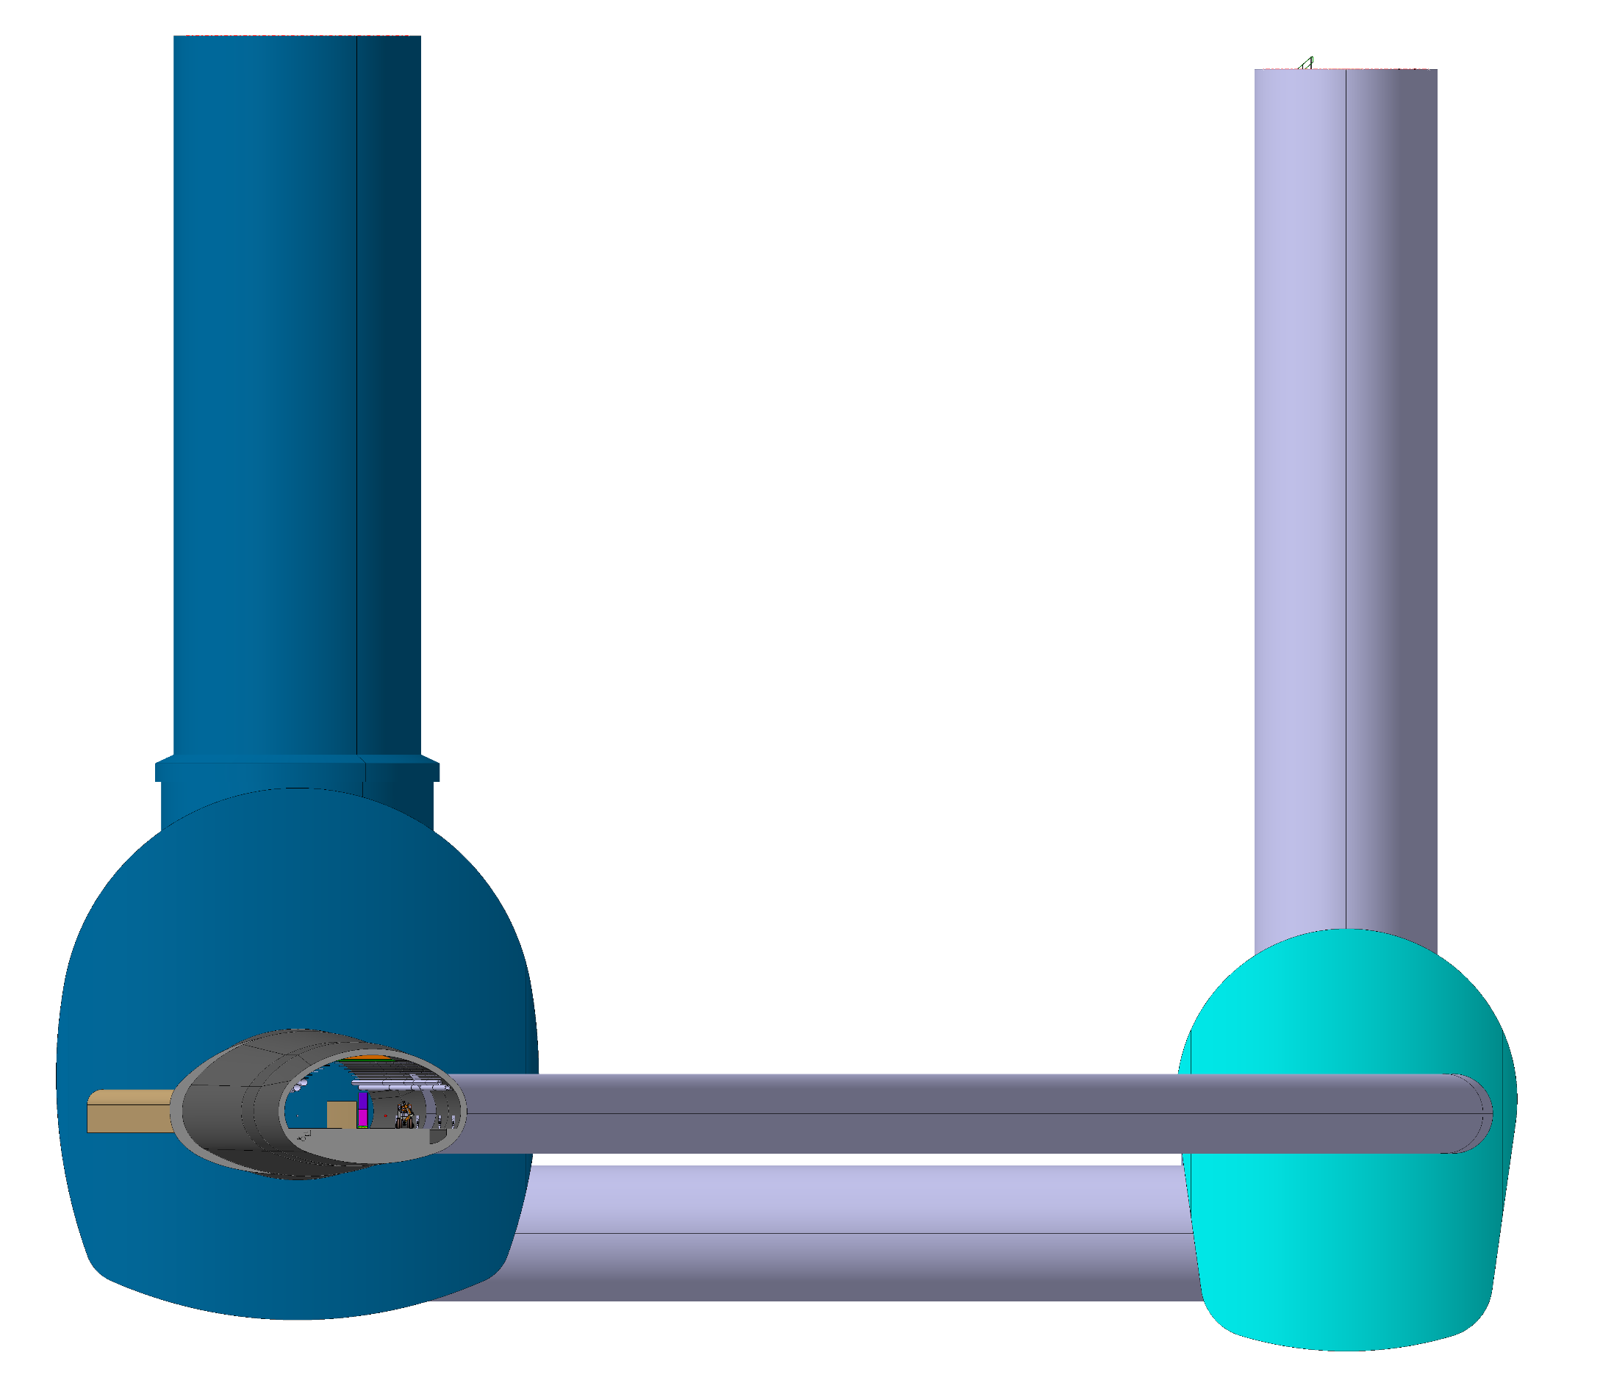
F. Valchkova-Georgieva
  FCC-ee Underground Structure at point A
Experimental Shaft ø18m
2 x Evacuation
connection tunnel
Experiment Cavern
Bypass tunnel ø 5.5m
Survey Gallery
Elliptical Service Shaft
Machine tunnel
Service Cavern
Connection tunnel ø 5.5m
Connection tunnel ø 10m

Slide 7
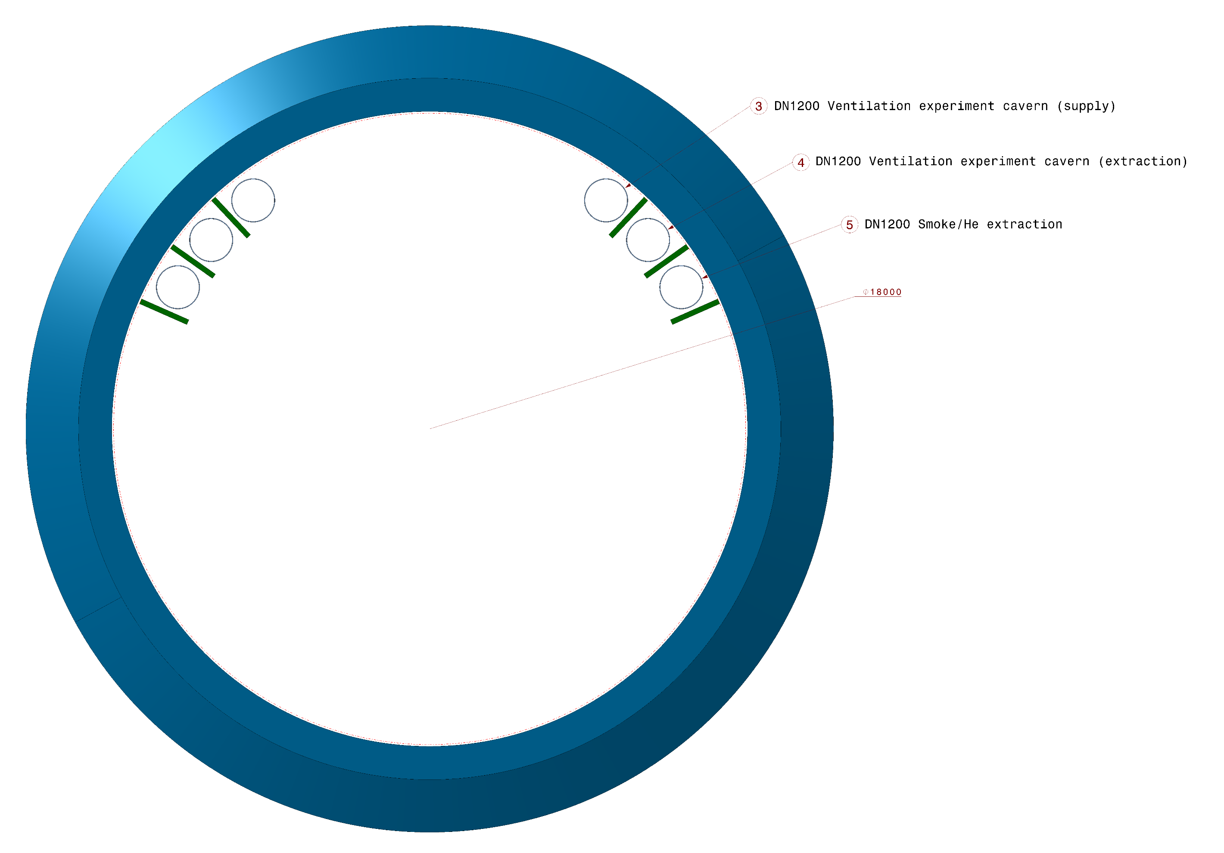
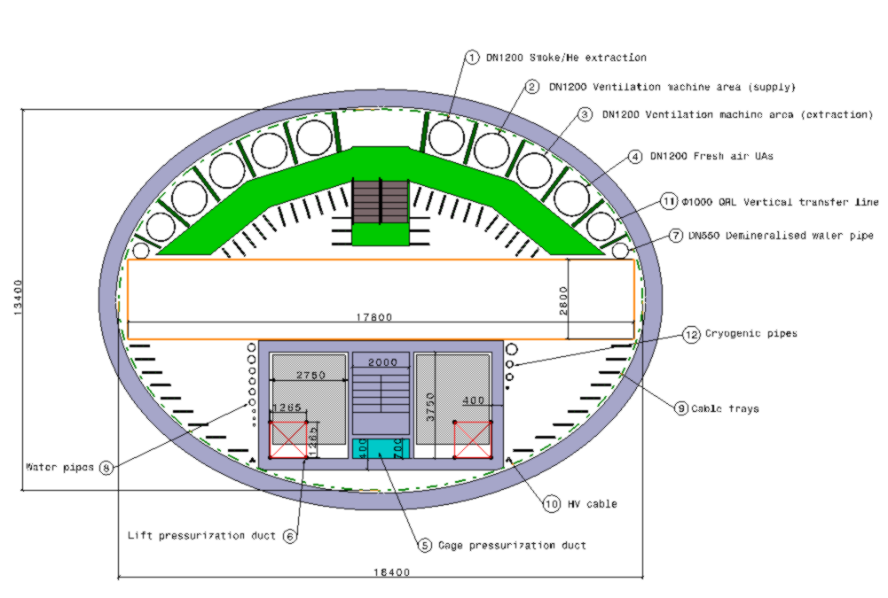
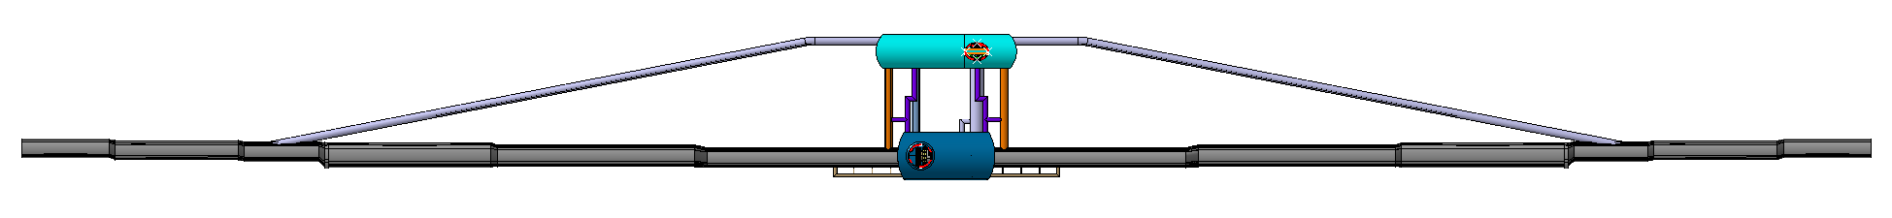
F. Valchkova-Georgieva
  FCC-ee Underground Structure at point A
Experiment Shaft
Elliptical Service Shaft
1.7 km

Slide 8
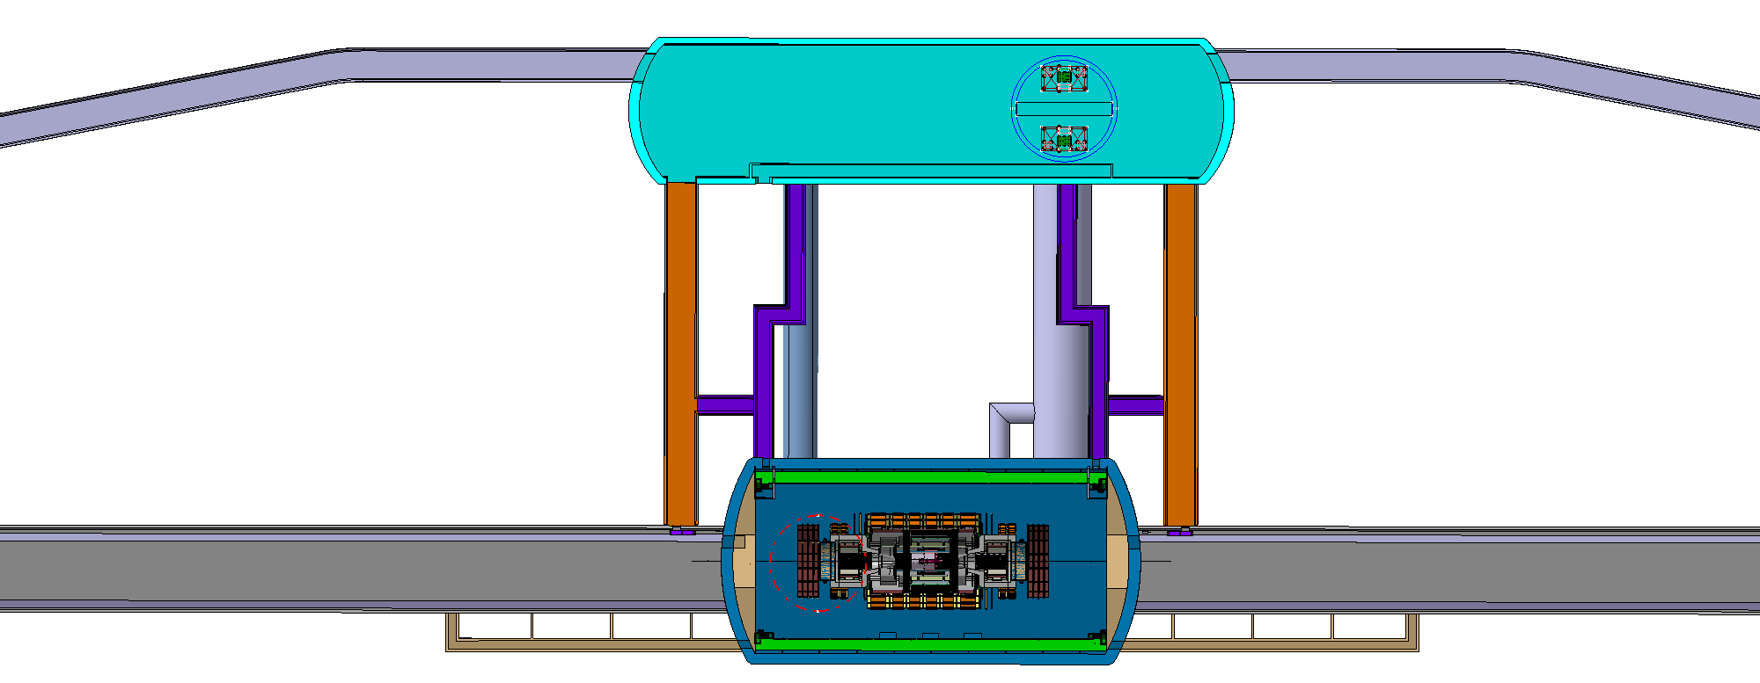
F. Valchkova-Georgieva
  FCC-ee Underground Structure at point A
Service Shaft ø18.2m
Safety area
Pressurized lift cage
Safety area
Pressurized lift cage

Slide 9
F. Valchkova-Georgieva
  FCC-ee beamstrahlung dump at point A

Slide 10
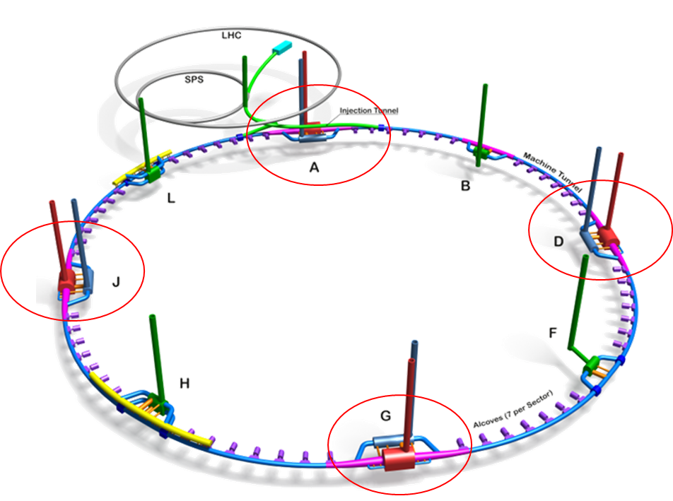
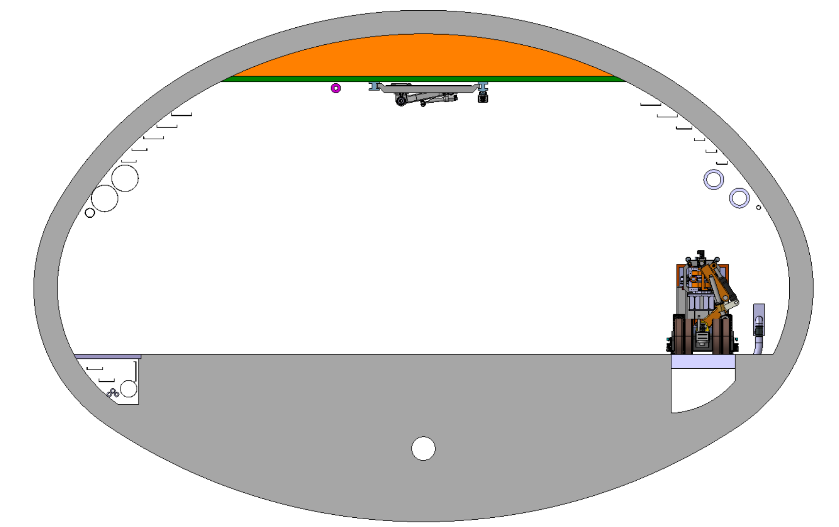
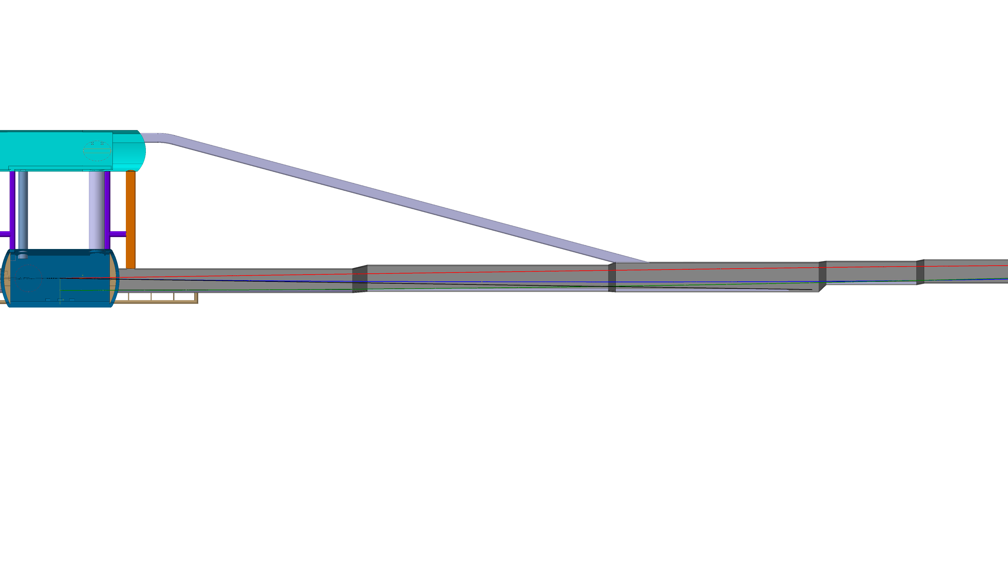
F. Valchkova-Georgieva
  FCC-ee beamstrahlung dump integration at point A
Beamstrahlung
5.73m
6160.7mm
3390.7mm
E+ ring
Booster ring
339.4mm
2.01m
0.98m
E- ring
IP
14.8m
125m

Slide 11
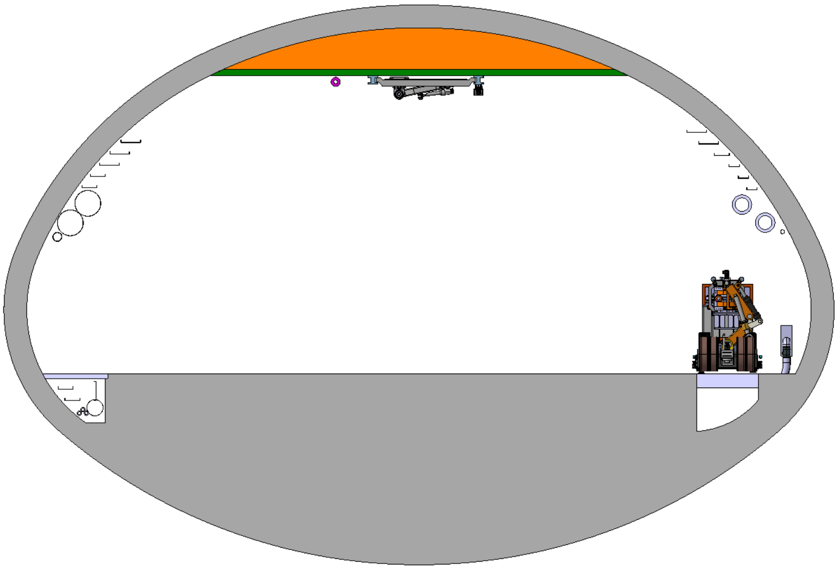
F. Valchkova-Georgieva
  FCC-ee beamstrahlung dump integration at point A
Beamstrahlung
6.51m
3467.5mm
7132mm
E+ ring
2603.2mm
Booster ring
2.01m
0.98m
E- ring
IP
16.4m
330m

Slide 12
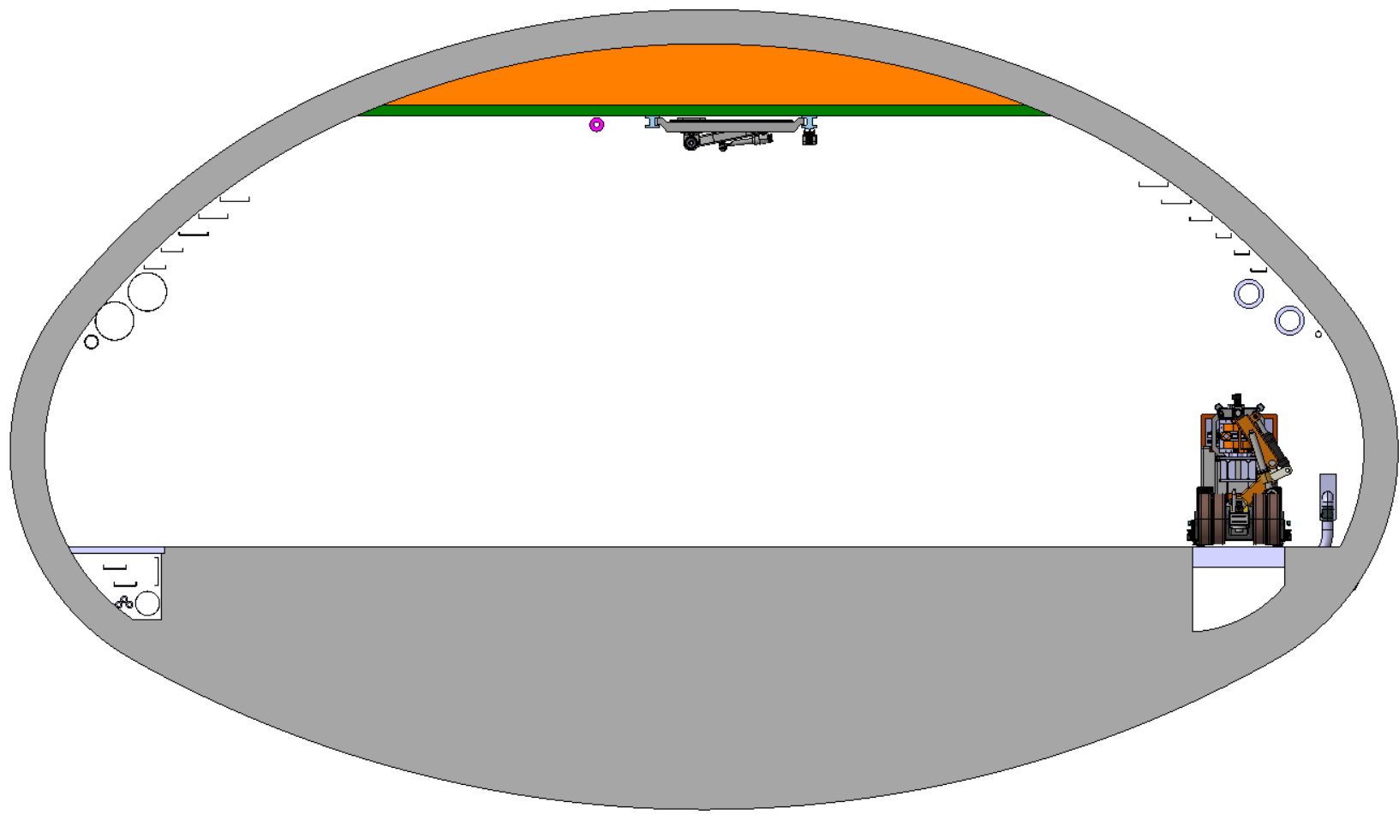
F. Valchkova-Georgieva
  FCC-ee beamstrahlung dump integration at point A
Beamstrahlung
1720mm
6.3m
8640mm
E+ ring
4340mm
0.98m
E- ring
Booster ring
IP
18.6m
443m

Slide 13
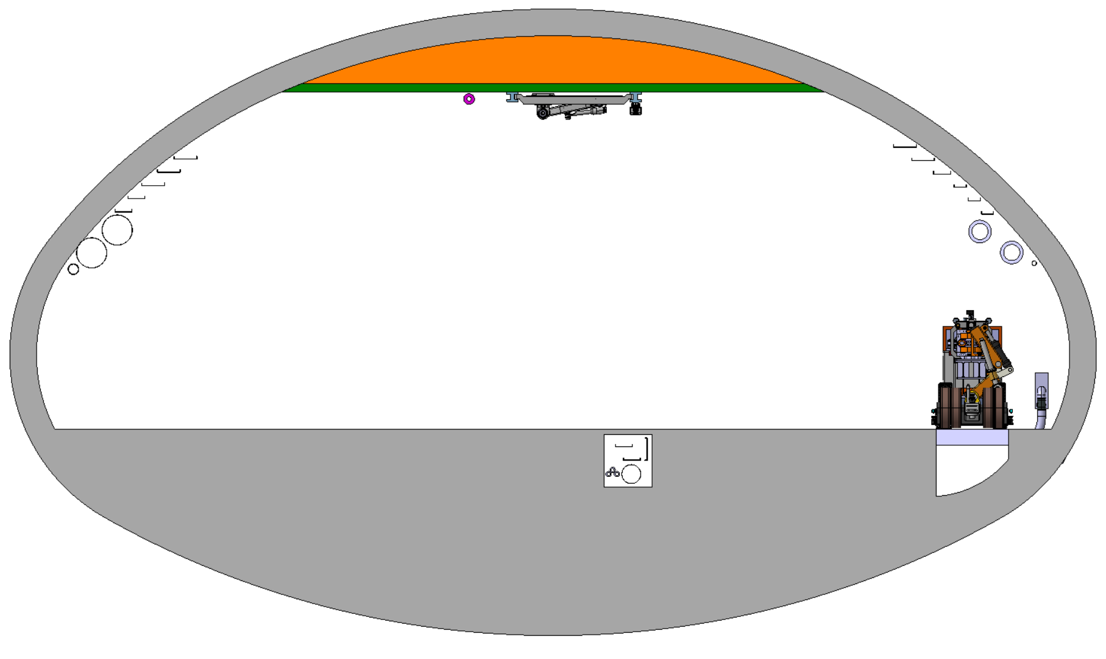
F. Valchkova-Georgieva
  FCC-ee beamstrahlung dump integration at point A
Beamstrahlung
4563.5mm
9419.9mm
6.3m
E+ ring
5415.4mm
0.98m
E- ring
Booster ring
IP
18.6m
500m

Slide 14
F. Valchkova-Georgieva
  Integration of FCC alcove and transport Layby

Slide 15
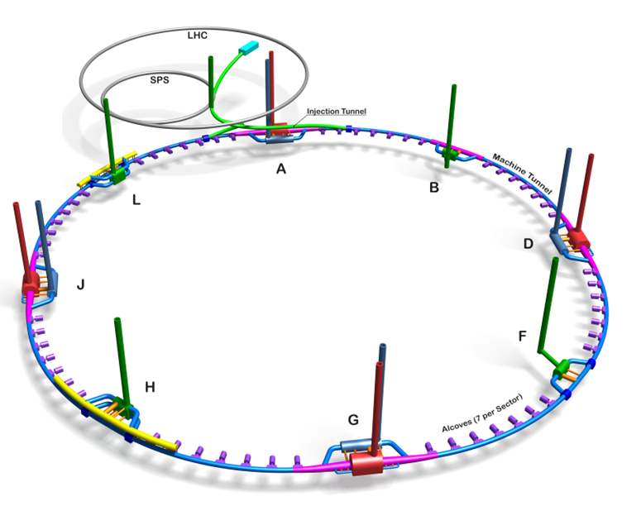
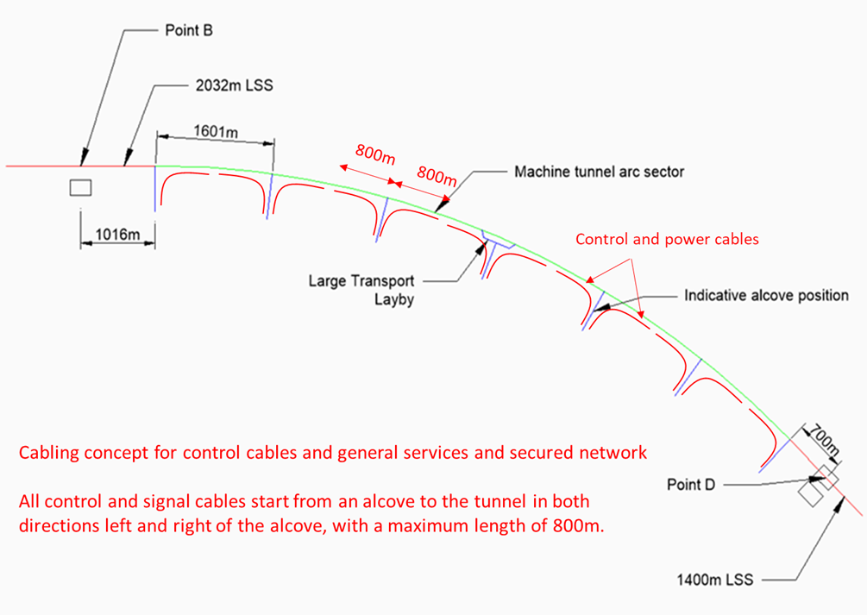
F. Valchkova-Georgieva
  FCC Alcove and transport Layby integration
Courtesy Jean-Paul Burnet
Schematic of the principle of cabling from the alcoves

Slide 16
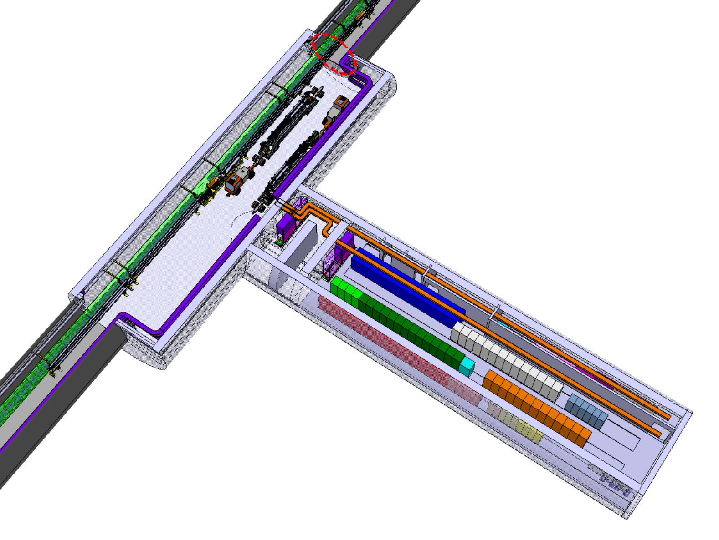
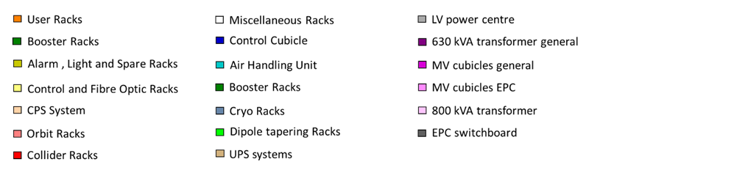
F. Valchkova-Georgieva
  FCC Small Alcove with Big Layby
9600
37500
5100
35000
10600
Fire detection’s equipment
Indicate the position of different electrical equipment in the FCC Alcove in the arc

Slide 17
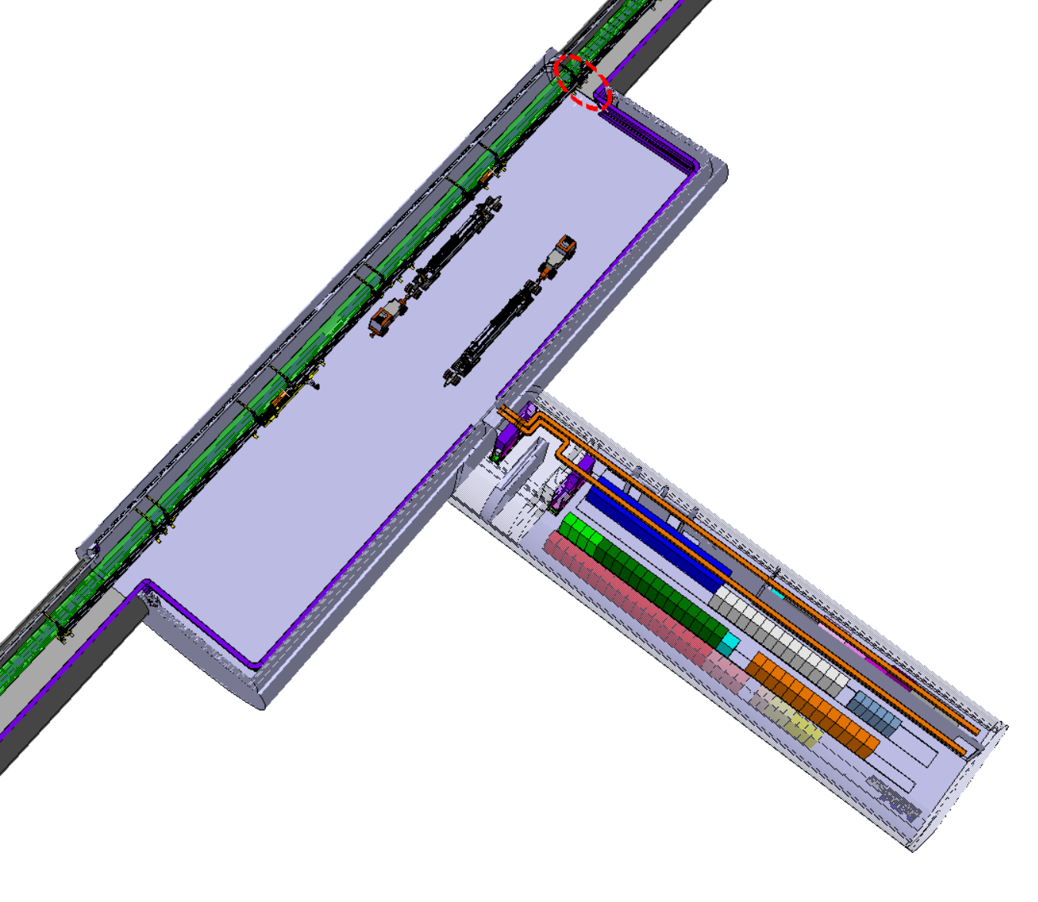
F. Valchkova-Georgieva
  FCC Small Alcove with Big Layby
15600
57000
5100
35000
10600
Fire detection’s equipment
Indicate the position of different electrical equipment in the FCC Alcove in the arc

Slide 18
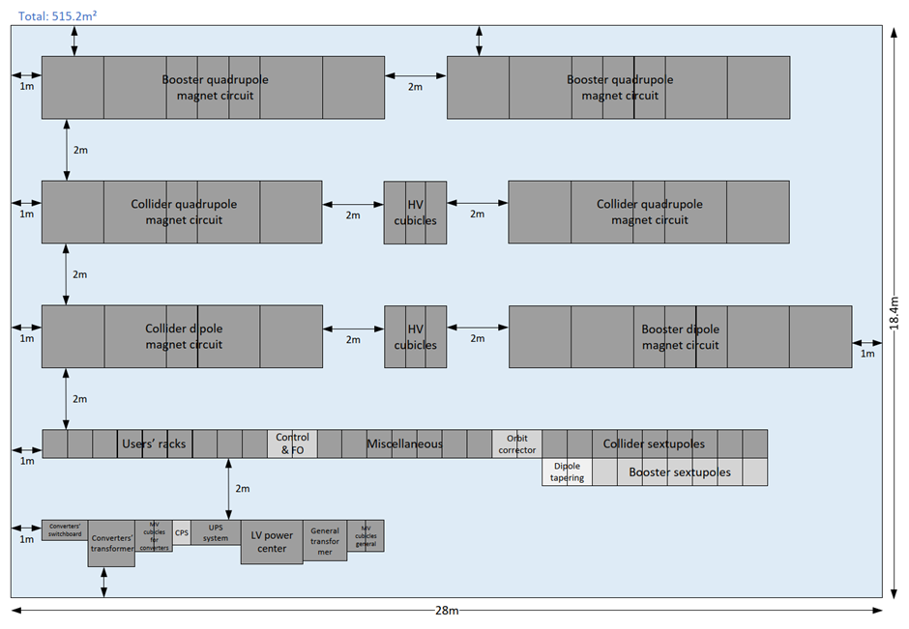
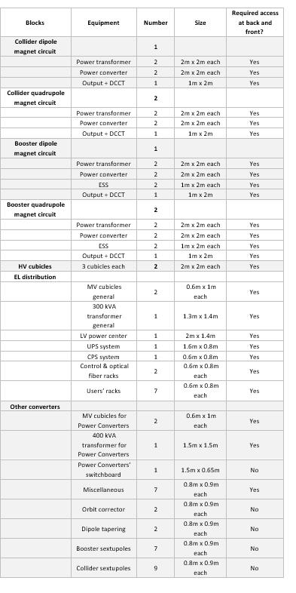
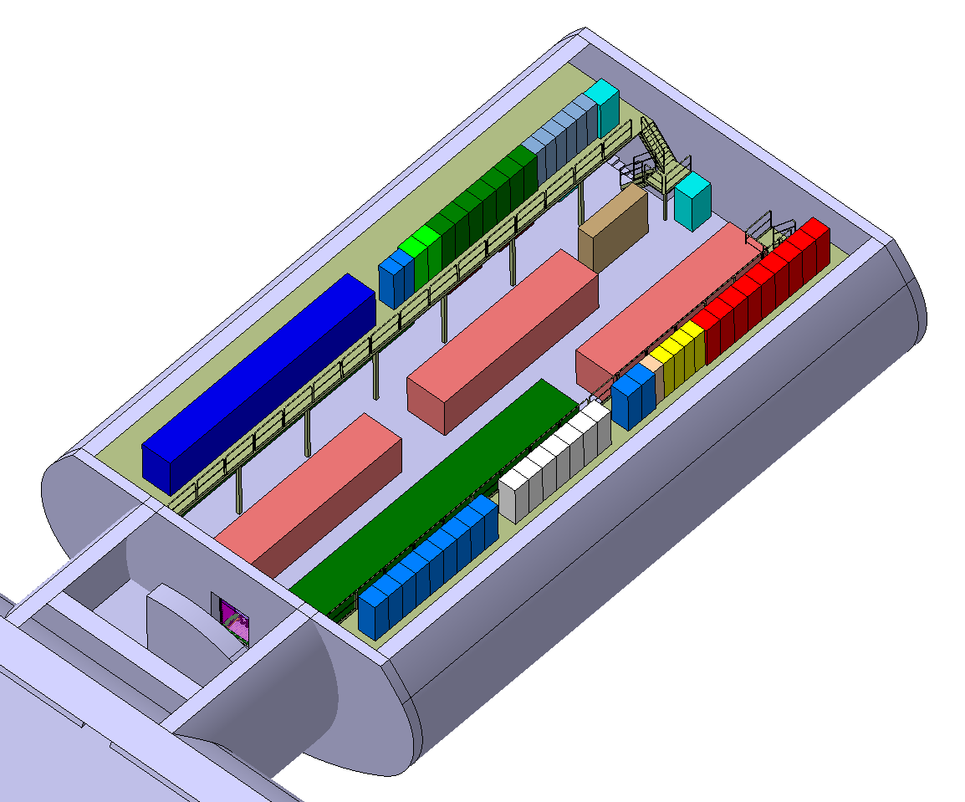
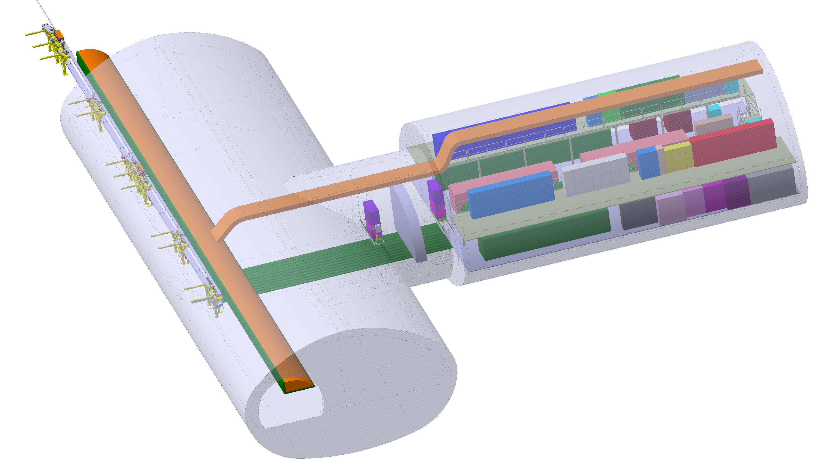
F. Valchkova-Georgieva
  Integration of FCC-ee Big Alcove
CV Air Handling Unit
Cryo Racks
18m
CV Control Cubicle
29m

Slide 19
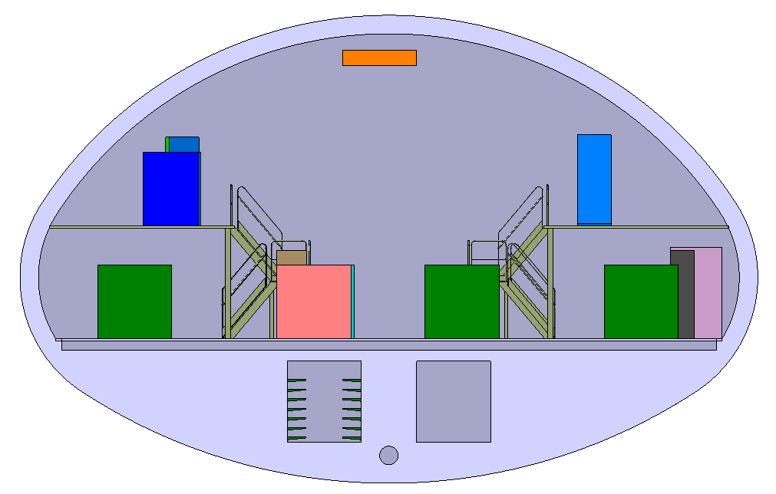
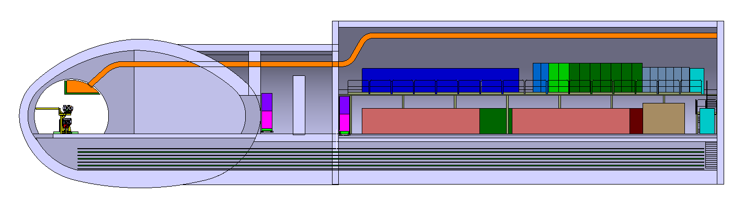
F. Valchkova-Georgieva
  Integration of FCC-ee Big Alcove
8.5m
3m
2.2m
2.5m
Smoke extraction
Passage for cable trays
Evacuation passage
Passage for cable trays

Slide 20
Thank you for your attention.
F. Valchkova-Georgieva
20

