Slide 1
FCCee integration point B
Injection/Extraction equipment
SY-ABT Pavlina Trubacova, Yann Dutheil, Sen Yue
15/05/2024

Slide 2
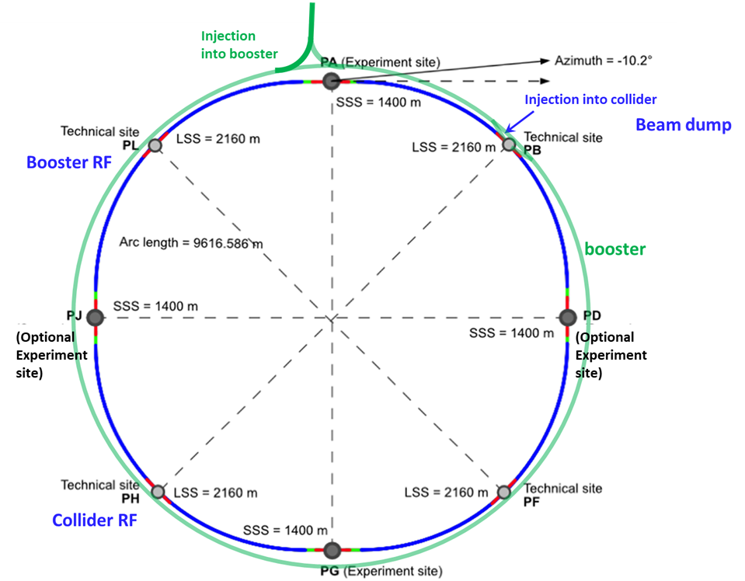
Injection
Point B
Extraction and dump
Pavlina Trubacova – SY-ABT 15/05/2024

Slide 3
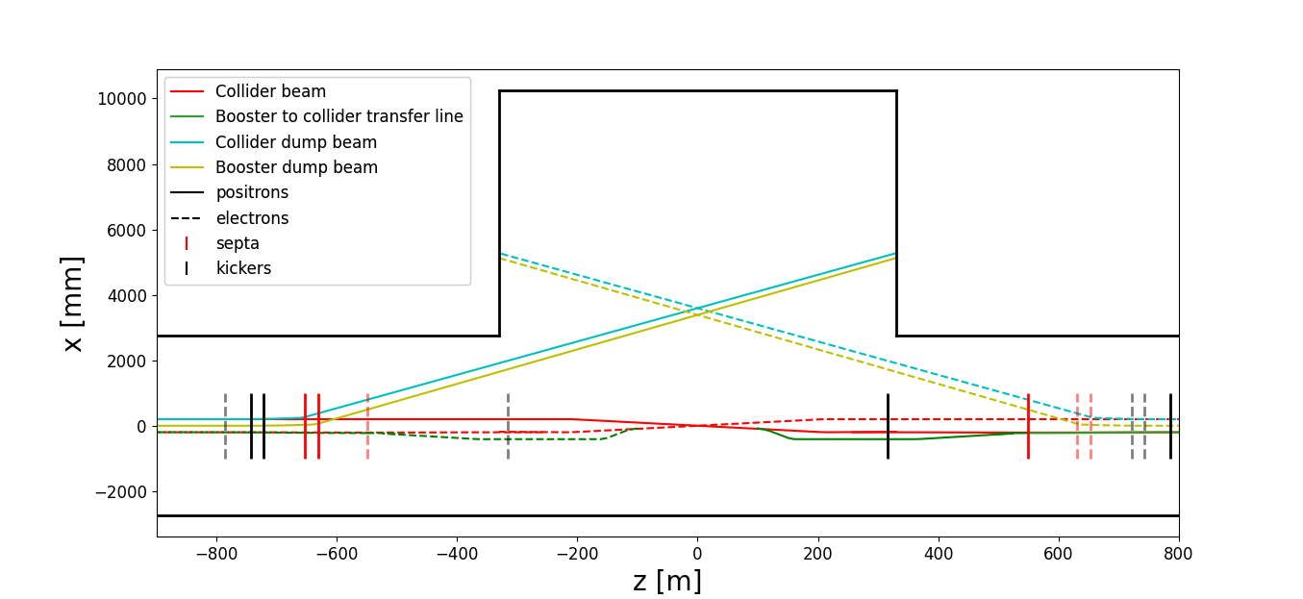
FCC Point B
Pavlina Trubacova – SY-ABT 15/05/2024

Slide 4
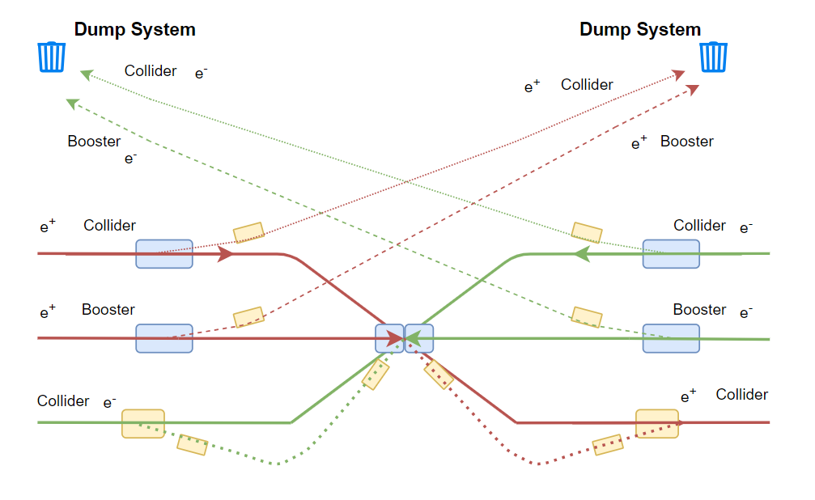
FCC Point B
Pavlina Trubacova – SY-ABT 15/05/2024

Slide 5
Conclusion
ABT group is in charge of designing the beam transfer systems : from beam dynamics concept to hardware manufacturing and control system
Kicker systems have fast rise & fall time -> generator have to placed relatively close and shielded from radiation, hence the special requirements on alcove placements
FCChh concepts are being reviewed in ABT to propose a consolidated alcove requests
Next steps
  Internal iteration on alcove placement requests for ee ongoing
  Consolidated request for ee with options on hh present concept around the summer
Pavlina Trubacova – SY-ABT 15/05/2024

Slide 7
Spare slides

Slide 8
e⁻ Booster ext. septa (-102.35 m)
e⁻/e⁺ Booster ext. kicker (-8.85 m)
e⁻/e⁺ Booster ext. kicker (0.65 m)
e⁺ Booster ext. septa (89.15 m)
FCC Point B
e⁻ Collider dump septa (653.261 m)
e⁻ Booster dump septa (634.6 m)
e⁻ Collider dump kicker (743.011 m)
e⁻ Booster dump kicker (717.9 m)
e⁺ Booster dump septa (-638.85 m)
e⁺ Collider dump septa (-661.261 m)
e⁻ Collider inj. kicker (-316.014 m)
e⁻ Collider inj. kicker (-786.514 m)
e⁺ Collider inj. kicker (312.514 m)
e⁺ Collider inj. kicker (782.514 m)
e⁺ Booster dump kicker (-726.6 m)
e⁺ Collider dump kicker (-747.511 m)
e⁺ Collider thick inj. septa (526.664 m)
e⁺ Collider thin inj. septa (547.464 m)
e⁻ Collider thick inj. septa (-532.664m)
e⁻ Collider thin inj. septa (-548.664 m)
Pavlina Trubacova – SY-ABT 15/05/2024

