Slide 1
The FCCee SRF system: preliminary integration, cross sections in points L & H
FCC ee integration meeting, 15 May 2024
Vittorio Parma, CERN
Vittorio Parma, Fabien Cottenot, Nadine Favre, Marc Timmins

Slide 2
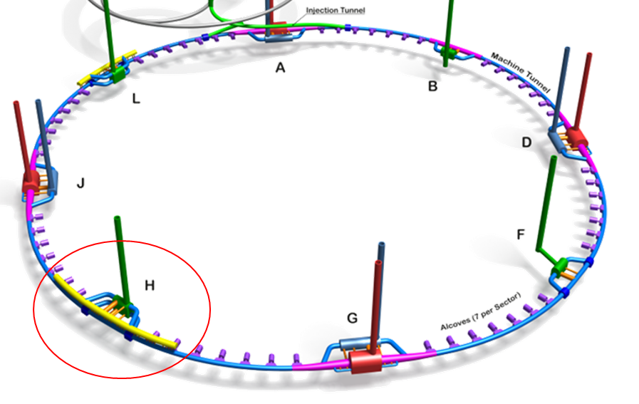

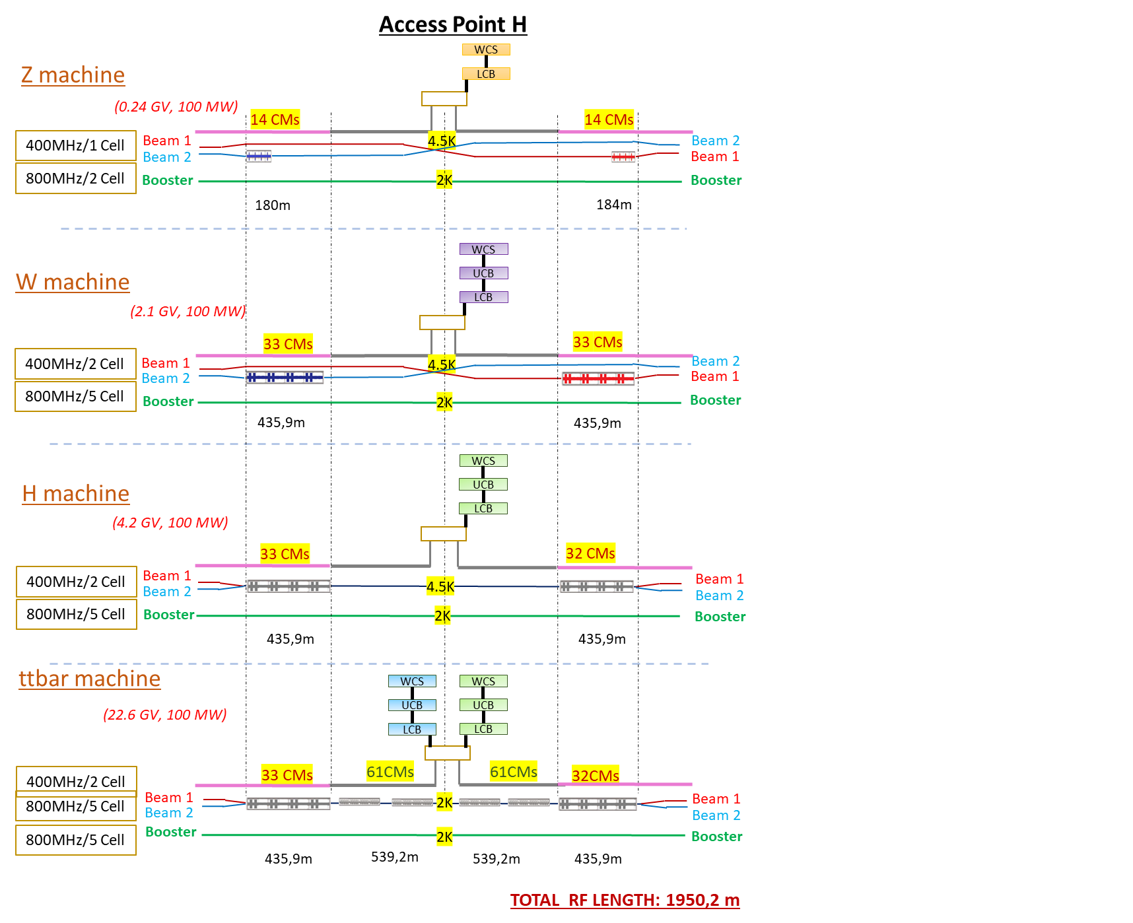
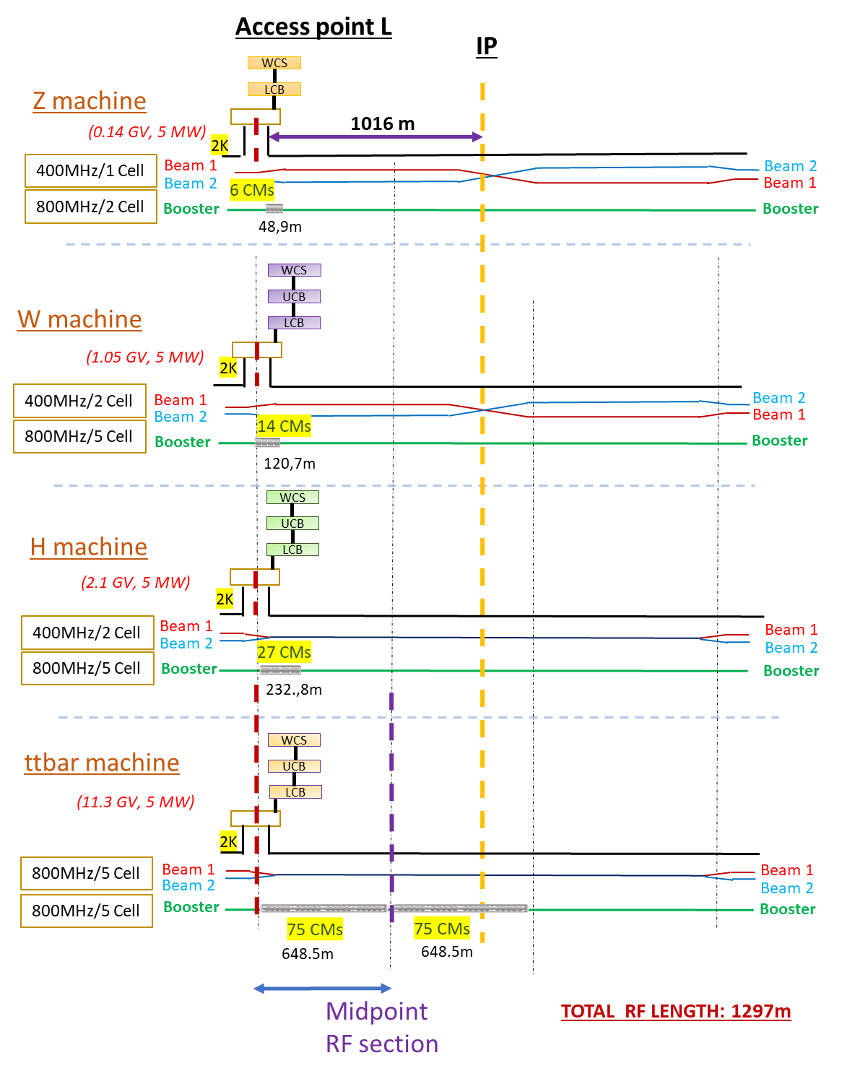
TLSS length: 2032 m
Collider
TLSS length: 2032 m
Booster
FCC week 2023
F. Valchkova-Georgieva

Slide 3
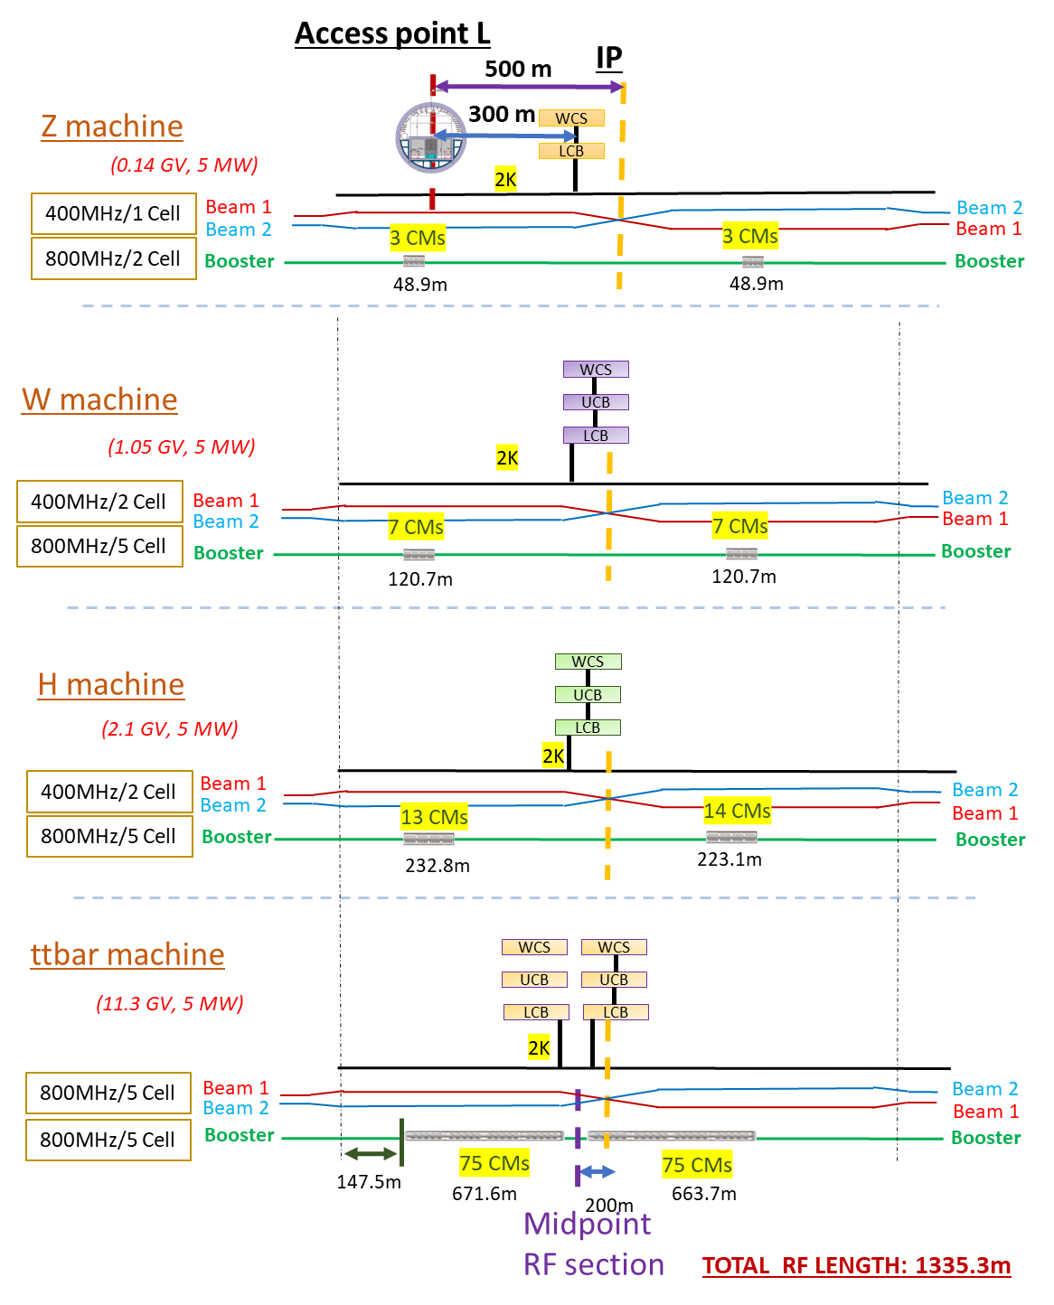
TLSS length: 2032 m
Collider
TLSS length: 2032 m
Booster
New (April ‘24)
F. Valchkova-Georgieva

Slide 4
Beam lines spacing from W to H
arc spacing 350
arc spacing
>800 mm
Z and W:
Beam spacing increase (CM width)
Separation/recombination dipoles
Beam 1 and 2 orbits identical
From W to H, ttbar
CM kept in position
2 to 1 beam line recombination
Beam 1 stronger deflection → different orbits (to be corrected elsewhere ?)

Slide 5
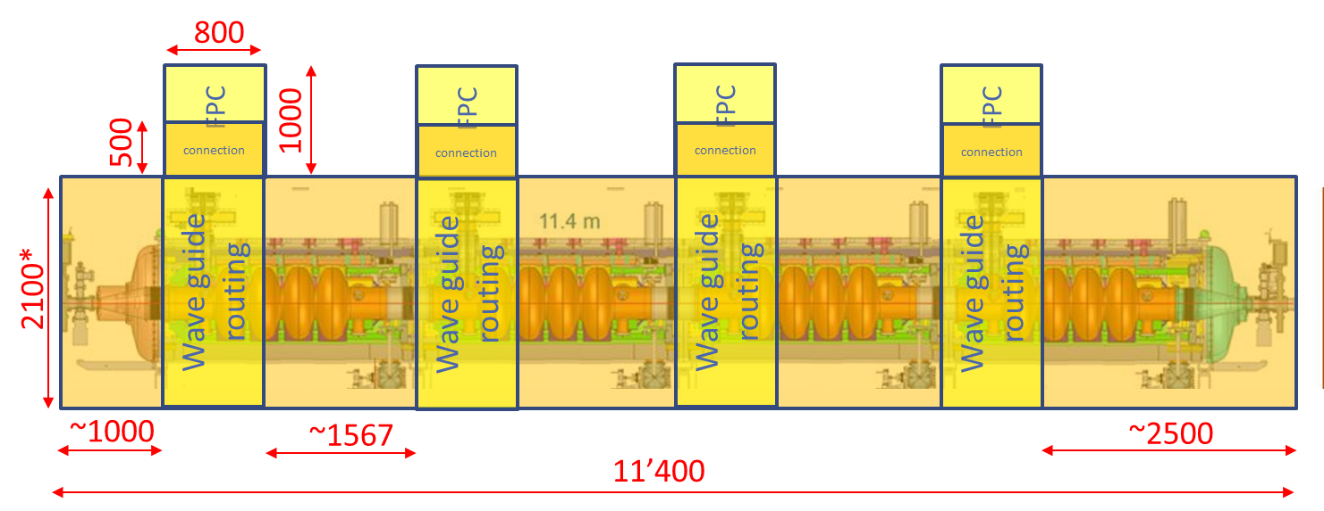
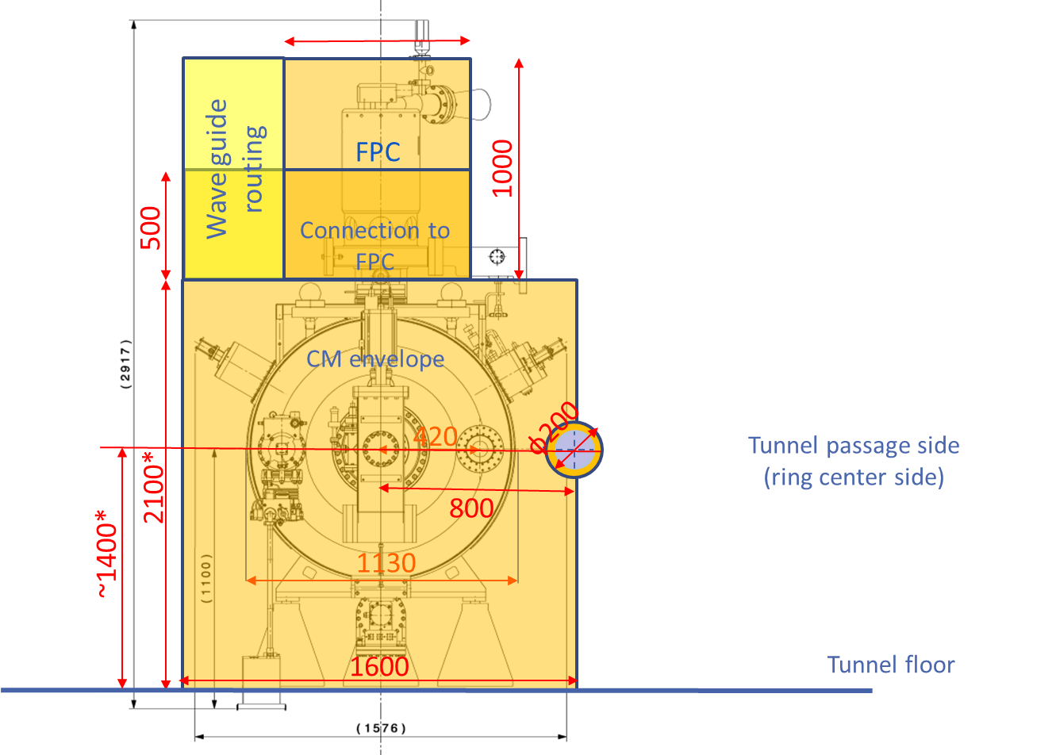
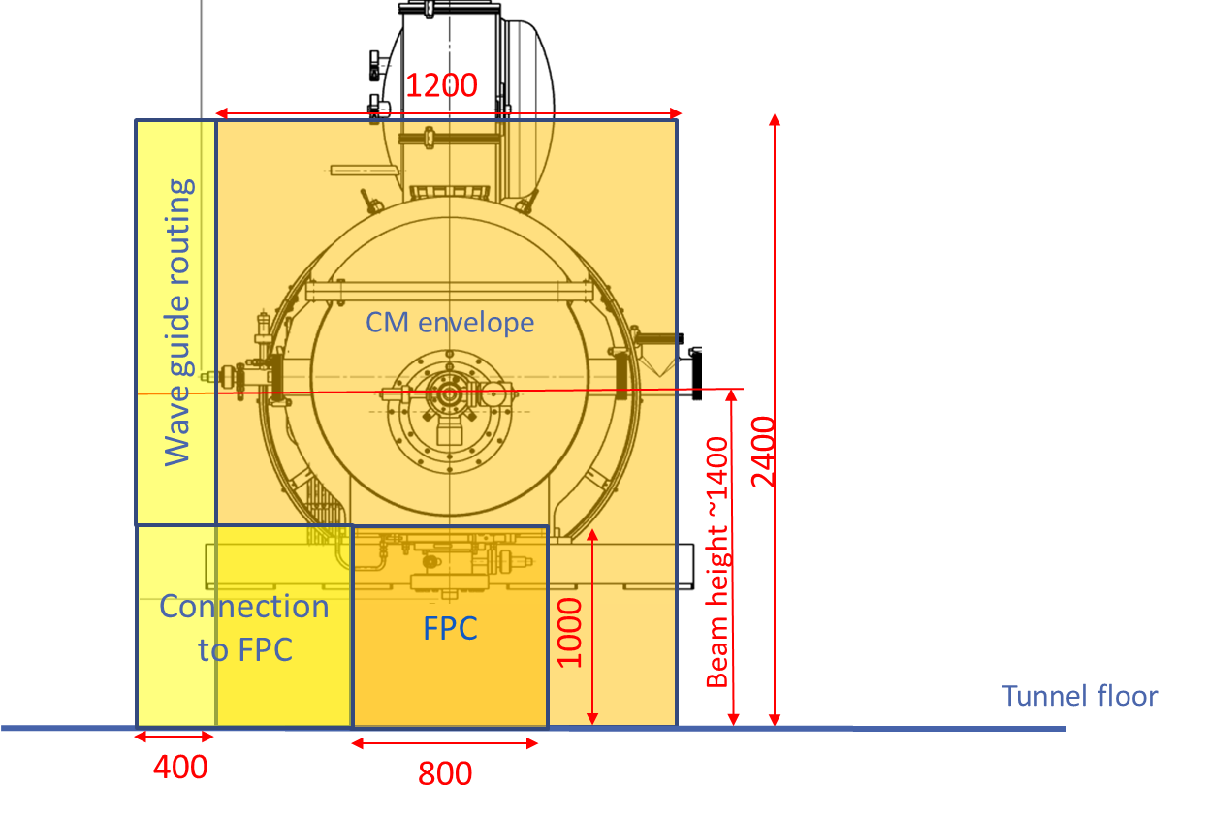
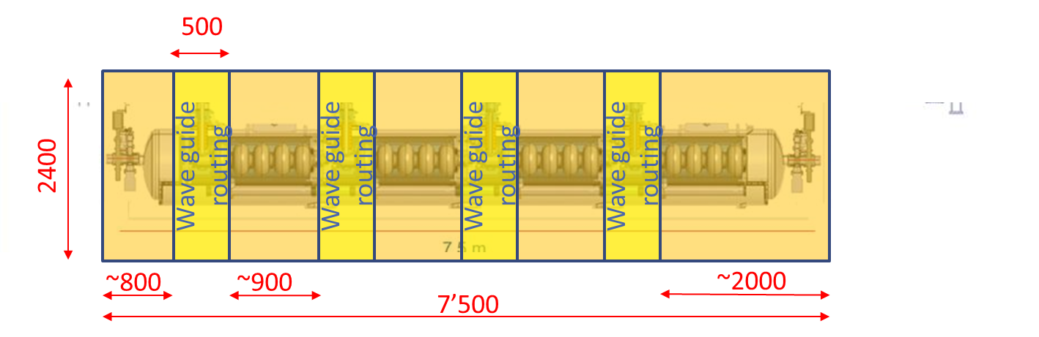
CM space occupation for integration study (since 2022)
400 MHz Cryomodule (based on LEP, 4-cell cavities)
800
beams spacing
* Beam height could be ~1000mm, but increased to 1400 due to 800 MHz CM
beam heights
800 MHz Cryomodule (based on SPL, 704 MHz)

Slide 6
New assumptions for integration study
CM space occupations replaced by conceptual design external envelopes:
  400 MHz: modified design of LHC CM
  800 MHz: FNAL conceptual design based on PIP-II
Cryo line/Service modules:
  New space occupation from CRG, based on new P&ID and based on LHC Crabs design
  Adapt position to integration needs
Harmonize x section integration of RF points with arc needs:
  Proposal of new beam heights
  Proposal of new beam spacings
Propose relocations of services in x sections of RF points
Integration of new positions of FPC/wave guide configurations and evolution with machines Z to ttbar (to be done)
Integration of all related ancillaries (ex. patch panels for RF, cryo, RF cables to loads) (to be done)
Accessibility for maintenance to CMs (space needs, platforms, etc.) (in progress)
Handling for installation of CM (to be done)
Longitudinal tunnel integration (Vac.valves system, warm magnets, etc) (to be done)

Slide 7
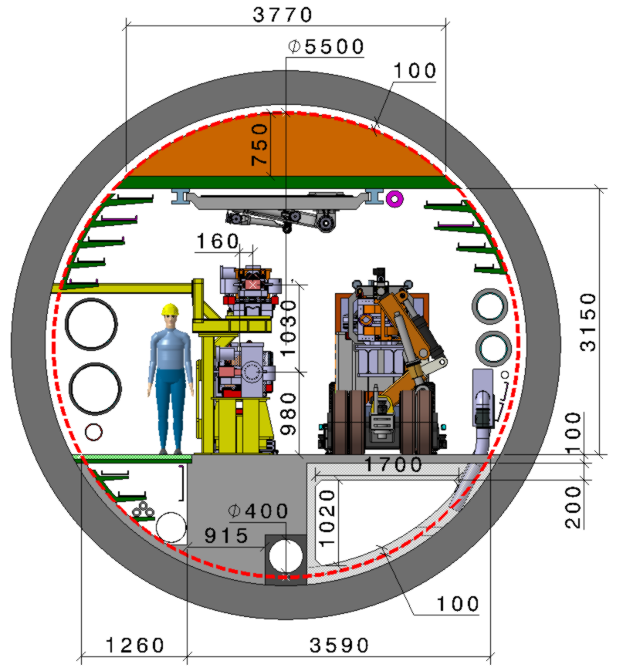
F. Valchkova-Georgieva & Dieudonne Adrien Ngo'O Ella
  Integration of FCC-ee machine elements (regular arc)
Machine tunnel 5.5m in diameter
He/Smoke extraction
5 Cable trays:
5 DC Cable trays
Leaky feed
4 Cable trays:
4 DC Cable trays
Chilled water
DN300
Magnet vehicle
Transport space reservation
2.2m x 2.25m (LxH)
Demineralized water
DN550
3 Cable trays:
3 DC cable trays
Compressed air
DN80
HV Cable
2 Cable tray:
2 Fibre optic Cable trays
Raw water
DN350
Collider Center

Slide 8
  Points H and L: beam pipes positions
w:
arcs: 350
H 800 → increase (960) (CM 400 MHz design)
L → 350 (like arc)
Machine tunnel 5.5m in diameter
h1:
arcs: 980
H,L: → increase (1200) (CM 400 MHz design)
s2
s1
3150
h2: h1+1030
arcs: 2010
H, L: 2230
h2
w
h1
s1,s2:
arcs: s1= 551, s2= 391
H: s1= 1240; s2= 400
L: s1= 700 ; s2: 700
Collider Center

Slide 9
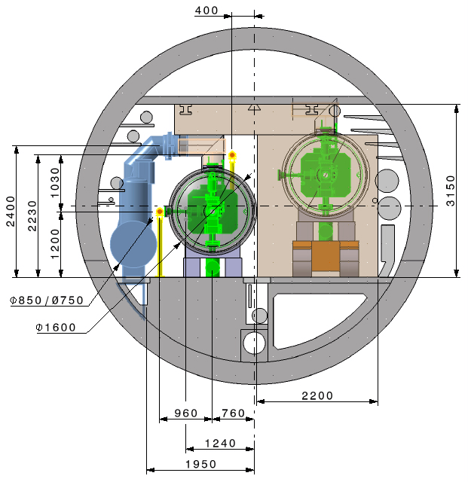
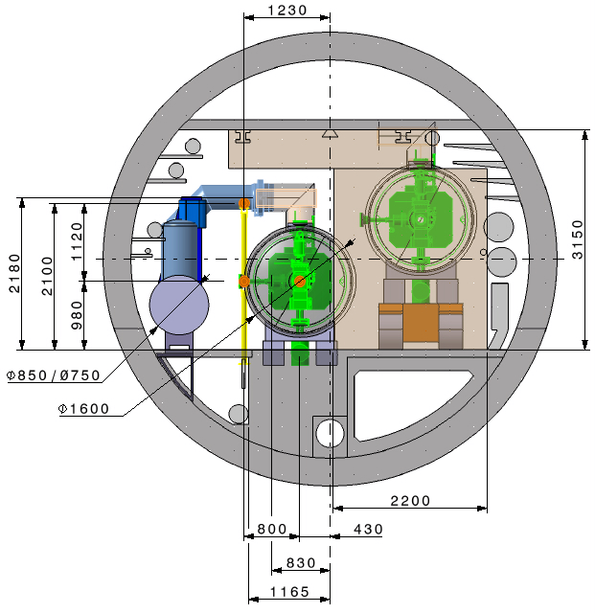
Point H _ 400 MHz
Current Integration cross section from Fani
Version z + w
Modification proposal
1 : Clash CM/floor
►Height 980 to 1200
2a: Clash CM/Transport
►Distance beam2 : 430 to 760
2b: CM/floor not supported
►Distance 1165 to 1950
3: Clash Circulating Beam / CM
►Distance beam1/2 : 800 to 960
4a : Clash CM transport / Robot
►To be studied
4b : Clash CM installation / Robot
►To be studied
4c : Clash CM in position / Robot
►To be studied
5a: Clash QRL Jumper / Booster
►Moved to the other side
5b: Clash QRL Jumper / Service
►To be studied
5a
4b
4a
5b
4c
3
2b
1
2a
(Fabien Cottenot)
2024/05/15

Slide 10
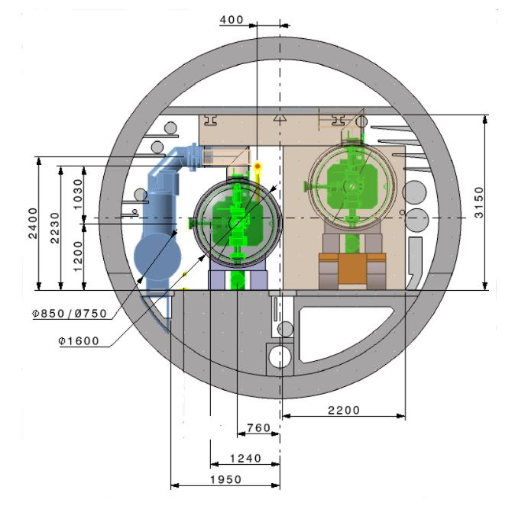
Point H _ 400 MHz
Current Integration cross section from Fani
Version h + ttbar
Modification proposal
1 : Clash CM/floor
►Height 980 to 1200
2a: Clash CM/Transport
►Distance beam2 : 430 to 760
2b: CM/floor not supported
►Distance 1165 to 1950
4a : Clash CM transport / Robot
►To be studied
4b : Clash CM installation / Robot
►To be studied
4c : Clash CM in position / Robot
►To be studied
5a: Clash QRL Jumper / Booster
►Moved to the other side
5b: Clash QRL Jumper / Service
►To be studied
5a
4b
4a
5b
4c
2b
1
2a
(Fabien Cottenot)
2024/05/15

Slide 11
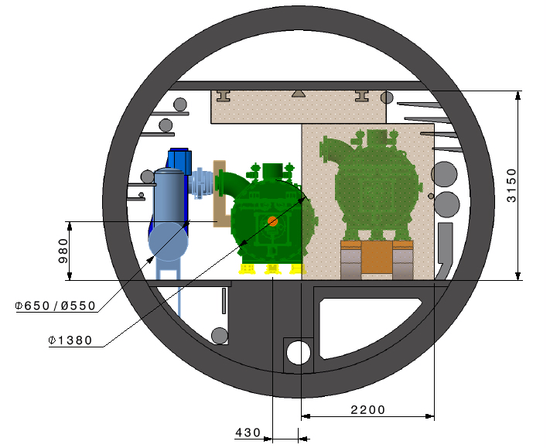
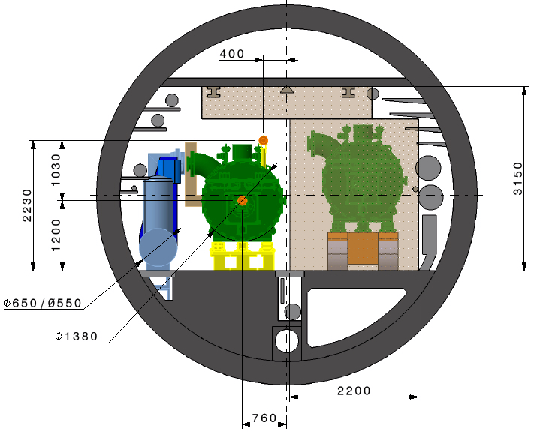
Point H _ 800 MHz
Current Integration cross section from Fani
Version ttbar
Modification proposal
5a
1 : CM/floor (for 400 MHz)
►Height 980 to 1200
2a: Clash CM/Transport
►Distance beam2 : 430 to 760
2b: CM/floor (for 400 MHz)
►Distance 1165 to 1950
5a: Clash QRL Jumper / Booster
►Moved to the other side
5b: Clash QRL Jumper / Service
►To be studied
5b
2b
1
2a
(Fabien Cottenot)
2024/05/15

Slide 12
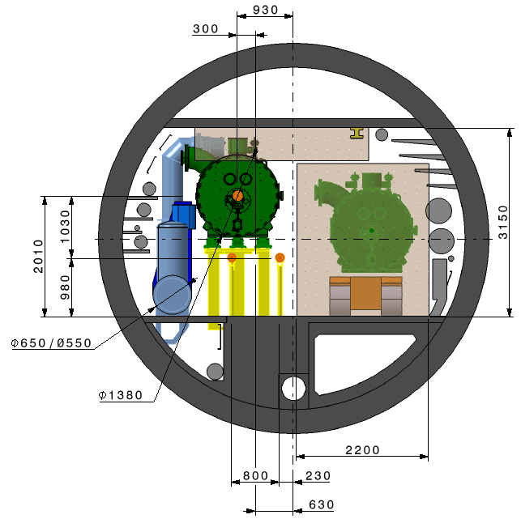
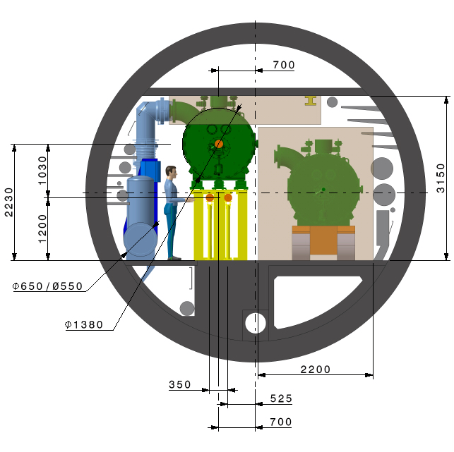
Point L _ 800 MHz
Current Integration cross section from Fani
Version z + w + h + ttbar
Modification proposal
2a
4a
1 : CM/floor
►Height 2010 to 2230
2a: Clash CM/QRL Jumper
2b: CM/floor not supported
►Distance booster : 930 to 700
3a: Clash Circulating Beam / CM support
►Distance beam1/2 : 800 to 350
3b: Beam height
►Height beam1/2 : 980 to 1200
4a : Clash CM installation / Robot
►To be studied
4b : Clash CM in position / Robot
►To be studied
5a: Clash QRL Jumper / Service
►To be studied
5a
4b
1
2a
2b
3b
3a
(Fabien Cottenot)
2024/05/15

Slide 13
Summary and next steps
New assumptions on CM and cryoline envelopes
New proposals of beam heights for discussion
Some integration conflicts still to be tackled (work in progress)
X sectional integration of PFC, wave guides, etc. still in progress
Longitudinal integration still to be studied
More to come for FCC week

Slide 14
Thank you for your attention.

