Slide 1

top-up injector margins
Frank Zimmermann
FCC-ee optics design meeting #176
19 December 2023

Slide 2


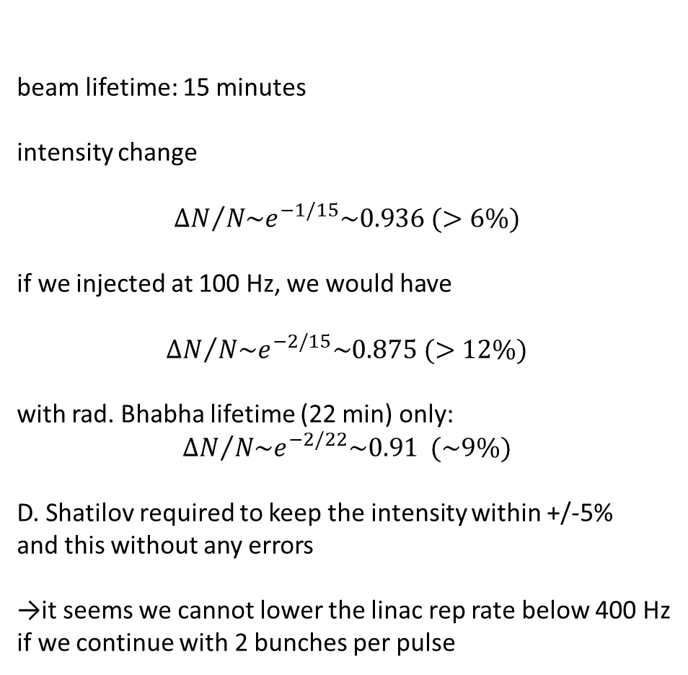
most demanding : operation at the Z
beam lifetime: 15 minutes
intensity change
$${ΔN}/{N\sim e^{−1/15}\sim 0.936 (>6\%)}$$
if we injected at 100 Hz, we would have
$${ΔN}/{N\sim e^{−2/15}\sim 0.875 (>12\%)}$$
with rad. Bhabha lifetime (22 min) only:
$${ΔN}/{N\sim e^{−2/22}\sim 0.91 (\sim 9\%)}$$
D. Shatilov required to keep the intensity within +/-5%
and this without any errors
→it seems we cannot lower the linac rep rate below 400 Hz
if we continue with 2 bunches per pulse
Mid-term parameters
11200 bunches / beam
injection at 2x200 Hz = 400 Hz
time to fill the booster = 11200/400 s = 28 s
up + top + down ramp ~ 1s
total cycle time 30 s
we can inject the same beam every 60 s or 1 minute
K. Oide
A. Vanel

